Slide 1
PyHEADTAIL examples
All our thanks to
D. Amorim, Kevin Li, Lotta Mether and Michael Schenk
CERN BE/ABP-HSC
and
Martial Fol and Saïd Errghioui (AZIMUTEC),
Marie Gauthier, Coline Morin, Stephanie Vandergooten et Lise Ribet (ESI)
Reference: http://kli.web.cern.ch/kli/

Slide 2
Agenda
Goals
Plan
Introduction to PyHEADTAIL
Structure of ipython files
Tracking examples
Setting up the environment
  Virtual box
  Ubuntu
  Anaconda
  PyHEADTAIL

Slide 3
Goals
Run macroparticle simulations with a state-of-the-art open source tracking code (PyHEADTAIL)
Simulate several case-studies related to the course
Play with beam parameters and observe the impact on the longitudinal beam dynamics

Slide 4
Plan
1h20 towards the end of the course in the computer room
A virtual box with examples can be set up on your own simulation environment on your own PC.
It is not mandatory to have this set-up
The detailed procedure and examples are on the Indico site.
Note: we should expect incompatibilities linked to open-source codes!

Slide 5
Agenda
Goals
Plan
Introduction to PyHEADTAIL
Structure of ipython files
Tracking examples
Setting up the environment
  Virtual box
  Ubuntu
  Anaconda
  PyHEADTAIL

Slide 6
Please download the Jupyter notebooks and make a copy in another folder to keep the original files

Slide 7
Introduction to PyHEADTAIL
Open source macroparticle tracking code developed at CERN:
Download link: https://github.com/PyCOMPLETE/PyHEADTAIL
Primary use: tracking simulation of collective effects in synchrotron accelerators
  Transverse and longitudinal beam dynamics (with feedback)
  Electron/ion cloud
  Impedances
  Space charge
Reference:
Introduction to PyHEADTAIL: USPAS course by Kevin Li et al (2015)
Not the only code of his kind!
  BLOND: longitudinal dynamics simulation code https://blond.web.cern.ch/
  HEADTAIL: the father of PyHEADTAIL! G. Rumolo et al (reference)
  elegant: 6D tracking code developed at Argonne National Lab (link)
  mbtrack and sbtrack: R. Nagaoka et al “Studies of Collective Effects in SOLEIL and DIAMOND Using the Multiparticle Tracking Codes sbtrack and mbtrack”, PAC09, Vancouver, May 2009.
  ORBIT (http://web.ornl.gov/~jzh/JHolmes/ORBIT.html), pyORBIT (http://sourceforge.net/projects/py-orbit/)
  And so many others!

Slide 8
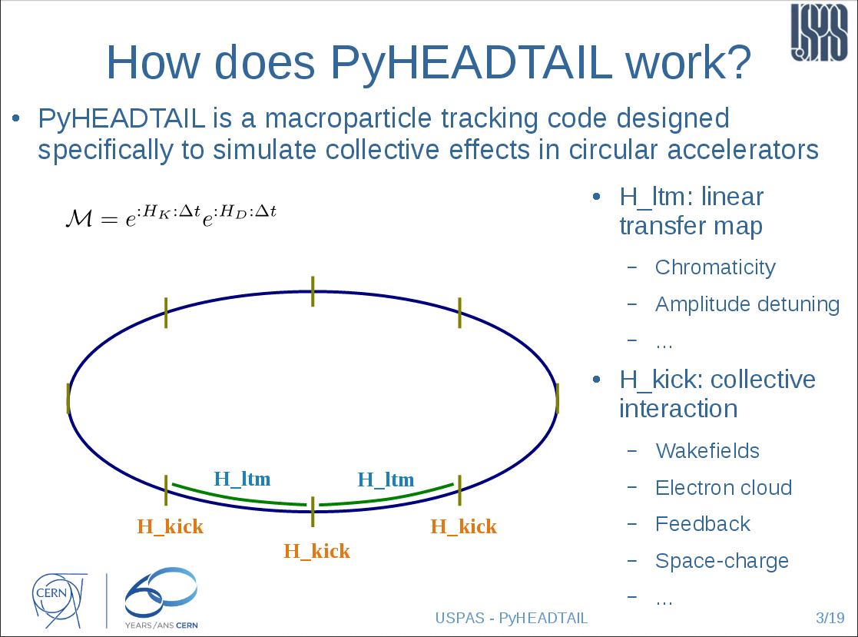
introduction to PyHEADTAIL
Courtesy Kevin Li
USPAS 2015

Slide 9
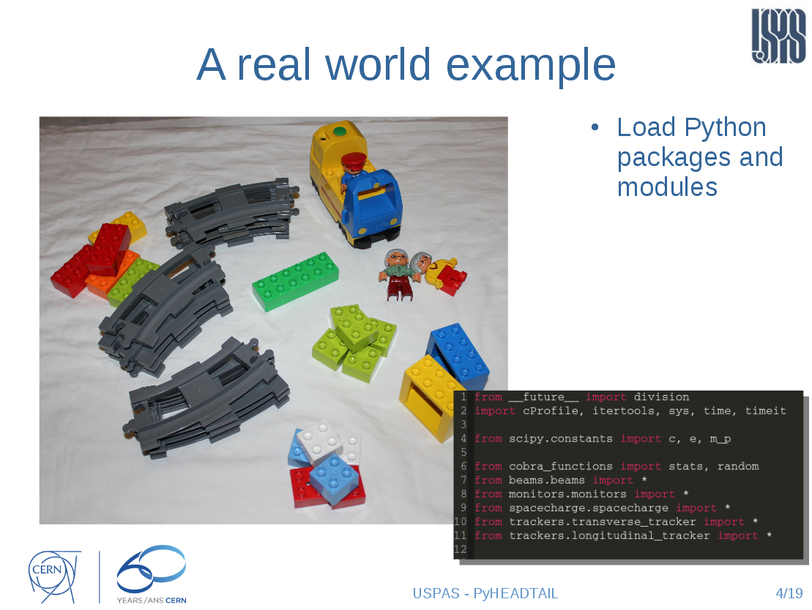
introduction to PyHEADTAIL
Courtesy Kevin Li
USPAS 2015

Slide 10
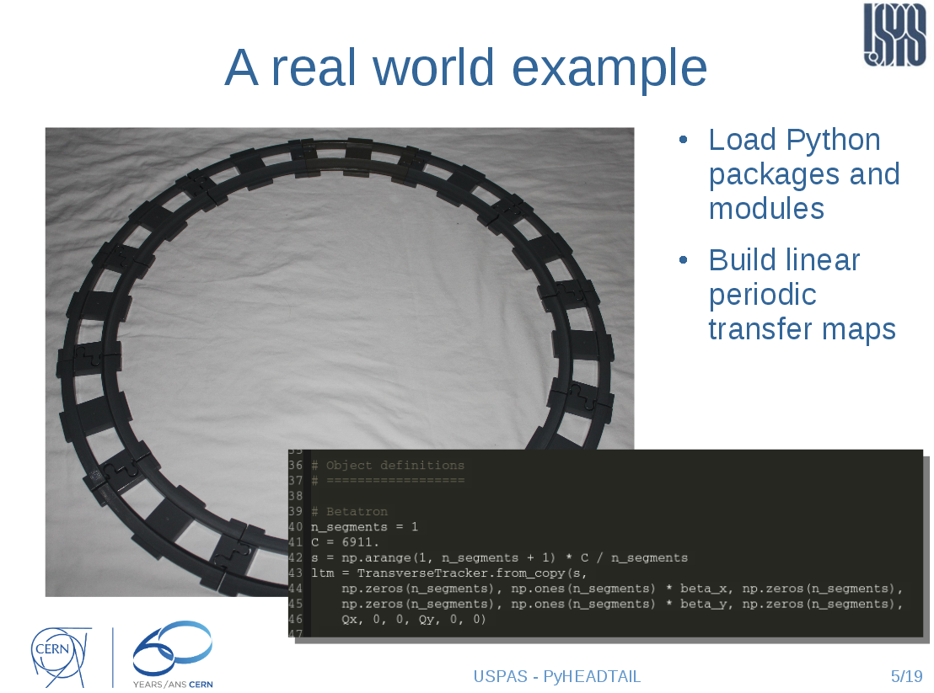
introduction to PyHEADTAIL
Courtesy Kevin Li
USPAS 2015

Slide 11
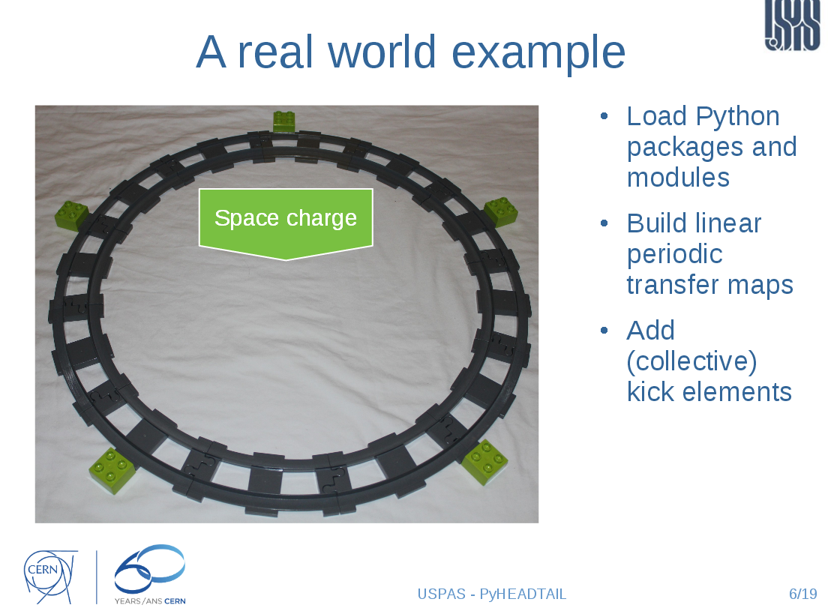
introduction to PyHEADTAIL
Courtesy Kevin Li
USPAS 2015

Slide 12
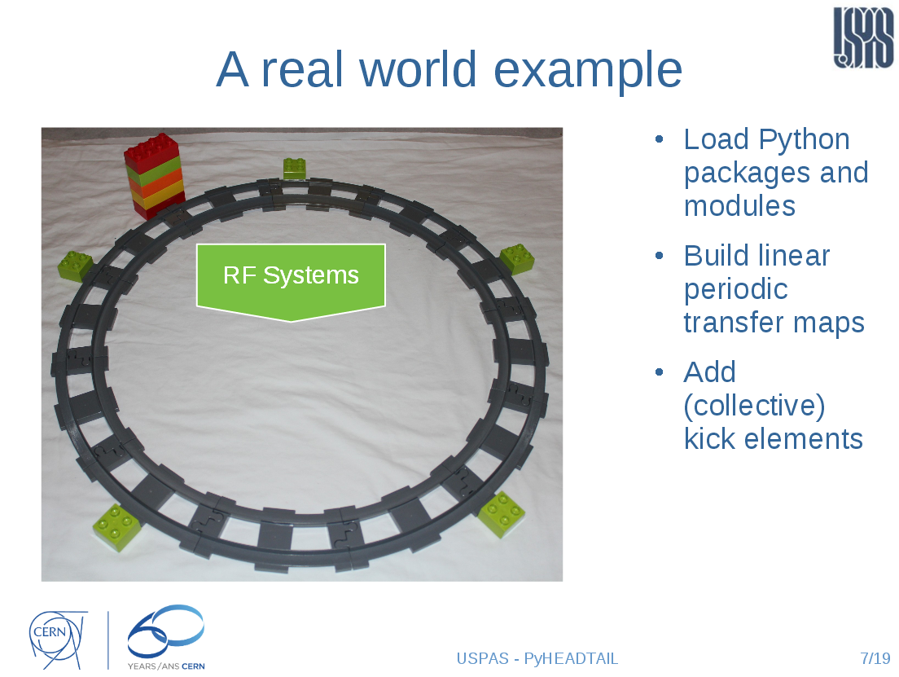
introduction to PyHEADTAIL
Courtesy Kevin Li
USPAS 2015

Slide 13
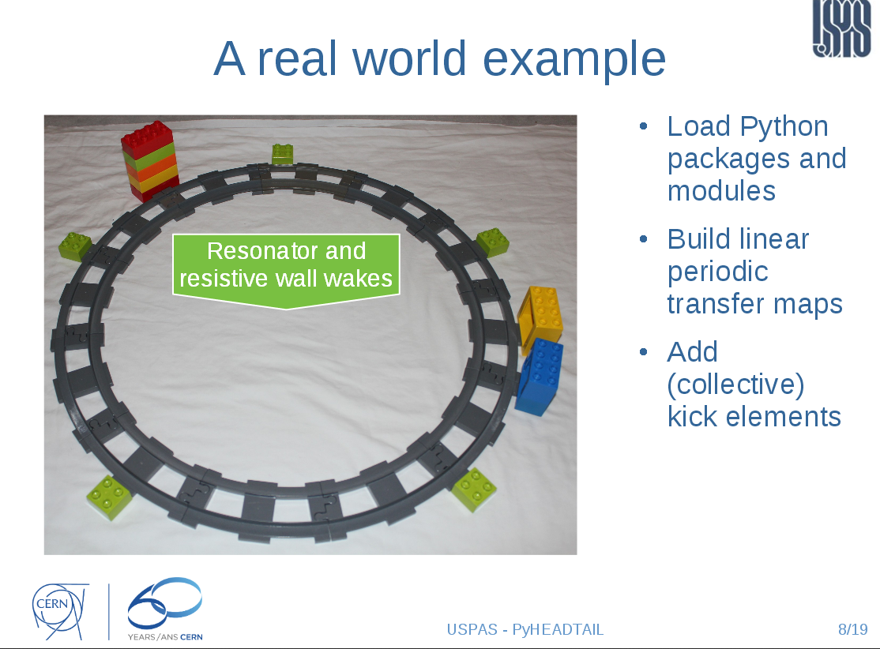
introduction to PyHEADTAIL
Courtesy Kevin Li
USPAS 2015

Slide 14
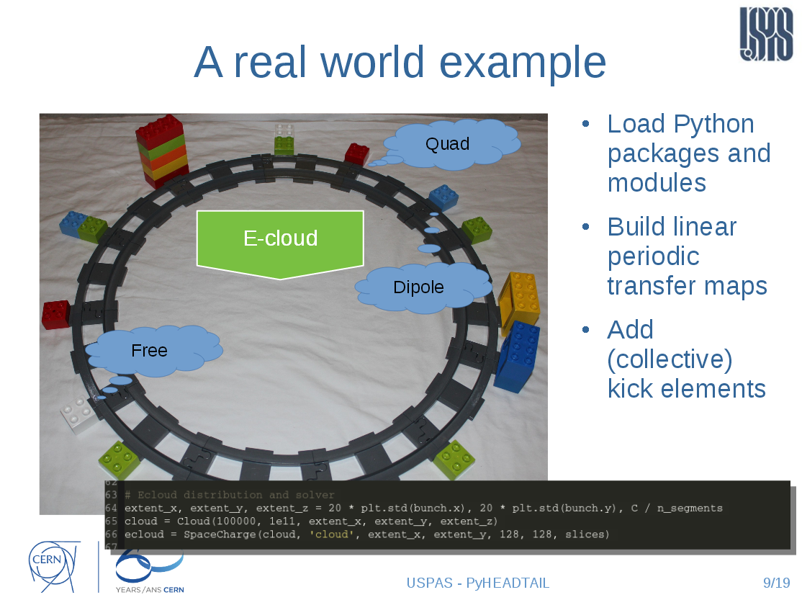
introduction to PyHEADTAIL
Courtesy Kevin Li
USPAS 2015

Slide 15
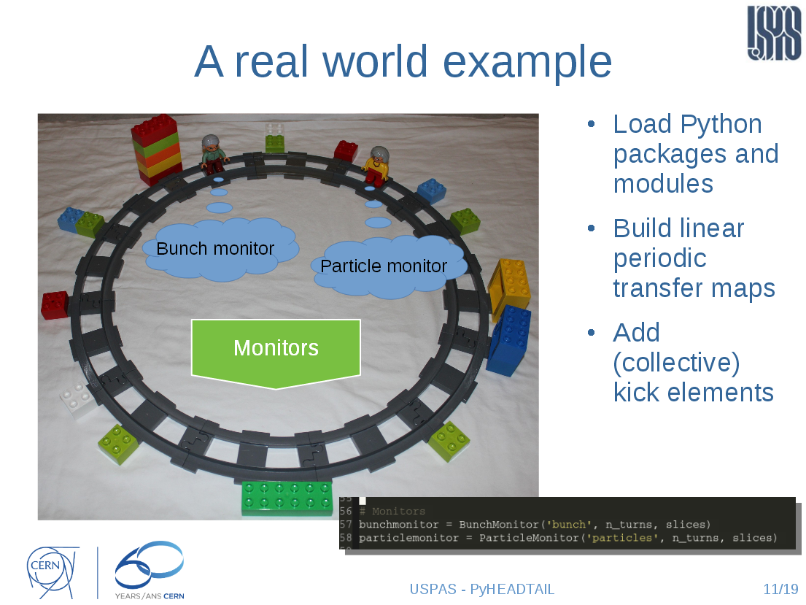
introduction to PyHEADTAIL
Courtesy Kevin Li
USPAS 2015

Slide 16
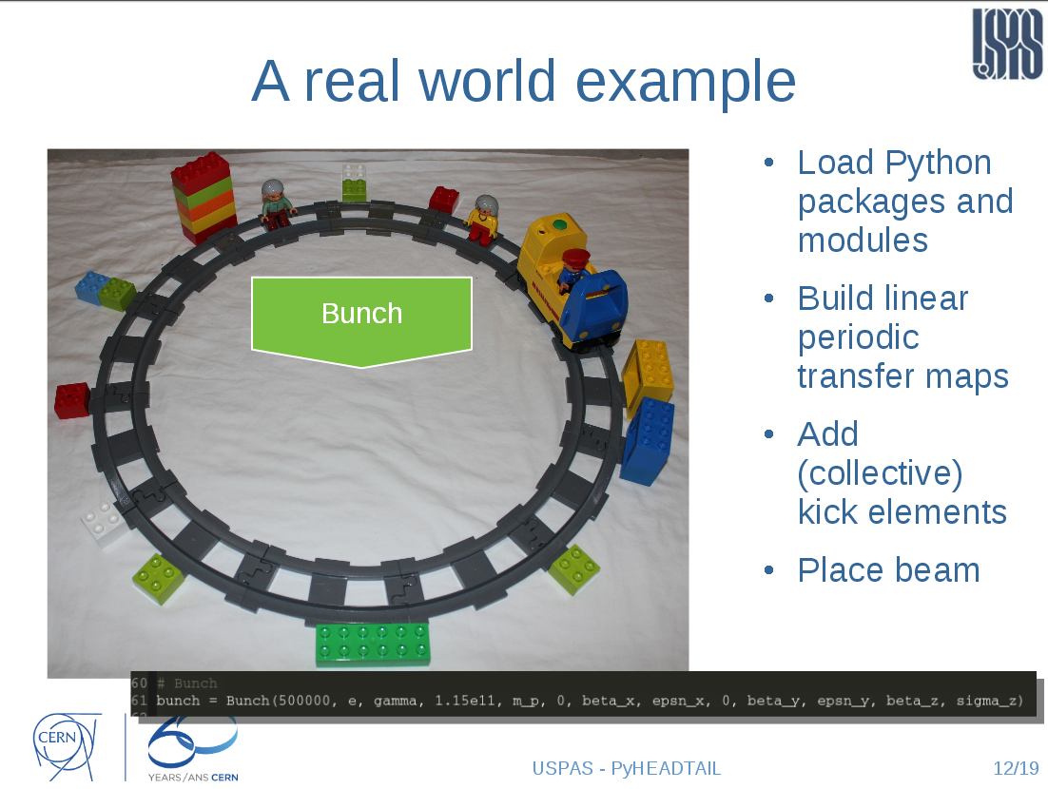
introduction to PyHEADTAIL
Courtesy Kevin Li
USPAS 2015

Slide 17
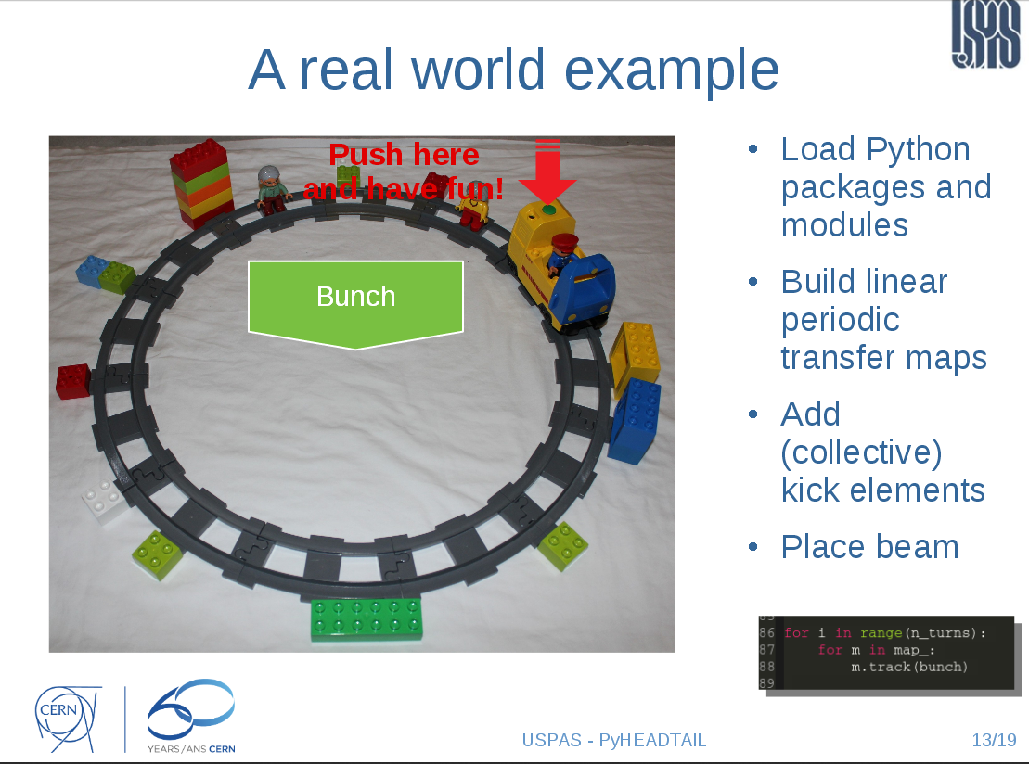
introduction to PyHEADTAIL
Courtesy Kevin Li
USPAS 2015

Slide 18
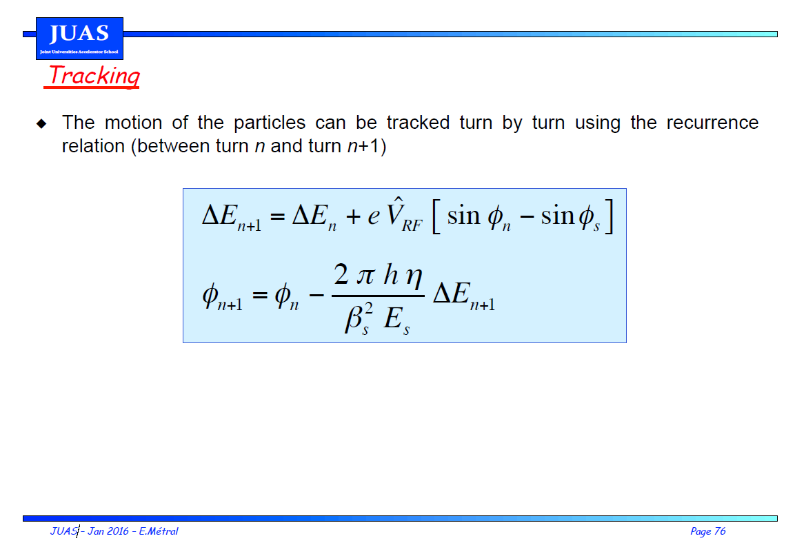
In our case: only RF systems

Slide 19
Agenda
Goals
Plan
Introduction to PyHEADTAIL
Structure of ipython files
Tracking examples
Setting up the environment
  Virtual box
  Ubuntu
  Anaconda
  PyHEADTAIL

Slide 20
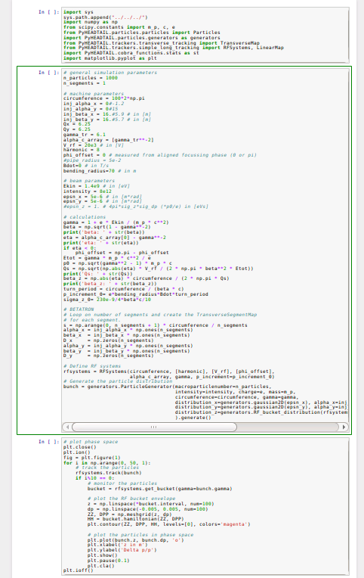
Structure of the ipython file
Import
needed libraries
Set beam and machine
parameters
Define RF system
Generate a matched
distribution corresponding
to these parameters
track
Loop over
number
of turns
monitor
plot

Slide 21
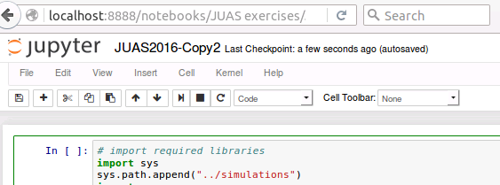
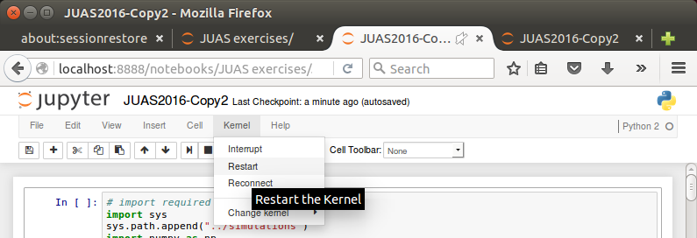
ipython cheat sheet
To restart the kernel at any point: “Kernel” → “Restart”
To only interrupt the kernel: “Kernel” → “Interrupt”
Shift-enter: execute current cell and move to next cell
Ctrl-enter: execute current cell and stay on current cell

Slide 22
Agenda
Goals
Plan
Introduction to PyHEADTAIL
Structure of ipython files
Tracking examples
Setting up the environment
  Virtual box
  Ubuntu
  Anaconda
  PyHEADTAIL

Slide 23
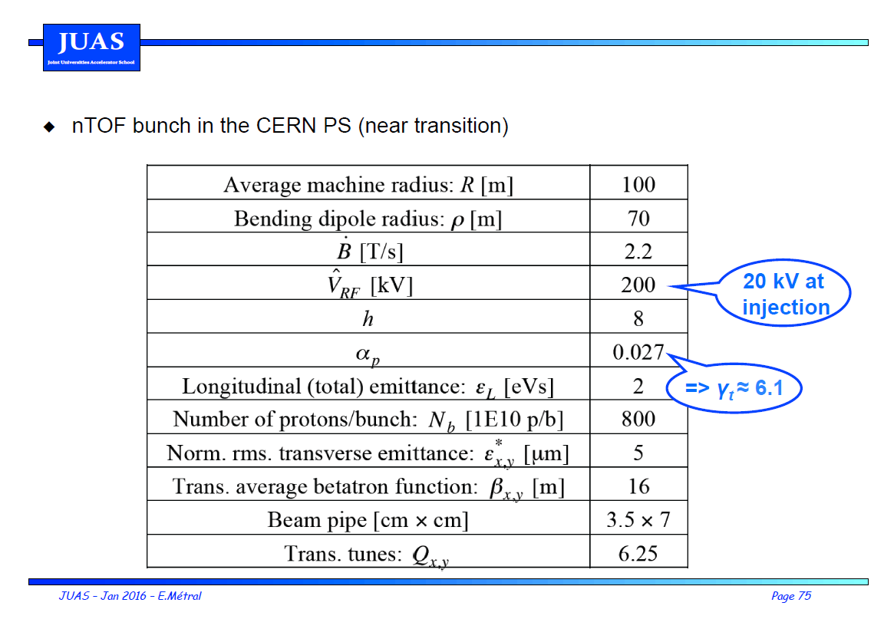
Tracking example: injection energy
0

Slide 24
Tracking example: injection energy
0

Slide 25
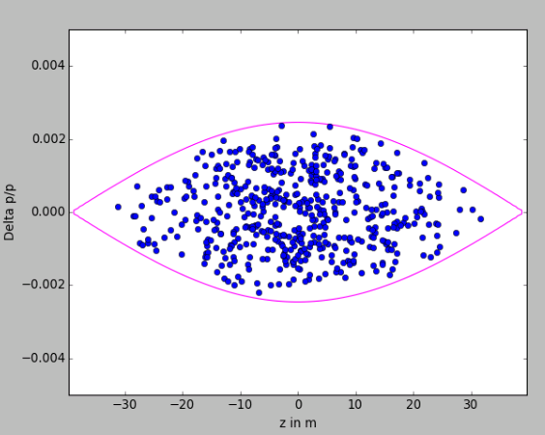
Synchrotron motion
Use a large number of particles (~500) and reset the graph every time (“plt.cla()” uncommented)
Are the particles rotating in the correct direction?
Why?

Slide 26
Top energy
What parameters should be changed for top energy (still no acceleration and h=8)?
What changes in the plot compared to injection energy?

Slide 27
Agenda
Goals
Plan
Introduction to PyHEADTAIL
Structure of ipython files
Tracking examples
  Impact of phase mismatch
  Impact of voltage mismatch
  Impact of acceleration
Setting up the environment
  Virtual box
  Ubuntu
  Anaconda
  PyHEADTAIL

Slide 28
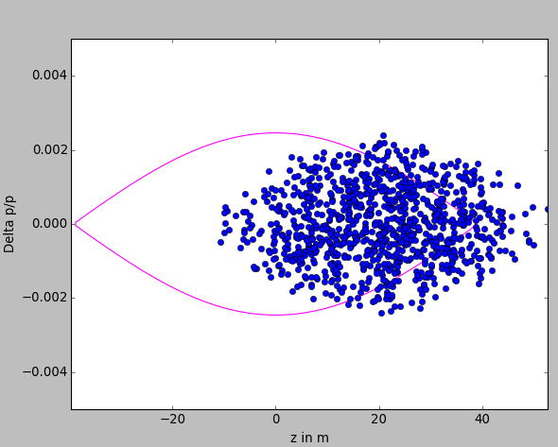
Impact of phase mismatch
Remove the division by 10 in sigma_z_0
Generate ~1000 particles
Add e.g. 5 or 20 m to all particles:
Track particles for ~5000 turns
Plot the distribution every 10 or 100 turns:
→ What will happen?

Slide 29
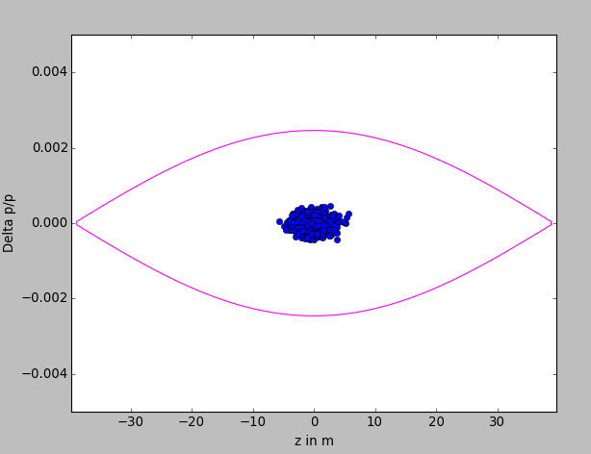
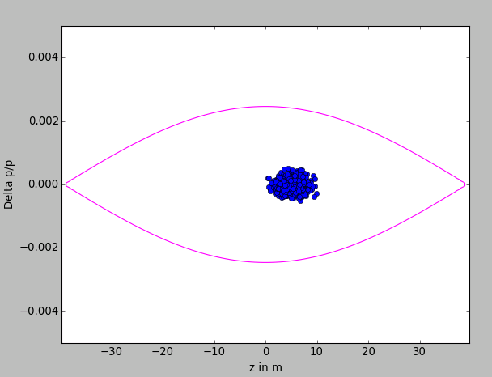
Impact of phase mismatch
Use a smaller bunch length (e.g. divide by 10)
Generate ~1000 particles
Add e.g. 5m to all particles:
Track particles for ~5000 turns
Plot the distribution every 100 turns:
→ What will happen?

Slide 30
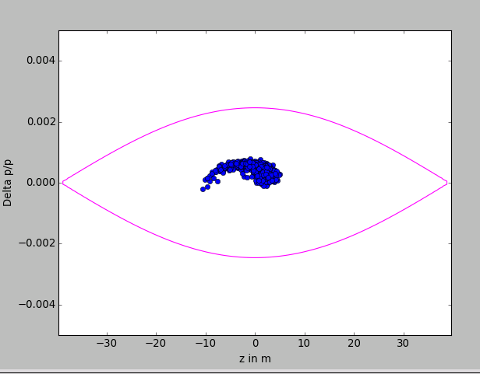
Impact of phase mismatch
Use a smaller bunch length (e.g. divide by 10)
Use ~1000 particles
Add e.g. 5m to all particles:
Track particles for ~5000 turns
Plot the distribution every 100 turns:
Filamentation and eventually?

Slide 31
Impact of phase mismatch
Use a smaller bunch length (e.g. divide by 10)
Use ~1000 particles
Add e.g. 5m to all particles:
Track particles for ~500000 turns
Plot the distribution every 1000 turns
Filamentation and eventually?

Slide 32
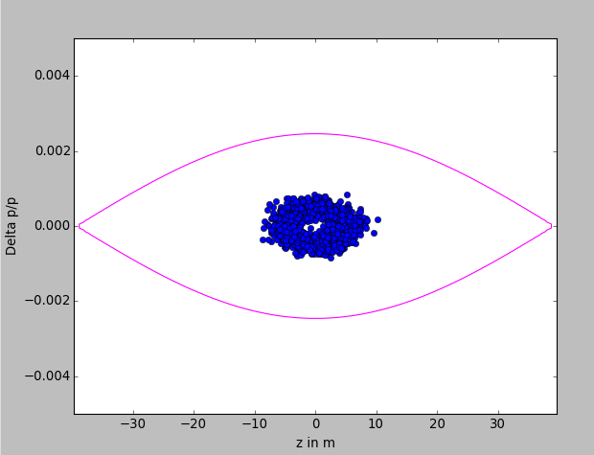
Impact of phase mismatch
Use a smaller bunch length (e.g. divide by 10)
Use ~1000 particles
Add e.g. 5m to all particles:
Track particles for ~500000 turns
Plot the distribution every 1000 turns:
→ Eventually emittance growth
→ Try also with larger mismatch (20 m)

Slide 33
Agenda
Goals
Plan
Introduction to PyHEADTAIL
Structure of ipython files
Tracking examples
  Impact of phase mismatch
  Impact of voltage mismatch
  Impact of acceleration
Setting up the environment
  Virtual box
  Ubuntu
  Anaconda
  PyHEADTAIL

Slide 34

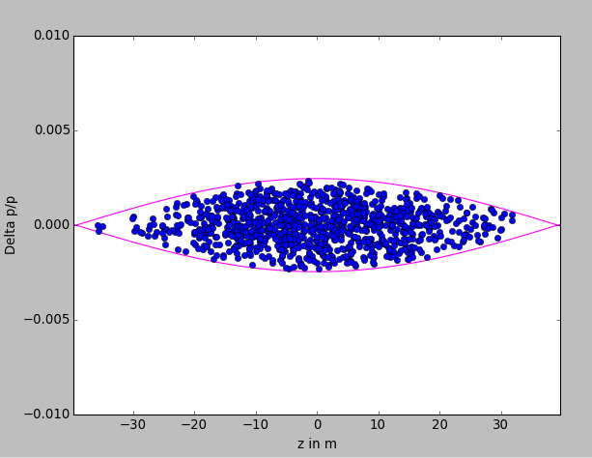
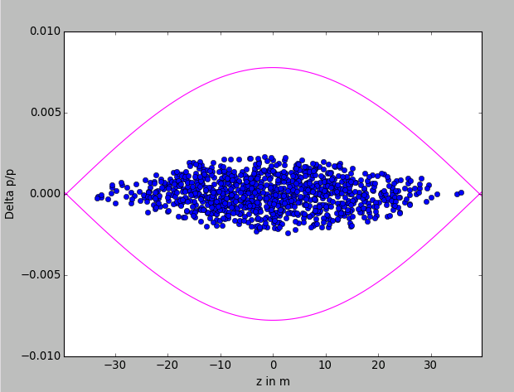
Impact of voltage mismatch (too high)
Use the nominal bunch length
track 1000 particles for 500 turns (plot every 10 turns)
Change V_RF to V_RF*10 after the bunch is matched to V_RF
→ What will happen?

Slide 35
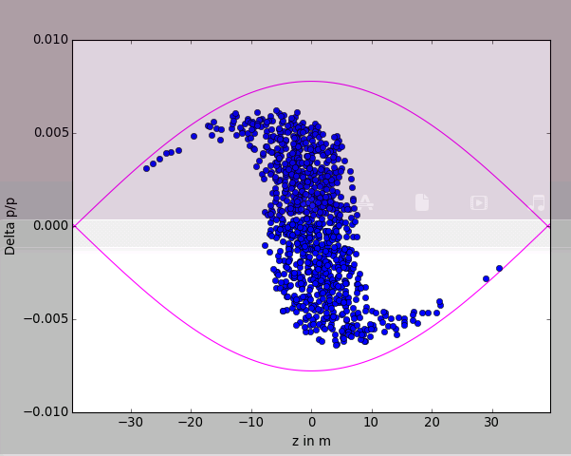
Impact of voltage mismatch (too high)
Use the nominal bunch length
track 1000 particles for 500 turns (plot every 10 turns)
Change V_RF to V_RF*10 after the bunch is matched to V_RF
Bunch rotation
Bunch shortening, if phased correctly, but…

Slide 36
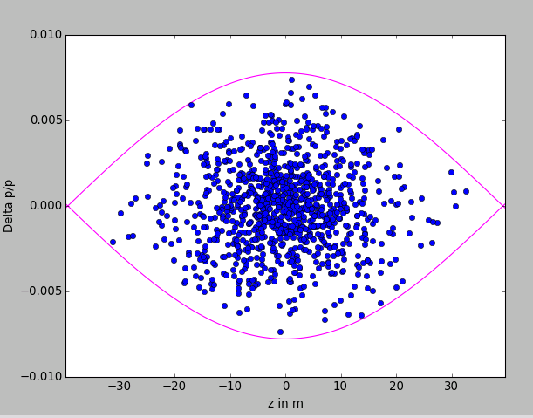
Impact of voltage mismatch (too high)
Use the nominal bunch length
track 1000 particles for 5000 turns (plot every 100 turns)
Change V_RF to V_RF*10 after the bunch is matched to V_RF
But should not wait too long!
Emittance growth!

Slide 37
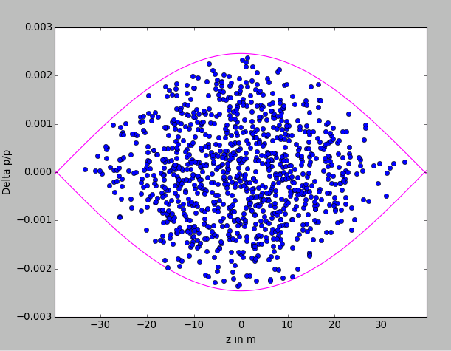
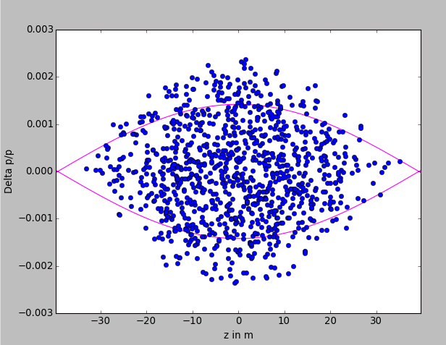
Impact of voltage mismatch (too low)
Use the nominal bunch length
track 1000 particles for 500 turns (plot every 10 turns)
Change V_RF to V_RF/10 after the bunch is matched to V_RF
Adapt the deltap plotting limits

Slide 38
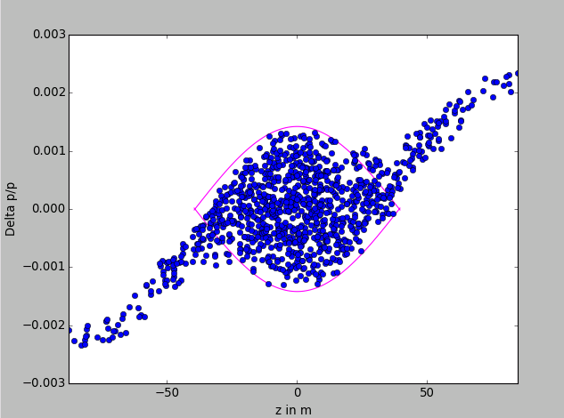
Impact of voltage mismatch (too low)
Use the nominal bunch length
track 1000 particles for 500 turns (plot every 10 turns)
Change V_RF to V_RF/10 after the bunch is matched to V_RF
Adapt the deltap plotting limits

Slide 39
Agenda
Goals
Plan
Introduction to PyHEADTAIL
Structure of ipython files
Tracking examples
  Impact of phase mismatch
  Impact of voltage mismatch
  Impact of acceleration
Setting up the environment
  Virtual box
  Ubuntu
  Anaconda
  PyHEADTAIL

Slide 40
Impact of acceleration
Use the nominal bunch length
Use 200 particles
Use V_RF=20 kV
Use Bdot=2.2 T/s
Does it work? Why?

Slide 41
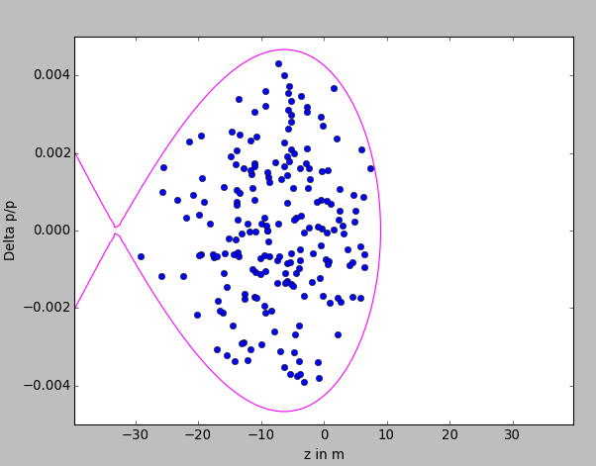
Impact of acceleration
Use the nominal bunch length
Use 1000 particles
Use Bdot=2.2 T/s
Change VRF to 200 kV
Compute the synchronous phase
Plot the phase space in in φ[degrees], ΔE [MeV]

Slide 42
Agenda
Goals
Plan
Introduction to PyHEADTAIL
Structure of ipython files
Tracking examples
  Impact of phase mismatch
  Impact of voltage mismatch
  Impact of acceleration
Setting up the environment
  Virtual box (if you do not have Linux already!)
  Ubuntu
  Anaconda
  PyHEADTAIL

Slide 43
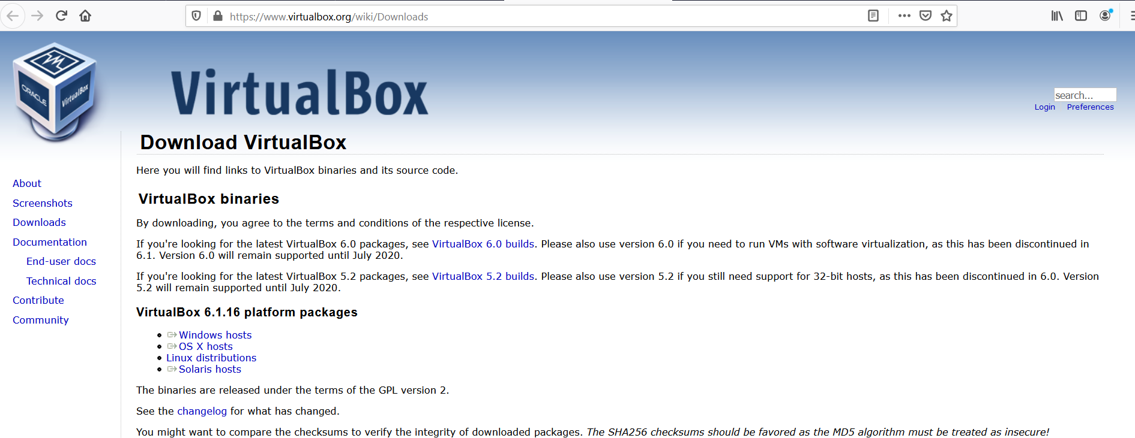
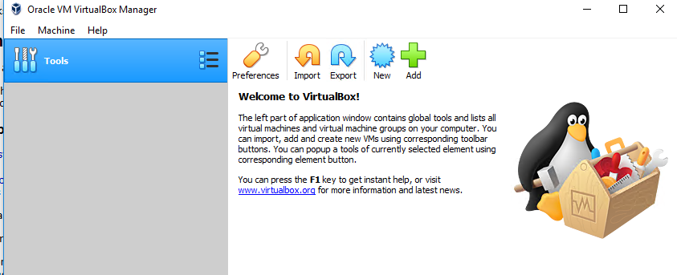
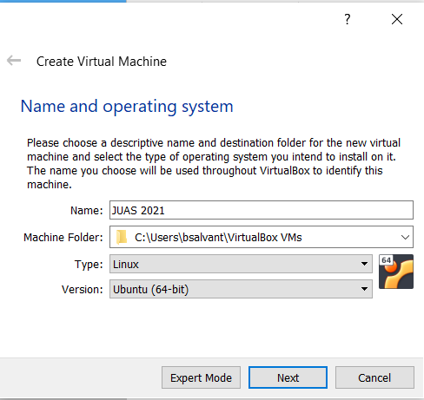
Setting up the operating system
Install a virtual box to get an Ubuntu environment
Ex: https://www.virtualbox.org/wiki/Downloads
Create a new virtual machine
with Ubuntu 64-bit

Slide 44
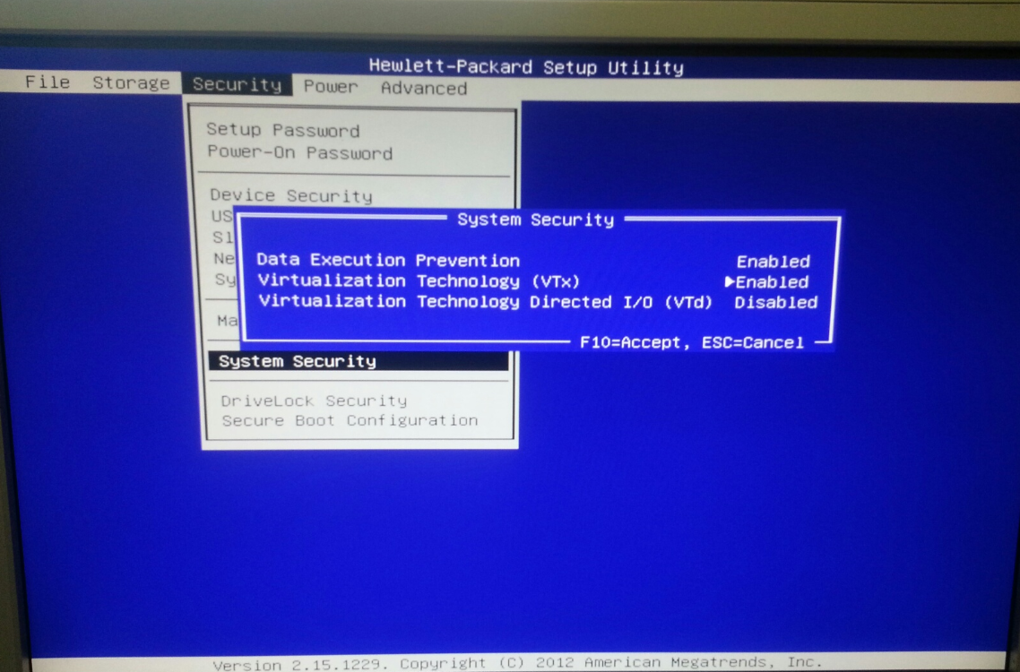
In case of a “VTx” error or an impossibility to select 64 bit operating system when launching the virtual machine, one needs to turn Virtualization Technology (VTx) on in the BIOS (see chapter 10.3 in https://www.virtualbox.org/manual/ch10.html#hwvirt )

Slide 45
Create virtual machine

Slide 46
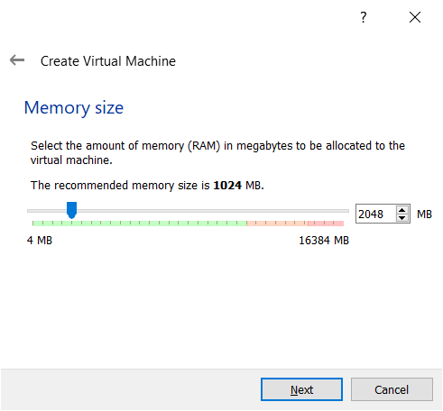
→ 2 GB is recommended by Ubuntu. This setting can be modified later.

Slide 47
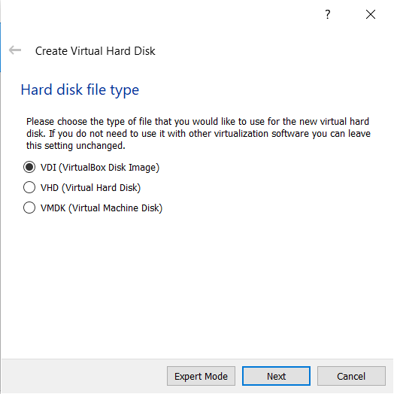

Slide 48
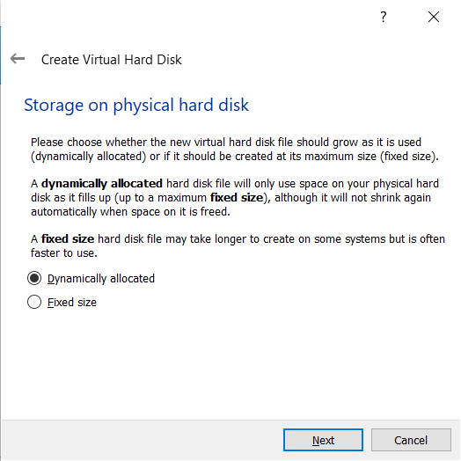

Slide 49
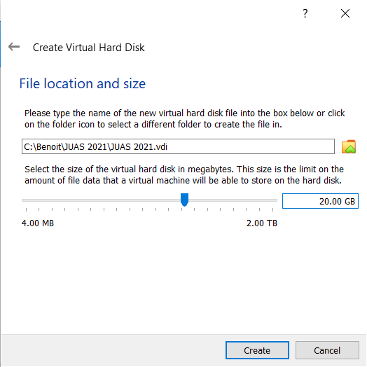
→ Assign 20 GB if possible.

Slide 50
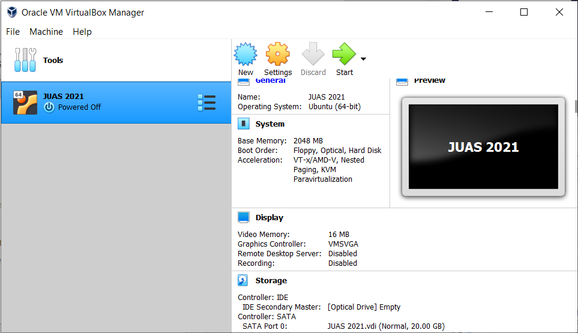
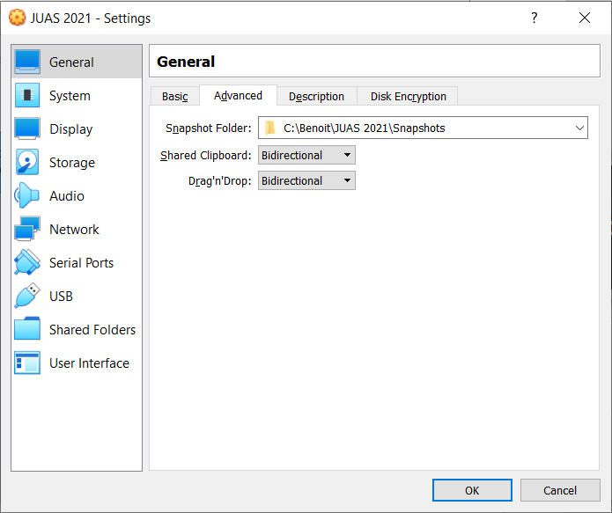
Tip: allow shared clipboard if you wish
In “settings” → “advanced”
of the newly created VM

Slide 51

Start the VM

Slide 52
Agenda
Goals
Plan
Introduction to PyHEADTAIL
Structure of ipython files
Tracking examples
  Impact of phase mismatch
  Impact of voltage mismatch
  Impact of acceleration
Setting up the environment
  Virtual box
  Ubuntu
  Anaconda
  PyHEADTAIL

Slide 53
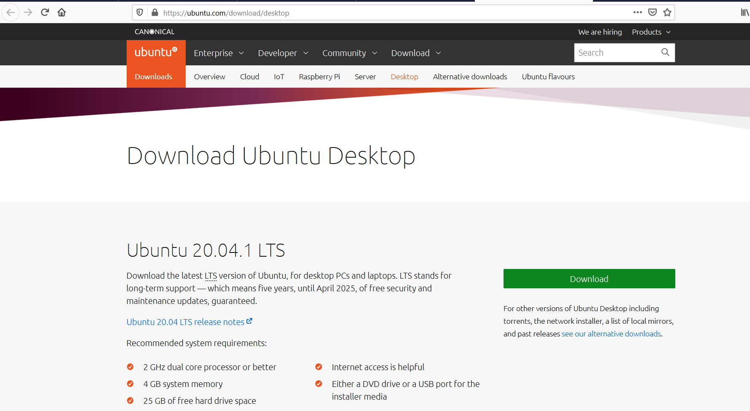
Download ubuntu
https://www.ubuntu.com/download/desktop (beware quite large iso file – 2.6 Go)

Slide 54
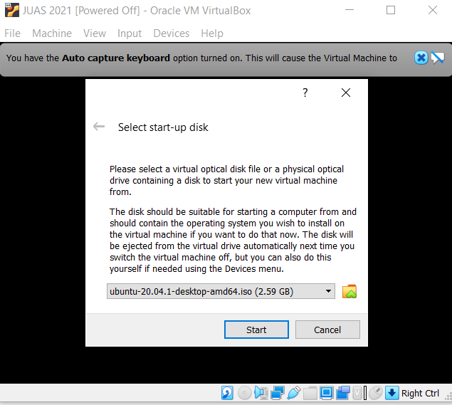
Select Ubuntu start up disk
You may have to click on the small green arrow to browse
for your Ubuntu installation image

Slide 55
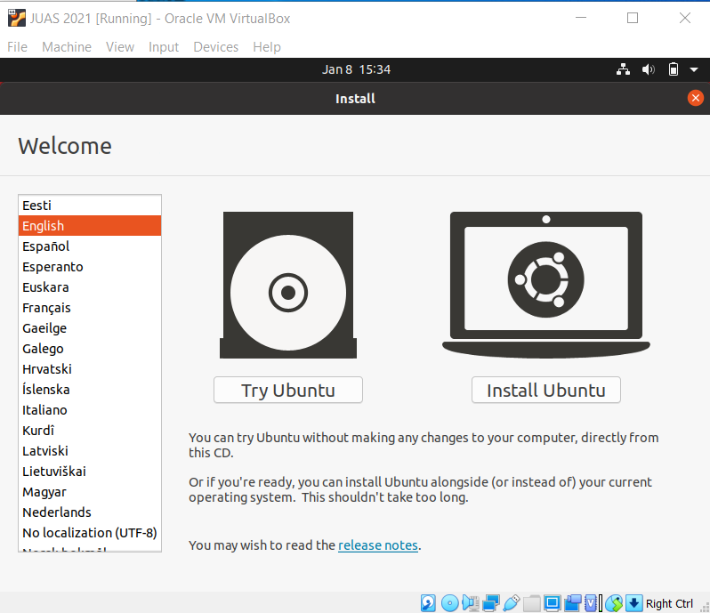
Install ubuntu

Slide 56
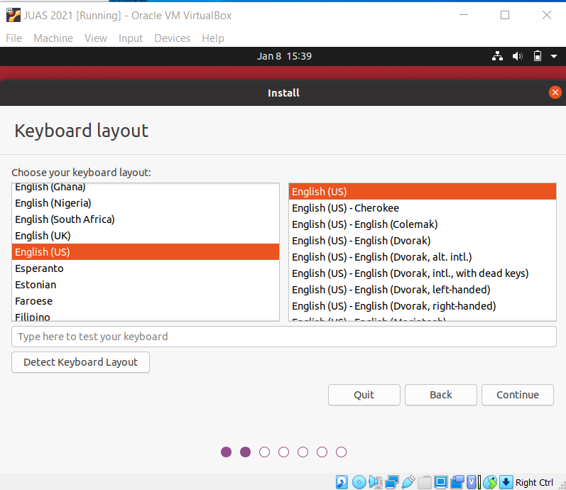
Choose the appropriate keyboard for your personal use (your physical keyboard configuration).
My keyboard is English (US)

Slide 57
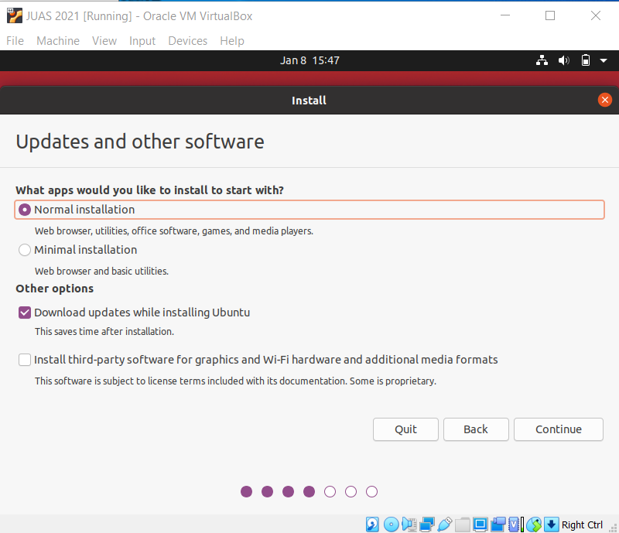
Choose normal installation

Slide 58
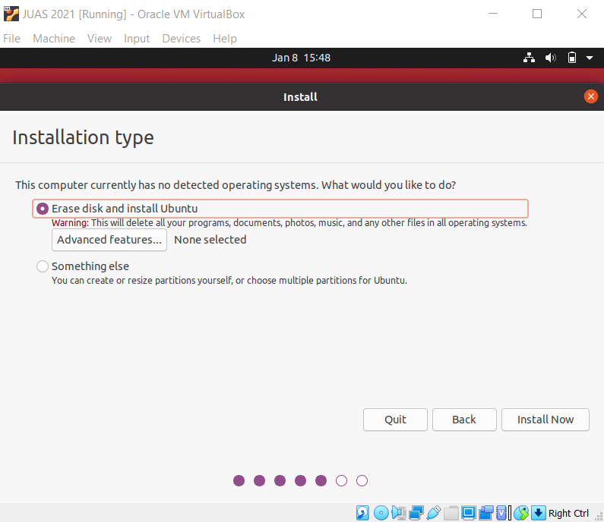
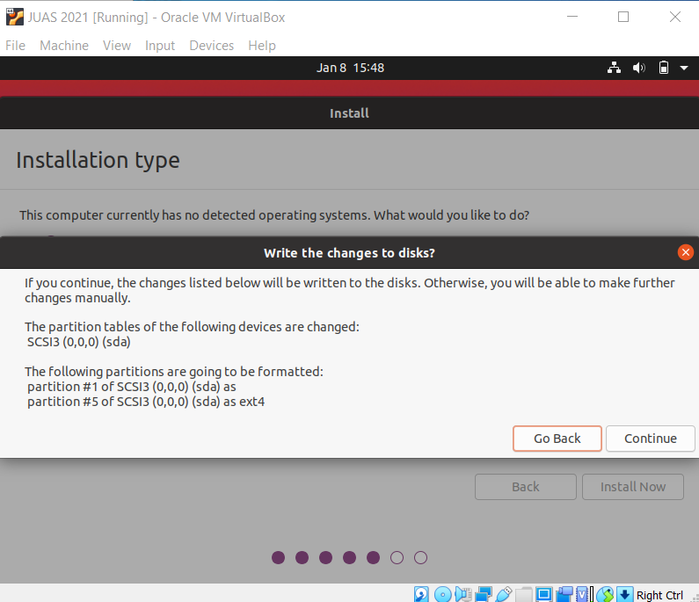
Keep default installation and “install now” and confirm with “continue” on the pop up
Then choose time zone and login details

Slide 59
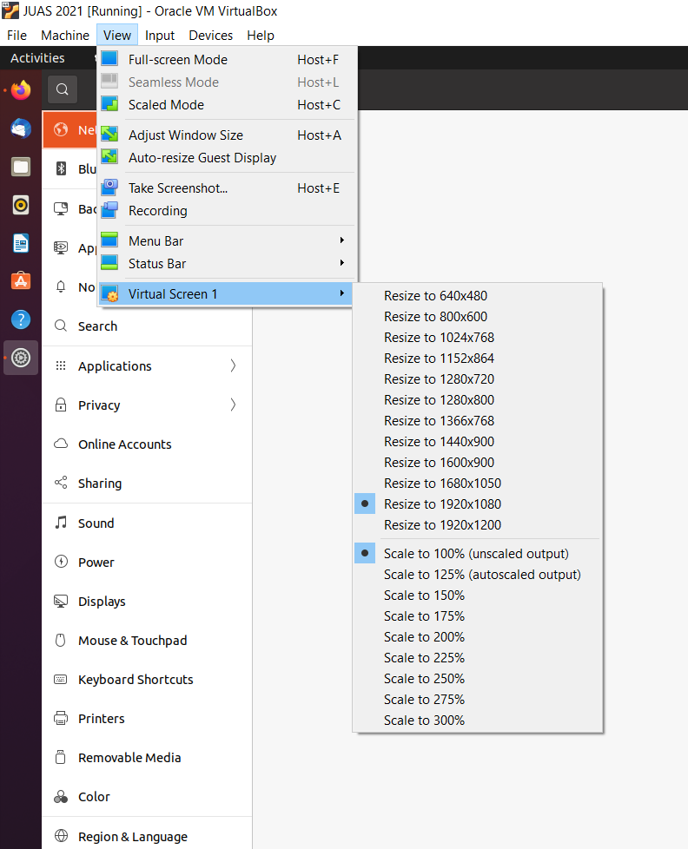
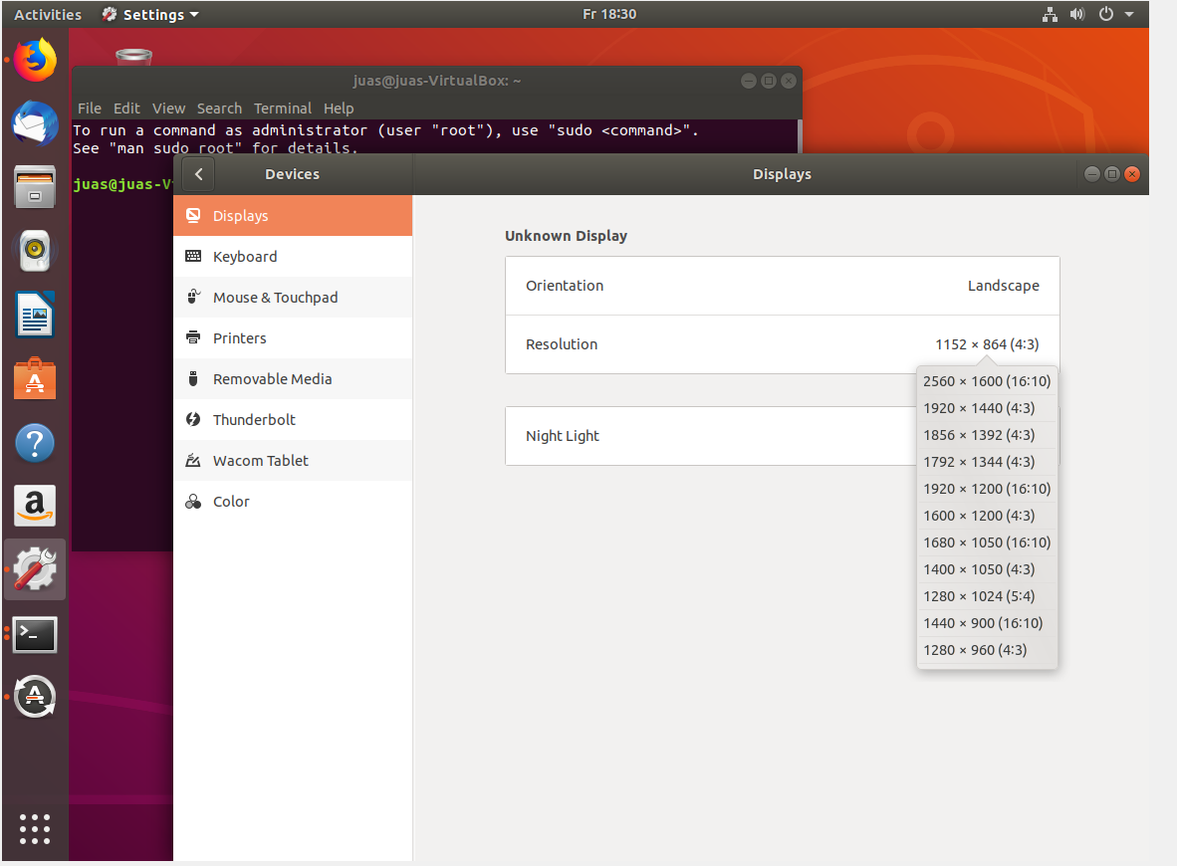
Then wait for file copy and Ubuntu installation restart the machine after it is complete
If the screen is too small,
  Change the scaling/seettings in the VM
  or
  change the display settings inside Ubuntu or
  shut down the VM
  go to the VM Settings
  » Display
  » Screen
  » Graphics Controller = VBoxVGA

Slide 60
Agenda
Goals
Plan
Introduction to PyHEADTAIL
Structure of ipython files
Tracking examples
  Impact of phase mismatch
  Impact of voltage mismatch
  Impact of acceleration
Setting up the environment
  Virtual box
  Ubuntu
  Anaconda
  PyHEADTAIL

Slide 61
Install anaconda
Download anaconda for Linux at https://www.anaconda.com/distribution/#download-section
or type
> wget https://repo.anaconda.com/archive/Anaconda3-2020.11-Linux-x86_64.sh
Then install it by typing
> sh Anaconda3-2020.11-Linux86_64.sh
In the download directory

Slide 62
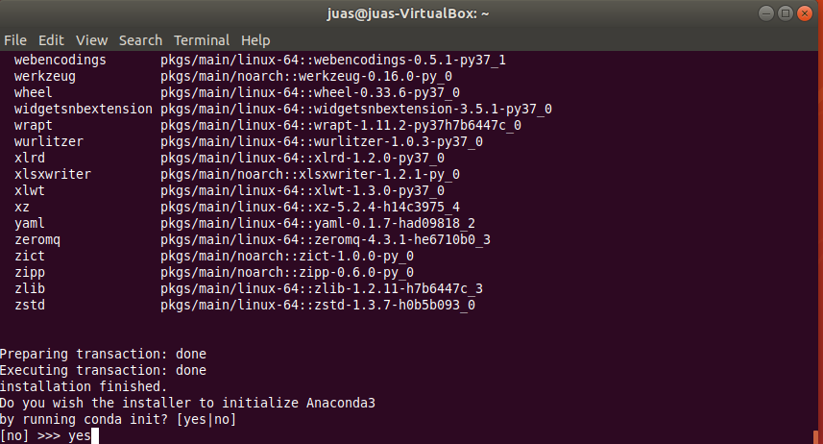
Do not forget to add Anaconda to path (answer yes or add the path yourself in the “.bashrc” configuration file)
Restart the shell (“>>source .bashrc” from the home directory)
Check that “>>ipython notebook” works
→ Anaconda contains all the necessary libraries to run PyHEADTAIL.

Slide 63
Agenda
Goals
Plan
Introduction to PyHEADTAIL
Structure of ipython files
Tracking examples
  Impact of phase mismatch
  Impact of voltage mismatch
  Impact of acceleration
Setting up the environment
  Virtual box
  Ubuntu
  Anaconda
  PyHEADTAIL

Slide 64

Installing PyHEADTAIL
website for installation and information: https://github.com/PyCOMPLETE/PyHEADTAIL
Add path to the end of the .bashrc to be able to import PyHeadtail from everywhere:
This only updates once a new terminal is opened (or do source ~/.bashrc)

Slide 65
In case of issues with PyHEADTAIL installation, most likely it is that fortran and C need to be installed:
sudo apt-get install gfortran
Sudo apt-get install gcc

Slide 66
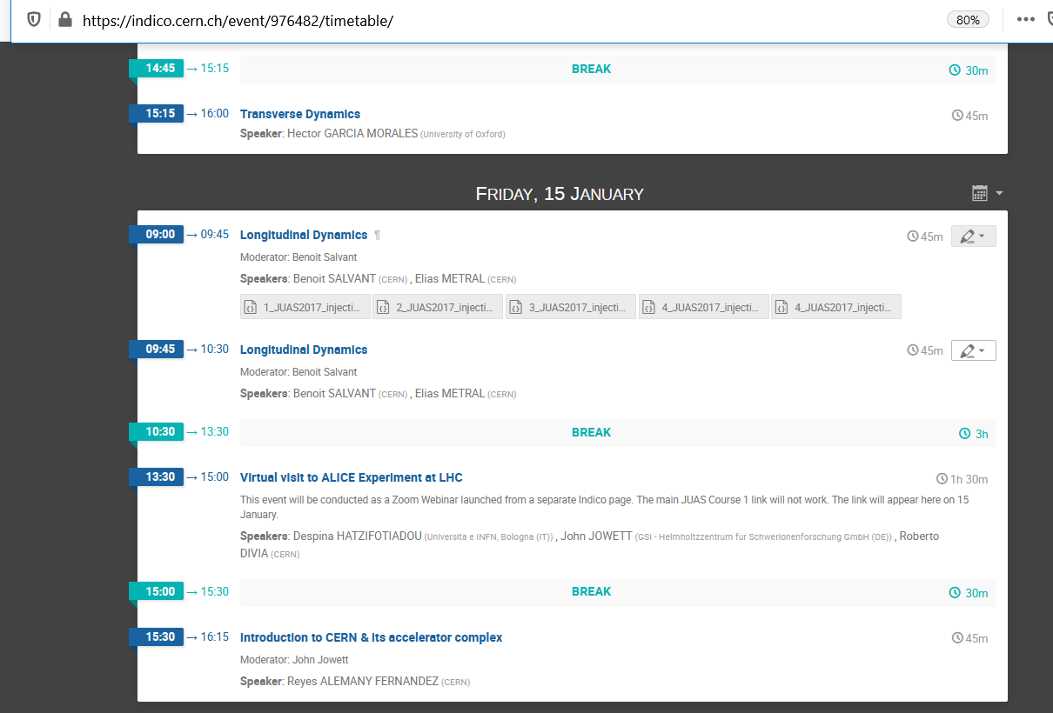
Finding the examples
From JUAS 2021 Indico site in the last tutorial of the course: https://indico.cern.ch/event/976482/timetable/
→ Download the *.ipynb files and open them browsing with “ipython notebook”

Slide 67





Changing variables
$$∆φ[rad]=−\frac{h}{R} z[m]$$
$$ΔΕ =\frac{Δp}{p}m_{0}γβ^{2}c^{2}$$
For protons
$$ΔΕ\left[GeV\right]=\frac{Δp}{p}0.938 γβ^{2}$$

