Slide 1
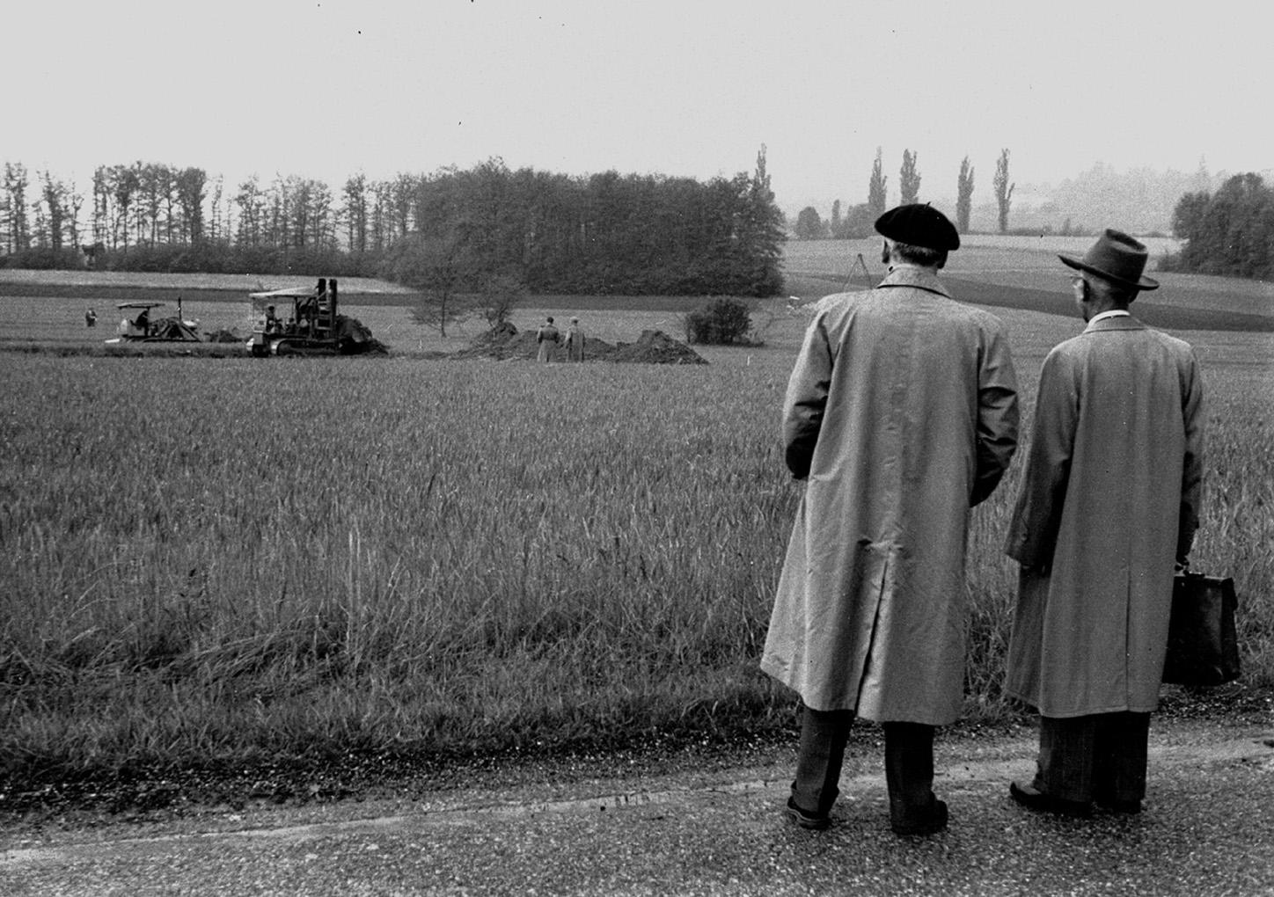
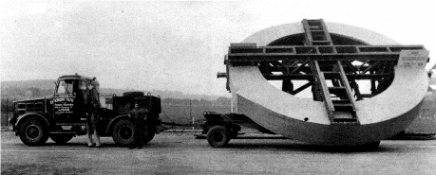
Overview of the CERN Accelerator Complex
CERN Lab 1954
1957: Synchrocyclotron ➔ 600 MeV, 15.7 m, 33 years of operation
1952: Geneva selected by the provisional Council as site for CERN
1953: approved by referendum in Canton Genève
1954: the first shovel of earth was dug on the Meyrin site
Reyes Alemany, Beams Department, CERN

Slide 2
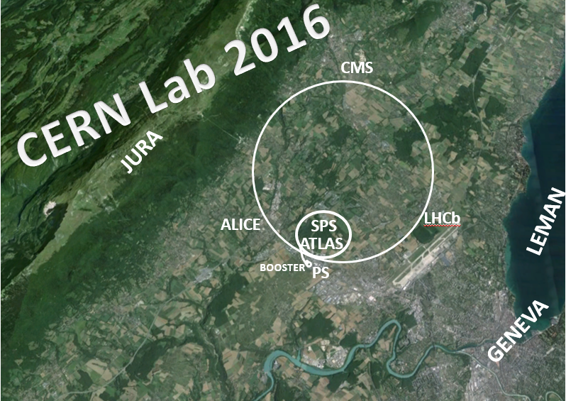
21
CMS
JURA
ALICE
SPS
LHCb
LEMAN
ATLAS
BOOSTER
PS
GENEVA
~ 70 000 m of accelerators (including transfer lines)

Slide 3
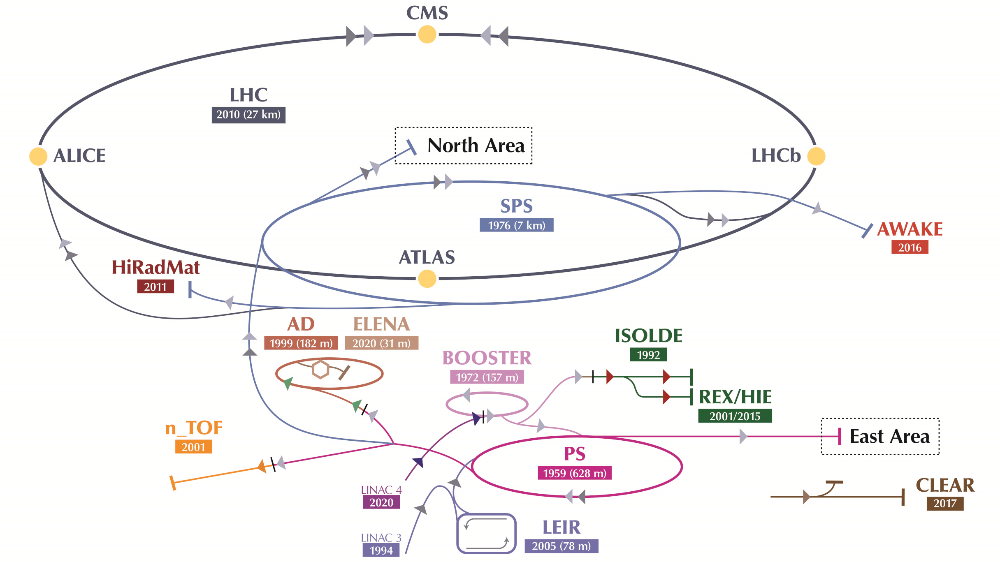
CERN Accelerator Complex Layout

Slide 4
CERN Proton Accelerator Complex
p+
H-

Slide 5
CERN Ion Accelerator Complex

Slide 6
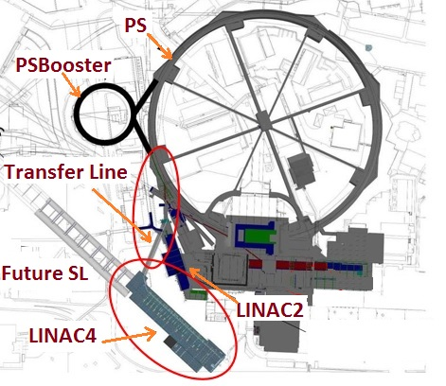
Linac 4

Slide 7
At this point I need to open a parenthesis to motivate why Linac 4 and many other upgrades have been carried out during the Long Shutdown 2 (LS2) (2019-2020) in the CERN Accelerator Complex
I have to talk about LHC Injector Upgrade (LIU) done during LS2 to meet the High-Luminosity LHC performance requirements

Slide 8
(

Slide 9
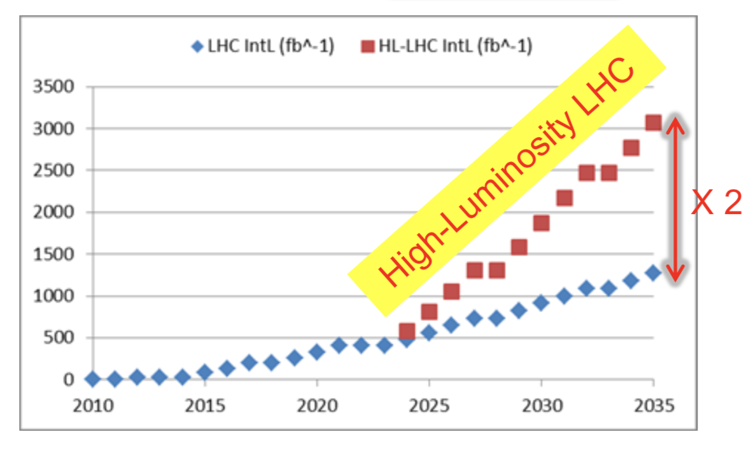


Injectors Post-LS2 era ➔ meet HL-LHC performance
What HL-LHC requires? ➔ increase by a factor of 2 the integrated luminosity
What is luminosity? ➔ one of the most important figures of merit of a collider
Integrated Luminosity
years
(Instantaneous) Luminosity ∝ number of interactions per unit of time
(Integrated) Luminosity ∝ number of interactions per unit of time x Δt
Physics cross-section (cm⁻²) at the collision energy (e.g. H➔𝜸𝜸)

Slide 10
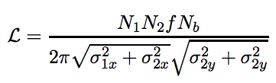

Injectors Post-LS2 era ➔ meet HL-LHC performance
How can we increase luminosity?
➔ Increasing the number of particles per colliding package (bunches) at the interaction point : N₁ and N₂
➔ Decreasing the size of the beams at the interaction point: σ’s
F
$$Brightness=N/σ$$
F: geometrical factors; can also be optimized to increase the luminosity

Slide 11
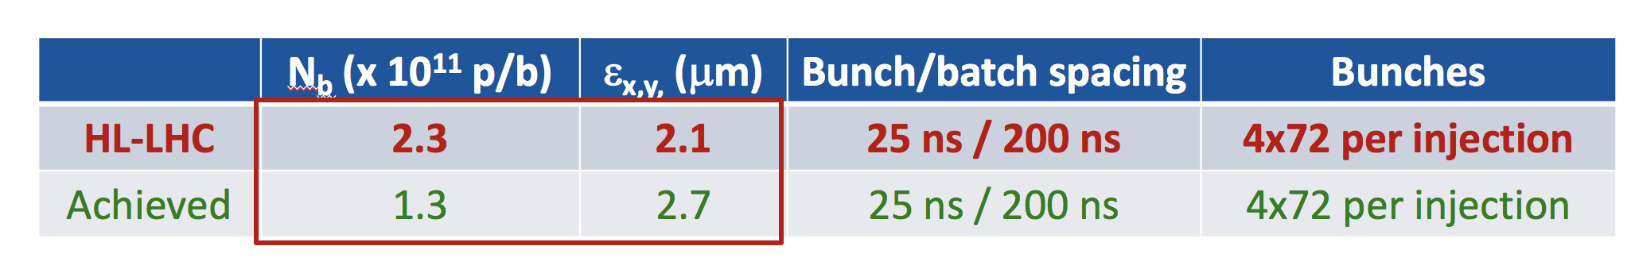

Injectors Post-LS2 era ➔ meet HL-LHC performance
How can we increase luminosity?
➔ Increasing the number of particles per colliding package (bunches) at the interaction point : N₁ and N₂
➔ Decreasing the size of the beams at the interaction point: σ’s
F
$$σ=\sqrt{β\frac{ε_{n}}{{\left(βγ\right)}_{rel}}}$$
How can we get there? ➔ LIU upgrades

Slide 12
)

Slide 13
Linac 4

Slide 14
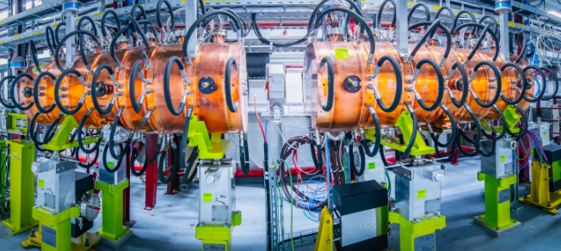
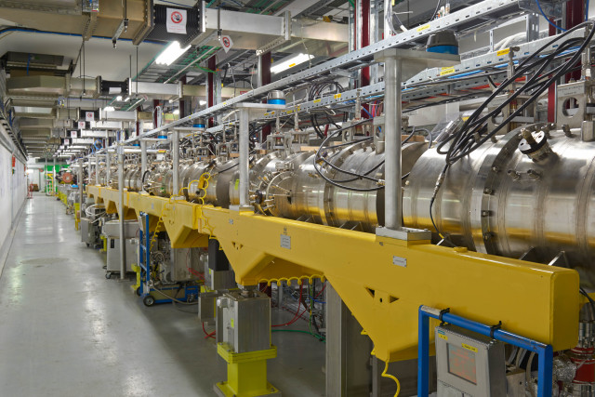
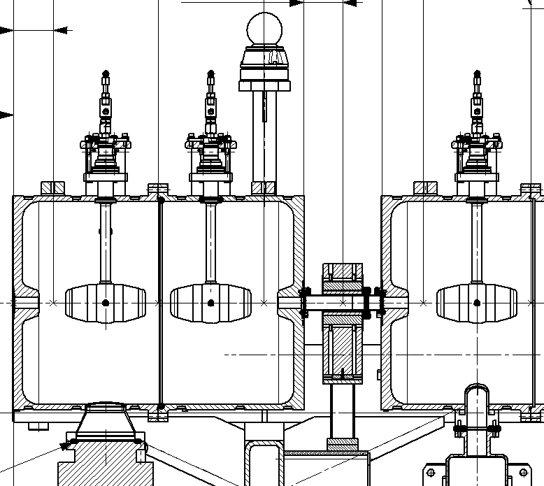
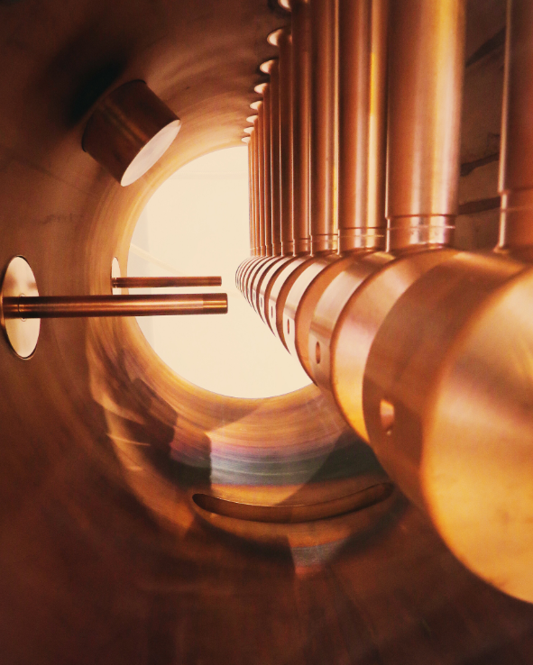
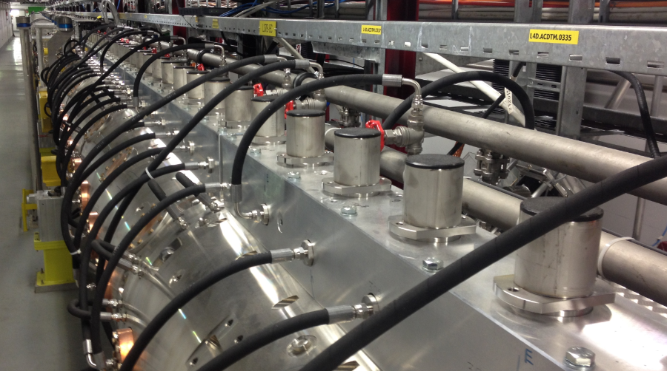
Source and Linac 4
DTL: drift tube linac
CCDTL: cell-coupled drift-tube linac
PIMS: pi-mode structure
Source

Slide 15

Source and Linac 4
Source H-
Two H- production mechanism:
H- from the plasma cell:
$$e+H_{2}→H^{−}+H$$
H- from the surface: electron transfer from the surface to an atom leaving the surface. This process is enhanced by lowering the surface work function via the deposition of alkali: e.g. Cesium

Slide 16
How Linac 4 contributes to reach the HL-LHC requirements?

Slide 17
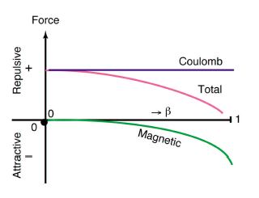

Linac 2 (50 MeV) ➔ Linac 4 (160 MeV)
At the beginning of the injector chain the particle energy is not yet relativistic
Space charge = Coulomb repulsive force is a problem
$$β=\frac{v}{c}$$
LINAC2
v(0.750 MeV➔50 MeV)=4% ➔31% of c
What can we do to suppress as much as possible the space charge?
We have to increase the velocity/energy of the particles as high as possible

Slide 18
Linac 2 (50 MeV) ➔ Linac 4 (160 MeV)
Space charge = Coulomb repulsive force is a problem
Defocusing force ➔ changes the tune of the particles
Increasing the energy decreases the tune change ☺
“Straight lines are forbidden areas for the beam”

Slide 19
Linac 2 (50 MeV) ➔ Linac 4 (160 MeV)
Defocusing force ➔ changes the tune of the particles
If one does the calculation it arrives to the conclusion that increasing the Linac energy to 160 MeV with respect to 50 MeV, reduces the tune change by a factor of 2.
But, we can operate the Booster with this tune spread!
How can we best make use of the factor 2 that we just gained?
We can increase by a factor of two the brightness ☺!!

Slide 20
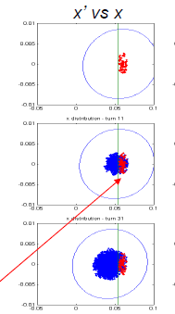
H⁻ Injection
e-
e-
p+
From LINAC4
H⁻
Stripping foil (99% efficiency)
Circulating p+
BOOSTER
Displaced Orbit
Injection chicane dipoles:
Bump off after injection to preserve the foil from unnecessary heating
Injection in the same phase space region!!!
Emittance better preserved
Not possible with LINAC2
Nb^{LINAC4} ≈ 2 Nb^{LINAC2}
!!!!

Slide 21
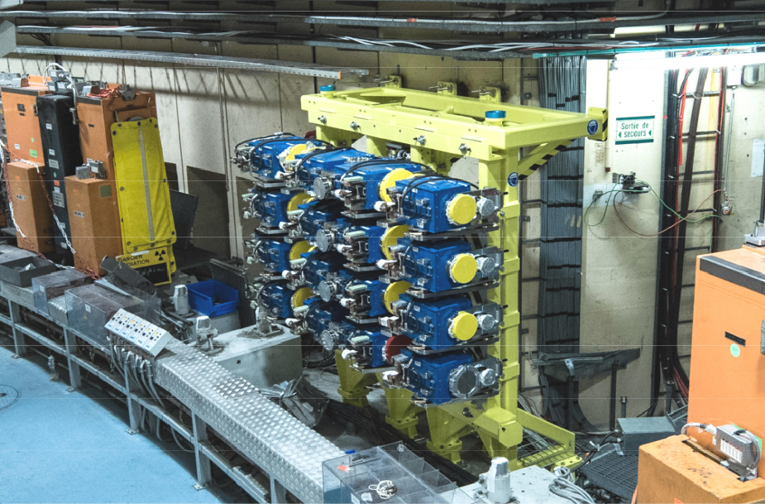
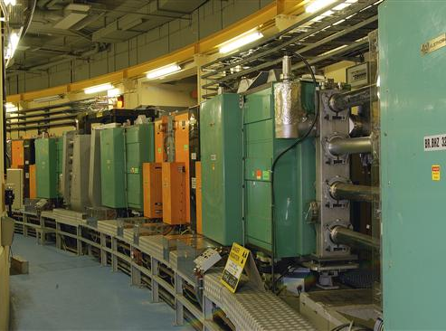
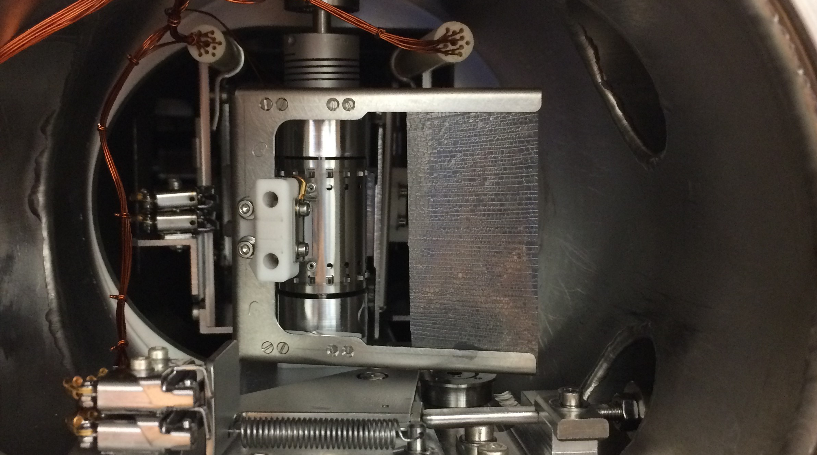
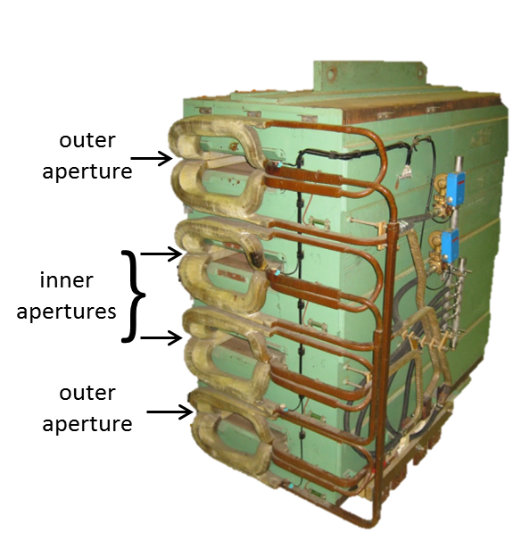
PS Booster
East Hall
Newly installed H- injection
Stripper foil for H- injection
C = 154 m
Commissioned in 1972
Built to increase the PS injection energy to compensate for space charge
Main dipoles
Pre-LS2 (p+):
E_{inj}=50 MeV
E_{ext}=1.4 GeV
LIU era (H-):
E_{inj}=160 MeV
E_{ext}=2 GeV
Synchrotron with 4 vertically stacked rings, each ¼ of PS Circumference
Duty cycle 1.2 s ➔ two cycles needed to fill the PS with protons for LHC

Slide 22


Slide 23
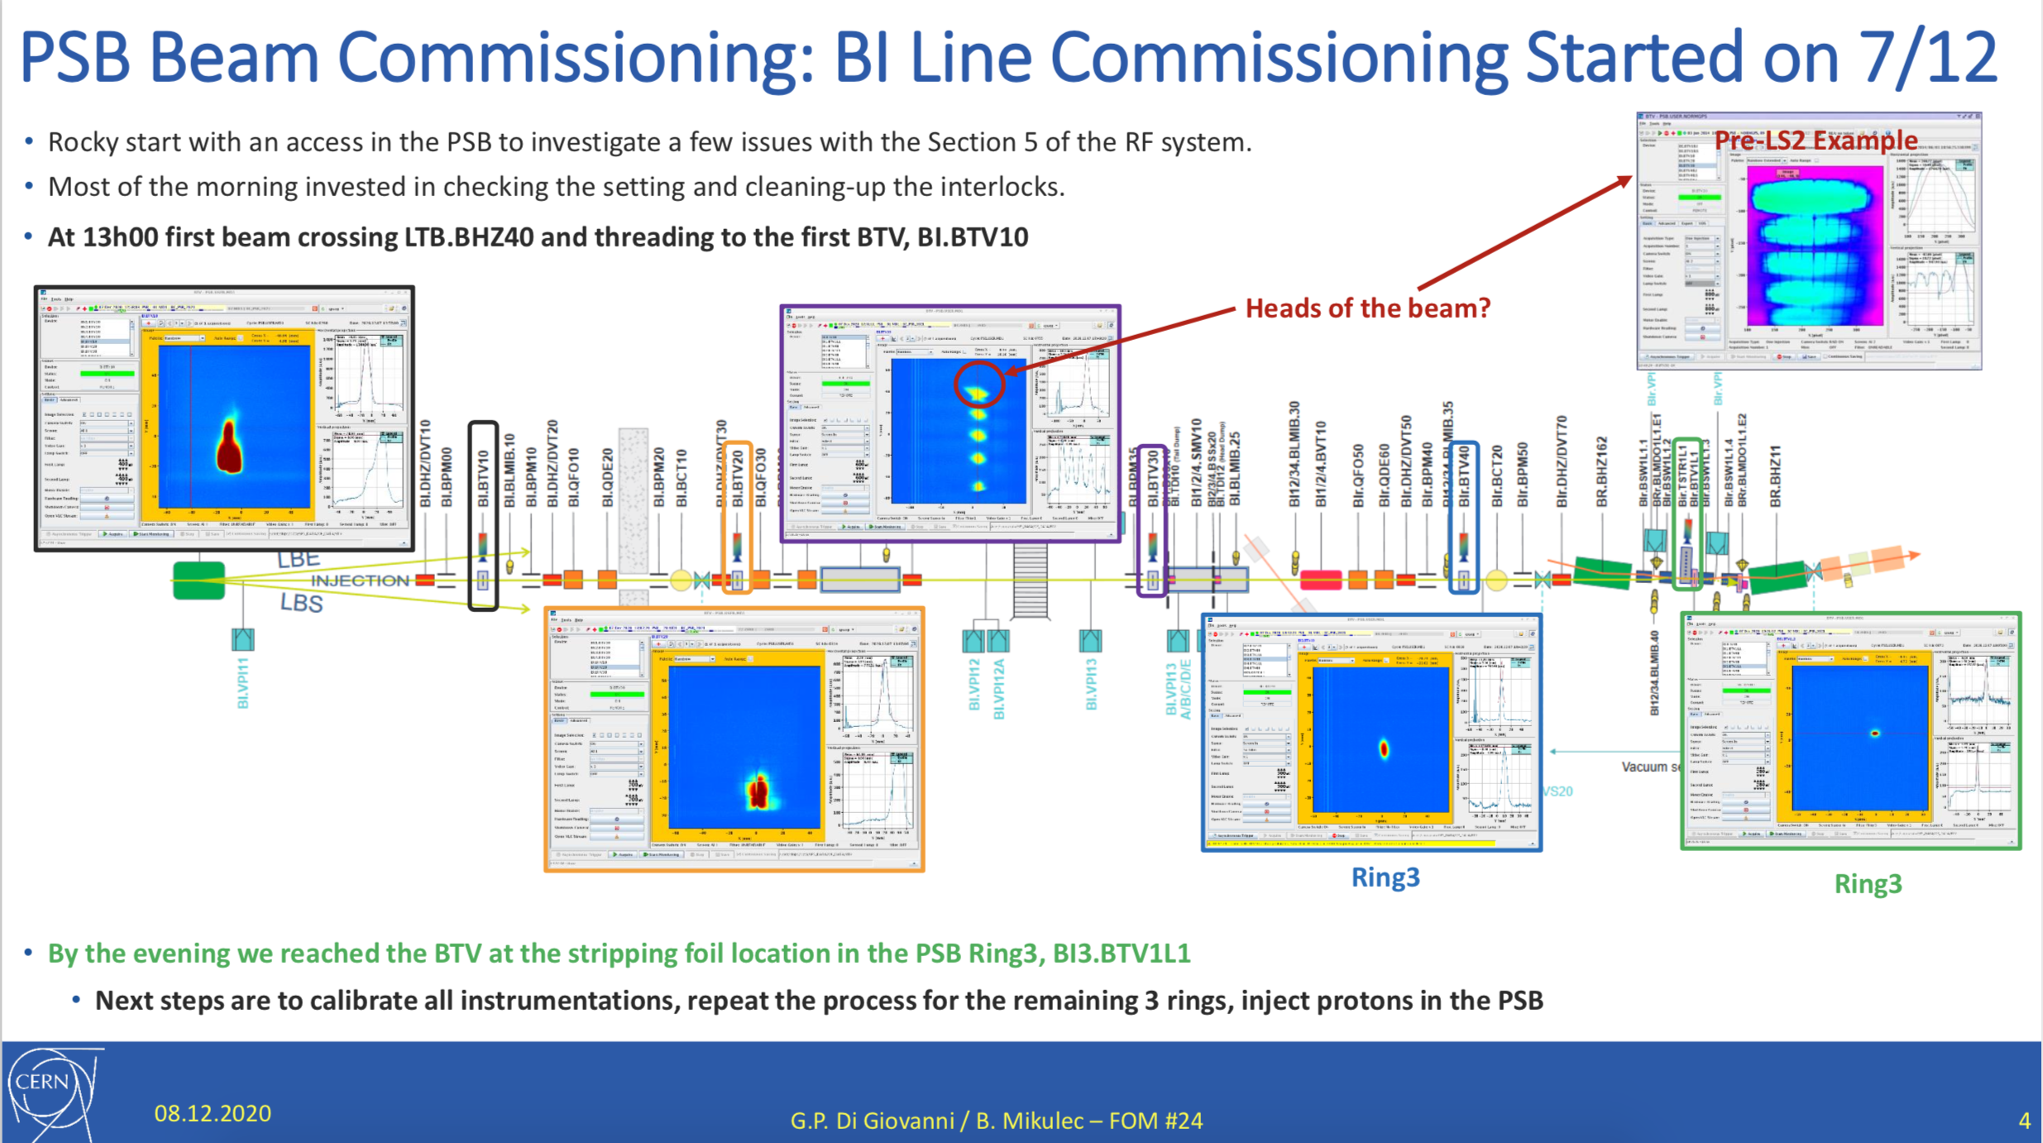
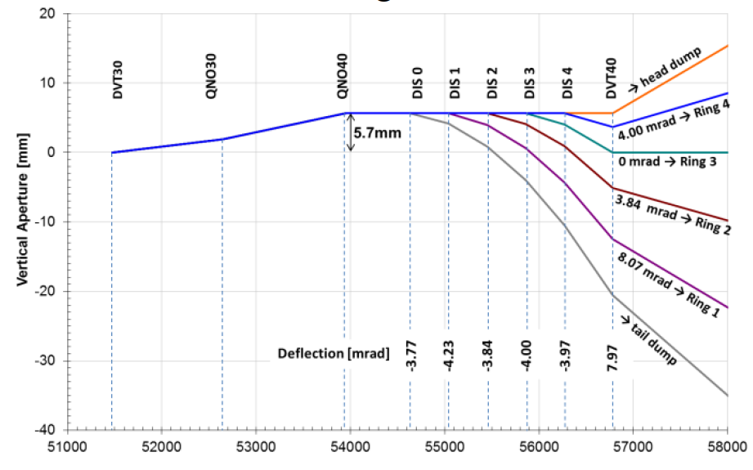
First H- beam in Booster Ring 3 (07.12.2020)
H- at the vertical septa and dipoles
H- direction
BTV at H- stripper foil
H- at the distributor position
INJECTION INTO RING 3

Slide 24
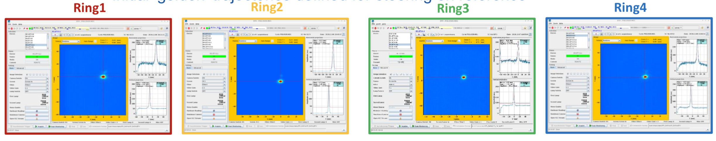
First H- beam in all Booster Rings entrance point (07.12.2020)
BTVs at the stripper foil position of each ring

Slide 25
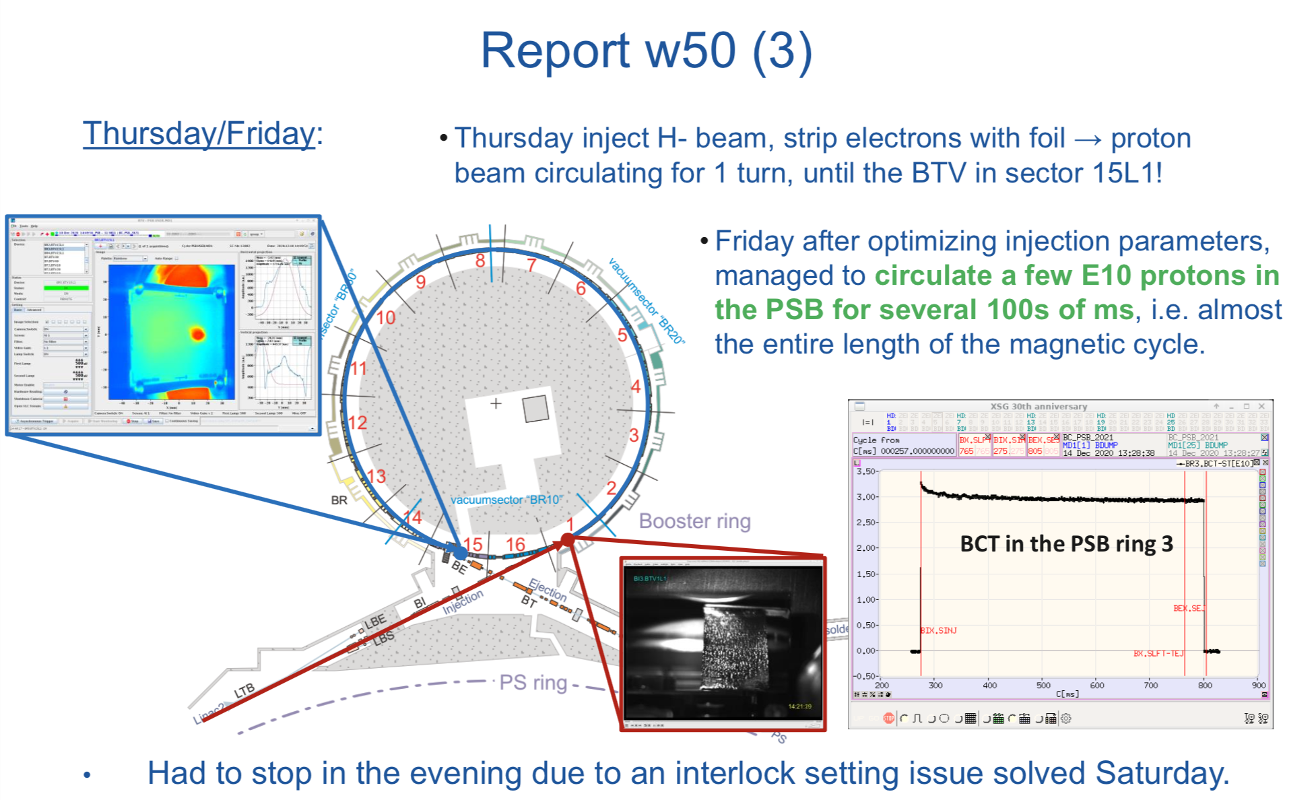
First protons circulating in Booster

Slide 26
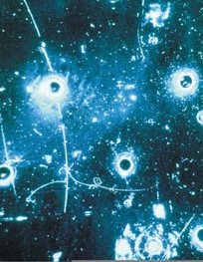
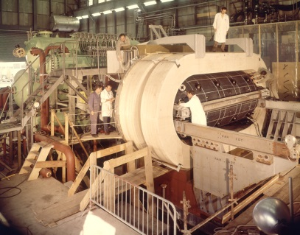
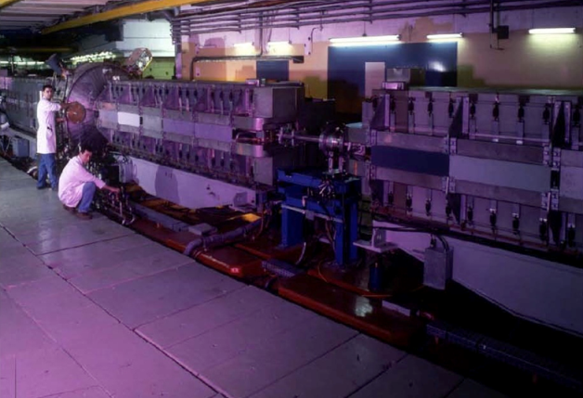
Proton Synchrotron (PS)
The oldest functioning machine at CERN
The first Alternating Gradient Machine!
1959
1970-1976
νµ beam
GARGAMELLE
First evidence of weak neutral currents (Zº)
Combined-function magnets (QFQDB)

Slide 27
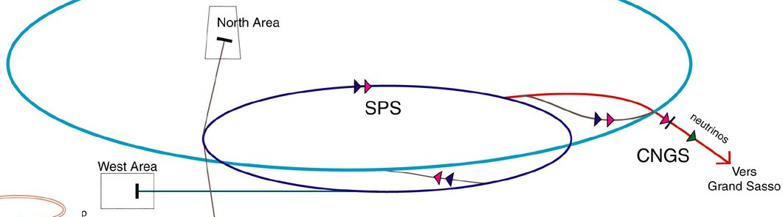
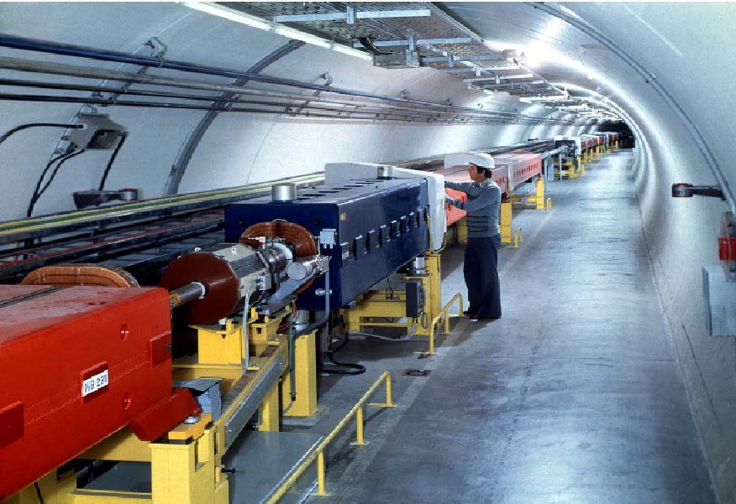

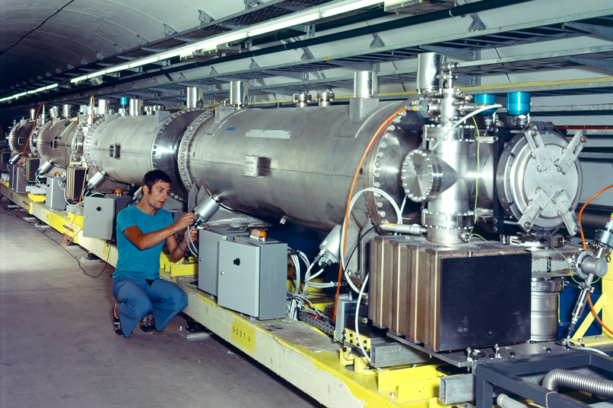
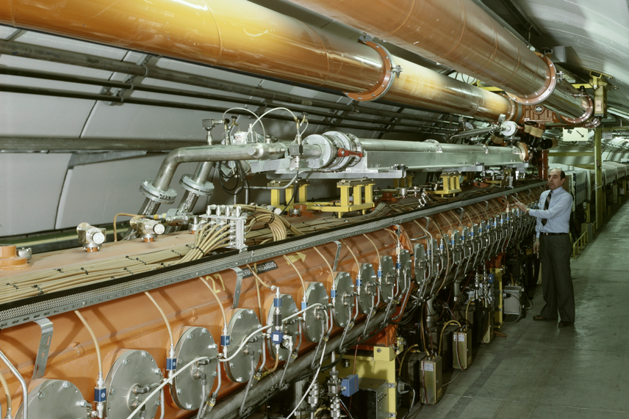
Super Proton Synchrotron (SPS)
North area
LHC
~ 7 km, 450 GeV, 1976
SPS
AWAKE
HiRadMat
-
2 T conventional separated-function magnets
SppS
has probed the inner structure of protons
investigated matter antimatter asymmetry
searched for exotic forms of matter
1983
W,Z
SEPTUM
RF

Slide 28
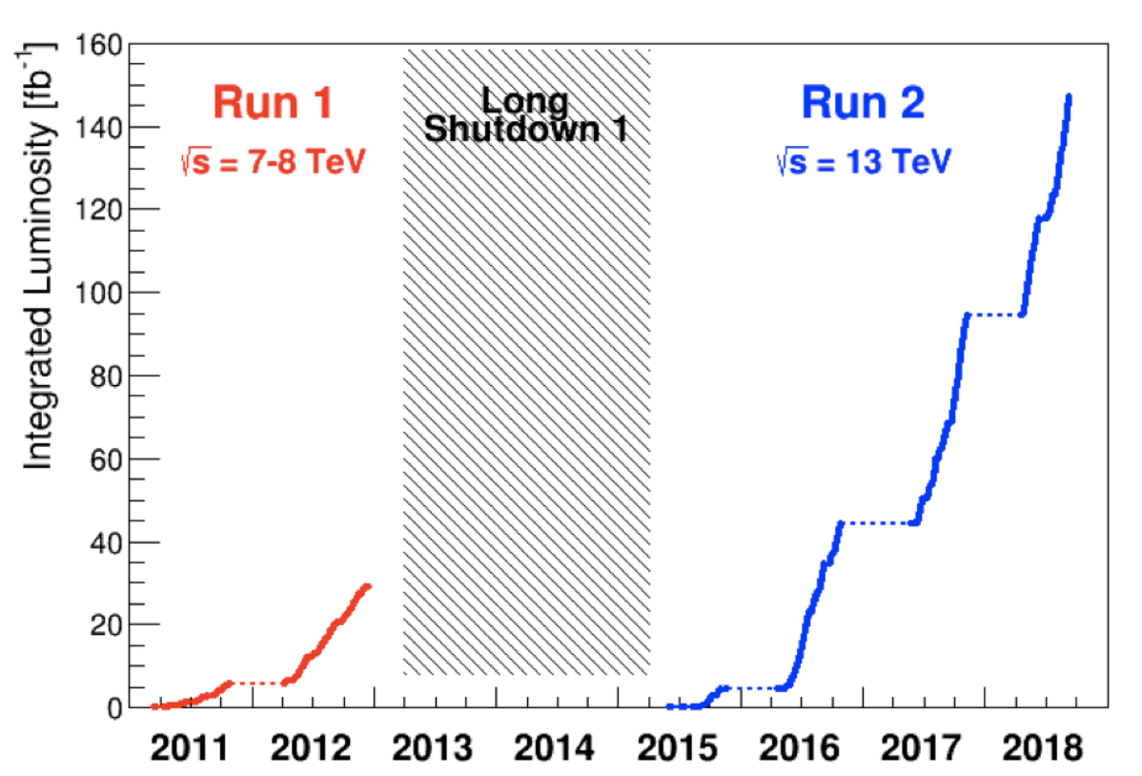
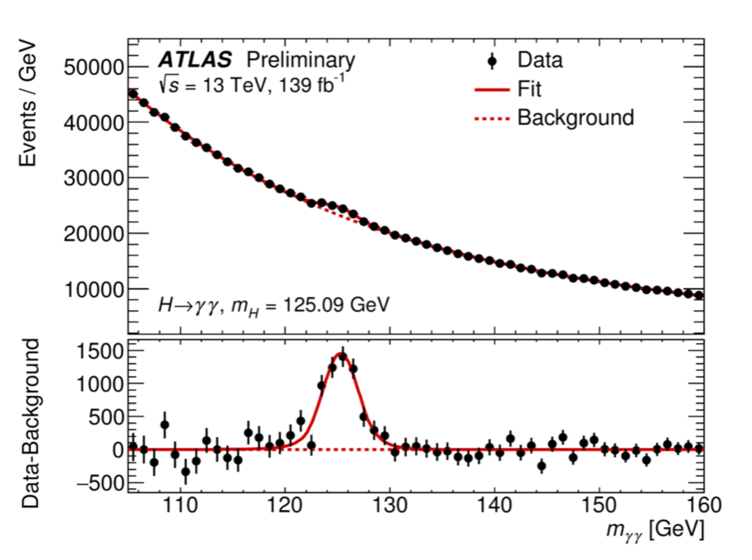
LHC Integrated performance
Higgs discovery

Slide 29
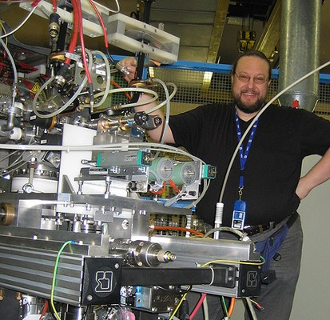
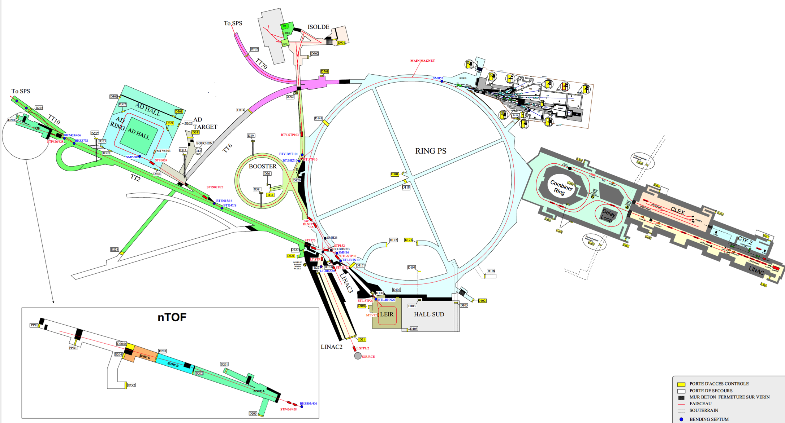
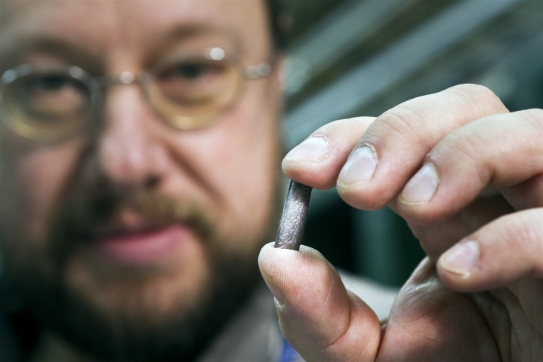
Ion Chain
Small sliver of solid isotopically pure 208Pb is placed in a ceramic crucible that sits in an "oven"
The metal is heated to around 800°C and ionized to become plasma. Ions are then extracted from the plasma and accelerated up to 2.5 keV/nucleon.
Pb29+
The source can also be set up to deliver other species… Ar and Xe

Slide 30
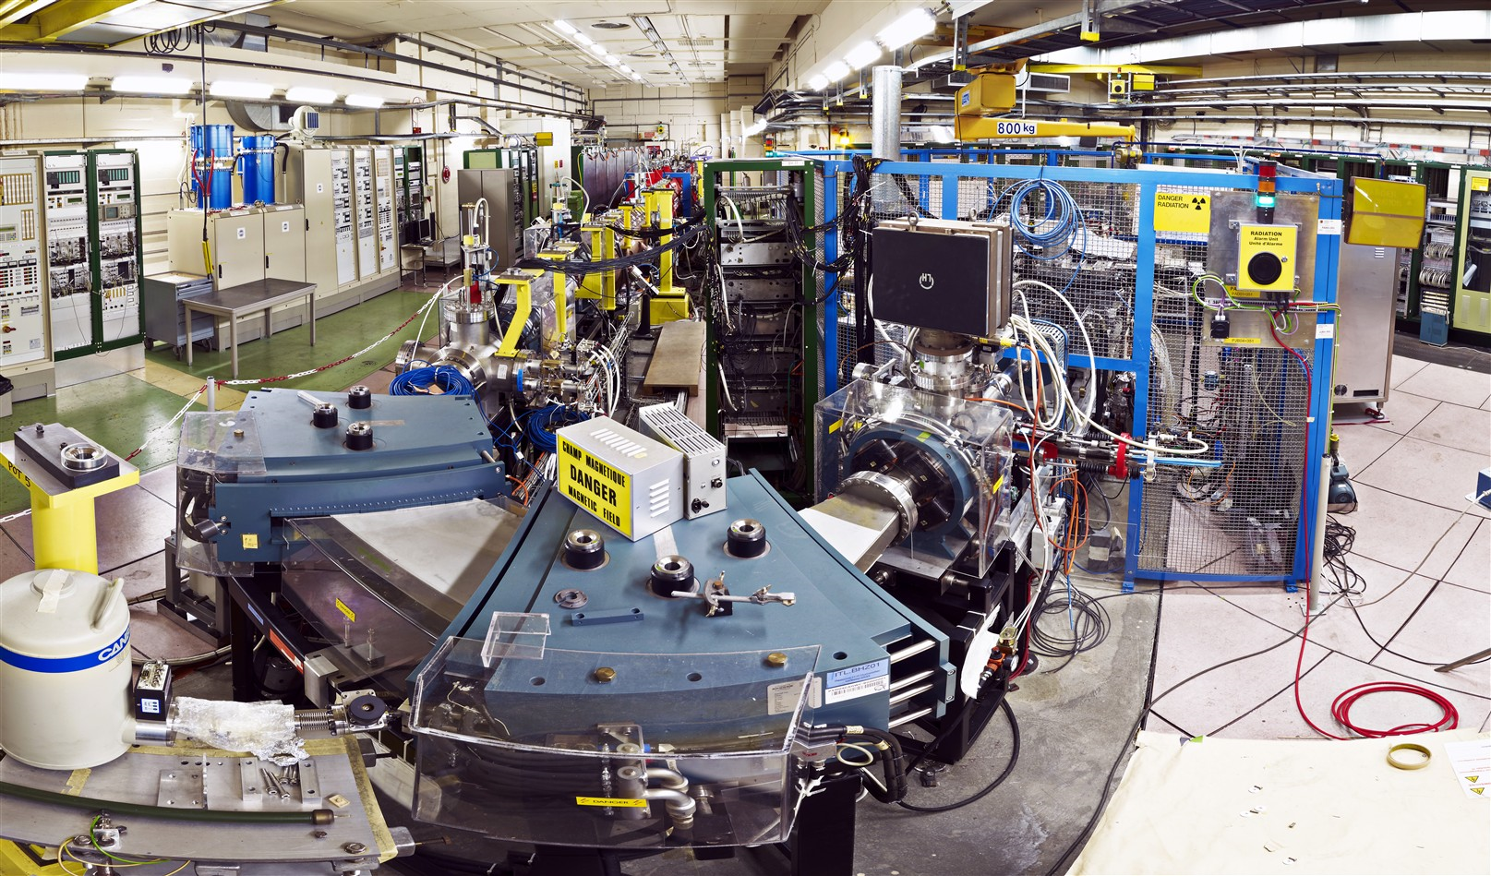
Linac 3
Stripping foil Pb29+ ➔ Pb54+
Stripping Efficiency is 20%
Interdigital-H (IH) linac 4.2 MeV/nucleon
Pb29+ 2.5 keV/nucleon
RFQ
Spectrometer to select Pb29+

Slide 31
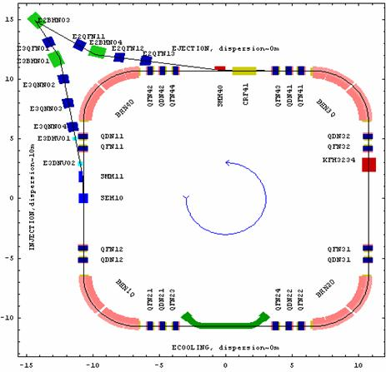
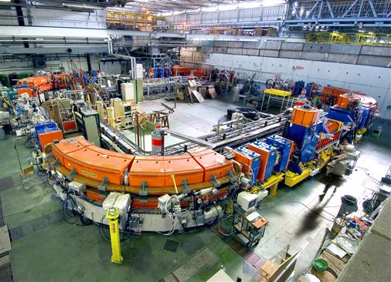
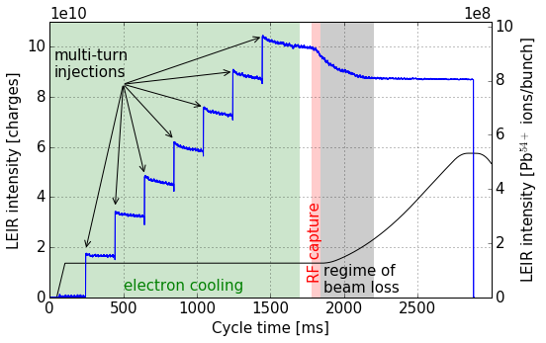
Ion Chain : Low Energy Ion Ring (LEIR)
LEIR Accumulates the 200 ms pulses from Linac3; then splits into 2 bunches
Electron Cooling is used to achieve the required brightness
Acceleration to 72 MeV/nucleon before transfer to the PS
LEIR Cycle is 3.6 s
The Pb54+ is finally fully stripped to Pb82+ in the transfer line from PS to SPS

Slide 32
Booster Experimental Areas
p+
H-

Slide 33
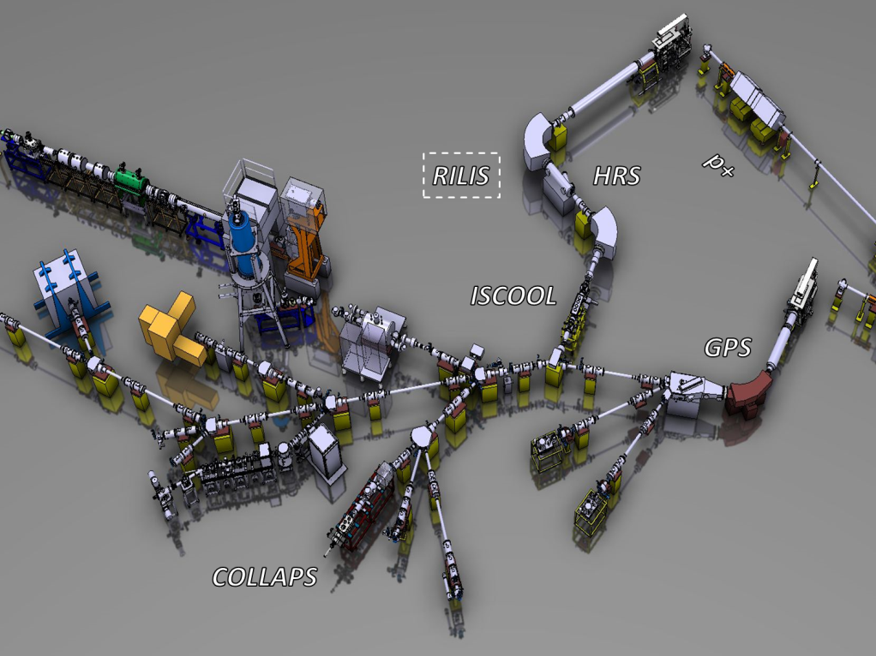

PSB Experimental Areas: ISOLDE
ISOLDE Synchrocyclotron: 1967-1990
ISOLDE PSB: 1992
Solid and liquid target materials ➔ wide spectrum of radioactive isotopes up to A =< 92. Radioactive isotopes are produced via proton-induced target fragmentation, spallation and fission reactions
REX-ISOLDE (2001)
1.4 GeV (from BOOSTER)
Ekin ≤ 3 MeV/n ➔ A ≤92
GPS: Global Purpose Separator
HRS: High Resolution Separator
HIE-ISOLDE: High Intensity and Energy ISOLDE
Ekin ≤ 60 keV/n
➔ Low mass isotopes
In 2017 we celebrated 50 years of physics at ISOLDE
(Isotope mass Separator On-Line Device)
on October 16, 1967 the first radioactive beam
CERN’s longest-running experiment site
Notes:
The feasibility of on-line production of short-lived radioactive isotopes was demonstrated already in 1951 by O. Kofoed-Hansen and K-O. Nielsen. They performed experiments on short-lived isotopes of noble-gas elements that were produced by connecting a target, irradiated by protons, directly to an isotope separator. Inspired by this, the European nuclear physics community proposed to build a general-purpose experiment for production of short-lived nuclei connected to the synchro-cyclotron (SC) at CERN. The project was approved in 1964 and the first experiment with the on-line isotope separator, named ISOLDE, was performed in 1967. The first four letters in the acronym has since then been the standard name for this type of radioactive isotope production, the ISOL technique. A technical development programme started to build target-ion-source systems that gave access to more and more elements. In 1972-74, a major upgrade of the SC beam intensity was performed. At the same time an improvement programme at ISOLDE resulted in a new layout called ISOLDE 2. The high intensity of produced isotopes and large scope of produced isotopes meant that ISOLDE had become a major international Facility to perform experiments on radioactive isotopes. The SC was shut down at the end of 1990 and CERN decided to move the ISOLDE activities to a beam from the PS Booster. A new experimental hall was built and the first experiments at the ISOLDE PSB Facility started in the middle of 1992 (Jonson & Richter, 2000). At the end of the nineties it was proposed to post accelerate the beams from ISOLDE. The REX ISOLDE accelerator was built and started its operation in 2001. A major upgrade program, HIE-ISOLDE, was approved in 2009.
REX ISOLDE: Various solid and liquid target materials are used to produce a wide spectrum of radioactive isotopes covering essentially the whole nuclear chart below uranium (Z = 92). Radioactive isotopes are produced via proton-induced target fragmentation, spallation and fission reactions

Slide 34
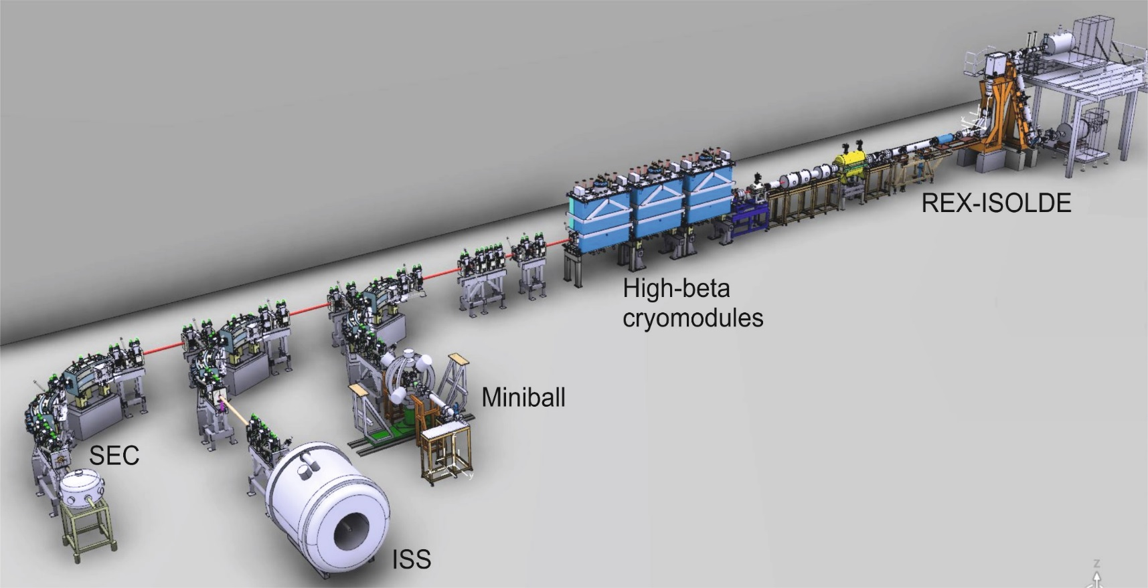

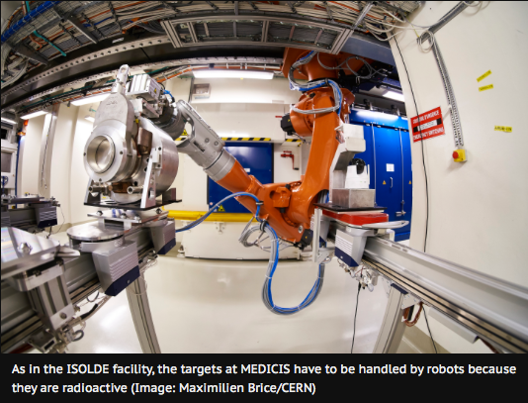
Next generation of nuclear physics:
HIE-ISOLDE (+SC RF): Ekin ≤ 10 MeV/n ➔ A ≤200
Nuclear & Atomic Physics & Astrophysics
Solid State
Life Sciences
Fundamental interactions
➔ wide range of radioisotopes, some of which can be produced only at CERN thanks to the unique ISOLDE facility, for hospitals and research centres in Switzerland and across Europe.
➔ devise and test unconventional radioisotopes with a view to developing new approaches to fight cancer
MEDICIS (Medical Isotopes Collected from ISOLDE)

Slide 35
PS Experimental Areas
p+
H-

Slide 36
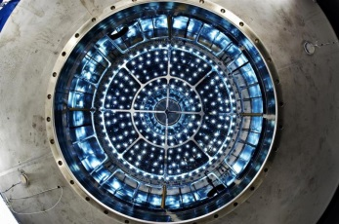
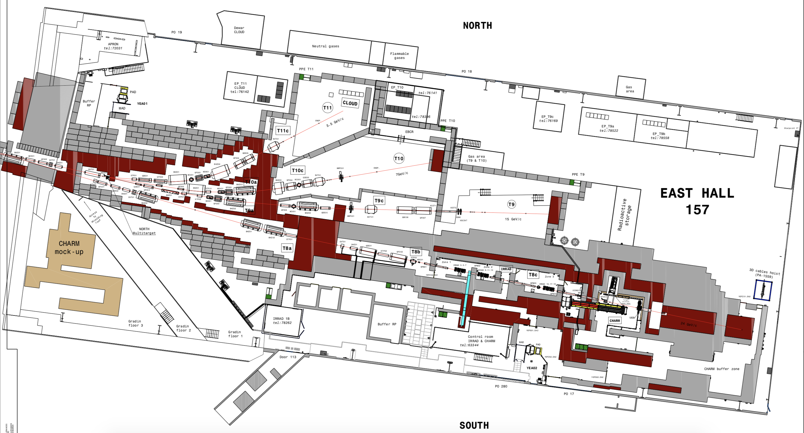
PS Experimental Areas: East Hall
Detector
Calibration
Proton
CLIMATE
Study the influence of galactic cosmic rays on the Earth's climate through the media of aerosols and clouds
& neutron irradiation facilities
p+ (26 GeV) on target = secondary beams
IRRAD
CHARM
Secondary Beams:
Momentum range 1-15 GeV/c
Electrons, Hadrons & Muons
Max 1-2 10⁶ particles per spill
For particle detectors and satellites
Notes:
The feasibility of on-line production of short-lived radioactive isotopes was demonstrated already in 1951 by O. Kofoed-Hansen and K-O. Nielsen. They performed experiments on short-lived isotopes of noble-gas elements that were produced by connecting a target, irradiated by protons, directly to an isotope separator. Inspired by this, the European nuclear physics community proposed to build a general-purpose experiment for production of short-lived nuclei connected to the synchro-cyclotron (SC) at CERN. The project was approved in 1964 and the first experiment with the on-line isotope separator, named ISOLDE, was performed in 1967. The first four letters in the acronym has since then been the standard name for this type of radioactive isotope production, the ISOL technique. A technical development programme started to build target-ion-source systems that gave access to more and more elements. In 1972-74, a major upgrade of the SC beam intensity was performed. At the same time an improvement programme at ISOLDE resulted in a new layout called ISOLDE 2. The high intensity of produced isotopes and large scope of produced isotopes meant that ISOLDE had become a major international Facility to perform experiments on radioactive isotopes. The SC was shut down at the end of 1990 and CERN decided to move the ISOLDE activities to a beam from the PS Booster. A new experimental hall was built and the first experiments at the ISOLDE PSB Facility started in the middle of 1992 (Jonson & Richter, 2000). At the end of the nineties it was proposed to post accelerate the beams from ISOLDE. The REX ISOLDE accelerator was built and started its operation in 2001. A major upgrade program, HIE-ISOLDE, was approved in 2009.
REX ISOLDE: Various solid and liquid target materials are used to produce a wide spectrum of radioactive isotopes covering essentially the whole nuclear chart below uranium (Z = 92). Radioactive isotopes are produced via proton-induced target fragmentation, spallation and fission reactions

Slide 37

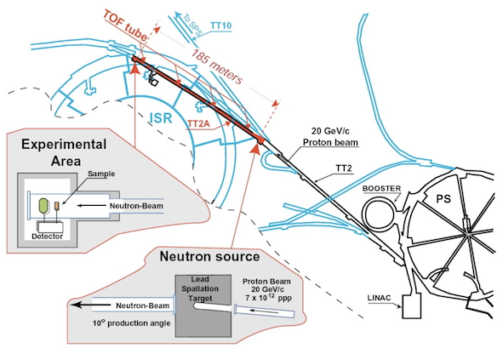
PS Experimental Areas: n-TOF
Study of neutron-induced reactions
Transmutation of nuclear waster
Symmetry Breaking in compound nuclei
Stellar Nucleosynthesis
n
p+
Each primary proton produces ~300 neutrons
E_{neutron} ➔meV - GeV
The neutron kinetic energy is determined by time-of-flight
Notes:
The feasibility of on-line production of short-lived radioactive isotopes was demonstrated already in 1951 by O. Kofoed-Hansen and K-O. Nielsen. They performed experiments on short-lived isotopes of noble-gas elements that were produced by connecting a target, irradiated by protons, directly to an isotope separator. Inspired by this, the European nuclear physics community proposed to build a general-purpose experiment for production of short-lived nuclei connected to the synchro-cyclotron (SC) at CERN. The project was approved in 1964 and the first experiment with the on-line isotope separator, named ISOLDE, was performed in 1967. The first four letters in the acronym has since then been the standard name for this type of radioactive isotope production, the ISOL technique. A technical development programme started to build target-ion-source systems that gave access to more and more elements. In 1972-74, a major upgrade of the SC beam intensity was performed. At the same time an improvement programme at ISOLDE resulted in a new layout called ISOLDE 2. The high intensity of produced isotopes and large scope of produced isotopes meant that ISOLDE had become a major international Facility to perform experiments on radioactive isotopes. The SC was shut down at the end of 1990 and CERN decided to move the ISOLDE activities to a beam from the PS Booster. A new experimental hall was built and the first experiments at the ISOLDE PSB Facility started in the middle of 1992 (Jonson & Richter, 2000). At the end of the nineties it was proposed to post accelerate the beams from ISOLDE. The REX ISOLDE accelerator was built and started its operation in 2001. A major upgrade program, HIE-ISOLDE, was approved in 2009.
REX ISOLDE: Various solid and liquid target materials are used to produce a wide spectrum of radioactive isotopes covering essentially the whole nuclear chart below uranium (Z = 92). Radioactive isotopes are produced via proton-induced target fragmentation, spallation and fission reactions

Slide 38
SPS Experimental Areas
p+
H-

Slide 39

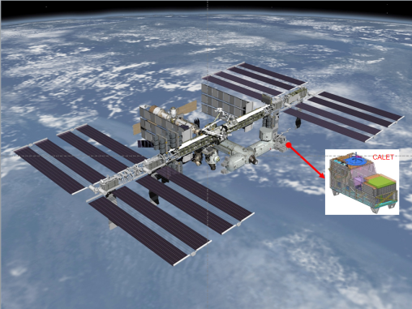
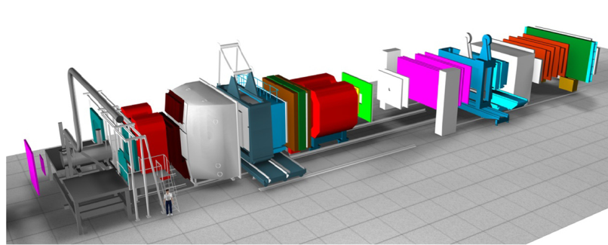
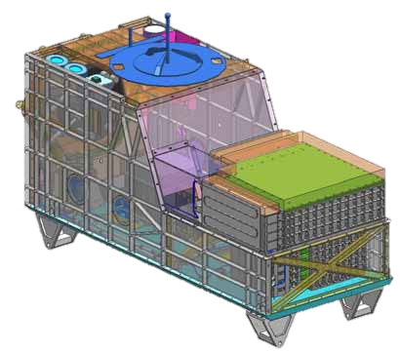
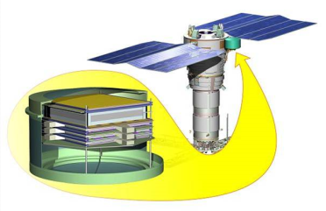



SPS Experimental Areas: North Area
CALET: Calorimetric Electron Telescope
Study of hadron structure and hadron spectroscopy with high intensity muon and hadron beams
7 beam lines (tot:5.8 km)
3 experimental halls
~ 2000 scientist/year
Slow extraction
3 primary targets
Ion physics program:
(Be, Ar, Xe)
~ 50 different clients/year
NEUTRON
High energy astroparticle physics on the International Space Station
NA61/SHINE (QCD experiment)
Russian regular satellite
Clarify the Cosmic Rays origin
COMPASS: Common Muon and Proton Apparatus for Structure and Spectroscopy
Physics Beyond the Standard Model

Slide 40



SPS Experimental Areas: Awake
Plasma wake acceleration
A “wake” is created when something is quickly pushed through a fluid or gaseous substance, like a boat cutting through water. In this case, the substance is plasma.
“Acceleration” simply refers to the effect: when a bunch of particles is placed behind a plasma wake, it accelerates, like a wake surfer.
There are a variety of ways to create plasma wake-field acceleration (PWFA): by sending a laser beam or a beam of particles
The concept was developed in an audacious 1979 paper by scientists Toshiki Tajima and John Dawson, both then at the University of California, Los Angeles.
Proof-of-principle:
Inject 10-20 MeV electron beam
acceleration of electrons to multi-GeV energy range in the wakefield driven by protons.
e-
p+ beam into a plasma
→ first proton driven PWA experiment world-wide
Proton Beam

Slide 41
SPS Experimental Areas:
Classical RF cavities:
10 MeV per meter.
PWFA:
500 GeV per meter
2018: Excellent year for AWAKE! → demonstrated proof-of-concept!
Achieves first ever acceleration of electrons in a proton-driven plasma wave
Electrons reached 2 GeV after 10 m of plasma!

Slide 42


SPS Experimental Areas:
Current and Future Accelerators operate with higher energy, higher intensity, smaller size beams.
HiRadMat is a facility designed, to study the impact of intense pulsed beam on materials
Thermal management
Radiation Damage to materials
Thermal shock – beam induced pressure waves
LHC nominal beam (2808 bunches with 1.5 1011 p+/b at 7 TeV) energy = 362 MJ/beam ➔ energy equivalent to
Ekin ( @155 km/h)≈360 MJ

Slide 43


SPS Experimental Areas:
Current and Future Accelerators operate with higher energy, higher intensity, smaller size beams.
HiRadMat is a facility designed, to study the impact of intense pulsed beam on materials
Thermal management
Radiation Damage to materials
Thermal shock – beam induced pressure waves
LHC nominal beam (2808 bunches with 1.5 1011 p+/b at 7 TeV) energy = 362 MJ/beam ➔ energy equivalent to
Ekin ( @155 km/h)≈360 MJ
Simulation: 8 LHC bunches @5 TeV impacting a Tungsten collimator jaw
Groove height ~ 1 cm
Ejected W fragments
Nb=72 (50 ns)
Ibeam=9.34 x 10¹²
Beam size=0.53 x 0.36

Slide 44
AD and ELENA
p+
H-

Slide 45




Antiproton Decelerator : AD
e+
-
p
Built in 1999 (from the old AC)
26 GeV/c PS Proton beam produces p (1 in 10⁷) which are focused and captured in the AD and decelerated to 100 MeV/c (5.3 MeV)
-
≈ c
Cooling is crucial!!!➔
Proton target
≈10% c

Slide 46


AD Layout
e+
-
p
C ~ 200 m
Target Area
Elena post-decelerator
2016 commissioning
ASACUSA
ATRAP
ALPHA
AEGIS
GBAR⁽¹⁾
BASE
-
Antiprotonic helium ➔m
p
Experimental Area
2011 H trapped for 16’
2002 first glimpse
inside H
Electron Cooling
1st meas. of gravitational effect on H
p magnetic moment
Gravitational effect on H

Slide 47



Slide 48

Reconstruction of Dark Matter distribution based on observations
Budget: Dark Matter: 33 %
Dark Energy: 66 %
Anything else (including us) 1%

Slide 49

CERN Lab 20??
LHC
HE_LHC:
27 km 33TeV 20T
VHE_LHC:
100 km 100 TeV
LHC Tunnel
VHE_LHC (80 km)
VHE_LHC (100 km)

Slide 50
Backup slides

Slide 51








Large Hadron Collider (LHC)
Betatron cleaning collimators
Beam Dump System
IP8
IR7
IP1
IR6
IT
SPS (~7 km)
IP5
LHC (27 km)
IP2
Sector 34
Momentum cleaning collimators
RF
DS
MS
IR4
ARC
CAS@Chavannes
IR3

Slide 52






Large Hadron Collider (LHC)
Geometry of the main dipoles
(Total of 1232 cryodipoles)
Heat
exchanger
Beam pipe (Ultrahigh beam vacuum 10⁻¹⁰ Torr like at 1000 km over sea)
Collars
Cold bore non-magnetic austenitic steel
Beam Screen
(Stainless Steel
+ Cu)
He Vessel
36.9 mm
Iron yoke
Thermal shield
46.5 mm
Superconducting coils
Vacuum vessel (10⁻⁶ mbar)
L ~ 15 m
8.3 T, 11.87 kA
T = 1.9 K, ~27.5 ton

Slide 53

Large Hadron Collider (LHC)
LHC arc cells = FoDo lattice* with
~ 90º phase advance per cell in the V & H plane
o
o
F
D
B1
F
B2
D
LHC TDR
MB: main dipole
MQ: main quadrupole
MQT: Trim quadrupole
MQS: Skew trim quadrupole
MO: Lattice octupole (Landau damping)
MSCB: Skew sextupole +
Orbit corrector (lattice chroma+orbit)
MCS: Spool piece sextupole
MCDO: Spool piece octupole +
Decapole
BPM: Beam position monitor

Slide 54



Fast cycle machines
E.g. SPS

Slide 55
Proton Synchrotron (PS)
BOOSTER (2 GeV) ➔ PS (26 GeV) ➔ SPS (450 GeV) ➔ LHC
BOOSTER (4 rings)
2nd batch
4
1st batch
3
2
Two injections from
BOOSTER to PS
(2 x 1.2 s)
1
PS
h=7 (6 buckets filled + 1 empty)
All operational beams cross transition (Transition energy 6.1 GeV)
h=1

Slide 56
Proton Synchrotron (PS)
SPS
25 ns
Up to 4 injections from PS of 72 bunches
72 bunches
84 buckets
h=84
12x25 ns GAP to cover the rise time of the PS ejection kicker
2xDouble splitting
18 bunches
21 buckets
h=21
26 GeV
2 GeV
Triple splitting
6 bunches
7 buckets
h=7
PS
Two injections from
BOOSTER to PS
2 GeV
h=1
BOOSTER
Nominal 25 ns beam production

Slide 57


H⁻ Injection into the Booster
e-
e-
From LINAC4
H⁻
Stripping foil (99% efficiency)
p+
BOOSTER
Displaced Orbit

Slide 58
CERN injector accelerator complex
Isolde
East Hall
SPS:
6911 m, 450 GeV, 1976
AD Hall
PSB:
154 m, 1.4 GeV, 1972
CTF3
n-ToF
PS:
628 m, 26 GeV, 1959
LEIR
Linac2:
33 m, 50 MeV, 1978
L/C (m),Energy after acceleration, Commissioning year

Slide 59
Further Reading
The LHC Design Report Volume 1: The LHC Main Ring, CERN-2004-003-V-1,
http://cds.cern.ch/record/782076/files/CERN-2004-003-V1.pdf
The LHC Design Report Volume 1: The LHC Infrastructure and Services, CERN-2004-003-V-2,
http://cds.cern.ch/record/782076/files/CERN-2004-003-V2.pdf
The LHC Design Report Volume 3: The LHC Injector Chain : CERN-2004-003-V-3:
http://cds.cern.ch/record/823808/files/CERN-2004-003-V3.pdf
Fifty years of the CERN Proton Synchrotron: Volume 1 :CERN-2011-004,
http://cds.cern.ch/record/1359959/files/cern-2011-004.pdf
Fifty years of the CERN Proton Synchrotron: Volume 2 :CERN-2013-005,
http://cds.cern.ch/record/1597087/files/CERN-2013-005.pdf
Linac4 Technical Design Report::
http://cds.cern.ch/record/1004186/files/ab-2006-084.pdf
Elena Conceptual Design Report:
http://cds.cern.ch/record/1309538/files/CERN-BE-2010-029.pdf
AWAKE Technical Design Report:
http://cds.cern.ch/record/1537318/files/SPSC-TDR-003.pdf
HiRadMat:
http://cds.cern.ch/record/1403043/files/CERN-ATS-2011-232.pdf

Slide 60

Generating a 25ns Bunch Train in the PS
Use double splitting at 25 GeV to generate 50ns bunch trains instead

Slide 61


Proton Synchrotron (PS)
2st Injection PSB ➔ PS
1st Injection PSB ➔ PS
The PS is the machine in the LHC Injector Chain where the Longitudinal characteristics of the LHC beam are determined

Slide 62




Large Hadron Collider (LHC)
Golden formula (you should know by heart)
Circumference ➔ FIXED!!! by LEP
$$Bρ= \frac{p}{Ze}$$
FIXED, no choice
$$ρ≈ \frac{26658.9 m}{2π}∙66\% ≈2780 m$$
~ 66% of the lattice elements are dipoles
p = nucleon momentum ➔ defined by the physics case ➔ TeV range ➔ 7 TeV
$B= \frac{p}{ρZe}≈3.33\frac{p \left(\frac{GeV}{c}\right)}{ρ\left(m\right)}=8.39 T$
We need SUPERCONDUCTING technology
Field limit for normal conducting magnets due to saturation

Slide 63


Large Hadron Collider (LHC)
Production rate of events is determined by the cross section Σ_{react}
and a parameter L that is given by the design of the accelerator:
… the luminosity
remember:
1b=10⁻²⁴ cm²
Integrated luminosity during RUN I
Official number: 1400 clearly identified Higgs particles “on-tape”

Slide 64
Overall Protons Delivered in 2012
Facility | Protons Deliverd | % of Total
Isolde | 1.15x10⁺²⁰ | 63.8%
CNGS | 3.9x10⁺¹⁹ | 21.6%
n-TOF | 1.9x10⁺¹⁹ | 10.2%
The rest | 8.13x10⁺¹⁸ | 4.5%
LHC | 3.25x10⁺¹⁶ | 0.018%
Total | 1.81x10⁺²⁰
Colliders are very Efficient!
The LHC Physics Program Used 0.018% of the protons produced in CERN accelerators during 2012!
Intensities as delivered to the facility, upstream losses ignored,
Beams for Machine Setup and Studies Excluded
The total delivered protons represents roughly 0.27mg (rest mass!)

Slide 65

Large Hadron Collider (LHC)
Liquid Nitrogen
Cold compressors
Superconducting cables of Nb-Ti
6 µm Ni-Ti filaments
He gas ➔ liquid @ 4.2 K ➔ superfluid @ 2.17 K
1 mm
LHC ~ 27 km circumf. with 20 km of superconducting magnets operating @8.3 T. An equivalent machine with normal conducting magnets would have a circumference of 100 km and would consume 1000 MW of power ➔ we would need a dedicated nuclear power station for such a machine. LHC consumes ~ 10% nuclear power station
λ point
1.9 K
LHC Requires
90,000 T of liquid Nitrogen
130 T of Liquid Helium to keep it cold

Slide 66











June 1994 first full scale prototype dipole
June 2007 First sector cold
ECFA-CERN workshop
April 2008
Last dipole down
1994 project approved by council (1-in-2)
25 y
SSC cancelled
Main contracts signed
83
84
90
91
92
93
94
95
96
97
98
99
00
01
02
03
04
05
06
07
08
09
10
2002 String 2
November 2006
1232 delivered
First set of twin 1 m prototypes Over 9 T
September 10, 2008
First beams around
May 9th 2012
Paul Collier – LHC: Past, Present and Future
66

Slide 67











August 2008
First injection test
May 2012
Ramping Performance
Feb. 2013
p-Pb⁸²⁺
New Operation Mode
October, 2011
3.5x10⁺³³, 5.7 fb⁻¹
First Hints!!
November 29, 2009
Beam back
Sept. 10, 2008
First beams around
June 28 2011
1380 bunches
1380
March 14th
2012
Restart
with Beam
October 14, 2010
L= 1x10⁺³²
248 bunches
Nov. 2012
End of p⁺ Run 1
Repair and Consolidation
2008
2009
2010
2011
2012
2013
November 2010
Pb⁸²⁺ Ions
March 30, 2010
First collisions at 3.5 TeV
Higgs Day
Sept. 19, 2008
Disaster
LS1
November 2011
Second Ion Run

Slide 68


Filling the LHC (2012)
 | 25 ns (design) | 50 ns (2012) | 25 ns (2012)#
Energy per beam [TeV] | 7 | 4 | 4
Intensity per bunch [x10¹¹] | 1.15 | 1.7 | 1.2
Norm. Emittance H&V [µm] | 3.75 | 1.8 | 2.7
Number of bunches | 2808 | 1380 | N.A. #
β* [m] | 0.55 | 0.6 | N.A. #
Peak luminosity [cm⁻²s⁻¹] | 1 × 10³⁴ | 7.7 × 10³³ | N.A. #
The 25 ns PS production scheme (2012)
1 PS Batch
1 SPS Batch
LHC filling pattern (2012)
..
1380 bunches over 26.7 km
# The 25 ns was only used for scrubbing and tests in 2012

Slide 69




CTF 3 – CLIC Test Facility
JURA
CLIC goal:
Drive Beam 100 A, 239 ns
2.38 GeV ➔240 MeV
Main Beam 1.2 A, 156 ns
9 GeV ➔ 1.5 TeV
RF Power Extraction & Transfer Structure (PETS)

Slide 70

CTF 3 – CLIC Test Facility
e-
JURA

Slide 71
CTF 3 – CLIC Test Facility
JURA
RF Power is sucked from Driver Beam

Slide 72

High Light Of HEP -Year
ATLAS event display: Higgs => two electrons & two muons

Slide 73


Linac4 : Replacing Linac2
Linac4 : Approved in 2007 as a replacement to Linac2
Energy 160 MeV (cf 50 MeV in Linac2) Doubles the space charge tune shift limit at injection into the PS Booster
H- Injection : CERN is one of the few labs still using p⁺
Connection to PSB LS2 (~ 2019)
50 Mev ➔ 160 MeV
0.31*1.12=0.35 ➔0.52*1.37=0.70
ΔQLINAC4 ≈ 0.5ΔQLINAC2
Delivers 40 mA, 400 μs pulses at 2 Hz

Slide 74

History of the Antiproton Decelerator Chain
Isolde
SPS
AD
2000
East Hall
PS ➔ Antiproton Decelerator
3.5 GeV ➔0.6 GeV
$$\overline{p }$$
PS
CTF3
PSB
Antiproton Accumulator
Antiproton Collector
26 GeV ➔ 3.5 GeV
p
1st Anti-Hydrogen ever produced
n-ToF
LEAR
e+
LEIR
Low Energy Antiproton Ring
1983 - 1996
Linac2
-
p

Slide 75

Let me open a parenthesis here to talk about
EMITTANCE and PHASE SPACE

Slide 76


(Phase space and emittance)
X
V
k
m
(friction ignored)
-1
0
1
Phase space
Analysis of x=f(t) ➔ provides information about the path taken by the system BUT NOT about the energy.
Analysis of v=f(t) ➔ provides information about the energy of the system BUT NOT about the trajectory taken.
… Let’s be inventive and try to analyse the evolution of the velocity as a function of position v=f(x)
x=max
v=0
U=max
K=0
x=max
v=0
U=max
K=0
x=0
v=max
U=0
K=max
U=potential energy
K=kinetic energy

Slide 77
(Phase space and emittance)
Each point (x,v) in the ellipse represents an STATE of the physical system with well define position and velocity.
All the points (x,v) in the ellipse have the SAME ENERGY (E₁)
If the initial elongation is smaller, then we get a smaller ellipse with energy E₂ (E₂<E₁).
If we change K the ellipse shape will change.
k
m
(friction ignored)
-1
0
1
Phase space
E₁
x=max
v=0
U=max
K=0
x=max
v=0
U=max
K=0
A beam of charged particles in an accelerator subjected to focusing and defocusing forces have the same dynamics as the system above. The beam dynamics also reproduces an ellipse in phase space …
E₂
x=0
v=max
U=0
K=max
U=potential energy
K=kinetic energy

Slide 78



(Phase space and emittance)
All particles with the same initial betatron amplitude (equivalent to x) at a given position in the accelerator (or time) but different phases or momentum due to momentum spread (equivalent to v), describe the same ellipse turn after turn
k₁
k₂
k₃
s₁
s₂
s₃
s
Along a beam line, the orientation and aspect ratio of the ellipse varies, BUT THE AREA remains CONSTANT in the absence of non-linear forces or acceleration
AREA ≈ EMITTANCE (Ɛ)
Beam size ➔ σ = √Ɛβ (in places without dispersion)

Slide 79
Let me use the BOOSTER injection to talk about
TUNE, PHASE SPACE PAINTING,
SPACE CHARGE, BRIGHTNESS

Slide 80


PS Booster: Einj=50MeV, C=154 m
Pulse from LINAC2=100 μs
x
TUNE
Qx=0.25
PSB
s
T=1.6 μs
C
Qx=1
x
$$\vec{B}$$
Particle Trajectory
1st inject. @xo
$$\vec{B}=0$$
s
C
SEPTUM

Slide 81
PS Booster: Einj=50MeV, C=154 m
Pulse from LINAC2=100 μs
x
TUNE
Qx=0.25
PSB
s
T=1.6 μs
C
Qx=1
x
$$\vec{B}$$
Particle Trajectory
2nd inject. @xo
$$\vec{B}=0$$
s
C
SEPTUM

Slide 82
PS Booster: Einj=50MeV, C=154 m
Pulse from LINAC2=100 μs
x
TUNE
Qx=0.25
PSB
s
T=1.6 μs
C
Qx=1
x
$$\vec{B}$$
Particle Trajectory
3rd inject. @xo
$$\vec{B}=0$$
s
C
SEPTUM

Slide 83



PS Booster: Einj=50MeV, C=154 m
Pulse from LINAC2=100 μs
x
TUNE
Qx=0.25
PSB
s
T=1.6 μs
C
Qx=1
x
$$\vec{B}$$
Particle Trajectory
3rd inject. @xo
$$\vec{B}=0$$
x'
Septum foil
s
e.g. 3-Turn Injection
(up to 13-turns possible)
Injected beam
C
SEPTUM
Circulating beam
$$\vec{B}=0$$
$$\vec{B}$$
x
Transverse Phase Space (x,x’)
- The bigger the number of turns the more intensity we can accumulate
- The problem is that the longer the injection takes, the more time the particles have to fill the whole available phase space + SPACE CHARGE ➔ emittance increases ➔ beam size increases
- The Booster is the machine in the LHC Injector Chain where the transverse brightness of the LHC beam is determined
Brightness = Intensity/Emittance

Slide 84


(Space Charge in One Slide)
vB
vA
E
E
F
B
p+
p+
+
Magnetic Attractive Force
vA=0
vB=0
Electric Repulsive Force
v
B
F
Particles in the beam feel a strong repulsive force = defocusing quadrupole ➔ change in tune
$$β=\frac{v}{c}$$
LINAC2
v(0.750 MeV➔50 MeV)=4% ➔31% of c

Slide 85

LINAC 4

Slide 86
Linac2
Proton Synchrotron
750 keV ➔ 50 MeV
1.4 GeV ➔ 26 GeV
Super Proton Synchrotron
Large Hadron Collider
26 GeV ➔ 450 GeV
450 GeV ➔ 7000 GeV
RFQ
90 keV ➔ 750 keV
Booster
50 MeV ➔ 1.4 GeV
Proton source
90 keV

Slide 87

Elena … More Deceleration
Degrader foil
(Efficiency=0.1%)
Today’s set-up
-
p
C=30 m
5.3 keV
5 keV
ELENA will overcome this problem + will be
able to deliver beams almost simultaneously to all four experiments resulting in an essential gain in total beam time for each experiment. This also opens up the possibility to accommodate an extra experimental zone.
A second stage of deceleration after AD Momentum: 100 – 13.7MeV/c
Kinetic : 5.3 – 0.1 MeV
Commissioning in 2016 Operation since 2017

Slide 88

Proton source
RFQ
Linac2
750 keV ➔ 50 MeV
90 keV
90 keV ➔ 750 keV
Booster
50 MeV ➔ 1.4 GeV
70 000 000
8 000 000
120 000
4 000
Proton Synchrotron
Large Hadron Collider
450 GeV ➔ 7000 GeV
1.4 GeV ➔ 26 GeV
m = 1 mg
v = 1.4 m/s
K = ½ m v²
K = 9.65 10⁻⁷ J
K = 6 TeV
230
Super Proton Synchrotron
0.85
26 GeV ➔ 450 GeV
13

Slide 89

The Proton Beam Starts Here …

Slide 90

Duoplasmatron Proton Source
Proton beam @ 90 keV to the RFQ
Protons (at 90 keV) are produced by creating a plasma using H₂ which is charged due to interaction with free electrons from the cathode. The plasma is then accelerated and becomes an ion beam.
e-
p+
H2

Slide 91

H- source for Linac 4
Instead creating protons from H, an electron is added, making a negatively charged hydrogen-ion. The ion source is fed with hydrogen gas. A discharge plasma is formed and a strong electric field strips away an electron from each hydogen atom.
e-
p+
e-
The positively charged (protons) from the plasma are attracted towards a cathode surface (metal surface with caesium) ➔ donor of electrons to the positively charged hydrogen ions, thus enhancing H- ion production
The H- ions leave the ion source with an energy of 45 keV

Slide 92





Radio Frequency Quadrupole (RFQ)
Originally 750 kV Cockcroft-Walton
RFQ is a linear accelerator that FOCUSES, BUNCHES & ACCELERATES
with HIGH EFFICIENCY (90% w.r.t. 50% of conventional accelerators) and
PRESERVES THE EMITTANCE
The whole beam dynamics depends upon the shape of the vane tips
1993 CW➔RFQ
Duoplasmatron
DTL
90 keV
750 keV
RFQ (1.75 m, 200 MHz)
1970 Kapchinskij and Teplyakov propose the idea
1979 Proof of principle @ Los Alamos

Slide 93



Linac 2
RFQ
DT (4 tanks,33 m)
750 keV
50 MeV
DTL (Alvarez structure 1945)
Pulse of beam ~100 μs long every 1.2 s
-
+
+
-
vA
E
vB
vA < vB ➔
LB
> LA
E
Drift tubes and spacing become larger as the energy increases
Focusing quads inside drift tubes
➔ L = vTrf = β_{rel}λo
LA
LB

