Slide 1
Linear imperfections and correction
Hannes BARTOSIK with the help of
Fanouria ANTONIOU and Sofia KOSTOGLOU
Accelerator and Beam Physics group
Beams Department CERN
Joint University Accelerator School
January 2021

Slide 2
Bibliography
Courses on linear imperfections
  O. Brüning, Linear imperfections, CERN Accelerator School, Intermediate Level, Zeuthen 2003, http://cdsweb.cern.ch/record/941313/files/p129.pdf
Books treating linear imperfections
  H. Wiedemann, Particle Accelerator Physics, Third edition, Springer, 2007.
  K. Wille, The physics of Particle Accelerators, Oxford University Press, 2000.
  S.Y. Lee, Accelerator Physics, 3rd edition, World Scientific, 2011.

Slide 3
Transverse beam dynamics reminder

Slide 4
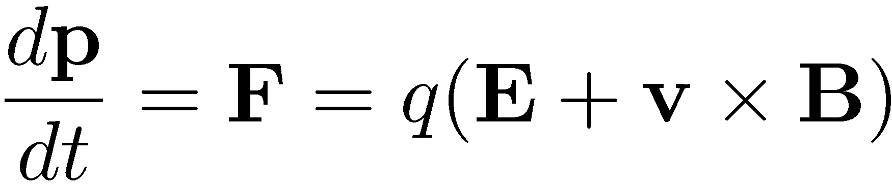



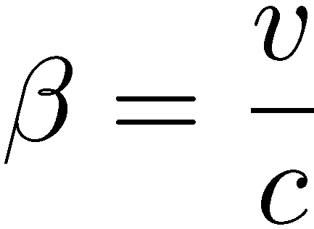
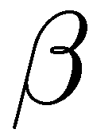
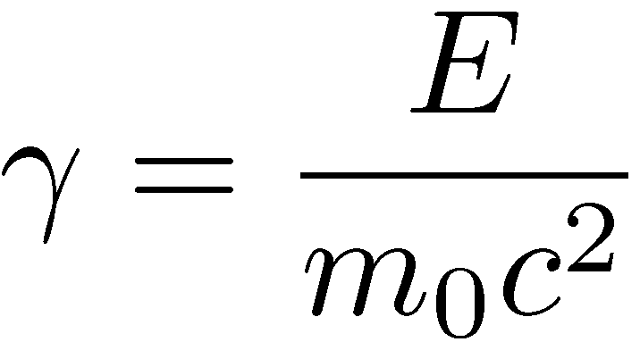
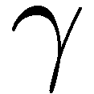
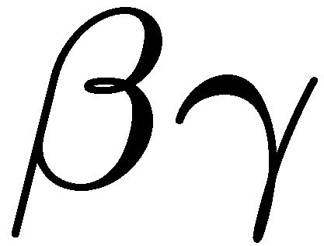
Equations reminder
Lorentz equation
: total energy
: kinetic energy
: momentum
: reduced velocity
: reduced energy
: reduced momentum

Slide 5
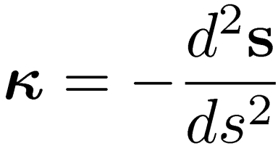
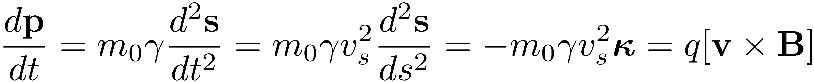
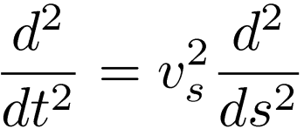
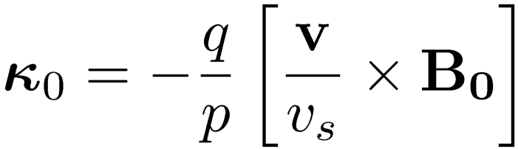
Reference trajectory
  Cartesian coordinates not useful to describe motion in a circular accelerator (not true for linacs)
  A system following an ideal path along the accelerator is used (Frenet reference system)
    The curvature vector is
    From Lorentz equation
    where we used the curvature vector definition and
  Using , the ideal path of the reference trajectory is defined by
u_{y}
Particle trajectory
u_{x}
u_{s}
Ideal path
y
s
x
ρ

Slide 6
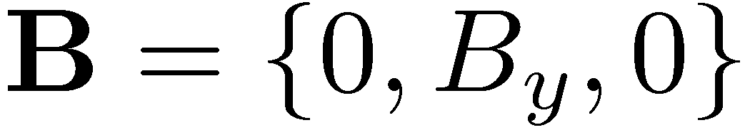
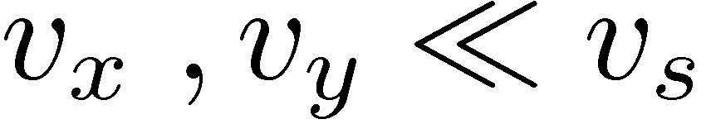
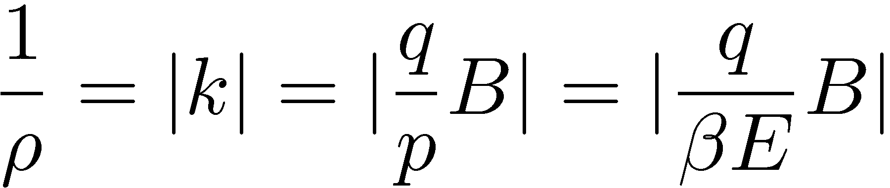
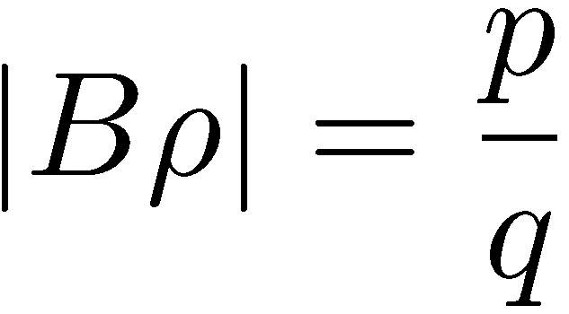
Beam guidance
  Consider uniform magnetic field in a direction perpendicular to particle motion. From the reference trajectory equation, after developing the cross product and considering that the transverse velocities , the radius of curvature ρ is given by
  We define the magnetic rigidity
  In more practical units
  For ions with charge multiplicity Z and atomic mass A, the energy per nucleon is

Slide 7
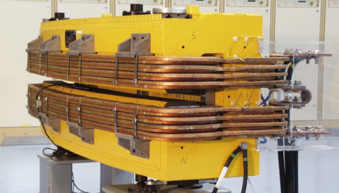
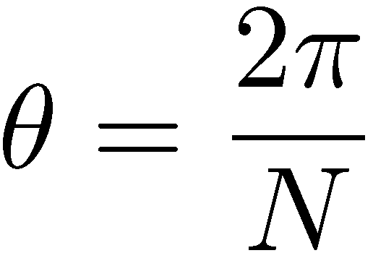
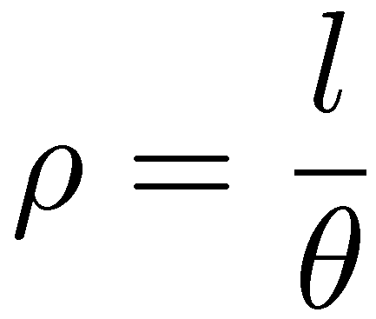
Dipoles – beam guidance
  Consider a ring for particles
  with energy E with N dipoles
  of length L (or effective length
  l, i.e. measured on beam path)
    Bending angle
    Bending radius
    Integrated dipole strength
  Note:
    By choosing a dipole field, the dipole
    length is imposed and vice versa
    The higher the field, the shorter or smaller
    number of dipoles can be used
    The ring circumference (cost) is
    influenced by the field choice
B
l

Slide 8
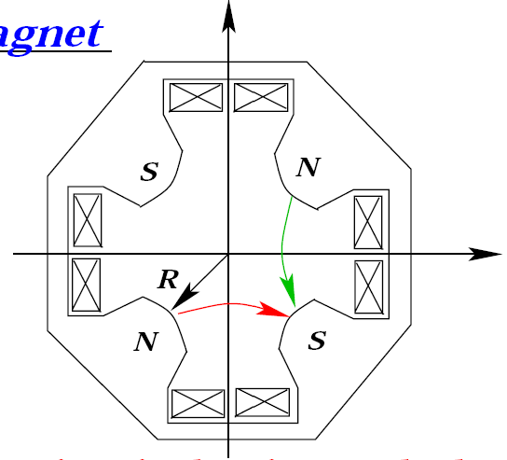
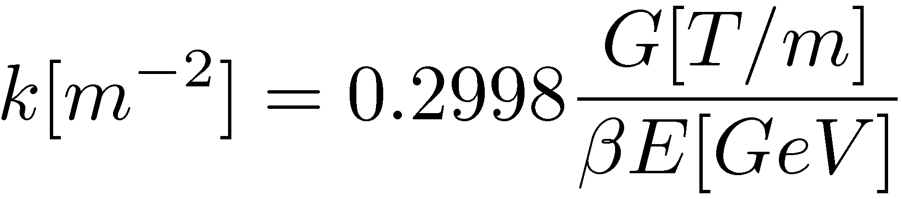
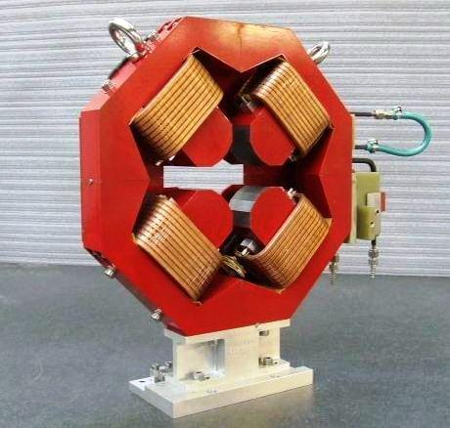
Quadrupoles – focusing/de-focusing
Quadrupoles are focusing in one plane
and defocusing in the other
  The field is
  The resulting force
  with the normalised gradient k defined as
  In practical units:
  is the integrated norm. quadrupole strength
Need to alternate focusing and
defocusing to control the beam,
i.e. alternating gradient focusing
F
v
B
F
v
B
… G is the gradient

Slide 9
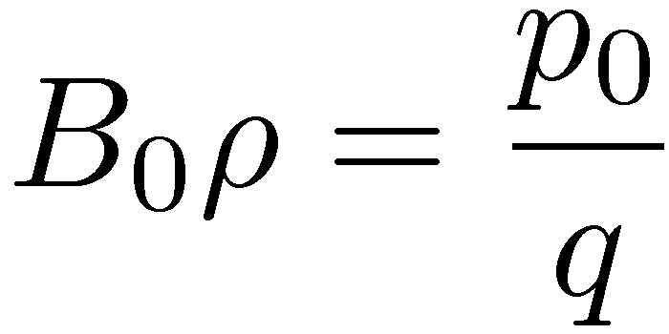
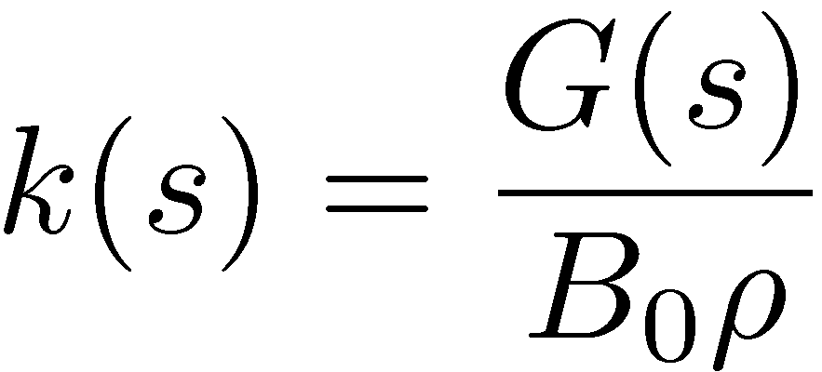
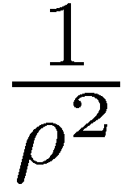
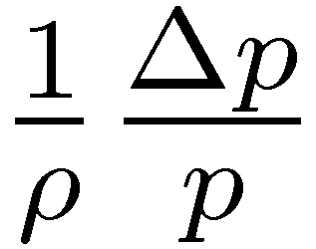
Equations of motion – Linear fields
  Consider s-dependent fields from dipoles and normal quadrupoles
  The total momentum can be written as
  With the magnetic rigidity and normalized gradient
  the equations of motion are
    Inhomogeneous equations with s-dependent coefficients
    The term corresponds to the dipole weak focusing and
    represents off-momentum particles

Slide 10
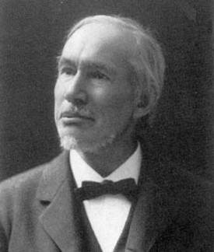
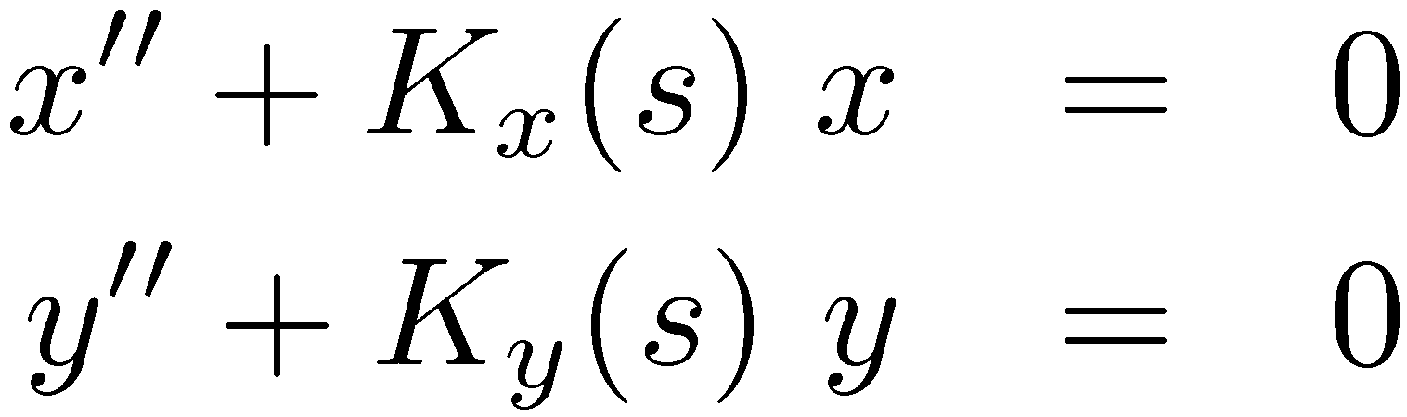
Hill’s equations
  Solutions are combination of the homogeneous and
  inhomogeneous equations’ solutions
  Consider particles with the design momentum.
  The Equations of motion become
  with and
Hill’s equations of linear transverse particle motion
  Linear equations with s-dependent coefficients (harmonic oscillator with time dependent frequency)
  In a ring (or in transport line with symmetries), the coefficients are periodic
  Not straightforward to derive analytical solutions for whole accelerator
George Hill

Slide 11
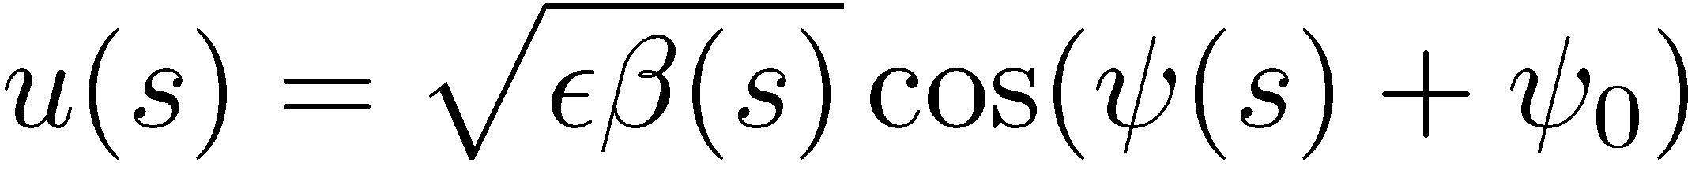
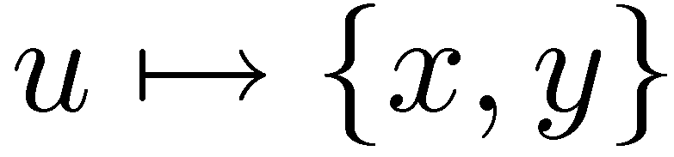
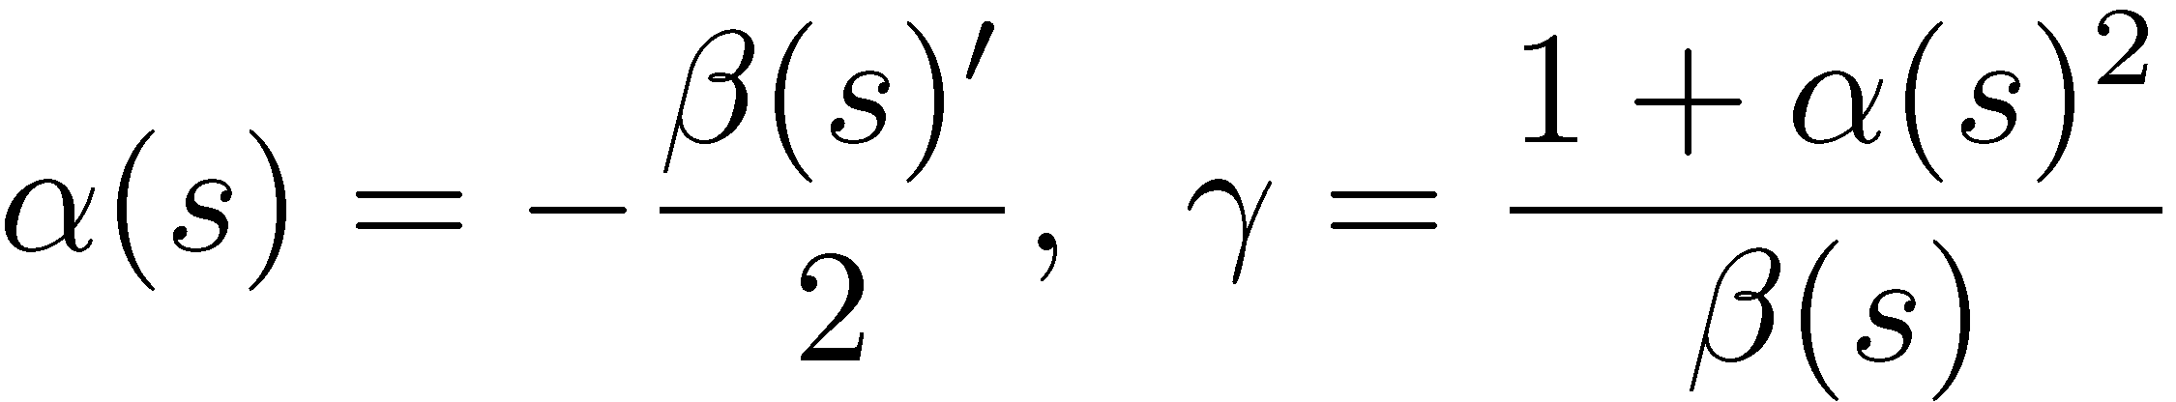
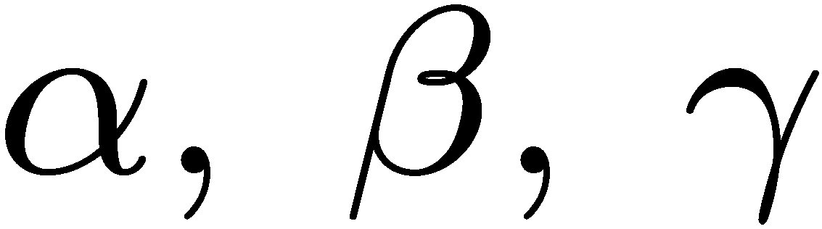
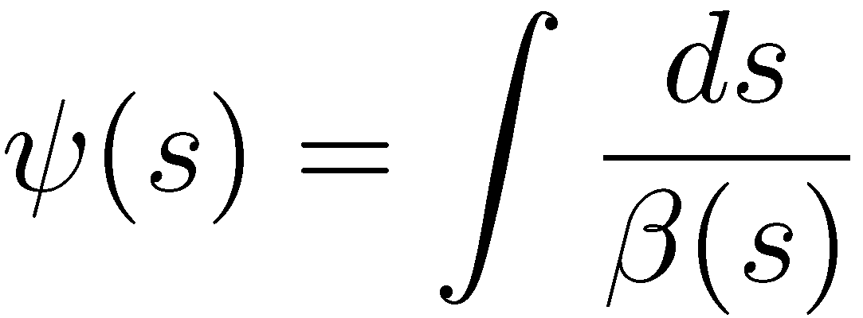

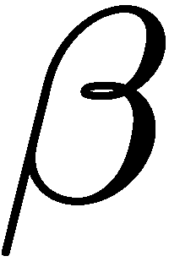
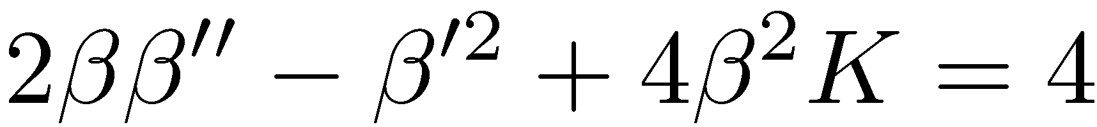
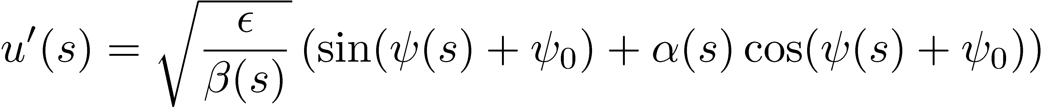
Betatron motion
  The on-momentum linear betatron motion of a particle in both planes is described by (Floquet theorem)
  with the twiss functions
  the betatron phase
  and the beta function is defined by the envelope equation
  By differentiation, we have that the angle is

Slide 12
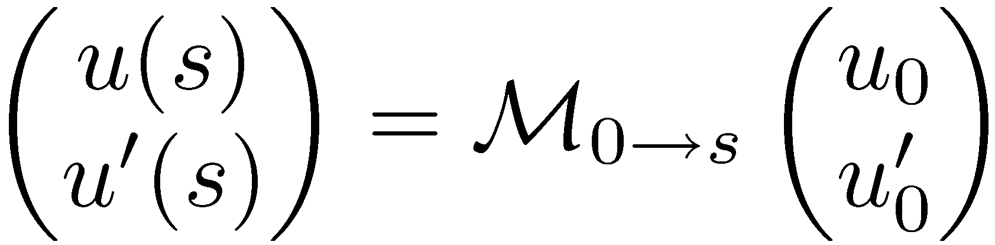
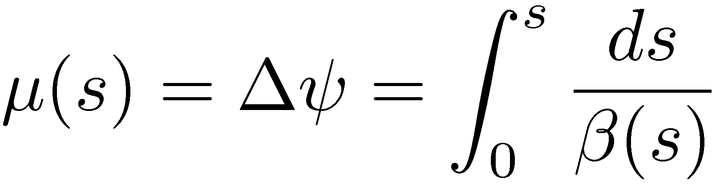
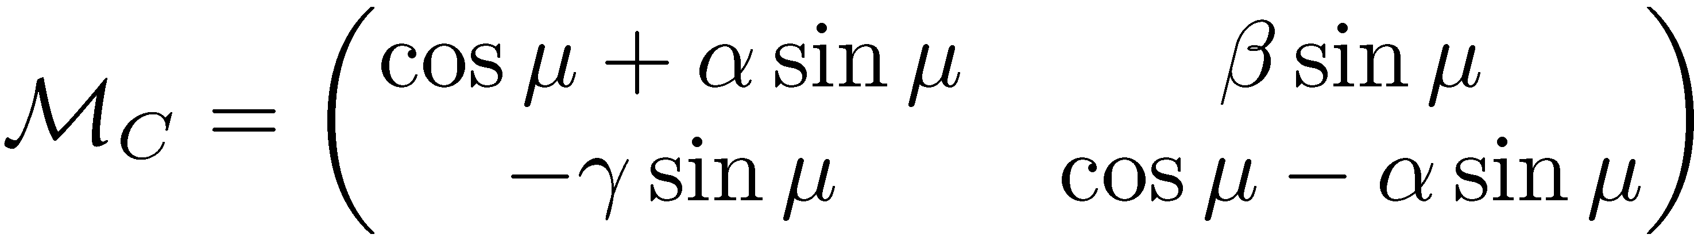
General transfer matrix
  The general transfer matrix from location 0 to s
  is obtained as
  with the phase advance
  For a periodic cell
  the transfer matrix is

Slide 13
Phase space ellipse
  The phase space coordinates (u, u’) of a single particle at a given location s of the machine lie on the phase space ellipse when plotted for several turns
  The values of the Twiss parameters and therefore the orientation of the phase space ellipse depend on the s location in the machine
  The Twiss parameters are periodic with the machine circumference. Their values are derived from the transfer matrix and they are uniquely defined at any point in the machine
turn 1
turn 7
turn 8
turn 6
turn 2
turn 5
turn 3
turn 4

Slide 14
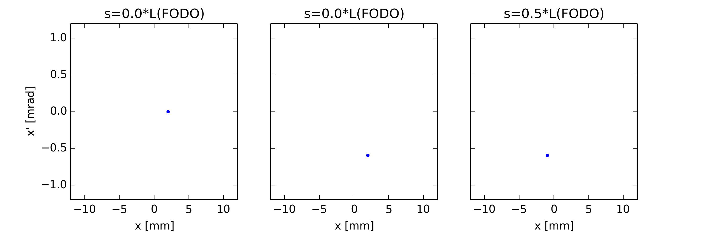
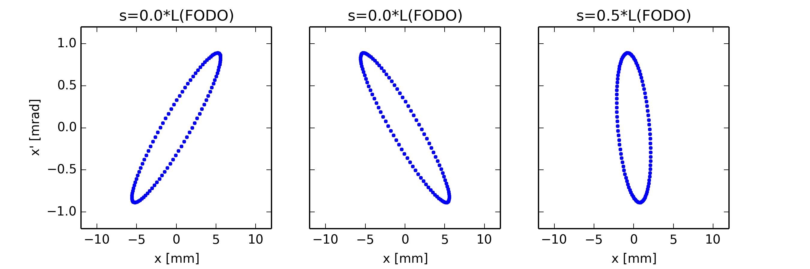
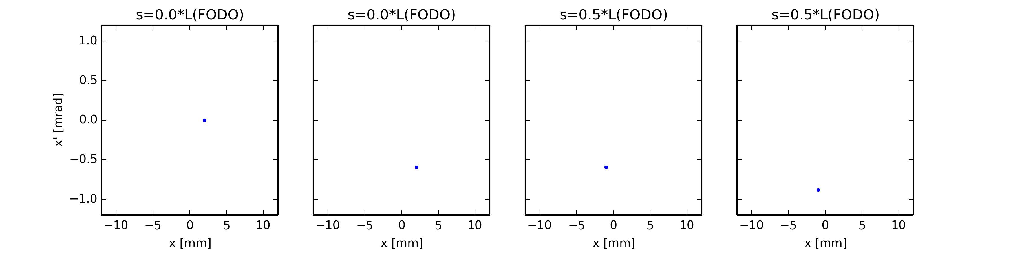
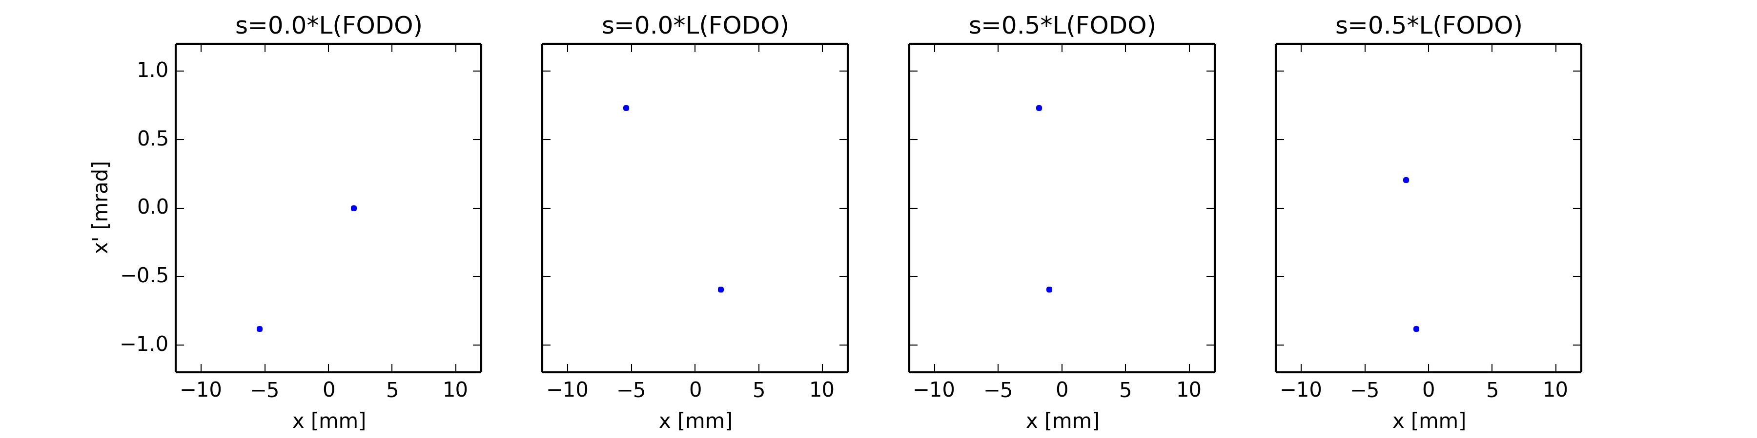
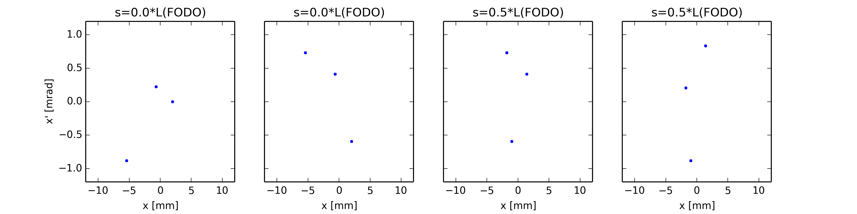
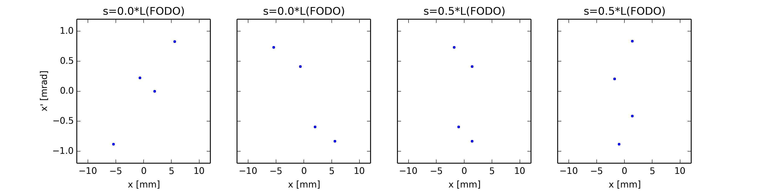
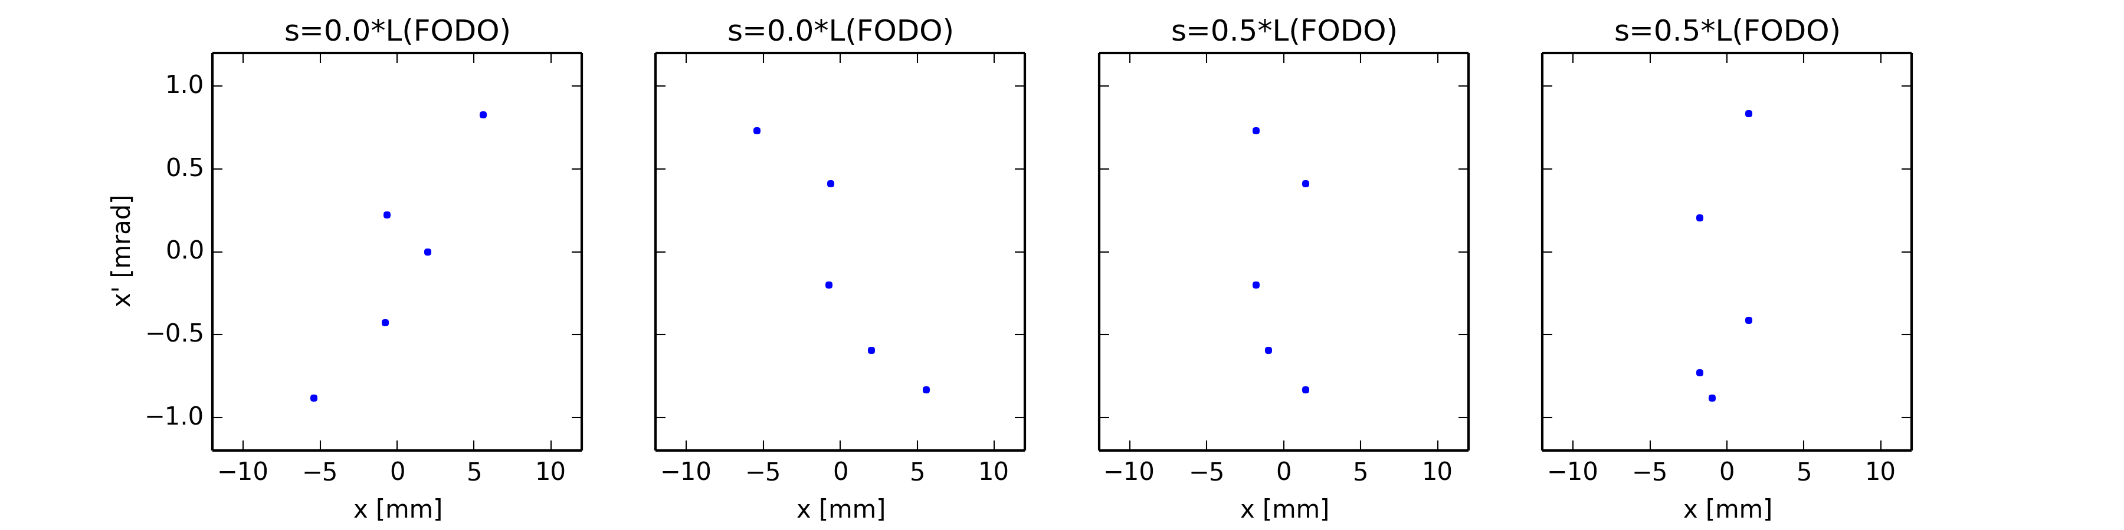
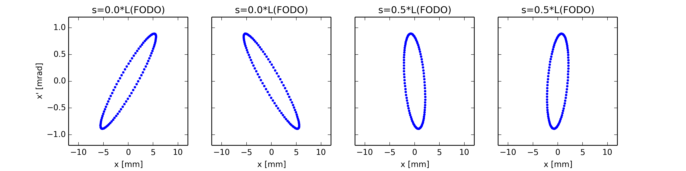
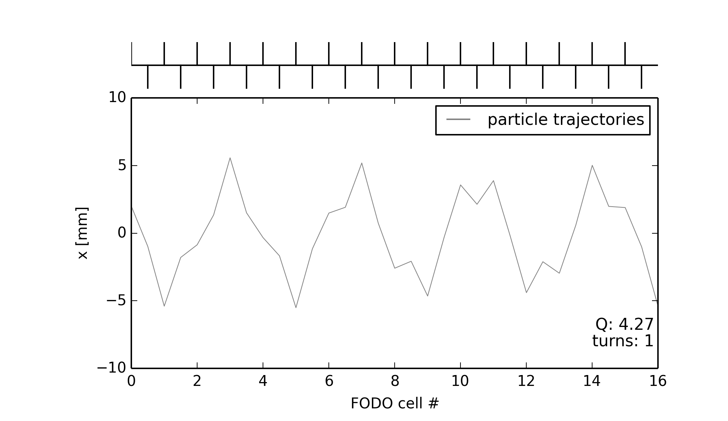


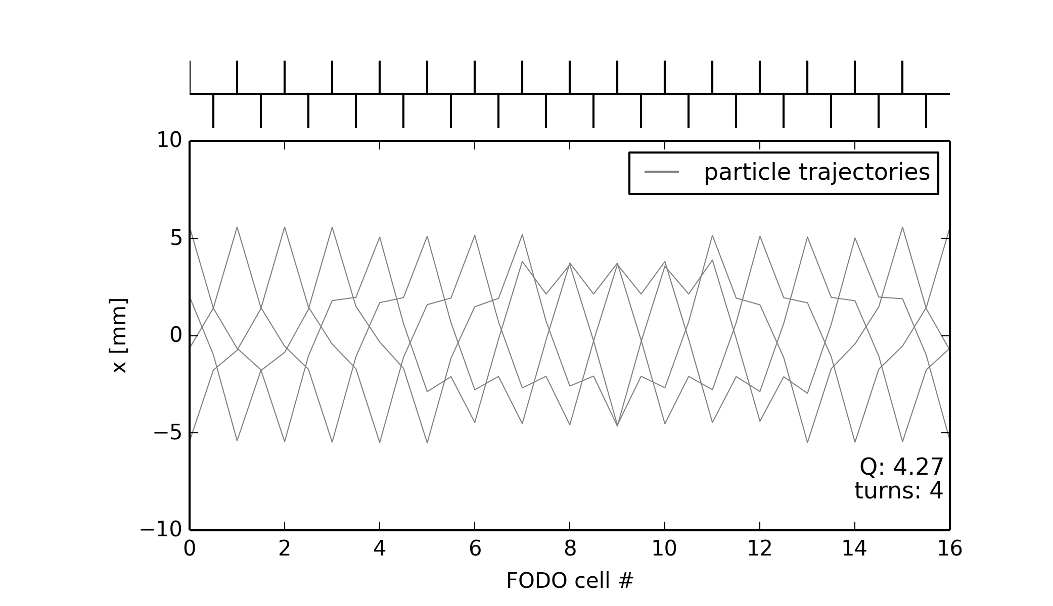
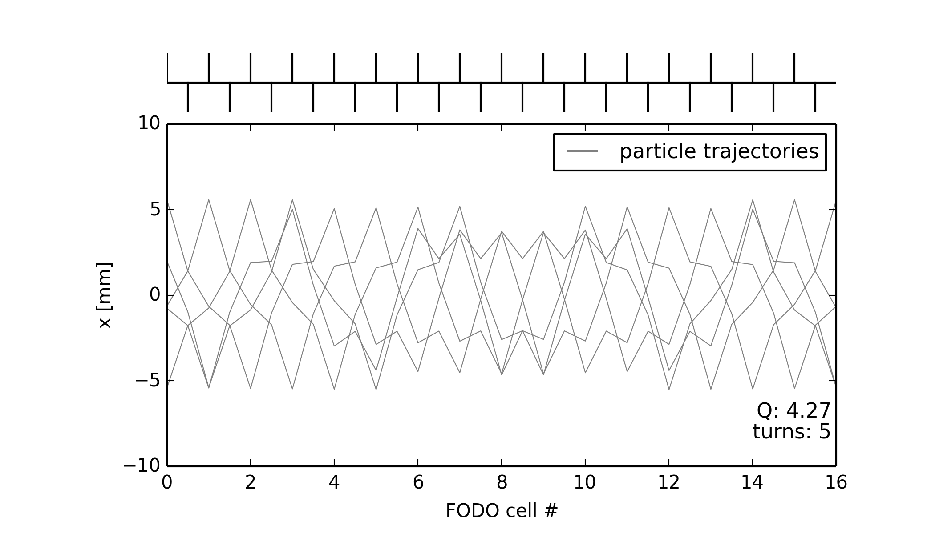
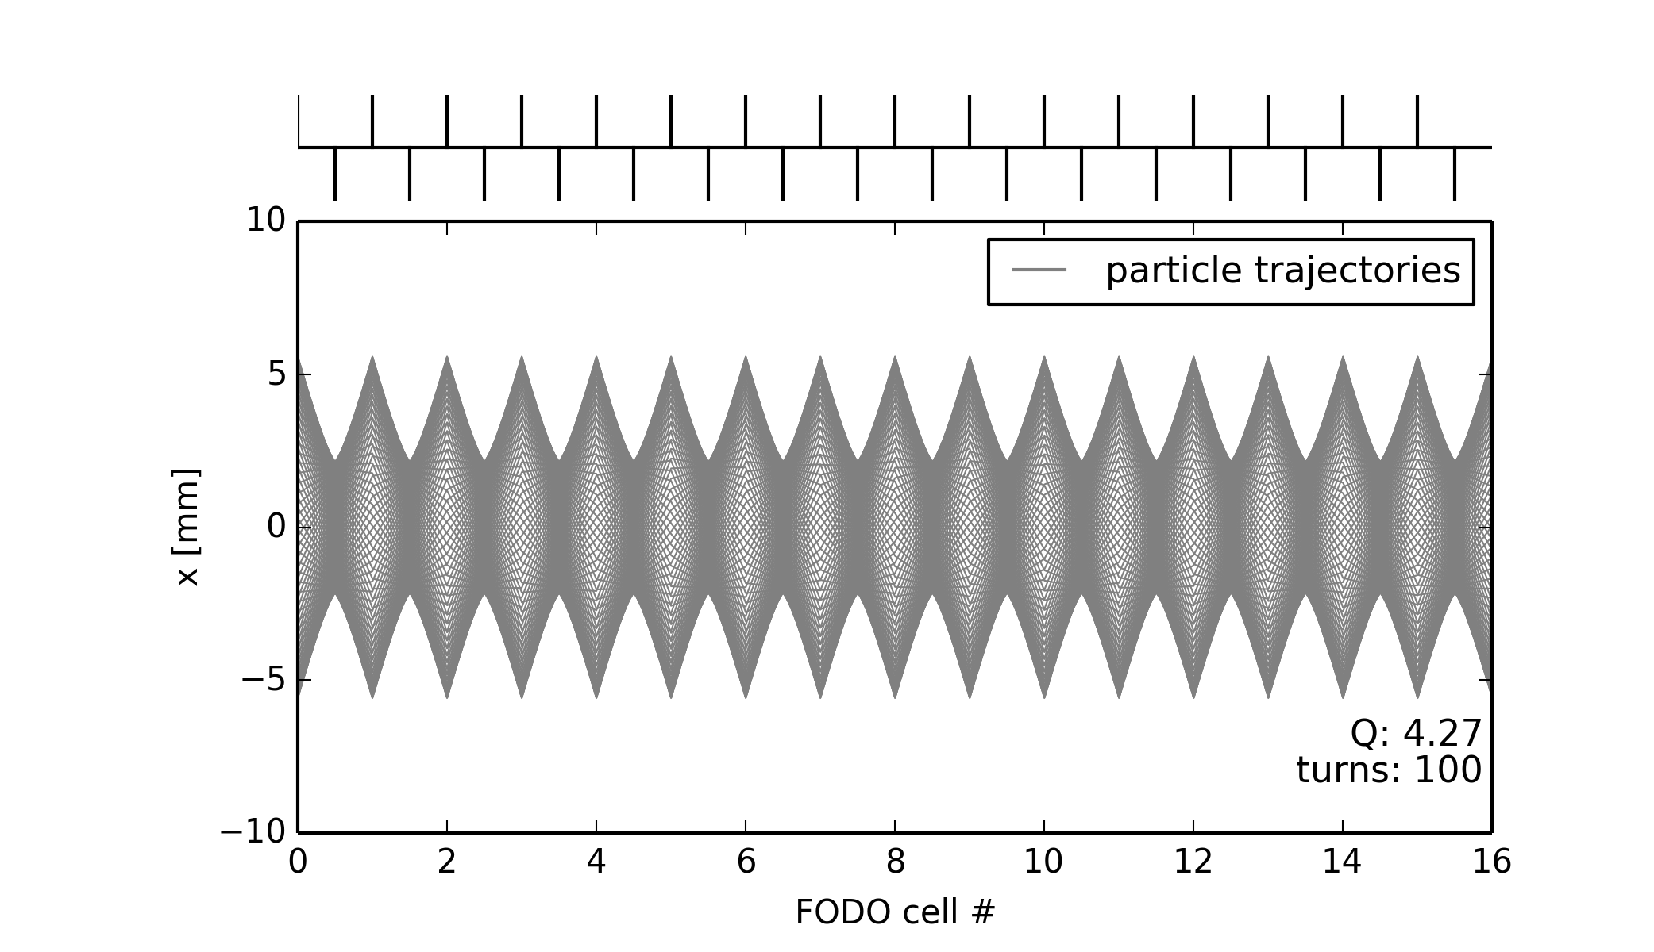
Illustration on a FODO lattice
a) Before foc. quad.
b) After foc. quad.
c) Before defoc. quad.
d) After defoc. quad.
a)
b)
QFs
c)
d)
QDs

Slide 15
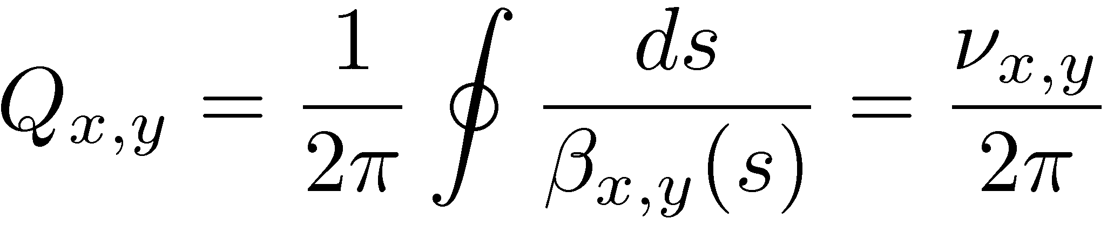
Tune and working point
  In a ring, the betatron tune is defined from the 1-turn phase advance
  i.e. number of betatron oscillations per turn
  The tune is defined by the quadrupole arrangement and strength around the machine
  The position of the tunes in a diagram of horizontal versus vertical tune is called working point
  The tunes are imposed by the choice of the quadrupole strengths
  One should try to avoid resonance conditions

Slide 16
Transverse linear imperfections and correction

Slide 17
Outline
Introduction
Closed orbit distortion (steering error)
  Beam orbit stability
  Imperfections leading to closed orbit distortion
  Effect of single and multiple dipole kicks
  Closed orbit correction methods
Optics function distortion (gradient error)
  Imperfections leading to optics distortion
  Tune-shift and beta distortion due to gradient errors
  Gradient error correction
Coupling error
  Coupling errors and their effect
  Coupling correction

Slide 18
Outline
Introduction
Closed orbit distortion (steering error)
  Beam orbit stability
  Imperfections leading to closed orbit distortion
  Effect of single and multiple dipole kicks
  Closed orbit correction methods
Optics function distortion (gradient error)
  Imperfections leading to optics distortion
  Tune-shift and beta distortion due to gradient errors
  Gradient error correction
Coupling error
  Coupling errors and their effect
  Coupling correction

Slide 19

From model to reality - fields
  The physical units of the machine model defined by the accelerator physicist must be converted into magnetic fields and eventually into currents for the power converters that feed the magnet circuits.
  Imperfections (= errors) in the real accelerator optics can be introduced by uncertainties or errors on: beam momentum, magnet calibrations and power converter regulation.
Magnet strength
Actual magnet current
Magnetic field (gradient)
Requested current
Beam momentum
Magnet
calibration curve (transfer function)
Power converter
Example of the LHC main dipole calibration curve

Slide 20

From model to reality - alignment
  To ensure that the accelerator elements are in the correct position the alignment must be precise – to the level of micrometers for CLIC !
    For CERN hadron machines we aim for accuracies of around 0.1 mm.
  The alignment process implies:
    Precise measurements of the magnetic axis in the laboratory with reference to the element alignment markers used by the survey group.
    Precise in-situ alignment (position and angle) of the element in the tunnel.
  Alignment errors are a common source of imperfections

Slide 21
Outline
Introduction
Closed orbit distortion (steering error)
  Beam orbit stability
  Imperfections leading to closed orbit distortion
  Effect of single and multiple dipole kicks
  Closed orbit correction methods
Optics function distortion (gradient error)
  Imperfections leading to optics distortion
  Tune-shift and beta distortion due to gradient errors
  Gradient error correction
Coupling error
  Coupling errors and their effect
  Coupling correction

Slide 22

Illustration of closed orbit distortion
Ideal machine toy model (no errors)
  Particle injected on the design (or reference) orbit … remains on the design orbit turn after turn

Slide 23






Illustration of closed orbit distortion
Ideal machine toy model (no errors)
  Particle injected on the design (or reference) orbit … remains on the design orbit turn after turn
  Particle injected with offset

Slide 24

Illustration of closed orbit distortion
Ideal machine toy model (no errors)
  Particle injected on the design (or reference) orbit … remains on the design orbit turn after turn
  Particle injected with offset … performs betatron oscillations around the closed orbit which is the same as the design orbit as long as there are no imperfections

Slide 25






Illustration of closed orbit distortion
Ideal machine toy model with dipole error (unintended deflection) somewhere in the lattice
  Particle injected on the design orbit … receives dipole kick every turn

Slide 26

Illustration of closed orbit distortion
Ideal machine toy model with dipole error (unintended deflection) somewhere in the lattice
  Particle injected on the design orbit … receives dipole kick every turn … and consequently performs betatron oscillation around a distorted closed orbit

Slide 27



Illustration of closed orbit distortion
Ideal machine toy model with dipole error (unintended deflection) somewhere in the lattice
  Particle injected on the design orbit … receives dipole kick every turn … and consequently performs betatron oscillation around a distorted closed orbit
  Particle injected onto distorted closed orbit remains on closed orbit

Slide 28

Sources of unintended deflections
Field error (deflection error) of a dipole magnet
  This can be due to an error in the magnet current or in the calibration table (measurement accuracy etc.)
  The imperfect dipole can be expressed as the ideal one + a small error
A small rotation (misalignment) of a dipole magnet has the same effect, but (mostly) in the other plane
imperfect dipole
ideal dipole
small dipole
error
→ horizontal kick
=
+
tilted dipole
ideal dipole
small dipole
error
→ vertical kick
φ
=
+

Slide 29

Misalignments causing feed-down
Horizontal misalignment of a quadrupole magnet
  Equivalent to perfectly aligned quadrupole plus small dipole

Slide 30
Misalignments causing feed-down
Horizontal misalignment of a quadrupole magnet
  Equivalent to perfectly aligned quadrupole plus small dipole
=
+
quadrupole dipole
horizontal offset creates horizontal (normal) dipole

Slide 31
Misalignments causing feed-down
Vertical misalignment of a quadrupole magnet
  Equivalent to perfectly aligned quadrupole plus small dipole
=
+
quadrupole dipole
vertical offset creates vertical (skew) dipole

Slide 32


Multipole expansion
Multipole expansion of transverse magnetic field
  Start from the general expression for the transverse magnetic flux in terms of multipole coefficients
  In some cases it is more convenient to use “normalized” components:
  so that:
e.g. normal quad
e.g. skew quad
Normal components
(“upright” magnets)
Skew components
(magnets rotated by )
Normalized normal components
Normalized skew components

Slide 33
Feed-down from multipoles
  Explicitly: the vertical field is the sum of all multipole components
Feed-down: lower order field components from misalignments
  Systematic horizontal offset in normal (skew) magnets creates normal (skew) feed-down components as seen with at y=0:
  Systematic vertical offset in normal magnets results in alternating skew and normal feed-down components (and vice-versa for skew magnets), as can be worked out from
dipole quadrupole sextupole octupole
2(n+1)-pole 2n-pole 2(n-1)-pole dipole
    for n = even for n = odd

Slide 34

Problem 1
  Derive an expression for the resulting magnetic field components (B_{x} and B_{y}) when the closed orbit in a normal sextupole is horizontally displaced by δx from its reference position. Do the same for an octupole.
  The field generated by a sextupole is
  The field generated by an octupole is
δx

Slide 35



Effect of single dipole kick
  Consider a single dipole kick at s=s₀
  The coordinates before and after the kick are
  Taking the solutions of Hill’s equations (u and u’) at the location of the kick, the orbit will close to itself only if
  This yields the following relations for the invariant and phase

Slide 36



Closed orbit from single dipole kick
  The initial conditions of the closed orbit at the location of the kick are therefore obtained as
  and
  For any location around the ring, the orbit distortion is written as
maximum distortion amplitude

Slide 37

Integer and half integer resonance
  Dipole kicks add-up in
  consecutive turns for Q = n
  Integer tune excites orbit
  oscillations (resonance)
  → orbit becomes unstable
  Dipole kicks get cancelled in consecutive turns for Q = n/2
  Half-integer tune cancels orbit
  oscillations

Slide 38

Single dipole kick vs. tune

Slide 39









Single dipole kick vs. tune
  Closed orbit distortion is most critical for tunes close to integer → closed orbit becomes unstable (but beam size not affected)
  The closed orbit distortion propagates with the betatron phase advance (e.g. single kick induces 4 oscillations for a tune of Q=4.x)

Slide 40





Closed orbit examples
  Example of horizontal closed orbit for a machine with tune Q = 6.x
  The kink at the location of the deflection (→) can be used to localize the deflection (if it is not known) → can be used for orbit correction.
Q = 6.1
Q = 6.2
Q = 6.5
Q = 6.9
Q = 6.7

Slide 41

A deflection at the LHC
  In the example below for the 26.7km long LHC, there is one undesired deflection, leading to a perturbed closed orbit.
Beam position x (mm)
Beam Position Monitor index along the LHC circumference
Where is the location of the deflection?

Slide 42

A deflection at the LHC
  To make our life easier we divide the position by and replace the BPM index by its phase → transform into pure sinusoidal oscillation
Beam position
Betatron phase
Can you localize the deflection now?

Slide 43





Global orbit distortion
Orbit distortion due to many errors
By approximating the errors as delta functions in n locations, the distortion at i observation points (Beam Position Monitors) is
with the kick produced by the j^{th} error
  Integrated dipole field error
  Dipole roll
  Quadrupole displacement
Courant and Snyder, 1957
φ_{j}

Slide 44



Example: Orbit distortion in SNS
  In the SNS accumulator ring, the beta function is about 6 m in the dipoles and about 30 m in the quadrupoles, the tune is 6.2
  Consider dipole errors of 1 mrad
  The maximum orbit distortion in dipoles is
  For quadrupole displacement giving the same 1 mrad kick (and betas of 30 m) the maximum orbit distortion is 25 mm, to be compared to magnet radius of 105 mm
β_{x}
β_{y}
D_{x}
horizontal rms CO
vertical rms CO

Slide 45


Statistical estimation of orbit errors
Consider random distribution of errors in N magnets
  By squaring the orbit distortion expression and averaging over the angles (considering uncorrelated errors), the expectation (rms) value is given by
Example:
  In the SNS ring, there are 32 dipoles and 54 quadrupoles
  The rms value of the orbit distortion in the dipoles
  In the quadrupoles, for equivalent kick

Slide 46

Correcting closed orbit distortion
Horizontal dipole correctors and BPMs close to focusing quads + Vertical dipole correctors and BPMs next to defocusing quads
  Highest sensitivity / effect on closed orbit due to beta-function maxima
Measure orbit in BPMs and minimize orbit distortion
  Locally
    Closed orbit bumps
    Singular Value Decomposition (SVD)
  Globally
    Harmonic: minimizing components of orbit frequency response from
    Fourier analysis
    MICADO: finding the most efficient corrector for minimizing the rms orbit
    Least square minimization using orbit response matrix of correctors
BPM: Beam Position Monitor
DH, DV: correctors
quadrupole
BPM
corrector
SPS
DH

Slide 47


Closed orbit bumps
Often it is needed to steer the closed-orbit away from the nominal trajectory in a localized part of a synchrotron
  Injection / extraction
  Local orbit correction (or steering around local aperture restrictions)
Standard bump configurations exist
  π-bump (with 2 correctors)
  3 and 4-corrector bumps
example of 2-corrector bump
dipole
septum
local orbit bump
dipole
example of 3-corrector bump
unperturbed closed orbit

Slide 48
Closed orbit bumps
Often it is needed to steer the closed-orbit away from the nominal trajectory in a localized part of a synchrotron
  Injection / extraction
  Local orbit correction (or steering around local aperture restrictions)
Standard bump configurations exist
  π-bump (with 2 correctors)
  3 and 4-corrector bumps
example of 2-corrector bump
dipole
septum
fast kick
extraction
dipole
example of 3-corrector bump
unperturbed closed orbit

Slide 49
Transport of closed orbit distortion
  Consider a transport matrix between positions 1 and 2
  The transport of transverse coordinates is written as
  Consider a single dipole kick at position 1
  The first equation may be rewritten (and similar for the second)
  Replacing the coefficient from the general betatron matrix

Slide 50
Orbit bumps: 2-corrector bump
x
QF
QF
QF
QF
QF
s
θ₁
θ₂
dipole
corrector
QD
QD
dipole
corrector
QD
QD
  Consider a cell in which correctors are placed close to the focusing quads
  The orbit shift at the 2nd corrector is
  This orbit bump can be closed by choosing a phase advance equal to between correctors (this is called a “ -bump”)
  The angle should satisfy the following equation

Slide 51

Orbit bumps: 3-corrector bump
x
QF
QF
QF
QF
QF
s
θ₁
θ₂
θ₃
QD
dipole
corrector
QD
dipole
corrector
QD
dipole
corrector
QD
  Works for any phase advance if the three correctors satisfy
  Angle of the closed orbit in the center of the bump is defined by above condition (cannot be adjusted independently of bump amplitude)

Slide 52
Orbit bumps: 4-corrector bump
x’_{b}
x
QF
QF
x_{b}
QF
QF
QF
s_{b}
s
θ₁
θ₂
θ₃
θ₄
dipole
corrector
QD
dipole
corrector
QD
dipole
corrector
QD
dipole
corrector
QD
      Works for any phase advance
      Position x_{b} and angle x’_{b} of the bump at location s_{b} can be adjusted independently
      Can be used for aperture
      scanning, extraction bumps, …

Slide 53
Problem 2
  Three correctors are placed at locations with phase advance of between them and beta functions of 12, 2 and 12 m. How are the corrector kicks related to each other in order to achieve a closed 3-corrector bump (i.e. what is the relative strength between the three kicks)?
x
QF
QF
QF
QF
QF
s
θ₁
θ₂
θ₃
QD
dipole
corrector
QD
dipole
corrector
QD
dipole
corrector
QD

Slide 54

Closed orbit correction: MICADO
  The problem of correcting the orbit deterministically came up a long time ago in the first CERN machines.
  B. Autin and Y. Marti published a note in 1973 describing an algorithm that is still in use today (but in JAVA/C/C++ instead of FORTRAN) at ALL CERN machines: MICADO*
(Minimization of the quadratic orbit distortions)

Slide 55



MICADO – how does it work?
  The intuitive principle of MICADO is rather simple
  Need a model of the machine
  Compute for each orbit corrector what the effect (response) is expected to be on the orbit

Slide 56


MICADO – how does it work?
  MICADO compares the response of every corrector with raw orbit
  MICADO picks out the corrector that has the best match with the orbit, and that will give the largest improvement to the orbit deviation rms
  The procedure can be iterated until the orbit is good enough (or as good as it can be)
…

Slide 57



MICADO – LHC Orbit example
  The raw orbit at the LHC can have huge errors, but the correction (based partly on MICADO) brings the deviations down by a factor 20
Uncorrected horizontal orbit of ring 1
50 mm
MICADO & Co
LHC vacuum chamber
Corrected horizontal orbit of ring 1
50 mm
34 mm
44 mm
At the LHC a good orbit correction is vital !

Slide 58
Response matrix approach
This approach works for orbit correction when using the measured orbit distortion (but also for beta-beating when using ∆β/β, etc.)
  Available set of correctors:
  Available observables (here the Beam Position Monitors):
  Assume the linear approximation is good (small corrections):
  Use optics model to compute response matrix (i.e. the orbit change in the i^{th} monitor due to a unit kick from the j^{th} corrector):
  … or use, e.g. MADX
  Invert or pseudo-invert the response matrix to compute an effective global correction based on the measured :
  In case the number of correctors is not the same as the number of Beam Position Monitors one has to perform a pseudo matrix inversion, for example using the “Singular Value Decomposition (SVD)” algorithm

Slide 59

Singular Value Decomposition
N monitors / N correctors
Monitors
N monitors / M correctors

Slide 60
Problem 3
SNS: A proton ring with kinetic energy of 1 GeV and a circumference of 248 m has 18, 1 m-long focusing quads with gradient of 5 T/m. In one of the quads, the horizontal and vertical beta function are 12 m and 2 m respectively. The rms beta function in both planes on the focusing quads is 8 m. With a horizontal tune of 6.23 and a vertical of 6.2, compute the expected horizontal and vertical orbit distortions on a single focusing quad given by horizontal and vertical misalignments of 1 mm in all the quads. What happens to the horizontal and vertical orbit distortions if the horizontal tune drops to 6.1 and 6.01?
S. Henderson et al. (2005)

Slide 61

Problem 4
The SPS is a 400 GeV proton synchrotron with a FODO lattice consisting of 108 focusing and 108 defocusing quadrupoles of length 3.22 m and a gradient of 15 T/m, with a horizontal and vertical beta of 108 m and 30 m in the focusing quads (30 m and 108 m for the defocusing ones). The tunes are Q_{x}=20.13 and Q_{y}=20.18. Due to a mechanical problem, a focusing quadrupole was sinking down in 2016, resulting in an increasing closed orbit distortion compared to a reference taken earlier in the year.
By how much the quadrupole had shifted down when the maximum vertical closed orbit distortion amplitude in defocusing quadrupoles reached 4 mm?
Why was there no change of the horizontal orbit measured?
How big would have been the maximum closed orbit distortion amplitude if it would have been a defocusing quadrupole?
Difference orbit wrt reference (18.08.2016)
horizontal BPMs (at focusing quadrupoles)
vertical BPMs (at defocusing quadrupoles)

Slide 62
Beam orbit stability
Beam orbit stability is very critical
  Injection and extraction efficiency of synchrotrons
  Stability of collision point in colliders
  Stability of the synchrotron light spot in the beam lines of light sources
Consequences of orbit distortion
  Miss-steering of beams, modification of dispersion function, resonance excitation, aperture limitations, lifetime reduction, coupling, modulation of lattice functions, poor injection/extraction efficiency
Sources for closed orbit drifts
  Long term (years - months): ground settling, season changes
  Medium term (days - hours): sun and moon, day-night variations (thermal), rivers, rain, wind, refills and start-up, sensor motion, drift of electronics, local machinery, filling patterns
  Short term (minutes - seconds): ground vibrations, power supplies, experimental magnets, air conditioning, refrigerators/compressors

Slide 63
Outline
Introduction
Closed orbit distortion (steering error)
  Beam orbit stability
  Imperfections leading to closed orbit distortion
  Effect of single and multiple dipole kicks
  Closed orbit correction methods
Optics function distortion (gradient error)
  Imperfections leading to optics distortion
  Tune-shift and beta distortion due to gradient errors
  Gradient error correction
Coupling error
  Coupling errors and their effect
  Coupling correction

Slide 64


Illustration of optics distortion
Ideal machine toy model with regular FODO lattice and quadrupole error at the end of circumference
  Particle injected with offset performs betatron oscillations but gets additional focusing from quadrupole error
  There is a tune-shift (additional de-/focusing)
  Beam envelope is distorted around the machine … “beta-beating”

Slide 65
Gradient error and optics distortion
Optics functions perturbation can induce aperture restrictions
Tune perturbation can lead to reduced beam stability (dynamic aperture)
Broken super-periodicity → excitation of all resonances
  In a ring made of N identical cells, only resonances with integer multiples of N can be excited
Sometimes control of optics is critical for machine performance
  Beta functions at collision points or at collimators (e.g. LHC)
Sources
  Errors in quadrupole strengths (random and systematic)
  Injection elements
  Higher-order multi-pole magnets and errors
Observables
  Tune-shift
  Beta-beating
  Excitation of integer and half integer resonances

Slide 66

Gradient error
  Consider the transfer matrix for 1-turn
  Consider a gradient error in a quad. In thin element approximation the quadrupole matrix without and with error are
  The new 1-turn matrix is
  which yields

Slide 67






Gradient error and tune-shift
  Can also be written as a new matrix with a new tune
  The traces of the two matrices describing the 1-turn should be equal
  which gives
  Developing the right hand side
  and finally
  For a quadrupole of length l the tune shift is
  For distributed quadrupole errors
≈
≈

Slide 68


Gradient error and beta distortion
  Consider the unperturbed transfer matrix for one turn
  with
  Introduce a gradient perturbation between the two matrices
  Recall that and write the perturbed term as
  where we used and and
a)

Slide 69


Gradient error and beta distortion
  On the other hand
  Equating the two terms
  using and integrating yields
  for distributed errors around the machine
b)
a) = b)

Slide 70






Optics distortion vs. tune
  Quadrupole errors have biggest impact close to integer and half integer tunes → envelope (or beam size) becomes unstable
  Optics distortion propagates with twice the tune (check the plot)

Slide 71

Quadrupole error in phase space
  Therefore integer tunes and half integer tunes need to be avoided for machine operation to avoid beam envelope becoming unstable due to quadrupole errors
  Recall: for integer tunes dipole errors drive the closed orbit unstable, but for half integer tunes they have minimum effect
Q = n (integer)
→ kicks from quadrupoles add up (same as for kicks from dipoles)
Q = n/2 (half integer)
→ kicks from quadrupoles add up (while kicks from dipoles cancel)

Slide 72


Optics distortion characteristics
  Let’s take a look at the LHC …
Example: one quadrupole gradient is incorrect
Nominal optics
Perturbed optics
Zoom into a subsection

Slide 73
Optics distortion characteristics
  The local beam optics perturbation
  … note the oscillating pattern
Nominal optics
Perturbed optics

Slide 74

Optics distortion characteristics
  The error is easier to analyse and diagnose if one considers the ratio of the betatron function perturbed/nominal.
  The ratio reveals an oscillating pattern called the betatron function beating (‘beta-beating’). The amplitude of the perturbation is the same all over the ring!

Slide 75

Optics distortion characteristics
  The beta-beating pattern comes out even more clearly if we replace the longitudinal coordinate with the betatron phase advance
  The result is very similar to the case of the closed orbit kick, the error reveals itself by a kink!
  If you watch closely you will observe that there are two oscillation periods per 2π (360 deg) phase. The beta-beating frequency is twice the frequency of the orbit!

Slide 76




Example: Gradient error in SNS
  Consider 18 focusing quads in the SNS ring with 0.01 T/m gradient error. In this location β = 12 m. The length of the quads is 0.5 m and the magnetic rigidity is 5.6567 Tm
    The tune-shift is
  For a random distribution of errors the beta beating is
    Optics functions beating > 20% by random errors (1% of gradient) in high dispersion quads of the SNS ring … defines correctors strengths

Slide 77
Gradient error correction
Quadrupole correctors
  Individual correction magnets
  Windings on the core of the quadrupoles (trim windings)
  Pairs of correctors at well-chosen locations for minimizing resonance
Methods & approaches
  Compute tune-shift and optics function beta distortion
  Move working point close to integer and half integer resonance to increase sensitivity
  Minimize beta wave or quadrupole resonance width with trim windings
  Individual powering of trim windings can provide flexibility and beam based alignment of BPM
Modern methods of response matrix analysis (LOCO) can fit optics model to real machine and correct optics distortion

Slide 78


Example: LHC optics corrections
  At β*=40cm, the bare machine has a beta-beat of more than 100%
  After global and local corrections, β-beating was reduced to few %
before and after local correction
final corrections
R. Tomas et al. 2016

Slide 79
Problem 5
The SPS is a 400 GeV proton synchrotron with a FODO lattice consisting of 108 focusing and 108 defocusing quadrupoles of length 3.22 m and a gradient of 15 T/m, with a horizontal and vertical beta of 108 m and 30 m in the focusing quads (30 m and 108 m for the defocusing ones). The tunes are Q_{x}=20.13 and Q_{y}=20.18.
Find the tune change for systematic gradient errors of 1% in the focusing and 0.5% in the defocusing quads.

Slide 80
Outline
Introduction
Closed orbit distortion (steering error)
  Beam orbit stability
  Imperfections leading to closed orbit distortion
  Effect of single and multiple dipole kicks
  Closed orbit correction methods
Optics function distortion (gradient error)
  Imperfections leading to optics distortion
  Tune-shift and beta distortion due to gradient errors
  Gradient error correction
Coupling error
  Coupling errors and their effect
  Coupling correction

Slide 81
Coupling
  Coupling may result from rotation of a quadrupole, so that the field contains a skew component
  A systematic vertical offset in a sextupole has the same effect as a skew quadrupole. For a displacement of the field becomes
tilted quadrupole
normal quadrupole
skew quadrupole
φ
skew quadrupole

Slide 82



4x4 Matrices
  Combine the matrices for each plane
  to get a total 4x4 matrix
with skew quadrupoles these matrix elements are non-zero
Uncoupled motion

Slide 83


Effect of coupling
Betatron motion is coupled in the presence of skew quadrupole components in the machine
  The field is and Hill’s equations are coupled
  The motion is still linear with two new eigen-mode tunes, which are always split. For a thin skew quadrupole with k_{s} the induced tune split is
  Coupling coefficients represent the strength of coupling
  … complex number characterizing the difference resonance
As the motion is coupled, vertical dispersion and optics function distortion appears

Slide 84
Closest tune approach
  Coupling makes it impossible to approach the tunes below
  , where is again the coupling coefficient

Slide 85

Closest tune approach
  Coupling makes it impossible to approach the tunes below
  , where is again the coupling coefficient
  The coupling coefficient can be measured very easily by trying to approach the tunes and measure the minimum distance
Tune measurement in the CERN PS
programmed Q_{y}
C–
quadrupole setting changed dynamically during storage time
programmed Q_{x}
tune peaks from both planes visible in Fourier spectra of horizontal and vertical motion
programmed Q_{y}
C–
programmed Q_{x}

Slide 86
Linear coupling correction
Coupling correctors
  Introduce skew quadrupoles into the lattice
  If skew quadrupoles are not available, one can make vertical closed orbit bumps in sextuple magnets (used in JPARC main ring until installation of skew quadrupole correctors)
Methods & approaches
  Correct globally/locally coupling coefficient (or resonance driving term)
  Correct optics distortion (especially vertical dispersion)
  Move working point close to coupling resonances and repeat
Remarks
  Correction especially important for beams with unequal emittances “flat beams” (coupling leads to emittance exchange)
  The (vertical) orbit correction may be critical for reducing coupling (e.g. due to feed-down sextupoles)

Slide 87
Summary of linear imperfections
  Linear imperfections such as magnet misalignments and field errors are unavoidable in a real accelerator, but they can be corrected to some extent as summarized in this table:
Error | Effect | Cure
fabrication imperfections | unwanted multipolar components | better fabrication / multipolar correctors coils
transverse misalignments | feed-down effect | better alignment / correctors
dipole kicks | orbit distortion / residual dispersion | corrector dipoles
quad field errors | tune shift, beta-beating | trim special quadrupoles
quadrupole tilts | coupling x − y | better alignment / skew quads
power supplies | closed orbit distortion / tune shift / modulation | improve power supplies and their calibration

Slide 88
Additional material

Slide 89




Weak focusing from dipoles
Consider a particle in a dipole field
  In the horizontal plane
    it performs harmonic oscillations
    with frequency
    the horizontal acceleration is described by
    Therefore dipoles provide a weak focusing effect in the horizontal plane
  In the vertical plane, the only force present is gravity
    Particles are displaced vertically following the usual law:
    With a_{g} ≈ 10 m/s², the particle is displaced by 18 mm (LHC dipole aperture) in 60 ms (few hundred turns in LHC) → need focusing!
particle with x₀ initial offset
y
x
s = vt
ρ
reference orbit

Slide 90
Closed orbit errors

Slide 91



Off-momentum particles in a dipole
Up to now all particles had the same momentum p₀
What happens for off-momentum particles, i.e. particles with momentum p₀+Δp?
  Consider a dipole with field B and
  bending radius
  Recall that the magnetic rigidity is
  and for off-momentum particles
  Considering the effective length of the dipole unchanged
  Off-momentum particles get different deflection (different orbit)
p₀+Δp
p₀
ρ+Δρ
ρ
θ

Slide 92



Dispersion equation
Consider the equations of motion for off-momentum particles
  The solution is a sum of the homogeneous (on-momentum) and the inhomogeneous (off-momentum) equation solutions
  In that way, the equations of motion are split in two parts
  The dispersion function can be defined as
The dispersion equation is

Slide 93
Closed orbit including dispersion
  Design orbit is defined by main dipole field
  On-momentum particles oscillate around the closed orbit (which is different compared to the design orbit in case of imperfections)
  Off-momentum particles oscillate around the chromatic closed orbit, defined by the dispersion function times the momentum offset added to the on-momentum closed orbit
on-momentum particle at a given s-location
off-momentum particle at a given s-location
prop. to particle momentum offset
give ellipse

Slide 94

Impact of earth tides on LHC energy
  The LHC circumference is oscillating periodically due to Earth tides, caused by sun and moon, which move the Earth surface up and down (the Moon contributes ~2/3, the Sun contributes ~1/3)
  A change of beam energy of 0.014% is observed (through radial beam excursion for given RF frequency), corresponding to a change of circumference of 1.1 mm
  Very important for experiments for calibrating collision events!
– predicted
– observed
E. Todesco and J. Wenninger, PR-AB 20, 081003 (2017)

Slide 95
Gradient errors

Slide 96


Example: Gradient error in ESRF
  Consider 128 focusing arc quads in the ESRF storage ring with 0.001 T/m gradient error. In this location = 30 m. The length of the quads is around 1 m. The magnetic rigidity of the ESRF is 20 Tm.
  The tune-shift is

Slide 97

Linear Optics from Closed Orbit
R. Bartolini, LER2010
J. Safranek et al.
Hor. β - beating
Ver. β - beating
Modified version of LOCO with constraints on gradient variations (see ICFA Newsletter, Dec’07)
β - beating reduced to 0.4% rms
Quadrupole variation reduced to 2%
Results compatible with mag. meas. and calibrations
Quadrupole gradient variation
LOCO allowed remarkable progress with the correct implementation of the linear optics

Slide 98






PSB half integer resonance correction
Compensation of quadrupole errors at half integer Q_{y}=4.5
  PSB has 16-fold symmetry
  2 families of normal quadrupole correctors
    +QNO4 and –QNO12 with Δμ_{x} = 2.25 * 2π
    +QNO8 and –QNO16 with Δμ_{x} = 2.25 * 2π
  Due to opposite polarity within each family, their contribution on beta-beating adds up (beta-beat frequency is twice the tune!) while there is no change of tune (same change of focusing & defocusing)
  The two families are orthogonal with respect to the half integer resonance driving term (every phase achievable)
QNO8L3 +
–
QNO12L3
QNO4L3
+
– QNO16L3

Slide 99

PSB half integer resonance correction
Experimental data!
F. Asvesta, CERN
dynamic resonance crossing
– bare machine
– correction

Slide 100
Chromaticity

Slide 101



Chromaticity from quadrupoles
  Linear equations of motion depend on the energy (term proportional to dispersion)
  Chromaticity is defined as:
  Recall that the gradient is
  This leads to dependence of tunes and optics function on the particle’s momentum due to the momentum dependent focusing of quadrupoles
  For a linear lattice the tune shift is:
  So the natural chromaticity is:
  Natural chromaticity is always negative
  (since quadrupoles have to provide overall focusing)
  Sometimes the normalized chromaticity is quoted

Slide 102

Chromaticity induced tune spread
  A beam consists of particles with momentum spread and through chromaticity this leads to a tune spread
  Example for SNS ring
    In the SNS ring, the natural chromaticity is –7
    (in both planes)
    Consider that momentum spread δp/p = ±1%
    Tune-shift for off-momentum particles
  To correct chromaticity need focusing for off-momentum particles
  Sextupoles

Slide 103
Chromaticity from sextupoles
  The sextupole field component in the x-plane is:
  In a location with non-zero dispersion the closed orbit is
  Then the field is
  With
  sextupoles introduce an equivalent focusing correction
  The sextupole induced chromaticity is
  The total chromaticity is the sum of the natural and sextupole induced chromaticity
quadrupole dipole

Slide 104
Schematic of chromaticity correction
  Quadrupole focusing depends on particle momentum
  Sextupole in location with dispersion: closed orbit offset for off-momentum particles from dispersion results in feed-down in sextupole giving quadrupole effect (focusing or defocusing depending on sign of momentum)

Slide 105
Chromaticity correction
  Install sextupoles in areas with high-dispersion and high beta
  Two families are able to control horizontal and vertical chromaticity
  (if installed in locations with different beta-functions in the two planes)
  Tune them to achieve desired chromaticity values
  Sextupoles introduce non-linear fields (can lead to chaotic motion)
  Sextupoles introduce tune-shift with amplitude
  Example:
    The SNS ring has natural chromaticity of –7
    Placing two sextupoles of length 0.3 m in locations where β=12 m, and the dispersion D_{x}=4 m
    For getting 0 chromaticity, their strength should be
    or a gradient of B₂=17.3 T/m²

Slide 106

Two vs. four sextupole families
  Two families of sextupoles not enough for correcting off-momentum optics functions’ distortion and second order chromaticity
  Possible solutions:
    Place sextupoles accordingly to eliminate second order effects (difficult)
    Large optics function distortion for momentum spreads of ±0.7%,when using only two families of sextupoles → more families (4 in the case of the SNS ring) and optimize their settings to minimize off-momentum optics beating

Slide 107


Problem 6
LEIR: Consider a heavy-ion synchrotron with 5 families of quadrupoles (no FODO structure) and the optical functions from the plot and table below.
What is the natural chromaticity of the machine? (quad length l_{q}=0.5m for all families, dipole length l_{d}=6.44m)
What is the optimum placement for the sextupole magnets to correct the chromaticity? Give their estimated k₂ value to get ? (assume l_{s} = l_{q})
QF1
QD1
QF3
QD2
QF2
ρ = 4.1m
 | k₁ (m⁻²) | β_{x} (m) | β_{y} (m) | D_{x} (m)
QF1 | 0.9041 | 7.9 | 7.9 | -10.9
QD1 | -1.1303 | 5.3 | 18.0 | -7.3
QF2 | 0.3088 | 7.2 | 10.8 | 0
QD2 | -1.3181 | 5.4 | 14.5 | 0
QF3 | 0.7167 | 7.4 | 7.6 | 0

