Slide 1
Free-Electron Lasers
Eduard Prat, Paul Scherrer Institut
JUAS, 27 January 2021

Slide 2
Contents
Introduction
Basic physics principles:
  Electron motion
  Undulator radiation
  Microbunching
  SASE FELs
  The FEL parameter ρ
Electron beam requirements
FEL driver accelerators
FEL projects around the world

Slide 3
I. Introduction

Slide 4
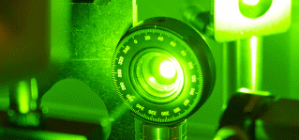
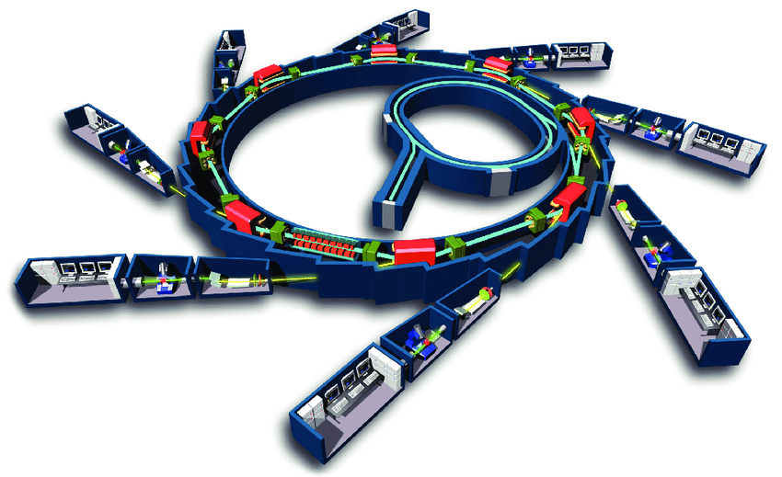
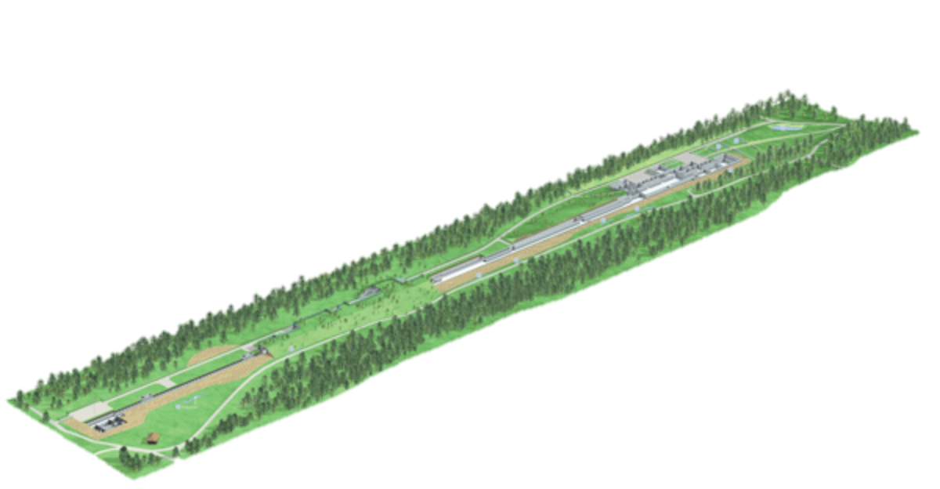
3 Types of Light Sources
Optical short pulse lasers
Pulse duration: +++ (few fs)
Wavelength: - - - (~800 nm)
Fastest processes can be analyzed
Spatial resolution limited
Synchrotrons
Pulse duration: o (few ps)
Wavelength: +++ (~ 0.1 nm)
→ Temporal resolution limited
Wavelength allows for atomic resolution
X-ray free-electron lasers
Pulse duration: +++ (few fs)
Wavelength: +++ (~ 0.1 nm)
Fastest processes can be analyzed
Wavelength allows for atomic resolution

Slide 5
3 Types of Light Sources
 | Optical lasers | Synchrotrons | FELs
Time atomic res. | Yes | No | Yes
Spatial atomic res. | No | Yes | Yes
Pulse energy | few mJ | < nJ | few mJ
Rep rate | < 0.1 MHz | ~500 MHz | ~0.1 – 1 MHz
Facility cost | Moderate (≥10 MEUR) | High (≥100 MEUR) (but government funded) | Very High (≥300 MEUR) (but government funded)
User accessibility | Poor, normally buy it yourself! | Good: ~50 user facilities worldwide (~10 beamlines each) | Fair: ~5 user facilities worldwide (1-2 beamlines each)
FELs are the only source providing atomic resolution in space and time but they are expensive → use them only when high power or ultra-short pulses are required
Synchrotrons are sufficient for most of studies on structural analysis
All light sources are necessary and complementary

Slide 6
Brilliance
At the business end, the appropriate figure-of-merit for light sources is the brilliance.
It takes into account:
  the number of photons produced per time unit (use second)
  the angular divergence of the photons (in mrad²)
  the cross-sectional area of the photon beam (use mm²)
  the number of photons falling within a certain bandwidth (BW) of the central wavelength
  (0.1% are customary)
Therefore the awkward but appropriate unit for brilliance is:
photons / s / mm² / mrad² / 0.1% (BW)
Some other terms are used in the literature
  brightness (should be reserved for the phase-space density of particle beams)
  intensity (should only be used for power per unit area!)
  photon flux (is the number of photons per time and area, it misses divergence and bandwidth)

Slide 7
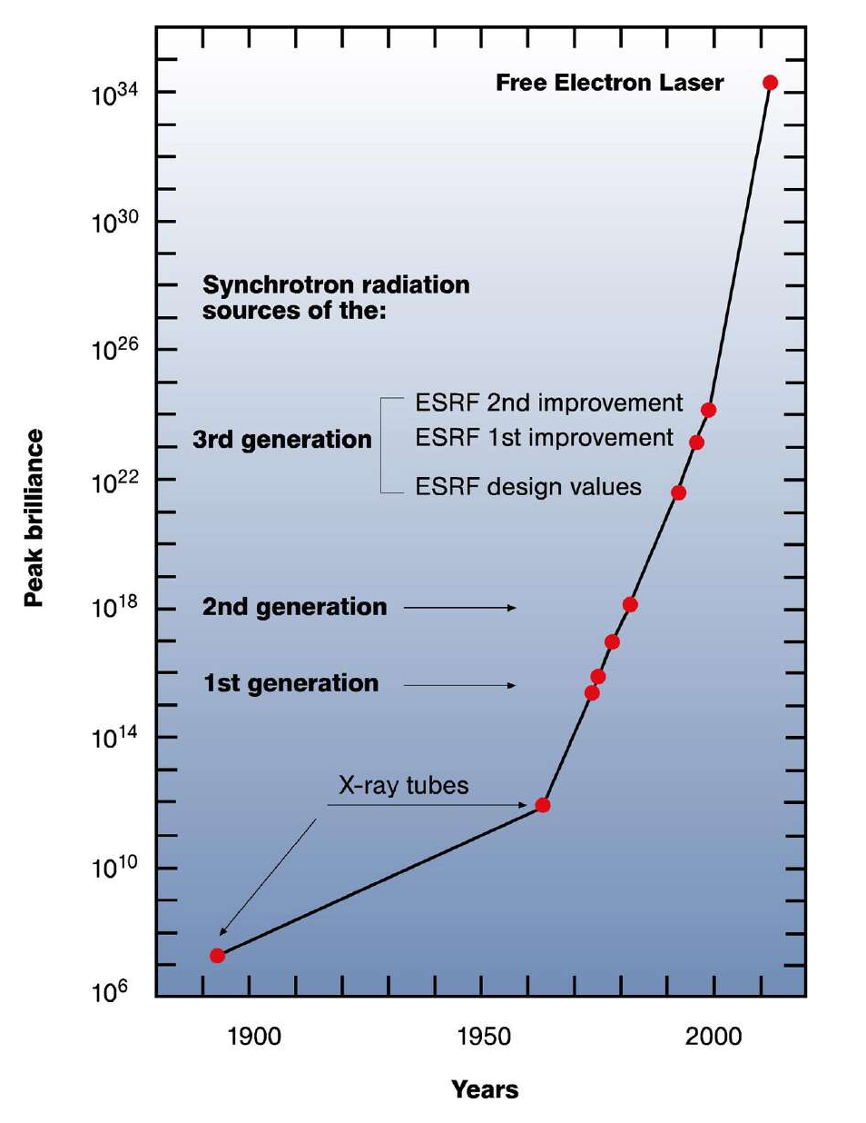
Historical evolution of peak brilliance
Classification of synchrotron light sources:
1st generation: parasitic use of synchrotrons built for particle physics
2nd generation: dedicated synchrotrons / storage rings built for photon science
3rd generation: dedicated storage rings optimized for operation with insertion devices (wigglers and undulators)
4th generation: free electron lasers
(ESRF is a reference for 3rd generation light sources)
Image: www.xfel.eu

Slide 8
4th generation light sources: FELs
The most brilliant light sources
Tunable wavelength, down to 1 Angstrom
Pulse Length less then 100 fs (sub fs demonstrated)
High Peak Power well above 1 GW
Fully Transverse Coherence
Longitudinal coherence (with special methods such as self-seeding)

Slide 9
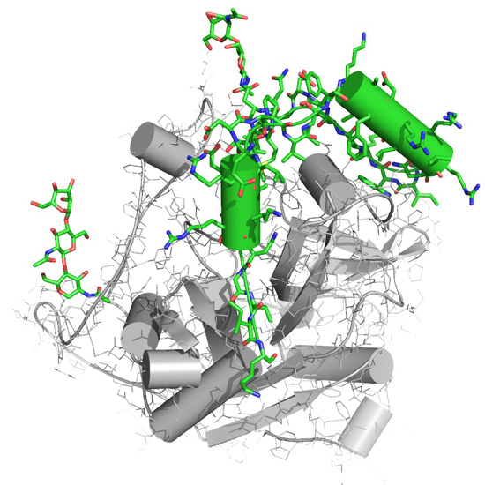
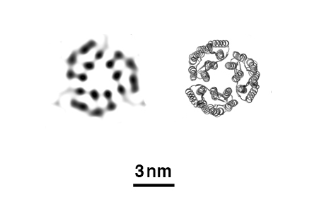
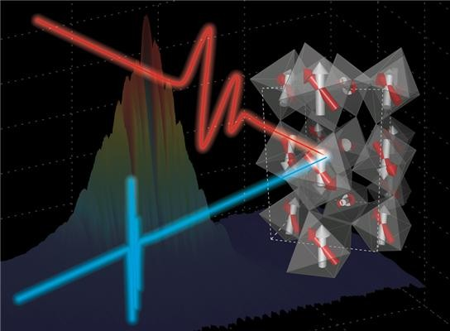
Science with light sources
FELs are unique light sources to observe matter on spatial AND time scales of atomic processes
They can address fundamental research questions across the disciplines of physics, chemistry, materials and life sciences.
Examples:
  Crystallography to determine structure and dynamics of biomolecules → discovery of new drugs for challenging diseases
  Observation of transitions in quantum materials → development of new materials for multiple applications
reconstruction
known
Ref. PNNL and FELs of Europe

Slide 10
II. Basic physics principles
Electron motion

Slide 11
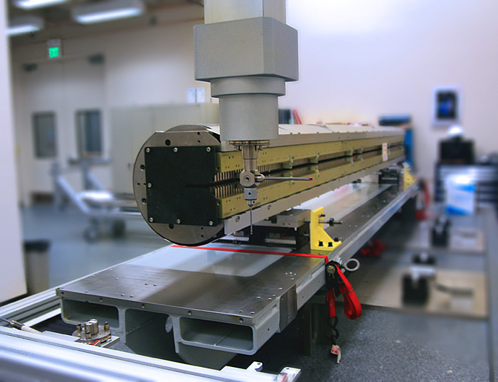
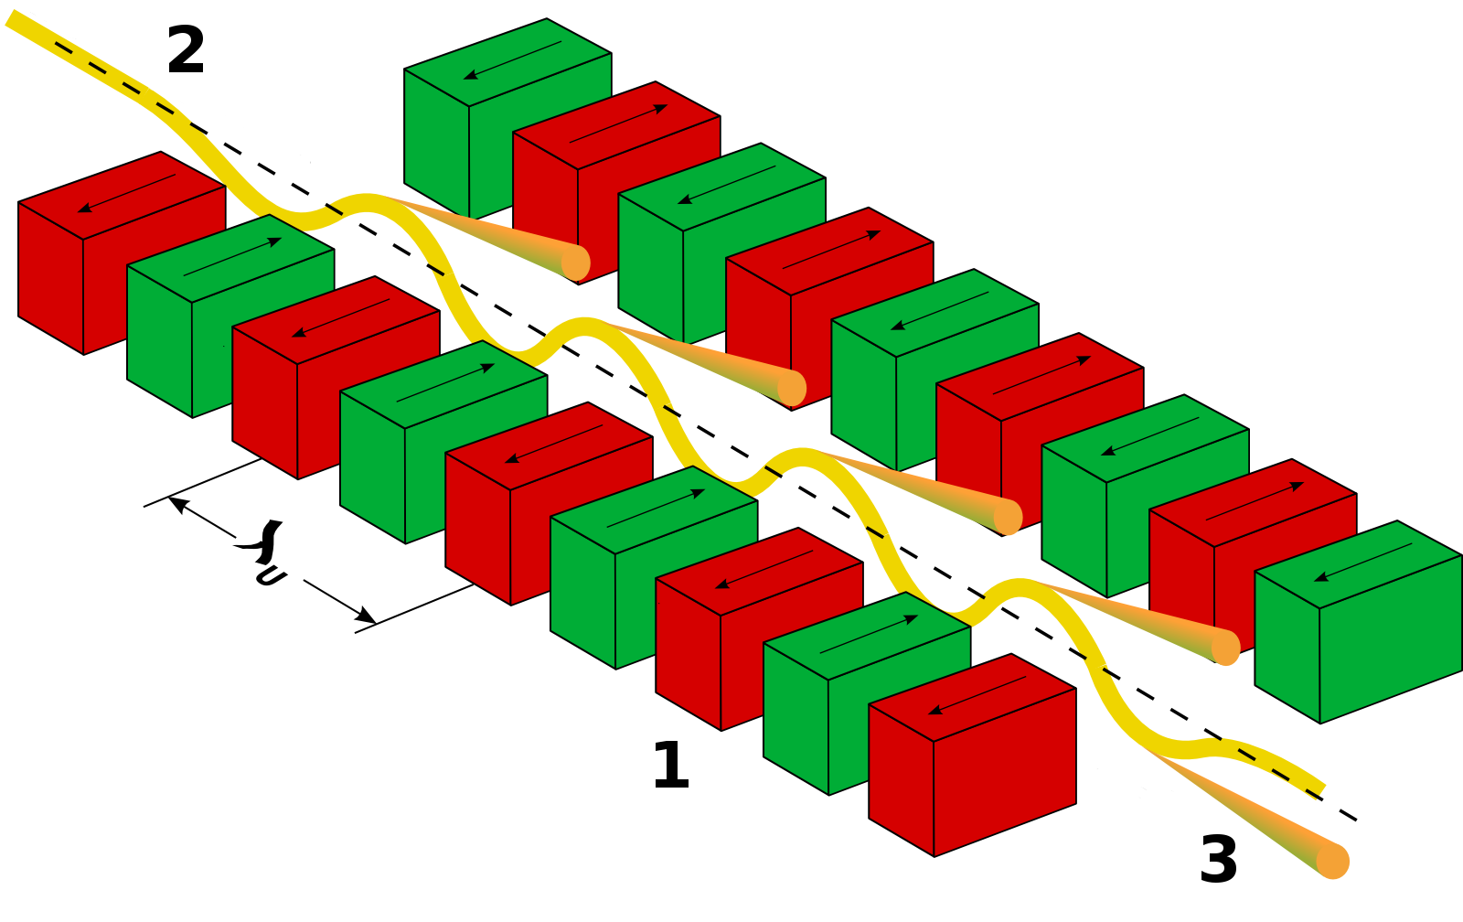
Forcing the Electrons to Wiggle…
… by injecting them into a period field of an wiggler magnet (also often called undulator).
Wiggler module from the LCLS XFEL

Slide 12
Wiggler Field
Defined by a transverse magnetic field which switch polarity multiple times, defining the undulator period λ_{u}
On Axis-Field:
Planar Undulator
Helical Undulator

Slide 13
Motion in Planar Undulator
Lorentz Force:
Dominant field in y
Dominant motion in z (~β_{z}ct)
From these 2 equations and after some algebra the transverse and longitudinal motion of the electrons can be derived
Transverse
Longitudinal
Undulator parameter
Average over one period

Slide 14
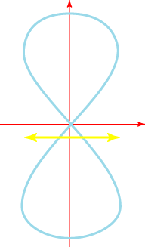
In the Co-moving frame
x
Longitudinal wiggle has twice the period.
Causes a figure “8” motion in the co-moving frame.
The longitudinal position is effectively smeared out
trajectory
z
Effective position
In a helical wiggle the longitudinal motion is constant

Slide 15
II. Basic physics principles. Undulator radiation

Slide 16
Resonance Condition (I)
Accelerated particles are emitting radiation
Condition to have a constructive interference between electrons and photons
Wavefront from emission point A when electron has moved by one period
Emission Direction: θ
R=cT
θ
Α

Slide 17
Resonance Condition (II)
For small angles

Slide 18
The FEL Resonant Wavelength
The wavelength can be controlled by
  Changing the electron beam energy,
  Varying the magnetic field (requires K significantly larger than 1)
Example: an undulator period of 15 mm, a K-value of 1.2 and an energy of 5.8 GeV (γ=11000) would give 1 Å radiation
The Free-Electron Lasers are based on undulator radiation in the forward direction with the resonant wavelength:

Slide 19
II. Basic physics principles. Microbunching

Slide 20
Basic ideas
The wiggling electrons emit radiation. Some of it co-propagates along the undulator.
The transverse oscillation allows the coupling of the electron beam with the radiation field.
Electrons absorbing more photons than emitting become faster and tend to group with electrons, which are emitting more photons than absorbing.
The FEL exploits a collective process, which ends with an almost fully coherent emission at the resonant wavelength.

Slide 21
Co-Propagation of Electrons and Field
The transverse oscillation allows to couple with a co-propagating field
The electron moves either with or against the field line
After half undulator period the radiation field has slipped half wavelength. Both velocity and field, have changed sign and the direction of energy transfer remains.
The net energy change can be accumulated over many periods

Slide 22
Energy Modulation & Longitudinal Motion
The energy change of an electron depends on its phase θ
For a given wavelength λ there is one energy γ_{r}, where the electron stays in phase with radiation field.
It can be proven that the condition that satisfies this is exactly the resonance condition.
Electrons with energies above the resonant energy, move faster (dθ/dz > 0), while energies below will make the electrons fall back (dθ/dz <0 ). For small energy deviations:
f_{c}: coupling factor (<1)
Δγ = 0
Δγ > 0
z
Δγ < 0

Slide 23
Motion in Phasespace
Wavelength typically much smaller than bunch length.
Electrons are spread out initially over all phases.
Δγ
Δγ
θ
θ
Δγ
Δγ
θ
θ
Electrons are bunched on same phase after quarter rotation

Slide 24
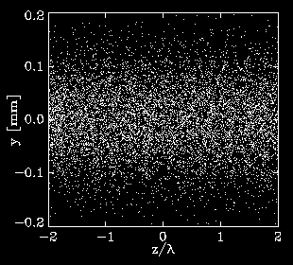
Microbunching
3D Simulation for
FLASH FEL over 4 wavelengths
Frame moving with electron beam through 15 m undulator
Wiggle motion is too small to see. The ‘breathing’ comes from focusing to keep beam small.
Transverse position
Slice of electron bunch (4 wavelengths)
Microbunching has periodicity of FEL wavelength. All electrons emit coherently.

Slide 25
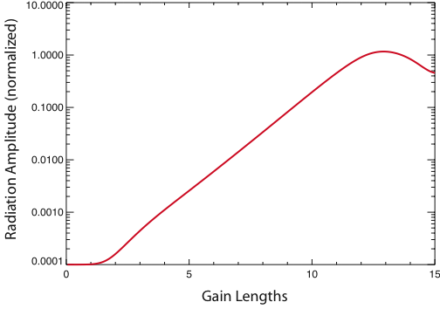
The Generic Amplification Process
Beyond saturation there is a continuous exchange of energy between electron beam and radiation beam.
Saturation (max. bunching)
Exponential Amplification
FEL Gain
Start-up Lethargy
Lethargy at start-up is the response time till some bunching has formed.

Slide 26
II. Basic physics principles. SASE FELs

Slide 27
FEL Modes
SASE FEL (Self-Amplified Spontaneous Emission)
FEL Amplifier (starts with an input signal)
Output
Electrons
Undulators
Spontaneous emission (shot noise)
is a broadband seed of “white noise”
Seed
Output
Electrons
Undulators
Seed must be above shot noise power

Slide 28
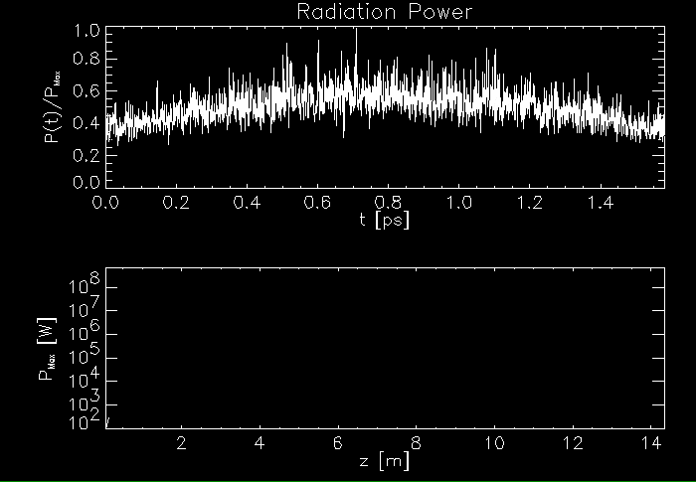
Typical Growth of SASE Pulse
Simulation for FLASH FEL

Slide 29
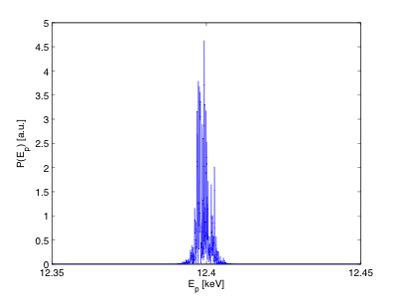
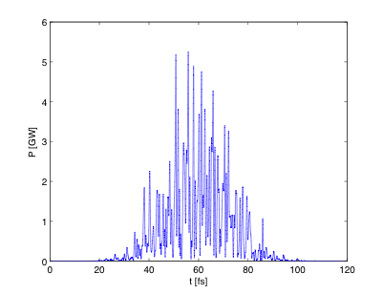
SASE FELs
FEL starts with the broadband signal of spontaneous radiation (almost a white noise signal)
Within the FEL bandwidth Δω the noise is amplified
Spikes in spectrum and time profile.
SwissFEL: Simulation for 1 Angstrom radiation
Spectrum at
saturation
1/t_{b}
Pulse at saturation
t_{c}
1/t_{c}
t_{b}
Cooperation Length:

Slide 30
II. Basic physics principles. The FEL parameter ρ

Slide 31
The Importance of the FEL Parameter ρ
FEL parameter ρ. Typical values= 10⁻⁴ – 10⁻²
Scaling of 1D theory
Beam Requirements:
f_{c}: coupling factor (~0.9 for planar undulator)
I: electron peak current
σ_{x}: transverse beam size
I_{A}: Alfven current (~17 kA)
Gain length
Efficiency
SASE Spike Length
Bandwidth
Energy Spread
Emittance

Slide 32
Summary of basic physics principles
FEL Process
Induced energy modulation
Increasing density modulation
Run-away process
(collective instability)
Enhanced emission
FEL utilized the strong coherent emission in the collective instability with the tuning ability of the wavelength.
Instability can only occur with a beam with low energy spread and emittance.

Slide 33
III. Electron beam requirements

Slide 34
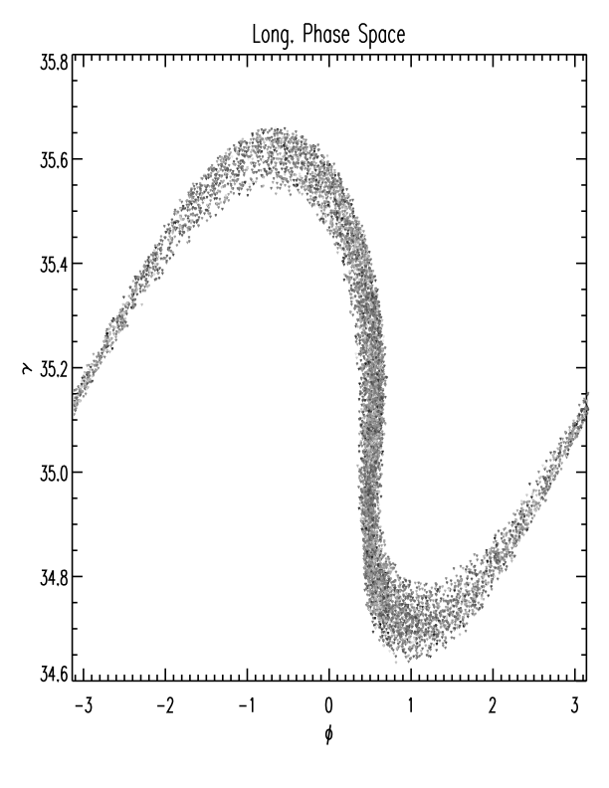
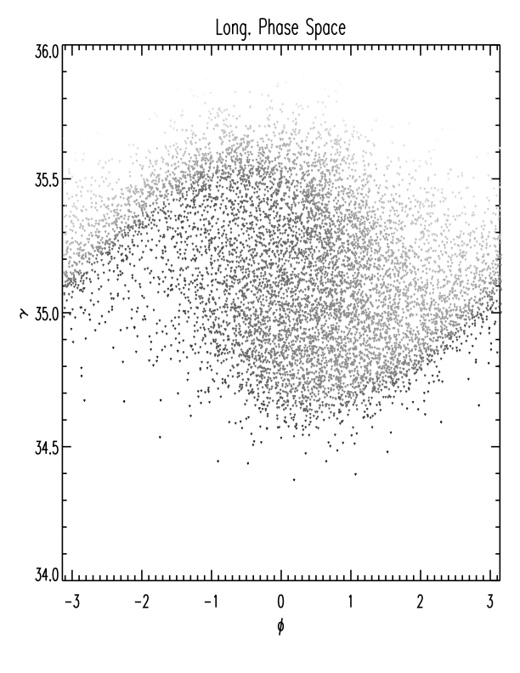
Electron Beam Requirements: Energy Spread
Only electrons within the FEL bandwidth can contribute to FEL gain.
FEL process is a quarter rotation in the separatrix of the FEL. If separatrix is filled homogeneously, no bunching and thus coherent emission can be achieved.
Small spread
Large spread
Strong Bunching
Weak Bunching
Energy Spread Constraint:

Slide 35
3D Effects - Emittance
The effective “emittance” for the fundamental mode of the radiation field is λ/4π.
The effective phase space ellipse should enclose all electrons, allowing them to radiate coherently into the fundamental mode.
Electrons, outside the ellipse, are emitting into higher modes and do not contribute to the amplification of the fundamental mode.
x’
x

Slide 36
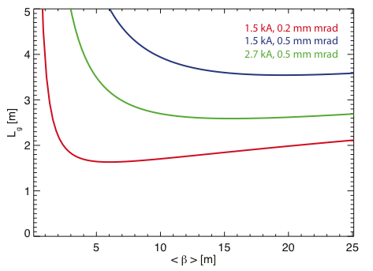
Optimizing the Focusing
Decreasing the β-function (increase focusing), increases the FEL parameter ρ.
Stronger focusing:
  Larger kinetic energy of betatron oscillation
  Less kinetic energy for longitudinal motion
  Smearing out of growing bunching
From 1D Theory:
3D Optimization for SwissFEL

Slide 37
IV. FEL driver accelerators

Slide 38
Linac-based FELs
FEL performance is determined by the electron beam: the peak current, the size, the energy spread and the emittance, i.e. the electron charge density in 6D.
The X-ray FEL requirements on the electron beam quality are so demanding that only linear accelerators can be used to provide the drive beam.
High energy, low emittance and high peak current beams are required in the undulators, but not available at feasible electron sources.
Typically long electron beams with low energy, small emittance and energy spread are produced, and then accelerated and compressed later. Compression should not dilute emittance too much (i.e. space-charge forces).

Slide 39
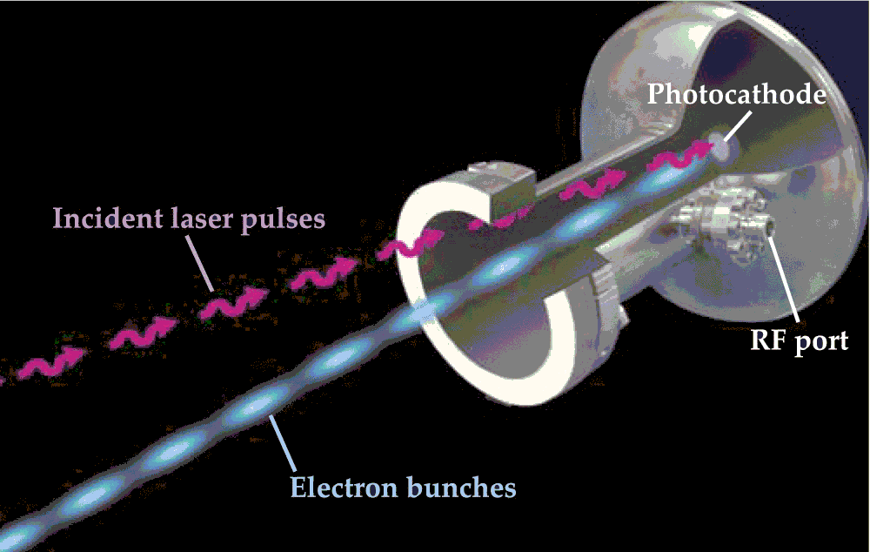
Electron sources
RF photo-injectors are normally used to generate high-brightness electron beams
Electrons are produced via the photo-electric effect by a laser of a proper wavelength impinging on a photocathode mounted inside an RF gun.
Final energy of the electrons is of few-several MeV
Other (less bright) alternatives: thermionic or DC guns
Emittance of the source is determined by: intrinsic emittance of the cathode, space-charge and RF effects.
Emittance goals:
Optimize the source emittance
Preserve emittance along the linac
C. Hernandez-Garcia, P. G. O' Shea, and M. L. Stutzman, Phys. Today 61(2), 44 (2008).
RF photo-injector

Slide 40
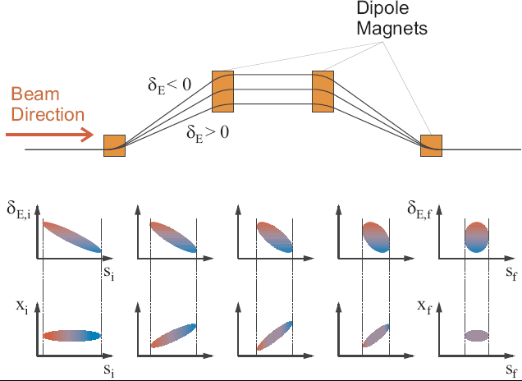
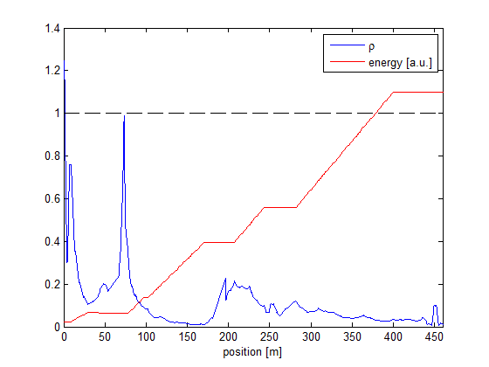
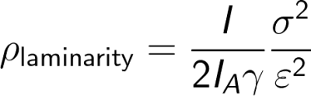
Bunch compression
Bunch compression principle
Energy chirp generation in rf structures
Transport through magnetic chicanes
Where to compress?
Early compression would lead to high charge density beams at low energies which would increase the emittance.
Late compression would require the transport of long bunches trough the linac without emitance dilution, which is difficult (RF-curvature, wake fields, …)
Multi-stage-compression: 2 stages in case of LCLS, FLASH, and SwissFEL
BC1
BC2

Slide 41
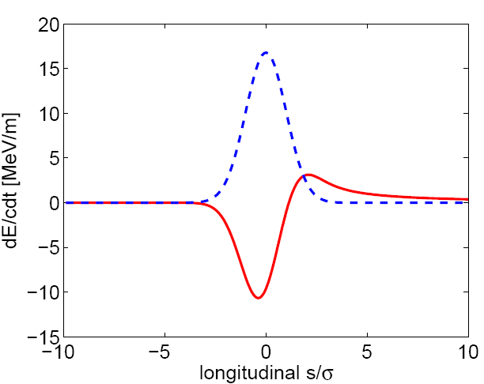
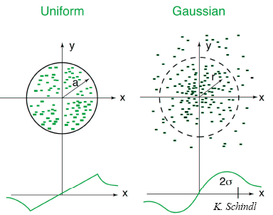
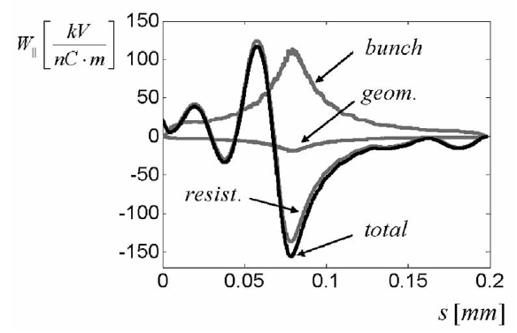
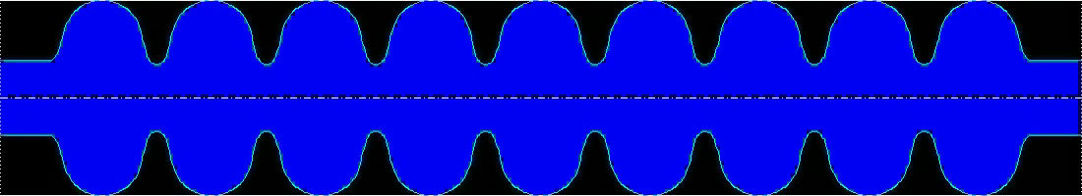
Self Interactions
High charge densities give rise to strong electro-magnetic fields generated by the electron bunches. Electrons within the bunch experience these fields.
Coherent Synchrotron Radiation
Space Charge fields
Wake fields
tail
head
tail
head

Slide 42
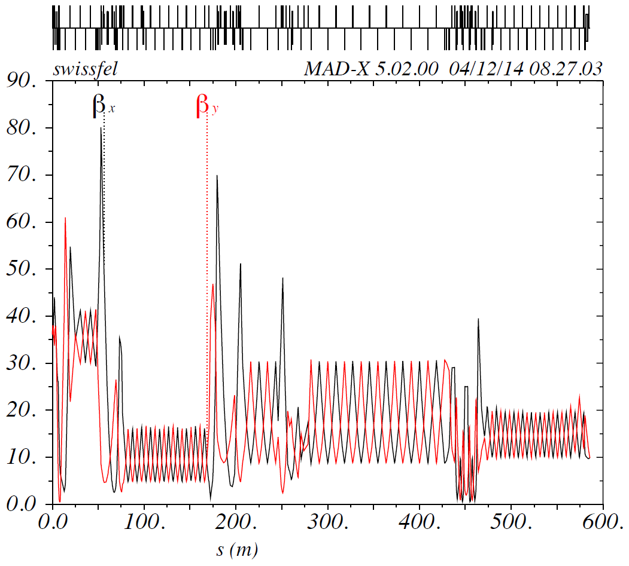
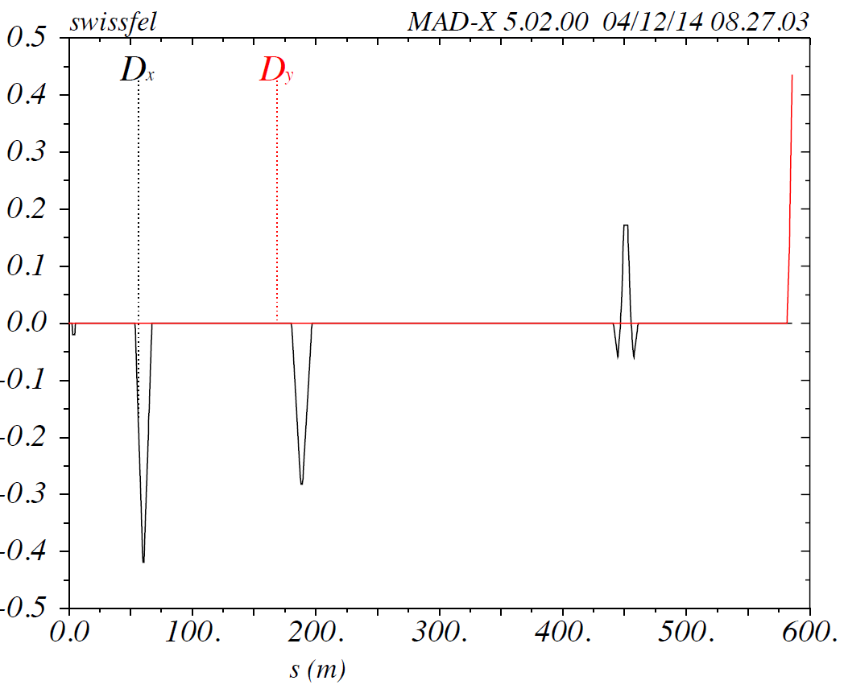
Electron beam optics
Optics design has to consider:
Maximum/minimum beam size
Chromaticity
Sensitivity to quadrupole field errors
CSR in bunch compressors
Diagnostics: TDC measurements, emittance measurements
Optimum beta-function in the undulator
…
Example for SwissFEL
β-function along the beamline
Example for SwissFEL
Dispersion along the beamline

Slide 43
Requirements of an FEL / Diagnostics
Diagnostics are required to characterize, setup and optimize the electron beam
Requirement
Implementation
Measurement/Verification
Electrons
Laser electron gun
(photocathode + RF cavity)
e.g. Wall current monitor
Focusing (optics)
Quadrupole magnets
Screen monitor
Localization (orbit)
Steering magnets (dipoles)
Beam position monitor (BPM)
Energy
Radiofrequency cavities
(3 GHz = S-band)
Spectrometer
(Dipole magnet)
Peak current
Laser pulse shape
Magnetic chicane
(bunch compressor)
Beam profile measurement
with RF deflector and
screen monitor
Beam size / emittance
Design electron gun
“emittance compensation”
“Pepperpot”/slits
(low energies)
Beam optical methods
(higher energies)

Slide 44
V. FEL projects around the world

Slide 45

X-ray FEL Projects Around the World
FLASH: first soft X-ray with high repetition rate (MHz), 2007
LCLS: first hard X-ray, 2009
SACLA: compact hard X-ray, 2011
FERMI: first soft X-ray seeded-FEL, 2013
PAL-XFEL: hard X-ray with low (20 fs) timing jitter, 2016
E-XFEL: hard X-ray with high repetition rate, 2017
SwissFEL: compact hard X-ray driven by low emittance beam, 2017
Future facilities: LCLS2 and SHINE (high repetition rate)
FLASH
FERMI
E-XFEL
PAL
XFEL
LCLS
SwissFEL
SACLA
LCLS-II
SHINE

Slide 46
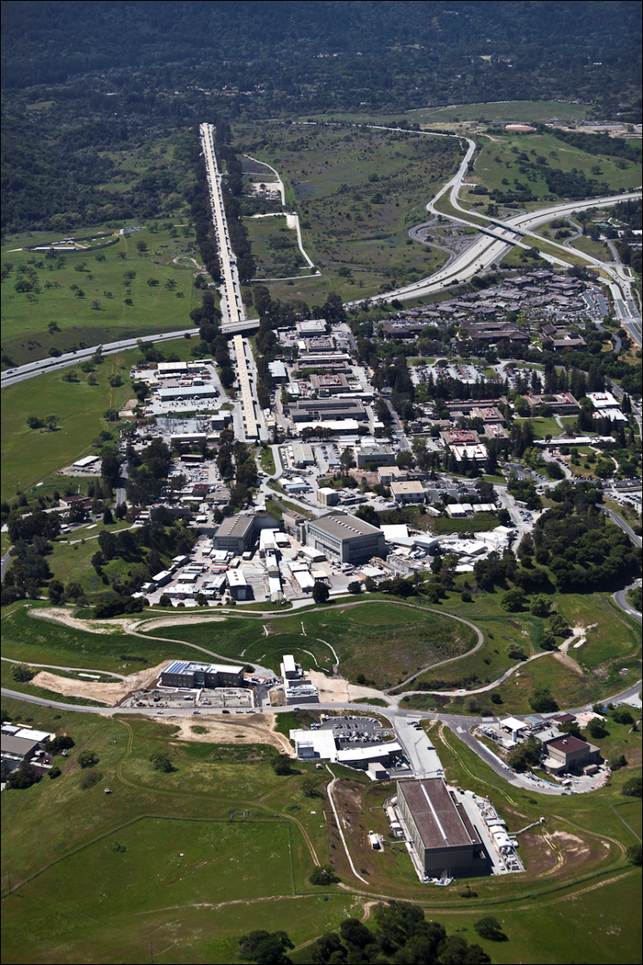
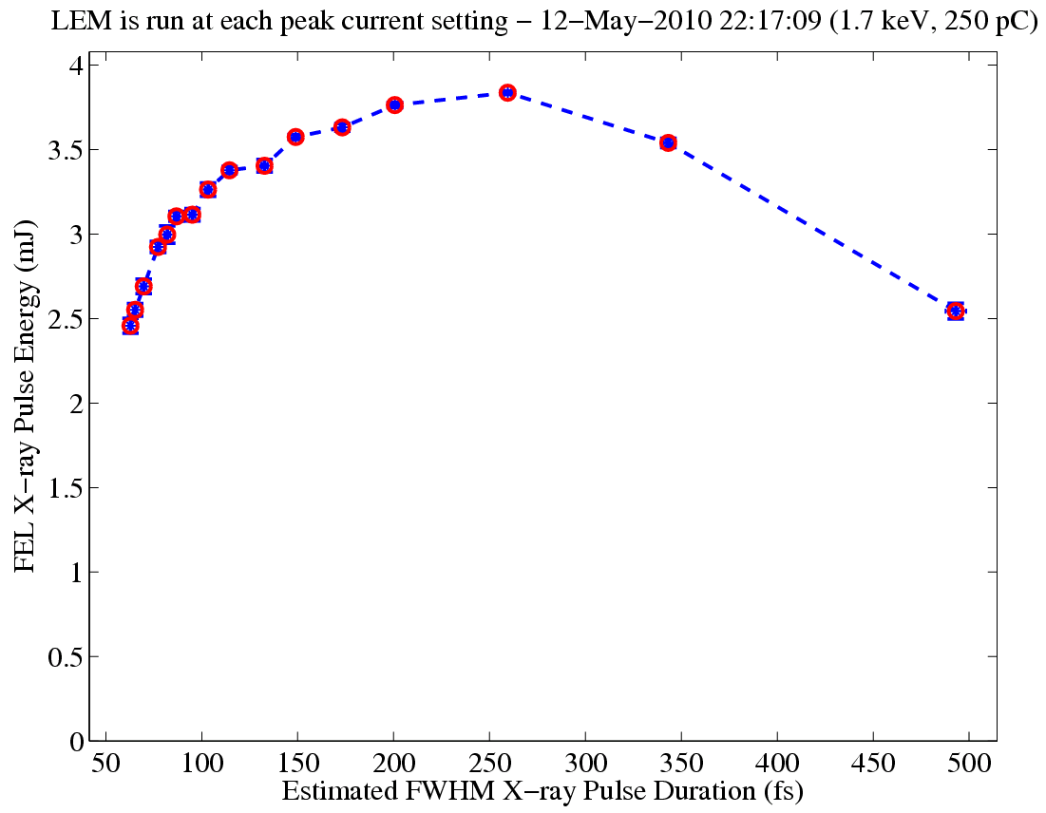
LCLS (Linac Coherent Light Source)
Electron energy = 3 - 15 GeV
Photon energy = 0.3 - 11 keV
X-ray pulse length = 5 - 500 fsec
Bandwidth = 0.005 - 2 %
Repetition rate = ≤ 120 Hz
Machine length ≈ 2 km
Last 1/3 of SLAC Linac
can vary pulse length
60 – 500 fs
and hold pulse energy
> 2.5 mJ
< 10 fs also available
FEL X-ray Pulse Energy (mJ)
Estimated FWHM Pulse Duration (fs)
Courtesy of P. Emma

Slide 47
LCLS Layout
RF electron gun
Two bunch compressors
Laser heater system
S-band linac (2.856 GHz) to 14 GeV
RF harmonic linearizer (11.424 GHz)
Permanent magnet undulator
6 MeV
σ_{z} ≈ 0.83 mm
σ_{δ} ≈ 0.05 %
135 MeV
σ_{z} ≈ 0.83 mm
σ_{δ} ≈ 0.10 %
250 MeV
σ_{z} ≈ 0.19 mm
σ_{δ} ≈ 1.6 %
4.30 GeV
σ_{z} ≈ 0.022 mm
σ_{δ} ≈ 0.71 %
13.6 GeV
σ_{z} ≈ 0.022 mm
σ_{δ} ≈ 0.01 %
Linac-0
L =6 m
Linac-X
L =0.6 m
ϕ_{rf}= −160°
rf
gun
L0-a,b
Linac-1
L ≈9 m
ϕ_{rf} ≈ −25°
Linac-2
L ≈330 m
ϕ_{rf} ≈ −41°
Linac-3
L ≈550 m
ϕ_{rf} ≈ 0°
...existing
linac
21-3b
24-6d
25-1a
30-8c
21-1
b,c,d
undulator
L =130 m
X
BC1
L ≈6 m
R₅₆≈ −39 mm
BC2
L ≈22 m
R₅₆≈ −25 mm
undulator
DL1
L ≈12 m
R₅₆ ≈0
DL2
L =275 m
R₅₆ ≈ 0
Courtesy of P. Emma
SLAC linac tunnel (1.6 km long)
research yard

Slide 48
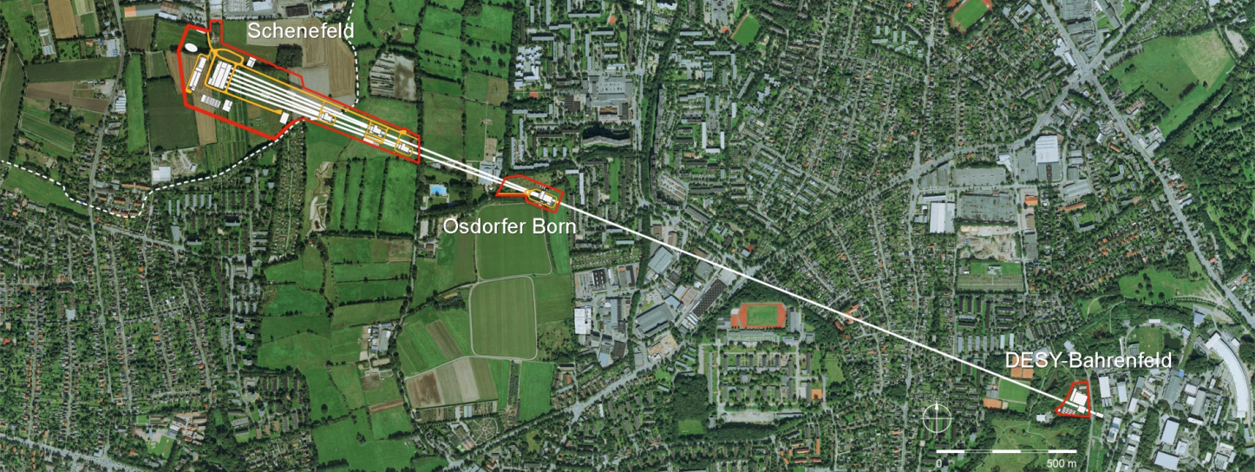
European-XFEL
17.5 GeV superconducting linac, almost 1 MW beam power
27000 pulses per second in 10 Hz burst mode
Three moveable gap undulators for hard and soft X-rays (0.25 to 25 keV)
Initially 6 equipped experiments
Total length around 3 km
Commissioning started in December 2015 / First FEL light in 2017
Experimental Hall
Photon Beam Lines
Beam Dumps
Electron Beam
Undulators
Distribution
Collimation
Linear Accelerator
Bunch
Compressors
Injector
Courtesy of W. Decking

Slide 49
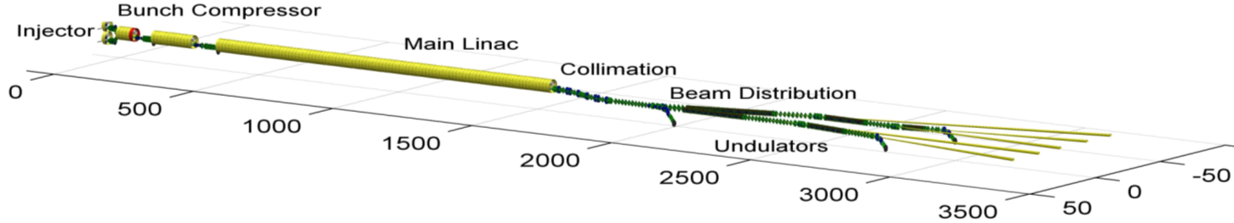
European-XFEL Layout
Courtesy of W. Decking
Quantity | Value
pulse repetition rate | 10 Hz
beam pulse length | 600 μs
bunch repetition frequency within pulse | 4.5 MHz
electron bunch length after compression | 2 – 180 fs (FWHM)
bunch charge | 0.02 – 1 nC
slice emittance | 0.4 - 1.0 mm mrad
slice energy spread | 4 – 2 MeV

Slide 50
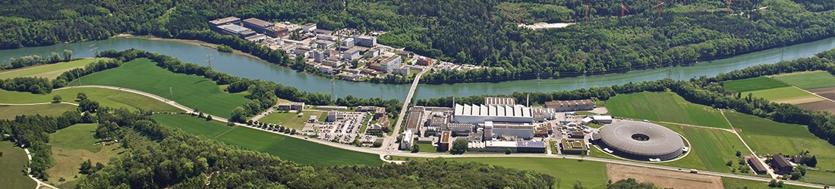
SwissFEL
Compact XFEL with 700 m length
X-ray FEL project in Switzerland (Villigen) with 2 beamlines
  Aramis (hard X-ray)
  Athos (soft X-ray)
Compact (~700 m) and cost-effective facility driven by electron beam with low energy (6 GeV) and ultra-low emittance.
Budget ~300 MCHF
First ideas more than 10 years ago.
Construction started in 2013.
Commissioning started in 2016.
2018: pilot experiments in Aramis. 2019: first user experiments.
Athos: first FEL light by end of 2019, first users from 2021.

Slide 51
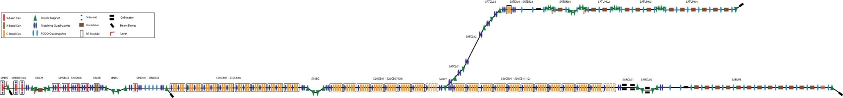
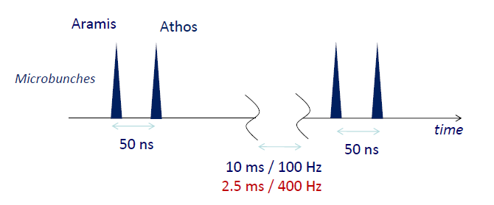
SwissFEL Layout
Total length: 715 m
Athos
2.4– 3.4 GeV
Rf gun
BC 1
3 GeV
BC 2
Collimator
Up to 5.8GeV
Injector
450 MeV
Linac 1
Linac 2
Linac 3
Aramis
2.1 GeV
Wavelength | 1 Å ‐ 70 Å
Pulse duration | 1 – 20 fs
e⁻ Energy | 5.8 GeV
e⁻ Bunch charge | 10 – 200 pC
Repetition rate | 100 Hz
Electron source
RF gun with laser driven Cu‐photocathode
RF structures
Gun and Injector: S-band
Linac: C-band
X-band for phase-space linearization
Undulator beamlines:
1. Aramis: hard X‐ray FEL (1‐7 Å)
Undulators with variable gap, period = 15mm
2. Athos: soft X‐ray FEL (7‐70 Å)
Undulators with variable gap , period = 40mm
Time structure
28 ns
28 ns
2 bunch operation: serve 2 undulator lines simultaneously at full repetition rate

Slide 52
References

Slide 53
References
Z. Huang and K. J. Kim, “Review of X-ray Free-Electron Laser Theory”. Physical Review Special Topics – Accelerator and Beams 10, 0.4801/1-034801/38, 2007.
K. J. Kim, Z. Huang, and R. Lindberg, Synchrotron Radiation and Free-Electron Lasers. Cambridge University Press, 2017.
C. Pellegrini, A. Marinelli, and S. Reiche, “The physics of x-ray free-electron lasers”. Reviews of Modern Physics 88, 015006, 2016.
E. L. Saldin, E. A. Schneidmiller and M. V. Yurkov, The Physics of Free-Electron Lasers. Springer, 1999.
P. Schmüser, M. Dohlus and J. Rossbach, Ultraviolet and Soft X-Ray Free-Electron Lasers. Introduction to Physical Principles, Experimental Results, Technological Challenges. Springer, 2009.
P. Willmott, An Introduction to Synchrotron Radiation. Techniques and Applications. Wiley, 2019.

