Slide 1
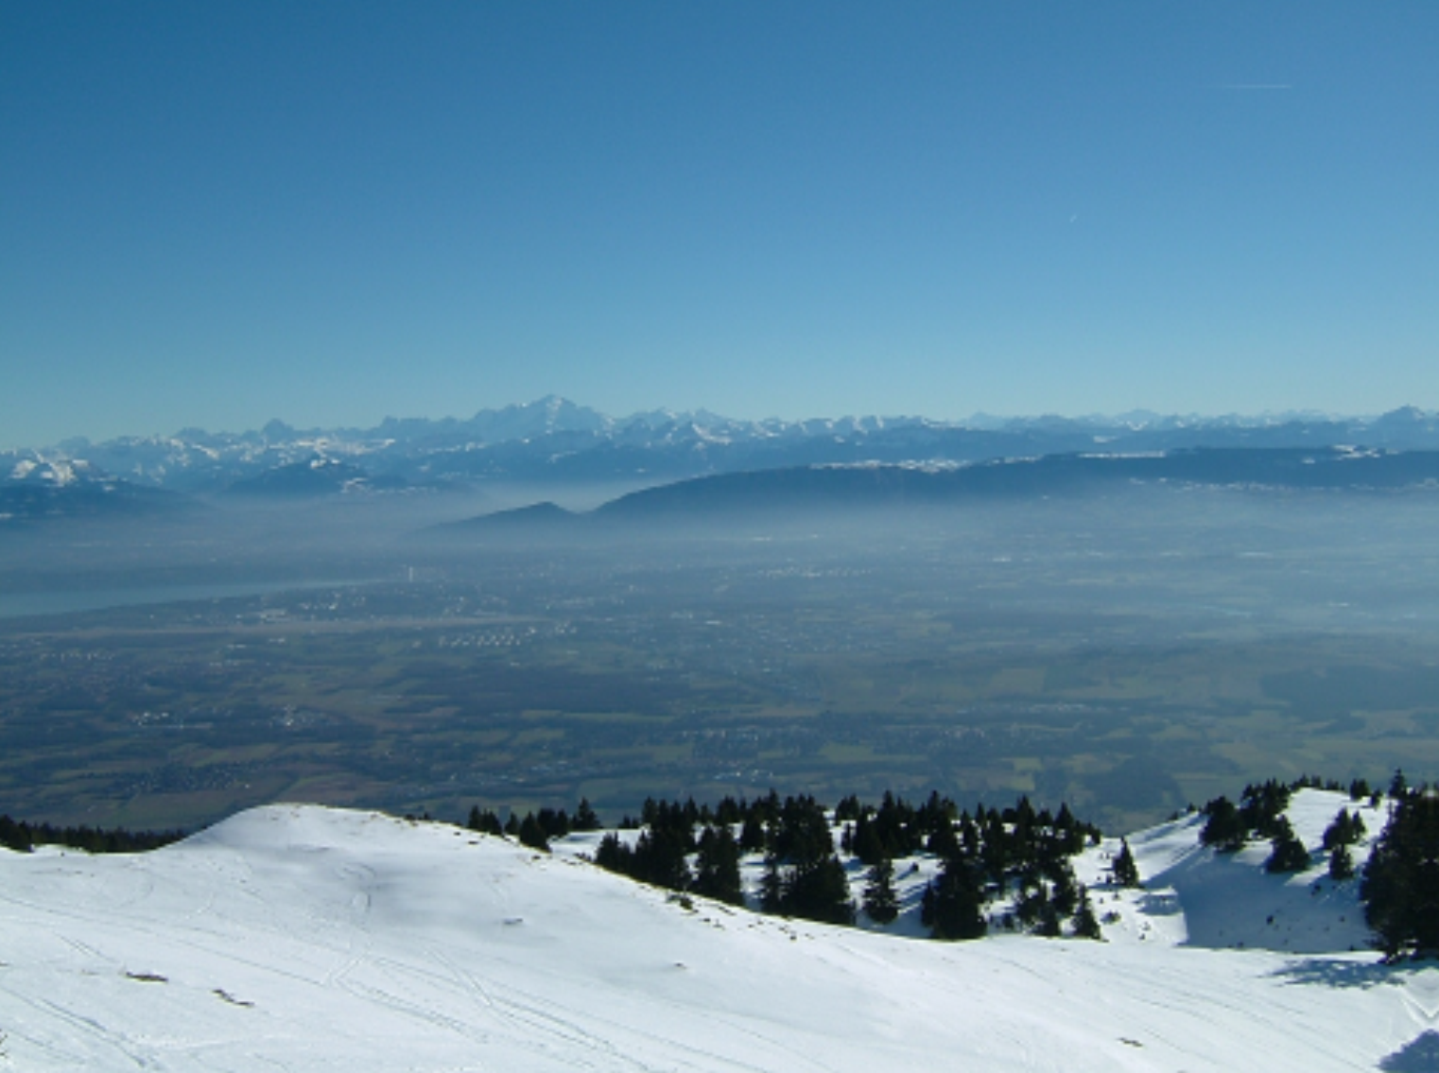
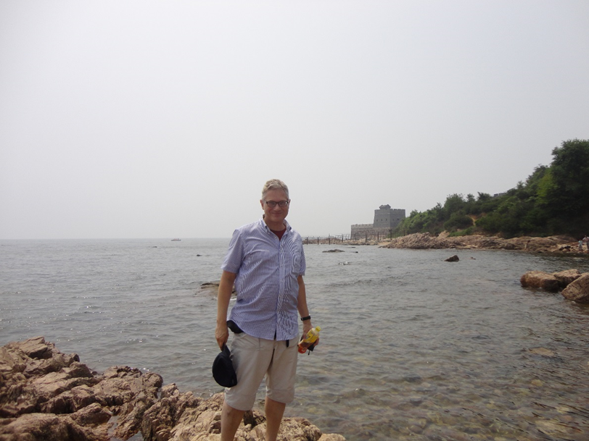


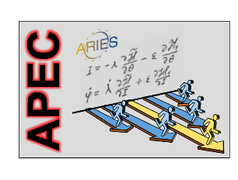
e⁺e⁻ Circular Colliders
Geneva
Frank Zimmermann
CERN, BE Department
JUAS, 28 January 2021
Qinhuangdao
Work supported by the European Commission under Capacities 7th Framework Programme, Grant Agreement 312453

Slide 2
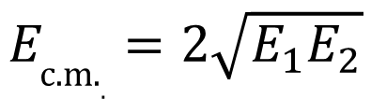
why colliders ? - energy
colliders were invented (1943) and patented (1953) by Rolf Wideröe
centre-of-mass energy:
beam hits
a “fixed target”
two equal
beams collide
colliding two beams against each other can provide
much higher centre-of-mass energies than fixed target!
$$E_{\text{c}\text{.}\text{m}\text{.}.}=2\sqrt{E_{1}E_{2}}$$
for two high-energy beams
of unequal energy

Slide 3
colliders constructed and operated
A. Ballarino
Colliders with
superconducting RF system
Colliders with
superconducting arc magnet system
Colliders with
superconducting magnet & RF
advances by new technologies and new materials
Notes:
New slide from Davide.
Showing that conductor development is launched at international level, Russia, Japan, (Korea and Europe in preparation)
Underline importance of that development as main cost driver for the hadron collider machine.

Slide 4

colliders and discoveries
Standard Model
Particles and forces
A. Ballarino
powerful instruments for discovery and precision measurement
Notes:
New slide from Davide.
Showing that conductor development is launched at international level, Russia, Japan, (Korea and Europe in preparation)
Underline importance of that development as main cost driver for the hadron collider machine.

Slide 5
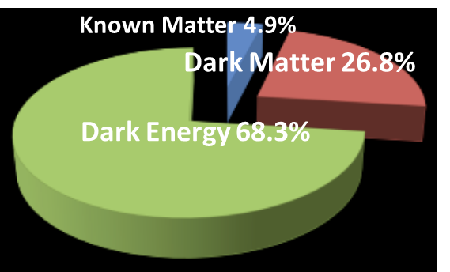
still many open questions
    Known matter is only 5% of universe!
    what is dark matter?
    what is dark energy?
    why more matter than antimatter?
    what about gravity?
F. Gianotti
also QCD,
quark-gluon plasma,
proton spin, etc.
Notes:
New slide from Davide.
Showing that conductor development is launched at international level, Russia, Japan, (Korea and Europe in preparation)
Underline importance of that development as main cost driver for the hadron collider machine.

Slide 6
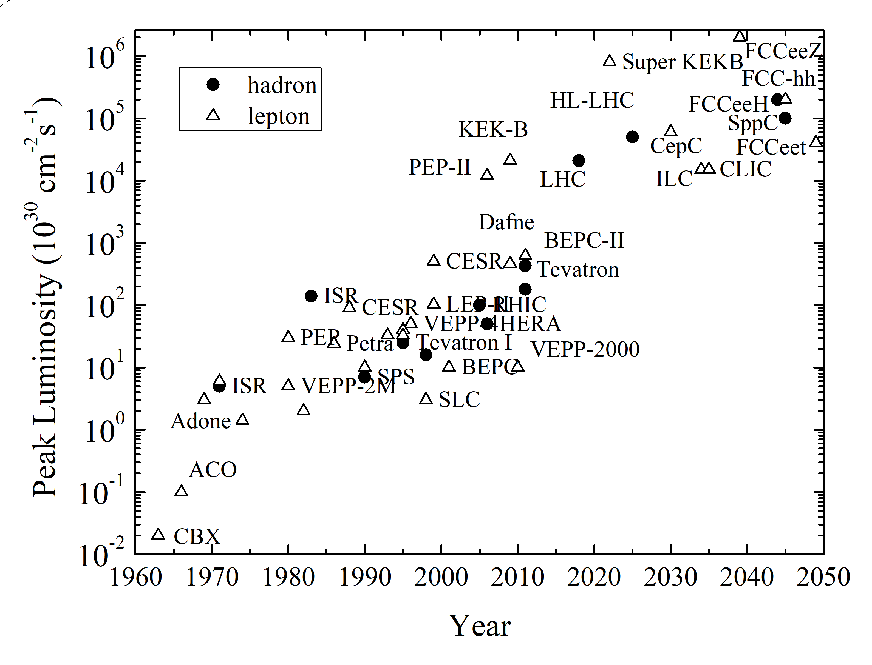
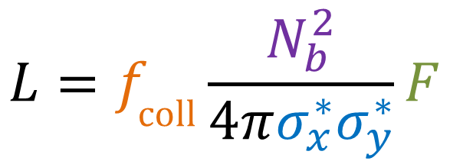
collider figure of merit: luminosity
R= σ L
tends to
decrease
as energy⁻²
luminosity
reaction rate
cross section
geometric factor
(crossing angle,
hour glass, pinch, …)
V. Shiltsev & F.Z., arXiv:2003.09084, submitted to RMP
bunch
population
$$L=f_{\text{coll}}\frac{N_{b}^{2}}{4πσ_{x}^{∗}σ_{y}^{∗}}F$$
bunch
collision
rate
horizontal & vertical
rms beam size
at collision point
peak luminosity increased by almost
7 orders of magnitude over 60 years

Slide 7
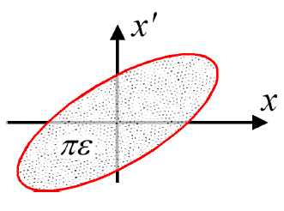
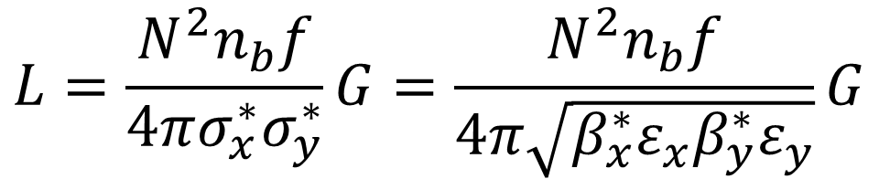
Luminosity
various limitations:
beam current (power)
beambeam tune shift
beamstrahlung….
$$L=\frac{N^{2}n_{b}f}{4πσ_{x}^{∗}σ_{y}^{∗}}G=\frac{N^{2}n_{b}f}{4π\sqrt{β_{x}^{∗}ε_{x}β_{y}^{∗}ε_{y}}}G$$
N | Number of particles per bunch
n_{b} | Number of bunches
f | Revolution frequency
σ* | Beam size at interaction point
G | reduction factor due to crossing angle and “hourglass effect”
ε | Emittance
ε_{n} | Normalized emittance
β* | Beta function at IP
M. Lamont

Slide 8
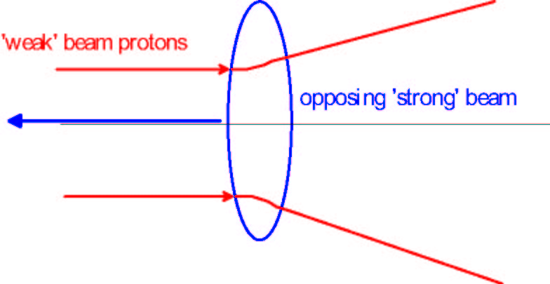
sketch of beam-beam collision
‘weak beam’ particles

Slide 9
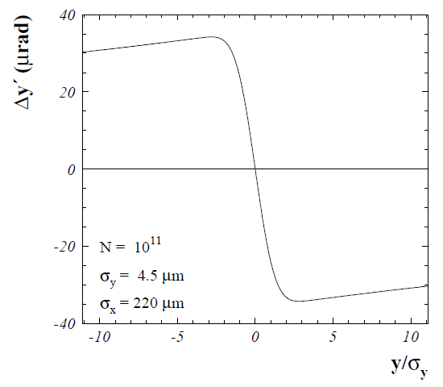
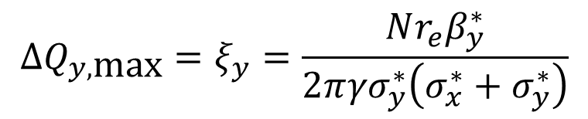
(nonlinear) beam-beam force
center of
opposing
beam
at small amplitude similar to effect of defocusing quadrupole
for pure head-on collision
for single
collision
$$ΔQ_{y,\text{max}}=ξ_{y}=\frac{Nr_{e}β_{y}^{∗}}{2π{γσ}_{y}^{∗}\left(σ_{x}^{∗}+σ_{y}^{∗}\right)}$$

Slide 10
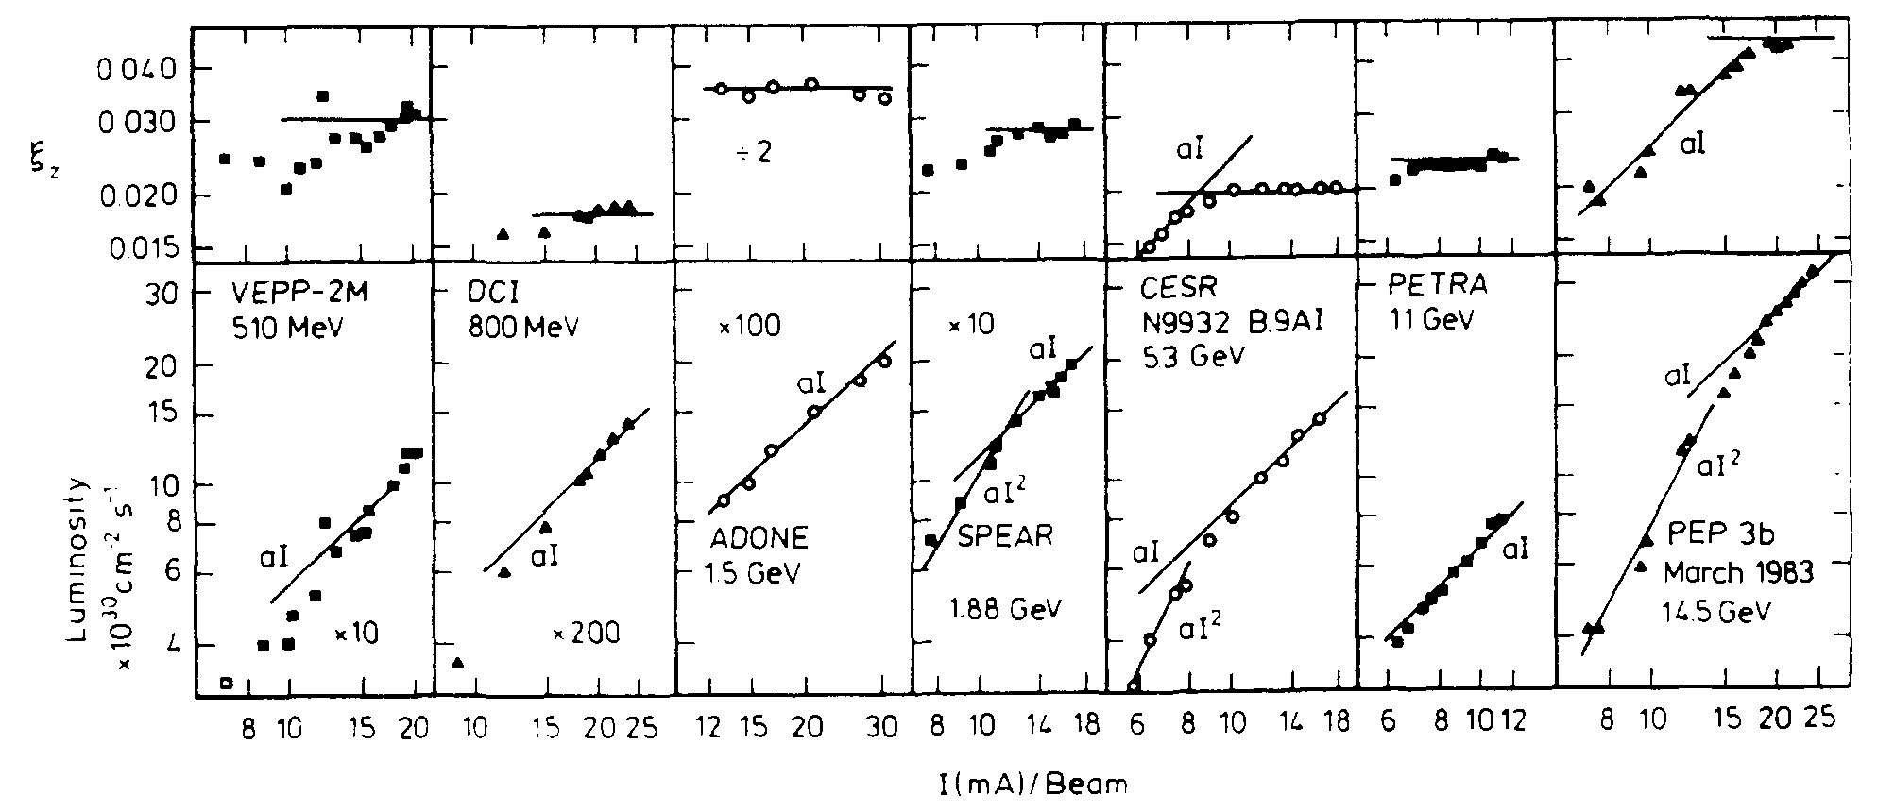
beam-beam limit in e⁺e⁻ colliders
J. Seeman, SLAC-PUB-3825, 1985
luminosity and vertical tune-shift parameter versus beam current for various electron-positron colliders; the tune shift saturates at some current value, above which the luminosity grows linearly

Slide 11
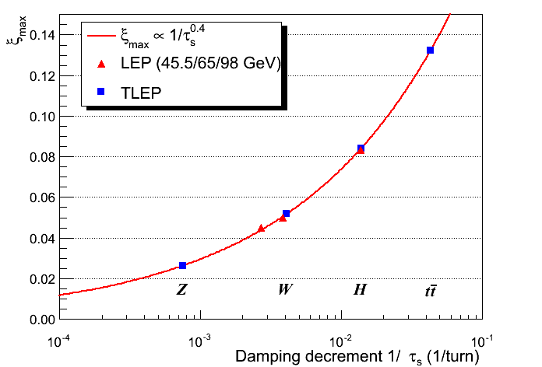
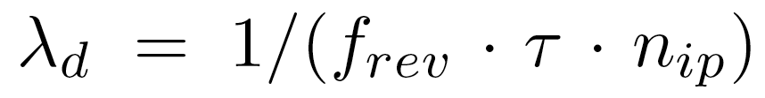
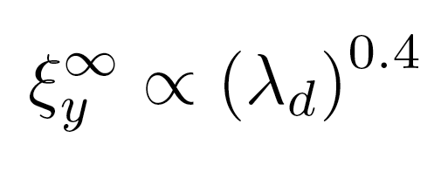

beam-beam limit in e⁺e⁻ colliders with strong radiation damping
R. Assmann,
K. Cornelis
damping decrement per IP
$$∝γ^{1.2}$$

Slide 12
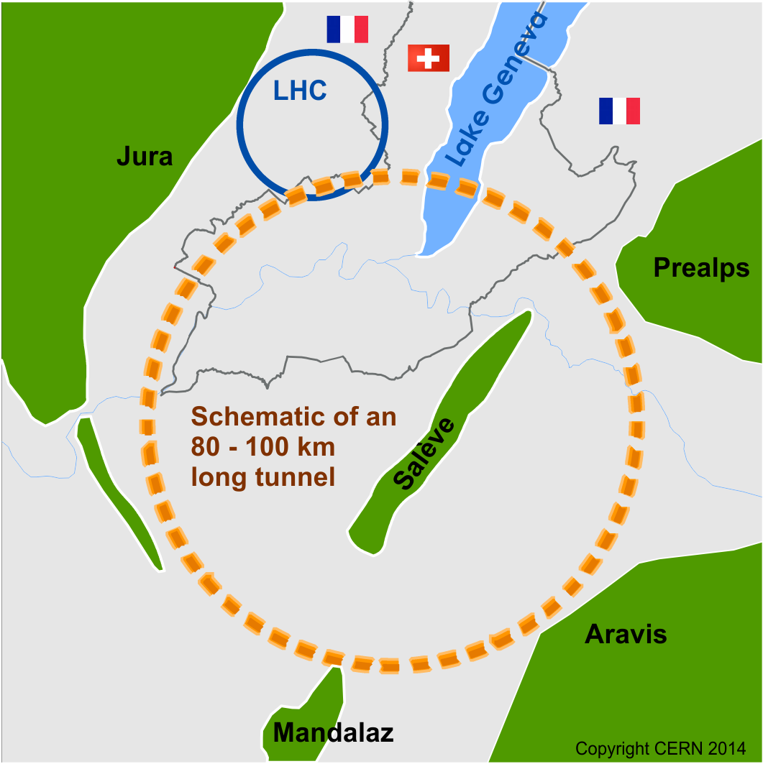
Future Circular Collider Study
launched in 2014
international FCC collaboration (CERN as host lab) to study:
pp-collider (FCC-hh) → defining infrastructure requirements
80-100 km infrastructure in Geneva area
e⁺e⁻ collider (FCC-ee) as a possible first step
p-e (FCC-he) option, HE-LHC …
~16 T ⇒ 100 TeV pp in 100 km

Slide 13
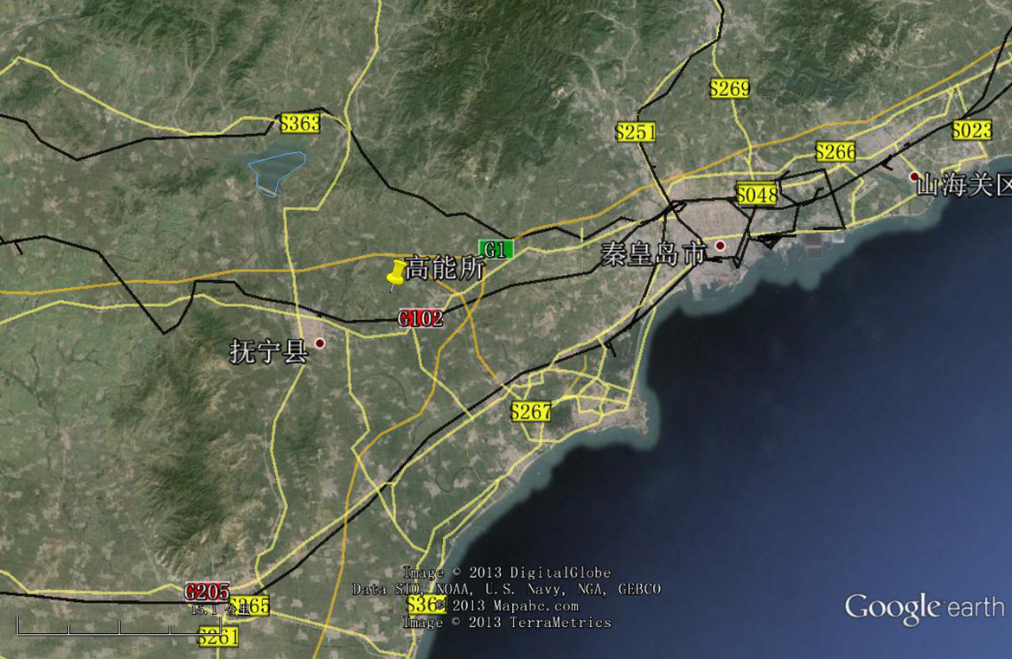
CepC/SppC study (CAS-IHEP), 100 km collider,
one of the proposed sites
Qinhuangdao (秦皇岛）
CepC, SppC
50 km
100 km
easy access
300 km east
from Beijing
3 h by car
1 h by train
“Chinese Toscana”
Yifang Wang

Slide 14

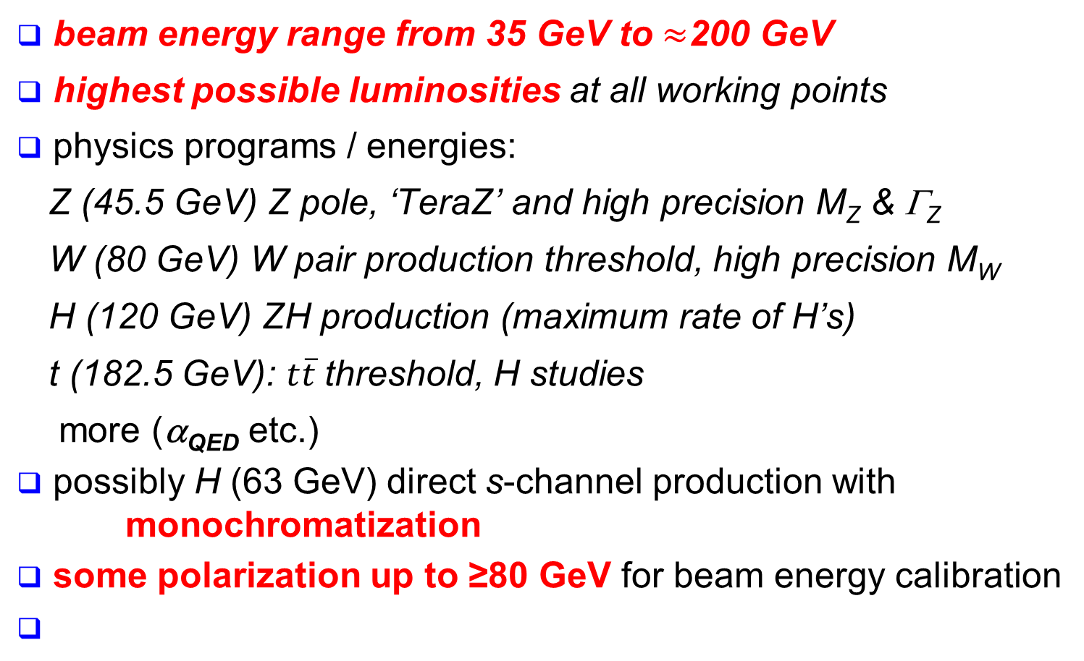
FCC-ee physics requirements
A. Blondel, J. Ellis , C. Grojean, P. Janot, et al.
beam energy range from 35 GeV to $≈$200 GeV
highest possible luminosities at all working points
physics programs / energies:
  Z (45.5 GeV) Z pole, ‘TeraZ’ and high precision M_{Z} & Γ_{Z}
  W (80 GeV) W pair production threshold, high precision M_{W}
  H (120 GeV) ZH production (maximum rate of H’s)
  t (182.5 GeV): $t\overline{t}$threshold, H studies
  more (α_{QED} etc.)
possibly H (63 GeV) direct s-channel production with monochromatization
some polarization up to ≥80 GeV for beam energy calibration

Slide 15
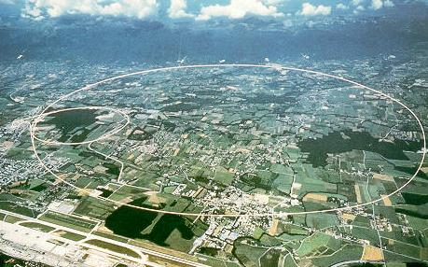
LEP/LEP2: highest energy so far
circumference 27 km
in operation from 1989 to 2000
maximum c.m. energy 209 GeV
maximum synchrotron radiation power 23 MW
LEP energy close to FCC-ee target + record synchrotron radiation with ~MeV photons

Slide 16
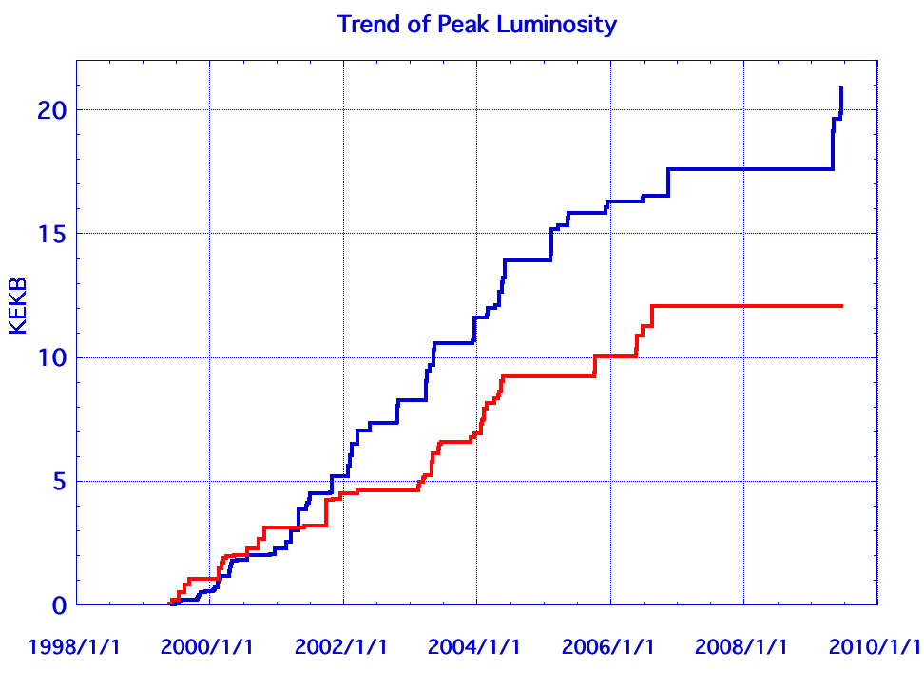
KEKB & PEP-II: high current, high L
performance of high-current high-luminosity e⁺e⁻ factories
conservatively predicted
I_{e+}=1.6 A, I_{e-}=1.2 A
P_{SR} ~ 5 MW
C = 3 km
KEKB
PEP-II
I_{e+}=3.2 A, I_{e-}=2.1 A
KEKB design
P_{SR} ~ 8 MW
C = 2.2 km
PEP-II design
source: KEK

Slide 17
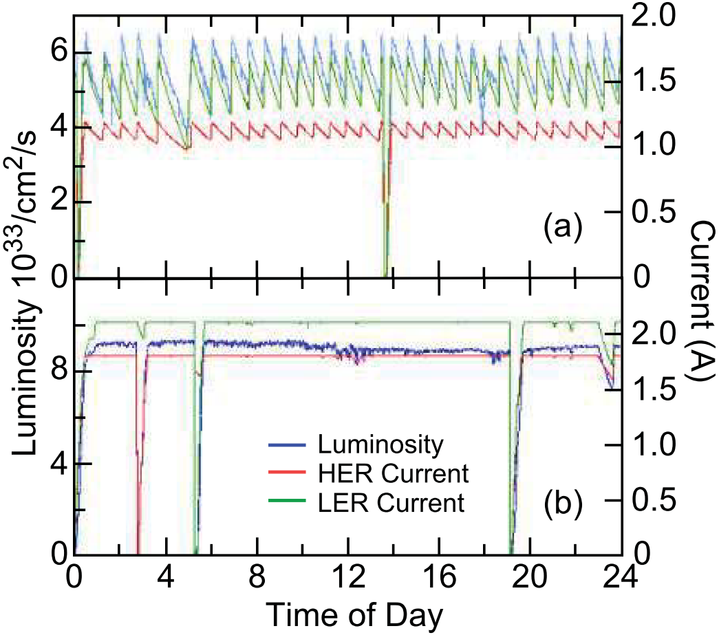
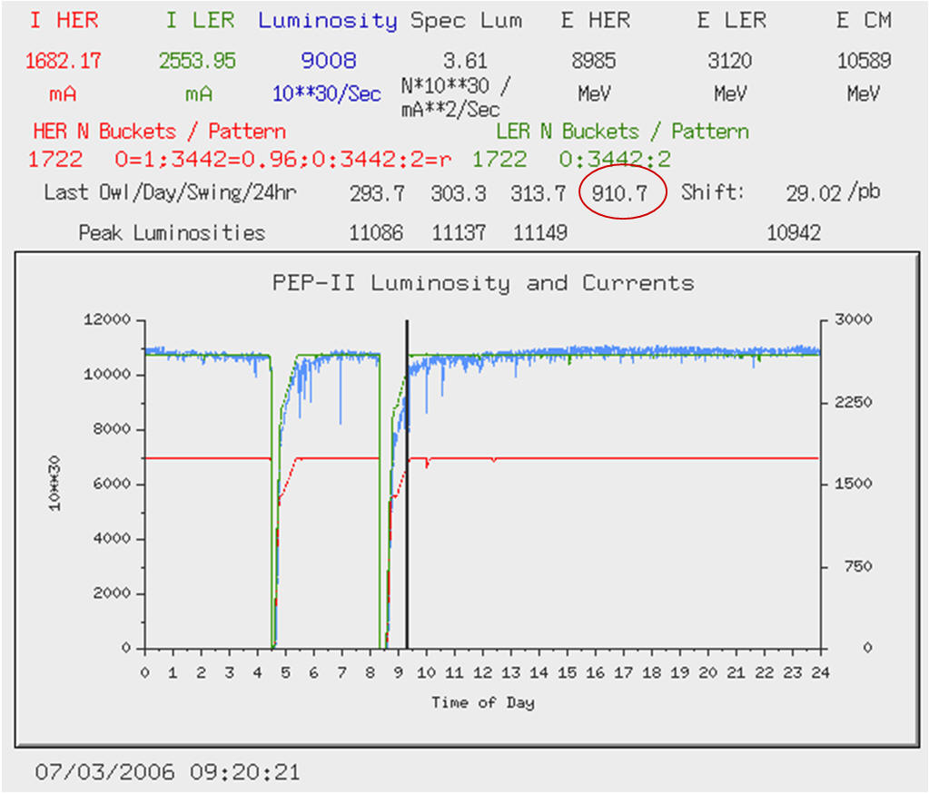
KEKB & PEP-II: top-up injection
first colliders with top-up injection (constant current, no transients, continuous optics tuning,…)
Before Top-Up
After Top-Up
J. Seeman
J. Seeman
average luminosity ≈ peak luminosity
similar results from KEKB

Slide 18
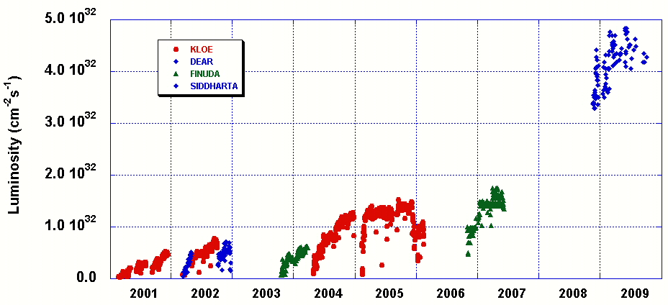
DAΦNE: “crab waist” collisions
DAΦNE Peak Luminosity
Design Goal
CRAB-WAIST Collision Scheme
M. Zobov

Slide 19
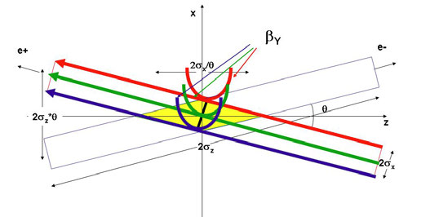
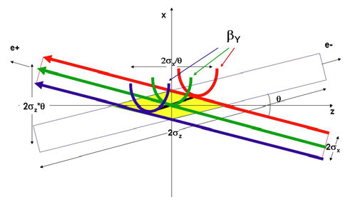
crab-waist crossing for flat beams
regular crossing
P. Raimondi,
et al.
crab waist -
vertical waist position
in s varies with horizontal
position x
allows for small β_{y}* and for small ε_{x,y}
and avoids betatron resonances (→higher beam-beam tune shift)

Slide 20
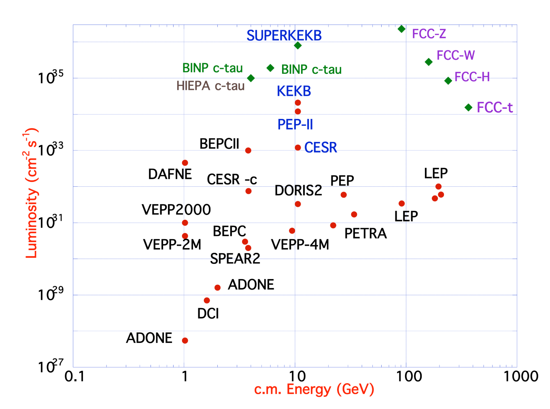
FCC-ee design concept
based on lessons and techniques from past colliders (last 40 years)
B-factories KEKB & PEP-II:
double-ring colliders,
high beam currents,
top-up injection
DAFNE: crab waist, double ring
S-KEKB: low β_{y}*, crab waist
LEP: high energy, SR effects
VEPP-4M, LEP: precision E calibration
KEKB: e⁺ source
HERA, LEP, RHIC: spin gymnastics
Marica Biagini
Marica Biagini
combining successful ingredients of several recent colliders → highest luminosities & energies

Slide 21
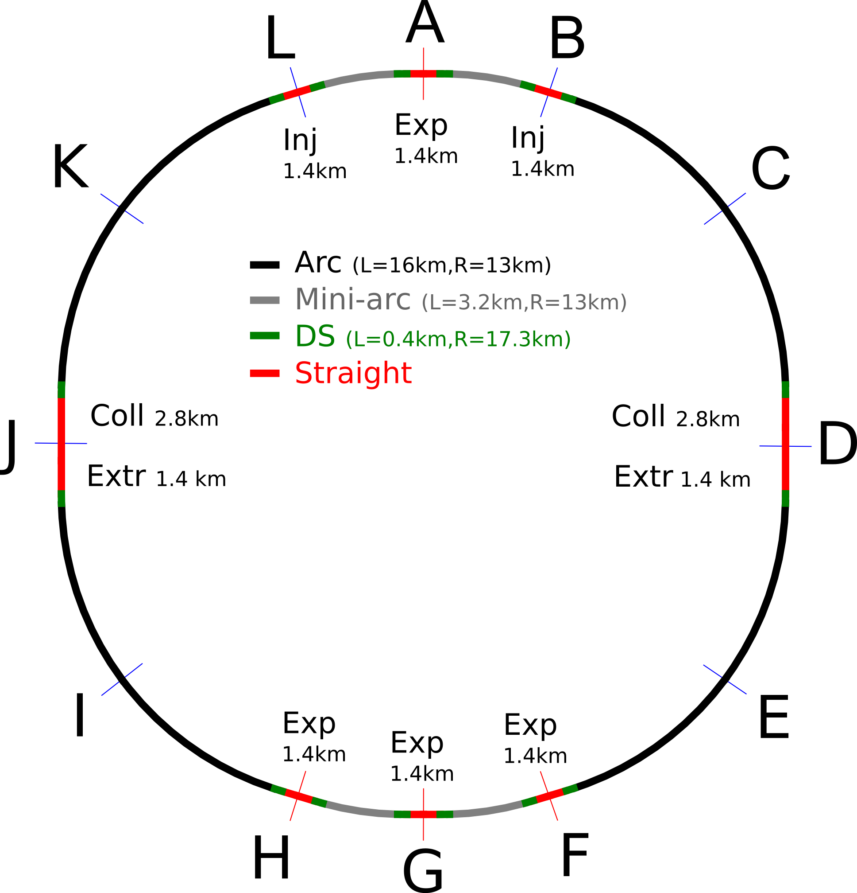
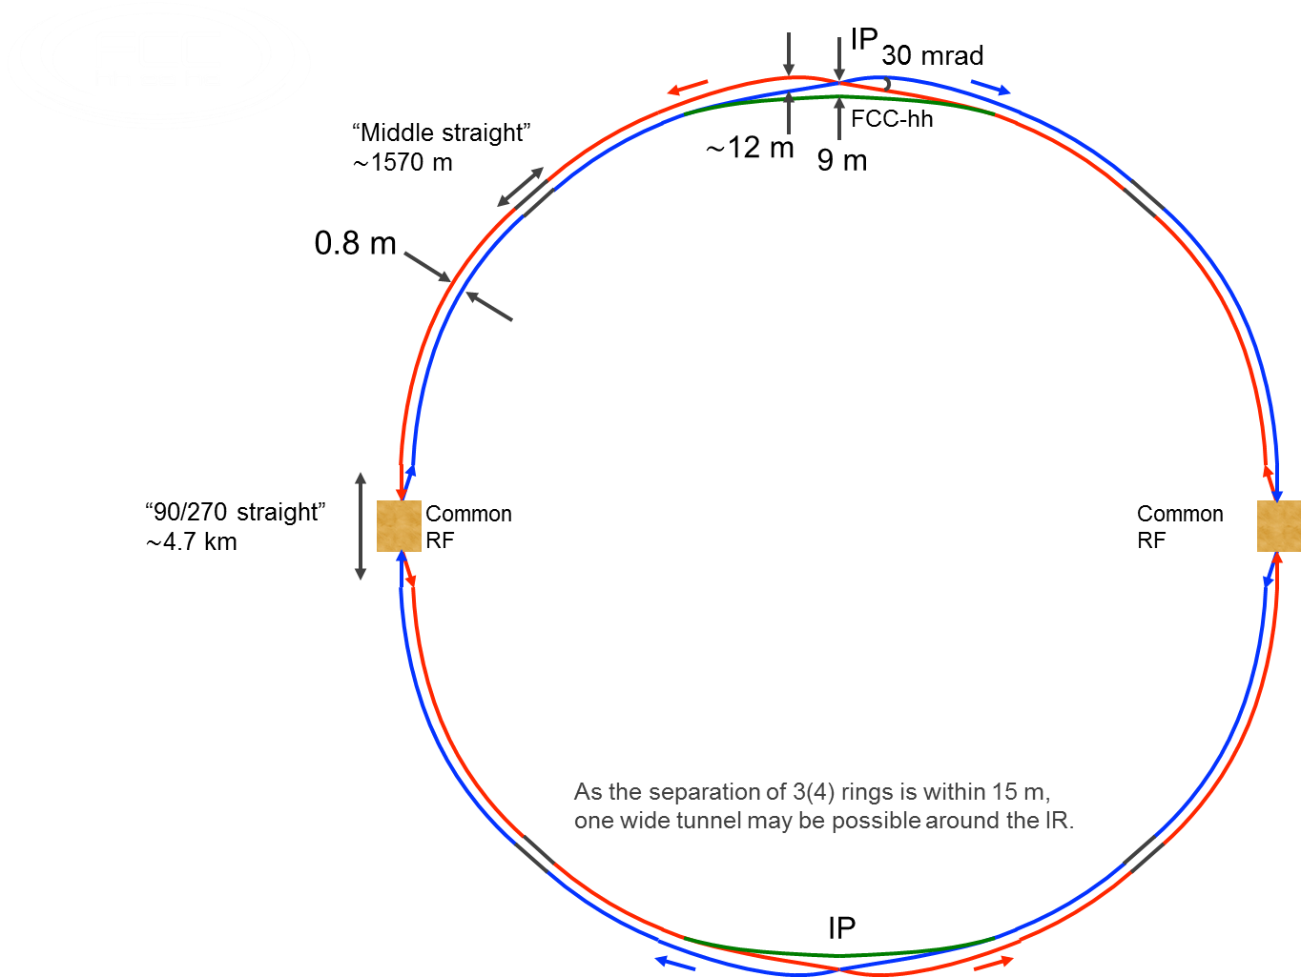
FCC consistent machine layouts
FCC-hh
FCC-ee 1, FCC-ee 2,
FCC-ee booster (FCC-hh footprint)
9 m off-centred IPs
wrt. hh IPs
consistent optics solutions for both machines available

Slide 22
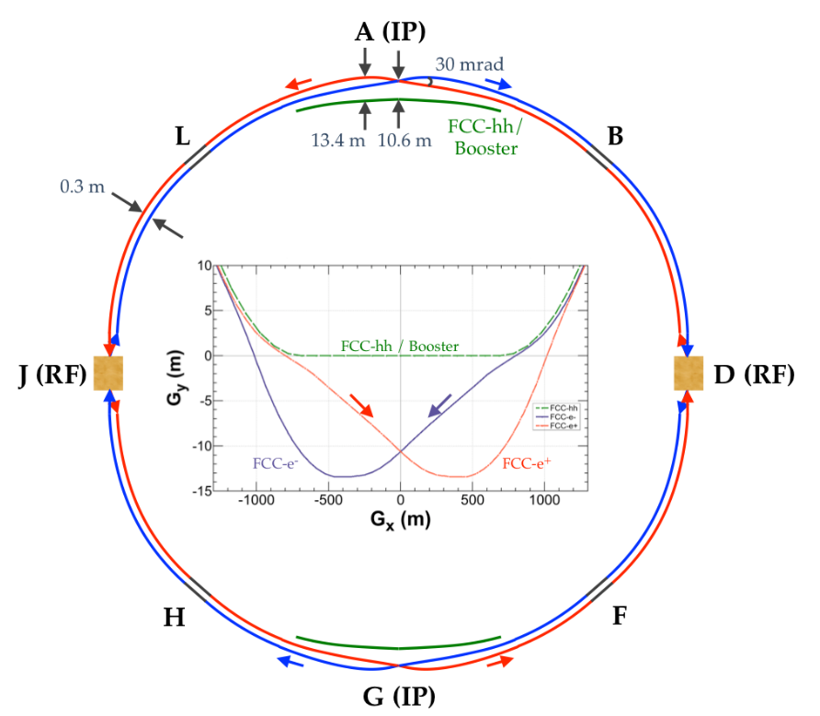
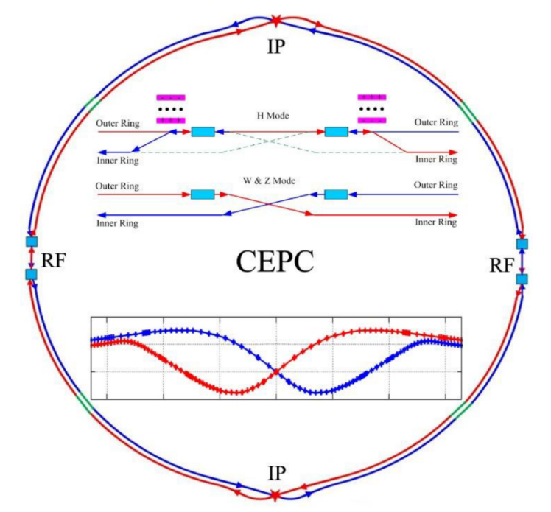
similar solutions for FCC-ee and CEPC
Double ring colliders with full-energy top-up booster ring,
CEPC evolved from initial 54 km - single-ring design, practically to the FCC-ee 100 km design.
2 IPs, 2 RF straights, tapering of arc magnet strengths to match local energy
Asymmetric IR layout to limit SR of incoming beams towards detectors and generate large crossing angle
Common use of RF systems for both beams at highest energy working point (ttbar/ZH for FCC-ee/CEPC)
FCC

Slide 23
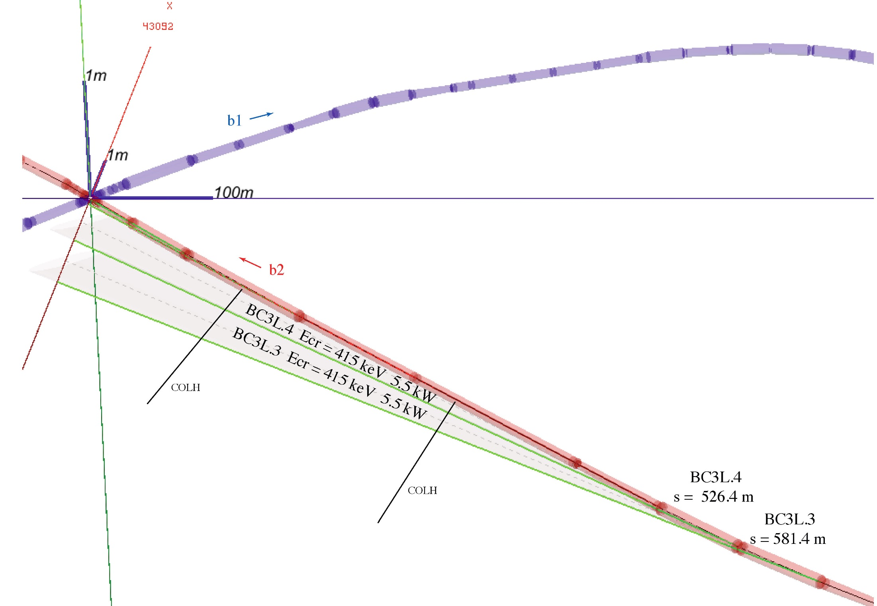
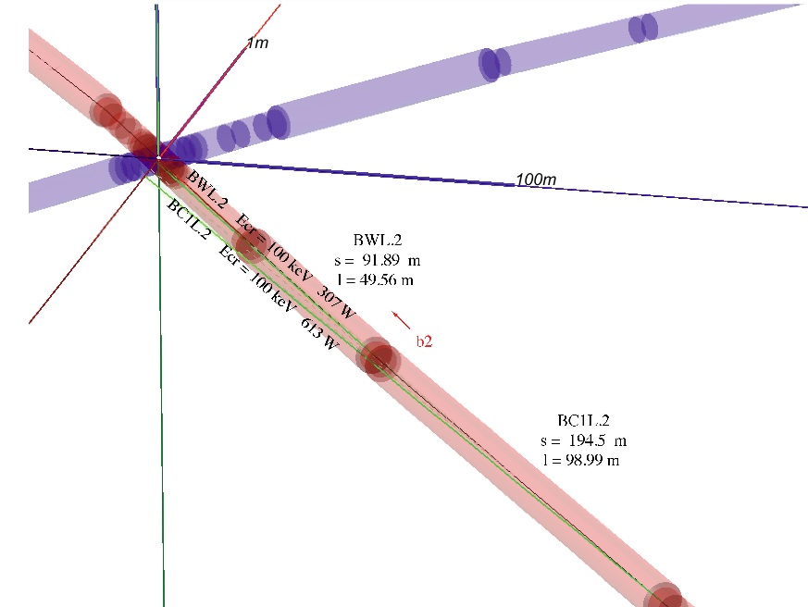
SR fans in the interaction region (IR)
weak bends and asymmetric optics to soften SR photons emitted towards detector
A. Blondel, H. Burkhardt, M. Koratzinos, K. Oide

Slide 24
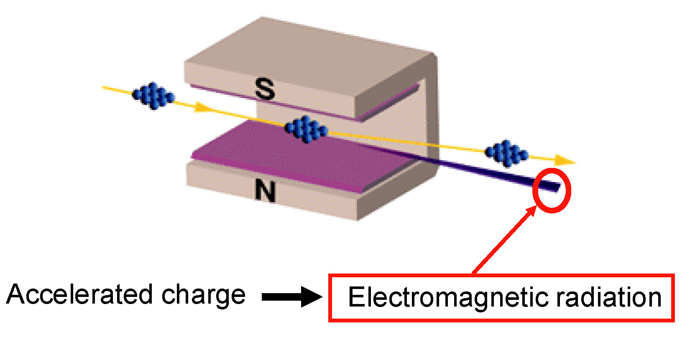
curved orbit of e⁻ in magnetic field
L. Rivkin

Slide 25


final focus chromaticity
δ<0
δ>0
δ=0
$$l^{∗}$$
spot size increase due to (uncorrected) chromaticity,
$$ξ≈\frac{l^{∗}}{β^{∗}}$$

Slide 26
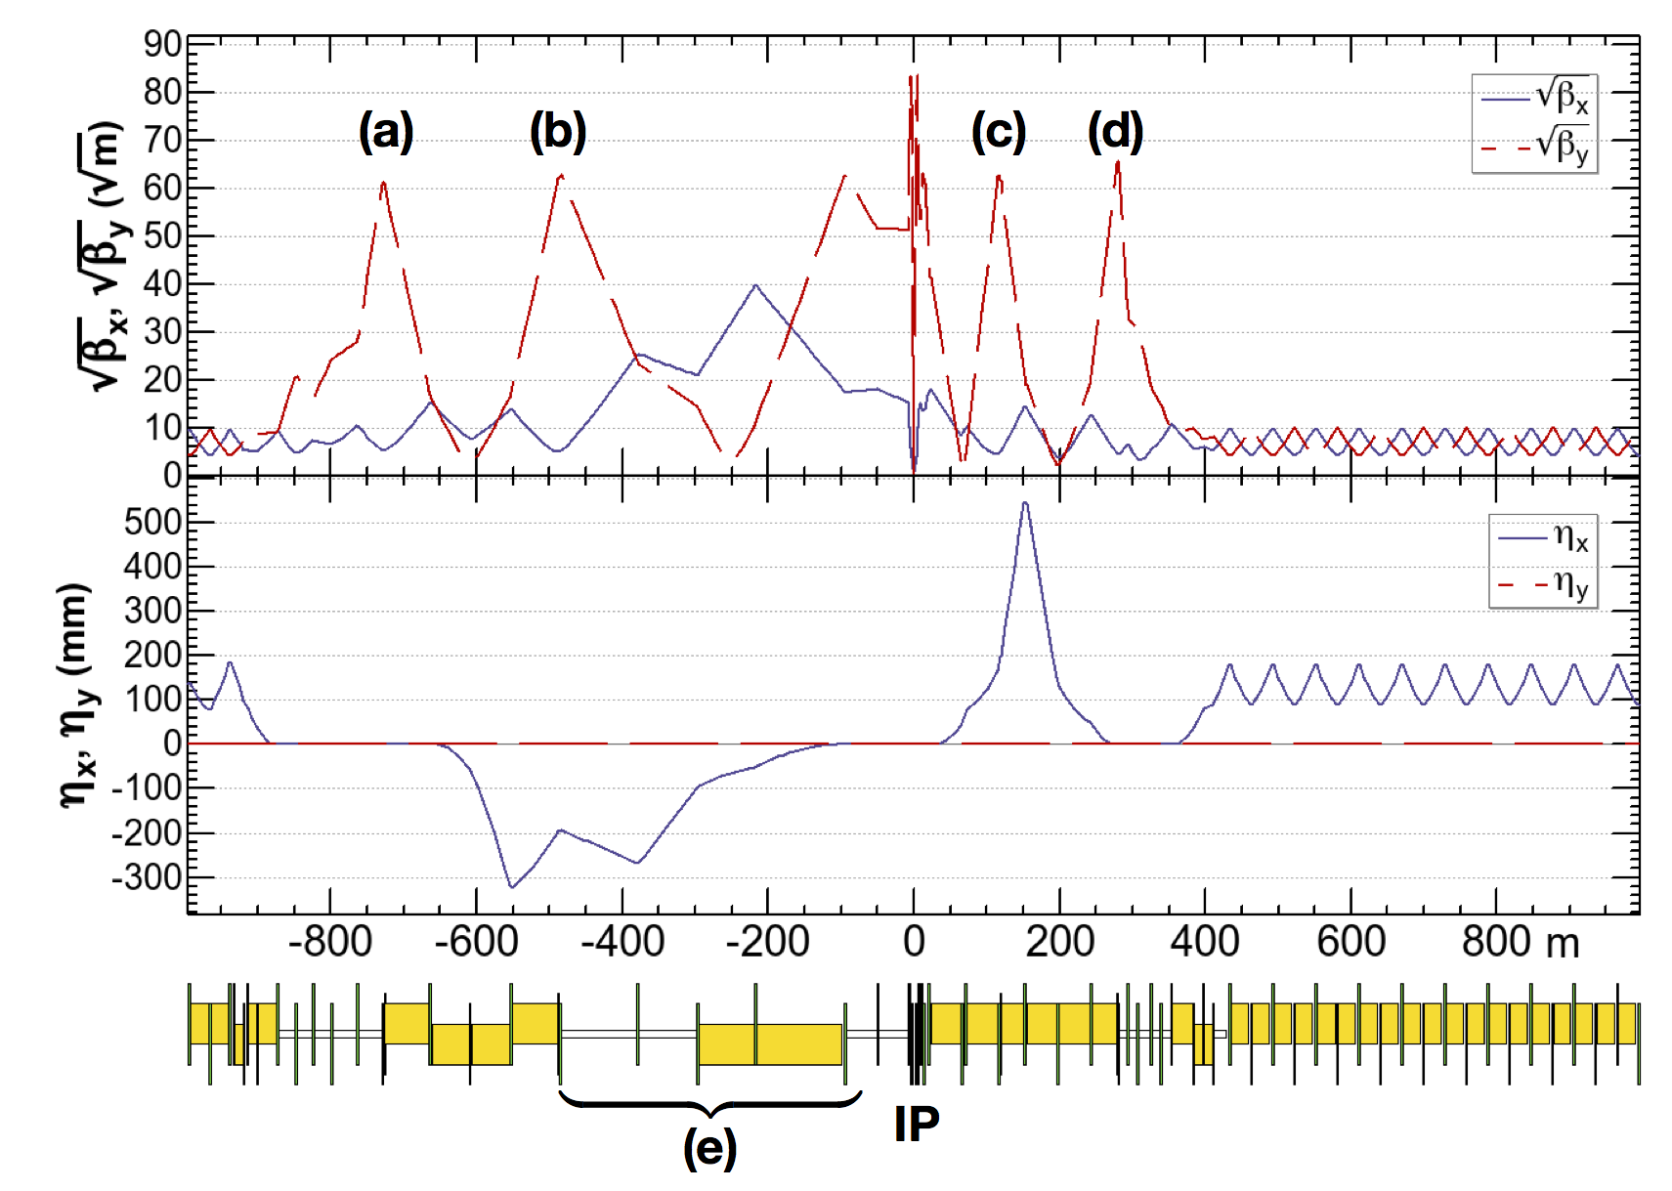
FCC-ee asymmetric crab waist IR optics
asymmetric IR optics to suppress synchrotron radiation toward the IP, E_{critical} <100 keV from 450 m from IP (e)
ttbar 182.5 GeV
yellow boxes:
dipole magnets
K. Oide
4 sextupoles (a – d) for local vertical chromaticity correction and crab waist, optimized for each working point.
Common arc lattice for all energies, 60 deg for Z, W and 90 deg for ZH, tt for maximum stability and luminosity

Slide 27
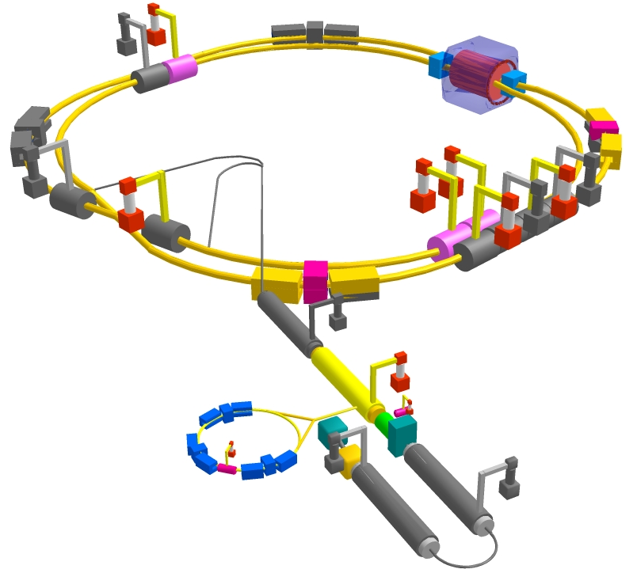
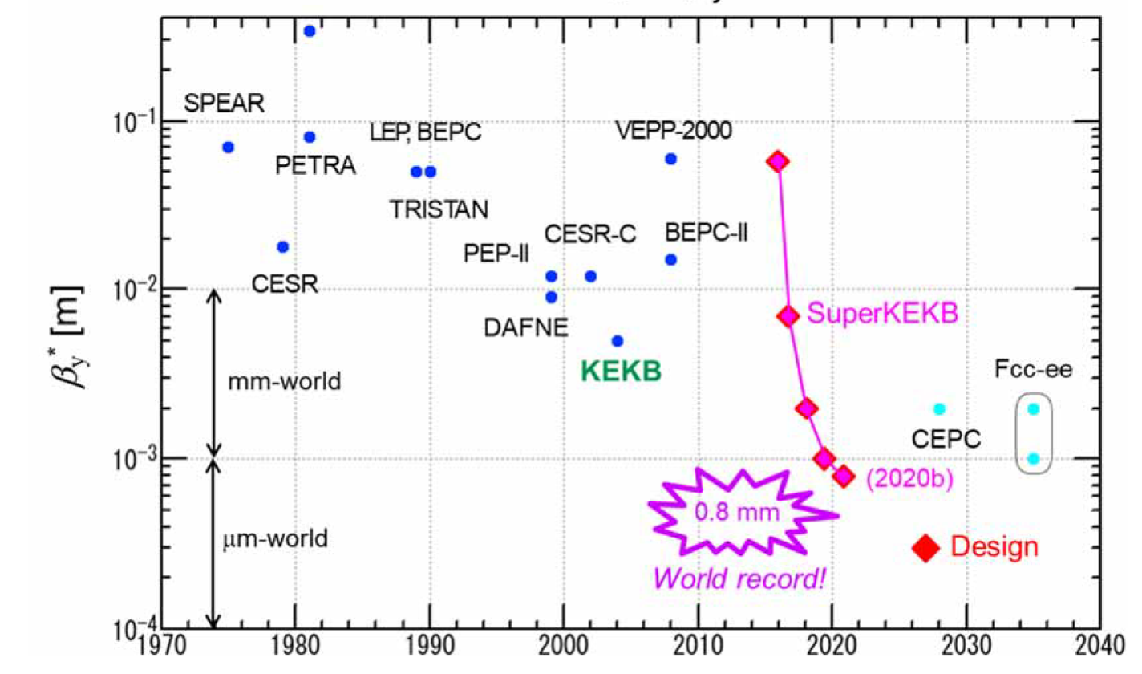
SuperKEKB – pushing luminosity and β*
Design: double ring e⁺e⁻ collider as B-factory at 7(e⁻) & 4(e⁺) GeV; design luminosity $\sim$8 x 10³⁵ cm⁻²s⁻¹; β_{y}* $\sim$0.3 mm;
nano-beam – large crossing angle collision scheme (crab waist w/o sextupoles); beam lifetime$\sim$5 minutes; top-up injection; ce⁺ rate up to $\sim$ 2.5 10¹² /s ; under commissioning
M. Tobiyama, K. Oide
Y. Funakoshi, Y. Ohnishi, K. Oide
SuperKEKB is demonstrating FCC-ee key concepts
β_{y}* = 0.8 mm achieved in both rings in summer 2020 – using the FCC-ee-style “virtual” crab-waist collision scheme

Slide 28

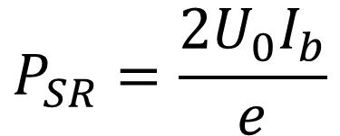


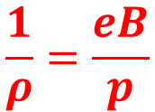
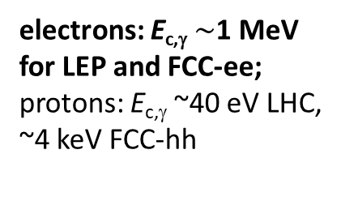
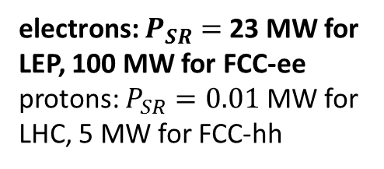
arc synchrotron radiation (SR) 1
energy loss per turn
$$U_{0}=\frac{e^{2}}{3ε_{0}}\frac{γ^{4}}{ρ}$$
$$\frac{1}{ρ}=\frac{eB}{p}$$
$$∝{E^{4}}/{m^{4}∝γ^{4}}$$
→ RF voltage
numerical values
for electrons
synchrotron radiation power
electrons: $P_{SR}=$23 MW for LEP, 100 MW for FCC-ee
protons: $P_{SR}=0.01$ MW for LHC, 5 MW for FCC-hh
$$P_{SR}=\frac{{2U}_{0}I_{b}}{e}$$
$$∝{E^{4}}/{m^{4}∝γ^{4}}$$
→ RF power
critical (typical)
photon energy
→ shielding
electrons: E_{c,γ} $\sim$1 MeV
for LEP and FCC-ee;
protons: E_{c,γ} ~40 eV LHC,
~4 keV FCC-hh

Slide 29
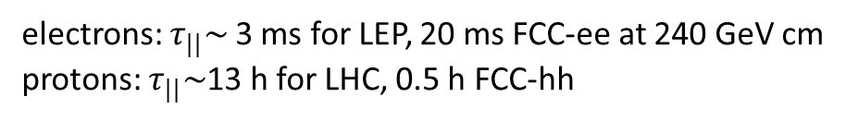
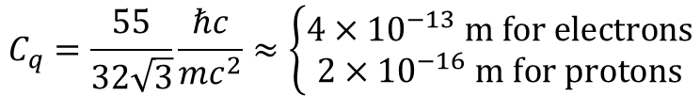
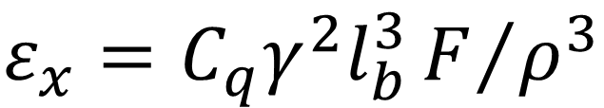


arc synchrotron radiation 2
radiation damping of transverse and longitudinal motion
→beam shrinkage
$$τ_{||}={τ_{x}}/2={\left(C/c\right)E}/{U_{0}}$$
$$∝{ρ^{2}}/{γ^{3}}$$
electrons: $τ_{||}\sim$3 ms for LEP, 20 ms FCC-ee at 240 GeV cm
protons: $τ_{||}\sim$13 h for LHC, 0.5 h FCC-hh
equilibrium emittance due to balance of radiation damping and quantum excitation
$$ε_{x}=C_{q}γ^{2}l_{b}^{3}F/{ρ^{3}}$$
$$l_{b}:length of half cell$$
→ cell length
$$C_{q}=\frac{55}{32\sqrt{3}}\frac{ℏc}{mc^{2}}≈\left\{\begin{matrix}4×{10}^{−13} m for electrons \\ 2×{10}^{−16} m for protons\end{matrix}\right.$$
$$F≈3 for standard arc optics (90\deg{FODO cell) }$$
increase of emittance with energy is compensated by large radius (ρ) and short cell length (l_{b})

Slide 30
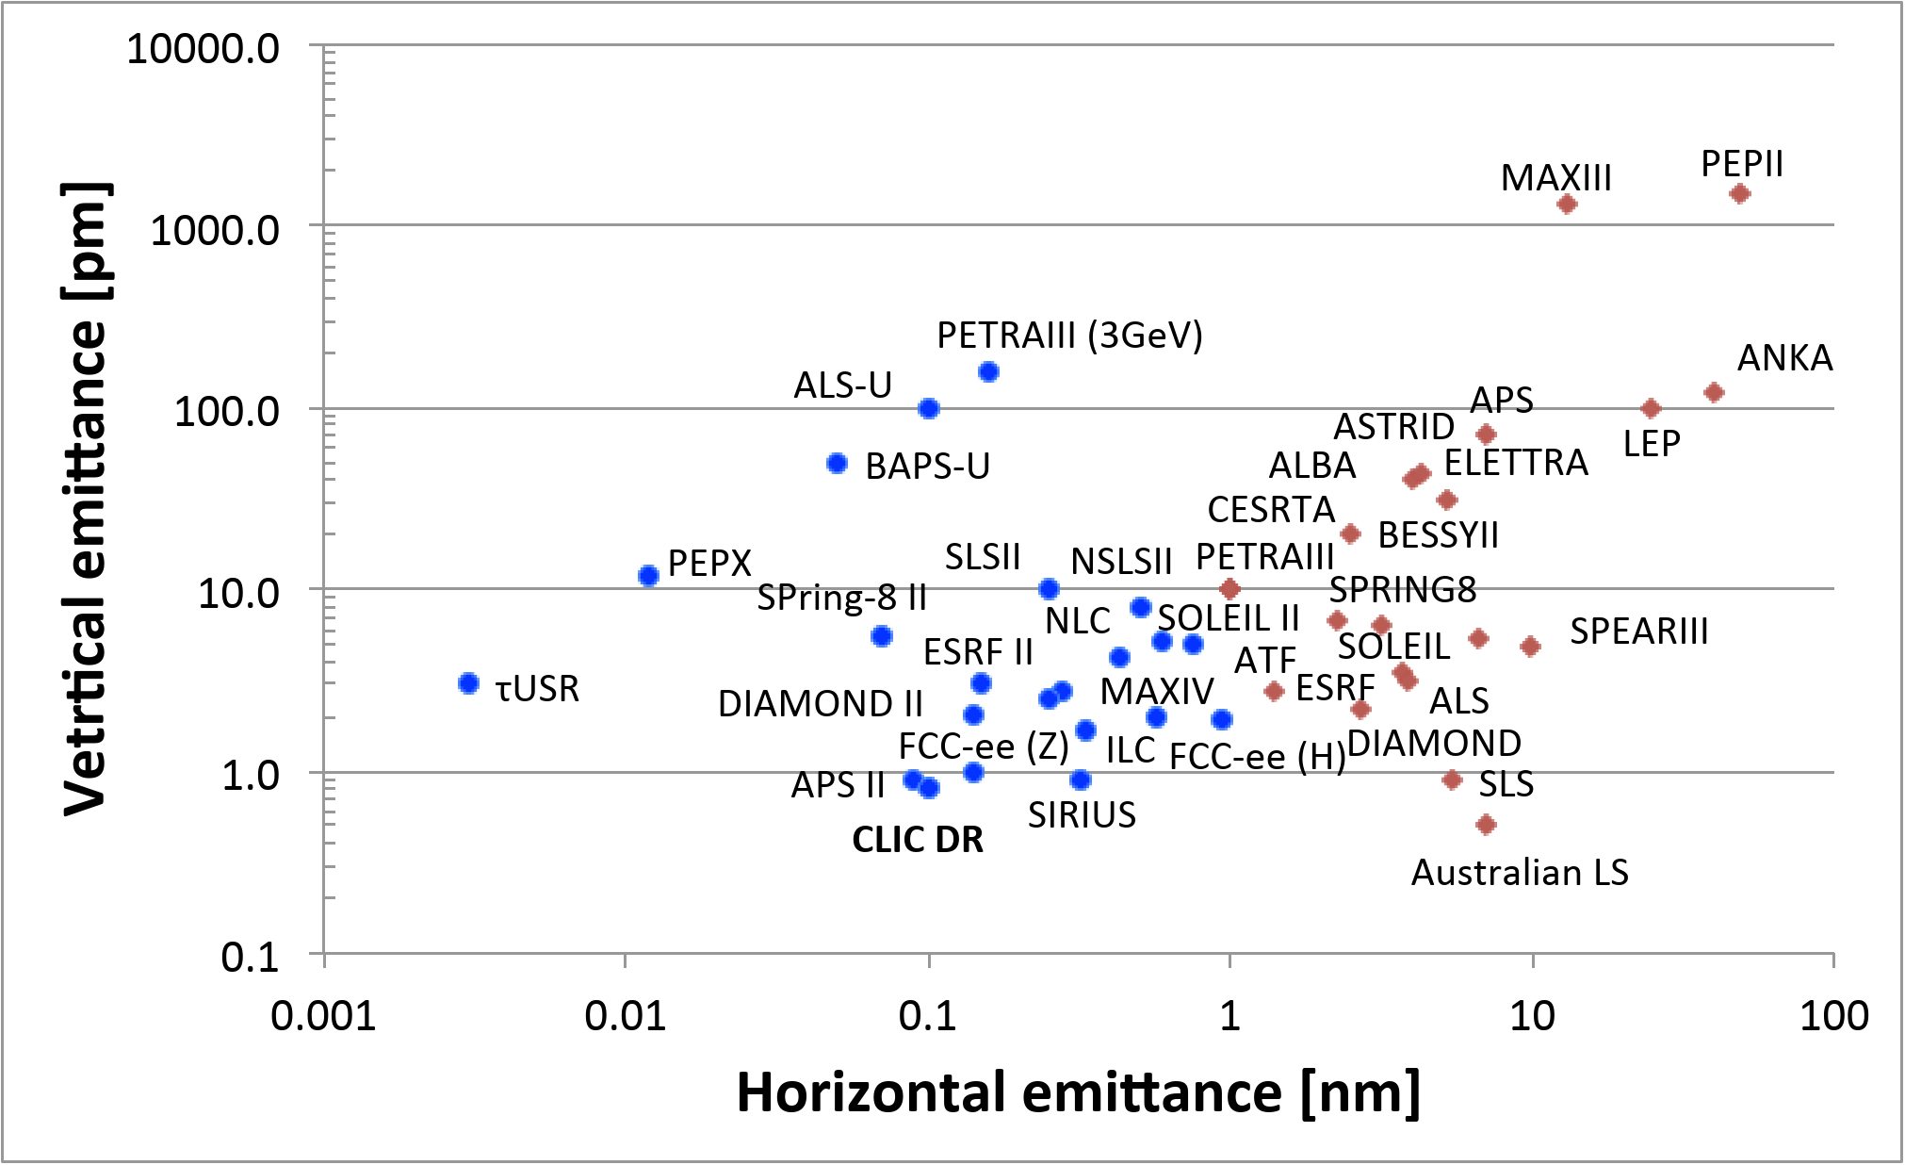
transverse emittances
Y. Papaphilippou

Slide 31
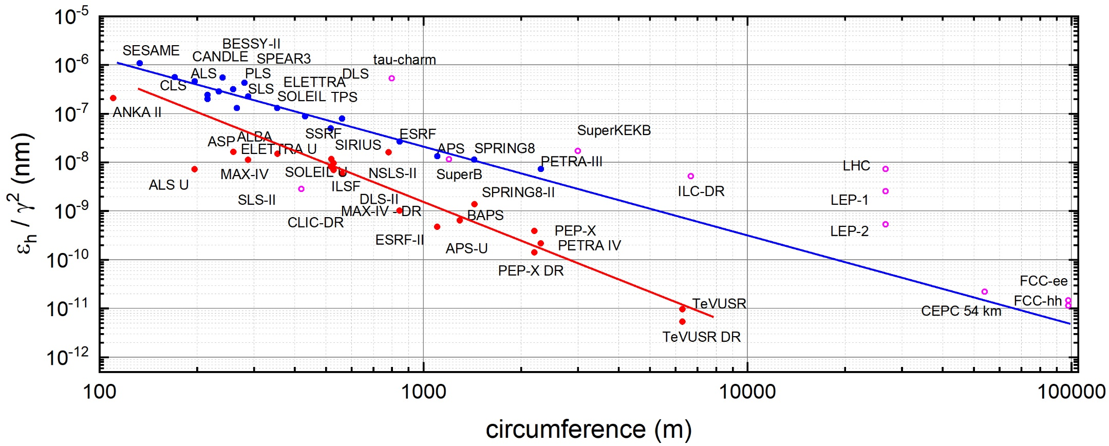
horizontal emittance / γ²
R. Bartolini, S. Casalbuoni
FCC-ee outperforming most of the
“ultimate storage ring” light sources

Slide 32
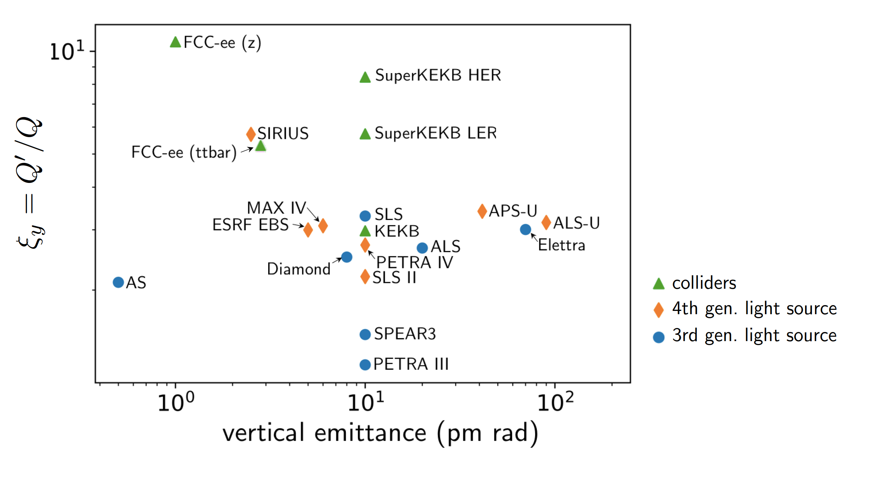
vertical emittance & chromaticity
T. Charles
FCC-ee $t\overline{t}$ emittance and chromaticity Q’/Q similar to SIRIUS light source

Slide 33
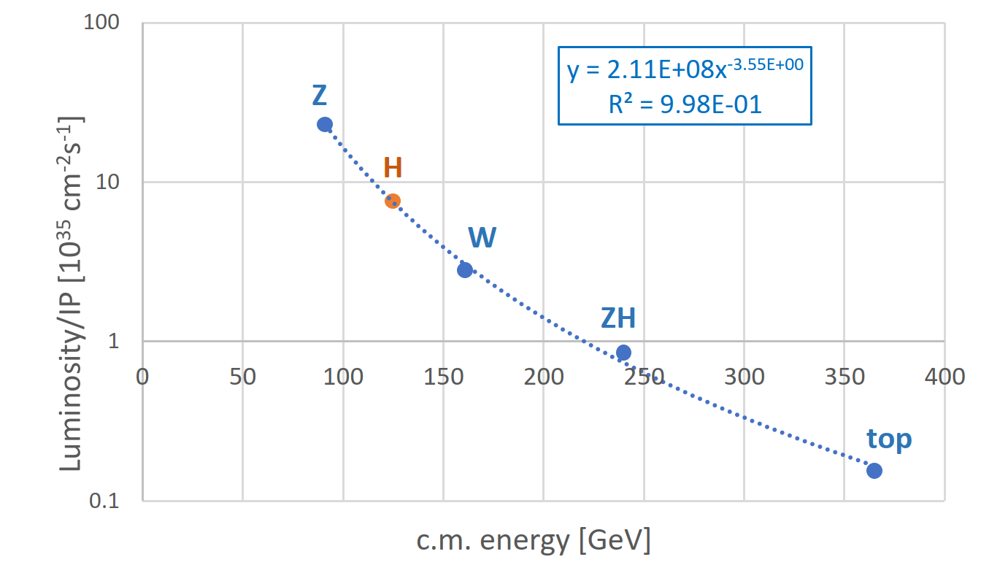
FCC-ee luminosity per IP

Slide 34

can we understand the luminosity scaling ?
H ≤ 1
Hour-glass
F ≤ 1
Crossing angle
2Φ
Beam-beam parameter
ρ: bending radius
$$β_{y}^{∗}∝\sqrt{E}$$
J. Wenninger

Slide 35
luminosity from LEP-2 to FCC-ee
>x4.5
x4
>x2
<x2
x1/25-1/50
much bigger factors on the Z pole: 10⁵$×$LEP-1 luminosity !

Slide 36
CDR baseline parameters
parameter | FCC-ee |  |  |  | LEP2
energy/beam [GeV] | 45.6 | 80 | 120 | 182.5 | 105
bunches/beam | 16640 | 2000 | 328 | 48 | 4
beam current [mA] | 1390 | 147 | 29 | 5.4 | 3
luminosity/IP x 10³⁴ cm⁻²s⁻¹ | 230 | 28 | 8.5 | 1.6 | 0.0012
energy loss/turn [GeV] | 0.036 | 0.34 | 1.72 | 9.2 | 3.34
synchrotron power [MW] | 100 |  |  |  | 22
RF voltage [GV] | 0.1 | 0.75 | 2.0 | 4.0+6.9 | 3.5
rms bunch length (SR,+BS) [mm] | 3.5, 12 | 3.0,6.0 | 3.2, 5.3 | 2.0, 2.5 | 12, 12
rms emittance ε_{x,y} [nm, pm] | 0.27, 1 | 0.84, 1.7 | 0.63, 1.3 | 1.5, 2.9 | 22, 250
longit. damping time [turns] | 1273 | 236 | 70 | 20 | 31
crossing angle [mrad] | 30 |  |  |  | 0
beam lifetime [min] | 68 | 59 | 12 | 12 | 434
FCC-ee & CEPC: 2 separate rings

Slide 37

beamstrahlung – a new limit at 182 GeV
hard photon emission at the IPs, ‘Beamstrahlung’, can become lifetime / performance limit for large bunch populations (N), small hor. beam size (σ_{x}) & short bunches (σ_{s})
e
γ
e
ρ : mean bending radius at the IP (in the field of the opposing bunch)
η : ring energy acceptance
lifetime expression by V. Telnov, modified version by A. Bogomyagkov et al
for acceptable lifetime, ρ×η must be sufficiently large
  flat beams (large σ_{x}) !
  bunch length !
  large momentum acceptance: aiming for >2% at 182.5 GeV
    - LEP: <1% acceptance, SuperKEKB ~ 1.5%
J. Wenninger, et al

Slide 38
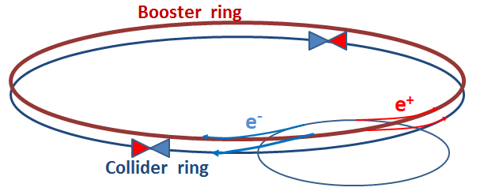
FCC-ee top-up injection
beside the collider ring(s), a booster of the same size (same tunnel) must provide beams for top-up injection to sustain the extremely high luminosity
  same size of RF system, but low power (~ MW)
  top up frequency ≈0.1 Hz
  booster injection energy ≈5-20 GeV
  bypass around the experiments
A. Blondel

Slide 39

dynamic aperture
K. Oide
adequate dynamic aperture on- and off-momentum

Slide 40



dynamic aperture limited by synchrotron radiation in quadrupoles !
Horizontal plane:
Radiative Beta-
Synchrotron Coupling (RBSC) [Jowett, 1994] –
additional energy loss due to radiation in quadrupoles shifts synchronous point and develops large synchrotron oscillations. → resulting horizontal tune shift onto the integer resonance
dynamic aperture with
and without deterministic synchrotron radiation in quadrupoles (w/o quantum fluctuations)
Vertical plane:
Radiation from quadrupoles modulates the particle energy
at twice the betatron frequency → parametric resonance independent of tune
A. Bogomyagkov et al.,
PRAB 22, 021001 (2019) ;
J. Jowett, Proc. 4th Workshop on LEP Performance,
CERN SL/94-06 (DI) (1994)

Slide 41

energy consumption – example CERN
Multi-years cycles for LHC
HL-LHC
LHC
LEP2
Cycles: 9m+3m
Cycles: 3 or 4 x (10m+2m) + 1.5yr
V. Mertens

Slide 42

RF as main power consumer
continually supplying circulating beam with
P_{SR}=100 MW power (SR losses) requires
wall-plug power P_{wall}=P_{SR}/η , note $I_{b}∝P_{SR}$
with η=conversion efficiency wall-plug → beam
FCC strategy:
RF system optimized for each energy
higher-gradient SC cavities (negligible wall losses, low cryo power)
highly efficient RF power sources

Slide 43

SRF cavities over 30 years | high Q₀ & E_{acc} → less cryopower
Enabling future efficient High Energy Machines
bulk Nb, 1.3 GHz, 2K
similar progress for Nb/Cu cavities
5 MV/m
Thermal Breakdown
20 - 25 MV/m
High field
Q-SLOPE
Q > 5e10
At medium field !!
E_{acc} > 100 MV/m
Q > 3e10
3 – 4 MV/m
Multipacting
10 – 15 MV/m
Field Emission
35 – 40 MV/m
mid field Q-slope
Q > 2e10
At high field
?
Anna Grassellino - ICFA 2017
A. Grasselino, ICFA Seminar, Ottawa 2017

Slide 44






after 80 years breakthrough in klystron technology
I. Syratchev
New bunching technologies.
Bunch saturation.

Slide 45





low-cost, energy-efficient arc magnets
twin-dipole magnet design with 2× power saving 16 MW (at 175 GeV), with Al busbars
twin F/D arc quadrupole design with 2× power saving; 25 MW (at 175 GeV), with Cu conductor
prototype
prototype
2900 units, 0.057 T, $\sim$22 m
2900 units, 10 T/m, 3.1 m
A. Milanese, Efficient twin aperture magnets for the future circular e⁺/e⁻ collider, Phys. Rev. Accel. Beams 19, 112401 (2016)

Slide 46
FCC-ee electrical power requirements

Slide 47



FCC-ee: efficient Higgs/electroweak factory
Z
91 GeV
ZH
240 GeV
WW
160 GeV
$\text{t}\overline{\text{t}}$
350-365 GeV
€200 electricity cost
per Higgs boson
luminosity L per supplied electrical wall-plug power P_{WP} is shown as a function of centre-of-mass energy for several proposed future lepton colliders
FCC-ee is greenest collider from Z to $t\overline{t}$
M. Benedikt, A. Blondel, P. Janot, et al., Nat. Phys. 16, 402-407 (2020), and
European Strategy for Particle Physics Preparatory Group, Physics Briefing Book (CERN, 2019)

Slide 48
circular e⁺e⁻ colliders: glorious history & exciting future
heeding lessons learnt:
}
SR effects of LEP
high currents of KEKB and PEP-II
top-up of KEKB and PEP-II
crab waist of DAFNE
crab waist & low β_{y}* of SuperKEKB
e⁺ source of KEKB
cryo availability of LHC
spin gymnastics of HERA
FCC-ee
individual parameters
mostly relaxed compared
with those in “demonstrator
machines”
“new” effects: beamstrahlung → lifetime limit, E spread,
synchrotron radiation in quadrupole magnets …
trend & challenge: making future colliders truly green !

Slide 49

“An e⁺-e ⁻ storage ring in the range of a few hundred GeV in the centre of mass can be built with present technology...” “…the most useful project on the horizon.”
Burt Richter, 1976
NIM 136 (1976) 47-60

Slide 50







…surely great times ahead!
Kjell Johnsen
“Pief” Panofsky
thank you !
Mike Lamont
Satoshi Ozaki
Robert H. Wilson
Lyndon Evans
Herwig Schopper

Slide 51
spare slides

Slide 52



polarization
two primary interests:
accurate energy calibration using resonant depolarization ⇒ measurement of M_{Z}, Γ_{Z}, M_{W}
  appealing feature – δM_{Z}, δΓ_{Z} ~ 0.1 MeV, δM_{W} ~ 0.3 MeV
physics with longitudinally polarized beams
  transverse polarization must be rotated into the longitudinal plane using spin rotators (see e.g. HERA)
Precession frequency ∝ E
R. Assmann
scaling from LEP observations :
polarization expected up to the WW threshold !
LEP like calibration up to the W threshold
loss of polarization due to growing energy spread
$$σ_{E}∝{E^{2}}/{\sqrt{ρ}}$$
LEP
integer spin resonances are spaced by 440 MeV:
energy spread should remain below ~ 60 MeV
A. Blondel, M. Koratzinos, S. Mane, U. Wienands, J. Wenninger,..

Slide 53

polarization build up
transverse polarization build-up (Sokolov-Ternov) is slow at FCC-ee (large bending radius ρ)
build-up is ~40 times slower than at LEP
τ_{p} ≈190 hours @ Z
wigglers may lower τ_{p} to ~12 h, limited by σ_{E} ≤ 60 MeV and power
  due to power loss the wigglers can only be used to pre-polarize some bunches (before main injection)
1 hour
≈ OK for energy calibration (few % P sufficient)
longitudinal polarization: levels of ≥ 40% required on both beams; excellent resonant compensation needed
  expected to be difficult, requires spin rotators or snakes, most likely only possible at lower intensity and luminosity
SLIM, PETROS, SITF etc. simulations
A. Blondel, U. Wienands, E. Gianfelice, J. Jowett, R. Rossmanith, J.Wenninger

Slide 54



important for e⁺e⁻
question of superperiodicity
example 4 IPs
K. Oide
A
B
A
B
A
L
SP=1
SP=1
SP=2
L
SP=4
B
G
L
G
G
$$mQ_{x}+nQ_{y}=p$$
$$mQ_{x}+nQ_{y}=2p$$
$$mQ_{x}+nQ_{y}=4p$$
resonance condition for lattice errors (DA) and for beam-beam

Slide 55
vertical tune Q_{y}
beam-beam tune spread from head-on collision
particles in the
transverse tail
tune spread
ΔQ_{y}
maximum
acceptable
tune
spread
is limited
by resonances
nQ_{x}+mQ_{y}=p
up to resonance
order |n|+|m|~13
tune footprint
particles at the center of the bunch
tune spread
ΔQ_{x}
horizontal tune Q_{x}

Slide 56
vertical tune Q_{y}
particles in the
transverse tail
tune spread
ΔQ_{y}
1 collision / turn
particles at the center of the bunch
2 collisions / turn
horizontal tune Q_{x}

Slide 57

luminosity scaling: damping
beam-beam parameter ξ measures strength of field sensed by the particles in a collision
beam-beam parameter limits are empirically scaled from LEP data (4 IPs)
R. Assmann & K. Cornelis, EPAC2000
x4.5
FCC-ee
vs LEP
x4
In reasonable agreement with first simulations for FCC ee
<x2
x1/25-1/50
$→$ extremely high luminosity
J. Wenninger, R. Assmann, S. White, K. Ohmi, D. Shatilov, et al.

Slide 58



FCC CDR and Study Documentation
FCC-Conceptual Design Reports (completed in 2018):
  Vol 1 Physics, Vol 2 FCC-ee, Vol 3 FCC-hh, Vol 4 HE-LHC
  CDRs published in European Physical Journal C (Vol 1) and ST (Vol 2 – 4)
  EPJ C 79, 6 (2019) 474 , EPJ ST 228, 2 (2019) 261-623 , EPJ ST 228, 4 (2019) 755-1107 , EPJ ST 228, 5 (2019) 1109-1382
Summary documents provided to EPPSU SG
  FCC-integral, FCC-ee, FCC-hh, HE-LHC
  Accessible on http://fcc-cdr.web.cern.ch/
>1350 contributors from
> 350 institutes,
a truly global effort

Slide 59
2020 Update of the European Strategy for Particle Physics
      Core sentence “order of the further FCC study”:
      “Europe, together with its international partners, should investigate the technical and financial feasibility of a future hadron collider at CERN with a centre-of-mass energy of at least 100 TeV and with an electron-positron Higgs and electroweak factory as a possible first stage. Such a feasibility study of the colliders and related infrastructure should be established as a global endeavour and be completed on the timescale of the next Strategy update.”

