Slide 1
Non-linear effects
Hannes BARTOSIK with help of Yannis PAPAPHILIPPOU
Accelerator and Beam Physics group
Beams Department CERN
Joint University Accelerator School
January 2021

Slide 2
Bibliography
Books on non-linear dynamical systems
  M. Tabor, Chaos and Integrability in Nonlinear Dynamics, An Introduction, Willey, 1989
  A.J Lichtenberg and M.A. Lieberman, Regular and Chaotic Dynamics, 2nd edition, Springer 1992.
Books on beam dynamics
  E. Forest, Beam Dynamics - A New Attitude and Framework, Harwood Academic Publishers, 1998.
  H. Wiedemann, Particle accelerator physics, 3rd edition, Springer 2007.
Lectures on non-linear beam dynamics
  A. Chao, Advanced topics in Accelerator Physics, USPAS, 2000.
  A. Wolski, Lectures on Non-linear dynamics in accelerators, Cockroft Institute 2015.
  R. Bartolini, Lecture on Non-linear dynamics, John Adams Institute 2017.
Papers on non-linear dynamics
  G. Guignard, CERN 76-06 and CERN 78-11
  J. Bengtsson, Nonlinear Transverse Dynamics in Storage Rings, CERN 88-05

Slide 3
Disclaimer
  This course is based on material from the JUAS course on non-linear dynamics by Y. Papaphilippou from the previous years.
  Parts of the slides were taken / inspired from the course on nonlinear dynamics of R. Bartolini (John Adams Institute, 2017) and the one of A. Wolski (Cockroft Institute, 2015).

Slide 4
Outline
Introduction – nonlinear effects from a single sextupole
Hamiltonian of the nonlinear betatron motion
Resonance topology and onset of chaos
Resonances are everywhere – can we do something?
Lattice optimization by tracking
Applications – making use of resonances
Summary

Slide 5
Outline
Introduction – nonlinear effects from a single sextupole
Hamiltonian of the nonlinear betatron motion
Resonance topology and onset of chaos
Resonances are everywhere – can we do something?
Lattice optimization by tracking
Applications – making use of resonances
Summary

Slide 6
Example of a simple storage ring
To correct or control chromaticity in a storage ring we need to install sextupole magnets
Nonlinear elements such as sextupole magnets can have significant impact on the particle motion (as we will see)
To illustrate this, we start with a very simple example
  Assume a circular machine built of identical cells
  There is one sextupole per cell, which is located at a point where the horizontal beta function is 1m, and the alpha function is zero (to control chromaticity in both planes we would need at least 2 sextupoles)
  The phase advance per cell can be tuned
  We consider for the moment only horizontal motion (i.e. y=0)
  We build a small simulation code to study the particle behavior in phase space turn-by-turn

Slide 7
Example of a simple storage ring
  The map from the sextupole in one cell to the sextupole in the next cell is just a rotation in phase space (periodic linear transfer matrix with beta=1 and alpha=0)
  The change in the horizontal momentum of a particle moving through the sextupole is found by integrating the Lorentz force
  with (assuming y = 0)
  If the sextupole is short we can neglect the small change in the coordinate x as the particle moves through the sextupole, in which case we obtain (thin lens approximation)

Slide 8
Example of a simple storage ring
  The map for a particle moving through a short sextupole can be represented by a “kick” in the horizontal momentum
  For the moment we consider a machine with a single cell, for which the map consists of the linear transfer map and one sextupole kick
  We choose a fixed value of k₂L and look at the effects of the maps for different tunes (i.e. phase advances) of the machine
  For each case we construct a phase space portrait by plotting x, p_{x} turn after turn for a range of initial conditions

Slide 9
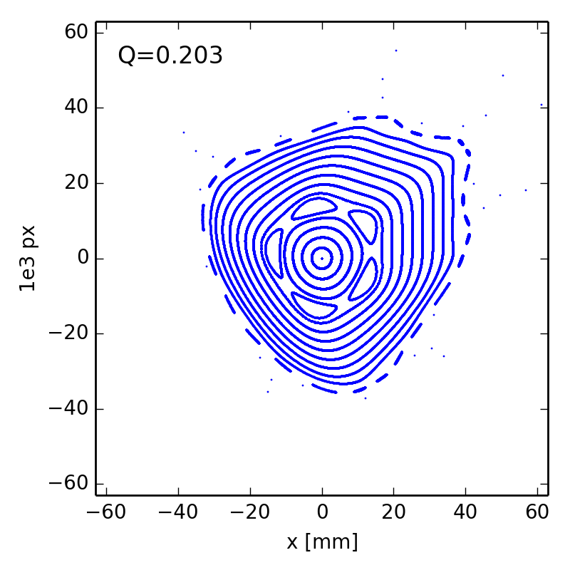
Example of a simple storage ring

Slide 10
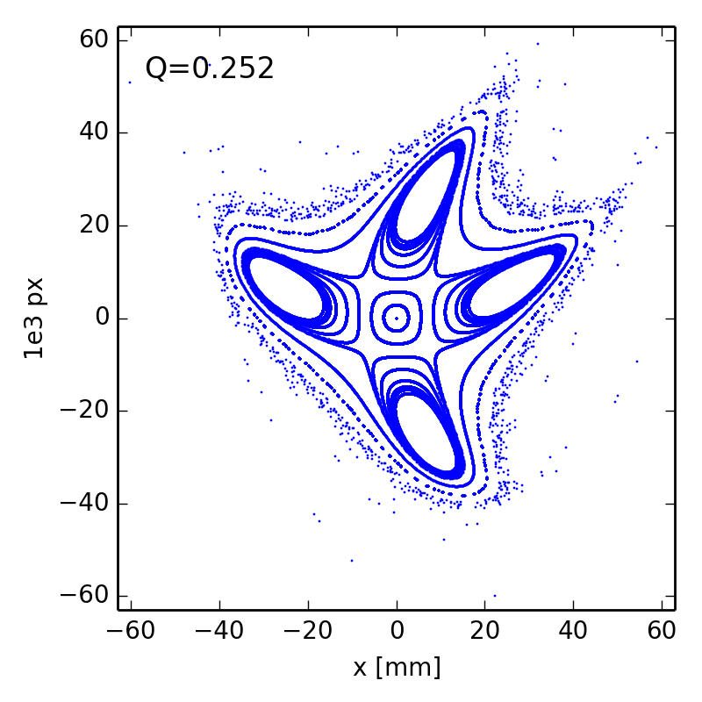
Example of a simple storage ring

Slide 11
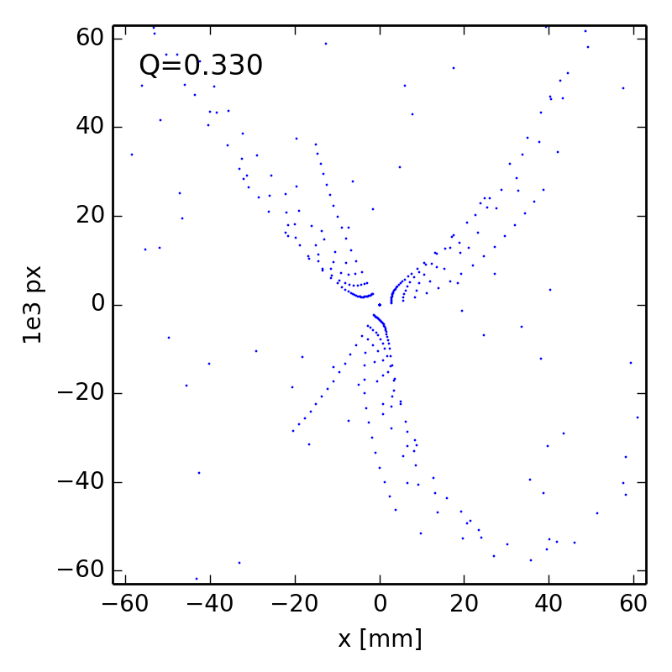
Example of a simple storage ring

Slide 12
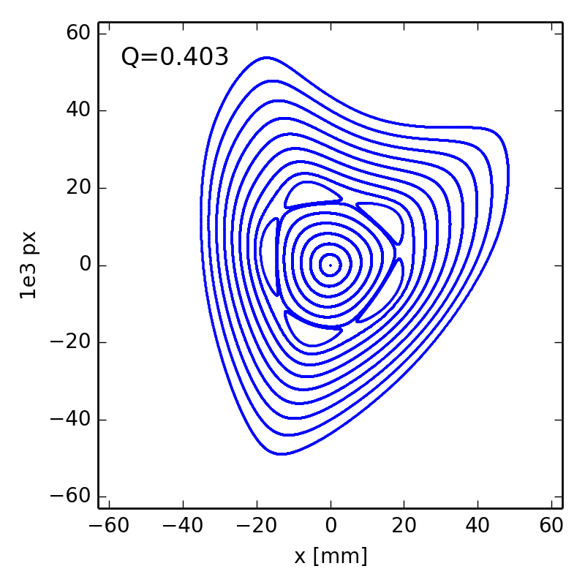
Example of a simple storage ring

Slide 13
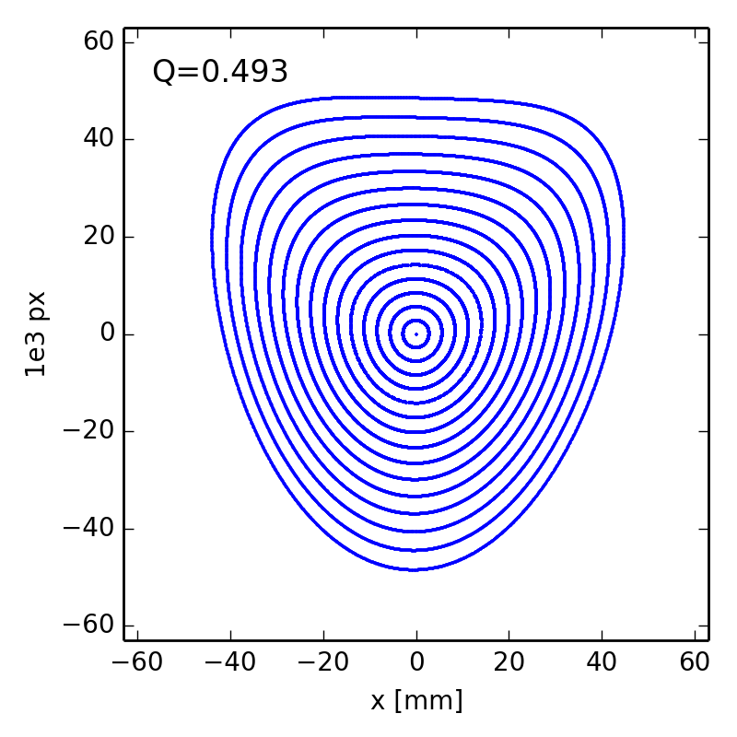
Example of a simple storage ring

Slide 14
Some observations
There are some interesting features in these phase space portraits to which it is worth drawing attention:
  For small amplitudes (small x and p_{x}), particles trace out closed loops around the origin: this is what we expect for a purely linear map.
  As the amplitude is increased, “islands” appear in phase space: the phase advance (for the linear map) is often close to m/p where m is an integer and p is the number of islands.
  Sometimes, a larger number of islands appears at larger amplitude.
  Usually, there is a closed curve that divides a region of stable motion from a region of unstable motion. Outside that curve, the amplitude of particles increases without limit as the map is repeatedly applied.
  The area of the stable region depends strongly on the phase advance: for a phase advance close to 2π/3, it appears that the stable region almost vanishes altogether.
  It appears that as the phase advance is increased towards π, the stable area becomes large, and distortions from the linear ellipse become less evident.

Slide 15
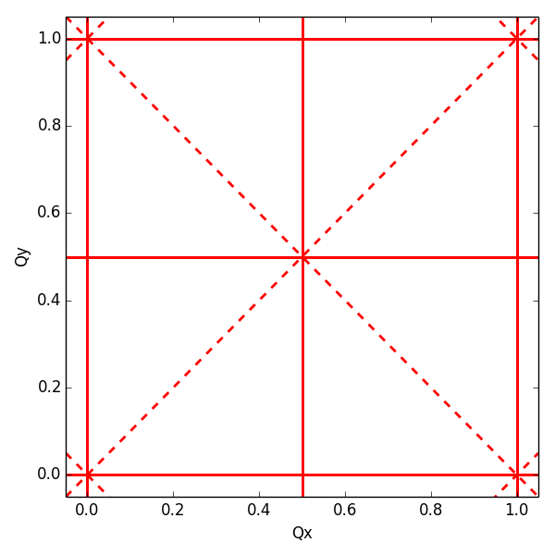
Resonances
  If we include vertical as well as horizontal motion, then we find that resonances occur when the tunes satisfy
  where n_{x}, n_{y} and r are integers. The resonance is of order |n_{x}| + |n_{y}|
Resonances up to order 2
normal resonances
(= even n_{y})
skew resonances
(= odd n_{y})

Slide 16
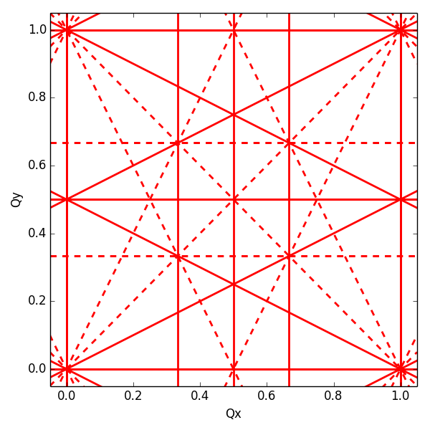
Resonances
  If we include vertical as well as horizontal motion, then we find that resonances occur when the tunes satisfy
  where n_{x}, n_{y} and r are integers. The resonance is of order |n_{x}| + |n_{y}|
Resonances up to order 3
normal resonances
(= even n_{y})
skew resonances
(= odd n_{y})

Slide 17
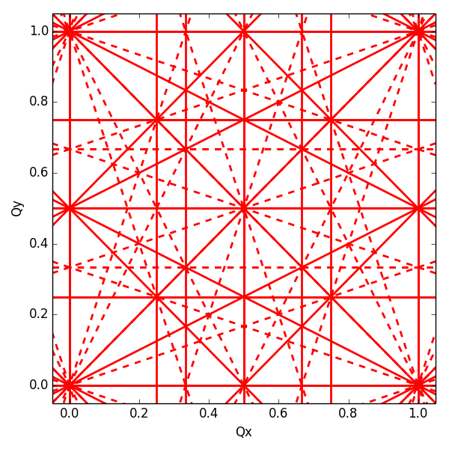
Resonances
  If we include vertical as well as horizontal motion, then we find that resonances occur when the tunes satisfy
  where n_{x}, n_{y} and r are integers. The resonance is of order |n_{x}| + |n_{y}|
Resonances up to order 4
normal resonances
(= even n_{y})
skew resonances
(= odd n_{y})

Slide 18
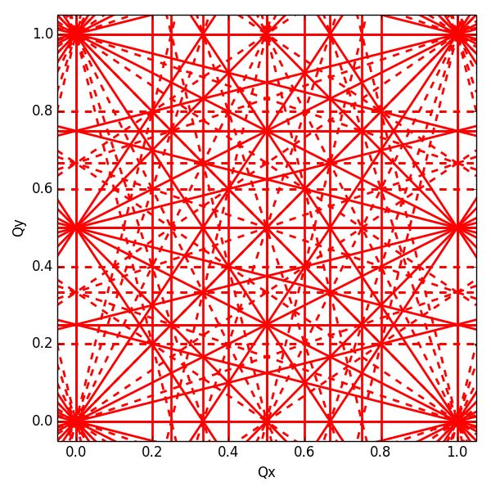
Resonances
  If we include vertical as well as horizontal motion, then we find that resonances occur when the tunes satisfy
  where n_{x}, n_{y} and r are integers. The resonance is of order |n_{x}| + |n_{y}|
Resonances up to order 5
normal resonances
(= even n_{y})
skew resonances
(= odd n_{y})

Slide 19
Outline
Introduction – nonlinear effects from a single sextupole
Hamiltonian of the nonlinear betatron motion
Resonance topology and onset of chaos
Resonances are everywhere – can we do something?
Lattice optimization by tracking
Applications – making use of resonances
Summary

Slide 20
Hamiltonian mechanics
  Given a function H(x, p; t) (called the Hamiltonian), the equations of motion for a dynamical system are given by Hamilton’s equations
  In Hamiltonian mechanics, the “state” of a system at any time is defined by specifying values for the coordinates x (or more generally q) and the conjugate momentum p
  “Physics” consists of writing down a Hamiltonian
  All Hamiltonian systems are “symplectic”: areas in phase space are conserved as the system evolves even when the dynamics are nonlinear. This important result is known as Liouville’s theorem.

Slide 21
Hamiltonian mechanics
  It follows from Hamilton’s equations that the Hamiltonian itself is conserved if the independent (“time-like”) variable does not appear explicitly in the Hamiltonian:
  Using Hamilton’s equations, we have
  If the Hamiltonian does not depend explicitly on t, then the Hamiltonian is conserved

Slide 22
Hamiltonian for linear betatron motion
  In a lattice made from dipoles and quadrupoles the Hamiltonian reads (in our usual coordinate system)
  where we have used the normalized momenta and
  The Hamiltonian consists of a kinetic term and a term for the vector potential accounting for the magnetic fields
  Using Hamilton’s equations and (for x and y) we find back Hill’s equations
kinetic term
dipole term
quadrupole term
(quadratic in x and y!)

Slide 23
Hamiltonian with nonlinear fields (I)
  The more general form of the Hamiltonian describing the motion of a charged particle in the accelerator coordinate system with any order of multipoles looks like this
  We have only a longitudinal component of the magnetic potential, i.e. A_{s}, since we restrict ourselves to pure transverse magnetic fields (hard edge approximation), with the following multipole expansion:
normal multipoles
skew multipoles

Slide 24
Hamiltonian with nonlinear fields (II)
  The Hamiltonian for the nonlinear betatron motion is then written like this
  We define H₀ the linear part (dependent only on dipoles and normal quadrupoles)
  and V the nonlinear part dependent on the nonlinear multipoles
short hand notation collecting terms according to powers of x and y

Slide 25
Normalizing linear part of Hamiltonian
  We define a canonical transformation that reduces the linear part of the Hamiltonian to a rotation
  In detail
  This transformation reduces
  ellipses in phase space to
  circles and the motion to a
  rotation along these circles
linear Courant-Snyder invariant

Slide 26
Resonance driving terms (I)
  The new Hamiltonian in action angle variables reads
  The complex coefficients h_{jklm} are called resonance driving terms
  since they generate angle dependent terms in the Hamiltonian that
  are responsible for the resonant motion of the particles (i.e. motion
  on a chain of islands or on a separatrix)
  The resonant driving terms are integrals over the circumference of the accelerator of functions which depend on the s-location of the multipolar magnetic elements

Slide 27
Resonance driving terms (II)
  The solution for the stable betatron motion can be written as a quasi periodic signal (to first order in the multipole strengths)
  On the islands the betatron tunes satisfy a resonant condition of type
with
→ solutions for stable betatron motion contain the driving terms
resonance

Slide 28
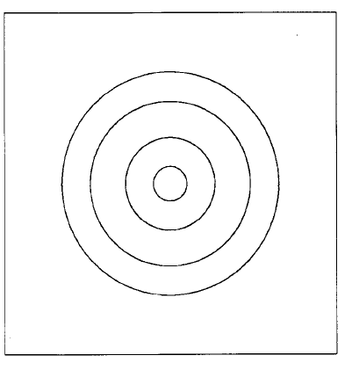
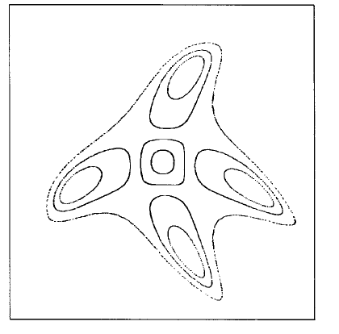
Resonance driving terms (III)
  Terms of type h_{jjll} are independ of the angle. They produce detuning with amplitude to the lowest order in the multipolar gradient (resulting in a tune spread for a beam!)
  The dynamics with only detuning terms (amplitude dependent phase advance)
  Angle dependent terms excite resonances creating fixed points and island structures in phase space. E.g. for the fourth order resonance (4,0)
  The phase space for the (4,0) resonance looks like this

Slide 29
Driving terms from sextupoles
  Starting from the general definition of driving terms we substitute the function that give the azimuthal distribution of the normal sextupoles
  Sextupoles generate the following resonant driving terms (see Guignard, Bengtsson)
Note:
No detuning terms (in first order of the sextupole strength) – they are generated only in second order
Pure horizontal but no pure vertical resonance terms (since no skew sextupoles)
from V₃₀
resonances: (3,0) (1,0)
from V₁₂
resonances: (1,2) (1,0) (1,-2)

Slide 30
Driving terms from octupoles
  In an analogous way we can see that the normal octupoles in the circular ring generate the following resonant driving terms (see Guignard, Bengtsson)
Note:
Detuning terms (in first order of octupole strength)
Also pure vertical resonances excited
from V₄₀
resonances: (4,0) (2,0) (det.)
from V₂₂
resonances: (2,2) (0,2) (2,0) (det.)
from V₀₄
resonances: (0,4) (0,2) (det.)

Slide 31
Sextupole excites 4^{-th} order resonance
  Let us consider the nonlinear Hill’s equation for the case of a linear lattice where a single sextupole kick is added
  Use perturbative procedure and solve this equation by successive approximations. The perturbation parameter ε is proportional to the sextupole strength k₂. We look for a solution of the type:
  Substituting, ordering the contributions with the same perturbative order we have
order zero: ε⁰
first order: ε¹
second order: ε²

Slide 32
Sextupole excites 4^{-th} order resonance
  At each step we are using functions already calculated at the previous steps
  The series obtained from the successive approximation are in general divergent. However, the canonical perturbation method shows that sextupoles can excite 4th order resonances in second order with the sextupole strength k₂
Linear solution
Term generated by the 3rd order resonance; linear with k₂ (first order)
Terms generated by the 4th order and 2nd order resonance; quadratic with k₂ (second order)

Slide 33
Outline
Introduction – nonlinear effects from a single sextupole
Hamiltonian of the nonlinear betatron motion
Resonance topology and onset of chaos
Resonances are everywhere – can we do something?
Lattice optimization by tracking
Applications – making use of resonances
Summary

Slide 34
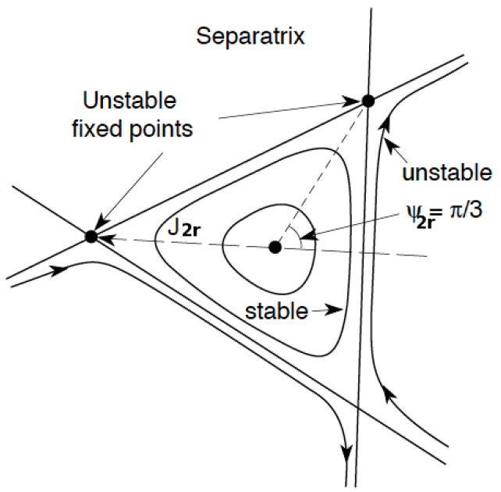
Topology of 3rd order resonance
  Regular motion near the center
  For increasing amplitudes the circles get deformed towards a triangular shape until the resonance condition is met
  The separatrix (barrier between stable and unstable motion) passes through 3 unstable fixed points

Slide 35
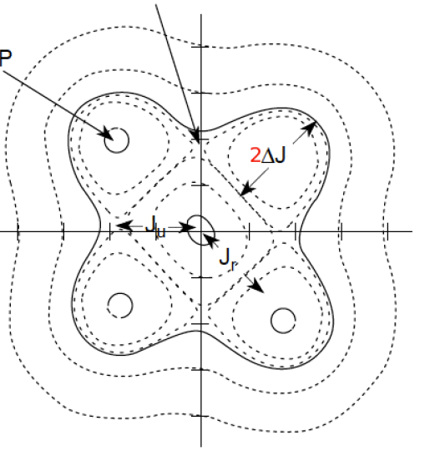
Topology of 4th order resonance
  Regular motion near the center, with curves getting more deformed towards a rectangular shape
  The separatrix passes through 4 unstable fixed points, but motion seems well contained
  Four stable fixed points exist and they are surrounded by stable motion (islands of stability)
UFP
SFP

Slide 36
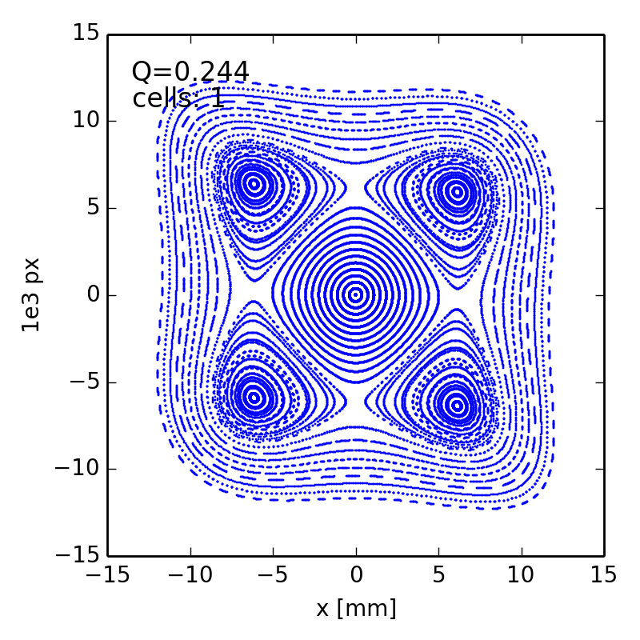
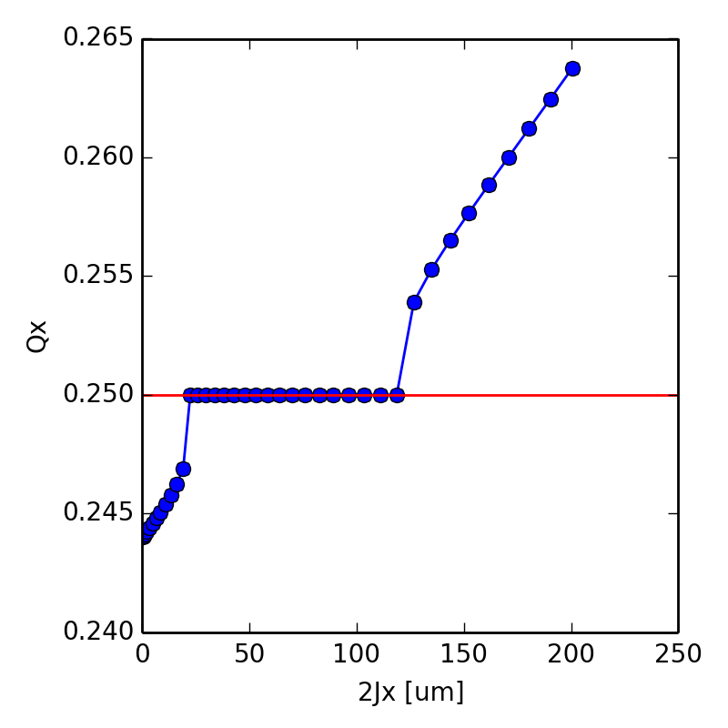
Particle trapped in 4th order resonance
  Simulation of simple storage ring with a single octupole close to 4th order resonance
  Detuning with amplitude (linear in action)
  Particles in the stable islands have tune locked to resonance

Slide 37
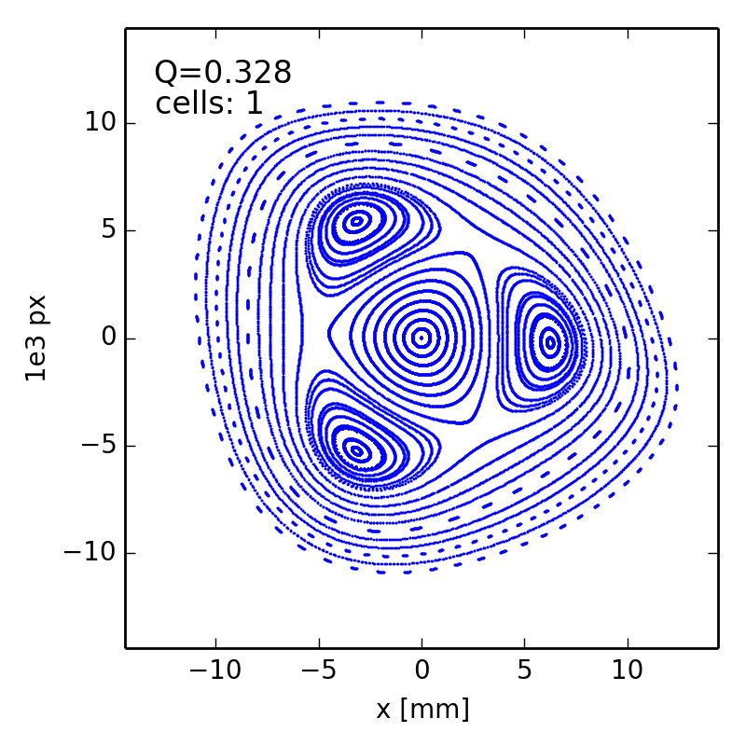
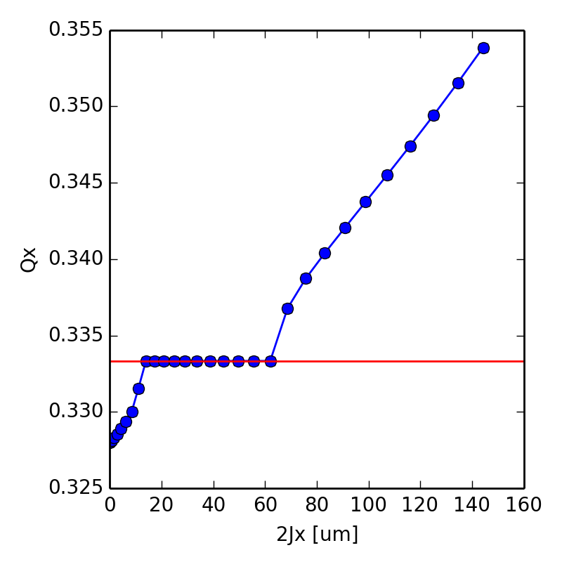
Particle trapped in 3rd order resonance
  Simulation of simple storage ring with a sextupole and an octupole close to 3rd order resonance
  The amplitude detuning induced by the octupole can create stable islands even for the 3rd order resonance (if the resonance is weak enough) – the tune of particles in islands is locked to the resonance while particles at higher amplitudes do not meet the resonance condition any longer → “stabilizing” effect

Slide 38
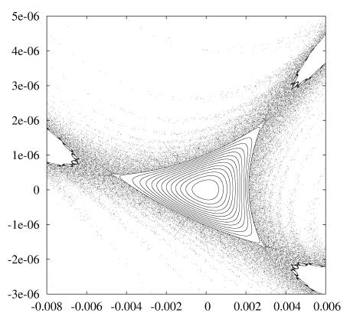
Path to chaos
  When perturbation becomes higher, motion around the separatrix becomes chaotic (producing tongues or splitting of the separatrix)
  Unstable fixed points are indeed the source of chaos when a perturbation is added

Slide 39
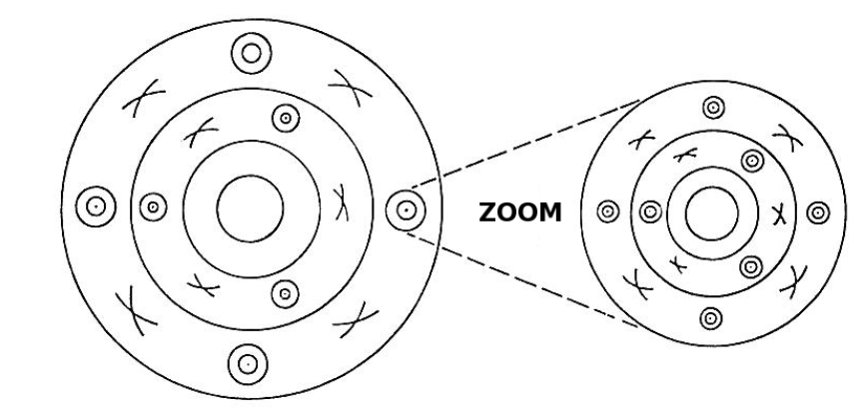
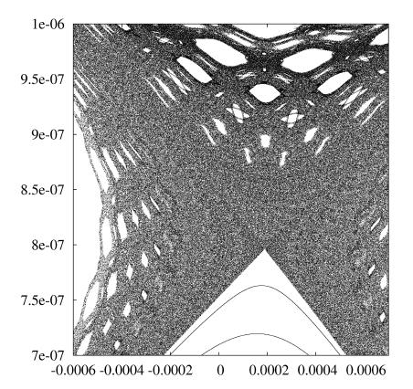
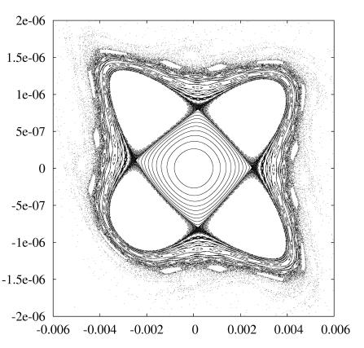
Chaotic motion
  Poincare-Birkhoff theorem states that under perturbation of a resonance only an even number of fixed points survives (half stable and the other half unstable)
  Get destroyed when perturbation gets higher, etc. (self-similar fixed points)
  Resonance islands grow and resonances can overlap allowing diffusion of particles

Slide 40
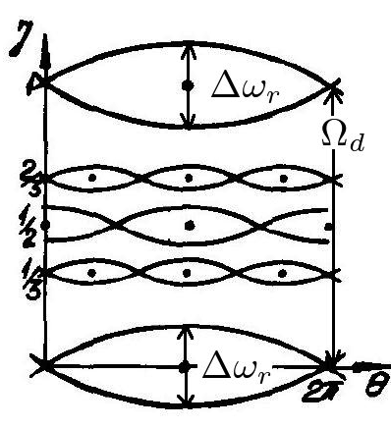
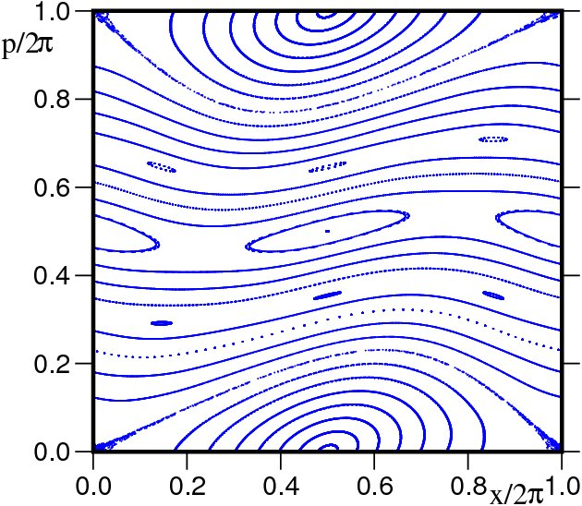
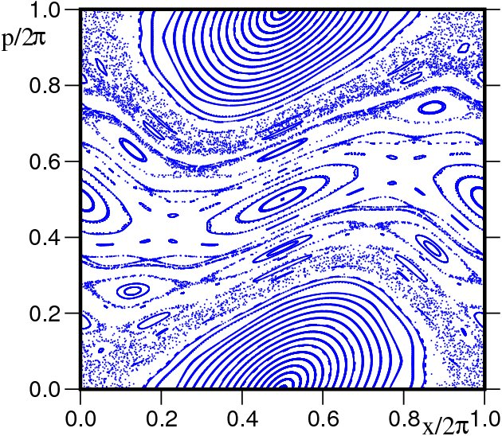
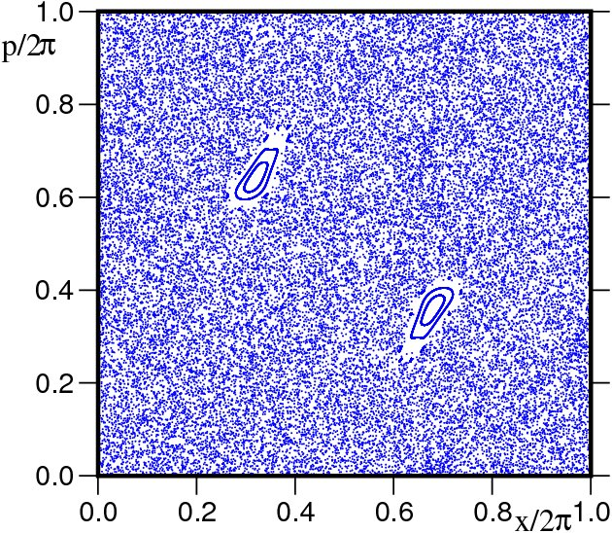
Resonance overlap criterion
  When perturbation grows, the resonance island width grows
  Chirikov (1960, 1979) proposed a criterion for the overlap of two neighboring resonances and the onset of orbit diffusion
  The distance between two resonances is
  The simple overlap criterion is
  Considering the width of chaotic layer and secondary islands, the “two thirds” rule applies
  The main limitation is the geometrical nature of the criterion (difficulty to be extended for > 2 degrees of freedom)

Slide 41
Outline
Introduction – nonlinear effects from a single sextupole
Hamiltonian of the nonlinear betatron motion
Resonance topology and onset of chaos
Resonances are everywhere – can we do something?
Lattice optimization by tracking
Applications – making use of resonances
Summary

Slide 42
Sources of nonlinear magnetic fields
  Resonances can be excited by nonlinear elements installed intentionally (e.g. sextupoles for chromaticity correction) and / or by unavoidable multipolar errors from magnet imperfections
  Especially superconducting magnets can have strong multipolar errors up to very high orders due to the finite size of the coils reproducing only partially the cos-θ dependence of the current distribution necessary to achieve pure dipole fields

Slide 43
What can we do about resonances?
  The number of resonance lines in tune space is infinite: any point in tune space will be close to a resonance of some order
  Remember that the driving terms creating resonances are complex numbers that are obtained by integrating contributions from individual multipoles around the machine taking into account the phase advance. By properly arranging these nonlinear elements around the machine circumference, some resonance driving terms can be cancelled
  Cancellation of resonance driving terms can be achieved by
  Lattice periodicity or designing machine sections with symmetry (e.g. arranging sextupoles in families with certain phase advances, …)
  Add sufficient multipole correctors to control driving terms

Slide 44
Lattice periodicity
  Consider a machine built of a number of identical cells. If a particular resonance is excited or suppressed depends on the resonance harmonic and the periodicity. In fact, the dynamics of a machine with P identical cells and tune of Q is the same as the one of a single sector with tune Q/P.
  Let’s have a look what happens in our simple storage ring when we increase the number of cells but adjusting the phase advance per cell such that the overall tune remains unchanged. At the same time we compute the resonance driving term contribution for each sextupole of the machine and plot it together with the phase space obtained from tracking

Slide 45
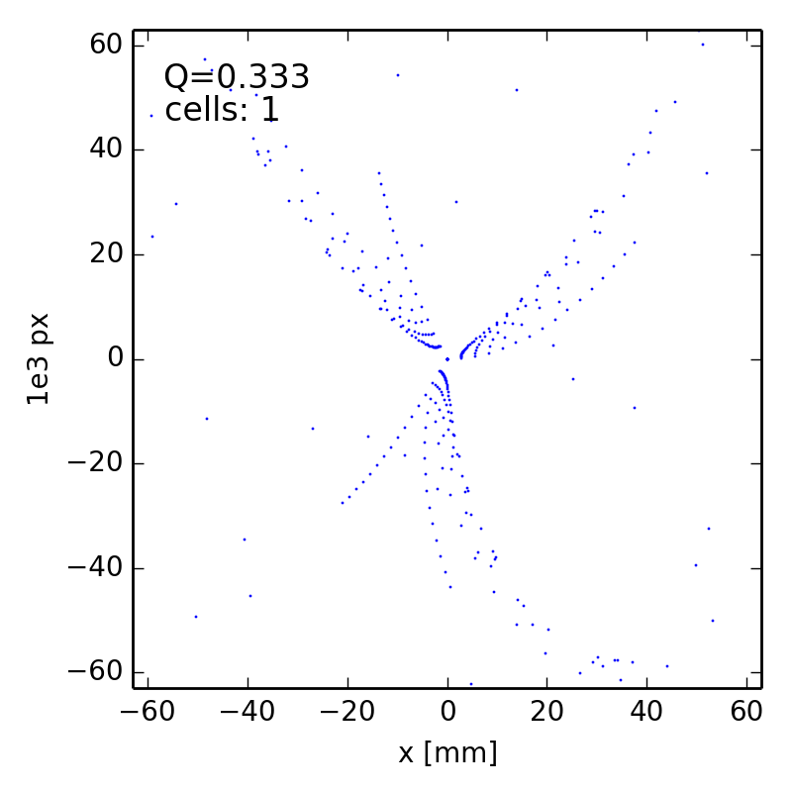
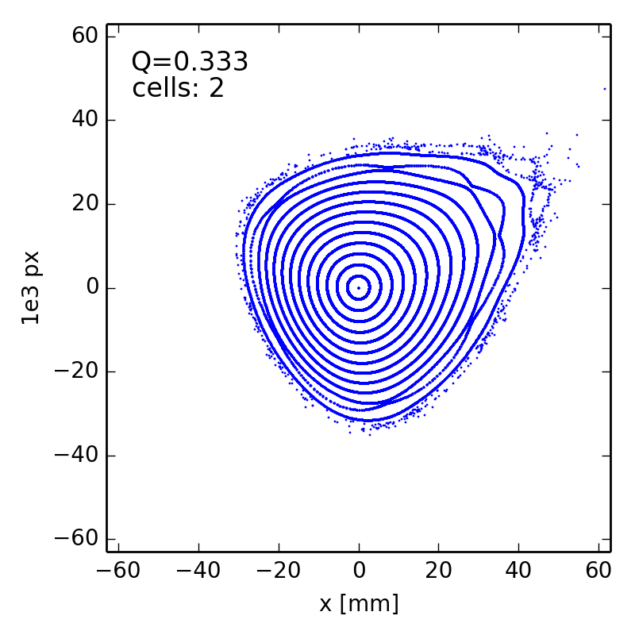
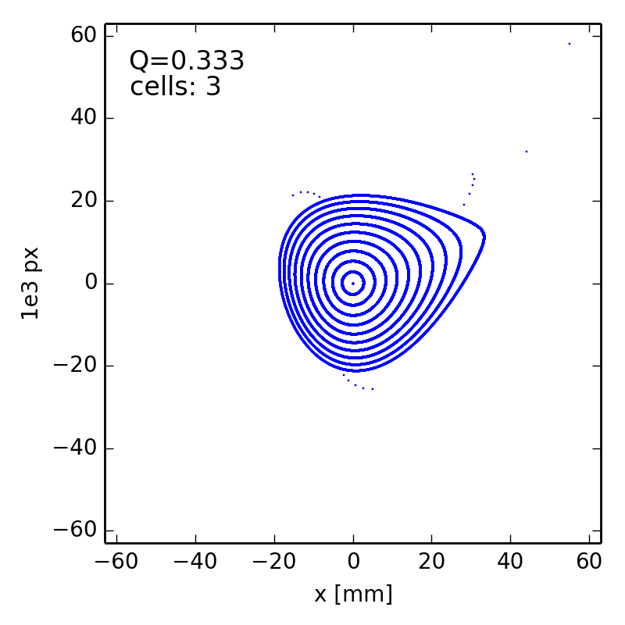
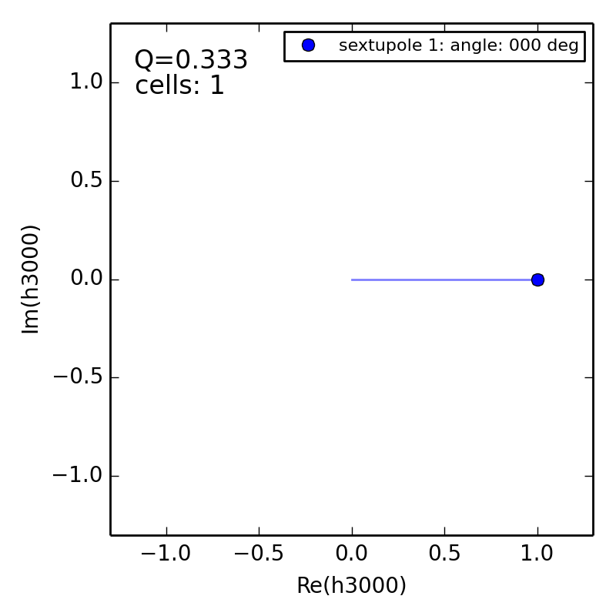
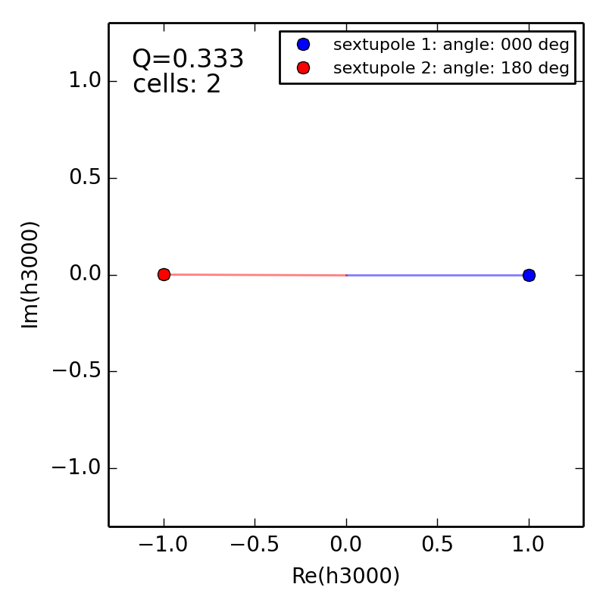
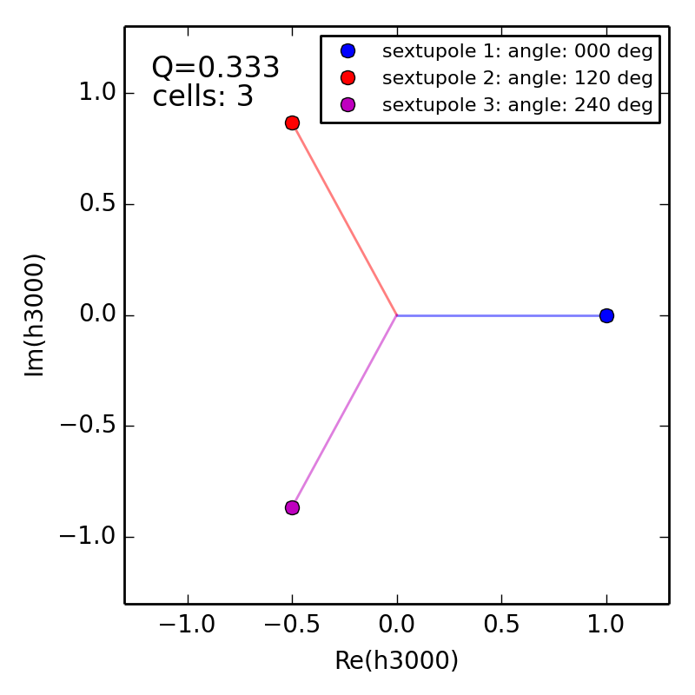
Simple storage ring with periodicity
  3 Qx = 1 resonance

Slide 46
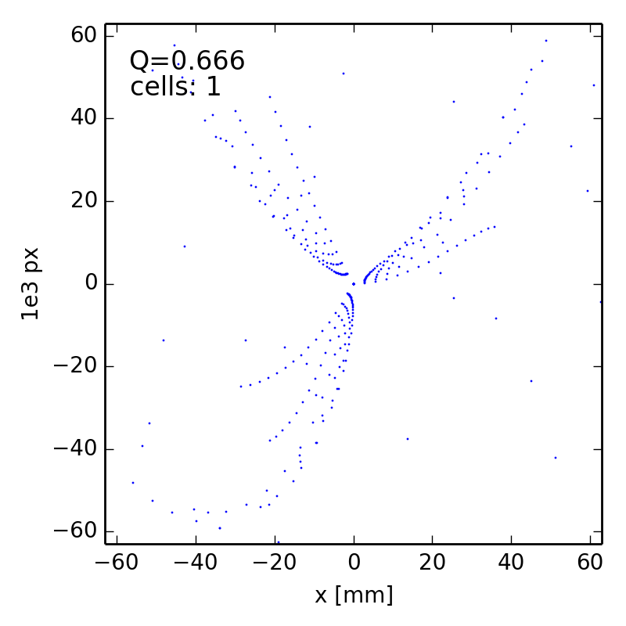
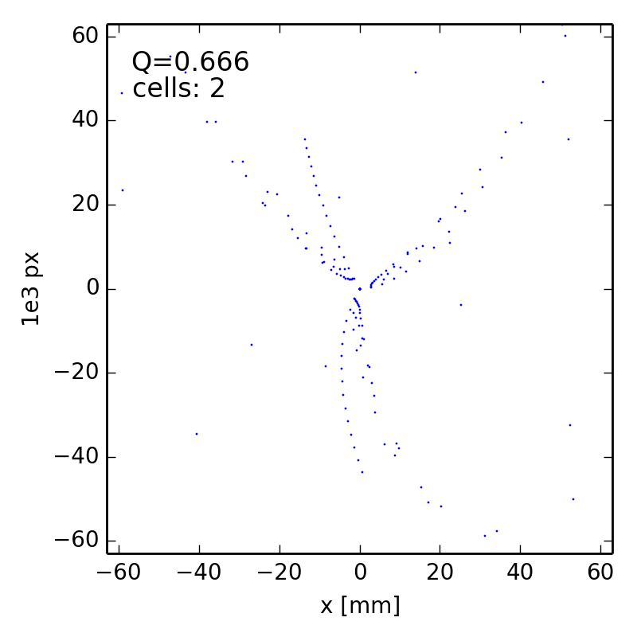
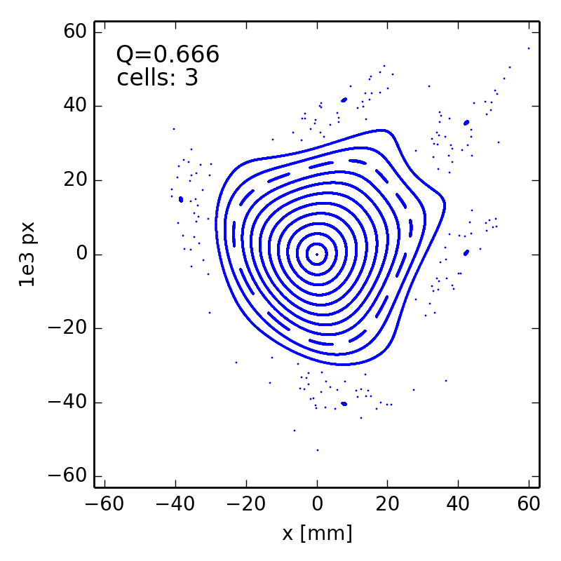

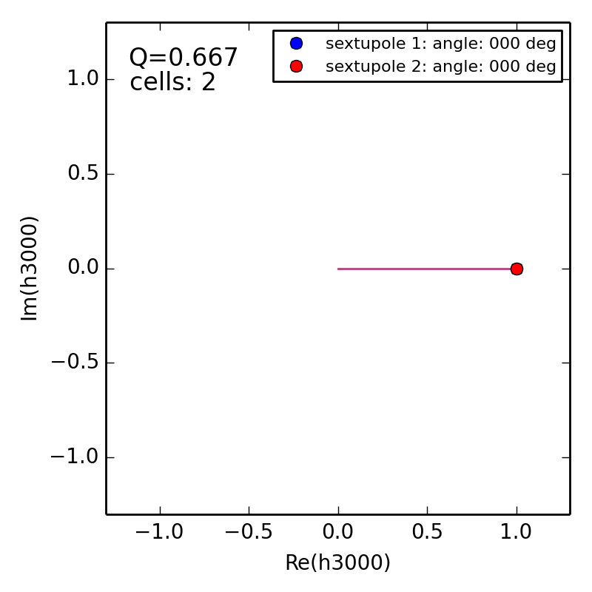
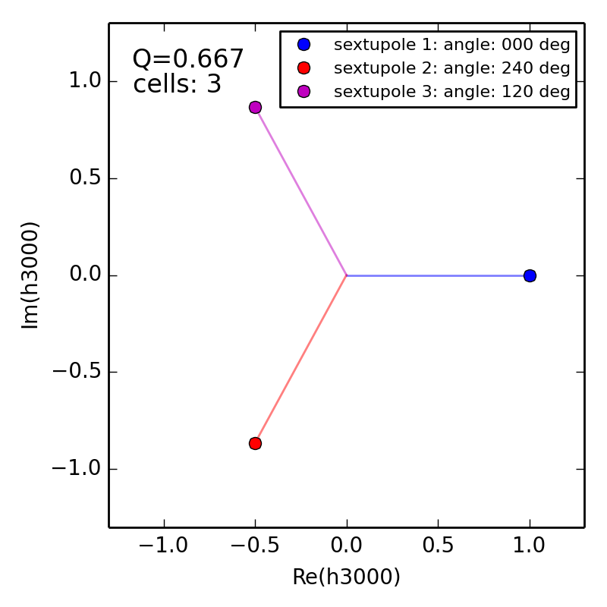
Simple storage ring with periodicity
  3 Qx = 2 resonance

Slide 47
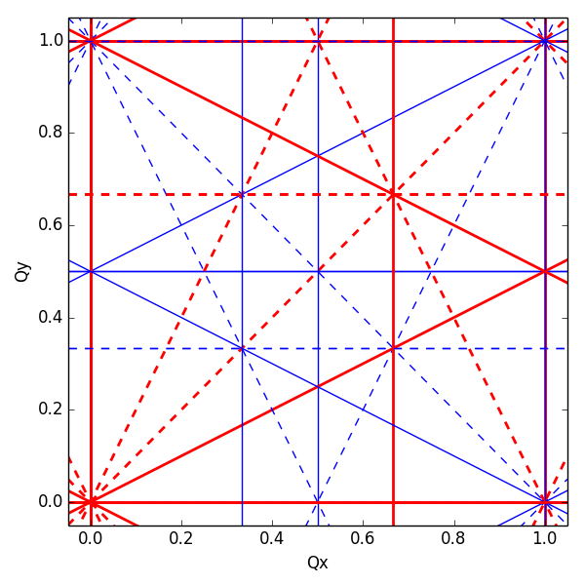
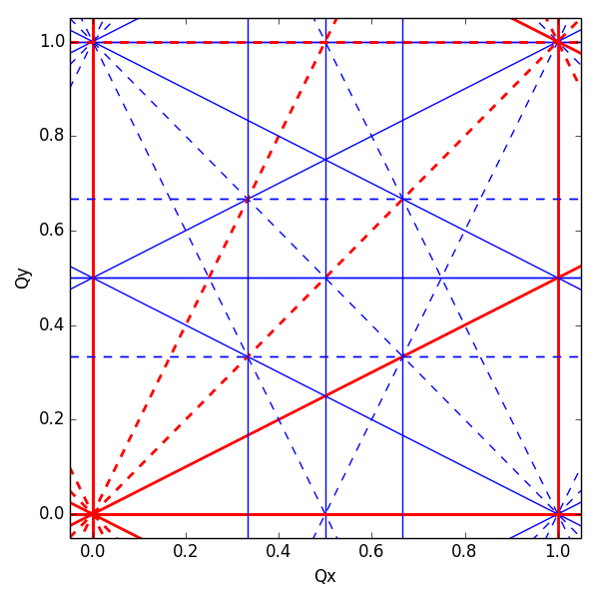
Resonance cancellation by periodicity
  By imposing a periodicity P in the lattice (i.e. building a machine from P identical cells) the resonance condition becomes
  Resonances for which r×P is integer → systematic
  If r×P is NOT integer the driving term cancels → non-systematic
periodicity P=1
periodicity P=2
periodicity P=3
solid lines: normal resonances
dashed lines: skew resonances

Slide 48
Real life example for periodicity: ALS
Advanced Light Source design lattice periodicity: 12
Measurement of beam loss as function of tune
Synchrotron light beam spot
Uncorrected optics
Corrected optics
Beta beating
Before optics correction: ~30%
After optics correction: <1%
Simulated phase space
  D. Robin, C. Steier, J. Safranek, W. Decking, “Enhanced performance of the ALS through periodicity restoration of the lattice,” proc. EPAC 2000.

Slide 49
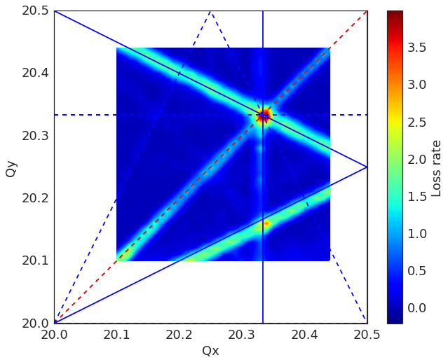
Real life example for periodicity: SPS
  SPS (hadron machine) has design lattice periodicity of 6
  Some indication for the strength of individual resonance lines can be inferred from the beam loss rate during dynamic tune scans, i.e. the derivative of the beam intensity at the moment of resonance crossing
  Sextupole resonances can be clearly identified although they should be suppressed by lattice periodicity … but SPS has no individual quadrupoles to restore optics functions distortions
Measured losses during tune scan
Measured loss rate in 2D scan
time
time

Slide 50
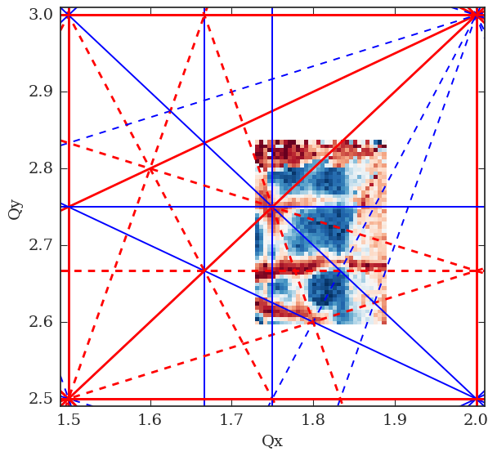
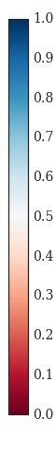
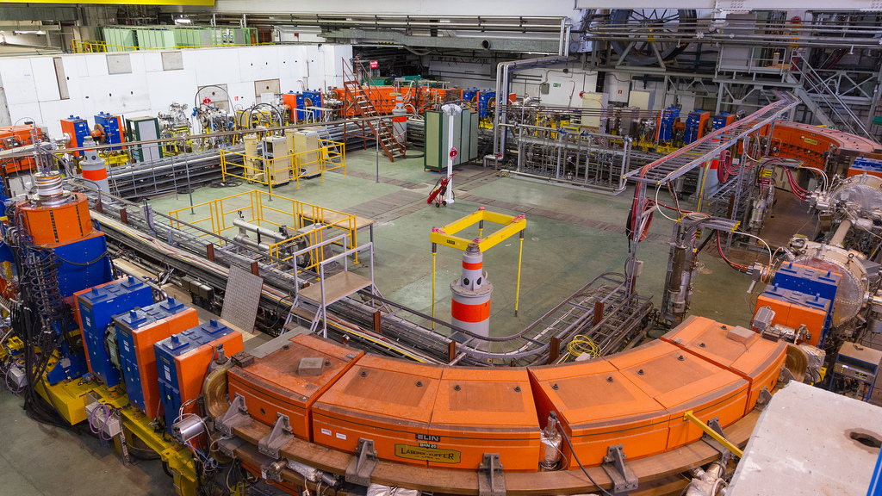
Real life example for periodicity: LEIR
  The Low Energy Ion Ring (LEIR) at CERN is a small ion accumulator with lattice periodicity ≤ 2 (optics perturbations due to e-cooler distort 2 fold symmetry)
  Many resonances observed in measurements
  Sources for some resonances not clear and presently under study (e.g. Qy = 2.66)
Relative intensity
  A. Saa Hernandez, D. Moreno, et al.

Slide 51
Compensation of individual resonance
  If a resonance is sufficiently weak, one can try to globally minimize the corresponding resonance driving term
  A pair of multipole correctors that are ~orthogonal in the corresponding resonance driving term is needed to cover all phases. Ideally these multipole correctors are installed in regions with zero / low dispersion in order not to change the (non-linear) chromaticity
  Note: A setting of multipole correctors that compensate a given resonance might unfortunately excite other resonances
Example: phase space reconstructed from measured turn-by-turn data in PSB ring 1 close to 3 Qy = 16 (systematic skew resonance)
bare machine
after compensation
  P. Urschütz et al.

Slide 52
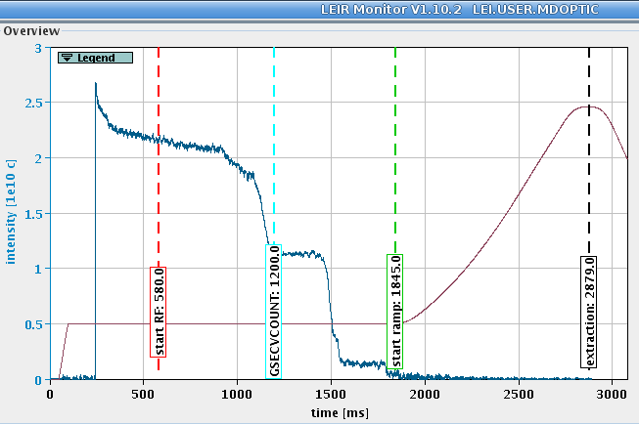
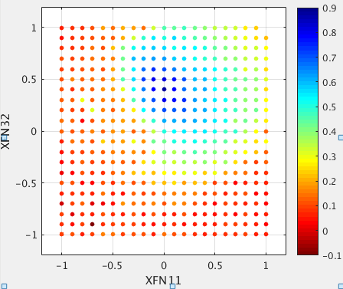
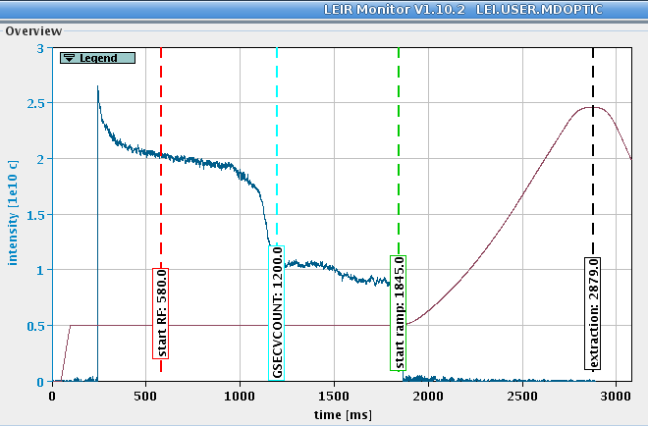
Resonance compensation at LEIR
  Brute force technique: sweep tune through resonance and observe beam loss for different settings of pair of multipole correctors
2 sextupole corrector acting on h1020 resonance driving term
Crossing Qy = 2.66
Crossing Qx+2Qy = 7
(XFN11 = 0 A, XFN32 = 0.4 A)
Crossing Qx+2Qy = 7
relative transmission
  A. Saa Hernandez et al.

Slide 53
Resonance compensation at PSB
  PSB is a machine with 4 rings and periodicity 16
  Each ring has a stack of multipole correctors (quadrupoles, sextupoles and octupoles, all normal and skew!) with appropriate phase advances
  Allows to compensate various resonances around the working point (actually needed because tune spread is large due to space charge)
2Q_{y}=9
2Q_{y}=9
3Q_{y}=15
3Q_{y}=15
Q_{x}+2Q_{y}=13
Q_{x}+2Q_{y}=13
compensation
of various resonances
  V. Forte et al.

Slide 54
Outline
Introduction – nonlinear effects from a single sextupole
Hamiltonian of the nonlinear betatron motion
Resonance topology and onset of chaos
Resonances are everywhere – can we do something?
Lattice optimization by tracking
Applications – making use of resonances
Summary

Slide 55
Dynamic aperture
  The most direct way to evaluate the non-linear dynamics performance of a ring is the computation of Dynamic Aperture (short: DA)
  Particle motion due to multi-pole errors is generally non-bounded, so chaotic particles can escape to infinity
  This is not true for all non-linearities (e.g. the beam-beam force)
  Need a symplectic tracking code to follow particle trajectories (a lot of initial conditions) for a number of turns (depending on the given problem) until the particles start getting lost. This boundary defines the Dynamic aperture
  As multi-pole errors may not be completely known, one has to track through several machine models built by random distribution of these errors
  One could start with 4D (only transverse) tracking but certainly needs to simulate 5D (constant energy deviation) and finally 6D (synchrotron motion included)

Slide 56
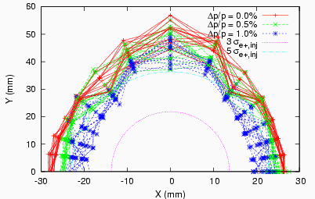
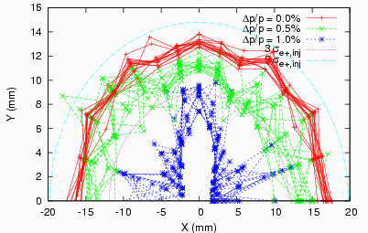
Dynamic Aperture plots
  Dynamic aperture plots show the maximum initial values of stable trajectories in x-y coordinate space at a particular point in the lattice, for a range of energy errors
  The beam size can be shown on the same plot
  Generally, the goal is to allow some significant margin in the design – the measured dynamic aperture is often smaller than the predicted dynamic aperture

Slide 57
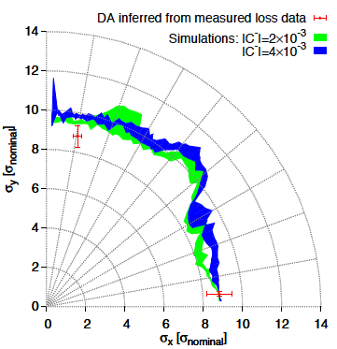
Dynamic Aperture of LHC
  During LHC design phase, DA target was 2x higher than collimator position, due to statistical fluctuation, finite mesh, linear imperfections, short tracking time, multi-pole time dependence, ripple and a 20% safety margin
  Good knowledge of the model led to good agreement between measurements and simulations for actual LHC
E.Mclean, PhD thesis, 2014

Slide 58
Genetic Algorithms
  MOGA –Multi Objective Genetic Algorithms are being used to optimise linear but also non-linear dynamics of electron storage rings
  Use knobs quadrupole strengths, chromaticity sextupoles and correctors with some constraints
  Target ultra-low horizontal emittance, increased lifetime and high dynamic aperture

Slide 59
Frequency Map Analysis
Frequency Map Analysis (FMA) is a numerical method which springs from the studies of J. Laskar (Paris Observatory) putting in evidence the chaotic motion in the Solar Systems
FMA was successively applied to several dynamical systems
  Stability of Earth Obliquity and climate stabilization (Laskar, Robutel, 1993)
  4D maps (Laskar 1993)
  Galactic Dynamics (Y.P and Laskar, 1996 and 1998)
  Accelerator beam dynamics: lepton and hadron rings (Dumas, Laskar, 1993, Laskar, Robin, 1996, Y.P, 1999, Nadolski and Laskar 2001)

Slide 60
NAFF algorithm
  When a quasi-periodic function in the complex domain is given numerically, it is possible to recover a quasi-periodic approximation in a very precise way over a finite time span several orders of magnitude more precisely than simple Fourier techniques
  This approximation is provided by the Numerical Analysis of Fundamental Frequencies – NAFF algorithm
  The frequencies and complex amplitudes are computed through an iterative scheme

Slide 61
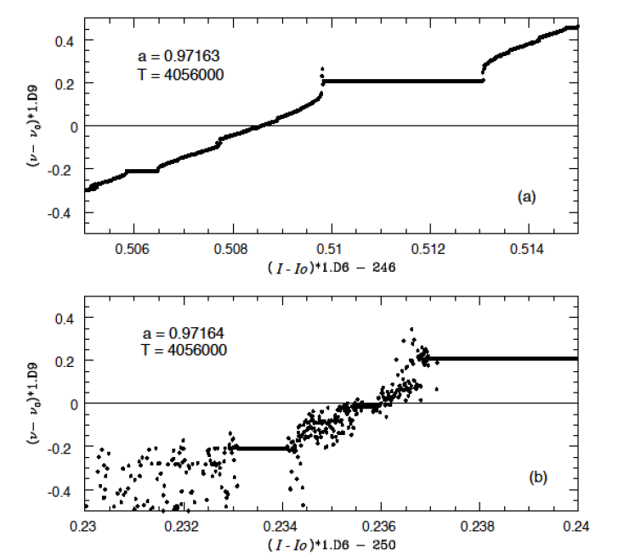
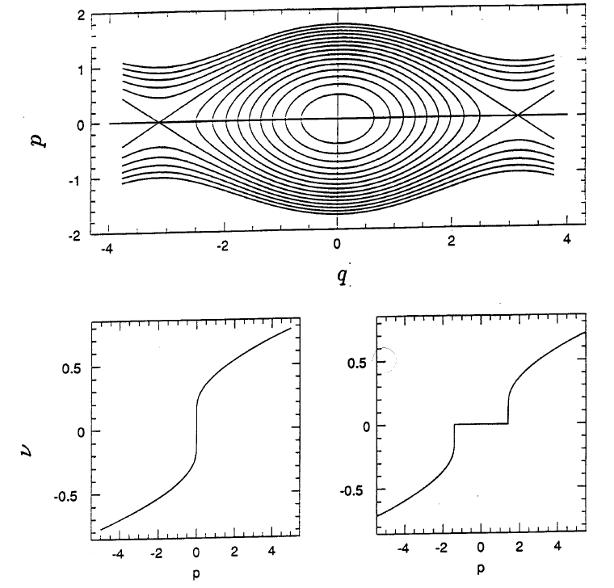
Aspects of the frequency map
  In the vicinity of a resonance the system behaves like a pendulum
  Passing through the elliptic point for a fixed angle, a fixed frequency (or rotation number) is observed
  Passing through the hyperbolic point, a frequency jump is observed

Slide 62

Building the frequency map
  Choose coordinates (x_{i}, y_{i}) with p_{x}=p_{y}=0
  Numerically integrate the phase trajectories through the lattice for sufficient number of turns
  Compute through NAFF Q_{x} and Q_{y} after sufficient number of turns
  Plot them in the tune diagram

Slide 63


Frequency Map for the ESRF
  All dynamics represented in two plots (Frequency Map / Diffusion Map)
  Regular motion represented by blue colors
  Resonances appear as distorted lines in frequency space (or curves in initial condition space)
  Chaotic motion is represented by red scattered particles and defines dynamic aperture of the machine
  FMA shows also nicely the detuning with amplitude
Frequency Map
Diffusion Map

Slide 64
Frequency Map for LHC in collision
  Frequency map analysis for LHC in collision
Large tune footprint and DA reduction due to “long range beam-beam” forces (electromagnetic field of other beam in interaction region)
DA clearly improved when compensating long range beam-beam with a wire
S. Fartoukh et al., PRSTAB, 2015

Slide 65
Experimental frequency maps
  Frequency analysis of turn-by-turn data of beam oscillations produced by a fast kicker magnet and recorded on a Beam Position Monitor
  Reproduction of the non-linear model of the Advanced Light Source storage ring and working point optimization for increasing beam lifetime
D. Robin, C. Steier, J. Laskar, and L. Nadolski, PRL 2000
experiment
simulation

Slide 66
Outline
Introduction – nonlinear effects from a single sextupole
Hamiltonian of the nonlinear betatron motion
Resonance topology and onset of chaos
Resonances are everywhere – can we do something?
Lattice optimization by tracking
Applications – making use of resonances
Summary

Slide 67
Where resonances can be of use
Resonances can be exploited to extract the beam in a controlled way
  Many physicists would like to have a continuous flux of particles to perform experiments with high energy (~low intensity) particles. Resonant slow extraction using 3rd order resonance is widely used to create a “spill” of the order of seconds, i.e. the beam is extracted over many thousands of turns.
  Resonant multi-turn extraction (MTE) was invented to transfer the beam over 5 turns from the PS to the SPS at CERN with minimal losses based on exciting a 4th order resonance.
  Resonant fast extraction is based on excitation of the half integer resonance by octupoles and a fast discharge of a quadrupole that pushes the particle tune onto the resonance so that they are extracted on a few ms.

Slide 68

Principle of resonant slow extraction

Slide 69

Principle of resonant slow extraction
  Closed orbit bump to bring beam close to septum

Slide 70

Principle of resonant slow extraction
  Closed orbit bump to bring beam close to septum
  Sextupole magnets excite 3rd order resonance. Large tune spread (e.g. from chromaticity and not octupoles since we do not want to stabilize the particles)

Slide 71

Principle of resonant slow extraction
  Closed orbit bump to bring beam close to septum
  Sextupole magnets excite 3rd order resonance. Large tune spread (e.g. from chromaticity and not octupoles since we do not want to stabilize the particles)
  ΔQ (distance to resonance) small – large amplitude particles close to separatrices

Slide 72

Principle of resonant slow extraction
  Closed orbit bump to bring beam close to septum
  Sextupole magnets excite 3rd order resonance. Large tune spread (e.g. from chromaticity and not octupoles since we do not want to stabilize the particles)
  ΔQ (distance to resonance) small – large amplitude particles close to separatrices
  ΔQ small enough that largest amplitude particles are unstable and follow separatrix with increasing amplitude - particles jump the septum and are extracted

Slide 73

Principle of resonant slow extraction
  Closed orbit bump to bring beam close to septum
  Sextupole magnets excite 3rd order resonance. Large tune spread (e.g. from chromaticity and not octupoles since we do not want to stabilize the particles)
  ΔQ (distance to resonance) small – large amplitude particles close to separatrices
  ΔQ small enough that largest amplitude particles are unstable and follow separatrix with increasing amplitude - particles jump the septum and are extracted
  As ΔQ approaches zero, particles with very small amplitude are extracted

Slide 74
Slow extraction at SPS
intensity
main field
4.8 s slow
extraction to
North Area
experiments
Beam quality =
constant spill
Correct & constant intensity on target
good & constant steering on target (symmetry = 100%)
resonant slow extraction

Slide 75
Multi-turn extraction – Introduction
Continuous Transfer (=non resonant multi-turn extraction) of high-intensity beams from CERN PS to SPS in use since 1973
  Drawback of high beam loss during the
  process due to physical slicing of the
  beam on septum
  Issues with machine activation (radiation)
  due to losses
Resonant Multi-Turn Extraction (MTE) proposed in 2001 to reduce losses at PS-to-SPS transfer
  MTE based on concepts of non-linear beam dynamics (Crossing of a stable 4th order resonance and particle trapping inside islands) to perform a “magnetic splitting” of the beam to avoid losses on septum
  Unique extraction process, has never been done elsewhere
  Used in routine operation for transfer of fixed target beam since 2015
M. Giovannozzi et. al

Slide 76





Resonant multi-turn extraction
Q_{x} = 0.20
Q_{x} = 0.25
Q_{x} = 0.2505
Q_{x} = 0.254
program non-linear elements to appropriate values to excite resonance (sextupole + octupole)
ramp horizontal tune across the resonant value
decrease current in the elements while increasing the tune
extract the beam once islands are sufficiently separated: 4 machine turns for the islands + 1 turn for the core
M. Giovannozi,
A. Huschauer et al.

Slide 77

Resonant multi-turn extraction
A. Huschauer

Slide 78
Resonant multi-turn extraction
  Calculation of the 4 islands in phase space around the PS machine

Slide 79
Outline
Introduction – nonlinear effects from a single sextupole
Hamiltonian of the nonlinear betatron motion
Resonance topology and onset of chaos
Resonances are everywhere – can we do something?
Lattice optimization by tracking
Applications – making use of resonances
Summary

Slide 80
Summary
  Non-linear elements create detuning with amplitude and excite resonances
  Appearance of fixed points (periodic orbits) determine the topology of the phase space
  Perturbation of unstable (hyperbolic points) opens the path to chaotic motion
  Resonances can overlap enabling the rapid diffusion of orbits
  Individual resonances can be compensated (to some extent)
  Need numerical integration (tracking) for understanding impact of non-linear effects on particle motion (dynamic aperture)
  Frequency map analysis is a powerful technique for analyzing particle motion in simulations but also in real accelerator experiments
  Resonances can be used for beam extraction

