Slide 1

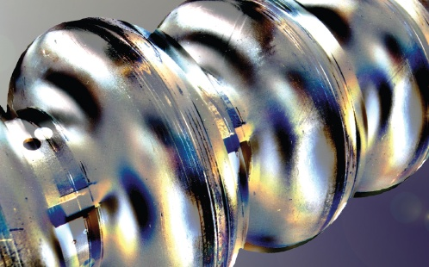
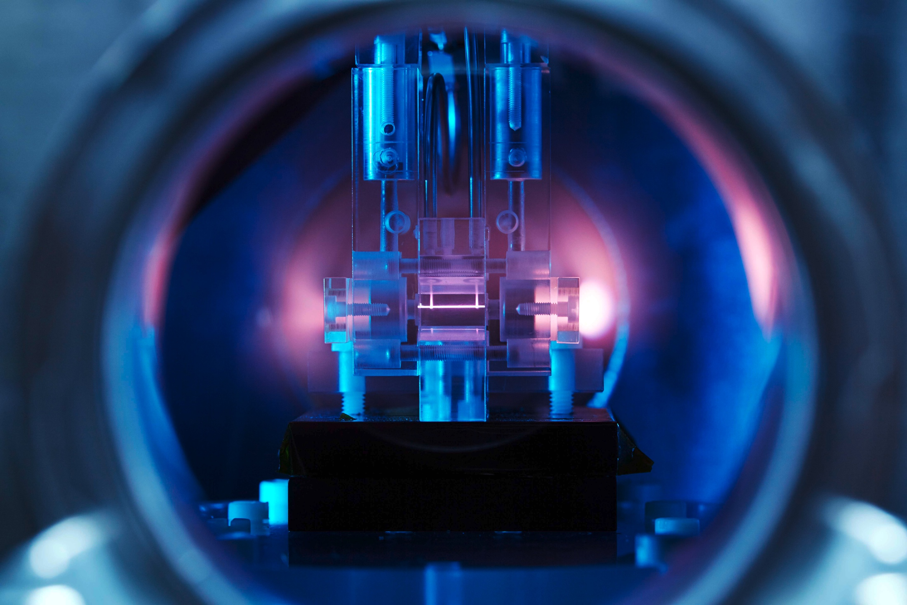
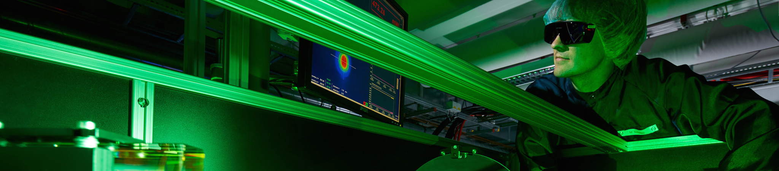
Novel High Gradient Particle Accelerators
Can we build smaller, less expensive accelerators?
JUAS 2021
Archamps, France – Virtual Presentation
26 January 2021
Open DESY PhD Positions to be filled
Tell your friends…
Contact: ralph.assmann@desy.de
Ralph W. Aßmann, DESY

Slide 2
Contents
Accelerators – From Conventional Techniques to Ultra-High Gradients
The Linear Regime
Tolerances
Outlook for Europe

Slide 3
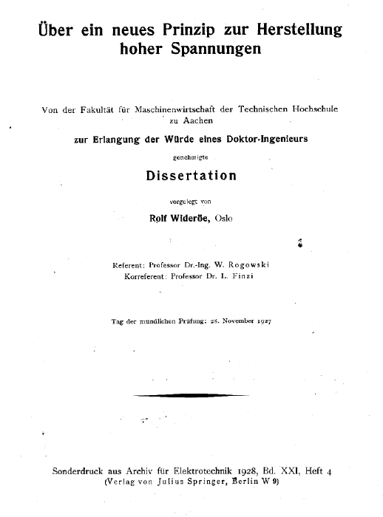
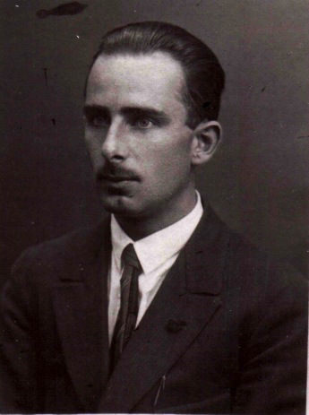
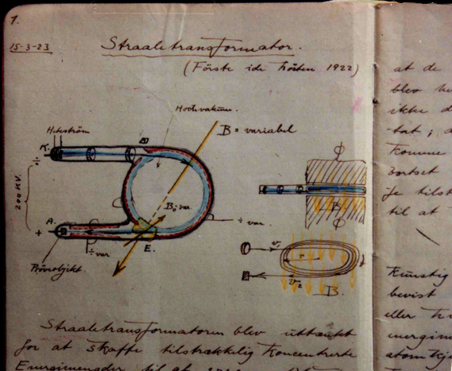
First RF Linac Setup: PhD Wideröe 1927 in Aachen
Where RF accelerators started in practice
27 pages

Slide 4

First RF Linac Setup: PhD Wideröe 1927 in Aachen
Where RF accelerators started in practice
27 pages

Slide 5
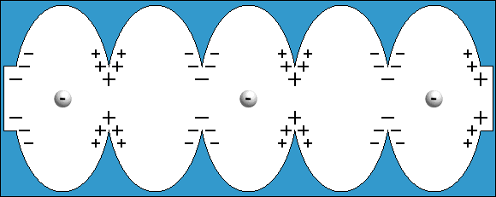
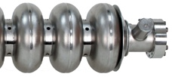
Electron Acceleration: The Success of RF
Alternating field (RF) synchronized to the particles
Higher energies with alternating voltage („RF“):
RF technology (first shown by Wideröe 90 years ago) a tremendous success story.
Lesson: Never give up if up, if colleagues say it does not work – unless they can prove it to you by scientific means.
Sketch Padamse, Tigner
“Runzelröhre”
20.000.000 Volt per Meter

Slide 6
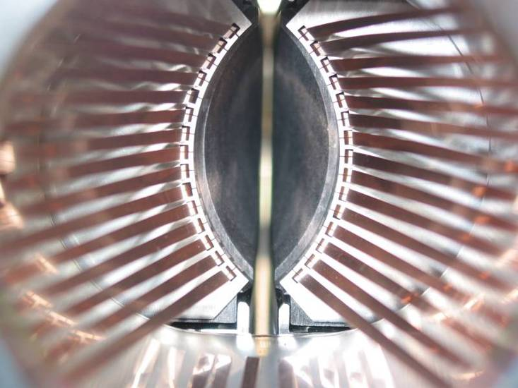
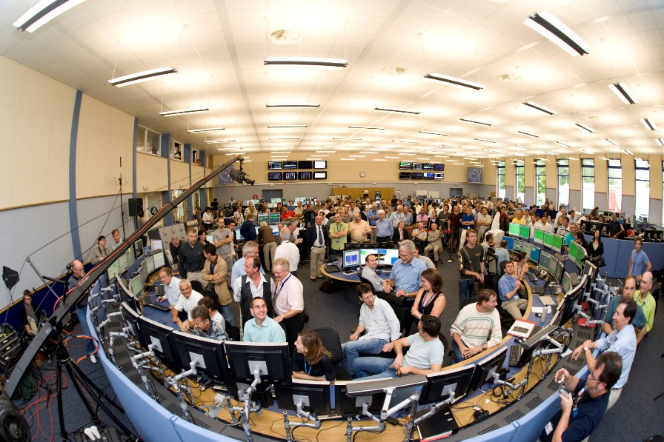
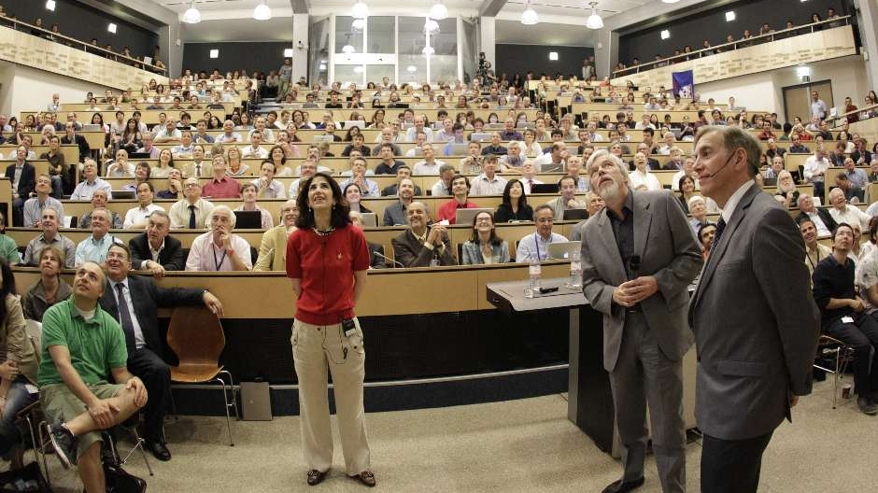
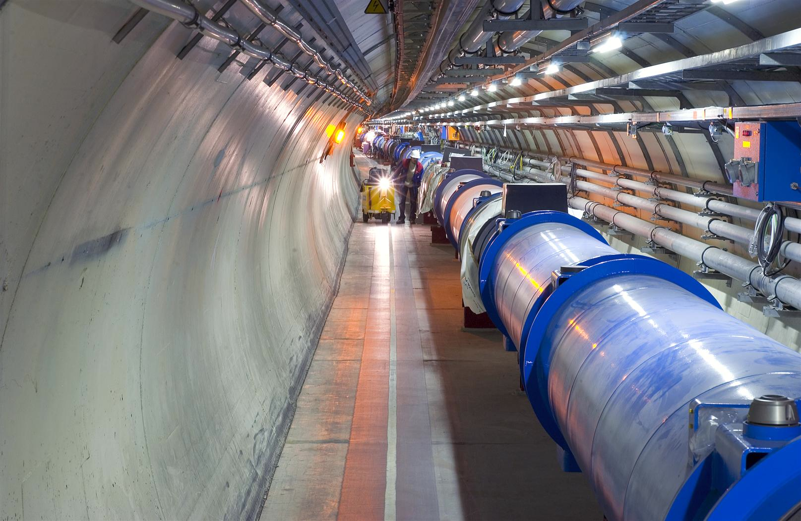

LHC as a Masterpiece of Accelerator Science
80 Years (and many inventions) later
Higgs
Sem.
4.7.
2012
First beam 10.9. 2008

Slide 7
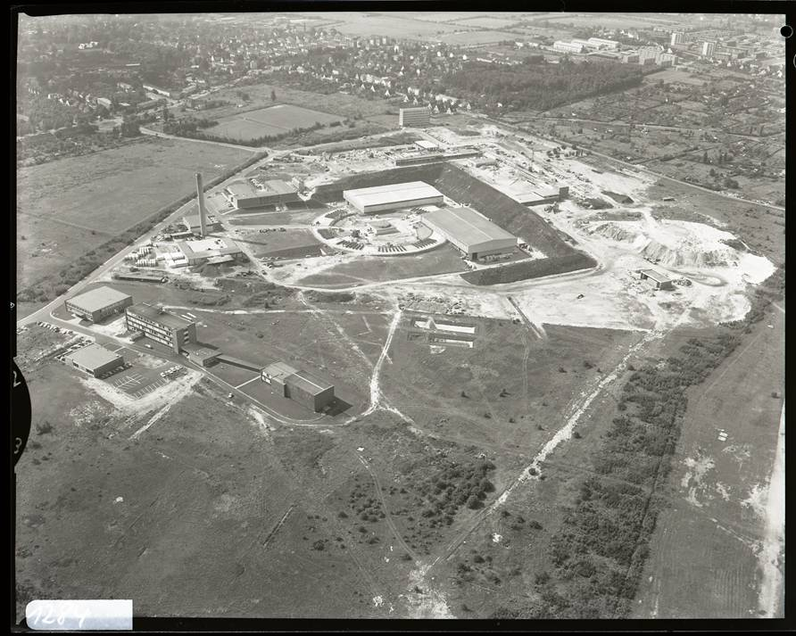
Particle accelerators have transformed DESY
From 50 years ago to today…
DESY started as a particle physics laboratory
Several flagship projects in the international race to discover new forces and particles.

Slide 8

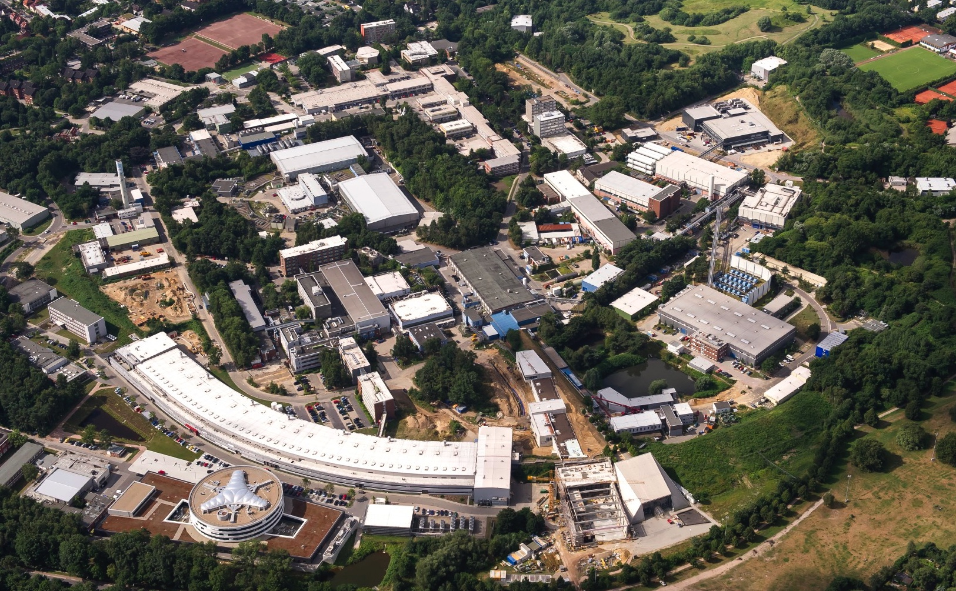

Particle accelerators have transformed DESY
From 50 years ago to today…
DESY
1962
SR
6 GeV
PETRA III
2010
FEL
17,5 GeV
P3X Ost
2015/16
EU.XFEL
2017
NanoLab
P3X Nord
2015
FLASH II
2015
variable gap U
FLASH
2005
4,2nm - 45nm
1,7nm 3rd harm
FEL
1,25 GeV
BUT:
Progress in Hamburg-based colliders limited by practical considerations on size and cost.

Slide 9
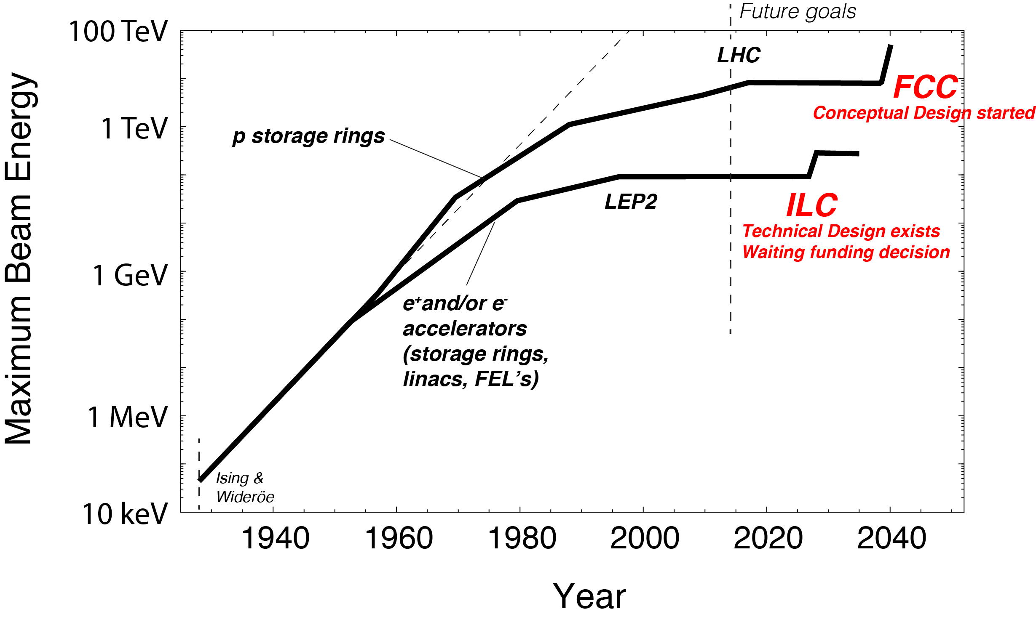
Slow-down in Energy Increase of Frontier Accelerators
Livingston plot leveling off – here our version, giving beam energy versus time
Hadron acc. project
HiLumi
Hadron acc. proposal
Lepton acc. project
Lepton acc. proposal
Advance of new colliders limited by practical constraints on required resources (budget, manpower) and size (does it fit on site?)

Slide 10
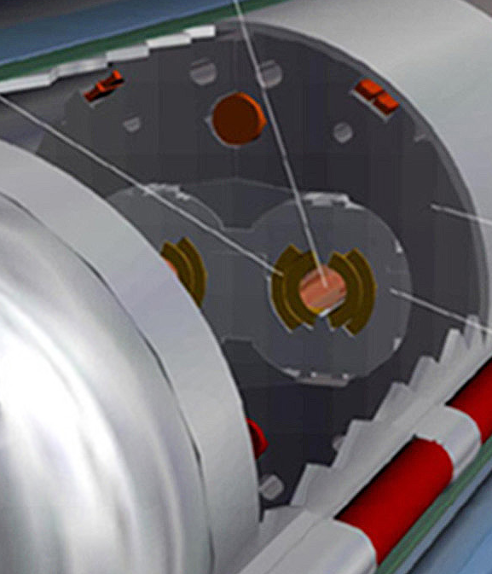
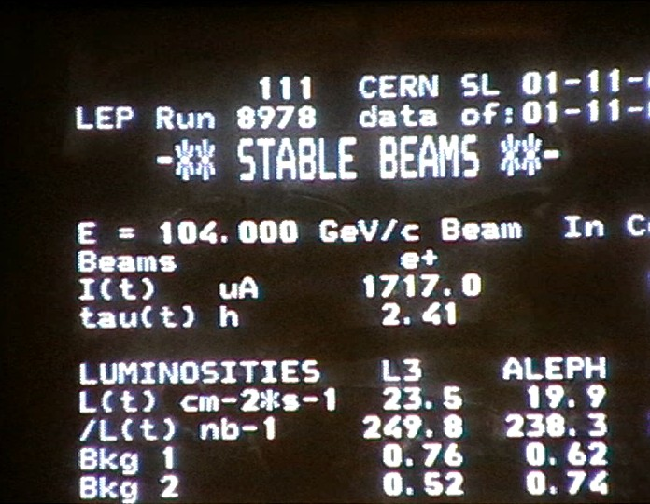
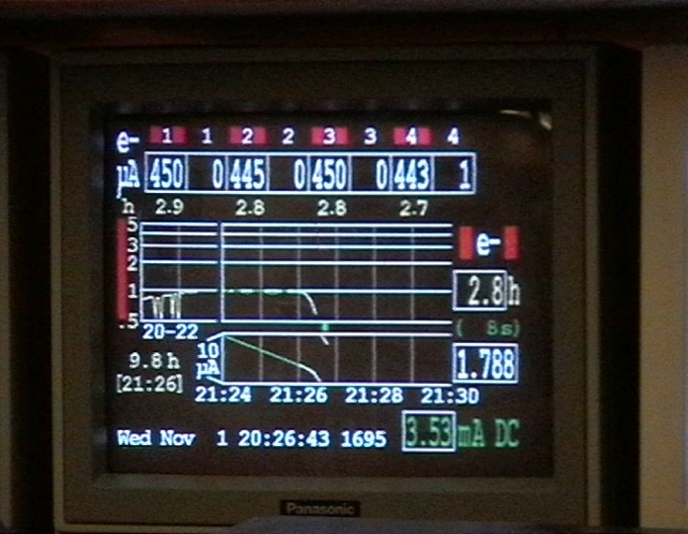
Why this slow-down? Part 1
Technical limitations in highly advanced and mature technologies
Hadron (p) circular collider
Limited by available bending field strength B_{y} (even super-conducting):
Increase momentum p by increasing radius R times bending field B_{y}
Lepton (e-,e+) circular collider
Limited by synchrotron radiation losses U₀, to be fed back by RF voltage V_{RF}:
Increase momentum p by increasing radius R and lowering bending field B_{y}
E.g. LEP2: 3% of energy lost per turn, 10,000 turns/second

Slide 11
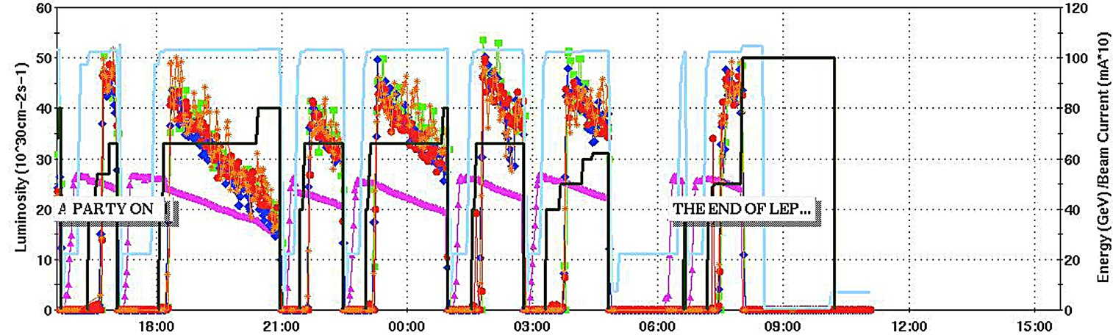
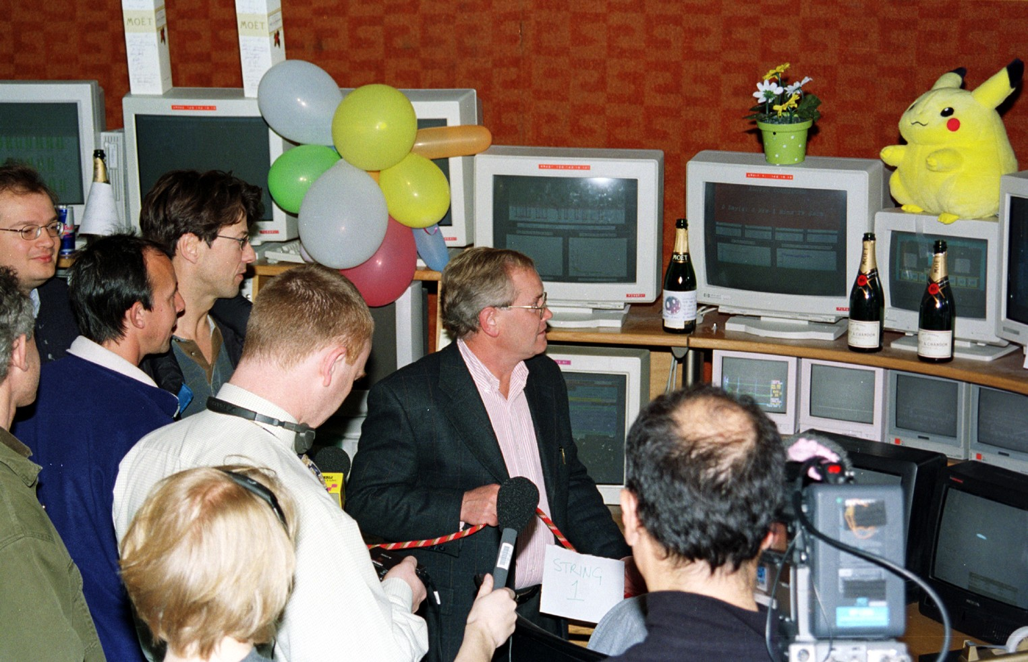
The End of LEP2
November 2nd, 2000, 7am
When we shut down LEP2 in 2000 we thought that it was the last e+e- circular collider due to synchrotron radiation limit!
But what about going linear? This avoids synchrotron radiation limitation! Why also slowing down?

Slide 12

Why this slow-down? Part 2
Technical limitations in highly advanced and mature technologies
Lepton (e-,e+) linear collider
Limited by achievable accelerating gradient (energy gain per length)
Increase momentum p by increasing gradient G_{acc} or length L
Achievable accelerating gradient limited by
peak surface field, flashovers, surface
damage and breakdown rate
Example shows a result from CLIC at
a high RF frequency of 30 GHz
By now, some important progress made
but gradients limited to 100 MV/m at max
presently
Flashover at too high voltages
Sketch Padamse, Tigner
“Runzelröhre”
20 MV per Meter
CLIC, W. Wuensch
Damaged location
30 GHz, 16 ns,
66 MV/meter
W. Wuensch

Slide 13
How to advance?
Looking for solutions
Hadron (p) circular collider
Increase bending field
SC bend magnet work (FCC-hh)
Increase radius = size (FCC-hh)
Lepton (e-,e+) circular collider
Increase supplied RF voltage
(FCC-ee)
Increase mass of acc. particle (muon)
Increase radius = size (FCC-ee)
Lepton (e-,e+) linear collider
Increase accelerating gradient
Pushing existing technology (ILC, CLIC)
New regime of ultra-high gradients (plasma, dielectric accelerators)
Increase length (ILC, CLIC)

Slide 14
How to advance?
If you look at it this way, you realize the complementarity of various accelerator R&D efforts, covering the whole space of possible solutions! We need to look at all the options to ensure the future!
Looking for solutions
Hadron (p) circular collider
Increase bending field
SC bend magnet work (FCC-hh)
Increase radius = size (FCC-hh)
Lepton (e-,e+) circular collider
Increase supplied RF voltage
(FCC-ee)
Increase mass of acc. particle (muon)
Increase radius = size (FCC-ee)
Lepton (e-,e+) linear collider
Increase accelerating gradient
Pushing existing technology (ILC, CLIC)
New regime of ultra-high gradients (plasma, dielectric accelerators)
Increase length (ILC, CLIC)

Slide 15
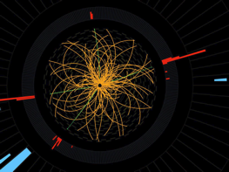
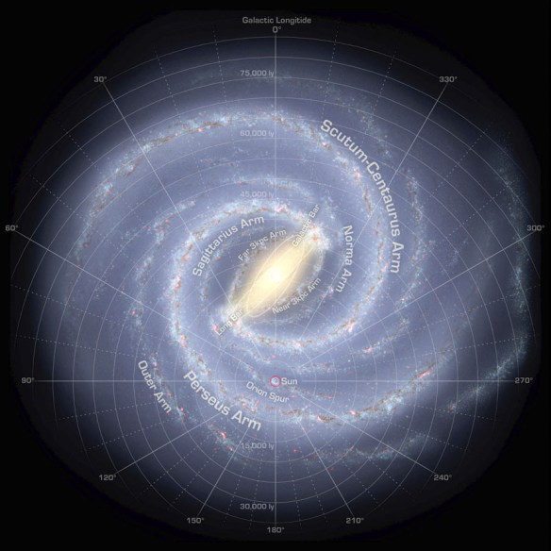

We can dream big ...
The ultimate colliders
FERMITRON
PLANCKATRON
1.22×10¹⁹ GeV
R. Assmann, EuroNNAc @ ICAN, 4/2014

Slide 16
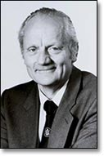
But: It is the cost not the size...
“Of course, it should not be the size of an accelerator, but its costs which must be minimized.”
Gustav-Adolf Voss,
builder of PETRA, DESY accelerator director
† 5. October 2013

Slide 17
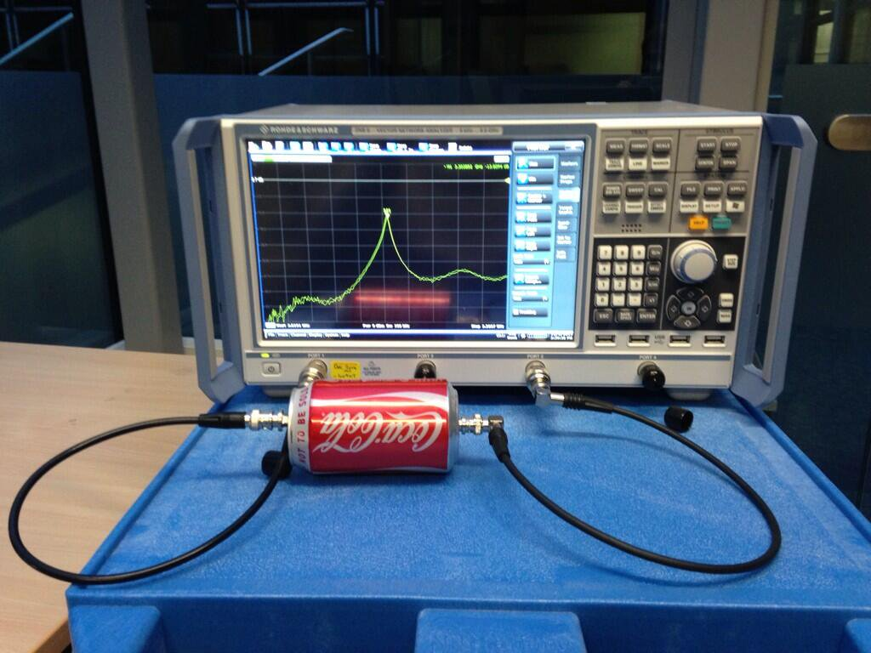
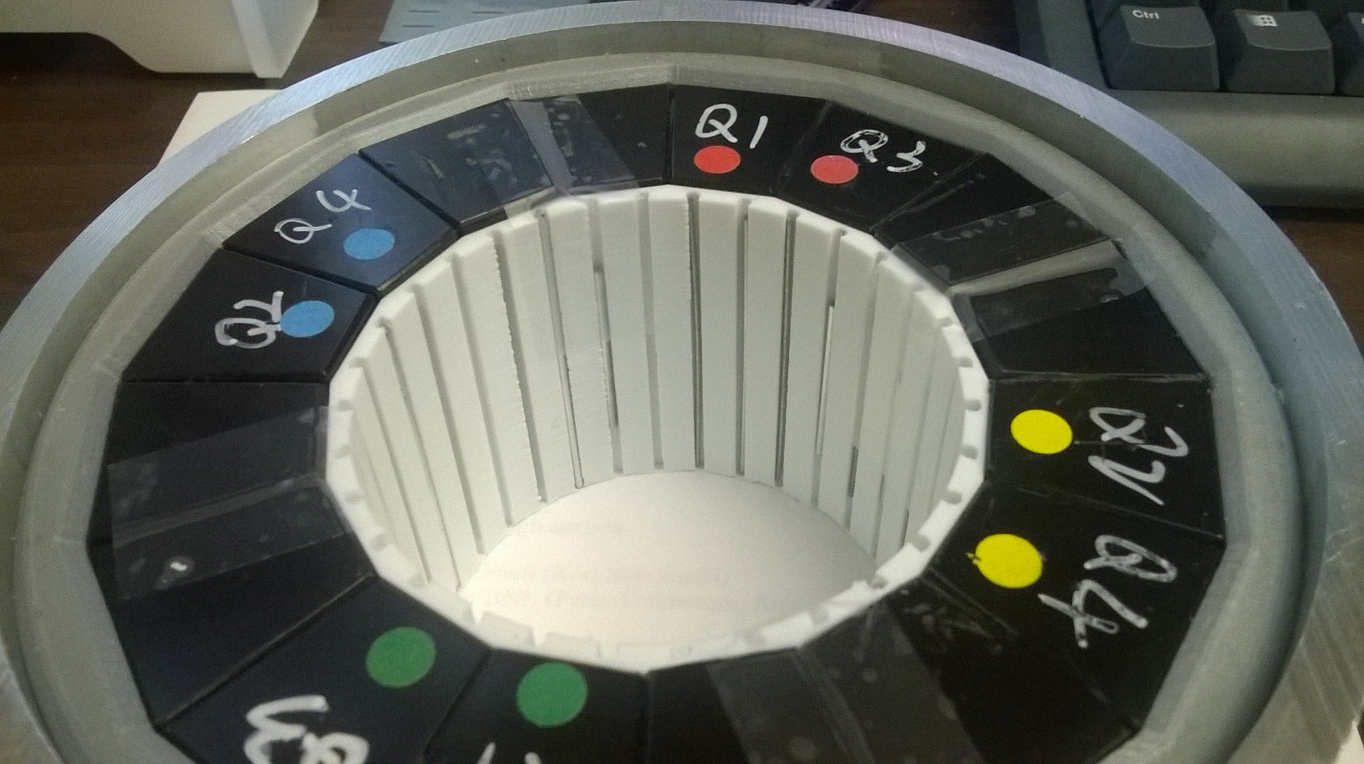
... we can dream affordable ...
Can we bring down cost per meter of accelerator by a factor 2 – 10?
Halbach quadrupole using NdFeB, 3D printed, 23.6 T/m, R=34.7mm bore (0.82T max), 10⁻⁴ errors at R=10mm
Ciprian Plostinar (RAL/STFC)
f = 3.3 GHz, Q = 50
Material cost: $1100. No alignment better than 0.25 mm required anywhere. Assembled with mallet.
Material and pictures courtesy S. Brooks, BNL

Slide 18
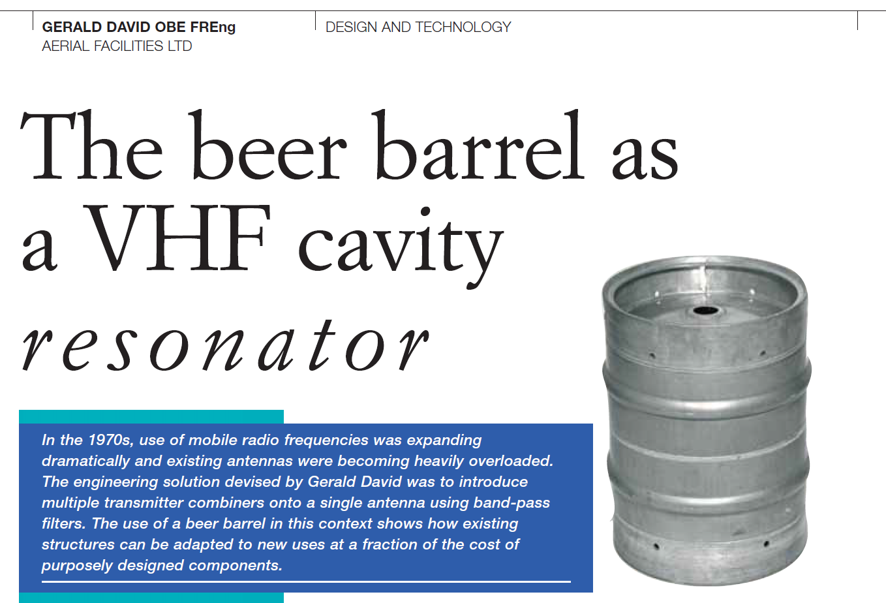
... and even more affordable ...
Can we bring down cost per meter of accelerator by a factor 2 – 10?
f = 150-165 MHz, Q = 9700
Material and pictures courtesy S. Brooks, BNL

Slide 19
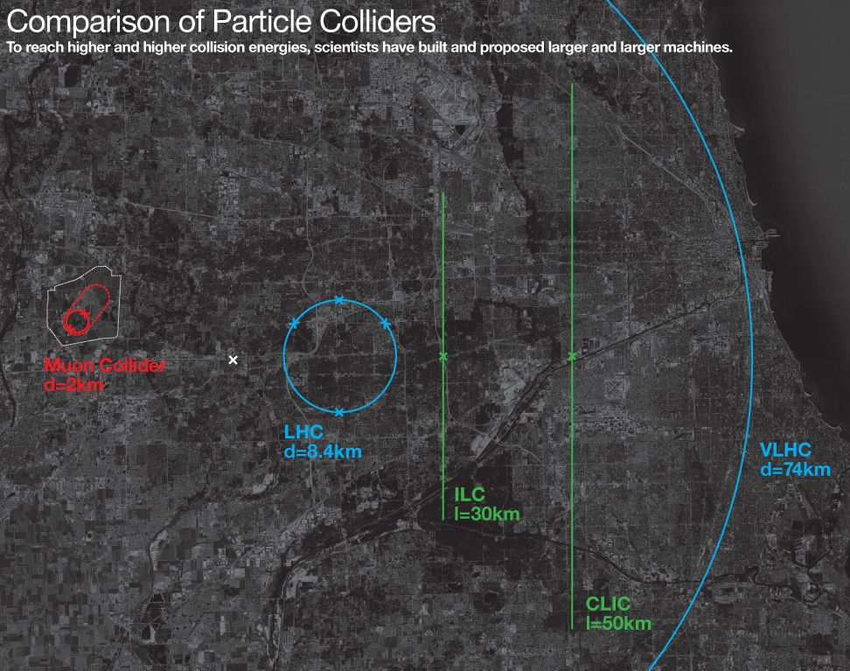
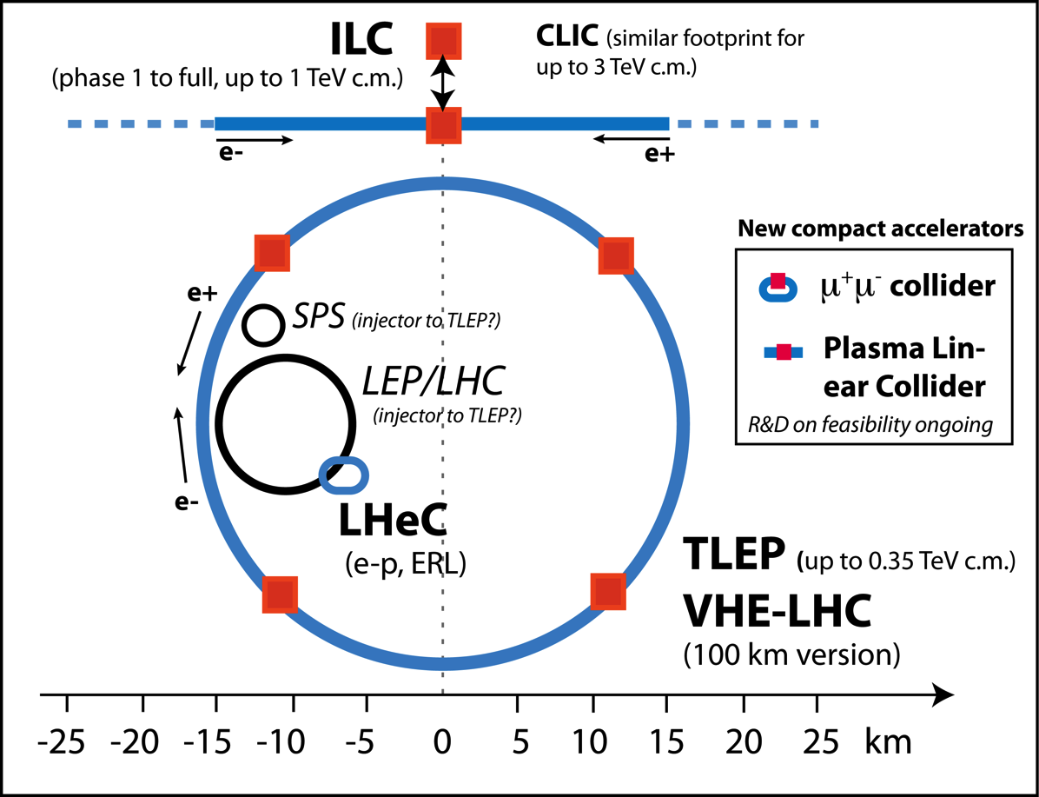
…and we can dream small (and affordable)!
New generation(s) of particle physics colliders?
TDR’s
published
FCC
Future Circular Collider
100 km, e+e-, pp
Technical design to be done
TDR to be
worked out
Courtesy Fermilab Website

Slide 20
The R&D on Compact Accelerators
BIG factors → Novel concepts pursue transformative concepts that can open new horizons in energy reach for HEP research
Looking for solutions
Hadron (p) circular collider
Increase bending field
SC bend magnet work (FCC-hh)
Increase radius = size (FCC-hh)
Factor 206.8 higher mass muon versus electron
Lepton (e-,e+) circular collider
Increase supplied RF voltage
(FCC-ee)
Increase mass of acc. particle (muon)
Factor 100 – 1000 higher accelerating gradient
Increase radius = size (FCC-ee)
Lepton (e-,e+) linear collider
Increase accelerating gradient
Pushing existing technology (ILC, CLIC)
New regime of ultra-high gradients (plasma, dielectric accelerators)
Increase length (ILC, CLIC)

Slide 21

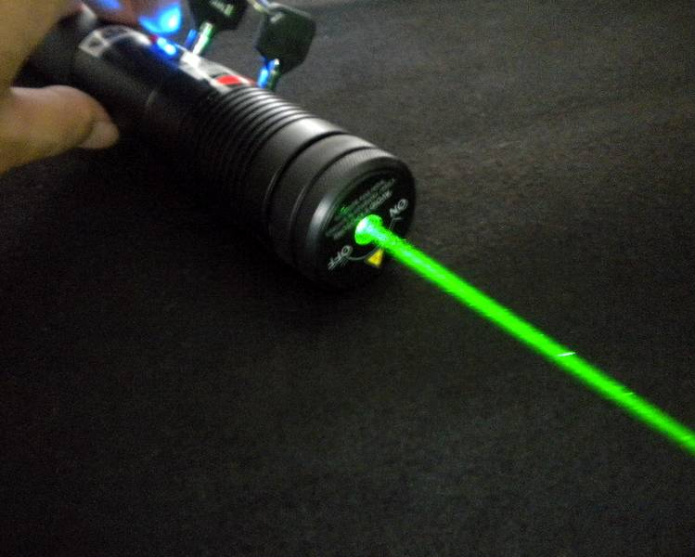
Acceleration: Conventional and Advanced
How to get higher accelerating voltage?
Surfer gain velocity and energy by riding the water wave!
Charged particles gain energy by riding the electromagnetic wave!
Modern lasers generate light pulses with very large transverse fields:
Many 1.000 billion volt per meter
Plasma or metallic structures couple fields to our particles!

Slide 22
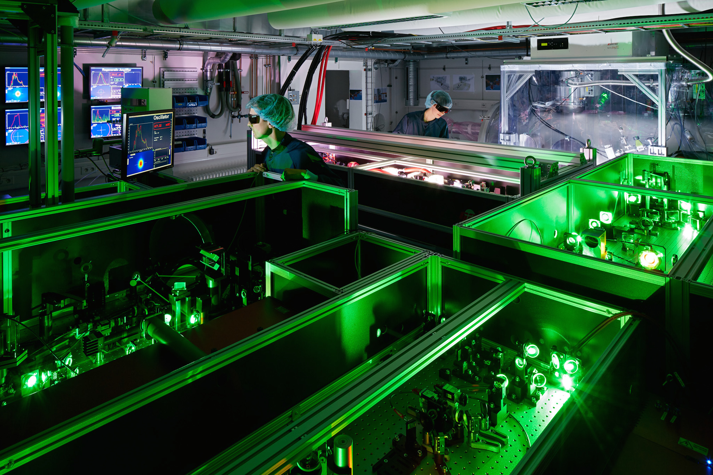
ANGUS Laser Laboratory for Accelerator R&D
200 TW Ti-Sa laser, DESY & University Hamburg

Slide 23


The Laser Promise: Transverse Electrical Field
We can produce every day very high transverse electrical fields

Slide 24


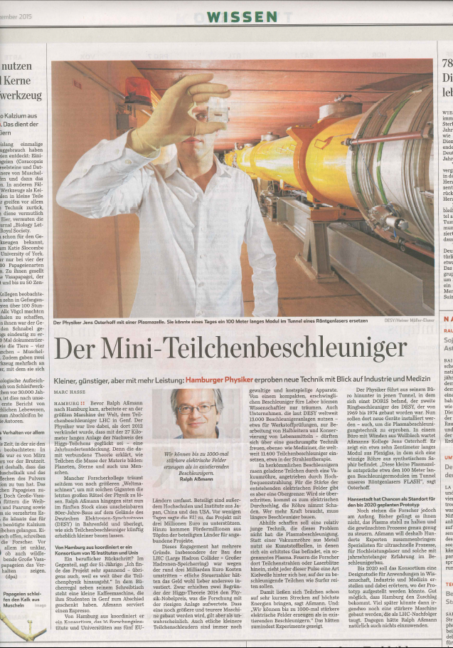
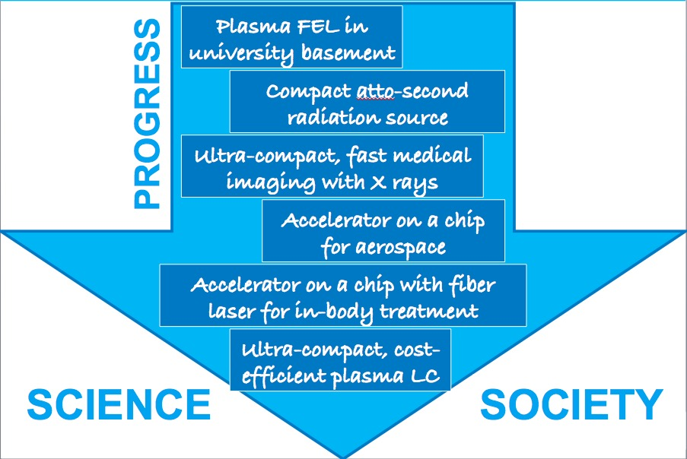




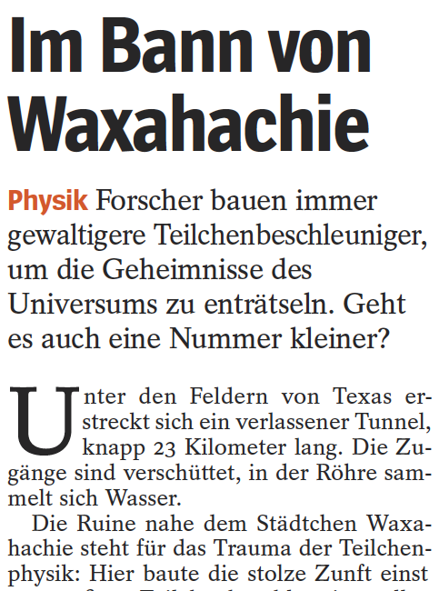
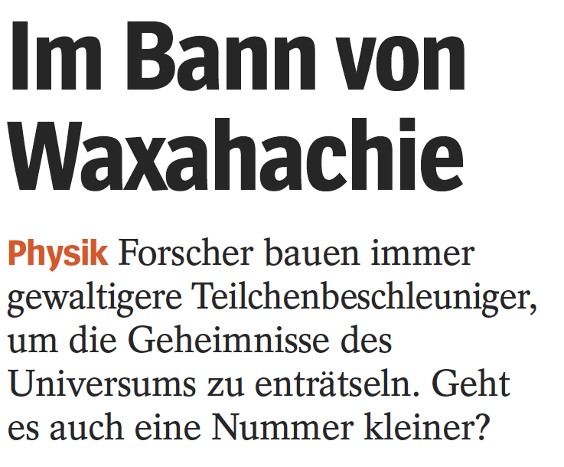
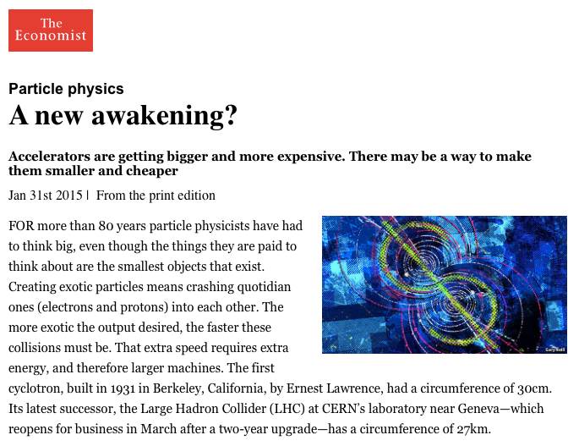
High fields trigger imagination of scientists and public…
New technology opens new possibilities

Slide 25
High Gradient – High Frequency – Small Dimensions
Understanding frequency bands and its basic properties
Sketch Padamse, Tigner
“Runzelröhre”
20.000.000 Volt per Meter

Slide 26
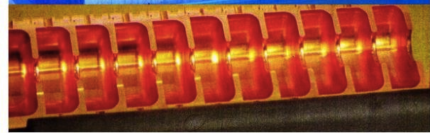
High Gradient – High Frequency – Small Dimensions
Understanding frequency bands and its basic properties

Slide 27
High Gradient – High Frequency – Small Dimensions
Understanding frequency bands and its basic properties

Slide 28
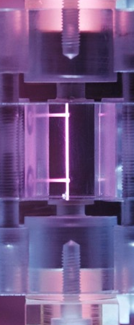

Slide 29
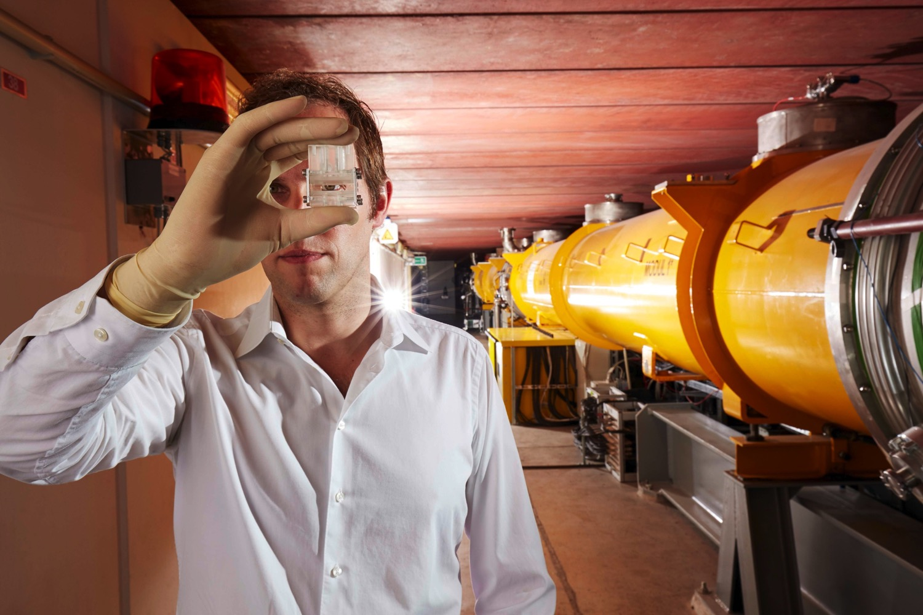
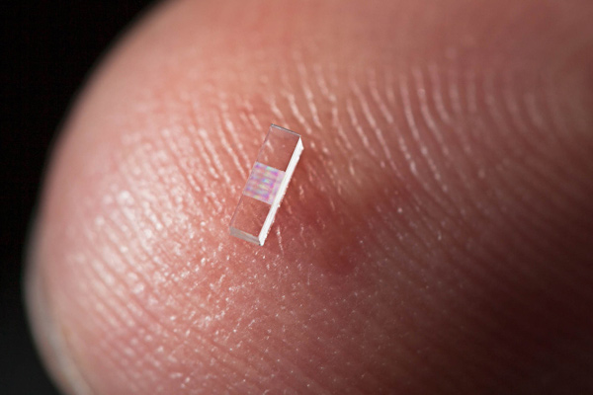
High Gradient – High Frequency – Small Dimensions
Powering novel accelerators
High → High → Small
Gradients Frequencies Dimensions
(1 – 100 GV/m) (> 100 GHz) (< 1 mm)
No klystrons for high frequencies!
Use particle bunches or laser pulses as drivers.
Material limitations solved through “new cavities”: dielectric materials,
plasma cavities, …
Two main directions:
1
2
Microstructure
Accelerator Laser- or beam driven
Vacuum accelerators
Conventional field design
Plasma
Accelerator
Laser- or beam driven
Dynamic Plasma Structure
Plasma field calculations

Slide 30
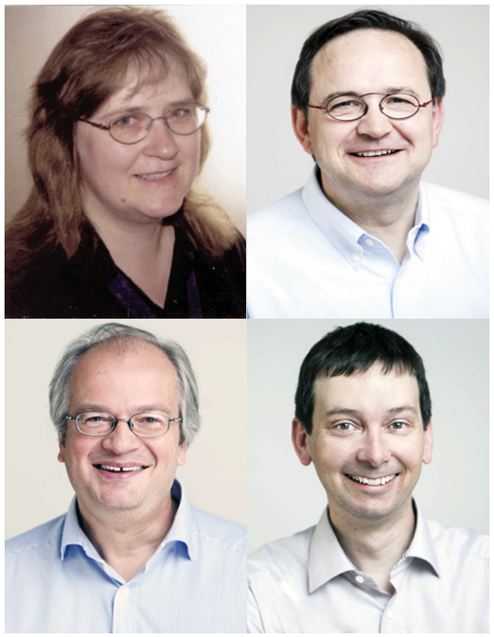
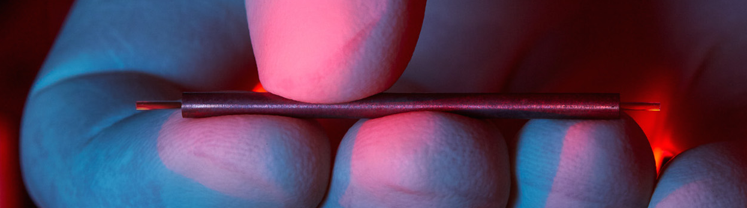

Laser-Driven Micro Structures (Vacuum) – 1
Vacuum dielectric accelerator
1 GeV/m possible but low absolute energies achieved so far
AXSIS project (ERC synergy grant) at DESY/
Uni Hamburg: THz laser-driven accelerator with
atto-second science → Kärtner/Fromme/Chapman/Assmann

Slide 31
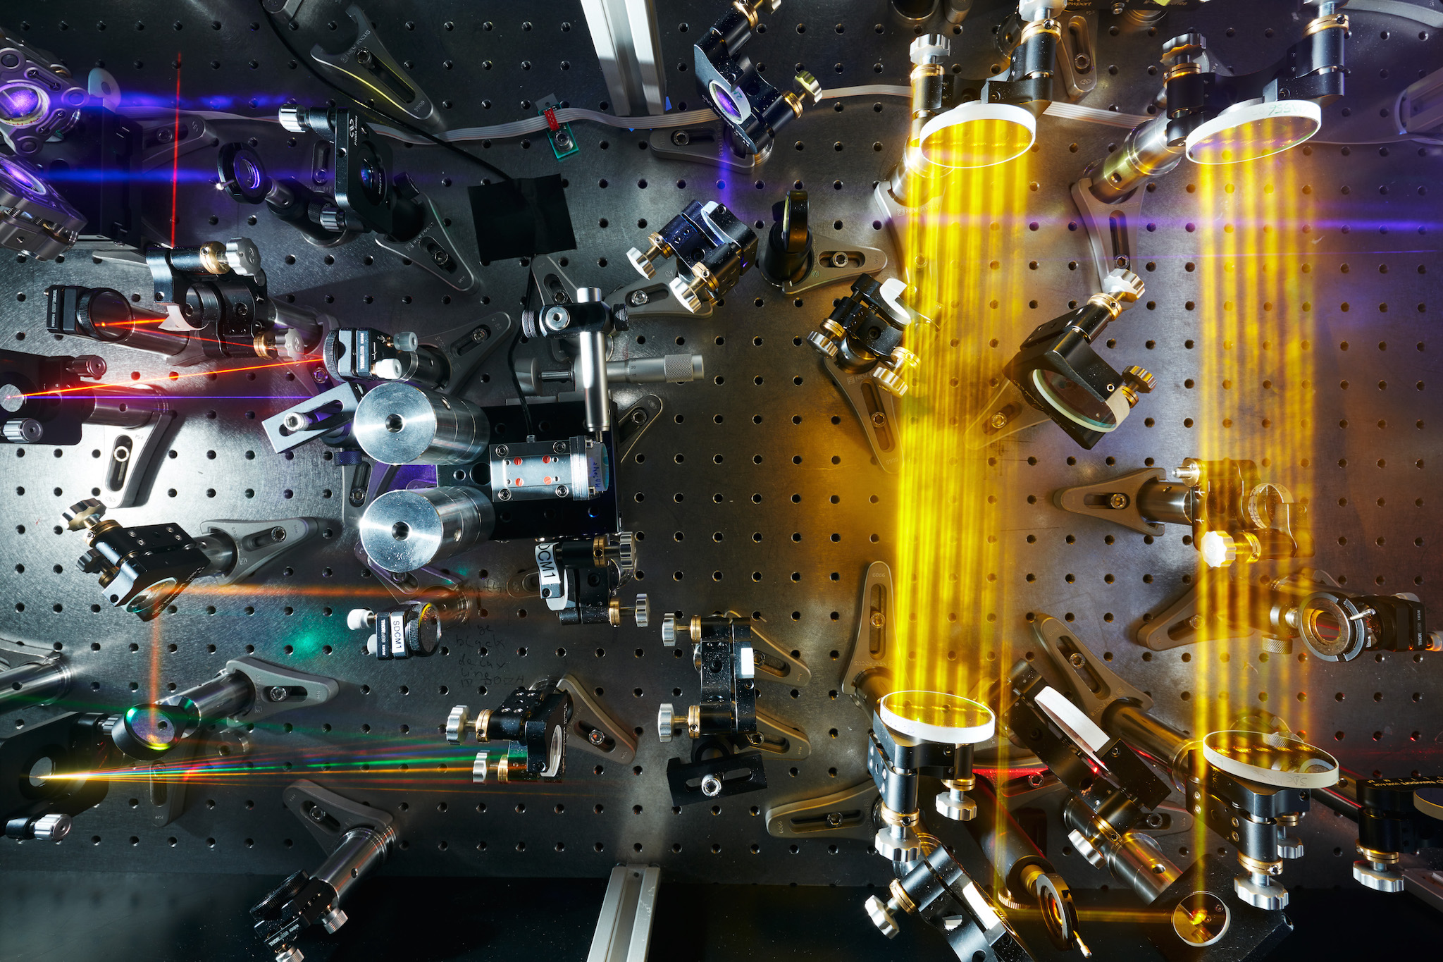
THz Laser Lab (DESY, CFEL, University Hamburg)
Vacuum dielectric accelerator

Slide 32

Laser-Driven Micro Structures (Vacuum) – 2
Vacuum dielectric accelerator
“Accelerator on a Chip” grant from Moore foundation for work by/at Stanford, SLAC, University Erlangen, DESY, University Hamburg, PSI, EPFL, University Darmstadt, CST, UCLA
Lasers drive structures
that are engraved on
microchips (e.g. Silicium)
Major breakthroughs can
be envisaged:
  Mass production
  Implantable accelerators
  for in-body irradiation of tumors
  Accelerators for outer space

Slide 33



Financed by Silicon Valley billionaire...
Science for society

Slide 34
The Laser Promise: Transverse Electrical Field
We can produce every day very high transverse electrical fields

Slide 35


Lorentz Force F
The direction of the field matters

Slide 36
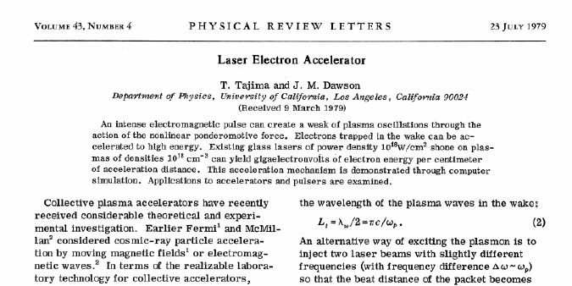
Laser Plasma Accelerator: Transverse to Longitudinal
Every accelerator is a transformator
Idea in 1979:
Use a plasma to convert the transverse space charge force of a beam driver (or the electrical field of the laser) into a longitudinal electrical field in the plasma!

Slide 37

The Plasma Accelerator Concept
Overcome high-field limitations of metallic walls with dynamic plasma structures (undestructible)
New idea in 1979 by Tajima and Dawson: Wakefields inside a homogenous plasma can convert
transverse forces into longitudinal accelerating fields
Pondero-motive force of a laser
Space charge force of a charged particle bunch (e-, p+)
Accelerating gradients of 10 GeV/m to
1,000 GeV/m
or
Courtesy M. Kaluza
Options for driving wakefields:
Lasers: Industrially available, steep progress, path to low cost
Limited energy per drive pulse (up to 50 J)
Electron bunch: Short bunches (need μm) available, need long RF accelerator
More energy per drive pulse (up to 500 J)
Proton bunch: Only long (inefficient) bunches, need very long RF accelerator
Maximum energy per drive pulse (up to 100,000 J)

Slide 38
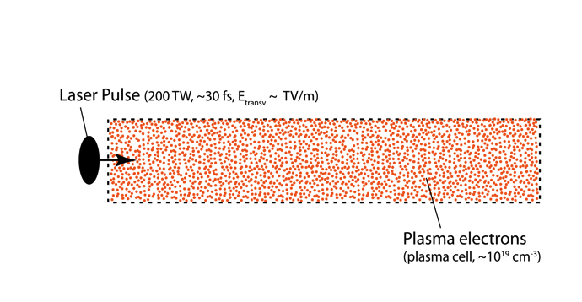
Laser Plasma-Acceleration
Internal injection
Works the same way with an electron beam as wakefield driver. But then usually lower plasma density. Ponderomotive force of laser is then replaced with space charge force of electrons on plasma electrons (repelling).

Slide 39
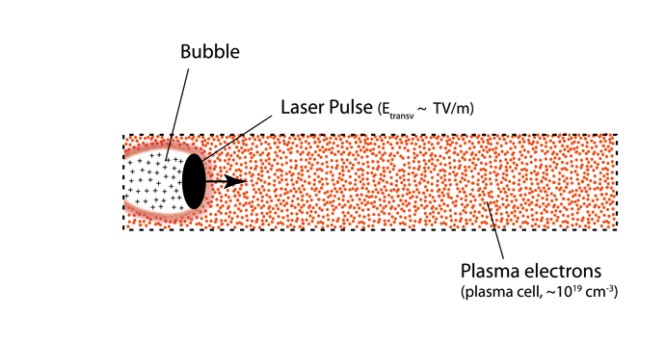
Laser Plasma-Acceleration
Internal injection

Slide 40
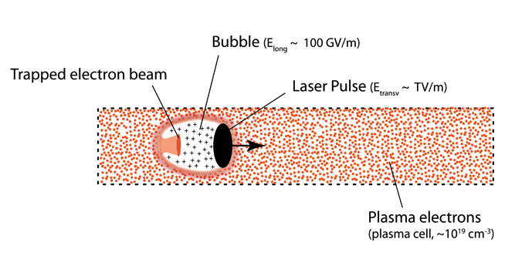
Laser Plasma-Acceleration
Internal injection → strong fields in the bubble suck in plasma electrons to form the electron beam

Slide 41
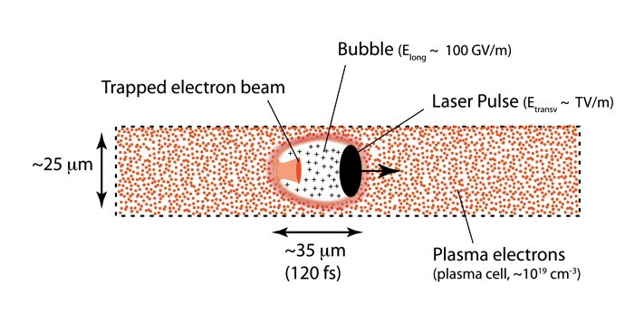
Laser Plasma-Acceleration
Internal injection

Slide 42
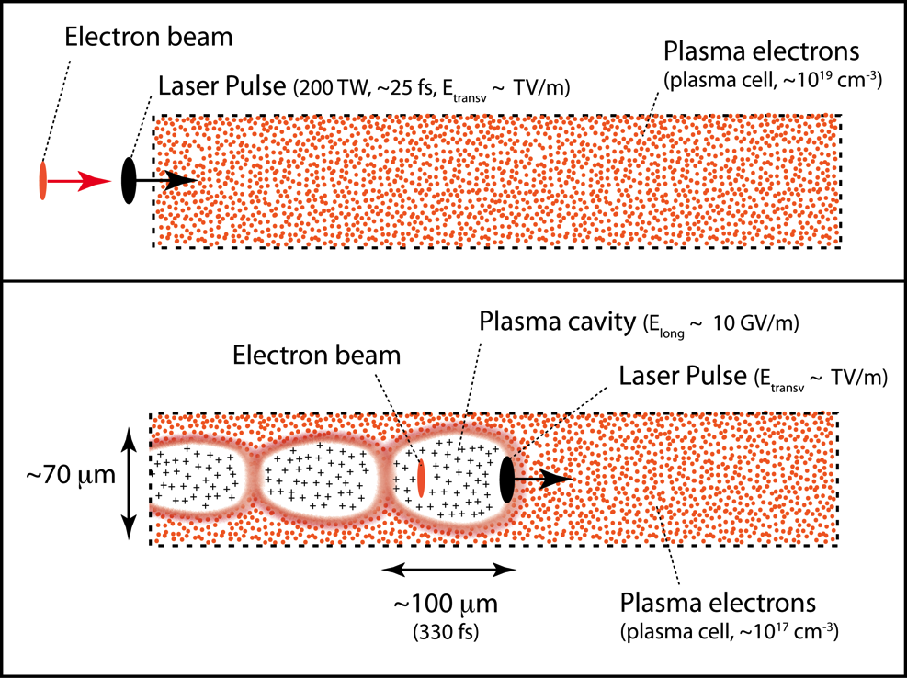

Laser Plasma Acceleration
External injection

Slide 43
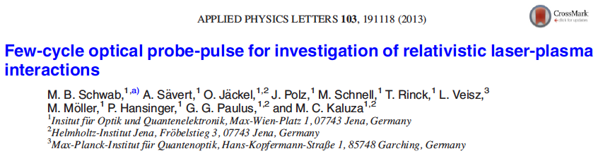
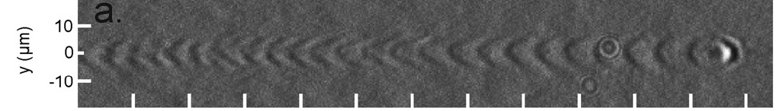
Photo Laser-Plasma Accelerator
Small but can be photographed
2013
100,000 MV/m
0.05 mm
0.25 mm
Metal (Copper)
S band
linac
structure
Microwaves for generation of RF waves
20 MV/m
100 mm
500 mm

Slide 44


LBNL: 4.25 GeV beams have been obtained
from 9 cm plasma channel powered by 310 TW laser pulses (15 J)

Slide 45



SLAC: 42 GeV acceleration has been shown
85 cm plasma driven by a 42 GeV electron beam, tail of bunch accelerated
Bob Siemann, SLAC
E167 collaboration
SLAC, UCLA, USC
I. Blumenfeld et al, Nature 445, p. 741 (2007)

Slide 46
Wait one moment… Compact and Cost-Effective?
Remember: It is not the size but the cost that matters
Consider laser-driven plasma: Presently one can buy 1 Peta-Watt Ti:Sa lasers from industry for a low double digit million € cost.
The most compact 1 PW laser is installed in HZDR, Dresden, Germany (part of ARD):
Required space: 120 m²
(can be visited)
The laser size drives the size of such an accelerator facility. With such a 1 PW laser electrons of 4.25 GeV have been produced within 9 cm (see LBNL result).
The 1 PW laser should be sufficient for a 10 GeV accelerator within about 20 cm. Total footprint: about 200-300 m² (incl. all infrastructure).
Now do this conventionally and compare size and cost!
(e.g. 10 GeV = 500 m of conventional acceleration with 20 MV/m)
Need to bring up quality, efficiency and repetition rate.
$
¥
¢
€
£

Slide 47
Contents
Accelerators – From Conventional Techniques to Ultra-High Gradients
The Linear Regime
Tolerances
Outlook for Europe

Slide 48

Linear Wakefields (R. Ruth / P. Chen 1986)
The formulae behind it all
ε = electrical field
z = long. coord.
r = radial coord.
a = driver radius
ω_{p} = plasma frequency
k_{p} = plasma wave number
t = time variable
e = electron charge
N = number e- drive bunch
ω = laser frequency
τ = laser pulse length
E₀ = laser electrical field
m = mass of electron
Can be analytically solved and treated. Here comparison beam-driven (PWFA) and laser-driven (beat wave = PBWA).

Slide 49

Linear Wakefields (R. Ruth / P. Chen 1986)
The formulae behind it all
Depends on radial position r
Changes between accelerating and decelerating as function of longitudinal position z
Accelerating field
π/2 out of phase
Transverse field
Changes between focusing and defo-cusing as function of longitudinal position z
Depends on radial position r

Slide 50

The Useful Regime of Plasma Accelerators
Where do we put the electron bunch inside the wave (or the surfer on the wave)
Two conditions for an accelerator:
Accelerated bunch must be in accelerating regime.
Accelerated bunch must be in focusing regime.
These two conditions define a useful range of acceleration!
Reminder metallic RF accelerator structures:
no net transverse fields for beam particles → full accelerating range is available for beam → usually place the beam on the crest of the accelerating voltage

Slide 51

Plasma Accelerator Phasing
Finding the useful regime

Slide 52

Plasma Accelerator Phasing
Finding the useful regime

Slide 53

Plasma Accelerator Phasing
Finding the useful regime

Slide 54

Plasma Accelerator Phasing
Finding the useful regime

Slide 55

Plasma Accelerator Phasing
Finding the useful regime

Slide 56

Plasma Accelerator Phasing
Finding the useful regime

Slide 57

Plasma Accelerator Phasing
Finding the useful regime

Slide 58

Plasma Accelerator Phasing
Finding the useful regime

Slide 59

Plasma Accelerator Phasing
Finding the useful regime

Slide 60
Comparison with OSIRIS simulation
Finding the useful regime
Calculation J. Grebenyuk

Slide 61
Comparison with OSIRIS simulation
Finding the useful regime
Laser pulse
Calculation J. Grebenyuk

Slide 62
Plasma Accelerator Phasing
Finding the useful regime

Slide 63


Optimization: Minimal Energy Spread
Avoid creation of too much energy spread (cannot be avoided by principle explained before)
R. Assmann
J. Grebenyuk
IPAC 2014
1 fs = 0.3 μm when travelling with light velocity c

Slide 64



Dephasing
Electron pulse
Laser (815 nm) group velocity v_{g} in plasma
(β = v/c, here consider relativistic beams)
Velocity difference Δv creates slippage ΔL:
Take plasma density n₀ = 10¹⁷ cm⁻³ (electrons per cm³). Therefore plasma wavelength λ_{p} = 0.1 mm.
Assume drive pulse from a laser with wavelength 815 nm.
Difference in velocities 1-β:
Δ(1-β) ≈ 3 x 10⁻⁵
Slippage: 30 μm per meter
= 30% of wavelength or 108° in “RF phase”!
Laser pulse
Δv

Slide 65


Optimization: Phase Slippage Stability/Reproducibility
Maximize distances over which we can accelerate Hit the same phase every time

Slide 66
Optimization: Phase Slippage Stability/Reproducibility
Maximize distances over which we can accelerate Hit the same phase every time

Slide 67


Warning: Non-Linearities are Important
Linear regime nice to get an understanding – Quasi-linear and non-linear regimes most often used
Plasma wakefield acceleration is most often operated in the so-called non-linear regime.
No time to discuss here – would require more time.
Accelerating field approaches triangular shape and focusing field is constant with radius → easier regime in many aspects.
Electron trapping (beam forming) occurs here.
Paper by Pukhov and Meyer-Ter-Vehn one of most cited papers in accelerators: refused at higher impact journals as irrelevant (“would never work”)

Slide 68
Contents
Accelerators – From Conventional Techniques to Ultra-High Gradients
The Linear Regime
Tolerances
Outlook for Europe

Slide 69

Plasma Accelerator Physics I
Small accelerators exhibit also very small tolerances – here is the difficulty
A plasma of density n₀ (same density electrons - ions) is characterized by the plasma frequency:
This translates into a wavelength of the plasma oscillation:
The wavelength gives the longitudinal size of the plasma cavity… Lower plasma density is good: larger dimensions.
0.3 mm for n₀ = 10¹⁶ cm⁻³

Slide 70

Plasma Accelerator Physics II
Small accelerators exhibit also very small tolerances – here is the difficulty
The plasma oscillation leads to longitudinal accelerating fields with a gradient of (higher plasma densities are better):
The group velocity of the laser in a plasma is as follows for ω_{p} << ω_{l}: (note ω_{l} is laser frequency)
The laser-driven wakefield has a lower velocity than a fully relativistic electron → slippage and dephasing. Lower densities are better.
9.6 GV/m for 10¹⁶ cm⁻³

Slide 71




Plasma Accelerator Physics III
Small accelerators exhibit also very small tolerances – here is the difficulty
The ion channel left on axis, where the beam passes, induces an ultra-strong focusing field. In the simplest case:
This can be converted into a optical beta function (lower density is better , as beta function is larger)::
The phase advance in the plasma channel is rapid:
300 kT/m for 10¹⁶ cm⁻³
β = 1.1 mm for 100 MeV

Slide 72


Plasma Accelerator Physics IV
Small accelerators exhibit also very small tolerances – here is the difficulty
The matched beam size in the ion channel is small:
Offsets between laser and beam centres will induce betatron oscillations. Assume: full dilution into emittance growth (energy spread and high phase advance).
Tolerances for emittance growth due to offsets Δx = σ_{x}:
Lower plasma density better: larger matched beam size, bigger tolerances.
DIFFICULTY
σ₀ = 1.3 μm for γε = 0.3 μm
DIFFICULTY
100% for 1.3 μm offset
Assmann, R. and K. Yokoya. Transverse Beam
Dynamics in Plasmas. NIM A410 (1998) 544-548.

Slide 73


Strong plasma focusing: Betatron motion
Plasma works as a focusing quadrupole
A plasma has a very strong focusing field in both planes.
Focusing strength and phase advance depends on plasma density.
Experiment with a beam-driven plasma at SLAC in 2001: Send an electron beam into a plasma and measure beam sizes at exit point.

Slide 74


Strong plasma focusing: Betatron motion and X rays
Wiggling electrons emit X rays → a plasma accelerator as accelerator and undulator at once
If an electron beam is injected mis-matched into a plasma, we expect strong beta mismatch oscillations of the beam size.
The oscillating electrons should radiate X rays.
This was seen in a SLAC experiment in 2001.
Plasma acts as undulator!

Slide 75

Plasma opens new reach but also difficulties…
Comparing plama to conventional accelerators
Conventional acceleration structures:
  Optimized to provide longitudinal acceleration and no transverse forces on the beam.
  Due to imperfections, transverse forces can be induced. These “wakefields” caused major trouble to the first and only linear collider at SLAC.
Plasma acceleration:
  Ultra-strong longitudinal fields → high accelerating gradient.
  Ultra-strong transverse fields → transverse forces cannot be avoided and must be controlled.
For fun: A look at the SLAC linac beam before entering the plasma!

Slide 76

Seeing Electron Beam…
~ 2e10 electrons, 30 GeV
1.8 mm
The transverse and longitudinally fields of the accelerator are set up to achieved small transverse beam sizes (right).

Slide 77
Accelerator Builder’s Challenge
(simplified to typical values)
  Match into/out of plasma with beam size ≈1 μm (about 1 mm beta function). Adiabatic matching (Whittum, 1989).
Control offsets between the wakefield driver (laser or beam) and the accelerated electron bunch at 1 μm level.
Use short bunches (few fs) to minimize energy spread.
Achieve synchronization stability of few fs from injected electron bunch to wakefield (energy stability and spread).
Control the charge and beam loading to compensate energy spread (idea Simon van der Meer).
Develop and demonstrate user readiness of a 5 GeV plasma accelerated beam.
σ_{x} (µm)
Phase Advance Ψ ∝ n_{e}^{1/2}L
PRL 2002, C. E. Clayton, B. E. Blue, E. S. Dodd, C. Joshi, K. A. Marsh, W. B. Mori, and S. Wang, P. Catravas, S. Chattopadhyay, E. Esarey, and W. P. Leemans, R. Assmann, F. J. Decker, M. J. Hogan, R. Iverson, P. Raimondi, R. H. Siemann, and D. Walz, T. Katsouleas, S. Lee, and P. Muggli

Slide 78

Accelerator Builder’s Challenge – Feasible?
We can generate nanometer beams – so we can inject
Difficult but we believe solutions can be found. Will not come for free…
50 nm with a 1.3 GeV electron beam
(from K. Kubo et al. Proc. IPAC 2014)

Slide 79

Accelerator Builder’s Challenge – Feasible?
Modern technology approaching atto-second regime
DESY Ultra-Fast Electronics and Synchronization
Femtosecond Precision in Laser-to-RF Phase Detection (from H. Schlarb, T. Lamb, E. Janas et al. Report on DESY Highlights 2013).

Slide 80
Contents
Accelerators – From Conventional Techniques to Ultra-High Gradients
The Linear Regime
Tolerances
Outlook for Europe

Slide 81






Novel Acceleration R&D in Europe
How can we develop plasma accelerators towards usability?
Independent national projects*, funded by national states. About 16 major facilities for novel plasma acceleration R&D.
European novel accelerator projects with international involvement
CERN experiment collaboration under leadership of MPI (A. Caldwell)
Funded by EU Horizon2020 as EU Design Study
ERC Synergy Grant
* See note on ELI

Slide 82




Helmholtz Support for Compact Accelerators
The agenda of the president of the Helmholtz Association (largest science organization in Germany)
Support programs:
Accelerator R&D ARD research topic in Matter&Technology (MT)
Independent research activity: same hierarchical level as HEP and photon science
IuVF funding “Plasma Accelerator”
Strategic investment 30M€ ATHENA soon? (same funding pot as Helmholtz LHC detector lab)
From today’s perspective the following challenges are identified
energy systems
information and data science
research earth system
new materials and agents
new mobility concepts
psych. disease
indiv. medicine
New generations of compact accelerators.

Slide 83


(A) EuPRAXIA Horizon2020 Design Study (DESY coordinated)
European Plasma Accelerator Infrastructure with Pilot Users, site-independent (now mid-term)
Collaboration of 40 institutes
  16 EU laboratories are beneficiaries
  24 associated partners from EU, Europe, Asia and US contribute in-kind, 4 joined after 1st year:
  KIT (Germany), FZJ (Germany),
  University Jerusalem (Israel), IAP (Russia)
  2 additional associate partners just joined: University Belfast, Ferdinand-Braun-Institute, Leibniz Association, Berlin
Collaboration brings together:
  Big science labs: photon science, particle physics
  Laser laboratories: high power lasers
  International laboratories: CERN, ELI (associated)
  Universities: accelerator research, plasma, laser
Organized in 8 EU-funded work packages and 6 in-kind work packages
125 scientists in our work list
It is a relatively small infrastructure so several bids for hosting it are being prepared in Italy, Germany, …

Slide 84





EuPRAXIA: A European Strategy for Accelerator Innovation
Do the required intermediate step between proof of principle and production facility – make one acc. unit!
PRESENT EXPERIMENTS
Demonstrating
100 GV/m routinely
Demonstrating GeV electron beams
Demonstrating basic quality
EuPRAXIA INFRASTRUCTURE
Engineering a high quality, compact plasma accelerator
5 GeV electron beam for the 2020’s
Demonstrating user readiness
Pilot users from FEL, HEP, medicine, ...
PRODUCTION FACILITIES
Plasma-based linear collider in 2040’s
Plasma-based FEL in 2030’s
Medical, industrial
applications soon

Slide 85




eXcellence
In Applications

Slide 86
EuPRAXIA Conceptual Design: Complete
First ever international design of a
plasma accelerator facility
CDR completed on time and submitted to EU on Oct 30th, 2019
CDR includes several new ideas and concepts, published at high level (e.g. Physical Review Letters)
Industry support in Advisory Board: Thales (France), Amplitude (France), Trumpf Scientific (Germany)
653 page CDR, 240 scientists contributed
http://www.eupraxia-project.eu/

Slide 87
EuPRAXIA Objectives
EuPRAXIA is a conceptual design study for a 5 GeV electron plasma accelerator
Address quality. Show plasma accelerator technology is usable:
  Incorporate established accelerator technology for optimal quality
  Combine expertise from accelerator, laser labs, industry, international partners
  Develop new technical solutions and a few use cases
Show benefit in size and cost versus established RF technology:
  Proposed solutions must offer a significant benefit, e.g. fitting constrained spaces (small labs, hospitals) and/or must be less effective.
  Cost benefits must include low operational costs (turn-key, industrial lasers at high repetition rate, cost-effective RF components, ...): small team, remote OP, …
Note: EuPRAXIA will initially be low power and low wall-plug power efficiency
Baseline (10 Hz): 10s of Watt with ~ 1 mJ/photon pulse energy
Efforts with industry and laser institutes to improve rep. rate & efficiency (incorporate fiber-based lasers with 30 % efficiency)

Slide 88



Already working today: Medical Imaging
from J.M. Cole et al, John-Adams-Institute, UK
Laser plasma based betatron X ray source

Slide 89

The Vision
Toshi Tajima 2010

Slide 90


Fully plasma-based beamline for generating betatron radiation as a compact X-ray source for medical imaging and material analysis. The user area is behind the wall on the right.
EuPRAXIA facility rendering picture

Slide 91


Design: Positron Annihilation Spectroscopy
EuPRAXIA would provide access to unique regime of detecting small defects at large penetration depths
Does not require highest quality of electron beam
Gianluca Sarri et al
Courtesy M. Butterling, HZDR

Slide 92

Fully plasma-based beamline for generating electron and positron beams. The accelerator stages can be seen in the front. In the back the beamline splits and leads to two user areas behind the back wall.
EuPRAXIA facility rendering picture

Slide 93




Try to finally realize low energy spread…
Old proposal from Simon van der Meer
Beam loading, energy spread and efficiency
1985 van der Meer
van der Meer: Nobel Prize Physics for invention of stochastic cooling → SppS collider at CERN

Slide 94


Solve external timing for laser-driven plasma accelerators
Achieve required sub-femtosecond timing and accuracy…

Slide 95


Reduce energy spread by a novel scheme
Jump from positive (focusing) to negative phase (defocusing) of plasma accelerator → kind of FODO scheme
... and many more good ideas and concepts in- and outside of EuPRAXIA
kHz beams, long guiding, plasma lenses, high charge, improved quality, hybrid nano-emittance guns, application development, undulator radiation, novel undulators, theory advances, better and faster simulations, hollow plasmas, ...

Slide 96

Compact Multi-Stage Plasma-Based Accelerator
Combined RF plus optical scheme
1.5 m long
5.5 GeV
0.03% slice energy spread
0.12 % total energy spread
sub-micron emittance

Slide 97









Compact Multi-Stage Plasma-Based Accelerator
Electron beam
Ref.: Ferran Pousa, Martinez de la Ossa, Brinkmann, Assmann
PRL 123, 054801 (2019)
Not to scale. Compact setup 1.5 m.
Laser 1
Coherent Synchrotron Radiation (CSR) and Space-Charge checked
Plasma mirror
(coupling of laser 2)
Plasma accel. stage 2
Plasma mirror
(laser 1 removal)
Active plasma lens
Magnetic chicane
Plasma accel. stage 1
Active plasma lens
Laser 2

Slide 98


Beam Transport Design
Here: high energy beam transport over 8 meters
Preserved beam quality is achieved in the design
Space has important benefits
A. Chance et al

Slide 99

EuPRAXIA: Progressing on the Quality Problem
Energy Spread
1 – 500 pC
EuPRAXIA points indicate start-to-end simulations
5 – 30 pC
300 – 400 pC
10 pC – 1 nC
Current FEL Facilities

Slide 100


Slide 101
(B) AWAKE Experiment at CERN
Aim: Demonstrate proton-driven plasma acceleration. 1 GeV electron acceleration in 10 meters
Thanks for AWAKE slides and information to A. Caldwell,
P. Muggli, G. Xia
All results preliminary and under detailed analysis!

Slide 102


AWAKE: Experimental Program and Results
Clearly see the
transverse blow-up
of the proton
beam. Only
possible with very
strong electric
fields !
The long proton bunch is modulated by plasma wakefield

Slide 103

AWAKE: Seeded SMI, e- Acceleration
Modulation pattern follows plasma wavelength, accelerates injected e-
2 GeV
electron acceleration
New principle works

Slide 104




AWAKE: Possible Long-Term Future HEP Applications
LHC providing drive bunch → low luminosity
e+ e- collider
e-p collider

Slide 105


(C1) Hamburg Infrastructure – FLASHForward
An electron beam-driven plasma accelerator R&D approach → towards HEP applications
    First beam in FF‣‣ - August 31, 2017
LYSO screen station

Slide 106


(C1) Hamburg Infrastructure – FLASHForward
An electron beam-driven plasma accelerator R&D approach → towards HEP applications

Slide 107


(C2) Hamburg Infrastructure – LUX
An laser-driven plasma R&D approach → towards FEL applications
A. Maier et al
About 1 GeV electrons from plasma accelerator, guide beam out of plasma, transport to undulator, generate X rays in undulator, dump electron beam, measure X rays (8 nm)
Next steps: towards harder X rays, lasing (saturation not possible in available length of undulator)

Slide 108





(C3) Hamburg Infrastructure – SINBAD
Several plasma experiments ongoing or under setup
Ex-DORIS

Slide 109
Conclusions
Long-term future
The long-term future is bright: there will be plenty of opportunities as technology advances!
Plasma colliders are another possible game changer. Energy very promising but beam quality insufficient:
  There are now near future science applications outside HEP, e.g. FEL. This can be the stepstone towards a plasma linear collider.
  Major projects going on, all including HEP aspects. Please follow up.
A long-term future with novel colliders does not come by itself: We (you) must work towards this goal and support it as required, continuing long tradition.

Slide 110


Wideröe at age 90
A visionary and optimist from young to old age
“After all, plans can only be made for those accelerators which can realistically be built with the means available, and obviously, these means are limited.
Ideas are not subject to any such considerations. The limitations are set only by the intellect of human beings themselves.
The theoretical possibilities with regard to accelerating particles by electromagnetic means (i.e. within the scope of the Maxwell equations which have been known since the 19th century), are nowhere near being exhausted, and technology surprises us almost daily with innovations which in turn allow us to broach new trains of thought.
…there are yet more fundamental breakthroughs to be made. They could allow us to advance to energies unimaginable today.“

Slide 111
Thank you for your attention...
Open DESY PhD Positions to be filled
Tell your friends…
Contact: ralph.assmann@desy.de
Courtesy S. Brooks, BNL

