Slide 1
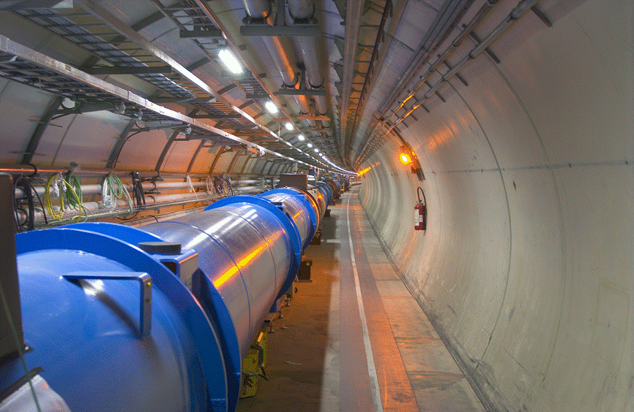
LHC and future high-energy circular colliders
O. Brüning
CERN, Geneva, Switzerland

Slide 2
Introduction: LHC Performance Goals
Collision energy: Higgs discovery requires E_{CM} > 1 TeV
p collisions E_{beam} > 5 TeV LHC: E = 7 TeV
Instantaneous luminosity: rate of events in detector
rare events L > 10³³cm⁻²sec⁻¹ L = 10³⁴cm⁻²sec⁻¹
Integrated luminosity: total number of events L
300fb⁻¹ with 1barn = 10⁻²⁸m² and femto = 10⁻¹⁵
depends on the beam lifetime, the LHC cycle and
‘turn around’ time and overall accelerator efficiency

Slide 3
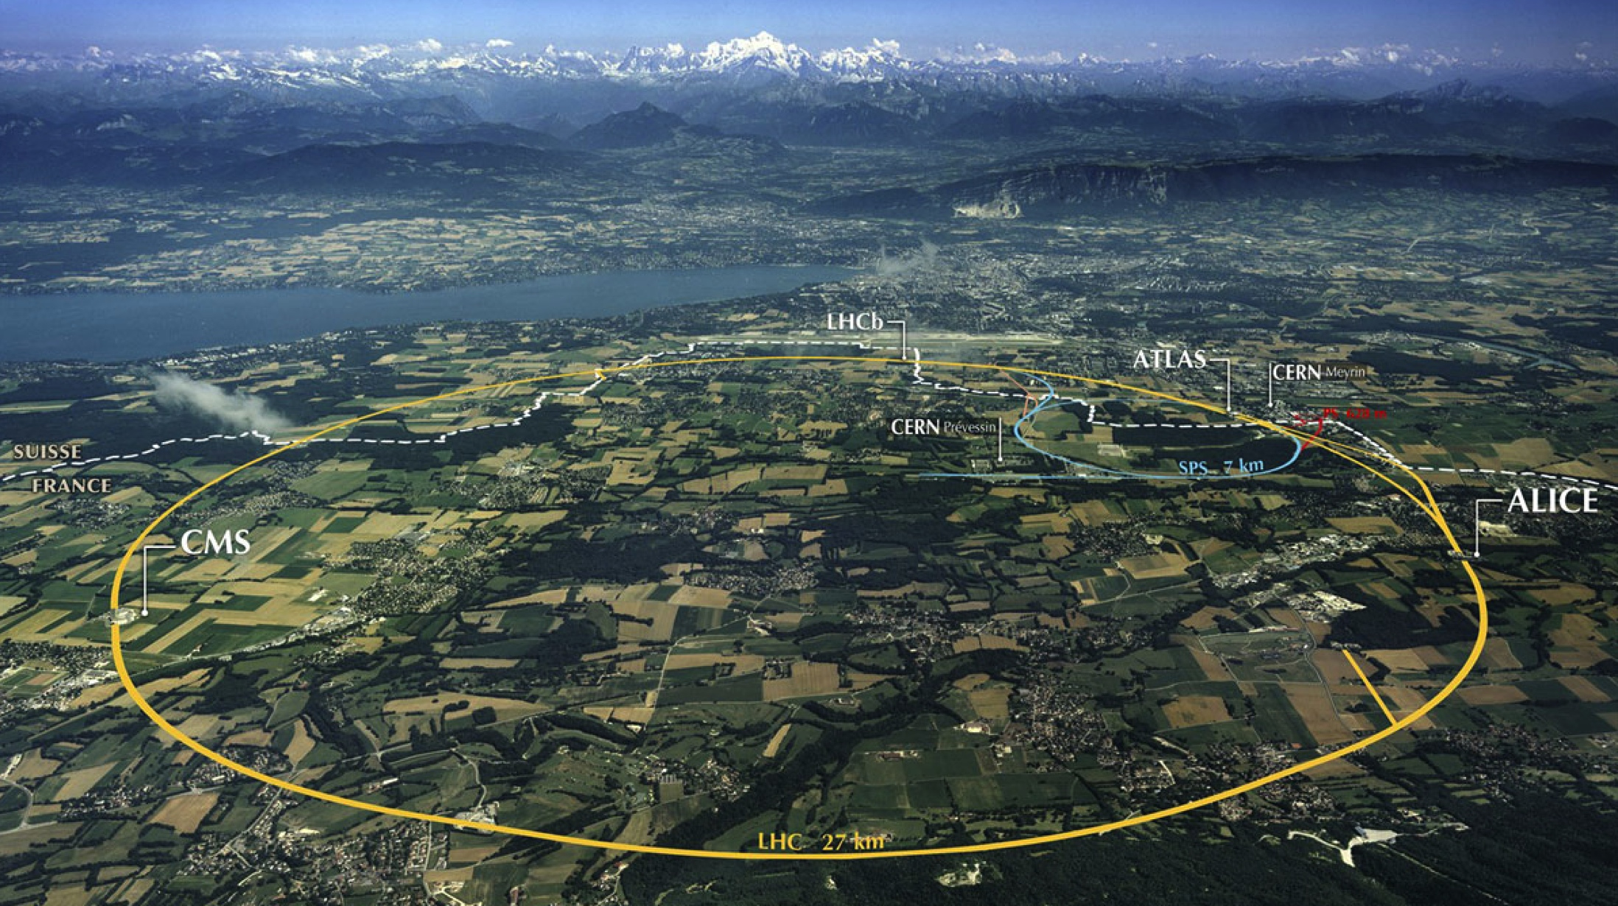
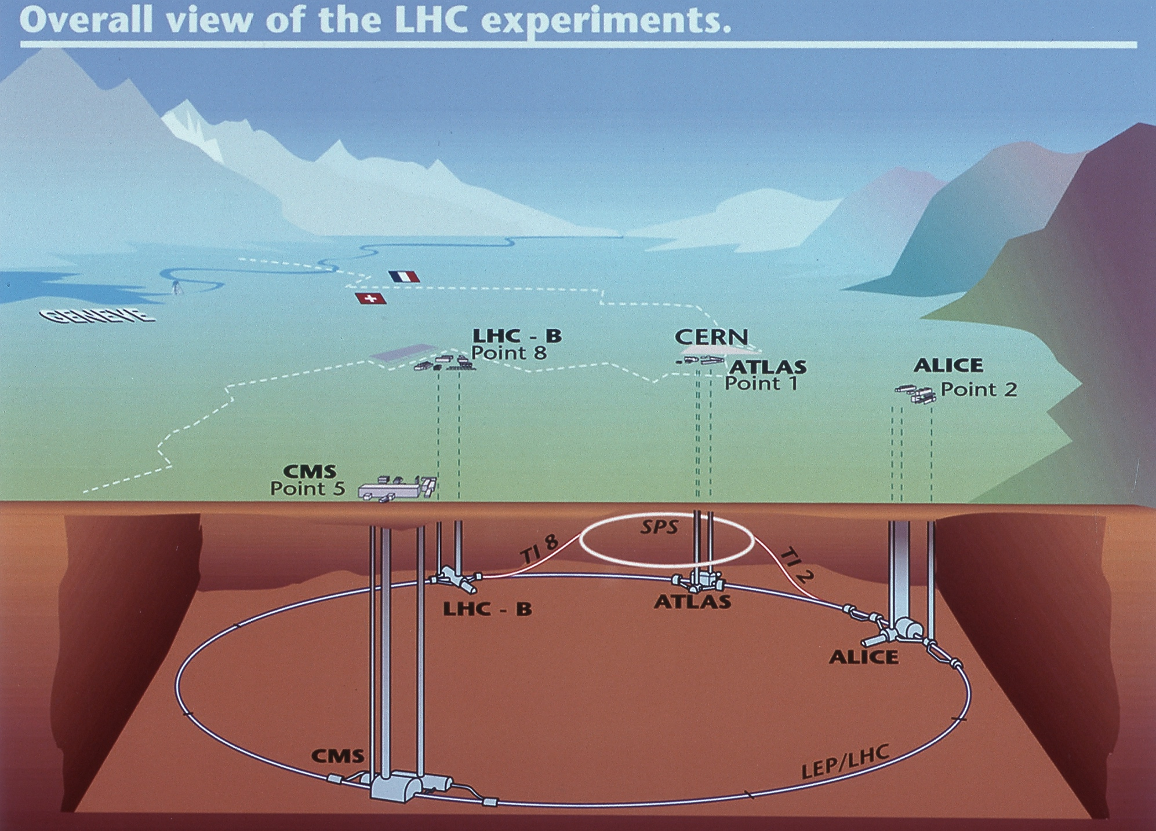
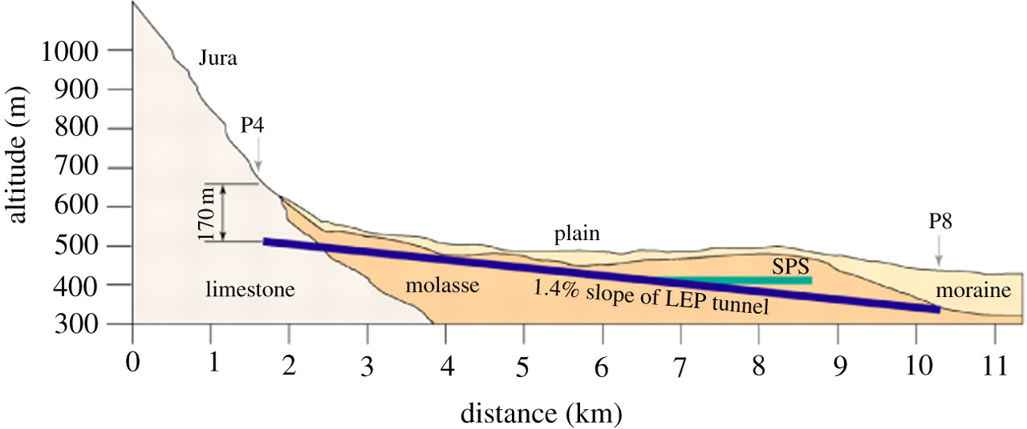
LHC 27km circumference: Big & Cold
Beam dumps
Injection B2
Injection B1
RF
1720 Power converters
> 9000 magnetic elements
7568 Quench detection systems
1088 Beam position monitors
4000 Beam loss monitors
150 tonnes Helium, ~90 tonnes at 1.9 K
140 MJ stored beam energy in 2012
370 MJ design and > 700 MJ for HL-LHC!
830 MJ magnetic energy per sector at 6.5 TeV
➔ ≈ 10 GJ total @ 7 TeV

Slide 4
LHC (Large Hadron Collider)
14 TeV proton-proton accelerator-collider built in the LEP tunnel
Lead-Lead (Lead-proton) collisions
1983 : First studies for the LHC project
1988 : First magnet model (feasibility)
: Approval by the CERN Council
1996-1999 : Series production industrialisation
: Declaration of Public Utility &
Start of civil engineering
1998-2000 : Placement of main production contracts
2004 : Start of the LHC installation
2005-2007 : Magnets Installation in the tunnel
2006-2008 : Hardware commissioning
2008-2009 : Beam commissioning and repair
2010-2037 : Physics exploitation
Ca. 20 years magnet development!!!
Ca. 30 years machine development!!!
➔ Significant Time scale extending well beyond that of a physicist career!!!
A 27 km circumference collider…
4

Slide 5

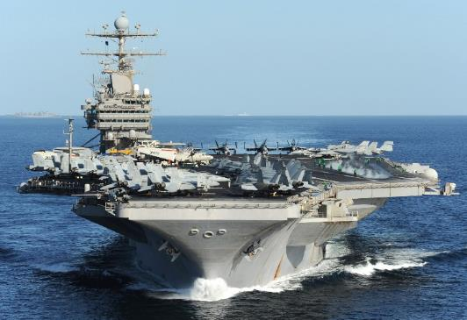
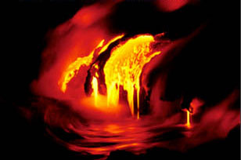
Energy management challenges: Example LHC
Energy stored in the LHC magnet system [8.3T]: ∼10 GJoule
Worry about beam losses:
Failure Scenarios ➔ Local beam Impact
➔ Equipment damage
Lifetime & Loss Spikes ➔ Distributed losses
➔ Magnet Quench & QPS
➔ Machine efficiency
e.g. Cryo Sectors: 95% availability requires 99% with 8 sectors
8 Sectors ➔ [12 Sectors ➔ 20 Sectors]
10 GJoule ≅ flying 700 km/h
10 GJoule ≅ 55 km/h
Sectorization!!
Tracking
[ppm]!!!
560 tons
88’000 tons
Energy stored in the two beams: 720 MJ [ 6 10¹⁴ protons (1 ng of H+) at 7 TeV ]
700 MJ melt one ton of copper
700 MJoule dissipated in 88 μs
⎝ 8 TW
Installed World Electrical Capacity:
3.8 TW
Beam Dump robustness [core and windows]
Kicker reliability ➔ many kicker elements
➔ Failure likelihood & reliability
1 electron volt = 1,602× 10⁻¹⁹ joule
Notes:
5
Aircraft carrier

Slide 6
Machine Efficiency
This becomes more challenging with increased Collider size and Requires even more powerful injector complex!!!!
Minimum of 2h between end of one, and start of the next fill
Average LHC Turnaround time of 4-5h!!!!
Average LHC fill length of 8h ➔ 65% of scheduled physics time!!!
ca. 50% in LHC operation including faults at best conditions!
6

Slide 7
LHC Performance
Over 160fb⁻¹ at 13 TeV so far with
ca. 70fb⁻¹ / year at hand!!!
Peak Luminosity close to 2 10³⁴ cm⁻²s⁻¹!!!
➔ > 350fb⁻¹ by the end of LHC Run3!!!
Cours de Printemps du LAL: April 23rd to 25th 2016
L. Rossi and O. Brüning; Visit of Dr. Hasan Mandal; Thursday 28th November 2019
Notes:
To be updated with last version before the CMSDAS meeting

Slide 8



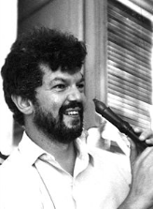

Higgs Discovery in July 2012 and 2013 Nobel Price for the Brout – Englert – Higgs mechanism
But many questions remain and the search continues!!!
Higgs properties [coupling]
More than one Higgs?
BSM Physics? Dark Matter & Dark Energy?
Need for more Data and Statistics!!
Doubling the Statistics requires 4 x more data!!!
➔ HL-LHC goal: 10 times the LHC data Volume
…for the theoretical discovery of a mechanism that contributes to our understanding of the origin of mass of subatomic particles, and which recently was confirmed through the discovery of the predicted fundamental particle, by the ATLAS and CMS experiments at CERN's Large Hadron Collider
Implys overcoming several limitations in the existing LHC!!!
Not only experiments: cryo cooling of triplet magnets & radiation damage in triplet magnets & machine efficiency!
➔ Need for an Upgrade!
8

Slide 9
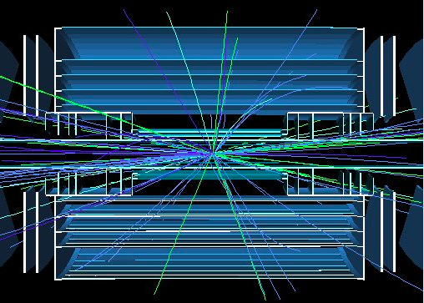
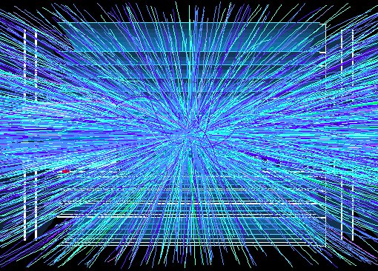
Goal of High Luminosity LHC (HL-LHC):
The main objective of the Hl-LHC is to determine and build a hardware configuration
and a set of beam parameters that will allow the LHC to reach the following targets:
Prepare machine for operation beyond 2025 and up to 2040
Devise beam parameters and operation scenarios for:
# enabling at total integrated luminosity of 3000 fb⁻¹
# implying an integrated luminosity of 250 fb⁻¹ per year,
# design oper. for μ ≤ 140 (➔ peak luminosity 5 10³⁴ cm⁻² s⁻¹)
Operation with levelled luminosity!
High machine efficiency and reliability are key upgrade ingredients!
400
events
5 events
Need to overcome several limitations in the existing LHC machine!!!

Slide 10
Luminosity Limitation: Debris from the IP Radiation damage to magnets at 300 fb⁻¹
Cold bore insulation
≈ 35 MGy
Q2
27 MGy
MCBX3 20 MGy
10

Slide 11
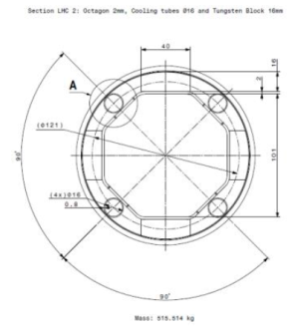
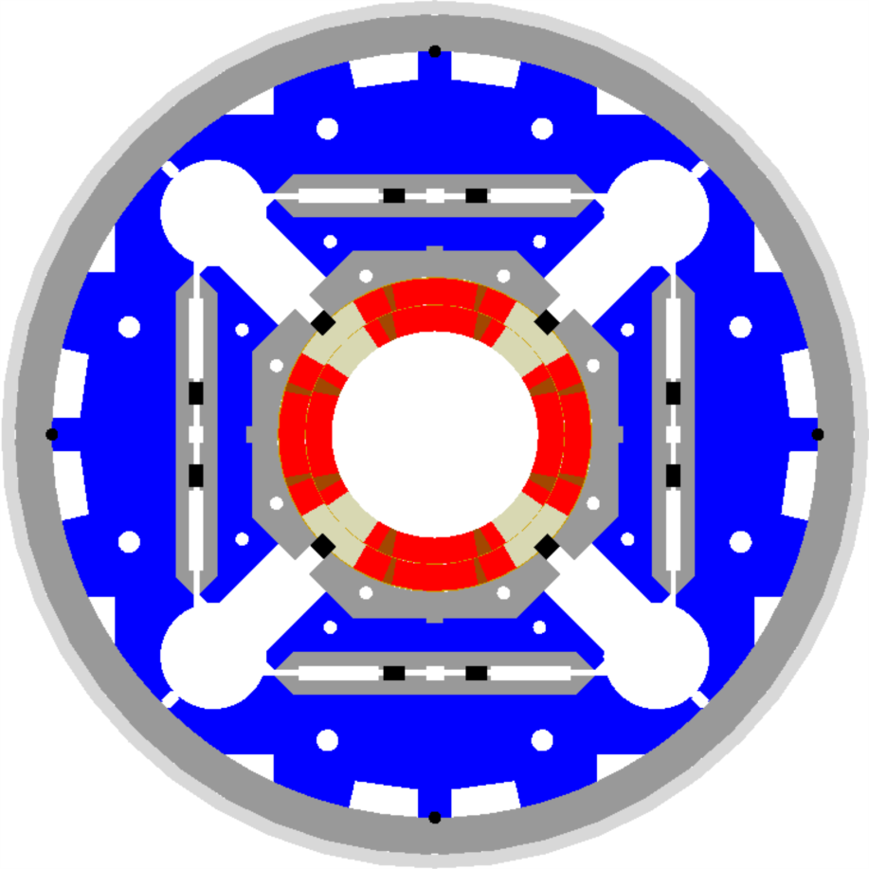
HL-LHC technical bottleneck: Radiation damage to triplet magnets
Tungsten blocks
Need to replace existing triplet magnets with radiation hard system (shielding!) such that the new magnet coils receive a similar radiation dose @ 10 times higher integrated luminosity!!!!! ➔ Shielding!
US-LARP MQXF magnet design
Based on Nb₃Sn
technology
Requires larger aperture!
70mm at 210 T/m ➔150mm diameter 140 T/m
8T peak field at coils ➔ 12T field at coils (Nb₃Sn)!!!
➔ New, brittle superconductor!
➔ New magnet technology!
Capillaries
➔ Longer magnets

Slide 12
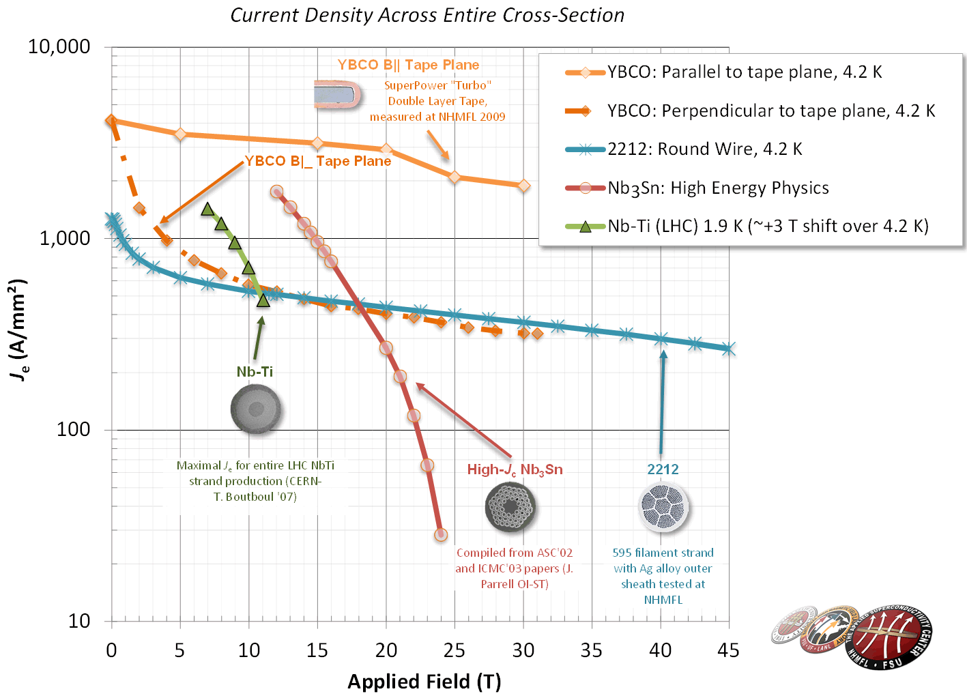
SC Magnet Technology
source: L. Rossi
Nb₃Sn
HL-LHC with 11-12T
16 T for HEP
Almost a commodity!
15-20 t per year for MRI
ITER needs 500 t
ca x5 cost LHC Nb-Ti
Brittle material
HTS (needed → 20 T)
➔ on going R&D!
Bi-2212: cost today 2-5x Nb₃Sn
YBCO: cost today 10x Nb₃Sn
12

Slide 13
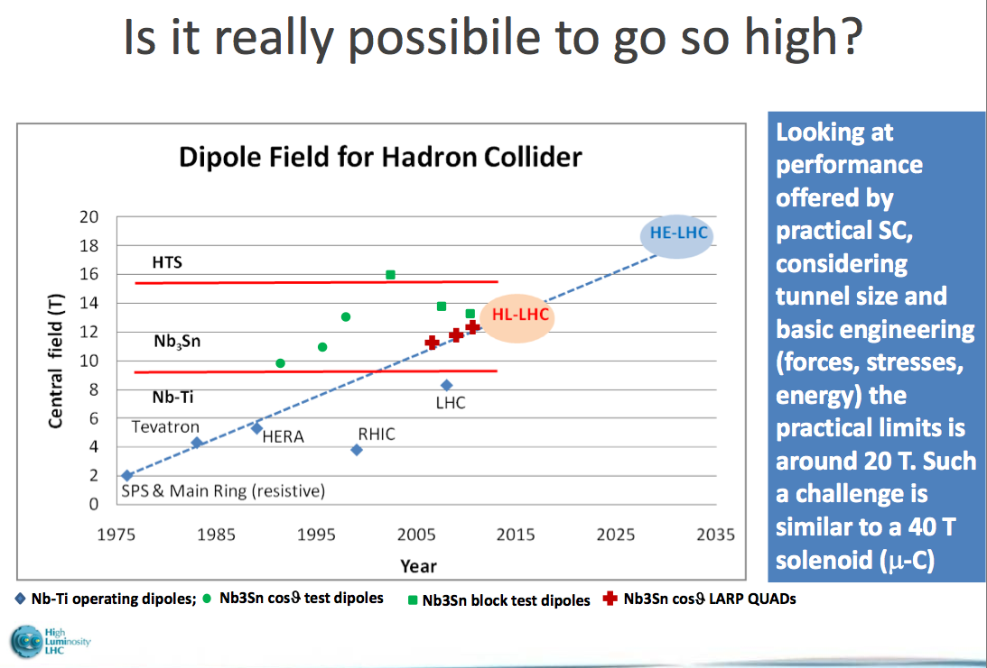
High Field SC Magnets
Magnet development requires substantial R&D effort!!!
Transition from NbTi to Nb₃Sn:
HL-LH lead the R&D for 11-15T magnets based on Nb₃Sn technology:
➔15-20 years R&D program
Transition to HTS:
Assume R&D period of similar siz
e ➔ 2035?
Transition from NbTi to Nb₃Sn: requires similar length of E&D!
HL-LHC led the R&D for 11-15T magnets based on Nb₃Sn technology:
Started in early 2000
➔15-20 years R&D program
➔ Ready by 2025
courtesy: L. Rossi (CERN)
13

Slide 14
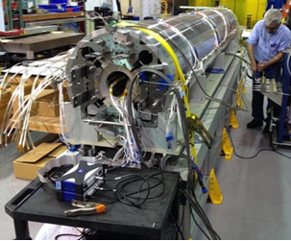
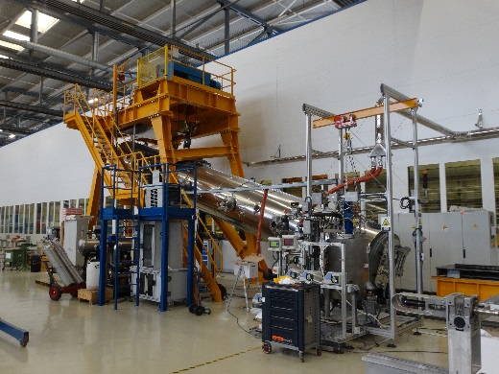
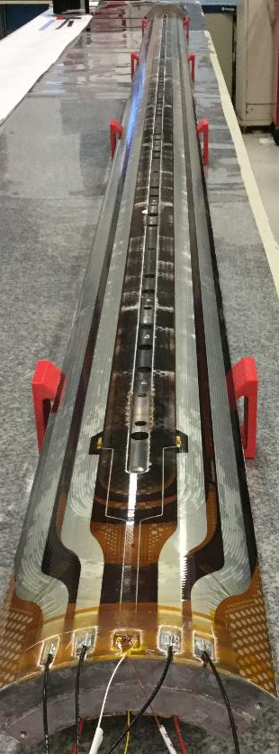
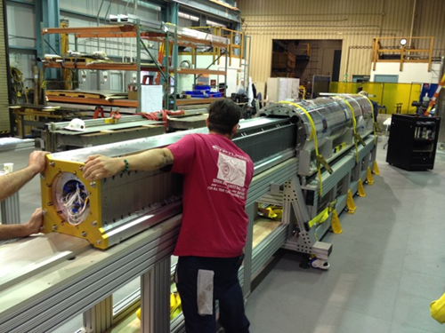
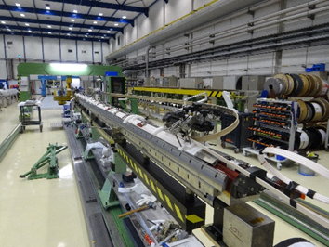

Nb₃Sn quadrupole: Long prototype under construction
Second short (1.5 m) under preparation for test at CERN
Insertion of coil package inside mechanical structure of the first IT quad prototypes (4.2 m long) in LBNL-USA
14

Slide 15
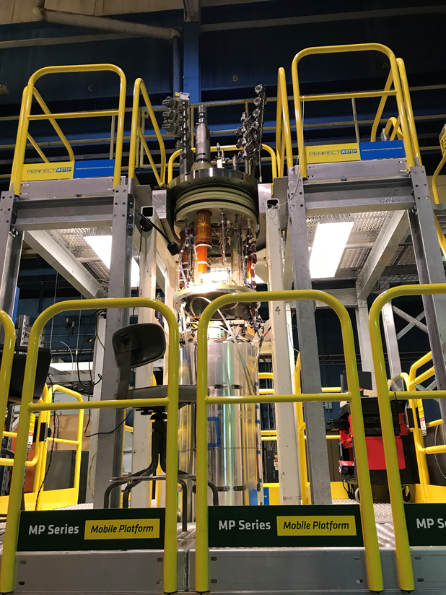
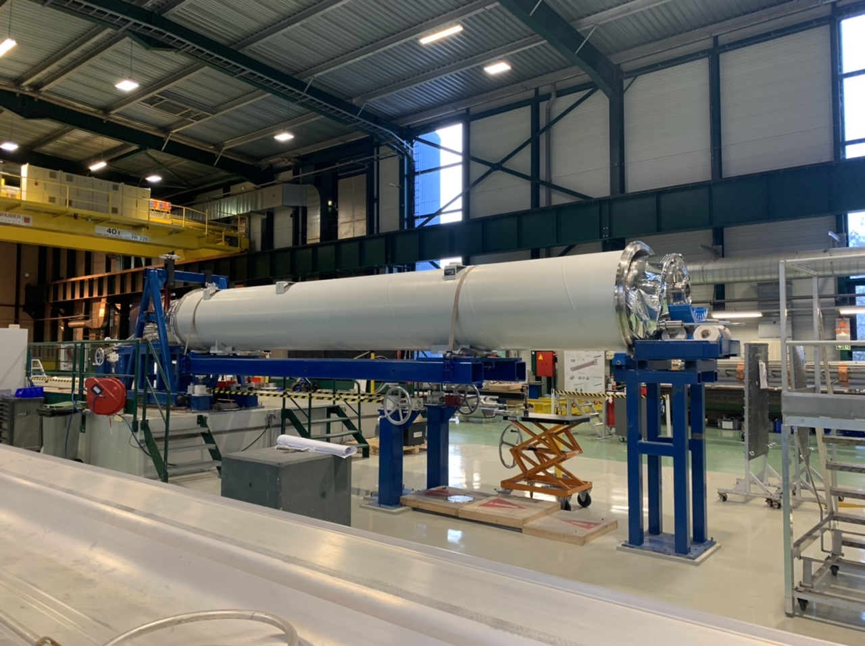


Nb₃Sn quadrupole: 1st Long prototypes almost finished
Developments in 2020:
Q1/Q3: FIRST IT QUAD for HL-LHC!!!
Now entering the phase of hardware production for most equipment!!!
2 US [AUP] magnets passed successfully tests in 2020 and received CD3 approval from DOE in 2020
First CERN prototype tested in 2020, second prototype being tested in February 2021
Q2: FIRST IT QUAD build at CERN!!!

Slide 16
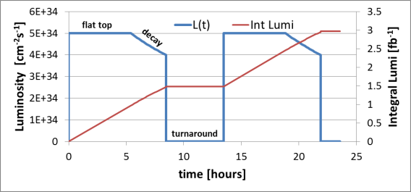

Luminosity optimization:
Luminosity Levelling at the luminosity frontier:
To cope with the total number of events per time interval and the
event pileup in the detector
➔ Design for highest possible virtual luminosity, but keep the
luminosity artificially lower during operation!!
All levelling methods have been successfully demonstrated in
Machine Studies in the LHC!!!
Worry about beam losses!!!!
Radiation to Electronics!!! ➔ Beam aborts & Loss of efficiency!!!!
➔ Loss in integrated luminosity!
➔ Shielding, Additional Cooling and Removal of all active elements from the tunnel!!!
Lifetime proportional to total particles:
$$τ_{eff}=\frac{N_{tot}}{n_{IP}∙σ_{tot}∙L_{leveled}}$$
Worry filling patterns and unwanted collsions!!!!
➔ Maximize the number of particles in the storage ring!
➔ Stored Beam Power!
16

Slide 17
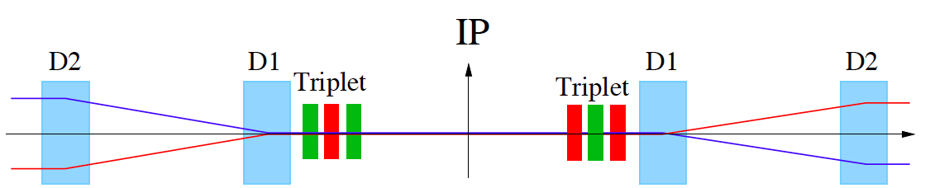
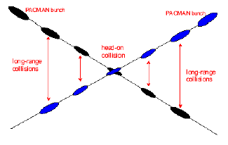
HL-LHC Challenges: Crossing Angle I
Insertion Layout:
ca.130m ➔ 150m
ca.50m
Parasitic bunch encounters:
Operation with ca. 2800 bunches @ 25ns spacing ➔ approximately 30 unwanted collision per
Interaction Region (IR).
➔ Operation requires crossing angle
non-linear fields from long-range beam-beam interaction:
efficient operation requires large beam separation at unwanted collision points ➔ Separation of 10 -12 σ ➔ large triplet apertures for HL-LHC!!

Slide 18
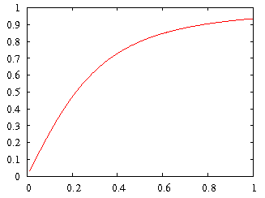
HL-LHC Upgrade Ingredients: Crab Cavities
Geometric Luminosity
Reduction Factor:
Crab Cavities:
Reduces the effect of geometrical reduction factor
Independent for each IP
Noise from cavities to beam Beam size and losses?!?
Challenging space constraints:
➔ requires novel compact
cavity design
effective cross section
HL-LHC

Slide 19
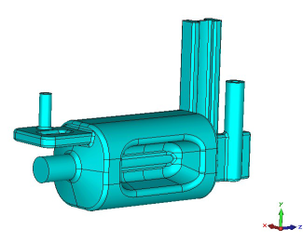
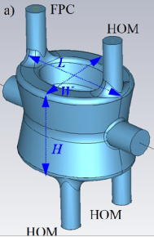
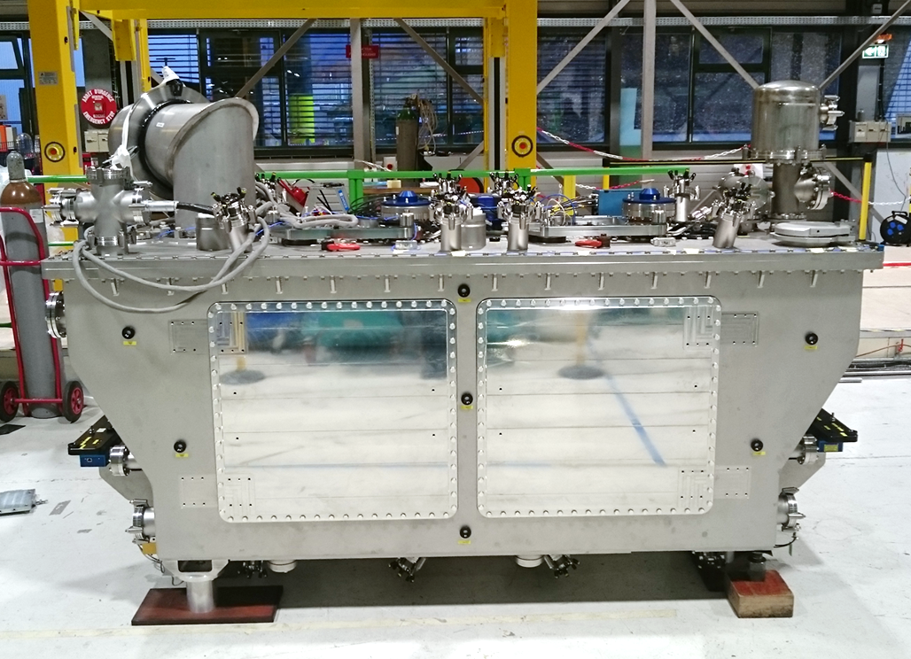
HL-LHC cavity designs
2 Designs with
Different Coupler concepts and
Deflection planes
RF Dipole: Waveguide or
waveguide-coax couplers
Double ¼-wave: Coaxial couplers with
hook-type antenna
DQW crab-cavity
Cryomodule for
SPS tests
Present baseline: 4 cavities / IP / side ➔ 16 total

Slide 20
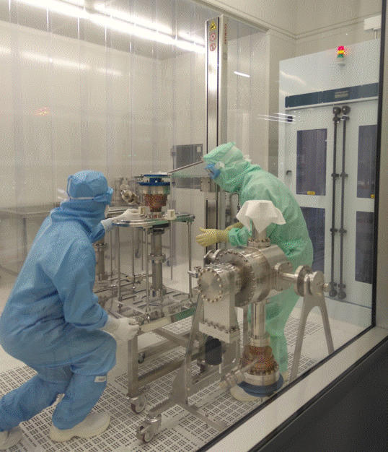
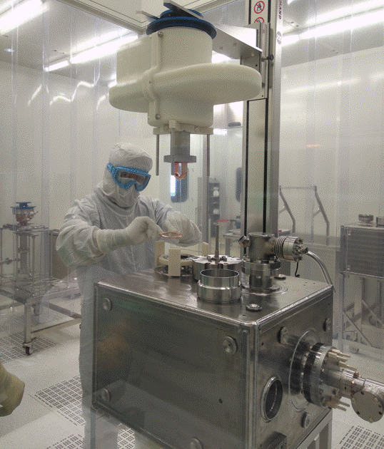
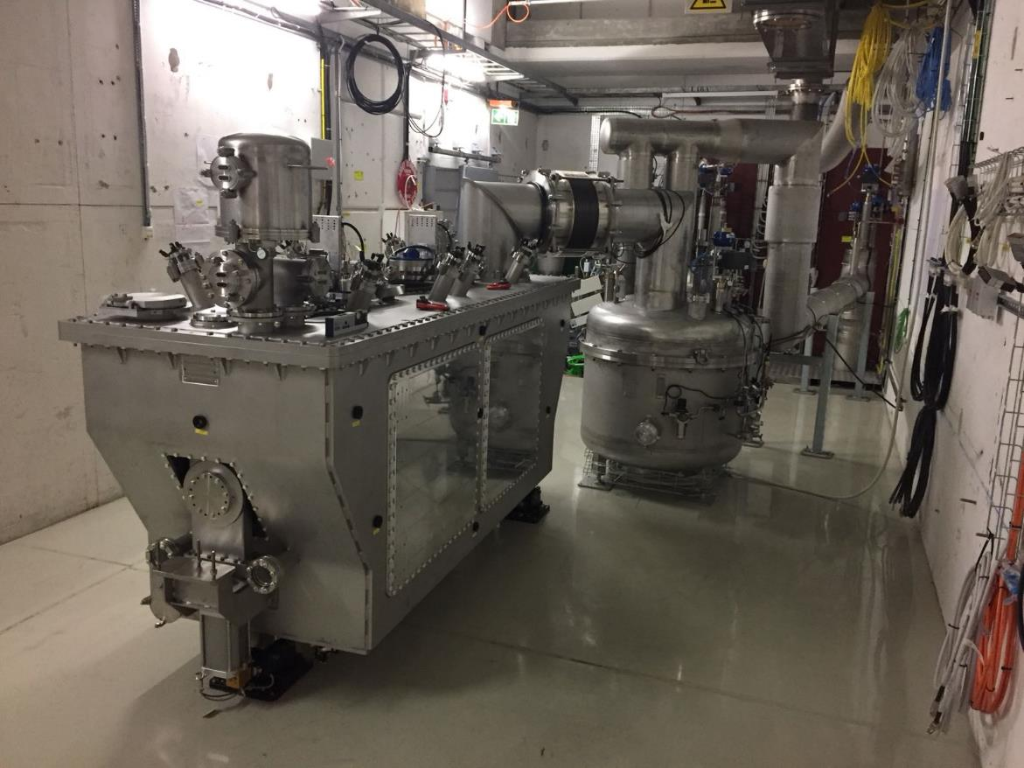
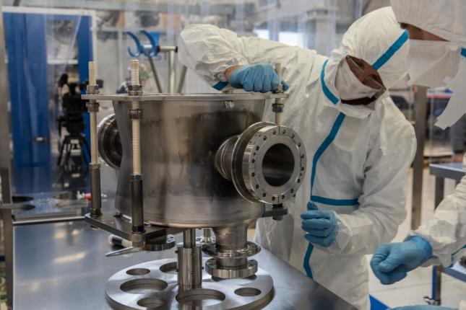
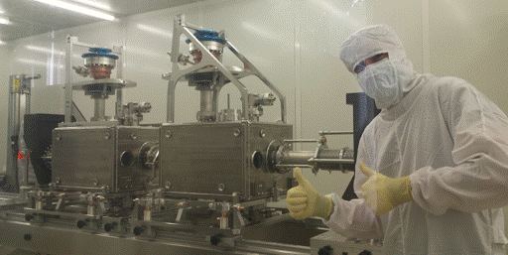
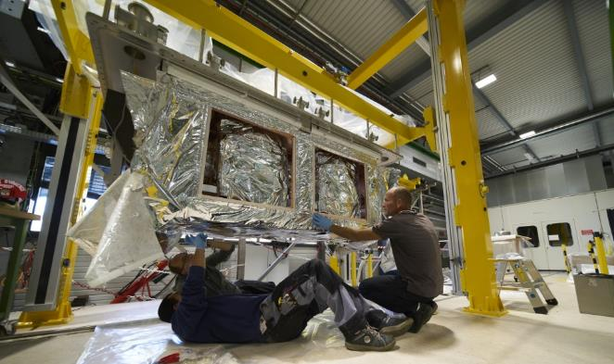
Crab cavity cryo-module for installation in the SPS
20

Slide 21
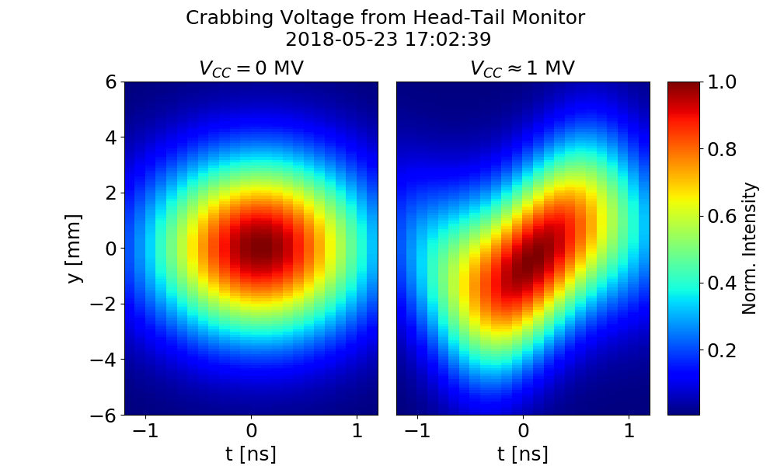
First proton crabbing ever!
TEST in SPS ongoing since 2018
Study and R&D
has been very useful to obtain this result
21

Slide 22
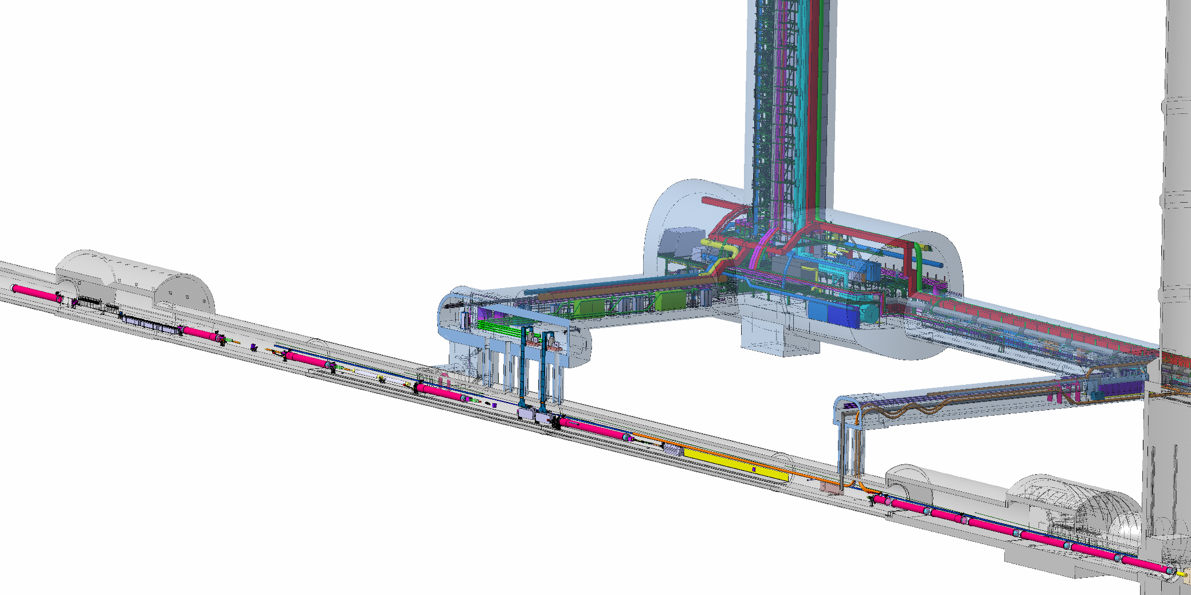
IR1 & IR5 Civil Engineering:
Vibrations of Civil Engineering Work can affect LHC operation!!!
CE work needs to be done when LHC is not operating
main work needs to be carried out during LS2 in order
to finish work in time for LS3
New Underground areas for the HL-LHC:
Space for new HL-LHC equipment [e.g. cryo and power converter]
Removal of all active components from the tunnel area
[R2E and equipment failure due to radiation]

Slide 23
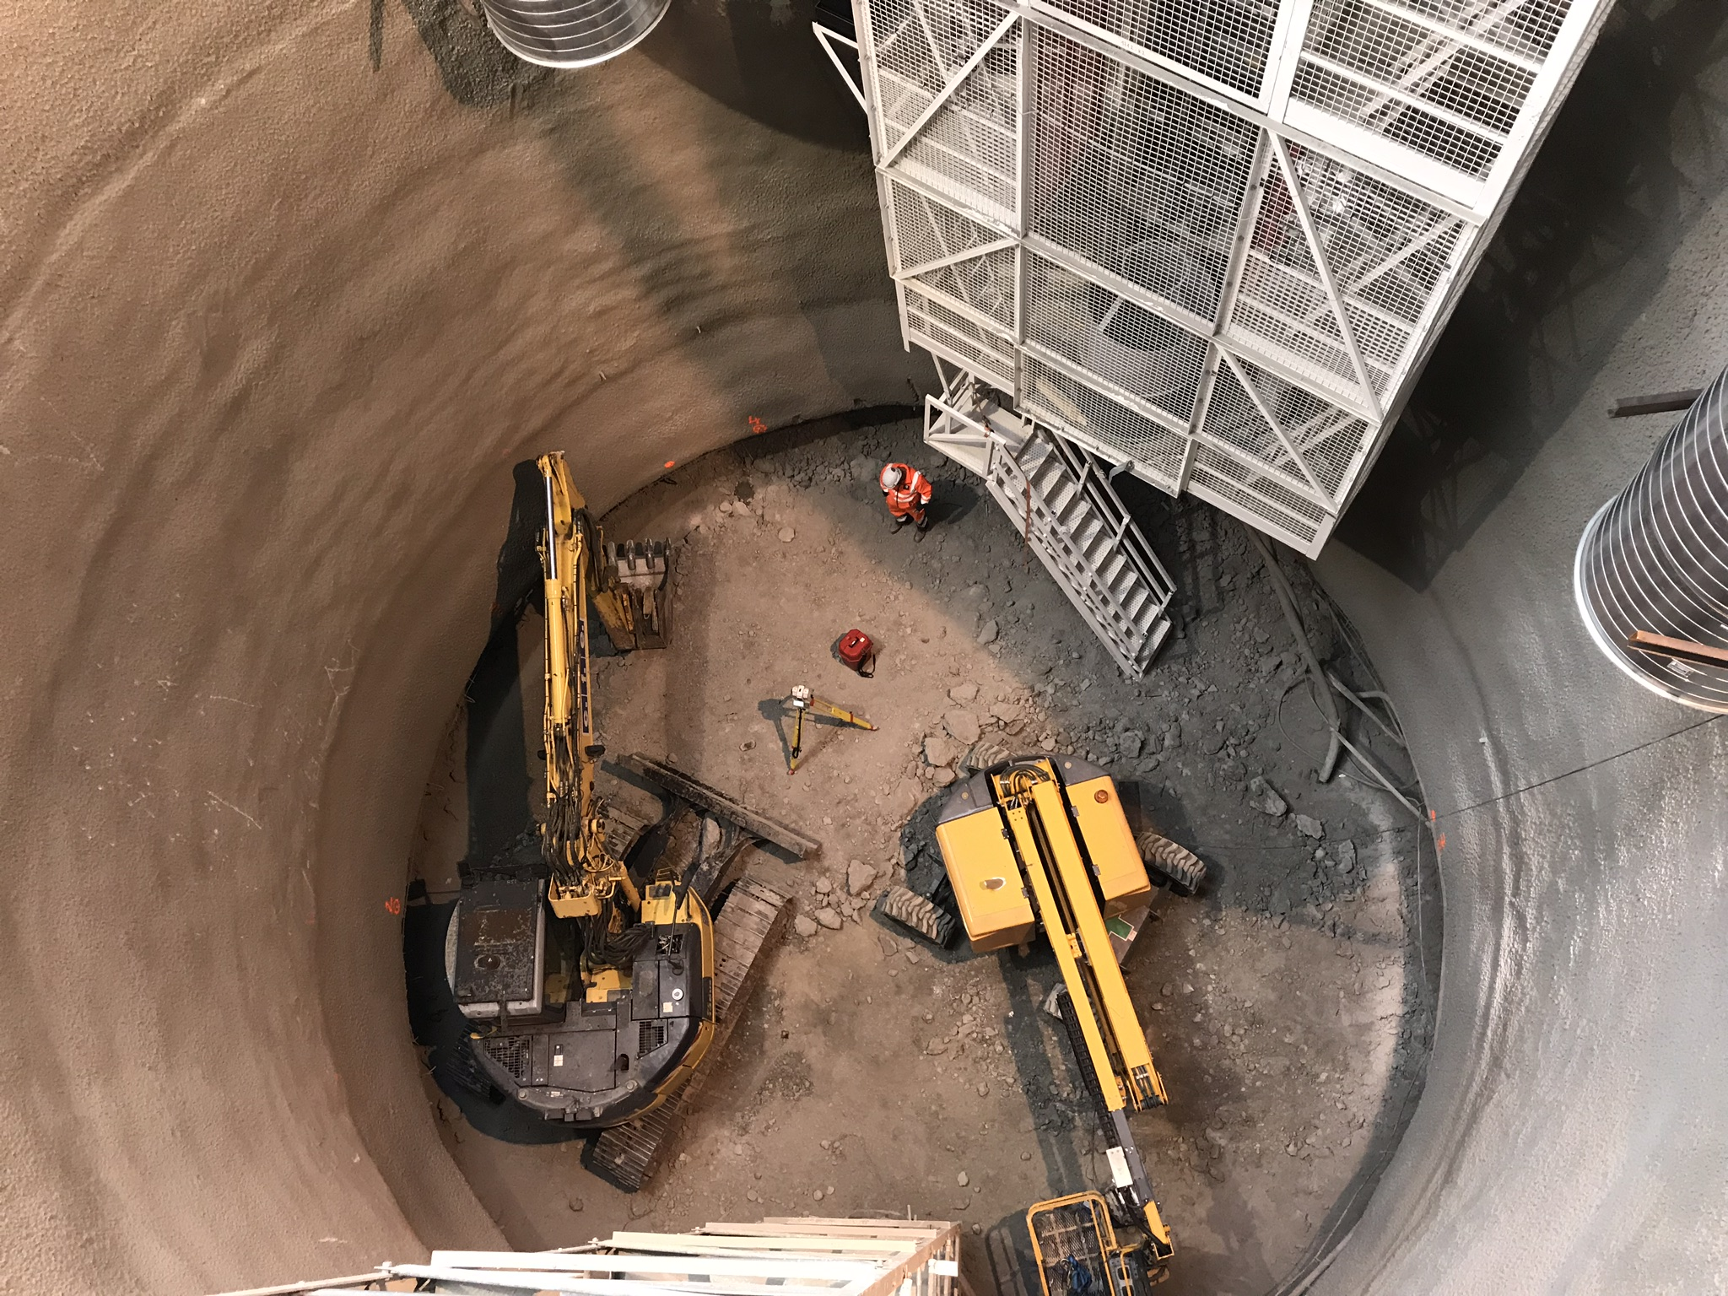
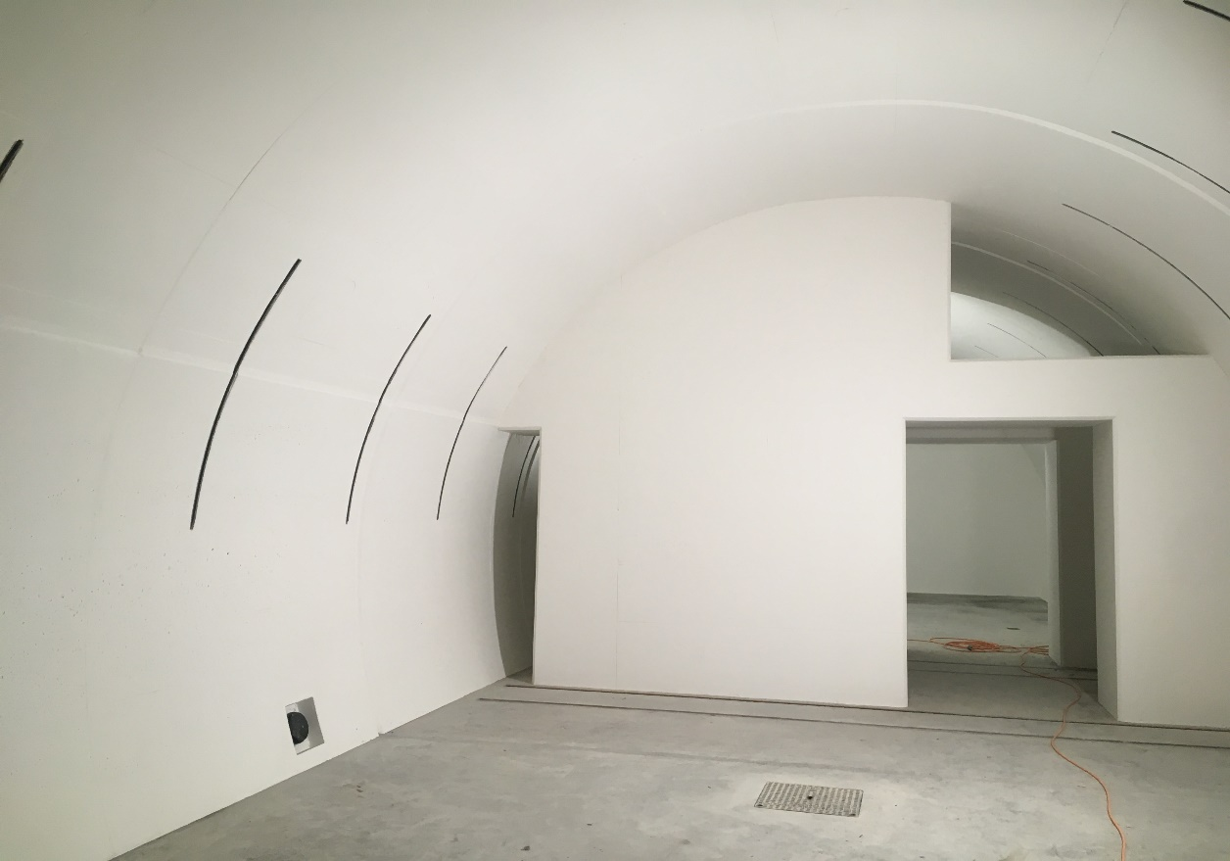
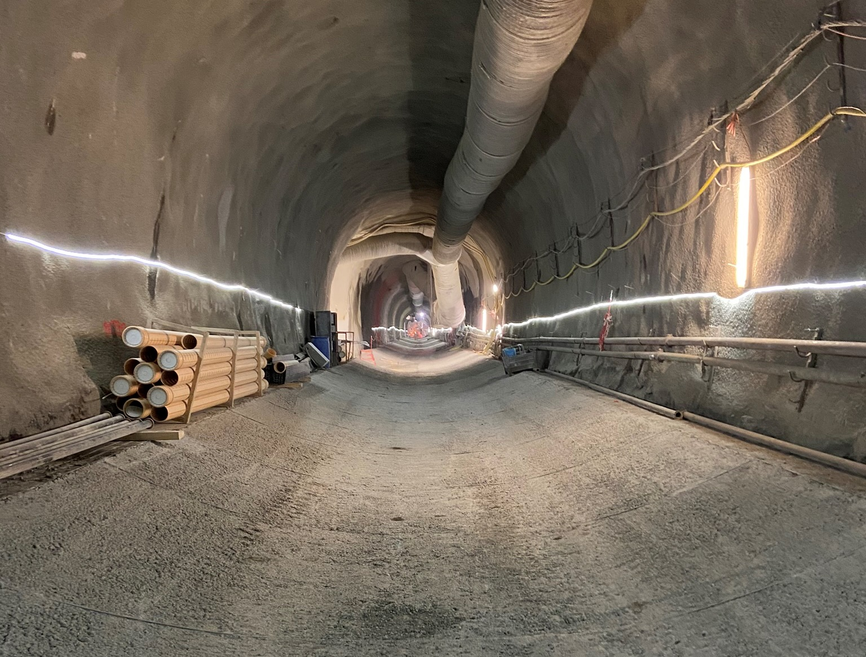
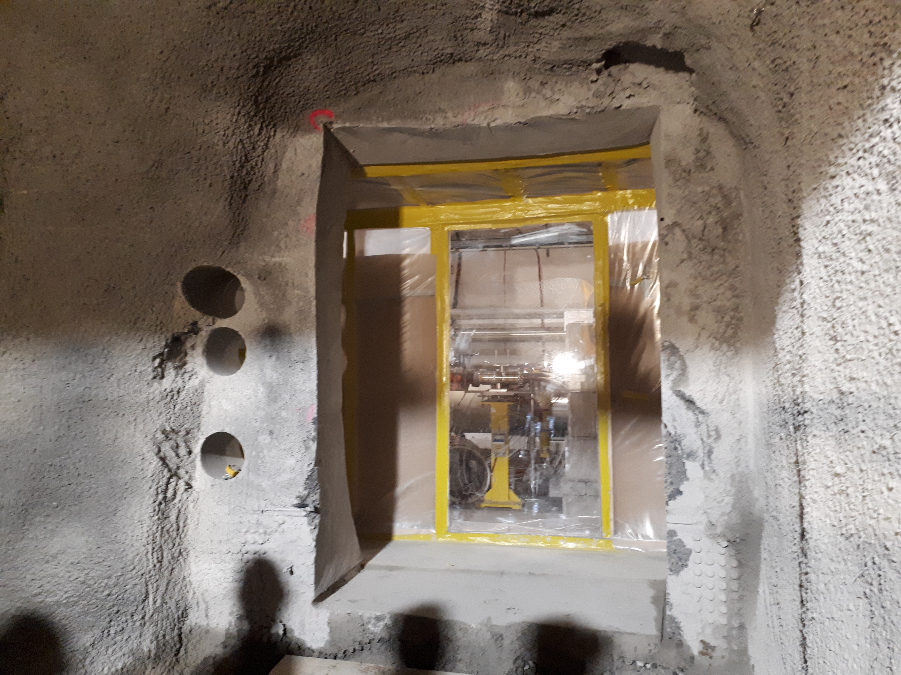
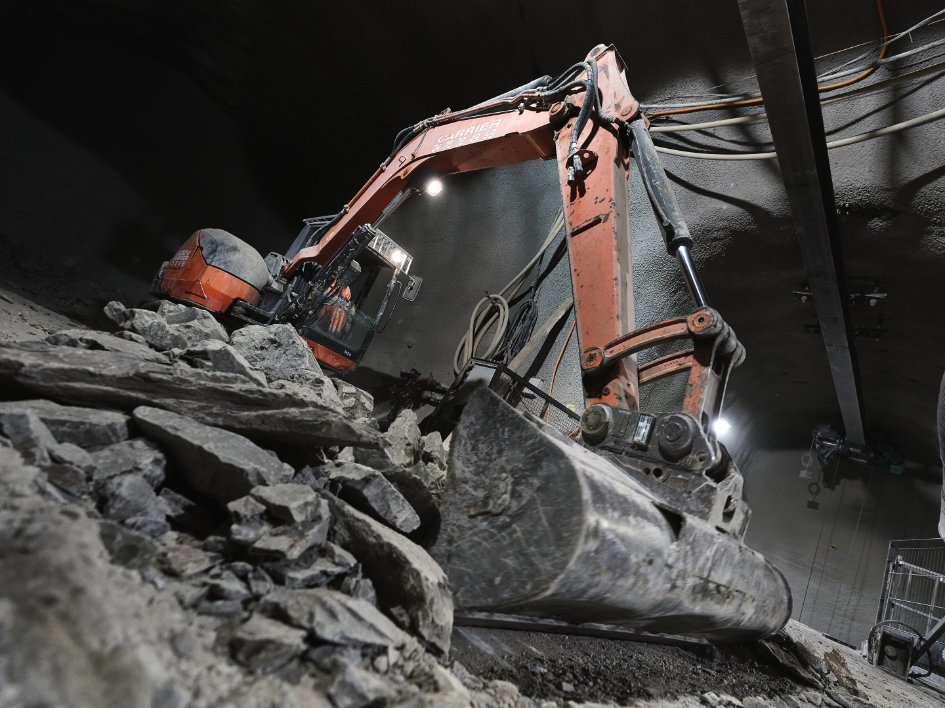
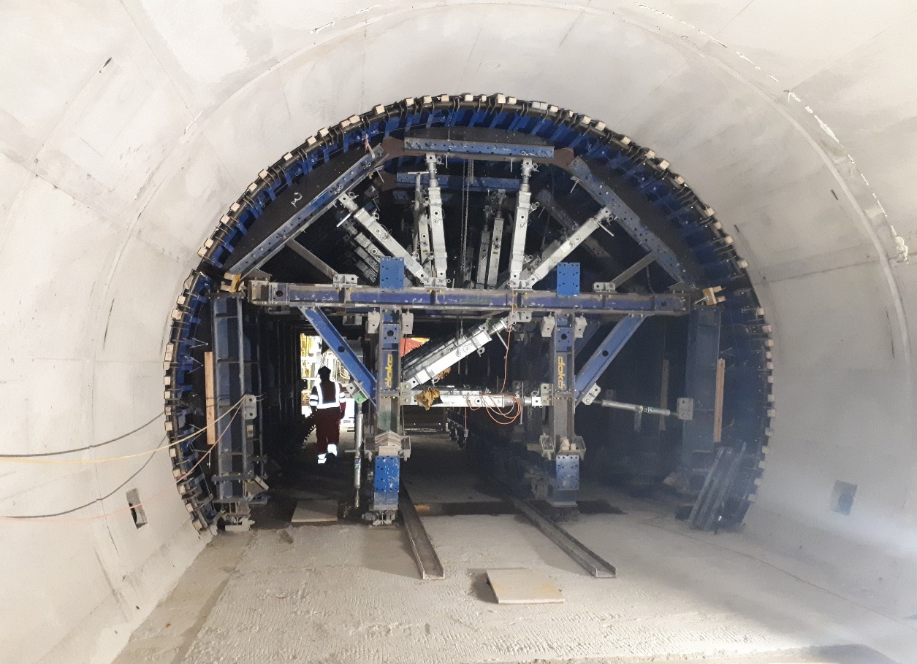
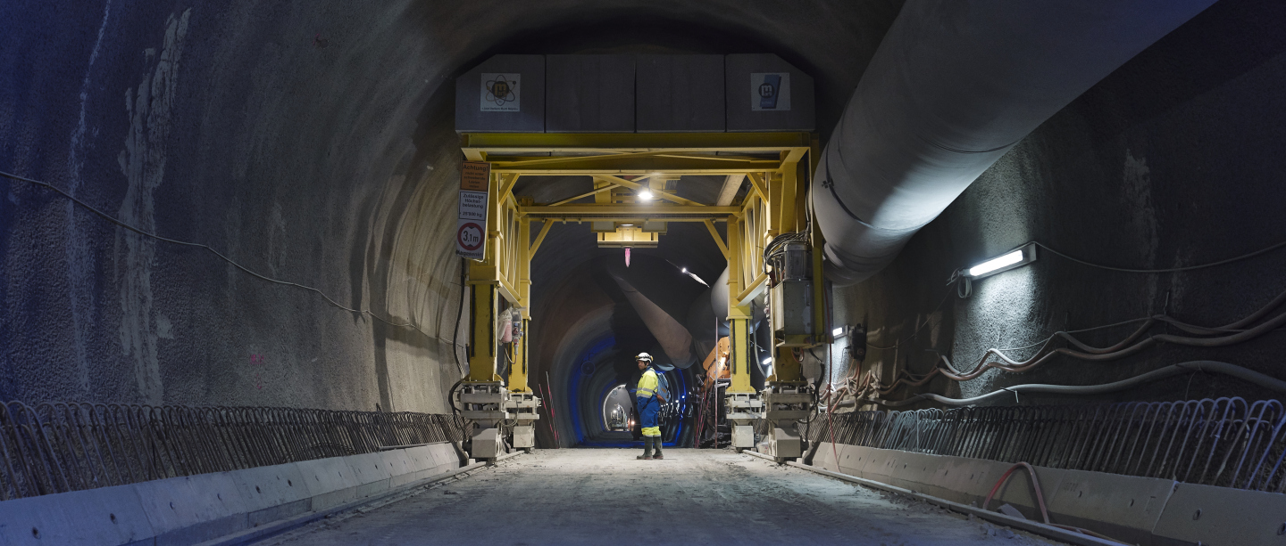
IR1 & IR5 Underground Civil Engineering: almost complete!
Transition to LHC tunnel
23

Slide 24
Beyond HL-LHC
2031 after LS4: Full Energy Exploitation of the LHC?
Beyond 2035: New project proposals!!!

Slide 25
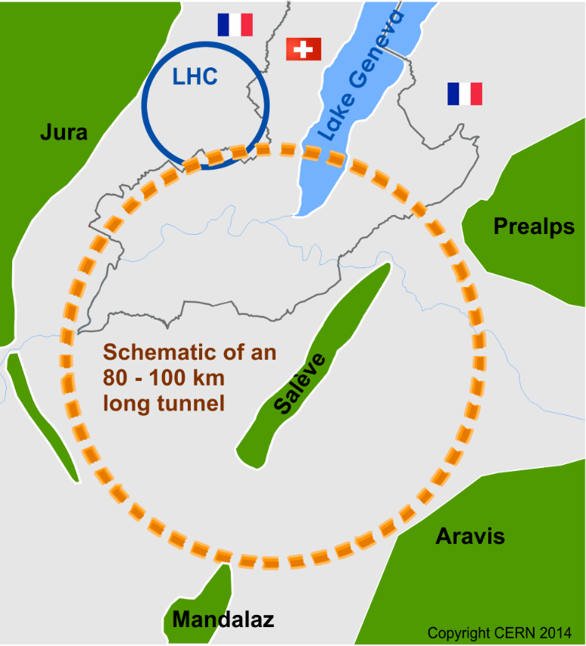
Future Circular Collider
International FCC collaboration (CERN as host lab) to study:
pp-collider (FCC-hh) → main emphasis, defining infrastructure requirements
80-100 km tunnel infrastructure in Geneva area, site specific
e⁺e⁻ collider (FCC-ee), as potential first step [light Higgs!]
p-e (FCC-he) option, integration one IP, ERL a la LHeC
HE-LHC with FCC-hh technology
20 T ⇒ 100 TeV pp in 100 km
[16 T ⇒ 80 TeV pp in 100 km]
25

Slide 26
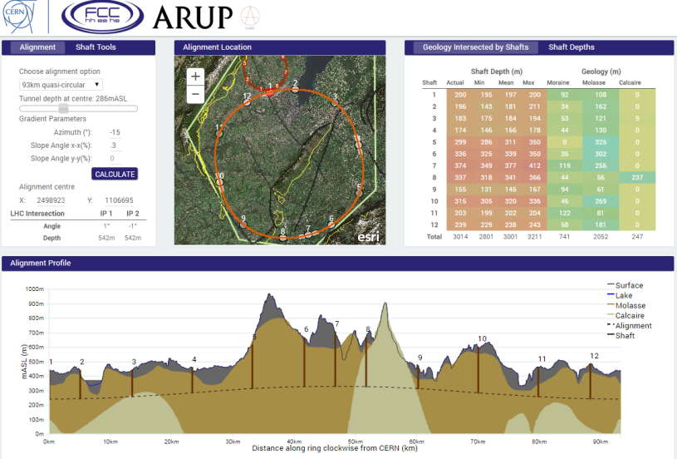
Layout Studies
First sectors available after 5 years for Technical Infrastructure installation
Total CE duration ~7 years
JUAS Seminar on LHC and Future Circular Colliders January 2019 Oliver Brüning, CERN
26

Slide 27
FCC-hh Key Parameters
Parameter | FCC-hh | HL-LHC
Energy [TeV] | 100 c.m. | 14 c.m.
Dipole field [T] | 16 | 8.33
# IP | 2 main +2 | 2 main +2
Luminosity/IP_{main} [cm⁻²s⁻¹] | 5-10 x 10³⁴ | 5 x 10³⁴
Energy/beam [GJ] | 8.4 | 0.7
Synchr. rad. [W/m/apert.] | 28.4 | 0.35
Bunch spacing [ns] | 25 (5) | 25
discharge 330 μs ⇒ 24 TW
JUAS Seminar on LHC and Future Circular Colliders January 2019 Oliver Brüning, CERN
27

Slide 28

FCC-ee Key Parameters
Parameter | FCC-ee |  |  | LEP2
Energy/beam [GeV] | 45 | 120 | 175 | 105
Bunches/beam | 16700 | 1360 | 98 | 4
Beam current [mA] | 1450 | 30 | 6.6 | 3
Luminosity/IP x 10³⁴ cm⁻²s⁻¹ | 28 | 6 | 1.8 | 0.0012
Energy loss/turn [GeV] | 0.03 | 1.67 | 7.55 | 3.34
Synchr. Power [MW] | 100 |  |  | 22
RF Voltage [GV] | 2.5 | 5.5 | 11 | 3.5
22 MW at LEP2
JUAS Seminar on LHC and Future Circular Colliders January 2019 Oliver Brüning, CERN
28

Slide 29
Key Technologies and Challenges
Superconducting magnets: 16T ➔ 20T
Superconducting RF cavities
High efficiency RF power sources
Affordable & reliable cryogenics
Synchrotron Radiation!
Reliability & availability concepts
e.g. Cryo Sectors: 92% availability requires 99% / sector with 8 sectors ➔ [12 Sectors ➔ 20 Sectors] ➔ 89% - 81%
Stored Energy in the beams
8.4 GJ / beam;
➔ discharge in 330 μs ⇒ 24 TW
29
Notes:
0.7 GJ : 1ton of Copper P= 700 10⁶ / 88 10⁻⁶ = 8 TW
8 GJ : 11 ton of Copper P = 8 10⁹ / 330 10⁻⁶ = 24 TW

Slide 30
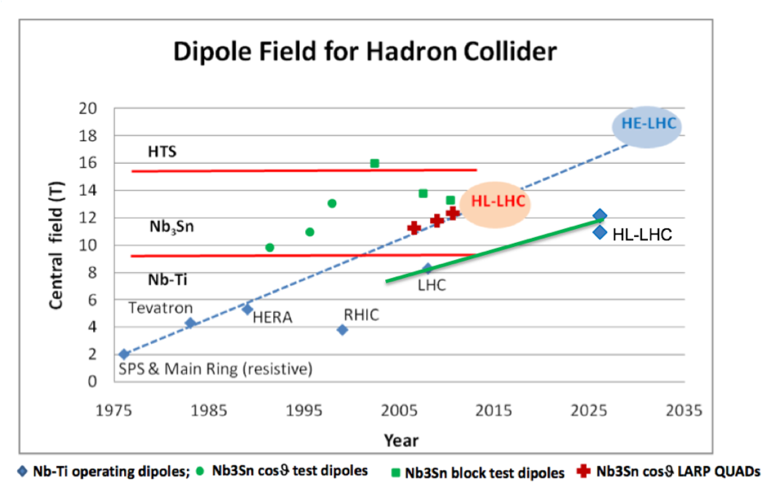
pp colliders – High Field SC Magnets
How High can we go? Livingston plot revisited:
Pushing NbTi technology took 25 years!
Transition from NbTi to Nb₃Sn:
HL-LHC lead the R&D for 11-15T magnets based on Nb₃Sn technology:
➔15-25 years R&D program
Pushing Nb₃Sn Technology and Transition to HTS:
Assume R&D period of similar length ➔ > 2040?
Transition from NbTi to Nb₃Sn:
HL-LH lead the R&D for 11-15T magnets based on Nb₃Sn technology:
➔15-20 years R&D program
Transition to HTS:
Assume R&D period of similar size ➔ 2035?
FCC
HL-LHC
courtesy: L. Rossi (CERN)
30

Slide 31

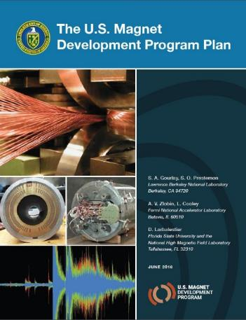

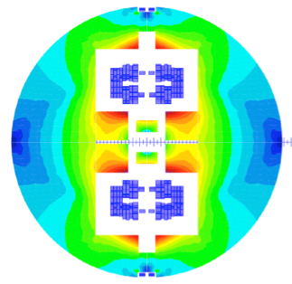

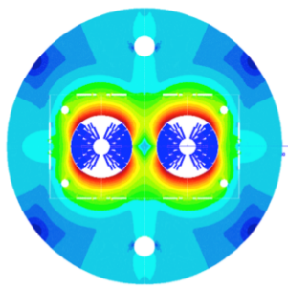
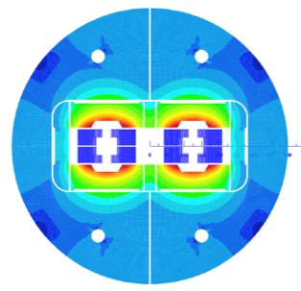
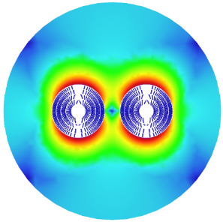

16 T dipole design activities and options
Swiss contribution
H2020
Cos-theta
Common coils
Canted
Cos-theta
Blocks
INFN
CIEMAT
LBNL
CEA
PSI
FNAL
Short model magnets (1.5 m lengths) will be built from 2017 - 2021
31

Slide 32
High Field Magnet challenges
- To reduce the cost of magnet production!
- To increase the critical current Jc
- To sustain larger forces
- To protect those magnets (large numbers in series)
To train those magnets faster
To keep the memory after installation and thermal cycles
Global optimization: magnet and powering
current leads, superconducting links, energy extraction, power converters; sectorization!
Sectorization!!!
32
Notes:
Sublayer of Lucio’s cable plot

Slide 33
Other Future Circular Collider Projects
What I have left out due to lack of time:
-Super KEK-B: a high luminosity e+ / e- Collider at KEK
-EIA: an Electron - Ion Collider planned for the U.S.A in 2020
-LHeC: an Electron – Hadron Collider based on the LHC
-HE-LHC: LHC with 16T dipole magnets
-FCC-eh: an Electron – Hadron collider based on the FCC-hh
-Chinese versions of the FCC variants: SppC and CepC
-Muon Collider

Slide 34
Reserve Transparencies

Slide 35

MQXFB CERN Prototype:
Failed to reach nominal current
But Nonetheless very positive results!
First CERN Prototype
First Horizontal MQXF cold-test
First 7m long magnet test
Reached 6.5 TeV equivalent without quench
CLIQ worked as planned
Stainless Steel shell around aluminum
All main concepts have been proven up to 15.15 kA!
Limitation only in one coil and in one location [CERN plans 5 coils / magnet]
Review assembly before 2nd prototype magnet construction
Next test of Prototype 2 will come in February 2021!
Inner triplet prototype MXQFB (coil length: 7.2 m) was tested @ SM18
All quenches at same coil and location

Slide 36
Full Energy Exploitation of the LHC
Working group – Chair: Oliver Bruning
Main scope and goals :
Study divided into 3 parts:
Implications for pushing the LHC to 7 TeV (nominal energy) (report by March 2017 – Done)
Implications for pushing the LHC to 7.7 TeV (ultimate energy) (report by June 2018 but better knowledge after LS2)
Implications and feasibility for pushing the LHC beam energy beyond ultimate by replacing some of the LHC magnets with 11T magnets (report by end 2018 on feasibility)
36

Slide 37
SC Magnet Technology
source: L. Rossi
Nb₃Sn
HL-LHC with 11-12T
16 T for HEP
Almost a commodity!
15-20 t per year for MRI
ITER needs 500 t
ca x5 cost LHC Nb-Ti
Brittle material
HTS (needed → 20 T)
➔ on going R&D!
Bi-2212: cost today 2-5x Nb₃Sn
YBCO: cost today 10x Nb₃Sn
-Higher Jc
-Brittle material
➔ technically
challenging
-More
expensive
then NbTi
37

Slide 38

Muon Collider Concept:
MC on FNAL site
Proton source:
Up to 4 MW,
with 2±1 ns long bunches
Goal: Produce a high intensity μ beam whose 6D phase space is reduced by a factor of ~10⁶ from its value at the production target
Fast acceleration mitigating muon decay
Collider up to 6-10TeV 2 detectors:
√s = 3 TeV
Circ: 4.5km L = 3×10³⁴ cm⁻²s⁻¹
M.A.Palmer: Muon Accelerators for High Energy Physics Applications: nSTORM, NuMAX & Beyond…
38

Slide 39


Muon Collider
Jean-Pierre Dellahaye; 2015
Multi-TeV lepton collider (≤10 TeV cm)
No beamstrahlung
→ superb energy resolution
No synchrotron radiation
→ relatively small footprint (but no damping!)
Possibilities for cost and MW savings
Circular
Muons
Linear
Challenges: MANY!!!!
39

Slide 40
Introduction: the LHC is a Synchrotron
uniform B field: R = constant
for E >> E₀
realistic synchrotron: B-field is not uniform
-drift space for installation
-different types of magnets
-space for experiments etc
high beam energies require: -high magnetic bending field
-large circumference
-large packing factor

Slide 41
Introduction: the LHC is a Synchrotron
physics goal: E = 7 TeV
existing infrastructure: LEP tunnel: circ = 27 km (ca. 17mi)
with 22 km arcs (ca. 14mi)
assume 80% of arcs can be filled with dipole magnets: F = 0.8
required dipole field for the LHC:
B = 8.38 T
(earth: 0.3 10⁻⁴ T)

Slide 42


Introduction: Magnet Technology
high beam energies require large rings and high fields
1) Iron joke magnet design 2) SC magnet design
-field quality given by pole face geometry -field quality given by coil geometry
-field amplified by Ferromagnetic material -SC technology avoids Ohmic losses
-iron saturates at 2 T -risk of magnet quenches
-Ohmic losses for high magnet currents -field quality changes with time

Slide 43


Introduction: Magnet Technology
Magnet Quench: loss of superconducting state
Need to avoid any significant movement of the coils!!!
Need to avoid any significant beam losses inside the magnets
Dedicated collimation system with absorbers in the machine
QPS system that induces beam abort when detecting a quench
Machine reliability and efficiency are key challenges!
LHC Dipole Magnets: 8.38T, with 11850A
➔ high ambient magnetic field > 8 T @ coil
Critical Surface for NbTi
Extreme Forces acting on the coils:
Ca. 12kA * 8.4T ➔ 100.000 Newton
per meter and winding layer!
ca. 50 cars ‘hanging’ per meter
➔ 1.8 K cooling with superfluid He (thermal conductivity)
➔ current density of 2.75 kA / mm²
At the limit of NbTi technology (HERA & Tevatron ca. 5 T @ 2kA/mm²)!!

Slide 44

Peak luminosities of Hadron colliders
LHC
HL-LHC
World Wide Integrated Luminosity prior to LHC: ca. 11fb⁻¹
LHC Design Goal: 300fb⁻¹ ➔ LHC likely performance: 350fb⁻¹ to 400fb⁻¹
HL-LHC goal: 3000fb⁻¹ to 4000fb⁻¹!
x 35
x 10
Proton / Proton
Proton / Anti-proton
V. Shiltsev,
Physics Uspekhi 55
(2012) 965
Polarized Proton / Proton
Electron / Proton
2020
2030
44

Slide 45
LHC Timeline I
LHC startup in 2008: (In)famous ‘Incident’

Slide 46

2008 Start-up and Incident: Interconnects

Slide 47


Magnet Interconnections:
Melted by arc
Dipole busbar

Slide 48
LHC Timeline I
LHC startup in 2008: (In)famous ‘Incident’
LHC repair of Sector 34 during 2008 to 2010:
‘unprecedented state of readiness’
LHC Run 1: 2010 to 2013
Commissioning in 2010 and 3 years of operation with 50ns
bunch spacing and reduced beam energy [3.5TeV to 4TeV]
➔ Higgs discovery in July 2012!!!

Slide 49
LHC Timeline II
2014 LS1: One year stop for consolidation of hardware
➔ Fixing splices with too high resistance
LHC Run 2 startup in 2015:
Repaired splices, but:
electrical short to ground during Hardware Commissioning
Bam energy set below nominal energy in order to minimize
the number of required training quenches: ➔ 6.5 TeV

Slide 50




LHC Beam Energy during Run 2
Unforeseen Obstacles:
Short in the magnet diode box following a training quench:
➔ released energy during quench at high
energy is capable of displacing debris that
has collected in the diode box
Second incident during training in ca. 252 quenches
(but also had 5-6 shorts before LS1)
Risk Assessment:
➔ Systematic cleaning and insulation of the diode box!!!
Decision for Intervention during LS2 and
to stay at 6.5TeV for RunII!!!

Slide 51
Run-II: Operation with a well understood machine and with margins for the magnets!
Magnet re-training ➔ 6.5 TeV instead of 7 TeV
Beam Optics ➔ well understood (< 10% globally; < 5% @ IP)!
Procedures and application software
➔ operational and well developed
Magnet field errors and correction
➔ well understood
➔ overall very efficient machine operation!!!!!

Slide 52
LHC Timeline IV: HL-LHC
2019-2021 LS2: Stop for Diode consolidation and
Upgrade of the LHC Injector complex [LIU]
Run 3: 2022 to 2024: Operation with 25ns @ nominal energy
2025-2027 LS3: 2.5 year stop for HL-LHC upgrade
HL-LHC: Run start in 2027

Slide 53


Main Goals and parameters:
40 time the old KEK B-Factory performance
2.1 x 10³⁴ cm⁻²s⁻¹ ➔ 8 x 10³⁵ cm⁻²s⁻¹
Very high Beam Current
Luminosity lifetime (5min!) ➔ top up operation!
Luminosity Frontier:
KEKB ➔ Super KEKB
Belle ➔ Belle II
ca. 3km
SuperKEKB+ SuperB
KEKB
PEP-II

Slide 54


EIC: eRHIC
Ion complex
Existing RHIC facility
and injector complex
One Collider ring
Electron cooling
Electron complex
New polarized source
and linac
New electron
accelerator ring
New Storage ring
Key challenges: fast injection [swap out at top energy], polarization, fast bunched
beam cooling, Crab cavities, Interaction Region magnets and SR,
polarization preservation and ERLs [cooling]

Slide 55



LHeC: A Electron – Hadron Collider
Super Conducting Recirculating Linac with Energy Recovery
Choose ⅓ of LHC circumference ➔
10³⁴ cm⁻² s⁻¹ Luminosity reach | PROTONS | ELECTRONS
Beam Energy [GeV] | 7000 | 60
Luminosity [10³³cm⁻²s⁻¹] | 16 | 16
Normalized emittance γε_{x,y} [μm] | 2.5 | 20
Beta Funtion β∗_{x,y} [m] | 0.05 | 0.10
rms Beam size σ∗_{x,y} [μm] | 4 | 4
rms Beam divergence σ’∗_{x,y} [μrad] | 80 | 40
Beam Current @ IP[mA] | 1112 | 25
Bunch Spacing [ns] | 25 | 25
Bunch Population | 2.2*10¹¹ | 4*10⁹
Bunch charge [nC] | 35 | 0.64
Two 1 km long, 10 GeV
SC LINACs with
3 accelerating and
3 decelerating passes in CW operation
Different Size Variations: e.g LHeC
ca. 9 km underground tunnel
installation
55

Slide 56
FCC in China: SppC and CepC
56

Slide 57

Introduction: the LHC is a Synchrotron
R = constant:
v = c B γ
LHC / LEP: ω₀ = 11.3 kHz

Slide 58


An extra boost from the injectors
A new production scheme – the “BCMS” - was put in place in the PS
RF cavities tuned at different frequencies play together to compress merge and split bunches
Beams ~30% brighter than standard scheme
The LHC performance fully relies on the performance of its injector complex
By itself one of the largest accelerator facility in the world with its own diverse and, for many aspects, unique physics program
Higher than nominal beam brightness!
Performance limited by the number of events the detectors
can digest in a single bunch collision [pileup]
and
the LHC cooling power!!!
E_{kin} = 2.5 GeV
➔ Well on track for exceeding the LHC goal of 300fb⁻¹
Achieved almost 70fb⁻¹ in 2018 and 160fb⁻¹ in Run2 [total of ca. 190fb⁻¹]
58

Slide 59










HL-LHC quadrupole R&D
RRP strand (0.85 mm,108/127)
J_{C}: 2450 A/mm² (12 T, 4.2 K)
Cu:non-Cu: 1.2
The challenge for high field magnets:
- Limit the training and keep memory !
- Increase J_{op}/J_{C} (presently at ≈ 40 % for Nb₃Sn at 1.9 K)
Aperture | 150 | (mm)
Gradient | 132.6 | (T/m)
Current | 16.47 | (kA)
Peak field | 11.4 | (T)
40 strands cable
(18.15 mm x 1.52 mm)
Courtesy of G. Ambrosio, G. Chlachidze, US-LAUP and CERN
59

Slide 60
LHC Upgrade Goals: Performance optimization
Luminosity recipe (round beams):
1) maximize bunch intensities
2) minimize the beam emittance
3) minimize beam size (constant beam power);
4) maximize number of bunches (beam power);
5) compensate for ‘F’;
6) Improve machine ‘Efficiency’
Injector complex
Upgrade LIU
triplet aperture
25ns & Xing
Crab Cavities
minimize number of unscheduled beam aborts

Slide 61
Luminosity Levelling
- In certain conditions and depending on the experiments request, it is desirable to adapt the luminosity dynamically with beams in collision – levelling
- Each levelling technique has its advantages and drawbacks
Experience at previous Hadron Beam Colliders had shown
that the beam lifetime and losses are very sensitive to the
transverse profile matching and overlap of the colliding
beams at the Interaction Point!!!!
Levelling by beam offset / separation
Levelling by crossing angle
Levelling by β* (= beam size at IP)
Complexity
61

Slide 62









Baseline upgrades
Completely new layouts Novel materials. IR1+IR5, per beam:
4 tertiary collimators 3 physics debris collimators fixed masks
56 new collimators to be produced by LS3 in
the present baseline!
Cleaning: DS coll. + 11T dipoles, 2 units per beam
Over 100 Collimators and absorbers to protect the SC magnets!!!
Ion physics debris: DS collimation
Low-impedance, high robustness secondary collimators

Slide 63


RunI operation: 50ns bunch spacing
Electron Cloud: strong suppresses of electron cloud effects!
reduced beam conditioning times

Slide 64
Technical Schedule for the 3 Options
20
22
24
26
28
30
32
34
36
38
40
42
Technical Design Phase
Strategy Update 2026 – assumed project decision
Dipole short models
16 T magnets
Dipole long models
SC Magnets
16 T dipole indust. prototypes
16 T dipoles preseries
16 T series production
FCC-hh
Civil Engineering FCC-hh ring
FCC-hh
CE TL to LHC
LHC Modification
Installation + test FCC-hh
CE FCC-ee ring + injector
FCC-ee
FCC-ee
Injector
Installation + test FCC-ee
HE-LHC
HE-LHC
LHC Removal
Installation HE-LHC
schedule constrained by 16 T magnets & Civil Engineering
→ earliest possible physics starting dates
FCC-hh: 2043
FCC-ee: 2039
HE-LHC: 2040 (with HL-LHC stop LS5 / 2034)
64

Slide 65










Superconducting magnet market
At present, the vast majority of the use of superconductors is for magnet applications:
MRI (NbTi): 5.5 BUSD/year^{[1]};
7.0 BUSD/year in 2017
NMR, science and research: (Nb3Sn)
∼ 1 BUSD/year^{[1]}
Large scale projects (HEP, Fusion) represent only a fraction of the total market and discontinuities:
Evaluated cost of LHC magnet system (material): 2 BUSD^{[2]}
Quoted cost of ITER magnet system (material): 1.4 BUSD^{[3]}
MRI
NMR
LHC
JT60SA
ITER
Sources: [1] from market report at Conectus.org, converted from repored 5.3 BEUR in 2013
[2] Report to the CERN Finance Committee, 2008, reported 1.7 BCHF(2008) escalated to 2013
[3] DOE Assessment of the ITER Project Cost Estimate, reported 1.09 BUSD(2002) escalated to 2013
65

Slide 66
Superconducting conductor production
NbTi in the world : ∼ 600 tons/year, driven by MRI production
Nb3Sn : ∼ 10 tons/year, driven by NMR magnets and laboratory solenoids
All of HTS (BSCCO, YBCO,…) and MgB2: around 100...200 km of 4-10 mm wide tape per year, presently driven by R&D applications and delivered by around 10 worldwide producers,
In total below 1 ton/year
LHC required 1300 tons of Nb-Ti (300 t/year peak production) (∼30% cost of the magnet)
ITER required 300 tons of Nb-Ti and 600 tons of Nb3Sn (250 t/year peak production)
HL-LHC requires: 30 tons Nb3Sn and about the same for NbTi
HE-LHC will require : ∼ 3’000 tons Nb3Sn
FCC-hh will require : ∼ 9’000 tons Nb3Sn (between 50% to 60% cost of the magnet)
66

