Slide 1
Reverse engineering of TAS support jacks N. Kristensen EN-EA-PE 95th HL-LHC WP8 Meeting, November 24th 2020

Slide 2
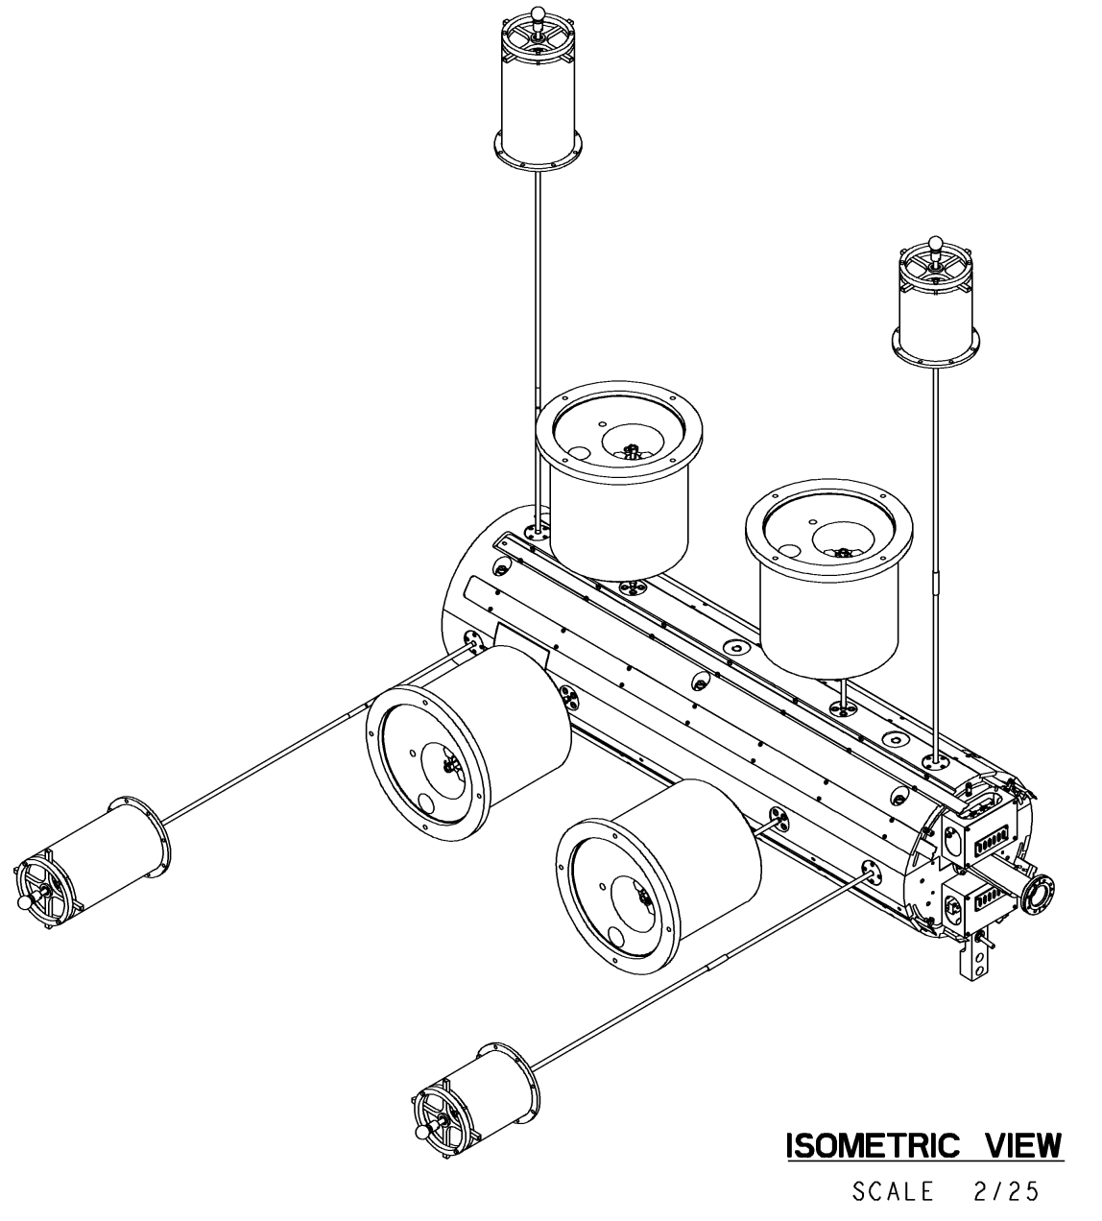
Why reverse engineer the support jacks?
Backlash found in one horizontal support jack
Unknown reason causing the backlash
Original drawings are only available in 2D
3D drawings could help understand the mechanism
It is considered to manufacture a new support jack
A reverse engineered model of the original could be used as a platform to design a new support jack
An opportunity to take care of any concerns there might exist of the original design

Slide 3
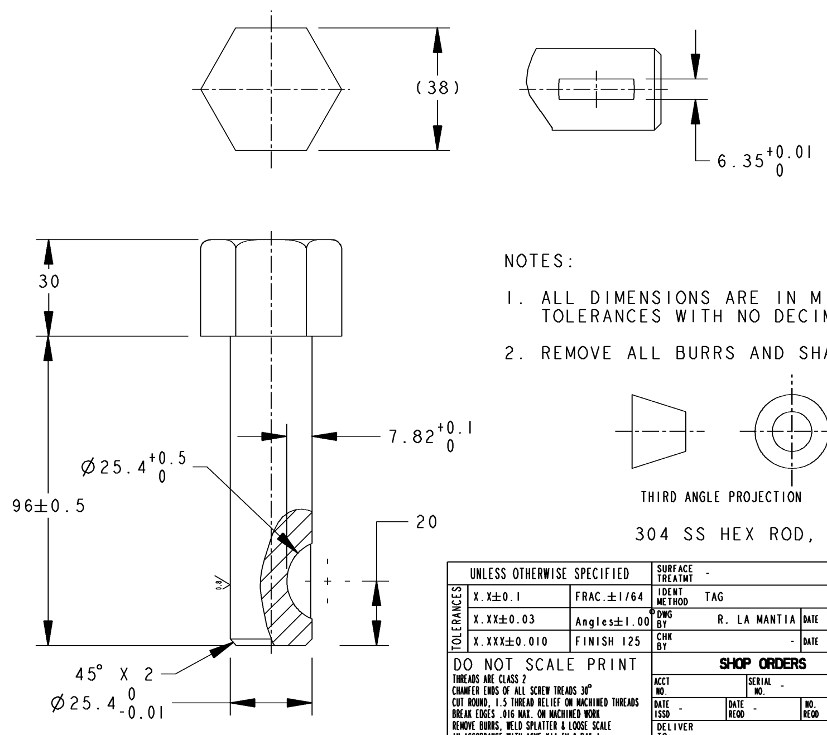
Challenges faced in the reverse engineering
Designed in America by University of California-Berkeley
American dimensioning ex. holes, bearing seats, shaft diameter… (inches)
American standard parts, ball bearings, bearings, washers, keys…
CERN catalogue and Tracepartsonline.net mainly provide parts for the European metric system
Initially designed in year 2000
The components used in 2000 is not necessarily similar to parts of today (jack screw)
Three missing drawings

Slide 4
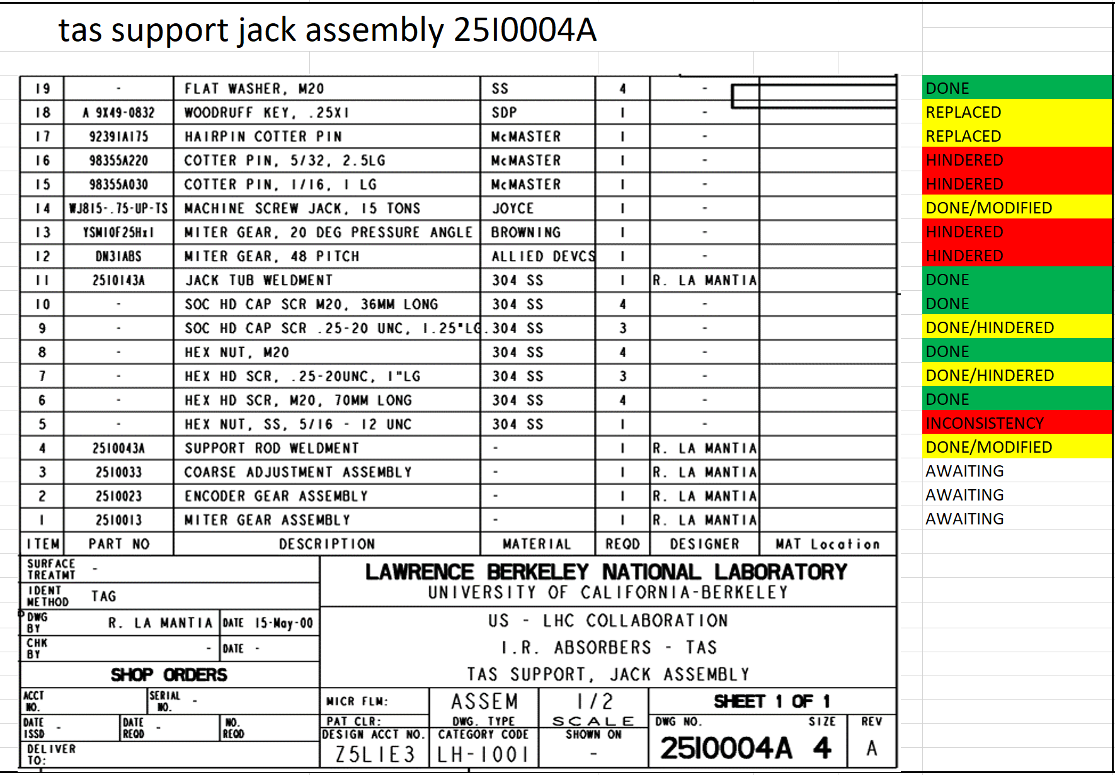
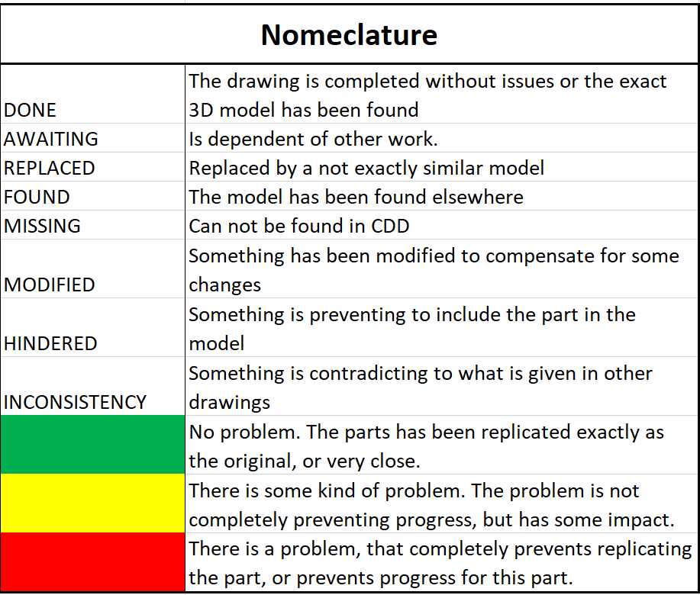
The process of reverse engineering
Three types of documents/files have been used in the process
An Excel document – for overview of the process
A word reporting document – for reporting how every item is reverse enginnered, or any complications there might have been
CATIA files – the reverse engineered 3D model itself

Slide 5
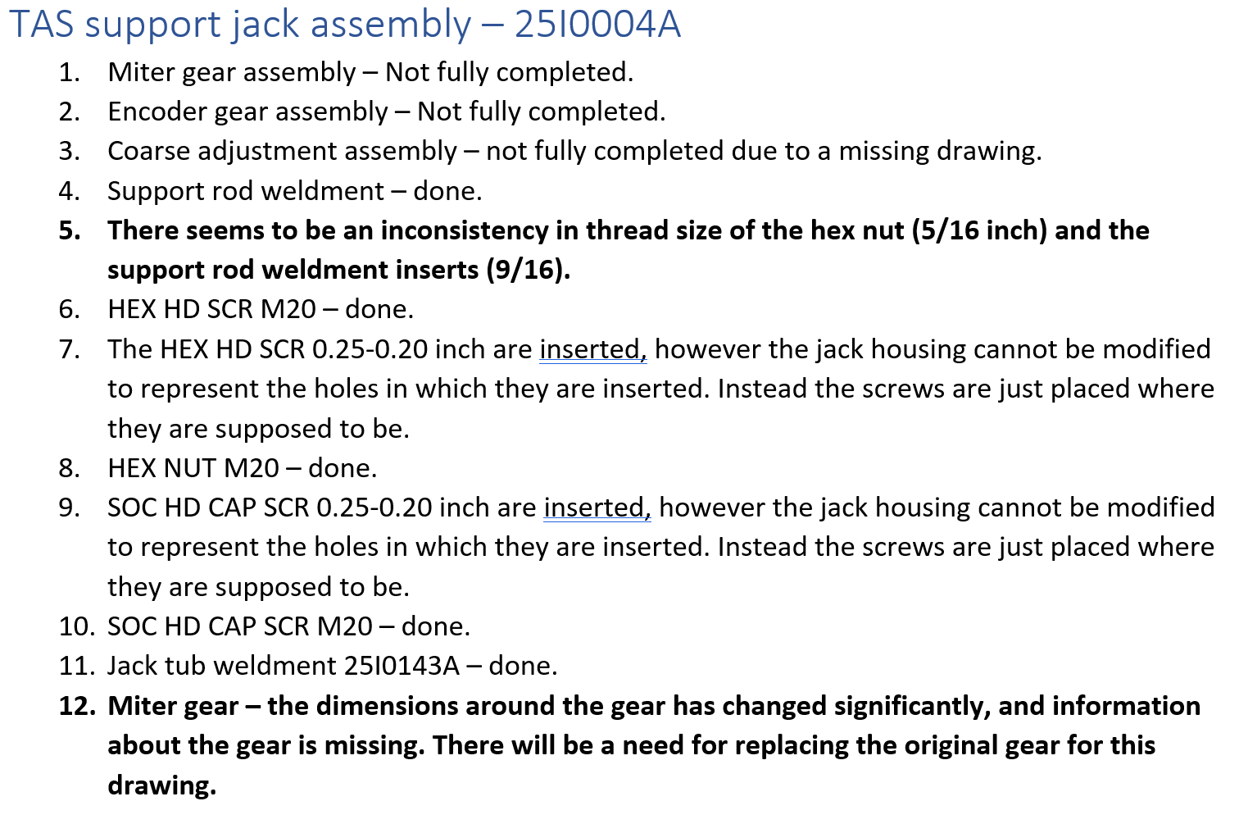
The process of reverse engineering
Three types of documents/files have been used in the process
An Excel document – for overview of the process
A word reporting document – for reporting how every item is reverse enginnered, or any complications there might have been
CATIA files – the reverse engineered 3D model itself

Slide 6
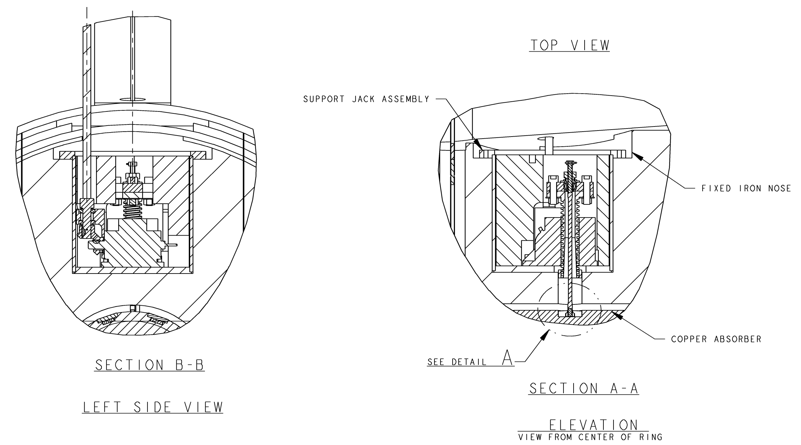
Original 2D model

Slide 7
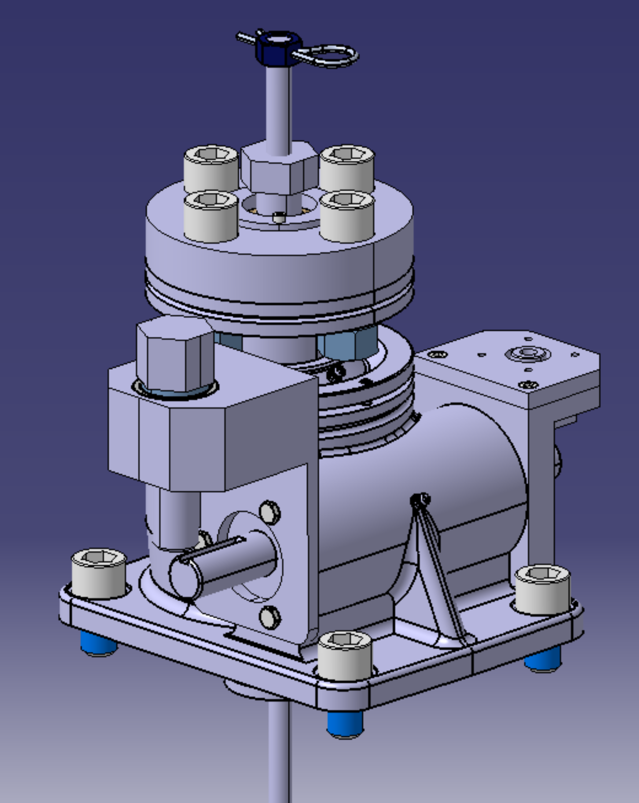
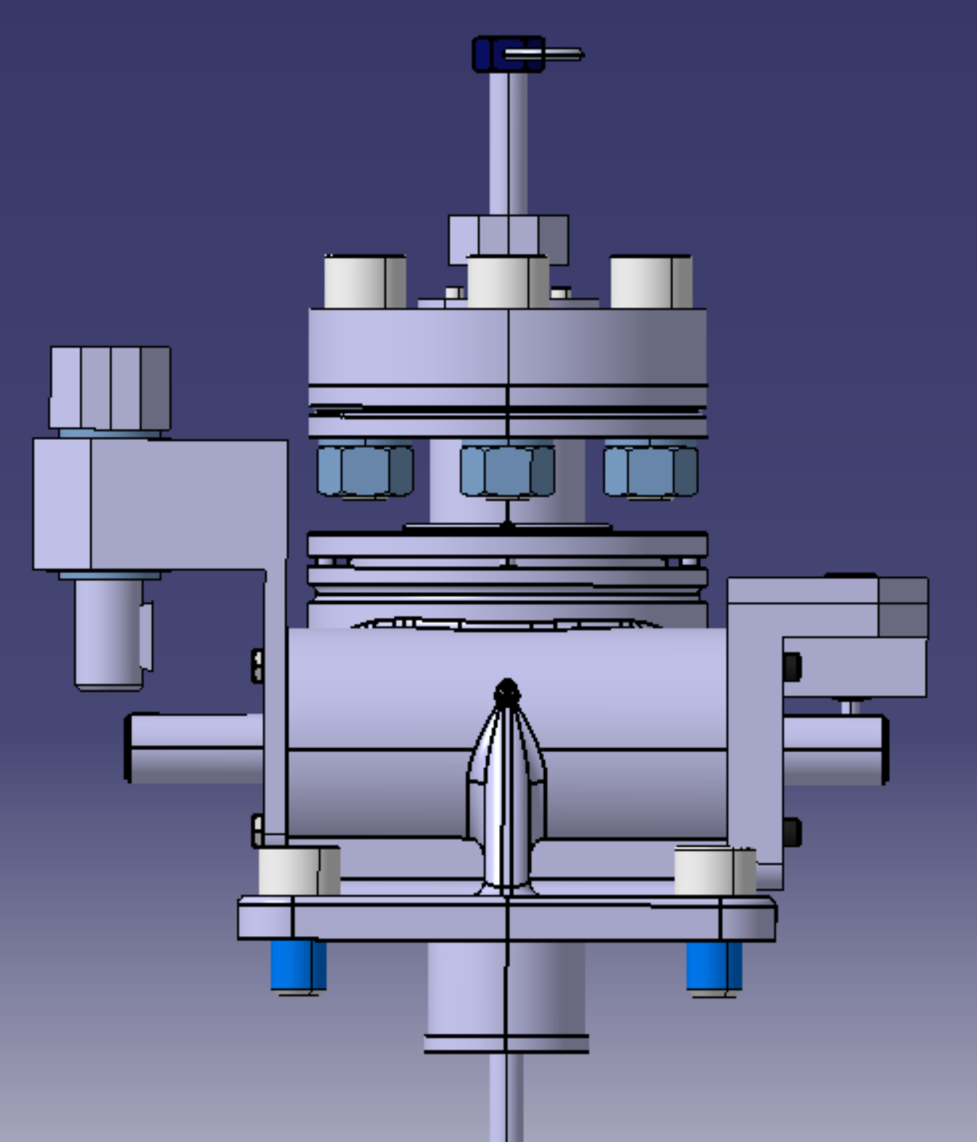
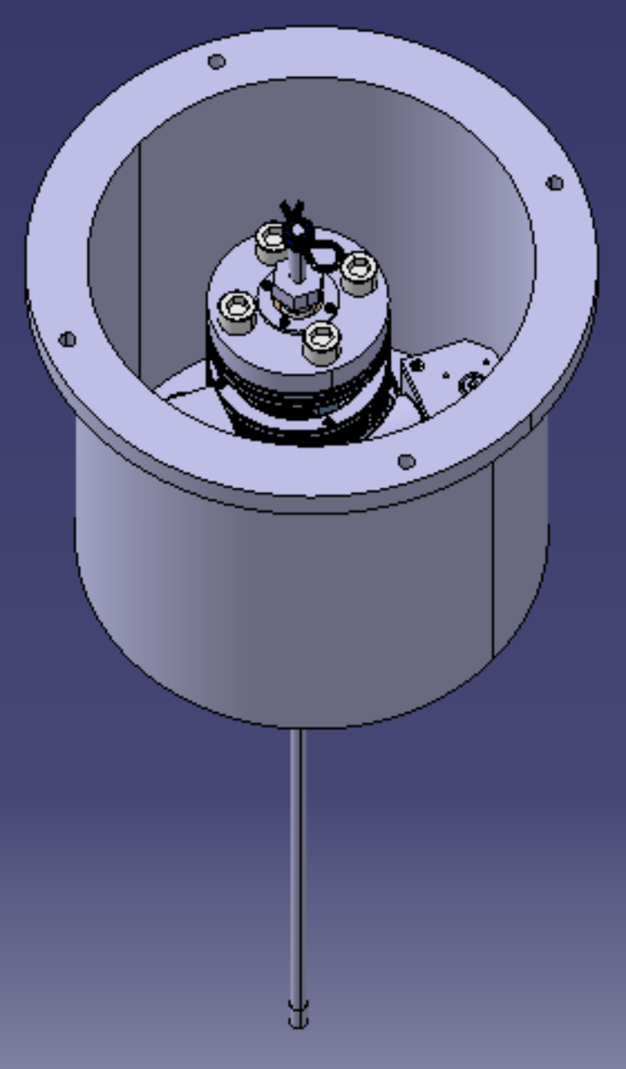
3D model

Slide 8
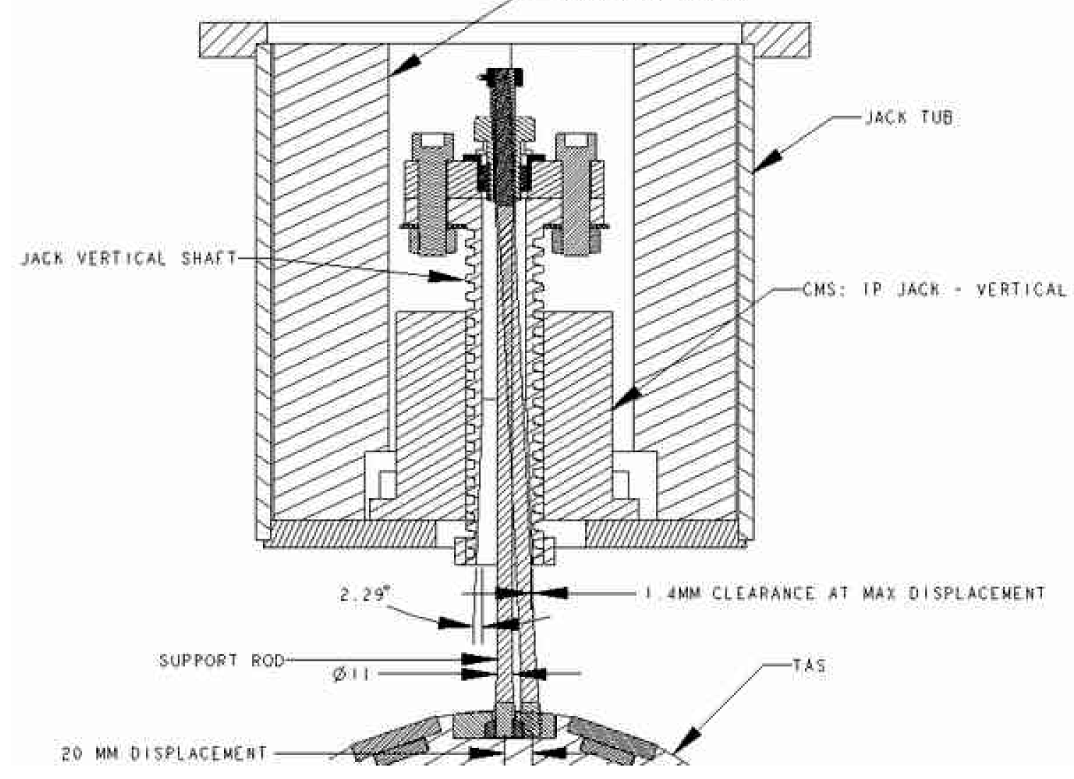
Evaluation of reverse engineered 3D model
Jack screw 3D model by Joyce Dayton
Only provided as a non-editable version
Has CERN customized features
A shell model without mechanical parts
It cannot be guaranteed that the model is similar to the original
Other standard components not found in its original version
Some dimensions of several parts has been changed to compensate for the choice of parts with different dimensions
Ultimately resulting in a compromising change of other dimensions
Despite some limitations, the work and the model is still considered to provide some insight into the working principals of the model, which can be used as platform from which further work can be based on

Slide 9
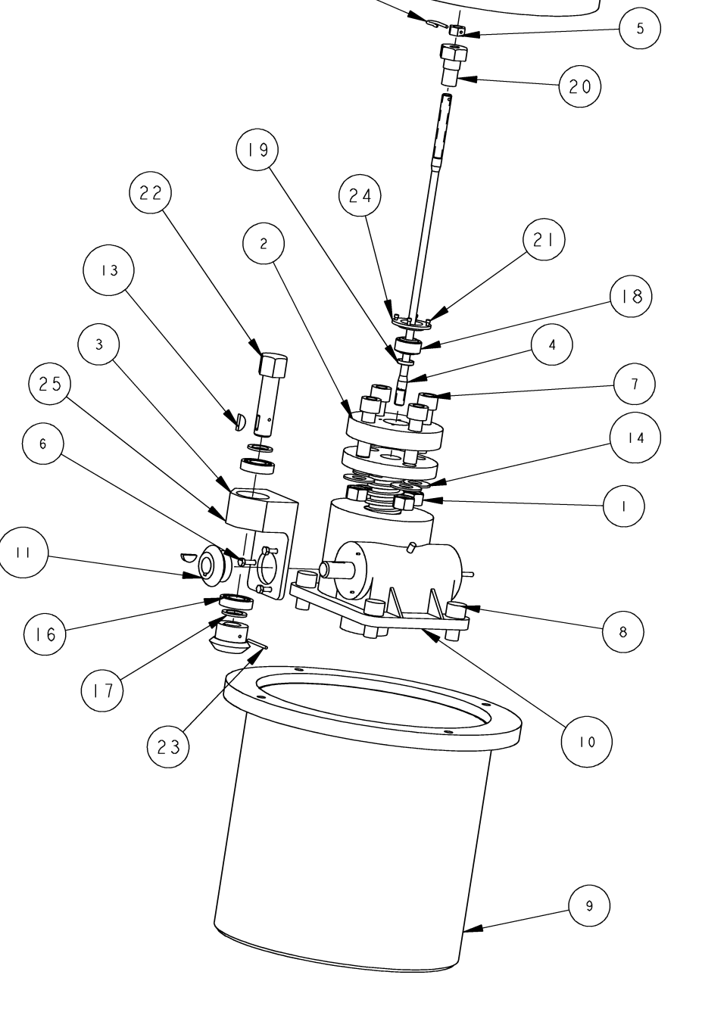
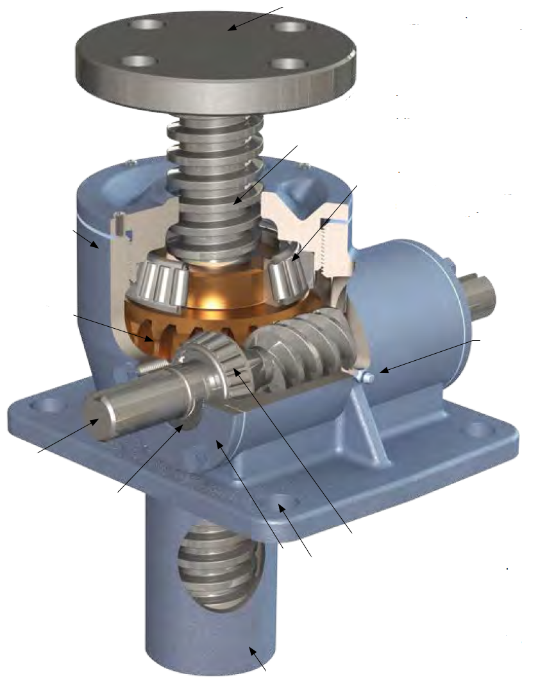
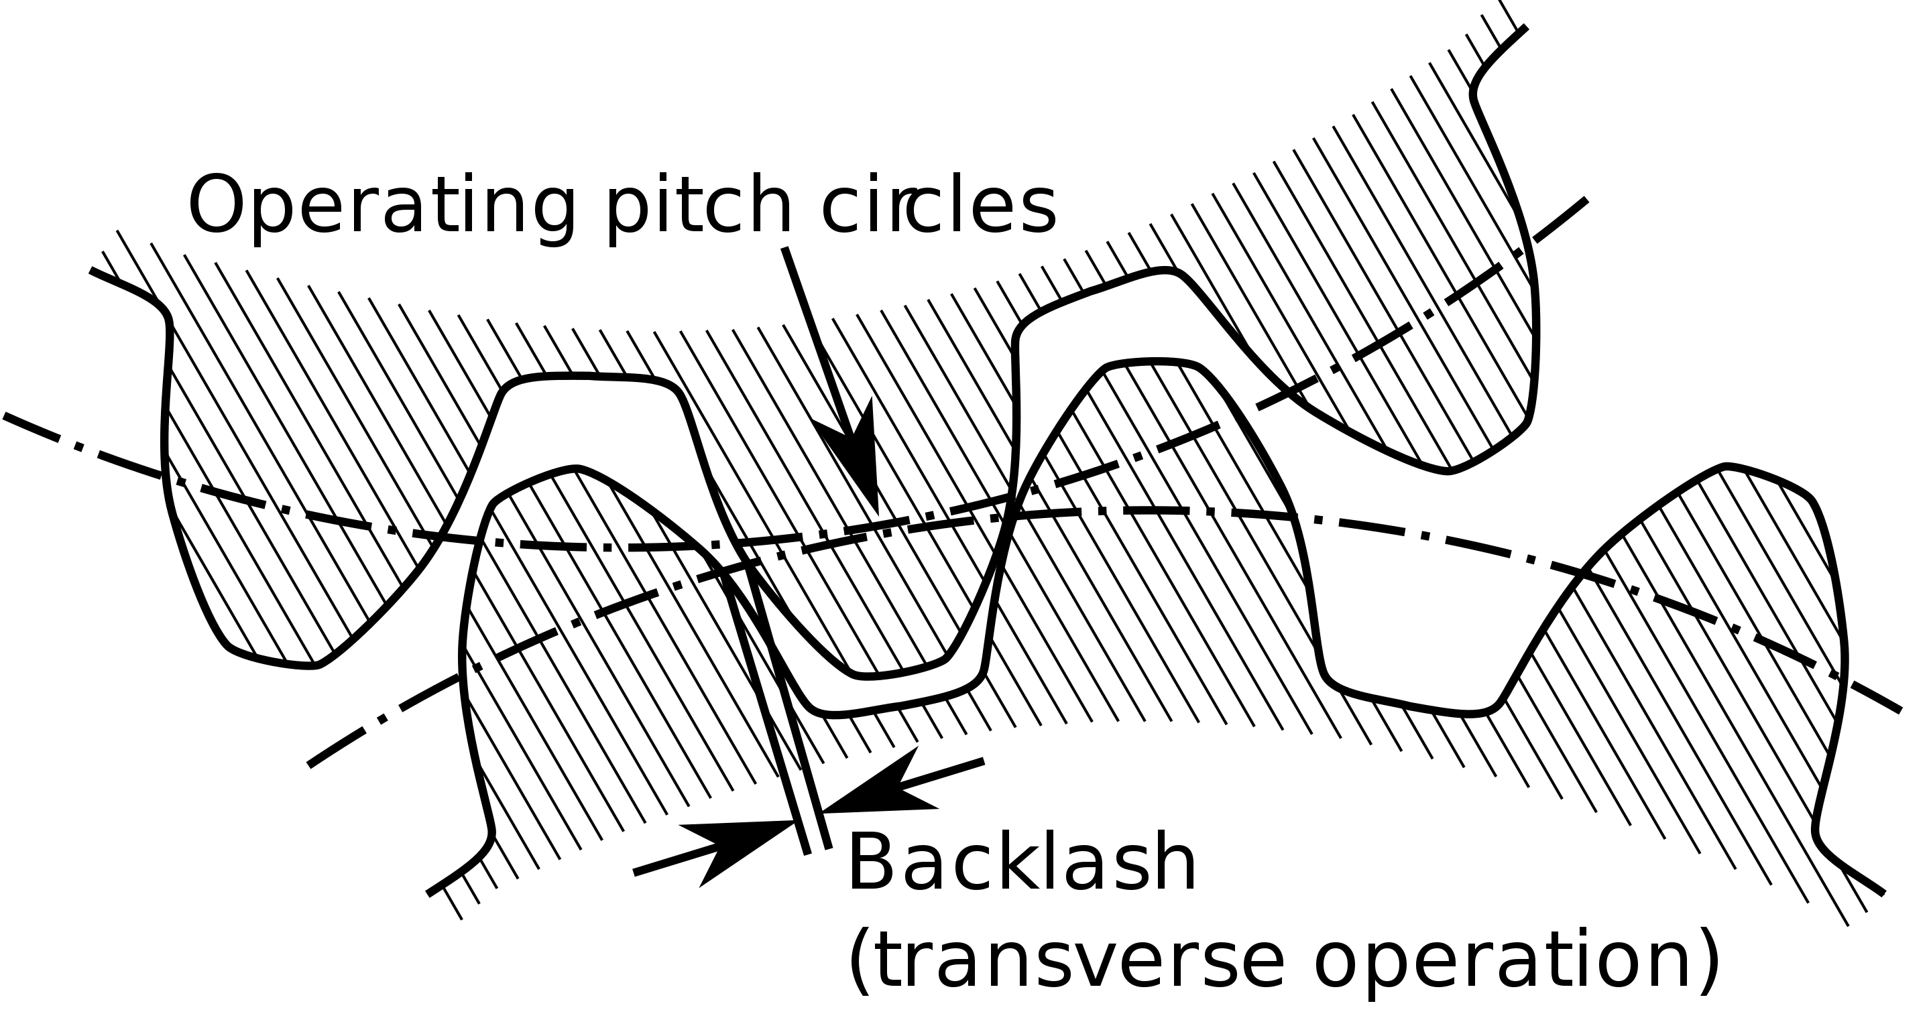
Potential sources of backlash in horizontal support jack
Nothing can be guaranteed with certainty, only hypothesis
Potential sources
Anti-backlash system - Without – as much as 0.4 mm of freeplay - With – best case, the freeplay is limited to 0.2 mm
The use of external gearing system
The use of grease - Radiation - Wrong positioning in the horizontal position
16 bolt connections are used to make sure the support jack is tightly fixed. Could any of these be loosely fitted?

Slide 10
What is next?
A report is being finalized
A new version will be designed from the ground up
Will rely on the same mechanical principals
Will be designed according to ISO standards (standard parts and the metric unit system)

Slide 11
Thank you
And thanks to Maria for support and Francisco for insight

