Slide 1

Proposal for a mock-up simulating the Q1-TAXS area and services
O. Boettcher & F. Sanchez Galan / WP8
CERN, 26th November 2020
EDMS: 2442684 v.1
121st HL-LHC TCC meeting

Slide 2
Outline
Introduction
Justification for the proposal
Description of mock-up simulations
Mock-up realization (concept, location, cost estimate, timeline)
Conclusions

Slide 3
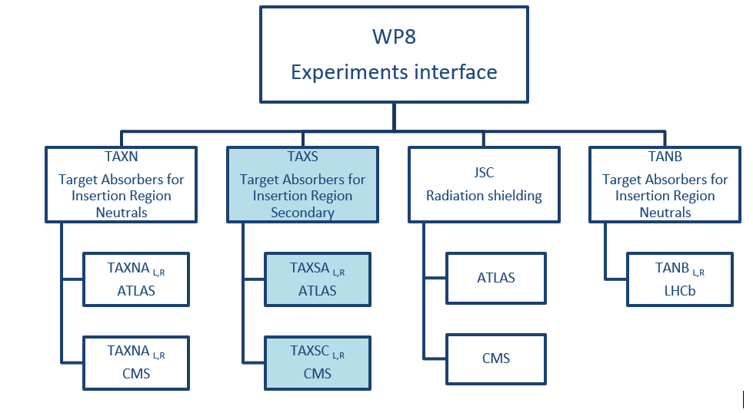
Identification of the proposal related to the
HL-LHC systems architecture
The mock-up is proposed to find solutions related to the change from TAS to TAXS.

Slide 4
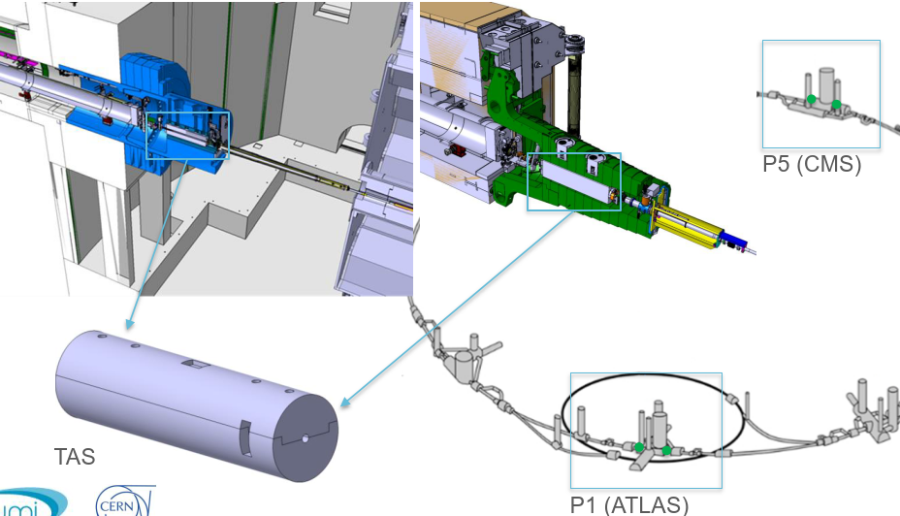
TAS replacement by TAXS
On both sides of ATLAS and CMS experiments the TAS will be replaced by TAXS with adapted design for HL-LHC.
The TAXS installation will be realized from the cavern sides (and is as such part of the experiments LS3 planning).

Slide 5
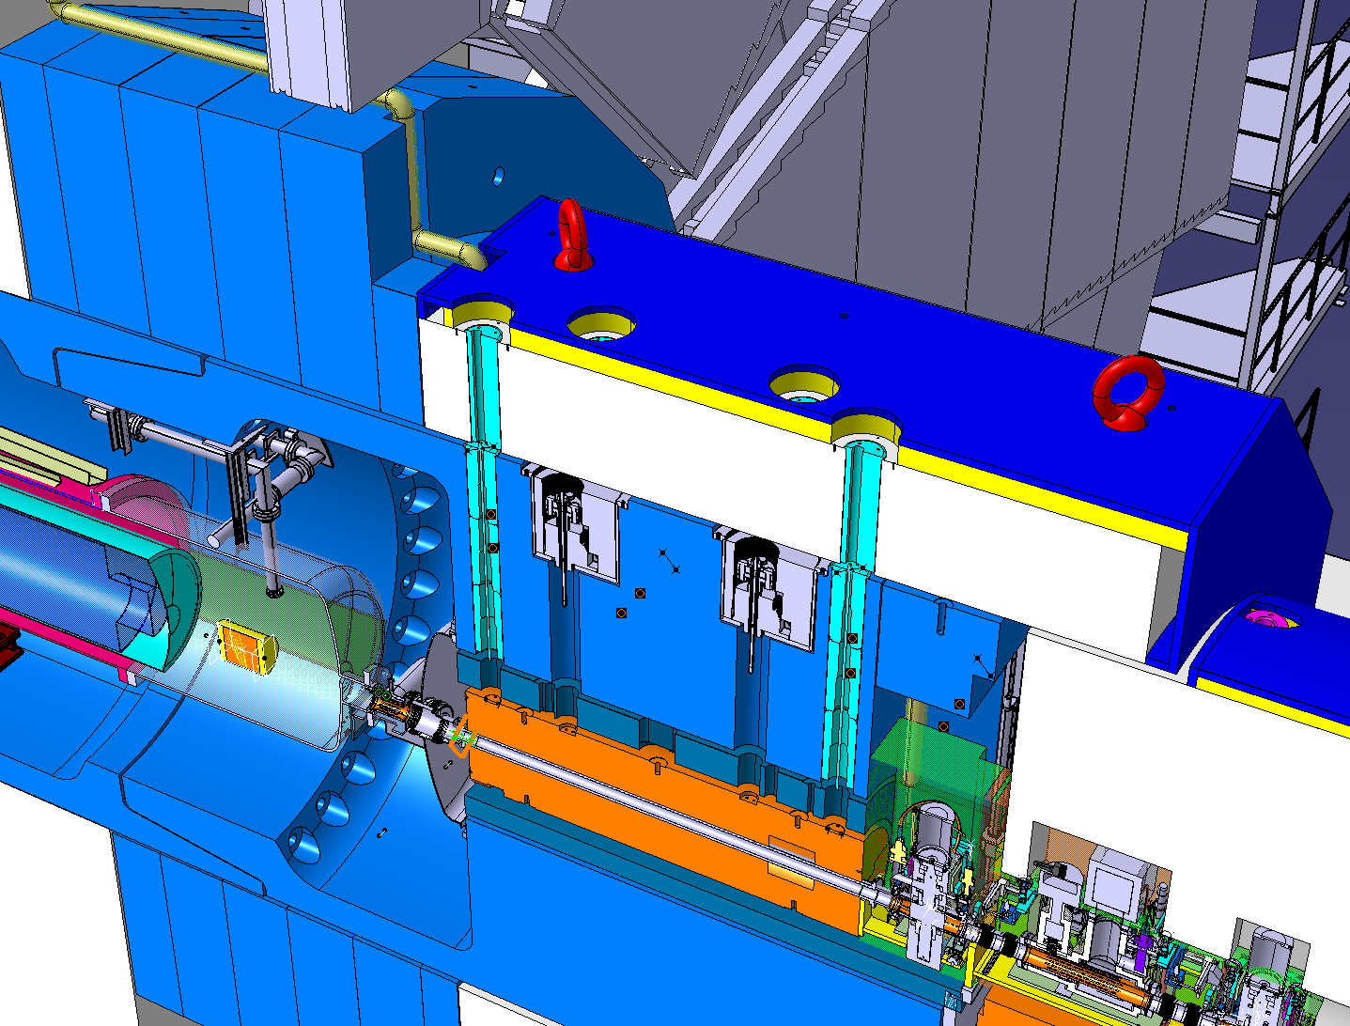
Q1-TAXS tunnel region
Q1 installation, connection to VAC equipment and TAXS will be realized from the tunnel and is part of HL-LHC planning.
Installation and integration of machine elements and services is challenging due to limited space (example ATLAS).

Slide 6
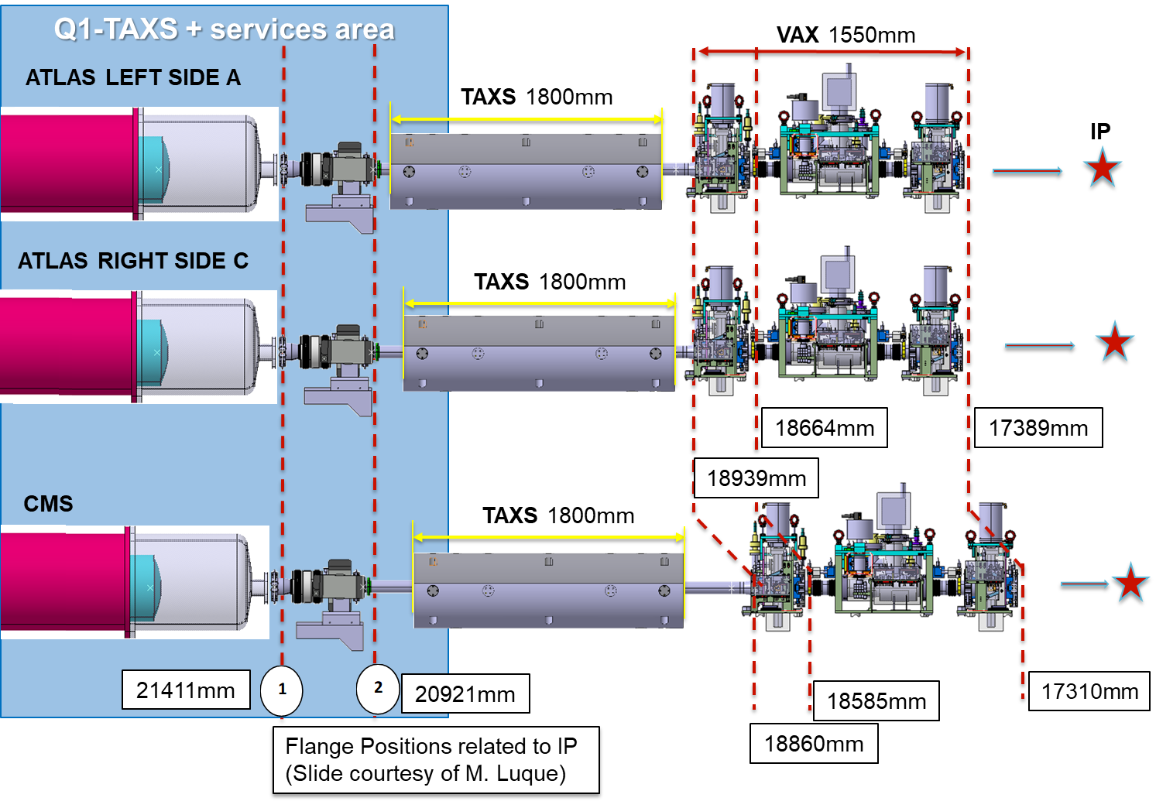
Proposal of the mock-up environment
For simulating the installation and connection of Q1, ion pump, TAXS, related services and cables it’s proposed to build a mock-up covering the last 3 meters of the tunnel end (blue area).

Slide 7
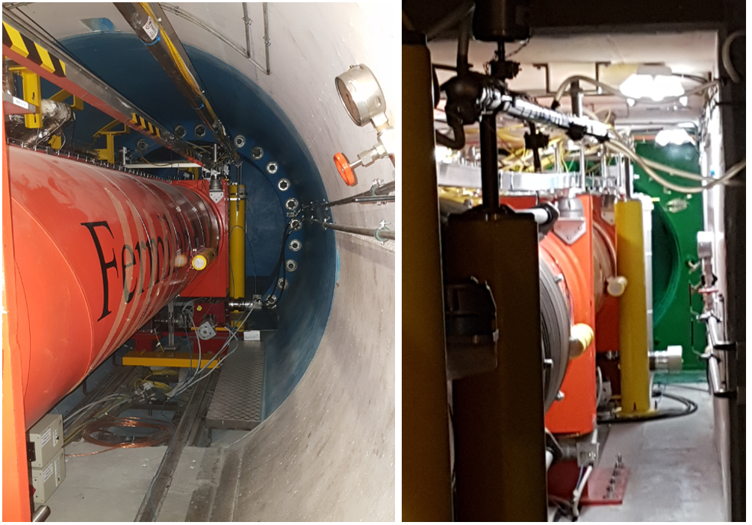
Actual situation – narrow access
ATLAS tunnel end RB16: tube diameter 250cm
CMS tunnel ends R542+R561: 200cm x 200cm

Slide 8
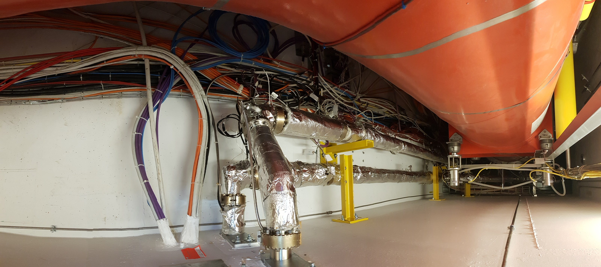
Actual situation – limited space for services
Cabling and services (CMS)

Slide 9
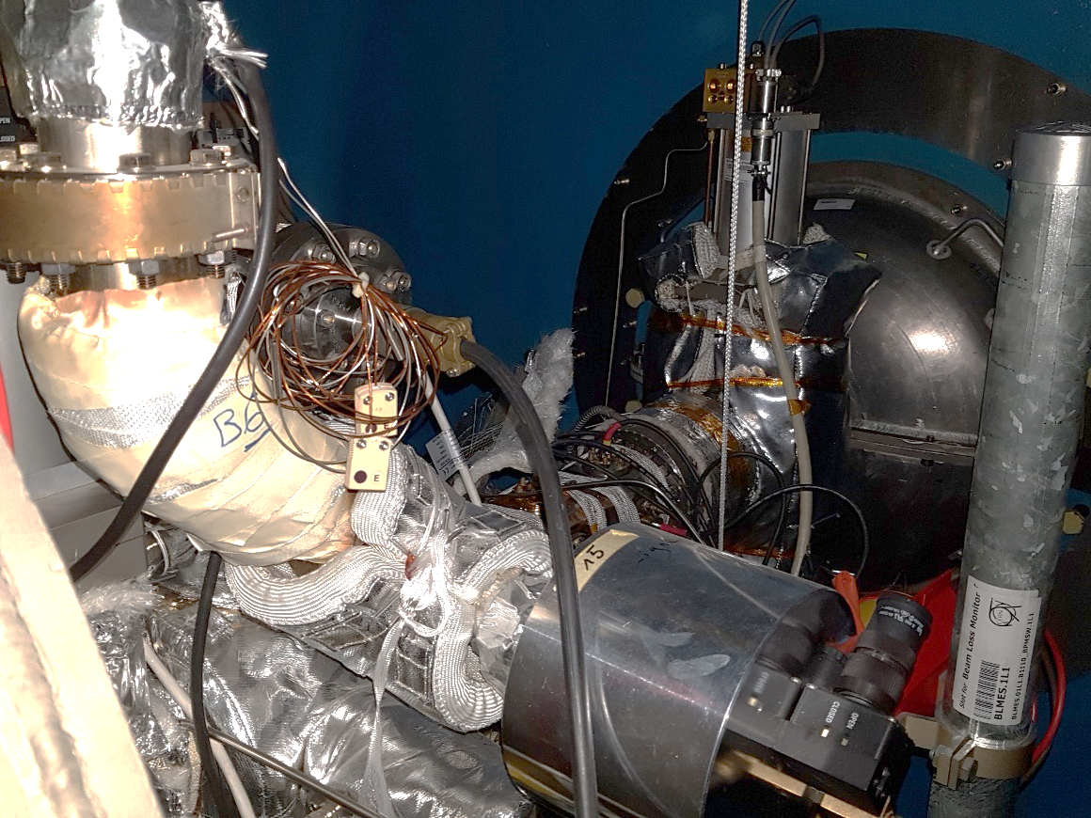
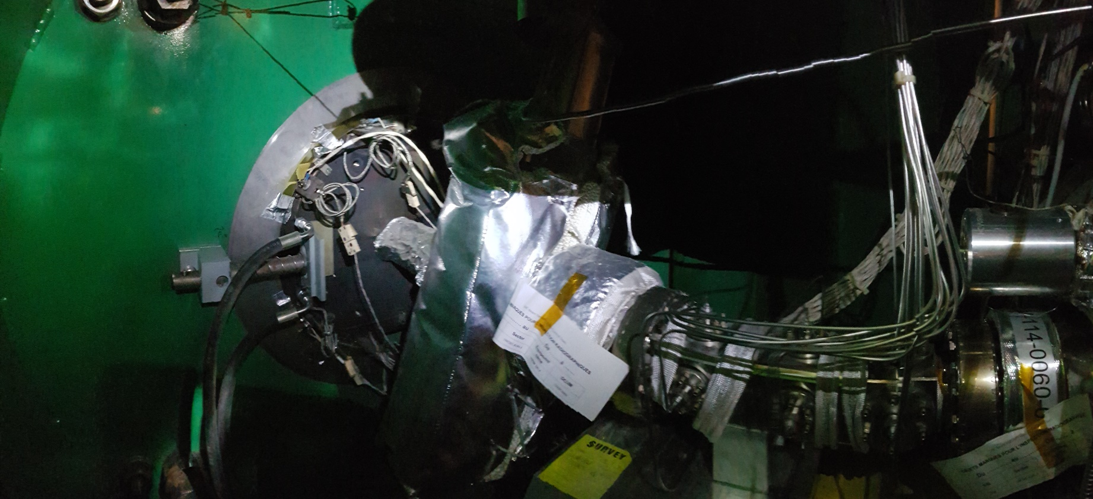
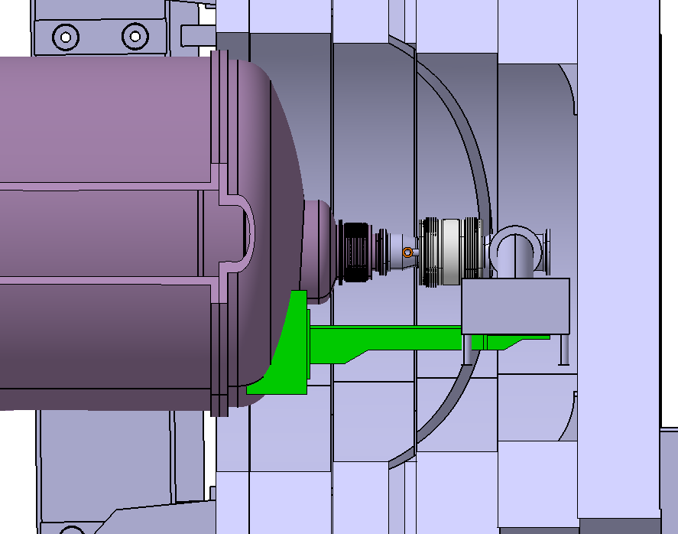
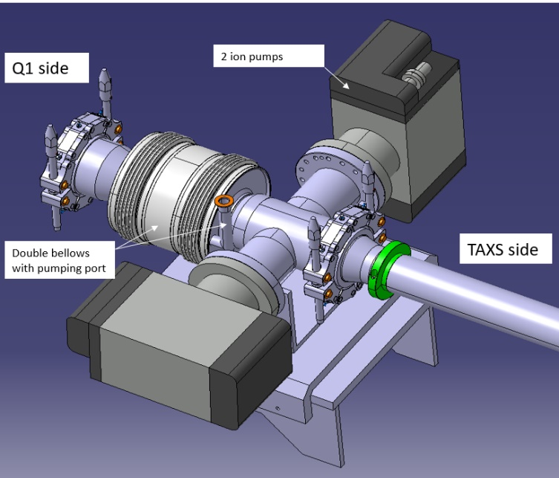
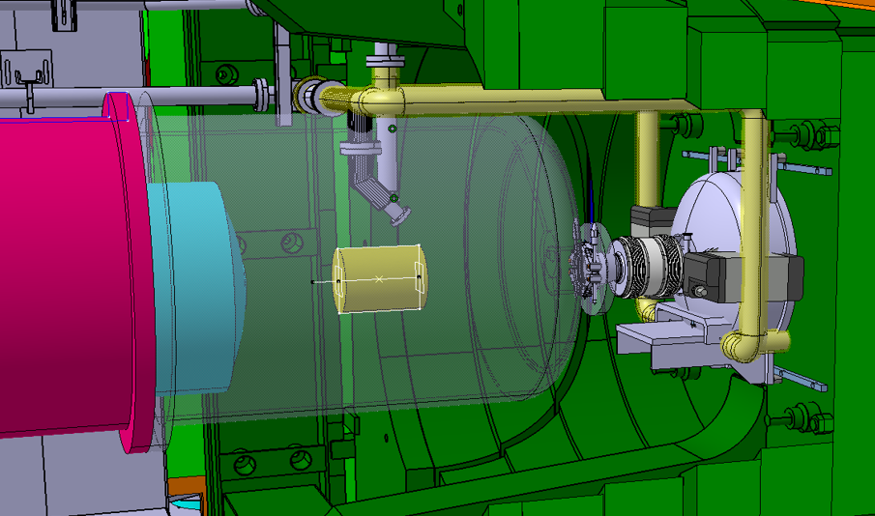
Actual situation – TAS (→ HL-LHC less space)
Existing TAS connection
CMS
ATLAS
HL-LHC connection area (for ATLAS left - Side A: <50cm)
Vacuum instrumentation attached to HL Q1
Courtesy WP12

Slide 10
Proposed mock-up simulations (1/3)
Installation of Q1-ion-pump-TAXS decoupled from HL-LHC and ATLAS/CMS planning: Independent from what comes first, the installation of the Q1 magnet or the insertion of the TAXS, the connection of both to the ion-pump flanges must successfully work in both scenarios. The mock up will be designed in a way that the installation phase can be probed until all factors are satisfactorily included.
Vacuum instrumentation attached to HL Q1
Courtesy WP12

Slide 11

Proposed mock-up simulations (2/3)
Integration of the Q1-TAXS services: Installation of service lines, instrumentation cables, support etc. Everything needs to be properly installed and in its foreseen place before the Q1-magnet is put in place. The mock up gives the opportunity to better discuss and test the layout and installation sequences, and to instruct and train the installation teams.

Slide 12
Proposed mock-up simulations (3/3)
Scenario tests: Due to the high level of radiation the Q1-TAXS regions will be designed as maintenance free. However, some repairs or upgrades may have to be realized during HL-LHC lifecycle. The mock-up allows to simulate different scenarios and optimize procedures. It would give the opportunity to develop and test new applications (e.g. remote operations by use of robots).

Slide 13
Mock-up realization - Components
The mock-up shall include:
The tunnel environment: The mock-up shall exactly be a copy of the tunnel. A modular design shall allow to simulate the areas of ATLAS and CMS.
All machine components as models, copies or prototypes: e.g. Q1-model, ion pump, TAXS flange, helium dome, support feet etc.
Real components of service lines, instrumentation cables, connectors, cable trays and support structures: it is proposed to work with sets of real components for which original tooling is as well required.

Slide 14
Mock-up – Architecture / Costs / Timeline
It is proposed to realize the mock-up modular, easy to reconfigure and to dismantle if necessary.

Slide 15
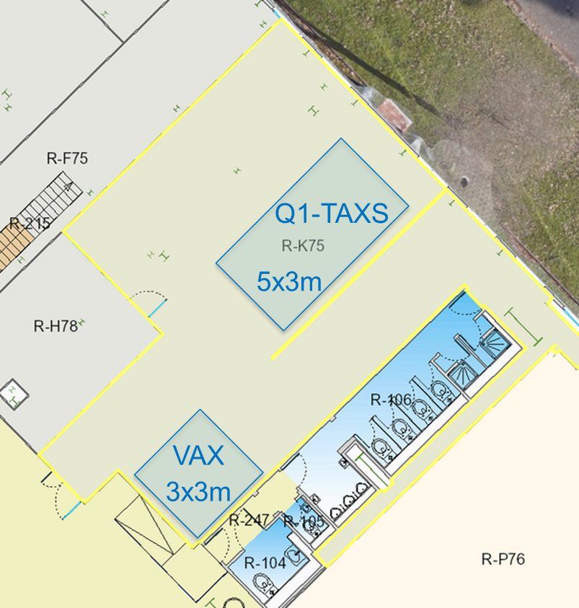
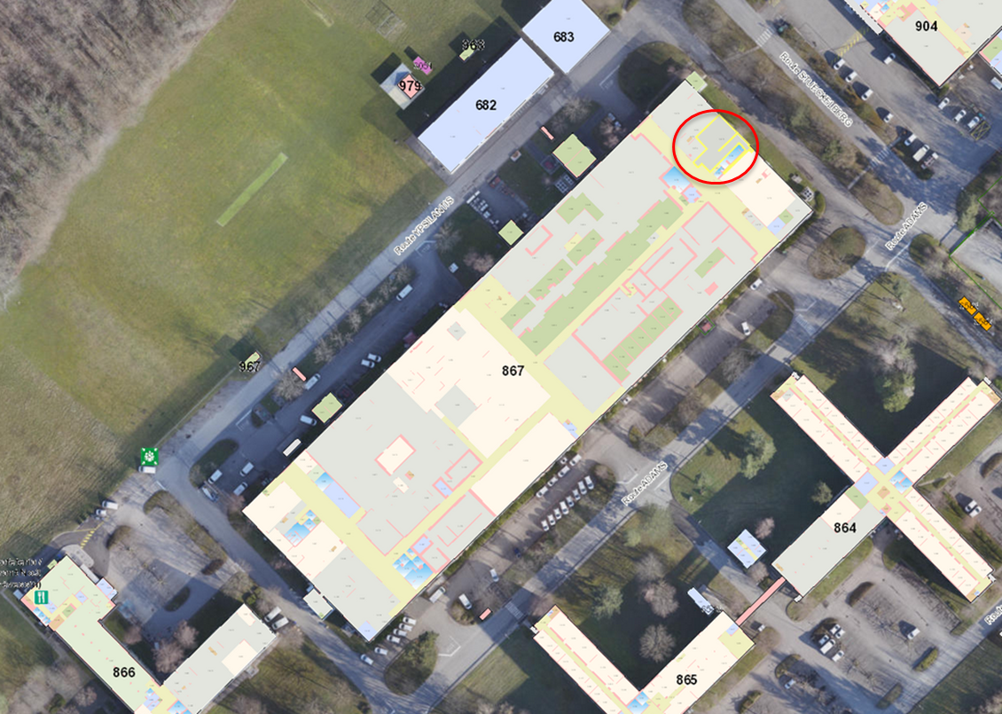
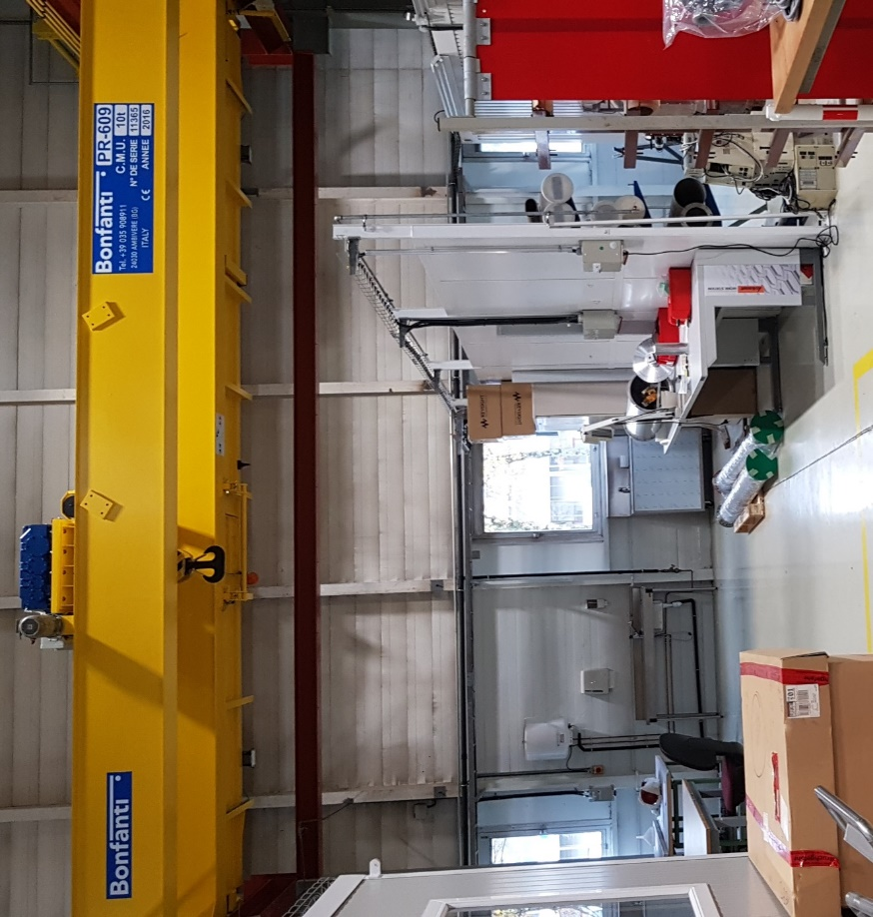
Mock-up realization - Location
The workshop 867/R-K75 would be organized to host the Q1-TAXS and services mock up.
(Note: The VAX mock-up actually located in bldg. 186 will be moved to this workshop during the next weeks.)
The workshop is already sufficiently equipped: electricity, compressed air, water and a 10t overhead travelling crane (PR-609).

Slide 16
Conclusion
The Q1-TAXS and services installation and integration is challenging. A lot of questions exist still related to planning, installation and the realization of vacuum tests.
Different situations in ATLAS and CMS need to be considered.
The proposed mock-up would help finding optimal solutions related to design, installation and operation.
Simulations with the mock-up could start as from July 2021 (cost estimate is 35 kCHF)

Slide 17
WP15 initiative
CAD 3D environment of the tunnel only at the level of the TAXS-Q1
CAD 3D model includes
Civil engineering models: tunnels, blockhouse (nose)
The LHC machine in the future HL configuration: space reserved for experiment, VAX reservation, TAXS, Q1, beam vacuum components connecting TAXS-Q1 (solution at this very moment). Including the different equipment and space reservations under the machine. It shows the latest situation of the HL Integration .
Services around: venting pipes, new HL alignment system WPS and HLS.
Not all the services are available yet (we are still missing water piping, cables trays… etc.) and not all the existing ancillaries are represented. We will need to work on the details
You can find here the ST references:
CMS IP5 Right: ST1391149_01 - TAXS-Q1 tunnel environment - IP5R
ATLAS IP1 Right: ST1391287_01 - TAXS-Q1 tunnel environment – IP1R
Slide inserted - 01/12/2020

Slide 18

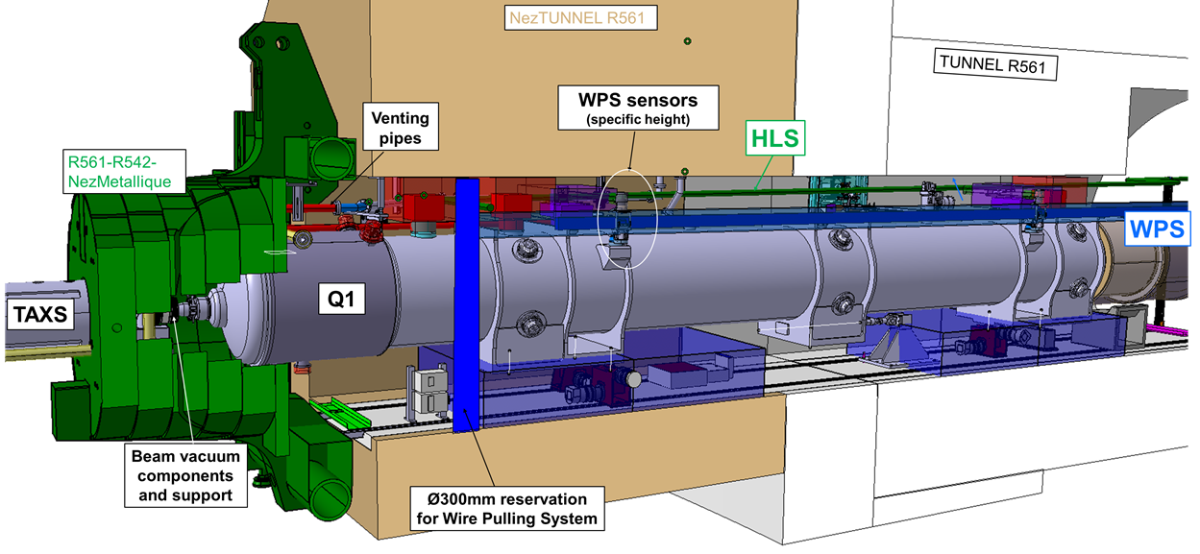
WP15 initiative
CAD 3D environment of the tunnel only at the level of the TAXS-Q1
WP15 is our
Slide inserted - 01/12/2020

Slide 19
THANK YOU FOR YOUR ATTENTION!!!
& thanks :
WP12
WP15

