Slide 1

Vacuum assembly for experimental areas (VAX) in Point 1 and Point 5
Łukasz Krzempek
01.12.2020

Slide 2
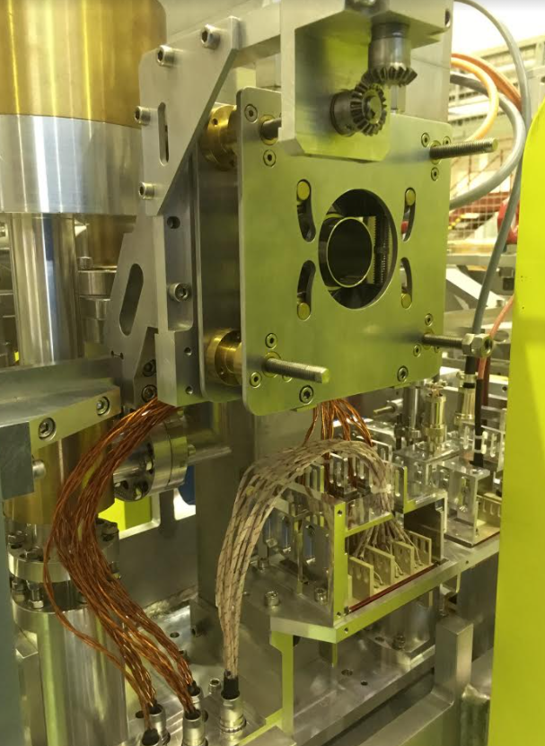
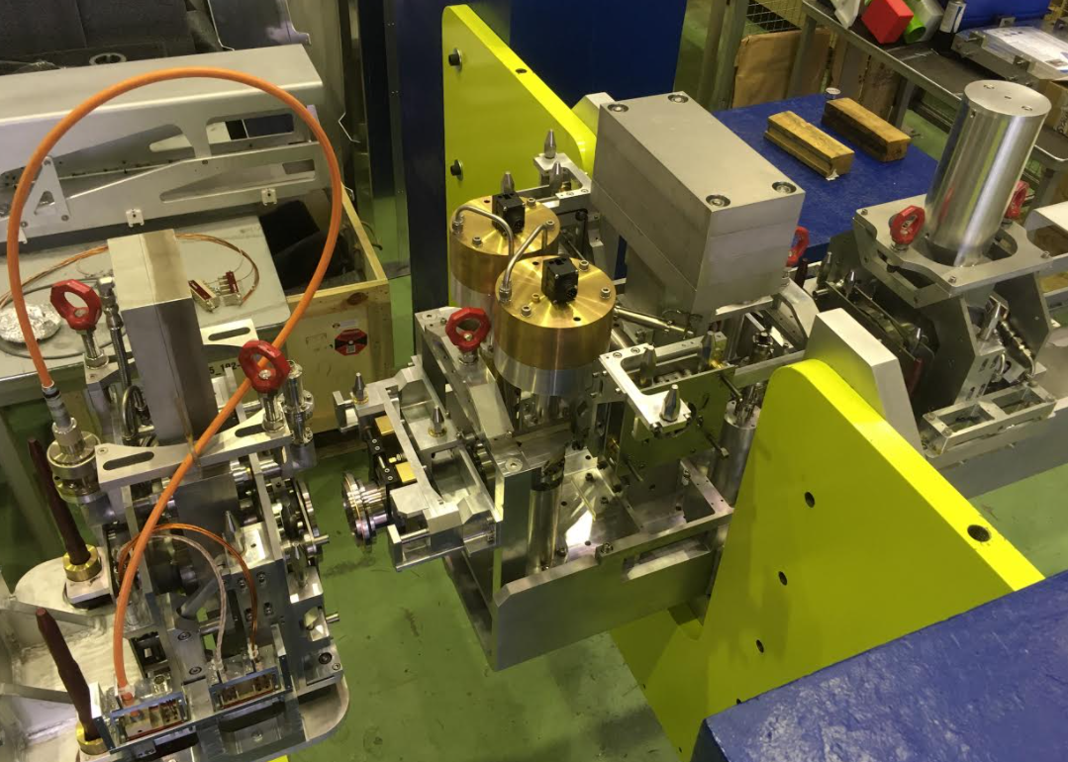
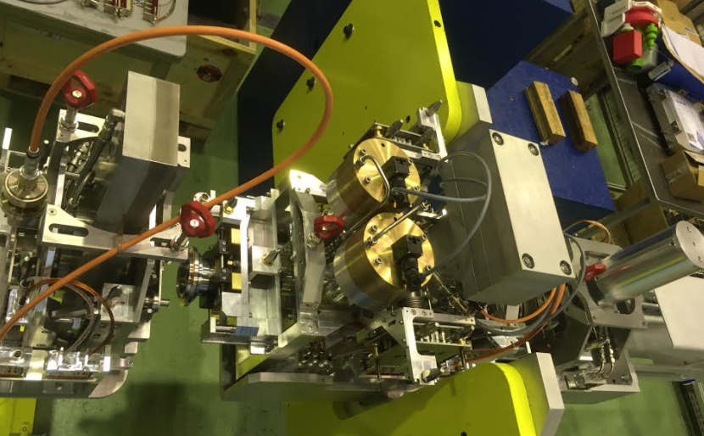
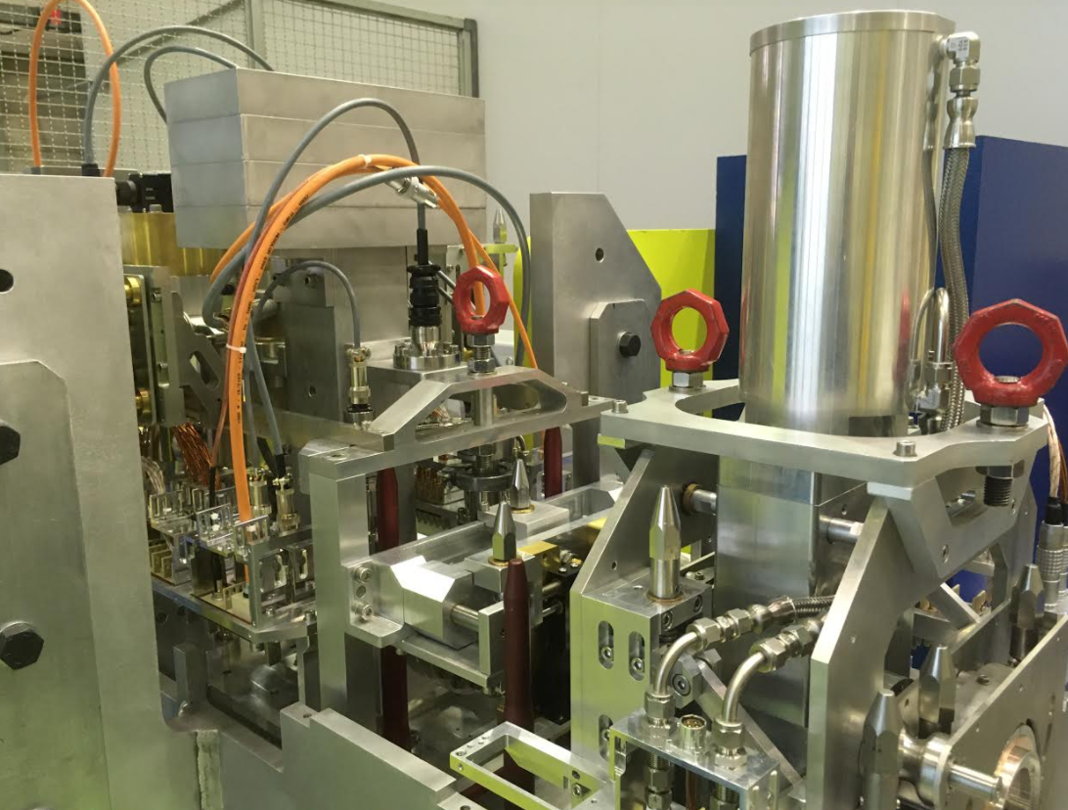
VAX prototype - complete
All VAX Modules are cabled
Bellows DN80 with compression mechanisms

Slide 3
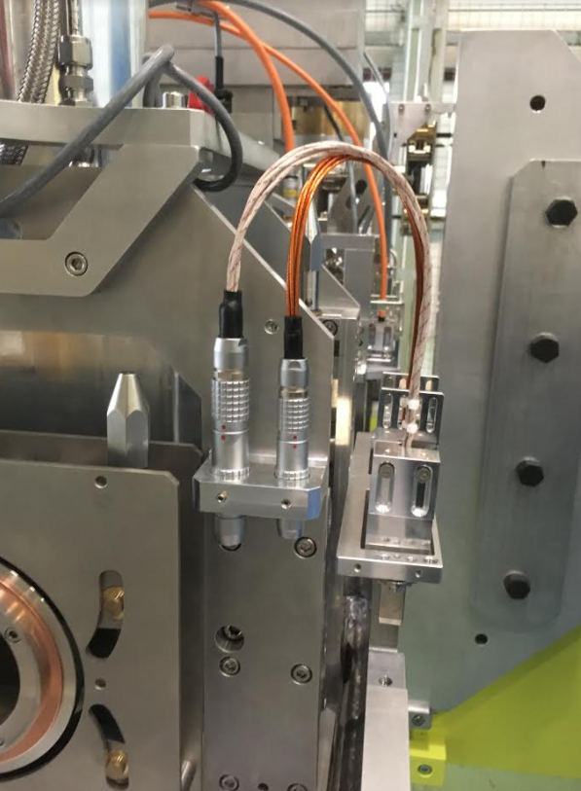
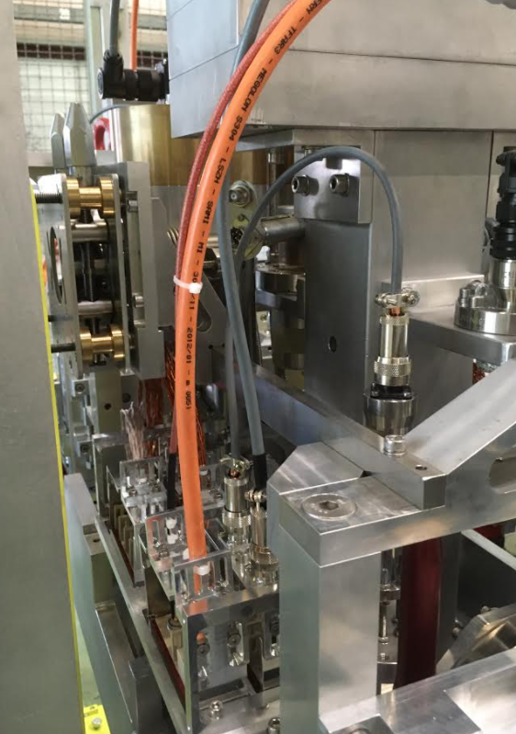
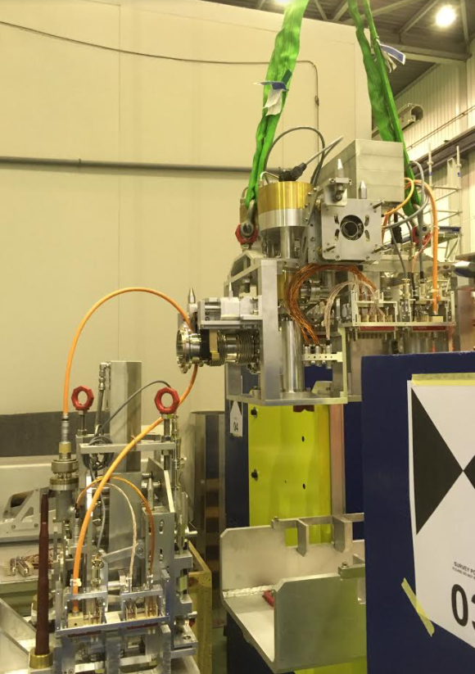
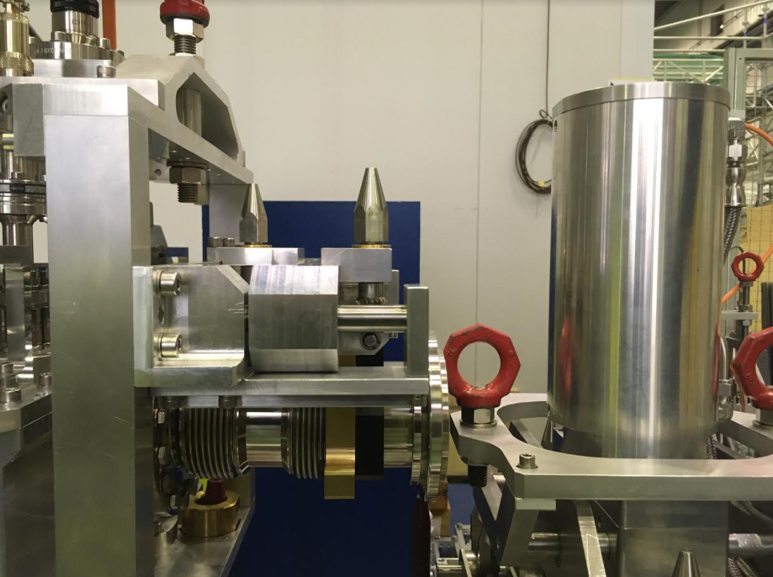
VAX prototype - complete
Check of envelope for the cables
Check of envelope for the cables

Slide 4
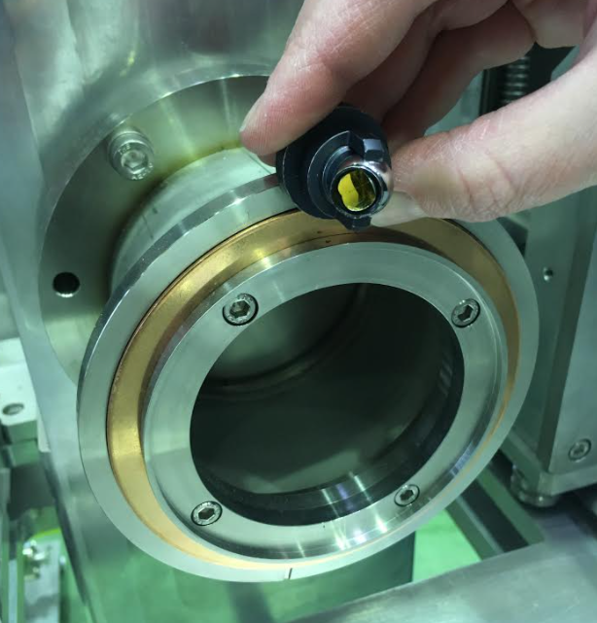
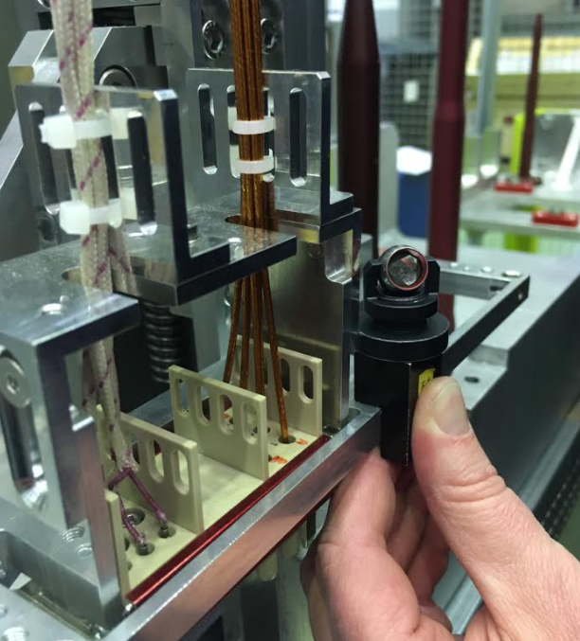
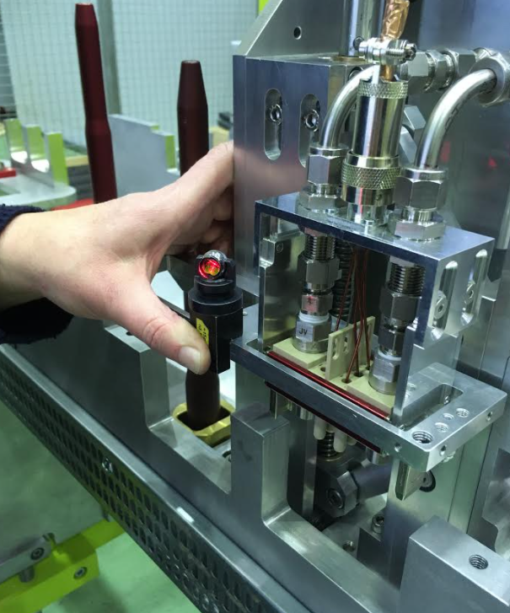
VAX prototype - fiducialisation
Fiducialisation of VAX Module 2 and 3
QCF flanges on both sides of each Module
Reference surface (depended on accessibility)

Slide 5
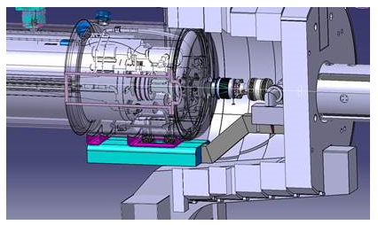
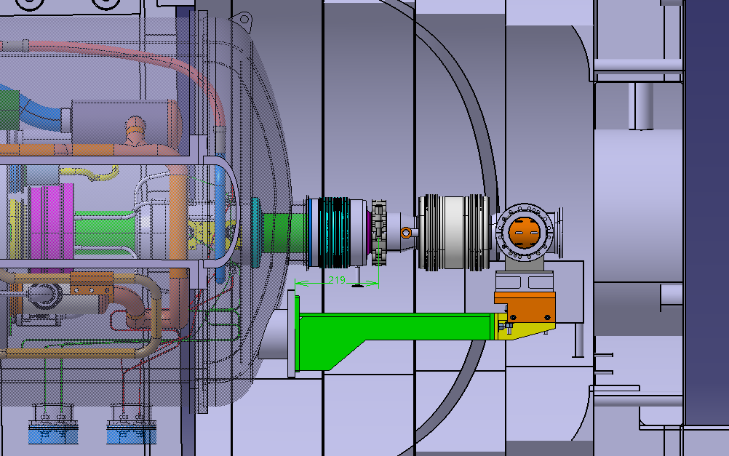
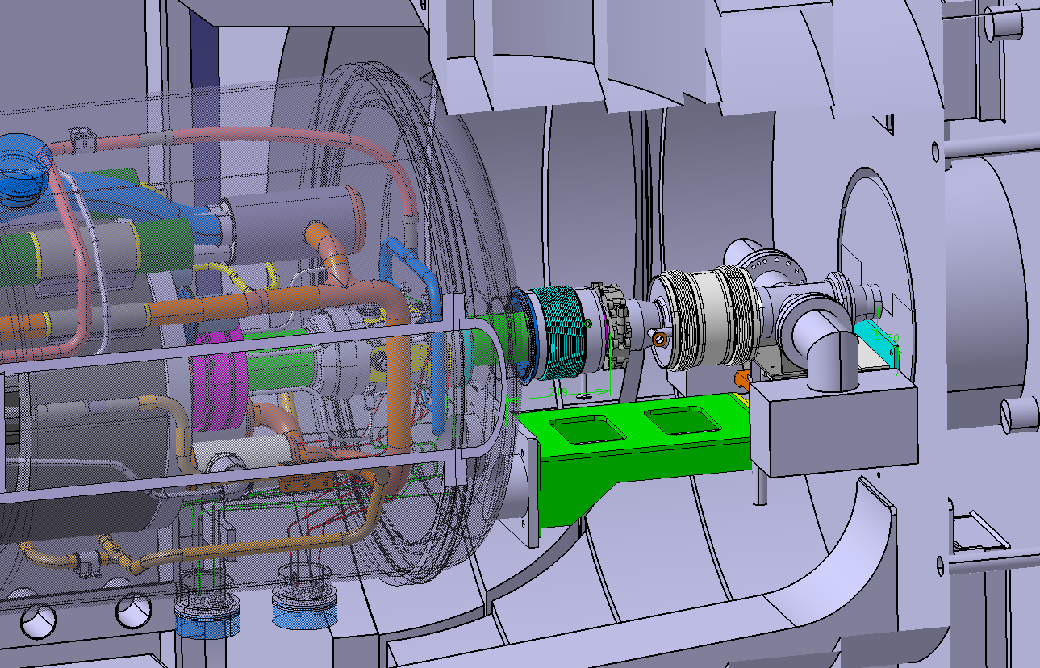
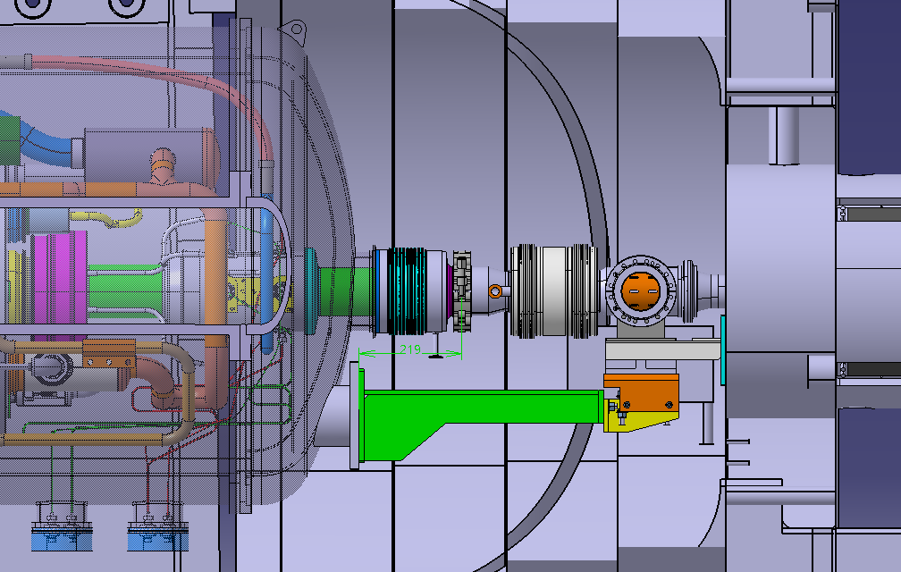
Q1 - TAXS
Before installation of TAXS
Concept no 1
When TAXS is installed
Detailed design of concept no 2
Concept no 2

Slide 6
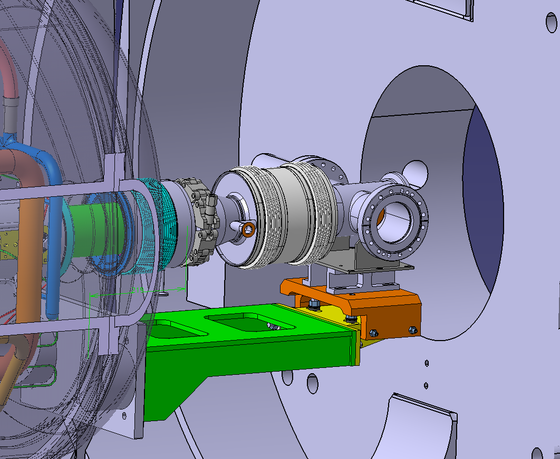
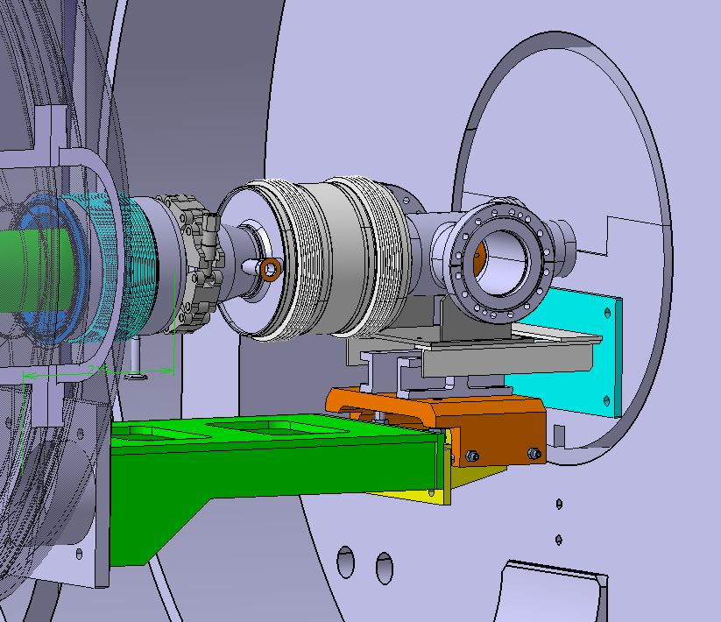
Q1 - TAXS
Alignment table is dismantled and lowered

Slide 7
Thank you

Slide 8
