Slide 1
Relocation to B867
M. Luque
EN-EA-PE
96th HL-LHC WP8 Meeting, December 1st 2020

Slide 2
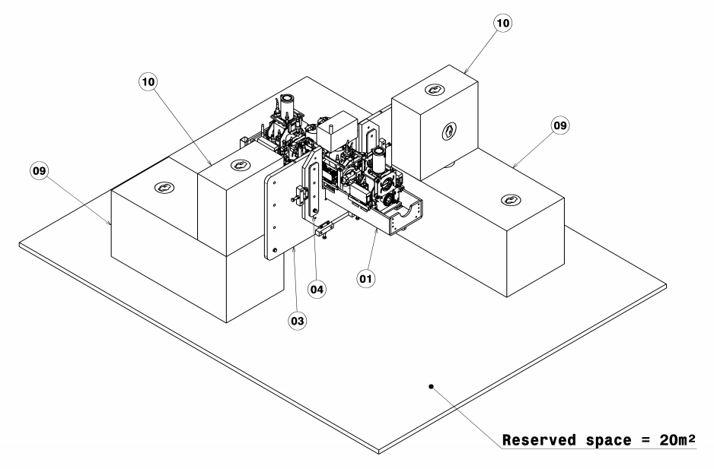
VAX SUPPORT PROTOTYPE
Prototype of VAX Support and blocks → 3,20x3,10m²
Requirement of some space around for moving and place modules

Slide 3
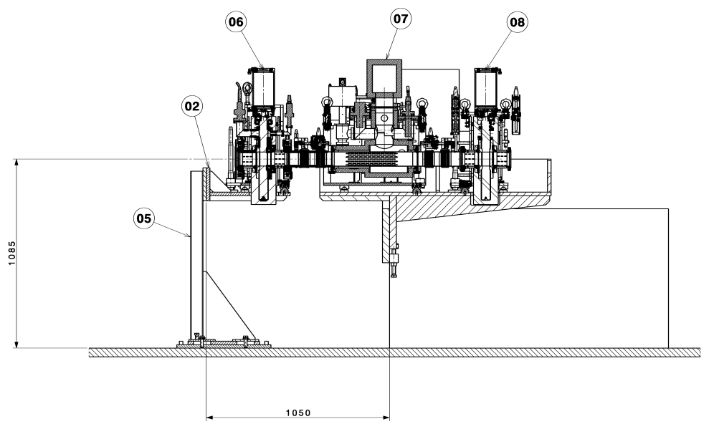
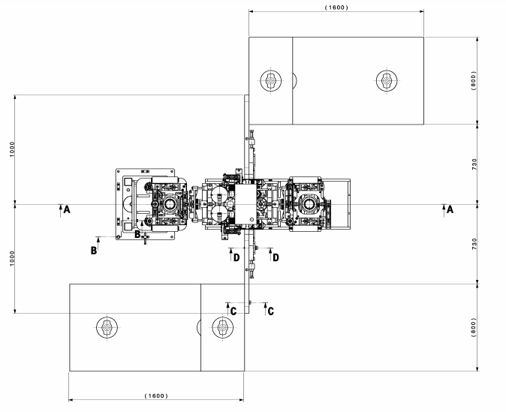
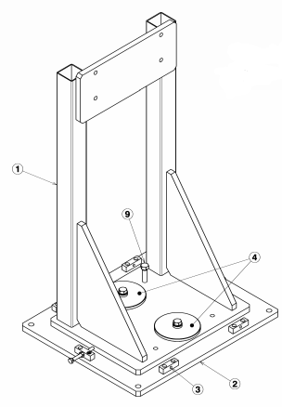
VAX SUPPORT PROTOTYPE

Slide 4
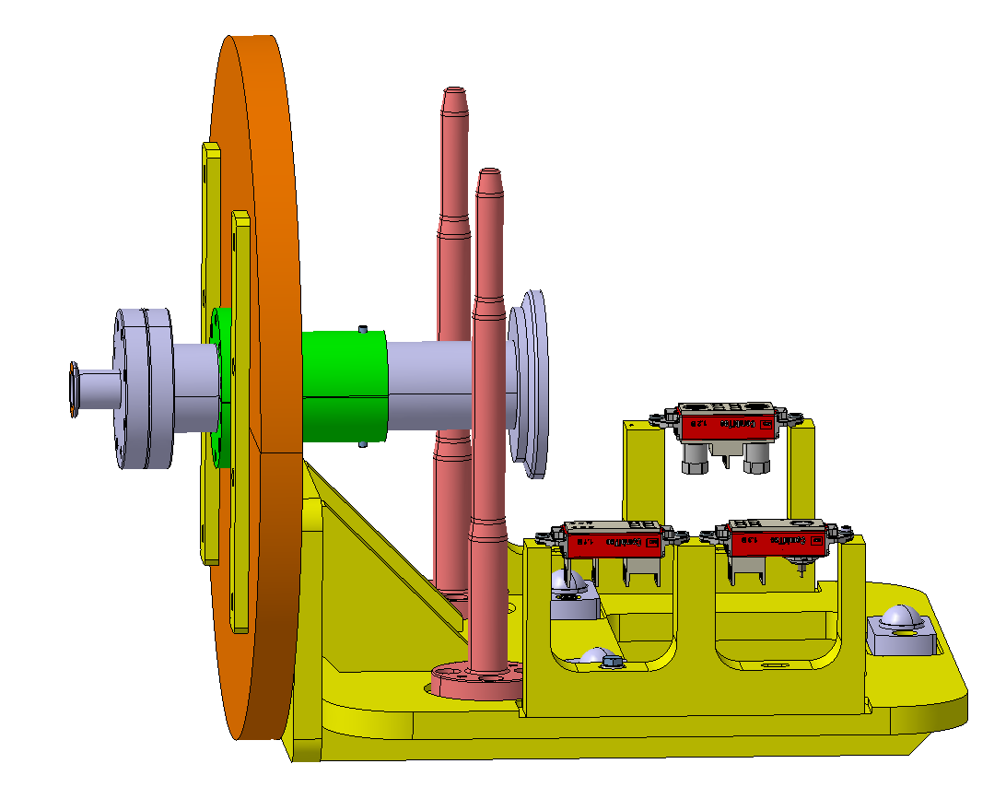
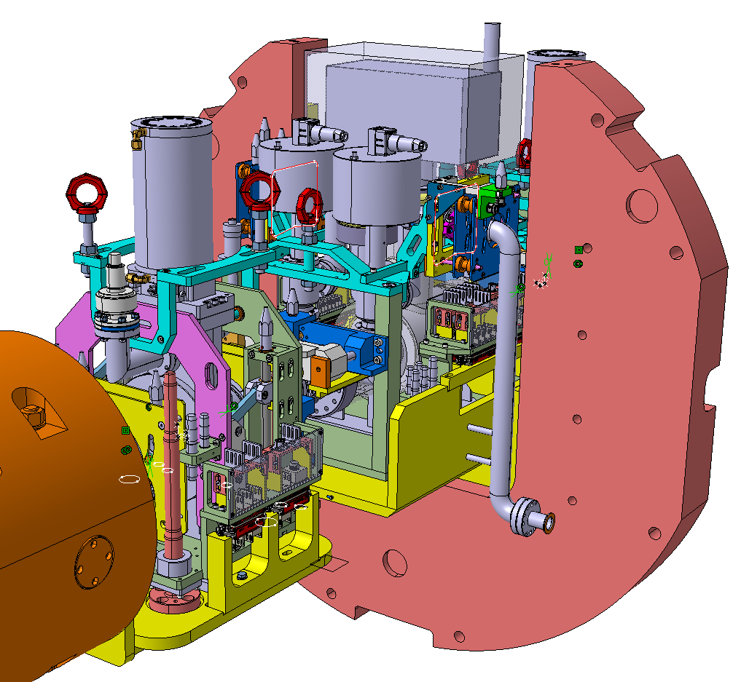
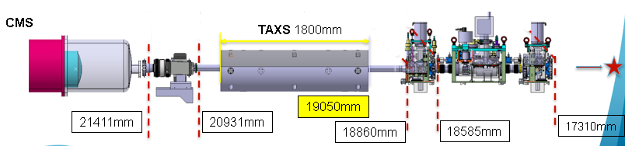
VAX CONNECTIONS TESTS
L.Krzempek

Slide 5
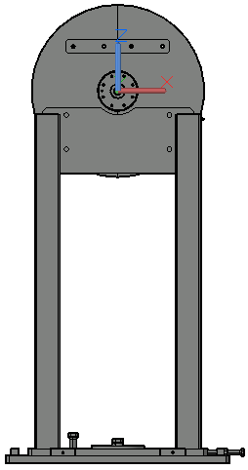
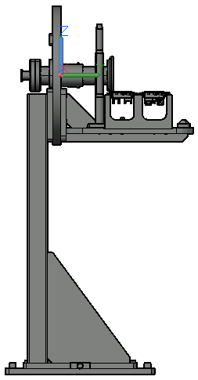
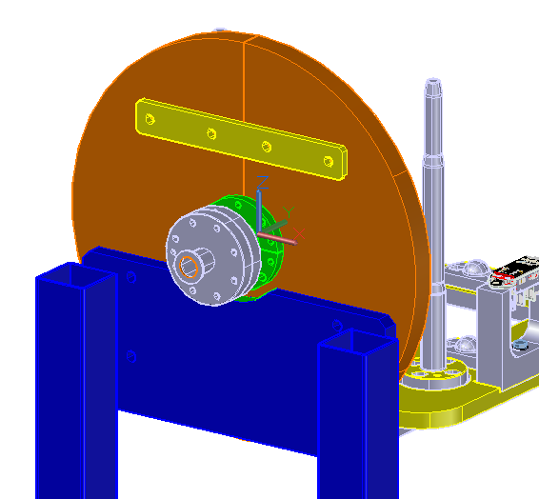
VAX CONNECTIONS TESTS

Slide 6
NEXT STEPS
DAY No | TASK | REQUIREMENTS | INVOLVED PEOPLE
 |  |  | A.B-L.S | L.K | J.S | A.K | HANDLING | TECHNICIAN | M.L
D1 | FIDUCIALISATION OF MODULES/FLANGES Scanning and laser tracker measurements | 3 modules in place. To coordinate the handling of M2 during the works. | X | X |  |  | X
D2 | LIFTING OF 3 MODULES | It can be also organized at the end of D1 or beginning of D3. |  |  |  |  | X |  | X
D3 | FIDUCIALISATION OF ASSEMBLY 1 | BP support and the structure attached to it should be previously installed on Assembly 1. | X |  | X | X |  |  | X
D4 | DISMOUNTING ASSEMBLY 1, MOUNTING ASSEMBLY 2, DRILLING ASSEMBLY 2 | Also the two structures attached should be installed at this time. |  |  | X | X | X | X | X
D5 | FIDUCIALISATION OF ASSEMBLY 2 |  | X
D6 | DISMOUNTING ASSEMBLY 2, FENCE, ETC |  |  |  |  | X | X | X | X
D7 | TRANSPORT OF:
 | MODULES AND OTHERS TO 867 | Before Christmas holidays |  |  |  |  | X |  | X
 | 2 ASSEMBLIES TO CMS | Before Installation |  |  |  |  | X |  | X
- | INSTALLATION OF ASSEMBLY 1 AND 2 IN CMS | 11th January
- | INSTALLATION OF MOCK UP IN 867 | Since January |  |  |  |  | X | X | X

Slide 7
Thank you

Slide 8
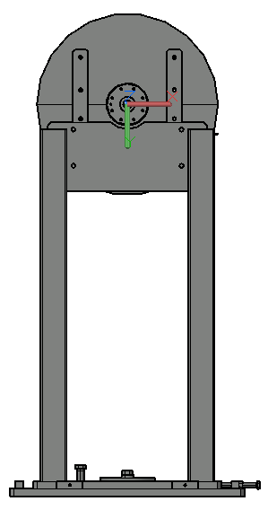
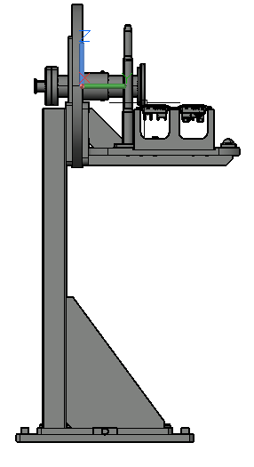
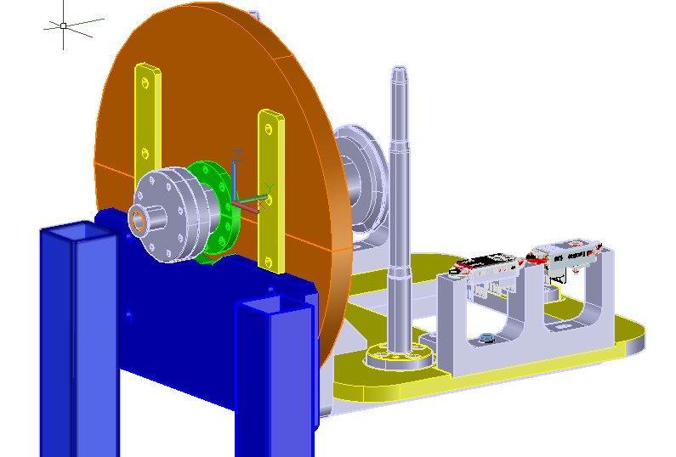
VAX CONNECTIONS TESTS Back up

