Slide 1
2021 Joint Universities Accelerator School
Superconducting Magnets
Section I
Paolo Ferracin
  (pferracin@lbl.gov)
Lawrence Berkeley National Laboratory (LBNL)

Slide 2
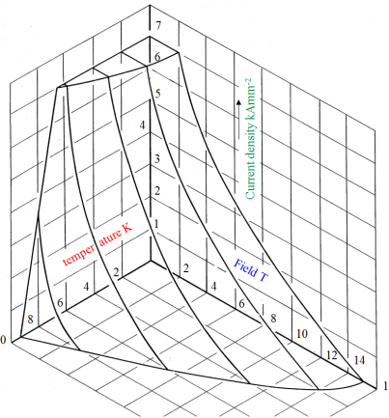
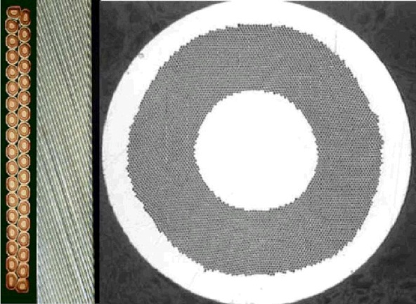
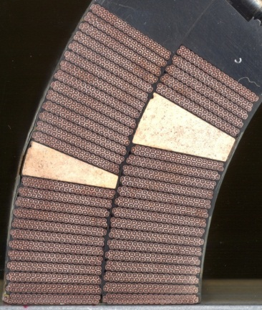
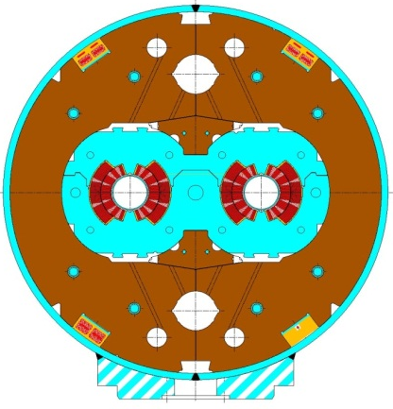
Introduction
Goal of the course
Overview of superconducting magnets for particle accelerators (dipoles and quadrupoles)
  Description of the components and their function
From the superconducting material to the full magnet
Superconducting material
Superconducting strand
Superconducting cable
Superconducting coil
Superconducting magnet

Slide 3
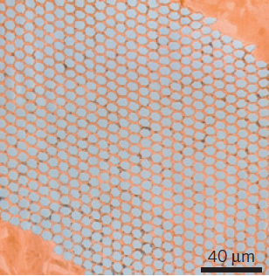
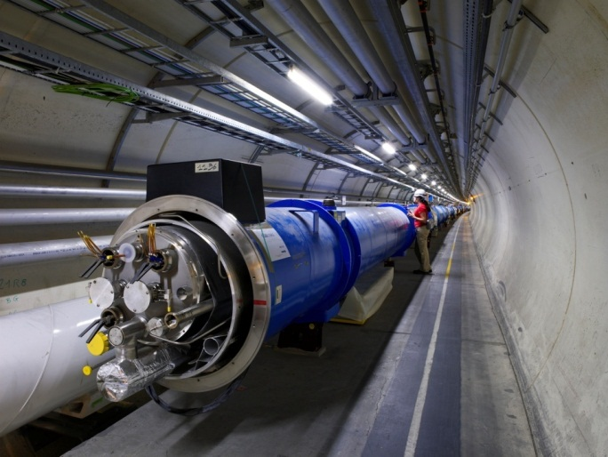

Introduction
Superconducting magnet technology
Multidisciplinary field: mixture of
  Chemistry and material science: superconducting materials
  Quantum physics: the key mechanisms of superconductivity
  Classical electrodynamics: magnet design
  Mechanical engineering: support structures
  Electrical engineering: powering of the magnets
  Cryogenics: keep them cold…
Very different order of magnitudes

Slide 4
Outline
Section I
  Particle accelerators and magnets
  Superconductivity and practical superconductors
Section II
  Magnetic design
Section III
  Coil fabrication
  Forces, stress, pre-stress
  Support structures
Section IV
  Quench, protection, training

Slide 5
References
Particle accelerators and magnets
Superconductivity and practical superconductors
  K.-H. Mess, P. Schmuser, S. Wolff, “Superconducting accelerator magnets”, Singapore: World Scientific, 1996.
  Martin N. Wilson, "Superconducting Magnets", 1983.
  Fred M. Asner, "High Field Superconducting Magnets", 1999.
  P. Ferracin, E. Todesco, S. Prestemon, “Superconducting accelerator magnets”, US Particle Accelerator School, www.uspas.fnal.gov.
  E. Todesco, “Masterclass - Design of superconducting magnets for particle accelerators”, https://indico.cern.ch/category/12408/
  A. Devred, “Practical low-temperature superconductors for electromagnets”, CERN-2004-006, 2006.
  Presentations from Luca Bottura and Martin Wilson

Slide 6


Particle accelerators and magnets
Principle of synchrotrons
  Driving particles in the same accelerating structure several times
Electro-magnetic field accelerates particles
Magnetic field steers the particles in a ∼circular orbit
Particle accelerated → energy increased → magnetic field increased (“synchro”) to keep the particles on the same orbit of curvature ρ
by E. Todesco
Constant

Slide 7
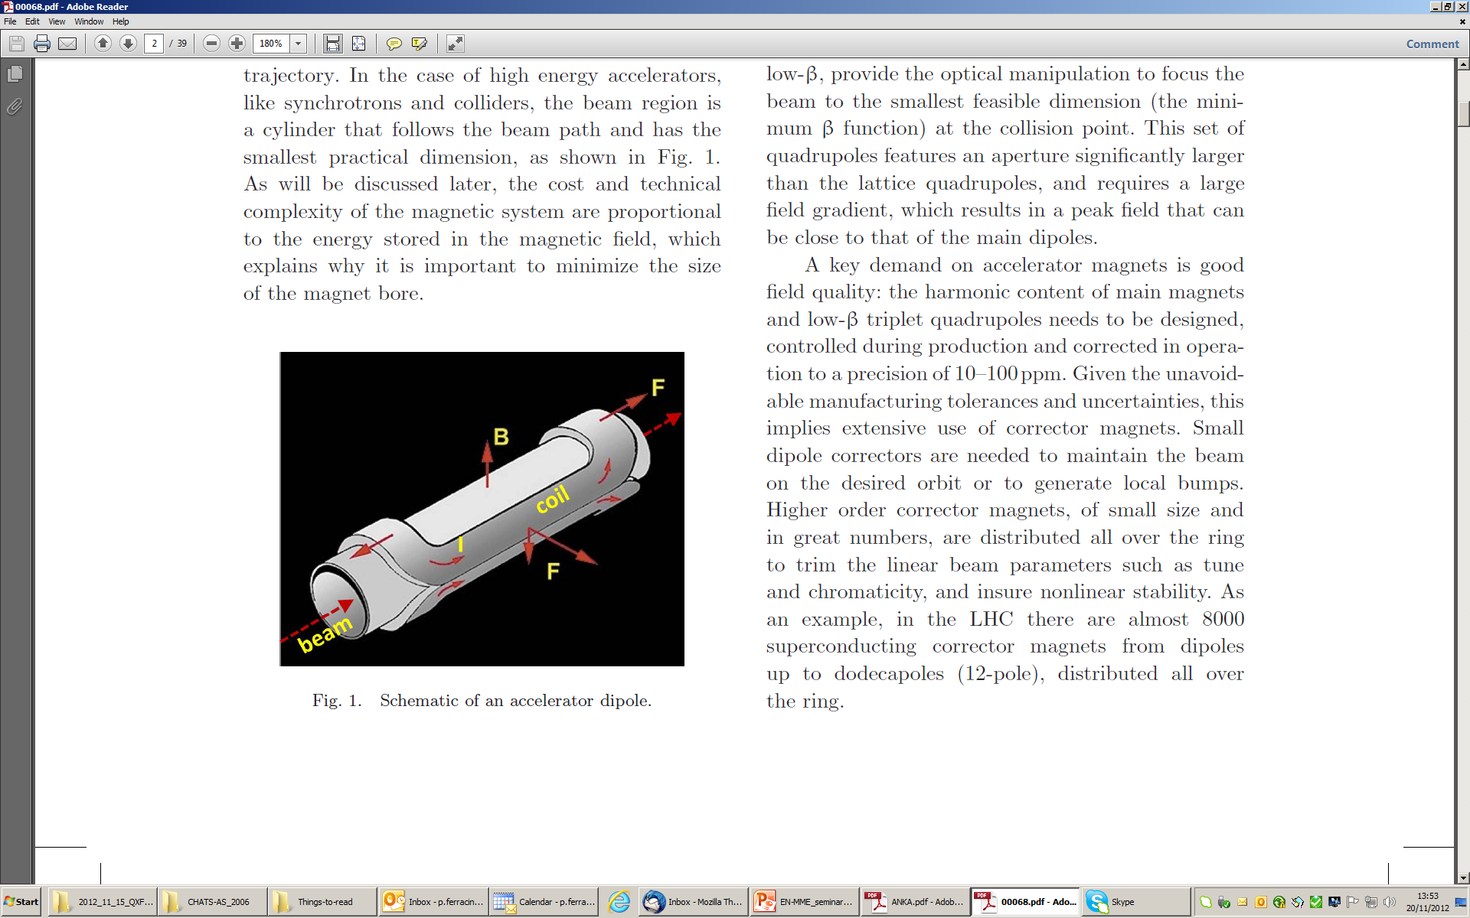
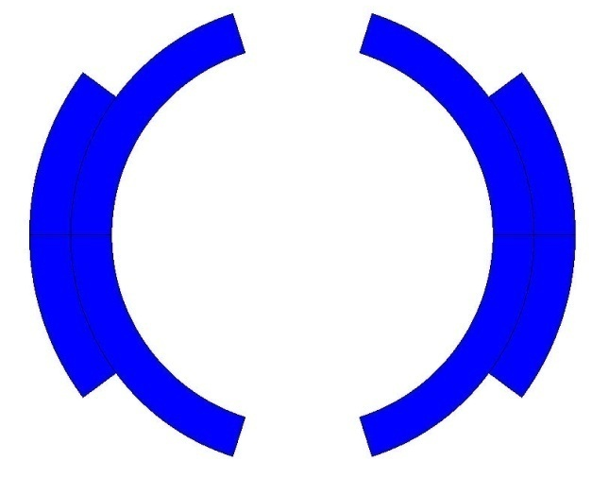
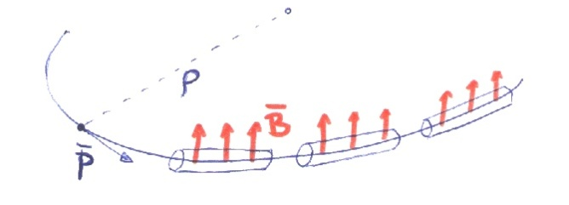
Particle accelerators and magnets
Dipoles
Main field components is B_{y}
  Perpendicular to the axis of the magnet z
Electro-magnets: field produced by a current (or current density)
Magnetic field steers (bends) the particles in a ∼circular orbit
×
by E. Todesco
×

Slide 8
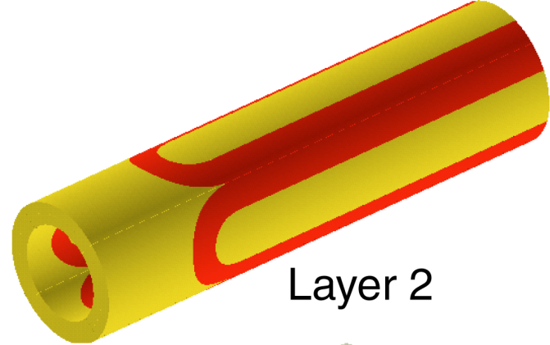
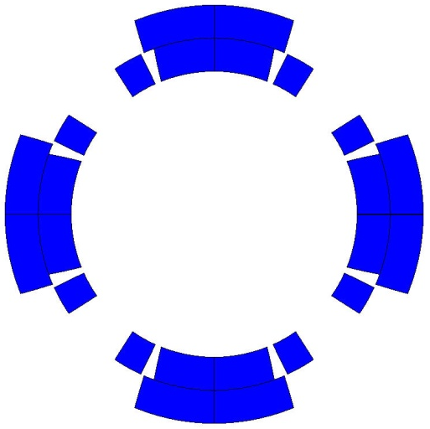
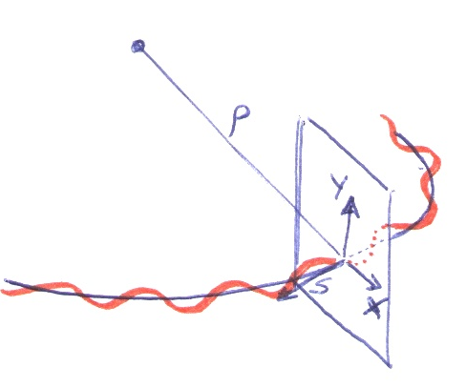
Particle accelerators and magnets
Quadrupoles
The force necessary to stabilize linear motion is provided by the quadrupoles
  They provide a field
    equal to zero in the center
    increasing linearly with the radius
They act as a spring: focus the beam
Prevent protons from falling to the bottom of the aperture due to the gravitational force
  it would happen in less than 60 ms
×
×
by E. Todesco

Slide 9
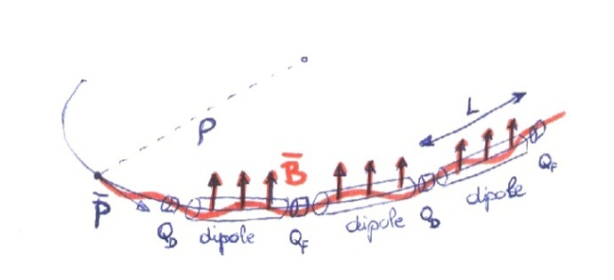
Particle accelerators and magnets
Quadrupoles
A typical accelerator structure is the FODO cell
  Alternating quadrupoles spaced by length L of similar gradient
One can prove that this gives positive focusing in both transverse planes
by E. Todesco
×
×
×
×

Slide 10

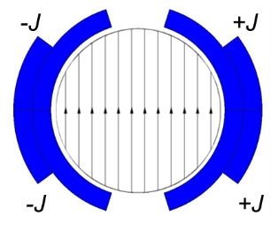
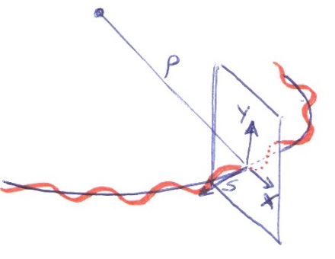
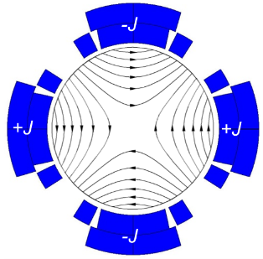
Particle accelerators and magnets
Dipoles: the larger B, the larger the energy
Quadrupoles: the larger B, the larger the focusing strength
For an electro-magnet, the larger B, the larger must be J
In normal conducting magnets, J ~ 5 A/mm²
In superconducting magnets, J_{e} ~ 600-700 A/mm²

Slide 11
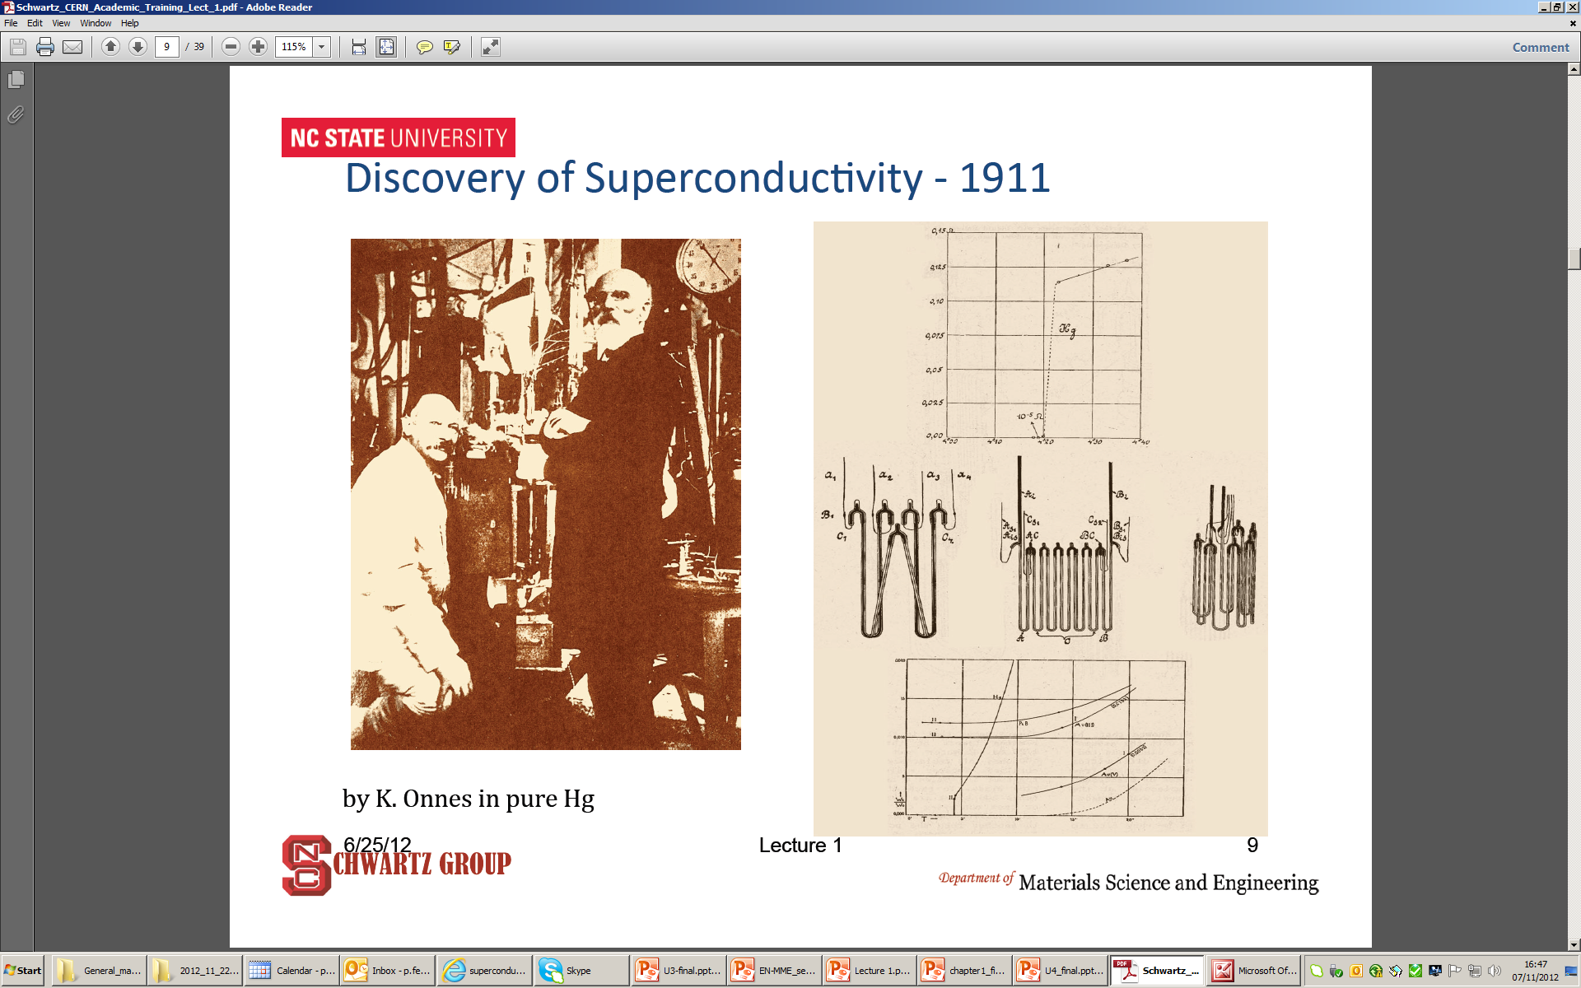
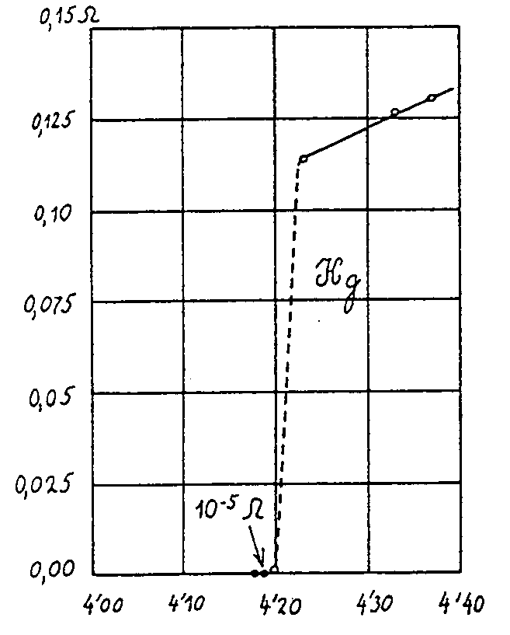
Superconductivity
The discovery
Superconductivity was discovered in 1911 by Kammerling-Onnes who observed that the resistance of a mercury wire disappeared (immeasurably small value) at 4.2 K
  Not just “little” resistance - truly ZERO resistance

Slide 12
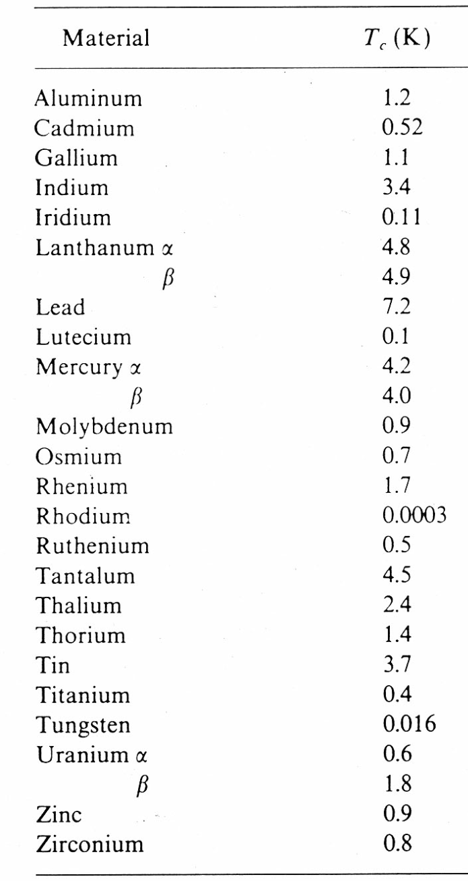
Superconductivity
Critical temperature
The temperature at which the transition takes place: critical temperature T_{c}
Below T_{c,} → no resistance
Observed in may materials
  but not in the typical best normal conductors (copper, silver, gold…)
At a temperature > T_{c} , a superconductor is a very poor conductor
2 kinds of superconductors
  Type I and Type II
    Different behaviour with magnetic field

Slide 13

Superconductivity
Type I superconductors
Meissner-Ochsenfeld effect (1933)
Perfect diamagnetism
  With T<T_{c} magnetic field is expelled
But, the B must be < critical field B_{c}
  Otherwise superconductivity is lost
by L. Bottura
B
B
Increase of field
Cool-down
Superconducting state
Normal state
Unfortunately, first discovered superconductors (Type I) with very low B_{c} (≤ 0.1 T)
  not practical for electro-magnets

Slide 14
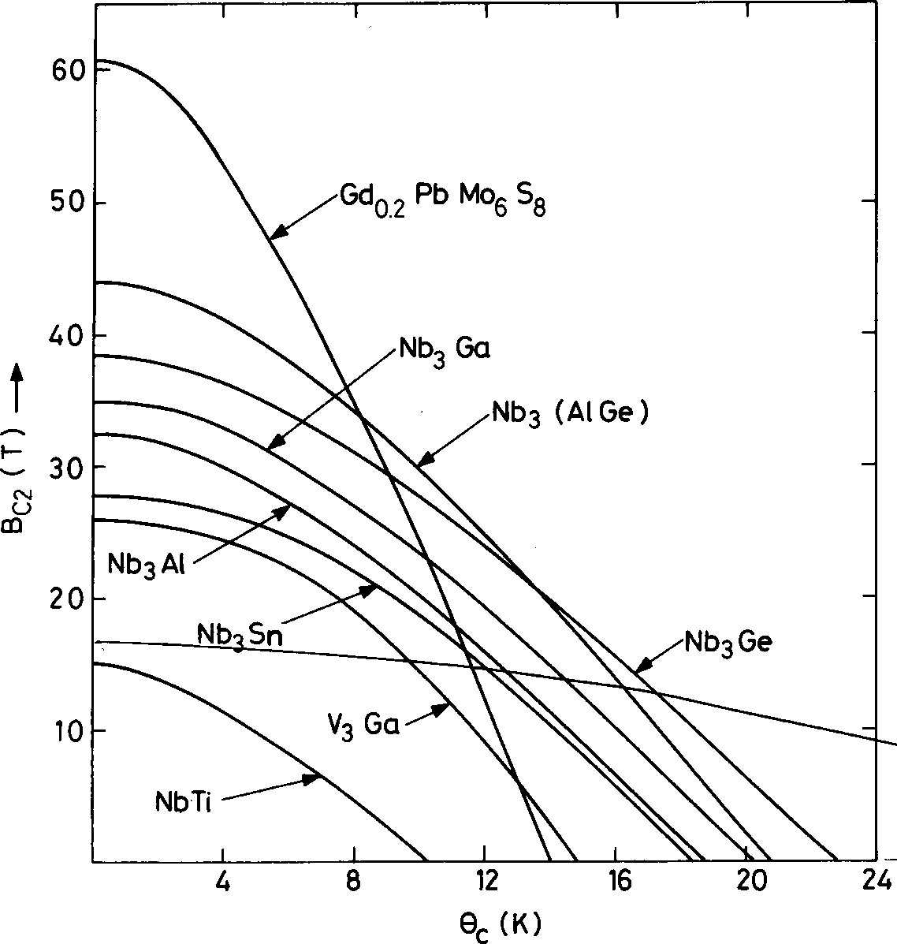
Superconductivity
Type II superconductors
So, for 40-50 years, superconductivity was a research activity
Then, in the 50’s, type II superconductors
  Between B_{c1} and B_{c2} : mixed phase
    B penetrates as flux tubes: fluxoids
      with a flux of φ_{o} = h/2e = 2 · 10⁻¹⁵ Wb
Much higher fields and link between T_{c} and B_{c2}
B<B_{c1}
B_{c1}<B<B_{c2}
by L. Bottura
T_{c} (K)

Slide 15
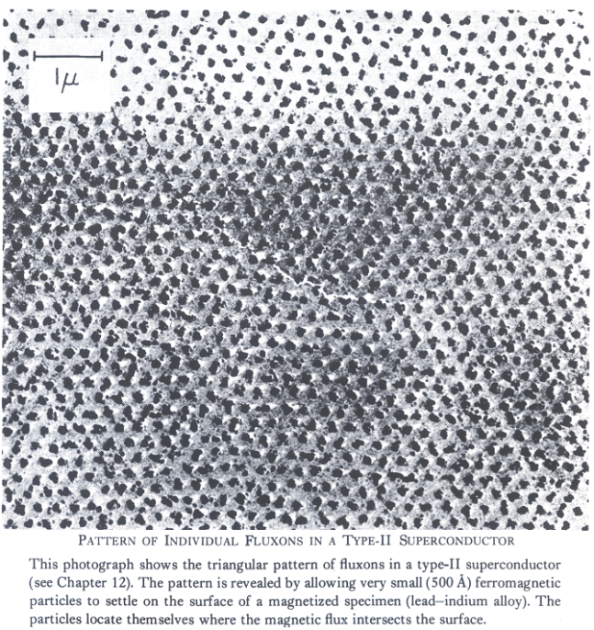
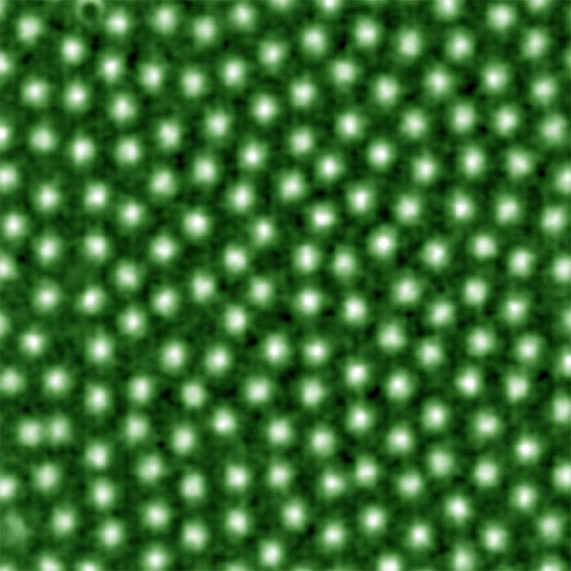
Superconductivity
Type II superconductors
Field penetrated in the form of flux tubes (fluxoids), each with a flux of
  φ_{o} = h/2e = 2· 10⁻¹⁵ Wb
Observed both in a photo by Essmann & Träuble (1967) and with magneto-optical imaging technique by Oslo Univerisity
http://www.mn.uio.no/fysikk/english/research/groups/amks/superconductivity/

Slide 16
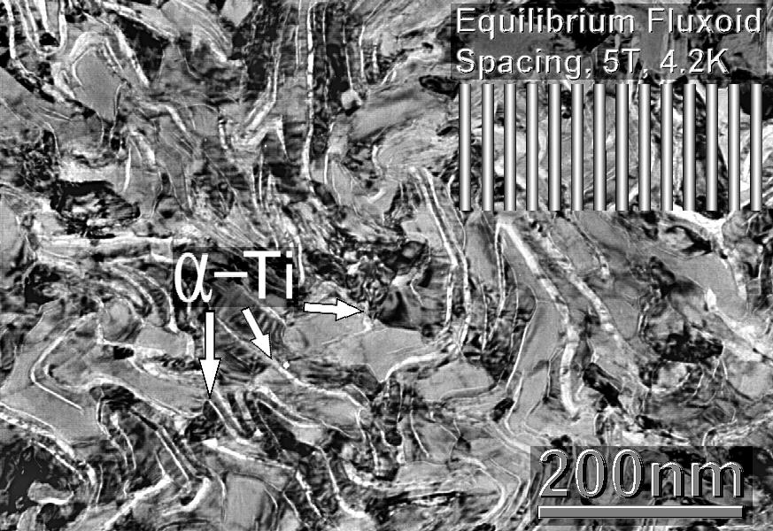
Superconductivity
Hard superconductors
…but, if a current is passed through the type II superconductor under a field >B_{c1}
  Lorentz force on the fluxoids
    F = J x B
The force causes a motion of tubes
  Flux motion (dB/dt)→ voltage (V)→ dissipation (V· I)
The fluxoids are therefore locked in pinning centers
  Defects or impurities in the structure: precipitates or grain boundaries
    Produced during fabrication

Slide 17
Superconductivity
Hard superconductors
The pinning centres exert a pinning force F_{p}
As long as F_{p} ≥ J x B
  No flux motions (flux tubes pinned) → no dissipation
The critical current density of the superconductor J_{c} is the current density at which, for a given B and at a given T the pinning force is exceeded by the Lorentz force
So, there is a mutual link between maximum J, B, and T
by M. Wilson

Slide 18
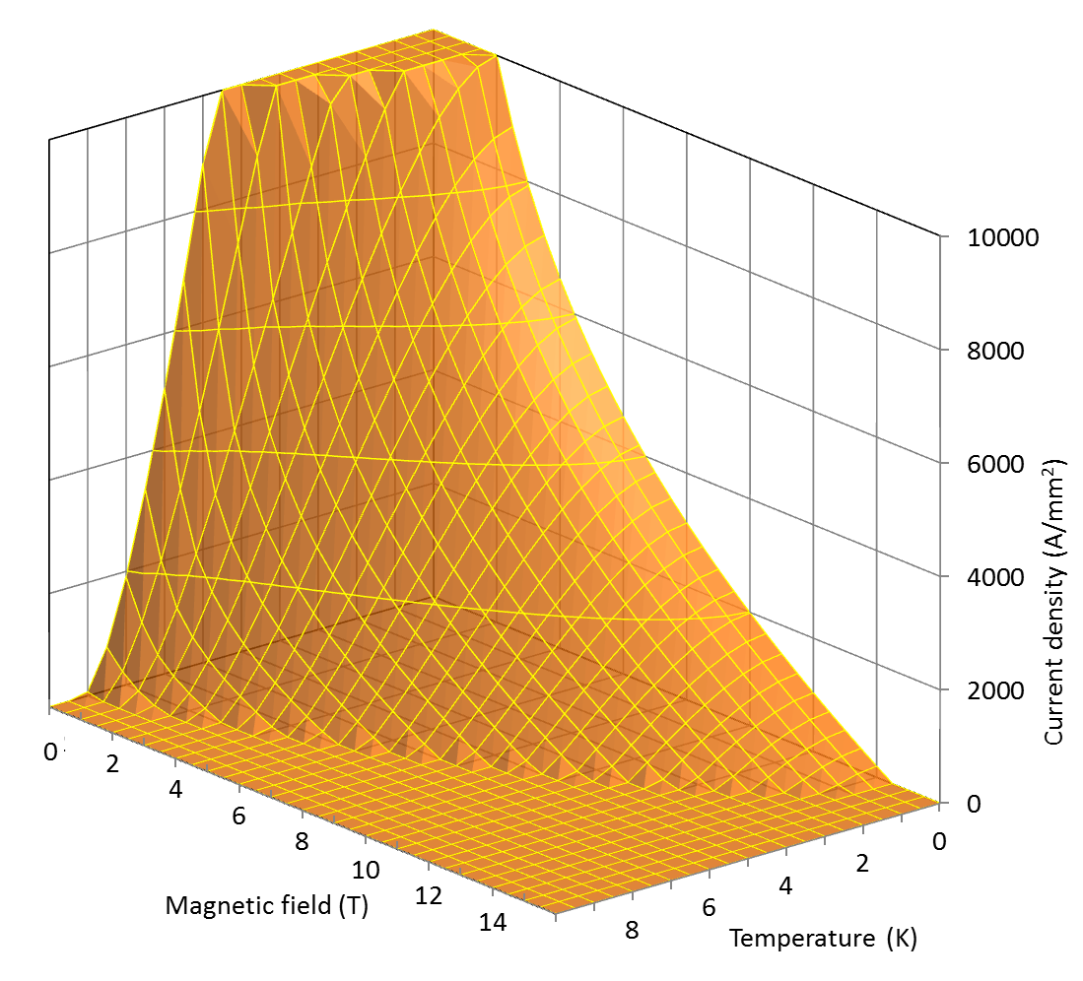
Superconductivity
Critical surface
A type II material is supercond. below the critical surface defined by
  Critical temperature Tc
    Property of the material
  Upper critical field B_{c2}
    Property of the material
  Critical current density J_{c}
    Hard work by the producer

Slide 19
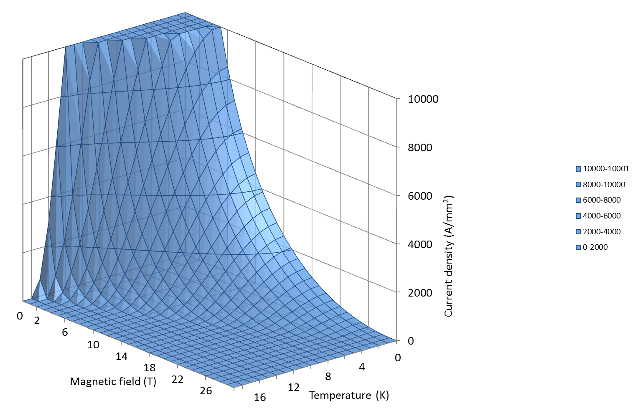
Superconductivity
Materials
Nb₃Sn and Nb-Ti, discovered in 1954 and 1961, are the most commonly used type II superconductors (80-90% of all devices).
Since their critical temperature T_{c} is 9 K (for Nb-Ti) and 18 K (for Nb₃Sn), they are defined as low T superconductors.
  High temperature superconductors (HTS) have a T_{c} up to 80-120 K.
Nb-Ti
Nb₃Sn

Slide 20
Superconductivity
Nb-Ti
Nb and Ti combine in a ductile alloy (called β phase)
  Easy to process by extrusion and drawing techniques.
T_{c} and B_{C2} depend on Ti content: the optimal is 46.5-47 in weight %.
  T_{c} is ~9.2 K at 0 T.
  B_{C2} is ~14.5 T at 0 K.
The critical current J_{c} depends on microstructure
  Cold works and heat treatments form α-Ti phase for flux pinning

Slide 21
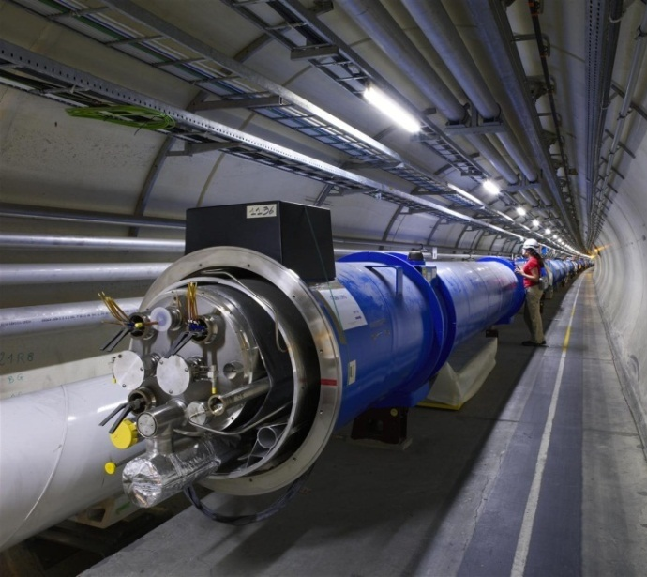
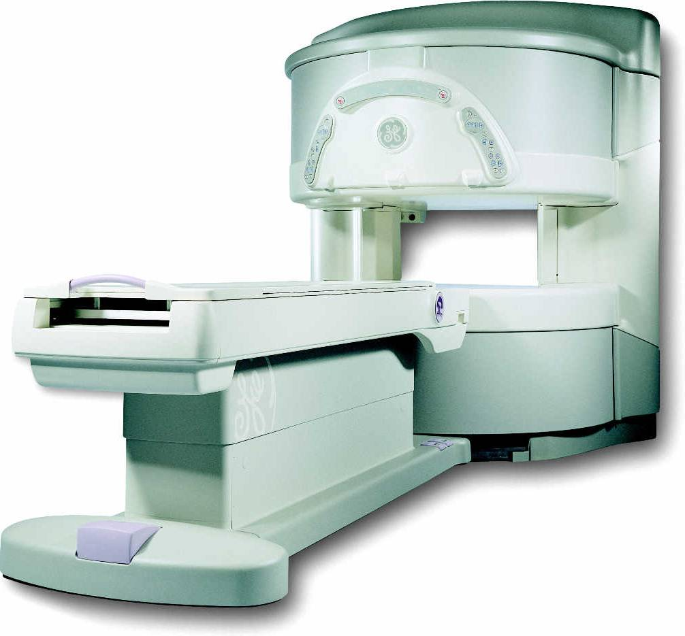
Superconductivity
Nb-Ti
Most widely used superconductor
Implemented on large scale for the first time in the the Tevatron accelerator, built at Fermilab in the early 80s
In High Energy Physics, used also for all the post-Tevatron accelerators
Other important applications
  MRI /NMR magnets
  Fusion magnets (Tore Supra, France).
The cost is ~ 200 US $ per kg of wire (about 1 euro per m of strand)

Slide 22
Superconductivity
Nb₃Sn
Nb and Sn can form an intermetallic compound from the A15 family (like Nb₃Al).
T_{C} and B_{C2} depend on Sn content: the optimal is 20-25 in weight%.
  T_{C} is ~18 K at 0 T
  B_{C2} is ~28 T at 0 K
The critical current J_{c} depends on the micro (grain) structure
  High J_{c} obtained with grains from 30 to 300 nm

Slide 23
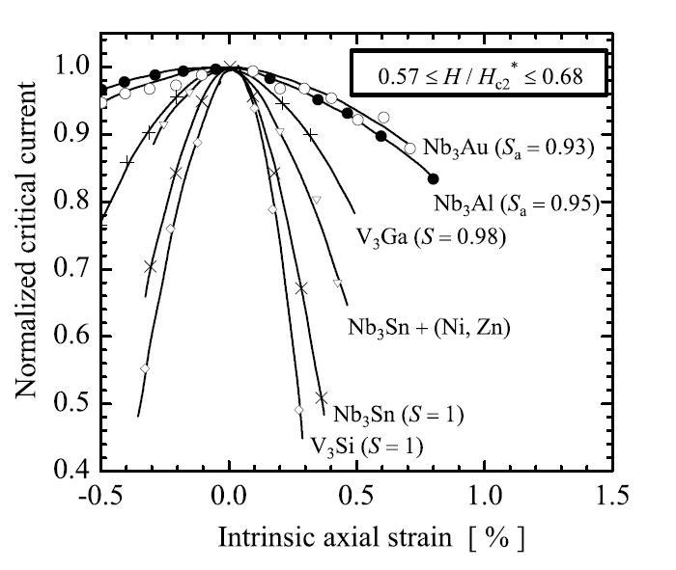
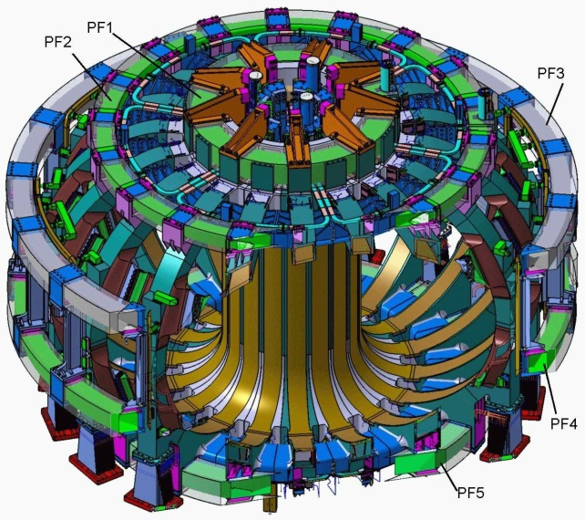
Superconductivity
Nb₃Sn
Nb₃Sn is brittle
  Cannot be extruded as Nb-Ti.
  Its formation must occur only at the end of the cable and/or coil fabrication process.
In addition, it is strain sensitive
  critical parameters ← → applied strain
Used in
  NMR, with field of about 20 T
  Model coils for ITER
  High energy physics (R&D)
The cost is approximately ~1500 US $ per kg of wire.
  ~5 euro per m of strand
by A. Godeke

Slide 24
Superconductivity
Nb-Ti vs. Nb₃Sn
Nb-Ti
Nb₃Sn

Slide 25
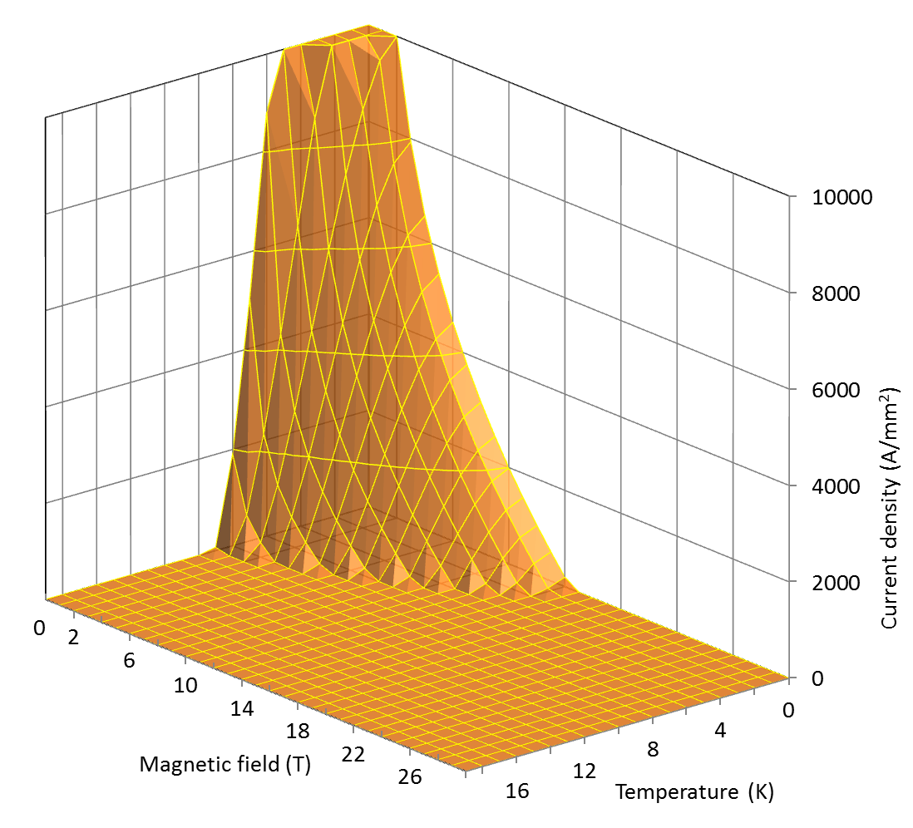
Superconductivity
Nb-Ti vs. Nb₃Sn
Nb-Ti
Nb₃Sn

Slide 26
Superconductivity from Cu to Nb₃Sn
Typical operational conditions (0.85 mm diameter strand)
Cu
Nb-Ti
Nb₃Sn
J_{e} ~ 5 A/mm²
I ~ 3 A
B = 2 T
J_{e} ~ 600-700 A/mm²
I ~ 300-400 A
B = 8-9 T
J_{e} ~ 600-700 A/mm²
I ~ 300-400 A
B = 12-13 T

Slide 27
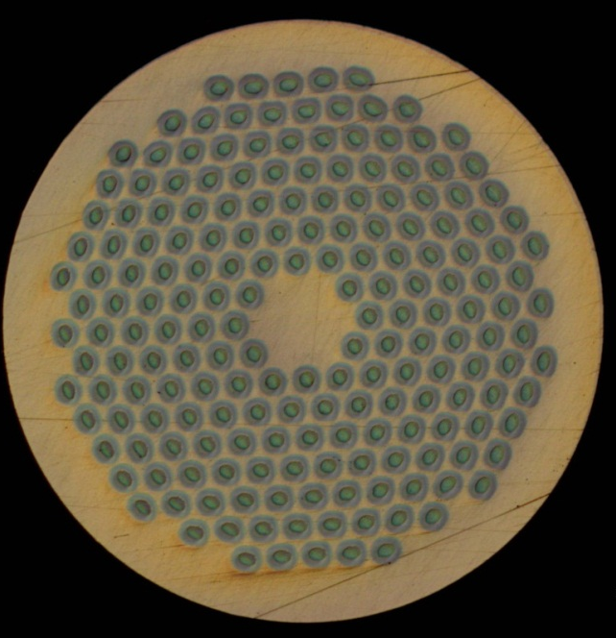
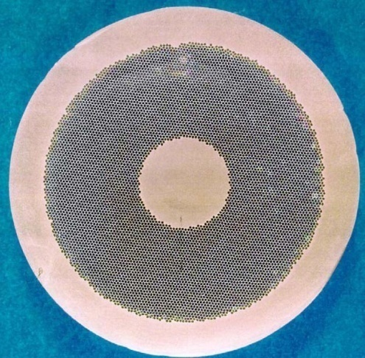
Practical superconductors
Typical operational conditions (0.85 mm diameter strand)
Cu
Nb-Ti
Nb₃Sn
J_{e} ~ 5 A/mm²
I ~ 3 A
B = 2 T
J_{e} ~ 600-700 A/mm²
I ~ 300-400 A
B = 8-9 T
J_{e} ~ 600-700 A/mm²
I ~ 300-400 A
B = 12-13 T

Slide 28
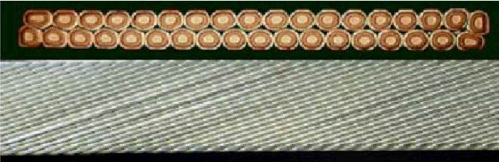
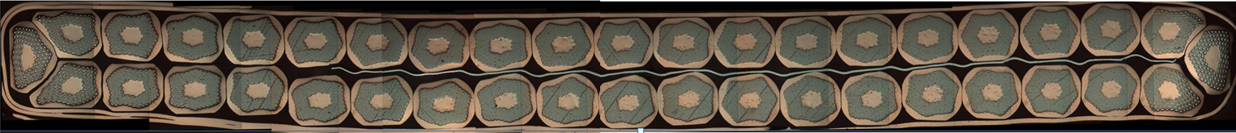
Practical superconductors
Introduction
Superconducting materials are produced in small filaments and surrounded by a stabilizer (typically copper) to form a multi-filament wire or strand.
A superconducting cable is composed by several wires: multi-strand cable.

Slide 29
Practical superconductors
Multi-filament wires motivations
The superconducting materials used in accelerator magnets are
  subdivided in filaments of small diameters
    to reduce magnetic instabilities called flux jumps
    to minimize field distortions due to superconductor magnetization
  twisted together
    to reduce interfilament coupling and AC losses
  embedded in a copper matrix
    to protect the superconductor after a quench
    to reduce magnetic instabilities called flux jumps

Slide 30
Practical superconductors
Multi-filament wires motivations
Fluxoid distribution depends on the applied B and on J_{c}.
Thermal disturbance → the local change in J_{c} → motion or “flux jump” → power dissipation
Stability criteria for a slab (adiabatic condition)
  a is the half-thickness of the slab
  j_{c} is the critical current density [A m⁻²]
  γ is the density [kg m⁻³]
  C is the specific heat [J kg⁻¹]
  θ_{c} is the critical temperature.
Nb-Ti filament diameters usually < 50 µm
B<B_{c1}
B_{c1}<B<B_{c2}
by L. Bottura

Slide 31
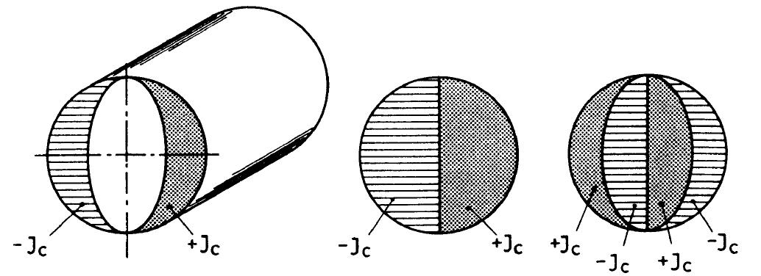
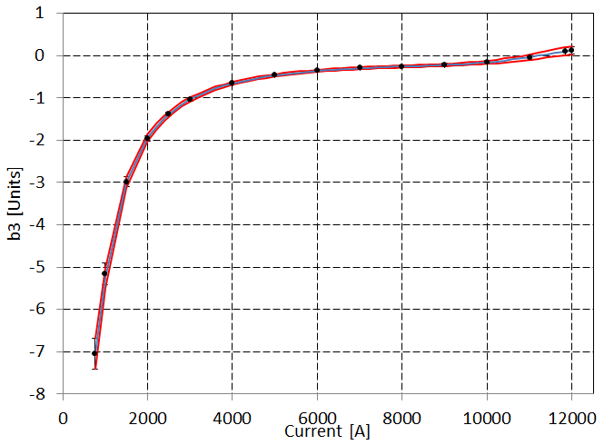
Practical superconductors
Multi-filament wires motivations
Superconductor magnetization
  When a filament is in a varying B_{ext}, its inner part is shielded by currents distribution in the filament periphery
    They do not decay when B_{ex}is held constant → persistent currents
  These currents produce field errors and ac losses proportional to J_{c}r_{f}
    LHC filament diameter 6-7 µm.
    HERA filament diameter 14 µm.
M
B_{ext}
by K.-H. Mess, et al.
Field distorsion/errors

Slide 32
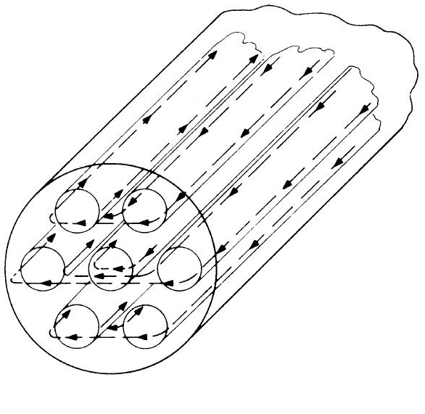
Practical superconductors
Multi-filament wires motivations
Inter-filament coupling
  When a multi-filamentary wire is subjected to a time varying magnetic field, current loops are generated between filaments.
  If filaments are straight, large loops with large currents → ac losses
  If the strands are magnetically coupled the effective filament size is larger → flux jumps
To reduce these effects, filaments are twisted
  twist pitch of the order of 20-30 times of the wire diameter.
by M. Wilson
by L. Bottura

Slide 33
Practical superconductors
Multi-filament wires motivations
Quench protection
  Superconductors have a very high normal state resistivity
    If quenched, could reach very high temperatures in few ms.
  If embedded in a copper matrix, when a quench occurs, current redistributes in the low-resisitivity matrix → lower peak temperature
  The copper matrix provides time to act on the power circuit
  In the case of a small volume of superconductor heated beyond the critical temperature the current can flow in the copper for a short moment, allowing the filament to cool-down and recover supercond.
  The matrix also helps stabilizing the conductor against flux jumps
by L. Bottura

Slide 34
Practical superconductors
Multi-filament wires motivations
Flux jumps
Persistent currents
AC losses
Quench protection

Slide 35
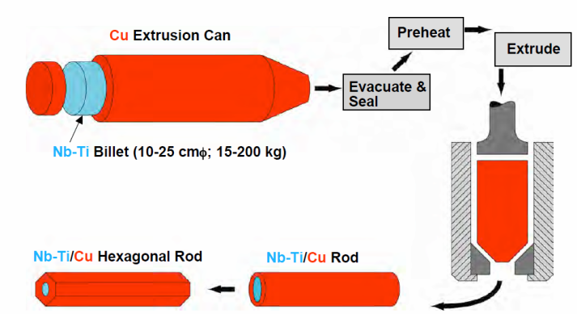
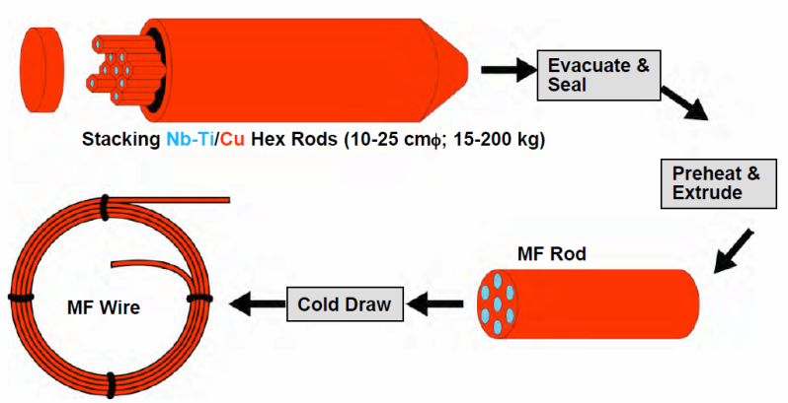
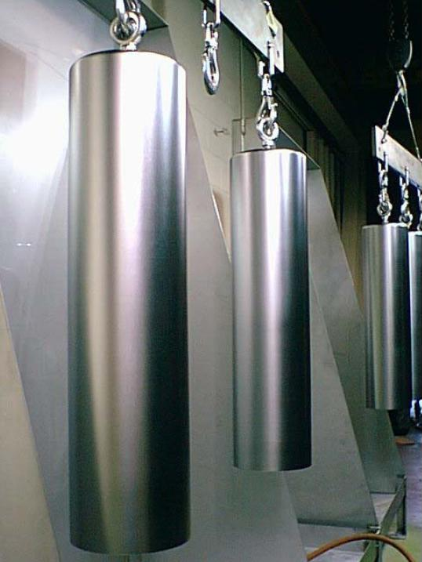
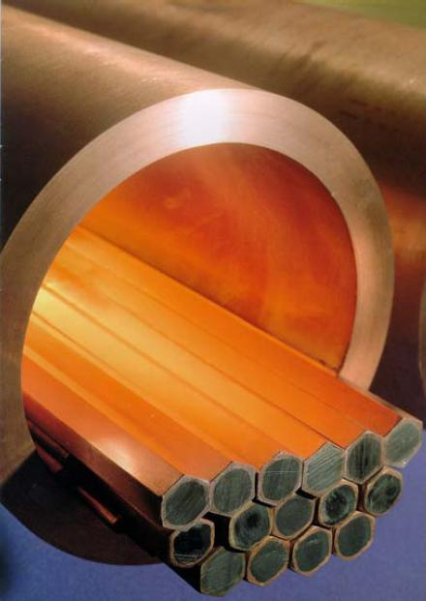
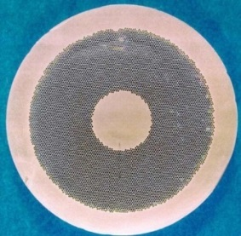
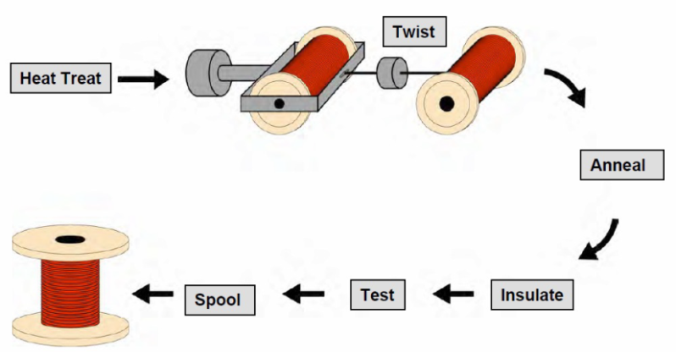
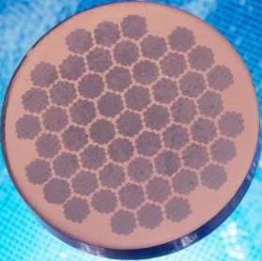
Practical superconductors
Fabrication of Nb-Ti multifilament wires
Nb-Ti ingots
  200 mm ∅, 750 mm long
Monofilament rods are stacked to form a multifilament billet
  then extruded and drawn down
  can be re-stacked: double-stacking process

Slide 36


Practical superconductors
Fabrication of Nb-Ti multifilament wires
Copper to superconductor ratio
  ensure quench protection without compromising the overall critical current of wire.
Filament diameter
  Minimize flux jumps and persistent currents
  Minimizing the wire processing cost
The inter-filament spacing
  small so that the filaments, harder then Cu, support each other during drawing operation
  large enough to prevent filament couplings
Cu core and sheath to reduce cable degradation
Main manufacturing issue: piece length
  It is preferable to wind coils with single-piece wire (to avoid welding)
    LHC required piece length longer than 1 km

Slide 37
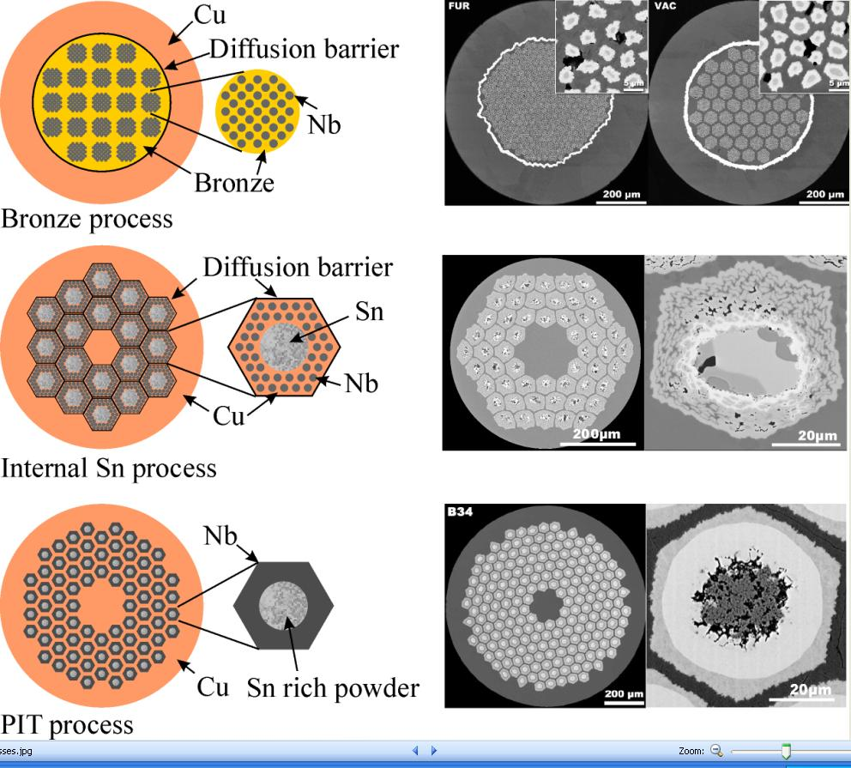
Practical superconductors
Fabrication of Nb₃Sn multifilament wires
Internal tin process
  A tin core is surrounded by Nb rods embedded in Cu (Rod Restack Process, RRP) or by layers of Nb and Cu (Modify Jelly Roll, MJR).
  Each sub-element has a diffusion barrier.
  Advantage: no annealing steps and not limited amount of Sn
  Disadvantage: small filament spacing results in large effective filament size (100 µm) and large magnetization effect and instability.
  Non-Cu J_{C} up to 3000 A/mm² at 4.2 K and 12 T.
by A. Godeke

Slide 38
Practical superconductors
Fabrication of Nb₃Sn multifilament wires
Powder in tube (PIT) process
  NbSn₂ powder is inserted in a Nb tube, put into a copper tube.
  The un-reacted external part of the Nb tube is the barrier.
  Advantage: small filament size (30 µm) and short heat treatment (proximity of tin to Nb).
  Disadvantage: fabrication cost.
  Non-Cu J_{C} up to 2300 A/mm² at 4.2 K and 12 T.
by A. Godeke
A. Godeke, [2].

Slide 39
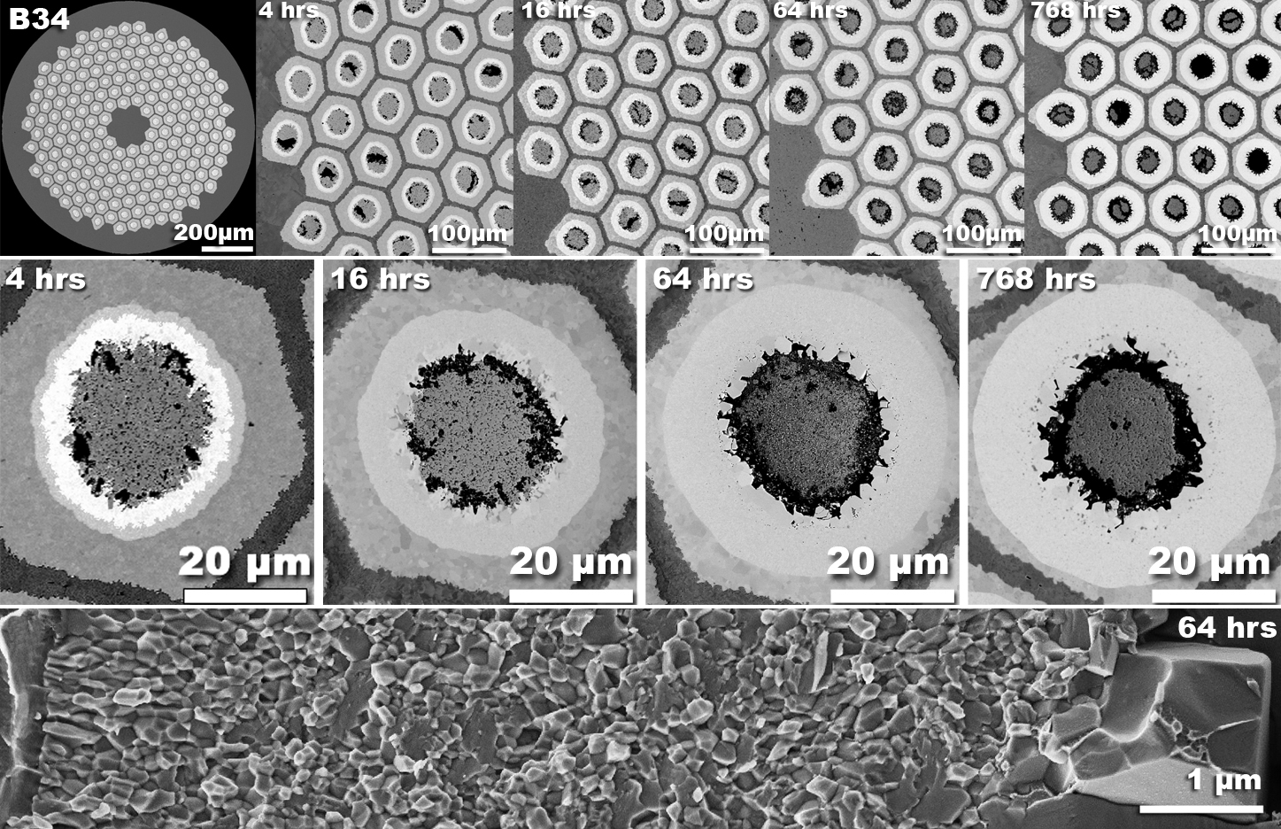
Practical superconductors
Fabrication of Nb₃Sn multifilament wires
Reaction of a PIT wire
by A. Godeke

Slide 40
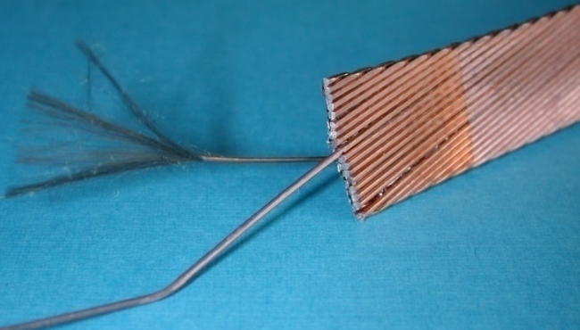
Practical superconductors
Multi-strand cables motivations
Most of the superconducting coils for particle accelerators wound from a multi-strand cable (Rutherford cable)
  Reduction of strand piece length
  reduction of number of turns
    easy winding
    smaller coil inductance
      less V for power supply during ramp-up;
      after a quench, faster discharge and V
  current redistribution in case of a defect or a quench in one strand
The strands are twisted to
  Reduce inter-strand coupling currents
    Losses and field distortions
  Provide more mechanical stability
by M. Wilson

Slide 41
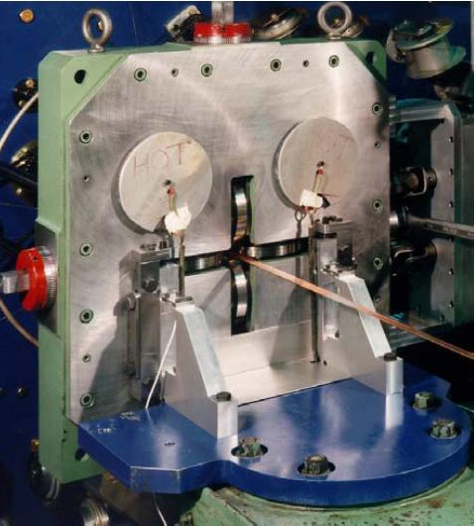

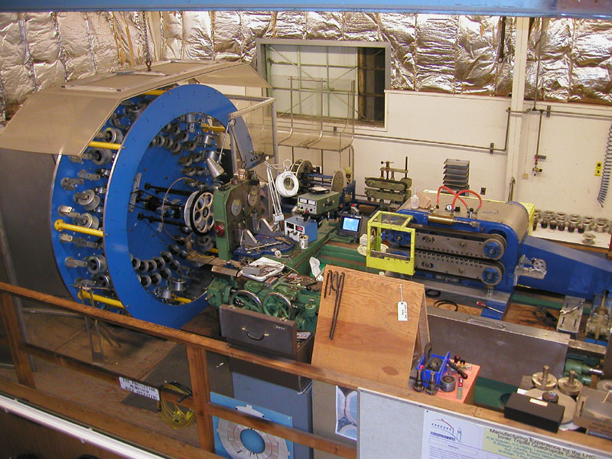
Practical superconductors
Multi-strand cables motivations
Rutherford cables fabricated by cabling machine
  Strands wound on spools mounted on a rotating drum
  Strands twisted around a conical mandrel into rolls (Turk’s head)
  The rolls compact the cable and provide the final shape
by M. Wilson

Slide 42
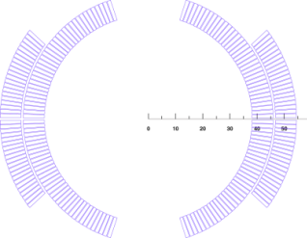
Practical superconductors
Multi-strand cables
A Rutherford cable can be rectangular or trapezoidal
  To stacking cables in an arc-shaped coil around the beam pipe
Cable compaction
  Ratio of the sum of the cross-sectional area of the strands (direction parallel to the cable axis) to the cross-sectional area of the cable
    88% (Tevatron) to 92.3% (HERA).
  Chosen to provide good mechanical stability + high current capability + enough space for helium cooling or epoxy impregnation.
Cables degradation
  Critical current density of a virgin wire before cabling is higher then the one of a wire after cabling

Slide 43



Practical superconductors
Multi-strand cables
Edge deformation may cause
  reduction of the filament cross-sectional area (Nb-Ti)
  breakage of reaction barrier with incomplete tin reaction (Nb₃Sn)
In order to avoid degradation
  strand cross-section investigated
  Edge facets are measured
    General rule: no overlapping of facets
Keystone angle is usually of ~ 1° to 2°

Slide 44



Practical superconductors
Cable insulation
The cable insulation must feature
  Good electrical properties to withstand turn-to-turn V after a quench
  Good mechanical properties to withstand high pressure conditions
  Porosity to allow penetration of helium (or epoxy)
  Radiation hardness
In Nb-Ti magnets overlapped layers of polyimide
In Nb₃Sn magnets, fiber-glass braided or as tape/sleeve.
Typically the insulation thickness: 100 and 200 µm.

Slide 45

Practical superconductors
Superconducting cables
Filling ratio: 0.25-0.3

