Slide 1
Accelerator Controls
Elke Zimoch :: Section Controls :: Paul Scherrer Institut
JUAS 2021

Slide 2
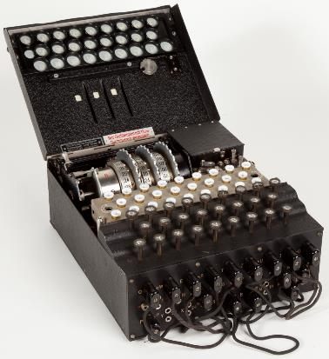
Why talking about Accelerator Controls?
Soon in the future (and once upon a time):
Scientist Dr. Example Guy wants to do
VeryImportantMeasurement_OneDotOne
for that he creates some actuators and detectors
Super_Creative_HardwareSolution
puts it into the accelerator
and calls the Controls Group
“Please make it run”.
I want to teach you a
minimum awareness about the control
system that «runs» the accelerator …

Slide 3
Table of Content
What is an Accelerator Control System?
Accelerator Control Systems Architecture
Examples of Control Systems
Control System Parts and Pieces
Borderlands of Control Systems
Conclusion

Slide 4
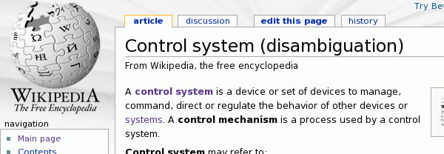
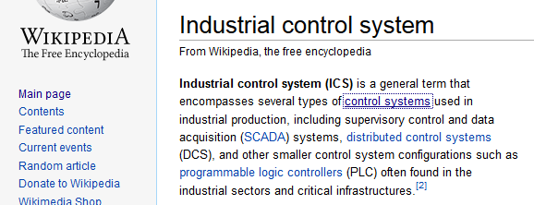
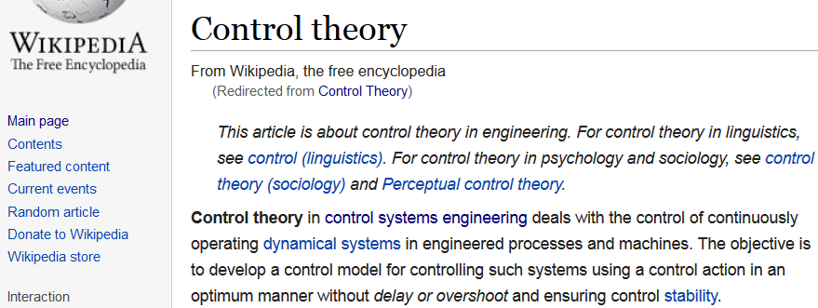
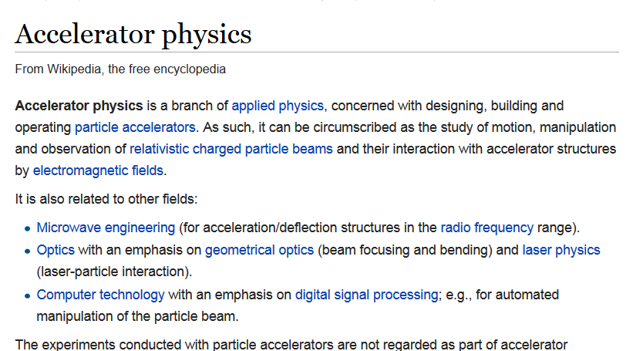

What is an Accelerator Control System?
Searching Wikipedia:
Notes:
From Wikipedia (https://en.wikipedia.org/wiki/Main_Page):
Control System: A control system is a device or set of devices to manage, command, direct or regulate the behavior of other devices or systems.
Accelerator Physics: Accelerator physics is a branch of applied physics, […]. It is also related to other fields: […] Computer technology with an emphasis on digital signal processing; e.g., for automated manipulation of the particle beam.
Industrial Control System: Industrial control system (ICS) is a general term that encompasses several types of control systems used in industrial production, […].
Control Theory: Control theory in control systems engineering deals with the control of continuously operating dynamical systems in engineered processes and machines. The objective is to develop a control model for controlling such systems using a control action in an optimum manner without delay or overshoot and ensuring control stability.
Control Systems Engineering: Control engineering or control systems engineering is an engineering discipline that applies automatic control theory to design systems with desired behaviors in control environments. The discipline of controls overlaps and is usually taught along with electrical engineering at many institutions around the world
Automation: Automation or automatic control, is the use of various control systems for operating equipment such as machinery, processes in factories, […] and other applications with minimal or reduced human intervention.
Unfortunately the „Controls Theory“ does not cover highly complex and diverse systems like accelerators. So, there is no theory to learn.
Conclusion: This is all related to Accelerator Control Systems, but does not hit the point.
Best match found on Wikipedia is the article about Distributed Control Systems https://en.wikipedia.org/wiki/Distributed_control_system

Slide 5
What is an Accelerator Controls System
does
(1/6)
Controls the accelerator (Source, Magnets, RF)
Provides diagnostics information (BPMs, Cameras)
Monitors environment (Vacuum, Temperature)
Feedback programs for beam parameters (orbit feedback)
Makes “the machine” running and controllable …
… reliable, with good performance, flexible … economical
safe (without producing black holes and destroying the world)
Notes:
As there is no easy answer to what an Accelerator Control System is, lets try to find out what it does.

Slide 6
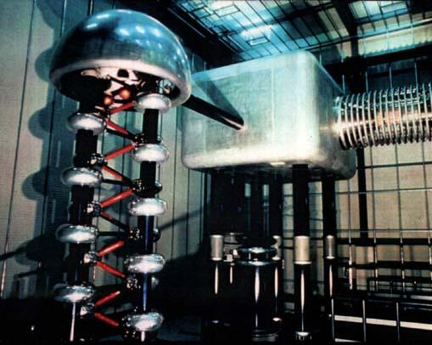
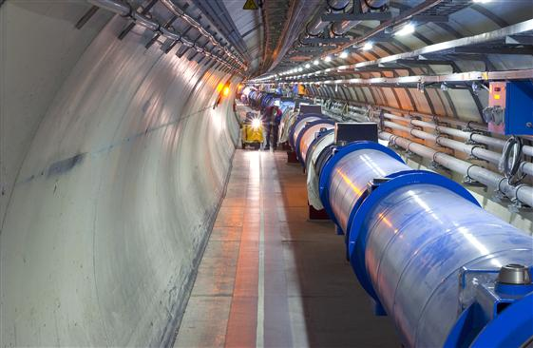
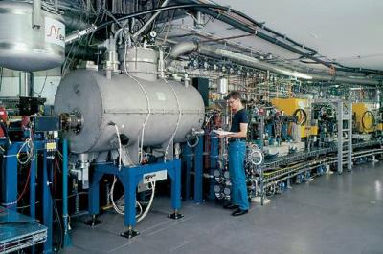
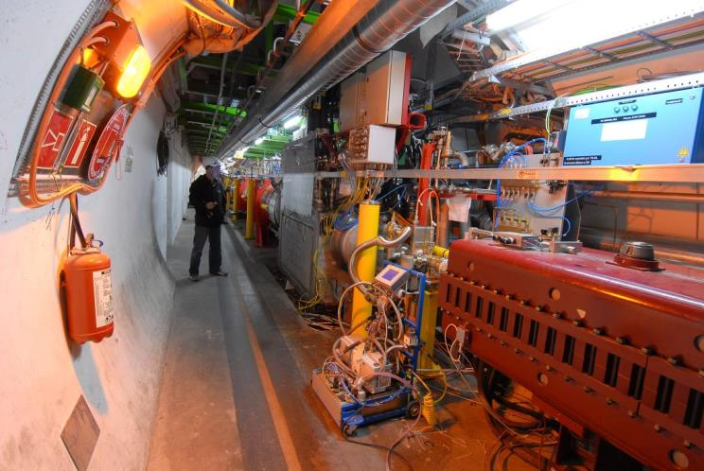
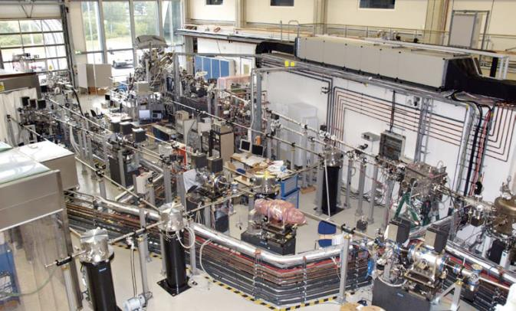
What does an Accelerator Control System? (2/6)
Controls the accelerator hardware:
Notes:
What does an Accelerator Control System actually control?
For example the number of components needed to run an accelerator:
Swiss Light Source (SLS at PSI) Accelerator components to control:
ca. 200 computers
ca. 600 magnets (+power supplies)
300 vacuum pumps
9 cavity structures
ca. 150 beam position monitors
21 beamlines (together)
ca. 300 computers
10 undulator magnets
more than 1200 motors
Distances between components (stroage ring with 130 m diameter): 50 km power cable and more than 500 km signal cable

Slide 7
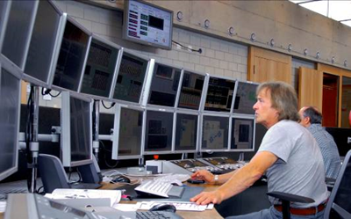
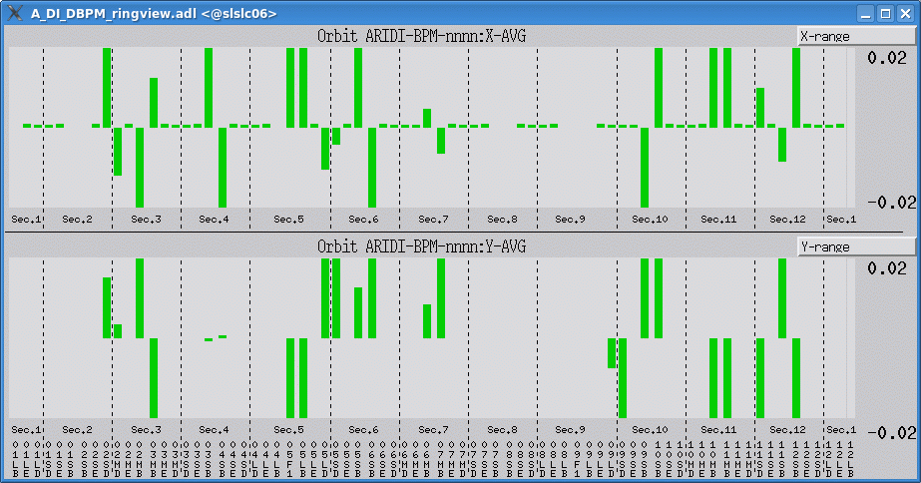
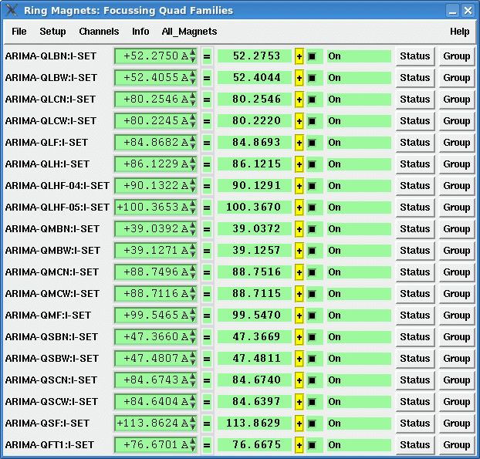
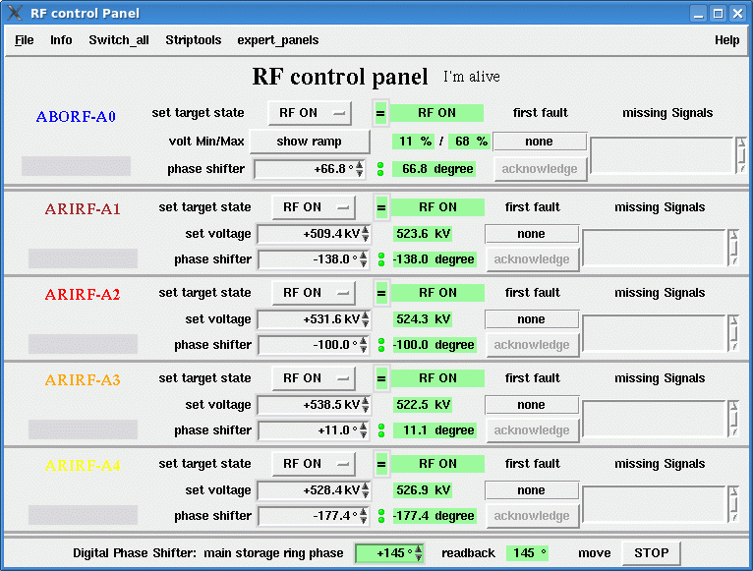
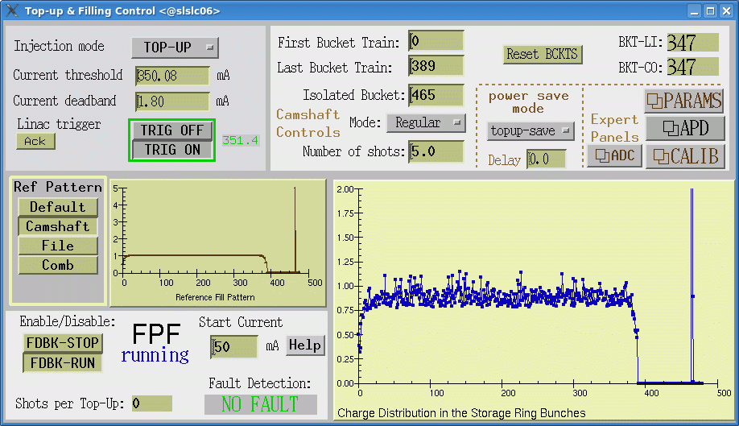
What does an Accelerator Control System? (3/6)
Make the accelerator controllable
… from a Control Room
… using Computer Systems
Notes:
For what do you need an Accelerator Control System (continued)?
Some examples of applications and programs needed to run an accelerator:
Device Control Panels
Feedback Systems (e.g. orbit feedback, filling pattern feedback)
Archiving and Data Acquisition Systems (Storage)
Scan tools for experiments and measurements
Conditioning tools for RF components
Simulations and comparisons with real accelerator
Alarm handling and machine protection

Slide 8
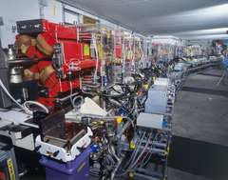
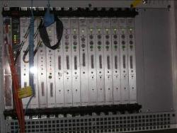
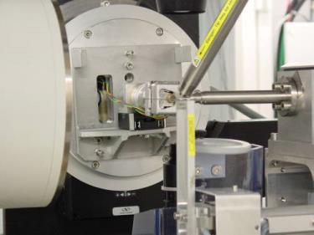
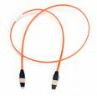
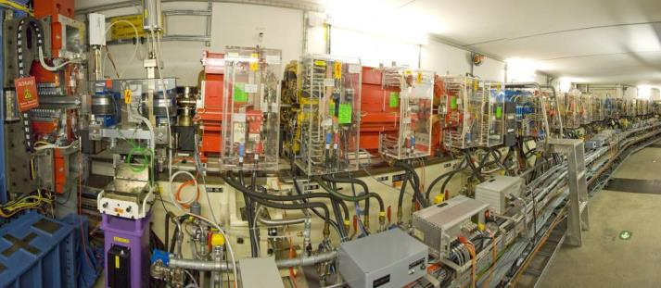

What does an accelerator control system? (4/6)
Control System
Operator
in Control Room
The control system connects the operator with the accelerator.
Notes:
The Accelerator Control System connects the Operator in the control room with the accelerator hardware. The control room might not be near the accelerator:
SLS is 200m away from PSI main control room
For SwissFEL the control room will be a kilometer away
Some experiments are controlled remote from all over the world

Slide 9

What does an Accelerator Control System? (5/6)
Accelerator
Control System
Inputs
Outputs
Values from all diagnostic devices
(BPMs, screens, ICT/PCT, etc.)
Information from the experiment
Read back values from devices (Magnets, RF, etc.)
Read back values from environment (Vacuum, Temperature, etc.)
Set values from devices (Magnets, RF, etc.)
Actuators of the environment (vacuum pumps, heaters, chillers, etc.)
Triggers
Alerts (SMS, emails, alarms, etc.)
Operator

Slide 10

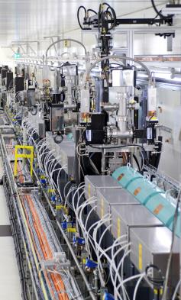
What does an Accelerator Control System? (6/6)
The
Accelerator Control System
does provide a keyhole view on the accelerator
is the only way to access any component remotely
Notes:
Conclusion:
The Accelerator Control System is the only connection between the Control Room (Operator) and the real hardware.
Everything that is not shown by the control system can not be seen.
If the control system is the only way to access hardware, all systems that are needed for this remote access belong to the control system.

Slide 11
Who uses an Accelerator Controls System
Who they are
What they want from the system
Accelerator Physicists
Operators (technical Staff, in most cases no theoretical background knowledge)
System Experts (Vacuum Experts, RF Group, …)
Experiment Users (not necessary Physicists)
Sponsors (Politicians, General Public, etc.)
Control System Specialists (Computer Scientists, Physicists, Nerds)
Access to ALL functions of the hardware (full control)
Implementation of complex algorithms
Easy and intuitive usage
Low cost, low manpower
Safe usage and reliable alarm handling
Easy maintainable
Easy extensible
fun
Notes:
The accelerator control system is used by many different groups for many different purposes – and has to support them all.

Slide 12
What is the Technical Environment?
Control Systems (one way or another) have to deal with …
Distributed end points and processes
Data Acquisition (front end hardware)
Real-time needs (where necessary)
Process control (automation, feedback, PID controller)
Central Services (Archive, Databases, Name Resolution)
Data transport (control system protocol, network)
Security (who’s allowed to do what from where?)
Time synchronization (time stamps, cycle ids, etc.)
that is:
Computers (in different flavors) and
Computer Environment

Slide 13
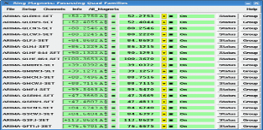
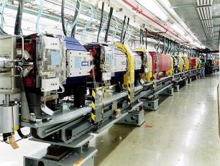
What is an Accelerator Controls System
Definition:
An Accelerator Control System is a computer environment that allows remote access to the accelerator hardware with a lot of different functionality to satisfy the requirements of several different user groups.
In addition a modern
Accelerator Control System:
tries to unify the access to different
hardware
(one way to rule them all)
0110001010001001

Slide 14
Table of Content
What is an Accelerator Control System?
Accelerator Control Systems Architecture
Examples of Control Systems
Control System Parts and Pieces
Borderlands of Control Systems
Conclusion

Slide 15
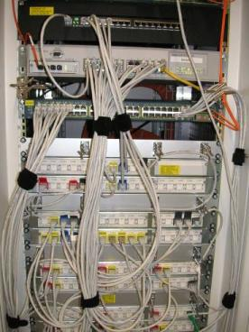
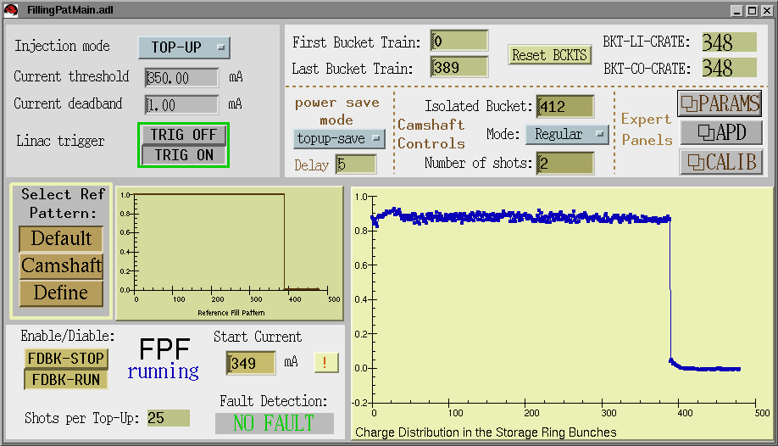
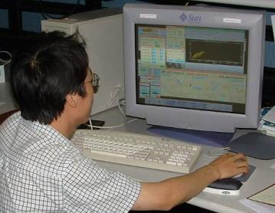
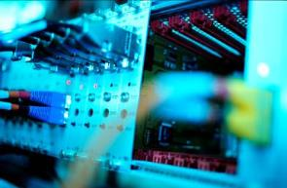
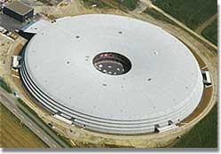

Requirements of an Accelerator Control System
Software
Operator
Hardware
reliable
good performance
flexible
easy maintenance
?
Accelerator
Experiment Scientist
Notes:
The requirements from different user groups might be different.
The most common requirements are:
Reliability – if I have beam time scheduled, I want it to happen
Good Performance – speed, responsiveness, modern possibilities
Flexibility – „hey, I have a good idea, lets try …“
Easy maintenance – this comes with limited resources

Slide 16
Why is easy Maintenance important?
Controls System Lifecycle:
Maintenance
(User Operation)
Controls Workload
Aging
Conception
Development
Commissioning
Decommissioning
2-10 years
20-30 years
Time
(not in scale)
“You have to run to stay where you are”
Workload never got to zero during accelerator lifetime
Normal accelerator lifetime ~ 30 to 40 years

Slide 17
Possible Architectures
Centralized
Columns
Layer
Network
Notes:
Centralized:
Single point of failure.
Columns:
No exchange of information between different systems.
Network (Peer-to-peer):
Can be difficult to maintain if an addition has to be added to all other systems.
Layer:
Can be difficult to find out where a information came from.
Practical solution:
Mix between some or all of those architectures.

Slide 18
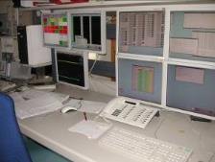


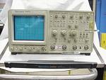
(Standard) Control System Layer Model
Client Software
Client
Data Acquisition
Archiving
Graphical User
Interfaces
Java Programs
Perl Scripts
Many, many others …
Network / Link-Layer
Glue
Protocol/Network
Server
Server Software
Realtime control
Custom Programs
Commercial Instruments
Custom hardware
Fiedlbus Systems
Technical Equipment
CAN bus
Serial
Connection
Simple Cable
Notes:
Three-tier standard model for distributed control systems.
The hardware layer was considered dumb when the terminology was developed.
Meanwhile „hardware“ can be as complicated as a robot (with its own controller) or an oszilloscope (with an operating system installed on a specialized computer).
More and more logic is moved to the hardware layer.
Therefore, I would like to call it now a 4-tier model.

Slide 19
Where is Physics in there?
Accelerator Simulation
(Mad, Elegant, etc.)
Client
Beam Diagnostics
Applications
Network / Link-Layer
Orbit Feedback
(other feedbacks)
Server
Beam Dynamics
measurements
Commercial Instruments
Custom hardware
Design of hardware
(Magnets, Cavities, etc.)
Technical Equipment
Accelerator
construction

Slide 20
Table of Content
What is an Accelerator Control System?
Accelerator Control Systems Architecture
Examples of Control Systems
Control System Parts and Pieces
Borderlands of Control Systems
Conclusion

Slide 21
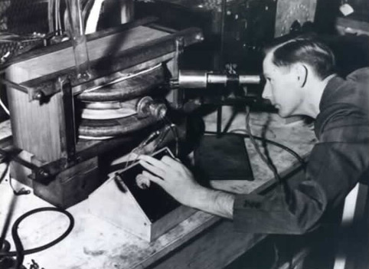
History of Accelerator Controls (1/3)
Diagnostics
first
Accelerator
Control
System
Settings
Donald Kerst with the first betatron, invented at the University of Illinois (USA)
in 1940
Notes:
https://physics.illinois.edu/people/history/betatron.asp
No Control System needed because:
Direct tuning with knobs
Direct diagnostics with own eyes
(Very) limited number of devices involved
> so the brain is the Accelerator Control System in this case

Slide 22
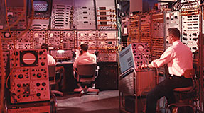
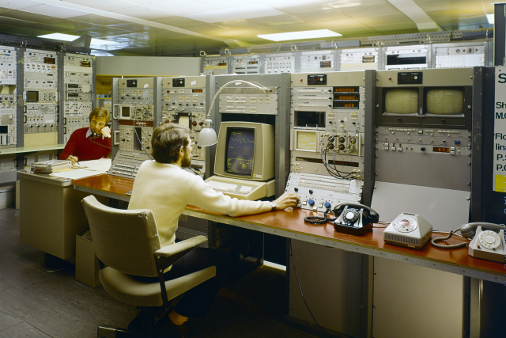
History of Accelerator Controls (2/3)
AGS control room, circa 1966
© 1974 CERN
Notes:
High Left: AGS control room, circa 1966
Alternating Gradient Synchrotron (AGS) is a Proton Accelerator at Brookhaven National Labs (BLN) in Long Island (USA)
Lower Right: Cern Control Room 1974
Jean-Pierre Potier (turning buttons) and Bertran Frammery (telephoning) on shift. The 26 GeV Synchrotron and later also its related machines (Linacs 1,2,3; PS-Booster; LEP-Injector Linacs and Electron-Positron Accumulator; Antiproton Accumulator, Antiproton Collector, Low Energy Antiproton Ring and more recently Antiproton Decelerator) were all controlled from the PS control room situated on the Meyrin site. The SPS and LEP were controlled from a separat control centre on the Prevessin site. In 2005 all controls were transferred to the Prevessin centre.
Date: Feb 1974
Original ref.: CERN-PHOTO-7402124X

Slide 23






History of Accelerator Controls (3/3)
International Conference on Accelerator and Large Experimental Physics Control Systems (ICALEPCS)
First held in 1987 in Villars-sur-Ollon (Switzerland), hosted by CERN.
The term "Control Systems" in ICALEPCS is broadly interpreted to include:
all components or functions, such as processors, interfaces, field-busses, networks, human interfaces, system and application software, algorithms, architectures, databases, etc.
all aspects of these components, including engineering, execution methodologies, project management, costs, etc.
Notes:
https://www.icalepcs.org/ - Next ICALEPCS will be held 18-22, October, 2021 virtual in Shanghai, China (cheapest possibility ever to get into Accelerator Controls!)
Exerpt from the dinner speech of Roland Müller on ICALEPCS 2013 (https://www.icalepcs.org/uploads/documents/LAA-speeches-2013.pdf):
[…]
In the 1980 ́s control system has not been seen as an essential part of accelerator projects. No forum existed to share expertise. On the other hand control systems have been frequently blamed for project delays and cost overruns.
Following 2 precursor events in Berlin and Brookhaven 1985 Peter Clout initiated a workshop in Los Alamos, the first devoted entirely to accelerator control systems. 130 participants presented 50 papers eventually published in Nuclear Instruments and Methods.
2 years later the follow up event the Europhysics conference COCONF in Villars-sur-Ollon already extended the scope to Large Experimental Physics Control Systems.
As the very first representative of an Asian institute Shin-Ichi Kurokawa from KEK participated in both events. On his initiative and with strong support from Axel Daneels from CERN it was already then decided to involve Asia as well as Europe and America in all follow-up events.
The second conference was held at Triumf in Vancouver in Canada in 1989 where the name has been coined. The third followed 1991 at KEK, Tsukuba, Japan, attended by 240 participants. […]

Slide 24
Solutions: Different Control System Examples
System Name:
EPICS
TANGO
DOOCS
ACS
SCADA
(WINCCOA)
Collaborations:
Used at more than one Lab
Pro:
Bugs are already found
Contra:
Complicated to adapt
to your problems
Single Site Systems:
Developed and used in one Lab
Pro:
Your problems solved
perfectly
Contra:
You are on your own
(no one can help)
Commercial System
Pro:
Outsource your problems
Contra:
Expensive
Notes:
SCADA = Supervisory control and data acquisition
WINCCOA is the successor of PVSS II from Simens.
Best solution: all systems are used somewhere to control accelerators successful. All systems support good experiments and produce excellent science. Therefore, the choice of system is political not technical.

Slide 25

What is EPICS?
EPICS (Experimental Physics and Industrial Control System)
  is a set of software tools and applications
  supports distributed control systems for large
  research facilities like accelerators
  uses Client/Server and Publish/Subscribe methods
  uses the Channel Access (CA) network protocol
In 1989 started a collaboration between Los Alamos National Laboratory (GTA) and
Argonne National Laboratory (APS)
(Jeff Hill, Bob Dalesio & Marty Kraimer)
More than 150 licenses agreements were signed, before EPICS became Open Source in 2004
GTA: Ground Test Accelerator
APS: Advanced Photon Source
https://epics-controls.org/
Notes:
Quote from the EPICS web page (https://epics-controls.org/about-epics/):
EPICS is a set of software tools and applications which provide a software infrastructure for use in building distributed control systems to operate devices such as Particle Accelerators, Large Experiments and major Telescopes. Such distributed control systems typically comprise tens or even hundreds of computers, networked together to allow communication between them and to provide control and feedback of the various parts of the device from a central control room, or even remotely over the internet.
EPICS uses Client/Server and Publish/Subscribe techniques to communicate between the various computers. Most servers (called Input/Output Controllers or IOCs) perform real-world I/O and local control tasks, and publish this information to clients using robust, EPICS specific network protocols Channel Access and pvAccess. These protocols are designed for high bandwidth, soft real-time networking applications that EPICS is used for, and is one reason why it can be used to build a control system comprising hundreds of computers.

Slide 26
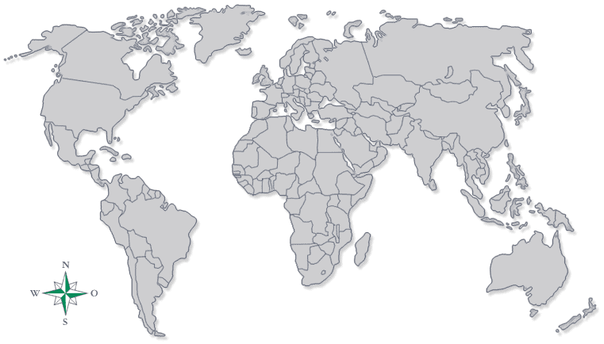
Who uses EPICS (Very Incomplete List)?
Notes:
Some EPICS users (very incomplete list):
The Advanced Photon Source at Argonne National Laboratory
Australian Synchrotron
Berlin Electron Synchrotron (BESSY II)
Brazilian Synchrotron Light Source (LNLS)
Deutches Elektronen Synchrotron (DESY)
Diamond Light Source
Fermilab (FNAL)
Jefferson Laboratory (JLAB)
Keck Observatory
KEK B-Factory
Laboratori Nazionali di Legnaro (INFN-LNL)
Lawrence Berkeley National Laboratory (LBL)
Los Alamos National Laboratory (LANL)
Swiss Light Source (SLS/PSI)
Spallation Neutron Source (SNS)
Stanford Linear Accellerator Center (SLAC)

Slide 27

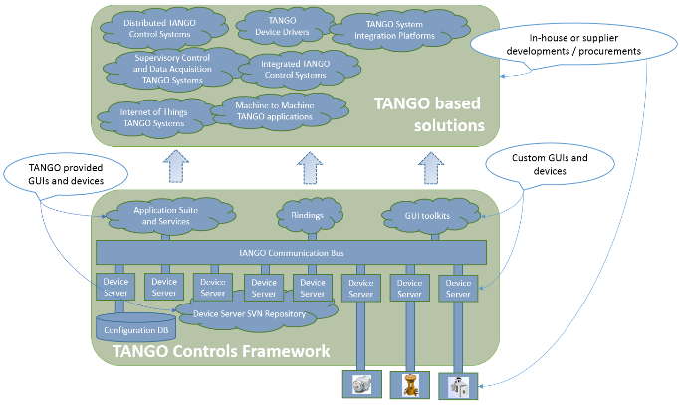











What is Tango?
TANGO (TAco Next Generation Objects)
  is a strictly object oriented toolbox
  for Control System development
  is a set of software tools and
  applications
  supports distributed control
  systems for accelerators
Started in 2001 with three collaborators, now there are 49
http://www.tango-controls.org/
Notes:
http://tango-controls.readthedocs.io/en/latest/overview/overview.html#what-is-tango-controls
CORBA and ZMQ to communicate between device server and clients
C++, Python and Java as reference programming languages
Linux and Windows as operating systems
Modern object oriented design patterns
Naturally implements a microservices architecture
Unit tested, continuous integration enabled
Hosted on Github (https://github.com/tango-controls)
Extensive documentation + tools, large community

Slide 28







Who is using Tango?
Russia 6
2
5
3
6
India 1
1
South Africa 1
3
1
17
2
3
1
Notes:
Find out about the 49 community members on http://www.tango-controls.org/partners/institutions/

Slide 29
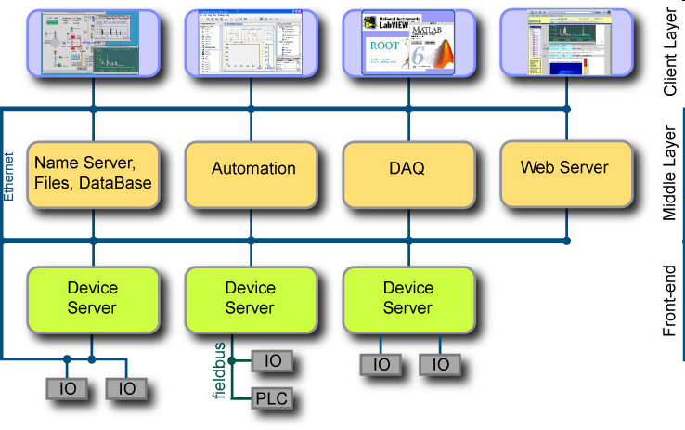

What is DOOCS (at DESY)?
DOOCS (Distributed Object Oriented Control System)
strictly object oriented system design (C++ and Java)
Class libraries as building blocks
Build for FLASH, now used for European XFEL
https://doocs-web.desy.de/index.html
Notes:
Quotations from https://doocs-web.desy.de/index.html#about
The Distributed Object-Oriented Control System - DOOCS - provides a versatile software framework for creating accelerator-based control system applications. These can range from monitoring simple temperature sensors up to high-level controls and feedbacks of beam parameters as required for complex accelerator operations.
DOOCS is based on an distributed client-server architecture combined with a device-oriented view. The devices are the basic entities and can be virtual i.e. implemented in software or real ones with hardware attached. Each control system parameter is made accessible via network calls through a device application.
Its transportation layer is based on the standardized, industrial RPC protocol and allows for a robust and efficient data transfer. Support for integrating a timing system providing clock, trigger and other time-based accelerator information is built-in into the core software and comfortably accessible within the framework.

Slide 30

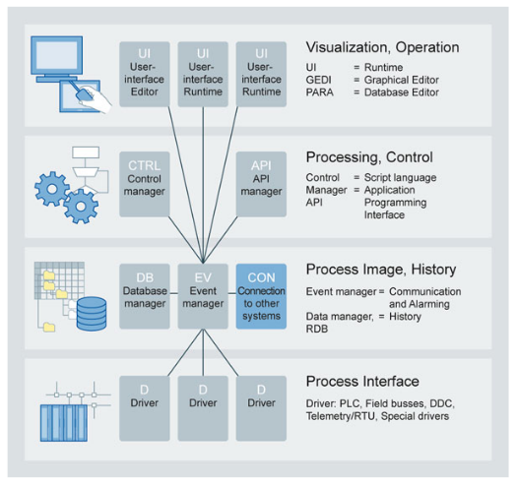
What is PVSS now WinCC-OA (at CERN)?
WinCC Open Architecture
former PVSS II (Prozessvisualisierungs- und Steuerungssystem 2)
  is an industrial SCADA product
  from the Austrian company ETM
  (bought by Siemens AG in 2007)
SCADA = Supervisory Control And Data Acquisition
(commercial software systems used extensively in industry for the supervision and control of industrial processes)
http://www.etm.at/index_e.asp
http://www.etm.at/index_e.asp
Notes:
Concepts of WinCC Open Architecture from www.etm.at (not very helpful):
Most modern design concepts are used at Simatic WinCC Open Architecture. The continuous object oriented technology sets new standards in SCADA systems. The open concept permits the integration of most different components. Specific solutions from the automation level up to the operating control and management level are provided.
WinCC Open Architecture features dedicated, autonomous program units for all key functions - the managers. A "manager" is a process that is responsible for specific tasks. For example, there is a separate manager for periphery connections, history data storage or for user interfaces.
The client-server architecture allows practically unlimited scaling of the system. WinCC Open Architecture is used from small single-site systems to distributed, redundant multi-site systems in a wide range of configurations

Slide 31

Mixed Systems
At DESY:
Tango, EPICS, and DOOCS mixed
At PSI:
ACS – EPICS migration
At PSI (former SLS beamline):
Tango beamline at EPICS accelerator
There are gateways between the systems
The choice for one system is not exclusive
By Evan Swigart

Slide 32
Table of Content
What is an Accelerator Control System?
Accelerator Control Systems Architecture
Examples of Control Systems
Control System Parts and Pieces
Borderlands of Control Systems
Conclusion

Slide 33
Technical Requirements
Use open source firmware/software.
You can change things and you have control of further developments
Use commercial solutions based on open standards developed and sold by a large number of companies
Don’t become dependent on single companies with proprietary solutions
Use standards with a long life-time (20 years+)
Keep long lifecycles of accelerators in mind

Slide 34
Reminder: Control System Layer Model
Client Software
Client
Data Acquisition
Archiving
Graphical User
Interfaces
Java Programs
Perl Scripts
Many, many others …
Network / Link-Layer
Glue
Protocol/Network
Server
Server Software
Realtime control
Custom Programs
Commercial Instruments
Custom hardware
Fiedlbus Systems
Technical Equipment
CAN bus
Serial
Connection
Simple Cable

Slide 35
High Level Software: Clients
Usually clients run in a
control room
and are used by
operators
Where is the logic? Where are the computations?
Thin Client
Fat Client
Server
Server
Only display of results
Production of results
Notes:
Control Room
There might be several control rooms: one for the accelerator and one for each beamline or experiment. Or there can be several control rooms around the world in a huge collaboration.
Operators
There might be dedicated personel for running an accelerator or experiment. Or the scientists and system experts can be on control room duty for some part of their working time.
Thin Clients: Only displays results that are produced in some server elsewhere. Therefore, the display is decoupled from the calculations or logic. Both can be changed independently (for example for updates or new features). Mostly used for expert screens that display the complete interface of the device.
Fat Clients: The results are produced inside the client software. The display is part of the same software. Everything is kept together but no other client can access the results. Usually done by scientists to cover their complete measurement, for example in MATLAB.

Slide 36
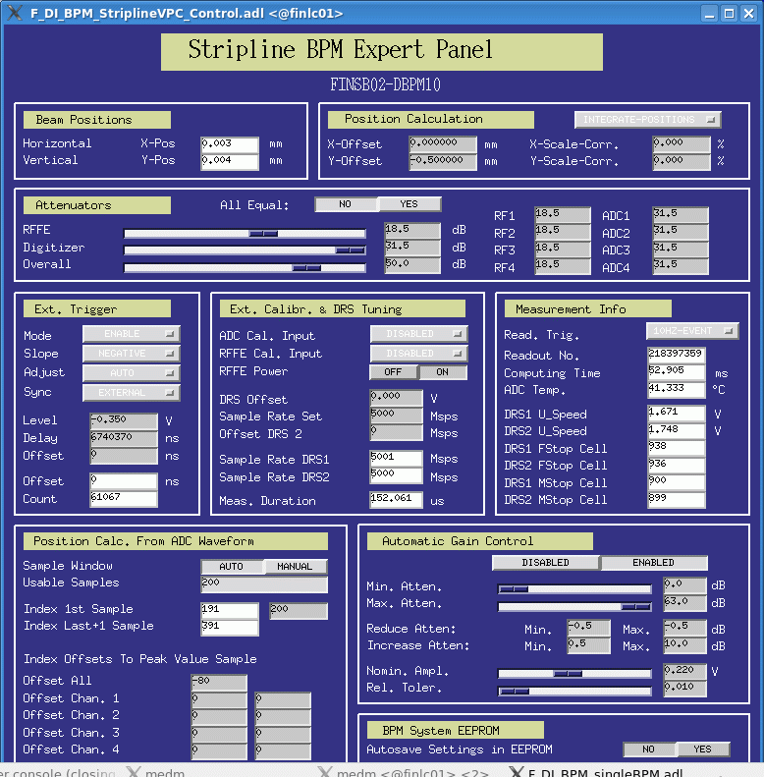
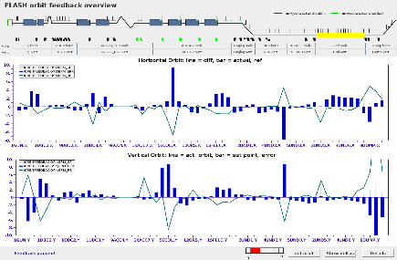
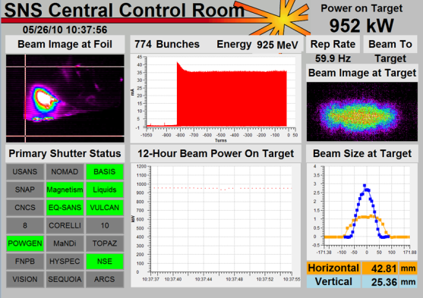
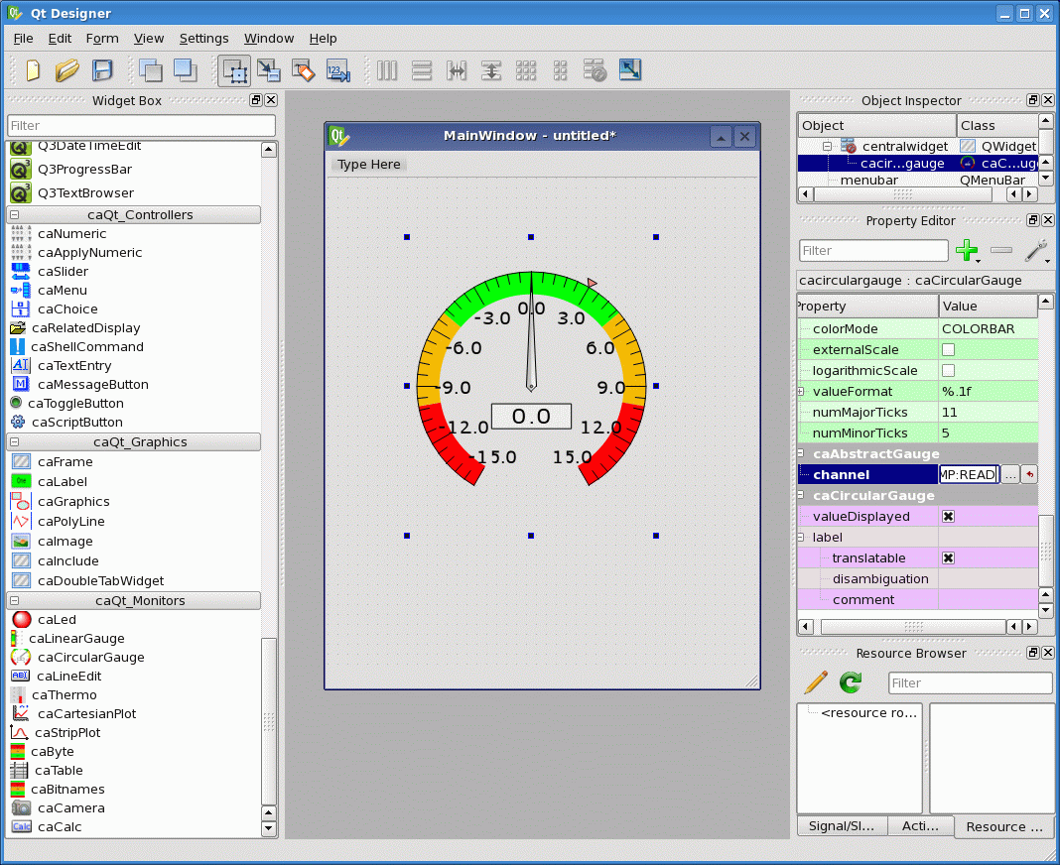

High Level Software: Graphical User Interfaces
GUIs: Usually thin clients
Example for an Editor
PSI is using a GUI builder called
caQtDM (EPICS based):
http://epics.web.psi.ch/software/caqtdm/
Notes:
Home page of JDDD (Java DOOCS Data Display): https://doocs-web.desy.de/index.html#documentation
BOY (Best OPI, Yet) Operator Interface for Control System Studio (EPICS based): https://github.com/ControlSystemStudio/cs-studio/wiki/BOY

Slide 37
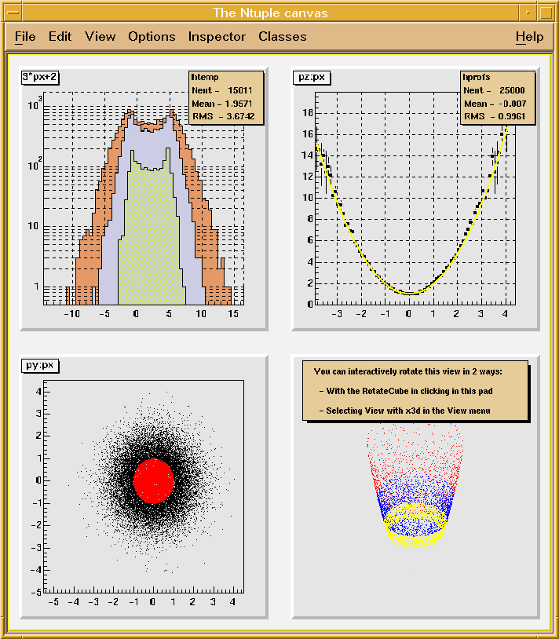
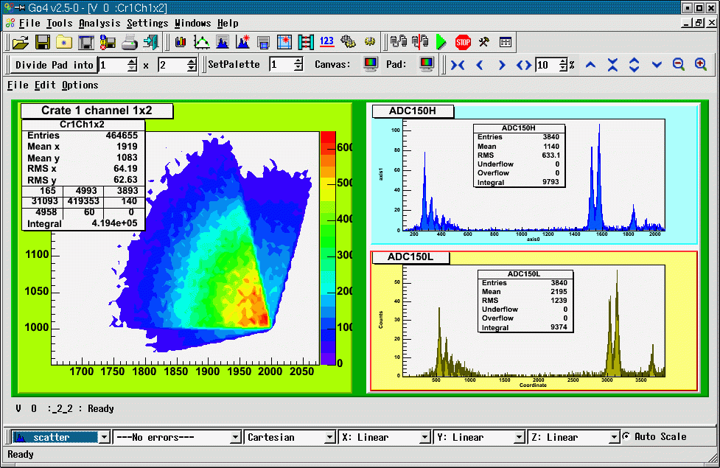
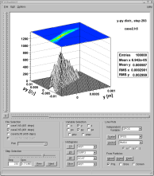
High Level Software: Science Applications
Examples for accelerator science applications:
Tune measurement and correction
Orbit correction
Beam based magnet alignment
Parameter scans
(to find optimal working points)
Filling pattern measurements
and correction
Correlation Plots
… general data analysis of accelerator data
Usually fat clients,
usually written by scientists (not by controls experts)
Notes:
Science Application often use or result in software libraries for specific purposes.
For example ROOT is an object-oriented program and library developed by CERN (https://root.cern.ch/)
Other labs use MATLAB from Mathworks for science applications.

Slide 38
Reminder: Control System Layer Model
Client Software
Client
Data Acquisition
Archiving
Graphical User
Interfaces
Java Programs
Perl Scripts
Many, many others …
Network / Link-Layer
Glue
Protocol/Network
Server
Server Software
Realtime control
Custom Programs
Commercial Instruments
Custom hardware
Fiedlbus Systems
Technical Equipment
CAN bus
Serial
Connection
Simple Cable

Slide 39
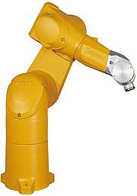
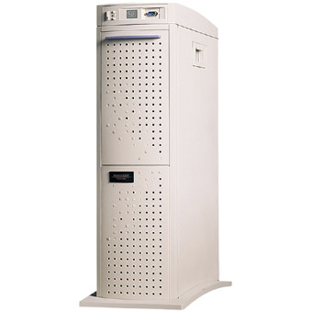
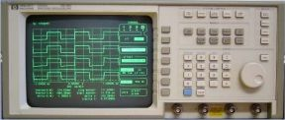
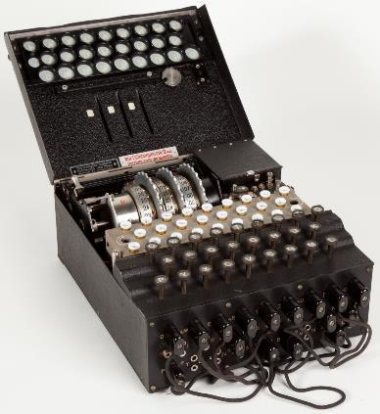
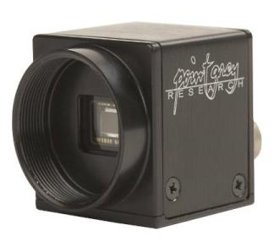
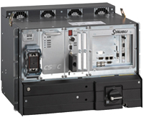


The Cheap Solution: PC based
user interface
Server Hardware
PC
Ethernet
firewire
camera
Oscilloscopes with LAN/GPIB
interface
Robot
network device
PCs are cheap, have standard network interfaces and support other field busses
field bus
(ethernet,
serial, USB,
firewire, …)
PCs life cycles are short compared to accelerators (no spares available after some time)

Slide 40



The Classic Solution: VME based
user interface
Server Hardware
VME
(Operating System: e.g. vxWorks)
Ethernet
Dumb Hardware
Motors
Magnets
VME cards life cycle is long,
VMEbus is an open standard,
Supported by Industry
Cable or
field bus
(analog I/O, digital I/O,…)
VME is expensive,
special operating system (VxWorks)

Slide 41


What is a VME Computer?
VME is an abbreviation for VERSAmodule Eurocard
Industry Computer based on VMEbus
Developed since 1980
It is not a PC
Real-time capable (i.e. delays are calculable)
Common used operating system is VxWorks from Wind River company (open source alternative: RTEMS)
Expensive (~800 Euro per interface card)
VME Card:
Eurocard size
VMEbus interface
VME Crate
https://en.wikipedia.org/wiki/VMEbus
Notes:
From https://en.wikipedia.org/wiki/VMEbus
Computers using VMEbus include
HP 743/744 PA-RISC Single-board computer
Sun-2 through Sun-4
HP 9000 Industrial Workstations
Atari TT030 and Atari MEGA STE
Motorola MVME
Symbolics
Advanced Numerical Research and Analysis Group's PACE.
ETAS ES1000 Rapid Prototyping System
several Motorola 88000 based Data General AViiON computers
Early Silicon Graphics MIPS-based systems including Professional Iris, Personal Iris, Power Series, and Onyx systems

Slide 42


A serial interface solution: Picotux based
user interface
Server Hardware
Example for tiny
computers with
single interface
Linux PC
Ethernet
Hardware with serial interface
Cheap and tiny solution,
Supports distributed devices
Serial interface (RS232, …)
All commercial chips have slightly different architecture (maintenance),
life cycle yet unknown

Slide 43


The Embedded Solution: Device Integrated CPU
user interface
Embedded Hardware
=
Server Hardware
+
Instrument
Ethernet
X-Ray BPM
Oscilloscopes
PLC
Low cost, have standard network interfaces and support distributed devices
All commercial chips have slightly different architecture (maintenance),
life cycle yet unknown

Slide 44
Reminder: Control System Layer Model
Client Software
Client
Data Acquisition
Archiving
Graphical User
Interfaces
Java Programs
Perl Scripts
Many, many others …
Network / Link-Layer
Glue
Protocol/Network
Server
Server Software
Realtime control
Custom Programs
Commercial Instruments
Custom hardware
Fiedlbus Systems
Technical Equipment
CAN bus
Serial
Connection
Simple Cable

Slide 45

What are PLCs?
PLC (Programmable Logic Controller)
  is a digital computer used to
  connect “dumb” devices
the PLC is designed
  for multiple inputs and outputs
  extended temperature ranges
  immunity to electrical noise
  resistance to vibration and impact
  as a real time system
Programs are typically stored in battery-backed or non-volatile memory
Products from different providers can NOT be mixed!
Notes:
Examples for companies:
Siemens S7
(https://www.siemens.com/global/en/home/products/automation/systems/industrial/plc.html)
Allen-Bradley
https://www.rockwellautomation.com/en-us/products/hardware/allen-bradley/programmable-controllers.html
Beckhoff
https://www.beckhoff.com/en-gb/

Slide 46
Field Busses
Field busses connect hardware to servers
A lot different busses available with different purposes and
different specifications as
  number of allowed devices
  speed
  allowed cable length
  topology (ring, star, linear, …)
ring
bus
linear
star
System
Controller
System
Controller
System
Controller
System
Controller
Notes:
From Wikipedia:
Fieldbus is the name of a family of industrial computer network protocols used for real-time distributed control, now standardized as IEC 61158.

Slide 47



Field Busses
Some example field bus systems:
CANbus (Controller area network)
https://en.wikipedia.org/wiki/CAN_bus
PROFIBUS (Process Field Bus)
https://en.wikipedia.org/wiki/Profibus
IEEE 1394 (Firewire)
https://en.wikipedia.org/wiki/IEEE_1394
EtherCAT (Ethernet based real time bus)
https://www.ethercat.org/en/technology.html
Difference to Ethernet and USB?
Field busses are real time capable (IEC 61158 specification)
Notes:
Definition of Real-time:
The worst case for the reaction time from signal in to reaction out can be determined. Real time is not necessarily fast (but often).
Ethernet and USB are used in place of field busses in accelerators where no real time capability is needed.

Slide 48
Table of Content
What is an Accelerator Control System?
Accelerator Control Systems Architecture
Examples of Control Systems
Control System Parts and Pieces
Borderlands of Control Systems
Conclusion

Slide 49
Borderlands of Control Systems
Accelerator Control Systems have fussy borders.
Some example for these borders are:
Timing and Synchronisation
Feedback Systems
Interlock-, Alarm-, and Machine Protection Systems
Experiment Data Acquisition
Relational Databases
Relationship of IT (Information Technology) and Controls
Notes:
All of these fields are needed in accelerator control. For all of these topics the responsibilities have to be clarified.

Slide 50
Borderlands of Control Systems
For example
1. Timing and Synchronisation

Slide 51
Why Synchronize?
Trigger injection
septum
Trigger injection
kicker
Trigger extraction
septum
Trigger injection
kicker
Booster injection
Booster extraction
Magnetic field of Kicker
Booster magnet / RF ramp
Magnetic field of septum
Time
seq. start
next seq. start
rep. rate = 3.125 Hz (320 ms)
Event sequence for booster synchronization:
Time
Notes:
Triggers might be needed in some advanced time to allow real hardware to ramp up or get the full field.
Especially important timing and synchronisation are for pulsed accelerators like FELs.
The example is taken from the booster synchrotron timing from the Swiss Light Source (PSI).

Slide 52



Solutions for Timing Systems
Master oscillator + delay cables
(1 trigger and measured cable lengths)
Master oscillator + digital delay generators
(https://www.thinksrs.com/products/DG535.htm)
(Master oscillator +) event generators/receiver
cards in computers (PC , VME, µTCA)
(http://www.mrf.fi/)
Timing and synchronization is needed to run an accelerator
Various solutions available and used
Timing and synchronization can be part of the Control System.
Clarify who is responsible for timing and synchronization to avoid problems!
Notes:
Accuracy of the timing signal can vary from some pico seconds down to femto seconds – but femto seconds are really hard to get: http://accelconf.web.cern.ch/accelconf/ipac2012/papers/weeppb006.pdf
Technology depends on needed accuracy and available budget.
Other solutions exist: https://en.wikipedia.org/wiki/White_Rabbit_Project
White Rabbit is the name of a collaborative project including CERN, GSI Helmholtz Centre for Heavy Ion Research and other partners from universities and industry to develop a fully deterministic Ethernet-based network for general purpose data transfer and sub-nanosecond accuracy time transfer. Its initial use was as a timing distribution network for control and data acquisition timing of the accelerator sites at CERN as well as in GSI's Facility for Antiproton and Ion Research (FAIR) project.

Slide 53
Borderlands of Control Systems
For example
2. Feedback Systems

Slide 54

Feedback Systems
For example:
Orbit Feedback (Position)
Energy Feedback
Filling pattern Feedback
If it needs to be fast, it needs separate cables!
Slow feedbacks can be realised with standard control system tools.
Notes:
See also https://en.wikipedia.org/wiki/PID_controller
A proportional–integral–derivative controller (PID controller or three-term controller) is a control loop mechanism employing feedback that is widely used in industrial control systems and a variety of other applications requiring continuously modulated control. A PID controller continuously calculates an error value e(t) as the difference between a desired setpoint (SP) and a measured process variable (PV) and applies a correction based on proportional, integral, and derivative terms (denoted P, I, and D respectively), hence the name.

Slide 55

Example: Orbit Feedback
Needed for beam position stability.
Measurement (once in a time):
Measure beam response matrix
(complete orbit for different corrector
magnet settings)
Invert the matrix
(normally not possible analytical, use numerical methods)
a stable method is singular value decomposition (SVD)
Feedback during runs:
Measure the beam position and correct it with the appropriate set of correctors
Notes:
See for example https://en.wikipedia.org/wiki/Singular-value_decomposition

Slide 56
Borderlands of Control Systems
For example
3. Interlock-, Alarm-, and Machine Protection Systems

Slide 57
What are Interlocks?
Everything is fine (No Alarm)
Go on working
Example: Vacuum pressure 1e-10 mbar
Something is strange (Warning)
Example: Vacuum pressure 1e-7 mbar
Alarm states
Alert people to take
some actions
Something is wrong (Error)
Example: Vacuum pressure 1e-6 mbar
Stop it or suffer from severe
consequences (Interlock)
Interlock
Automatic reaction needed
Example: Vacuum pressure 1e-5 mbar
Automatic beam dump executed
Notes:
All interlock and safety systems need to be hard wired and not involve software (if possible).
Training of the operators need to include alarm handling. As often several alarms occure at the same time (or at the same time as far as a human can see) this can be complicated. For running machines, alarm handling is one of the two main tasks of the operators (the other is setting up and tuning of different machine modes).
The example vacuum pressures are taken from the Swiss Light Source.

Slide 58


What are Alarms
Murphy's law:
Anything that can go wrong
will go wrong.
Alarms help to avoid Real Problems
Alarms help to find problems
Example:
  Beam position more than 1 mm of from reference
  Vacuum pressure higher than 1e-6 mbar
  Orbit Feedback Program not running
People should react on alarms
EPICS Alarmhandler

Slide 59
Interlock Systems
Interlock Systems have to be
  taking automatic actions (no people involved) - fast
  Reliable (99% might not be enough)
  as simple as possible (see Murphy’s law)
Avoid computers in Interlock Systems
Decouple “running” the accelerator (=Control System)
from “stopping” the accelerator (=Interlock System)
There can/will be more than one Interlock System in an accelerator (local, global, different goals, etc.), for example:
  Vacuum Interlock
  Equipment Protection System
  local RF Interlock Systems
Clarify who is responsible for Interlock Systems to avoid problems!

Slide 60
Borderlands of Control Systems
For example
4. Experiment Data Acquisition

Slide 61

Data Acquisition (Examples)
EIGER X 9M Detector
(Synchrotron-Beamline at SLS):
  two-dimensional hybrid pixel array
  detectors, which operate in
  single-photon counting mode
  composed of 3110 x 3269 = 10,166,590 Pixel
  maximum frame rate 238 Hz
  ca. 10 MB → 2.3 GB/s
  →more than 8 TB per hour
  (5 years ago:
  2 TB in 8 hours with Pilatus)
PILATUS 6M
https://www.dectris.com/
Notes:
For basic funcionality see https://en.wikipedia.org/wiki/Hybrid_pixel_detector

Slide 62





Data Acquisition (Examples)
The Large Hadron Collider will produce roughly 15 petabytes (15 million gigabytes) of data annually – enough to fill more than 1.7 million dual-layer DVDs a year!
  GRID computing to allow access
https://en.wikipedia.org/wiki/Worldwide_LHC_Computing_Grid
Notes:
See also https://wlcg.web.cern.ch/ for Worldwide LHC Computing Grid
The Worldwide LHC Computing Grid project is a global collaboration of around 170 computing centers in more than 40 countries, linking up national and international grid infrastructures.

Slide 63
Is Data Acquisition Controls?
Data Acquisition requires
  Network infrastructure
  Computer storage infrastructure
  Server infrastructure for data access
  Environment (e.g. Grid) for data access
  Manpower for setup and maintenance
Detectors
  can provide information about accelerator
  (beam position)
  need to be adjusted to accelerator setup (connection to control system needed)
Some detectors (e.g. BPMs) are part of the accelerator anyway
Not
necessary
Yes its
needed
Has to be discussed to avoid problems!

Slide 64
Borderlands of Control Systems
For example
5. Relational Databases

Slide 65


What is a Relational Database?
Used for “stable” Data (Lattice,
Magnet Data etc.)
Good for searching
Might be slow for runtime data
Examples:
  Oracle
  MySQL
  MSAccess
Language to access data is
SQL (Structured Query Language)
for all examples
Relational Databases are useful for Control Systems
Some accelerator control systems have integrated relational databases
Setup and Maintenance require knowledge and manpower
Notes:
In most cases the setup of the database framework (i.g. installation of the database) is consideret an IT task. The creation, composition, and fill up with data might be considered a controls task (or even a task for beam dynamics physicists).

Slide 66
Borderlands of Control Systems
For example
6. Relationship of IT (Information Technology) and Controls

Slide 67
Who is Responsible for What?
Most large research institutes have a Controls Group in addition to a IT Group
Why separate IT from Controls?
IT
Office PC installation
Operating Systems for
Office applications
Infrastructure (network cables)
Central Services (Computing Cluster, Server Room …)
Controls
Accelerator computer installation
Integration of accelerator hardware
Control Room applications
Distributed processes
Databases, Timeserver, Network, Security
Controls is dependent on IT.
Responsibilities have to be discussed to avoid problems!
Notes:
IT = Information Technology (includes Computers but also Telephone, Mobile …)

Slide 68
Table of Content
What is an Accelerator Control System?
Accelerator Control Systems Architecture
Examples of Control Systems
Control System Parts and Pieces
Borderlands of Control Systems
Conclusion

Slide 69
Summary: What is Accelerator Controls
It is hard to define – but every Accelerator has one
It is organized in layers separating hardware from applications
It is (has to be) a distributed system, involving some network protocols
The borders are not clearly defined
  For example: Where starts the hardware responsibility (PLCs, embedded systems)?
Definition:
An Accelerator Control System is a computer environment that allows remote access to the accelerator hardware with a lot of different functionality to satisfy the requirements of several different user groups.
Notes:
It is not considered science but needs a lot knowledge about science (physics and computer science, sometimes politics)

Slide 70
References
Bad news: There is no book on Accelerator Control Systems
Good news: You can find some things in the Internet
ICFA Newsletter Number 47 (December 2008) on Control System:
http://icfa-usa.jlab.org/archive/newsletter/icfa_bd_nl_47.pdf
EPICS: https://epics-controls.org/
Tango: http://www.tango-controls.org/
CERN Controls Group: https://be-dep-co.web.cern.ch/
PSI Controls Group: http://epics.web.psi.ch/
…search the institute web pages …
International Conference on Accelerator and Large Experimental Physics Control Systems (ICALEPCS): https://www.icalepcs.org/

Slide 71

What to Learn as a Controls Guy?
Be curious about what your customers do (accelerator physics, experiments, medical treatment, etc.)
Enjoy programming
  Script Language (python or similar)
  Object Oriented (Java, C++, etc.)
Enjoy computer environments
Useful skills include (non-essential)
  Basic knowledge in Accelerator
  Physics or general Physics
  Database structures/sql commands
  Linux and/or Windows administration
  Network administration
  PLC, FPGA or DSP programming (nearly electronics)
  Graphical User Interface design
Quick test:
Do you feel comfortable with this
screenshot?

Slide 72
Wir schaffen Wissen – heute für morgen
The
End

