Slide 2

Vacuum Systems
Lecture 4
V. Baglin
CERN TE-VSC, Geneva

Slide 3
Outline
Synchrotron radiation and photodesorption
Vacuum instability and ion stimulated desorption
Particle losses and ion stimulated desorption
Electron cloud and related surface parameters

Slide 4
1. Synchrotron radiation
and
photodesorption

Slide 5
1.1 Synchrotron radiation

Slide 6
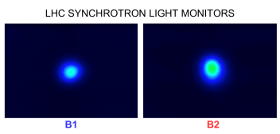
Synchrotron radiation: visible light
In synchrotron, particles can radiate light by synchrotron radiation
Can be used for diagnostics purposes :
CERN Control Centre LHC beams SR displays
But particles loose energy by synchrotron radiation ➔ should be compensated by RF system
Beam emittance shrink by synchrotron radiation
Power is dissipated on the machine elements
Molecules are desorbed from the vacuum chamber wall due to synchrotron radiation

Slide 7
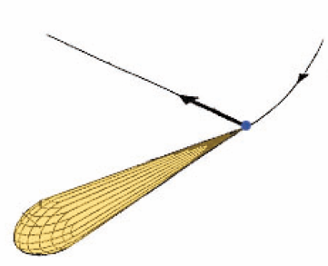
Synchrotron Radiation
A charged particle which is accelerated produce radiation
The power of the centripetal radiation is larger than the longitudinal radiation (factor )
For a relativistic particle, the radiation is highly peaked (opening angle ~ 1/ )
The radiation energy range from infra-red to gamma rays: from meV to MeV
References :
K. Hübner, CAS 1984, CERN 85-19
R.P. Walker, CAS 1992, CERN 94-01
A. Hofmann, CAS 1996, CERN 98-04
L. Rivkin, CAS 2008

Slide 8
Critical energy
The critical energy split the power spectrum in two equals parts
90 % of the emitted photons have an energy lower than the critical energy
Magnetic rigidity:

Slide 9
Dissipated power
The energy emitted by the synchrotron radiation per turn and per particle is:
The average power emitted per turn by the beam is:
So, the average power emitted by the beam per unit of length is:

Slide 10
Dissipated power
The average power emitted by the beam per unit of length is
Electrons :
Protons:

Slide 11
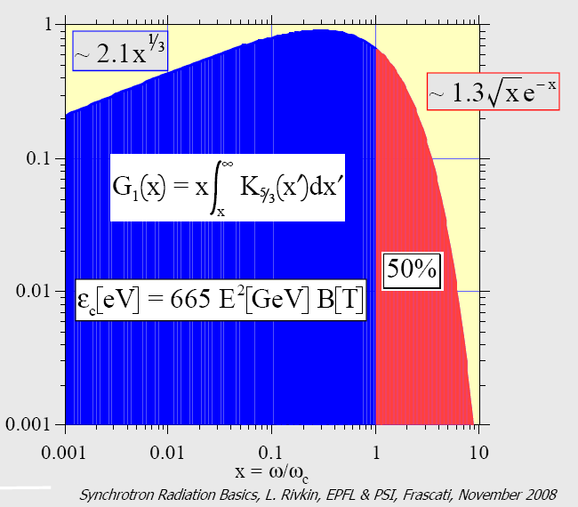
Power spectrum
The SR power emitted by a particle is a function of the vertical angle and the wavelength.
Integrating over the vertical angle, one obtains the spectral power density per unit of length :

Slide 12
Photon flux
Since the photon flux is linked to the power by :
The photon flux per unit length in a relative energy band is written:
So, the total photon flux per unit of length is:

Slide 13
Linear photon flux
The photon flux per unit of length is given by :
Electrons :
Protons:

Slide 14
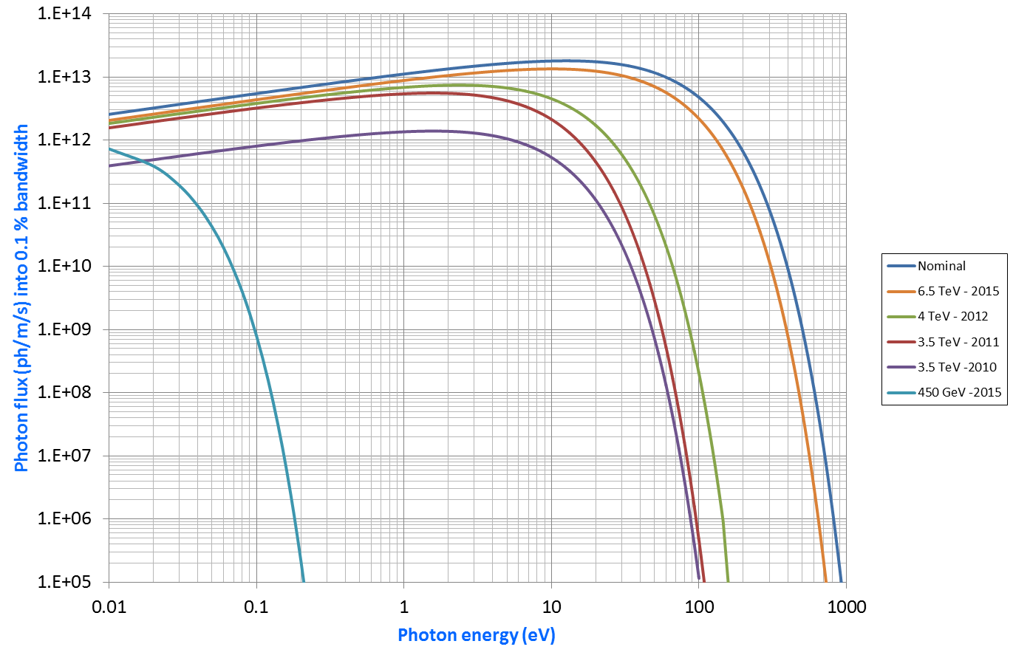
LHC SR Spectrum : from IR to UV
With nominal parameters : 7 TeV and 585 mA
2010, 2011, 2012 and 2015 spectra
Key parameter: photodesorption yield
7 TeV
450 GeV

Slide 15
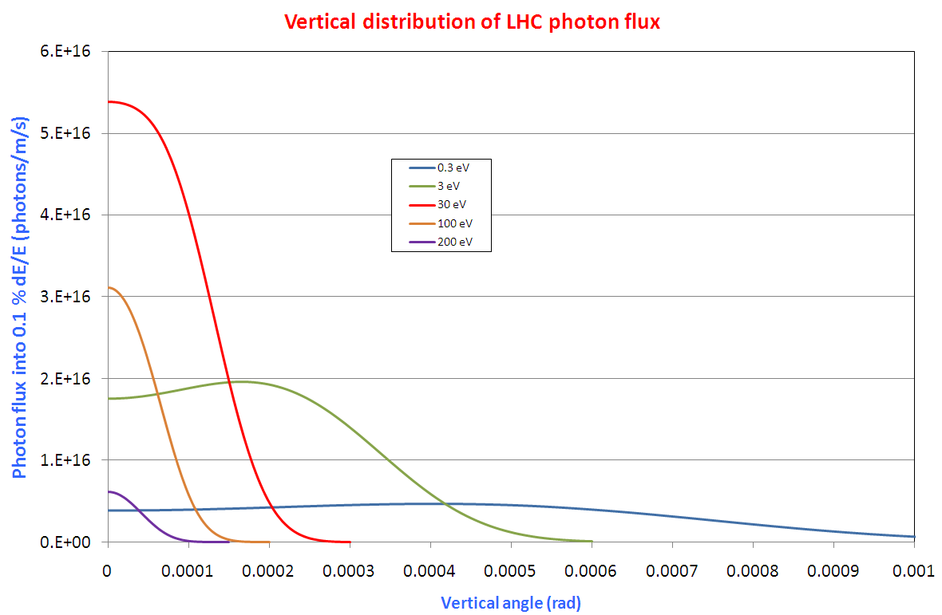
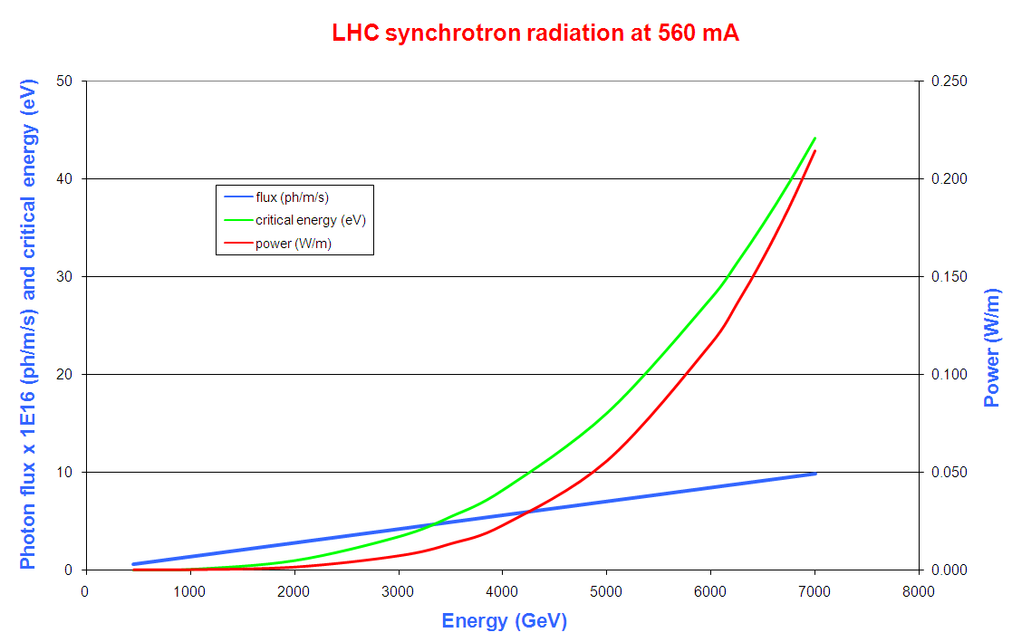
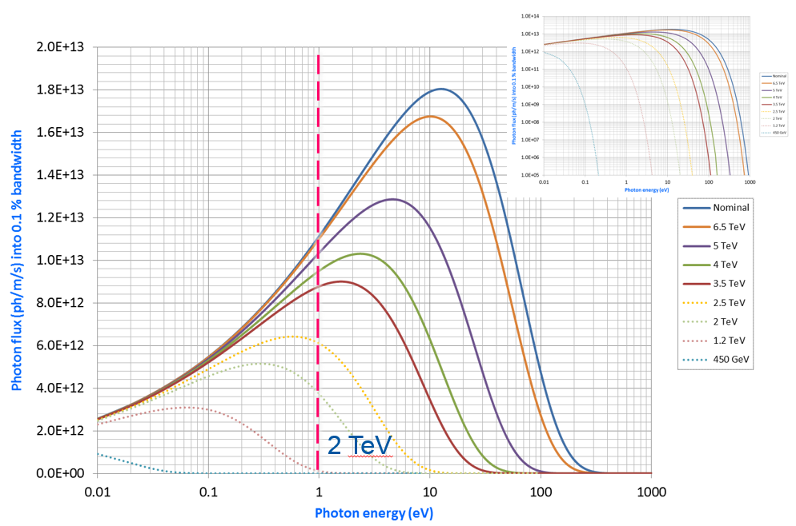
LHC SR properties
E⁴
E³
E
1/gamma opening angle
7 TeV
ε_{c}= 44 eV
0.2 W/m
10¹⁷ photons/m/s
1/gamma = 0.13 mrad

Slide 16
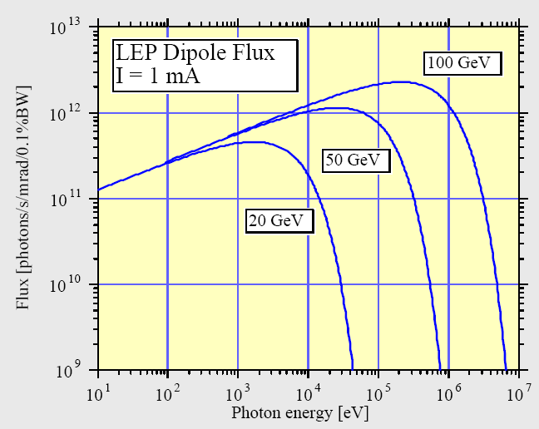
LEP SR spectrum: X-rays & gamma rays

Slide 17
SR impact on different type of machines …
 |  | Soleil | KEK-B |  | LEP |  |  | LHC
 |  |  | LER | HER | Inj. | 1 | 2 | Inj. | Col.
Particle |  | e⁻ | e⁺ | e⁻ | e⁻ | e⁻ | e⁻ | p | p
Beam current | mA | 500 | 2600 | 1100 | 3 | 3 | 7 | 584 | 584
Energy | GeV | 2.75 | 3.5 | 8 | 20 | 50 | 96 | 450 | 7000
Bending radius | m | 5.36 | 16.31 | 104.46 | 2962.96 |  |  | 2784.302
Power | W/m | 14 030 | 20 675 | 5 820 | 0.8 | 30 | 955 | 0 | 0.2
Critical energy | eV | 8 600 | 5 800 | 11 000 | 6 000 | 94 000 | 660 000 | 0 | 44
Photon flux | photons/m/s | 3 10¹⁹ | 7 10¹⁹ | 1 10¹⁹ | 3 10¹⁵ | 7 10¹⁵ | 3 10¹⁶ | 7 10¹⁵ | 1 10¹⁷
Dose at 3000 h | photons/m | 4 10²⁶ | 8 10²⁶ | 1 10²⁶ | 3 10²² | 7 10²² | 3 10²³ | 7 10²² | 1 10²⁴
In LEP, and all synchrotron light sources, the evacuation of the power is an issue
The LHC operates at 7 TeV with ~ .6 A. Power evacuation is an issue for the cryogenic system (1 kW/arc !!)
The critical energy varies from a few 10 eV to 660 keV. Strongly bound molecules can be desorbed
The photon flux is large, so large gas load. Adequate dimensioning of the effective pumping speed is required
The annual photon dose is large. Implications on gas reduction and radiation

Slide 18
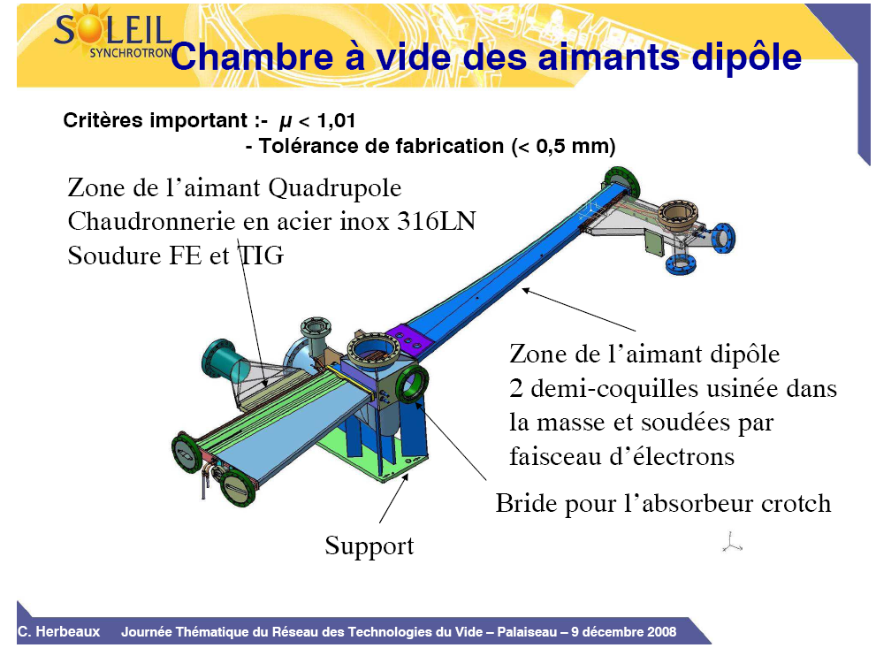
… heavy consequences on design
Stainless steel
NEG coated, in-situ baked to 180ºC
(C. Herbeaux et al.)
A complex vacuum chamber design with a light extraction path, pumping and instrumentation ports and power absorbers (crotch)

Slide 19
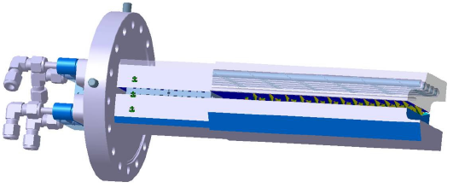
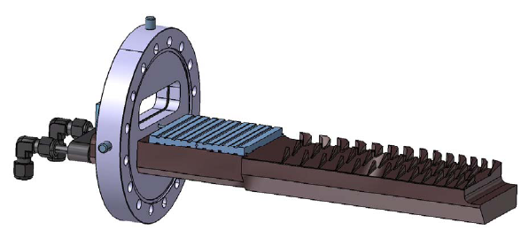
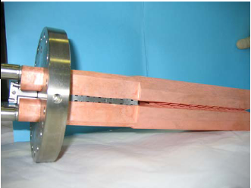
… heavy consequences on design
SOLEIL Design
(C. Herbeaux et al.)
Soleil « crotch » power absorber: Water cooled copper Glidcop (256 W/mm²)

Slide 20
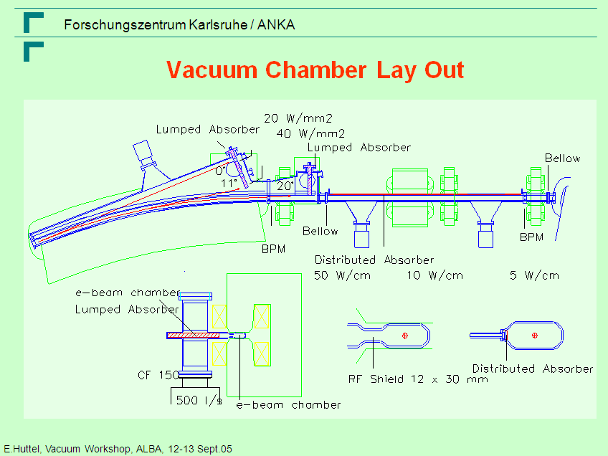
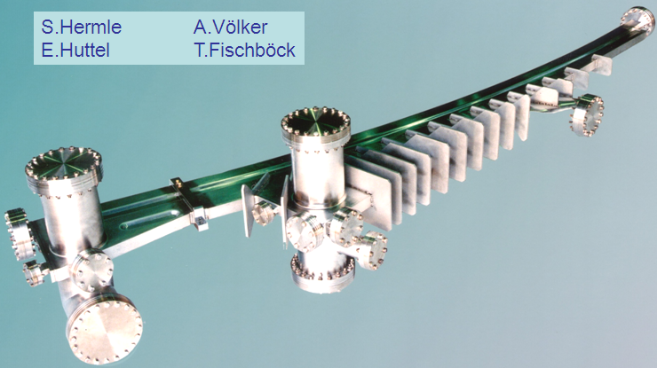
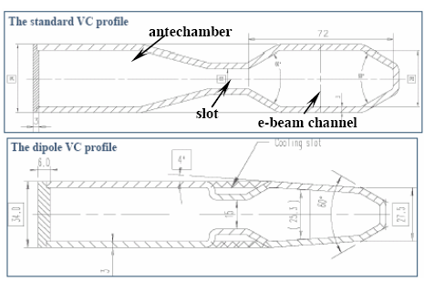
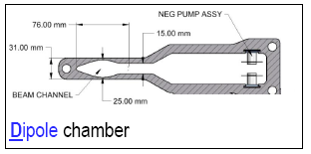
… heavy consequences on design
ANKA Design
(E. Huttel et al.)
ALBA Design
(E. Al-Dmour, EPAC 2006)
NSLS-2 Design
Antechamber design to absorb the SR power externally to the beam path with the integration of a distributed pumping

Slide 21
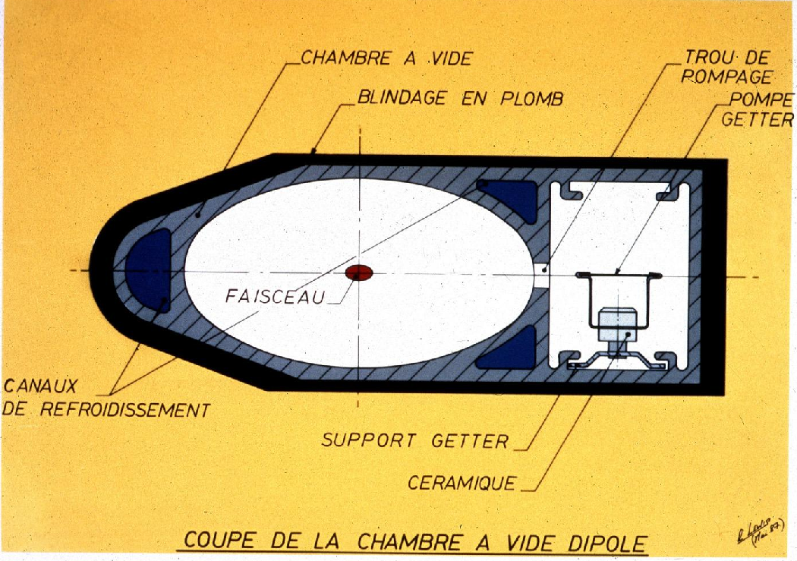
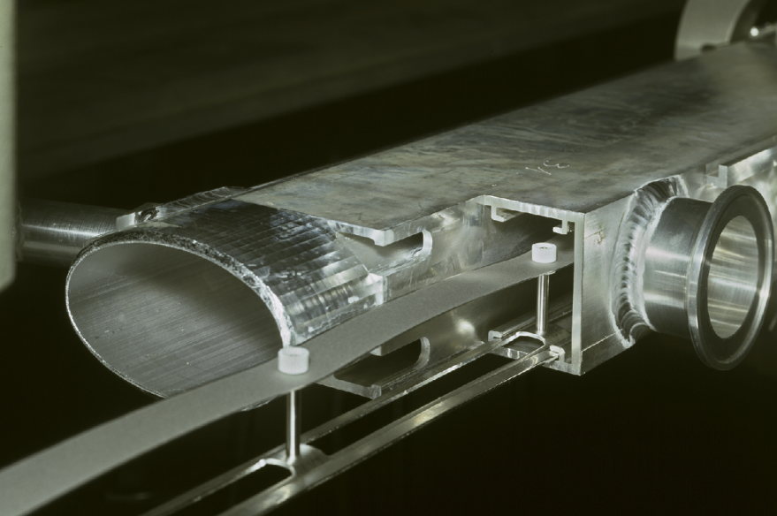
… heavy consequences on design
LEP Design
(CERN LEP Vacuum group)
Antechamber and distributed NEG pumping, water cooling and lead shielding

Slide 22
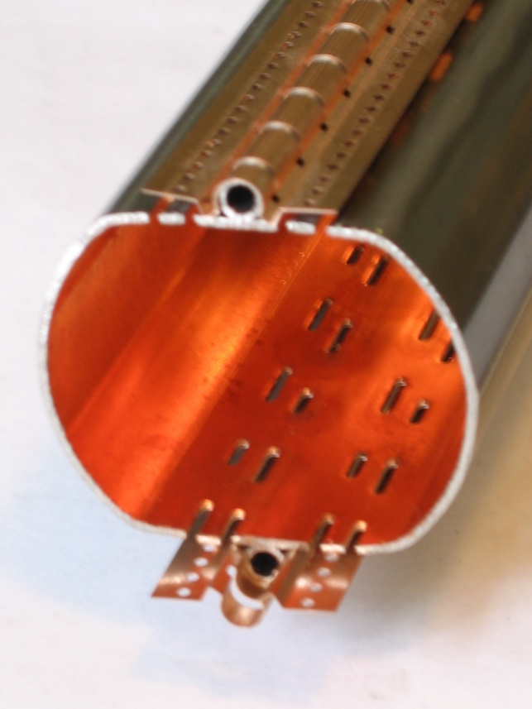
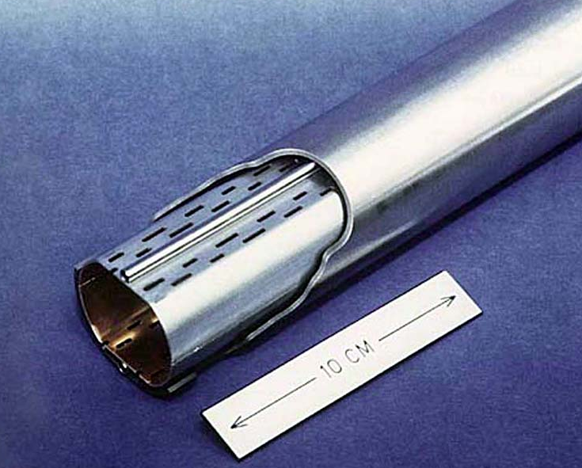
… heavy consequences on design
Courtesy N. Kos CERN TE/VSC
Courtesy N. Kos CERN TE/VSC
LHC Design
(CERN LHC Vacuum group)
Perforated Cu colaminated beam screen to intercept the SR power protecting the 1.9 K cold bore and to allow a distributed pumping

Slide 23
1.2 Photodesorption

Slide 24
Photodesorption
The interaction of photons (light) with matters produce the desorption of neutral gases inside the vacuum system
The photon stimulated desorption (PSD) of physisorbed (meV) or chemisorbed (eV) molecules can be direct or non-direct
The identified transmitters are photoelectrons, secondary electrons and phonons
The photon stimulated molecular desorption is a function of the nature of the material, its temperature, its surface state, of the photon energy and the irradiation angle.
No model exists, therefore in-situ qualification of material is required for the design of a future machine.

Slide 25
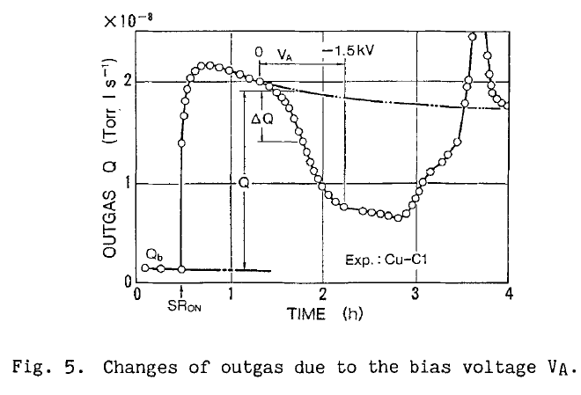
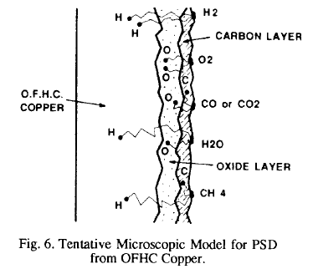
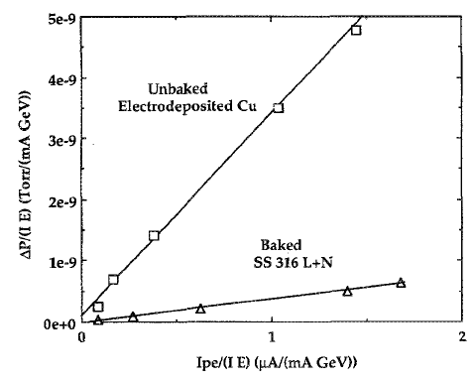
Photodesorption: present understanding
The photodesorption process is linked to the production of photoelectrons and secondary electrons
Photoelectrons contribute to the gas load by ESD
The oxide and carbon layers are believed to be the source of gas
The diffusion of atoms into the solid and their recombination at the surface plays a role
T. Kobari et al Proc .of Vacuum Design of Synch Light Sources Conference, Argonne, 1990
O. Gröbner et. al. EPAC 1992
J. Gómez-Goñi et al. JVSTA 12(4) Jul/Aug 1994, 1714

Slide 26
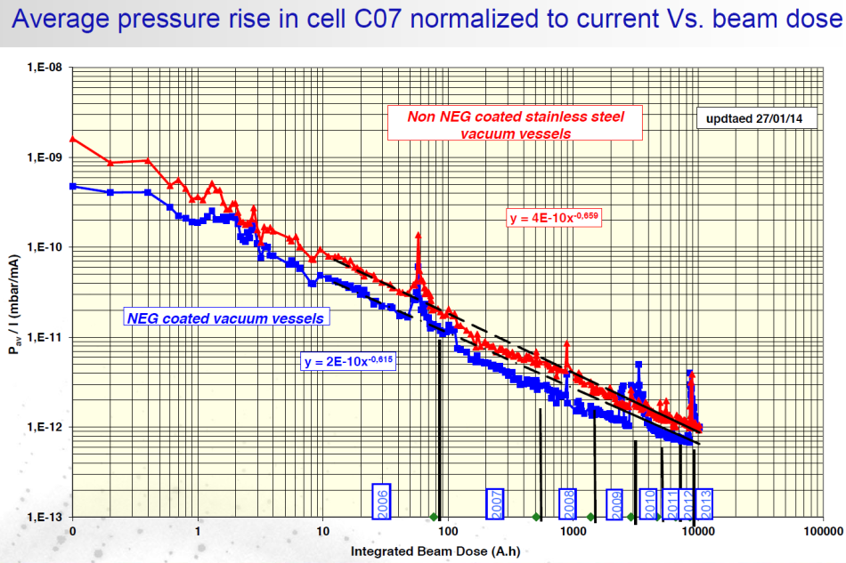
Dynamic pressure due to PSD
The dynamic pressure decreases by several orders of magnitude with photon dose: “photon conditioning”
The photon desorption yield is characterised by η_{photon}
Beam cleaning during the first period of LEP
SOLEIL
With beam P ~ 10⁻¹⁰ Torr
With beam P ~ 2 10⁻⁹ mbar
O. Gröbner. Vacuum 43 (1992) 27-30
C. Herbeaux, Journée thématiques RTVide, décembre 2014

Slide 27



Photo-desorption yield measurement
SR light is extracted from a dipole magnet to irradiate the chamber at ~ 11 mrad
SR fan is vertically collimated therefore photon flux < 4 eV are attenuated
The gas load is measured by the throughput method via a conductance (72.5 ℓ/s for N₂)
A wire and a collector are biased for current measurement to estimate the photon reflectivity and photoelectron yield
$η=\frac{G}{\dot{Γ}} C \left(ΔP_{2}−ΔP_{1}\right) ≈\frac{G}{\dot{Γ}} CΔP_{2}$
$$Q_{0}=C \left(P_{2}−P_{1}\right)$$
$${Q= η\dot{Γ }+Q}_{0}=C \left(P_{2}^{′}−P_{1}^{′}\right)$$
With G = 4.3 10¹⁹ molecules/mbar.ℓ at RT
J. Gómez-Goni et al. J. Vac. Sci. Technol. A 12(4), Jul/Aug 1994, 1714
V. Baglin et al. EPAC 1998, Stockholm, Sweden.

Slide 28
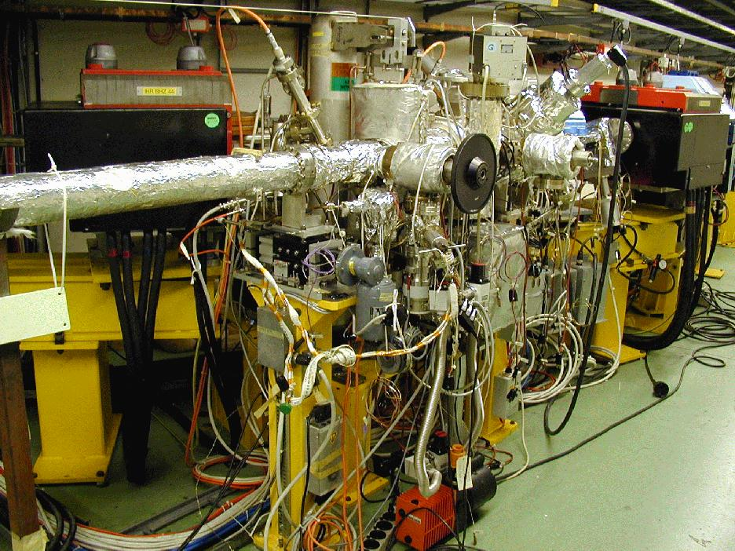
CERN EPA Synchrotron Light Facility 42 - 1999
The LEP Pre-Injector as a multipurpose facility, J-P. Potier, L. Rinolfi, EPAC 1998, Stockholm, Sweden, 1998

Slide 29
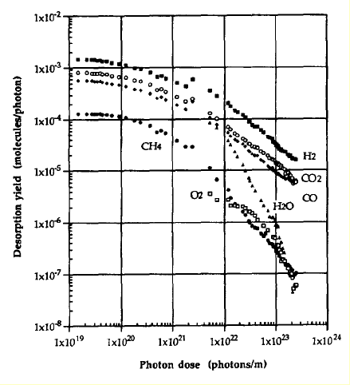
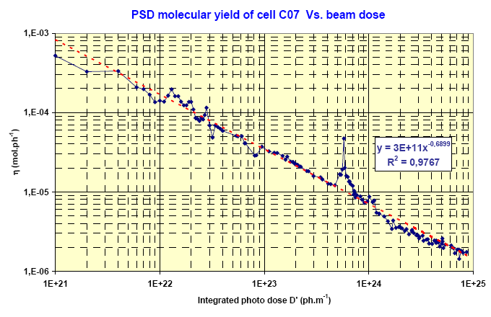
Conditioning under photon irradiation
Typical desorption yield range: from 10⁻³ molecule/photon to 10⁻⁶ when conditioned
Cu baked at 150°C
NEG coated SS activated at 180°C
C. Herbeaux et. al. EPAC 2008, Gênes, Italie
O. Gröbner et al.
J.Vac.Sci. 12(3), May/Jun 1994, 846-853
The hydrogen desorption is characterised by a diffusion process: a = 0,5
M. Andritschky et al., Vacuum 38 (8-10), 933, (1988)
a ~ 0.9-1.3

Slide 30
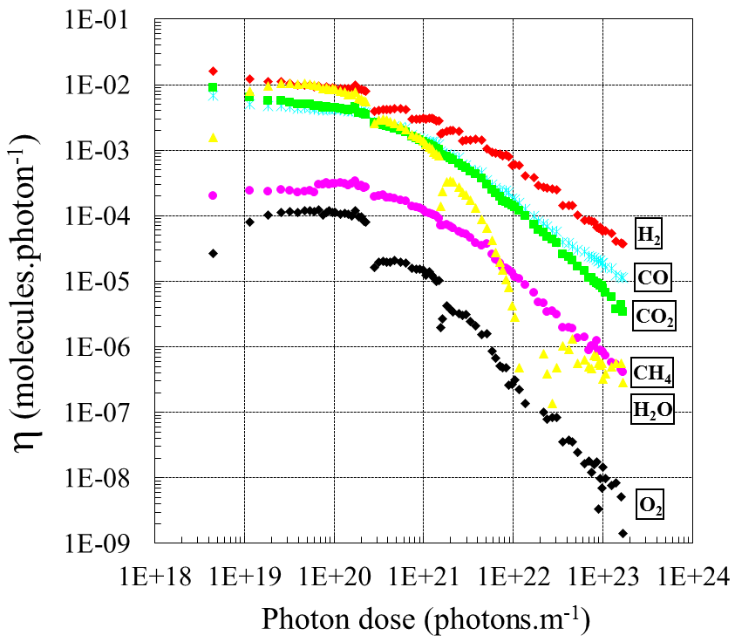
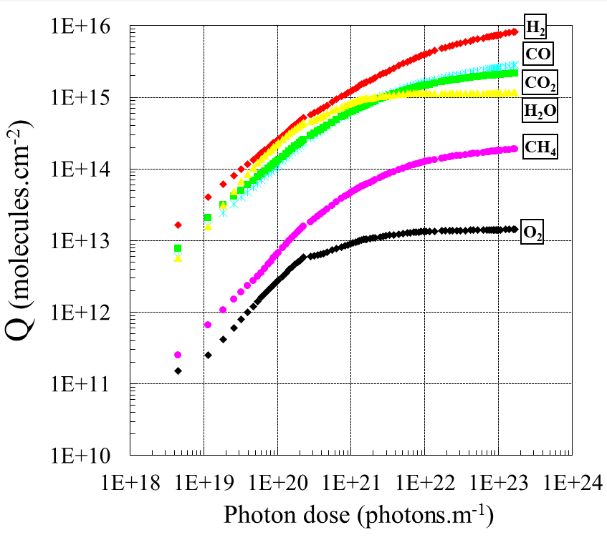
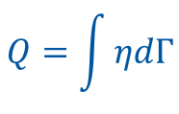
Gas load
The total desorbed quantity amounts to 15 monolayers for an unbaked system
$$Q=\int{ηdΓ}$$
Unbaked stainless-steel
3.75 keV
Unbaked stainless-steel
3.75 keV
Gas | H₂ | CH₄ | H₂O | CO | CO₂ | Total
molecules/cm² x 10¹⁵ | 8.1 | 0.2 | 1.1 | 2.8 | 2.2 | 14.4
C. Herbeaux et al. JVSTA 17(2) Mar/Apr 1999, 635

Slide 31

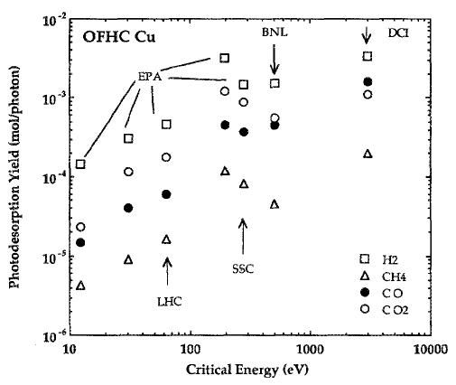
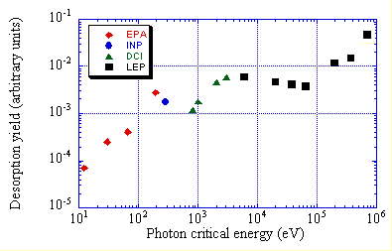
Evolution with critical energy
At low energy, the photoelectric effect dominates
Above a few 100 keV, Compton diffusion dominates and produce a cascade of energetic recoil electrons with a diffusion of secondary photons
150°C bake-out
O. Gröbner. CAS 99-15
J. Gómez-Goñi et al. JVSTA 12(4) Jul/Aug 1994, 1714

Slide 32
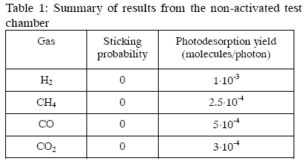
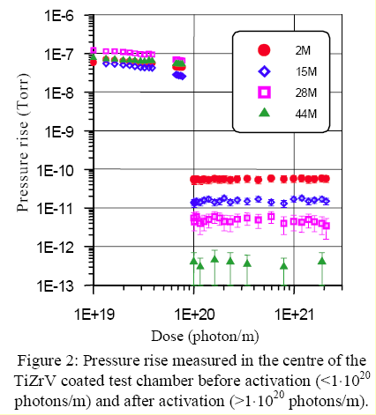
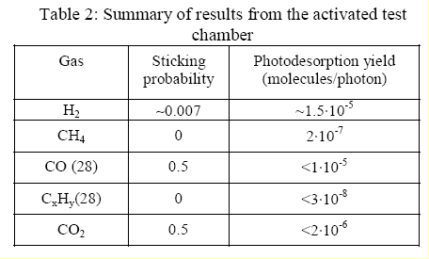

Photodesorption of NEG films
Very low desorption yields: “ultra” clean surface
Be aware of the difference between effective and intrinsic yields
$$η_{intrisic}≃{\left(\frac{S}{C}+\sqrt{\frac{S}{C_{t}}}\right) × η}_{effective}$$
V. Baglin et al. CERN VTN 98-04, 1998.
Non- Activated
Baked at
80°C
Activated
Activated at
190°C
TiZrV film on stainless-steel
4.5 keV
V. Anashin et al. EPAC 2002, Paris, France.

Slide 33
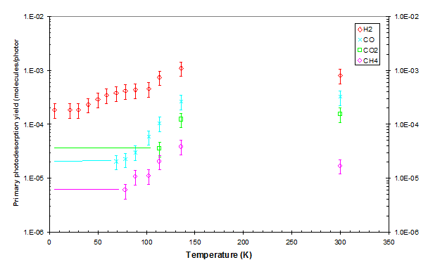
Photodesorption at Cryogenic Temperature
Initial yield, η₀, are smaller than at room temperature
V. Baglin et al., Vacuum 67 (2002) 421-428

Slide 34
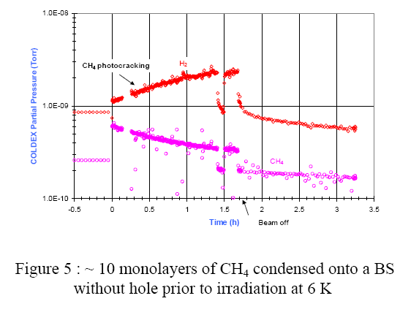
What about physisorbed molecules?
Desorption of physisorbed molecules
Photo-cracking of molecules
V. Anashin et al., Vacuum 53 (1-2), 269, (1999)
V. Baglin et al. EPAC 2002, Paris, France.
Stainless steel
250-300 eV
Perpendicular incidence

Slide 35

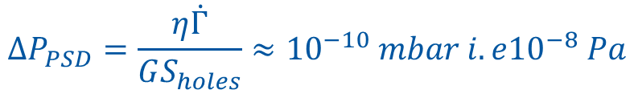
Photo-desorption in LHC
Let’s consider a nominal beam circulating in the LHC which beam screen operates at 15 K, what is the initial pressure increase?
S_{holes} = 316 l/s/m
LHC photon flux = 10¹⁷ ph/m/s
Desorption yield, = 2 10⁻⁴ H₂/ph
Pressure increase at 15 K:
What is the corresponding gas density?
In 2018, the measured gas density was n = 2.5 10¹² H₂/m³, the corresponding molecular photo-desorption yield is then 10⁻⁵ H₂/ph
$$ΔP_{PSD}=\frac{η\dot{Γ}}{GS_{holes}}≈{10}^{−10} mbar i.e{10}^{−8} Pa$$
$$n=\frac{P}{k T}={5 10}^{13} H_{2}m^{−3}$$

Slide 36
2. Vacuum instability and ion
stimulated desorption

Slide 37
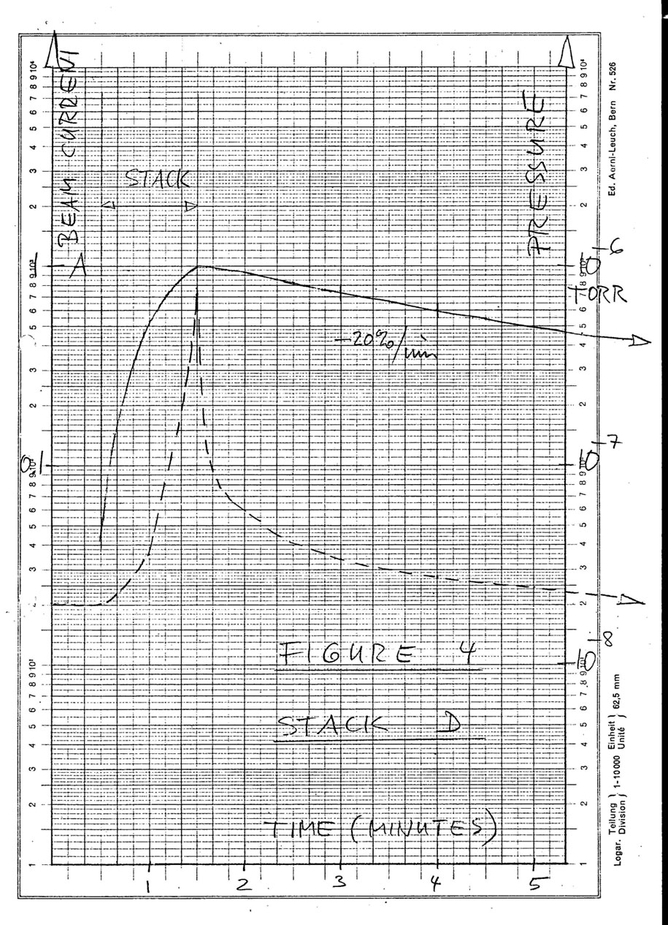
The phenomenon
High current machines: ISR, LHC …
current
Beam current increases to 1 A
Pressure increases up to 10⁻⁶ Torr (x 50 in a minute)
Beam loss
pressure
First documented pressure bump in the ISR
E. Fischer/O. Gröbner/E. Jones 18/11/1970

Slide 38
The mechanism of vacuum instability
Origin are ions produced by beam gas ionisation
Quasi stationary long tube (C=0)
When the beam current approach the critical current, the pressure increases to infinity

Slide 39
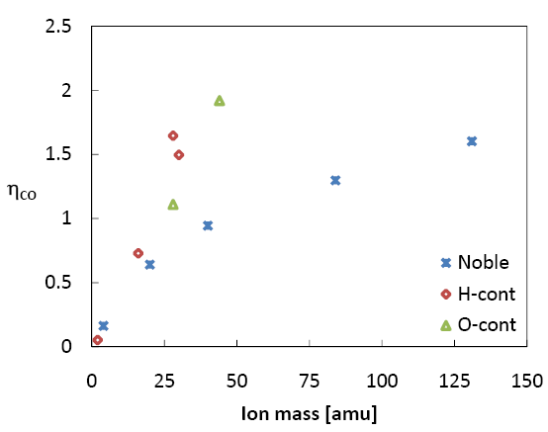
Ion desorption yield
Varies with the material, the ion energy and ion species
Several units of molecules can be desorbed by ions ➔ Sputtering
5 keV, Baked
0.2-0.5 keV
He⁺, Ne⁺, Ar⁺, Kr⁺, Xe⁺
H₂⁺, CH₄⁺,C₂H₄⁺, C₂H₆⁺
CO⁺,N₂⁺,CO₂⁺
LHC beam current (A)
G. Hulla, PhD Thesis, Vienna Tech. U, 2009
O. Gröbner, CERN 99-05
Unbaked
stainless steel
Baked
stainless steel
N₂⁺
N₂⁺
A.G. Mathewson, CERN ISR-VA/76-5
A.G. Mathewson, CERN ISR-VA/76-5

Slide 40
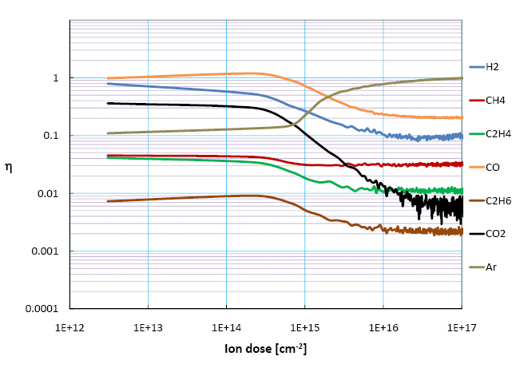
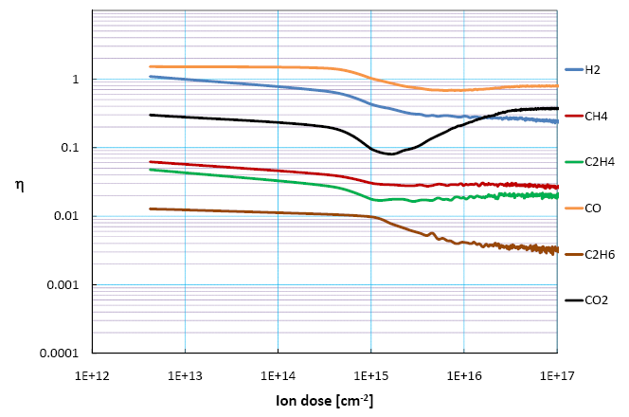
Conditioning and implantation
A conditioning is observed but at high dose, some ions can be implanted !
7 keV, Cu Baked, Ar⁺
7 keV, Cu Baked, CO⁺
G. Hulla, PhD Thesis, Vienna Tech. U, 2009
G. Hulla, PhD Thesis, Vienna Tech. U, 2009
In the LHC : the maximum flux is about 3 10⁸ ions/(cm².s) i.e. a dose of 3 10¹⁵ ions/(cm².year)
In the LHC, there is no “beam” conditioning under ion bombardment

Slide 41
How to ensure vacuum stability ?
Beam conditioning being negligible, one must decrease the desorption yield and optimise the pumping speed
ISR : Argon glow discharge (Ar, 10 % O₂,~ 400 V, 10¹⁸ Ar/cm²)) with in-situ bakeout :
A.G. Mathewson, CERN ISR-VA/76-5

Slide 42
3. Particle losses
and
ion stimulated desorption

Slide 43
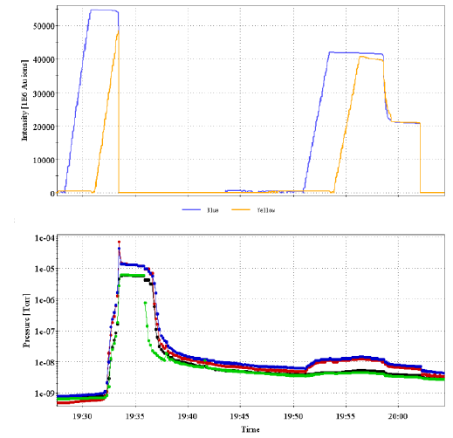
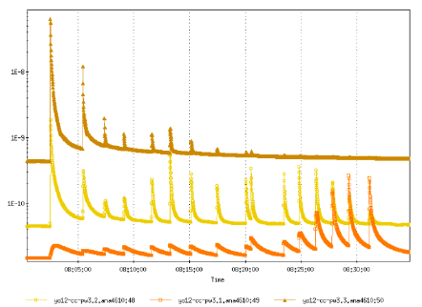
RHIC
Loss of ions from a beam leads to large pressure increases: 10⁻⁸ …10⁻⁵ mbar!
110 bunches, Au⁷⁹⁺,
9.9 GeV/u
3 10⁹, Au⁷⁹⁺, 9.9 GeV/u
1, 2 & 3 mrad
W. Fischer et. al. EPAC 2006, Edinburgh, Scotland
W. Fischer et. al. EPAC 2002, Paris, France

Slide 44
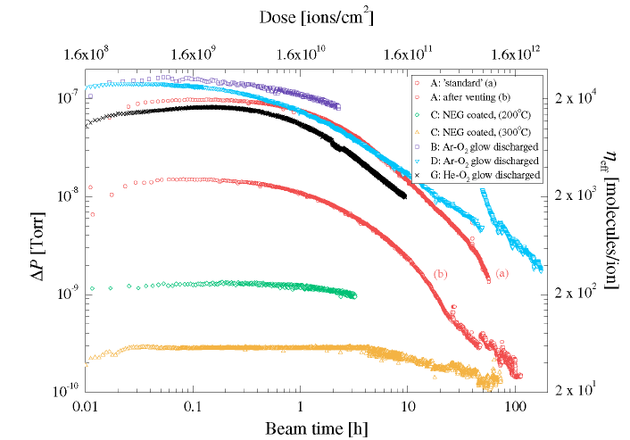
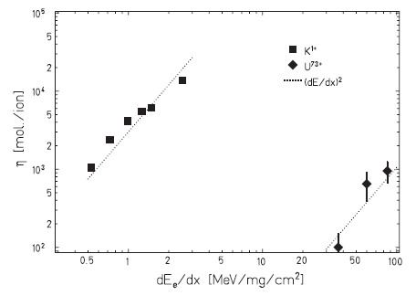
High energy ions
Desorption yields range from 20 – 20 000 molecules per ion
Pb⁵³⁺, 4. 2 MeV/u, 14 mrad
E. Mahner et al. ,
Phys. Rev. ST Accel. Beams 6, 013201 (2003)
The desorption is determined by the energy given to the electrons (electronic stopping force)
L. Prost et al. , PRL 98, 064801 (2007)
The desorption induced by the electrons is the responsible mechanism

Slide 45
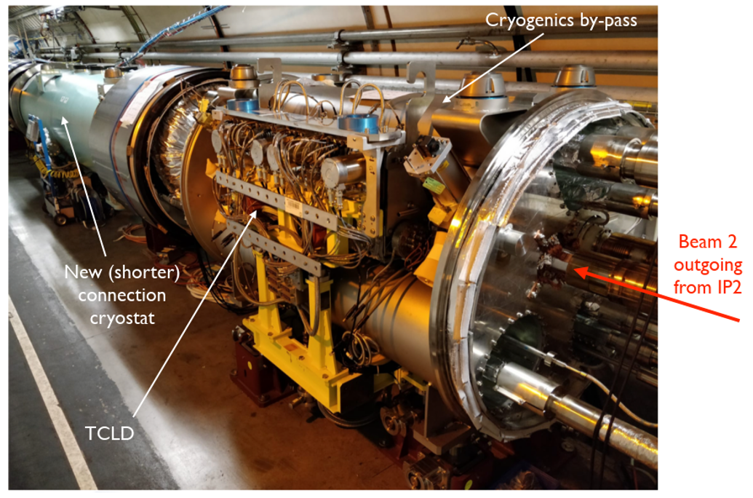
HL-LHC ions collimator
Located in the LHC arcs around IP2 to intercept lead beams with modified charge produced at the interaction point: Pb81+ instead of PB82+
W jaws
TCLD & LEN Bypass
TCLD
Courtesy S. Redaelli, F. Savary

Slide 46
4. Electron cloud
and related surface parameters

Slide 47
4.1 Introduction

Slide 48
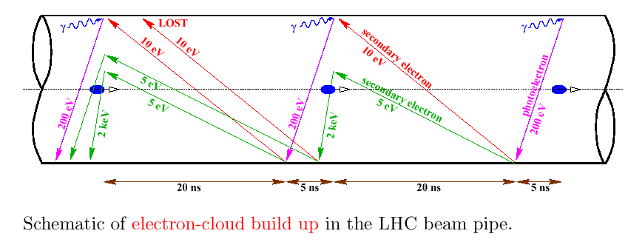
LHC mechanism
F. Ruggiero et al., LHC Project Report 188 1998, EPAC 98
Key parameters:
- beam structure
- bunch current
- vacuum chamber dimension
- secondary electron yield
- photoelectron yield
- electron and photon reflectivities
…

Slide 49
How to mitigate the electron cloud?
Once again, play with the key parameters :
  - Reduce the photoelectron yield (grazing incidence has larger yield than perpendicular incidence)
  - Reduce the secondary electron yield (scrubbing, NEG or amorphous carbon films, geometry)
  - Reduce the amount of electrons in the system (solenoid magnetic field, clearing electrodes, material reflectivity)
  Adapt the beam structure or the vacuum chamber dimensions to reduce the multiplication
  …

Slide 50
4.2 Photons from SR

Slide 51
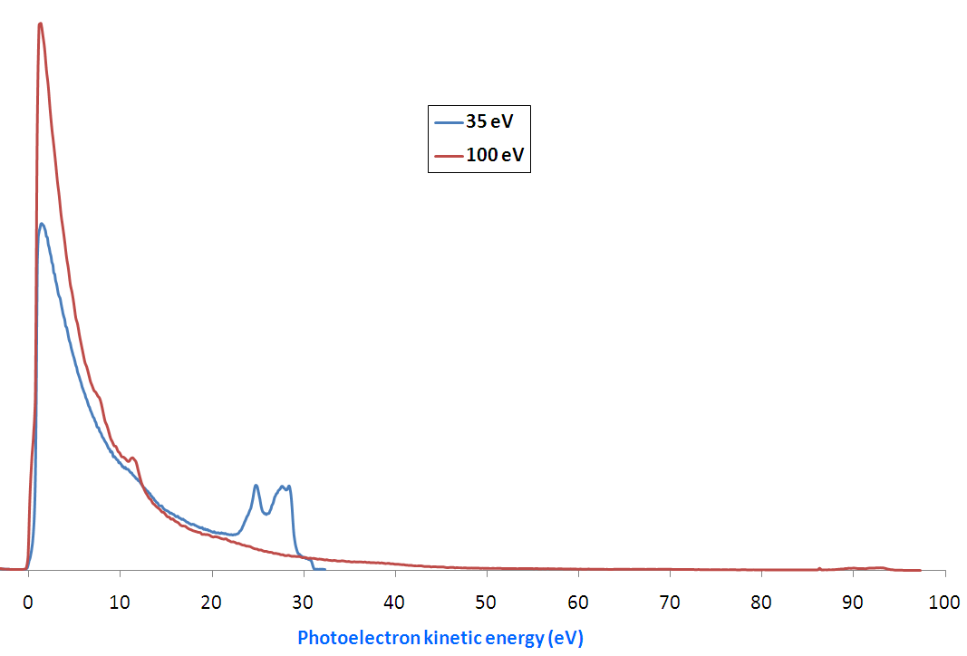
Photoelectrons
Photoelectric effect : when a photons irradiates a surface with enough energy, it produces electrons
The energy of emitted electrons varies from :
0 eV to (hν – W_{f}) eV
Most of the electrons are secondaries
A few 0.1 % to 1 % have high energy
Gold
R. Cimino et al. , Phys. Rev. ST Accel. Beams 2, 063201 (1999)

Slide 52
EDC under SR irradiation
EDC: Electron distribution curve
SR dose reduce the amount of low energy photoelectrons
The total yield is decreased by 40 % after 1 day of nominal LHC operation
R. Cimino et al. Phys. Rev. AB-ST 2 063201 (1999)

Slide 53
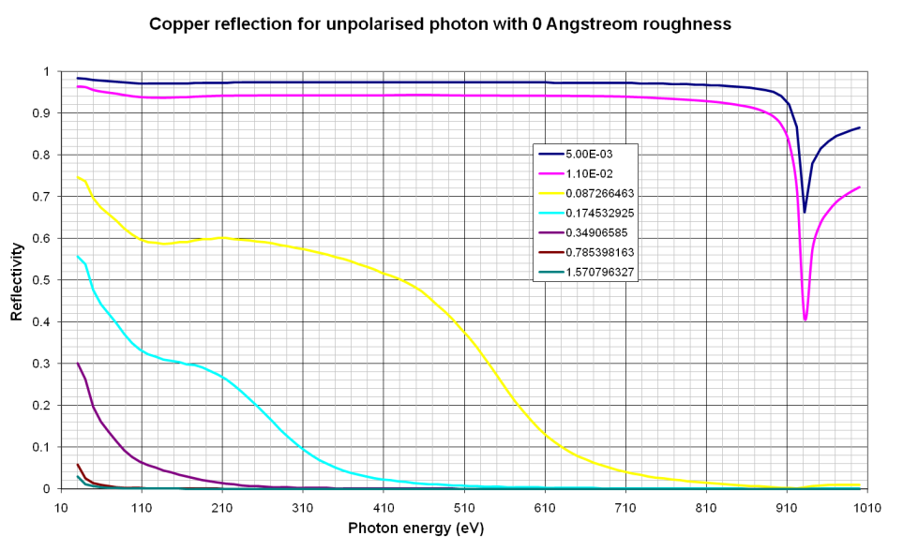


Photon reflectivity
From 1 to 80% forward reflectivity
Low reflectivity at perpendicular incidence
High reflectivity at grazing incidence i.e. this is the case of SR in accelerators
In LHC, 5 mrad gives more than 95% reflection
Copper adsorption at 920 eV
Henke databook
DCI, Ec=3 keV
In complex geometries, ray tracing is done with e.g. Synrad
V. Baglin et al., Trieste, 1998
O. Gröbner et al., 24-4-1988

Slide 54
4.3 Electrons from the electron cloud

Slide 55



Electron Distribution Curve (EDC)
Penetration depth: 1 – 10 nm
The Electron Distribution Curve shows :
  - A component at reflected electron energy
  - Secondary electrons with low energy
Most of the emitted electrons have low energy
N. Balcon et al,
IEE Trans. On Plasma Sci. 40, 2012, 282
CASINO code
Escape depth: <10 nm
Courtesy R. Cimino

Slide 56

Secondary Electrons Yield
Technical material
Maximum around 200-300 eV
δ_{max} ~ 2 to 3.5
312 eV
N. Hilleret et al., LHC Project Report 433 2000, EPAC 00

Slide 57

Very low SEY
C. Scheuerlein et al. Appl.Surf.Sci 172(2001)
M. Taborelli et al., ECM workshop, 2008
TiZrV film
LHC RT beam pipes
Amorphous carbon
HL-LHC Cryogenic Triplets
The origin of the low SEY is different in both case :
- nature of the surface
- smooth versus rough surfaces

Slide 58
LHC : Scrubbing of the surface
Photoelectrons produced by SR are accelerated towards the test sample
Reduction of SEY under electron irradiation is observed
1 to 10 mC/mm² is required to scrub the surface
Growth of a carbon layer (AES, XPS)
δmax_{ini}
δmax_{final}
δ_{max}
LHC design:
δmax ~ 1.3
V. Baglin et al., Chamonix, 2001

Slide 59
SEY at cryogenic temperature
Beam scrubbing at 10 K but SEY increases with gas condensation
Fully scrubbed Cu
1.2
δ
total
1.0
Contribution
of secondaries
0.80
to
δ
δ
0.60
0.40
N. Hilleret. LHC MAC December 2004
0.20
Contribution of reflected
electrons to
δ
0.0
0
50
100
150
200
250
300
350
Primary Energy (eV)
R. Cimino , I.R. Collins, App. Surf. Sci. 235, 231-235, (2004)
The control of the surface coverage in a cryogenic machine is a must
N. Hilleret et. al. Chamonix 2000

Slide 60


Electron desorption yield
Unbaked copper
Threshold around 10 eV
G. Vorlaufer et al., CERN VTN, 2000

Slide 61

Electron dose
Reduction of the electron desorption yield with the electron dose: ~ 40 monolayers of gas desorbed from the surface during beam scrubbing
 | H₂ | CH₄ | H₂O | CO | CO₂
η₀ | 2 10⁻¹ | 2.5 10⁻² | 1 10⁻¹ | 3.5 10⁻² | 5 10⁻²
D₀ x 10¹⁴ | 3 | 1 | 6 | 2 | 4
a | 0.47 | 0.62 | 0.66 | 0.49 | 0.54
Molecules/cm² desorbed after 10¹⁹ e/cm² i.e 16 mC/mm²
 | H₂ | CH₄ | H₂O | CO | CO₂
x 1e15 | 28 | 0.5 | 4.6 | 3.4 | 4.6
G. Vorlaufer et al., CERN VTN, 2000

Slide 62



Electron desorption at cryogenic temperature: Cu
The yields are very large
  ➔ physisorbed molecules under e⁻ bombardment are strongly recycled in the gas phase
For a monolayer (10¹⁵ molecules/cm²)
 | H₂ | CH₄ | CO | CO₂
η | 500 | 5 | 10 | 0.5
Studied for 300 eV electrons with :
Pure gas
Equimolecular mixture of 4 gases
Standard LHC gas composition
H. Tratnik et al., Vacuum 81, 731,(2007)

Slide 63




ESD in LHC
In 2015, about 1W/m was dissipated on the LHC beam screen due to electron cloud heat load, what is the corresponding ESD yield?
S_{holes} = 0,316 m³/s/m, n=2.25 10¹³ H₂/m³
Mean electron energy 100 eV
Electron flux = 6 10¹⁶ e/m/s
Electron Stimulated Desorption yield:
What is the corresponding electron dose, D ?
  D= 2 10²¹ e/cm² or 3 C/mm²
In 2018, heat load drops to 0.3 W/m and n=2.5 10¹² H₂/m³
  D= 2 10²² e/cm² or 32 C/mm²
$$η=\frac{nS_{holes}}{\dot{Γ}}={10}^{−4} H2/e$$
$$η={4 10}^{−5} H2/e$$

Slide 64
Lecture 4 summary
In accelerators, the circulating beam can contribute to stimulate molecular desorption
Those phenomenon can lead to much larger gas load than the thermal outgassing rate
Photon stimulated desorption originates from SR
Ion stimulated desorption originates from beam gas ionisation and can lead to vacuum instability
Particle losses
Electron stimulated desorption originates from an electron cloud

Slide 65
Some References
Cern Accelerator School, Vacuum technology, CERN 99-05
Cern Accelerator School, Vacuum in accelerators, CERN 2007-03
Cern Accelerator School, Vacuum for particle accelerators, Glumslov, June 2017
The physical basis of ultra-high vacuum, P.A. Redhead, J.P. Hobson, E.V. Kornelsen. AVS.
Scientific foundations of vacuum technique, S. Dushman, J.M Lafferty. J. Wiley & sons.
Les calculs de la technique du vide, J. Delafosse, G. Mongodin, G.A. Boutry. Le vide.
Vacuum Technology, A. Roth. Elsevier Science
Foundations of vacuum science and technology, Ed by J.M. Lafferty. J. Wiley & sons.
Vacuum in Particle Accelerators: Modelling, Design and Operation of Beam Vacuum Systems, O. Malyshev. Wiley VCH.
Some Journals
Journal of Vacuum Science and Technology
Vacuum
Applied Surface Science
Nuclear Instruments and Methods
Physical Review Accelerator and Beams

Slide 66
Thank you for your attention !!!

Slide 68
Complementary
information

Slide 69
1.1 Synchrotron radiation

Slide 70


… heavy consequences on design
Complementary information
Extruded Aluminum
Ex-situ baked to 150ºC
TPS Design
G.Y Hsiung et al.
A complex vacuum chamber design with a light extraction path, pumping and instrumentation ports and power absorbers (crotch)

Slide 71
1.2 Photodesorption

Slide 72



Desorption yield vs gas load
Complementary information
The quantity removed during the cleaning process is a useful information to estimate intervals between getter reactivation or surface coverage on a cryogenic surface
Baked OFHC Cu
3.75 keV
Unbaked stainless-steel
3.75 keV
$$η=η_{0} e^{−\frac{Q}{Q_{o}}}$$
O. Gröbner et al.
J.Vac.Sci. 12(3), May/Jun 1994, 846-853
C. Herbeaux et al. JVSTA 17(2) Mar/Apr 1999, 635
 | H₂ | CH₄ | CO | CO₂ |  | H₂ | CH₄ | CO | CO₂
η₀ (molecules/ph) | 9.2 10⁻⁴ | 2.3 10⁻⁴ | 3.7 10⁻⁴ | 5.5 10⁻⁴ |  | 8.8 10⁻³ | 4.4 10⁻⁴ | 5.7 10⁻³ | 8.4 10⁻³
Q_{o} (Torr l /m) | 3.0 10⁻² | 4.5 10⁻⁴ | 8.4 10⁻³ | 1.1 10⁻² |  | 1.9 10⁻¹ | 3.9 10⁻³ | 5.7 10⁻² | 4.0 10⁻²
Q₀ (molecules/cm²) | 2.3 10¹⁴ | 3.5 10¹² | 6.5 10¹³ | 8.5 10¹³ |  | 1.5 10¹⁵ | 3.1 10¹³ | 4.5 10¹⁴ | 3.2 10¹⁴

Slide 73
2. Vacuum instability and ion
stimulated desorption

Slide 74
Description of the mechanism
Complementary information
In the case of a machine with distributed pumping (C≠0) :
When the denominator approach zero, the pressure diverge
so
therefore
In the case of more complex geometry, numerical tools are used

Slide 75
Ionisation cross section
Complementary information
It is a function of the speed & the charge of the projectile and of the nature of the residual gas.
F.F. Rieke, W. Prepejchal , Phys. Rev. A5, 1507 (1972)
 | Ionisation cross-section (in 10⁻¹⁸ cm²)
Gas | 26 GeV | 450 GeV | 7000 GeV
H₂ | 0.27 | 0.36 | 0.45
He | 0.27 | 0.36 | 0.45
CH₄ | 1.9 | 2.5 | 3.2
H₂O | 1.4 | 1.9 | 2.4
N₂ | 1.6 | 2.2 | 2.7
CO | 1.6 | 2.2 | 2.7
O₂ | 1.8 | 2.4 | 3.1
Ar | 1.7 | 2.4 | 3.1
CO₂ | 2.5 | 3.4 | 4.3
Heavy gas must be avoided

Slide 76




Ion desorption
Complementary information
S(E)
Described by the nuclear and electronic stopping force (stopping power)
Low masses (H₂) are desorbed by the electronic energy transfer to the lattice
High masses are desorbed by the direct nuclear momentum transfer between two particles
G. Hulla, PhD Thesis, Vienna Tech. U, 2009

Slide 77

At cryogenic temperature
Complementary information
Desorption of physisorbed gas
H₂⁺, 3.2 K
(N. Hilleret, R. Calder, IVC, 1977)
η’_{H2} ~ 2000
η’_{CO2} ~ 2
@ 5 keV and 1 monolayer
J. Barnard et al., Vacuum 47 (4), 347, (1996)
Critical current is changed to
It is a function of the geometry, the gas specie, the sticking coefficient and of the 2 desorption yields

Slide 78
Complementary information
LHC beam screen stability
A minimum pumping speed is provided beam the beam screen’s holes
Beam screen’s holes provide room for LHC upgrades …..
 | H₂ | CH₄ | CO | CO₂
(ηI)_{crit} [A] | 1300 | 80 | 70 | 35
Courtesy N. Kos CERN TE/VSC
NB : In the long straight sections, vacuum stability is provided by TiZrV films and ion pumps which are less than 28 m apart

Slide 79
Pressure increase in LHC due to ions ?
Complementary information
The ion flux is a function of the pressure and the beam current
For nominal parameters, P~ 10⁻⁸ mbar and I ~ 600 mA
Ion energy will be about 100 eV, so the desorption yield about 2 molecules/ion
Beam screen pumping speed, S
Pressure increase due to ion:
No visible pressure increase in LHC

Slide 80
3. Particle losses
and
ion stimulated desorption

Slide 81



Mecanism
Complementary information
Surface effect (except diffusion H₂) due to a thermal activation
« Inelastic thermal spike model » : a temperature map coupled to the thermal desorption model
M. Bender et al. , NIM B 267 (2007) 885-890
Xe²⁹⁺, 1.4 MeV/u, Perpendicular
300° C
Temperature of atomic Cu subsystem after Xe impact
Desorbed particles per Xe per dt

Slide 82


Remedies: collimation!
Complementary information
Use of NEG films (LEIR, RHIC, GSI)
Use of beam conditioning
Intercept ion loss on dedicated collimators:
  - LEIR : 30 μm gold film on SS 316 LN, perpendicular incidence
- GSI : 0.1 μm gold film, perpendicular incidence. Absorbeur inserted in a secondary vacuum chamber. NEG film
C. Omet et. al. EPAC 2008, Genoa, Italy
- HL-LHC : movable collimator – 150 W of 7 ZxTeV ions coming from BPFP
BFPP:
²⁰⁸Pb⁸²⁺ + ²⁰⁸Pb⁸²⁺ → ²⁰⁸Pb⁸²⁺ + ²⁰⁸Pb⁸¹⁺ + e⁺
. J. Jowett

Slide 83
4. Electron cloud
and related surface parameters

Slide 84
4.1 Introduction

Slide 85


Complementary information
History: observed at the ISR
Vacuum stability test of a baked aluminium chamber 200°C, diam 160 mm (1976-1977)
Observation of pressure spikes, particularly during transverse displacement of a proton bunch
The existence of the spike varies with :
- bunch length
- number of proton bunch
Existence of a current threshold (120 mA for 20 bunches)
Different gas composition (dominated by H₂ instead of CO)
Measurement of a significant electron current on the clearing electrodes
Gas desorption is stimulated by electrons
Electrons are accelerated by the proton bunch: multipactor effect
O. Gröbner, ISR-VA/77-38

Slide 86


PEP-II
Complementary information
Electron cloud in the positron ring was foreseen during the design phase: TiN coating on Aluminium
J. Seeman et al., EPAC 2000, Vienna, Austria
Emittance blow up above 800 mA (SR light)
Observation of non linear pressure rise
Winding of solenoids in the straight section
Luminosity increase

Slide 87


Complementary information
KEKB
Observation at IP
Cu OFHC vacuum chamber, unbaked, NEG pumping
Emittance blow up in the vertical plane of the positron beam
Positron bunch instability due to the cloud of photoelectrons
Observed in multibunch mode
Installation of permanent magnets then solenoids
Y. Funakoshi et al., EPAC 2000, Vienna, Austria
K. Ohmi, F. Zimmermann, PRL 85, 3821 (2000)
Luminosity increase
KEKB LER Solenoids

Slide 88

RHIC
Complementary information
Stainless steel vacuum chamber baked at 250°C in the straight sections
Stainless steel vacuum chamber cooled at 4 K in the arcs
Pressure increase with protons and ions beams
NEG, bakeout, solenoids, beam structure …..
Luminosity increase
H. Hseuh et al., EPAC 2002, Paris, France

Slide 89


SPS
Complementary information
Unbaked stainless steel vacuum chamber
7.7 10¹⁰ protons/bunch
Pressure increase observed with LHC type beams
Measurement of electron current on a pick up
J.M. Jimenez et al., EPAC 2000, Vienna, Austria
60 h of beam conditioning
Ok for LHC beam injection
J.M. Jimenez et al., EPAC 2000, Vienna, Austria

Slide 90




Simple model
Complementary information
Synchronism condition:
Speed increment due to the kick
Intensity threshold:
Enough energy gain due to the kick to produce secondaries:
O. Gröbner. PAC 97, Vancouver, Canada
Electrons in the vacuum chamber wall vicinity receive a kick of 190 eV, those in the beam vicinity receive 15 keV.

Slide 91
4.2 Photons from SR

Slide 92

Behaviour with critical energy
Complementary information
SR irradiation at EPA
Grazing incidence, 11 mrad
The photoyield increases when increasing critical energy.
Photon reflectivity slightly decreases when increasing critical energy
PY*: photoelectrons per absorbed photons
I.R. Collins et al. EPAC 1998,Stockholm, Sweden
NB : molecular desorption yields are linear in the range, 10 – 300 eV. So the photoelectron yield should be also proportional to critical energy

Slide 93



Photoelectrons for a LHC type beam screen
Complementary information
The Photoyield decrease with beam conditioning
It varies from 1 to 4 % under perpendicular incidence
~ 40 μm
~ 500 μm
Sawteeth, Ec=194 eV
V. Baglin et al., Chamonix, 2001

Slide 94






Photon reflectivity of LHC type material
Complementary information
The saw tooth structure reduces the reflectivity
Flat Cu
Saw tooth
N. Mahne et al. App. Surf. Sci. 235, 221-226, (2004)

Slide 95
4.3 Electrons from the electron cloud

Slide 96



Geometrical effect
Complementary information
After a coffee discussion, a drilled sampled by the VAC workshop (H. Kos)
Ø ~1 mm , 92 holes/cm²
Original idea with groove only:
SEY max < 1.3 for Cu unbaked !!
Measurement courtesy A. Kuzucan
A fancy effect or a real application ?

Slide 97



Laser Engineered Structure Surface
Complementary information
Principle: laser treatment of a tube at atmospheric pressure
Production of a micrometric structure
Appl. Phys. Lett. 101, 2319021 (2012). Physics Highlights – Physics Today (February 2013). Opt. Mater. Exp. 1,1425 (2011).
δ_{max}< 0.8 !
CERN data, 2015
Applied Physics Letters 12/2014; 105(23): 231605
Still under development by STFC and Dundee university, so it came too late for the LHC construction !

Slide 98


Origin of the SEY reduction at 300 K
Complementary information
R. Cimino et al. PRL 109, 064801(2012)
δ_{max}
2.2
1.35
Modification of C1s core level
Conversion sp³ => sp²
High energy electrons increase the number of graphitic like C-C bounds
1.1
1.05
HOPG : highly oriented pyrolity graphite
Graphitization of the carbon contamination layer
under electron irradiation

Slide 99


Conditioning and electron energy
Complementary information
At 300 K, the scrubbing efficiency of low energy electron is less than high energy electrons
Electron energy distribution at the LHC vacuum chamber wall
~ half of the electrons have E < 20 eV
R. Cimino et al. PRL 109, 064801(2012)
Knowing the energy distribution of electrons is of paramount importance
R. Cimino , I.R. Collins, App. Surf. Sci. 235, 231-235, (2004)

Slide 100

Electron scrubbing
Complementary information
After a dose of ~ 5 10¹⁸ e/cm² i.e. 8 mC/mm², the maximum of SEY equals ~ 1.3
The scrubbing process desorbs several monolayers of gas from the surface
Potential impact on:
  frequency of NEG activation
  increase of SEY due to gas condensation
 | H₂ | CH₄ | H₂O | CO | CO₂
Q x 10¹⁵ | 19 | 0.4 | 4 | 2 | 3
several monolayer of gas are desorbed when a surface is conditioned

Slide 101




Electron desorption studies at different temperature
Complementary information
Hydrogen desorption
H₂ electron desorption can be explained by a diffusion model with a non-uniform concentration i.e. H is produced by dissociation of hydroxydes under electron bombardement
However, the diffusion coefficients taken for RT and 200ºC were the same
J. Gómez-Goñi, A.G. Mathewson. J. Vac. Sci. Technol. A 15(6) (1997) 3093
No obvious correlation between the surface composition determined by AES and desorption yields as a function of temperature : No changes in AES spectra vs 1 to 3 orders of magnitude decrease for the yields.
The thickness of the oxide layer is more than 3 monolayers (AES scanning depth).
A porous surface oxide layer provide the reservoir of gas
M.H. Achard et al., Vacuum 29-2, 53,(1978)

Slide 102
4.5 Beam structure

Slide 103




Multipacting: Influence of Beam Structure
Complementary information
Bunch intensity:
a threshold effect
Beam intensity:
pressure linearity
G. Bregliozzi et al., IPAC San Sebastian, 2011
Time separation:
Non-linearity
VGI.134.7L1.B
VGPB.237.7R1.B

