Slide 2

Vacuum Systems
Lecture 1
V. Baglin
CERN TE-VSC, Geneva

Slide 3
Vacuum?
A transverse field across several engineering and scientific disciplines
Complementary information

Slide 4
Outline
Introduction
Gas kinetic theory & gas flow
Measurement & production of vacuum

Slide 5
1. Introduction

Slide 6
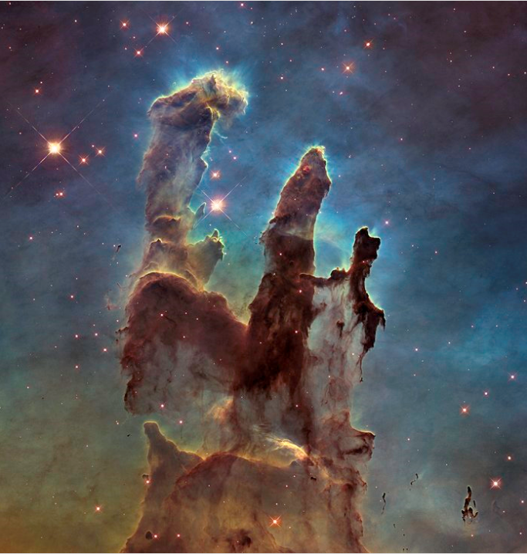
Vacuum
“Perfect vacuum” does not exist on earth nor in space!
Interstellar medium in a galaxy such as the Milky Way:
  Composed of molecules, ions atoms, cosmic rays & dust (size 0.1 micron)
  In molecular clouds, which are cold (>10 k) and dense region n ~ 10⁴ molecules/cm³
  Atoms density:
    50 H/cm³ at 100 K (~10⁻¹³ Pa)
    1 H/cm³ at 10 000 K (~10⁻¹³ Pa)
Pilar of the creation
Nasa-ESA Hubble
Herschel: molecules in the Orion nebula

Slide 7
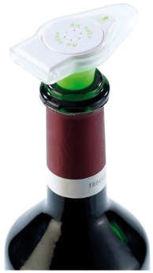
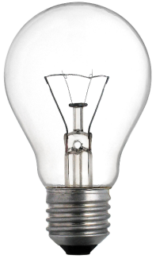
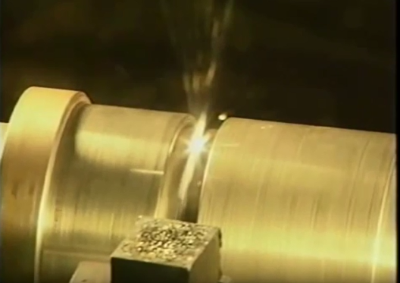
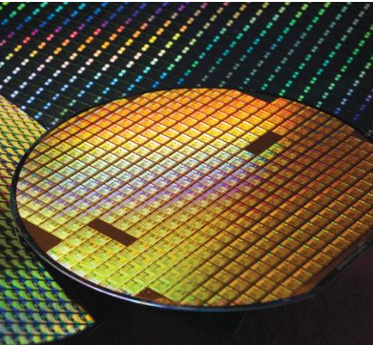
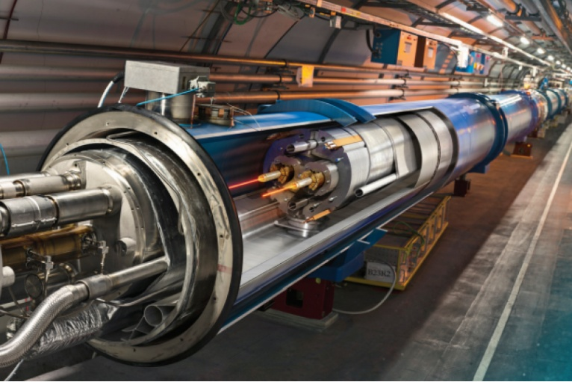
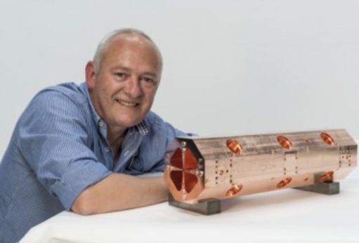
Vacuum Systems on Earth
Vacuum technology is present in many devices/ systems
Vacuum pump
For wine
Light bulb
0.7 atm of Ar
Electron beam welding machine
10⁻⁵ – 10⁻² mbar
Semiconductor industry
10⁻⁶ – 10⁻² mbar depending on process
Under vacuum brazing
10⁻⁷-10⁻⁶ mbar at 200-1300°C
Design: 10¹⁵ H₂/m³ i.e. 2 10⁻⁹ mbar at 15 K
(~10⁻⁸ mbar at 300 K)
Accelerator
The objective of Vacuum is to reduce the collision of molecules on the surrounding environment to preserve the quality of the process

Slide 8
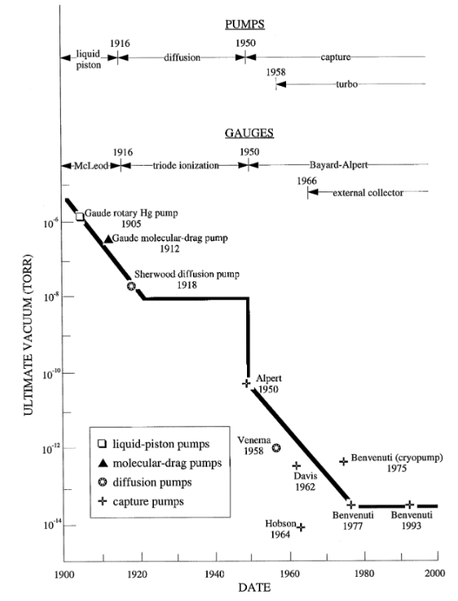
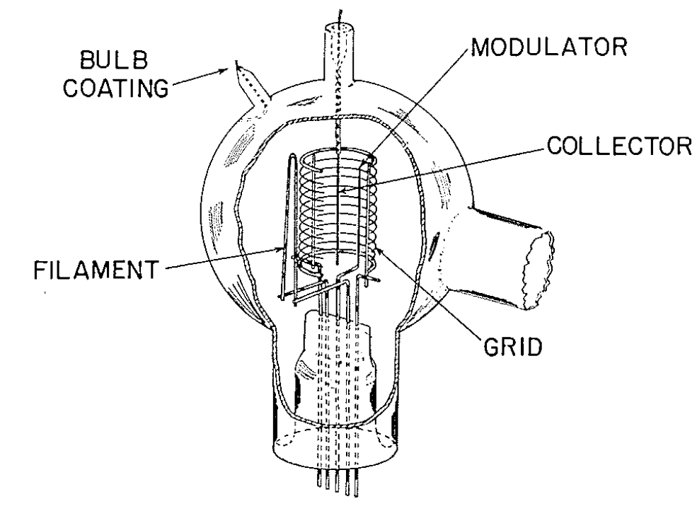
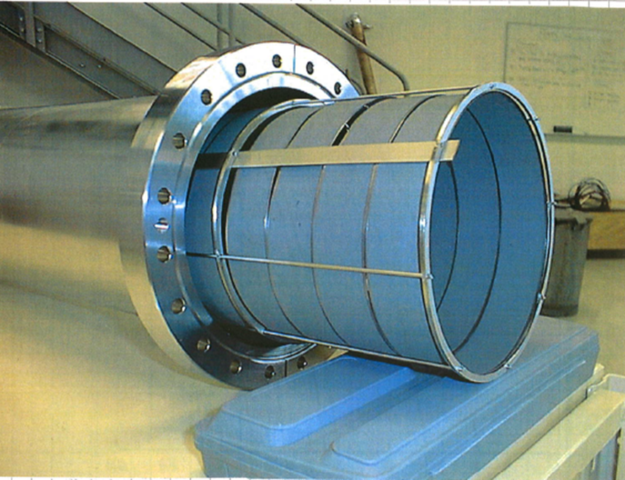
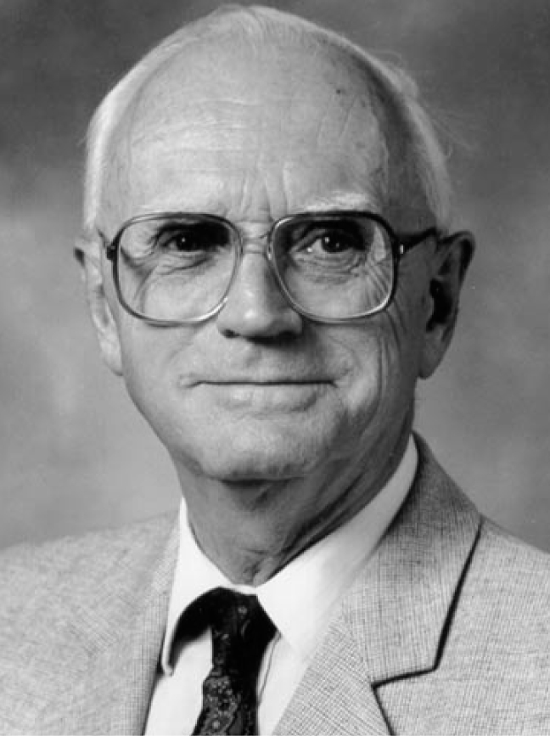
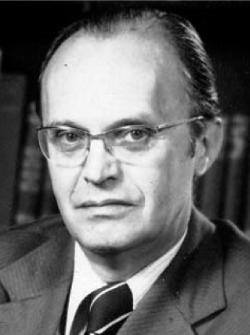

Vacuum gauges & (capture) pumps
1964: 7 10⁻¹⁵ Torr
obtained with a multi-baked Aluminosilicate glass finger immersed in liquid helium
1993: ~ 10⁻¹⁴ Torr
Passively activated NEG at 350 °C
ST707 NEG mounted on a frame & Helmer gauge
Modulated BA gauge
P. A. Redhead et al, Can. J. Phys. 40,1814 (1962)
C. Benvenuti et al, Vacuum 44,511-13 (1993)
P. A. Redhead, Vacuum 53 (1999) 137-149
J.P Hobson
P.A Redhead
C. Benvenuti

Slide 9
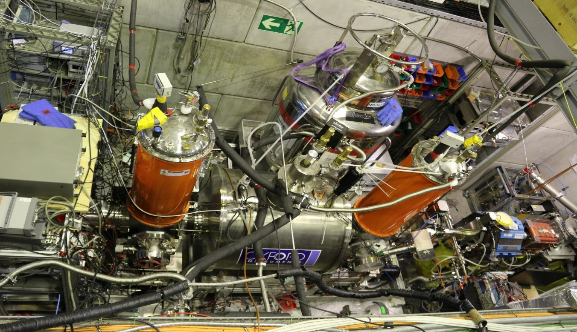
Lowest (measured) pressure
Recently obtained at the BASE experiment (the Baryon-Antibaryon Symmetry Experiment)
By measuring the decay of anti-protons due to beam-gas scattering, the estimated pressure in the cryogenic Penning trap is ~ 10⁻¹⁹ mbar i.e. 2 400 molecules/m³
BASE experiment implemented into the AD facility
BASE, Eur. Phys. J. Special Topics 224, 3055-3108 (2015)

Slide 10
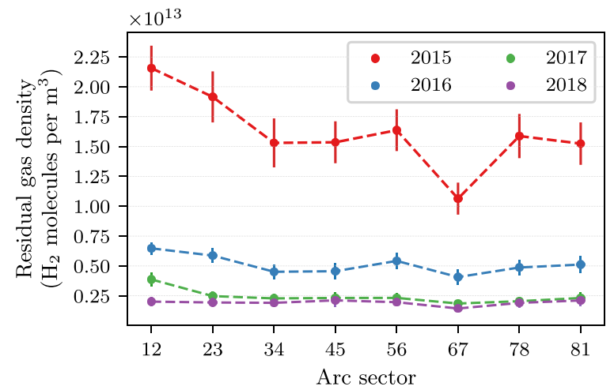
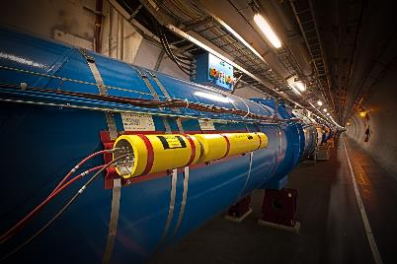

Pressure in the LHC arcs during RUN2
Measure of beam-gas scattering, using beam loss monitors
2 10⁻¹⁰ mbar
2 10⁻¹¹ mbar
 | Design | 2015 | 2018
Life time | 100 h | 185 days | 4,5 years !!
$$\frac{dI}{dt}=− σLnf I=−\frac{1}{τ} I$$

Slide 11
2. Gas kinetic theory
& gas flow

Slide 12
2.1 Gas kinetic theory

Slide 13
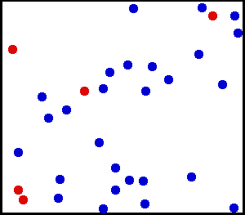
Introduction
Assume a large number of molecules, always moving in a disordered manner
The size of molecules is very small as compared to the intermolecular distance
Molecules moves in a rectilinear uniform manner between successive collisions
Collisions (elastic) are against molecules themselves or against the wall
The molecular trajectories are broken lines
http://www.matierevolution.fr

Slide 14
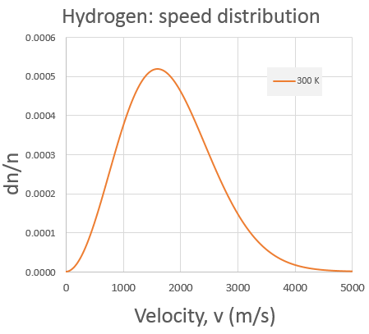
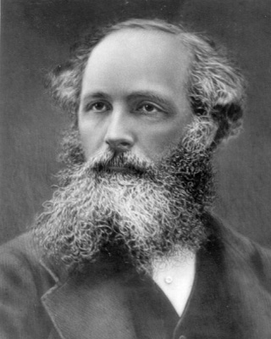
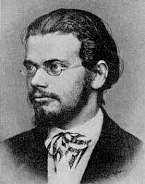

Maxwell Boltzmann Distribution
Assume a pure gas, in thermal equilibrium and enclosed in an isothermal volume
In this case:
  The molecule density is constant in the volume and do not vary in time
  The direction of the molecule’s speed is uniform
  The speed distribution is stationary
$\frac{dn}{n}={\frac{4}{\sqrt{π}}\left(\frac{m}{2kT}\right)}^{3/2}v^{2} e^{−\frac{mv^{2}}{2kT}}$ $dv$
v_{p}
The speed of the molecules follows a Maxwell-Boltzmann distribution
Most of the molecules have a speed around the maximum, v_{p}
Less than 1/1000 of molecules have speed:
  v<0.1 v_{p} or v>3 v_{p}
Maxwell 1860
Boltzmann 1870

Slide 15
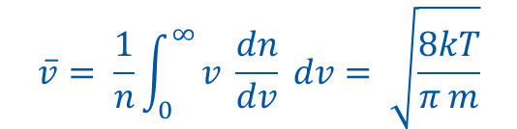
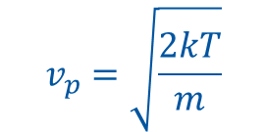

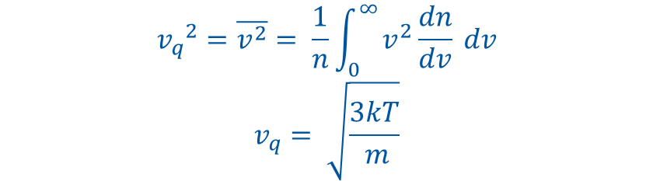
Maxwell Boltzmann Distribution
The most probable speed is given at the maximum of the distribution: d(dn/n)/dv =0. It equals
$$v_{p}=\sqrt{\frac{2kT}{m}}$$
The mean thermal speed equals:
$$\overline{v}= \frac{1}{n}\int_{0}^{∞}{v \frac{dn}{dv}} dv= \sqrt{\frac{8kT}{π m}}$$
The average quadratic speed equals:
$${v_{q}}^{2}=\overline{v^{2}}= \frac{1}{n}\int_{0}^{∞}{v^{2}\frac{dn}{dv}} dv$$
$$v_{q}= \sqrt{\frac{3kT}{ m}}$$
The corresponding kinetic energy is:
$$\frac{1}{2}m {v_{q}}^{2}= \frac{3}{2}kT$$
All the molecular speeds scales like ~ √ (T/m)

Slide 16
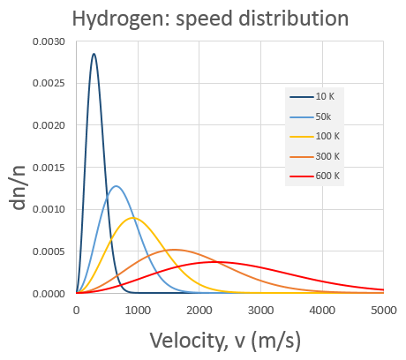
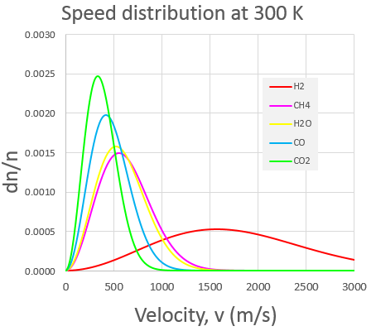
Maxwell Boltzmann Distribution
The gas velocity:
  increase with increasing temperature
  is the largest for light molecules
~ √ (T/m)

Slide 17
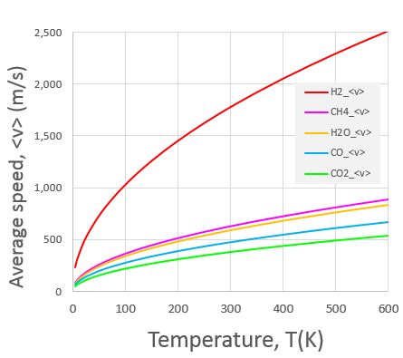
Average velocity
The mean thermal speed range from ~ 100 till 1000 m/s:
  The traveled distance in a second is much larger than the vacuum chamber dimensions!
~ √ (T/m)
T (K) | He | Air | Ar
4.2 | 150 | 55 | 50
300 | 1300 | 470 | 400
600 | 1800 | 660 | 560

Slide 18

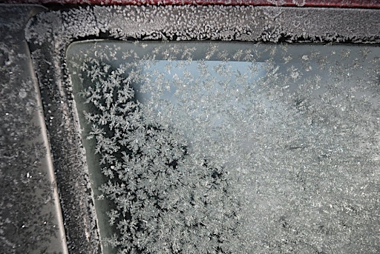
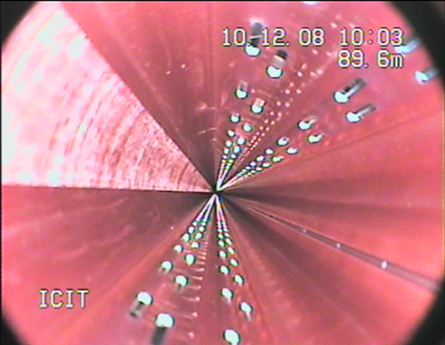

Collision on the wall
The molecular collision rate on the wall (the incidence rate), ν, can be derived from the Maxwell Boltzmann distribution
$$ν=\frac{number of collision with the wall}{area of wall x time}= \frac{1}{4} n \overline{v}$$
Monolayer formation time
10¹⁵ molecules/cm²
At room temperature, a monolayer is formed in 1 s at 10⁻⁶ Torr : Langmuir formation time
1 L = 1 monolayer.s
Very low pressure is preferred to minimize surface contamination,
A monolayer is formed in:
1 ns at 1 atm
1 s at 10⁻⁶ mbar
1 day at 10⁻¹¹ mbar !!!
Ice formed at atm pressure
LHC beam pipe is under vacuum

Slide 19


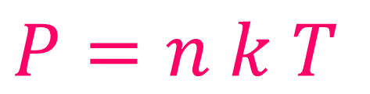
Pressure & Ideal gas law
Molecules which collide a wall of surface A, produce a force, F, onto it.
The pressure P, exerted on the wall by the molecules is defined by the ratio of the force to the surface:
It can be shown that, for any particle velocity distribution, the pressure is given by the mass density and the quadratic speed:
$$P=\frac{1}{3} ρ {v_{q}}^{2}$$
In the special case the particle velocity distribution, follows a Maxwell Boltzman distribution, the pressure is given by the IDEAL GAS LAW:
$$P=n k T$$
For such a gas, the pressure, P [Pa], is defined by the gas density, n [molecules.m⁻³] , the temperature of the gas, T [K] and the Boltzman constant k , (1.38 10⁻²³ J/K)
The pressure increases linearly with the gas temperature

Slide 20
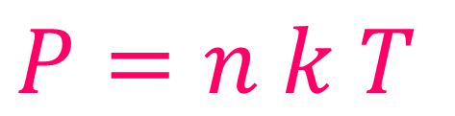
Ideal gas law: illustration
$$P=n k T$$
Ultra-High Vacuum
  take LHC design
  n= 10¹⁵ molecules/m³
    k = 1.38 10⁻²³ J/K
    T = 300 K i.e. room temperature
    P = 10¹⁵ x 1.38 10⁻²³ x 300 = 4 10⁻⁶ Pa
The ideal gas law relation is another expression on the Avogadro’s law:
  Molar volume
  The occupied volume by one mole in standard condition equals 22.4 ℓ (i.e. 22.4 10⁻³ m³)
    ➔ n = N / V = 6.02 10²³ / 0.0224 m³ = 2.7 10²⁵ molecules/m³
  Atmospheric pressure at 0°C (standards conditions)
    P = 101 300 Pa,
    k = 1.38 10⁻²³ J/K
    T = 273 K i.e. 0°C
    ➔n = 101 300 / (1.38 10⁻²³ x 273) = 2.7 10²⁵ molecules/m³

Slide 21
Units
The pressure is the force exerted on the wall by the molecules per unit of surface :
1 Pa = 1 N/m²
 | Pa | kg/cm² | Torr | mbar | bar | atm
1 Pa | 1 | 10.2 10⁻⁶ | 7.5 10⁻³ | 10⁻² | 10⁻⁵ | 9.81 10⁻⁶
1 kg/cm² | 98.1 10³ | 1 | 735.5 | 980 | 0.98 | 0.96
1 Torr | 133 | 1.35 10⁻³ | 1 | 1.33 | 1.33 10⁻³ | 1.31 10⁻³
1 mbar | 101 | 1.02 10⁻³ | 0.75 | 1 | 10⁻³ | 0.98 10⁻³
1 bar | 1.01 10⁵ | 1.02 | 750 | 10³ | 1 | 0.98
1 atm | 101 300 | 1.03 | 760 | 1 013 | 1.01 | 1
Examples:
  10⁻⁶ Torr is converted to 1.33 x 10⁻⁶ = 1.3 10⁻⁶ mbar
  10⁻⁶ Torr is converted to 133 x 10⁻⁶ = 1.3 10⁻⁴ Pa
  4 10⁻⁶ Pa is converted to 4 10⁻⁶ / 133 = 3 10⁻⁸ Torr
  4 10⁻⁶ Pa is converted to 4 10⁻⁶ / 100 = 4 10⁻⁸ mbar

Slide 22
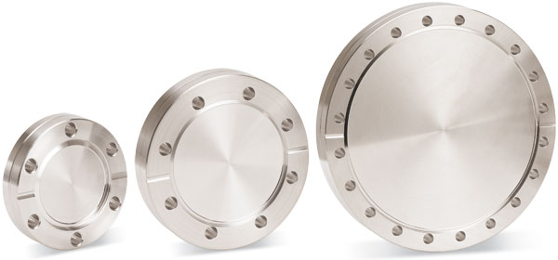
Force applied on a vacuum vessel
When the vacuum vessel is evacuated, a force is applied onto it
It amounts to 1 kg/cm²
Example: force applied on a blank flange
Picture Kurt J. Lesker
D (mm) | 16 | 35 | 63 | 80 | 100 | 130 | 150 | 212
kg | 2 | 10 | 32 | 52 | 81 | 137 | 182 | 363
As a consequence of the « vacuum force » …

Slide 23
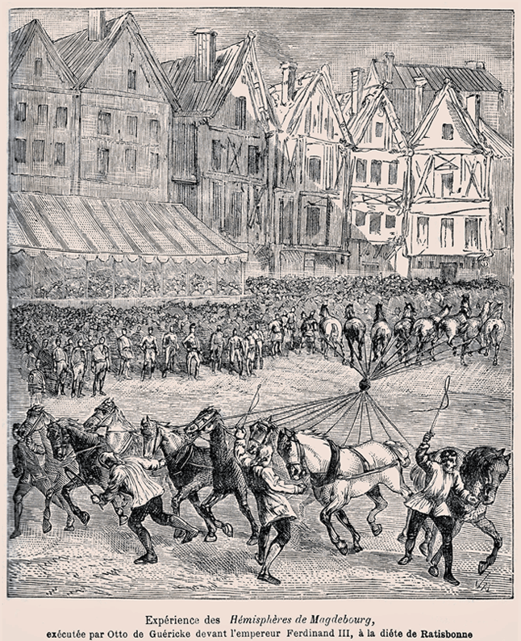
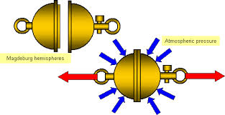
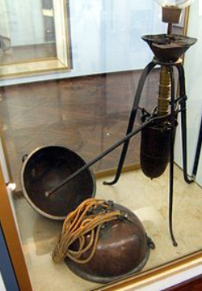
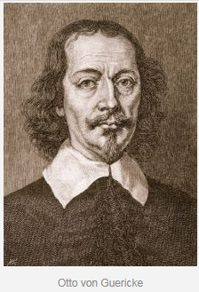
“Vacuum force”: Magdeburg hemisphere
1654, Regensburg
55 cm diameter ➔ 25 Tons

Slide 24
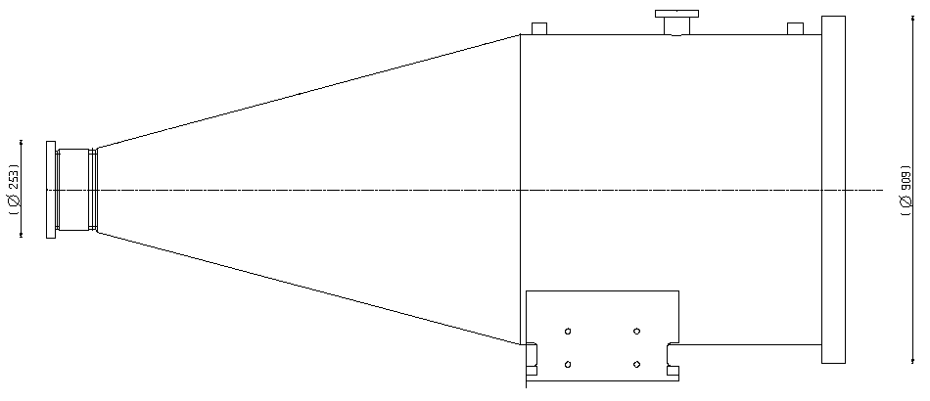
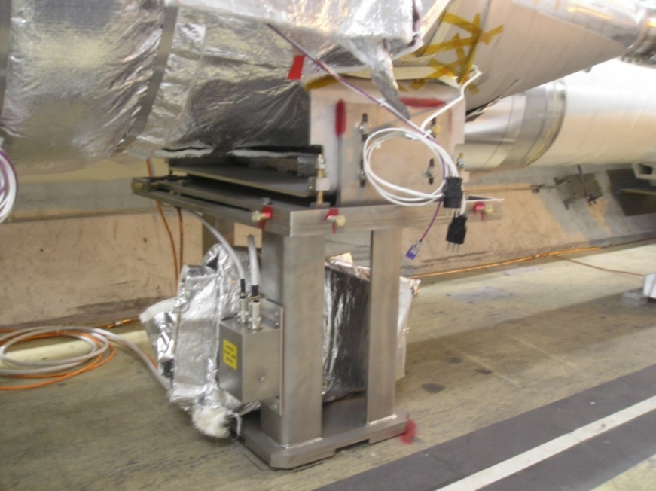
Work with the Mechanical Design Office !
0.5 ton
6.6 tons
60
Otherwise…

Slide 25
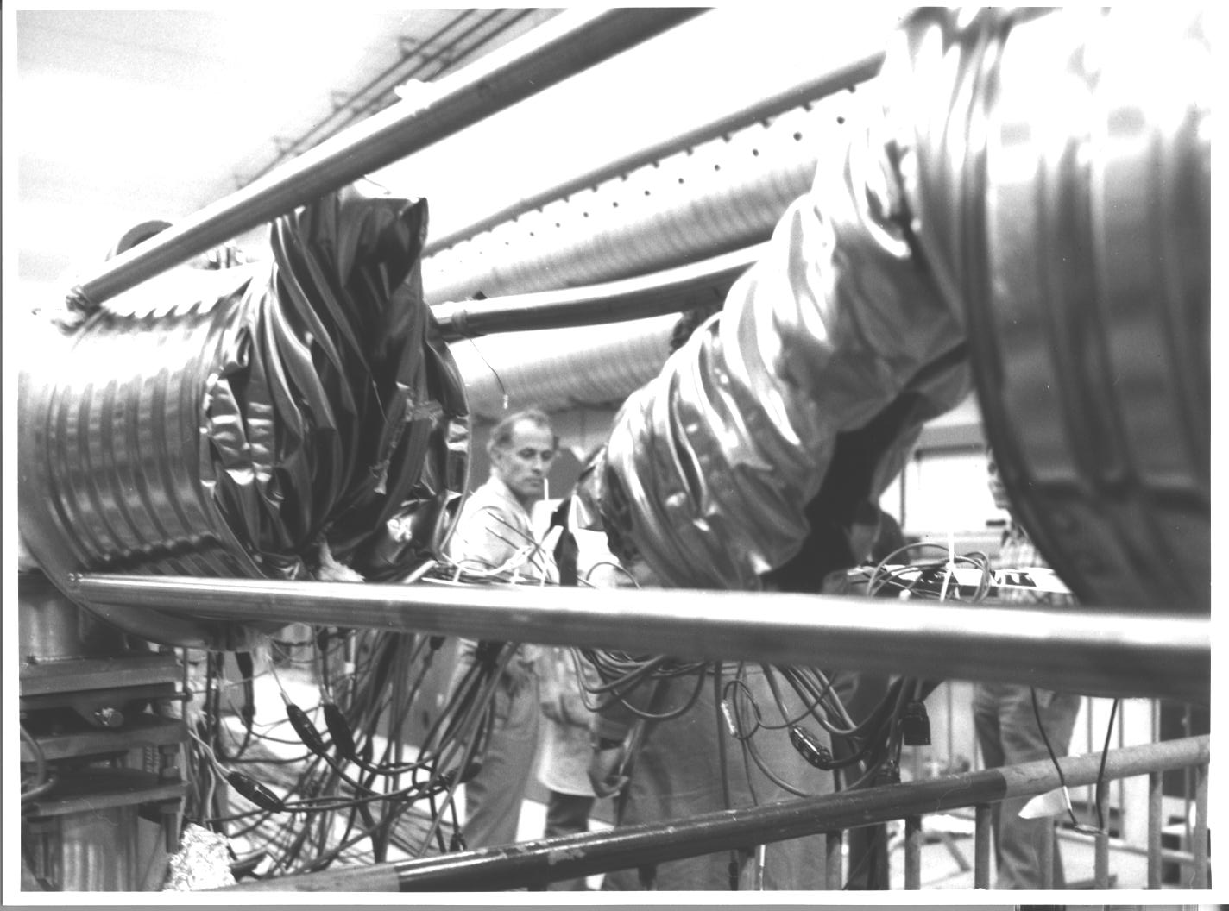
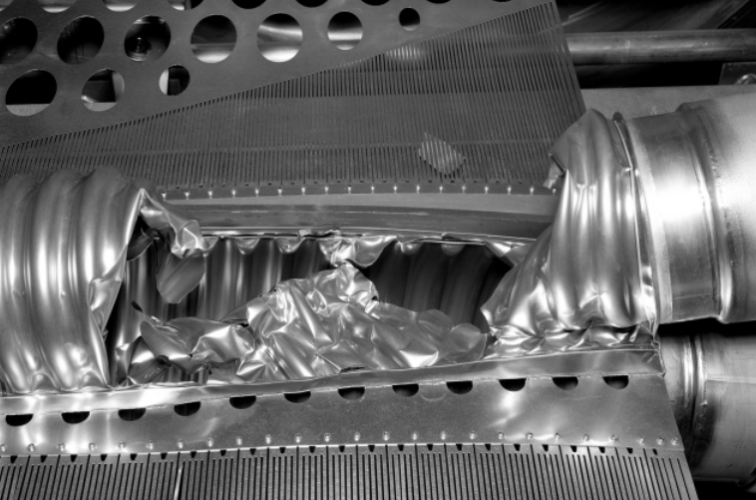
Typical accidents with UHV!
Case of the CERN ISR in the 70’s :
“spontaneous” breaking of a bellow (either due to a bad design or to a fixed point not well attached)
Imploded “flat fish” at an ISR intersection

Slide 26
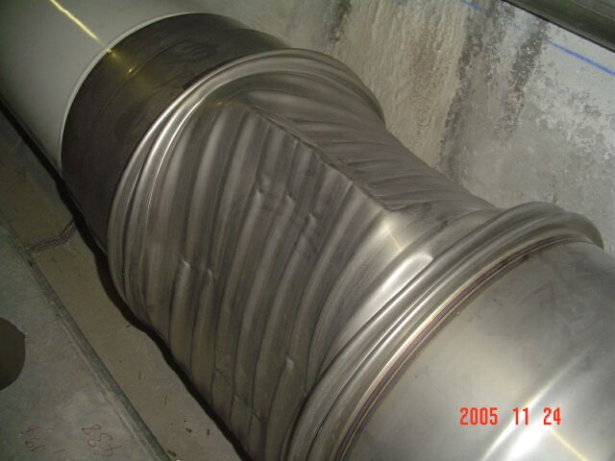
Even in modern times …
Accident still possible nowadays even with modern computing tools …
Case of the QRL’s bellows in the LHC deformed during pump down,
Origin attributed to a non-conform bellow with a too small corrugation high

Slide 27
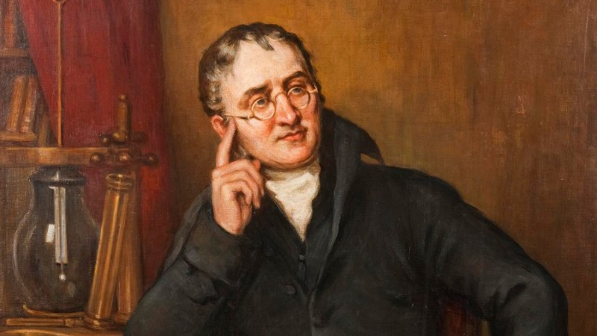
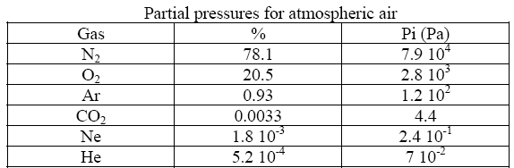
Total Pressure and Partial Pressure
The gas is usually composed of several types of molecules (ex : air, residual gas in vacuum systems)
The total pressure, P_{Tot}, is the sum of all the partial pressure, P_{i} (Dalton law)
John Dalton, 1801

Slide 28
2.2 Gas flow

Slide 29
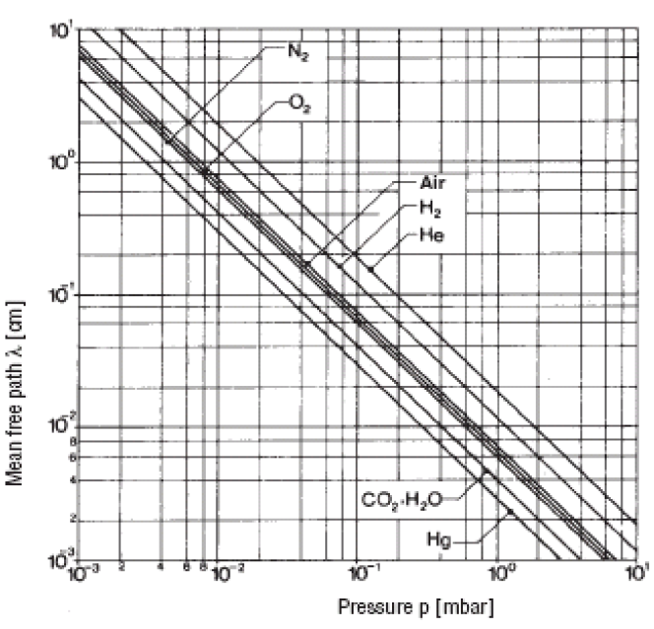
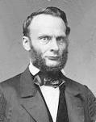

Mean Free Path
It is the path length that a molecules traverse between two successive impacts with other molecules. It was derived by Clausius.
It is a function of the pressure, P, of the temperature, T, and of the molecular diameter, σ.
$$λ=\frac{1}{\sqrt{2}πnσ^{2}}=\frac{1}{\sqrt{2}π}\frac{kT}{P}\frac{1}{σ^{2}}$$
Molecule | Diameter (Å)
H₂ | 2.8
H₂O | 2.9
O₂ | 2.9
N₂ | 3.7
CO₂ | 3.2
R. Clausius

Slide 30
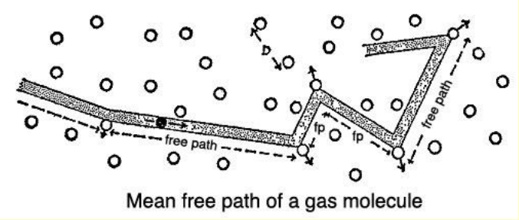
Mean Free Path: air at room temperature
At atmospheric pressure, λ = 70 nm
At 1 Torr, λ = 50 μm
At 10⁻³ Torr, λ = 5 cm
At 10⁻⁷ Torr, λ = 500 m
At 10⁻¹⁰ Torr, λ = 500 km
Increasing mean free path
when decreasing pressure

Slide 31
Classification of vacuum
From atmospheric pressure to very low pressure, the mean free path varies over more than 10 orders of magnitude!
Low or Rough vacuum
  10⁵ to 10² Pa ; 10³ to 1 mbar
Medium vacuum
  10² to 10⁻¹ Pa ; 1 to 10⁻³ mbar
High vacuum (HV)
  10⁻¹ to 10⁻⁵ Pa ; 10⁻³ to 10⁻⁷ mbar
Ultra-high vacuum (UHV)
  10⁻⁵ to 10⁻¹⁰ Pa ; 10⁻⁷ to 10⁻¹² mbar
Extreme-high vacuum (XHV) (below actual limit of “standard” instrumentation)
  <10⁻¹² Pa ; <10⁻¹² mbar

Slide 32
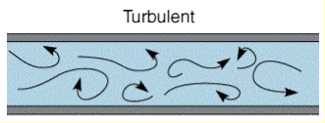
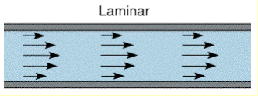
Flows
The turbulent flow is established around the atmospheric pressure
In the low vacuum (10³-1 mbar), the flow is viscous and laminar.
In the high vacuum (10⁻³ – 10⁻⁷ mbar) and ultra-high vacuum (10⁻⁷–10⁻¹² mbar), the flow is molecular. The mean free path is much larger than the vacuum chamber diameter. Molecules interact only with the vacuum chamber walls
Molecular flow is the main regime of flow to be used in vacuum technology
In this regime, the vacuum vessel has been evacuated from its volume.
The pressure inside the vessel is dominated by the nature of the surface.

Slide 33
Molecular Flow: domain of application
Assume an accelerator ring operating under UHV:
  vacuum chamber diameter ~ 10 cm
  average pressure 10⁻⁸ mbar (= 7.5 10⁻⁹ Torr)
    ➔ PxD = 7.5 10⁻⁹ x 10 = 7.5 10⁻⁸ Torr.cm ➔ molecular regime
  mean free path:
    ➔ λ = 5 10⁻⁵ / 7.5 10⁻⁸ = 667 m
Assume a large vacuum vessel, e.g. a large cryostat, operating under UV:
  vacuum chamber diameter ~ 10 m (=1000 cm)
  average pressure 10⁻⁵ mbar (= 7.5 10⁻⁶ Torr)
    ➔ PxD = 7.5 10⁻⁶ x 1000 = 7.5 10⁻³ Torr.cm ➔ molecular regime
  mean free path:
    ➔ λ = 5 10⁻⁵ / 7.5 10⁻⁶ = 7 m

Slide 34
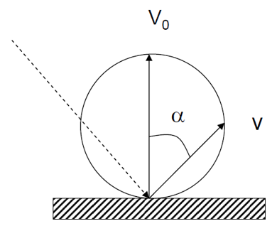
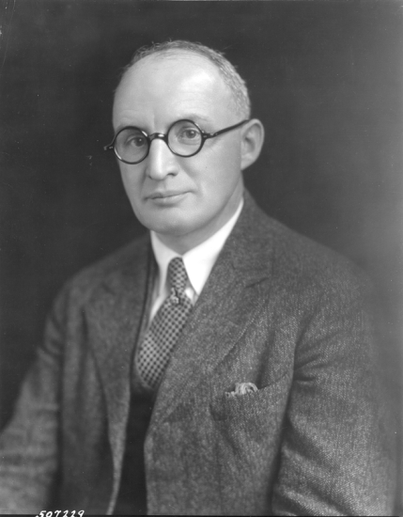


Molecule interaction with the wall
In the molecular regime, Knudsen observed that the speed of the molecules is reduced due to interactions with the pipe
Following the collision on the wall, owing to the roughness of the surface, the molecule is re-emitted into the vacuum system according to a Beer-Lambert law.
Knudsen number
$$V=V_{o}\cos{α}$$
$$K=\frac{λ}{d}$$
This observation introduced the concept of conductance (Dushman)
Saul Dushman (1883–1954)

Slide 35
Conductance
It is defined by the ratio of the molecular flux, Q, to the pressure drop along a vacuum vessel. It is a function of the shape of the vessel, the nature of the gas and its temperature.
Adding conductances in parallel
Adding conductances in series
Q
P₁
P₂
C₁
Q
Q
P₁
P₂
C₂
C₁
C₂
P₁
P₂
Q

Slide 36
Conductance Calculus in Molecular Regime
For a (thin) orifice :
The conductance of an orifice of 10 cm diameter is 900 l/s
For a tube :
The specific conductance of a tube of 10 cm diameter is 120 l/s.m
To increase the conductance of a vacuum system, it is better to have a vacuum chamber with large diameter and short lenght

Slide 37
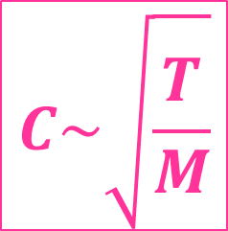
Scaling of conductances
The conductance scales like:
Gas | M | C_orifice [l/s] | C_tube [l/s.m]
Air | 29 | 900 | 120
H₂ | 2 | 3427 | 457
CH₄ | 16 | 1212 | 162
CO | 28 | 916 | 122
CO₂ | 44 | 731 | 97
$$C\sim \sqrt{\frac{T}{M}}$$
at room temperature

Slide 38
Pumping Speed
The pumping speed, S, is the ratio of the flux of molecules pumped to the pressure
S range from 10 to 20 000 l/s
Q range from 10⁻¹⁴ mbar.l/s/cm² for metalic tubes to 10⁻⁵ – 10⁻⁴ mbar.l/s/cm² for plastics
mbar.l/s
l/s
mbar
3 orders of magnitude for pumping
vs
10 orders of magnitude for outgassing
Outgassing MUST be optimised to achieve UHV

Slide 39


Effective pumping speed
It is the pumping speed seen from P’ trough the pipe of conductance, C
Q, C
Pumping speed
P
P’
$$\left\{\begin{aligned}Q=P S \\ Q=C \left(P^{′}−P\right)\end{aligned}\overset{⇒}{} Q= \frac{SC}{S+C}P′\right.= S_{eff}P′$$
S
Conductance
$$S_{eff}= \frac{SC}{S+C}$$
This is the result of adding in series the conductance C with the pumping speed S
If:
  C=S then S_{eff} = S/2
  C>> S then S_{eff} = S
  C<< S then S_{eff} = C, the system is “conductance limited”
Large conductances preserve the efficiency
of the pumping system

Slide 40

Effective pumping speed
Assume a 10 m long 10 cm diameter vacuum pipe evacuated by a turbomolecular pump of 60 l/S
C
Seff, P
S
C = 120 / 10 = 12 l/s
S = 60 l/S
Seff = (12x60)/(12+60) = 10 l/s
The system is conductance limited and the (effective) pumping speed, hence pressure, at the upstream part is defined by the conductance of the pipe!

Slide 41


Differential pumping system
This system allows to decouple a vacuum system from another one (e.g. in Linac source, between baked and unbaked vacuum system)
UHV
10⁻¹
Q, C
Q₁, C
Q₄, C
P₁
P₂
P₃
P₄
Q₂, S
Q₃, S
Commercial differential pumps
Pictures Edwards

Slide 42
3. Measurement &
production of vacuum

Slide 43
3.1 Vacuum gauges

Slide 44
Vacuum gauges pressure range
16 orders of magnitude !
Pa
10⁻¹²
10⁻¹⁰
10⁻⁸
10⁻⁶
10⁻⁴
10⁻²
10
10²
10⁴
Capacitance
Spinning rotor
Piezo
Pirani
Penning
Bayard-Alpert
Helmer, extractor
mbar
10⁻¹⁴
10⁻¹²
10⁻¹⁰
10⁻⁸
10⁻⁶
10⁻⁴
10⁻²
10
10²

Slide 45





Pirani Gauge
Pirani gauges are used in the range 1 atm -10⁻⁴ mbar to monitor the roughing of a vacuum system
Robust, gas dependent, accuracy 10-100 %
Operating principle based on the variation of the heat conductivity trough a gas
  ➔ pressure reading above 1 mbar are wrong
Tungsten wire
wikipedia
M. Pirani 1906
Inficon Pirani gauge
Pfeiffer Pirani gauge
Edwards Pirani gauge

Slide 46



Penning Gauge
Penning gauges are commonly used in the range 10⁻⁵ -10⁻¹⁰ mbar. They are use for interlocking purposes
Robust, gas dependent, accuracy ~ 20-50 %
It is a cold cathode ionisation gauge i.e. there are no hot filament: electron are produced by field emission
The operating principle is based on the measurement of a discharge current in a Penning cell which is a function of pressure : I⁺ = P^{n}, n is close to 1
B
F. Penning 1937
Pfeiffer Penning gauge

Slide 47


A discharge in a Penning gauge
a Penning gauge:
Courtesy Pfeiffer
Penning gauge ON behind a window
In the dark, the discharge is seen
Pictures courtesy B. Henrist, TE-VSC

Slide 48




Bayard-Alpert Gauge
Bayard-Alpert gauges are used for vacuum measurement purposes in the range 10⁻⁶ -10⁻¹² mbar.
It is a hot filament ionisation gauge. Electrons emitted by the filament perform a few oscillations inside the grid and ionise the molecules of the residual gas. Ions are then collected by an electrode.
Ion collector = 0 V
Filament = + 50 V
Grid = + 150 V
Modulator = + 150 V
L.G. Pittaway. J. of Phys. D: Appl. Phys. 3, 1113-1121, 1970
Courtesy B. Jenninger

Slide 49


A burned filament
Obviously, even is there are 2 filaments, the gauge is polluted therefore the pressure measurement will not be correct !
It is wise to exchange the vacuum gauge
Pictures courtesy B. Henrist, TE-VSC

Slide 50




Bayard-Alpert Gauge: Sensitivity
The ion current collection can be described by:
$$I^{+}=I_{e}σ n L$$
Where :
I⁺ is the ion current
I⁻ is the filament current
σ is the ionisation cross section
n the gas density
L the electron path length
The vacuum gauge sensitivity, S in mbar⁻¹, is defined by:
$$S= \frac{σ L}{k T}$$
$$I^{+}=I_{e} S P$$
I_{e} (mA) | P (mbar) | I⁺ (pA)
4 | 10⁻¹⁰ | 16
4 | 10⁻¹² | 0.16
0.1 | 10⁻¹⁰ | 0.4
0.1 | 10⁻¹² | 0.004
The gauge needs to be calibrated for several gases
S_{N2} ~ 40 mbar⁻¹
The pressure reading is expressed in nitrogen equivalent
In UHV, typical collected current are in the pA range

Slide 51




Bayard-Alpert Gauge: Sensitivity
The sensitivity can be measured and also computed from simulations
$$S_{i}= \frac{σ L}{k T}$$
Space charge
effect
Relative sensitivity:
$$S_{rel,i}= \frac{S_{N2}}{S_{i}}$$
4 mA
$$P_{i}= S_{rel,i} P_{N2}$$
B. Jenninger et al. Vacuum 138 (2017) 173-177
 | H₂ | He | CH₄ | Ne | N₂ | CO | C₂H₆ | Ar | CO₂ | Xe
S_{i} (mbar⁻¹) | 19.06 | 7.46 | 60.62 | 10.48 | 41.84 | 42.30 | 114.71 | 53.19 | 54.48 | 7.50
S_{rel,i} (mbar,i/mbar,N₂) | 2.20 | 5.61 | 0.69 | 3.41 | 1.00 | 0.99 | 0.36 | 0.79 | 0.77 | 4.83
The sensitivity relative error equals ~ 10 %
A pressure reading in N₂ equivalent is: P_{read} =2 10⁻¹⁰ mbar, in the case the main molecular species is H₂, the real pressure is: P = S_{rel,H2} x P_{read} = 4.4 10⁻¹⁰ mbar

Slide 52
3.2 Gas analysis

Slide 53




Residual Gas Analysers
Residual Gas Analysers are used in the range 10⁻⁴ -10⁻¹³ mbar. Their purpose is to do gas analysis
A filament produces electrons which ionise the residual gas inside a grid.
A mass filter is introduced between the grid and the ion collector.
The ion current can be measured in Faraday mode or in secondary electron multiplier mode.
G.J. Peter, N. Müller. CAS Vacuum in accelerators CERN 2007-003
Picture Pfeiffer
1 mA
Q ~ 2 10⁻⁹ mbar.l/s
ΔM at FHWM = 0.5 AMU
Range: 10⁻¹⁴ till 10⁻⁵ A
Gain ~ 10³ -10⁴ electrons/ion

Slide 54




RGA: Cracking pattern
Ions produced inside the grid can be fragmented into sub-species by the collisions with electrons
The table gives the percentage of the fragments with respect to the main peak
Example Mass 28
Nitrogen is traced by mass:
  28 (N₂⁺)
  14 (N⁺): I₁₄ = 0.14 I₂₈
Carbon monoxide is traced by mass:
  28 (CO⁺)
  12 (C⁺): I₁₂ = 0.06 I₂₈
Carbon dioxide is traced by mass:
  44 (CO₂⁺)
  28 (CO⁺): I₂₈ = 0.13 I₄₄
  16 (O⁺): I₁₆ = 0.16 I₄₄
  12 (C⁺): I₁₂ = 0.10 I₄₄

Slide 55






RGA: Spectrum
A typical spectrum of a baked vacuum system: P = 10⁻¹⁰ mbar
M/e | Ion | Molecule
2 | H₂⁺ | H₂
15 | CH₃⁺ | CH₄
28 | CO⁺ | CO
40 | Ar⁺ | Ar
44 | CO₂⁺ | CO₂
12 | C⁺ | CO+CO₂
16 | O⁺ | Filament artefacts
19 | F⁺
2
28
16
44
12
19
15
40
H₂
Di-Hydrogen
M/e=2;1
CH₄
Methane
M/e=15;(16)
H₂O
Water
M/e=18;17;16
CO
Carbon monoxide
M/e=28;12
Ar
Argon
M/e=40;20
CO₂
Carbon dioxide
M/e=44;16;28;12
N₂
Nitrogen
M/e=28;14
O₂
Oxygen
M/e=32;16

Slide 56



RGA: Partial Pressure
The RGA needs to be calibrated against a total pressure gauge for standard gases.
To consider the RGA ageing, relatives sensitives are used and a normalization factor, K, is introduced
$$P_{i, N2}=K S_{abs,CO,RGA}{×S}_{rel,i,RGA} ×I_{i}$$
According to the Dalton’s law, the reading given by the total pressure gauge shall equal the sum of the partial pressure, expressed in nitrogen equivalent:
$P_{N2 }=$ $\sum_{j=1}^{n}{P_{j, N2}=K S_{abs,CO,RGA} \sum_{j=1}^{n}{\left(S_{rel,j,RGA}×I_{j}\right) }}$
Therefore:
$$K=\frac{P_{N2 }}{S_{abs,CO,RGA} \sum_{j=1}^{n}{\left(S_{rel,j,RGA}×I_{j}\right) }}$$
So:
$P_{i}=S_{rel,i} {P_{i, N2}= S}_{rel,i} \frac{S_{rel,i,RGA}}{\sum_{j=1}^{n}{S_{rel,j,RGA} × I_{j}}}$ $P_{N2 }I_{i}$
 | H₂ | CH₄ | N₂ | CO | Ar | CO₂
S_{rel,i,RGA} (Torr N₂/Torr) | 1.09 | 0.93 | 0.99 | 1 | 1.18 | 1.96

Slide 57
Typical spectrum of a baked vacuum system
Baked system with P= 10⁻¹⁰ mbar N₂ eq
2
28
44
 | H₂ | CH₄ | CO | Ar | CO₂
I (A) | 1 10⁻⁹ | 2 10⁻¹² | 7 10⁻¹¹ | 5 10⁻¹³ | 2 10⁻¹¹
P (mbar) | 2 10⁻¹⁰ | 1 10⁻¹³ | 6 10⁻¹² | 4 10⁻¹⁴ | 3 10⁻¹²
% Pi | 96 | 0 | 3 | 0 | 1
Note: a simple estimation from the total pressure measurement would give P= 2.2 10⁻¹⁰ mbar!

Slide 58

Typical spectrum in the presence of an air leak
RGA are also useful to identify, trace and estimate air leaks
Air leak
M/e | Ion | Molecule
14 | N⁺ | N₂
28 | N₂⁺ | N₂
32 | O₂⁺ | O₂
40 | Ar⁺ | Ar
Assume a 8 cm diam. tube with specific conductance ~ 60 ℓ.s.m:
  a leak detected 10 m away from the gauge (at P= 8 10⁻⁷ mbar)
  Hence, a pumping speed of 6 ℓ/s at the level of the leak gives a leak rate of:
    6 x 8 10⁻⁷ = 5 10⁻⁶ mbar.ℓ/s (i.e.)
Beware, oxygen being highly chemically reactive, its mass is not always present in the spectrum!

Slide 59
3.3 Vacuum pumps

Slide 60
Vacuum pumps pressure range
16 orders of magnitude !
Pa
10⁻¹²
10⁻¹⁰
10⁻⁸
10⁻⁶
10⁻⁴
10⁻²
10
10²
10⁴
Oil sealed mech. pump
Turbo molecular pump
Sputter ion pump
Cryopumps
Ti sublimation pump
NEG & cryogenics pumps
mbar
10⁻¹⁴
10⁻¹²
10⁻¹⁰
10⁻⁸
10⁻⁶
10⁻⁴
10⁻²
10
10²

Slide 61



Turbomolecular pumping group
Used to pump down from atmosphere and commission vacuum sectors down to 10⁻¹¹ mbar
Mobile system based on rotary vane primary pump and turbomolecular pump
Primary pump
Valve
Turbomolecular pump
Primary pump
Turbomolecular pump
Primary pump

Slide 62


Sputter Ion Pump
This pump operate in the range 10⁻⁵ -10⁻¹¹ mbar. It is used to maintain the pressure in the vacuum chamber of an accelerator.
Pumping speed range from 1 to 500 l/s.
Titanium sputtered from the cathode bombarded by accelerated ions provides pumping.
The ion current is proportional to pressure, hence these pumps are used for interlocks
Picture Agilent, Varian

Slide 63
Lecture 1 summary
The kinetics of gas molecules is described by a Maxwell-Boltzmann distribution.
The pressure is defined by the ideal gas law.
As a function of mean free path, several regime of flow exits.
The molecular flow is the regime of vacuum systems: the molecules interact only with the vacuum chamber wall.
The conductance characterise the pressure drop along a vacuum component
The pressure in a vessel is defined by the ratio of the gas flow to the pumping speed
Main instruments for vacuum measurement are: Pirani, Penning, Bayart-Alpert gauges and residual gas analysers
Main devices for vacuum pumping are: primary, turbomolecular and ion pumps.

Slide 64
Some References
Cern Accelerator School, Vacuum technology, CERN 99-05
Cern Accelerator School, Vacuum in accelerators, CERN 2007-03
Cern Accelerator School, Vacuum for particle accelerators, CERN-ACC-2020-0009
The physical basis of ultra-high vacuum, P.A. Redhead, J.P. Hobson, E.V. Kornelsen. AVS.
Scientific foundations of vacuum technique, S. Dushman, J.M Lafferty. J. Wiley & sons.
Les calculs de la technique du vide, J. Delafosse, G. Mongodin, G.A. Boutry. Le vide.
Vacuum Technology, A. Roth. Elsevier Science
Foundations of vacuum science and technology, Ed by J.M. Lafferty. J. Wiley & sons.
Some Journals Related to Vacuum Technology
Journal of vacuum science and technology
Vacuum

Slide 65
Thank you for your attention !!!

Slide 67
Complementary
informations

Slide 68
2.1 Gas kinetic theory

Slide 69

Collision on the wall
Complementary information
The molecular collision rate on the wall (the incidence rate), ν, can be derived from the Maxwell Boltzmann distribution
$$ν=\frac{number of collision with the wall}{area of wall x time}= \frac{1}{4} n \overline{v}$$
Monolayer formation time
10¹⁵ molecules/cm²
At room temperature, a monolayer is formed in 1 s at 10⁻⁶ Torr : Langmuir formation time
1 L = 1 monolayer.s
Very low pressure is preferred to minimize surface contamination:
1 ns at 1 atm
1 s at 10⁻⁶ mbar
1 day at 10⁻¹¹ mbar !!!
H₂ at 300 K

Slide 70

Collision on the wall: cryogenic temperature
The molecular collision rate on the wall (the incidence rate), ν, can be derived from the Maxwell Boltzmann distribution
Complementary information
n (H₂/m³) | V (H₂/cm²/s) | Time
10¹⁰ | 5 10⁷ | 220 d
10¹¹ | 5 10⁸ | 22 d
10¹² | 5 10⁹ | 2
10¹³ | 5 10¹⁰ | 5 h
10¹⁴ | 510¹¹ | 30 min
10¹⁵ | 5 10¹² | 3 min
H2 at 4.2 K

Slide 71
2.2 Gas flow

Slide 72
Complementary information
Turbulent and Viscous Flows
When pumping down from atmospheric pressure, the physics is characterised by different flow regimes. It is a function of the pressure, of the mean free path and of the components dimensions.
Reynolds number, Re :
  if Re > 2000 the flow is turbulent
  it is viscous if Re < 1000
The turbulent flow is established around the atmospheric pressure
In the low vacuum (10³-1 mbar), the flow is viscous. The flow is determined by the interaction between the molecules themselves. The flow is laminar. The mean free path of the molecules is small compared to the diameter of the vacuum chamber

Slide 73
Complementary information
Transition and Molecular Flows
In the medium vacuum (1-10⁻³ mbar), the flow is transitional. In every day work, this range is quickly crossed when pumping down vacuum chambers. In this regime, the calculation of the conductance is complex. A simple estimation is obtained by adding laminar and molecular conductances.
In the high vacuum (10⁻³ – 10⁻⁷ mbar) and ultra-high vacuum (10⁻⁷–10⁻¹² mbar), the flow is molecular. The mean free path is much larger than the vacuum chamber diameter. The molecular interactions do not longer occurs. Molecules interact only with the vacuum chamber walls
Molecular flow is the main regime of flow to be used in vacuum technology
In this regime, the vacuum vessel has been evacuated from its volume.
The pressure inside the vessel is dominated by the nature of the surface.

Slide 74
As a function of pressure
Complementary information
P (mbar) | Force per unit surface | Density (molec.cm⁻³) | Mean free path | Incidence rate (cm⁻².s⁻¹) | Monolayer formation time
1013 | 1 kg/cm² | 2.5 10¹⁹ | 0.1 μm | 2.9 10²³ | 3.4 ns
1 | 1 g/cm² | 2.5 10¹⁶ | 0.1 mm | 2.9 10²⁰ | 3.4 μs
10⁻³ | 1 mg/cm² | 2.5 10¹³ | 10 cm | 2.9 10¹⁷ | 3.4 ms
10⁻⁶ | 1 μg/cm² | 2.5 10¹⁰ | 100 m | 2.9 10¹⁴ | 3.4
10⁻⁹ | 10 μg/m² | 2.5 10⁷ | 100 km | 2.9 10¹¹ | 1 h
10⁻¹² | 10 ng/m² | 2.5 10⁴ | 10⁵ km | 2.9 10⁹ | 40 days

Slide 75







Conductance: Analogy to electricity
Complementary information
The flux, Q, correspond to the current, I
The pressure, P, corresponds to the voltage, V
The inverse of the conductance, C, corresponds to the resistance, R
Adding resistances in parallel
Adding resistances in series
R, I
Ohm’s law:
V₁
V₂
$$\left(V_{1}−V_{2}\right)=R I ⟺\frac{1}{R}=\frac{I}{\left(V_{1}−V_{2}\right)}$$
$$C=\frac{Q}{\left(P_{1}−P_{2}\right)}$$
R₁
$$\frac{1}{R}=\frac{1}{R_{1}}+\frac{1}{R_{2}}$$
$$C=C_{1}+C_{2}$$
R₂
$$\frac{1}{C}=\frac{1}{C_{1}}+\frac{1}{C_{2}}$$
$$R=R_{1}+R_{2}$$
R₁
R₂
Vacuum systems can be computed using software developed for electrical engineering!

Slide 76




More conductances
Complementary information
Short tube: the conductance of an orifice multiplied by the Clausing factor i.e. the transmission probability trough the “short tube”
For long circular tube, the transmission probability equals:
Table & plot courtesy of Y. Li and X. Liu
http://uspas.fnal.gov/materials/15ODU/Session1_Fundamentals.pdf

Slide 77



Calculating conductances with Molflow+
Complementary information
A test particle Monte-Carlo code for molecular flow
http://molflow.web.cern.ch/
R. Kersevan – M. Ady
courtesy of Y. Li and X. Liu

Slide 78
3.1 Vacuum gauges

Slide 79


Pirani Gauge
Complementary information
Pirani gauges are commonly used in the range 1 atm -10⁻⁴ mbar.
The operating principle is based on the variation of the thermal conductivity of the gases as a function of pressure. A resistor under vacuum is heated at a constant temperature (~ 120°C). The heating current required to keep the temperature constant is a measure of the pressure.
In the viscous regime, the thermal conductivity is independent of the pressure. Therefore pressure readings given above 1 mbar are wrong !
True vs indicated pressure
K. Jousten. J.Vac.Sci. Technol. 26(3), May/Jun 2008, 352-359

Slide 80

Penning Gauge
Penning gauges are commonly used in the range 10⁻⁵ -10⁻¹⁰ mbar. They are use for interlocking purposes
It is a cold cathode ionisation gauge i.e. there are no hot filament
The operating principle is based on the measurement of a discharge current in a Penning cell which is a function of pressure : I⁺ = P^{n}, n is close to 1
Complementary information
At high pressure the discharge is unstable due to arcing.
At low pressure, the discharge extinguishes which means zero pressure reading …
Electrons are produced by field emission and perform oscillations due to the magnetic field
Along the path length, molecules are ionised and ions are collected onto the cathode
WARNING : leakage current on the HV cables simulates a higher pressure
(cathode)
P. Redhead. J.Vac.Sci. 21(5), Sept/Oct 2003, S1-S5

Slide 81



Spinning rotor gauge
Complementary information
It is a reference standard which allows an absolute measurement of the pressure
It is fully bake able up to 450 deg (so low outgassing rate)
SRG gauges are used in the range 5 10⁻⁷ -10⁻² mbar, accuracy ~ 2 %, uncertainty ~0.5 %.
A stainless steel ball is magnetically levitated and rotated by a drive assembly
Collisions of the gas molecules with the surface of the ball decelerates the ball: the principle of measurement is mechanical
The viscosity of the gas shall be entered into the power supply for pressure measurement
$$P=\frac{d_{Ball}}{10}\frac{ρ_{Ball}}{σ_{gaz}}\sqrt{\frac{2πRT}{M}}\frac{\left(T_{rev, n+1}−T_{rev, n}\right)}{{\overline{T_{rev}}}^{2}}$$
Viscosity, s_{gaz} | H₂ | He | CH₄ | H₂O | N₂ | CO | Ar | CO₂ | Xe
10⁻⁶ Pa.s | 8.8 | 19.6 | 10.8 | 9 | 17.5 | 17.6 | 22.1 | 14.6 | 21.9

Slide 82



Capacitance diaphragm gauge
Complementary information
It allows an absolute direct measurement of the pressure: the reading is
independent of the gas species!
It operates in the range 10⁻⁵ – 10⁴ mbar
Electrodes are placed in a vacuum of ~ 10⁻⁷ mbar maintained by a getter.
The capacitance varies under the deflection of a 25 micron thick diaphragm due to the vacuum force (the pressure in the vacuum system)
The sensitivity of the diaphragm deflection is 0.4 nm (10⁻⁴ pF) !
It is sensitive to thermal fluctuations: a thermostated housing is used (45 +/0.02 degres C)
Uncertainty : 0.3 to 10 % - Accuracy: 0.15 %
N2
Courtesy Vacom
K. Jousten, S. Nael, J.Vac. Sci.Technol. A 29(1), Jan/Feb 2011, 011011-1

Slide 83

Strain gauge
Complementary information
It allows a direct measurement of the pressure: the reading is independent of the gas species!
A strain sensor is placed in a sealed volume
The change of the pressure causes a diaphragm to move against the piezo sensitive plate of the strain sensor.
This induce the change of the resistance of the piezoelectric transducer part of a bridge network

Slide 84


Bayard-Alpert Gauge: CERN construction
Complementary information
Large electron path length are needed to increase the vacuum gauge sensitivity: L ~ 7 cm
The ionization volume (grid volume) must be large
The gauge is mounted on a DN63 flange
It is bake able to 400°C
Low outgassing rate (~ 5 10⁻¹⁰ mbar.l/s)
Large sensitivity ~ 40 mbar⁻¹ for N₂
a. W Filament: Ø0.18, height 30
b. Closed grid: Ø35 x 45, pitch 2
Platinium-iridium wire: Ø0.13
c. W Collector: Ø0.05, length 42
d. Modulator: Ø0.7, length 42
V_{grid} = 50 cm³

Slide 85



Bayard-Alpert Gauge: Filament
Complementary information
Electron are produced at the W filament by thermo-electronic emission
The emission is a function of the work function, Φ, of the material
Filaments are made of Iridium/Ytrium, W/Thorium coated to reduce the work function, thereby reducing the operating temperature, T, (thus gas load into the system)
Richardson-Dushman equation
Typical chemical reactions at the filament
$$J=A T^{2} e^{−\left(φ/{kT}\right)}$$
A = (1-r) A_{o}
A₀ = 120 A/(cm²K²)
Material | A | Φ (eV)
W | 60 | 4.54
W-Th | 3 | 2.63
Ir | 60 | 5.3
Ir-Y | 2 | 2.6
D. Alpert, Le Vide 17 (1962),19
Some electrons can bombard the grid with ~ 150 eV: they can desorb gas molecules and produce an artificial increase of the pressure.
The vacuum gauges are therefore “degassed” by electron bombardment at large current (~ 10 mA) and energy () of the grid and electrodes
Filaments have pumping speed: 0.1 – 1 l/s

Slide 86


Bayard-Alpert Gauge: X-rays
Complementary information
Electrons which are bombarding the grid, creates photons by bremsstrahlung
A fraction of those photons irradiated the collector producing a photoelectron
The photoelectron production is interpreted by the electronic system as a positive charge i.e. as a constant pressure, P_{x-ray}
X-ray limit of P_{xray} ~ 2 10⁻¹² mbar

Slide 87



Bayard-Alpert Gauge: Modulation
Complementary information
A correction of the residual pressure due to the x-ray can by applied by the “modulation” technique
Modulator | High Pres. | Low Pres.
0 V | I’₁ = I’⁺ | I₁ = I⁺ + I_{x}
+ grid | I’₂ = k I’⁺ | I₂ = k I⁺ + I_{x}
$k= \frac{I_{2}^{′}}{I_{1}^{′}}$ = $\frac{P_{2}^{′}}{P_{1}^{′}}$
$$⇒P= \frac{P_{1} − P_{2}}{1−k}$$
$$I^{+}= \frac{I_{1} − I_{2}}{1−k}$$
 | H₂ | He | CH₄ | N₂ | CO | C₂H₆ | Ar | CO₂
k | 0.86 | 0.91 | 0.89 | 0.89 | 0.89 | 0.89 | 0.89 | 0.89
X-ray limit of P_{xray} ~ 2 10⁻¹² mbar

Slide 88


Helmer gauge
Complementary information
Electrostatically-deflected ion beam with an electron suppressor grid
Very low x-ray value ~ 5 10⁻¹⁴ mbar
10⁻¹³ to 10⁻⁶ mbar with Ie ~ 10 mA
10⁻⁶ to 10⁻⁴ mbar with Ie ~ 0.18 mA
Sensitivity: 20 mbar⁻¹ for N₂
Bakeable to 450 deg C, degassing current at 100 mA with + 500 V on the grid

Slide 89


Helmer gauge and XHV
Complementary information
Recently measured pressure is ~ 5 10⁻¹⁴ mbar in a dedicated set up
Courtesy B. Jenninger

Slide 90


Extractor gauge
Complementary information
The ion collection (collector) is located outside the ionization region (grid)
The reflector used to reflect the ions on the collector tip for sensitivy enhancement
Low x-ray value ~ 10⁻¹² mbar
10⁻¹² to 10⁻⁴ mbar
Operating current: 1.6 mA, filament in Iridium with yttric oxid coating
Sensitivity: 5 mbar⁻¹ for N₂ (due to the small grid volume Ø12 x 25)
Bakeable up to 350°C
Anode: grid at 220 V
Cathode: filament at 100 V
Reflector at 205 V
Ion collector at 0 V
V_{grid} = 10 cm³

Slide 91
3.2 Gas analysis

Slide 92

RGA: Unbaked system
Complementary information
A typical spectrum of an unbaked vacuum system
M/e | Ion | Molecule
2 | H₂⁺ | H₂
18 | H₂O⁺ | H₂O
 | H₂ | CH₄ | H₂O | CO | CO₂
I (A) | 1 10⁻⁹ | 1 10⁻¹⁰ | 2 10⁻⁸ | 7 10⁻¹⁰ | 2 10⁻¹⁰
P (mbar) | 1 10⁻⁹ | 3 10⁻¹¹ | 1 10⁻⁸ | 4 10⁻¹⁰ | 2 10⁻¹⁰
% Pi | 10 | 0 | 85 | 3 | 1

Slide 93


RGA: Contamination
Complementary information
RGA spectra are used to qualify the cleanliness of a vacuum system
A typical spectrum of a hydrocarbons contaminated system
Peaks are separated by 14 units corresponding to one or more CH₂ groups (C_{n}H_{2n+2})
Acceptance limits are defined for validation tests

Slide 94
3.3 Vacuum pumps

Slide 95

Primary Pumps
Are used to pump down from atmosphere down to 10⁻² mbar with a speed of a few m³/h
They are usually used as a backing pump of turbomolecular pumps
Two categories : dry and wet pumps.
Dry pumps are expensive and need additional cooling (water)
Wet pumps are operating with oil which acts as a sealing, a lubricant, a heat exchanger and protects parts from rust and corrosion
Complementary information
Oil Sealed Rotary Vane Pump
A.D. Chew. CAS Vacuum in accelerators CERN 2007-003

Slide 96




Turbomolecular Pump
This pump operates in the molecular regime and is used to pump down an accelerator vacuum system. Usually, it is installed with its primary pump on a mobile trolley : it can be removed after valving off
Its ultimate pressure can be very low : 10⁻¹¹ mbar
Its pumping speed range from 10 to 3 000 l/s
Complementary information
Picture Pfeiffer
The pumping mechanism is based on the transfer of impulse. When a molecule collide a blade, it is adsorbed for a certain lenght of time. After re-emission, the blade speed is added to the thermal speed of the molecules. To be significant, the blade speed must be comparable to the thermal speed hence it requires fast moving surfaces (~ 40 000 turns/min)
The compression ratio (P_{inlet}/P_{outlet}) increase exponentially with √M : “clean” vacuum without hydrocarbons. So, the oil contamination from the primary pump is avoided

Slide 97



Sputter Ion Pump
This pump operate in the range 10⁻⁵ -10⁻¹¹ mbar. It is used to maintain the pressure in the vacuum chamber of an accelerator.
Their pumping speed range from 1 to 500 l/s.
When electrons spiral in the Penning cell, they ionised molecules. Ions are accelerated towards the cathode (few kV) and sputter Ti. Ti, which is deposited onto the surfaces, forms a chemical bounding with molecules of the residual gas. Noble gases and hydrocarbons ,which does not react with Ti, are buried or implanted onto the cathode.
Advantage : like for a Penning gauge, the collected current is proportional to the pressure. It is also used for interlock.
Complementary information
Triode
(noble gas)
Picture Agilent, Varian

Slide 98


Sublimation pump
Complementary information
This pumps operates in the UHV regime in a range << 10⁻⁹ mbar
It is used as a complementary pumping system to e.g. ion pumps.
Their pumping speed is very large : ~5 000 l/s, typical surface ~ 1000 cm²
A Ti filament is sublimated by Joule effect. Ti is adsorbed on the vacuum chamber wall and provides molecular pumping by a “gettering” effect.
Getterable gases are H₂, H₂O, O₂, CO, O₂ , CO₂ and,
When assisted with liquid N₂ cooling H₂ pumping speed is boosted
Sublimation at regular intervals is needed.
l/s cm⁻² | H₂ | D₂ | H₂O | CO | N₂ | O₂ | CO₂
300 K | 2.6 | 3.1 | 7.3 | 8.2 | 3.5 | 8.7 | 4.7
77 K | 17.0 | 6.2 | 14.6 | 11.0 | 8.2 | 11.0 | 9.3
K. Welch, Capture pumping technology, Pergamon press, 1991

Slide 99



NEG cartridge
Complementary information
This pumps operates in the UHV regime in a range < 10⁻⁸ mbar
It is used as a complementary pumping system to e.g. ion pumps.
Zr based getter materials are sintered into porous disks.
After activation at ~ 500ºC for 1h, the pumping speed can be large: 100 – 2 000 l/s
Large sorption capacity: >0.1 – 10 mbar.l for N₂, CO and > 10 mbar.l for H₂!
Reminder: 1 mbar.l = 4.3 10¹⁹ molecules, ~ 1 monolayers of a 10m long,Ø10 tube
H₂ diffuse into the bulk, CO is adsorbed in 1 active site whereas N2 requires 6.
Gas mixture: CO adsorption inhibit H₂ and N₂ pumping
Courtesy G. Bregliozzi, J. Callagher, 2012

Slide 100

NEG coated chamber
Complementary information
A ~ 1 μm getter getter film made of TiZrVa is coated inside a vacuum chamber
Ti-Zr-V is coated by magnetron sputtering with Kr gas
Pumping Speed
P. Costa Pinto, P. Chiggiato / Thin Solid Films 515 (2006) 382-388
Courtesy P. Chiggiato
Very large pumping speed : ~ 250 l/s/m for H₂, 20 000 l/s.m for CO
Very low outgassing rate
But : limited capacity and fragile coating sensitive to pollutant (hydrocarbons, Fluor …)

