Slide 1
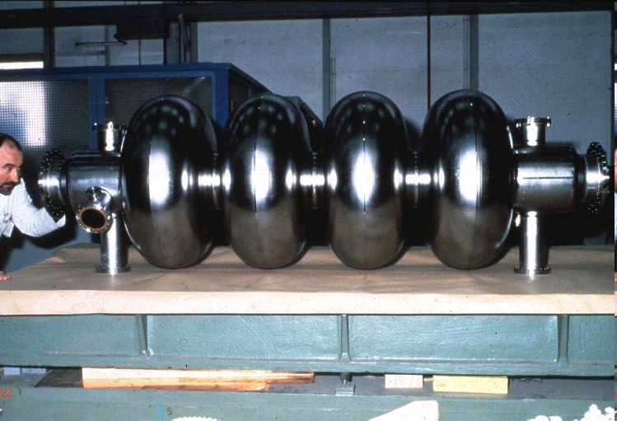
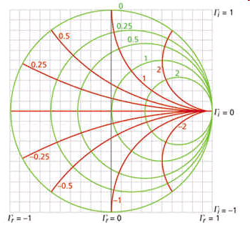
JUAS RF Course 2021
Cavities RF Theory
Superconducting LEP cavity The Smith Chart
Fritz.Caspers@cern.ch manfred.wendt@cern.ch
Notes:
Welcome everybody

Slide 2
Basics on RF Transmission, and Resonant Structures
Section A
Basics
Transmission-lines
Striplines, Microstrip-lines, Slotlines
Waveguide and single cell cavity structures
Decibel
Equivalent circuit
Characteristic in time and in frequency domain
Beam-cavity interaction
Section B
Scaling laws
Simulation techniques
Higher order modes (HOMs)
Transit time factor
Coupling and tuning
Different shapes of cavities
Voltage breakdown & Multipactor
Multi-cell cavities,
travelling wave structures
Contents
Notes:
Here we start ..trying to do the entire field of RF engineering in a few hours, which is completely impossible; thus please do not be shocked...when you retain (as a newcomer to RF) 5 % of what is shown in the coming 200 +slides ..its already great..and for those of you who are already biased..another 5..10%.. the aim is really that you become familiar with some notations and basics concepts in this field. Thus here is the menu..appetizer (greetings from the kitchen) and main course..

Slide 3
S-Parameters, Smith Chart, and Active Systems
Section C
RF systems
Navigation in the Smith Chart
Examples
Rulers on the
Smith Chart
Section D
S-Parameters
The scattering matrix
Section E
Active elements
  Transistors
  Gridded tubes
  Klystrons
  IOTs
Measurement devices and concepts
Superheterodyne Concept
Contents
Notes:
The menu..second course..and dessert..

Slide 4
A Simplified RF System
Section A
Low-level
RF system
High power
RF system
RF source
High power RF
waveguide or coaxial
distribution system
LLRF
High power
RF input coupler
RF field probe
signal
RF cavity resonator
q
v
beam
E
metallic beam pipe
Notes:
The pillbox cavity is the mother of most RF resonators used for particle accelerators..and its essentially a transformer to bring the power available from the generator to a very high voltage level. And since operating in vacuum we somewhere a vacuum barrier and often there is some sort of feedback circuit to stabilize the Rf voltage and also to meet other requirements

Slide 5
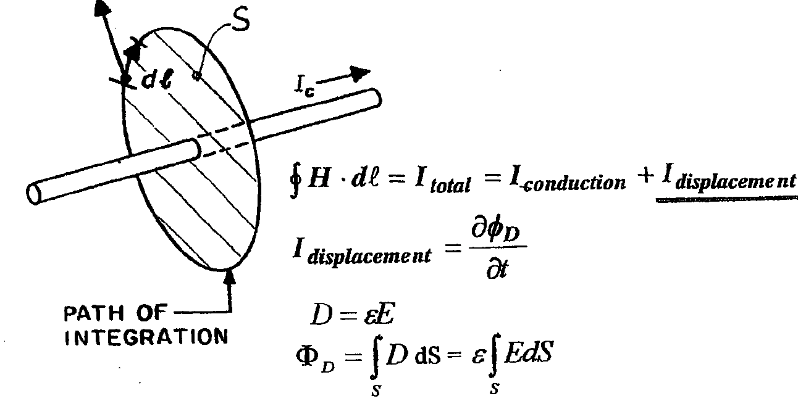
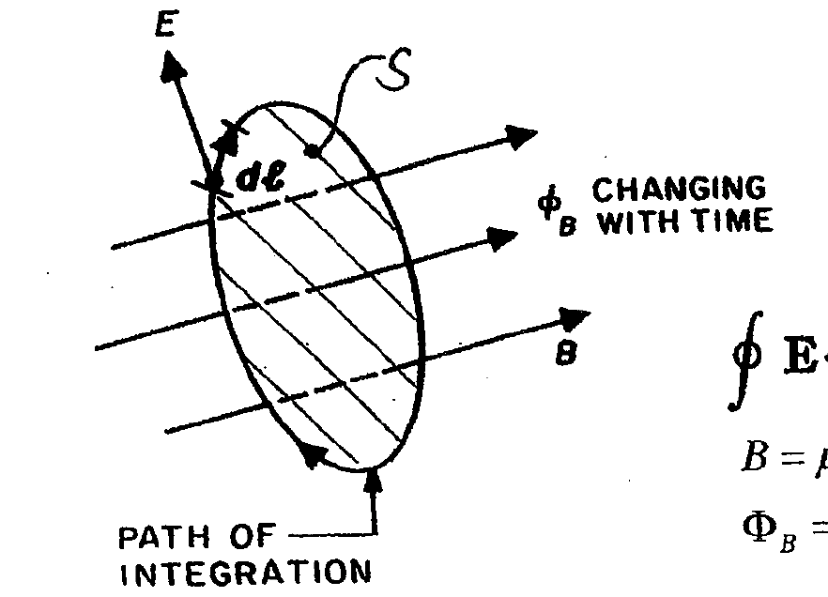
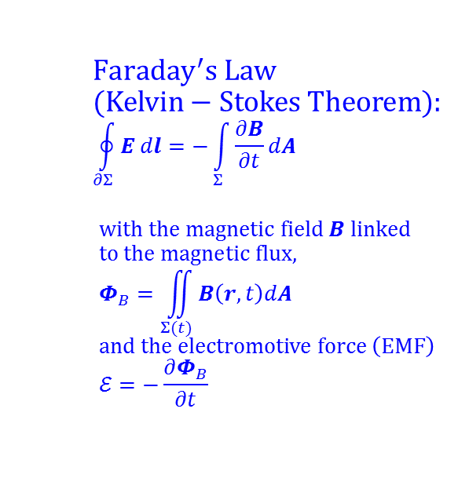
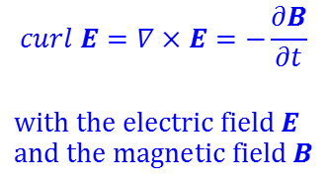
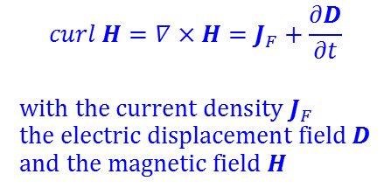
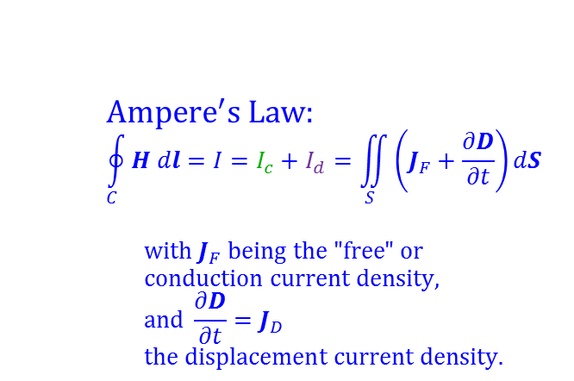
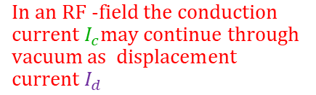
Maxwell’s equations (1)
$$Ampere^{′}s Law: \\ \oint_{C}^{ }{H dl=I=I_{c}+I_{d}=\iint_{S}^{ }{\left(J_{F}+\frac{∂D}{∂t}\right)dS}}$$
$$\text{with} J_{F} \text{being} \text{the}\text{ "}\text{free}\text{" }\text{or} \\ \text{conduction} \text{current} \text{density}\text{,} \\ \text{and} \frac{∂D}{∂t}=J_{D} \\ \text{the} \text{displacement} \text{current} \text{density}\text{.}$$
$$curl H=∇×H=J_{F}+\frac{∂D}{∂t}$$
$$\text{with} \text{the} \text{current} \text{density} J_{F} \\ \text{the} \text{electric} \text{displacement} \text{field} D \\ and the magnetic field H$$
conductive
current
displacement
current
$$\text{In} \text{an} \text{RF}\text{ −}\text{field} \text{the} \text{conduction} \text{current}{ I}_{c}\text{may} \text{continue} \text{through} \text{vacuum} \text{as} \text{displacement} \text{current}{ I}_{d}$$
$$Faraday^{′}s Law \\ (Kelvin−Stokes Theorem): \\ \oint_{∂Σ}^{ }{E dl=−\int_{Σ}^{ }{\frac{∂B}{∂t}dA}}$$
$$\text{with} \text{the} \text{magnetic} \text{field} B \text{linked} \\ \text{to} \text{the} \text{magnetic} \text{flux}\text{,} \\ Φ_{B}=\iint_{Σ(t)}^{ }{B\left(r,t\right)dA} \\ \text{a}\text{nd} \text{the} \text{electromotive} \text{force} \left(\text{EMF}\right) \\ ℰ=−\frac{∂Φ_{B}}{∂t}$$
$$curl E=∇×E=−\frac{∂B}{∂t}$$
$$\text{with} \text{the} \text{electric} \text{field} E \\ \text{and} \text{the} \text{magnetic} \text{field} B$$
integral form
differential form
Basics
Notes:
Maxwells equations will get you..all over the place..but its important to develop a kind of feeling or intuition for them…a sort of training for your protein computer to "feel "Maxwells equations and to visualize them

Slide 6
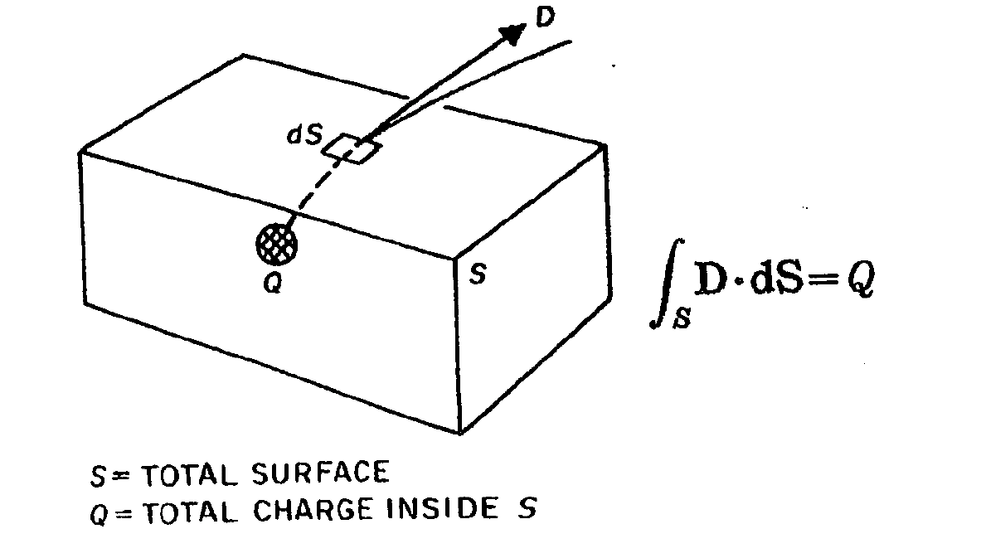
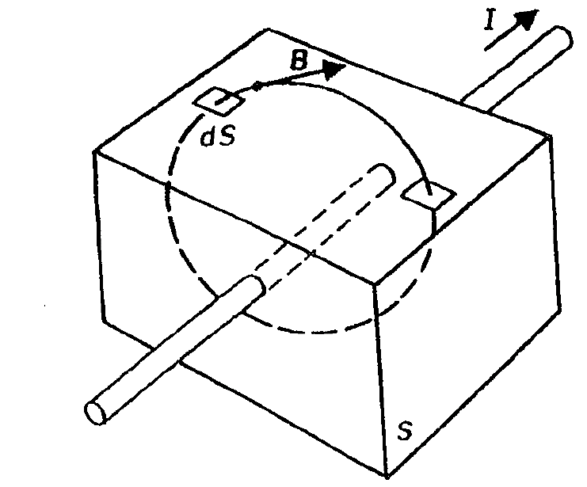
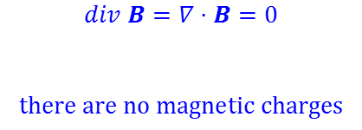
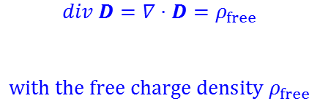
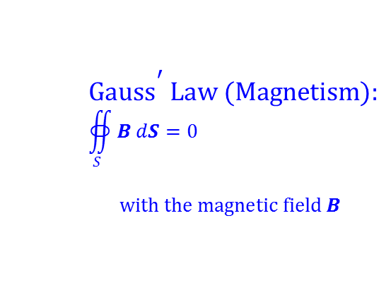
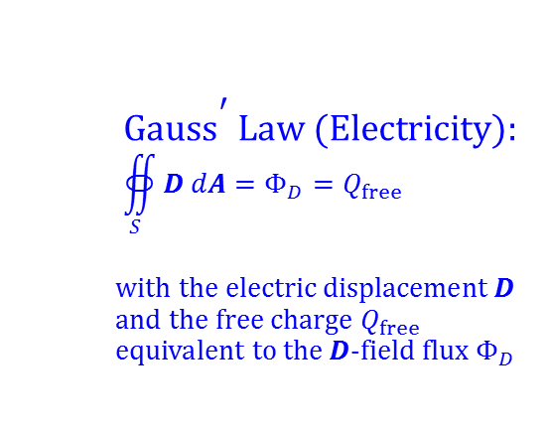
Maxwell’s equations (2)
$$\text{Gaus}{\text{s}}^{\text{′}} \text{Law}\text{ (}\text{Electricity}\text{):} \\ ∯_{S}^{ }{D dA}=Φ_{D}=Q_{free}$$
$$\text{with} \text{the} \text{electric} \text{displacement} D \\ \text{and} \text{the} \text{free} \text{charge} Q_{free} \\ \text{e}\text{quivalent} \text{to} \text{the} D\text{−}\text{field} \text{flux} Φ_{D}$$
$$div D=∇⋅D=ρ_{free}$$
$$\text{with} \text{the} \text{free} \text{charge} \text{density} ρ_{free}$$
The surface S must be closed!
$$\text{Gaus}{\text{s}}^{\text{′}} \text{Law}\text{ (}\text{Magnetism}\text{):} \\ ∯_{S}^{ }{B dS}=0$$
$$\text{with} \text{the} \text{magnetic} \text{field} B$$
$$div B=∇⋅B=0$$
$$\text{there} \text{are} \text{no} \text{magnetic} \text{charges}$$
Integral form
differential form
Basics
Notes:
we need a bit of mathematics..sometimes..

Slide 7

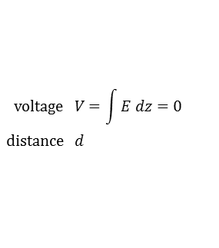





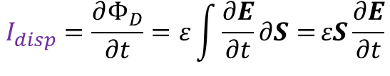
Displacement and conduction currents in a simple capacitor
end plates =
sides planes of
a pillbox cavity
for vacuum and approximately for air:
μ = μ₀ = 4π·10⁻⁷ = 1.257·10⁻⁶ Vs/(Am)
ε = ε₀ = 8.854·10⁻¹² As/(Vm)
$$\text{surface} S$$
E
$$I_{cond}$$
$$I_{disp}$$
$$I_{cond}$$
E
The conduction current passes as displacement current the capacitor gap
$$\text{voltage} V=\int{E dz=0} \\ \text{distance} d$$
$$I_{cond}$$
$$I_{disp}=\frac{∂Φ_{D}}{∂t}=ε\int{\frac{∂E}{∂t}∂S=}εS\frac{∂E}{∂t}$$
Displacement current in the dielectric:
Conduction current in conductor:
with the electric flux Φ_{D} and the charge Q.
$$I_{disp}=I_{cond}$$
$$I_{cond}=\frac{∂Q}{∂t}=C\frac{∂V}{∂t}=ε\frac{S}{d}d\frac{∂E}{∂t}=εS\frac{∂E}{∂t}$$
Basics
Notes:
The message here is very simple: The conduction current on the wire continues as displacement current through the capacitor. This can happen intentionally and also quite often in a non intended manner ..the origin of MANY EMI EMC problems..

Slide 8
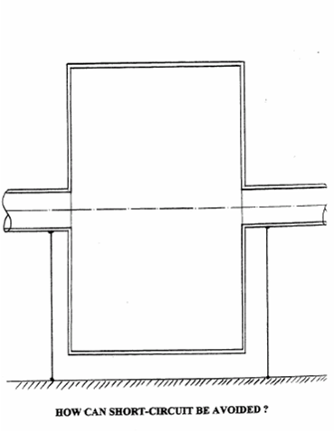
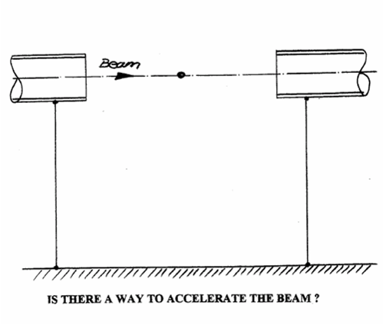

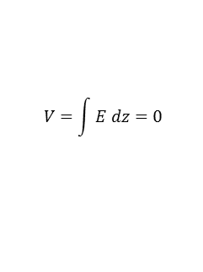
From L and C to a cavity
With a gap in the beam pipe we still have both ends at the same electric potential
Creates E-field for accelerating the particles;
Along the cavity walls the field is zero and so is the integral
put a cavity in there
$$V=\int{E dz=0}$$
E_{z}
Beam
Short circuit,
thus no scalar potential difference
$$Caveat:Do not try to construct equipotential planes$$
$from the electric field$ pattern in this cavity..why?
Capacitor at high frequencies,
The Feynman Lectures on Physics
Can the short-circuit be avoided?
Answer: No - but it doesn’t bother us at high frequencies.
Basics
Notes:
And just doing one little further step we arrive at the pillbox..and please not that DC wise the pillbox is on ground everywhere but inside very BIG electric and magnetic field can be excited. Thus for DC (direct current) everything is on a equipotential surface.

Slide 9

TEM transmission lines (1)
Transverse electric modes (TEM) can propagate on any structure with at least two conductors
Given a structure with
C’ ... capacitance per unit length in Faraday per meter [F/m]
L’ ... inductance per unit length in Henry per meter [H/m]
It then follows (no losses assumed)
If (vacuum or approximately air), then the velocity of
propagation is equal to the velocity of light
$$C’≈67\frac{pF}{m} L’≈167\frac{nH}{m}$$
Typical values for an air filled TEM line (not necessarily coax):
Transmission lines
Notes:
Somehow we have to bring the power from the generator to the load..and the most common way is the TEM transmission line which is available in MANY different versions. Here we focus however on the coaxial line (cable) for good reasons..

Slide 10


TEM transmission lines (2)
Formulae for the characteristic impedance Z_{L} can be found in many textbooks (e.g. “Reference Data for Radio Engineers” or others). From a known Z_{L} (= line impedance; thus index L) the values for C’ and L’ can be deduced by
C’ [pF/m] = $\frac{ 100 }{3ZL}$ $\sqrt{εr }$
For 50 Ohm and ε_{r} =1
we get ≈67 pF/meter
v
L
L’ [nH/m] = $\frac{ 100ZL}{30}$ $\sqrt{εr }$
For 50 Ohm and ε_{r} =1
we get ≈167 nH/meter
L
v
C’ [pF/m] = 55.6 ε_{r} / ln(D/d) with D/d =2.3 for a 50 Ohm air-filled cable
L
Assuming μ_{r}= 1 here
And of course D/d=R/r
Reference: Meinke Gundlach Taschenbuch der Hochfrequenztechnik 3 rd edition;1968 page 253..255; or K3 in 4 th edition
Note that v stands for the phase velocity in the coax cable which in case of vacuum as dielectric becomes = c = speed of light
a useful link: https://en.wikipedia.org/wiki/Coaxial_cable
Transmission lines
Notes:
Those 2 simple equations contain a LOT of Physics..and we like to use them in examinations.. they permit to calculate the "characteristic" impedance of some TEM where this characteristic impedance is the ratio of "voltage“ and "current"(both defined via integrals over the field) for a wave travelling either forward or backward along this transmission line of cable.

Slide 11
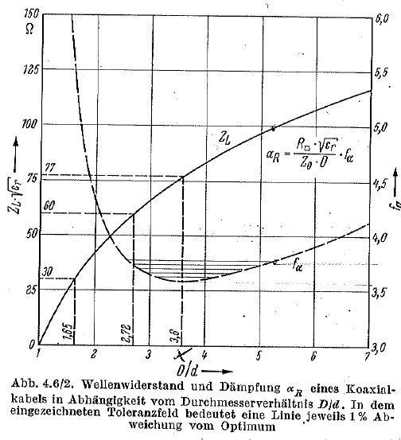
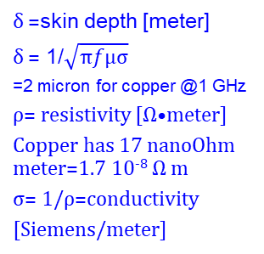
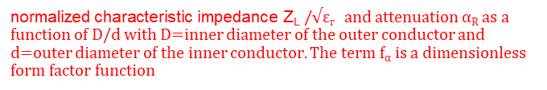
TEM transmission lines (3)
Coaxial cable with minimum loss:
R_{S}=Surface resistance [Ohm]
= R□
The term f_{α} is a dimensionless form factor function
α_{R} in [Neper/meter] with 1 Np=8.685 dB
dB=decibel
δ =skin depth [meter]
δ = 1/$\sqrt{πfμσ}$
=2 micron for copper @1 GHz
ρ= resistivity [Ω•meter]
Copper has 17 nanoOhm meter=1.7 10⁻⁸ Ω m
σ= 1/ρ=conductivity
[Siemens/meter]
Z₀ =377Ohm
Reprinted from O.Zinke, H.Brunswig, Volume 1 (1973)
Lehrbuch der Hochfrequenztechnik, p.122
normalized$\text{c}\text{haracteristic} \text{impedance} \text{ZL} /$√ε_{r} and attenuation α_{R} as a function of D/d with D=inner diameter of the outer conductor and d=outer diameter of the inner conductor. The term f_{α} is a dimensionless form factor function
Transmission lines
Notes:
The slide contains a lot of compressed information..take your time to read it quietly..but you may retain already that for an empty coax cable to optimum impedance is around 77 Ohm (in terms of losses) ..but most cables are not empty but rather filled with some dielectric material which has epsilon values between 2..3 and this way we arrive at 50 Ohm which is used all over the world.

Slide 12
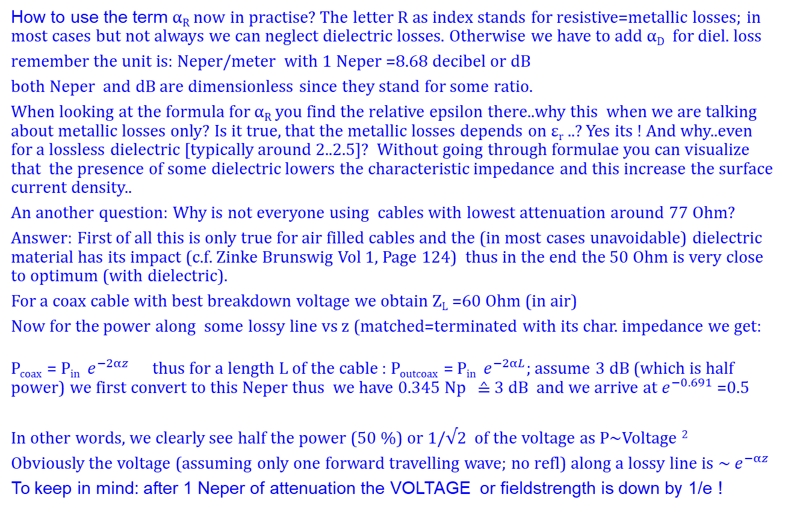
TEM transmission lines; loss (4)
How to use the term α_{R} now in practise? The letter R as index stands for resistive=metallic losses; in most cases but not always we can neglect dielectric losses. Otherwise we have to add α_{D} for diel. loss
remember the unit is: Neper/meter with 1 Neper =8.68 decibel or dB
both Neper and dB are dimensionless since they stand for some ratio.
When looking at the formula for α_{R} you find the relative epsilon there..why this when we are talking about metallic losses only? Is it true, that the metallic losses depends on ε_{r} ..? Yes its ! And why..even for a lossless dielectric [typically around 2..2.5]? Without going through formulae you can visualize that the presence of some dielectric lowers the characteristic impedance and this increase the surface current density..
An another question: Why is not everyone using cables with lowest attenuation around 77 Ohm?
Answer: First of all this is only true for air filled cables and the (in most cases unavoidable) dielectric material has its impact (c.f. Zinke Brunswig Vol 1, Page 124) thus in the end the 50 Ohm is very close to optimum (with dielectric).
For a coax cable with best breakdown voltage we obtain Z_{L} =60 Ohm (in air)
Now for the power along some lossy line vs z (matched=terminated with its char. impedance we get:
P_{coax} = P_{in} $e^{−2αz}$ thus for a length L of the cable : P_{outcoax} = P_{in} $e^{−2αL}$; assume 3 dB (which is half power) we first convert to this Neper thus we have 0.345 Np ≙ 3 dB and we arrive at $e^{−0.691}$ =0.5
In other words, we clearly see half the power (50 %) or 1/√2 of the voltage as P∼Voltage ²
Obviously the voltage (assuming only one forward travelling wave; no refl) along a lossy line is ∼ $e^{−αz}$
To keep in mind: after 1 Neper of attenuation the VOLTAGE or fieldstrength is down by 1/e !
Transmission lines
Notes:
Here is an introduction to NEPER its really important to know that notation since is directly related to the exponential decay (due to losses) of a signal along the line..and then we also show the relation to the more frequently used db (deci -BEL)

Slide 13
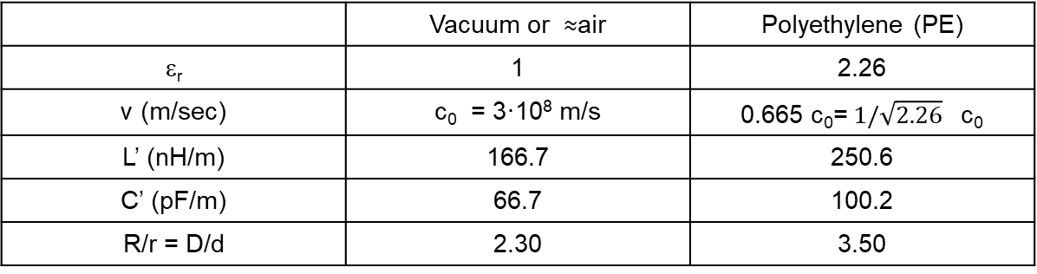
TEM transmission lines (5)
Applied to 50-Ohm-lines (the impedance mostly used) one finds
 | Vacuum or ≈air | Polyethylene (PE)
ε_{r} | 1 | 2.26
v (m/sec) | c₀ = 3·10⁸ m/s | 0.665 c₀= 1/$\sqrt{2.26}$ c₀
L’ (nH/m) | 166.7 | 250.6
C’ (pF/m) | 66.7 | 100.2
R/r = D/d | 2.30 | 3.50
AIR
PE
inner conductor
outer conductor
Further reading: Table 2.1; Pozar book
and/or
B.C.Wadell: Transmission line Design handbook;Artech ;ISBN 0-89006-436-9
r
inner conductor
R
outer conductor
Transmission lines
Notes:
Some examples what you can find in the RF lab...of course if the dielectric is air..the inner conductor has to be supported in one way or another ...

Slide 14
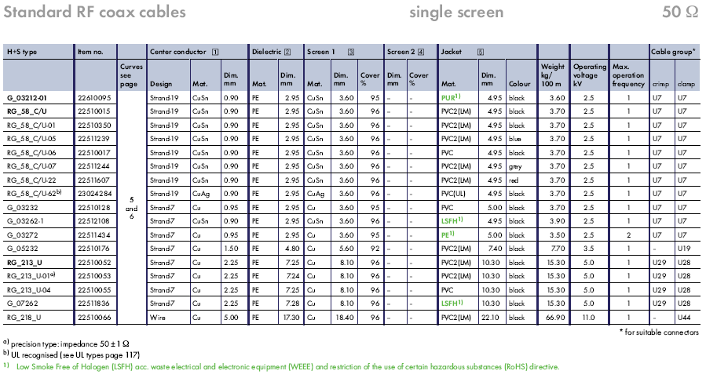
TEM Transmission lines (6)
RG 58 and RG 213 are very common
Transmission lines
Notes:
A table with some practical data of frequently used RF cables

Slide 15
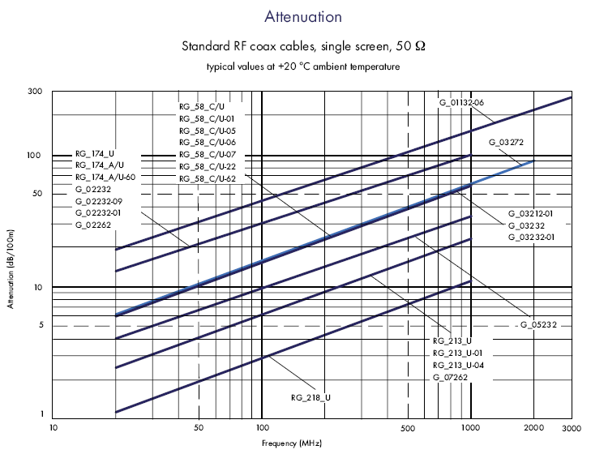
TEM Transmission lines (7)
Transmission lines
Notes:
A very well known cable in the RF lab is the RG 58 (often called BNC cable but BNC is a connector norm) and the N-cable (N is also a connector) is frequenly the RG 213..and the bigger the diameter of the cable the smaller the attenuation; obviously ..but why exactly?

Slide 16
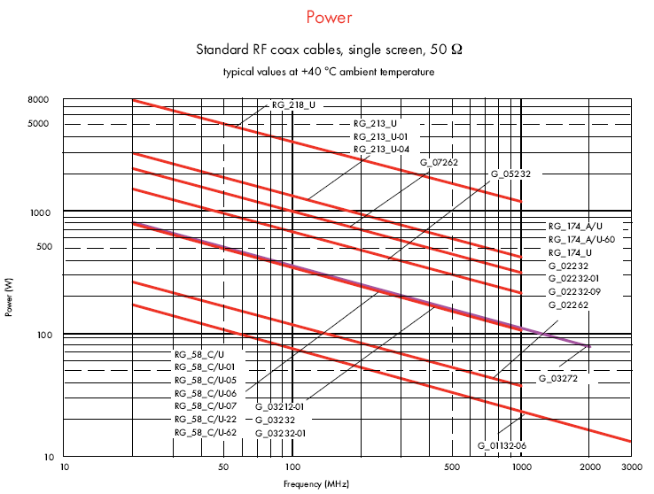
TEM Transmission lines (8)
Transmission lines
Notes:
And since the attenuation increases with frequency we can transmit more power (HEATING!) in a region of low attenuation that for high attenuation (i.e. towards higher frequencies) where the cable diameter is a parameter..the bigger the cable diameter the more power can pass..with acceptable heating and some safety margin

Slide 17
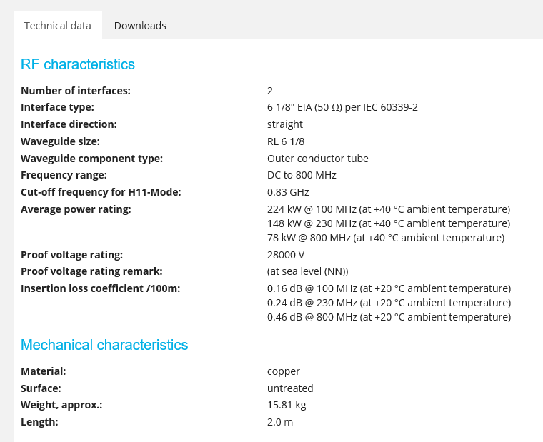
TEM Transmission lines (9)
And here are the data of some real big coax line: 6 1/8 inch=155.6 mm
As inner diameter of the outer conductor.
This line is straight, not corrugated
Remember: most of the metallic losses are at the inner conductor.
You may calculate the Q of a coax resonator made with this line at 100 MHz.
And crosscheck the cutoff for H₁₁
EIA stands for electronic industries standard
Data: from the SPINNER company webpage
Transmission lines
Notes:
And in some cases one like to use REAL BIG diameter cables up to 30 cm diameter for Mega Watts..but there is a limit...the arrival of higher order coaxial cable modes..better stay away there..

Slide 18
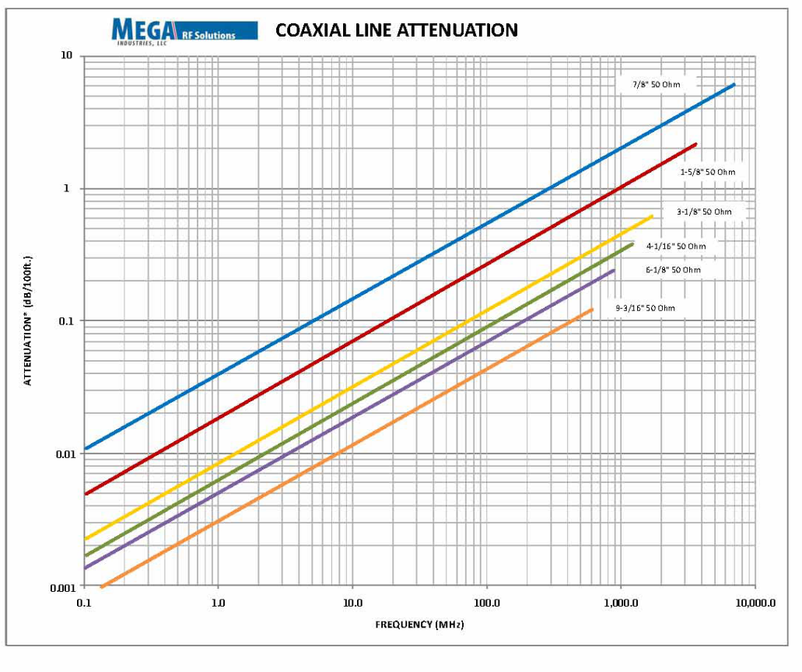
TEM Transmission lines (10)
And here is another attenuation graph for BIG coax lines; note then unit [dB/100 feet]
Transmission lines
Notes:
to get a feeling on attenuation numbers of REAL BIG cables..(or COAX lines) ..this is HEAVY stuff ! You can see it at CERN in the SPS power plant at BA3

Slide 19
General Transmission lines
TEM lines: coaxial, stripline ,“microstrip as quasi TEM”, slotline
  frequency range: 0...~100 GHz
  largest practical size: 350 mm for outer conductor, 150 mm for the inner conductor (used at CERN for the 200 MHz power plant)
  power rating: for CW operation at 200 MHz: 1 MW
  low-pass like line, upper frequency limit given by higher order modes
    But the fundamental TEM mode still exists, this rule is a practical limit
  relatively high attenuation
  power limited by inner conductor (high field => thermal load and risk of voltage breakdown there)
  in general easier to handle than waveguides
  Stripline and microstrip are usually rather small, slotline=dual to microstrip
Waveguides
  frequency range 0.32...325 GHz (standard guides)
  largest practical size: 590 mm x 298 mm
  power rating: 150 MW peak ( short pulse) at 310 MHz
  low attenuation
  bandpass, low frequency cut-off determined by dimension
Watch a good old school “visual” introduction into transmission-lines:https://youtu.be/I9m2w4DgeVk
Transmission lines
Notes:
Coax transmission lines are not the entire story ..there is a number of others..most important from the non TEM family: Waveguides

Slide 20
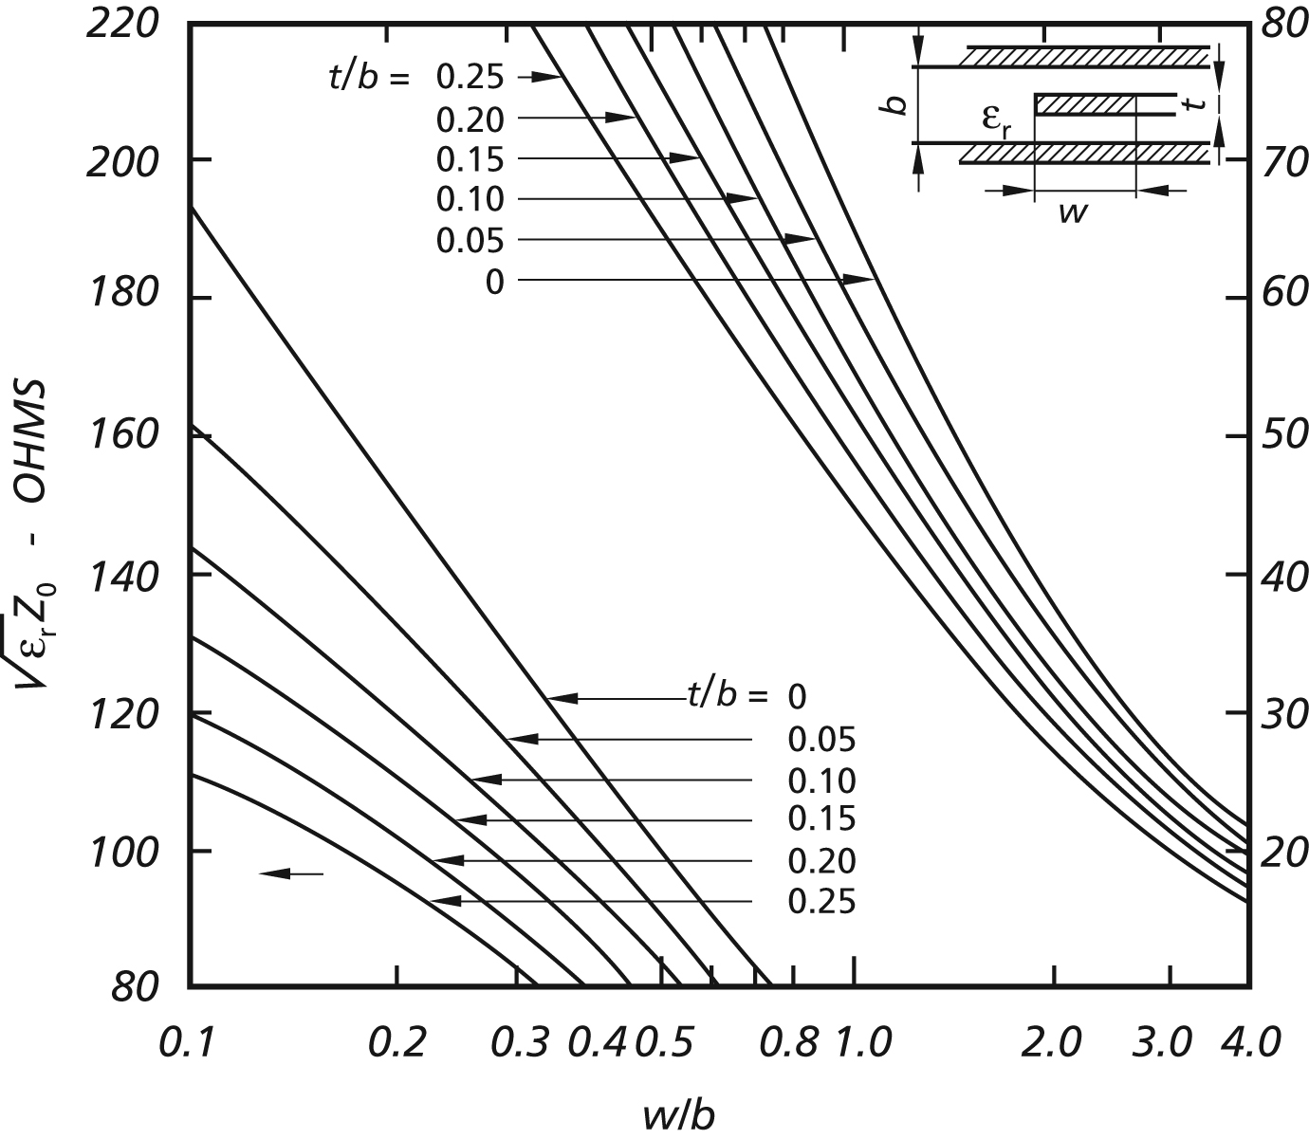

Striplines (1)
A stripline is a flat conductor between a top and bottom ground plane. The space around this conductor is filled with a homogeneous dielectric material. This line propagates a pure TEM mode. With the static capacity per unit length, C’, the static inductance per unit length, L’, the relative permittivity of the dielectric, ε_{r} and the speed of light c the characteristic impedance Z_{L} of the line is given by
L
v
$$\sqrt{\text{ε}\text{r} \text{ZL} }$$
L
Characteristic impedance of striplines
Striplines, Microstriplines, Slotlines
Notes:
A stripline is a sandwich..with bottom and top cover..and some strip in between (and the microprocessor of your computer is full of them ..in many layers)

Slide 21
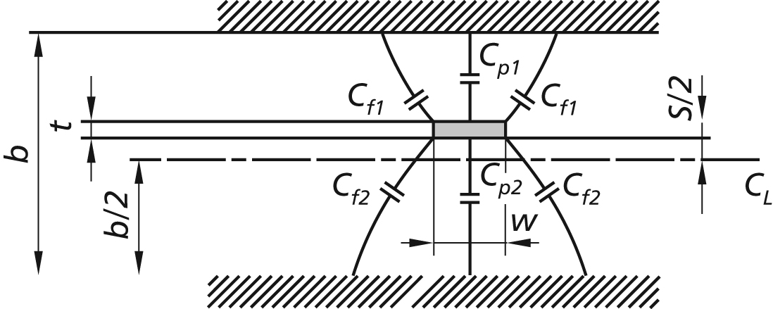
Striplines (2)
For a mathematical treatment, the effect of the fringing fields may be described in terms of static capacities. The total capacity is the sum of the principal and fringe capacities C_{p} and C_{f}.
t = thickness of the strip
S/2 = distance to center plane
C_{L}= center layer or plane
From: Howe
Stripline circuit design
Fig 2-6
ISBN: 089006-020-7
C_{f} stands for fringe field capacity,
C_{p} stands for principal capacity
Striplines, Microstriplines, Slotlines
Notes:
sometimes the strip of the stripline is not in the centre..and here you see a quasi analytical way how to calculate the char. impedance ;these days most likely you would do it anyhow on a computer with some numerical code or look it up in a table

Slide 22
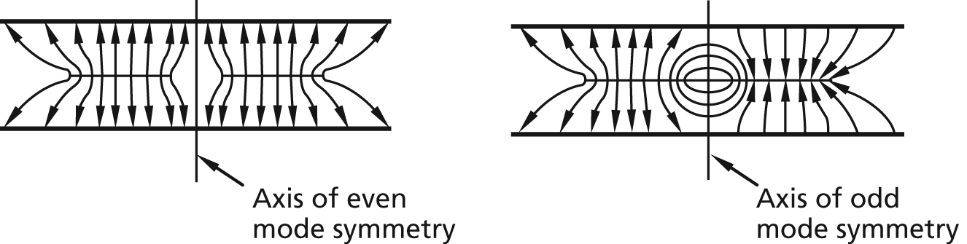
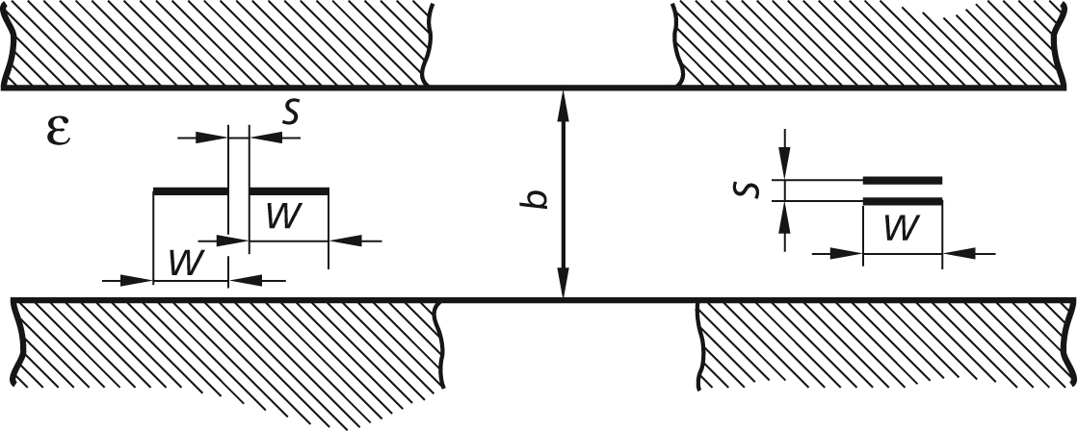
Striplines (3)
Coupled striplines (in odd and even mode):
Howe
Stripline circuit design
Fig 4-1
L,even
L,odd
side-coupled
broad-coupled
This formula for side-coupled structure only.
Striplines, Microstriplines, Slotlines
Notes:
There may be more than one strip inside the sandwich..and if the strips are close enough to each other they talk to each other and this is a kind of coupler and interesting enough its nearly always directional because we have two coupling mechanisms an electric and a magnetic one. Directive means that an incident wave on one line of the coupler excites (theoretically only , in practise mainly) a wave in the coupled line into a particular direction..for this type of coupler usually backwards.

Slide 23
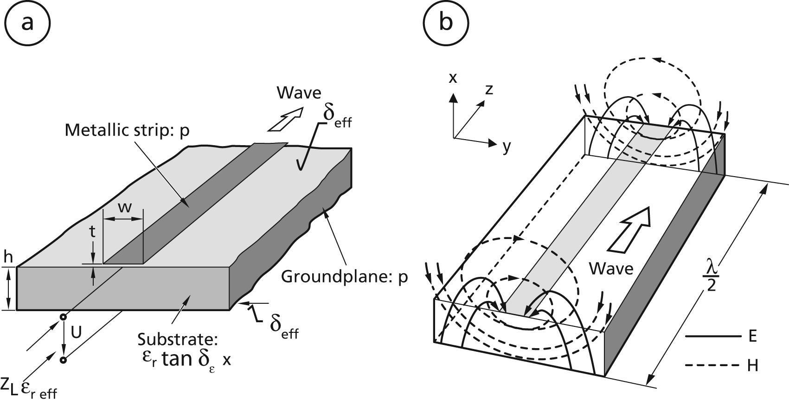
Microstriplines (1)
A microstripline may be visualized as a stripline with the top cover and the top dielectric layer taken away. It is thus an asymmetric open structure, and only part of its cross section is filled with a dielectric material. Since there is a transversely inhomogeneous dielectric, only a quasi-TEM wave exists. This has several and severe implications such as a frequency-dependent characteristic impedance and a considerable dispersion. And “why the hell” are people using it?
Mechanical construction
Static field approximation
Note: Quasi-TEM wave due to different dielectric constants in different parts of the cross-section. We do get longitudinal field components.
From: R.K Hoffmann; Integrierte Mikrowellenschaltungen Springer 183 page 142, also in English available
Striplines, Microstriplines, Slotlines
Notes:
The microstrip line is something asymmetric and open to one side thus accessible to attach certain components...and it not always 'MICRO"

Slide 24
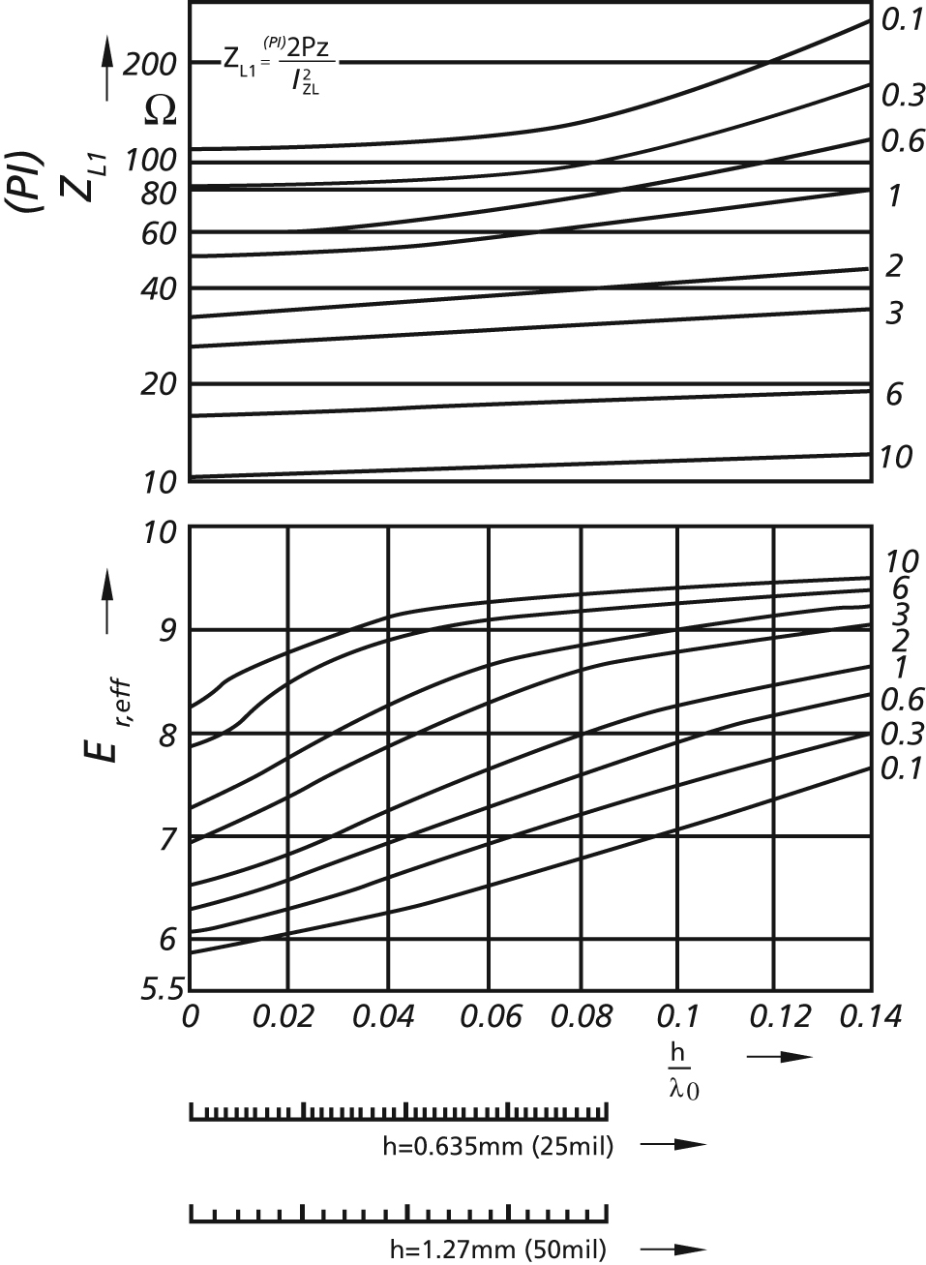
Microstriplines (2)
ε_{r,eff}
frequency-dependent characteristic impedance Z_{L} according to the PI= power-current definition of the char. impedance Z_{L}
The traces are parametrized (0.1 ..10) as w/h ; w =strip width; h=substrate thickness
effective permittivity with an alumina substrate ε_{r} =9.7
The traces are parametrized (0.1 ..10) as w/h ; w =strip width; h=substrate thickness
From: R.K Hoffmann:Integrierte Mikrowellenschaltungen (Springer) page 169..also in english available
Striplines, Microstriplines, Slotlines
Notes:
in contrast to the normal TEM lines (coax, stripline) the microstrip has a frequency dependent char. impedance and also a frequency dependent velocity of propagation as seen by the effective epsilon vs frequency. In a simplified manner one can say the fraction of field which is at low frequencies in air , is getting "pulled in" towards the dielectric when moving to higher frequencies. Note that the frequency in the abscissa is hidden in the wavelength lamda.

Slide 25
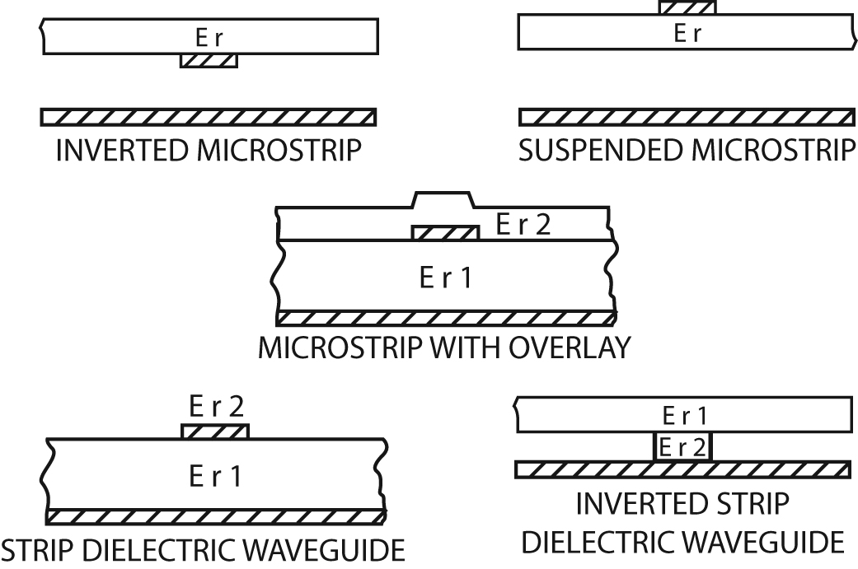
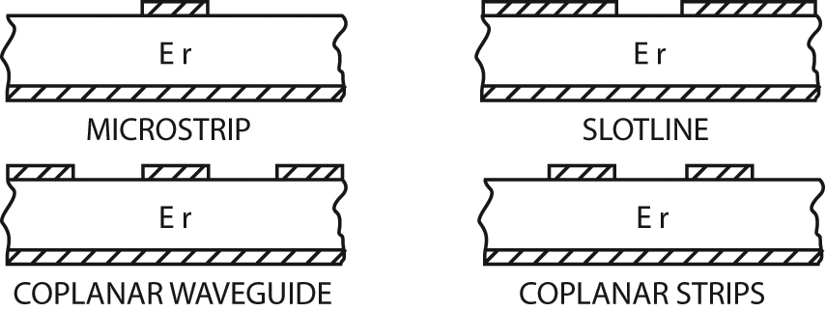
Microstriplines (3)
Planar transmission lines used in MIC (microwave integrated circuits)
Various transmission lines derived from microstrip
ε_{r}
ε_{r}
ε_{r}
ε_{r}
ε_{r2}
ε_{r1}
ε_{r}
ε_{r}
ε_{r2}
ε_{r2}
ε_{r1}
ε_{r1}
This is a kind of printed optical fibre and this type of structure is becoming more and more important in integrated optics; the metal layer may also be dielectric
Striplines, Microstriplines, Slotlines
Notes:
and there is an etire "Zoo" of related line structures including lines which are kind of printed optical fibers (dielectric waveguides with metallic ground planes)

Slide 26
Slotlines (1)
The slotline may be considered as the dual structure of the microstrip. It is essentially a slot in the metallization of a dielectric substrate. The characteristic impedance and the effective dielectric constant exhibit similar dispersion properties to those of the microstrip line.
(a) Mechanical construction
(b) Field pattern
(TE approximation)
(c) Longitudinal and transverse current densities
(d) Magnetic line current model.
From: R.K Hoffmann:Integrierte Mikrowellenschaltungen (Springer) page 374
Striplines, Microstriplines, Slotlines
Notes:
A really interesting element although not very often used is the slotline derived via Babinets principle. Thus in short the slot carries a "magnetic current" which is ab abstraction to apply duality concepts.

Slide 27
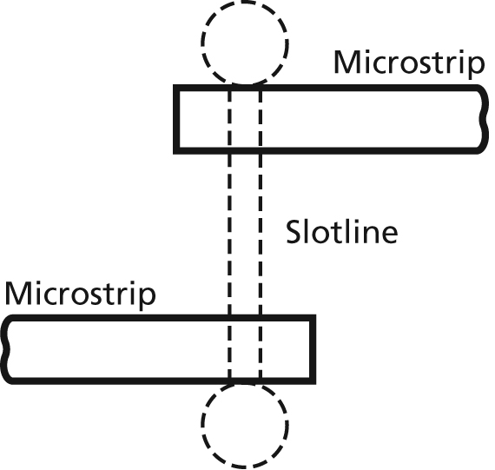
Slotlines (2)
A broadband (decade bandwidth) pulse inverter. Assuming the upper microstrip to be the input, the signal leaving the circuit on the lower microstrip is inverted since this microstrip ends on the opposite side of the slotline compared to the input. The “bone”(broken line) denotes missing metal (slotline) in the metallization (=groundplane) of the microstrip.
Two microstrip-slotline transitions connected back to back for 180° phase change.
Striplines, Microstriplines, Slotlines
Notes:
with a combination of microstrip and slotline one can make very interesting circuits....

Slide 28
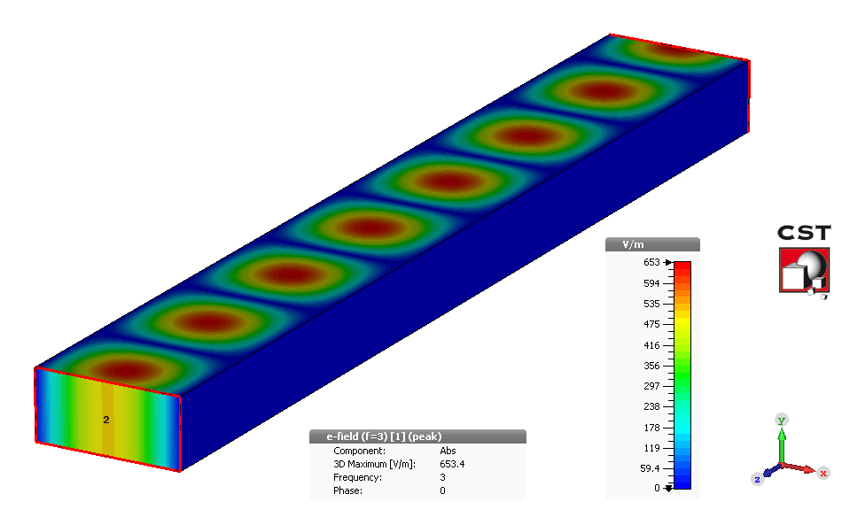
Let there be waveguide modes ☺
Details have been discussed in other lectures (hopefully ☺)
For all homogeneous waveguides (any cross section), there are two basic types of modes, with different orthography:
h…height
w…width
L…length
Europe: USA:
H mode = TE
E mode = TM
L
h
w
H modes are characterized by the fact that they have only an H-component in the direction of propagation and no E-field in this direction (Transverse Electric)
E modes on the other hand are characterized by the fact that they have only an E-component in direction of propagation and no H-field in this direction (Transverse Magnetic)
  → Waveguide modes in a homogeneous waveguide with homogeneous fill (no partial fill with dielectric) are described by a maximum of up to five mode parameters
Waveguides
Notes:
and now we are again more back to earth...the well known rectangular cross- section waveguide..

Slide 29
“Electric” boundary condition for cavities and waveguides
In the stationary (general) case:
On perfect conducting surfaces the parallel component of the electric field has to vanish:
E_{ll} = 0
There is no perpendicular magnetic field to a conducting surface:
B┴ = 0
  E-field and B-field are coupled: B┴ ≠ 0 would cause E_{ll} ≠ 0
Waveguides
Notes:
and the very important boundary conditions: No tangential electric field on the surface of an ideal conductor; and also no normal (RF) field ...The electric field is obvious. But the magnetic field? any time dependent normal magnetic field would induce some tangential E -field and then we back to square 1.

Slide 30
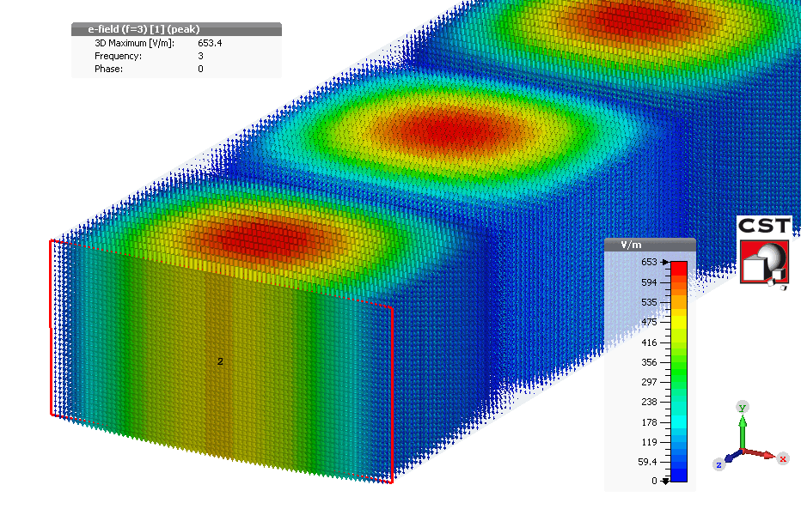
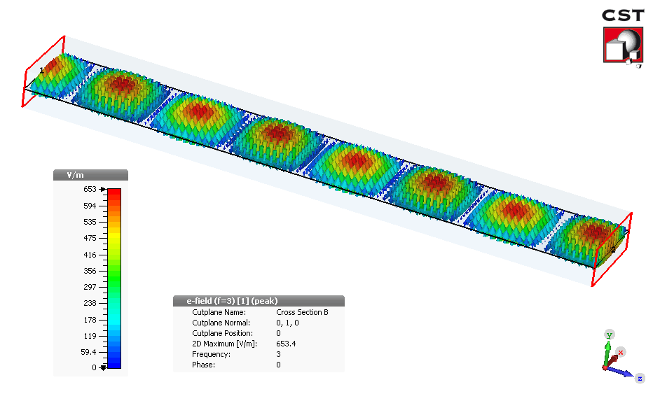
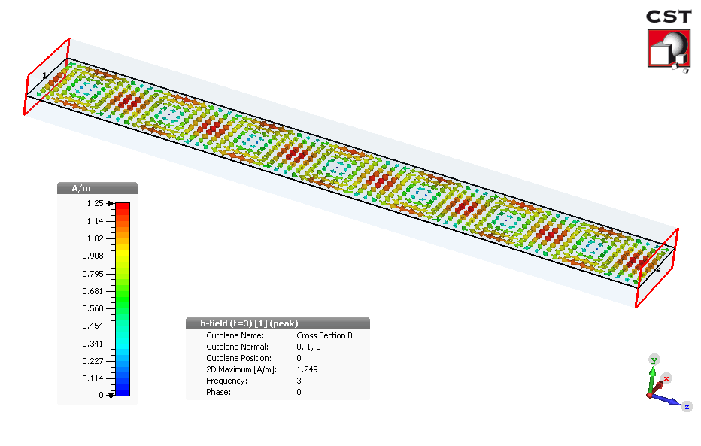
Well known waveguide modes (1)
The most well known waveguide modes are:
Rectangular waveguide:
  H₁₀ (TE₁₀) (fundamental mode,
  depends only from the width)
Electric field
in cross section
Power flow
Power flow
Electric field
Magnetic field
Waveguides
Notes:
When you see those movies the first time..take your time , and visualize this quietly, asking yourself what it all means..

Slide 31
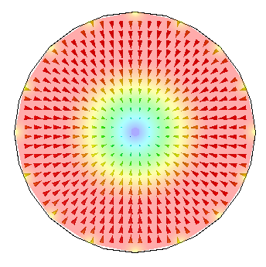
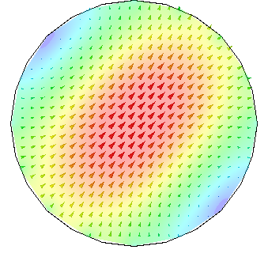
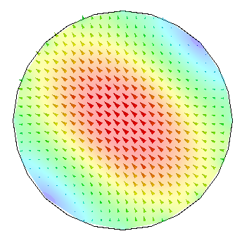
Well known waveguide modes (2)
Cylindrical waveguide:
  E₀₁ (TM₀₁) mode is similar to the mode in coaxial cables.
  H₁₁ (TE₁₁) mode has 2 polarizations, and the lowest cut-off frequency
Transverse electric field (cross section)
How is the polarization defined?
Answer: W.r.t. the E field plane!
Why E field? Because it is easier to measure!
Transverse electric field (cross section)
Pictures: courtesy E. Jensen
Waveguides
Notes:
and of course there are waveguides with circular cross section often made on purpose as waveguide but sometimes accidentally (the beampipe)..and you realize already the first problem..for the fundamental mode there are two polarisations in contrast to the rectangular waveguide which has a single mode there. Thats why you find in practical engineering more frequently rectangular waveguides...

Slide 32
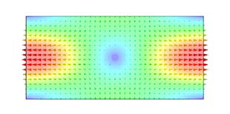
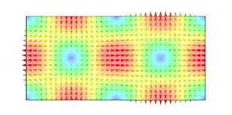
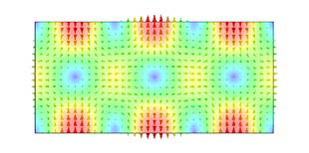
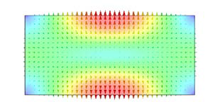


Higher order waveguide modes (1)
Rectangular waveguide (transverse electric field in cross section):
TE₁₁
TE₂₁
TE₃₁
TM₁₁
TM₂₁
TM₃₁
Pictures: courtesy E. Jensen
Waveguides
Notes:
but also rectangular waveguide have higher order modes...and theree you can see from the mode plots the relation to the indices..first index..number of maxima along the horizontal axis , second index number of maxima along the vertical axis.

Slide 33



Rectangular waveguide
E- and H- field lines
Surface current distribution
H₁₀
Modes in a rectangular waveguide with dimensions a and b.
solid lines: E-field,
dotted lines: H-field
Reprinted from Saad, T S, Microwave Engineers’ Handbook, Artech House
Also: Pozar book Fig 3.9
Waveguides
Notes:
here we have another view on what happens in a rectangular waveguide..start with the plots in the upper right corner..and just remember..the surface current continue as displacement currents..and for a H- mode there are no longitudinal E-field components and vice versa for the E mode...

Slide 34



Higher order waveguide modes (2)
Circular waveguide (cross-section plot of the transverse electric field):
TE₂₁: 2 pairs of maxima in azimuth, one maximum radially
TE₃₁: 3 pairs of maxima in azimuth, one maximum radially
TE₂₁
TE₃₁
TM₁₁
Pictures: courtesy E. Jensen
Waveguides
Notes:
For the round = circular cross section waveguide the meaning of the indices is similar as for the rectangular one..however here we talk for the first index about PAIRS of maxima along the circumference and radially we count the number of maxima (not pairs)

Slide 35




Circular waveguide
H₀₁ = low loss
E₀₁ =beam interaction
H₁₁ = fundamental
Modes in a circular waveguide with radius a
solid lines: E field, dotted lines: H field
Please note the similarity to the pillbox cavity!
Reprinted from Saad, T S, Microwave Engineers’ Handbook, Artech House
Also: Pozar book Fig 3.14
Waveguides
Notes:
and again ..in this projection ..fields and surface currents for the circular cross section waveguide

Slide 36


Higher order Mode chart of a Coaxial line
$$λ_{K}… \text{cutoff} \text{wavelength}$$
Index K related to: kritische Wellenlänge
← German textbook…
Related info:
Pozar book
Fig 3.16 and Fig 3.17
Suggestion for exercise:
Find ALL points in this diagram
where modes including the
TEM one, become degenerate
and discuss your results
Which ones of the higher order modes shown have two polarisations?
For a 50 Ohm coax line with D=100 mm at which frequency comes the first HOM (higher order mode) in?
Why is this a problem? Theoretically all modes are (mathematically) orthogonal to each other and thus should not couple..?!
Is the cutoff frequency for H₁₁ in an empty tube with same D as a coax line bigger or smaller than in a coax line ?
Reprinted from Meinke, H. and Gundlach, F. W.,
Taschenbuch der Hochfrequenztechnik,S.471
Vierte Auflage, Springer-Verlag, Berlin (1986)
Empty circular waveguide
Cavity structures
Notes:
Also coaxial lines have higher order modes..and that’s the end of their normal range of operation ..and better stay 20..30% below that critical frequency

Slide 37


Mode chart of a rectangular waveguide
Mode free range for H10
i.e only the H₁₀ Mode can propagate
a/b=2
Usually
Cutoff frequency for H₁₀ is at λ/a=2 or a= λ/2.This means that even for a very flat (b/a<<1) waveguide the H₁₀ mode can propagate provided that a> λ/2
a/b=2
$λ_{co}=$free space wavelength at cutoff
Cutoff frequency = frequency of the mode under consideration; lowest=H₁₀
Some degenerate modes: E₁₁ with H₁₁;E₂₁ with H₂₁;E₁₂ with H₁₂;E₂₂ with H₂₂
Remember: H = TE E = TM
Waveguides
Notes:
Hopefully this chart is not too confusing..lots of modes..let first focus the H10 ..the vertical axis shows a normalized frequency staring at cutoff on top (upper left corner ) and then increasing when going down. The red line on top of the diagram symbolizes the cutoff frequency for the H10 mode (any aspect ratio of b/a thus also for very "flat" waveguides and the more we increase the frequency (lower part of the plot) the modes come it..

Slide 38

Mode chart of a cylindrical waveguide
E₁₂ and H₀₂ are the next degenerate ones vs frequency
See also: Pozar book Fig 3.13
1.305
Why is the reference the H₁₁ mode?
Because it is the fundamental mode of the cylindrical waveguide!
Caveat: 2 polarisation states (degenerate) for this mode as it is a dipole mode
Which of those modes are monopole = cylinder symmetric? (E₀₁, H₀₁, E₀₂ )
Which of those modes are “degenerate”(same cut-off frequency); H₀₁ with E₁₁
Waveguides
Notes:
for the "round"waveguide we see clearly that the first mode (the H11) has a much smaller range to "life alone"compared to the rectangular waveguide..and in addition this mode already has two polarisations..and the next one ..the E01 has a nice electric field component with a maximum on axis and this can talk quite easily to the beam

Slide 39

Wavelength of a waveguide mode
For ANY waveguide mode in a homogeneous waveguide the wavelength in the waveguide λ_{g} at waveguide cut-off goes to infinity (phase velocity=infinity)
With increasing frequency the waveguide wavelength is becoming smaller and approaching the free space wavelength for very high (normalized to f_{c} ) frequencies.
This graph can be useful e.g for finding resonances of higher order modes in coax lines
λ= free space wavelength
λ_{g} = waveguide wavelength
λ_{co} = free space wavelength
at waveguide cutoff;
e.g. 15 cm (or 2 GHz) for a
rectangular waveguide
with a=7.5 cm (about S-band)
Example: read from the graph
where the waveguide wavelength
is twice the free space
wavelength ( at about 0.73 = λ/λ_{co} )
2.74 GHz
0.73
cutoff=2GHz which is λ_{co} =15 cm
Waveguides
Notes:
there is a general relation valid for all waveguide modes in homogenous (metallic, hollow) waveguides; at cutoff the phase velocity is infinite ( YES IT IS) but no problem with Einstein and passing faster than light..take the time and work through the example..shown here

Slide 40


Elliptical waveguide (1)
E field lines for TE₁₀ mode
E field lines for TE_{c11} mode
The small index c stands for the polarization and refers to sine (s) or cosine (c).
Reprinted from Flexwell,
RFS Datasheet
Elliptical Waveguides
The cut-off wavelengths of the various modes that can propagate in an elliptical waveguide can be found analytically using rather complicated methods or numerically.
Application: beam pipes often have elliptical cross sections Here the H_{11C} is no longer degenerate with the H_{11s} like for the “round” tube.
Waveguides
Notes:
rectangular waveguides are not so easy to install (waveguide plumming) thus there is a compromise between round and rectangular ones..the elliptic waveguide (and also in certain accelerators the beampipe has an elliptic cross section)

Slide 41

Elliptical waveguide (2)
Typical attenuation values for flexible elliptical waveguides:
Over-moded rigid rectangular cross-section waveguides are rather seldom used in industry.
Application are e.g. for fusion reactor related plasma heating
EO stands for overmoded waveguide and E for elliptical
How to read this diagram?
Example: Go to 20 GHz and compare the attenuation of a standard elliptical waveguide (E 220) with an overmoded for the same frequency range e.g. the EO 19 (roughly a factor 3 better)
Note that for normal waveguides (E) the attenuation in the usable frequency range goes down with frequency while for the EOs it increases.
Reprinted from Flexwell,
RFS Datasheet
Elliptical Waveguides
Waveguides
Notes:
Elliptical waveguide typically have a undulated metallic wall in order to be able to bend them ..thus in way ..an kind of LONG bellows..and nomen est omen..the name of the company "Flexwell"..and those waveguides come coiled up on big drums..

Slide 42

Elliptical waveguide (3)
Datasheet
Reprinted from Flexwell,
RFS Datasheet
Elliptical Waveguides
Waveguides
Notes:
A boring table to give an overview.. also to see max power levels , group velocities (never bigger than c) and practical frequency ranges..

Slide 43
General Solution for a
Rectangular (brick-type) Cavity
When describing field components in a Cartesian coordinates system (assuming a homogeneous and isotropic material in a space charge free volume) with harmonic functions (angular frequency ω) then each Cartesian component needs to fulfill Laplace's equation:
As a general solution we can use the product ansatz for Ψ
From this one obtains the general solution for Ψ (Ψ may be a vector potential or field)
with the separation condition
standing waves
travelling waves
see also: G. Dome, RF Theory
Proceeding Oxford CAS, April 91
CERN Yellow Report 92-03, Vol. I;
W. Demtroeder, Experimentalphysik 2,
Springer 2004
Cavity basics
Notes:
Yes we do need from time to time a bit of theory with terrible math…..40 years ago this was the standard introduction for RF students and part of the exam..now its more of academic interest since the computer does everything and all problems which can be solved analytically (by real artists) are already done.

Slide 44
General Solution in
Cylindrical Coordinates
As a general solution we can use the product ansatz for Ψ
From this one obtains the general solution for Ψ (Ψ may be a vector potential or field)
and the functions
Here the separation condition is
standing waves
travelling waves
Hint: the index m indicating the order of the Bessel and Neumann function shows up again in the argument of the sine and cosine for the azimuthal dependency.
Cavity basics

Slide 45

Bessel Functions (1)
A nice example of the derivation of a Bessel function is the solution of the cylinder problem of the capacitor given in the Feynman reference (Bessel function via a series expansion).
Comment: For the generalized solution of cylinder symmetrical boundary value problems (e.g. higher order modes on a coaxial resonator) Neumann functions are required. Standing wave patterns are described by Bessel- and Neumann functions respectively, radially travelling waves in terms of Hankel functions.
Hint: Sometimes the Bessel function is called Bessel function of first kind,
a Neumann (or Weber’s) function is a Bessel function of second kind,
and a Hankel function is called a Bessel function of third kind.
J₀
the term “root” stands for zero-crossing
J₁
J₂
first root of the Bessel function of 0th order
second root of the Bessel function of 1st order
Cavity basics
Notes:
For cylindrical boundary value problems it good to have an idea about Bessel functions..they look a bit like an attenuated sinewave vs higher values of the abscissa. And only the Bessel function of 0th order has a value of 1 for the argument zero.

Slide 46

Bessel Functions (2)
Some practical numerical values:
k-th roots of the first five Bessel functions:
See: http://mathworld.wolfram.com/BesselFunctionZeros.html
Cavity basics
Notes:
Graphics is nice..but sometimes tabulated values are also very helpful ..in particular when solving exam problems..we need both...maybe..

Slide 47


Bessel Functions (3)
For determination of cutoff frequencies of E and H type waveguide modes (travelling wave case):
Reprinted from Zinke, O. and Brunswig, H., Lehrbuch der Hochfrequenztechnik, erster Band
Cavity basics
Notes:
And this way we arrive very quickly at practical numbers to determine the cutoff frequencies of different modes in a "round“ waveguide.

Slide 48

Neumann Functions
N₀
N₁
N₂
Neumann functions are often also denoted as Y_{m}(r).
Important f.e. for coaxial cables. The conductor in the core averts the pole at r=0
Cavity basics
Notes:
And there are also Neumann functions (import for higher order modes in coax cables.) they all have a pole at Zero thus irrelevant for a circular waveguide since the energy density there would become infinite..

Slide 49

Electromagnetic waves
Propagation of electromagnetic waves inside empty metallic channels is possible: there exist solutions of Maxwell’s equations describing waves
These waves are called waveguide modes
There exist two types of waves,
  Transverse electric (TE) modes:
  → the electric field has only transverse components
  Transverse magnetic (TM) modes:
  → the magnetic field has only transverse components
Propagate at above a characteristic cut-off frequency
In a rectangular waveguide, the first mode that can propagate is the TE₁₀ mode. The condition for propagation is that half of a wavelength can “fit” into the cross-section => cut-off wavelength λ_{c} = 2a
The modes are named according to the number of field maxima they have along each dimension. The E field of the TE₁₀ mode for instance has 1 maximum along x and 0 maxima along the y axis.
For circular waveguides, the maxima are counted in the radial and azimuthal direction
Transverse E-field of the fundamental TE₁₀ mode
Cavity basics
Notes:
A recap what we had discussed already ..just using a differnt phrasing..

Slide 50
Mode Indices in Resonators (1)
E
TE₁₀₁
=H₁₀₁
For a structure in rectangular coordinates the mode indices simply indicate the number of half waves (standing waves) along the respective axis. Here we have one maximum along the x-axis, no maximum in vertical dimension (y-axis), and one maximum along the z-axis. TE₁₀₁ corresponds to TE_{xyz}
Cavity structures
Notes:
And from the infinitely long transmission line we arrive at the resonator when we ad endplates and the we also get now 3 indices. In cartesian coordinates = number of half waves along the respective axis.

Slide 51

Mode Indices in Resonators (2)
TM₀₁₀
= E₀₁₀
For a structure in cylindrical coordinates:
The first index is the order of the Bessel function or in general cylindrical function.
The second index indicates “the root” of the cylindrical function which is the number of zero-crossings.
The third index is the number of half waves (maxima) along the z-axis.
Hint: In an empty pillbox there will be no Neumann function as it has a pole in the center (conservation of energy). However we need Bessel and Neumann functions for higher order modes of coaxial structures.
E_{z}
E_{z}
-B_{θ}
The number m of maxima along the azimuth is coupled to the order of the Bessel function (see slide on theory).
Cavity structures
Notes:
Here we are at the mother of all accelerator cavities..the pillbox..and with some intuition the mode indices become evident and self explaining

Slide 52
Fields in a pillbox cavity
Cavity height: h
cavity radius: a
TM₀₁₀ mode resonance
= E₀₁₀ mode resonance for
TM₀₁₀ resonance frequency independent of h!!!
In the cylindrical geometry the E and H fields are proportional to Bessel functions for the radial dependency.
E_{z}
a
E_{z}
-B_{θ}
h
Capacitor at high frequencies,
The Feynman Lectures on Physics
Cavity structures

Slide 53
Common cavity geometries (1)
Square prism H₁₀₁ or TE₁₀₁
E
b
c
a
Comment: For a brick-shaped cavity (the structure is described in Cartesian coordinates) the E and H fields would be described by sine and cosine distributions. The mode indices indicate the number of half waves along the x-,y-, and z-axis, respectively.
this simplifies in the case a=c:
Cavity structures
Notes:
This is a nice brick shaped cavity..why do we find this rarely in particle accelerators?

Slide 54
Common cavity geometries (2)
Circular cylinder: E₀₁₀, = TM₀₁₀
a
E
h
B_{θ}
1
Note: h denotes the full height of the cavity
In some cases and also in certain numerical codes, h stands for the half height
1: This formula uses Linac definition and includes time transit factor (v=c)
Cavity structures
Notes:
The mother of all cavities for particle accelerator..the pillbox..in practice for a back of an envelope estimate and for the exam you may take the skindepth from the plot some slides earlier

Slide 55
Common cavity geometries (3)
Circular cylinder:
H₀₁₁
H₁₁₁
Cavity structures
Notes:
Pillbox shaped cavities (round cylinders) may also support other modes depending on the aspect ratio above or below the E010 mode.

Slide 56
Common cavity geometries (4)
Coaxial TEM
Important: alternative formula:
Q=β/(2α) where α is in Neper and β=2π/λ
without losses in endplates
b
short
a
L
h
E
Coaxial line with minimum loss
→ slide TEM transmission lines (3)
short
Taken from S. Saad et.al.,
Microwave Engineers‘ Handbook, Volume I, p.180
Cavity structures
Notes:
With coaxial lines one can build very nice resonators..they have advantages and disadvantages wrt the pillbox..

Slide 57



Common cavity geometries (5)
Sphere
Sphere with cones
E
2a
“Nose cone cavity”
“Energy storage in LEP”
the tips of the cone don’t touch
a spherical “λ/4-resonator”
Cavity structures
Notes:
Our old energy storage cavity the sphere..because the the shere has the best Q values since the ratio of surface to volume is optimum..BUT MANY modes

Slide 58
R/Q for cavities
The full formula for calculating the R/Q value of a cavity is
with
This leads to
The sinus can be approximated by sin(x) = x (for small values of x) leading to
see lecture: RF cavities, E. Jensen, Varna CAS 2010
(First zero of the Bessel function of 0th order)
Cavity structures
Notes:
A bit of theory to calculate the R/Q and in the end a nice and easy approximation ( good for exams)

Slide 59

Mode chart of a brick-shaped cavity – Version 1
The resonant wavelength of the H_{mnp} resonance calculates as
Reprinted from Meinke, H. and Gundlach, F. W.,
Taschenbuch der Hochfrequenztechnik,S.469
Erste Auflage, Springer-Verlag, Berlin (1968) and
Techniques of Microwave Measurements by Carol G. Montgomery, 1st ed., 1947; by permission, McGraw-Hill Book Co., N. Y.
for a E_{mn} or a H_{mn} wave with p half waves along the c-direction.
… some degenerate modes
Attention: The chart is only valid for a:b = 2:1
Cavity structures
Notes:
Wherever lines are crossing we have a mode degeneration i.e. two modes at the same frequency this should be avoided in practice..to operate the cavity there.

Slide 60

Mode chart of a Pillbox cavity – Version 1
Cylindrical cavity with radius a, height = h and resonant wavelength λ_{0.}
H stands for TE and
E for TM modes.
Reprinted from Meinke, H. and Gundlach, F. W.,
Taschenbuch der Hochfrequenztechnik,S.471
Erste Auflage, Springer-Verlag, Berlin (1968) and
Techniques of Microwave Measurements by Carol G. Montgomery, 1st ed., 1947; by permission, McGraw-Hill Book Co., N. Y.
2a
Example:
E₀₁₀: λ₀ ≈ 2.6a=1.3D
H₁₁₁: h ≈ 2a
H₁₁₂: h ≈ 4a
Modecharts: see also
Pozar book
Fig 6.9
Cavity structures
Notes:
More important for “round”accelerator cavities is the mode crossing for the E010 mode (or TM 010) the yellow-brown vertical line..if the high is rather small one is in a safe region..

Slide 61
Mode chart of a Pillbox cavity – Version 2
2.5
2
1.5
1
0.5
H₂₁₂
E₀₁₂
H₁₁₂
H₀₁₂ E₁₁₂
H₀₁₁ E₁₁₁
H₂₁₁
Cylindrical cavity with radius a, height = h and resonant wavelength λ_{0.}
H stands for TE and
E for TM modes.
E₁₁₀
Reprinted from Meinke, H. and Gundlach, F. W.,
Taschenbuch der Hochfrequenztechnik,S.471
Erste Auflage, Springer-Verlag, Berlin (1968) and
Techniques of Microwave Measurements by Carol G. Montgomery, 1st ed., 1947; by permission, McGraw-Hill Book Co., N. Y.
E₀₁₁
(2a/λ₀)²
H₁₁₁
Example:
E₀₁₀: (2a/λ₀)² ≈ 0.6 → λ₀ ≈ 2.6a
H₁₁₁: h ≈ 2a
H₁₁₂: h ≈ 4a
E₀₁₀
Modechart: see also
Pozar book
Fig 6.9
Note that the very important ( for accelerator applications) E₀₁₀ mode resonant frequency does NOT depend on the height of the cylinder
1 2 3 4
(2a/h)²
Why do we have this strange normalisation (2a/h)² in the abscissa and similar in the ordinate ?
Answer: to get straight lines in the diagram.
Cavity structures
Notes:
Another version of the mode chart for the pillbox…up to your taste which one you prefer..

Slide 62


Mode chart of a Pillbox cavity – Version 3
Caution! Here, c refers to the length of the cavity NOT the speed of light!
Reprinted from Zinke, o. and Brunswig, H., Lehrbuch der Hochfrequenztechnik, erster Band
$$λ=λ_{0 }… \text{free} \text{space} \text{wavelength}$$
Cavity structures
Notes:
And one more modechart…

Slide 63

Basic equivalent circuits
Often an equivalent circuit with elements in series is used (a)
However for our purpose a circuit with parallel elements (b) is preferable since an efficient acceleration of a beam requires the maximum possible voltage and such a circuit has maximum impedance at resonance
Hence the cavity is a transformer with maximum impedance seen by the beam
Voltage source, impedance = 0
Current source, impedance = $∞$
(a)
(b)
Equivalent circuit
Notes:
There are basically two ways to make an equivalent circuit for some power source; the IDEAL voltage source ( source impedance by definition =0) with some resistor added in series; or the IDEAL current source ( source impedance=infinite) with some admittance in parallel. Both methods are equivalent as seen from the terminals of the (DC or AC) source; however, an ideal Voltage source or generator should never be short circuited since it would theoretically generate an infinite current and a current source should never be left open as it would generate (without load) and infinite high output voltage.

Slide 64
Equivalent circuit (1)
The generator may deliver power to R_{p} and to the beam, but also the beam can deliver power to R_{p} and Rg!
Generator
The beam is usually considered as a current source with infinite source impedance.
Ideal transformer
(no parasitic elements hidden in the coupling loop)
Beam
^{Lossless resonator}
We have Resonance condition, when
^{→ Resonance frequency:}
Equivalent circuit
Notes:
Here we see the basic equivalent circuit for an accelerator cavity using the parallel RLC circuit; since one can find in the literature also the series resonant circuit , lets discuss why the parallel one has certain advantages: Well, the answer it that at resonance the cavity represents a large impedance seen by the beam..and the functionality of the cavity is basically a transformer which transforms the power available from the generator to a very high voltage or field strength seen by the beam.

Slide 65



Equivalent circuit (2)
Characteristic impedance “R upon Q”
Stored energy at resonance
Dissipated power
Q-factor
Shunt impedance (circuit definition)
Tuning sensitivity
Coupling parameter (shunt impedance over generator or feeder impedance Z)
(R/Q) is independent of Q and a pure geometry factor for any cavity or resonator! This lumped element formula here assumes a HOMOGENEOUS field in the capacitor !
$$W=W_{c}+W_{L}=\frac{{{CV}_{c}}^{2}}{2}=\frac{{{LI}_{L}}^{2}}{2}$$
$$P=\frac{{V_{c}}^{2}}{2R}$$
V_{C}: Peak voltage at capacitor
I_{L}: Peak current in the coil
W: stored energy
P: dissipated power
$$R=\frac{{V_{c}}^{2}}{2P}$$
Equivalent circuit
Notes:
This slide is maybe rather important for examinations. … it contains a few simple formulae..please take the time to understand those formulae and avoid just using them “blindly”..prepare your self a few simple numerical examples ..to get a feeling for the numbers

Slide 66

The Quality Factor (1)
The quality (Q) factor of a resonant circuit is defined as 2π the ratio of the stored energy W over the energy dissipated P in one oscillation cycle.
The Q factor can be given as
  Q₀: Unloaded Q factor of the unperturbed system, e.g. an isolated cavity without external loading
  Q_{L}: Loaded Q factor with measurement or power supply circuits connected
  Q_{ext}: External Q factor of the measurement circuits without cavity
These Q factors are related by
$$Q=2π W\frac{f_{RES}}{P}=\frac{ω_{RES}W}{P}$$
Equivalent circuit
Notes:
We need some definition of the Q factor..and the mutual relation between them (loaded unloaded , external)

Slide 67
The Quality Factor (2)
Q as defined in a Circuit Theory Textbook:
Q as defined in a Field Theory Textbook:
Q as defined in an optoelectronics Textbook:
Reprinted from Madhu S. Gupta, Educator‘s Corner, IEEE MicroWave Magazine,
Volume 11, Number 1, p. 48-59, February 2010.
See also: G. Dome, CAS (CERN Accelerator School), Oxford, June 1992
Equivalent circuit
Notes:
And as usual there are several definitions possible…which all make sense and have their justification..

Slide 68

The geometry factor G for cavities
The geometry factor is together with the Q-value an important figure of merit for cavities; this is in particular relevant for superconducting cavities. Lets take the surface resistance R_{s} and we obtain a very simple formula
G = R_{s} Q
R_{s} is a function of many parameters like surface roughness , material and also treatment of the surface inside the cavity and normally assumed constant over the entire surface.
Typical values for G are around 270 Ohm for pillbox like cavities used for highly relativistic beams and as low as 20 Ohm for cavities used for slow beams.
One may calculate G also with the knowledge of Q in a similar way as the calculation of Q is done via the stored energy in a cavity and the power dissipated per period.
$$Q=2π W\frac{f_{RES}}{P}=\frac{ω_{RES}W}{P}$$
Cavity structures
Notes:
Another element in our toolbox…

Slide 69
Transit time factor (1)
The “voltage” in a cavity along the particle trajectory (which coincides with the axis of the cavity) is given by the integral along this path for a fixed moment in time:
But: the field in the cavity is varying in time:
Thus, the field seen by the particle is
E_{z}
const. electrical field,
e.g. E₀₁₀ mode (E_{r} = E_{θ} = 0)
E_{z}(z)
E₀=E_{z}(z)
z
Cavity gap length L
Beam-cavity interaction
Notes:
How can we visualize the transit time factor..we just compare the Integral of the electric field seen by a charged particle passing through the cavity WITH INFINITE VELOCITY at the moment when the field is maximum with the same Integral EDS for a particle with finite velocity (e.g. c or less) and also crossing the cavity in the center when the field has it peak value,.

Slide 70
Transit time factor (2)
The transit time factor describes the amount of the supplied RF-energy that is effectively used to accelerate the traversing particle.
relative loss in accelerating voltage
Usually, as a reference the moment of time is taken when the longitudinal field strength of the cavity is at its maximum, i.e. cos(φ)=1. A particle with infinite velocity passing through the cavity at this moment would see
Now the particle is sampling this field with a finite velocity. This velocity is given by . The resulting transit time factor returns therefore as
Transit time factor, p.565f. ,Alexander Wu Chao,
Handbook of Accelerator Physics and Engineering
Beam-cavity interaction
Notes:
And all this with a few formulae

Slide 71
Transit time factor (3)
Example: Cavity gap length L = λ₀/2
λ₀ = 1m corresponding to f = 300MHz
particle velocity v = c or β = 1
E_{z}(z)
E₀ = 1V/m
“blue area”
z
-λ₀/4
λ₀/4 = 0.75m corresponding to π/2 (only for v = c)
E₀ = 1V/m
Field strength seen by the particle
“green area”
t =- π/2
t = π/2
t
Beam-cavity interaction
Notes:
Some examples…

Slide 72
Acceleration
We have “slow” particles with β significantly below 1. They become faster when they gain energy and in a circular accelerator with fixed radius we must tune the cavity (increase its resonance frequency).
When already highly relativistic particles become accelerated (gaining momentum) they cannot become significantly faster as they are already very close to c, but they become heavier. Here we can see very nicely the conversion of energy into mass. In this case no or little tuning of the resonance frequency of the cavity is required. It is sufficient to move the frequency of the RF generator within the 3dB bandwidth of the cavity.
Fast tuning (fast cycling machines) can only be done electronically and is implemented in most cases by varying the inductance via the effective μ of a ferrite.
Beam-cavity interaction
Notes:
Requirements for cavities…

Slide 73
Input Impedance: Z-plane
Equivalent circuit
Notes:
Here we have the famous and well known locus if impedance of a parallel RLC resonator in the complex impedance plane..we need it over and over gain..

Slide 74
Input Admittance: Y-plane
Equivalent circuit
Notes:
And of course we may also look into the Y plane and there the circle from the impedance plane transforms also into a circle (but in this case with infinite radius) ..thus a straight line

Slide 75
3 dB bandwidth
In the Z-plane (= impedance) |Z| reduces to 0.707 to the value at resonance.
The real part of Z becomes 50% of the real part of that at resonance.
The phase deviates +- 45 degrees from the phase at resonance.
0.707 in voltage = unit voltage – 3dB (decibel)
0.707 in voltage = 50% in power since power ~ V²
The Q factor of a resonance peak or dip can be calculated from the center frequency and the 3 dB bandwidth as .
Equivalent circuit
Notes:
And there are several equivalent ways and definitions to express or describe the “bandwidth” of that resonant circuit

Slide 76
Transients on an RC-Element (1)
I(t)
V(t)
A voltage source would not work here! Explain why.(infinite current when switched on)
Build up
~(1-e^{-t/τ})
Decay
~ e^{-t/τ}
63% of maximum
37% of maximum
Behavior in time and in frequency domain
Notes:
And at some moment in time we must switch on our generator..we have a transient..but what will happen then? Lets looks at the RC element first

Slide 77
Transients on an RC-Element (2)
Behavior in time and in frequency domain
Notes:
From one transient we got to many of them..and there are two regions..in one case the distance of the pulses (small repetition rate) from the generator is rather large compared to the time constant (left side of the slide) and on the right hand side of the slide the repetition rate is rather fast

Slide 78
Response of a tuned cavity to sinusoidal drive current (1)
^{Drive current I}
In the first moment, the cavity acts like a capacitor, as seen from the generator (compare equivalent circuit). The RF is therefore short-circuited
In the stationary regime, the inductive (ωL) and capacitive reactances (1/(ωC)) cancel (operation at resonance frequency!).
All the power goes into the shunt impedance R => no more power reflected, at least for a matched generator...
^{Cavity response U}
Behavior in time and in frequency domain
Notes:
And from the RC element we make the transition to the RLC resonant circuit and we can nicely visualize (nearly without mathematics) what happens….

Slide 79




Numerically calculated response of a cavity in the time domain
Linear scale here
Practical procedure when doing this on the VNA:
Adjust the points A1 and A2 (markers in the time domain trace) such that the ratio is 8.6 dB (one Neper or 1/e on linear scale) and then read the time difference t₂-t₁ using the markers on the screen
see: I. Awai, Y. Zhang, T. Ishida, Unified calculation of microwave resonator parameters, IEEE 2007
Behavior in time and in frequency domain
Notes:
And not surprising ..results measured on a real cavity or obtained by simulation show the same signature..as obtained from our rather simple model

Slide 80

Practical Q measurement of a cavity in the time domain (1)
Reprinted from CST 3D EM Simulations tutorial
Usually we consider the time dependent voltage of a resonator, thus we have the factor 2 in the exponent (formula above)
Behavior in time and in frequency domain
Notes:
And here we use just a few simple formulae (nicely suitable for exam questions)

Slide 81

Practical Q measurement of a cavity in the time domain (2)
Reprinted from CST 3D EM Simulations tutorial
1 Neper
Behavior in time and in frequency domain
Notes:
Graphical displays always help intuitive understanding. And when you see this from numerical simulations or on the screen during a measurement in the machine it’s a “deja vue” experience.

Slide 82
Response of a tuned cavity to sinusoidal drive current (2)
Differential equation of the envelope
(shown without derivation):
are complex quantities, evaluated at the stimulus (drive) frequency.
For a tuned cavity all quantities become real. In particular Z = R, therefore
V... envelope amplitude
C... cavity capacitance
I... drive current
Z... cavity impedance
R... real part of cavity impedance
This τ value refers to the 1/e decay of the field in the cavity or the voltage at a lumped element. Sometimes (rarely) one finds τ_{w} referring to the energy with 2τ_{w}= τ.
T = 1/f
The voltage (or current) decreases to 1/e of the initial value within the time τ.
see also: H. Klein, Basic concepts I
Proceeding Oxford CAS, April 91
CERN Yellow Report 92-03, Vol. I
"Q over π periods"
Behavior in time and in frequency domain
Notes:
Some mathemeatics..and Do remember we usually refer to the FIELD inside the cavity for the 1/e decay

Slide 83
Beam-cavity interaction (1)
Cavity response in time domain c(t) from one very short bunch
Bunched beam b(t) with bunch length t_{b}, bunch spacing T and beam current I₀
step height
ΔV = q/C
remnant voltage
from previous bunches
Resulting response for bunched beam obtained by convolution ⊗ of the bunch sequence with the cavity response r(t) = b(t) ⊗ c(t)
Condition that the induced signals in the cavity add up:
cavity resonant frequency f_{res} must be an integer multiple of bunch frequency 1/T
Beam-cavity interaction
Notes:
Its pretty much like hitting a bell and listening to the sound ; However what makes the specific sound of s real bell?..its the higher order (acoustic) modes..

Slide 84
Beam-cavity interaction (2)
For a quantitative evaluation the worst case is considered with the induced signals adding up in phase.
Two approaches:
Equilibrium condition: Voltage drop between two bunch passages compensated by newly induced voltage
Summing up individual stimuli
V_{end} e^{-T/τ}
V_{end}
V_{end}-q/C
Beam-cavity interaction
Notes:
The bunched beam is exciting the cavity (bell) like a “machine gun”

Slide 85
Beam-cavity interaction in Frequency domain
Frequency domain
beam spectrum B(f)
cavity response C(f)
Resulting spectrum
obtained by multiplication
R(f) = B(f) * C(f)
We see strong central line with two sidebands. This is AM modulation. Where do you find this AM modulation in the time domain?
Beam-cavity interaction
Notes:
Here we assume that the spectrum of a single bunch of finite length and gaussian shape rotating in the machine looks like as shown in the first row. And the cavity is a filter..depending on the position of this filter wrt (with respect to) the line spectrum we filter out one or more lines…

Slide 86
Typical parameters for different cavity technologies
Cavity type | R/Q | Q₀ | R
Ferrite loaded cavity (low frequency, rapid cycling) | 4 kΩ | 50 | 200 kΩ
Room temperature copper cavity (type 1 with nose cone) | 192 Ω | 30 * 10³ | 5.75 MΩ
Superconducting cavity (type 2 with large iris) | 50 Ω | 1 * 10¹⁰ | 500 GΩ
Beam-cavity interaction
Notes:
Here is a comparison of several basic types of cavities..why is there not just one simple type of cavity? Different requirements demand different types of cavities

Slide 87
Different definitions of the shunt impedance
Four relevant parameters:
Shunt impedance, e.g.: r = 3.3 MΩ
  Linac definition:
  Electrical (or circuit) definition:
  for circular machines the effective voltage V_{eff} is used => factor 2
Lenght of the cavity gap, e.g.: L = 0.2 m
Phase between particle (bunch) and RF signal, e.g.: cos(ϕ) = 0.866
Transit-time factor, e.g.: T = 0.756
(T and ϕ¹ defined later in more detail, see transit time factor slides!)
=> confusion can be maximized by using 2⁴ = 16 different definitions...
Linac and electrical definition most often used.
-> Typically used shunt impedance definitions for the above cavity example:
r = 3.3 MΩ (using the circuit definition, w/o transit-time factor)
rT² = 1.89 MΩ (using the circuit definition, including the transit-time factor)
R = 6.6 MΩ (using the linac definition, w/o transit-time factor)
RT² = 3.77 MΩ (using the linac definition, including the transit-time factor)
1: ϕ refers to the phase of the particle in the centre of the cavity w.r.t. the rf signal. Typically cos(ϕ) =1 is used.
Beam-cavity interaction
Notes:
For historical reasons we always have to fight (discriminate) those two basic definitions..the LINAC definition which goes on peak voltage and the CIRCUIT definition which goes on RMS.

Slide 88
Learning targets(1) for Section A
At the end of this chapter you should
Be able to write down Maxwells equations in integral and differential form
Have understood why cavities are used for particle accelerators
Have understood that in time dependent fields the scalar electric potential is meaningless and not defined (unless superposition of an e-stat field)
Be familiar with the basics of coaxial transmission lines and be able to calculate their char. Impedance , their loss and their phase velocity
Have understood the skin-depth
Know about the most common modes in cylindrical and brick shaped resonators
Be familiar with basics resonant circuits made by lumped elements (R,L,C) and be able to carry out basic calculations like finding the resonance frequency and Q value.
Be able to use the graphical mode charts to identify modes in a given resonator with a certain geometry.
Have understood the meaning of the mode indices for rectangular and cylindrical cavities.
Know about different definitions of the shunt impedance( Linac, Circuit, with and without transit time factor)
Have understood the logic and mathematical tools of functions to describe fields in rectangular and cylindrical coordinates (in particular Bessel functions )
Be able to draw the locus of impedance of a resonator in the impedance plane
Have an idea about field patterns of the most important modes in different waveguides (rectangular, round) and related wall current distributions
Be able to design the lumped element equivalent circuit for a cavity driven by a generator and interacting with the beam
Beam-cavity interaction
Notes:
To give you feedback…and motivate looking up some slides again…

Slide 89
Section B
Electromagnetic scaling laws
A cavity of a given geometry can be scaled using three rules:
The ratio of any cavity dimension to λ is constant. To put it another way, all cavity (linear, not volume) dimensions are inversely proportional to frequency
Characteristic impedance R/Q = const.= independent of λ
Q * δ / λ = const. This formula is REALLY important
The skin depth δ is given by
with the conductivity σ ,the permeability μ, and the angular frequency ω=2πf.
Note that it is proportional to
For instance, in copper (σ_{copper} = 5.8*10⁷ S/m) the skin depth is ≈9 mm at 50 Hz, while it decreases to ≈ 2 μm at 1 GHz.
i
Scaling laws
Notes:
Scaling is always VERY useful for crosschecks ..and in the old days ..scale experiments have been conducted on complicated structures ..in both directions..scaling up and scaling down e.g. a big airplane was scaled down the reasonable size for radar cross section measurements in anechoic chamber..or an optical glass fiber was scaled up to a Teflon rod with 10 mm diameter..for field measurements.

Slide 90


Skin-effect and scaling laws for copper
Skin-effect graph, plot for copper at room temperature and no DC magnetic field
Reprinted from Meinke, H. and Gundlach, F. W.,
Taschenbuch der Hochfrequenztechnik,
Dritte Auflage, Springer-Verlag, Berlin (1968) and
Techniques of Microwave Measurements by Carol G. Montgomery, 1st ed., 1947; by permission, McGraw-Hill Book Co., N. Y.
Examples:
f | λ | δ (copper)
1 GHz | 0.3 m | 2 μm
100 MHz | 3 m | 6.6 μm
1 MHz | 300 m | 66 μm
50 Hz | 6 000 km | 9.3 mm
μ₀ = 4π ∙ 10⁻⁷ Vs/Am
ε₀ = 8.854187 ∙ 10⁻¹² As/Vm
c $≈$3 ·10⁸ m/s
Plotted are the wavelength λ in [m], the skin depth δ in [μm] and the ratio (λ/δ) * 10⁶ for copper. Conductivity of copper: σ = 58*10⁶ S/m
Scaling laws
Notes:
This slide can be very useful for exams..

Slide 91
Scaling of a pillbox-type cavity
Starting point: SUPERFISH simulation results for a cavity of a given geometry with copper walls. Parameters: f = 3030 MHz, Q₁ = 9625 and R = 631 kΩ, thus R/Q= 65.56 Ω
Question: What are the characteristic parameters (Q, R/Q, λ) of a cavity of similar shape, that operates at a frequency of 814.5 MHz, built with steel walls?
(σ_{copper} = 58 MS/m, here we assume σ_{steel} ≈ 2 MS/m) ;MS=Mega Siemens
Answer: For the first cavity (copper) we find
Skin depth δ₁ = 1.195 μm,
Resonant wavelength λ₁ = c/f₁ = 98.97 mm,
Q₁ * δ₁ / λ₁ = 0.1162
For the larger steel cavity all dimensions have to be scaled by the inverse frequency ratio f₁/f₂, which gives a factor of 3030/814.5 = 3.72
=> λ₂ = 3.72 λ₁ = 368 mm (free space wavelength)
The characteristic impedance remains unchanged.
R₂/Q₂ = R₁/Q₁ = 632 * 10³ / 9625 = 65.56 Ω
The skin depth for steel at 814.5 MHz is δ ₂ = 12.5 μm…or 5.38 more than copper
Using Q₁ * δ₁ / λ₁ = Q₂ * δ₂ / λ₂ we find Q₂ = 3420
Finally, the shunt impedance gets
R₂ = (R₁/Q₁) * Q₂ = 65.56 * 3420 = 224 kΩ
i
Scaling laws
Notes:
And here we go from the skin depth scaling to cavities…the frequency ratio between both cavities is about 3.7…the volume ratio a bit more than 50…and the skin depth ratio about 1.93…try to invent your own examples…

Slide 92
Decibel (1)
The Decibel is the unit used to express relative differences in signal power. It is expressed as the base 10 logarithm of the ratio of the powers of two signals:
P [dB] = 10⋅log(P/P_{ref})
Signal amplitudes can also be expressed in dB. Since power is proportional to the square of a signal's amplitude, the voltage in dB is expressed as follows:
V [dB] = 20⋅log(V/V_{ref})
P_{ref} and V_{ref} are the reference power and voltage, respectively.
A given value in dB is the same for power ratios as for voltage ratios
There are no “power dB” or “voltage dB” as dB values always express a ratio!!!
Decibels
Notes:
There is eternal confusion about dB…we try to shed some light there..

Slide 93
Decibel (2)
The following table helps to indicate the order of magnitude associated with dB:
Power ratio = voltage ratio squared!
S-parameters are defined as ratios and sometimes expressed in dB, no explicit reference needed!
 | power ratio | V, I, E or H ratio, S_{ij}
-20 dB | 0.01 | 0.1
-10 dB | 0.1 | 0.32
-3 dB | 0.50 (-50%) | 0.71
-1 dB | 0.794 (about -20%) | 0.891 (about-11%)
0 dB | 1 | 1
1 dB | 1.258 (about+26%) | 1.122 (about+12%)
3 dB | 2.00 (+100%) | 1.41
10 dB | 10 | 3.16
20 dB | 100 | 10
n * 10 dB | 10^{n} | 10^{n/2}
Decibels
Notes:
Some examples to memorize for cross checks..and plausibility checks

Slide 94
Decibel (3)
Conversely, the absolute power and voltage can be obtained from “referenced” dB values (dBm, dBW, etc.), e.g.:
Logarithms are useful as the unit of measurement because (1) signal power tends to span several orders of magnitude and (2) signal attenuation losses and gains can be expressed in terms of subtraction and addition.
Reference: dB or not dB (Rohde&Schwarz, 2006)
(Application Note: 1MA98_6e_dB_or_not_dB) and/or
https://www.ahsystems.com/EMC-formulas-equations/typical-conversion-formulas.pdf
0 dBm on 50 Ohm are 223 mV effectiv ( = rms) or 314 mV peak
Decibels
Notes:
dB or not db…

Slide 95
Decibel (4)
Frequently dB values are expressed using a special reference level and not SI units. Strictly speaking, the reference value should be included in parenthesis when giving a dB value,
e.g. +3 dB (1W) indicates 3 dB at P_{ref} = 1 Watt, thus 2 W sometimes this is written as dBW(dB referring to 1 Watt)
For instance, dBm defines dB using a reference level of P_{ref} = 1 mW, which is equivalent to V_{ref} = 223.6 mV, assuming a reference impedance of 50Ω.
Thus, 0 dBm correspond to -30 dBW, where dBW indicates a reference level of P_{ref}=1W.
Other common units:
  dBmV for the small voltages, V_{ref} = 1 mV
  dBμV/m for the electric field strength radiated from an antenna, E_{ref} = 1 μV/m
Decibels
Notes:
With an additional index dB figures become something absolute..

Slide 96
Decibel (5)
If the basic values from Decibel (3) are known, then one can easily calculate intermediate values:
14dB = 20dB – 6dB -> power ratio: 100/4 = 25
17dB = 20dB – 3dB -> power ratio: 100/2 = 50
33dB = 20dB + 10dB + 3dB ->power ratio: 100*10*2 = 2000
Decibels
Notes:
Examples can help

Slide 97
Simulation Tools
Poisson Superfish (poisson equation; poisson = fish in French)
CST Studio Suite, Mafia (Maxwell’s finite integration algorithm), http://www.cst.com
Ansoft HFSS (High frequency structure simulator), http://www.ansoft.com
GdfidL (“Gitter drauf fertig ist die Laube” – no joke, really true!)
Simulation techniques
Notes:
These days the use of numerical simulation tools and techniques is absolutely mandatory..we can only do a VERY short introduction here

Slide 98
Simulation Techniques (1)
Frequency domain analysis
  CST Microwave Studio, Ansoft HFSS
  Uses a tetrahedral mesh
  Maxwell’s equations solved in frequency domain for one frequency point at a time
  Frequency sweeps may take very long time, very powerful PC or computer cluster needed!
  Applications: quite universal
Time domain analysis
  CST Microwave Studio
  Space is discretized by a rectangular mesh
  Excitation of structure with time domain pulse
  Transformation to frequency domain by Fourier Transform => entire frequency range with only one run => fast!!!
  Bad convergence for resonant structures, since pulse does not decay fast
  Applications: Waveguide transitions, connectors, antennas, but no resonant structures such as cavities!!!
Simulation techniques
Notes:
Some basics…and fundamentals for num simulations

Slide 99
Simulation Techniques (2)
Eigenmode analysis
  Microwave Studio, Mafia, HFSS, Superfish …
  Allows to calculate eigenmodes of resonant structures
  Used for instance to determine resonant frequencies of cavities, including higher order modes
The Mesh
Space discretized by a mesh
Mesh width in the order of a tenth of the wavelength in the material
Successive mesh refinement to improve precision
Expert systems or user determine critical regions where mesh needs to be denser
Magic T shown below: Roughly 10⁵ mesh cells and a few seconds to minutes simulation time on a present-day PC
Simulation techniques
Notes:
Basic rule :keep the linear dimension of the mesh cell below a tenth of the wavelength at the frequency of interest in you structure

Slide 100




3D Simulation examples
A Magic T with Microwave Studio 4.3
  Arrows show the E field of the TE₁₀ mode
  Power goes in at the front port
  How much power gets out by the other ports?
A T-junction with HFSS 9.0
  Junction (H-plane) with conducting iris
  Magnitude of TE₁₀ electric field
Iris¹
1:Due to the iris, the field is not symmetric!
Simulation techniques
Notes:
A practical example…

Slide 101
Nose cone cavity: field pattern
type-1 cavity with all symmetries exploited
entire type-1 cavity
nose cone
beam
equatorial conducting plane
beam pipe
The electric field lines are plotted
Simulation techniques
Notes:
Numerical field simulations were done already more than 40 years ago…requiring hours and hours of computer time and all this is done today in a few seconds on a PC or laptop

Slide 102

Superfish: 2 ½ D simulation¹
Mesh view
Calculate resonant modes using eigenmode analysis
Use symmetries to reduce the number of mesh points!!!
  rotational symmetry around axis
  left-right symmetry by defining metallic boundary (electric field lines perpendicular to this plane)
Increasing mesh density
nose cone
beam
beam pipe
1:The name Superfish is derived from the Poisson equation (poisson is French for fish)
Why 2 ½ D? 2 D for the rotational symmetry of the object ½ D for using electric and magnetic symmetry planes
This example is a very old simulation from around 1980
Simulation techniques
Notes:
More mesh cell density required in regions of inhomogeneities..

Slide 103

Higher order modes (HOMs)
Slightly different cavity:
126 MHz
288 MHz
406 MHz
nose cone
beam
equatorial conducting plane
beam pipe
Higher order modes in a 100-MHz cavity.
All these modes are TM type modes. This is due to the boundary condition: electric wall in equatorial plane.
references: G. Rogner, CERN report SPS/SME/Note 86-65
Higher order modes
Notes:
Some examples of higher order mode simulations in cavities built 40 years ago

Slide 104


Spiral resonators
For small β relatively low RF frequencies have to be used
Drift tubes are mounted on λ/4 lines acting as λ/4 resonators (will be treated in second part of lectures)
Long λ/4 lines coiled up to make structure smaller
A β = 5.4 % power resonator
Different forms of cavities

Slide 105


Ferrite loaded cavities (1)
Tuning possible by choosing an appropriate static or slowly varying magnetic bias field => differential μ adjustable. Bias field and RF field are parallel.
B versus H with added AC field
μ_{r} versus H
μr [Vs/Am]
H [A/m]
A period of the AC field corresponds to one round in one of the little hysteresis loops.
Bias B field parallel to RF magnetic field
in above plot
Different forms of cavities

Slide 106


Ferrite loaded cavities (2)
This is essentially a λ/4 cavity with magnetically variable length.
Ferrite toroidal discs, interleaved with copper sheets on “equipotential lines” for cooling.
Picture: K. Kasper (GSI)
ceramic window
Bus bars to supply the DC bias, the DC field is parallel (azimuthally) to the RF field.
Source: H. Damerau (CERN), private communication
Cavity in the SIS (SchwerIonen Synchrotron)
at GSI, frequency range from 0.8 – 5.4 MHz
Different forms of cavities

Slide 107

Ferrite loaded cavities (3)
Tunable cavity for TRIUMF (Three Universities Meson Facility, Vancouver) designed by LANL (Los Alamos).
Ferrite loading makes line electrically longer => cavity size can be reduced
Bias B field in ferrite orthogonal to RF magnetic field
tunable between 46 and 61 MHz by variable bias field
ceramic window
beam
ferrite toroidal discs
In this mode of operation of orthogonal bias, the DC field is orthogonal to the RF field. The μ of the ferrite can be varied in a more efficient way as compared to parallel magnetic bias.
bias coil
From: ISK Gardner: "Ferrite dominated cavities" CERN 92-03, Vol. II [2]
Different forms of cavities

Slide 108
Tuning of cavities (1)
Slater’s perturbation theorem:
Inductive tuner
  In regions of high magnetic field
  increases resonant frequency (ΔW < 0)
Capacitive tuner
  In regions of high electric field
  decreases resonant frequency (ΔW > 0)
Coupling and Tuning
Notes:
Tuning and or detuning can have many reasons…variation in air pressure on an evacuated cavity..someone does a perturbation measurement in the lab ..moving a perturbing object through the cavity…..the need to follow with the cavity the revolution frequency of the beam ..and others..

Slide 109


Tuning of cavities (2)
Operational tuning
  paddle tuner
  bulk tuner
Tuning by global deformation
  mechanically (SC cavities)
  thermally
Initial tuning during manufacture
  Bumping, dummy tuners
  modification of joint sizes or plating thickness
capacitively loaded
λ/4 coaxial cavity
“paddle
tuner”
beam
“bulk
tuner”
Source of right image: G.R Swain et al., "Cavity tuning for the LAMPF 805 MHz Linac", 1972 Linac Conference, p. 242
Coupling and Tuning
Notes:
We have to discriminate between static e.g. to compensate for manufacturing tolerance and dynamic tuning (air pressure variations ..beam cycle)

Slide 110

Coupling cavities to the outside world (1)
Direct coupling (DC coupling)
Generator (tube) has to "see" a certain voltage U
basic λ/4 - resonator
“Wideroe” or
λ/2 structure
U
U
Source: M. Puglisi: “Conventional RF cavity design”
CAS "RF engineering for Particle Accelerators", CERN 92-03, Vol. 1
Coupling and Tuning
Notes:
Here we get a practical application of the resonant coax line as accelerating structure..and in the old days the vacuum tube was sitting directly on the cavity (radiation hard device)

Slide 111


Coupling cavities to the outside world (2)
Acts as transformer:
Inductive coupling
Generator requirement:
P ... required power
Z ... optimum load resistance
Induced voltage in loop:
Capacitive coupling
Generator requirement:
Induced displacement current
Coupling and Tuning
Notes:
Other applications of resonant coax lines in a vacuum vessel ..notice that when the gap is gap is short we get a good transit time factor also for slow particles..

Slide 112

General example (1)
A single-cell configuration: 114-MHz room temperature cavity of CERN PS. Type I profile with nose-cone to optimize shunt impedance
1: higher order mode (HOM) coupling loop which serves for eliminating beam-induced power
2: HOM filter
3: HOM power guided towards load and dissipated
1
2
beam
3
Different shapes of cavities
Notes:
And here we have a more modern (well not really.. around 1985) normal conducting cavity for relativistic beams ..with nice nose cones and lots of higher order mode couplers..but where is the coupler for the fundamental? Lets have a look at the next slide..

Slide 113

General example (2)
The 114 MHz cavity used in the 80th in the CERN PS ..it was rather quickly removed/replaced for different reasons..one of them: lots of RF pollution (EMC) at 114 MHz Geneva airport did not like that..(landing approach system)
R. Garoby et al; PAC 1987
Different shapes of cavities
Notes:
And here you see that virtually every spot on the surface of this cavity is used for some coupler , window , damper etc….the RF power feed is in the lower left corner (cable to amp)..interesting enough is the mechanically movable short “S” to short-circuit the gap

Slide 114

RF window (example)
C
E
An RF window for the 114 MHz cavity
On which side is the vacuum?
How does the structure continue on the left side?
5: Ceramic disc
6: Coupling loop
7: Vacuum seal
A: Pressurized side (air)
B: Cavity side (vacuum)
C: Cooling water ducts
D: Inner conductor
E: Outer conductor
A
5
B
D
RF power
5
Rf spiral contact
C
Different shapes of cavities
Notes:
Rf windows exist in MANY versions..here is one example..sometimes they are NOT 50 Ohm in order to keep the voltage (field strength) on the ceramic low..and frequently they require water cooling..multipactor on the vacuum side and sparking on the air side can be an issue.

Slide 115
“Kilpatrick” voltage breakdown (1)
The maximum E field achievable is limited by a process known as RF breakdown. The Breakdown voltage is given by
where W [eV] is the impact energy of the electrons and E the electric field [V/m]
(W = E * gap width for DC, W < E * gap width for RF).
High power effect
Destructive!!
Breakdown voltage proportional to square root of frequency
Ref.: W. D. Kilpatrick, Criterion for vacuum sparking designed to include both Rf and DC, The Review of Scientific Instruments, Vol. 28, No. 10, 1957
Breakdown voltage given in plot for vacuum (solid lines) and in air (dashed line)
Voltage breakdown & Multipactor
Notes:
At some level of the Rf field in high power structure , vacuum breakdown may occur; for higher frequencies than 10 Mhz normally vacuum is a much better insulator than air. Just keep in mind that’s important to know the term Kilpatrick limit and to remember that in the meantime its just a rough guideline..there were many structures reported which (due to good surface treatment) could stand field strength of several Kilpatrick “limits”

Slide 116

“Kilpatrick” voltage breakdown (2)
Possible Spark Region
No-Spark Region
Ref.: W. D. Kilpatrick, Criterion for vacuum sparking designed to include both Rf and DC, The Review of Scientific Instruments, Vol. 28, No. 10, 1957
Voltage breakdown & Multipactor
Notes:
Here we see that its good to go to high frequencies in order to allow for high gradients in vacuo..and we get a ballpark for design

Slide 117


Multipactor (1)
Basically,
Electrons get accelerated in an electric field
When they hit the wall, secondary electrons are freed
If the electric field changes sign as it is the case for RF fields, the secondary electrons will eventually see an accelerating field
Therefore, at least for some distinct frequency bands and accelerating voltages, resonance effects can be expected
log(V)
V ... gap voltage
f ... RF frequency
w ... gap width
log( f * w)
Voltage breakdown & Multipactor
Notes:
In contrast to breakdown , multipactor is just nasty..thus why should we care…?..its nasty enough to require mitigation (like “training”or “formation” of cavities..and we also have beam induced multipactor or electron could in the beampipe

Slide 118

No multipactor for very small gap width or very high frequencies
Multipactor (2)
}
More formally,
Multipactor is a resonant avalanche discharge, typically a low-power effect.
The basic "two-point" resonance condition is met if the time of flight of an electron between electrodes equals an odd number of RF half cycles
Other necessary condition: The coefficient of secondary electron emission must be larger than 1. This corresponds to an energy range between 50 eV and 5000 eV for copper surfaces
Peak voltage
f = const.
frequency * gap width f*w [GHz*mm]
0.00033 0.001 0.033 0.01 0.33 0.1 0.33
Multipactor calculator available at
http://www.estec.esa.nl/multipac/
gap width / wavelength w/λ
Voltage breakdown & Multipactor
Notes:
We se nicely that multipactor occurs in frequency bands..and the worst region is for a frequency- gapwidth product between 0.1 and 1..it all a bit like a reflex klystron (but what the hell is this?)

Slide 119


Measured time domain response of a cavity and e-cloud
Very few electrons= small signal from the electron probe (cyan)
many electrons= large signal from the electron probe (cyan)
Cavity E field (green trace) and electron probe signal (cyan trace) with and without multipacting. 200 μs RF burst duration. Notice the exponential fill of the cavity with RF energy from the generator and also exponential decay after the RF burst
see: O. Heid, T Hughes, COMPACT SOLID STATE DIRECT DRIVE RF LINAC EXPERIMENTAL PROGRAM, IPAC Kyoto, 2010
Voltage breakdown & Multipactor
Notes:
On the left hand side a cavity with few electrons and on the right hand side ..lots of electrons (big violet trace) signal) ; maybe caused by not very well treated surfaces in the second case..

Slide 120
Learning targets for Section B
At the end of this chapter you should
Be able to use mode charts for rectangular and cylindrical cavities
Be familiar with scaling laws and able to apply them
Have a basic idea on the mechanism of multipactor
Ba able to explain qualitatively the “multipactor bands”
Have understood the difference between multipactor and voltage breakdown
Know some fundamental concepts of coupling to the modes of a cavity and be able to discuss their advantages and disadvantages for a particular shape or mode
Know some of the methods how to tune cavities and how to use the related formulae
Have understood the basic strategies used in numerical simulation
Have an idea about field pattern of higher order modes for different cavity shapes
Having understood the meaning of db and be able to convert any dB value to linear in terms of power and also voltage ratio.
Know by heart the most relevant dB to linear conversions e.g. 3 dB =factor 2 in power and vice versa
Be familiar with the mode chart for higher order modes of coaxial lines and resonators and able to carry out related calculations
Having understood the relevance and meaning of the transit time factor both for highly relativistic and also for slow beams.
Be familiar with the skin effect and be able to apply the formulae as well as the graph for all kind of technically used metals in accelerator design
Beam-cavity interaction
Notes:
To give you some feedback where you are…and maybe which slides you should read again

Slide 121

Section C
RF systems
RF systems
Single cavity
Multiple cavities
Individual RF sources
Common RF source
Standing wave cavities
Travelling wave cavities
RF load
Typically used in applications
with low beam loading,
e.g. ring accelerators (storage rings)
Typically used in applications
with high beam loading,
e.g. linear accelerators (linacs)
Why? The standing wave cavity need for time to be filled with RF energy compared to the travelling wave one
Multiple cell cavities
Notes:
There are MANY ways to implement an RF system..it first good to know what we have in our toolbox and then select the best tool for the job to be done..what is beam loading? in short: how much energy stored in the cavity is taken out by the beam..per passage..

Slide 122
Standing wave cavities
The only possible phase differences between the SW fields in lossless cells are 0° or 180° wrt βλ
For N cells there are N possible longitudinal modes. Practically used modes:
  0° (zero mode): Gap distance βλ with β = v/c. Structures: Alvarez Drift Tube Line (DTL)
  90° (π/2 mode): Distance active cell to coupling cell βλ/4 or βλ/2. Structures: Side coupled, Disk and Washer
  180° (π mode): Gap distance βλ/2. Structures: Wideroe, superconducting cavities (LHC, TESLA), Interdigital (IH)
+Ε
+Ε
+Ε
βλ
beam axis
+Ε
+Ε
+Ε
0
0
0
−Ε
−Ε
+Ε
+Ε
+Ε
−Ε
−Ε
Multiple cell cavities
Notes:
Standing wave cavities are like coupled pendulum..the may oscillate in phase (all in the same direction) or against each other..it mainly depends on the transit time factor which mode we select for operation

Slide 123
Travelling wave cavities
Phase difference between adjacent cells can be chosen arbitrarily to assure synchronism with beam. Values around 2π/3 often give best compromise between structure length, group velocity (filling time) and overall dissipation.
Without beam loading, (almost) the entire input power is dissipated in the absorber and the end of the structure.
The field decay due to attenuation of the structure can be taken into account by designing "constant gradient“ rather than constant geometry structures.
There exists a specific amount of beam loading for which all RF power is transmitted to the beam, resulting in zero power dissipated in the absorber =>"fully loaded" structure.
Repercussion of beam loading and structure transients on generator is minimized.
Structures
Loaded waveguide (generally used in electron linacs, e.g. CERN LIL, CLIC ...), Parallel bar
Multiple cell cavities
Notes:
Our toolbox is filled with nice elements..but which one to select? Depends on their advantages and disadvantages for a given task

Slide 124


Examples (1)
Standing wave cavity in multicell configuration
This superconducting cavity was used in CERN’s LEP
"Type II" profile without nose-cone to avoid multipactor and reduce r/Q
Multiple cell cavities
Notes:
We will see this kind of structure again the the SC Rf lecture..the main purpose for Lep..store the energy when there is no bunch passing by. (instead of using the NC spheric resonator (the copper ball in the open air CERN museum) .

Slide 125

Examples (2)
Standing wave drift tube resonator
Below: An ALVAREZ structure (Drift tubes with interposed quadrupole magnets), used in the CERN 50 MeV Proton LINAC
Frequency: 202.56 MHz thus λ≈1500 mm
Quadrupole
permanent magnet
Input
T = 50 keV
β = 0.03996
βλ = 59.1 mm
Output
T = 50 MeV
β = 0.31405
βλ = 464 mm
Multiple cell cavities
Notes:
Moderate or small beam loading..thus standing wave operation and one can literally see how the beam becomes faster from left to right

Slide 126






Examples (3)
RF-out
(to load)
RF-in
Travelling wave accelerating structures
TW and SW operation of disk-loaded acceleration structures
beam
out
beam
in
CLIC X-Band TW structure
(modified E₀₁ –mode compared to normal E₀₁ –mode in a smooth cylinder)
RF in
No RF to load
courtesy R.M. Jones
(Linacs Week, April 2007)
courtesy S. Stapnes
(CLIC 2013 workshop)
=H₁₀
High beam current
Most RF power
given to beam
“short” structure – low Ohmic losses
5-cell TW 2/3 π mode Superfish simulation
Multiple cell cavities
courtesy A. Setty
(PAC 2013)
Notes:
And here we have TW structures for VERY high frequencies (CLIC) and strong beam loading (why very high frequencies? they allow us to have very strong gradients..up to 200 MV/meter for this kind of structure..and why strong beam loading?..we need a good wall plug efficiency..and you can literally see how the beam takes out then power from the cavity when passing through (middle right)

Slide 127


Side coupled structures
Cavity geometry changes to optimize shunt impedance
Higher shunt impedance => higher accelerating gradient
Side coupled cavity configuration for optimum shunt impedance
Beam
Channel
Source: E.A. Knapp and W Shlaer: Design and initial performance of a 20MeV high-current side-coupled cavity electron accelerator, 1968 Linac Conference Proceedings, p. 635 to 649
Accelerating
Cavity
Coupling
Cavity
Multiple cell cavities
Notes:
Side coupled structure allow fast “recharging” of the cavity ..sort of “parallel ”feeding compared to series. one(from the end)

Slide 128

The IH structure
IH stands for Interdigital H mode
Interleaved fingers “adapt” the deformed H (TE) mode that is usually only deflecting
Inside the resonator tank cylindrical cavity drift tubes of varying length (matching the ion velocity) are mounted alternating on opposite sides. The magnetic field lines are parallel to the beam axis and the induced currents flow azimuthally on the wall, creating electric fields of alternating direction between the drift tubes. This field forces the ions forward.
The big pot is necessary for transverse focusing.
Properties of the structure on the right:
E_{in} = 300 keV, E_{out} = 1.1-1.2 MeV
Electrode voltage V_{eff} = 4.05 MV
Tank length L = 1.5 m
Number of gaps = 20
Peak power consumption W_{peak} = 36 kW
Source: fy.chalmers.se/subatom/f2bfw/poster97_ps_pic/ ihstructure.ppt
Multiple cell cavities
Notes:
We had learned that H modes don’t accelerate? Yes for a homogenous wall or beampipe..but here we add “teeths”and thus bend the field theway we like it..and then it does what we want..this structure us typically for rather slow beams which need focusing (space charge forces)

Slide 129

A disc loaded waveguide structure
CERN LIL (Linear Injector for LEP), operating frequency 2.98 GHz
The cavity resonance frequency can be changed by punch-tuning (dimple tuning) at these spots.
Multiple cell cavities
Notes:
Another version of the travellig wave cavity (fed at the left end) for a LINAC (beamloading) ..but after production we still need fine tuning of the cells..

Slide 130

Voltage Standing Wave Ratio (1)
Origin of the term “VOLTAGE Standing Wave Ratio – VSWR”:
In the old days when there were no Vector Network Analyzers available, the reflection coefficient of some DUT (device under test) was determined with the coaxial measurement line.
Was is a coaxial measurement line?
This is a coaxial line with a narrow slot (slit) in length direction. In this slit a small voltage probe connected to a crystal detector (detector diode) is moved along the line. By measuring the ratio between the maximum and the minimum voltage seen by the probe and the recording the position of the maxima and minima the reflection coefficient of the DUT at the end of the line can be determined.
Voltage probe weakly coupled to the radial electric field.
RF source
f=const.
Cross-section of the coaxial measurement line
Smith Chart and VSWR
Notes:
And now..back to basics…to the very old days of RF engennering..you will see later; why

Slide 131
Voltage Standing Wave Ratio (2)
VOLTAGE DISTRIBUTION ON LOSSLESS TRANSMISSION LINES
For an ideally terminated line the magnitude of voltage and current are constant along the line, their phase vary linearly.
In presence of a notable load reflection the voltage and current distribution along a transmission line are no longer uniform but exhibit characteristic ripples. The phase pattern resembles more and more to a staircase rather than a ramp.
A frequently used term is the “Voltage Standing Wave Ratio VSWR” that gives the ratio between maximum and minimum voltage along the line. It is related to load reflection by the expression
Remember: the reflection coefficient Γ is defined via the ELECTRIC FIELD of the incident and reflected wave. This is historically related to the measurement method described here. We know that an open has a reflection coefficient of Γ=+1 and the short of Γ=-1. When referring to the magnetic field it would be just opposite.
Smith Chart and VSWR
Notes:
The term VSWR gets you soon or later when you work with RF..thus its good to know what we are talking about

Slide 132
Voltage Standing Wave Ratio (3)
Γ | VSWR | Refl. Power |-Γ|²
0.0 | 1.00 | 1.00
0.1 | 1.22 | 0.99
0.2 | 1.50 | 0.96
0.3 | 1.87 | 0.91
0.4 | 2.33 | 0.84
0.5 | 3.00 | 0.75
0.6 | 4.00 | 0.64
0.7 | 5.67 | 0.51
0.8 | 9.00 | 0.36
0.9 | 19 | 0.19
1.0 | ∞ | 0.00
With a simple detector diode we cannot measure the phase, only the amplitude.
Why? – What would be required to measure the phase?
Answer: Because there is no reference. With a mixer which can be used as a phase detector when connected to a reference this would be possible.
Watch a good old school “visualization”
of waves and reflections:
https://youtu.be/DovunOxlY1k
Smith Chart and VSWR
Notes:
When we have a standing wave pattern on some transmission line we can derive the reflection factor from the end via the ratio Maximum to minimum..and DO remember there is a phase jump of 180 deg between adjacent “nodes” (in particular important for coax resonators)

Slide 133
The Smith Chart (1)
The Smith Chart represents the complex Γ-plane within the unit circle. It is a conform mapping of the complex Z-plane onto itself using the transformation
L
Imag(Γ)
Imag(Ζ)
L
L
Real(Ζ)
Real(Γ)
→The real positive half plane of Z is thus
transformed into the interior of the unit circle!
Smith Chart
Notes:
And also the Smith Chart is unavoidable..lets see how we can understand it intuitively..it just a kind of conformal mapping

Slide 134
The Smith Chart (2)
This is a “bilinear” transformation with the following properties:
generalized circles are transformed into generalized circles
  circle → circle
  straight line → circle
  circle → straight line
  straight line → straight line
angles are preserved locally
a straight line is nothing else than a circle with infinite radius
a circle is defined by 3 points
a straight line is defined by 2 points
Smith Chart
Notes:
Some rules for the conformal mapping..from the plane of complex impedance (which is very familiar to all of us) to the plane of complex refection coefficient (which looks a bit odd..in the beginning)

Slide 135
The Smith Chart (3)
Normalized impedance = lower case letter (symbol)
Not normalized=CAPITAL
Impedances Z are usually first normalized by
where Z_{L} is some characteristic impedance (e.g. 50 Ohm). The general form of the transformation can then be written as
This mapping offers several practical advantages:
1. The diagram includes all “passive” impedances, i.e. those with positive real part, from zero to infinity in a handy format. Impedances with negative real part (“active device”, e.g. reflection amplifiers) would be outside the (normal) Smith chart.
2. The mapping converts impedances or admittances into reflection factors and vice-versa. This is particularly interesting for studies in the radiofrequency and microwave domain where electrical quantities are usually expressed in terms of “direct” or “forward” waves and “reflected” or “backward” waves. This replaces the notation in terms of currents and voltages used at lower frequencies. Also the reference plane can be moved very easily using the Smith chart.
L
Smith Chart
Notes:
Not much more to add…

Slide 136

The Smith Chart (4)
The Smith Chart (Abaque Smith in French)
is the linear representation of the
complex reflection factor
This is the ratio between backward and forward wave
(implied forward wave a=1)
i.e. the ratio backward/forward wave.
The upper half of the Smith-Chart is “inductive”
= positive imaginary part of impedance, the lower
half is “capacitive” = negative imaginary part.
Smith Chart
Notes:
Thus we have this funny and confusing mesh of bent lines (for the impedance)..but with a polar coordinate system ((see vector in blue) underlayed..for the complex reflection coefficient

Slide 137
Important points
Imag(Γ)
Short Circuit
Important Points:
Short Circuit Γ = -1, z = 0
Open Circuit Γ = 1, z → ∞
Matched Load Γ = 0, z = 1
On circle Γ = 1
lossless element
Outside circle Γ = 1 active element, for instance tunnel diode reflection amplifier
Open Circuit
Real(Γ)
Matched Load
Smith Chart
Notes:
Lets just jump into the cold water…with a sort of example..

Slide 138
The Smith Chart (5)
3. The distance from the center of the diagram is directly proportional to the magnitude of the reflection factor. In particular, the perimeter of the diagram represents full reflection, |Γ|=1. Problems of matching are clearly visualize.
Power into the load = forward power – reflected power
max source power
“(mismatch)” loss
Here the US notion is used, where power = |a|².
European notation (often): power = |a|²/2
These conventions have no impact on S parameters, only relevant for absolute power calculation
Smith Chart
Notes:
And continue with another example…

Slide 139
The Smith Chart (6)
4. The transition
impedance ⬄ admittance
and vice-versa is particularly easy.
Impedance z
Reflection Γ
Admittance 1/z
Reflection -Γ
Smith Chart
Notes:
And here comes a nice twist…we can easily swap from the impedance coordinates in the Smith Chart to admittance coordinates by using the “mirror”point (180 deg phase change); but why this..in case we are adding (complex) impedances its good to use the (bent) impedance coordinate system..but when we have something in parallel it better to add admittances…or we have already both in color on a combined Smith Chart (red vs blue circles)

Slide 140
Navigation in the Smith Chart (1)
in red: Impedance plane (=Z)
in blue: Admittance plane (=Y)
Series L
Shunt L
 | CW | CCW
Red circles | Series L | Series C
Blue circles | Shunt C | Shunt L
Shunt C
Series C
Navigation in the Smith Chart
Notes:
Adding a series L (pos imag) or a series C (neg Imag impedance) means moving along the locus of constant real part of the (red) impedance coordinate; and the same way when connecting elements in parallel just adding admittances…take the blue course..

Slide 141
Navigation in the Smith Chart (2)
G
R
Red arcs | Resistance R
Blue arcs | Conductance G
Con-centric circle | Transmission line going Toward load Toward generator
Toward load
Toward generator
Navigation in the Smith Chart
Notes:
Great.. more confusion..whats that?we have a given impedance which we can transform into another one by adding a length of transmission line…imagine we start at the short circuit point..and then we add some short length of transmission line(we would move along the outer boundary of the Smith Chart) then we know it will be something inductive..or we can look at it from another point of view..we have a generator, some transmission line and at the end some (complex ) load..and at any position fo the line we can define a complex impedance; or just keep in mind for the moment moving to the generator =clockwise (it does not matter if the generator is left or right in the equivalent circuit)

Slide 142

Impedance transformation by transmission lines
The S-matrix for an ideal, lossless transmission line of length l is given by
where
is the propagation coefficient with the wavelength (this refers to the wavelength on the line containing some dielectric).
N.B.: It is supposed that the reflection factors are evaluated with respect to the characteristic impedance Z₀ of the line segment.
How to remember that when adding a section of
line we have to turn clockwise: assume we are at Γ=-1
(short circuit) and add a very short piece of coaxial cable.
Then we have made an inductance thus we are in the upper
half of the Smith-Chart.
Navigation in the Smith Chart
Notes:
And here we explain this rule from the previous slide with a bit more mathematics..

Slide 143
λ/4 - Line transformations
Impedance z
A transmission line of length
transforms a load reflection Γ_{load} to its input as
This means that normalized load impedance z is transformed into 1/z.
In particular, a short circuit at one end is transformed into an open circuit at the other. This is the principle of λ/4-resonators.
Impedance
1/z
when adding a transmission line
to some terminating impedance we move
clockwise through the Smith-Chart.
Navigation in the Smith Chart
Notes:
Arriving at the famous lamda/4 transformation…which has many applications..(e.g. to adapt impedance ) in an extreme case you can go from a short to open..

Slide 144

Example: a Step in Characteristic Impedance (1)
Consider a connection of two coaxial cables, one with Z_{C,1} = 50 Ω characteristic impedance, the other with Z_{C,2} = 75 Ω characteristic impedance.
L
L
1
Connection between a 50 Ω and a 75 Ω cable. We assume an infinitely short cable length and just look at the junction.
2
L
L
L
L
Step 1: Calculate the reflection coefficient and keep in mind: all ports have to be terminated with their respective characteristic impedance, i.e. 75 Ω for port 2.
Thus, the voltage of the reflected wave at port 1 is 20% of the incident wave and the reflected power at port 1 (proportional Γ²) is 0.2² = 4%. As this junction is lossless, the transmitted power must be 96% (conservation of energy). From this we can deduce b₂² = 0.96. But: how do we get the voltage of this outgoing wave?
L
L
Impedance step
Notes:
This example shows us that we need “power waves”[ next chapter ] to work easily in a consistent manner..since so far we just talked about “voltage and current “waves

Slide 145


Example: a Step in Characteristic Impedance (2)
Step 2: Remember, a and b are power-waves and defined as voltage of the forward- or backward travelling wave normalized to $√ZL$
The tangential electric field in the dielectric in the 50 Ω and the 75 Ω line, respectively, must be continuous.
t = voltage transmission coefficient in this case. (t = 1.2)
This is counterintuitive, one might expect 1-Γ. Note that the voltage of the transmitted wave is higher than the voltage of the incident wave. But we have to normalize to $√ZL$ to get the corresponding S-parameter. S₁₂ = S₂₁ via reciprocity! But S₁₁ ≠ S₂₂, i.e. the structure is NOT symmetric.
Z_{L1} = 50 Ω
Z_{L2} = 75 Ω
PE ε_{r} = 2.25
Air, ε_{r} = 1
Impedance step
Notes:
Normalizing to SQRT (Z0) make s life MUCH easier and permits also to connect cables with different characteristic impedance

Slide 146
Example: a Step in Characteristic Impedance (3)
Once we have determined the voltage transmission coefficient, we have to normalize to the ratio of the characteristic impedances, respectively. Thus we get for
We know from the previous calculation that the reflected power (proportional Γ²) is 4% of the incident power. Thus 96% of the power are transmitted.
Check done
To be compared with S₁₁ = +0.2!
Impedance step
Notes:
And in this example we see Why and how..

Slide 147
Example: a Step in Characteristic Impedance (4)
Visualization in the Smith chart
As shown in the previous slides the voltage of the transmitted wave is with
t = 1 + Γ
V_{t} = a + b and subsequently the current is
I_{t} Z = a - b.
Remember: the reflection coefficient Γ is defined with respect to voltages. For currents the sign inverts. Thus a positive reflection coefficient in the normal definition leads to a subtraction of currents or is negative with respect to current.
V_{t}= a+b = 1.2
I_{t} Z = a-b
-b
b = +0.2
incident wave a = 1
Note: here Z_{load} is real
Impedance step and Smith Chart
Notes:
Such power waves can also be visualized in the Smith Chart where usually the incident wave coming from the generator has the value “1”and the related vector has a phase of 0 deg. (BUT starting from the short circuit point in the Smith Chart for graphical representation.[the green arrow]; why not from the center of the Smith chart as we had learned just a moment ago? This vector is NOT a complex reflection factor..it stands for a voltage wave..and the yellow arrow is the current waveThe red vector is the transmitted voltage wave on the right hand side of the boundary between both cables (bigger than the incident one) ; the blue vector the reflected voltage wave and the black one the reflected current wave

Slide 148
Example: a Step in Characteristic Impedance (5)
General case
Thus we can read from the Smith chart immediately the amplitude and phase of voltage and current on the load (of course we can calculate it when using the complex voltage divider).
z = 1+j1.6
Normalized impedances
Small letter ( lower case)
V₁= a+b
b
a = 1
a
-b
I₁ Z = a-b
Z_{G} = 50Ω
I₁
~
V₁
Z = 50+j80Ω
(load impedance)
The green arrow= Incident wave as normalized to 1 and 0 deg phase.
The blue arrow= the well known complex refl. coefficient
The red arrow= normalized voltage on the complex load
The yellow arrow = normalized current on the complex load
The black arrow = inverted by 180 deg refl.coefficient to read the admittance
and to get (construct) the current vector for the load.
b
Impedance step and Smith Chart
Notes:
And after the introduction from the previous slide now everything fits nicely together also for a complex load (hopefully)

Slide 149


Simulation results
of a 1 MHz resonator
Cavity response vs. frequency
Top: logarithmic magnitude
Bottom: phase
Data represented in Smith Chart
Shown is the model of a Ferrite loaded cavity:
R=200 kΩ, Q=50, f_{res}=1 MHz
Resonator in the Smith Chart
Notes:
The locus of impedance or rather complex reflection coefficient in the Smith Chart (remember what we had for the impedance in the complex impedance plane); here the circle is in the “detuned short position”..why is this called detuned short..because when the cavity is out of resonance (detuned) it looks like a short (we are at 9 o clock then)

Slide 150



Example:
Measurement of Q with VNA in Reflection
Small C adjustable for critical coupling
But how?
This is the recipe:
Get the resonance frequency and read out the 3dB-points
Calculate Q = f_{res}/∆f.
3dB here!
(only for critical coupling)
Ooops? Not so straightforward?
?
NOT here!
Classical mistake!
Resonator in the Smith Chart
Notes:
Yes there are MANY ways the measure the Q (which one ..loaded unloaded..will see) in reflection and the usual classical mistake done by every newcomer..(shown here)

Slide 151

Example: Determination of Q in the Smith chart (1)
This is “our” recipe: Put your network analyzer display format in Smith-chart.
detuned
short position
(used for resonators with parallel equivalent circuit)
detuned
open position
Note: here the circle is close to the detuned open position, which is typically for a resonator with a capacitive coupling pin.
3dB here!
(only for critical coupling)
NOT here!
Classical mistake!
Resonator in the Smith Chart
Notes:
Some good rules what to do and what not to do..

Slide 152


Example: Determination of Q in the Smith chart (2)
  Move your graph in the Smith-chart to the so-called “detuned short position”.
  For this, you display the imaginary part of S₁₁ in Cartesian coordinates (lower part of the display) and change the phase offset and electrical delay such that the graph is symmetric to the abscissa and horizontal.
  Hint: Put Markers on the plot to make sure that your graph is symmetric
Smith Chart plot
Short
Open
Match
“Rotates” the circle into the detuned short position
= axis of symmetry
Im{S₁₁} plot
Resonator in the Smith Chart
Notes:
And this is the practical “recipe”

Slide 153



Example: Determination of Q in the Smith chart (3)
  Use markers (in S₁₁ format) in the Smith-chart to read out the frequencies at points (1) and (2), in the upper and lower halves of the circle, this is the maximum of |Im{S₁₁}|.
  Calculate the difference in frequency ∆f, this is the 3 dB bandwidth of the loaded cavity.
  Read-out the resonant frequency f_{res} at point (3)
  Now the formulae will give you the loaded Q:
$$Q_{L}=\frac{f_{res}}{Δf}$$
Here:
Q_{L}= 16.1 MHz / 70 kHz
Q_{L} = 230
Note:
to determine the unloaded Q₀, the condition for placing the markers (in impedance format) in Step 3 is:
Im{Z} = Re{Z}
All other steps stay the same.
Resonator in the Smith Chart
Notes:
And once again..in more detail..

Slide 154






The Quality Factor [Q-Value] (4)
The quality (Q) factor of a resonant circuit is defined as ratio of the stored energy W over the energy P dissipated in one oscillation cycle:
The Q-factor of an impedance loaded resonator:
  Q₀: unloaded Q-value of the unperturbed system
  Q_{L}: loaded Q-value, e.g. measured with the
  impedance of the connected generator
  Q_{ext}: external Q-factor, representing the effects
  of the external circuit (generator and coupling circuit)
Q-factor and bandwidth
  This is how we actually ”measure” the Q-factor!
$$Q=2π\frac{energy stored}{energy dissipated in 1 cycle}=\frac{{2πf}_{res}W}{P}$$
$$\frac{1}{Q_{L}}=\frac{1}{Q_{0}}+\frac{1}{Q_{ext}}$$
tune k for
critical coupling:
$$Q_{0}=Q_{ext}$$
$$Q=\frac{f_{res}}{Δf}$$
$${⟹Q}_{0}=2 Q_{L}$$
$$with: Δf=f_{+3dB}−f_{−3dB}$$
With Q_{L} being our
measured Q-value
Resonator in the Smith Chart
Notes:
Relating loaded unloaded and external Q

Slide 155


Q-factor from an S₁₁ measurement (5)
arbitrary coupling (here: over-critical)
f_{B}
Im(S₁₁)(f) for a resonator
at critical coupling
critical coupling
detuned
short
position
(Z=0)
f₁
Y=±j
f₃
f_{A}
Re{Z}=Im{Z}
$$Q_{L}=\frac{{(f}_{A}+f_{B })/2}{f_{A}−f_{B}}$$
f₅
f_{A}
f_{res}
f₆
f_{B}
Correct for the uncompensated effects of the coupling loop
  Electrical length adjustment: ”straight” Im{S₁₁}(f)
Adjust the locus circle to the detuned short location
  Rotate the circle to the detuned short position using the phase offset.
Verify no evanescent fields
penetrating outside the beam ports
  i.e. no frequency shifts if the boundaries at the beam ports are altered
f₄
f₂
detuned
open
position
(Y=0)
Frequency marker points in the Smith chart:
f_{1,2}: Im{S₁₁}=max. to calculate Q_{L}
f_{3,4}: Y=Re±j1 to calculate Q_{ext}
f_{5,6}: Re{Z}=Im{Z} to calculate Q₀; set marker format to Re{Z} and Im{Z} or go to the complex impedance plane via conversion menu
Resonator in the Smith Chart
Notes:
Again a practical recipe and take the time to understand it..it works VERY well for reasonably strong (i.e. near critical ) coupling which means that the circle of the locus of refl coefficient is about half the diameter of the S.C. For very weak) small circle and very strong coupling (big circle) we may have to apply other display options (in the cartesian mode) for proper use of the markers

Slide 156

What about all these rulers below the Smith chart (1)
How to use these rulers: (if you do this on paper, otherwise use electronic markers)
You take the modulus of the reflection coefficient of an impedance to be examined by some means, either with a conventional ruler or better take it into the compass. Then refer to the coordinate denoted to CENTER and go to the left or for the other part of the rulers (not shown here in the magnification) to the right except for the lowest line which is marked ORIGIN at the left. This line essentially only serves to take the length into the compass as its just flipped over wrt the line above
0
Example
Notes:
These graphical rulers are very practical in case you are using the paper version of the Smith Chart..if you have an electronic version or if you look at the Smith Chart on the screen of your VNA; its still good to know the practical meaning and the mututal relatiions between the different notations

Slide 157
What about all these rulers below the Smith chart (2)
First ruler / left / upper part, marked SWR. This means VSWR, i.e. Voltage Standing Wave Ratio, the range of value is between one and infinity. One is for the matched case (center of the Smith chart), infinity is for total reflection (boundary of the SC). The upper part is in linear scale, the lower part of this ruler is in dB, noted as dBS (dB referred to Standing Wave Ratio). Example: SWR = 10 corresponds to 20 dBS, SWR = 100 corresponds to 40 dBS [voltage ratios, not power ratios].
0
The “reflection coefficient E” corresponds to the usual definition of Γ and “reflection coefficient I” is the inverse with equal modulus
Rulers of the Smith Chart
Notes:
Lets start with the SWR or VSWR which can also be expressed in dBS (a factor 10 on voltage is 20 dB)

Slide 158
What about all these rulers below the Smith chart (3)
Second ruler / left / upper part, marked as RTN.LOSS = return loss in dB. This indicates the amount of reflected wave expressed in dB. Thus, in the center of SC nothing is reflected and the return loss is infinite. At the boundary we have full reflection, thus return loss 0 dB. The lower part of the scale denoted as RFL.COEFF. P = reflection coefficient in terms of POWER (proportional |Γ|²). No reflected power for the matched case = center of the SC, (normalized) reflected power = 1 at the boundary.
0
Rulers of the Smith Chart
Notes:
The terms return loss is often used in publications and discussions..this is a way to visualize it..

Slide 159
What about all these rulers below the Smith chart (4)
Third ruler / left, marked as RFL.COEFF, E or I = gives us the modulus (= absolute value) of the reflection coefficient in linear scale. Note that since we have the modulus we can refer it both to voltage or current as we have omitted the sign, we just use the modulus. Obviously in the center the reflection coefficient is zero, at the boundary it is one.
The fourth ruler has been discussed in the example of the previous slides: Voltage transmission coefficient. Note that the modulus of the voltage (and current) transmission coefficient has a range from zero, i.e. short circuit, to +2 (open = 1+Γ with Γ=1). This ruler is easy to use for Z_{load} = real, i.e. the case of a step in characteristic impedance of the coaxial line.
0
Rulers of the Smith Chart
Notes:
Remember for the reflection coefficient its by definition the ratio of voltage of the reflected vs incident wave ..simply because it was simpler in the old days to measure the electric field (via probe) than the magnetic one and the litter “I” is related to the magnetic field ratio (via current)

Slide 160

What about all these rulers below the Smith chart (5)
First ruler / right / upper part, denoted as ATTEN. in dB assumes that we are measuring an attenuator (that may be a lossy line) which itself is terminated by an open or short circuit (full reflection). Thus the wave is travelling twice through the attenuator (forward and backward). The value of this attenuator can be between zero and some very high number corresponding to the matched case.
The lower scale of ruler #1 displays the same situation just in terms of VSWR.
Example: a 10dB attenuator attenuates the reflected wave by 20dB going forth and back and we get a reflection coefficient of Γ=0.1 (= 10% in voltage).
1
Another Example: 3dB attenuator gives forth and back 6dB which is half the voltage.
Γ=0.5 in this case (3 db attenuator open), thus the reflected power is 0.25= Γ² which means that 75% of the power are transmitted into this attenuator
Rulers of the Smith Chart
Notes:
The attuation (first line right hand side) is rarely used these days but you find it still on many paper version of the S.C and its often hard to get an explanation of its meaning..always remember here that whe you do it graphically , you have to place the needle of the compass at the center after having taken the length of the vector for Γ into the compass

Slide 161
What about all these rulers below the Smith chart (6)
Second ruler / right / upper part, denoted as RFL.LOSS in dB = reflection loss. This ruler refers to the loss in the transmitted wave, not to be confounded with the return loss referring to the reflected wave. It displays the relation in dB.
Example: , transmitted power = 50% thus loss = 50% = 3dB.
Note that in the lowest ruler the voltage of the transmitted wave (Z_{load} = real) would be if referring to the voltage.
1
Example
Notes:
Caveat for confusion..return loss and reflection loss ! Retunr loss is much more common these days..

Slide 162
What about all these rulers below the Smith chart (7)
Third ruler / right / upper part, denotes the power transmission coefficient.
Example: , transmitted power = 50% thus loss = 50% = 3dB.
Note that in the lowest ruler the voltage of the transmitted wave (Z_{load} = real) would be . But we are not gaining energy despite a transmitted voltage>incident wave since power is ∼V² /Z
And the forth ruler (refer to E when on the right side from centre and I when on the left side) gives us the voltage of the transmitted wave.
1
Rulers of the Smith Chart
Notes:
The power transmission coefficient MUST always be below one (otherwise perpetuum mobile) on a boundary..however in an active medium it may be bigger than unity but then ones need an external power source..the voltage of the transmitted wave can be bigger than the voltage of the incoming wave provided that the char impedance on the “ other”side of the boundary is higher than on the side of the incoming wave

Slide 163
Learning targets for Section C
At the end of this chapter you should
Be familiar with the basic methods how to implement an RF system (standing and travelling waves)and know some of the advantages and disadvantages of either method
Know some the classic Rf cavities to accelerate slow beams
Have an idea on the shape of superconducting cavities (why this shape)
Know that multiple cell cavities have a filling time to be charged with power from a generator which is usually considerably larger as for a single cell cavity
Know the advantage of the 3Pi/2 mode.
Know all the basics of the Smith Chart (Cardinal points in Γ : -1, j ,0 , -j , 1) and be able to navigate there on paper and also via some electronic version
Have understood the difference between normalized and non normalized complex impedances (upper /lower case symbols) in the Smith Chart and how to read their numerical value.
Be able to use the Smith Chart also for complex admittances and convert mutually
Know the meaning of the different vector (origin and point “-1”) to a given point I t he Smith Chart.
Be able to do a transformation over a lossless line on the Smith Chart.
Be able to add some passive elements in the Smith Chart.
Have a rough idea of the different rulers at the bottom of the Smith Chart; you do not need to be familiar with all of them just the 2 or 3 most relevant ones.
Have understood the meaning and origin of the voltage standing wave ratio (VSWR ) and how to convert this to a reflection coefficient Γ.
Know the importance of a reference plane to define an impedance.
Beam-cavity interaction
Notes:
Now you have a good idea of what is in your toolbox …the properties of your tools ..and practice in order to become familiar in using them..some are sophisticated..

Slide 164

Section D
Introduction of the S-parameters
The first paper by Kurokawa
Introduction of power waves instead of voltage and current waves used so far (1965)
Note that only real values for the char. impedance Z_{i} are considered in practice.
K. Kurokawa, ‘Power Waves and the Scattering Matrix,’
IEEE Transactions on Microwave Theory and Techniques,
Vol. MTT-13, No. 2, March, 1965.
Forward and backward running waves
Notes:
Introduction of POWER waves…since using voltage and current wave only may lead to problems

Slide 165
Example: A generator with a load
Z_{G} = 50Ω
1
V(t) = V₀sin(ωt)
V₀ = 10 V
~
V₁
Z_{L} = 50Ω
(load
impedance)
1’
Voltage divider:
This is the matched case, since Z_{G} = Z_{L}. Thus we have a forward travelling wave only, no reflected wave. Thus the amplitude of the forward travelling wave in this case is V₁=5V, a₁ returns as (forward power = )
a₁ is always independent of the load impedance (wave source)
Matching means maximum power transfer from a generator with given source impedance to an external load
In general, Z_{L} = Z_{G}*
Forward and backward running waves
Notes:
Here we do the transition from the well known lumped circuit voltage divider i.e. a generator with source impedance and some external load into the RF language using waves and scattering parameters

Slide 166
Power waves (1)
a₁
Z_{G} = 50Ω
1
L
L
I₁
L
V(t) = V₀sin(ωt)
V₀ = 10 V
~
V₁
Z_{L} = 50Ω
(load
impedance)
L
L
1’
Definition of power waves:
a₁ is the wave incident on the termination one-port (Z_{L})
b₁ is the wave running out of the termination one-port
a₁ has (here) a peak amplitude of 5 V/√(50Ω); Just half the generator voltage V₀
What is the amplitude of b₁? Answer: b₁ = 0 in case of a matched load
And how to get b₁ in general ? Very simple: b₁ = Γ a₁ with Γ= refl coeff.
Dimension: [V/√(Z_{L})], in contrast to pure voltage or current waves
b₁
Forward and backward running waves
Notes:
Here we practice how to determine the waves “a”and “b” keeping in mind that we use POWER waves i.e. normalized to the Square root of the char. Impedance..just use the definitions for the moment and you will later what its good for..

Slide 167



Power waves (2)
This is the definition of a and b
(see Kurokawa paper):
L
L
L
L
Here comes a probably more practical method for determination. Assume that the source (Voltage generator with V₀ see next slide) is terminated with an external load equal to the generator impedance. Then we have the matched case and only a forward travelling wave (no reflection). Thus, the voltage on this external resistor is equal to the voltage of the outgoing wave.
V
V
V_{i}$=\sqrt{ZL }$ (a_{i} +b_{i} ) = $V_{i}^{inc}$ +$V_{i}^{refl}$
L
L
L
V
I_{i}$=1/\sqrt{ZL }$ (a_{i} -b_{i} ) = ($V_{i}^{inc}{⎻V}_{i}^{refl}$)/Z_{L}
L
L
When b_{i} = 0 we get I_{i}$= \frac{V0 /2√ZL }{\sqrt{ZL }}$ $=V0 /2ZL$
Caution! US notion: power = |a|² whereas European notation (often): power = |a|²/2
Forward and backward running waves
Notes:
Relating power waves and voltage waves..

Slide 168
Analyzing a lumped element 2-port
a₁
a₂
Z_{G} = 50Ω
1
2
I₁
Z
I₂
V(t) = V₀sin(ωt)
V₀ = 10 V
~
V₁
V₂
Z_{L} = 50Ω
1’
2’
b₁
b₂
A 2-port or 4-pole is shown above between the generator output [accessible points outside source impedance (plane 1-1’)] and the load. DUT=Z ! (DUT=device under test)
One strategy for practical solution: Determine currents and voltages at all ports (classical network [voltage divider] calculation techniques) and from there determine “a” and “b” for each port. Alternatively start with the determination of Γ in plane 1-1’.
Don’t forget to normalize the results to the case of a matched load and Z=0 i.e. no DUT.
The waves “a” always travel towards an N-port, the waves “b” always travels away from an N-port
Forward and backward running waves
Notes:
A more complex example…calculated as normal complex voltage divider and then translated into powerwaves and S-parameters. (S-parameters come on the next slide)

Slide 169

Forward and backward running waves
Notes:
Power waves and S-parameters pretty much the same which we have seen already at the first slide of Section D

Slide 170

L
S-parameters
Notes:
The same message as we discussed already a few slides earlier..just in a different phrasing

Slide 171

L
L
L
L
L
L
L
L
L
L
L
L
L
L
L
L
L
S-parameters
Notes:
Just a reminder on what we had a few slides ago.

Slide 172

L
Z_{S} = Source impedance = generator imp.
All ports including the generator port MUST be terminated for a proper S-parameter measurement
S-parameters
Notes:
And here we have a nice definition of S-parameters for a two port

Slide 173

L
L
L
L
L
S-parameters
Notes:
The relations between S11 and input impedance

Slide 174

L
L
L
Here the US notion is used, where power = |a|².
European notation (often): power = |a|²/2
These conventions have no impact on S-parameters, only relevant for absolute power calculation
S-parameters
Notes:
A reminder on the power waves…

Slide 175

L
L
L
L
Here the US notion is used, where power = |a|².
European notation (often): power = |a|²/2
These conventions have no impact on S parameters, only relevant for absolute power calculation
S-parameters
Notes:
The meaning of the S-parameters expressed in words..

Slide 176
The Scattering-Matrix (1)
The abbreviation S has been derived from the word scattering. For high frequencies, it is convenient to describe a given network in terms of waves rather than voltages or currents. This permits an easier definition of reference planes. For practical reasons, the description in terms of in- and outgoing waves has been introduced.
Waves travelling towards the n-port:
Waves travelling away from the n-port:
The relation between a_{i} and b_{i} (i = 1..n) can be written as a system of n linear equations (a_{i} being the independent variable, b_{i} the dependent variable):
In compact matrix notation, these equations are equivalent to
The scattering matrix
Notes:
Here make the transition from a one port to a 4 port device and really use the S-matrix

Slide 177
The Scattering Matrix (2)
The simplest form is a passive one-port (2-pole) with some reflection coefficient Γ.
With the reflection coefficient Γ it follows that
Two-port (4-pole)
A non-matched load present at port 2 with reflection coefficient Γ_{load} transfers to the input port as
Reference plane
The scattering matrix
Notes:
The input reflection coefficient of a two-port terminated by some arbitrary load impedance; Very important to remember: that ALLthe S_Matrix is definded under the condition that ALL ports including the generator port are terminated with the their respective char. Impedance which may not always be 50 Ohm. If you try to measure S11 of some two port and port 2 is open or shorted you don’t measure S11.

Slide 178
Examples of 2-ports (1)
Line of Z_{L}=50Ω, length l=λ/4
Port 1:
Port 2:
Attenuator 3dB, i.e. half output power
backward
transmission
RF Transistor
forward
transmission
non-reciprocal since S₁₂ ≠ S₂₁!
=different transmission forwards and backwards
The scattering matrix
Notes:
Some examples of passive and active two ports..

Slide 179
Examples of 2-ports (2)
Ideal isolator
Port 1:
Port 2:
a₁
b₂
only forward
transmission
A wave can only pass from left to right through an ideal isolator
A possible implementation is the Faraday rotation isolator presented on the following slide
The scattering matrix
Notes:
A non reciprocal device

Slide 180

Examples of 2-ports (3)
Faraday rotation isolator
Transition from rectangular to round waveguide
Port 2
Port 1
Transition from rectangular to round waveguide
Attenuation foils
The left waveguide uses a TE₁₀ mode (=vertically polarized H field). After transition to a circular waveguide, the polarization of the mode is rotated counter clockwise by 45° by a ferrite.
Then follows a transition to another rectangular waveguide which is rotated by 45° such that the forward wave can pass without reflection or attenuation.
However, a wave coming from the other side will have its polarization rotated by 45° clockwise as seen from the right hand side.
The scattering matrix
Notes:
How does the isolator really works? Maybe this example is one of the best ways without using heavy mathematics.

Slide 181

Examples of 3-ports (1)
Port 1:
Port 2:
Resistive power divider
a₁
Z₀/3
Z₀/3
b₂
b₁
a₂
Z₀/3
a₃
b₃
Port 3:
3-port circulator
b₂
Port 2:
a₂
Port 1:
Port 3:
a₁
b₃
The ideal circulator is lossless, matched at all ports,
but not reciprocal. A signal entering the ideal circulator
at one port is transmitted exclusively to the next port in
the sense of the arrow.
b₁
a₃
The scattering matrix
Notes:
Our Rf toolbox has MANY objects…

Slide 182


Examples of 3-ports (2)
Practical implementations of circulators:
Port 3
Port 1
Port 2
Stripline circulator
Waveguide circulator
Port 3
ground plates
Port 1
ferrite disc
Port 2
A circulator contains a volume of ferrite. The magnetically polarized ferrite provides the
required non-reciprocal properties, thus power is only transmitted from port 1 to port 2,
from port 2 to port 3, and from port 3 to port 1.
The scattering matrix
Notes:
There are small and really BIG circulators….(Megawatt range)

Slide 183

Examples of S matrices: 3-ports (3)
The T splitter is reciprocal and lossless but not matched at all ports. Using the losslessness condition and symmetry considerations one finds for E and H plane splitters
E plane waveguide
Port 1
Port 2
H plane waveguide
H-plane splitter
Port 3
Note: change in sign of wave going left and right
Port 1
Port 2
E-plane splitter
Port 3
The scattering matrix
Notes:
An interesting splitter please have a close look at the electric fields kines of the E-plane spliter in order to visualize the 180 deg phase change between the left and right arm..in contrast to the H-plane splitter which is in phase..

Slide 184

Examples of 4-ports (1)
Ideal directional coupler
Picture from: http://www.thetestequipmentstore.com/waveguide.htm
To characterize directional couplers, three important figures are used:
the coupling
the directivity
the isolation
Input
Through
a₁
b₃
b₂
b₄
Coupled
Isolated
The scattering matrix
Notes:
Why is a directional coupler directional? Because it has two coupling mechanism..typically electric and magnetic (would also be possible with two independent electric ones or magnetic but that’s very unusual). This permits building directional couplers (old telephone system) with lumped elements for frequencies down to a few Hz. Using only , say an electric one you get a probe with no directivity.Do not mix up directivity and reciprocity.

Slide 185


Examples of 4-ports (2)
Magic-T also referred to as 180º hybrid:
Port 4
Port 2
The H-plane is defined as a plane in which
the magnetic field lines are situated. E-plane
correspondingly for the electric field.
Port 1
Port 3
Can be implemented as waveguide or coaxial version.
Historically, the name originates from the waveguide version
where you can “see” the horizontal and vertical “T”.
The scattering matrix
Notes:
The magic T in waveguide implementation ..you can find it also as Sum and delta mode `0/180 deg Coupler and it exists in MANV versions, apart from waveguide..it can be made in stripline technology , lumped element technology , using special versions of a coax line transforemer etc etc

Slide 186
Evaluation of scattering parameters (1)
Basic relation:
Finding S₁₁, S₂₁: (“forward” parameters, assuming port 1 = input,
port 2 = output e.g. in a transistor)
- connect a generator at port 1 and inject a wave a₁ into it
- connect reflection-free absorber at port 2 to assure a₂ = 0
- calculate/measure
- wave b₁ (reflection at port 1)
- wave b₂ (generated at port 2)
- evaluate
DUT
2-port
DUT = Device Under Test
Z_{g}=50Ω
4-port
Matched receiver
or detector
prop. a₁
Directional Coupler
proportional b₂
The scattering matrix
Notes:
Now as we found in our tool box the directional coupler we can quickly build a simple networkanalzyer..and in fact that the way how VERY cheap networkanalzyers are made these days…just a directional coupler..some detectors ..a cheap frequency synthesizer as signal source and lots of software in an external laptop

Slide 187
Evaluation of scattering parameters (2)
Finding S₁₂, S₂₂: (“backward” parameters)
- interchange generator and load
- proceed in analogy to the forward parameters, i.e.
inject wave a₂ and assure a₁ = 0
- evaluate
For a proper S-parameter measurement all ports of the Device Under Test (DUT) including the generator port must be terminated with their characteristic impedance in order to assure that waves travelling away from the DUT (b_{n}-waves) are not reflected back and convert into a_{n}-waves.
The scattering matrix
Notes:
Doing practical measurements

Slide 188
Scattering to transfer matrix parameters conversion
The T-parameter matrix is related to the incident and reflected normalised waves at each of the ports.
T-parameters may be used to determine the effect of a cascaded 2-port networks by simply multiplying the individual T-parameter matrices:
b₁
a₂
b₃
a₄
T⁽¹⁾
T⁽²⁾
S₁,T₁
a₁
b₂
a₃
b₄
T-parameters can be directly evaluated from the associated S-parameters and vice versa.
From S to T:
From T to S:
The scattering matrix
Notes:
When a chain of elements (e.g. amplifier , directional coupler etc) its very tedious to carry out a calculation via S-parameters..they should first be transformed into T parameters (T-matrix) and then we give the job to a computer ..but its important to know that we have this in our toolbox….

Slide 189
Learning targets for Section D
At the end of this chapter you should
Know the reason for the introduction of the S-parameter concept
Have understood why for RF-circuits its more convenient to analyse them in terms of waves instead of voltages and currents
Know the definition of power waves and why this concept had been introduced.
Know the difference between normal voltage (or current) waves and power waves.
Be familiar with the concept, definition, motivation and implication of reference planes
Keep in mind that S=parameters always need some reference impedance
Be able to deduce the S-matric of a very simple lumped element circuit by hand.
Be able to read and understand datasheet of components in terms of S-parameters
Know about basic properties of 1..4 ports in terms of S-parameters.
Know the difference between reciprocity and symmetry.
Know the difference between coupling ,directivity and isolation in directional couplers
Know the definition of reciprocity in terms of S-parameters.
Be familiar with the S-matrix of nonreciprocal elements (isolator, circulator, amplifier)
Have understood the basic microwave circuit building blocks, such as directional coupler, power divider (lossy and lossless) isolator/circulator, magic T
Know that that a “port” has to be assigned for each mode including the polarisation state if relevant (e.g. dipole modes). That’s sometimes overlooked in simulations
Never forget that the measurement condition for S-parameters assumes that all ports of the device under test have to be properly terminated including the generator port.
Beam-cavity interaction
Notes:
Check what has found a good place in your protein computer

Slide 190
Section E
Amplifiers (1)
Semiconductors
  Bipolar transistors
  Field effect transistors
  many others
Frequency range: 0...100 GHz
Power range: from close to thermal noise level to many kW
High reliability, but lifetime not infinite (thermal fatigue, metal migration, etc.)
Often unforgiving, failure is normally definitive
Inherently low-voltage, high current devices compared to tubes
Low to medium gain
Active elements
Notes:
Some more items in our toolbox..everyone has to use amplifiers..

Slide 191
Amplifiers (2)
Gridded Tubes (electron tubes)
Frequency range: 0...0.5 GHz (tetrodes), 0...3 GHz (triodes)
Power range:
  for CW (continuous wave) up to 30 MHz: 1 MW
  at 300 MHz: 200 kW
  pulsed at 200 MHz: 4 MW
Medium reliability, lifetime cathode limited to 5000...40000 hours
Relatively robust
Inherently medium to high voltage, low current devices
Density modulated
High gain at low frequencies, medium gain at high frequencies
Active elements
Notes:
And there are MANY versions of amplifiers and for particle accelerators vacuum tubes are still in use..

Slide 192
Amplifiers (3)
Klystrons
Frequency range: 0.3...10 GHz
Power range:
  CW at 350 MHz: 1 MW
  pulsed at 3 GHz: 30 MW
Medium reliability, lifetime cathode limited
Needs expert care
Inherently very high voltage device
Velocity modulated( a priori, which then converts to density mod.)
Very high gain (≈40 to 60 dB, about 10 dB per passive resonator)
Tend to be noisy (acoustically and electrically)
Others
Travelling wave tubes, magnetrons (Microwave ovens!!), Gyrotrons
2-beam accelerators (CLIC)
Active elements
Notes:
For high microwave power..we need vacuum tubes..which are themselves small particle (electron) accelerators

Slide 193


Transistors (1)
Example: a field effect transitor (FET)
Structure of an advanced
pulse-doped MESFET
High Power and Low Distortion GaAs FET
Active elements
Notes:
In transitors and integrated circuits you find many layer of striplines..the CPU of any computer is a complicated and compact stripline network operating with clock rates of several GHz

Slide 194

Transistors (2)
Transistor scattering parameters
They will be covered in detail in the second part of this lecture...
The input and output reflection
S₁₁ and S₂₂
The forward transmission S₂₁ and the backward transmission S₁₂
Active elements
Notes:
An example of the locus of S-parameters of a transistor in the Smith Chart

Slide 195


Gridded tubes-here a triode
Filament burns off electrons
acceleration in DC field
density modulation by grid
=> voltage controlled current source
A medium power external anode transmitting tube
Active elements www-bd.fnal.gov/public/ triode_klystron.html
Notes:
Note that the wires for “THE” grid are really thin and fragile..why? To let the electrons pass though to the anode…BUT DO make sure that the bias of the grid is right..otherwise the electrons may go to the grid and destroy it in milliseconds.

Slide 196

Klystrons (1)
velocity modulation in first cavity
extraction of high intensity RF field in second cavity
Filament (electron gun) emits electrons
drift space
acceleration in DC field
RF input
RF output
A very good and recent review paper: M. Thumm: State of the Art of high power gyro devices and
free electron Masers; J Infrared Milli Terahz Waves (2020) 41:1-140 DOI 10.1007/s10762-019-00631-y
Active elements
Notes:
www-bd.fnal.gov/public/ triode_klystron.html…….a table top electron accelerator

Slide 197

Klystrons (2)
extraction of high intensity RF field in second cavity
RF output
bunching cavity
RF input
accelerating DC field
electron source (heated)
Active elements
Notes:
www-bd.fnal.gov/public/ triode_klystron.html

Slide 198

Travelling Wave tubes (TWTs)
From: Minenna et al..”the travelling wave tube in the history of telecommunication.”
The TWT is basically a slow cave structure (e.g. helix or series of coupled cavities)
where the beam is in synchronism with the phase velocity of this structure.
TWTs can have bandwidths up to 2 octaves and may show very high gain (40 dB).
They have been used for rather low noise small signal amplifiers and many are still in operation
in satellites these days (reliability issues) as power amplifiers (TV satellites)
The range for different models is from 300 MHz to beyond 100 GHz.
Usually the electron beam (space charge forces) is kept focused by (permanent ) magnets
for a solenoidal field .
Both, forced air cooled and water cooled ( in particular for the collector) versions exist.
Active elements
Notes:
www-bd.fnal.gov/public/ triode_klystron.html

Slide 199

IOT – Inductive Output Tubes (1)
History of the IOT: www.bext.com/iot.htm
Active elements
Notes:
We have recently replaced the old klystrons for the 800 Mhz SPS Rf power plant by IOTs…

Slide 200

IOT – Inductive Output Tubes (2)
Active elements
Notes:
One of the main advantages of the IOT is the fact that its rather robust and easier to control compared to other high power tubes in the frequency range

Slide 201

IOT – Inductive Output Tubes (3)
Active elements
Notes:
These days all those electron trajectories and be nicely calculated via numerical codes ..in the old days there was a lot of extrapolation and guess work involved as well as very complicated analytical formulae; question: why do we have 3 collectors? Basically 2 reasons ..to distribute the heat load more or less evenly and to avoid reflected electrons..

Slide 202

IOT – Inductive Output Tubes (4)
A big advantage of the IOT is the rather linear gain avoiding the peak from klystrons near max. power levels; important for level control
Active elements
Notes:
And here we see Why the IOT is much nice to control..more or linear all over the range

Slide 203

Comparison of solid state and vacuum technology for
RF power generation (1986)
Solid state devices move steadily up in frequency
Abbreviations:
X Field: crossed field, especially magnetrons
TWT: Travelling wave tubes
CC TWT: coupled cavity TWT
Ref.: Gilmour, A S, Microwave Tubes, Artech House, 1986
Active elements

Slide 204

Comparison of solid state and vacuum technology for
RF power generation (2009)
Active elements

Slide 205
Some comments on solid state power amplifiers
Since solid state power amplifiers are getting more and more important since about 40 years
Here some general comments on technological issues:
Wideband (one octave) “High Fidelity” amplifiers (e.g. as used for stochastic beam cooling:
They are typically “Class A or AB”, often water cooled and use a signal combiner technology “tree” via 90 deg Hybrids and internal dummy loads in order to ne insensitive to mismatch.
As an example one can mention the power amplifiers (octave bandwidth 100 Watt CW) developed at CERN around 1985 for the AAC stoch cooling systems
Regarding narrowband systems, “radial”or cavity type power combiner are often applied and Class C amplifier concepts. This kind of amplifiers do produce harmonics which are however filtered out.
As for the (numerical) optimisation : Nonlinear techniques are required !
Active elements
Notes:
The development of Rf power amplifiers is slowly but steady evolving mainly with new solid state elements and new technology there..

Slide 206
Measurement devices (1)
There are many ways to observe RF signals. Here we give a brief overview of the four main tools we have at hand
Oscilloscope: to observe signals in time domain
  periodic signals
  burst signal
  application: direct observation of signal from a pick-up, shape of common 230 V mains supply voltage, etc.
Spectrum analyzer: to observe signals in frequency domain
  sweeps through a given frequency range point by point
  application: observation of spectrum from the beam or of the spectrum emitted from an antenna, etc.
Measurement devices
Notes:
Its important to know the basic functionality of all these devices..nowadays they come usually in rather small boxes (compared to the old days) often portable (and not only transportable) and LOTS of soft buttons on the screen..

Slide 207
Measurement devices (2)
Dynamic signal analyzer (FFT analyzer)
  Acquires signal in time domain by fast sampling
  Further numerical treatment in digital signal processors (DSPs)
  Spectrum calculated using Fast Fourier Transform (FFT)
  Combines features of a scope and a spectrum analyzer: signals can be looked at directly in time domain or in frequency domain
  Contrary to the SPA, also the spectrum of non-repetitive signals and transients can be observed
  Application: Observation of tune sidebands, transient behavior of a phase locked loop, etc.
Network analyzer
  Excites a network (circuit, antenna, amplifier or such) at a given CW frequency and measures response in magnitude and phase => determines S-parameters
  Covers a frequency range by measuring step-by-step at subsequent frequency points
  Application: characterization of passive and active components, time domain reflectometry by Fourier transforming reflection response, etc.
Measurement devices
Notes:
It takes some time to become familiar (for the first go) with those complex devices…and just reading the short version of the manual which is 500 pages on paper is not always fun

Slide 208

Superheterodyne Concept (1)
Design and its evolution
The diagram below shows the basic elements of a single conversion superhet receiver. The essential elements of a local oscillator and a mixer followed by a fixed-tuned filter and IF amplifier are common to all superhet circuits. [super ετερω δυναμισ] a mixture of Latin and Greek … it means: another force becomes superimposed.
The advantage to this method is that most of the radio's signal path has to be sensitive to only a narrow range of frequencies. Only the front end (the part before the frequency converter stage) needs to be sensitive to a wide frequency range. For example, the front end might need to be sensitive to 1–30 MHz, while the rest of the radio might need to be sensitive only to 455 kHz, a typical IF. Only one or two tuned stages need to be adjusted to track over the tuning range of the receiver; all the intermediate-frequency stages operate at a fixed frequency which need not be adjusted.
This type of configuration we find in any conventional (= not digital) AM or FM radio receiver.
en.wikipedia.org
Superheterodyne Concept
Notes:
This basic circuit should always be kept in mind when operating a spectrumanalzyer

Slide 209
Superheterodyne Concept (2)
IF
RF Amplifier = wideband frontend amplification (RF = radio frequency)
The Mixer can be seen as an analog multiplier which multiplies the RF signal with the LO (local oscillator) signal.
The local oscillator has its name because it’s an oscillator situated in the receiver locally and not far away as the radio transmitter to be received.
IF stands for intermediate frequency.
The demodulator can be an amplitude modulation (AM) demodulator (envelope detector) or a frequency modulation (FM) demodulator, implemented e.g. as a PLL (phase locked loop).
The tuning of a normal radio receiver is done by changing the frequency of the LO, not of the IF filter.
en.wikipedia.org
Superheterodyne Concept
Notes:
The way how the good old radio was buit (now it all DSP (digital signal processing but with the same functionality)

Slide 210

Example for Application of the Superheterodyne Concept in a Spectrum Analyzer
The center frequency is fixed, but the bandwidth of the
IF filter can be modified.
The video filter is a simple low-pass with variable bandwidth before the signal arrives to the vertical deflection plates of the cathode ray tube.
Agilent, ‘Spectrum Analyzer Basics,’
Application Note 150, page 10 f.
Superheterodyne Concept
Notes:
With this simplified equivalent circuit in mind you can operate a modern spectrumananalyzer without reading he manual..

Slide 211
Further reading
Introductory literature
A very good general introduction in the context of accelerator physics: CERN Accelerator School: RF Engineering for Particle Accelerators, Geneva
The basics of the two most important RF measurement devices: Byrd, J M, Caspers, F, Spectrum and Network Analyzers, CERN-PS-99-003-RF; Geneva
General RF Theory
RF theory in a very reliable compilation: Zinke, O. and Brunswig H., Lehrbuch der Hochfrequenztechnik, Springer
Rather theoretical approach to guided waves: Collin, R E, Field Theory of Guided Waves, IEEE Press
Another very good one, more oriented towards application in telecommunications: Fontolliet, P.-G.. Systemes de Telecommunications, Traite d'Electricite, Vol. 17, Lausanne
And of course the classic theoretical treatise: Jackson, J D, Classical Electrodynamics, Wiley
For the RF Engineer
All you need to know in practice: Meinke, Gundlach, Taschenbuch der Hochfrequenztechnik, Springer
Very useful as well: Matthaei, G, Young, L and Jones, E M T, Microwave Filters, Impedance-Matching Networks, and Coupling Structures, Artech House
D. Pozar, Microwave engineering, Wiley
Literatur
Notes:
And MANY thanks for your patience…

Slide 212
Learning targets for Section E
At the end of this chapter you should
Be able to handle and understand datasheets of active elements written in terms of Smith Chart plots or complex S-parameter tables
Have some ideas on solid state elements used in RF engineering
Know a little bit about the history evolution of Rf power sources (transition from vacuum tubes to solid state)
Have understood the working principle of a klystron
Have understood the concept of an IOT
Be able to discuss the main differences between IOT and klystron
Have an idea about a 2 beam accelerator and its motivation
Have understood the motivation and power of the superheterodyne concept both in terms of classical mixers and also via digital down conversion
Know the basic difference between a network and a spectrum analzyer
Know about the limitations but also range, bandwidth and sensitivity of modern oscilloscopes
Have understood that a “signal analyzer” takes (bandlimited ) data in the time domain and displays them in the frequency domain often as “spectrogram”
Keep in mind that the good old transistor radio FM receiver for 20 Euro used the superheterodyne concept.
Remember that the superheterodyne is often nick-named “heterodyne “in the US and “super“ in Germany.
Beam-cavity interaction
Notes:
This is not the end…also not the beginning of the end..but maybe the end of the beginning (Churchill at D- day 1944 in the Normandie)

Slide 213
Appendix
The RF diode
The RF mixer
Backup slides
Appendix

Slide 214



The RF diode (1)
We are not discussing the generation of RF signals here, just the detection
Basic tool: fast RF* diode
(= Schottky diode)
In general, Schottky diodes are fast
but still have a voltage dependent
junction capacity (metal – semi-
conductor junction)
Equivalent circuit:
A typical RF detector diode
Try to guess from the type of the connector which side is the RF input and which is the output
Video output
*Please note, that in this lecture we will use RF for both the RF and micro wave (MW) range, since the borderline between RF and MW is not defined unambiguously
RF diode

Slide 215



The RF diode (2)
Characteristics of a diode:
The current as a function of the voltage for a barrier diode can be described by the Richardson equation:
The RF diode is NOT an ideal commutator for small signals! We cannot apply big signals otherwise burnout
RF diode

Slide 216


The RF diode (3)
In a highly simplified manner, one can approximate this expression as:
and show as sketched in the following, that the RF rectification is linked to the second derivation (curvature) of the diode characteristics:
V_{J} … junction voltage
RF diode

Slide 217

The RF diode (4)
This diagram depicts the so called square-law region where the output voltage (V_{Video}) is proportional to the input power
The transition between the linear region and the square-law region is typically between -10 and -20 dBm RF power (see diagram)
Since the input power is proportional to the square of the input voltage (V_{RF}²) and the output signal is proportional to the input power, this region is called square- law region.
In other words:
V_{Video} ~ V_{RF}²
Linear Region
-20 dBm = 0.01 mW
RF diode

Slide 218

The RF diode (5)
Due to the square-law characteristic we arrive at the thermal noise region already for moderate power levels (-50 to -60 dBm) and hence the V_{Video} disappears in the thermal noise
This is described by the term
tangential signal sensitivity (TSS)
where the detected signal
(Observation BW, usually 10 MHz) is 4 dB over the thermal noise floor
Output Voltage
4dB
Time
If we apply an RF-signal to the detector diode with the same power as its TSS, its output voltage will be 4 dB over the thermal noise floor.
RF diode

Slide 219
The RF mixer (1)
For the detection of very small RF signals we prefer a device that has a linear response over the full range (from 0 dBm ( = 1mW) down to thermal noise (= -174 dBm/Hz = 4·10⁻²¹ W/Hz)
This is the RF mixer which is using 1, 2 or 4 diodes in different configurations (see next slide)
Together with a so called LO (local oscillator) signal, the mixer works as a signal multiplier with a very high dynamic range since the output signal is always in the “linear range” provided, that the mixer is not in saturation with respect to the RF input signal (For the LO signal the mixer should always be in saturation!)
The RF mixer is essentially a multiplier implementing the function
f₁(t) · f₂(t) with f₁(t) = RF signal and f₂(t) = LO signal
Thus we obtain a response at the IF (intermediate frequency) port that is at the sum and difference frequency of the LO and RF signals
RF mixer

Slide 220



The RF mixer (2)
Examples of different mixer configurations
A typical coaxial mixer (SMA connector)
RF mixer

Slide 221

The RF mixer (3)
Response of a mixer in time and frequency domain:
Input signals here:
LO = 10 MHz
RF = 8 MHz
Mixing products at
2 and 18 MHz
plus higher order terms at higher frequencies
RF mixer

Slide 222

Dynamic range and IP3 of an RF mixer
The abbreviation IP3 stands for the third order intermodulation point where the two lines shown in the right diagram intersect.
Two signals (f₁,f₂ > f₁) which are closely spaced by Δf in frequency are simultaneously applied to the DUT.
The intermodulation products appear at +Δf above f₂ and at –Δf below f₁
This intersection point is usually not measured directly, but extrapolated from measurement data at much smaller power levels in order to avoid overload and damage of the DUT
RF mixer

Slide 223

Solid state diodes used for RF applications
There are many other diodes which are used for different applications in the RF domain
Varactor diodes: for tuning applications
PIN diodes: for electronically variable RF attenuators
Step Recovery diodes: for frequency multiplication and pulse sharpening
Mixer diodes, detector diodes: usually Schottky diodes
TED (GUNN, IMPATT, TRAPATT etc.): for oscillator
Parametric amplifier Diodes: usually variable capacitors (vari caps)
Tunnel diodes: rarely used these days, they have negative impedance and are usually used for very fast switching and certain low noise amplifiers
RF mixer

Slide 224
Looking through a 2-port (1)
In general:
were Γ_{in} is the reflection coefficient when looking through the 2-port and Γ_{load} is the load reflection coefficient.
The outer circle and the real axis in the simplified Smith diagram below are mapped to other circles and lines, as can be seen on the right.
Line λ/16:
0
1
2
z=1
∞
Attenuator 3dB:
1
2
0
z=1
∞
z = 0
z = ∞
z = 1 or
Z = 50 Ω
Navigation in the Smith Chart

Slide 225
Looking through a 2-port (2)
1
If S is unitary
→ Lossless Two-Port
2
Lossless
Passive
Circuit
0
1
∞
Lossy
Passive
Circuit
1
2
∞
Lossy Two-Port:
Is unconditionally stable
1
0
1
Active Circuit:
Is potentially unstable
(possibility: oscillation)
2
Active
Circuit
0
1
∞
Navigation in the Smith Chart

