Slide 1
JUAS 2021 RF Computer Exercises
Michele Bozzolan, Fritz Caspers, Manfred Wendt

Slide 2










A short Smith Chart Refresher (1)
The Smith Cart (in impedance / admittance coordinates)
represents the complex $Γ$-plane (in polar coordinates) within the unit circle.
It is a conformal mapping of the complex $Z$-plane
on the $Γ$-plane by applying the transformation:
⇒ the real positive half plane of $Z$ is thus
transformed (Möbius) into the interior of the unit circle!
$$ℑ\{Z\}$$
$$\left|Γ\right|$$
complex
$Γ$-plane
$$ℑ\{Z\}$$
$$Γ=\frac{Z−Z_{0}}{Z+Z_{0}}$$
complex
$Z$-plane
$$∠Γ$$
$$ℜ\{Z\}$$
$$ℜ\{Z\}$$

Slide 3
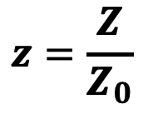
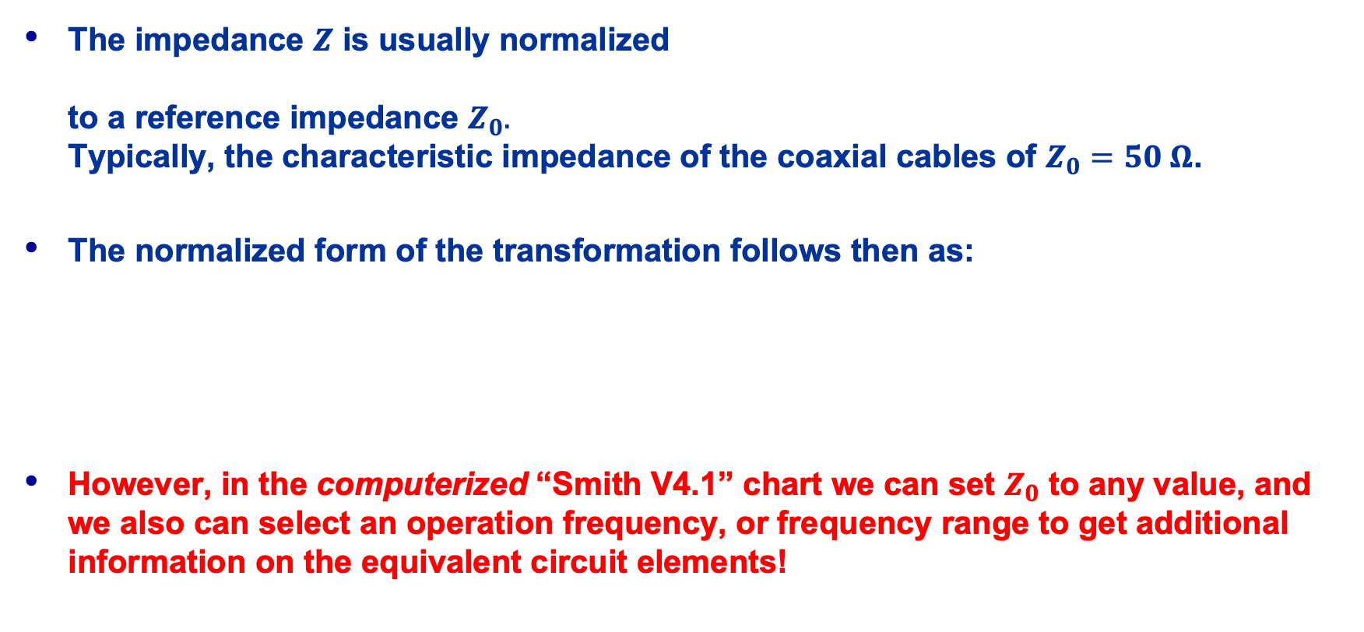
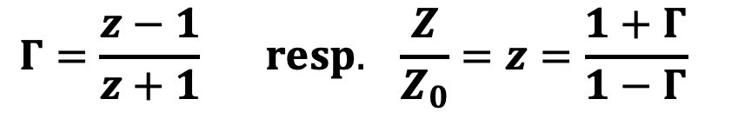
A short Smith Chart Refresher (2)
$$z=\frac{Z}{Z_{0}}$$
The impedance $Z$ is usually normalized
to a reference impedance $Z_{0}.$
Typically, the characteristic impedance of the coaxial cables of $Z_{0}=50 Ω$.
The normalized form of the transformation follows then as:
However, in the computerized “Smith V4.1” chart we can set $Z_{0}$ to any value, and we also can select an operation frequency, or frequency range to get additional information on the equivalent circuit elements!
$$Γ=\frac{z−1}{z+1} resp. \frac{Z}{Z_{0}}=z=\frac{1+Γ}{1−Γ}$$

Slide 4
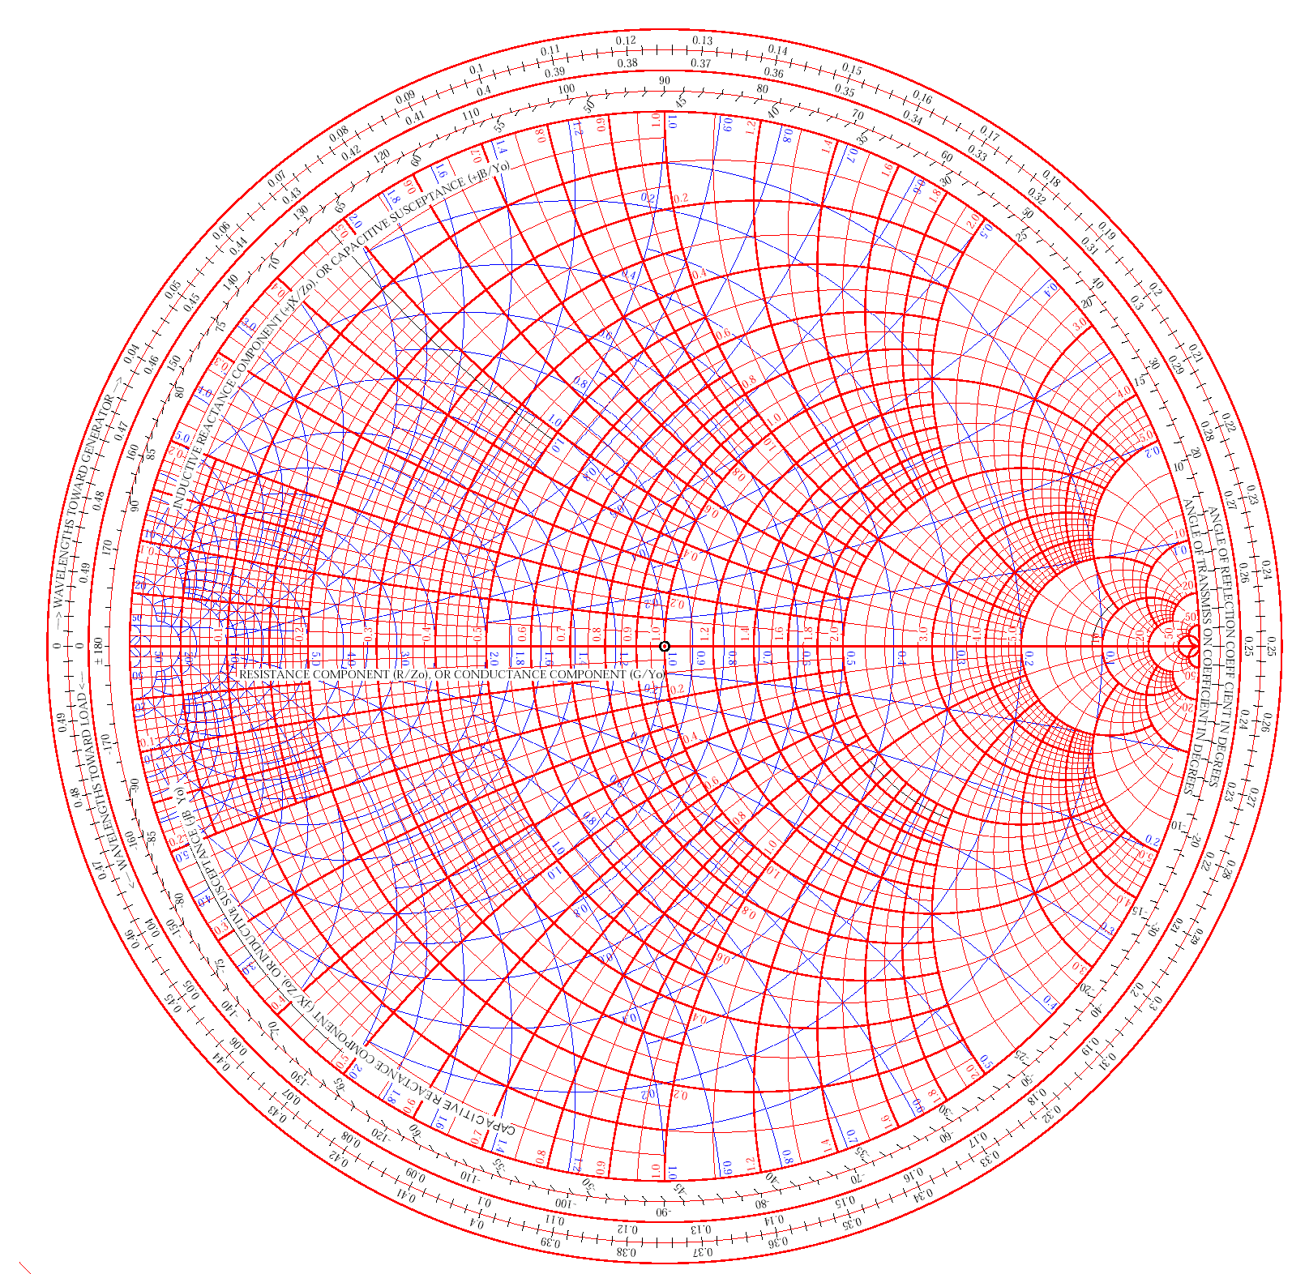
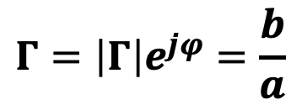


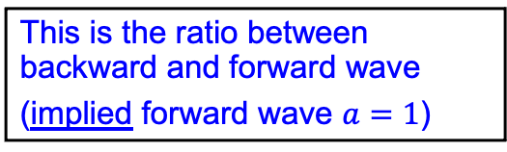
A short Smith Chart Refresher (3)
In the Smith chart,
the complex reflection factor
is expressed in linear cylindrical coordinates, representing the ratio of backward vs. forward traveling waves.
$$\left|Γ\right|$$
$$Γ=\left|Γ\right|e^{jφ}=\frac{b}{a}$$
$$arg\left(Γ\right)$$
This is the ratio between backward and forward wave
(implied forward wave $a=1$)

Slide 5








A short Smith Chart Refresher (4)
The distance from the center of the directly proportional to the magnitude of the reflection factor $\left|Γ\right|$, and permits an easy visualization of the matching performance.
  In particular, the perimeter
  of the diagram represents
  total reflection: $\left|Γ\right|=1$.
  (power dissipated in the load) =
  (forward power) – (reflected power)
$$\left|Γ\right|=1$$
$$\left|Γ\right|=0.75$$
$$\left|Γ\right|=0.5$$
$$\left|Γ\right|=0.25$$
$$\left|Γ\right|=0$$
$$P={\left|a\right|}^{2}−{\left|b\right|}^{2}$$
$$={\left|a\right|}^{2}\left(1−{\left|Γ\right|}^{2}\right)$$
available source power
mismatch losses

Slide 6






The Smith Chart – “Important Points”
Important Points:
Short Circuit
$Γ=−1, z=0$
Open Circuit
$Γ=+1, z→∞$
Matched Load
$Γ=0, z=1$
On the circle $Γ=1$:
lossless element
Upper half:
”inductive” =
positive imaginary part of $Z$
Lower half:
”capacitive” =
negative imaginary part of $Z$
$$ℑ\{Γ\}$$
Short Circuit
$$z=0 \\ Γ=−1$$
Open Circuit
$$z=∞ \\ Γ=+1$$
$$ℜ\{Γ\}$$
$$z=1 \\ Γ=0$$
Matched Load

Slide 7
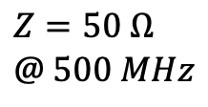
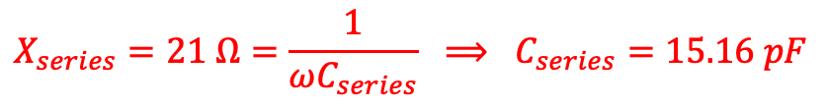






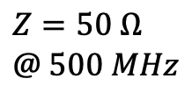







Impedance Matching
Example of a simple impedance matching for a single frequency
$$R=4 Ω$$
$$R=4 Ω$$
$$R=4 Ω$$
$$Z @ 500 MHz?$$
$$Z=50 Ω \\ @ 500 MHz$$
$$L=6.68 nF$$
$$L=6.68 nF$$
$$L=6.68 nF$$
$$Z=50 Ω \\ @ 500 MHz$$
$$Z_{series}= ?$$
$$R_{series}=46 Ω$$
$$Z=R+jωL=\left(4+j21\right) Ω$$
$$Z=R+jωL+Z_{series}=50 Ω$$
$$C_{series}=15.16 pF$$
$$Z_{series}=R_{series}+jX_{series}=50 −\left(4+j21\right) Ω$$
$$⟹ R_{series}=46 Ω$$
$$X_{series}=21 Ω=\frac{1}{ωC_{series}} ⟹ C_{series}=15.16 pF$$

Slide 8
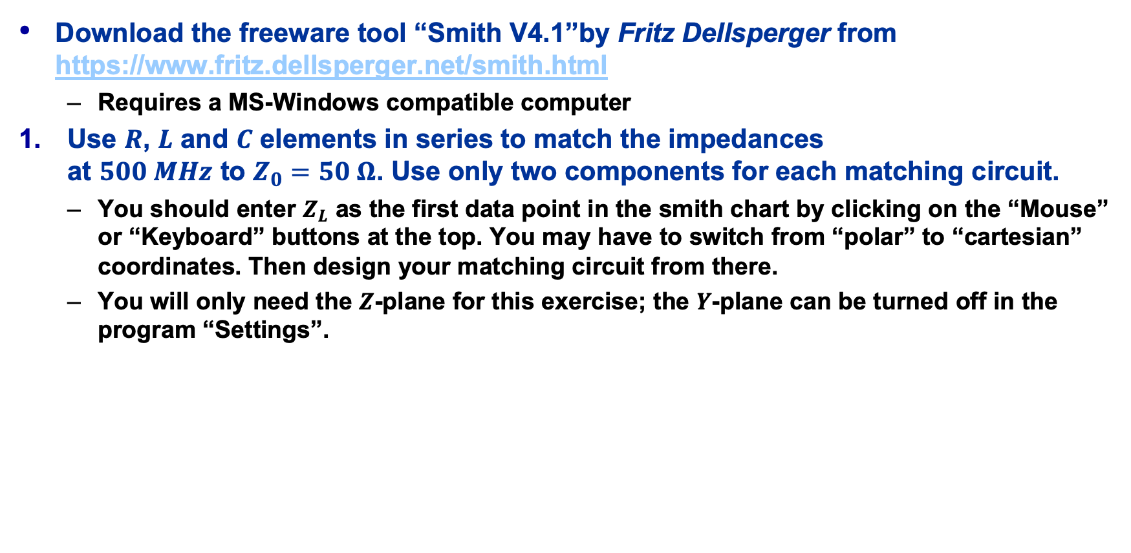
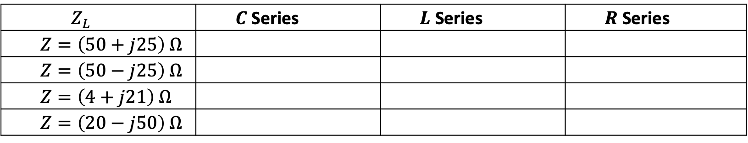
Matching Network Exercises with “Smith V4.1” (1)
Download the freeware tool “Smith V4.1”by Fritz Dellsperger from
https://www.fritz.dellsperger.net/smith.html
  Requires a MS-Windows compatible computer
Use $R$, $L$ and $C$ elements in series to match the impedances
at $500 MHz$ to $Z_{0}=50 Ω$. Use only two components for each matching circuit.
  You should enter $Z_{L}$ as the first data point in the smith chart by clicking on the “Mouse” or “Keyboard” buttons at the top. You may have to switch from “polar” to “cartesian” coordinates. Then design your matching circuit from there.
  You will only need the $Z$-plane for this exercise; the $Y$-plane can be turned off in the program “Settings”.
$$Z_{L}$$ | $C$ Series | $L$ Series | $R$ Series
$$Z=\left(50+j25\right) Ω$$
$$Z=\left(50−j25\right) Ω$$
$$Z=\left(4+j21\right) Ω$$
$$Z=\left(20−j50\right) Ω$$

Slide 9
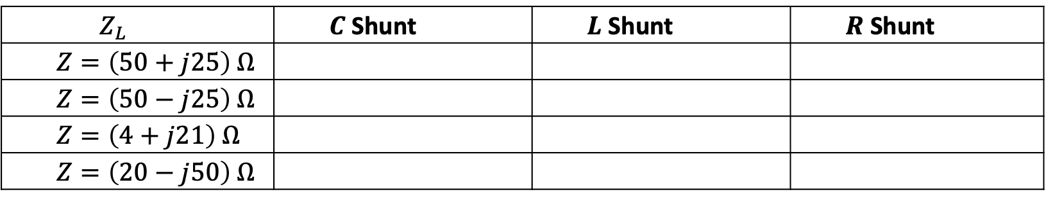

Matching Network Exercises with “Smith V4.1” (2)
Use $R$, $L$ and $C$ elements in parallel to match the impedances
at $500 MHz$ to $Z_{0}=50 Ω$. Use only two components for each matching circuit.
  Hint: You will only need the $Y$-plane for this exercise
  Another hint: Make use of “Undo” if something goes wrong or restart the program.
$$Z_{L}$$ | $C$ Shunt | $L$ Shunt | $R$ Shunt
$$Z=\left(50+j25\right) Ω$$
$$Z=\left(50−j25\right) Ω$$
$$Z=\left(4+j21\right) Ω$$
$$Z=\left(20−j50\right) Ω$$

Slide 10
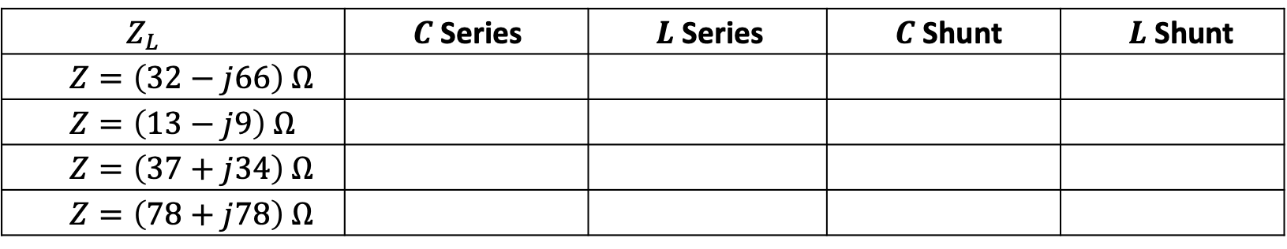
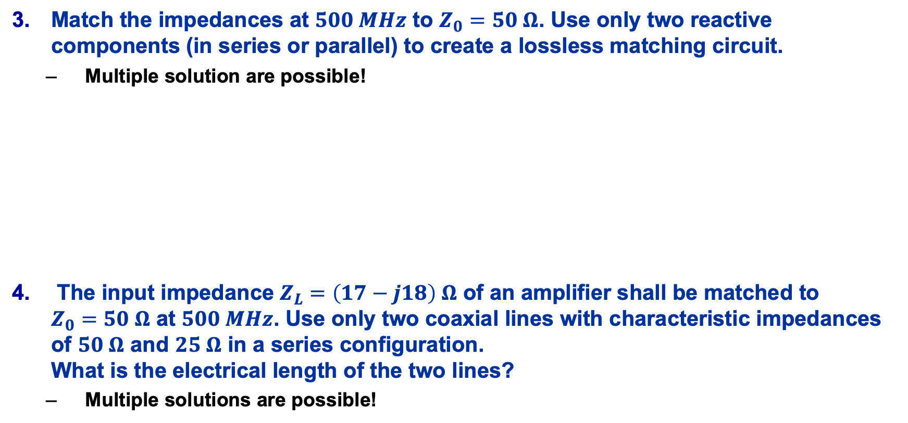
Matching Network Exercises with “Smith V4.1” (3)
Match the impedances at $500 MHz$ to $Z_{0}=50 Ω$. Use only two reactive components (in series or parallel) to create a lossless matching circuit.
  Multiple solution are possible!
The input impedance $Z_{L}=\left(17−j18\right) Ω$ of an amplifier shall be matched to
$Z_{0}=50 Ω$ at $500 MHz$. Use only two coaxial lines with characteristic impedances of $50 Ω$ and $25 Ω$ in a series configuration.
What is the electrical length of the two lines?
  Multiple solutions are possible!
$$Z_{L}$$ | $C$ Series | $L$ Series | $C$ Shunt | $L$ Shunt
$$Z=\left(32−j66\right) Ω$$
$$Z=\left(13−j9\right) Ω$$
$$Z=\left(37+j34\right) Ω$$
$$Z=\left(78+j78\right) Ω$$

