Slide 1
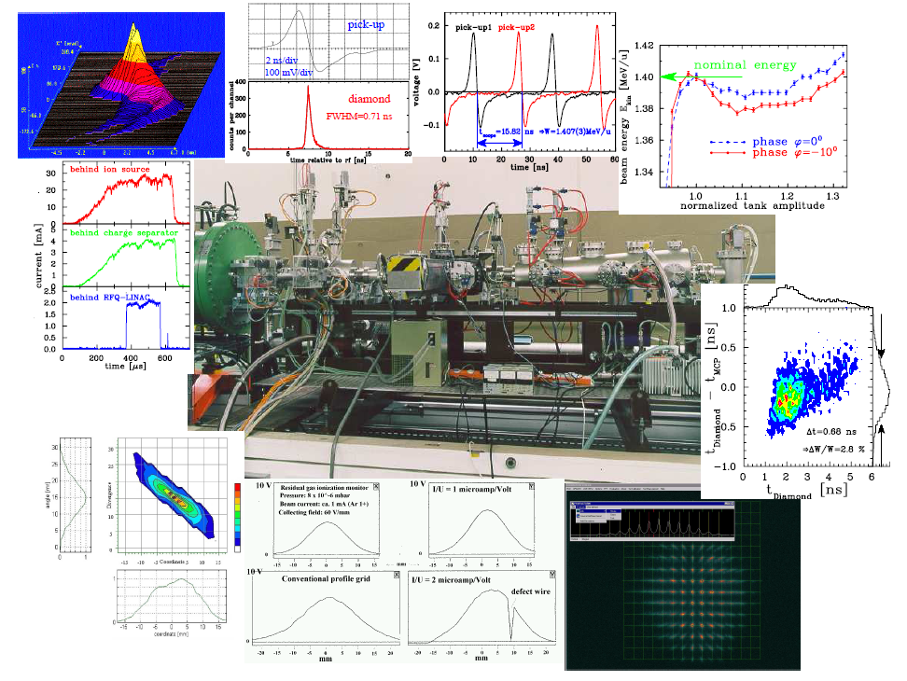
Beam Diagnostics and Instrumentation
JUAS 2021, remote lecture
Peter Forck, moderation Sajjad Mirza
Gesellschaft für Schwerionenforschnung (GSI) and University Frankfurt

Slide 2
Demands on Beam Diagnostics
Diagnostics is the ’sensory organs’ for the beam.
It deals with real beams in real technical installations including all imperfections.
Three types of demands lead to different installations:
Quick, non-destructive measurements leading to a single number or simple plots
Used as a check for online information. Reliable technologies have to be used
Example: Current measurement by transformers
Instruments for daily check, malfunction diagnosis and wanted parameter variation
Example: Profile measurement, in many cases ‘intercepting’ i.e destructive to the beam
Complex instruments for severe malfunctions, accelerator commissioning & development
The instrumentation might be destructive and complex
Example: Emittance determination
General usage of beam instrumentation:
Monitoring of beam parameters for operation, beam alignment, acc. development.....
Instruments for automatic, active beam control
Example: Closed orbit feedback using position measurement by BPMs
Non-destructive (’non-intercepting’) methods are preferred:
The beam is not influenced
The instrument is not destroyed

Slide 3
The Role of Beam Diagnostics
The cost of diagnostics is about 3 to 10 % of the total facility cost:
≈ 3 % for large accelerators or accelerators with standard technologies
≈ 10 % for versatile accelerators or novel accelerators and technologies.
Cost Examples:
The amount of man-power is about 10 to 20 %:
very different physics and technologies are applied
technologies have to be up-graded, e.g. data acquisition and analysis
accelerator improvement calls for new diagnostic concepts.

Slide 4
Relevant physical Processes for Beam Diagnostics
Process | Physics | Technique | Examples
Electro-magnetic caused by moving charges | classical electro-dynamics | U & I measurement, low & high frequencies | Faraday cups, pick-ups, current transformers
Emission of photon by accelerated charges: (high relativistic e⁻ & p) | classical electro-dynamics | optical techniques (from visible to x-ray) | synchrotron radiation monitors
Interaction of particles with photons | atomic physics, optics, lasers | optical techniques, particle detectors | laser scanners, bunch length measurement, polarimeters
Coulomb interaction of charged particles with matter | atomic and solid state physics | U & I measurement, optical techniques, particle detectors | scintillators, viewing screens, ionization chambers, ionization profile monitor
Nuclear- or elementary particle physics interactions | nuclear physics | particle detectors | beam loss monitors, polarimeters, luminosity monitors

Slide 5
Relevant physical Processes for Beam Diagnostics
Process | Physics | Technique | Examples
Electro-magnetic caused by moving charges | classical electro-dynamics | U & I measurement, low & high frequencies | Faraday cups, pick-ups, current transformers
Emission of photon by accelerated charges: (high relativistic e⁻ & p) | classical electro-dynamics | optical techniques (from visible to x-ray) | synchrotron radiation monitors
Interaction of particles with photons | atomic physics optics, lasers | optical techniques, particle detectors | laser scanners, bunch length measurement, polarimeters
Coulomb interaction of charged particles with matter | atomic and solid state physics | U & I measurement, optical techniques, particle detectors | scintillators, viewing screens, ionization chambers, ionization profile monitor
Nuclear- or elementary particle physics interactions | nuclear physics | particle detectors | beam loss monitors, polarimeters, luminosity monitors
Beam diagnostics deals with the full spectrum of physics and technology,
⇒ this calls for experts on all these fields and is a challenging task!
And of cause accelerator physics for proper instrumentation layout.

Slide 6
Beam Quantities and their Diagnostics I
LINAC & transport lines: single pass ↔ Synchrotron: multi pass
Electrons: always relativistic ↔ Protons/Ions: non-relativistic for E_{kin} < 1 GeV/u
Depending on application: low current ↔ high current
Overview of the most commonly used systems:
Beam quantity |  | Transfer line | Synchrotron
Current I | General Special | Transformer, dc & ac Faraday Cup Particle Detectors | Transformer, dc & ac Pick-up Signal (relative)
Profile x_{width} | General Special | Screens, SEM-Grids Wire Scanners, OTR Screen MWPC, Fluorescence Light | Ionization Profile Monitor Wire Scanner, Synchrotron Light Monitor
Position x_{cm} | General Special | Pick-up (BPM) Using position measurement | Pick-up (BPM)
Transverse Emittance ε_{trans} | General Special | Slit-grid Quadrupole Variation Pepper-Pot | Ionization Profile Monitor Wire Scanner Transverse Schottky

Slide 7
Beam Quantities and their Diagnostics II
Beam quantity |  | Transfer line | Synchrotron
Bunch Length Δφ | General Special | Pick-up Secondary electrons arrival Electro-optical laser mod. | Pick-up Wall Current Monitor Streak Camera Electro-optical laser mod.
Momentum p and Momentum Spread Δp/p | General Special | Pick-ups (Time-of-Flight) Magnetic Spectrometer | Pick-up (e.g. tomography) Schottky Noise Spectrum
Longitudinal Emittance ε_{long} | General Special | Buncher variation Magnetic Spectrometer | Pick-up & tomography
Tune and Chromaticity Q, ξ | General Special | --- --- | Exciter + Pick-up Transverse Schottky Spectrum
Beam Loss r_{loss} | General | Particle Detectors
Polarization P | General Special | Particle Detectors Laser Scattering (Compton scattering)
Luminosity L | General | Particle Detectors
Destructive and non-destructive devices depending on the beam parameter.
Different techniques for the same quantity ↔ Same technique for the different quantities.
Remark: In most cases no diagnostics device installed inside the rf-cavities (except cyclotron)

Slide 8
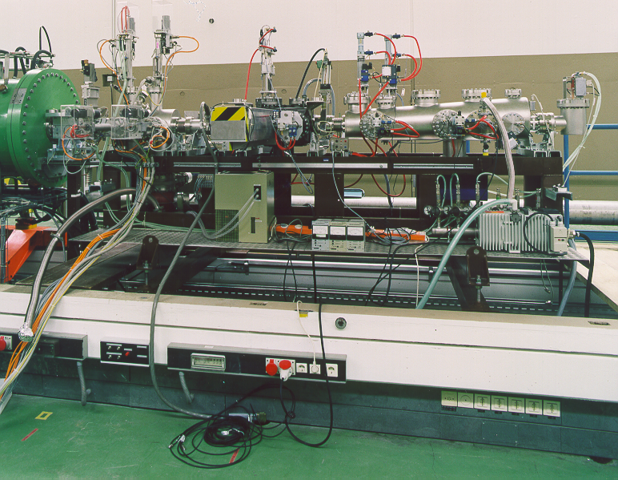
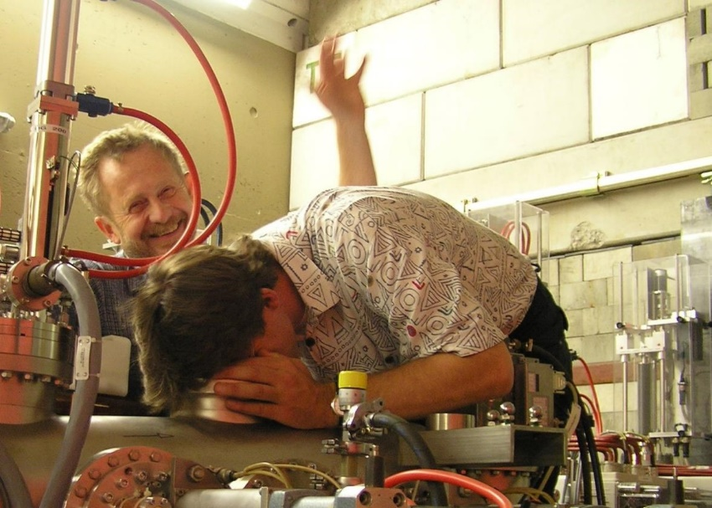
Example: Diagnostics Bench for the Commissioning of an RFQ
transformer
slit-grid emittance
transformer
pick-up
ionization profile monitor
pick-up
pepper-pot emittance
Faraday cup
These instruments are better suited than a human sensory organ
RFQ
SEM-grid
bunch shape monitor
2.5 m

Slide 9
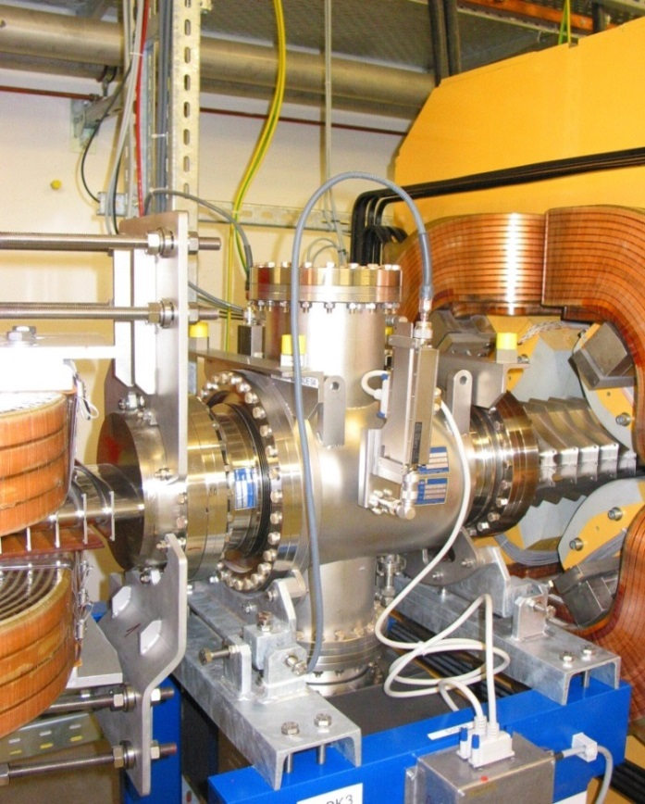
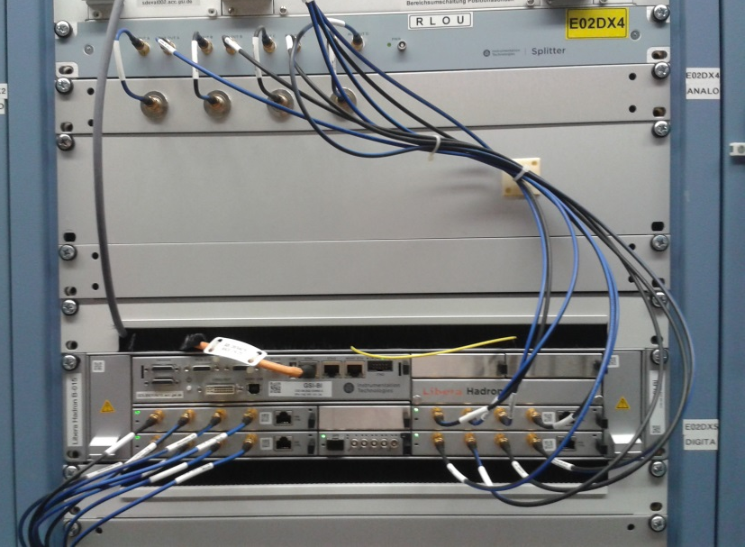
Typical Installation of a Beam Instrument
Quadrupole
Linear Ampl.
‘long cable’ out
LAN
ADCs
Beam
Long cable
‘long cable’
typ. ≈ 100 m
concrete wall
Accelerator tunnel:
→ action of the beam to the detector
→ low noise pre-amplifier and first signal shaping
Local electronics room:
→ analog treatment, partly combining other parameters
→ digitalization, data bus systems (GPIB, VME, cPCI, µTCA...)

Slide 10
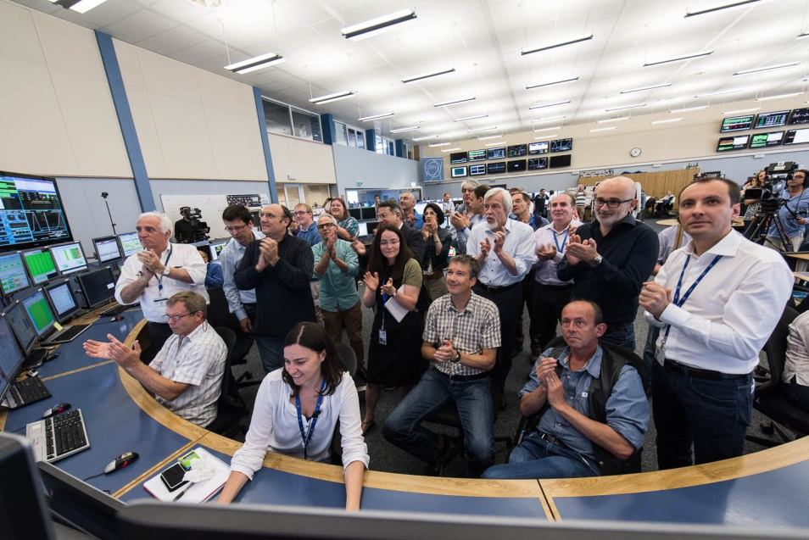
Typical Installation of a Beam Instrument
Modern trend:
High performance ADC
& digital signal processing
‘long cable’
typ. ≈ 100 m
Happy people at
LHC Sept. 10, 2008
concrete wall
Accelerator tunnel:
→ action of the beam to the detector
→ low noise pre-amplifier and first signal shaping
Local electronics room:
→ analog treatment, partly combining other parameters
→ digitalization, data bus systems (GPIB, VME, cPCI, µTCA...)
Beam alignment
by ‘turning knobs’
Control room:
→ visualization and storage
→ parameter setting

Slide 11
Outline of the Lecture
The ordering of the subjects is oriented by the beam quantities:
Current measurement: Transformers, cups, particle detectors
Profile measurement: Various methods depending on the beam properties
Transverse emittance measurement: Destructive devices,
determination by linear transformations
Pick-ups for bunched beams: Principle and realization of rf pick-ups,
closed orbit and tune measurements
Measurement of longitudinal parameters: Beam energy with pick-ups,
time structure of bunches for low and high beam energies, longitudinal emittance
Beam loss detection: Secondary particle detection for optimization and protection
It will be discussed: The action of the beam to the detector, the design of the devices, generated raw data, partly analog electronics, results of the measurements.
It will not be discussed: Detailed signal-to-noise calculations, analog electronics,
digital electronics, data acquisition and analysis, online and offline software....
General: Standard methods and equipment for stable beams with moderate intensities.

Slide 12
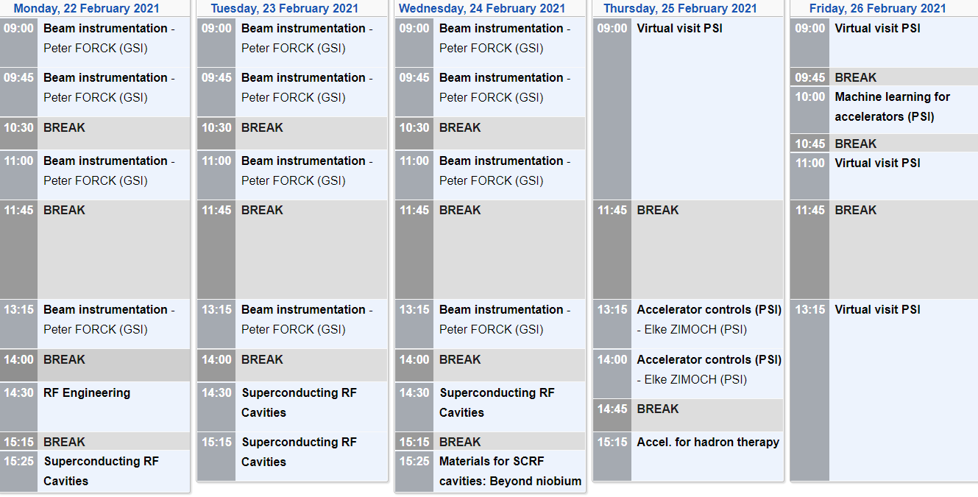
Organization of the Lecture
Lecture:
Emittance
Pick-up
Longi. parameters
Additionally on March 10:
Practical work at company Bergoz
with beam current transformers
Lecture:
Longi. parameters
Beam loss det.
Lecture:
Overview
Current
Lecture:
Transverse profile
Exercise & presentation:
Your hard work!
Lecture:
Transverse profile
& Exercise
Lecture
& Exercise
General: Please ask questions & make comments → all interrupts are welcome!
Sajjad Mirza is your ‘advocate’. This is your event!

Slide 13
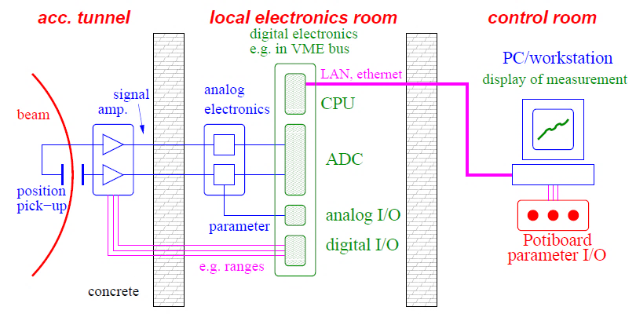
Goal of the Lecture
Signal generation
Valid interpretation
The goal of the lecture should be:
Understanding the signal generation of various device
Showing examples for real beam behavior
Enabling a correct interpretation of various measurements.

