Slide 1
Measurement of Beam Current
The beam current is the basic quantity of the beam.
It this the first check of the accelerator functionality
It has to be determined in an absolute manner
Important for transmission measurement and to prevent for beam losses.
Different devices are used:
Transformers: Measurement of the beam’s magnetic field
They are non-destructive. No dependence on beam energy
They have lower detection threshold.
Faraday cups: Measurement of the beam’s electrical charges
They are destructive. For low energies only
Low currents can be determined.
Particle detectors: Measurement of the particle’ s energy loss in matter
Examples are scintillators, ionization chambers, secondary e− emission monitors
Used for low currents at high energies e.g. for slow extraction from a synchrotron.
Generally: Beam instruments are mounted outside of rf cavities to prevent for
electro-magnetic interference from the high field; only inside cyclotrons some BI.

Slide 2
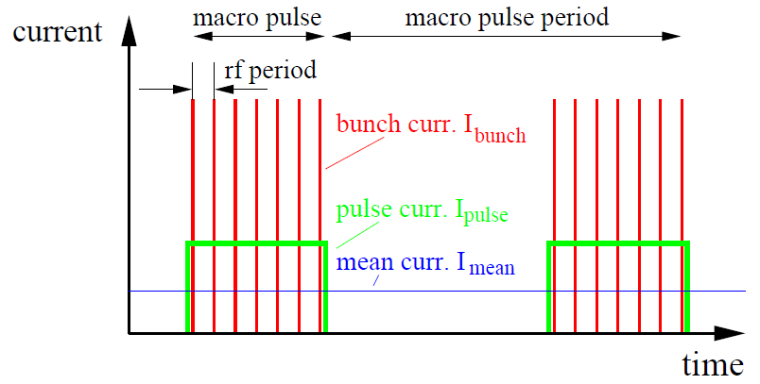
Beam Structure of a pulsed LINAC
Pulsed LINACs and cyclotrons used for injection
to synchrotrons with t_{pulse} ≈100 μs:
One distinguish between:
Mean current I_{mean}
→ long time average in [A]
Pulse current I_{pulse}
→ during the macro pulse in [A]
Bunch current I_{bunch}
→ during the bunch in [C/bunch]
or [particles/bunch]
Remark: Van-de-Graaff (ele-static):
→ no bunch structure

Slide 3
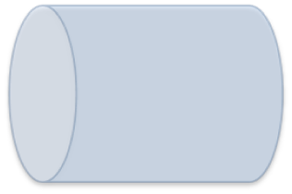
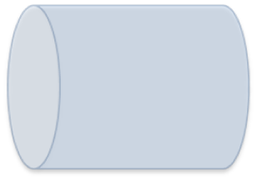

Magnetic field of the beam and the ideal Transformer
Beam current of N_{part} charges with velocity β
cylindrical symmetry
→ only azimuthal component
$$\vec{B}= µ_{0}\frac{I_{beam}}{2πr}∙\vec{e_{φ}}$$
Example: I =1μA, r =10cm ⇒ B_{beam}= 2pT, earth B_{earth}= 50μT
Idea: Beam as primary winding and sense by sec. winding.
⇒ Loaded current transformer
I₁/I₂= N₂/N₁ ⇒ I_{sec} = 1/N · I_{beam}
Inductance of a torus of μ_{r}
Goal of torus: Large inductance L
and guiding of field lines.
Definition: U = L · dI/dt
Torus to guide the magnetic field
I_{beam}
v_{out}
R

Slide 4
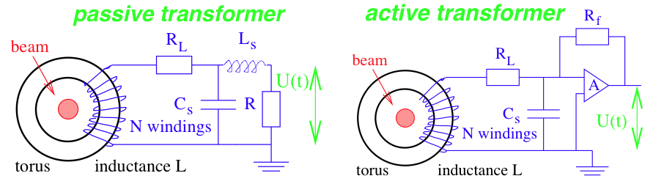
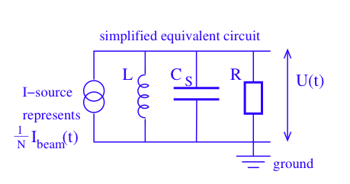
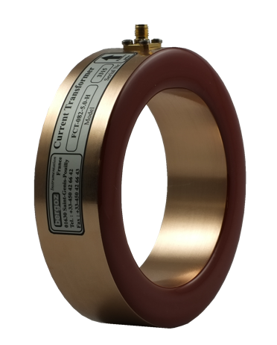
Simplified electrical circuit of a passively loaded transformer:
Passive Transformer or Fast Current Transformer FCT
Analysis of a simplified electrical circuit of a passively loaded transformer:
A voltages is measured: U = R · I_{sec} = R /N · I_{beam} ≡ S · I_{beam}
with S sensitivity [V/A],
equivalent to transfer function or transfer impedance Z
beam
Equivalent circuit for analysis of sensitivity and bandwidth
(disregarding the loss resistivity R_{L})

Slide 5
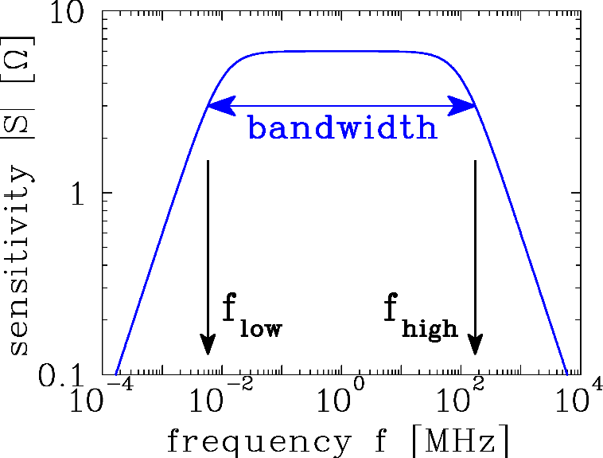
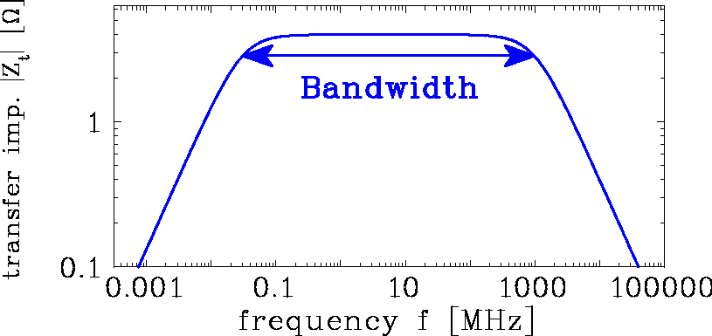
Bandwidth of a Passive Transformer or FCT
Analysis of a simplified electrical circuit of a passively loaded transformer:
For this parallel shunt:
Low frequency ω << R/L : Z → iωL
i.e. no dc-transformation
High frequency ω >> 1/RC_{S} : Z → 1/iωC_{S}
i.e. current flow through C_{S}
2π f_{low}=R/L
2πf_{high}=1/RC_{S}
Working region R/L < ω < 1/RC_{S} : Z ≃ R
i.e. voltage drop at R and sensitivity S=R/N.
No oscillations due to over-damping by low R = 50 Ω to ground.

Slide 6
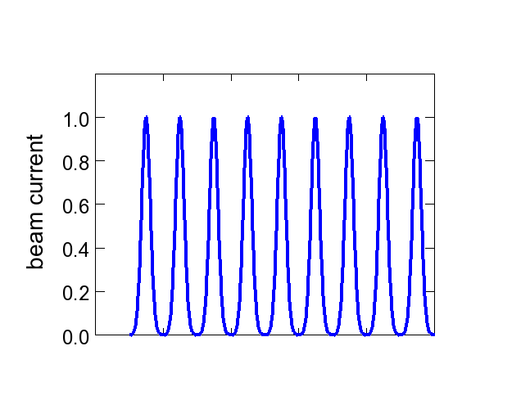
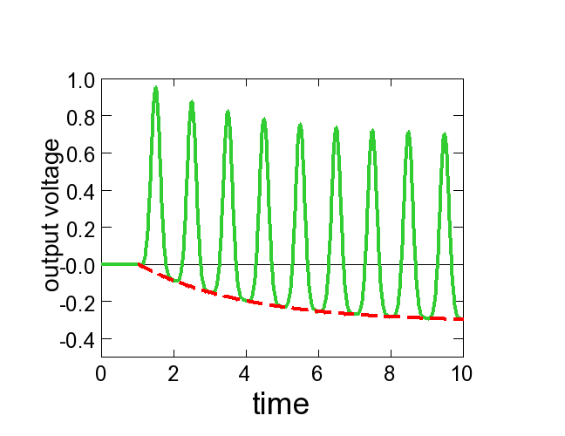

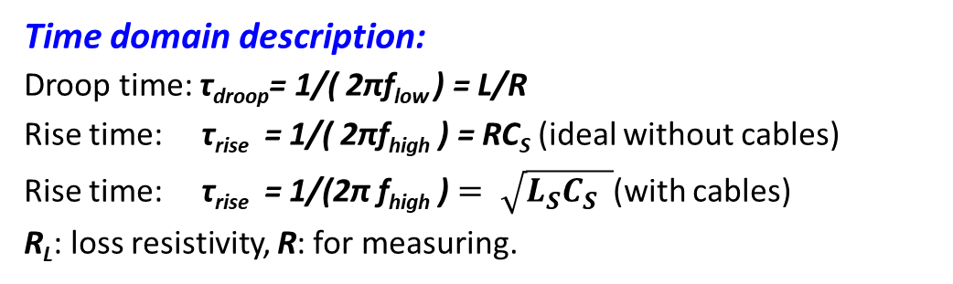

Response of the Passive Transformer: Rise and Droop Time
Time domain description:
Droop time: τ_{droop}= 1/( 2πf_{low} ) = L/R
Rise time: τ_{rise} = 1/( 2πf_{high} ) = RC_{S} (ideal without cables)
Rise time: τ_{rise} = 1/(2π f_{high} ) $= \sqrt{L_{S}C_{S} }$(with cables)
R_{L}: loss resistivity, R: for measuring.
beam current
beam bunch
Bunch train:
beam current
test
pulse
time
time
output volt.
$$τ_{droop}=L/R$$
signal
time
time
$$τ_{rise}=\sqrt{L∙C_{S}}$$
2π f_{low}
=R/L
2πf_{high}
=1/RC_{S}
baseline
Baseline: U_{base} ∝ 1 - exp(-t/τ_{droop})
positive & negative areas are equal

Slide 7
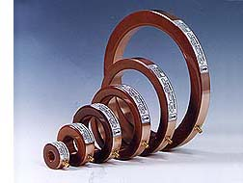
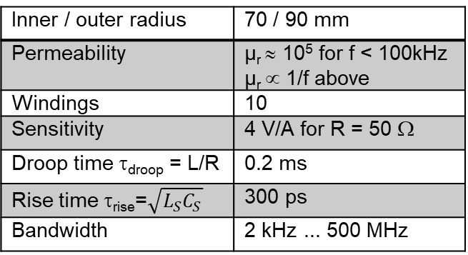
Example for Fast Current Transformer
From
Company Bergoz
For bunch beams e.g. transfer between synchrotrons
typical bandwidth of 2 kHz < f < 1 GHz
⇔ 1 ns < t _{batch} < 200 μs is well suited
Example GSI type:
Inner / outer radius | 70 / 90 mm
Permeability | µ_{r} ≈ 10⁵ for f < 100kHz µ_{r} ∝ 1/f above
Windings | 10
Sensitivity | 4 V/A for R = 50 Ω
Droop time τ_{droop} = L/R | 0.2 ms
Rise time τ_{rise}=$\sqrt{L_{S}C_{S}}$ | 300 ps
Bandwidth | 2 kHz ... 500 MHz
∅ 200 mm
Numerous application e.g.:
Transmission optimization
Bunch shape measurement
Input for synchronization
of ‘beam phase’
synchrotron
FCT
injection
extraction

Slide 8
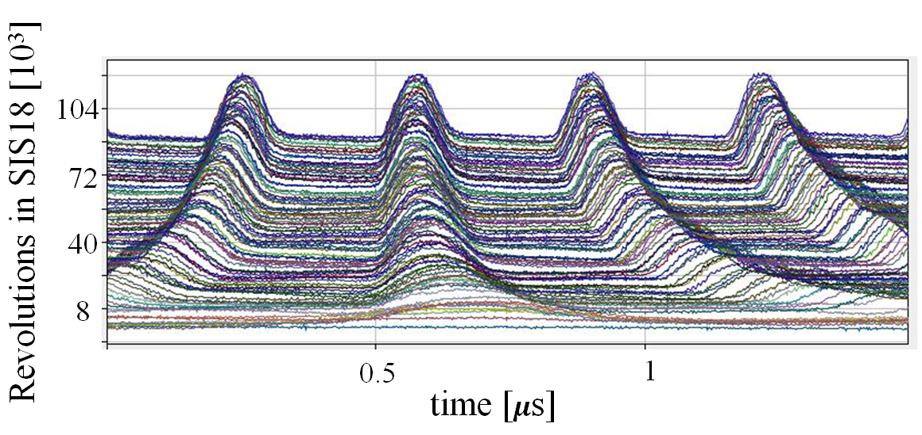
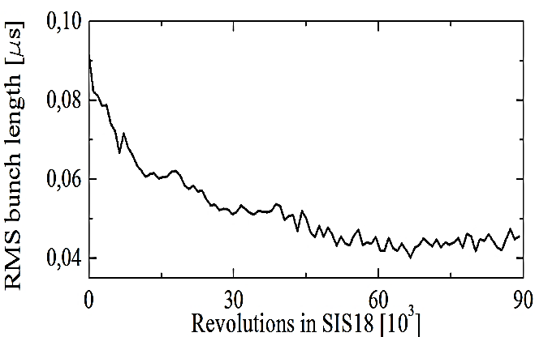
Example for Fast Current Transformer
From
Company Bergoz
For bunch beams e.g. transfer between synchrotrons
typical bandwidth of 2 kHz < f < 1 GHz
⇔ 1 ns < t _{batch} < 200 μs is well suited
Example GSI type:
Inner / outer radius | 70 / 90 mm
Permeability | µ_{r} ≈ 10⁵ for f < 100kHz µ_{r} ∝ 1/f above
Windings | 10
Sensitivity | 4 V/A for R = 50 Ω
Droop time τ_{droop} = L/R | 0.2 ms
Rise time τ_{rise}=$\sqrt{L_{S}C_{S}}$ | 300 ps
Bandwidth | 2 kHz ... 500 MHz
∅ 200 mm
Example: U⁷³⁺ from 11 MeV/u (β = 15 %) to 350 MeV/u within 300 ms (displayed every 0.15 ms)
FCT
synchrotron
0
1.5
injection
extraction

Slide 9
‘Active’ Transformer with longer Droop Time
Active Transformer or Alternating Current Transformer ACT:
uses a trans-impedance amplifier (I/U converter) to R ≈ 0 Ω load impedance i.e. a current sink
+ compensation feedback
⇒ longer droop time τ_{droop}
Application: measurement of longer t > 10 μs e.g. at pulsed LINACs
The input resistor is for an op-amp: R_{f}/A << R_{L}
⇒ τ_{droop} = L/(R_{f} /A+R_{L}) ≃ L/R_{L}
Droop time constant can be up to 1 s!
The feedback resistor is also used for range switching.
An additional active feedback loop is used to compensate the droop.

Slide 10
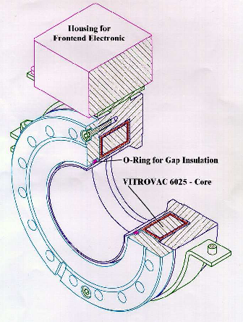
‘Active’ Transformer Realization
Active transformer for the measurement of long
t > 10 μs pulses e.g. at pulsed LINACs
Inner / outer radius | 30 / 45 mm
Permeability | µ_{r} ≈ 10⁵ for f < 100kHz µ_{r} ∝ 1/f above
Windings | 2x10 crossed
Max. sensitivity | 10⁶ V/A with amplifier
Current resolution | 0.2 µA for full BW
Droop | 0.5 % per 5 ms
Rise time | 200 ns
Bandwidth | 2 kHz ... 1 MHz

Slide 11
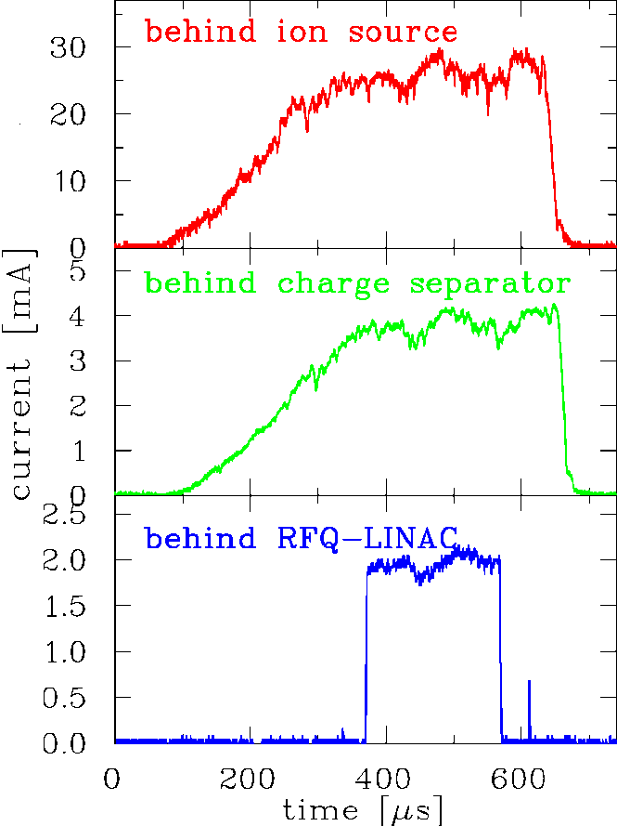
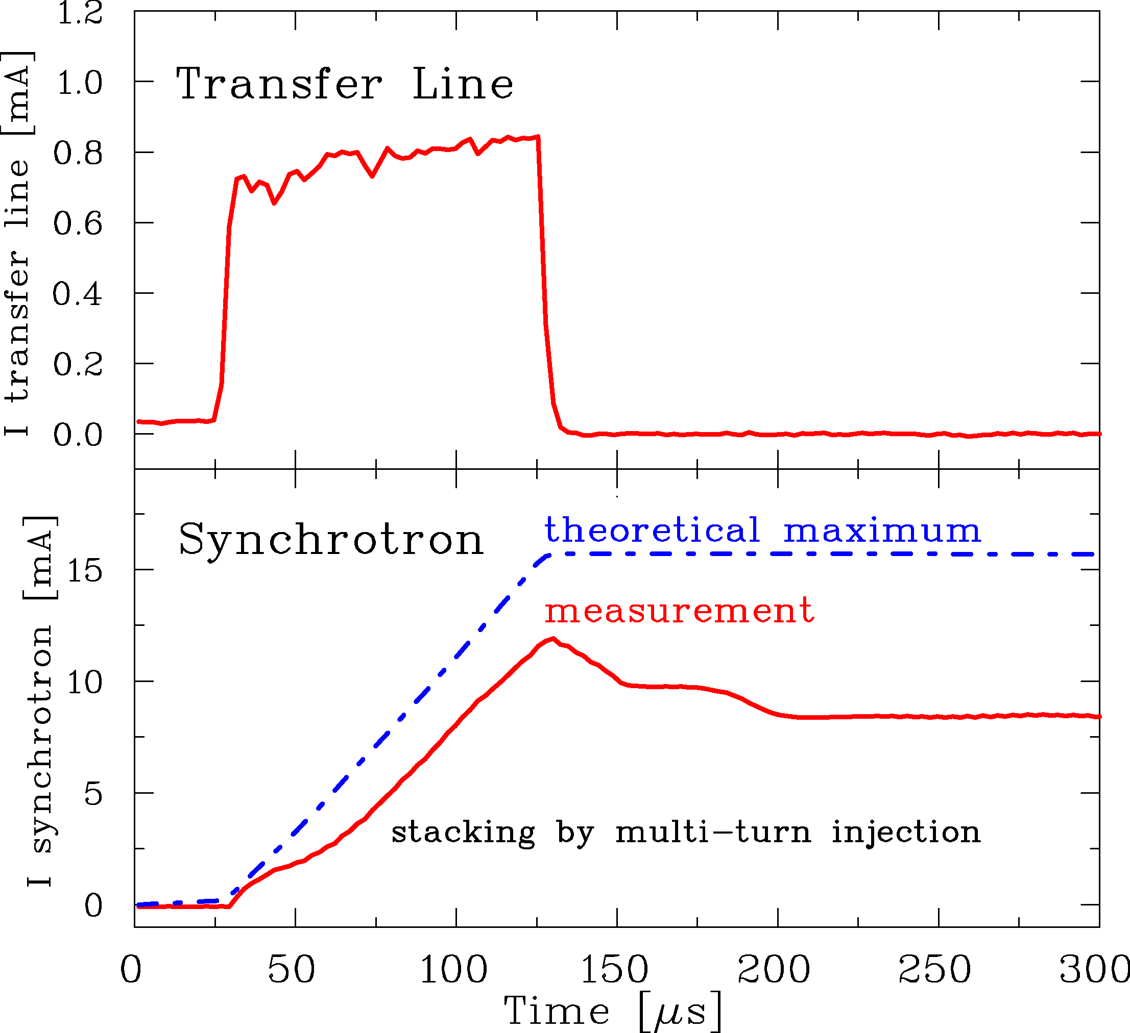
‘Active’ Transformer Measurement
Active transformer for the measurement of long t > 10 μs pulses e.g. at pulsed LINACs
Example: Transmission and macro-pulse shape for Ni²⁺ beam at GSI LINAC
Example: Multi-turn injection of a Ni²⁶⁺ beam into GSI Synchrotron, 5 μs per turn
ACCT
synchrotron
source
ACCT
→ Transformer are frequently
used for operation.
ACCT
injection
extraction
RFQ
LINAC

Slide 12
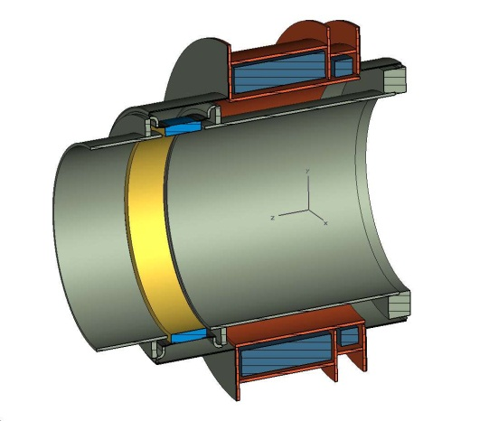
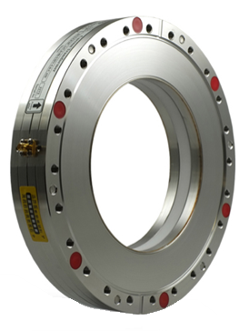
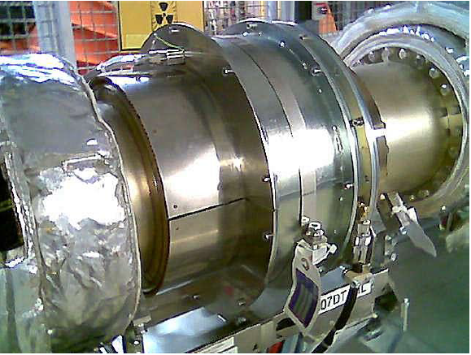
Shielding of a Transformer
Task of the shield:
The image current of the walls have to be bypassed by a gap and a metal housing.
This housing uses µ-metal and acts as a shield of external B-field
(remember: I_{beam} = 1 μA, r = 10 cm ⇒ B_{beam} = 2pT, earth field B_{earth} = 50 µT)
magnetic shield &
current bypass
transformer
torus
ceramic gap
beam
vacuum pipe ∅ 150 mm
beam
ceramic
gap
∅CF200
courtesy Company Bergoz

Slide 13
Design Criteria for a Current Transformer
Criteria:
1. The output voltage is U ∝ 1/N ⇒ low number of windings for large signal.
2. For a longer droop time, a large inductance L is required due to τ_{droop} = L/R:
L ∝ N² and L ∝ μ_{r} (μ_{r} ≈10⁵ for amorphous alloy)
3. For a large bandwidth the integrating capacitance C_{s} should be low τ_{rise} = √L_{s}C_{s}
Depending on applications the behavior is influenced by external elements:
Passive transformer: R = 50 Ω, τ_{rise} ≈ 1 ns for short pulses
Application: Transfer between synchrotrons : 100 ns < t_{pulse} < 10 μs
Active transformer: Current sink by I/U-converter, τ_{droop} ≈ 1 s for long pulses
Application: macro-pulses at LINACs : 100 μs < t_{pulse} < 10 ms
General:
The beam pipe has to be intersected to prevent the
flow of the image current through the torus
The torus is made of 25 μm isolated flat ribbon
spiraled to get a torus of ≈15 mm thickness,
to have large electrical resistivity
Additional winding for calibration with current source

Slide 14
The Artists View of Transformers
The active transformer ACCT
The passive, fast transformer FCT
Cartoons by Company Bergoz, Saint Genis
On March 10: Comparison of these types at company Bergoz
Notes:
14

Slide 15
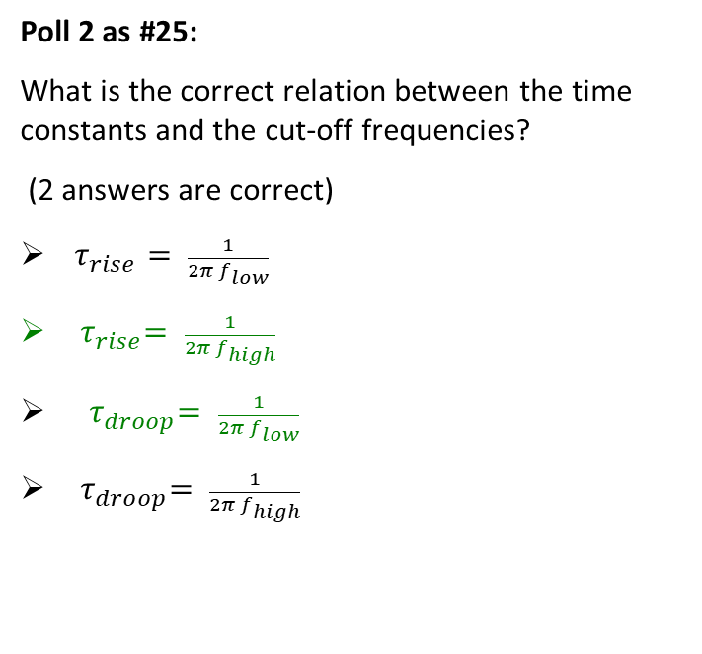
Poll concerning Beam Current Transformers
Poll 1:
What is the sensitivity for a current transformer? It is the ratio between the measurable voltage and…
the beam current
the current in the transformer windings
the beam induced current flowing in the vacuum wall
Poll 2 as #25:
What is the correct relation between the time constants and the cut-off frequencies?
(2 answers are correct)
$τ_{rise}= \frac{1}{2π f_{low}}$
${ τ}_{rise}= \frac{1}{2π f_{high}}$
${ τ}_{droop}= \frac{1}{2π f_{low}}$
${ τ}_{droop}= \frac{1}{2π f_{high}}$
Notes:
15

Slide 16
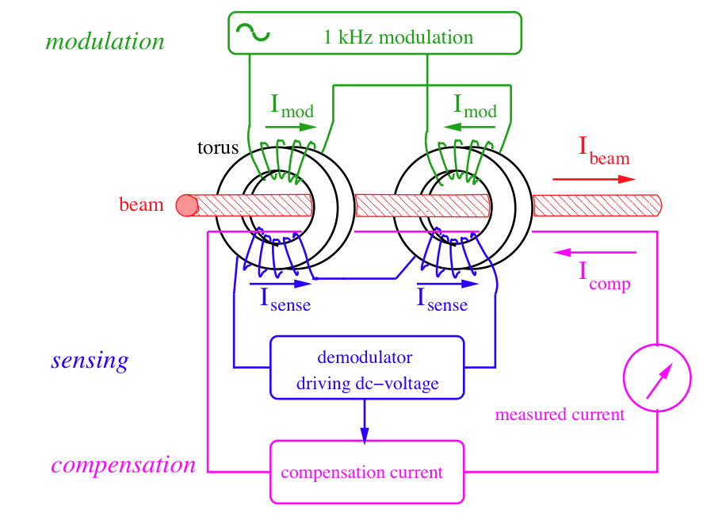
The dc Transformer
How to measure the DC current? The current transformer discussed sees only B-flux changes.
The DC Current Transformer (DCCT) → look at the magnetic saturation of two tori.
Depictive statement:
A single transformer needs varying beam. The trick is to ‘switch two transformers’!
Modulation of the primary windings forces
both torii into saturation, twice per cycle
Sense windings measure the modulation
signal and cancel each other.
But with the I_{beam}, the saturation is shifted
and I_{sense} is not zero
Compensation current
adjustable until I_{sense} is zero once again
Notes:
16

Slide 17
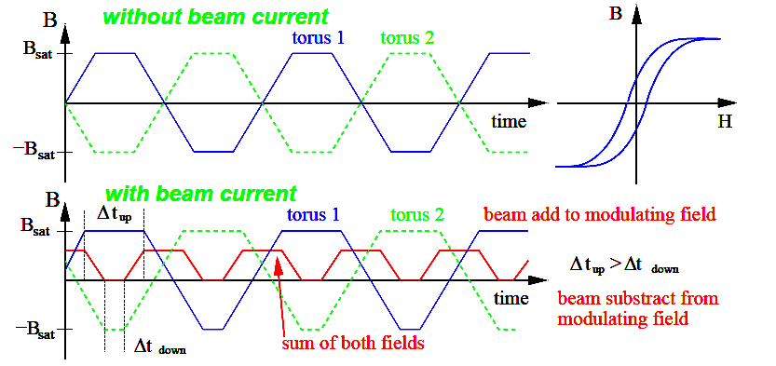
The dc Transformer
Modulation without beam:
typically about 1 kHz to saturation
→ no net flux
Modulation with beam:
saturation is reached at different times, → net flux
Net flux: double frequency than modulation
Feedback: Current fed to compensation winding
for larger sensitivity
Two magnetic cores: Must be very similar.
Notes:
17

Slide 18
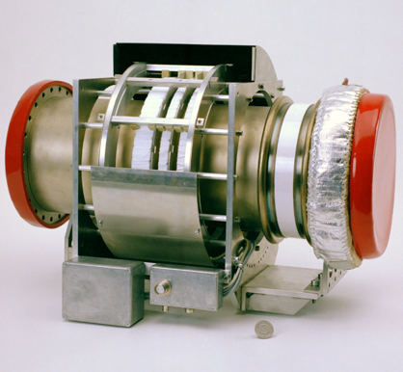
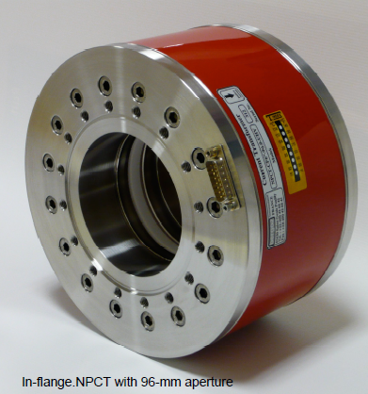
The dc Transformer Realization
Example: The DCCT at GSI synchrotron
(designed 1990 at GSI):
dc transformer
2 cores mounted
ac transformers
(two types)
Torus radii | r_{i} = 135 mm r_{o}=145 mm
Torus thickness | d = 10 mm
Torus permeability | µ_{r} = 10⁵
Saturation inductance | B_{sat} = 0.6 T
Number of windings | 16 for modulation & sensing 12 for feedback
Resolution | I^{min}_{beam} = 2 µA
Bandwidth | Δf = dc .... 20 kHz
Rise time constant | τ_{rise} = 10 µs
Temperature drift | 1.5 µA/ºC
ceramic gap
magnetic shield
∅200 mm flange
Recent commercial product specification (Bergoz NPCT):
Most parameters are comparable the GSI-model
Temperature coefficient: 0.5 µA/ºC
Resolution: ≈ 10 µA (i.e. not optimized)
Notes:
18

Slide 19
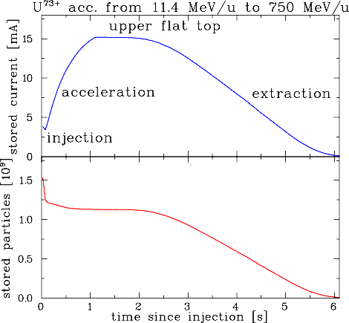
Measurement with a dc Transformer
Example: The DCCT at GSI synchrotron:
⇒ Observation of beam behavior with 20 µs time resolution → most important operation tool.
Example: U⁷³⁺ accelerated from
11. 4 MeV/u (β = 15.5%) to 750 MeV/u (β = 84 %)
Important parameters:
Detection threshold: 1 µA
(= resolution)
Bandwidth: dc to 20 kHz
Rise-time: 20 µs
Temperature drift: 1.5 µA/⁰C
⇒ compensation required.
DCCT
synchrotron
injection
extraction
On March 10: Demonstration of DCCT at company Bergoz
Notes:
19

Slide 20
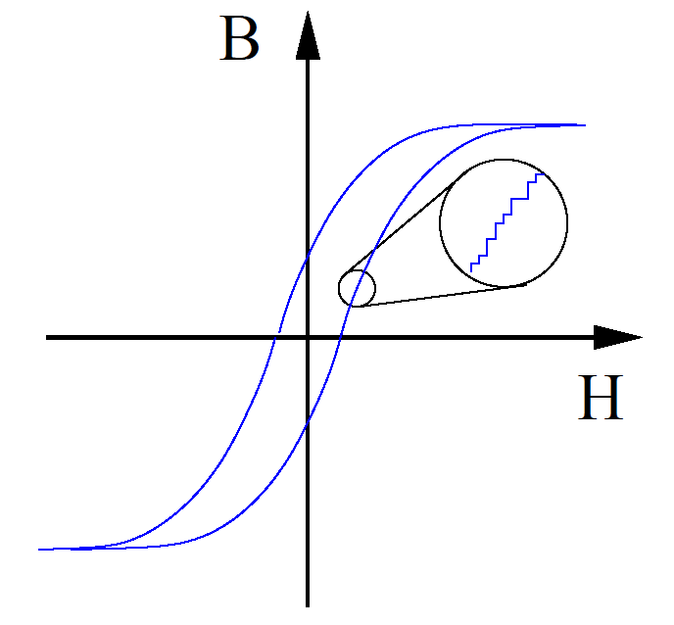
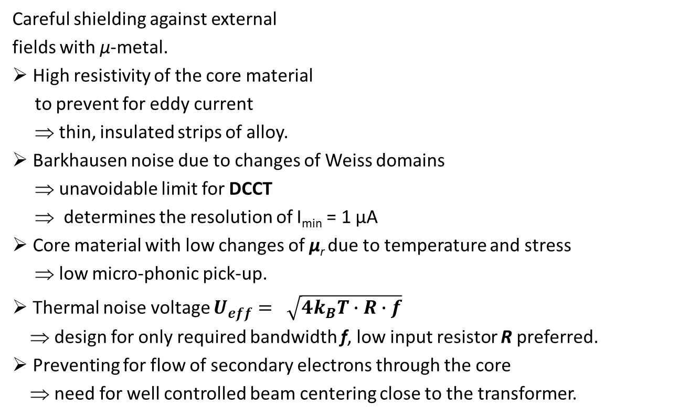
Design Criteria and Limitations for a dc Transformer
Careful shielding against external
fields with μ-metal.
High resistivity of the core material
to prevent for eddy current
⇒ thin, insulated strips of alloy.
Barkhausen noise due to changes of Weiss domains
⇒ unavoidable limit for DCCT
⇒ determines the resolution of I_{min} = 1 µA
Core material with low changes of μ_{r} due to temperature and stress
⇒ low micro-phonic pick-up.
Thermal noise voltage $U_{eff}= \sqrt{4k_{B}T∙R∙f}$
⇒ design for only required bandwidth f, low input resistor R preferred.
Preventing for flow of secondary electrons through the core
⇒ need for well controlled beam centering close to the transformer.
Notes:
20

Slide 21
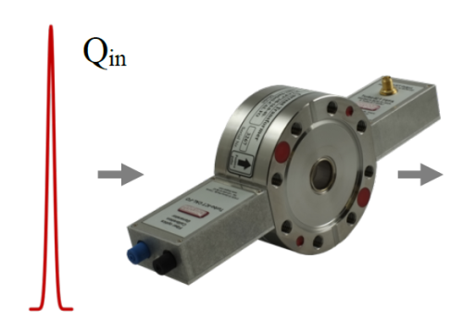
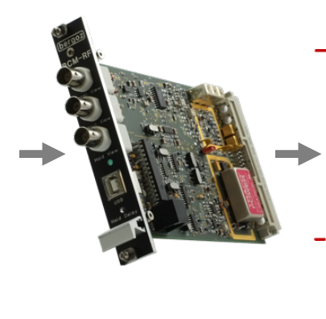
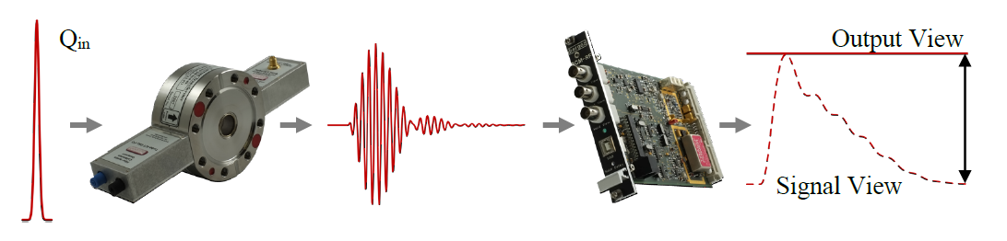
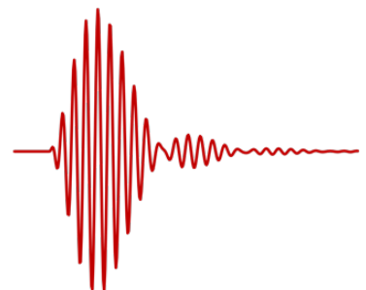
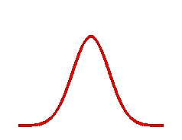
Integrating Current Transformer ICT for short Pulses
Short, single pulse at FELs: Too short to be recorded by FCT due to rise time τ_{pulse}$≪$ τ_{rise} ≈ 1ns
⇒ depictive statement: ‘analog stretching of signal information’ yields charges per bunch
beam
Q_{in}, ps time range
ringing at 180 MHz
100ns range
output after sample&hold
Stretched,
10 ns range
bandpass
1µs range
U_{out}∝ Q_{in}
ICT operation principle for ps pulses:
Image current on shell with gap
Storage of induced charges at C_{int}
‘Slow’ recombination of charges
Sensing this current with FCT
⇒ stretched pulse, length
independent on input → called ICT
Torus1 for correct inductance:
damped resonant circuit of entire devices
Broad bandpass filter ⇒ ringing signal,
to enlarge sensitivity →called Turbo-ICT
torus 1
torus 2: FCT for readout
slotted shell around tori with gap
integrating C_{int} ≈ nF
bunched beam
sample
&hold
amplifier
bandpass
S&H
windings
N_{signal} ≈ 10
R_{load}=50Ω
stretched pulse
ringing pulse

Slide 22
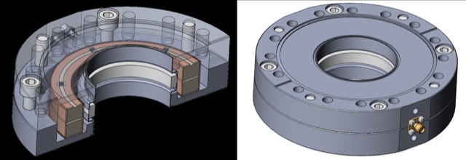
Integrating Current Transformer ICT for short Pulses
Typical parameter of a Turbo-ICT as used at FELs and Laser Plasma Accelerators:
Tori thickness | l = 5 mm respectively
Full scale range | 500 fC ...1 nC
Resolution | 10 fC_{rms} ⇔ 10⁵ e⁻ / bunch
Max. pulse repetition | 500 ns for single pulses
Dynamic range | 80 dB by logarithmic amp.
flange
CF100
bunched beam
slotted
shell
ceramic
gap
capacitor C_{int}
torus 1
torus 2: FCT
ICT operation principle for ps pulses:
Image current on shell with gap
Storage of induced charges at C_{int}
‘Slow’ recombination of charges
Sensing this current with FCT
⇒ stretched pulse, length
independent on input → called ICT
Torus1 for correct inductance:
damped resonant circuit of entire devices
Broad bandpass filter ⇒ ringing signal,
to enlarge sensitivity →called Turbo-ICT
torus 1
torus 2: FCT for readout
courtesy Company Bergoz
slotted shell around tori with gap
integrating C_{int} ≈ nF
bunched beam
sample
&hold
amplifier
bandpass
S&H
windings
N_{signal} ≈ 10
R_{load}=50Ω
stretched pulse
ringing pulse
On March 10: Comparison of ICT & Turbo-ICT at company Bergoz

Slide 23
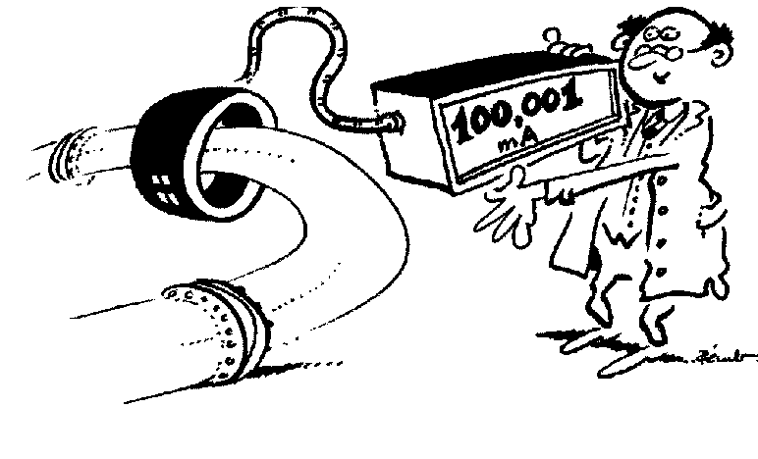
Summary for Transformers for Current Measurement
Transformer: Measurement of the beam’s magnetic field
➢ Magnetic field is guided by a high μ toroid
Types of transformers:
FCT for bunches: I_{min} ≈ 30 µA, bandwidth ≈ 10 kHz ... 500 MHz
ACT for macro-pulses: I_{min} ≈ 0.2 µA, bandwidth ≈ 100 Hz ... 3 MHz
DCCT for dc beams: I_{min} ≈ 1 µA, BW ≈ dc ... 20 kHz, based two toroids + modulation
ICT short pulses: Q_{min} ≈ 10 fC Image charge storage → analog pulse stretching,, no timing
➢ Non-destructive, used for all beams
Resolution limit
Fast Transformer FCT
Active transformer ACT
DC transformer DCCT
Company Bergoz
23
Notes:
23

Slide 24
Poll concerning dc Beam Current Transformers
Poll 2:
A dc current transformer DCCT consists of …
1 torus with 2 windings modulated by 1 frequency
1 torus with 1 winding modulated by 2 frequencies
2 tori with 1 winding each modulated by 1 frequency with 180 degree phase shift
2 tori with 2 windings each modulated by 1 frequency with 180 degree phase shift
2 tori with 2 windings each modulated by 2 frequencies
Notes:
24

Slide 25
Measurement of Beam Current
The beam current is the basic quantity of the beam.
It this the first check of the accelerator functionality
It has to be determined in an absolute manner
Important for transmission measurement and to prevent for beam losses.
Different devices are used:
Transformers: Measurement of the beam’s magnetic field
They are non-destructive. No dependence on beam energy
They have lower detection threshold.
Faraday cups: Measurement of the beam’s electrical charges
They are destructive. For low energies only
Low currents can be determined.
Particle detectors: Measurement of the particle’s energy loss in matter
Examples are scintillators, ionization chambers, secondary e− emission monitors
Used for low currents at high energies e.g. for slow extraction from a synchrotron.

Slide 26
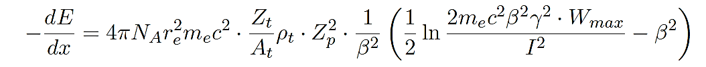
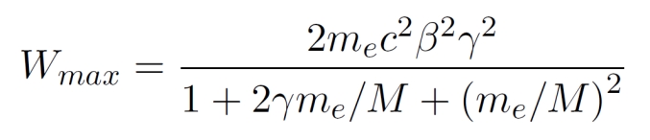
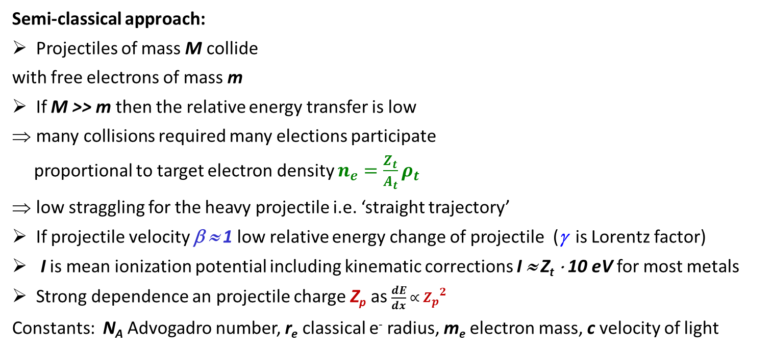
Energy Loss of Ions in Matter
Bethe-Bloch formula:
(simplest formulation)
Semi-classical approach:
Projectiles of mass M collide
with free electrons of mass m
If M >> m then the relative energy transfer is low
many collisions required many elections participate
proportional to target electron density $n_{e}=\frac{Z_{t}}{A_{t}}ρ_{t}$
low straggling for the heavy projectile i.e. ‘straight trajectory’
If projectile velocity β ≈ 1 low relative energy change of projectile (γ is Lorentz factor)
I is mean ionization potential including kinematic corrections I ≈ Z_{t} ⋅ 10 eV for most metals
Strong dependence an projectile charge Z_{p} as $\frac{dE}{dx} ∝ {Z_{p}}_{}^{2}$
Constants: N_{A} Advogadro number, r_{e} classical e⁻ radius, m_{e} electron mass, c velocity of light
e⁻
beam, charge Z_{p}
‚δ-ray’
mass M
e⁻
Material
Z_{t} , A_{t} , ρ_{t}
Maximum energy transfer from projectile M to electron m_{e}:
Notes:
26

Slide 27
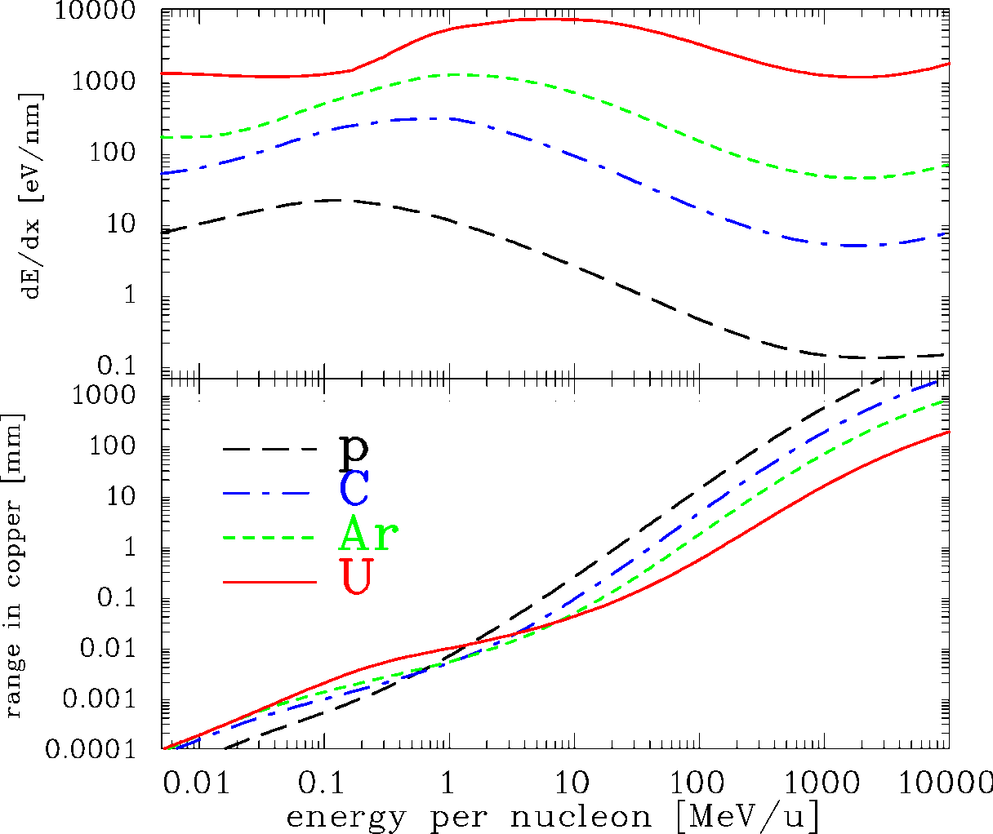
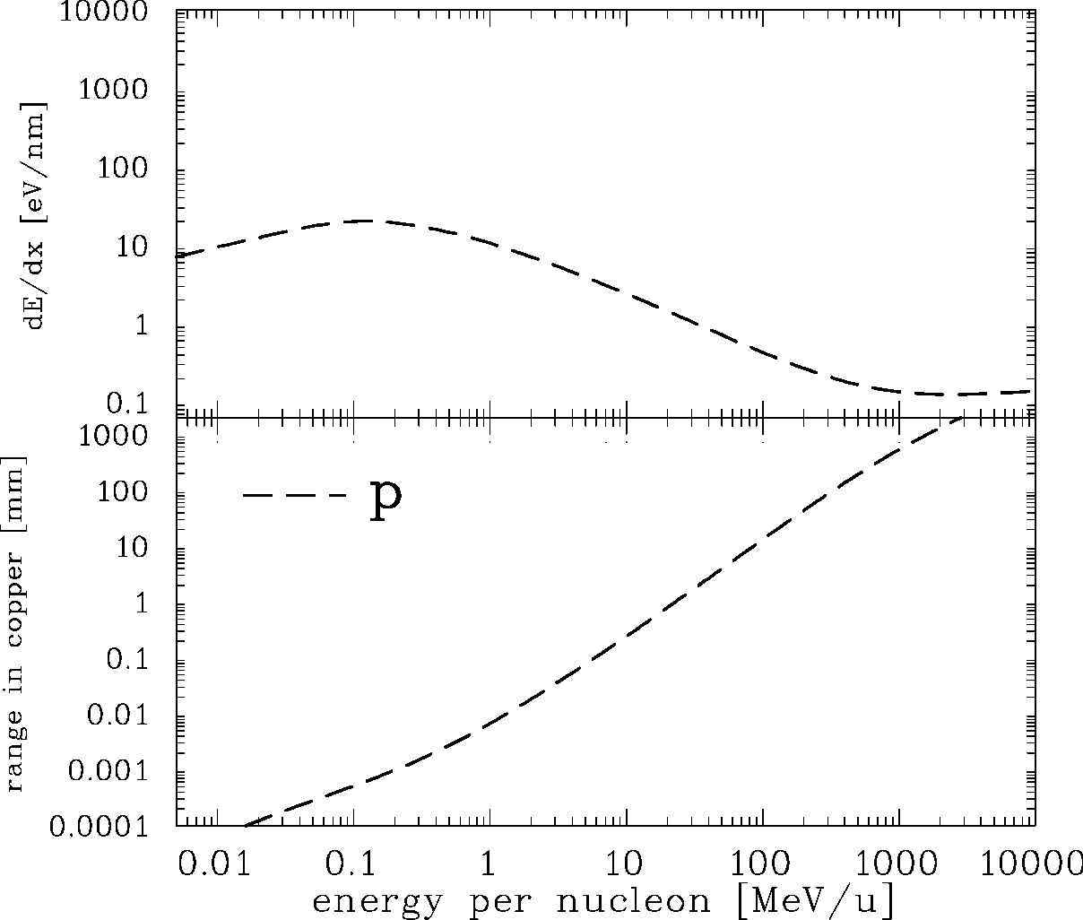
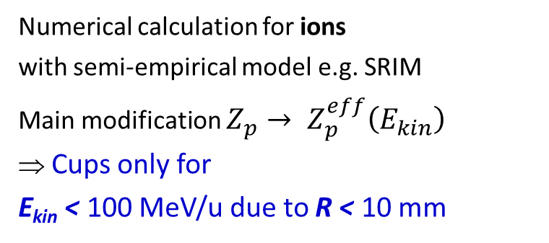
Energy Loss of Ions in Copper
Bethe-Bloch formula:
(simplest formulation)
Range:
with approx. scaling R∝ E_{max}^{1.75}
Synchrotron
LINAC, Cycl.
Source
Numerical calculation for ions
with semi-empirical model e.g. SRIM
Main modification $Z_{p}→ Z_{p}^{eff}\left(E_{kin}\right)$
⇒ Cups only for
E_{kin} < 100 MeV/u due to R < 10 mm
Approximation e.g. $Z_{p}^{eff} ≈Z_{p} \left[1−\exp\left(−125∙β∙Z_{p}^{−2/3}\right)\right]$ Barkas formula
Notes:
27

Slide 28
Secondary Electron Emission by Ion Impact
Energy loss of ions in metals close to a surface:
Closed collision with large energy transfer → fast e⁻ with E_{kin}>> 100 eV
Distant collision with low energy transfer → slow e⁻ with E_{kin} ≤ 10 eV
‘diffusion’ & scattering with other e⁻: scattering length L_{s} ≈ 1 - 10 nm
at surface ≈ 90 % probability for escape
Secondary electron yield and energy distribution comparable for all metals!
⇒ Y = const. * dE/dx (Sternglass formula)
Different targets:
e⁻
beam
δ-ray
Electrons per ion
e⁻
L_{s} ≈ 10 nm
From E.J. Sternglass, Phys. Rev. 108, 1 (1957)
Notes:
28

Slide 29
Secondary Electron Emission by Ion Impact
Energy loss of ions in metals close to a surface:
Closed collision with large energy transfer → fast e⁻ with E_{kin}>> 100 eV
Distant collision with low energy transfer → slow e⁻ with E_{kin} ≤ 10 eV
‘diffusion’ & scattering with other e⁻: scattering length L_{s} ≈ 1 - 10 nm
at surface ≈ 90 % probability for escape
Secondary electron yield and energy distribution comparable for all metals!
⇒ Y = const. * dE/dx (Sternglass formula)
observation
angle
ϕ = 105º
e⁻
most electrons
E_{kin} < 20 eV
beam
δ-ray
e⁻
L_{s} ≈ 10 nm
From C.G. Drexler, R.D. DuBois, Phys. Rev. A 53, 1630 (1996)
Notes:
29

Slide 30
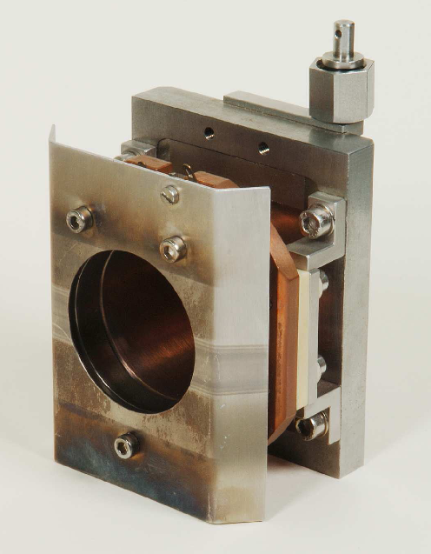
Faraday Cups for Beam Charge Measurement
The beam particles are collected inside a metal cup
⇒ The beam’s charge are recorded as a function of time.
The cup is moved in the beam pass → destructive device
perm. magnet
50mm
Currents down to 10 pA with bandwidth of 100 Hz!
Magnetic field:
To prevent for secondary electrons leaving the cup
and/or
Electric field:
Potential barrier at the cup entrance.
HV electrode

Slide 31
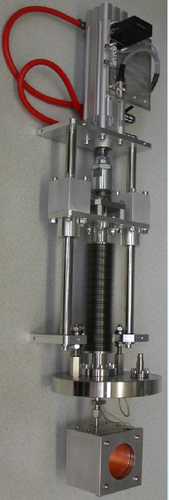
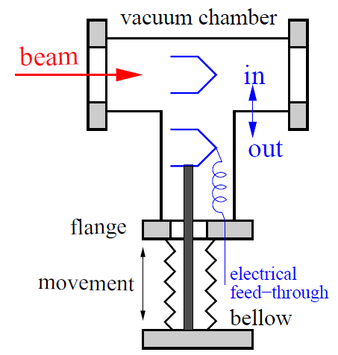
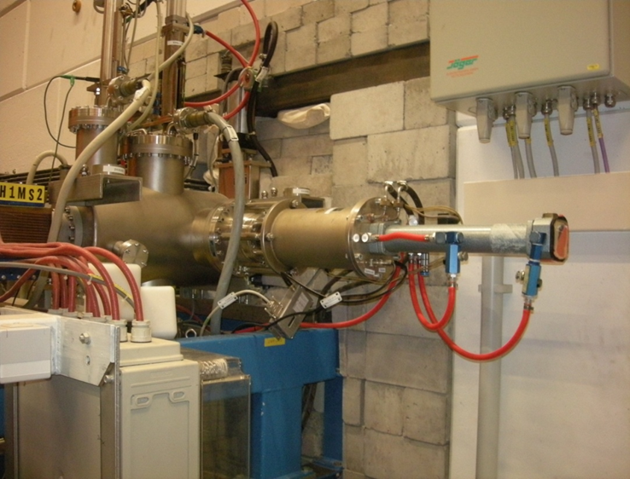
Realization of a Faraday Cup at GSI LINAC
The Cup is moved
into the beam pass.
Faraday Cup
∅60 mm
pneumatic drive
vacuum flange
here ∅150 mm
vacuum flange
here ∅150 mm
Faraday Cup
bellow
compression
for movement
1 m
∅60 mm
pneumatic
drive
source
Cup:
beam stopped
RFQ
LINAC

Slide 32
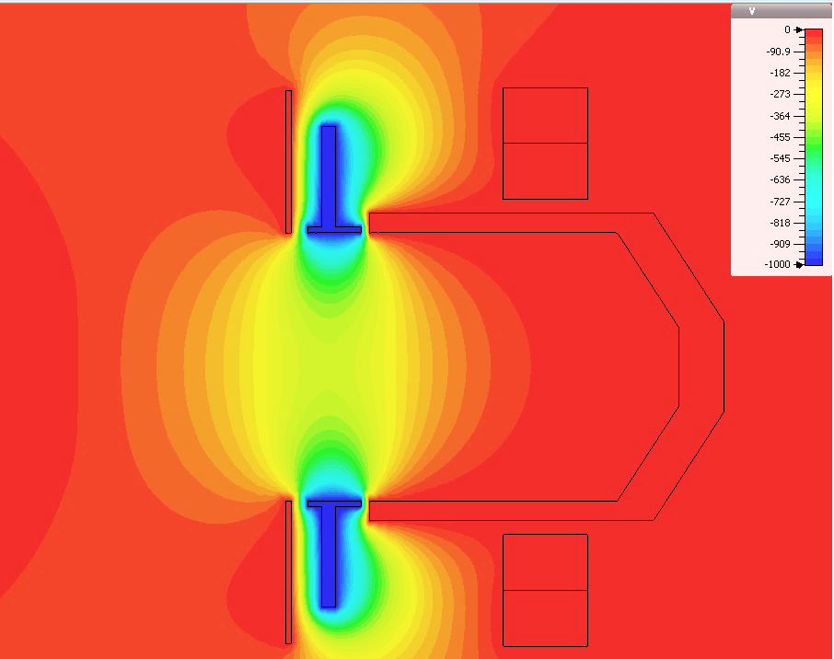
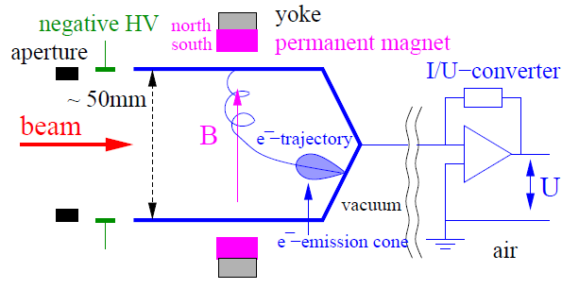
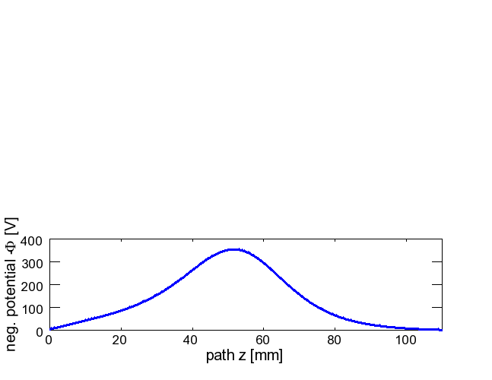
Secondary Electron Suppression: Electric Field
Electrical potential Φ
A ring shaped electrode is used
at the entrance of Faraday Cup:
Typical voltage 100 to 1000 V
HV electrode
on -1 kV
path z
50 mm
Cup
body
potential on central axis for -1 kV@electrode
Result:
here: potential at center ≈ 35 % of applied voltage
Courtesy of J. Latzko, GSI
Notes:
32

Slide 33


Secondary Electron Suppression: Magnetic Field
Yoke of soft iron
Co-Sm permanent magnets within the yoke
and the calculated magnetic field lines.
The central field strength is B ≈ 0.1 T.
magnets:
north pole
south pole
north south
Yoke of soft iron
B
permanent magnets
magnets:
north pole
south pole
Courtesy of J. Latzko, GSI
Notes:
33

Slide 34

The Artists View of Faraday Cup
Company Bergoz
Notes:
34

Slide 35



Energy Loss of Electrons in Copper & Faraday Cups of e⁻
Collisional loss by Bethe-Bloch formula dE/dx |_{col} ∝ f(E_{kin}) ⋅ Z_{t} is valid for all charged particles.
However, radiation loss dE/dx |_{rad} by Bremsstrahlung (i.e. γ-rays of some MeV) dominates
for energies above E_{kin} > 10 MeV with the scaling dE/dx |_{rad} ∝ E_{kin} ⋅ Z_{t}².
Moreover, e⁻ shows much larger longitudinal and transverse straggling.
Collisional loss
v_{i} , E_{i}
v_{f} , E_{f}
electron
liberated
electron
+
nucleus
Bremsstrahlung
photon:
E_{γ} = E_{i} - E_{f}
v_{i} , E_{i}
e⁻ -source
LINAC
synch.
electron
+
v_{f} , E_{f}
nucleus
Minimum of Bethe-Bloch dE/dx |_{col}
roughly at E_{kin} ≈ m₀ c² = 511 keV (rest mass)
⇔ β ≈ 90 % and $γ=\frac{1}{\sqrt{1− β^{2} }}≈2$
Al stopper: Stopping of e⁻ gently in low-Z material
Pb-shield: Absorption of Bremsstrahlungs-γ
⇒ Used as beam dump
Notes:
35

Slide 36

Energy Loss of Electrons in Copper & Faraday Cups of e⁻
Collisional loss by Bethe-Bloch formula dE/dx |_{col} ∝ f(E_{kin}) ⋅ Z_{t} is valid for all charged particles.
However, radiation loss dE/dx |_{rad} by Bremsstrahlung (i.e. γ-rays of some MeV) dominates
for energies above E_{kin} > 10 MeV with the scaling dE/dx |_{rad} ∝ E_{kin} ⋅ Z_{t}².
Moreover, e⁻ shows much larger longitudinal and transverse straggling.
Al stopper: Stopping of e⁻ gently in low-Z material
Pb-shield: Absorption of Bremsstrahlungs-γ
⇒ Used as beam dump
Faraday Cup at ALBA used as beam dump
From U. Iriso (ALBA)
→ To questions on Faraday Cups
Notes:
36

Slide 37
Poll concerning invasive Instrumentation and Faraday Cups
Poll 3:
What mean invasive beam instrumentation?
A gas is injected in the beam path
A detector is moved in the beam path
The beam is stopped
A tip is injected at the beam halo
Poll 4:
A Faraday Cup is used to measure…
the beam’s electric field
the beam voltage
the beam current
the charge state of an ion beam
Poll 5:
Electronic stopping is mediated by…
exchange of electrons between projectile and target
Coulomb interaction
strong interaction
weak interaction
Notes:
37

Slide 38
Measurement of Beam Current
The beam current is the basic quantity of the beam.
It this the first check of the accelerator functionality
It has to be determined in an absolute manner
Important for transmission measurement and to prevent for beam losses.
Different devices are used:
Transformers: Measurement of the beam’s magnetic field
They are non-destructive. No dependence on beam energy
They have lower detection threshold.
Faraday cups: Measurement of the beam’s electrical charges
They are destructive. For low energies only
Low currents can be determined.
Particle detectors: Measurement of the particle’s energy loss in matter
Examples are scintillators, ionization chambers, secondary e− emission monitors
Used for low currents at high energies e.g. for slow extraction from a synchrotron.

Slide 39

Low Current Measurement for slow Extraction
Slow extraction from synchrotron: lower current compared to LINAC,
but higher energies and larger range R >> 1 cm.
Particle counting:
max: r ≃ 10⁶ 1/s
Energy loss in gas (IC):
min: I_{sec} ≈ 1 pA
max: I_{sec} ≈ 1 μA
Sec. e− emission:
min: I_{sec} ≈ 1 pA
Max. synch. filling:
Space Charge Limit (SCL).
Particle detector technologies for ions of 1 GeV/u, A = 1 cm²:
synchrotron
Scint., IC & SEM
Particles per second
injection
extraction
Notes:
39

Slide 40


Example of Scintillator Counter
Example: Plastic Scintillator i.e. organic fluorescence molecules in a plastic matrix
Here: BC 400 (emission λ_{max} = 420 nm, pulse width ≈ 3 ns + cable dispersion, size )
Advantage: any mechanical from, cheap, blue wave length, fast decay time
Disadvantage: not radiation hard
Particle counting: Photomultiplier → discriminator → scalar → computer
1’’ Photomultiplier
gain: 10⁶
rise time 1.9 ns
max. average count rate 3⋅10⁶ 1/s
BC400 Scintillator
75 x 75 mm²
1 mm thickness
Notes:
40

Slide 41

Low Current Measurement: Particle Detectors
Electronic solid state amplifier have finite noise contribution
Theoretical limit:
Signal-to-Noise ratio limits the minimal detectable current
Idea: Amplification of single particles with photo-multiplier, sec. e⁻ multiplier or MCPs
and particle counting typically up to ≈ 10⁶ 1/s
Scheme of a photo-multiplier:
Photon hits photo cathode
Secondary electrons are
acc. to next dynode ΔU ≈ 100 V
Typ. 10 dynodes ⇒ 10⁶ fold amplification
Advantage: no thermal noise
due to electro static acceleration
Typical 1 V signal output
voltage divider with resistors R
HV
dynodes
photon
readout
U≈1 V @50Ω
electron
photo cathode
Notes:
41

Slide 42

Monitoring of Slow Extraction
Slow extraction from a synchrotron delivers countable currents
Example: Comparison for different detector types:
DCCT
IC
extracted beam
synchrotron
IC &
Scint.
Scintillator
extracted beam
injection
extraction
Parameters: dc-transformer inside the synch., ionization chamber and scintillator
for a 250 MeV/u Pb⁶⁷⁺ beam with a total amount of 10⁶ particles.
Notes:
42

Slide 43

Ionization Chamber (IC): Electron Ion Pairs
Energy loss of charged particles in gases → electron-ion pairs → low current meas.
Example: GSI type:
diameter ∅55 mm
Length Δx
2x 3.2 mm
Voltage:
U_{HV} = 1 kV
Gas: 80% Ar + 20% CO₂
W-value
is the average energy
for one e⁻ -ion pair:
Gas | Ionization Pot. | W-value
He | 24.5 eV | 42.7 eV
N₂ | 15.5 eV | 36.4 eV
O₂ | 12.5 eV | 32.2 eV
Ar | 15.7 eV | 26.3 eV
CO₂ | 13.7 eV | 33.0 eV
GSI realization:
Energy calculation dE/dx with SRIM or LISE
Current measurement via
current-to-frequency converter IFC
Notes:
43

Slide 44
Secondary Electron Monitor (SEM): Electrons from Surface
For higher intensities SEMs are used.
Due to the energy loss, secondary e⁻ are emitted from a metal surface.
The amount of secondary e⁻ is proportional to the energy loss
Example: GSI SEM type:
Material | Pure Al (99.5%)
# electrodes | 3
Active surface | 80 x 80 mm ²
Distance between electrodes | 5 mm
Applied voltage | + 100 V
Advantage for Al: good mechanical properties.
Disadvantage: Surface effect!
e.g. decrease of yield Y due to radiation
⇒ calibration versus IC required to reach 5%.
It is a surface effect:
Sensitive to cleaning procedure
Possible surface modification by radiation
Sometimes they are installed permanently in front of an experiment.
Notes:
44

Slide 45



GSI Installation for SEM, IC and Scintillator
SEM in vacuum
IC in Ar-gas at 1 bar
Feed-through with Ø 200 mm flange
beam
SEM
PMT
gas filled
Scintillator
IC
P. Forck et al., DIPAC’97
→ To conclusions
→ To questions on detectors
Notes:
45

Slide 46
Poll concerning Particle Detectors
Poll 6:
What is the basis of an ionization chamber?
It detects only ions
It contains always ions
It is based on ionizations of a gas
Poll 7:
What is scintillation? It is light emitted cause by the energy loss of the particles and …
excitation of electronic states
excitation of lattice vibration
related mechanical stress
emission of thermal photon
Notes:
46

Slide 47


Appendix: GSI Heavy Ion Research Center
German national heavy ion accelerator facility in Darmstadt
Accelerators:
Acceleration of all ions
LINAC: up to 15 MeV/u
Synchrotron: up to 2 GeV/u
Research area:
Nuclear physics ≈ 60 %
Atomic physics ≈ 20 %
Bio physics (e.g. cell damage)
incl. cancer therapy ≈ 10 %
Material research ≈ 10 %
Extension by
international FAIR facility
GSI is one of 18 German large scale research centers.

Slide 48



Appendix: The Accelerator Facility at GSI
Synchrotron, Bρ=18 Tm
E_{max} p: 4.7 GeV
U: 1 GeV/u
Achieved e.g.:
Ar¹⁸⁺: 1·10¹¹
U²⁸⁺: 3·10¹⁰
U⁷³⁺: 1·10¹⁰
Ion Sources:
all elements
UNILAC
SIS
UNILAC
FRS
ESR
ESR:
Storage Ring, Bρ=10 Tm
UNILAC: all ions p – U :
3 – 12 MeV/u, 50 Hz, max. 5 ms
Up to 20 mA current
Atomic & Plasma Physics
Radiotherapy
Nuclear Physics

Slide 49
Appendix: Beam Instruments at GSI Accelerator Facility
Synchrotron:
Current: 2 DCCT, 1 ACCT, 1 FCT
Profile: 1 SEM-Grid, 1 IPM, 1 Screen
Position: 16 BPM
Tune, mom. spread: 1 Exciter + BPM
1 Schottky
Ion Sources:
all elements
UNILAC
SIS
UNILAC
FRS
Transport Lines:
Current: 8 FCT
15 Part. Detec.
Profile: 10 SEM-Grid
26 MWPC
18 Screens
Position: 8 BPM
ESR
LINAC:
Current: 52 transformers, 30 Faraday-Cups
Profile: 81 SEM-Grids, 6 BIF
Position & phase: 25 BPM
Trans. emittance: 9 Slit-Grid, 1 pepper-pot
Long. emittance: 3 devices of different type

Slide 50


Appendix: UNILAC at GSI: Current Measurement
Faraday Cup: for low current measurement and beam stop, total 30
Transformer ACCT: for current measurement and transmission control
total 52 device
They are used for alignment and interlock generation
Transfer to
Synchrotron
HLI: (ECR,RFQ,IH)
To SIS ↑
All ions, high current, 5 ms@50 Hz, 36&108 MHz
MEVVA
MUCIS
50 m
Foil Stripper
Alvarez DTL
RFQ IH1 IH2
U⁴⁺
U²⁸⁺
PIG
Gas Stripper
11.4 MeV/u
β = 0.16
2.2 keV/u
β = 0.0022
Constructed in the 70th, Upgrade 1999,
further upgrades in preparation
120 keV/u
β = 0.016
1.4 MeV/u ⇔β = 0.054

Slide 51



Appendix: GSI Heavy Ion Synchrotron: Overview
rf cavity,
quadrupoles, dipoles
acceleration
acceleration
Important parameters of SIS-18
Important parameters of SIS-18
Circumference | 216 m
Inj. type | Multiturn
Energy range | 11 MeV → 2 GeV
Acc. RF | 0.8 → 5 MHz
Harmonic | 4 (= # bunches)
Bunching factor | 0.4 → 0.08
Ramp duration | 0.06 → 1.5 s
Ion range (Z) | 1 → 92 (p to U)
Ion (Z) | 1 → 92 (p to U)
Circumference | 216 m
Inj. type | Multiturn
Injection energy | 11 MeV/u
Max. final energy | ≈ 2 GeV/u
Ramp duration | 0.1 → 1.5 s
Acc. RF | 0.8 → 5 MHz
Harmonic | 4 (= # bunches)
Bunching factor | 0.4 → 0.08
Beam current | 10 µA to 100 mA
injec-
tion
injec-
tion
extrac-
tion
extrac-
tion
Dipole, quadrupoles,
transfer line
commissioning 1991
51

Slide 52
Appendix: GSI Heavy Ion Synchrotron: Current Measurement
acceleration
ACCT: injected current
0.01... 1 MHz
Important parameters of SIS-18
DCCT: circulating current
0... 10 kHz
Ion (Z) | 1 → 92 (p to U)
Circumference | 216 m
Inj. type | Multiturn
Injection energy | 11 MeV/u
Max. final energy | ≈ 2 GeV/u
Ramp duration | 0.1 → 1.5 s
Acc. RF | 0.8 → 5 MHz
Harmonic | 4 (= # bunches)
Bunching factor | 0.4 → 0.08
Beam current | 10 µA to 100 mA
FCT: bunch structure
0.01... 500 MHz
injec-
tion
Faraday Cup: beam dump
extrac-
tion
52

Slide 53

Appendix: 3rd Generation Light Sources
Soleil, Paris, E_{electron}= 2.5 GeV, C = 354 m
3rd Generation Light Sources:
Synchrotron-based
with E_{electron} ≈ 1…8 GeV
Light from undulators & wigglers, dipoles,
with E_{γ} < 10 keV (optical to deep UV)
Users in:
Biology
(e.g. protein crystallography)
Chemistry
(e.g. observation of reaction dynamics)
material science
(e.g. x-ray diffraction)
Basic research in solid state and atomic physics
Unique setting: intense, broad-band light emission
(monochromator for wavelength selection)
National facilities in many counties,
some international facilities.

Slide 54

Appendix: The Spanish Synchrotron Light Facility ALBA
3rd generation Spanish national synchrotron light facility in Barcelona
Layout:
Beam lines: up to 30
Electron energy: 3 GeV
Top-up injection
Storage ring length: 268 m
Max. beam current: 0.4 A
Commissioning in 2011
Talk by Ubaldo Iriso: at DIPAC 2011, adweb.desy.de/mpy/DIPAC2011/html/sessi0n.htm
see also www.cells.es/Divisions/Accelerators/RF_Diagnostics/Diagnostics

Slide 55
Appendix: The Spanish Synchrotron Light Facility ALBA: Overview
3rd generation Spanish national synchrotron light facility in Barcelona
Layout:
Beam lines: up to 30
Electron energy: 3 GeV
Top-up injection
Storage ring length: 268 m
Max. beam current: 0.4 A
Commissioning in 2011
LINAC 100 MeV
Booster 100 MeV → 3 GeV
Storage Ring: 3 GeV
From U. Iriso, ALBA

Slide 56

Appendix: The Synchrotron Light Facility ALBA: Current Meas.
BTS
2 FCT
Beam current:
Amount of electrons
accelerated,
transported and stored
Several in transport lines
One per ring
SR
1 FCT
1 DCCT
1 AE
FCT
DCCT
FCUP
AE
BCM
LTB
1 FCT
1 FCUP
3 BCM
Abbreviation:
FCT: Fast Current Transformer
DCCT: dc transformer
FCUP: Faraday Cup
AE: Annular Electrode
BCM: Bunch Charge Monitor
BOOSTER
1 FCT
1 DCCT
1 AE
Remark:
AE: Annular Electrode
i.e. circular electrode acting
like a high frequency pick-up
From U. Iriso, ALBA

Slide 57
Summary for Current Measurement
Current is the basic quantity for accelerators!
Transformer: → measurement of the beam’s magnetic field
➢ magnetic field is guided by a high μ toroid
➢ types: passive (large bandwidth), active (low droop)
and dc (two toroids + modulation)
➢ lower threshold by magnetic noise: about I_{beam} > 1 μA
➢ non-destructive, used for all beams
Faraday cup: → measurement of beam’s charge
➢ low threshold by I/U-converter: I_{beam} > 10 pA
➢ totally destructive, used for low energy beams
Scintillator, → measurement of the particle’s energy loss
IC, SEM: ➢ particle counting (Scintillator)
➢ secondary current: IC from gas ionization or SEM sec. e⁻ emission surface
➢ no lower threshold due to single particle counting
➢ partly destructive, used for high energy beams
→ To questions on current measurement
Notes:
57

Slide 58
Backup slides

Slide 59
Quiz related to Current Transformers
What is the numerical value of the earth magnetic field?
What is the sensitivity S of a beam current transformer?
What is the rise time constant τ_{rise} and to which cut-off frequency f??? is it connected?
What is the droop time constant τ_{droop} and to which cut-off frequency f??? is it connected?
Why a single bunch of 1 ps cannot be measured by a FCT?
What is the principle idea behind a dc current transformer?
→ Back to Faraday Cup
Notes:
59

Slide 60
Quiz related to Faraday Cups
What is meant by invasive beam instruments?
What is the physics process of the energy loss of protons with E_{kin} > 10 MeV in matter?
What is the physics process of the energy loss of electrons with E_{kin} > 10 MeV in matter?
Why are secondary electrons emitted from a surface due to charge particle impact?
→ Back to particle detector
Notes:
60

Slide 61
Quiz related to Particle Detectors for Beam Current
What happens if a particle in a transfer line loses 10 % of is kinetic energy
e.g. by passing through a ionization chamber? What happens if the energy loss is 1 %?
To which physical processes does the word ‘scintillation’ refers?
What is a photo-multiplier?
What is an ionization chamber?
Can ICs be used for other purposes a beam current measurement as well?
What is the physics process of the energy loss of electrons with E_{kin} > 10 MeV in matter?
→ Back to facility discussion
Notes:
61

Slide 62
Quiz related to Beam Current Measurement
What is an appropriate device for beam current measurements for the following parameter?
(Further examples are given in Exercise #2)
Proton beam:
Behind an ion source by electro-static acceleration to 100 keV and a current o 100 mA?
Behind a electro-static TANDEM accelerator delivering 10 MeV/u protons and 100 nA?
Behind a pulsed LINAC for 100 MeV protons with 100 mA current and 1 ms duration?
Inside a synchrotron with protons of 100 MeV and 100 mA current?
Extracted proton beam of 1 GeV from a synchrotron with 1 µs resulting in 100 mA current?
Extracted proton beam of 1 GeV from a synchrotron with 1 s resulting in 100 nA current?
Electron beam:
What is the difference for electrons with basically the same parameter (i.e. kin. energy)?
Inside a synchrotron with 1 GeV electrons but 10 nA current?
Notes:
62

