Slide 1
Superconducting RF cavities for accelerators
Fritz Caspers/Manfred Wendt/ Michele Bozzolan/Sergio Calatroni
with many slides by: Wolfgang Weingarten, Tobias Junginger, Sarah Aull, Benedikt Peters, Michael Bartel and others
JUAS lecture 2021
Notes:
This lecture has a long history over the last 25 years. The original version was prepared by W. Weingarten and used until about 2005 and then underwent many extensions , simplifications and modifications. The very basics of superconductivity are already discussed in the context of SC magnets and thus rather briefly repeated here.

Slide 2
OUTLINE OF LECTURE
Basics of superconductivity
Basics of RF cavities
Interaction of the cavity with the beam
Technological issues
Diagnostics
State of the art SRF research
Notes:
A short overview....

Slide 3
Basics of superconductivity
Motivation
Historical remarks
Surface impedance and plane waves in normal conductors
Basics of RF superconductivity
Meissner effect
Two kinds of superconductors
Materials
Two fluid model
London equations and penetration depth
Complex conductivity, surface impedance and BCS theory
How to measure the surface impedance
Critical fields
Summary
Recommended Literature
Notes:
And some tools relevant for RF superconductivity

Slide 4
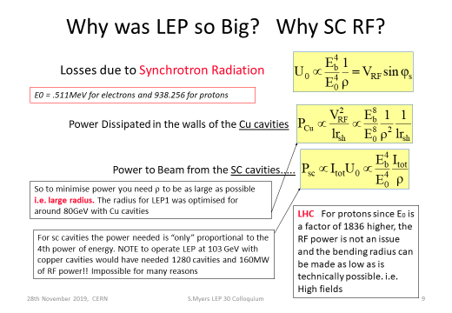
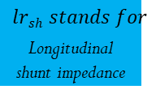

Motivation (1/5)
$$ρ=machine$$
$radius$ (here)
E_{b}=beam energy; V_{RF}=total voltage from all cavities
$$lrsh stands for$$
_{Longitudinal shunt impedance}
Since P is proportional V² we arrive at the 8th power for NC,
but remain with the 4th power for SC as the cavity losses are small
Notes:
This is the important issue...for a machine with given radius AND synchrtron radiation losses (yes we have it also with hardrons in the LHC now) ..mainly for leptons..the synchrotron radiation scales with 4th power of the energy of the electrons..that was THE big issue for LEP. You see some further explanations added into the slides produced and shown by Steve Myers..

Slide 5
Motivation (2/5)
(R_{s}=surface resistance)
(R_{a}=machine radius)
(Q₀=unloaded Q of cavity used )
The hypothetical copper cavity with 3 MegaWATT/per meter length would be very hard to cool
For
Notes:
Copper cavities already get really hot with one MV/meter surface field..good SC cavities can do 30 MV/m ..and in contrast to NC cavities there is very little power loss between subsequent bunches. The normalisation „per meter“refers here to the length of the cavity sections, thus the internal field inside the cavities are locally somewhat higher than the numbers shown here

Slide 6
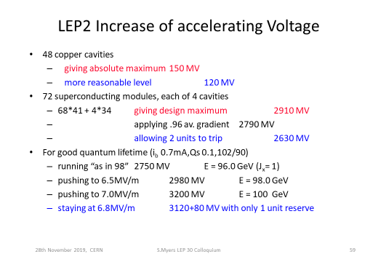
Motivation (3/5)
Notes:
Remember that in LEP we had up to 2 KW (average) synchrotron radiation (soft X-rays) loss per meter which had to be cooled away and of course compensated by the RF..thats a lot with 27 km circumference

Slide 7
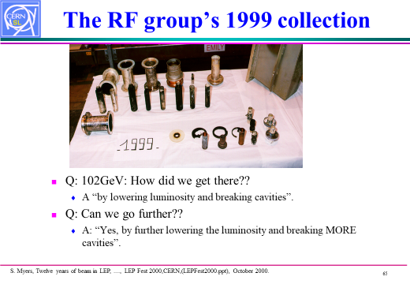
Motivation (4/5)
Notes:
Lot of hardware burned away from the high (RF) power requirements...

Slide 8
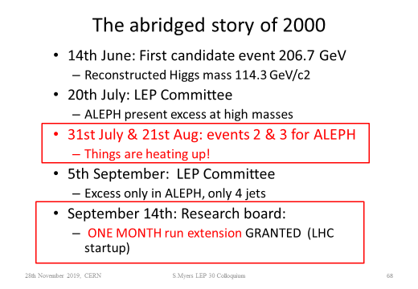
Motivation (5/5)
We were not far from getting the HIGGS in LEP
And 3 additional SC cavity modules were already prepared for the winter shutdown
Notes:
At this very hot time first indirect candidates were seen in LEP ..but not enough to „sell“them

Slide 9
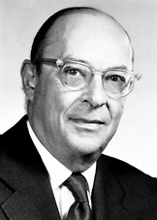
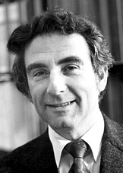
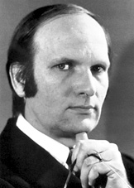
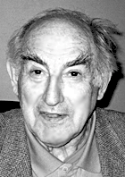
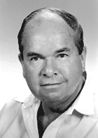
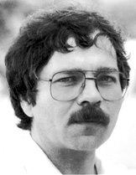
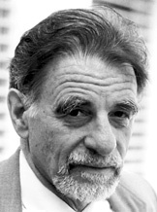
Historical remarks 1/4
1908 Liquefaction of helium (4.2 K)
1911 Zero resistance
1933 Meissner effect
1935 Phenomenological theory of H & F. London
1950 Ginzburg – Landau theory
1951 – 2 TYPE II superconductors (Abrikosov)
1957 Bardeen – Cooper – Schrieffer theory (BCS-Theory)
1960 Magnetic flux quantisation
1962 Josephson effect
1986 High temperature superconductors (Bednorz – Müller)
Bardeen – Cooper – Schrieffer (BCS)
Ginzburg
Abrikosov
Bednorz
Müller
Notes:
The history..since more than 100 years by now..

Slide 10
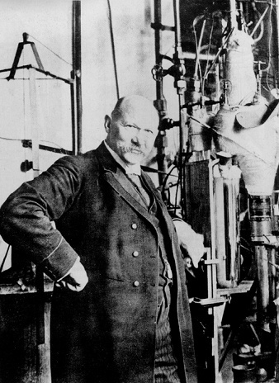
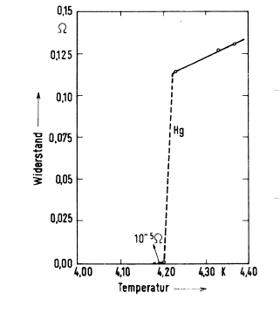
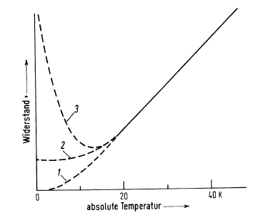
Historical remarks 2/4
Nobel prize for « his investigations on the properties of matter at low temperatures which led, inter alia, to the production of liquid helium »
Trace1:Dewar 1904
Trace2:Matthiessen 1864
Trace3:Lord Kelvin 1902
resistance
resistance
From: Scientific American
March 1997 Page 98;
article on K.Onnes
H. Kamerlingh – Onnes in his laboratory at Leiden (NL)
What is the meaning of those 3 traces (1,2,3) in the Figure? Those were the predictions for the resistance characteristic towards low temperatures according to different theories at the time of SC discovery
Notes:
This famous slide is well known all over the word

Slide 11
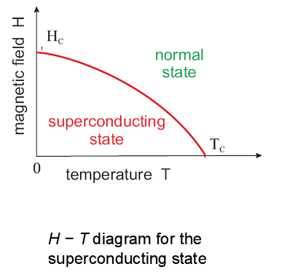
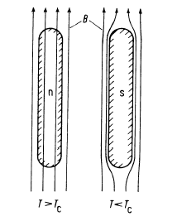
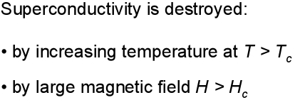

Historical remarks 3/4
Zero resistivity
Meissner effect
Left side: normal conducting
no field expulsion
Right side: superconducting
with field expulsion
T_{c}= critical temperature
H_{c}=critical magnetic field
There is a certain confusion about the use of B and H for the (external) magnetic field;
Some authors prefer B others H….thus one can find the H-T diagram but also the B-T one
Notes:
Now we aere digging deeper ..how does superconductivity work in detail..

Slide 12
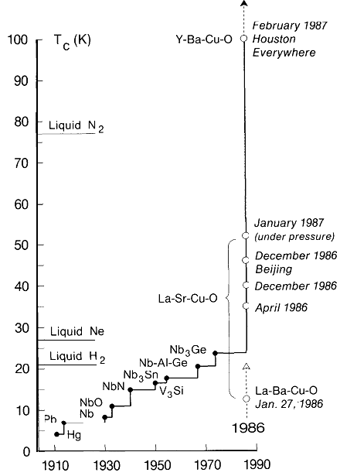
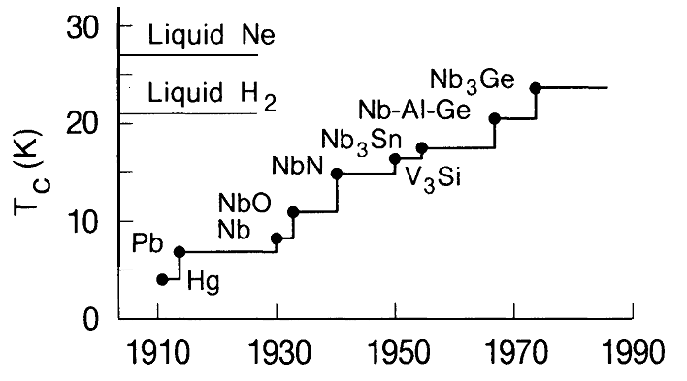
Historical remarks 4/4
jargon: YBCO
Yttrium–Barium
Cuprate
NbC
Development of the superconducting transition temperatures after the discovery of the
phenomenon in 1911. The materials listed are metals or inter-metallic compounds and reflect the
respective highest T_{c}’s - Adapted from G. Bednorz – Nobel lecture
NbC
Notes:
We had until 1986 only the classical superconductors and then came the the high temperature ones...which are very interesting for powerful magnets but a bit less for RF cavities..guess why?

Slide 13
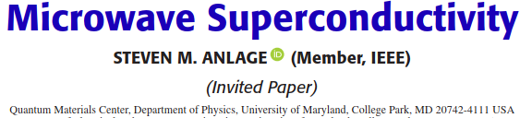
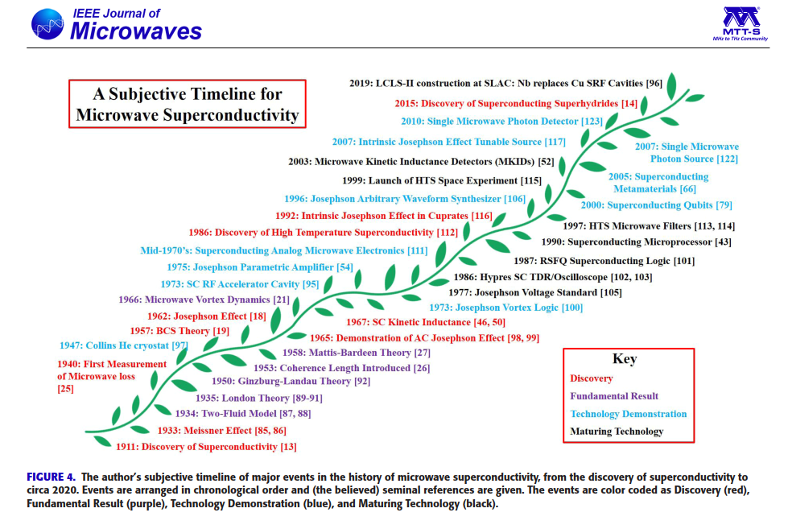
Historical remarks, a very recent (2021) review
(Vol 1; No 1, Jan 2021)
Notes:
And here are the latest news from the press.. a hot and interesting field…despite cryo technology..we could spend a lot of time on this slide alone, discussing all the inventions and new effects there in in detail but we will focus here on a few points mentioned…on this graph

Slide 14
Surface Impedance
For a plane EM wave incident on a semi-infinite flat metallic surface:
j
E, H always in complex notation
E, H parallel to the surface
R_{s} and X_{s} are real and imaginary part of the surface impedance respectively
The homogeneous plane wave propagates in z-direction i.e. normal incidence
Reference frame coordinates:
x, y parallel to the surface of the metal
z perpendicular to the surface
z=0: on the surface
E
(super)
conductor
H ⊗
vacuum
z=0
Notes:
The key issue for RF superconductors is the surface impedance

Slide 15

Plane Waves in Vacuum
From Maxwell’ s equations:
and:
with the wavenumber:
= α+jβ
follows the wave equation in free space:
with the free space impedance:
Notes:
There is a general problem using the letter i and j for the square root of -1; engineers like j and physisists rather use i (in the exponential of the e- function for wave propagation)

Slide 16
Plane Waves in Metals
Generalized wavenumber:
j
Local current density and E-field:
J =surface current density
not to be confounded with j=√-1
Conductivity in the metal:
with:
j
In practice σ is assumed to be frequency independent (ωτ<<1):
j
Wave equation in metals:
For the wave propagation of a good conductor we have of course also an “α” term, but in order
to get the skin depth, the “envelope” as described by “β” is sufficient
with:
being the field penetration or skin depth
Notes:
Surface current densiity J is denoted in bold; beta is the wave propgation beta here.

Slide 17
Surface Impedance in “normal” Metals
The surface impedance Z_{s} is defined at the interface between two media. It can be calculated in a similar way as for continuous media.
You take Maxwell’s equation, set the appropriate boundary conditions for the continuity of the waves (incident, reflected, transmitted), and you get:
Introducing appropriate numbers, e.g. for copper at ambient temp. for f = 1 GHz:
j
j
j
σ_{Cu} = 58.5 ·10⁶ S/m (for copper) R_{s} = 8.2 milli Ω per unit square S/m stands for Siemens /meter What is the skin depth?..about 2 micron
Notes:
We know this already from the normal Rf lecture ..but its good to do a recap from time to time.. This example is nice for „scaling“ exercises.

Slide 18
Surface Resistance
Since we will deal a lot with the surface resistance R_{s}, here is a simple DC model that gives a rough idea of what it means:
Consider a square sheet of metal and calculate its resistance to a transverse current flow:
The surface resistance R_{s} is the resistance that a square piece of conductor opposes to the flow of the currents induced by the RF wave, within a layer δ (skin depth)
ρ is the specific electrical resistance, given in [Ωm]…and the inverse is the conductivity σ
For copper: ρ_{Cu} = 17･10⁻³ Ω･mm²/m = 17 nΩ m (A one meter long Cu-wire of 1 mm² cross-section has 17 mΩ )
a
a
current
δ
d
Notes:
Keep in mind the the resistance per unit square is demensionless and independent of the side length of the quare=a...i.e. a may be 1 mm or 1 meter..the result is the same

Slide 19
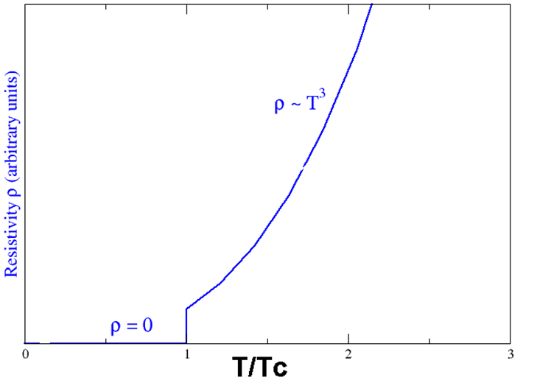
Superconductivity
ρ=specific resistivity
Notes:
At the critical temperature the DC (!) resistance has the well known step and then increases proportional to the 3 rd power of temperature

Slide 20
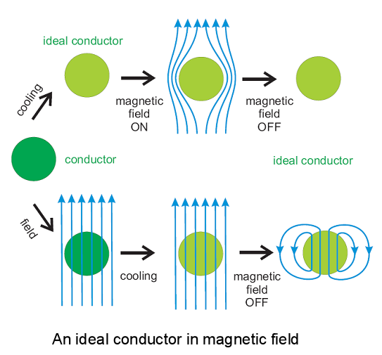
Meissner effect 1/3
For a hypothetical ideal conductor any change (vs time) in the ambient magnetic field induces persistent surface currents. If cooled inside a magnetic field from ambient to cryo then there can be a strong magnetic field inside at cryo
Notes:
Also this slide may be rather well known...the ideal conductor just has a very long memory for the eddy currents and remembers any transient ..forever (warm or cold)..in particular ..we can have a magnetic field inside also at cold depending on the previous history for the ideal conductor

Slide 21
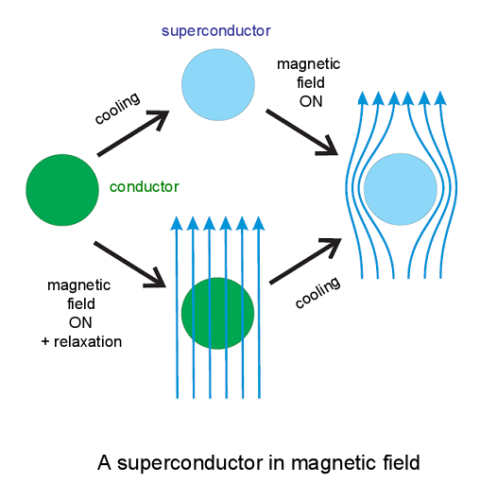
Meissner effect 2/3
A superconductor (well, yes a conventional one) is always field free at cryo. Caveat for frozen flux during cooldown in a magnetic field
A permanent magnet (or an SC magnet) will hover STABLE above an SC surface; this would not work for normal magnets (this way)
Notes:
For the superconductor there is no way to get the magnetic fiield in (at cryo) regardless of the previous history

Slide 22
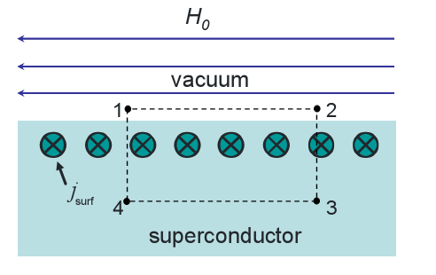
Meissner effect 3/3
1. Magnetic lines of force outside a superconductor are always tangential to its surface
2. A superconductor in an external magnetic field always carries an electric current near its surface
Thus, the surface current is completely defined by the magnetic field at the surface of a superconductor.
Notes:
The (conventional) superconductor really does not like a magnetic field inside and make the inside of the volume field free by having a suitable surface current distribution which creates some magnetic field outside and this just exactly compensates the inner field to zero

Slide 23
Theories of Superconductors
Gorter & Casimir two fluid model
London Equations
Pippard’s Coherence length ξ
Ginzburg-Landau
Second order phase transition of complex order parameter Ψ
BCS (Bardeen-Cooper-Schrieffer)
Microscopic theory
Two Fluid Model revised
(Strong coupling – Elihasberg)
Notes:
A few points of superconductor theory..the two fluid model is essential for understandg the mechanism and also why we have losses in Rf superconductors

Slide 24
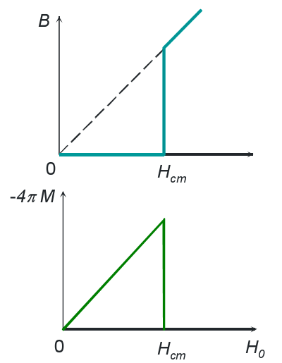
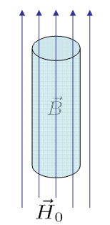

Two kinds of superconductors 1/3
Magnetic properties of a type I superconductor
Magnetic properties of a superconductor can be derived from ρ = 0 and B = 0
Type I superconductors are all elemental superconductors (except niobium)
Magnetization curve
The field inside the
bulk of the SC is always
zero until we reach the
critical field and then it
jumps up; there is no
hysteresis
The magnetization grows
Steadily with increasing
external field and then
jumps down at the critical
field level
The magnetization compensates the external field, thus the SC bulk is field free.H₀ is outside the material
Analogy to classical magnets, where M = B_{remanent} /μ_{0 ;} inside bulk
H_{cm} … critical magnetic field
https://en.wikipedia.org/wiki/List_of_superconductors
Notes:
How to find out which superconductor are Type 1 and Type 2 respectively? Well most pure metals are type one..with some exceptions..there is a LONG list in wikipedia

Slide 25
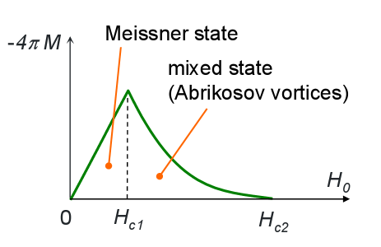
Two kinds of superconductors 2/3
Type II superconductor
Magnetic properties of a type II superconductor
Above the 1st critical field H_{c1} magnetic flux penetrates into the bulk
Above the 2nd critical field H_{c2} the material is normal conducting (except for a thin surface layer that remains superconducting until the 3rd critical field H_{c3} only thin surface layer not bulk)
Magnetization curve inside bulk
Notes:
This is the SIGNATURE of a type 2 superconductor

Slide 26
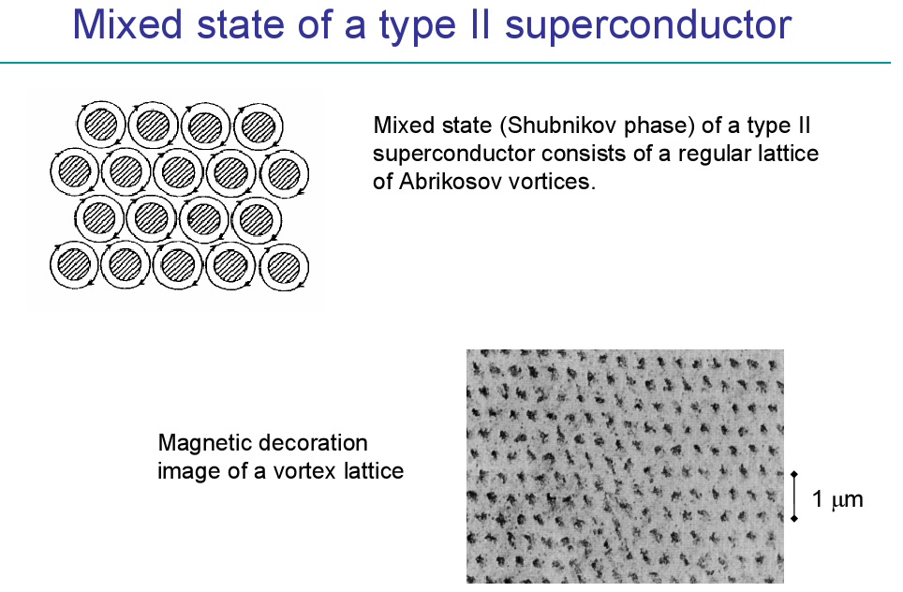
Two kinds of superconductors 3/3
Notes:
Vortices also play a big role in aviation..you can sometimes see them from the wing tips of big airliners..and they are often quite stable slowly falling down and sometimes destroyig the tiles on houses in the landing approach path…and vortices have caused several severe aircraft accicents

Slide 27
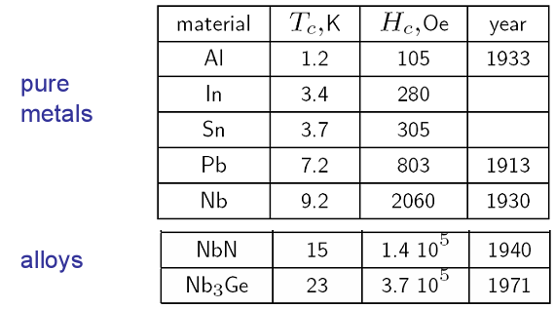
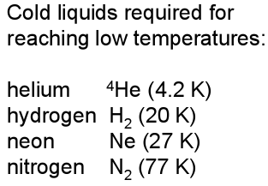
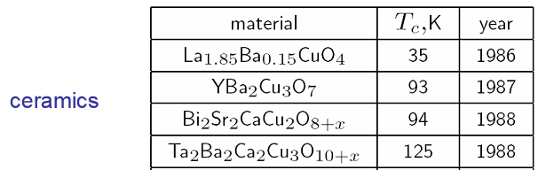
Materials 1/2
Type I
Type II
Caveat:
In the left table the old unit Oe (cgs syst)
for Oersted is used..this goes now to
Gauss [Ampere/meter];one Gauss≈79 A/m
See also
https://en.wikipedia.org/wiki/Oersted
=YBCO (jargon)
=Bismuth 2212=2xBi,2xSr,1xCa,2xCu
Notes:
Most pure metals which can become superconductve are Type1 superconductors..except Nb...and most compounds are Type II (with few exceptions); of course we have an interest in the highest possible critical temperature and the max magnetic field...the price to be paid may be technological issues..(brittleness..).For ceramic Type I or Type II are ususally not defined.

Slide 28
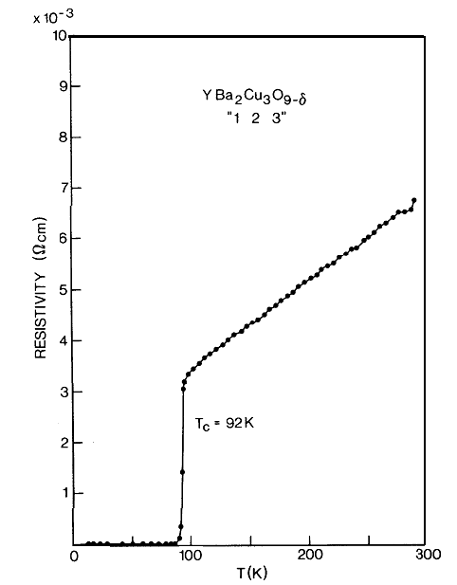
Materials 2/2
Resistivity of a single-phase YBa₂Cu₃0₇ sample (Yttrium Barium cuprate) as a function of temperature.
1xYttrium;2xBarium;3xCopper
Just for comparison:
Copper at room temperature has
a resistivity of 17 nanoOhm· meter
or 170 microOhm · centimeter
Thus one can see that above the
critical temperature this high TC
material becomes REALLY bad
Notes:
This is a typical high temperature supraconductor (ceramic style) from the cuprate family ...Yttrium Barium Cuprate..Note that cavities made from high temperature superconductors can operarate in a strong DC magnetic field

Slide 29
Two fluid model
Basic ingredients for RF superconductivity
Two fluid model (Gorter-Casimir)
Maxwell electrodynamics
n
electron density
n_{s}
T_{c}
Basic assumptions of two fluid model
all free electrons of the superconductor are divided into two groups
superconducting electrons of density n_{s}
normal electrons of density n_{n}
The total density of the free electrons is
n = n_{s} + n_{n}.
As the temperature increases from 0 to T_{c}, the density n_{s} decreases from n to 0.
temperature (K)
n =total number of free electrons
Notes:
Obviously we would like to work with as many as possible superconducting electrons

Slide 30
London Equations
These are the first equations discovered for the electrodynamics of superconductors
The London penetration depth is denoted as λ_{L}
The density of normal conducting electrons = n_{s}
Elementary charge = e
Electric and magnetic field (resp) E, B
The symbol Λ (capital lamda) can be understood as a “kinetic inductivity” of the SC electrons. (discussed also later)
Restmass of the electron = m
Postulated on plausibility arguments
j_{s}= surface current density
Applying B = ∇×A on the vector potential A
Applying Ampere’s law
to London’s 2nd eq. gives:
Exponential decay of the B-field inside the superconductor
Notes:
Complicated math. stuff (sorry) but good enough to get a basic idea

Slide 31
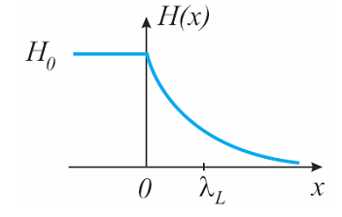

London penetration depth
On introducing the vector potential A via
B= curlA or rotA
one obtains a relationship between the supercurrent and the vector potential, very similar to Ohm’s law
Λ$=−$A / j_{s}
Element | Al | Nb (crystal) | Nb (film) | Pb | Sn | YBCO
λ_{L} [nm] | 50 | 47 | 90 | 39 | 51 | 170
Compare to NC Cu skin depth:
2 μm @ 1 GHz
The London equations allow finding the penetration depth inside the superconductors- orders
of magnitude smaller than a normal metal , the London penetration depth is indep. from frequ.
Notes:
Its important to keep the order of magntidude in mind….ballpark below 100 nanometer for metals

Slide 32
Complex Conductivity 1/3
You will probably be only half surprised to hear that a superconductor at T > 0 has a R_{s} ≠ 0.
This can be understood in the framework of the previous two fluids model, where a population of normal electrons of density n_{n} and a population of “superconducting electrons” of density n_{s}=n₀(1-T⁴/T_{c}⁴) coexist such as n_{n}+n_{s}=1 and both give a response to the varying EM fields.
Let’s “invent” the conductivity of superconducting electrons:
j
j
First step for studying the electrodynamics of a superconductor is to define its conductivity
which we estimate from normal metals in the limit of a relaxation time approaching infinity..
Its an imaginary number
Notes:
We have a mixture of normal conducting and superconducting electrons in the material and the ratio between both is a function of temperature

Slide 33
Complex Conductivity 2/3
Do you think the previous formula looks like a joke: conductivity of a perfect conductor is an imaginary number?
There is indeed real physics behind it. Recall London equations, from which we can set-up the following equivalence, in the “dirty” limit:
The value of Λ is the expression of the kinetic inductivity of the “superconducting electrons”: basically, the electron pairs have a mass, and they get accelerated by the RF wave. This is the same as what happens with the magnetic field produced inside an inductor.
London&London Proc. Roy. Soc A149 (1935) 71
Pippard Proc. Roy. Soc. A216 (1953) 547
Normal metal | Superconductor (London theory)
Notes:
Just keep in mind that the cooper pairs= SC electrons are sort of tunneling through the crystal lattice witout „collision“ in contrast to normal electrons which have a rather short mean free path length

Slide 34
Complex Conductivity 3/3
The conductivity of superconductors then becomes:
Where n_{s}=n₀(1-T⁴/T_{c}⁴) and n_{n}=n₀(T⁴/T_{c}⁴) with n₀ total electron density
Note:
j
j
conductivity of “normal electrons”
conductivity of “superconducting electrons”
The normal conducting electrons make the real part (losses) and the superconducting ones the imaginary part
with
Notes:
If course we all know that a superconductor is lossless because the lossy part is „shorted“ by the SC electrons..at DC ..but for RF we do get certain losses.

Slide 35
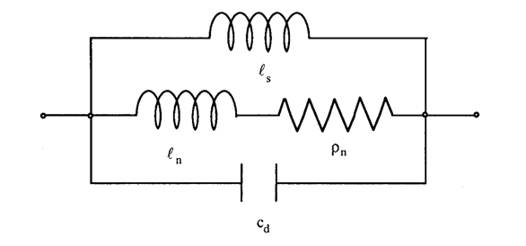
Equivalent Circuit
Indeed, if you take the time derivative of you get the 1st London eq:
Λ is interpreted as a specific inductance. This justifies representing the complex conductivity of a superconductor with an equivalent circuit of parallel conductors:
if you are strongly interested in theory
How can we understand a specific inductance? In analogy to a specific resistance ρ (here: ρ_{n} ) its the inductance of a very small volume element
Λ
One can nicely visualize how the resistor is shorted
by the lossless inductance at DC (but not for RF)
j
j
Notes:
Let try to make complicated things easy..some inductance with a parallel resistor

Slide 36
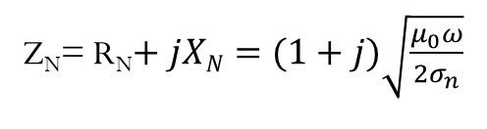
Surface Impedance
It is now possible, within the basic approximations we have made, to calculate the surface impedance of a superconductor.
Take the formula for normal metals:
Perform the substitution: σ_{n}→ σ_{s} =σ₁-jσ₂
Calculate:
In the approximation of small  (small ωτ → σ₁<σ₂)
and 0<T<0.5T_{c} (n_{n}<n_{s} → σ₁<σ₂) it gives:
Which is a good description of the experimental data, but…
Z_{N}= R_{N}$+ jXN=(1+j)\sqrt{\frac{μ_{0}ω}{2σ_{n}}}$
Notes:
The penetration depth Lamda does not depend on frequency, contrary to the normal metal.The two fluid model is good for undersranding and gives nice approximative results; its suitable mostly for impure metals (short mean free path compared to to coherence length) but not very accurate for pure superconductors

Slide 37
BCS Theory
General and complicated equations can be approximated for low frequencies hν «2Δ as:
The surface impedance Z can be calculated from σ₁/σ_{n} and σ₂/σ_{n}
However the formulas seen until now are approximate valid only in a very specific limit.
Calculations can be done having a full validity range (but only for H_{RF}<<H_{c})
Δ is the energy gap between the ground state of the cooper pairs and the next higher state where they disintegrate into single electrons
Abrikosov Gorkov Khalatnikov, JETP 35 (1959) 182
Miller, Phys. Rev. 113 (1959) 1209
Nam, Phys. Rev. A 156 (1967) 470
Halbritter, Z. Phys. 238 (1970) 466 and KFK Ext. Bericht 3/70-6
Those equations can be solved numerically. Some people still use the Fortran program written by
Halbritter in 1970 now converted into C-language
Notes:
Numerical results can be very close to experimental numbers

Slide 38
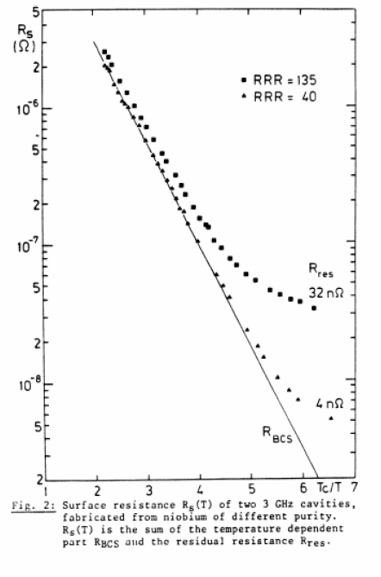
BCS Surface Resistance (1/2)
Material parameter dependence of R_{s} (T, f )
Niobium @ 3 GHz
Can be calculated theoretically, from material parameters (resistivity, critical temperature) Depends on temperature.
example for 2K
this graphic
Depends usually on defects, normal-conducting inclusions, surface contamination. Typically, does not depend on temperature
RRR: residual resistance ratio
Different purity (RRR) often gives rise to different residual resistance
Notes:
38
You may try in the graphic a higher temperature (going left on the abszissa) and compare the result with the handy formula result on the next slide..and you see that lower operational temperature really reduce the surface reistance a lot..but the penalty is the load to the cryo system..and we may like this slide for exams..

Slide 39
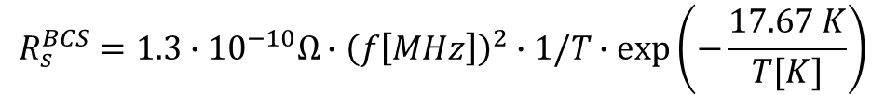
BCS Surface Resistance (2/2)
Simplified formula, for T < (T_{c}/2)
Thus it is (αT_{c} /T) in the exponent
The formula is valid for non-pure metals (two-fluid). In case of niobium this is RRR<20
A is a material constant that depends on the electrical resistivity ρ_{n} .
T = absolute temperature;
k = Boltzmann’s constant
2Δ is the binding energy of the cooper pairs, related to the critical temperature of the SC material;
α≅1.7÷2 depends on the material and is called coupling constant
α for niobium amounts to 1.92 and T_{c}=9.2K
$$R_{s}^{BCS}=1.3∙{10}^{−10}Ω∙{\left(f\left[MHz\right]\right)}^{2}∙1/T∙\exp\left(−\frac{17.67 K}{T[K]}\right)$$
Numerical example for comparison with the results from the graphic in the previous slide
For f=3 GHz (ω=2πf) and T=2 K) Agreement is quite good for the 32nOhm trace, since this
formula is good for not too pure materials (rather low RRR values i.e. high residual resistance)
R_{s} [Ohm] = 1.3·10⁻¹⁰ (3000)² · ½ · e ^{(-8.83)} = 8.7 · 10⁻⁸ [Ohm]
Notes:
39
RRR<20 means that the electron mean free path must be shorter than the superconducting coherence length (the size of Cooper pairs)
Ist always good to have a practical numerical example and we like those simple formulae for the exam..

Slide 40
How to measure RF Surface Impedance 1/7
Normally some kind of resonator is applied for the samples
You MUST avoid any sliding contacts since they have usually an undefined contact resistance and spoil the Q of the cavity and you should avoid any radiation losses
Often a TE₀₁₁ mode type resonator is used..works very well, not sensitive to contact resistance between the tube and the end plates due to azimuthal wall current only
But if you would like to go to lower frequencies then the quadrupolar resonator is a good choice
For even lower frequencies the shielded two wire coaxial resonator has been used (for the LHC beam screen)
Notes:
Some practical approaches...how to measure surface impedance and reistance

Slide 41
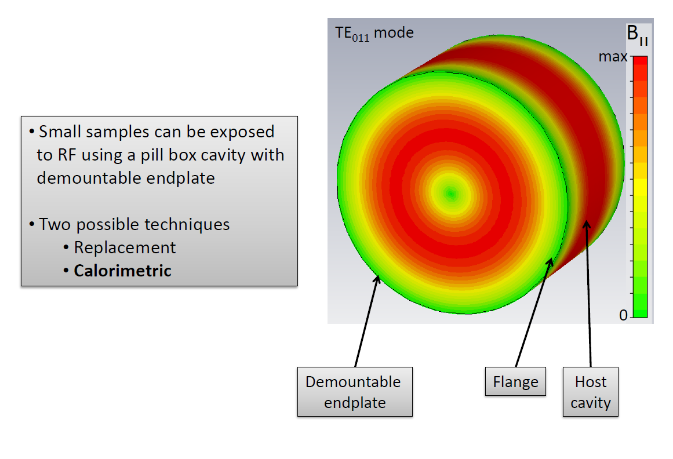
How to measure RF Surface Impedance 2/7
Why is it good to use a TE₀₁₁mode pillbox ?
There are no wall currents in longitudinal direction the mode is cylinder symmetric and thus the setup is insensitive to the contact resistance of the removable endplate or flange; Caveat: mode degeneracy
In red or green inside the cavity:
azimuthal surface current density which
is equal to the longitudinal or radial
(cover plates/flange) B-field respectively
Replacement = Q-measurement with copper cover versus DUT
Calorimetric = heat loss evaluation normally for measurements in cryo
Figure by T. Junginger
Notes:
Now we can discuss advantages and disadvantages between both methods..replacement..yopu have to take the structure maybe out of a cryostat make the change and bring it back again...more often done at room temperature tests (still a good Q measurements remains to be done) on the bench in the lab...but for cryo ..this is heavy..and there the calorimetric method comes in.

Slide 42
How to measure RF Surface Impedance 3/7
Figure by T. Junginger
The procedure: Start at a rather low temperature of the bath..then turn on some DC power (DC,1) until
the bath temperature of interest is reached, then turn on the RF and reduce the DC power to DC,2 to keep the bath temperature constant and then calculate..
Notes:
What happens here axatly? Why do we turn the DC on..? For calibration..trying to stay constant at the „temperature of interest“ and then when the RF comes ON the DC power is reduced accodingly to keep the temperature of interest at the same level.

Slide 43
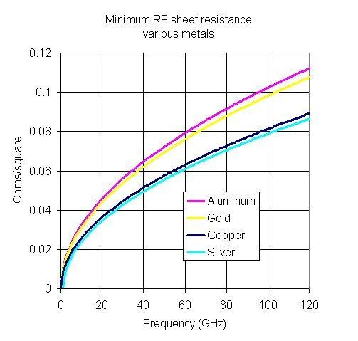
How to measure RF Surface Impedance 4/7
Minimum RF resistance per unit square (sheet resistance) for different metals
warm copper
Surface resistance vs frequency for copper and Niobium at @2K and 4.5 K respectively (left graph by B.Tenenbaum)
Just a quick cross-check: Are the traces on the right hand side at room temperature or at cryo?
Scaling is always good: recall that (warm) copper has at 1 GHz about 8 milliohm/unit square
Lets read at 100 GHz ..we see 80 milliohm..there..whats your answer? (we may like this for exam)
Notes:
And here we get a small practical exercise ... to practise scaling..the answer is pretty clear...we talk about warm copper (300 K); otherwise it would not be easy to get the traces for copper at low temperature if we dont know its RRR value (=residual resistance ratio)

Slide 44
How to measure RF Surface Impedance 5/7
Why should we use this kind of resonator when we have the nice TE₀₁₁ type pillbox?
Answer: It allows for lower frequencies or a smaller sample size compared to the pillbox resonator
Note, that the eddy currents induced in the sample are only local (“focused”) and don’t pass over contacts.
This setup is still (2021) in operation at cern.
This 4 rod structure is connected at the end such that we have two pairs of rods operated in an odd mode,
since we need currents shown in red in the “end rings” in order to induce also currents
(like a transformer or just eddy currents) in the sample under test, which is just underneath
Notes:
The purpose is to avoid contact to the sample ..because contact resistance is always a big mess…and hard to control..evaluation via change in Q or calorimetric

Slide 45
How to measure RF Surface Impedance 6/7
This setup has been intensively used for measurements of the normal conducting copper losses of the LHC beam screen at cryo temperature at with a strong static magnetic field; it now again under discussion for the FCC beam screen evaluation which may have high Tc superconducting coating (compatible with the strong DC magnetic field)
From: F. Caspers et al; Surface resistance measurements… LHC project report 307
Notes:
This configuationw as used over more than 15 years until someone said..we dont need it anymore lets scrap it..and 3 years later it was re-surrected..and re building it from sratch

Slide 46
How to measure RF Surface Impedance 7/7
The examples shown so far are by no means exhaustive
For the design of new measurement setups e.g. related to the evaluation of surface roughness impact, one may have to take anisotropy issues into account , depending on the structure of the surface roughness (e.g. laser erosion for multipactor reduction)
For very high frequencies confocal resonator (Fabry Perot type) setups were used.(A Fabry-Perot is also known as confocal resonator)
For tube-like (beam-pipe style) samples the first resonance frequency of often too high to cover the frequency range of interest. In this case one may insert a sapphire rod which at cryo has extremely low RF losses and an epsilon around 10 (caveat: anisotropic)
Notes:
This kind of measurements have a lot of caveats…

Slide 47
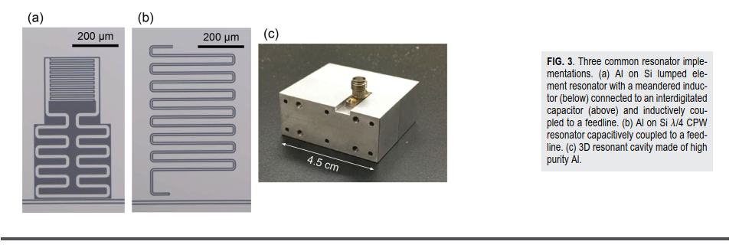
Recent measurement layouts and examples for SC resonators (2021) #1
These examples are for high purity aluminum which has excellent RRR at very low temp
Materials loss measurements using superconducting microwave resonators Cite as: Rev. Sci. Instrum. 91, 091101 (2020); https://doi.org/10.1063/5.0017378 Submitted: 07 June 2020 . Accepted: 20 August 2020 . Published Online: 23 September 2020 C. R. H. McRae, H. Wang, J. Gao, M. R. Vissers, T. Brecht, A. Dunsworth, D. P. Pappas, and J. Mutus
The article mentioned above is rather recent and give a nice overview on recently developed and applied resonator based measurement methods; really recommended for further reading
Notes:
Some example from a very recent publication and there one can find all sort of references to previous work done in the last 30 years or so..but it good to know about early history of those kind of meas in order to avoid re-inventing th wheel and repeating old mistakes

Slide 48
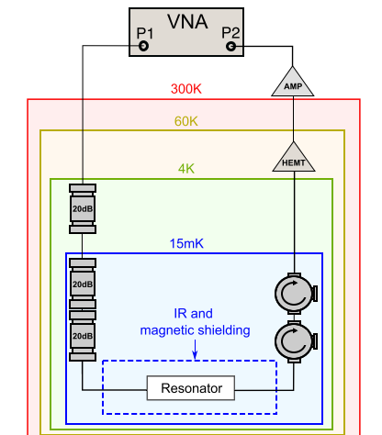
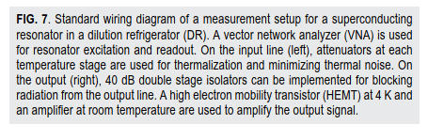
Recent measurement layouts and examples for SC resonators (2021) #2
This setup is for measurements at REALY very
low temperatures (15 milli K !!!); a comparable
version is in operation in Korea (CAPP) for axion
research; the NORMAL conducting cavity (at deep
Cryo ! to enhance the Q and reduce thermal noise)
is the actual axion receiver then.
(caveat: axion cavities are operated in a strong DC
magnetic field which is not compatible with
conventional superconductors)
Materials loss measurements using superconducting microwave resonators Cite as: Rev. Sci. Instrum. 91, 091101 (2020); https://doi.org/10.1063/5.0017378 Submitted: 07 June 2020 . Accepted: 20 August 2020 . Published Online: 23 September 2020 C. R. H. McRae, H. Wang, J. Gao, M. R. Vissers, T. Brecht, A. Dunsworth, D. P. Pappas, and J. Mutus
Notes:
In certain cases a real big efford is required to get to VERY low temperatures..quantum regime..

Slide 49
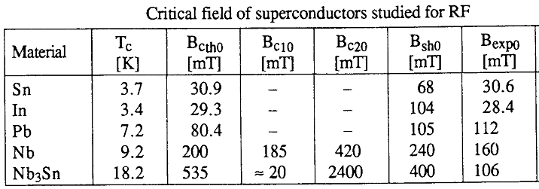
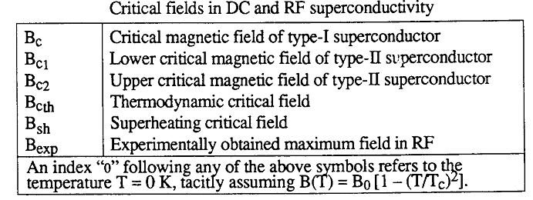
Critical field(s) 1/2
Notes:
A list of some parameters and materials relevant for RF SC..some of the terms shown here are explained on the next slide

Slide 50
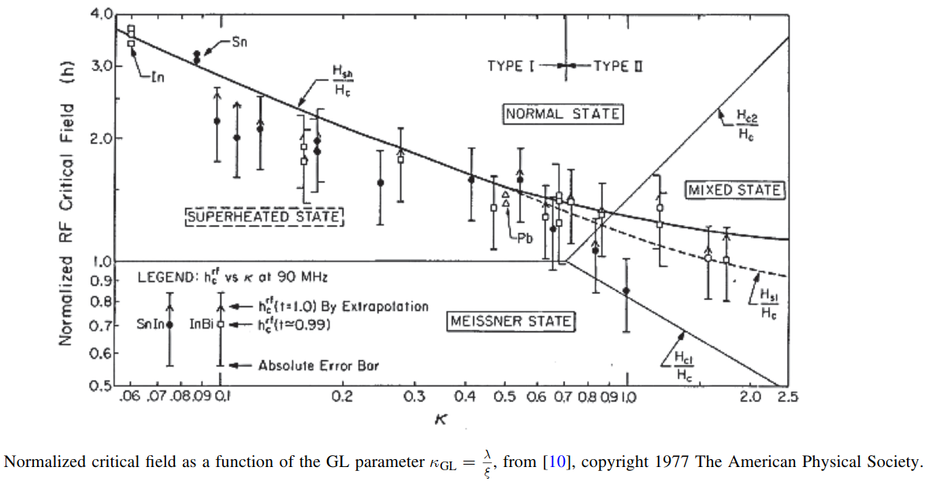
Critical field(s) 2/2
Yogi T, Dick G and Mercereau J 1977 Phys. Rev. Lett. 39 826–9
H_{sh} Superheating field is a metastable state than can be reached only in transient – or in RF
Notes:
There is still a debate among experts if Hsh is really the correct ultimate field limit for RF fields

Slide 51
Other deterministic parameters for cavity performance
Until till now we discussed the role of the RF frequency, the He bath temperature, and sc material with its characteristic critical field and temperature. There are still other (less important) parameters that determine the performance of the cavity as well:
Influencing quantity | Impact quantity | Physical explanation | Cure
External static magnetic field B_{ext} | Residual surface resistance | Creation of vortices | Shielding of ambient magnetic field by Mu-metal / Cryoperm
Residual resistivity ratio RRR | BCS surface resistance | Mean free path dependence of R_{res} | Annealing steps during ingot production/after cavity manufacture
Ratio peak magnetic field to accelerating gradient B_{p}/E_{a} | Max. accelerating gradient | Critical magnetic field as ultimate gradient limitation | Optimization of cavity shape
Nb-H precipitate | Q-value / acc. gradient (Q-disease) | Lowering of T_{c}/B_{c} at precipitates of Nb-H | T-control during chemical polishing Degassing @ 700 °C Fast cool-down
“frozen magnetic flux”
This undesired and normal
conducting compound is often
created during cooldown inside
the cavity when hydrogen present
Notes:
A lot of technological issues are entering the process and ALL of them have to be controlled carfully

Slide 52
Summary
Superconducting materials:
are characterized by zero resistivity (in DC) and the Meissner effect;
Show the (thermodynamic) phase transition into the superconducting state below a critical temperature and below a critical field;
have a non-zero surface resistance for RF which can be understood by the two-fluid model and the London theory
are subdivided into type I and type II, depending on the value of the Ginzburg-Landau parameter κ;
may be alloys or elements, for which they are of type I, except Nb, the technically most important one, which is type II and has the largest critical temperature and critical field;
Notes:
This may be interesting for multiple choice questions in the exam

Slide 53
Learning targets
After this chapter you should
be familiar with the motivation for using RF superconducting cavities in accelerators
be able to dicuss why SC Rf cavity technology is barely used outside the accelerator field
see the benefits but also the problems related to RF SC technology
have understood the main difference between DC and RF superconductivity
be able to calculate the RF surface impedance of a given material vs frequency
have understood the concept of the resistance and impedance per unit square
be able to name some of the materials used for RF SC applications
have understood the principal difference wrt conventional Rf superconductors and high temp RF superconductors
be familiar with the basics, history and important milestones of superconducting technology in general
be able to describe the meaning and relevance of vortices in the context of SC technology
know the difference between type I and type II superconductors
have some ideas (be able to give examples) how to measure the surface impedance of RF superconductivity
-
Notes:
And try to pratise some of the simple formulae we gave in this chapter

Slide 54
Basics of RF cavities (slightly different wrt the RF lecture)
Variety of RF cavities (examples)
Cavity characteristics
Cavity characteristics (peak fields, stored energy, …)
Pillbox resonator –basics, field distribution
Computer codes to determine the cavity parameters
Different mode families
Transmission line
Response of a sc cavity to RF (determination of Q₀, E_{acc}, …)
Measuring setup (Q(E_{acc}) curve, …)
Pass-band modes
Typical example of storage ring cavity (LEP)
Summary
Notes:
54
Well yes we did hear already about many aspects of cavities in the NC lecture..but a small recap does not hurt..too much

Slide 55
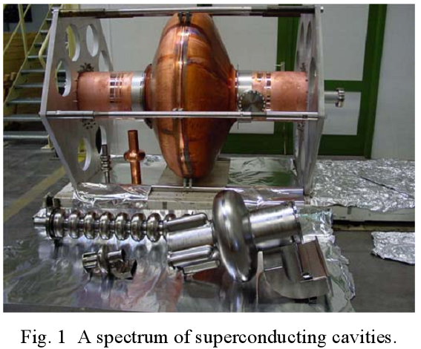
Examples of RF cavities
The big object is a single
cell copper cavity niobium
coated inside;
In the foreground some
smaller multiple and single
cell cavities
Usually cavities are
elliptical for beta=1 particles
Why elliptical? Its better for two point multipactor…..inside the cavity; however test cavities may be “round”
different frequencies..different sizes ..from 200 MHz in this photo up to 3 GHz
(from H. Padamsee, CERN-2004-008)
Notes:
55
A collections of cavities…

Slide 56
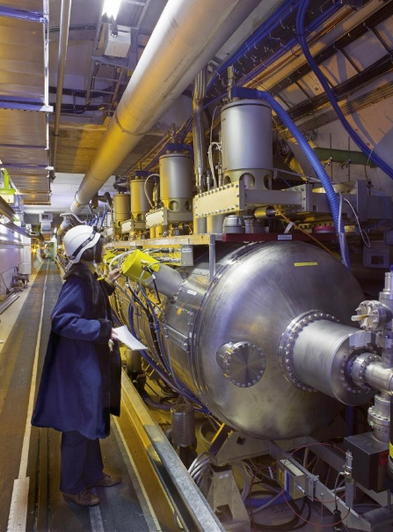
LHC - CERN
f_{res} = 400 MHz
R/Q = 89 Ω
Q₀ = 2 x 10⁹
E_{acc} = 5.33 MV/m
P_{in} = 116 kW (CW)
Niobium-film on Cu
1-2 µm thickness
4 single-cell cavities per cryomodule
Each resonator delivers 2 MV
Blade tuner (detail discussed later)
«Doorknob» power coupler, 75 Ω coaxial shown on another slide (air cooled in cryo )
Total of 8 cavities per beam: 16 MV
Notes:
56
Compare the field in each cavity (single cell) of 5.33 MV/meter with the kick delivered to the beam as 2 MegaVolt..what happens with the 116 KW when there is no beam?

Slide 57
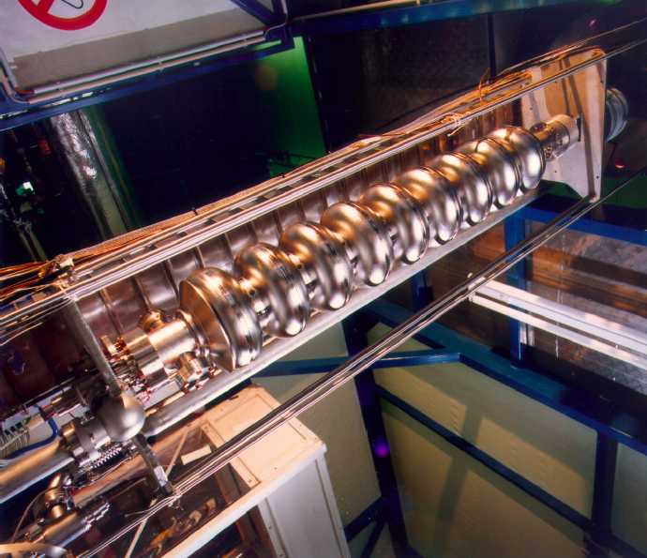
XFEL – DESY 1/4
f_{res} = 1300 MHz
Standing wave
RRR 300 Niobium
TM₀₁₀ π-mode
active length=1.038m
Q₀ >10¹⁰
Iris diam. = 70 mm
Nominal gradient =23.6 MV/m
Cell to cell coupling K=1.87%
B_{peak}/E_{acc}=4.26 mT/MV/m
From: Review of the European XFEL Linac
System Beam dynamics meeting; March 26
2007 Desy (Hans Weise)
Notes:
Now we have an application for electron beams..and this cavity shape was REALLY optimised for a very good ratio of accelerating field vs surface magnetic field

Slide 58

XFEL - DESY 2/4
XFEL cryomodule assembly of eight, rather small 9-cell cavity modules, in a cleanroom
to avoid any dust inside the cavity which would be fatal

Slide 59

XFEL - DESY 3/4
Cryomodule installation in the tunnel (the XFEL consists out of 101 cryomodules)
These days all SC cavities look more less like this..a big cryo vessel and some cavities deep inside
Notes:
The cleanroom is required to avoid particle contamination on the surface.(inside the cavities).and it takes weeks for assemply of an entire cryo module

Slide 60

XFEL–DESY the blade tuner, as used also in the LHC (4/4)
Contrary to the case of LEP cavities , the LHC
cavity tuner is purely mechanical in order to provide
the large tuning range at full speed required to
compensate beam loading. The cavity cradle, with its
two thick end plates joined by four columns forms a
rigid assembly, free of harmful resonances, which can
take the strong tuning forces (~ 20 kN) without
excessive deformation. The cavity end plate and the
cradle end plate are pulled together via thin (0.75 mm)
stainless-steel blades and torsion shafts with long lever
arms (Figure LEFT). This arrangement provides a lever
action (ratio 14:1) without sliding parts or backlash.
The internal stresses (290 Mpa) inside the blades stay
below the elastic limit. The axial force and movement
at the extremities of the two lever arms, inside the cold
cradle, are transferred to the outside via two thin-
walled stainless-steel cylinders acting as counterrotating
torsion shafts The latter are driven by stainless steel cables
(∅ = 3 mm) providing again a transmission without
friction or backlash. Furthermore, this system allows
displacement of the cradle during cooldown and provides
a low heat conductance.
From: Boussard et al PAC 1999 The LHC SC cavities
Notes:
Compare with the the cavities for LHC on the previous slide for hadrons

Slide 61

CEBAF - JLAB
Here we see the different production
Stages of those SC cavities
Half shells to start with for each cell
Waveguide port couplers
One waveguide for the RF-in
The other for HOMs –out
Note that practically ALL SC multiple
cell cavities are operated in the
standing wave mode (in contrast to
NC multiple cell cavities which are
often in travelling wave mode…some
of them in forward traveling wave
mode ..some using backward waves
This (trav. wave) allows more bandwidth
and is also applied for heavy
beamloading
Notes:
Some practical examples

Slide 62

SPL - CERN/ SNS - ORNL
704 MHz SRF cavity R&D study to upgrade the CERN injectors with a high intensity superconducting RF proton linac (SPL); however, the SPL did never “fly”
Notes:
Development work is never lost…and will ususally be applied later

Slide 63


Heavy Ion accelerators ATLAS - ANL
Excitation via tank
probe or loop
“antenna”
This is kind of similar to a NC spiral resonator from
GSI for 27Mhz (EPAC 88); nice photo not available
https://accelconf.web.cern.ch/e88/PDF/EPAC1988_1140.PDF
Photo of a GSI spiral resonator(not the 27 MHz version, but NC)
Notes:
This is the superconducting version of a cavity with similar shape (but normal conducting) developed at GSI in the early 80th..This type of structure is good for slow beams and has a very high shunt impedance

Slide 64





Shapes of heavy ion accelerator cavities
a λ/2 style
coax resonator
as SC spoke cavity
the beam passes in
the middle 2 gaps
(L to R)
Single spoke resonator λ/4 with 2 gaps
seen by the beam in the “open”end
Single spoke resonator λ/2
beam
beam
Multiple spoke
lamda/2 style
SC resonator
A superconducting 4 Rod RFQ
Notes:
Thats one practical application of coaxial line theory for resonators…note that for low beta beams there are often two gaps to pass for the beam while the sign inverts during the passage of the beam through some hole on the resonator like a drift tube)

Slide 65
Equivalent circuit
The generator may deliver power to R_{p} and to the beam, but also the beam can deliver power to R_{p} and Rg!
Generator
The beam is usually considered as a current source with infinite source impedance.
Ideal transformer
(no parasitic elements hidden in the coupling loop)
Beam
$$R_{p}=\text{resistor} \text{representing} \text{the} \text{losses} \text{of} \text{the} \text{parallel} \text{RLC} \text{equivalent} \text{circuit} (\text{resonator} \text{losses})$$
We have resonance condition, when
^{→ Resonance frequency:}
Notes:
The well know equivalent circuit as a reminder…

Slide 66


Pill box resonator
Field distribution TM₀₁₀ mode:
r
J₀ …. Bessel function of 0th order
h
B
Electric field
E
Resonance-condition
J₁ ... Bessel function of 1st order
h
E
Magnetic field
Source: The Feynman Lectures on Physics, Vol. II
r
Type in Google or similar: Feynman capacitor at high frequencies
Notes:
66
We had this already on the normal conducting Rf lecture..just take the time to read again the very nice derivation by Feynman („capacitor at high frequencies“ )which is available on the Web

Slide 67

Pill box resonator , R/Q
Plot by A. Mostacci
Thus we see for a relativistic beam there is an optimum for R/L ratio around 1.
For slow beams the gap must become shorter such that the beam sees not more than half a RF period
For very long cavities with this mode “nothing “ happens and very short cavities (R/L<0.5)
are not so efficient; remember: the resonant frequency of this mode (E₀₁₀) only depends on the radius R
Notes:
67

Slide 68

The geometry factor G for cavities (1)
The geometry factor is together with the Q-value an important figure of merit for cavities; this is in particular relevant for superconducting cavities. Lets take the surface resistance R_{s} and we obtain a very simple formula
G = R_{s} Q
W=Stored energy in the cavity and P_{c} = current losses in the wall per period
R_{s} is a function of many parameters like surface roughness, material and also treatment of the surface inside the cavity and normally assumed constant over the entire surface.
Typical values for G are around 270 Ohm for pillbox like cavities used for highly relativistic beams and as low as 20 Ohm for cavities used for slow beams.
One may calculate G also with the knowledge of Q in a similar way as the calculation of Q is done via the stored energy in a cavity and the power dissipated per period.
G=453/(1+radius/length)
$$Q=2πf_{RES}\frac{W}{Pc}=\frac{ω_{RES}W}{Pc}$$
Notes:
68
The geometry factor is more often used for SC cavities…and its NOT a direct function of beta=v/c of the beam..but an indirect one since the shs=ape of the cavity and thus the geometry factor changes as a function of beta=v.c

Slide 69



The geometry factor G for cavities (2)
And here we have the same story from other authors and using a different notation
W⇾U and P ⇾P_{c} or P_{d}
G = R_{s} Q
G=453/(1+radius/length)
Thus for a very long cavity:G ⇾453 Ohm
Notes:
69
The geometry factor is more often used for SC cavities…and its NOT a direct function of beta=v/c of the beam..but an indirect one since the shs=ape of the cavity and thus the geometry factor changes as a function of beta=v.c..in this slide we nice simple formulae for exams

Slide 70


The geometry factor G for cavities (3)
Plot by A. Mostacci
And now we have a nice plot for The G-factor as well as for the Q factor as a functions of R/L
Just keep in mind that for SC cavities the Unloaded Q is quasi infinite…compared to the loaded one
Notes:
70
Graphics are always appreciated and nicely usable for exams..

Slide 71



Resonators
As we said at the beginning, an accelerating RF cavity is indeed a resonator for an electromagnetic wave. We already mentioned the idea of comparing an RF cavity to an RLC circuit.
Two important quantities characterise a resonator (remember your first physics course..): the resonance frequency f₀ and the quality factor Q₀
E² or V²
$$Q_{0}=\frac{f_{0}}{Δf}=\frac{ω_{0}W}{P_{c}}$$
E²=0.5
1/πτ₀
P_{C} = wall current losses per period
3 dB bandwidth=Δf
0.71 in voltage or
0.5 in power
E(t)$=E_{0}\exp{(}−t/{τ_{0})}$
τ_{O} = time constant for unloaded Q
Since we are only talking about losses in the cavity
Where W is the energy stored in the cavity volume and P_{c} /ω₀ is the energy lost per RF period by the induced surface currents, not from external loading
Notes:
71
The ususal resonance curve but caveat for the 3 dB points , which are 50 % in power and 71% in voltage

Slide 72



The quality- and geometry factors
Let’s expand on the latter definition: with W= stored energy in cavity; P_{c} loss per period
Thus:
G depends only on the shape of the cavity, and is generally calculated numerically with computer codes (MAFIA, URMEL, HFSS...)
For a “pillbox” cavity G is e.g. 257 Ω. For an accelerating cavity for relativistic particles (β=1) like those used at CERN; G ranges in 270÷295 Ω.
The Q₀ factor of a SC cavity is in the 10⁹÷10¹⁰ range!
L=L_{eff} is the effective inductance of the equivalent RLC circuit
$$Q_{0}=\frac{ω_{0}W}{P_{c}}$$
W $=\frac{1}{2}μ_{0}{\int_{V}{\left|H\right|}}^{2}d{V} P_{c}=\frac{1}{2}R_{s}{\int_{S}{\left|H\right|}}^{2}d{s}$
$$Q_{0}=\frac{ω_{0}μ_{0}}{R_{s}}\frac{{\int_{V}{\left|H\right|}}^{2}dV}{{\int_{S}{\left|H\right|}}^{2}d{s}}=\frac{G}{R_{s}}=\frac{ω_{0}L_{eff}}{R_{s}}$$
Notes:
72
Relation between Q and G

Slide 73
Fields and the G-factor
Our cavities are meant to accelerate particles, and the accelerating electric field is of basic importance.
However most of the considerations on the surface impedance are based on the surface magnetic field and on the induced currents.
For a given geometry, there exists a fixed proportionality between H₀, E₀ and E_{acc}.
 | “Pillbox” | Elliptical
H₀/E_{acc} [mT/(MV/m)] | 3.33 | 4.55
E₀/E_{acc} | π/2 | 2.3
G [Ω] | 257 (example) | 295 (example)
Notes:
73
Some practical numbers to get a ballpark and a feeling

Slide 74

Shape versus β
Remember: 2d f₀ ≤ βc here: β =v/c
Trading between transit time factor and geometry factor
We know that for a relativist beam the gap length should be<λ/4, since then the particle sees a half wave
Example: 300 MHz; beta=1, λ=1 meter; a good gap length is ≈50 cm and >50 cm leads to cancellation
Electron accelerators | Proton accelerators | Ion accelerators
β ≅ 1 | β ≅ 0.5 | 0.05 ≤ β ≤ 0.2
350 MHz ≤ f₀ ≤ 3 GHz | 500 MHz ≤ f₀ ≤ 1.5 GHz | 50 MHz ≤ f₀ ≤ 150 MHz
Γ ≅ 270 Ω (geom. factor) | Γ ≅ 170 Ω (geom. factor) | Γ ≅ 20 Ω (geom. factor)
d ≅ 35 cm (f₀ = 350 MHz) | d ≅ 20 cm (f₀ = 350 MHz) | d ≅ 5 cm (f₀ = 150 MHz)
λ/4 coax
resonator
with two
short gaps
d
Notes:
74
Keep in mind that the field extens a bit further into the beampipes than the gap length defined this way thats why D is in practise a bit smaller than lamda/2

Slide 75

Cavity characteristics
η is used for the free space
impedance here, not efficiency
W stands for stored energy
in the cavity here
shunt impedance R:
V_{a}=accelerating voltage, circuit definition
R/Q measures the interaction of the cavity with the beam:
$$\frac{R}{Q}=\underset{R}{\underbrace{\frac{V_{a}^{2}}{2⋅P}}}⋅\underset{1/Q}{\underbrace{\frac{P}{ω⋅W}}}=7.10\frac{4}{π^{3}}⋅\frac{h}{R}⋅η$$
η= 377 Ohm
The peak surface electric and magnetic fields constitute the ultimate limit for the accelerating gradient => minimize the ratio E_{p}/E_{a} and B_{p}/E_{a}.
B
B_{p}
beam
E₀
E_{p}
Notes:
75
The formula in the lower part of the give a very nice and simpe relation between the surface field and the accelerating voltage in a „standard“ pillbox.(we like this for examinations) .Just compare with the deflection of a relativistic particle by a homogeneous plane wave (the rule is that 1 Tesla is equivalent to 300 MV/meter) thats why we use mostly magnetic kickers

Slide 76
Cavity characteristics - Summary
Symbol | Name | Definition | Pillbox cavity [0.35 GHz, 4.2 K, Nb] | Accelerating cavity [0.35 GHz, 4.2 K, Nb]
E_{p}/E_{a} | Peak normalized surface electric field |  | 1.6 | 2
B_{p}/E_{a} [mT/(MV/m)] | Peak normalized surface magnetic field |  | 3.1 | 4
R_{s} [nΩ] | Surface resistance | E_{x}/H_{y} | 40 | 40
h [m] | Cavity length | h ≈λ/2 (often a bit smaller) | 0.43 | 0.43
E_{a} [MV/m] | Accelerating gradient | Energy gain/length | 10 | 10
V [MV] | Accelerating voltage | V=E_{a} ·h | 4.3 | 4.3
G [Ω] | Geometry factor | G=R_{s}·Q; 226 for L/a=1 | 260 (example) | 275(example)
Q [10⁹] | Quality factor | Q=ωW/P | 6.5 | 6.9
R/Q [Ω] | (R/Q) factor | (R/Q)=V²/(2ωW) | 450 | 280
R [MΩ] | Shunt impedance | R=V²/(2P) | 3·10⁶ | 2·10⁶
W [J] | Stored energy | W=V²/[2ω(R/Q)] | 9 | 15
P [W] | Dissipated power | P=ωW/Q | 3 | 5
h/R | Ratio cavity length to radius | n/a | 1.3 | 0.5
Notes:
76
A useful slide ..also for examinations

Slide 77
Cavity characteristics – Summary table
Table: Equivalence of cavity and lumped-element circuit parameters
Cavity | Lumped-element circuit
Accelerating voltage V | Peak voltage V
Resonant frequency ω₀ | ω₀ = 1/√(LC)
Stored energy W | W = (1/2)CV²
Dissipated power P_{c} | P_{c} = (1/2) V²/R
Radiated power P_{rad} | P_{rad} = (1/2) V²/R_{i}
Shunt impedance R = V²/(2·P_{c}) | R
Unloaded Q - value Q₀ = ω₀·W/P_{c} | Q₀ = ω₀·RC
External Q - value Q_{ext} = ω₀·W/P_{rad} | Q_{ext} = ω₀·R_{i}C = R_{i}/(R/Q)
(R/Q) value R/Q = V²/(2 ω₀·W) | R/Q = √(L/C) = 1/(ω₀·C)
Coupling factor β = Q₀/Q_{ext} | β = R/R_{i}
Loaded Q - value Q_{L} = Q₀/(1+ β) (because Q_{L}⁻¹ = Q₀⁻¹ + Q_{ext}⁻¹) | Q_{L} = ω₀·RC/(1+ β)
Turns ratio n = √[(R/Q) ·Q_{ext}/Z₀] | n = √(R_{i}/Z₀)
Wave imp. Z₀ = 50 Ω also η=377Ω
From W. Weingarten, CERN-1992-03
Notes:
Caveat: the voltage seen by the beam can come close to the peak value (to be corrected by the transit time factor) but we have LINAC and circuit definition

Slide 78

Computer codes for RF cavities
Computer codes to determine the cavity parameters
Notes:
78
For the practical computation make use of symmetries and apply where adequate and permitted, electric and magentic walls in oder to save oncomputer memory and time

Slide 79


Q-value of a SC cavity as a function of the E-field level
This is a nice plot
of the measured unloaded
Q-values for SC cavities as a function of the internal electric field…or gradient
But how to measure it?
Someone suggested: Just make a feedback loop and let the cavity oscillate… well yes, it would work in principle, but then how to control the power level?
In reality it’s a bit more tricky..see next slide
Proceedings of the 2nd superconducting linear accelerator meeting in Japan, Fed 2000, available from KEK
Notes:
The slight increase in Q vs field for low acc gradients is not completely understood yet

Slide 80
Measuring setup (1/2)
Q determined by measuring the decay time of the cavity response
Measurement of Q vs E_{acc}
Notes:
Here we see a complicated looking test set-tup..dont worry..explanations next slide

Slide 81
Measuring setup (2/2)
How does the setup on the previous slide work and why was it build this way?
What is the required functionality?
We would like to be able to control the power level inside the cavity under test
We must be able to follow the resonance frequency of the cavity which may and will change
during the measurement (why?)
We have to keep in mind that with unloaded Q values in the ballpark of 10⁹ to10¹¹
the 3 dB bandwidth will be a few Hz.
In this rather old setup (about 20 years ago) a VCO (voltage controlled oscillator) is used which
“locks” to the cavity resonance and has an analog feedback loop to stay in tune
(These days one would do that digitally with a synthesizer if using that kind of method)
Using a controllable signal source also permits to control the power level over a wide range
which would not be easy with a self oscillating circuit
And now comes the “catch”..because so far this method is not so different from the typical
3 dB method with a networkanalyzer(which would not really work in this case..why exactly?)
The cavity is “filled” with Rf energy to a desired level and then a switch is opened and we let it ring
From this ringing (like a bell which got hit) we can measure the decay time and get the Q from there
But there is a caveat: The decay trace is depending on the power level in the cavity not always perfectly
exponential (nonlinear system) and thus certain time windows have to be applied then.
And recently also the “auto oscillator” method was implanted; caveat to excite the desired mode
Notes:
Try to re-invent this concept yourself..maybe you have a brilliant idea ..to make it better or easier..but no way to measure the unloaded Q with a VNA

Slide 82



Passband modes
Phase shift from cell to cell
Zero mode not shown here
Zero Mode
Pendulums in phase
45 deg
90 deg
Pi mode
Pendulums 180 deg off phase
135 deg
180 deg
http://de.wikipedia.org/wiki/Gekoppelte_Pendel
Notes:
The nice analogie to the coupled pendulums

Slide 83

http://www.youtube.com/watch?v=IAPWpViY19A
Pendelreihe in Aktion - YouTube
Notes:
If you find time..play the movie its still on the web

Slide 84

Typical storage ring cavity (LEP)
Bulk niobium cavity of LEP (there were 16 bulk niobium and 272 Niobium-on-Copper cavities in LEP), electron-beam welded, 352 MHz.
Long ports for main couplers, short ports for HOM couplers and diagnostics (field probes)
Notes:
Heavy SC cavity stuff at 352 MHz…

Slide 85
Summary
The pillbox resonator (TM₀₁₀ mode) allows – as a paradigm - the analytical description of typical accelerator parameters, such as peak surface fields (E and H), power loss and Q-value, shunt impedance, geometrical shunt impedance, geometry factor, etc.
« Real » accelerator cavities are designed by making use of computer codes such as Microwave Studio, MAFIA, SUPERFISH, etc.
The response of a cavity to an RF pulse is well described by lumped circuit networks, in particular by the transmission and reflection of an electromagnetic wave
A formula is presented to determine the coupling factor β (or the reflection factor (ρ = old notation), now Г , and finally the unloaded Q-value Q₀, the accelerating voltage V (accelerating gradient E_{a}) and the surface resistance R_{s}.
We also use the geometry G here which is less important for NC cavities.
Notes:
Our tool box is ready for use…

Slide 86
Learning targets
After this chapter you should
Have an idea about SC muliple cell resonator structures and their mechanical implementation
Know that for coupled resonators the resonance frequencies are splitting up
Have understood the concept of the test setup for the amplitude dependent Q measurement on a SC cavity in particular proper control of all parameters
Know that the Q value of superconducting cavities is field strength dependent
Be able to understand and mutually convert different notations and symbols for RF cavities
Be able to give some examples of typical shapes for SC cavities
Be familiar with G-factor and have an idea about its order of magnitude
Know that the G-Factor gets worse for Low beta cavities and why
Be able to explain the difference between R/Q , Q and G-factor
Be able to draw a sketch of a 0 mode and Pi mode in a multiple cell cavity
Give some examples of higher order mode couplers and explain their principe of operation
Know why elliptical shape cavities have advantages even when they are mechanically more delicate
Have an idea about mechnical oscillations from the batch structure and be able to explain them
-
Notes:
Home work…..sorry…

Slide 87
Recommended literature
Literature
W. Buckel and R. Kleiner, « Superconductivity: Fundamentals and applications, Wiley VCH 2004
V. V. Schmidt « The physics of superconductors », Springer 1997
M. Tinkham, « Introduction to superconductivity », McGraw-Hill 1996, and many others
Nobel lectures (http://nobelprize.org/nobel_prizes/physics/laureates/)
Notes:
Hope you find time for further reading

Slide 88
Interaction of cavity with beam
Descriptive introduction
Analytical introduction
Transfer of RF power from the cavity to the beam
The fundamental mode power coupler
Transfer of RF power from the beam to the cavity
Higher order modes and their damping
The frequency tuner
Summary
Notes:
The cavity is a transformer and in Case of SC..nearly lossless..

Slide 89

Descriptive Introduction
JUAS Lecture Archamps 2008
Notes:
89
Surfing on the waves..means to stay in synchronism..more or less..in particular important for multi cell cavities

Slide 90

Particle passing through cavity
Notes:
Sorry not a movie, but good enough to visualize the fields and what the particle sees in the different positions

Slide 91




Analytical Introduction
Notes:
And here .. A bit more in detail and a small amount of math

Slide 92

The fundamental mode power coupler for LHC 400 MHz
Air cooling inlet
Air inlet antenna
Displacement mechanism
Air pressure interlock
RF screen
Bellows
Motor drive
Capacitor for DC bias
RF input
Short circuit
Ceramic window
Antenna (copper)
From: Boussard et al; PAC 1999
The LHC SC cavities
Notes:
This version had been replaced in the meantime but it was a great engeneering achievement

Slide 93

LHC solution of the power coupler
Notes:
You see the nice flat 352 MHz waveguide and the inside air cooled (!!) power coupler which will sticks deep into the SC region..Why not water cooled?

Slide 94
Transfer of RF power from the beam to the cavity
Need for Higher Order Mode (HOM) coupler
Imagine worst case
the cavity resonant frequency is « tuned » to a spectral line of the beam
Generator switched off, I_{g}=0.
This means that the beam is decelerated because the cavity acts as pickup then
Remedy: keep Q_{ext} as low as possible.
Output power (reflected):
1st example (LEP); RF Generator trip.
We obtain for the accelerating mode
2nd example;
We obtain for the higher order mode with (R/Q) = 10 Ω, Qext = 20000
Notes:
Why do we talk only about Q ext here? The actucal cavity has a quasi infinite Q and the total Q is given basically by the external Q.

Slide 95

Higher order modes
https://cds.cern.ch/record/306421/files/CERN-96-03.pdf , paper by E. Haebel ,CAS 96-03
Sometimes this kind of modes are also called trapped mode..they can “stick” on ANY kind of small discontinuity (in- and outward) in an otherwise smooth beampipe and are close to cutoff of the related waveguide mode if the discontinuity (cavity) is very small
Notes:
Some examples for the transition from a cavity to a trapped mode..if the cavity is small (just a „dent“) enough we like to call it a trapped mode

Slide 96
A typical HOM spectrum
SPL= superconducting proton linac 704 MHz
Notes:
HOMs are always present and a BIG hassle and there are hundreds of paper how to fight them by lowering their Q values…this is also valid for non intended cavities like the housing of a wire scanner

Slide 97

How to deconfine HOMs
Open beam tube
OK for single cell cavity, but high cryo-load by thermal radiation
¹http://www.lns.cornell.edu/Events/HOM10/Agenda.html
Notes:
What really means “deconfine…basically..lets the HOMs travel away from the cavity if the cutoff frequency of the beampipe is in the right range and have them absorbed there..but caveat not all modes can be deconfined an travel away even if the beampipe is large enough to let them pass..we also have the coupling between the waveguide modes and HOM mode in the cavity and sometimes this does not fit together

Slide 98

Damping HOMs : Loads inside the beampipe
Ferrites
low power handling capacity if cold
higher power handling capacity if warm
mechanical and vacuum design not easy;
The catch is to keep the ferrites away from the field of the fundamental mode
Notes:
In this design a careful trading has to be done with ferrite losses from the beam and HOM losses..and warm ferrites tend to have bad outgassing

Slide 99
Damping HOMs Resonant coaxial transmission line dampers
Compensate internal impedances: The HOM coupler becomes a resonator coupled to the cavity resonator. It may have two eigenfrequencies because we then have two coupled resonators
Obtainable Q for HOMs: down to 50
Pros:
Couplers with several resonances possible (HERA, LEP, LHC, ILC are of this type)
Demountability
Fundamental mode rejection:
LEP: Fundamental mode E-field rejected by stop-filter in front of HOM coupler
Fundamental mode H-field rejected by loop plane perpendicular to cavity axis
Risk of detuning of notch filter
BUT: High currents request for superconducting material prepared under ultra-clean conditions (like the cavity) and lHe cooling
Prone to electron emission from inside cavity
Notes:
HOMs are a royal mess..but unavoidable..where even the beam as a current source finds an impedance it wants to deposit some energy..

Slide 100

Resonant coaxial transmission line type HOM dampers: Technical solutions
Note that for the big
coupler (left) we have
a mixture of magnetic
and electric coupling,
while the small button
type unit on the right is
essentially only electric
Note, that the external
resonant coax lines
are not shown here which
are essential for the
proper functionality of
this concept
LHC HOM coupler
Notes:
The is a HUGE variety of all kind of shaped of HOM couplers..driven by space requirements..multipactor cooling…cost ..imaginations of the builder reliability issues..

Slide 101

Resonant coaxial transmission line dampers
An example
from DESY, XFEL
Many thanks
to Hans Weise
For more details on the functional concept of the resonant coax transmission line damper , see
Strong Damping of single cell accelerator cavities by resonant loops; W. Schminke
CERN-SPS-ARF- WS-GS 81-68; cern SPS 81-86-ARF 1981 available via CDS cern

Slide 102

The frequency tuner
The frequency of the cavity must be tuned to the harmonic spectral line of the bunched beam => need to develop a frequency tuner. Slater’s theorem states that
4W
V
W
The plunger is maybe good for slow tuning say 0.1 Hz) but not easy to operate at say 30 Hz
Notes:
102
Ist like an accordeon….and this type of accordeon style frequency tuning had been proposed around 1980 for the NC SPS single cavities by some hydraulic mechanism in the tunnel but of course never realized this way inseated we had a plunging tuner (very 10 seconds or so) with lots of vacuum problems on its bellows

Slide 103


Mechanical oscillations
For example: at LEP, radiation pressure on the cavity walls of about 1000N in total possible
Its essentially the batch pattern that reduces periodically the fieldstrength (beamloading) and if this hits
a mechanical resonance we may get a problem .. frequencies are usually a few 10Hz to serval hundred Hz
Notes:
103

Slide 104

The LEP solution
Why do we need a heater for A cryo cavity?
Notes:
104

Slide 105

Integration into LEP cryostat 1/2
Notes:
105
Integration of the actual cavity into the vacuum vessel is a major task low heat loss, cryo cooling, maybe tuners.. All sort of diagnostics .. RF-robes ..the main coupler

Slide 106
Integration into LEP cryostat 2/2
Comments:
The LEP cryostat could reliably be operated under CW conditions with beam and in pulsed conditions without beam in the present LHC tunnel environment (1.4 % slope).
It is worth noting that the lHe tank, the gas openings, and gHe collector were relatively small.
Pulsed operation: The thermal diffusivity κ=λ/(c∙ρ) is such that it takes ~1 ms before the temperature pulse arrives at the niobium helium interface => advantage compared to CW operation.
This cryostat was tested under pulsed conditions with beam in the CERN SPS.
Notes:
It’s the sum of MANY elements which have to work properly together..and the chain like to rupture at the weakest point

Slide 107

LEP Cryomodules 1/2
Mass production of the RF Cryo modules..basically they all look very similar ..some BIG tube
and then some more or less big cavity inside..
Notes:
Industrial production…

Slide 108

Cryomodules 2/2
installed in LEP tunnel
Notice the rather flat waveguides for about 350 MHz; there would have simply been no space for the normal aspect ratio (around 1 to2); can you guess the larger side? (how many cm)
Notes:
Installation of this type of waveguides in the tunnel can be very delicate ..ESS (Lund) knows that really well..give it enough margin

Slide 109
Summary and learning targets
A lumped network circuit diagram allows an analytical description of the interaction of the RF cavity with the beam
The cavity is designed to minimize the reflected RF power (which would be wasted anyhow in a load) by eliminating the « reactive beam loading » through tuning the frequency of the cavity and by matching the external Q to the nominal beam current.
The beam consists of bunches passing the cavity in batches of milliseconds¹ that may excite higher order modes (HOMs) of the cavity to high voltages, if not sufficiently damped by HOM couplers.
Frequency tuners are in addition needed to damp frequency shifts from mechanical resonances excited by external noise sources (microphonics) or the interaction of the electromagnetic pressure with the cavity wall (Lorentz force detuning).
¹ for large storage rings such as LEP

Slide 110
Technological issues
Cryogenics
Anomalous losses:
Residual losses\magnetic shielding
Electron field emission
Electro polishing
Electron Multipacting (dust free assembly)
Heat removal (Quench - the role of large thermal conductivity, Coating a copper cavity with a thin niobium film)
Quality assurance and stochastic parameters
Cavity production
Improvement of cavity performance
Summary

Slide 111

Basic Cryogenics
Caveat: (Vert axis)
Theor. min power
from Carnot cycle;
Power demand in a real world may be 4..20 times higher
KIT

Slide 112


Basic Cryogenics (cont.)
Some simple relations and
definitions of symbols
(from Wikipedia)

Slide 113


Basic Cryogenics cont.
pT-curve, Material properties
S= Solid
V=Vapor
L=Liquid
Schematic of a phase diagram,
http://moodle.zhaw.ch/mod/book/tool/print/index.php?id=63256
Phase diagram of helium,
CAS 2002, G. Vandoni

Slide 114
Basic Cryogenics cont.
One of the few macroscopic quantum phenomena
Special effects
Extremely low viscosity in thin channels
Very high heat transport capability
Can be described by two-fluid theory
He II and superfluidity
Schematic of
fountain
effect
experiment
Schematic of film flow experiment
Ratio of normal and superfluid densities of He II
All pictures on this slide by: S.V. Van Sciver, Helium Cryogenics
Notes:
Superfluid helium really creeps up the walls along the surface to go the lower level and how does it know about the lower level?via the film on the surface….and honey has a high viscocity..

Slide 115
Basic Cryogenics cont.
Thermal conductivity
The change in thermal conductivity in helium increases seven orders of magnitude at the lambda point (the λ point is defined as the temperature and pressure when helium becomes superfluide= He II)
At low temperatures many material properties can change very rapidly with temperature .
e.g. heat capacity, electrical conductivity, vapour pressure
M. Murakami, Cryogenics, Volume 52, Issue 11, November 2012

Slide 116


SC vs.NC the different efficiencies
η_{c}=Carnot efficiency
What is Ẇ ?...answer: W= work over time or dW/dt = power [Joule/second]
From Weingarten lecture CERN SC-RF CAS 96-03

Slide 117

Anomalous losses
So-called « anomalous losses » account for all contributions to the RF losses that are not described by the intrinsic parameters of the superconducting material (critical temperature, critical field, BCS (or two fluid ) surface resistance R_{s}, etc.).
These anomalous losses show up as heat and are visible in the R_{s} (T) and Q₀(E_{a}) plots, as well as in the « temperature maps ».
From: CERN CAS 96-03; Weingarten lecture
Fig. 12 Rs (Tc/T) and Q(Ea) curves that show typical performance limits

Slide 118

Magnetic shielding
Why do we need a magnetic shielding?
R_{mag} is the additional surface resistance
due to trapped flux
R_{N} is the normal SC state surface
Resistance
Good ref: The Book by Padamse
Basically the magnetic flux is dragged
by RF currents (via Lorentz force) and
the normal conducting core dissipates
due to electrical resistivity because its
dragged
R_{mag} = magneto-resistance
Notes:
The message here: Make sure that during cooldown there is no magnetic flux frozen into the superconductor possibly via additional magnetic shielding or compensation of external magnetic fields
Simple formula..nice for exams..

Slide 119


Electron field emission 1/3
https://cds.cern.ch/record/306421/files/CERN-96-03.pdf

Slide 120






Electron field emission 2/3
Typical particulate emitters containing impurities
2 µm
2 µm
500 nm
E_{on}(2nA) =140 MV/m
= 31, S = 6.8·10⁻⁶ µm²
E_{on}(2nA) = 132 MV/m
β = 27, S = 7·10⁻⁵ µm²
E_{on}(2nA) > 120 MV/m
= 46, S = 6·10⁻⁷ µm²
E_{on}=onset field i.e. when the field emission starts; β = field enhancement factor; S= equivalent area
for the field emission of electrons
Al
Si Nb
Al Mg Nb
The analysis method applied for the picture above was EDX (scanning electron microscope) sending electrons in and getting X-rays out like X-ray fluorescenz
Notes:
Tiny little dust particles and other pieces of dirt can make a royal mess

Slide 121

Electron field emission 3/3
Fowler Nordheim theory
Notes:
121
With a very huge surface field, electrons can pass the barrier of the metal surface and we get the cold electron emitter..however the current densities are small..milliAmpere/cm^2 sometimes also used in cold cathodes..

Slide 122
Electropolishing: How it works
The metal is immersed in an electrolyte and subjected to direct current. The metal part to be treated is made anodic and under certain conditions, a controlled dissolution of the metal is achieved.
DC Power supply
+
-
A
V
Usually highly corrosive
and toxic
chemical solutions
Cathode
Anode
(Part to be electropolished)
from: L. Ferreira, B2FiftyTwo Seminar, Jan 2014
Notes:
People tried MANY polishing processes over the years e.g. sand blasting in the very early days..not really good shooting small sand grain into the metal surface..this is one which survived and is often applied..

Slide 123
Electropolishing vs Mechanical based polishing
Final roughness is function of initial surface finishing and removed thickness
hundreds µm
Mechanical polishing
Electropolishing
Usually highly corrosive and/or toxic solutions..disadvantages !
Handling;
Process equipment;
Installation to process extracted fumes;
Installation to process waste water.
from: L. Ferreira, B2FiftyTwo Seminar, Jan 2014

Slide 124


Electron multipacting
Localized heating by multipactor impact from electron currents due to secondary emission
in resonance with the RF field.
Historically this phenomenon was a severe limitation for the performance of sc cavities.
That is the standard design like for example LHC or LEP cavities.
TESLA-XFEL-ILC cavities are elliptical (longitudinal cut) in that region
The invention of the “circular” shape opened up the avenue for higher gradients.
the good TESLA shape
And here an early shape with lots of multipactor and a bad geometry factor
CAS SRF CERN 96-03, Proch: quest for high gradients (both pictures)
Notes:
124
This circular shape helped a lot to reduce 2 point multipactor

Slide 125

Field limitations – thermal breakdown
Occurs at sub mm size defects with high resistance
RF currents flow through the defects
Defects heat up due to ohmic losses
Area surrounding the defect is heated as well
Thermal breakdown occurs if the surrounding area is heated above T_{c}
From H. Padamsee: CERN -2004 - 008
Notes:
Some little piece of dirt can cause local heating.. And thats it..

Slide 126



Heat removal
Thermal Improvement of thermal conductivity for Niobium sheets
Pure copper at ambient=400 W/(meter K)
Cause for “quench”:
[Watt/(meter·Kelvin)]
RRR=113
RRR=40
T_{c}= critical temperature
T_{B} =temperature of helium bath
λ = thermal conductivity
R_{n}=surface resistance of the normal
conducting defect
r =radius of normal conducting defect
The better(=higher) the RRR, the
better the heat conductivity
RRR…. residual resistance ratio
Notes:
126
Thus we see that towards low temperature the thermal conductivity REALLY goes down..this does not make life easier when working in that range

Slide 127

Thin film Nb coating
Coating a copper cavity with a thin Nb film via Magnetron sputtering
Important role of high thermal conductivity substrate (Nb/Cu cavity)
How does magnetron sputtering work? A central electrode (cathode, the large tube seen in the picture) made of solid niobium is inserted in the cavity to be coated. The cavity is evacuated and then some noble gas (Ar or Kr) is admitted at low pressure (1e-3 mbar). A plasma is created between the cathode and the cavity itself (anode) with a special-purpose DC power supply of a few kW, and an external magnetic field enhances the ionization process (magnetron effect). The positive ions of the plasma bombard the cathode and erode it, sputtering away niobium atoms that are “sprayed” onto the cavity surface making up the film. Typical thickness achieved is of 1-2 microns.

Slide 128
Improvement of quality assurance efforts: ORNL/JLAB results
Nevertheless, in spite of all technological efforts, performance of SC cavities is often stochastic; but much better these days (2021)
high β
E_{a}= 18.2 ± 2.6 MV/m
In these plots, yield
means “the fraction
of the produced cavities
having an operating
accelerating field higher
than the ref-value in
the x-axis¨
high β
E_{a}= 18.2 ± 2.6 MV/m
10, 60 Hz is the repetition rate of the machine (SNS); there were indications of inter-cavity coupling by field emission, that depended on the rep rate of the machine
Source: I. E. Campisi and S.–H. Kim, SNS Superconducting Linac operating experience and issues,
Accelerator Physics and Technology Workshop for Project X, November 12-13, 2007
http://projectx.fnal.gov/Workshop/Breakouts/HighEnergyLinac/agenda.html
low β
E_{a}= 17.1 ± 1.9 MV/m
Notes:
There is a scatter around some mean value (red dots)

Slide 129
Stochastic parameters
Influencing quantity | Impact quantity | Physical explanation | Cure
Field emission sites (foreign particles sticking to the surface, size, density) | Q – value / acc. gradient radiation HOM coupler quench | Modified Fowler-Nordheim-theory | Electro-polishing Assembling in dust-free air Rinsing with ultrapure water (control of resistivity and particulate content of outlet water) and alcohol High pressure ultrapure water rinsing (ditto) “He- processing” Heat treatment @ 800 – 1400 °C
Secondary emission coefficient δ | Electron-multipacting | Theory of secondary electron emission | Rounded shape of cavity Rinsing with ultrapure water Bake-out RF - Processing
Unknown | Q – slope / Q-drop (Q – value / acc. gradient) | Unknown | Annealing 150 °C Electro-polishing
Metallic normal-conducting inclusions in Nb | Acc. gradient | Local heating up till critical temperature of Nb | Inspection of Nb sheets (eddy current or SQUID scanning) Removal of defects ( ≈ 1 μm) Sufficiently large thermal conductivity (30 - 40 [W/(mK)])
Residual surface resistance | Q – value / acc. gradient | Unknown to large extent | Quality assurance control of a multitude of parameters
Notes:
Having a tight control on ALL technological parameters is the key issue the chain breaks at the weakest point..and we need reliability

Slide 130

An example for the production process
From: C. Antoine, (Practical) Limitations & possible solutions ,CAS 2013
Notes:
In the meantime those procedures are very well defined AND controlled during production and quality checks

Slide 131

Improvement of cavity performance #1
P. Schmüser et al.; The Superconducting TESLA Cavities; Phys. Rev. Special Topics - AB 3 (9) 092001
?
HPR=High pressure water rinsing; HPP=high (microwave) power processing
BCP= buffered chemical polishing (standard surface treatment for Nb)
Notes:
131

Slide 132
Improvement of cavity performance # 2
Lilje & Schmueser
Notes:
132

Slide 133
Summary and learning targets
The choice of the technology (normal conducting vs. superconducting) depends on a variety of parameters: mass of accelerated particle, beam energy, beam current, mains power consumption, etc.
If superconducting, the typical interval of RF frequencies is between 300 MHz and 3 GHz.
The technically most suitable superconducting material being niobium, choosing lower frequencies allows operation at 4.2 – 4.5 K, the boiling temperature of lHe, higher frequencies request operation at 1.8 – 2 K. However, the cryogenic installation is much more demanding.
The production of sc cavities requests careful application of quality control measures during the whole cycle of assembly in order to avoid the degradation of performance by « anomalous losses ».
The « anomalous losses » contribute to an extra heat load, which is expensive to cool and which may limit the performance.
Notes:
A few things to remember…

Slide 134

Diagnostics 1/8
Many features of the cavity can be tested by RF-measurements.
But losses, which occur in the form of localized heat can only be detected by additional diagnostics.
The classical approach is temperature mapping.
In the picture:
Herbert Lengeler
Notes:
134
Here we see Herbert Lengeler ..one of the fathers of RF SC technology at CERN, early 80ths

Slide 135

Diagnostics 2/8
Temperature mapping equipment (~ 1980)
The temperature sensing elements
were Allen Bradley carbon resistors
of nominally 100 Ohm at ambient
The entire setup is later submerged
in liquid helium.
Special care had to be taken for the
selection of the integrated circuit
Elements since normal silicon bipolar
transistors “ freeze” out at cryo.
Notes:
Lots of temperature probes wit cryo compatible electronics

Slide 136

Diagnostics 3/8
Temperature mapping results (today= 2004); a hot spot was detected and later the criminal item(copper particle) got removed..
From H. Padamsee: CERN -2004 - 008
Notes:
Thats the real hard work.. until the last tiny particle it out..

Slide 137

Diagnostics 4/8
T-mapping for the diagnosis of anomalous losses
Notes:
137
A sort of unususal projection of the the cavities surface into a 2 D plot

Slide 138

Diagnostics 5/8
T-mapping for electron field emission diagnosis not Mutipactor
Notes:
138

Slide 139




Diagnostics 6/8 an Introduction to OSTs
Second sound in superfluid helium
First used by K. Shepard at Argonne NL for detecting the quench location in split ring resonator
https://accelconf.web.cern.ch/SRF2011/posters/thpo026_poster.pdf
The second sound wave is related to the normal fluid fraction of the helium while the superfluid part passes through the membrane
Oscillating
superleak
Transducer=OST
Hannes Vennekate
Mohammed Fouaidy
Where does the name second sound come from? The first sound wave propagates as an entropy (temperature) wave and the second is density wave
Notes:
139
The second sound wave has a velocity aour 20 meter/second..really slow..and remember the second sound wave moves the membrane since related related to the normal fluid part of the He..

Slide 140
Diagnostics 7/8
Detection and localisation of quenches on superconducting RF cavities by the measurement of the second sound with OSTs
The localisation of a quench can be done with a relatively small number of sensors
OST 1
Second sound “triangulation”
OST 2
Notes:
140
A very nice method for in situ diagnostics

Slide 141
Diagnostics 8/8
Green line: values from Hepak (helium property programm)
Red line: temperature from measurement
This measurement was done at 1.977 K
v₂(1.977 K)=17.14 m/s
Signal of the measurement at t=2.52 ms
Distance to heater v₂t=4.32 cm
Notes:
141
And we get really clean signal using this technique

Slide 142
State of the art SRF research
Reaching ultimate performance with bulk Nb cavities
Maximizing the quality factor Q₀
Reaching high accelerating gradients E_{acc}
Beyond Niobium: New materials
High temperature superconductors
Low temperature superconductors: Nb based materials
Search of new materials beyond Nb (i.e. Nb3Tn,V3Si, NbN for low temperatures and YBCO for high temp); the primary goal is energy saving, not so much the absolute performance in terms of acc. gradient. But reliability is always the fundamental requirement.
Notes:
YBCO not yet practical for most accelerator Rf applications

Slide 143





High Q versus high E_{acc}
High Q is crucial for CW applications (e.g. light sources)
moderate E_{acc} (12 – 20 MV/m)
Cryogenics is cost driver
High Q reduces cryogenic load
(P_{diss} ~E²_{acc}/Q)
High E_{acc} is crucial for pulsed applications (e.g. particle physics)
Machine size is cost driver.
What meas CW? = continuous wave
= good geom
factor
G. Ciovait, THYB201, IPAC 2013
G. Ciovait, THYB201, IPAC 2013
Notes:
It’s the combination of good geometry factor and suppression of multipactor inside the cavity that make the high gradient

Slide 144

Maximizing Q: Ideal and Reality
In the ideal case: Is Q constant up to the theoretical limit?
Recent theoretical calculations yield increasing Q for increasing rf field.[See B.P. Xiao et al., Physica C 490 (2013)]
Notes:
And then usual difference between theory and practice…but numbers around 60 Mv/meter have been achieved now (2021)

Slide 145

Maximizing Q: Improving treatments
Baking at 800°C with injection of N₂ degrades cavity performance.
After the removal of several µm by EP, the performance increases and exceeds baseline.
Q slope reverses to “anti Q slope”.
Comparison with Argon suggest interstitial effect instead of NbN formation.
Experimental data in good agreement with B.P. Xiao’s field dependent model.
A. Grassellino, TUIOA3, SRF 2013

Slide 146

Maximizing Q: Improving cooling procedures
Cooling speed through T_{c} and spatial temperature gradients impact the residual resistance.
Measurements of the ambient field suggest that changes in flux trapping and the creation of thermal currents cause changes in R_{res}.
We an improvement with each cooling cycle
Vogt et al, PRST-AB 16.102002 (2013)
Notes:
These kind of tricks are usually found experimentally

Slide 147

Achieving maximal gradients
High performing cavities are limited by field emission or quench
Avoiding emission sites by
Centrifugal barrel polishing: grinds larger defects
Improved Electro-polishing: smoothens surface on sub-µm scale
Cleaner handling: avoid (re-) contamination
World record E_{acc} = 59 MV/m (Q = 4·10⁹)
1.3 GHz
Single cell
Bulk Nb
Geng et al, WEPMS006, PAC07

Slide 148


Surface Preparation
Electro-Polishing:
Best surface finish for cavities
Final roughness depends on initial surface finish
Centrifugal barrel polishing:
Mechanical removal and smoothening
of the surface with abrasive “stones”.
from: L. Ferreira,
B2FiftyTwo Seminar
Jan 2014
Clean handling:
Any preparation of the surface and the final assembly needs to be done in a clean room (ISO 4).
Re-contamination has to be avoided.
P. Michelato,
SRF Tutorials, 2013
Produces a new damage layer that need to be etched.

Slide 149
Materials beyond Nb: Potential Benefits
Higher Q due to lower BCS surface resistance:
Reduces cryogenic dynamic losses (operation costs)
Allows operation at higher temperature (reduces cryogenic static losses)
Higher accelerating gradients:
Reduces installation costs due to more compact accelerators
Reduced materials costs
Inexpensive materials, well formable, high thermal conductivity
Simplified fabrication and assembly
Separating cavity shape from rf surface (Coatings)
More flexibility in design of cryomodules

Slide 150

Zoo of Superconductors
Notes:
And the population of this Zoo is still growing

Slide 151

Materials beyond Niobium: Requirements
High critical temperature T_{c}: $R_{BCS}∝e^{\left(−∆/{kT}\right)}$; $T_{c}∝∆$
Small penetration depth λ: $R_{BCS}∝λ^{3}$
High critical field H_{c}: Operation at high gradient
High thermal conductivity: prevent quenches
Compound phase should be stable over a broad composition range
Compound phase needs to be stable from 2 – 300 K
Material should be inert and formable

Slide 152
Classes of superconductors
 | Nb | Low Temp. SC | MgB₂ | YBCO
T_{c} [K] | 9.2 | 10 - 20 | 39 | > 90
λ [nm] | 40 | 60-180 | 140 | 150-1000
H_{c} [mT] | 200 | 200-600 | 430 | 1400
κ | 0.8 | 20-130 | 40 | 100
remarks |  |  | 2 sc gaps | Ceramic, anisotropic
High temperature superconductors are not very suitable for srf applications, but there are applications now
Not all parameters are known for all potential candidates.

Slide 153



LTS: A15 & B1 compounds
A15 structure A₃B
LTS=low temperature superconductors
A15, B1 =crystalline structure
A atoms: transition elements
B atoms: non transition or transition elements
Stable and high T_{c}: Nb₃Sn, V₃Ga, V₃Si, Mo₃Re
A15 compounds are not formable due to extreme brittleness
Phase diagram of the Nb-Sn system
B1 structure AB
A atoms: metallic
B atoms: non-metallic
Stable and high T_{c}: NbC, NbN
A Godeke, Supercond. Sci. Technol. 19 (2006) R68–R80
Notes:
A really complicated chemistry and crystallography behind all this

Slide 154


A15 compounds: Nb₃Sn
Low thermal conductivity would favor coating a copper cavity with Nb₃Sn.
Successful fabrication so far: Sn vapor diffusion into Nb cavity, alloying Nb₃Sn (Wuppertal 1985, Cornell 2013)
Typical Q(E) niobium
2 K,1.3 GHz
4.2 K,1.3 GHz
Both pictures from: Nb3Sn for SRF Application
M. Liepe (Cornell), WEIOA04, SRF 2013
Notes:
Nice results at 4.2 K….

Slide 155
Summary
For now, only high Q at moderate E_{acc} or high E_{acc} at moderate Q can be achieved.
The high Q research tries to understand loss mechanisms and develops new recipes to minimize the residual resistance.
Maximum E_{acc} can only be achieved by high-end surface preparation. Improving polishing and cleaning procedures is mandatory for multicell cavities and serial production.
New materials have lower BCS surface resistance (higher Q) and/or higher critical field (higher E_{acc}).
HTS are not very suitable for most rf applications.
Nb₃Sn is the most promising alternative material so far.
Advantage of Nb3Tn: Operation possible at 4.2 K vs 1.9 K typical for NB; thus energy savings by factor of 2 for cryogenics for same Q₀ and E_{cc} ; and in principle one may get a higher superheating field and thus even more acc gradient
Notes:
And from here we can have a look into the future..and on practical applications on operation these days

Slide 156
ACKNOWLEDGMENT
A lot of ‘material’ from CERN will be used but this does not mean that ‘material’ from other institutions is considered inferior.
Other material was taken from contributions to the CERN Accelerator Schools, CAS ¹ (CERN-2006-002, CERN-2005-03, CERN-2005-04, CERN-2004-08, CERN-1996-03, CERN-1992-03, as well as earlier ones and other sources mentioned).
R. P. Feynman et al., Lectures on Physics Vol. II
P. Schmüser et al.; The Superconducting TESLA Cavities; Phys. Rev. Special Topics - AB 3 (9) 092001
A. W. Chao & M. Tigner, Handbook of Accelerator Physics and Engineering, World Scientific
Alexey Ustinov, Lecture on superconductivity, University Erlangen-Nürnberg (from which I used some slides w.r.t. Superconductivity)
(http://www.pi.uni-karlsruhe.de/ustinov/group_hp/fluxon.physik.uni-erlangen.de/pages/lectures/WS_0708/Superconductivity-2007-01.pdf)
and an excellent textbook of the field: H. Padamsee, J. Knobloch, and T. Hays, RF Superconductivity for accelerators & H. Padamsee, RF Superconductivity, Weinheim 2008, resp.
¹ http://cdsweb.cern.ch/collection/CERN%20Yellow%20Reports
Last but not least I thank my colleagues E. Haebel and J. Tuckmantel for many discussions, clarifications, and presentation material.
Notes:
And thanks for your patience..and everyone who contributed to this lecture over the last 25 years

Slide 157
BACKUP SLIDES

Slide 158
Surface tension at nc-sc interface 1/2
nc
Fig. 1: Interface between normal to superconducting metal for a type II superconductor with λ > ξ. b denotes the (microscopic) magnetic field and ψ describes the wave function of the superconducting condensate.
sc
b
ψ
z
ξ
r
λ
Inspecting Fig. 1, the energy balance DE between the condensation energy E_{c} and the diamagnetic energy E_{B} for a planar interface area A and an applied magnetic field B, is

Slide 159
Surface tension at nc-sc interface 2/2

Slide 160

Different mode families 1/2
Lilje&Schmueser
Notes:
160

Slide 161

Different mode families 2/2
Lilje&Schmueser
Notes:
161

Slide 162
Transmission line 1/2
Introduction of the notion of reflection and transmission factors.
Z=E_{y}/H_{z}
Medium 1
Medium 2
H
E
E
E
H
H
γ₁ Z₁
γ₂ Z₂
y
x
z

Slide 163
Transmission line 2/2
From continuity at the interface:
Medium 1
Medium 2
H
E
E
E
H
H
γ₁ Z₁
γ₂ Z₂
y
x
X=0
z
Notes:
163

Slide 164
Response of a cavity to RF 1/5
Apply transmission line theory (to a one-port impedance):
I_{r}
I_{i}
I_{t}
Z₁
V_{r}
V_{i}
V_{t}
Z₂
Reflexion factor ρ
Transmission factor τ

Slide 165
Response of a cavity to RF 2/5
Reflexion factor Γ depends on position, the coupling factor β does not:
I_{r}
I_{i}
I_{t}
Z₁
V_{r}
V_{i}
V_{t}
Z₂

Slide 166

Response of a cavity to RF 3/5
Determination of Q₀ and accelerating voltage/gradient
¹)
L = nominal cavity length: only cells, cutoff excluded
¹ ) Remember

Slide 167
Response of a cavity to RF 4/5
The response of a two port cavity is equivalent to that of a one-port cavity
V_{i}
V_{t}
Z₀^{in}
L
R
Z₀^{out}
C
1:n
m:1
V_{i}
V_{t}
Z₀^{in}
L
R
R^{out}
C
V_{i}
V_{t}
Z₀^{in}
L
R’
C

Slide 168
Response of a cavity to RF 5/5
V_{i}
V_{t}
Z₀^{in}
L
R’
C

Slide 169

Transient Response 1/2
Apply Kirchhoff’s current law at node (1)
Differentiate and transform lumped circuit elements into cavity parameters by using preceding “Table 7”
Find the general solution of the homogeneous differential equation
Find the solution of the inhomogeneous differential equation
Notes:
169

Slide 170



Transient response 2/2
Determination of Q₀ and accelerating voltage/gradient (2)
Oscilloscope signal for voltage measurement
Remember:

Slide 171
Surface Impedance 2/2
How to generalize to larger  ? Take: (Pippard Proc. Roy. Soc. A216 (1953) 547)
Introduce a parameter ξ in some way proportional to :
Then substitute corresponding quantities into Chambers’ formula:
Pippard used this formula to fit his experimental data, and found:
This was the first definition ever of the coherence length ξ₀

Slide 172


Pippard’s Data
We are now ready to go into the real (“heavy”) stuff: the BCS formulation.
In BCS theory the values for σ₁/σ_{n} and σ₂/σ_{n} can be calculated.
These are then used to calculate the surface impedance
Notes:
To be moved into the appendix I would say

Slide 173



BCS Theory 1/2
Mattis & Bardeen, Phys. Rev. 111 (1958) 412
1st step:
2nd step:
3rd step:
Notes:
To be moved into the appendix I would say

Slide 174
Transfer of RF power from the cavity to the beam 1/3
I_{r}
V
I_{g}
I_{b RF}
L
R
Z
C
I_{k}
A circulator guarantees that under no circumstances there is no reflected wave impinging to the RF generator

Slide 175
Transfer of RF power from the cavity to the beam 2/3
Re-write preceding equation
in cavity parameters

Slide 176
Transfer of RF power from the cavity to the beam 3/3
Minimize reflected power
Actions: 1) compensate « reactive beam loading » to zero by detuning Δω
2) define optimum Q_{ext} for nominal beam current for I_{r} = 0
RF power
Check:

Slide 177
Pill box resonator
B
beam
E
Stored energy U:
Dissipated power P:
Q factor:
Notes:
177

