Slide 1
Beam Loss Monitors
When energetic beam particles penetrates matter, secondary particles are emitted:
this can be e⁻, γ, protons, neutrons, excited nuclei, fragmented nuclei...
⇒ Spontaneous radiation and permanent activation is produced.
⇒ Large variety of Beam Loss Monitors (BLM) depending on the application.
Protection: Sensitive devices e.g. super-conducting magnets to prevent quenching (energy absorption by electronic stopping)
→ interlock signal for fast beam abortion.
Operation: Alignment of the beam to prevent for activation
→ optimal transmission to the target.
Accelerator physics: using these sensitive particle detectors for accelerator development.
Several devices are used, depending on particle rate and required time resolution
Some applications for usage

Slide 2
Basic Idea of Beam Loss Monitors
Basic idea for Beam Loss Monitors BLM:
A loss beam particle must collide with the vacuum chamber or other insertions
Interaction leads to some shower particle:
e⁻, γ, protons, neutrons, excited nuclei, fragmented nuclei
detection of these secondaries by an appropriate detector outside of beam pipe
relative cheap detector installed at many locations
vacuum pipe
beam
lost beam particle
display
BLM detector
Secondary products
from electro-magnetic or hadronic shower
interlock
front-end
electronics
digitalization
& fast analysis

Slide 3
Outline:
Physical process from beam-wall interaction
Different types of Beam Loss Monitors
different methods for various beam parameters
Machine protection using BLMs
Summary

Slide 4
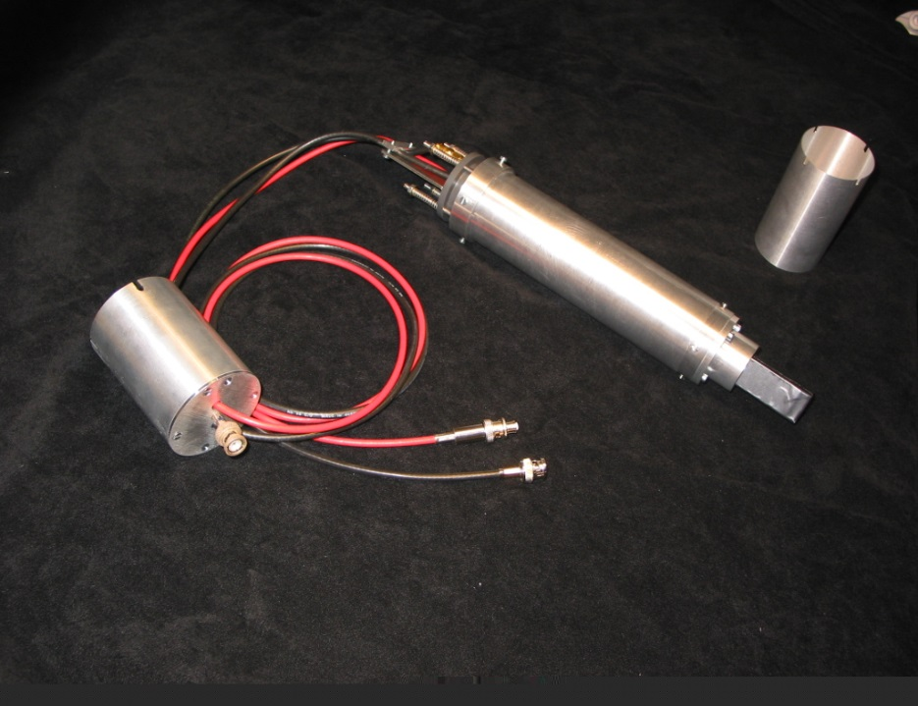
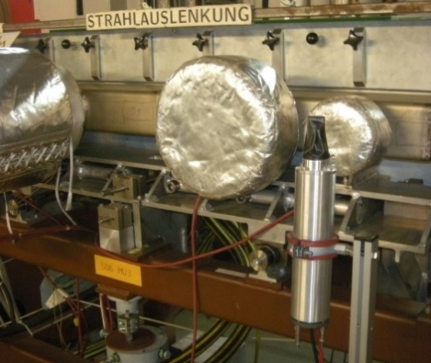
Scintillators as Beam Loss Monitors
Plastics or liquids are used:
detection of charged particles
by electronic stopping
detection of neutrons
by elastic collisions n on p in plastics
and fast p electronic stopping.
Scintillator + photo-multiplier:
counting (large PMT amplification)
or analog voltage ADC (low PMT amp.).
Radiation hardness:
plastics 1 Mrad = 10⁴ Gy
liquid 10 Mrad = 10⁵ Gy
Example: Analog pulses of plastic scintillator:
⇒ broad energy spectrum
due to many particle species and energies.
HV base
Photo-multiplier
inside
Analog pulses U(t)
40 ns
100 mV
Scintillator
2x2x5 cm³
Pulse high distribution N(U)
50 mV

Slide 5
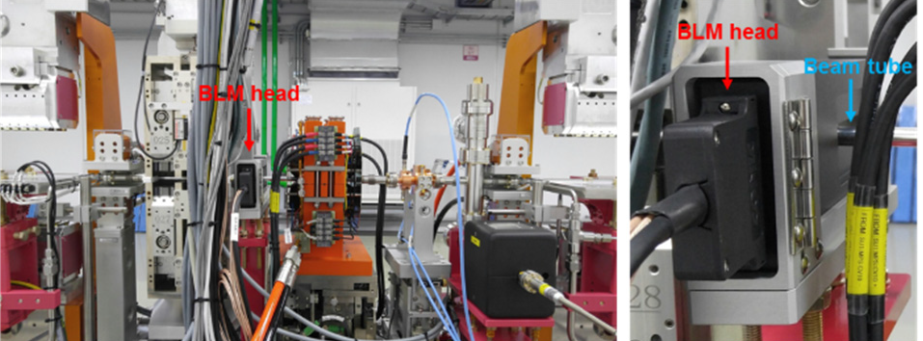
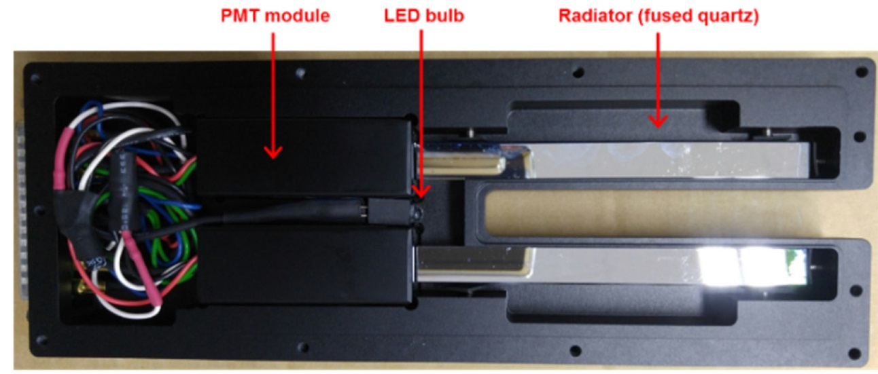

Cherenkov Light Detectors as Beam Loss Monitors
Cherenkov detectors:
Passage of a charged particle v faster than propagation of light v > c_{medium} = c /n
Technical: Quartz rod n=1.5 & photomultiplier
Example: Korean XFEL behind undulator
Cherenkov light emission:
For v > c_{medium} = c /n
light wave-front like a wake
broadband light emission
light propagation
$$\frac{c}{n}∙t$$
θ
beam
v⋅ t
Advantage:
Detection of fast electrons only
not sensitive to γ & synch. photons
No saturation effects
Prompt light emission
Usage: Mainly at FELs for
short and intense pulses
beam
11mm
120mm
H. Yang, D.C. Shin, FEL Conf. 2017

Slide 6
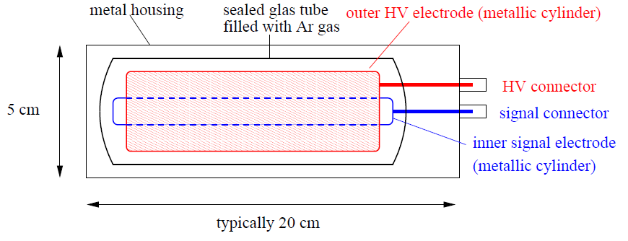
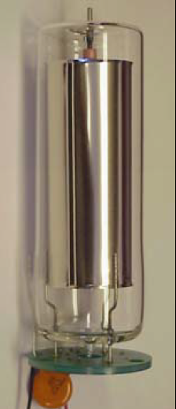
Ionization Chamber as BLM
Energy loss of charged particles in gases → electron-ion pairs → current meas.
W is average energy for one e⁻ -ion pair:
Gas | Ionization Pot. [eV] | W-Value [eV]
Ar | 15.7 | 26.4
N₂ | 15.5 | 34.8
O₂ | 12.5 | 30.8
Air |  | 33.8
shower particle
Sealed tube Filled with Ar or N₂ gas:
Creation of Ar⁺-e⁻ pairs,
average energy W=32 eV/pair
Measurement of this current
Slow time response
due to ≈ 10 μs drift time of Ar⁺.
Per definition: Direct measurement of dose !
15 cm
Notes:
6

Slide 7
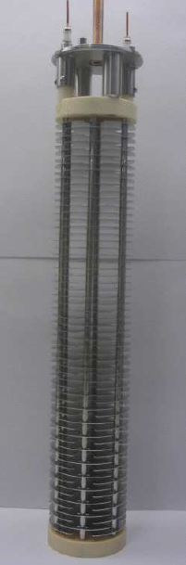
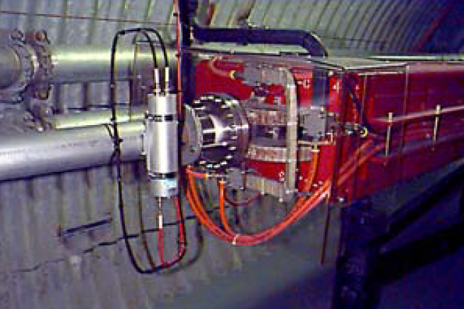
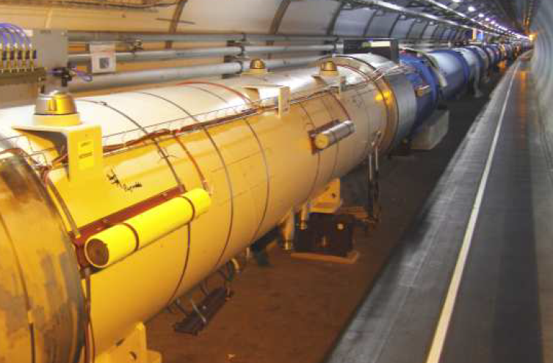
Ionization Chamber as BLM: TEVATRON and CERN Type
Parameter | TEVATRON, RHIC | CERN type
Size | 15cm, ∅ 6 cm | 50 cm, ∅ 9 cm
Gas | Ar at 1.1 bar | N₂ at 1.1 bar
# of electrodes | 3 | 61
Voltage | 1000 V | 1500 V
Reaction time | 3 µs | 0.3 µs
38 cm
15 cm
4000 BLMs at LHC⇔ each ≈ 6m
TEVATRON, RHIC type
CERN type

Slide 8
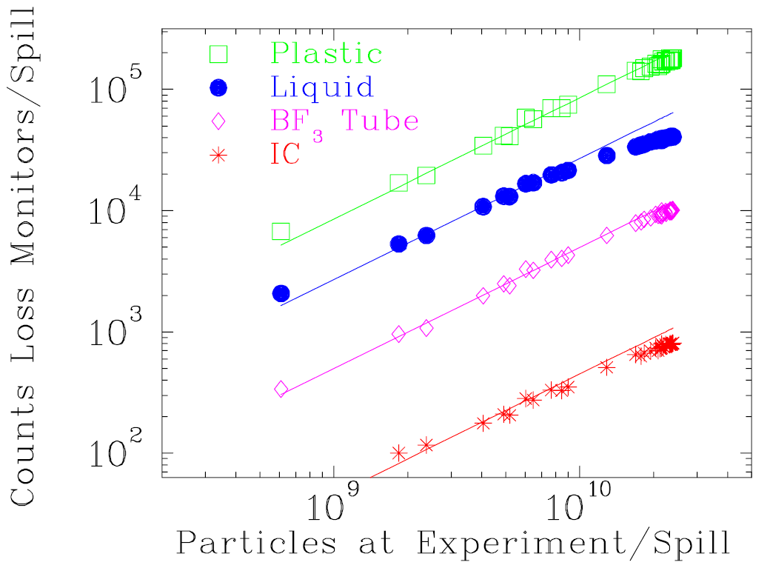
Comparison of different Types of BLMs
Different detectors are sensitive to various physical processes
very different count rate, but basically proportional to each other
Example: Beam loss 800 MeV/u O⁸⁺
for different BLMs at GSI-synchr.:
Typical choice of the detector type:
Ionization Chamber:
Advantage:
- Measurement of absolute dose
Disadvantage:
- Low signal (low γ, eff, no neutron detection),
- Sometimes slow, ion drift time 10 ... 100 µs
⇒ Often used at proton accelerators
Scintillator, Cherenkov detector:
Advantage:
- Fast current reading or particle counting
- Can be fabricated in any shape, cheap
Disadvantage:
- Need calibration in many cases
- Might suffer from radiation
⇒ Often used at electron accelerators
⇒ Linear behavior for all detectors
⇒ Quite different count rate:
r_{IC} < r_{BF3} < r_{liquid} < r_{plastic}

Slide 9
Outline:
Physical process from beam-wall interaction
Different types of Beam Loss Monitors
different methods for various beam parameters
Machine protection using BLMs
interlock generation for beam abort
Summary

Slide 10
Machine Protection Issues for BLM
Losses lead to permanent activation ⇒ maintenance is hampered
and to material heating (vacuum pipe, super-cond. magnet etc.) ⇒ destruction.
Types of losses:
Irregular or fast losses by malfunction of devices (magnets, cavities etc.)
→ BLM as online control of the accelerator functionality and interlock generation.
Regular or slow losses e.g. by lifetime limits or due to collimator
→ BLM used for alignment.
Demands for BLM:
High sensitivity to detect behavior of beam halo e.g. at collimator
Large dynamic range:
→ low signal during normal operation, but large signal in case of malfunction
→ detectable without changing the full-scale-range
e.g. scintillators from 10² 1/s up to 10⁷ 1/s in counting mode.
Monitoring of loss rate in control room and as interlock signal for beam abortion.

Slide 11
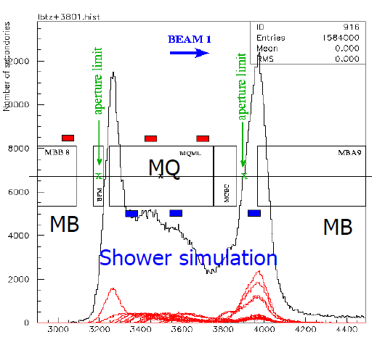
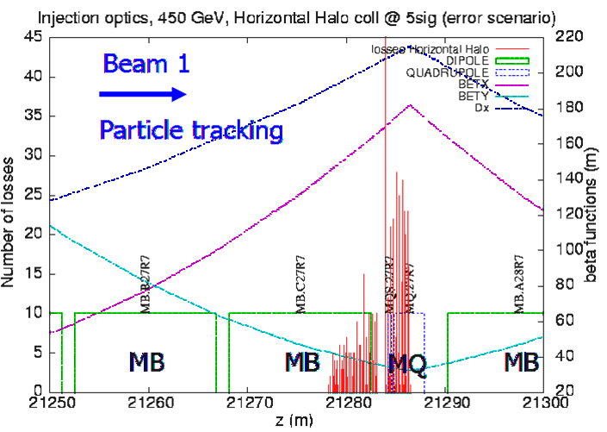
Application: BLMs for Quench-Protection
Super-conducting magnets can be heated above critical temperature T_{c} by the lost beam
⇒ breakdown of super-conductivity = ’quenching’.
⇒ Interlock within 1 ms for beam abortion generated by BLM.
Position of detector at quadruples due to maximal beam size.
High energy particles leads to a shower in forward direction → Monte-Carlo simulation.
Example: Simulation of lost protons at LHC at 450 GeV
→ at focusing quad. D & β_{x} maximum
Example: Simulation of shower particles
Beam Loss Monitors
dispersion
β_{x}-function
lost
protons
β_{y}-function
dipole
dipole
0
4
8
12
0
10
20
30
40
50
Beam path s (m)
Beam path s (m)
quadrupole
B. Dehning, JAS 2014, CERN-2016-002

Slide 12
Poll concerning longitudinal Phase Space
Poll 28:
Which answer is wrong? Beam loss monitors are used …
to prevent for unnecessary activation
as a system to restrict people access outside of the accelerator shielding
for quench protection for super-conducting components
for beam alignment
Notes:
12

Slide 13
Summary Beam Loss Monitors
Measurement of the lost fraction of the beam:
detection of secondary products
sensitive particle detectors are used outside the vacuum
cheap installations used at many locations
Used as interlock in all high current machines for protection.
Additionally used for sensitive ‘loss studies’.
Depending on the application different types are used:
Frequently used:
Scintillators: very sensitive, fast response, largest dynamics, not radiation hard
PIN diode: insensitive, fast response, not radiation hard, cheap
IC: medium sensitive, slow response, radiation hard, cheap, absolute measurement of dose
Used for special application:
(Electron Multiplier: medium sensitive, fast response, radiation hard)
BF₃ tube: only neutrons, slow response, radiation hard, expensive
Optical fibers: insensitive, very slow, radiation hard, very high spatial resolution.

