Slide 2
Materials fabrication in SRF cavities: beyond niobium
Sergio Calatroni – CERN
With the contribution of: Cornell U., FNAL, ICMAB, INFN-LNL, JLAB, STFC, Temple U.

Slide 3
Outline
Motivation (one of several): the FCC-ee study
State of the art of bulk Nb
Techniques for Nb₃Sn SRF cavities:
  Thermal diffusion of Sn vapours
  Liquid Sn diffusion
  Magnetron sputtering
Techniques for NbN / NbTiN SRF cavities
  Thermal diffusion of N
  Magnetron sputtering
Techniques for other materials
  MgB₂
  REBCO

Slide 4
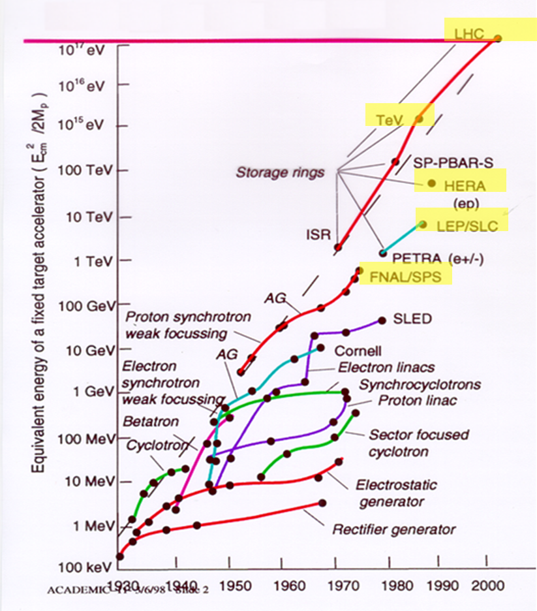
The history of accelerators
Exponential development for more than 80 years
In many cases accelerator needs have been the driving force behind new technologies
Superconductivity, key technology of high-energy and high intensity machines since the 1980s (SC magnets and/or SRF)
!! Not up to date !!
Courtesy O. Brunner - CERN
4
Notes:
US Electron-Ion Collider Project –
In US, two electron-ion colliders, eRHIC and JLEIC, have been proposed in BNL and JLab respectively

Slide 5
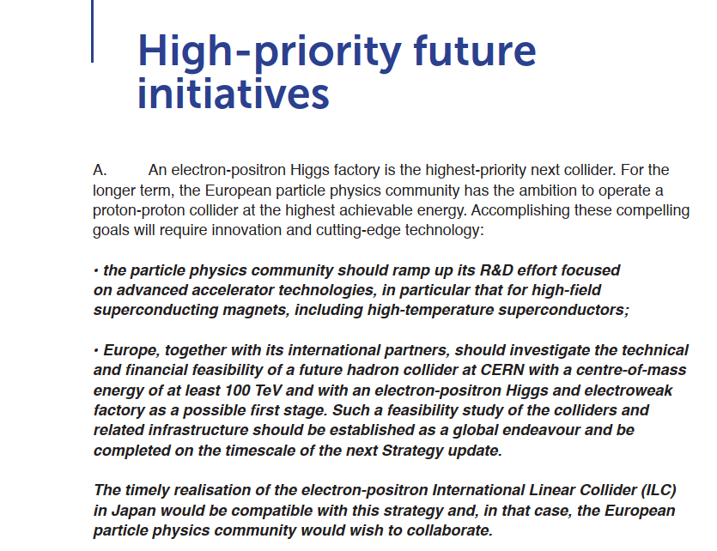

The next step

Slide 6
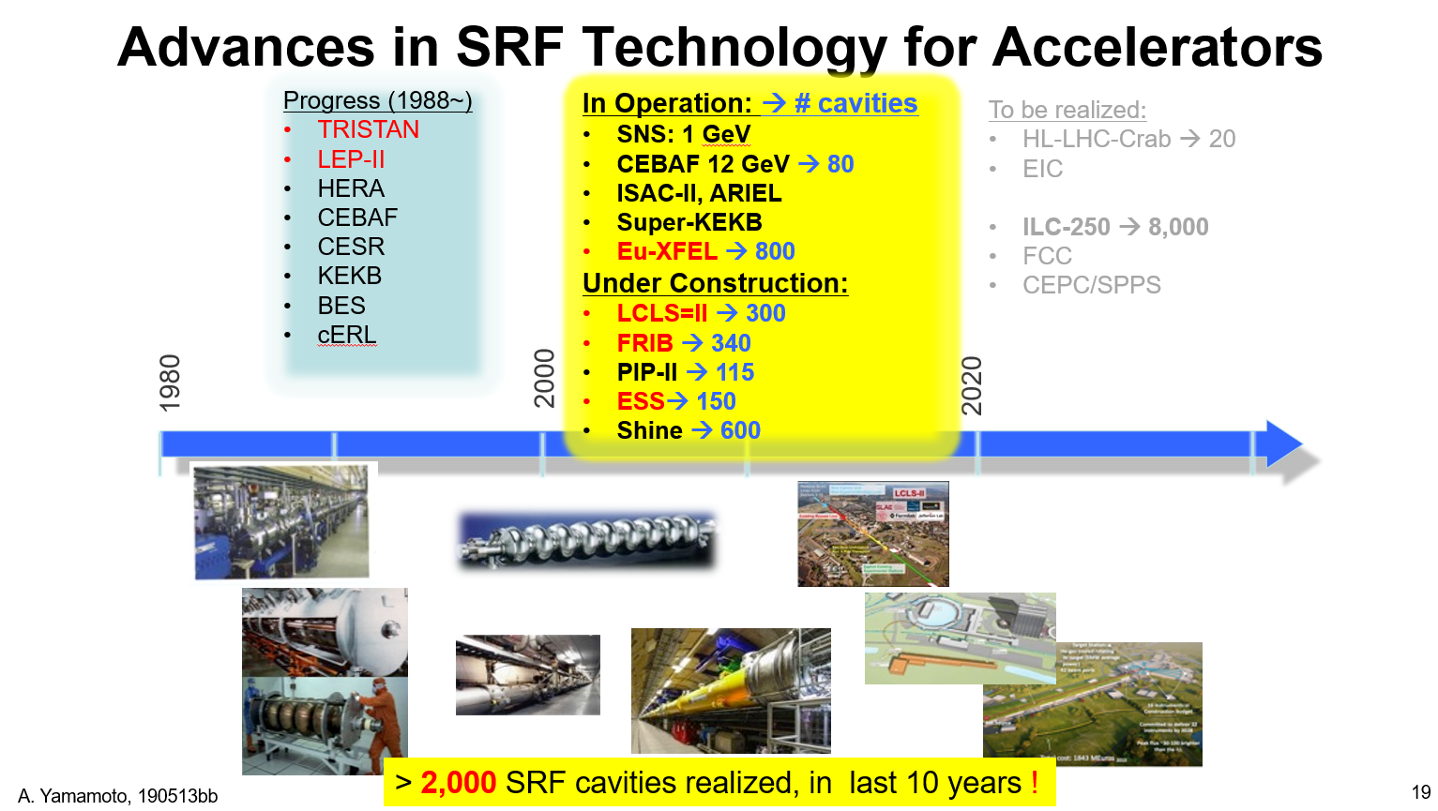
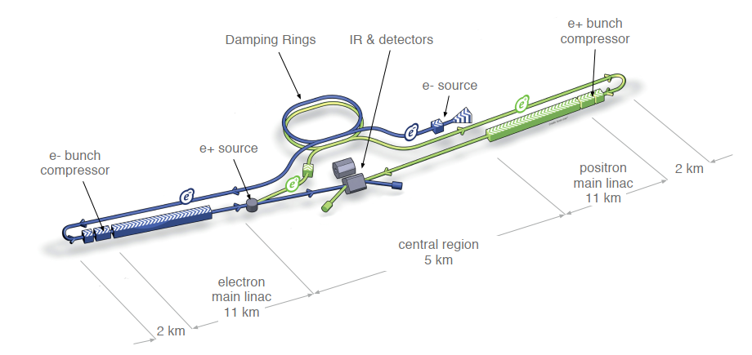
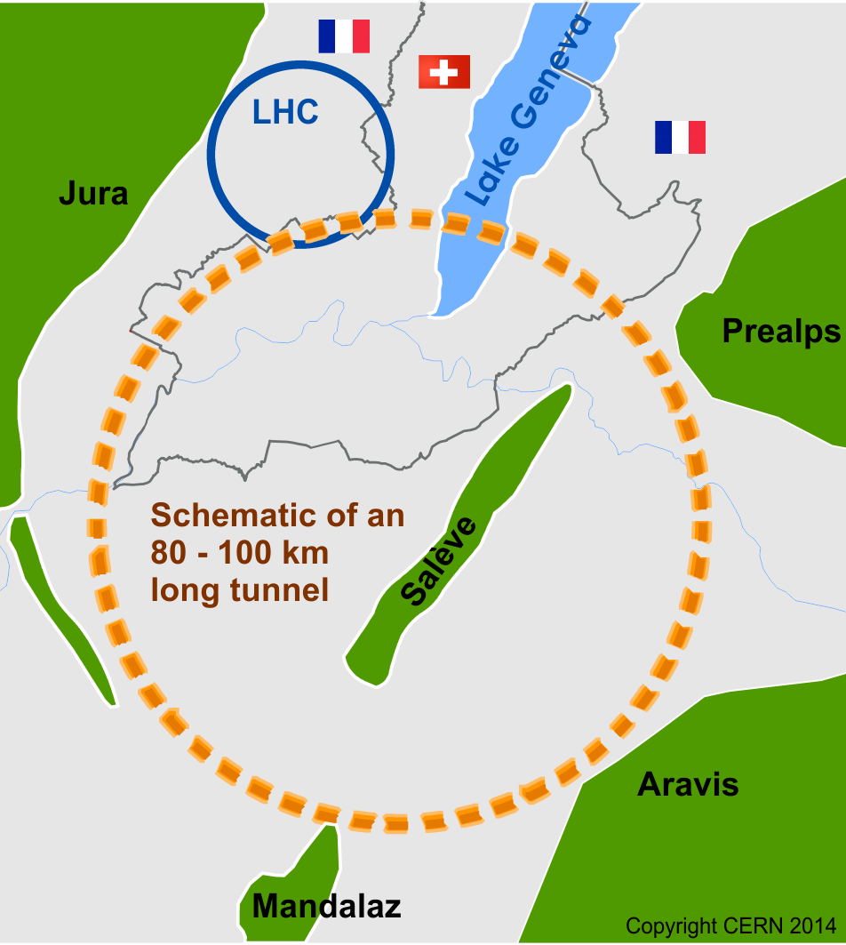
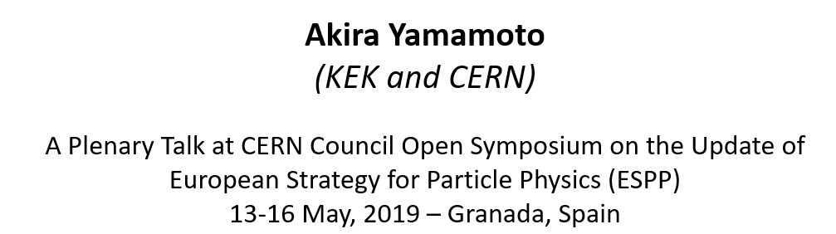
6
Notes:
US Electron-Ion Collider Project –
In US, two electron-ion colliders, eRHIC and JLEIC, have been proposed in BNL and JLab respectively

Slide 7
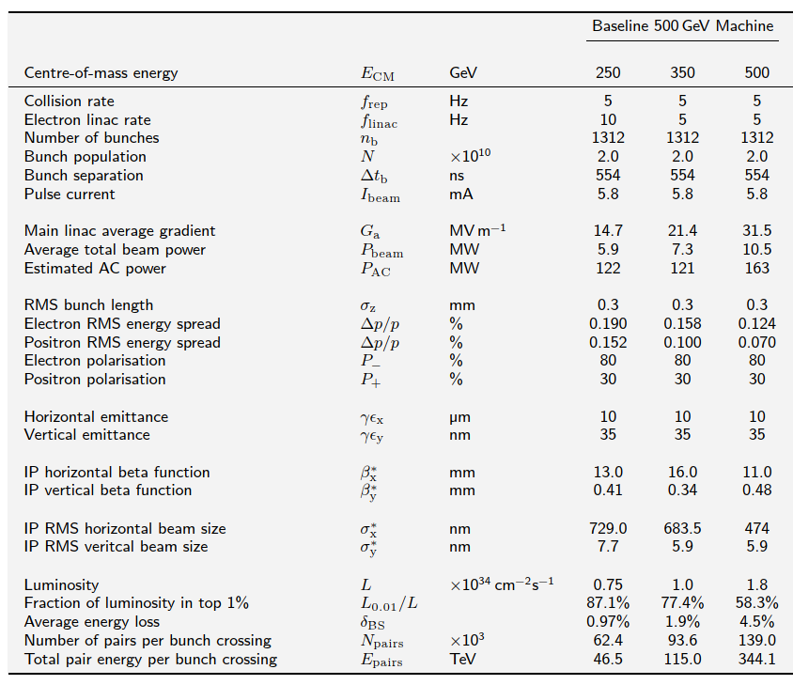
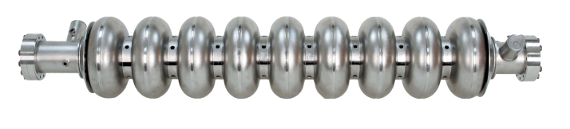
The International Linear Collider (ILC) – 500 GeV CM
E_{acc} 31.5 MV/m @ Q₀ > 10¹⁰

Slide 8
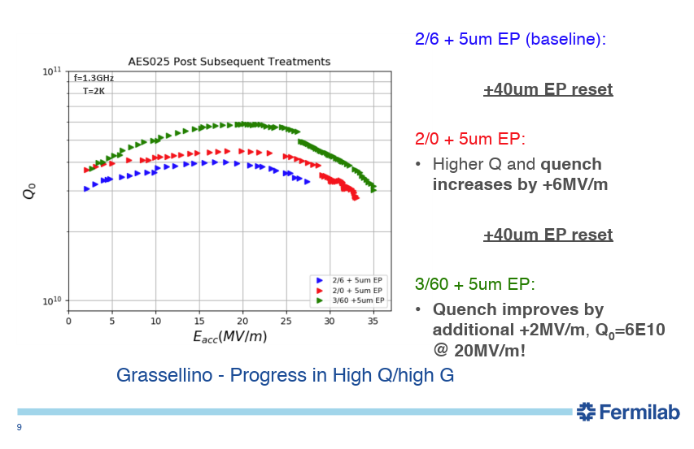
State of the art: bulk niobium + nitrogen doping
Courtesy A. Grassellino - FNAL

Slide 9
What kind of doping?

Slide 10
Results

Slide 11
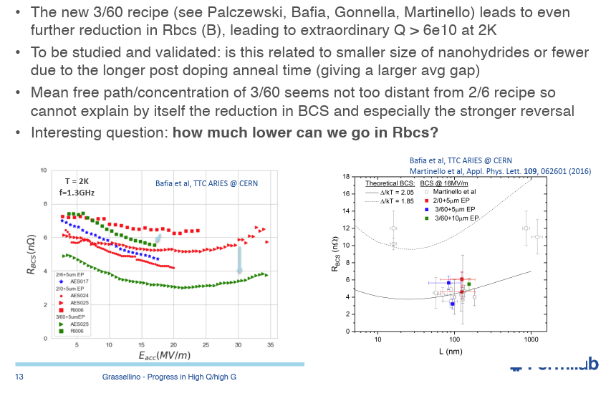
Inverse slope
Courtesy A. Grassellino - FNAL

Slide 12
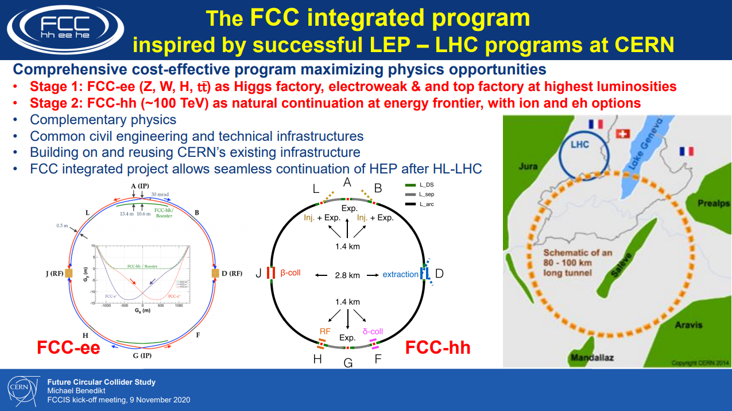
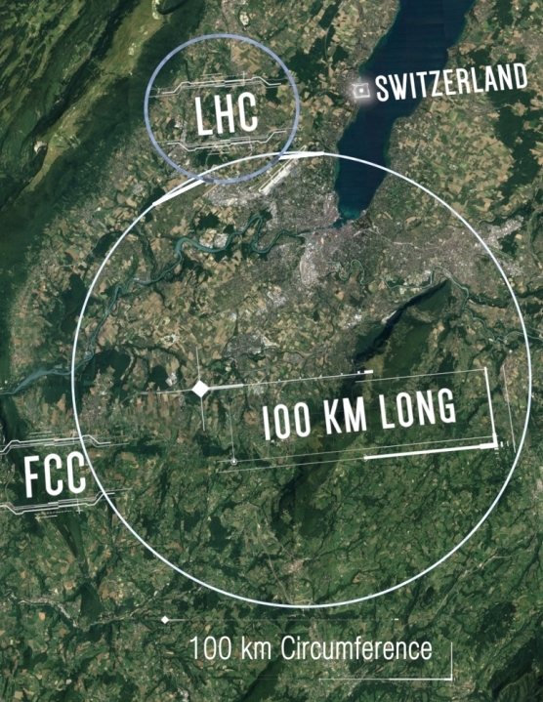

Slide 13
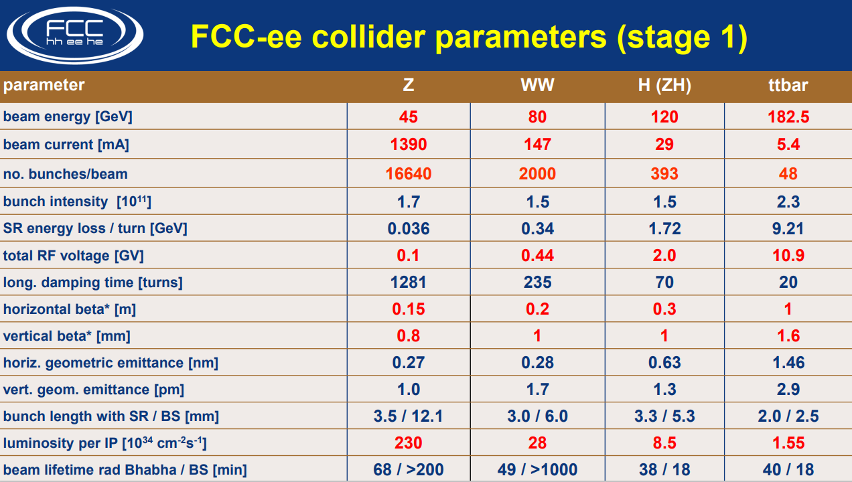
The FCC-ee parameter list

Slide 14
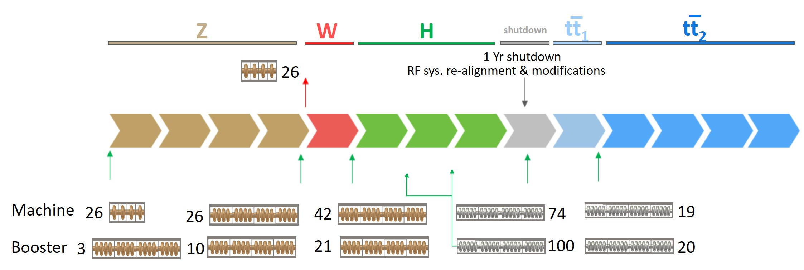
The challenge of the FCC-ee
~1 MW per cavity
~> 20 MV/m
Machine | E (GeV) | ε_{c} (keV) | I (mA) | F (ph/s) | P per beam (MW) | F’(ph/s/m) | P’(kW/m)
Z | 45.6 | 19.6 | 1390 | 4.85·10²² | 50 | 6.25·10¹⁷ | 0.65
W | 80 | 105.7 | 147 | 9.30·10²¹ | 50 | 1.20·10¹⁷ | 0.65
H | 120 | 356.6 | 29 | 2.79·10²¹ | 50 | 3.59·10¹⁶ | 0.65
tt | 182.5 | 1254.5 | 5.4 | 7.88·10²⁰ | 50 | 1.02·10¹⁶ | 0.65
Courtesy Roberto Kersevan - CERN
Z
High intensity (Z, FCC-hh): 400 MHz Nb/Cu 1-cell cavities
Higher energy (W, H): 400 MHz 4-cell Nb/Cu cavities
W
H
tt₂
tt₁
tt machine complement: 800 MHz 5-cell cavities (4/CM.), based on bulk Nb
Courtesy O. Brunner - CERN

Slide 15
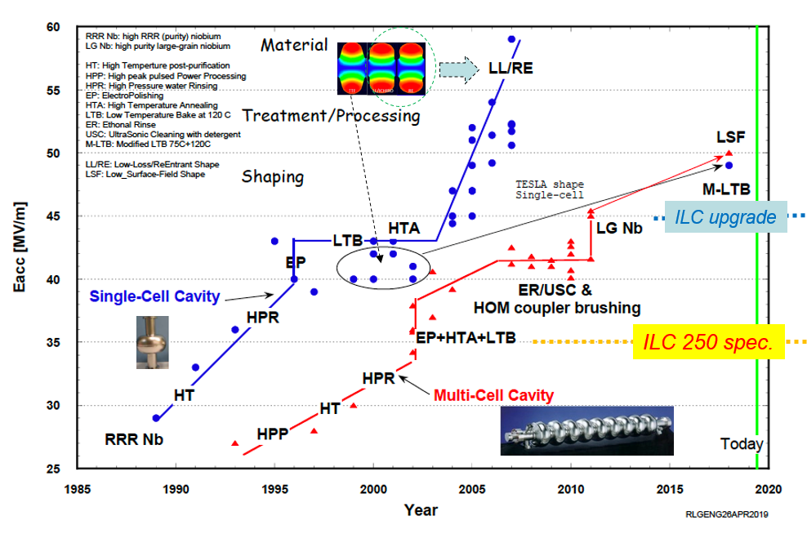
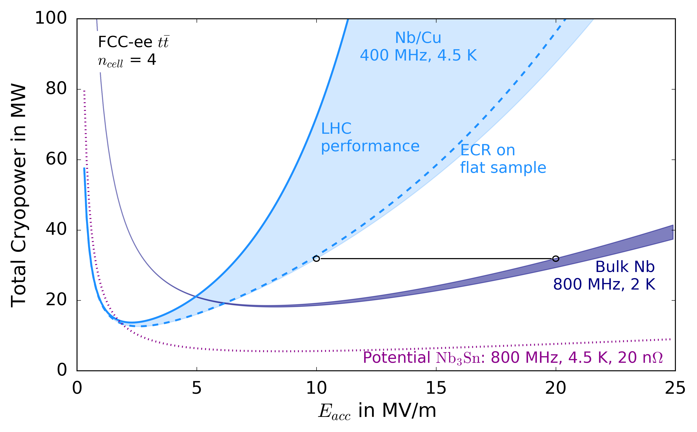
A promising future!
Nb/Cu R&D program
Strong efforts to overcome the 'Q-slope‘ problem:
QPR studies
Innovative techniques (HIPIMS, ECR)
Cu substrate Quality & Substrate Preparation
R&D on seamless cavities
Electrodeposition of copper
Bulk Nb
Well mature technology !
High-Q (> 3E10), high-G (>45 MV/m)
New treatments: Low-T or/and N-infusion
Cost need to be reduced !
Cryomodule design:
Active shielding
Active compensation of microphonics
A15 R&D program
New material such as NB3Sn/MgB2 could drastically improve performance
(S. Aull et al.)
Example FCC-ee (𝑡𝑡 ̅ ): orders of magnitude
Courtesy S. Aull - CERN

Slide 16

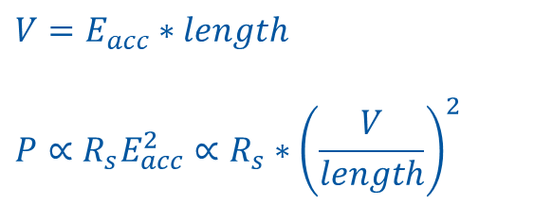

Power losses in SRF – for a given total voltage
$$P={\frac{1}{2}R}_{s}H_{s}^{2}$$
$$E_{acc}≈H_{s}$$
$$V=E_{acc}∗length$$
$$P∝R_{s}E_{acc}^{2}∝R_{s}∗{\left(\frac{V}{length}\right)}^{2}$$
Cryogenic power
Static cryogenic losses
Dissipated power
Length of accelerating section

Slide 17



Power losses
$$E_{acc}≈H_{s}$$
$$Q_{0}=\frac{Γ}{R_{s}}$$
$$P={\frac{1}{2}R}_{s}H_{s}^{2}$$
A small accelerating field is favorable in circular accelerators,
in terms of overall energy consumption
(S. Aull et al.)
Example FCC-ee (𝑡𝑡 ̅ ): orders of magnitude

Slide 18
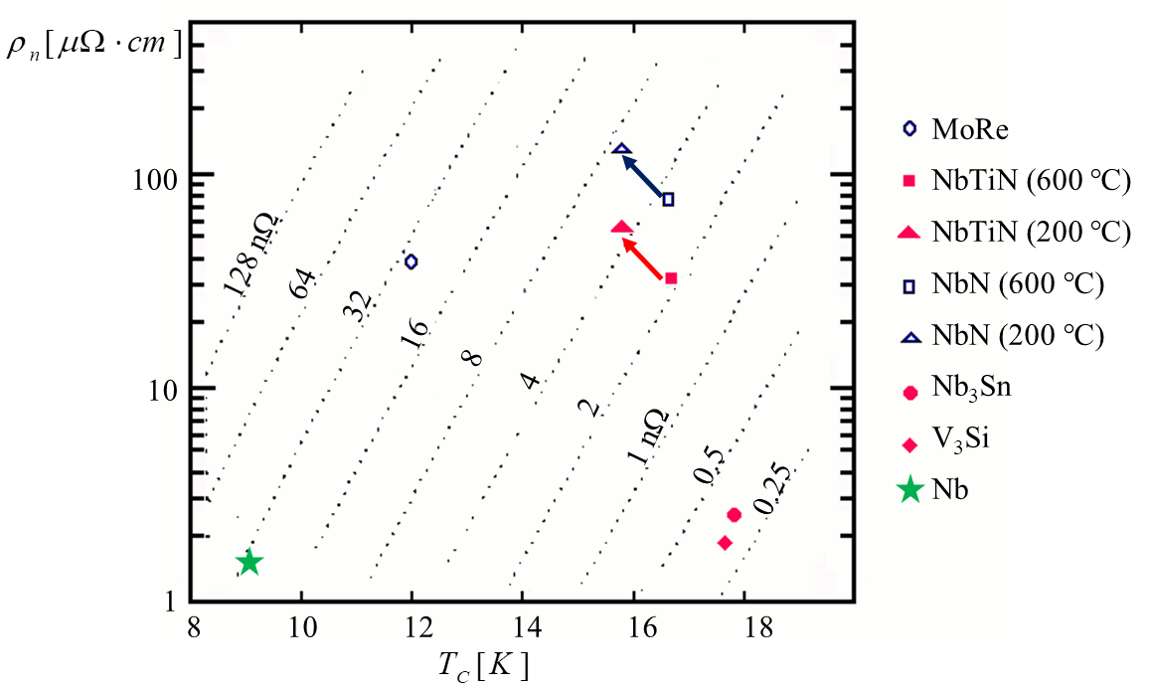
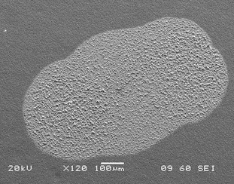
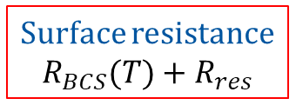
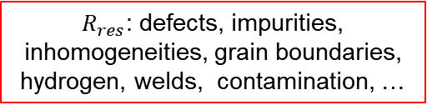


Surface resistance
$R_{res}$: defects, impurities, inhomogeneities, grain boundaries, hydrogen, welds, contamination, …
(500 MHz)
Surface resistance
$$R_{BCS}(T)+R_{res}$$
$R_{BCS}(T)$: “Intrinsic”
$R_{res}$: “Extrinsic”
R_{BCS} (4.5 K) of these A15 and B1 materials is comparable to R_{BCS} (1.9 K) of Nb
Provided R_{res} is also kept similar, operation at 4.5 K could allow great power savings

Slide 19
Outline
Motivation (one of several): the FCC-ee study
State of the art of bulk Nb
Techniques for Nb₃Sn SRF cavities:
  Thermal diffusion of Sn vapours
  Liquid Sn diffusion
  Magnetron sputtering
Techniques for NbN / NbTiN SRF cavities
  Thermal diffusion of N
  Magnetron sputtering
Techniques for other materials
  MgB₂
  REBCO

Slide 20
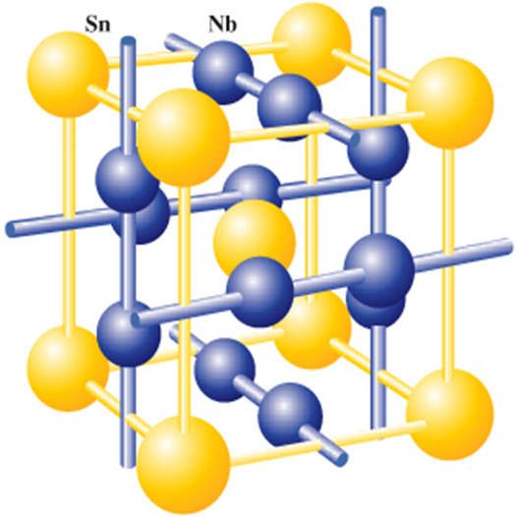
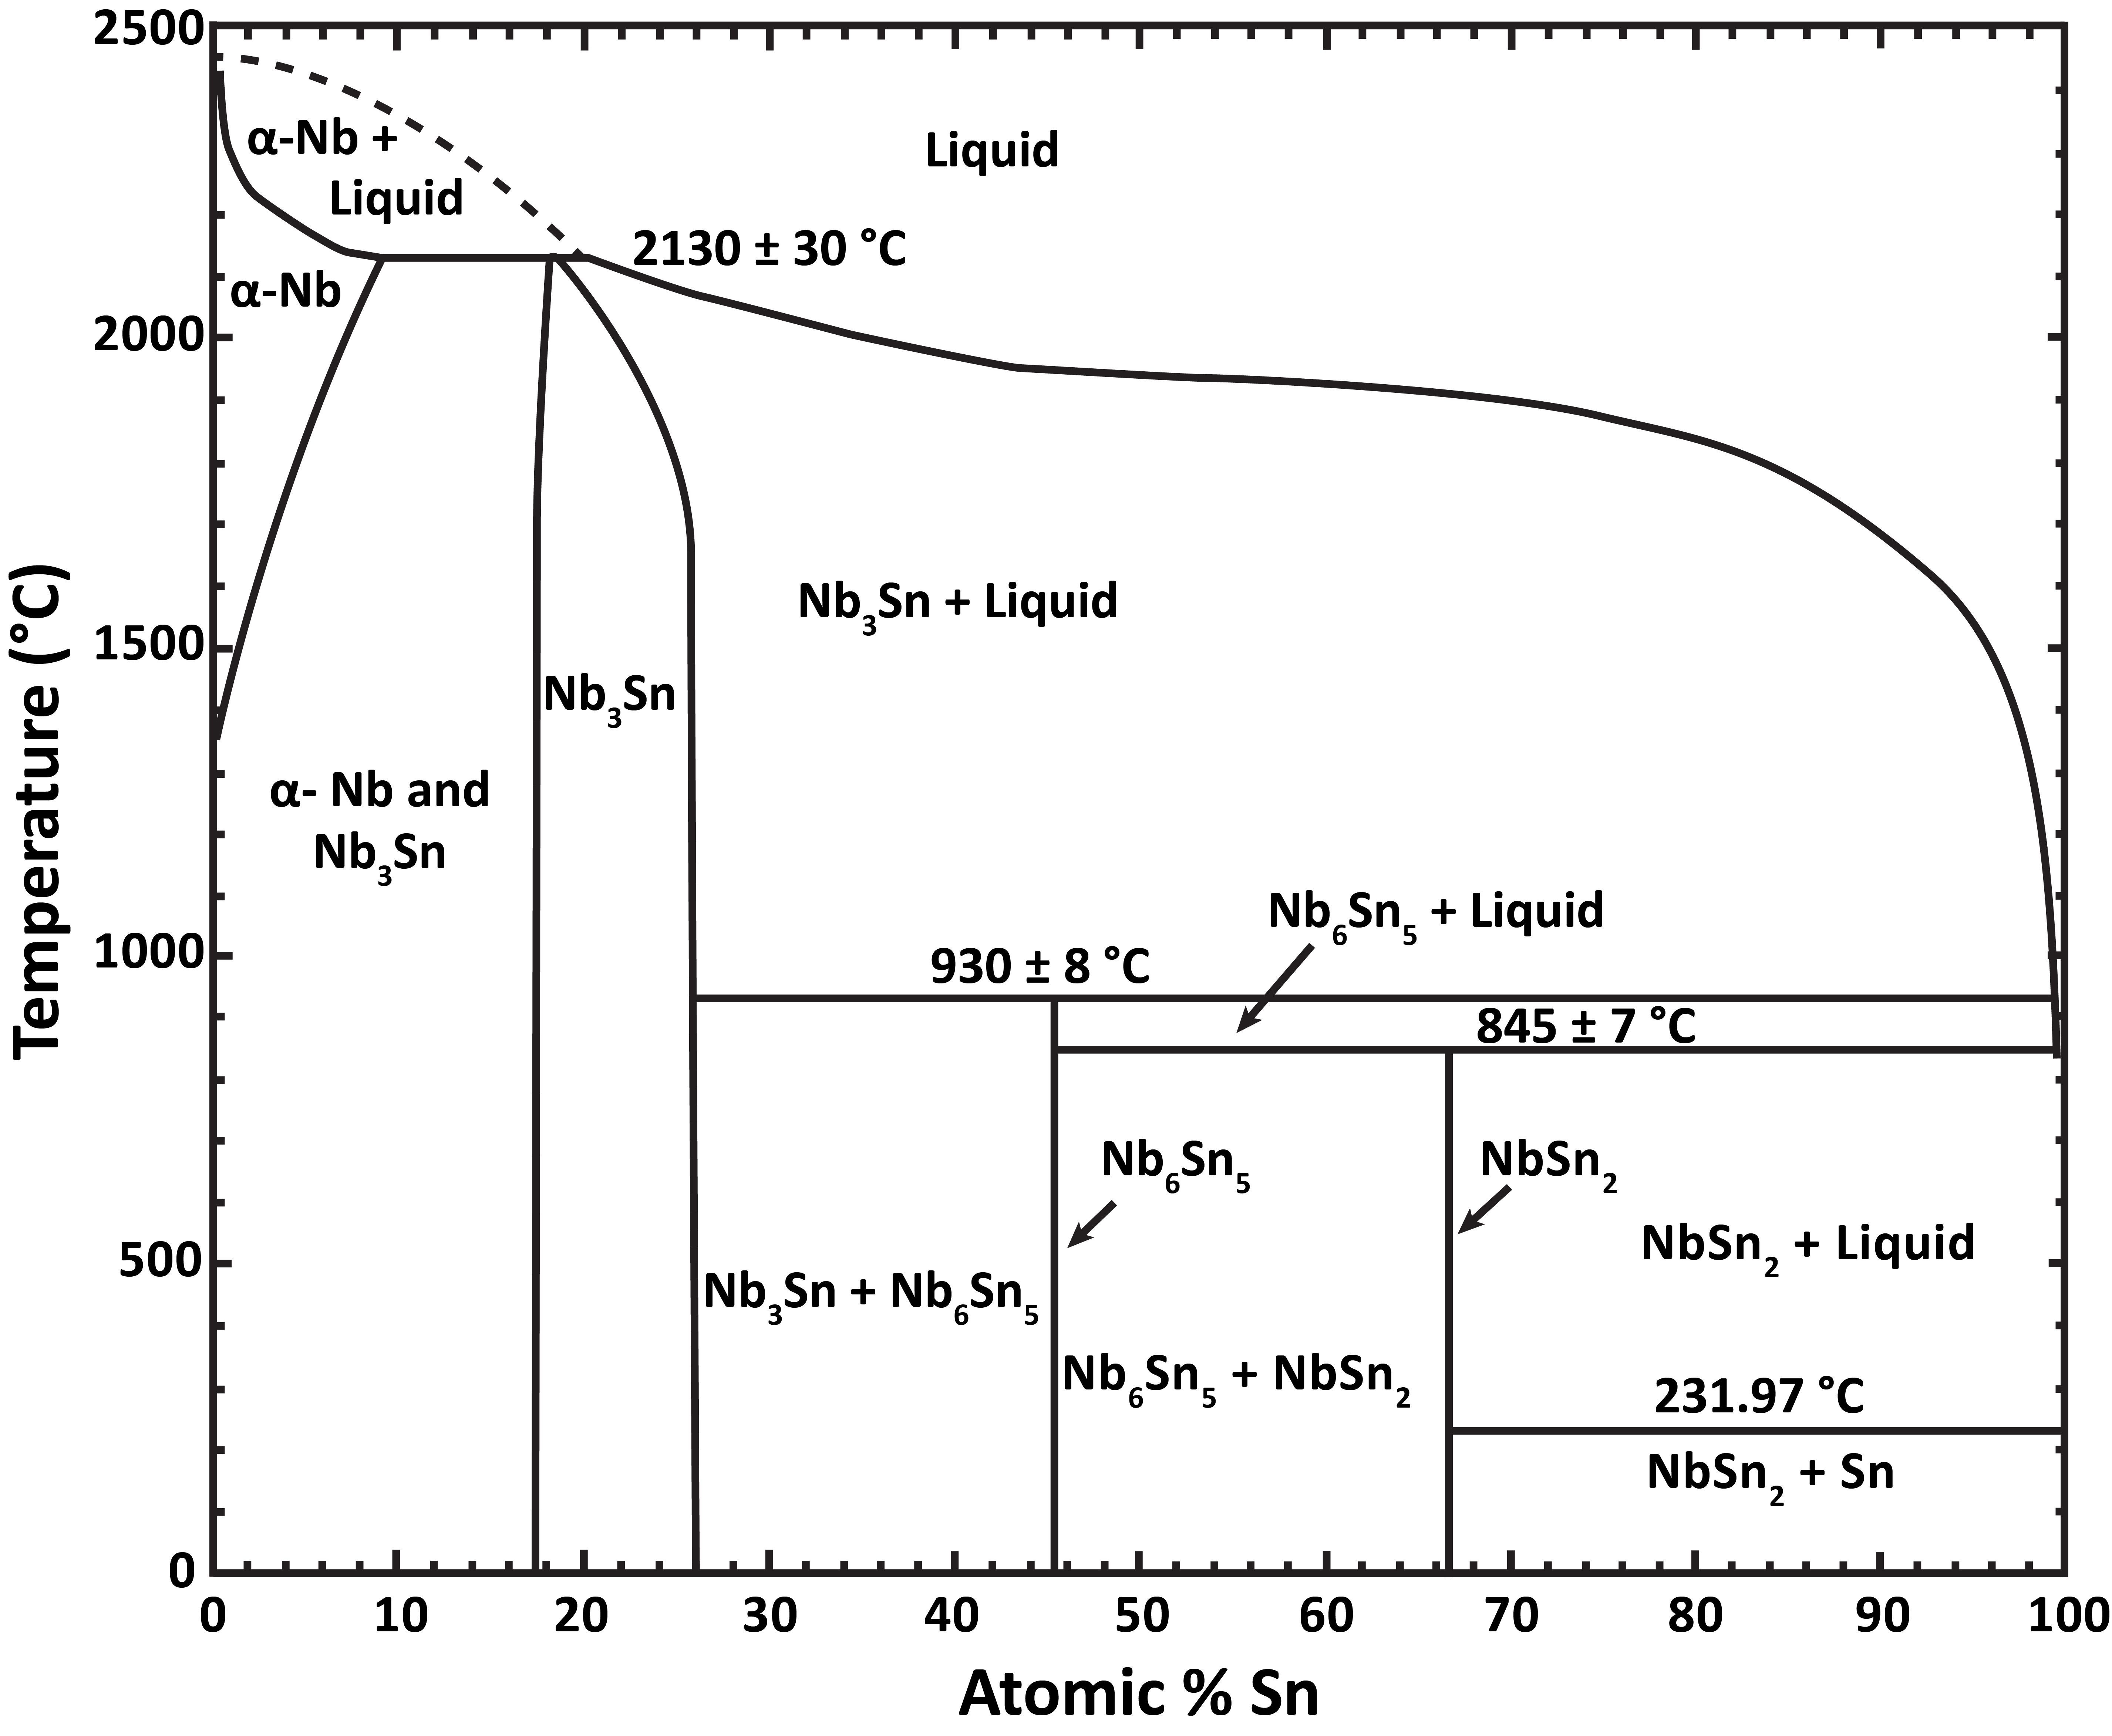
Nb₃Sn
Two main routes:
Using a bulk Nb cavity, and forming Nb₃Sn on its surface , reacting either Sn vapours or Sn liquid
Using a Cu cavity, and sputter a thin Nb₃Sn film on its surface, either by co- or sequential sputtering or from an alloyed target
Image by Charlie Sanabria - CC BY 4.0

Slide 21
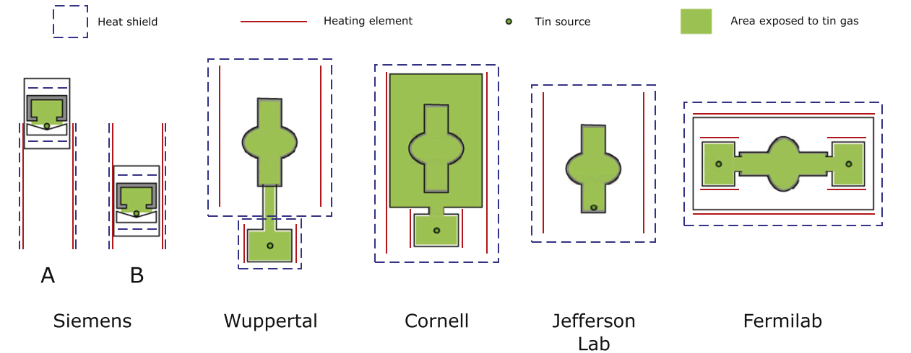
Furnace configurations
1970 1990 2010 2015 today
(Coordinated development work)
Image courtesy S. Posen, D. Hall - Supercond. Sci. Technol. 30 (2017) 033004

Slide 22
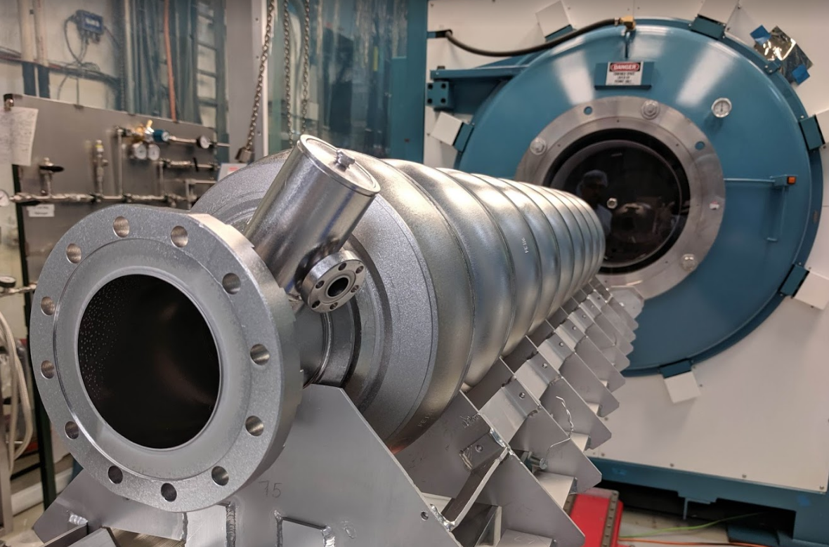
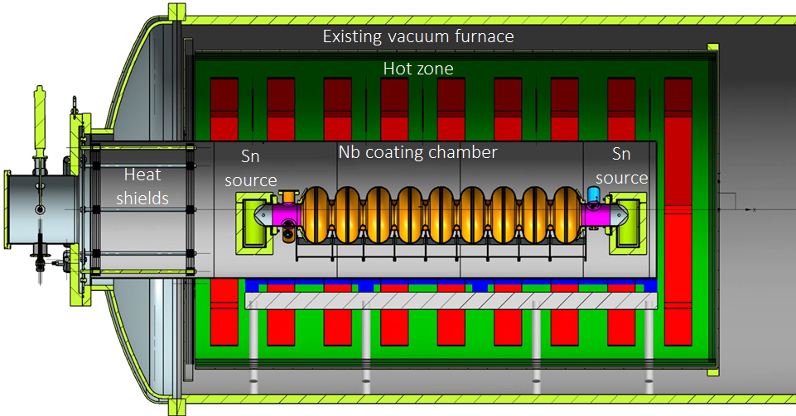
Nb₃Sn from vapours
Set-up of a 9-cell ILC cavity in Fermilab coating furnace (two tin sources, independent heating)
Courtesy S. Posen – FNAL (SRF 2019 talk)

Slide 23
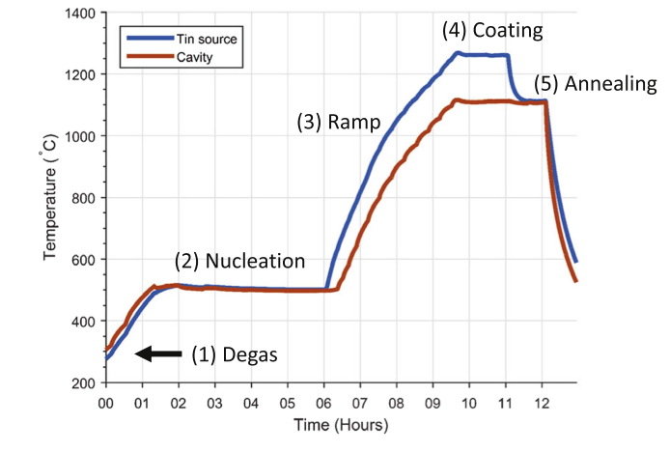
Thermal cycles, vapour pressures
Excess of Sn to uniformly cover all the surface is needed, before Nb natural oxide is reduced.
By means of controlled-temperature Sn source
By means of added SnCl₂ source (larger Sn vapour pressure)
  (still unclear the role of Cl, might promote nucleation sites)
By means of thicker Nb oxide (anodization)
  (thicker oxide detrimental to RRR, leading to quenches)
Plots courtesy S. Posen, D. Hall - Supercond. Sci. Technol. 30 (2017) 033004

Slide 24
Layer evolution with and without SnCl₂
With SnCl₂
Slide courtesy of Uttar Pudasaini, Jefferson Lab - Thin Films 2018 Talk

Slide 25
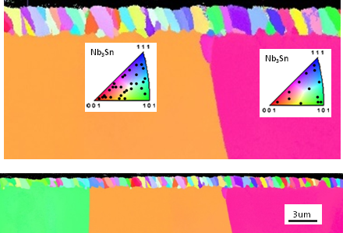
Growth process
Sn arrives at Nb surface from Sn source
Sn reacts with Nb until full coverage of Nb₃Sn is obtained.
Nb₃Sn progresses by Sn diffusion through Nb₃Sn grain boundaries, reaching and reacting with the Nb substrate.
Nb₃Sn film grain orientation is independent from Nb grain orientation
Images courtesy of Uttar Pudasaini, Jefferson Lab - Thin Films 2018 Talk

Slide 26
Nb₃Sn layer
Slide courtesy of Ryan Porter, Cornell U.

Slide 27
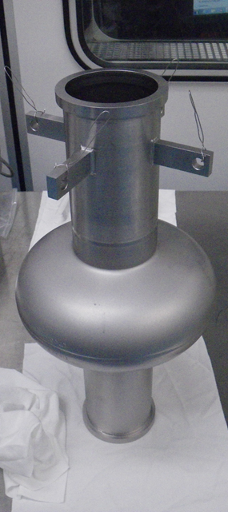
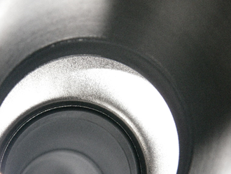
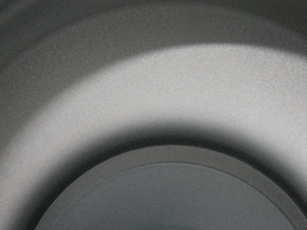
Coating (doesn’t look that much different…)
Before
After
Images courtesy of Ryan Porter, Cornell University - TTC 2018 Talk

Slide 28
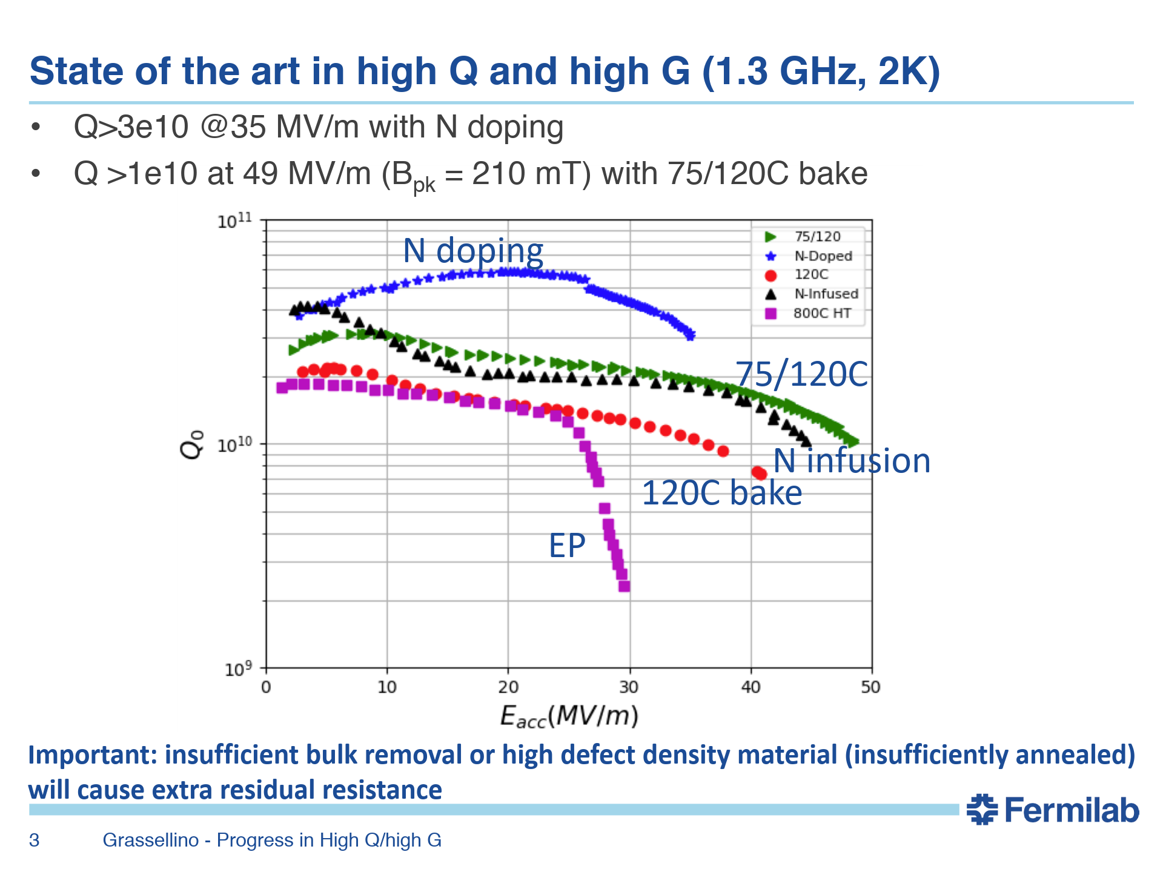
RF results: Nb bulk reference
Bulk Nb at 2 K

Slide 29
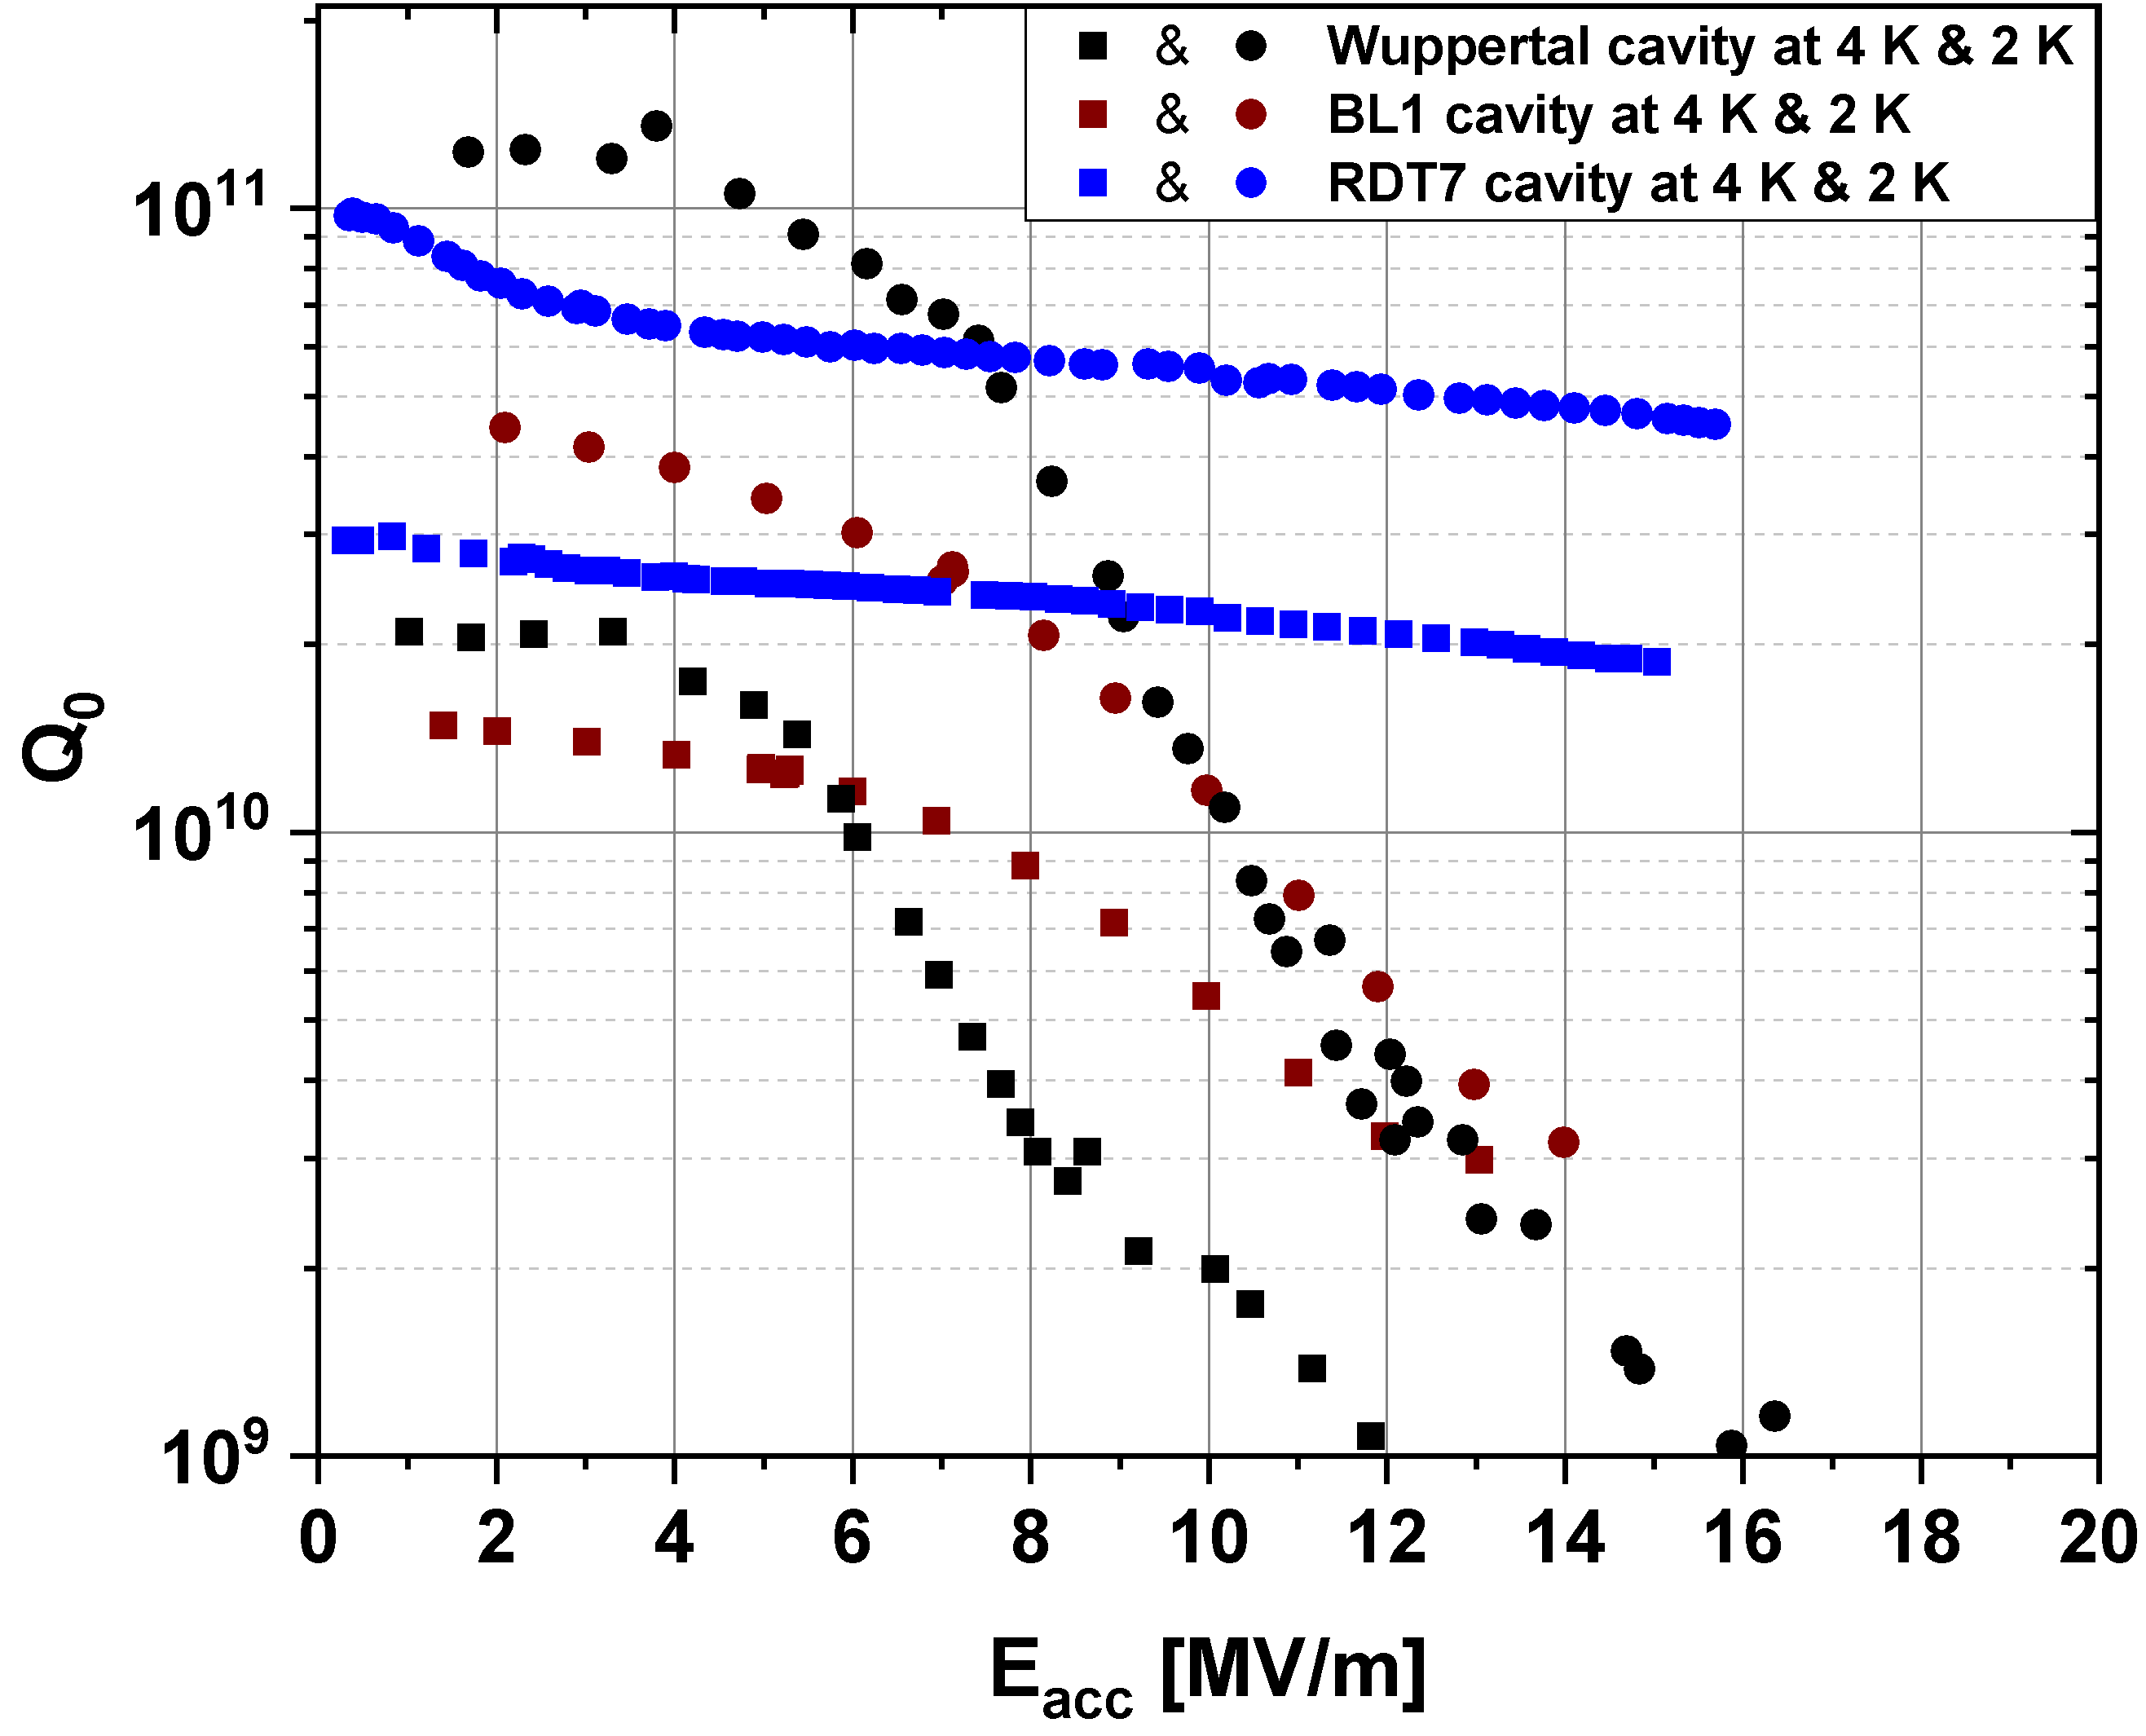
Nb₃Sn results (1.3 GHz cavities)
Nb₃Sn from JLAB
Bulk Nb at 2 K
Very high Q₀
Plot courtesy of Uttar Pudasaini, Jefferson Lab - Thin Films 2018 Talk

Slide 30
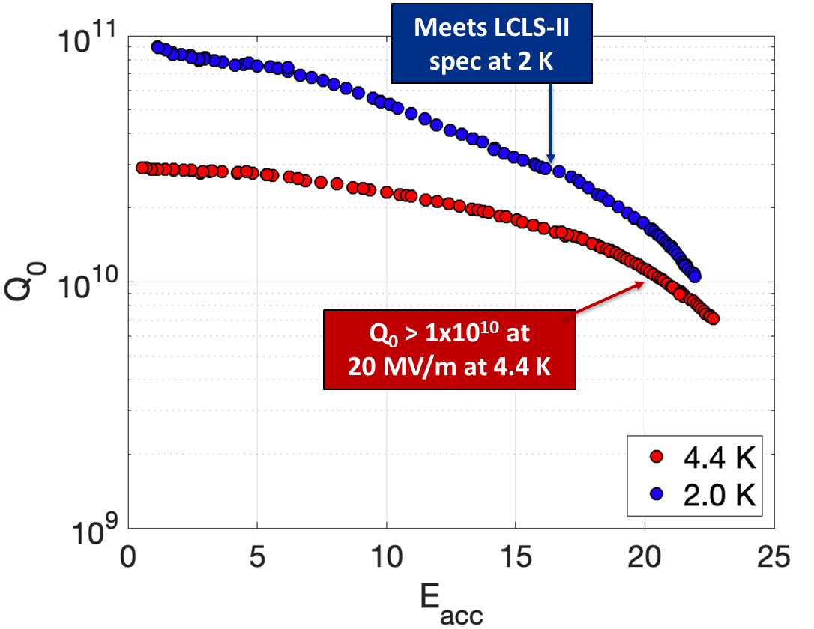
Nb₃Sn results (1.3 GHz cavities)
Nb₃Sn from FNAL
Bulk Nb at 2 K
Very high Q₀
Largest achieved E_{acc}
Plot Courtesy S. Posen – FNAL (TTC 2019 talk)

Slide 31
Nb₃Sn results (1.3 GHz cavities)
Nb₃Sn from Cornell U.
Bulk Nb at 2 K
Very good performance at 4.2 K
4.2 K
Plot Courtesy R. Porter – Cornell U.

Slide 32
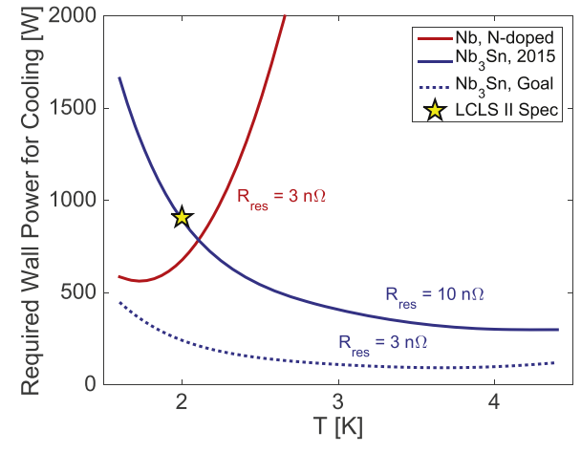
Cryogenic efficiency: operation at 4.2 K
Potential for 1.3 GHz cavities, ILC / LCLS-II type
@16 MV/m
Single cell cavity
Plot from S. Posen, D. Hall - Supercond. Sci. Technol. 30 (2017) 033004
Plot Courtesy R. Porter – Cornell U.

Slide 33
Nb₃Sn via liquid diffusion: setup

Slide 34
Nb₃Sn via liquid diffusion: samples

Slide 35
Nb₃Sn via liquid diffusion: RF performance

Slide 37
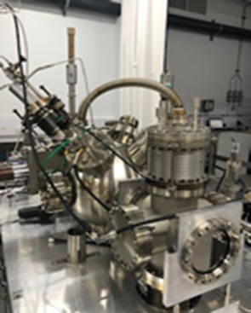
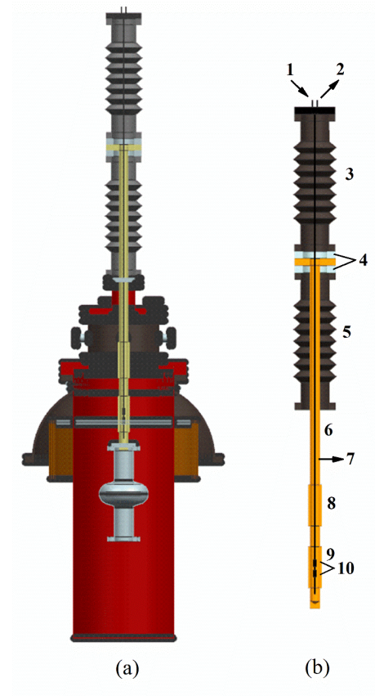
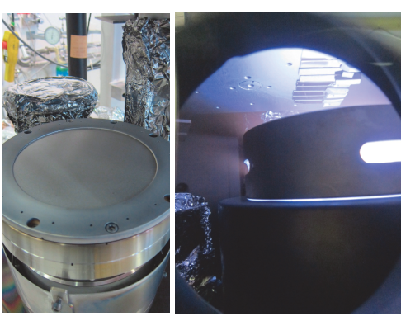
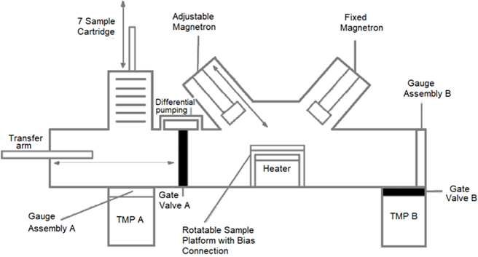
Nb₃Sn thin films on copper
JLAB, INFN-LNL:
multilayer sequential sputtering
CERN: sputtering from alloyed target
STFC: co-sputtering from
Nb and Sn targets
Images courtesy of G. Rosaz – CERN, R. Valizadeh – STFC, N. Sayeed - JLAB

Slide 38
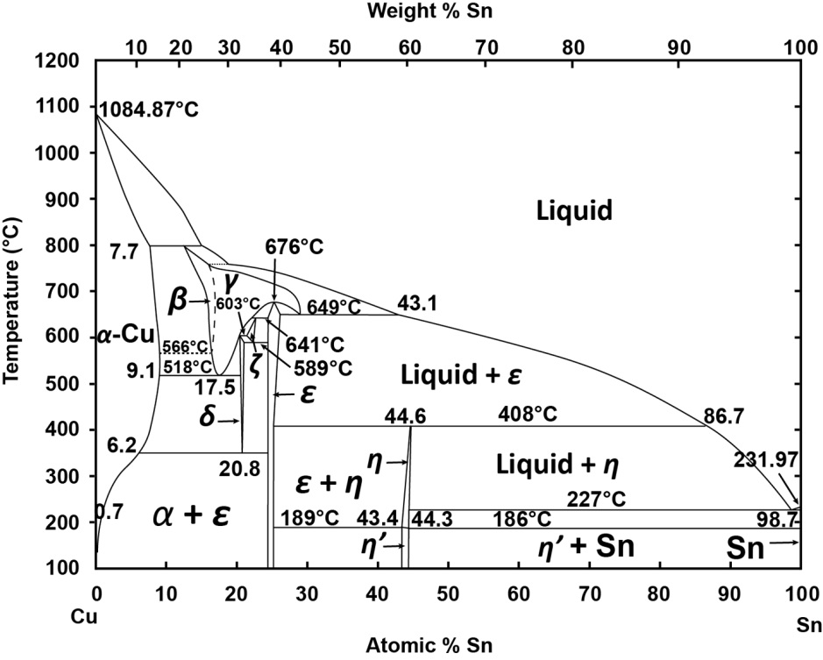
Thermal treatment
Annealing temperatures must be compatible with copper, brazed SS flanges
Cu-Sn diffusion problem
Phase diagrams by C. Sanabria - CC BY 4.0
Annealing temperatures | 600 - 800ºC
Annealing time | 24 h… 72 h
Coating temperatures | 600 - 735ºC
Additional Annealing | 24 h… 72 h
Images courtesy of G. Rosaz – CERN. [1] A. Godeke. Supercond. Sci. Technol., 19 (2006) R68-R80

Slide 39
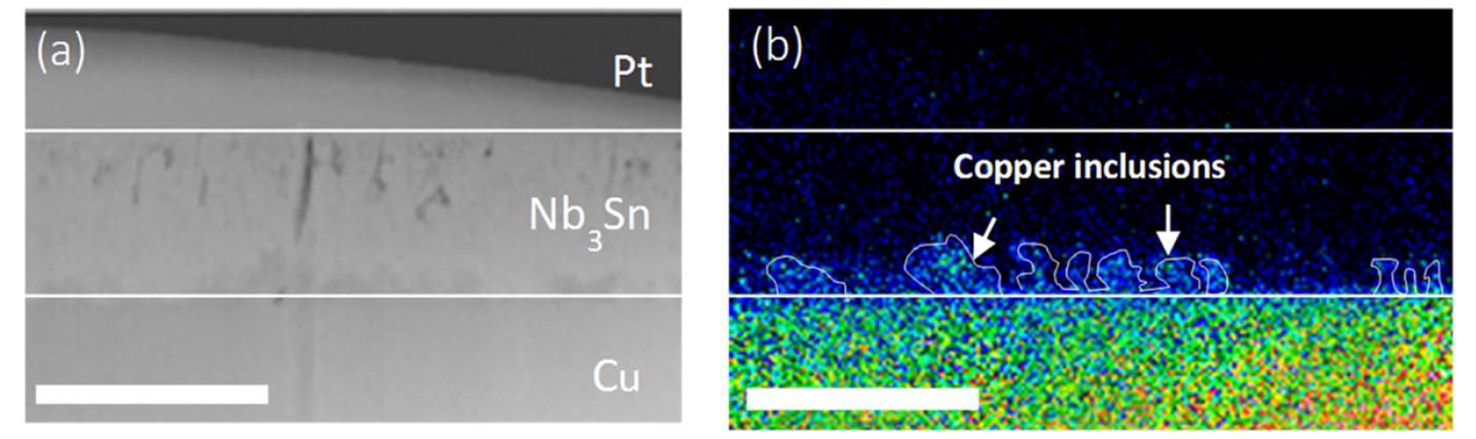
Intermixing – Cu diffusion
SEM
EDS
E. A. Ilynia, G. Rosaz, et al., Supercond. Sci. Technol. 32 (2019)

Slide 40
Barrier Layer of Ta
Courtesy of G. Rosaz – CERN. [1] A. Godeke. Supercond. Sci. Technol., 19 (2006) R68-R80
The Ta barrier layer is the solution in order to avoid any Cu diffusion into the Nb₃Sn layer.

Slide 41
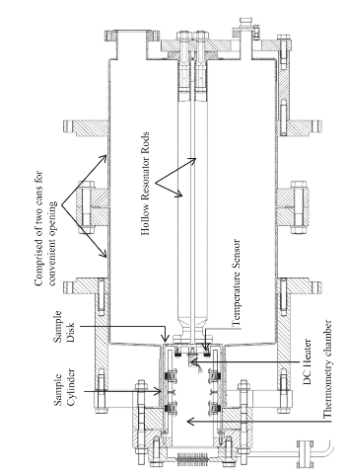
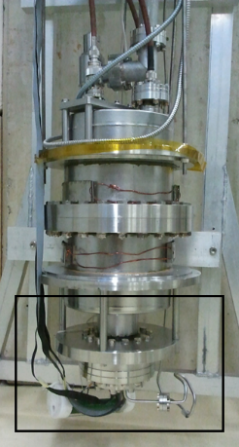
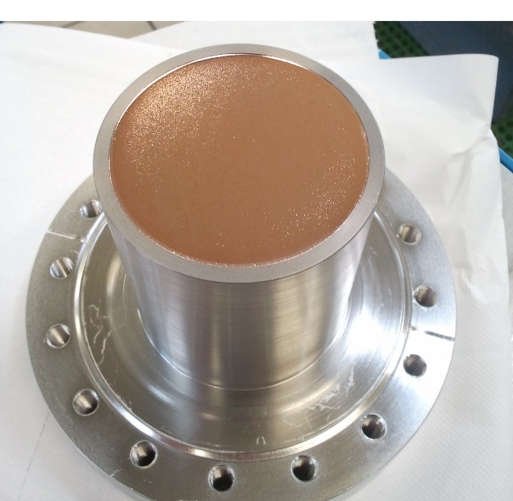
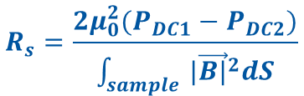
RF characterization with quadrupole resonator
Calorimetric technique
$$R_{s}=\frac{2μ_{0}^{2}(P_{DC1}−P_{DC2})}{\int_{sample }{{|\vec{B|}}^{2}dS}}$$
Courtesy of M. Arzeo – CERN

Slide 42
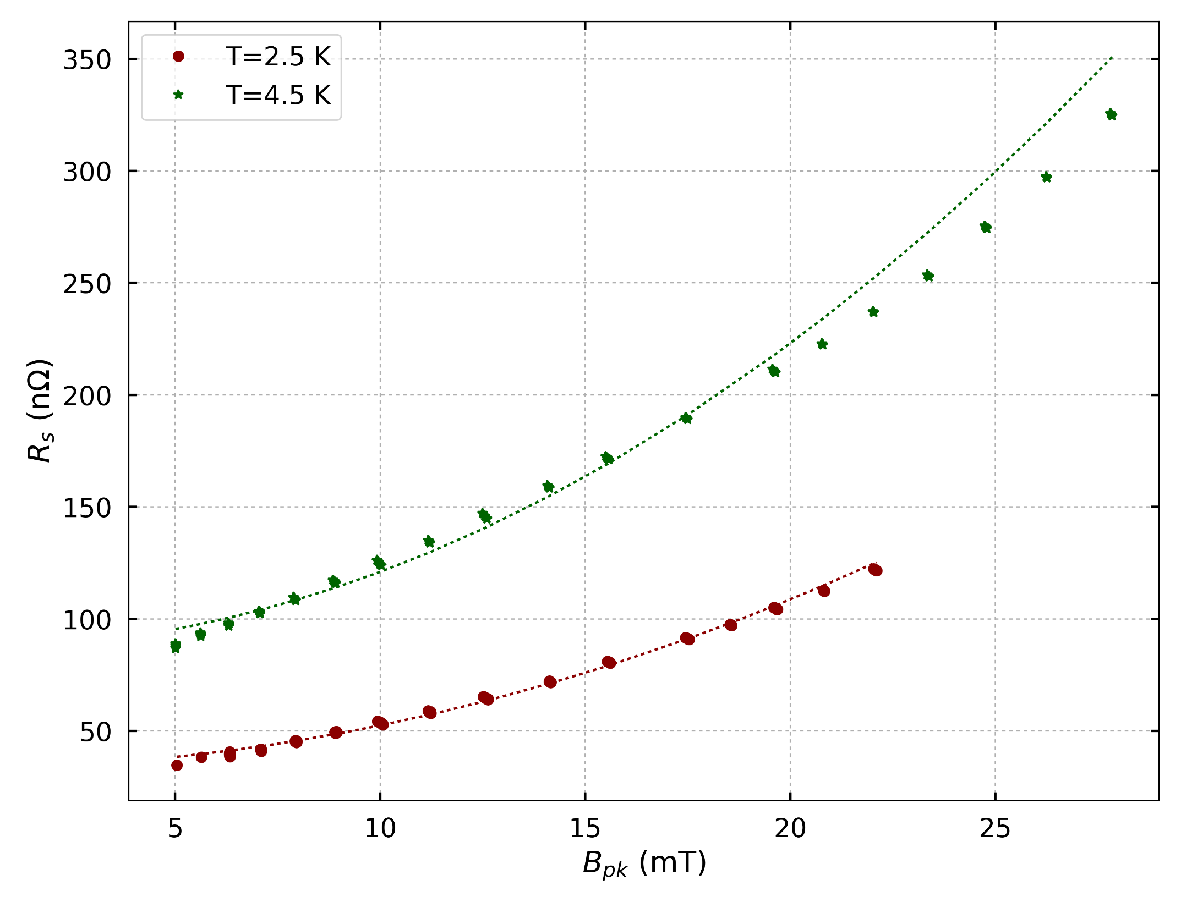
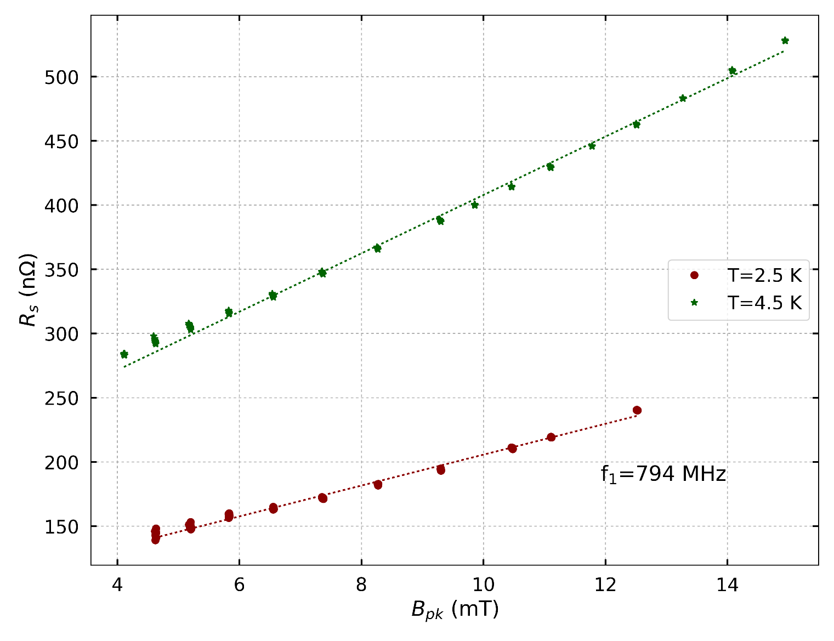
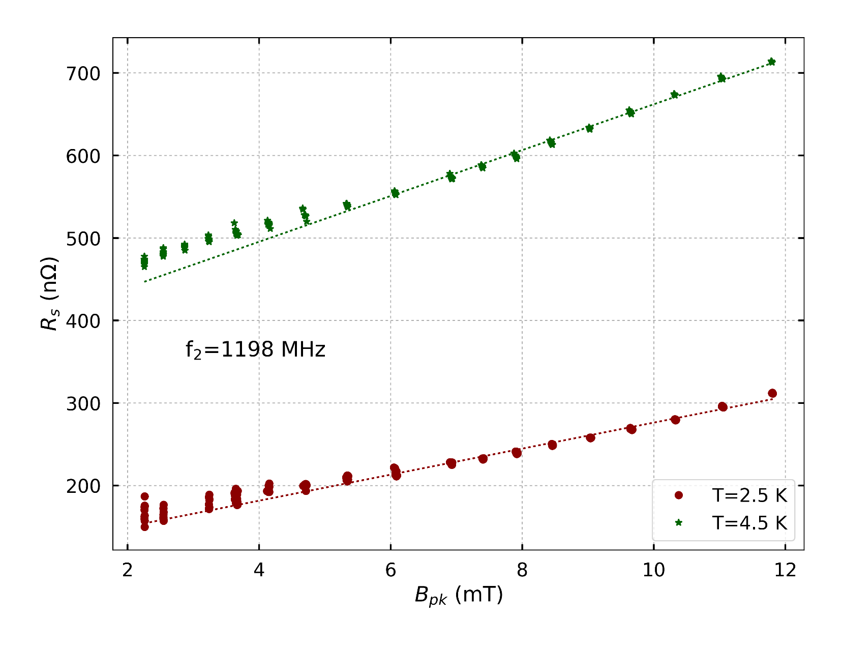
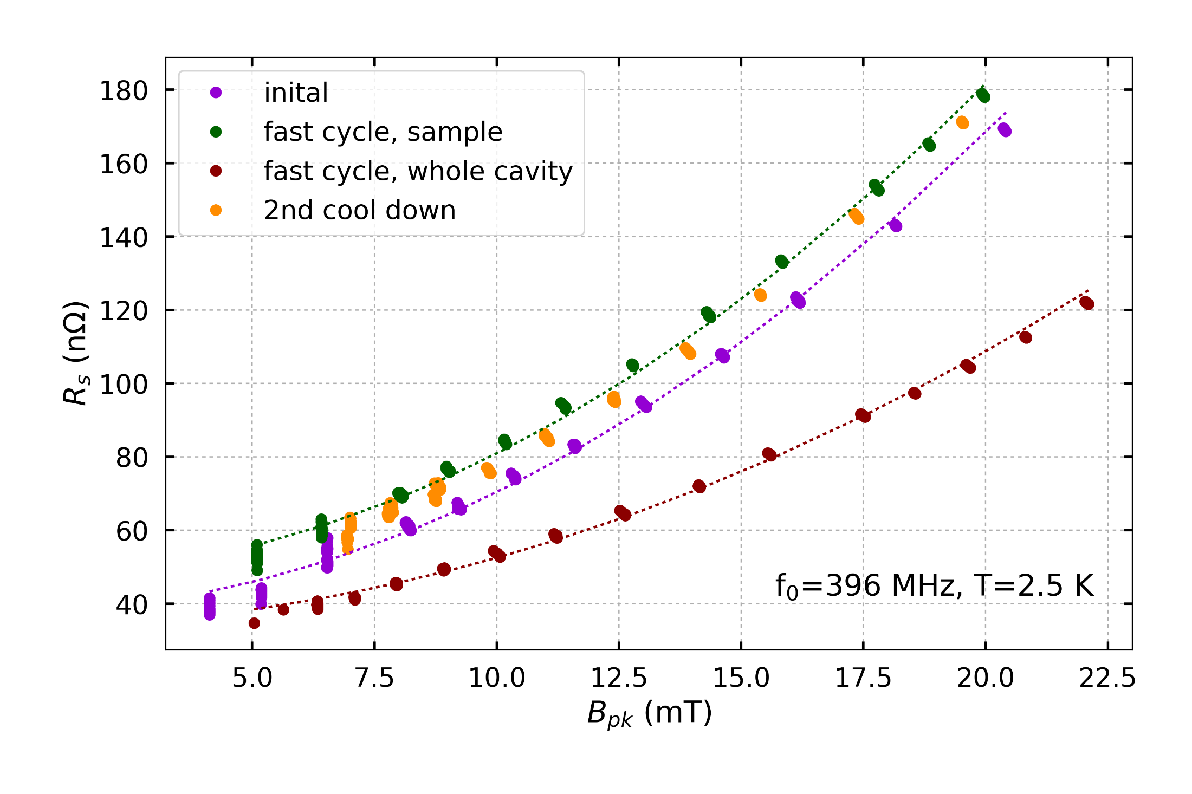
RF performance
f≈400 MHz
The slope increases with both temperature and frequency
It requires further investigation
Large sensitivity to thermal cycling
Courtesy M. Arzeo, A. Miyazaki, W. Venturini-Delsolaro – CERN

Slide 43
Nb₃Sn by sputtering: QPR results
Comparing to Nb/Cu LHC cavities
Courtesy M. Arzeo, A. Miyazaki, W. Venturini-Delsolaro – CERN

Slide 44
Multilayer coating @ LNL (on bulk Nb)
Courtesy C. Pira – INFN-LNL

Slide 45
RF performance at 6 GHz
Courtesy C. Pira – INFN-LNL

Slide 46
Outline
Motivation (one of several): the FCC-ee study
State of the art of bulk Nb
Techniques for Nb₃Sn SRF cavities:
  Thermal diffusion of Sn vapours
  Liquid Sn diffusion
  Magnetron sputtering
Techniques for NbN / NbTiN SRF cavities
  Thermal diffusion of N
  Magnetron sputtering
Techniques for other materials
  MgB₂
  REBCO

Slide 47
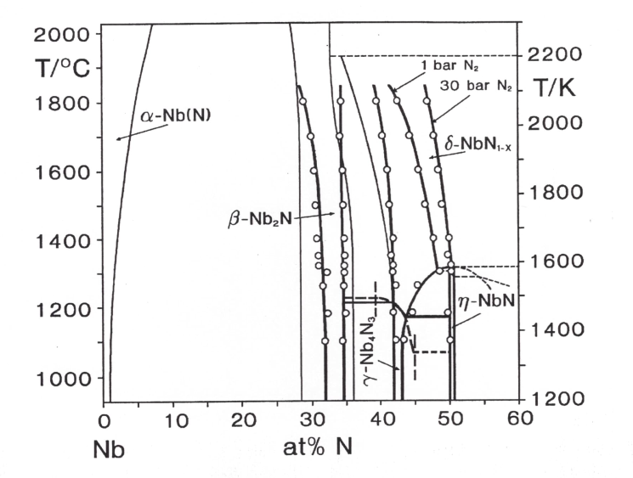
The NbN phase diagram
SC fcc phase
T_{C} = 17.3 K
SC tetragonal phase
T_{C} = 12÷15 K
Courtesy R. Musenich – Genova U.

Slide 48




NbN Thermal diffusion
Reaction at 1700 K for 3 hours in 130 mbar N₂

Slide 49


The NbTiN phase diagram at 1200 °C
Equilibrium nitride phase for any Nb,Ti ratio
Segregation of other phases for non optimal composition range
Stabilization of δ-phase at low temperature (from Musenich)

Slide 50



NbTiN by thermal diffusion
(NbTi cavities were tested as well, but NbTi is not a good candidate material)
From R. Musenich – Genova U.

Slide 51


Sputter coating of cavities

Slide 52



Nb_{1-x}Ti_{x}N by sputtering
Optimum for SRF
SC NbTi magnets

Slide 53



Thin film coatings: reactive sputtering
Nb target
Ar + N₂→
Sputtering rate [a.u.]
Substrate
Formation of nitrides
Sputtering yield: Y_{Nb} > Y_{NbN}
Problem understood and techniques devised to control instability and film composition: larger pumping speed, target to substrate surface ratio…

Slide 54




Characterization by simple resonators (examples)
Very promising R_{BCS}
High R_{res}
Little effect of external DC magnetic field
(Lot of work done for SC-RF devices in many labs)
TE011 demountable cavity at 6.5 GHz, NbN
Microstrip resonator at 3.5 GHz, NbTiN

Slide 55



Cavity coatings: CEA-Saclay (TE011 plates at 4 GHz)
Tc = 16.0 K
Tc = 16.31 K
Tc = 16.17 K
Proc. SRF 1993
Development towards 1.5 GHz stopped
Proc. SRF 1991

Slide 56

Sputtering of 500 MHz at CERN
Nb target
Ar + N₂→
T_{coating} ≈ 200 °C
Substrate
Formation of nitrides
Sputtering yield: Y_{Nb} > Y_{NbN}
Proc. SRF 1991

Slide 57


Sputtering of 500 MHz at CERN
Measured T_{c} ≈ 14.5 K
R_{BCS} = 9 nΩ
R_{res} = 18 nΩ
Scaled LEP specs for bulk Nb @ 4.5 K
Proc. SRF 1991

Slide 58







Grain-boundary model
$$ρ=ρ_{i}+ρ_{G.B.}=ρ_{i}+\frac{I_{c}R_{j}}{J_{c}a}$$
Phys.Rev.B 43 (1991) 6128

Slide 59


Grain boundaries fit
ρ_{intragrain} ≈ 40÷50 µΩcm
ρ_{G.B.} ≈ 20÷30 µΩcm
30÷40% of total
ρ_{Grain-Boundaries} [µΩcm]
S.C. – Thesis 1990

Slide 60



Sputtering of 1.5 GHz at CERN at 350 °C
Analysis: ρ_{G.B.} < 20 % of the total resistivity
M. Marino - Proc. SRF 1997

Slide 61

Further developments: optimise coating temperature
1.5 GHz
Nb/Cu
150 °C
1÷3 nΩ
400 nΩ
Massimo Marino PhD Thesis 1999

Slide 62
Known limitations
Limit of pumping speed
Cathode temperature and surface ratio
Sputtering profile of cathode, differential adsorption
Atomic composition distribution on cavity Ti/Nb

Slide 63
Known limitations
Limit of pumping speed and cathode surface
Cathode temperature and surface ratio
Sputtering profile of cathode, differential adsorption
Atomic composition distribution on cavity Ti/Nb
Control of instabilities problematic
New techniques: pulsed sputtering (loss of efficiency)

Slide 64

Known limitations
Limit of pumping speed and cathode surface
Cathode temperature
Sputtering profile of cathode, differential adsorption
Atomic composition distribution on cavity Ti/Nb
Evolution of cathode composition during sputtering through N₂ absorption.
Cooling of cathode

Slide 65
Known limitations
Limit of pumping speed
Cathode temperature and surface ratio
Sputtering profile of cathode, differential adsorption
Atomic composition distribution on cavity Ti/Nb
N₂ to NbTi ratio depends on position, can be problematic close to sputtering threshold.
Better designs are possible

Slide 66

Known limitations
Limit of pumping speed
Cathode temperature and surface ratio
Sputtering profile of cathode, differential adsorption
Atomic composition distribution on cavity Ti/Nb

Slide 67
Known limitations
Limit of pumping speed
Cathode temperature and surface ratio
Sputtering profile of cathode, differential adsorption
Atomic composition distribution on cavity Ti/Nb
Non homogenous composition along cavity meridian
(Can be troublesome for Nb₃Sn)
Better cathode design

Slide 68
NbN and NbTiN by PE-ALD @ Cornell
Plasma-Enhanced Atomic Layer Deposition
Slide courtesy T. Oseroff – Cornell U.

Slide 69
Outline
Motivation (one of several): the FCC-ee study
State of the art of bulk Nb
Techniques for Nb₃Sn SRF cavities:
  Thermal diffusion of Sn vapours
  Liquid Sn diffusion
  Magnetron sputtering
Techniques for NbN / NbTiN SRF cavities
  Thermal diffusion of N
  Magnetron sputtering
Techniques for other materials
  MgB₂
  REBCO

Slide 70

Motivation

Slide 71
MgB₂ by HPCVD at Temple University
Courtesy Xiaoxing Xi – Temple U.

Slide 72


Slide 73

RF results on samples
Mg-Cu eutectic liquid promote growth aty low temperature process, <500°C.
MgCu₂ alloy layer grows on top of Cu substrate
Courtesy Xiaoxing Xi – Temple U.

Slide 74

Courtesy Xiaoxing Xi – Temple U.

Slide 75

Courtesy Xiaoxing Xi – Temple U.

Slide 76

Courtesy Xiaoxing Xi – Temple U.

Slide 77

Courtesy Xiaoxing Xi – Temple U.

Slide 78

Poor RF properties due to poor connectivity of MgB₂ coating caused by incomplete reaction of B with Mg-Cu alloy.
Longer time deposition can achieve more complete reaction.
Copper
Courtesy Xiaoxing Xi – Temple U.

Slide 79



High-Temperature Superconductors
Y-123
YBCO
REBCO
Tl-1223
By PJRay - Own work, CC BY-SA 4.0, https://commons.wikimedia.org/w/index.php?curid=46193149

Slide 80






REBCO: old idea, new materials and technologies
Collaboration within CERN FCC-hh study to apply HTS for beam impedance reduction
  Operation at 50 K, 16 T, needed J_{c} of 25 kA/cm²
S. Calatroni, E. Bellingeri, C. Ferdeghini, M. Putti, R. Vaglio, T. Baumgartner and M. Eisterer, “Thallium-based high-temperature superconductors for beam impedance mitigation in the Future Circular Collider”, Supercond. Sci. Technol. 30 (2017) 075002
T. Puig, P. Krkotić, A. Romanov, J. O’Callaghan, D. A. Zanin, H. Neupert, P. C. Pinto, P. Demolon, A. Granadeiro Costa, M. Taborelli, F. Perez, M. Pont, J. Gutierrez and S. Calatroni, “Coated conductor technology for the beamscreen chamber of future high energy circular colliders”, Supercond. Sci. Technol. 32 (2019) 094006
Important results on RF behavior of HTS in presence of strong magnetic field
  Potential use for muon collider capture cavities, SRF cavities for axion detection,
  Potential operation at 77 K

Slide 81





REBCO: how to make cavities?

Slide 82


Technique and results
Bonding technology under active development (first results very encouraging)
3x improvement at 8 GHz at 50 K compared to copper
expected 20x improvement at 1 GHz (f^{3/2})
no degradation from stacking
Courtesy J. Gutierrez - ICMAB

Slide 83
Spin-off: axion detection
Axions as solution for strong-CP problem
Axions as dark matter candidates:
  Dark matter axions (low mass) converting to photons in B-Field
  By means of microwave cavities in solenoid magnet
  Sensitivity goes as B² V Q_{cav} where B is the applied field, V the total volume, Q is the quality factor of the cavity
ADMX type experiment: using tunable cavities in the ~1 GHz range

Slide 84


ADMX
From Gianpaolo Carosi LLNL

Slide 85


Checking other frequencies
Theoretical predictions (plot from Gray Rybka 2017)
HTS can have much better Q at lower frequencies
There is a crossover with copper at high frequencies: to be verified with our data

Slide 86




Pictures from CAPP
Twelve sectors, with glued HTS tapes, 5.7 GHz
RADES at CERN will explore ~8 GHz

Slide 87
Conclusions
Promising candidate new materials for SRF: A15 (Nb₃Sn, V₃Si, …) and B1 (NbN, NbTiN, …)
Very successful results for Nb₃Sn from Sn vapour diffusion
  Technological evolution over >30 years, great leap in the past 10 years
Fast-pace evolution for Nb₃Sn films on Cu
  Mastering Sn-Cu diffusion is the key for success… as in magnets!
NbN being pursued in several places
  Probably intrinsically limited by metastable δ-phase
NbTiN remains the best B1 candidate
  Composition accuracy and grain size need to be solved
Other innovative materials will require further developments
  MgB2 being pursued only at Temple University
  REBCO might be a viable alternative, for some niche applications. New-generation coated-conductors have very peculiar performance

Slide 88
Acknowledgements
Cornell University: Matthias Liepe, Thomas Oseroff, Ryan Porter
Fermilab: Anna Grassellino, Sam Posen
ICMAB: Joffre Gutierrez
INFN-LNL: Cristian Pira
Jefferson Lab: Anne-Marie Valente-Feliciano
STFC: Reza Valizadeh
Temple University: Xiaoxing Xi

