Slide 1
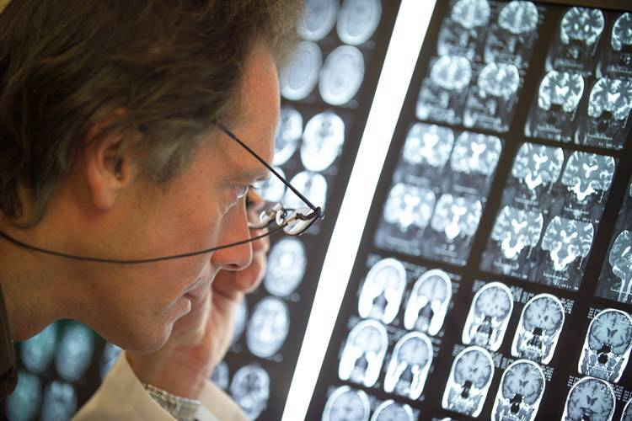
PART III:
Particle therapy of cancer
1

Slide 2
The HOLY GRAIL of Radiation Therapy
Ideal Situation
Provide a lethal dose to the tumor
and
Spare perfectly the surrounding healthy tissue
In Practice
Deposit the radiation dose more precisely in the target volume
with less dose in the surrounding healthy tissues.

Slide 3
Photon-Proton dose distribution comparison
The spread out Bragg peak (SOBP)
Position of the Bragg peak depends on beam energy
Incomming energy modulation ⇒ SOBP
No dose downsteam and low dose upstream of tumor
Up to 50% reduced risk of radiation induced secondary cancer
Drastically lower risk of adverse effects (treatment toxicity, side effects, growth abnormality) – better quality of life

Slide 4
Main requirements for a proton therapy system
Ability to reach the tumor
  Range in patient: up to 32 g/cm²
  Range modulation:up to full range, with steps of 0.5 g/cm²
  Field size: up to 30 x 40 cm
Ability to reach the from any selected direction
  Isocentric Gantry
  Precise, robotic patient positioner
Ability to verify and control the dose deposition using IC’s
Ability to reach the tumor accurately
  Penumbra: maximum 2 mm at skin
  Distal dose falloff: maximum 1 mm above physical limit
  Patient positioner accuracy and reproducibility: 0.5 mm for small displacements
  Gantry accuracy and reproducibility: 1 mm radius circle of confusion
  Patient alignment methods: lasers, light fields, X-rays

Slide 5
Accelerator parameters driving technology choice
Energy: defines the range in the patient (230 MeV enough)
Energy definition: defines the range accuracy and the distal falloff
Beam current: defines the dose rate (10¹¹ p/sec enough (10 nA))
Beam current stability and noise: defines ability to use wobbling and scanning
Accurate and fast beam intensity control: needed for conformal therapy

Slide 6
Cyclotrons for Proton & Carbon therapy?
In 1991, when IBA entered in PT, the consensus was that the best accelerator for PT was a synchrotron
IBA introduced a very effective cyclotron design, and today the majority of PT centers use the cyclotron technology (Not only IBA but also Varian, Mevion, SHI)
Over the last 25 years, users came to appreciate the advantages of cyclotrons:
  Simplicity & reliability
  Intense, continuous (non pulsed) beam current
  Lowest cost and size
  But, most importantly, the ability to modulate rapidly and accurately the proton beam current

Slide 7
Real oscilloscope measured signals
sub-msec response time
Modulation signal
Beam current

Slide 8
Why is fast current modulation important?
A big issue with scanned beam is the motion of the target during irradiation
If you cannot control accurately and rapidly the current ,or if the beam is slowly pulsed, your only choice is step-and-shoot (spot scanning)
Assuming a 10 mm (FWHM) beam spot size, a 50% overlap and a 20 Hz pulse rate, the maximum scanning speed will be 0.2 m/sec
With this speed, for a large size tumor, repainting many time each layer is not really an option
In contrast, with a cyclotron you can scan at 20 m/sec and rescan many times each layer

Slide 9
Change of energy?
Cyclotrons are simpler at fixed energy
Energy change by graphite degrader at waist after cyclotron exit, followed by divergence slits and energy analyzer
This very effectively decouples the accelerator from the patient
Fragmentation products are effectively eliminated in slits and ESS
Yes, neutrons are produced, but ESS is well shielded and the average beam currents are very low > little activation
How fast? 5 mm step in energy in 100 msec. Respiration cycle is 2…4 seconds => 100 msec is fine

Slide 10
Accelerators for proton therapy: two alternatives
Small synchrotron
Advantages
  Naturally variable energy
Disadvantages
  Current limited if low energy injection
  Beam current stability & low noise is difficult on small synchrotrons
  Fast and accurate beam current control difficult to achieve
  More complex with negative impact on availability
Compact cyclotron
Advantages
  No physical current limitation
  Beam current stability & noise specifications currently achieved on small cyclotrons
  Fast and accurate beam current control over 1000/1 range easy to achieve
  Low complexity, resulting in highest availability
Disadvantages
  Variable energy requires external Energy Selection System

Slide 11
Typical Proton Therapy Facility Layout

Slide 12
Main Sub-systems of a cyclotron based PT facility
230 MeV isochronous cyclotron
Energy Selection System (ESS)
Beam Transport and Switching System
Isocentric Gantries (typically 3) and one Fixed Beam Line
Nozzles for matching the beam wrt the required treatment (scattering, wobbling or scanning, diagnostics)
Robotic Patient Positioners
Software Control and Safety System

Slide 13
The 230 Mev Cyclotron at MGH/NPTC in Boston
Protons only
Fixed energy
200 tons
∅ = 4.7 m

Slide 14
The Energy Selection System
Graphite or Beryllium wedge is used for coarse energy definition
Emittance slits are used to define the emittance of the transmitted beam
Analyzing magnet system defines accurately the range at nozzle entrance
Laminated magnets and quads allow 10% energy change in 2 seconds

Slide 15
The carbon wedge degrader

Slide 16
IBA PT subsystems : the beam transport lines.
The energy selection system. WPE, Essen, 2010.

Slide 17
The Beam Transport and Switching System

Slide 18
The isocentric gantry => about 10 m high
Good alignment is of crucial importance

Slide 19
The purpose of the nozzle
to spread the proton beam to obtain a uniform dose distribution in a large volume
  Double scattering for small to moderate fields
  Wobbling for the largest and deepest fields
  Pencil Beam Scanning for the most precise conformal mapping
Modulate the proton energy (range in patient)
to measure accurately the dose delivered to the patient
Provide alignment of the patient with the proton field

Slide 20
IMPT: Pencil Beam Scanning principle

Slide 21
A patient friendly treatment room is important

Slide 22
A Proton Therapy Facility is like a small Hospital
A proton therapy system is much more than only an accelerator
It is a complex, multi-room system, filling a hospital building.
The total investment is around 100 M€, of which 45 M€ for the equipment
Many people (doctors, therapists, physicists, nurses) work daily in a PT facility
A PT facility can treat 1500 patients/year and generate revenues in the order of 30 M€/year!

Slide 23
The UPHS Particle Therapy Centre, Philadelphia
One of the largest Particle Therapy centre to date!
4 Gantry Rooms
1 Fixed Beam Room
1 Experimental Room
Beam since July 2008

Slide 24
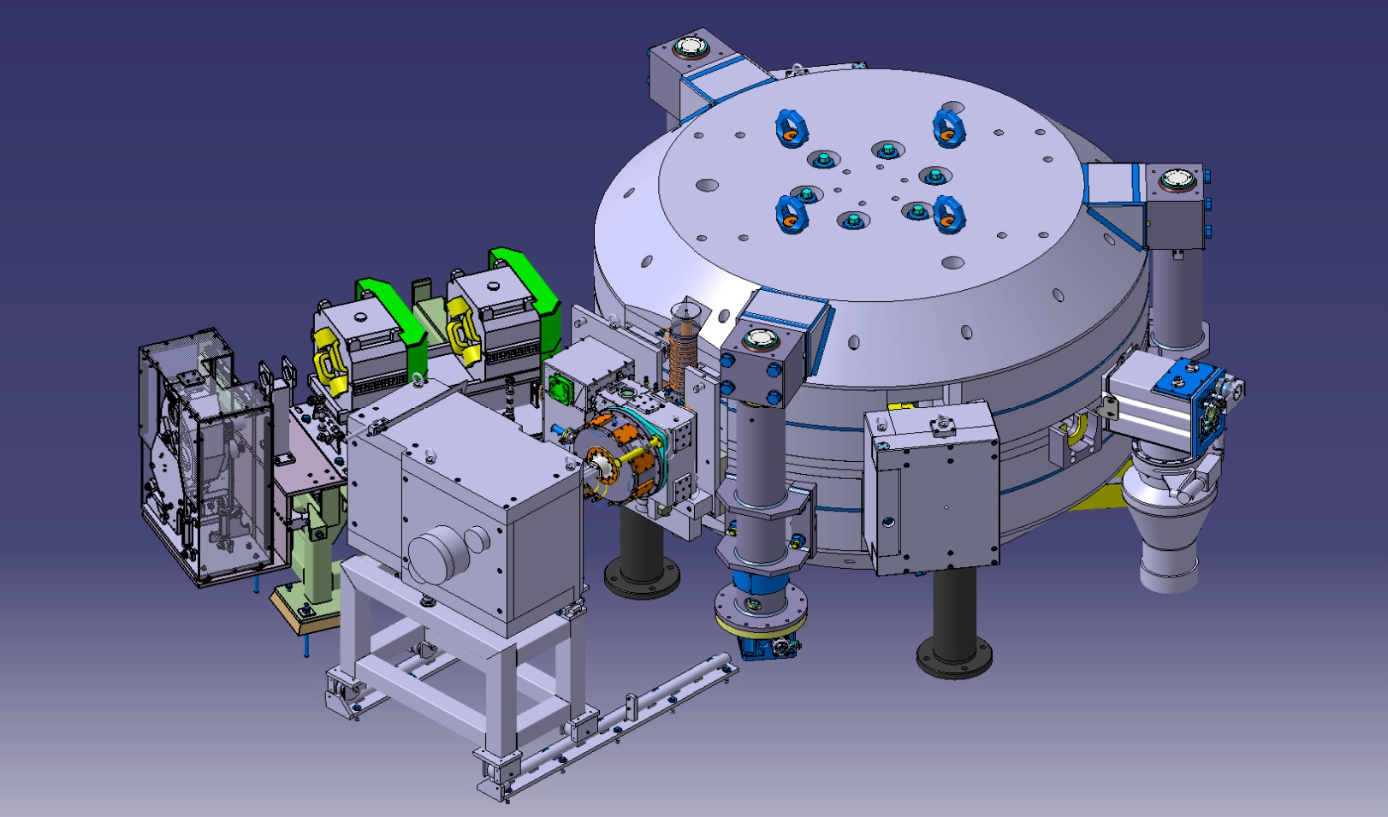
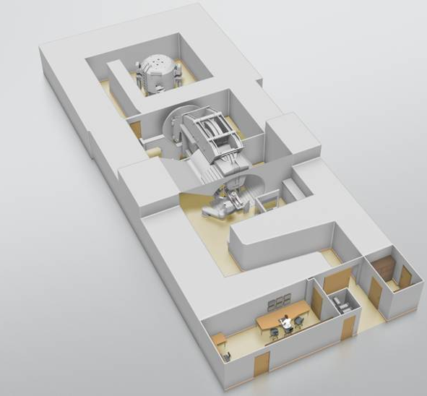
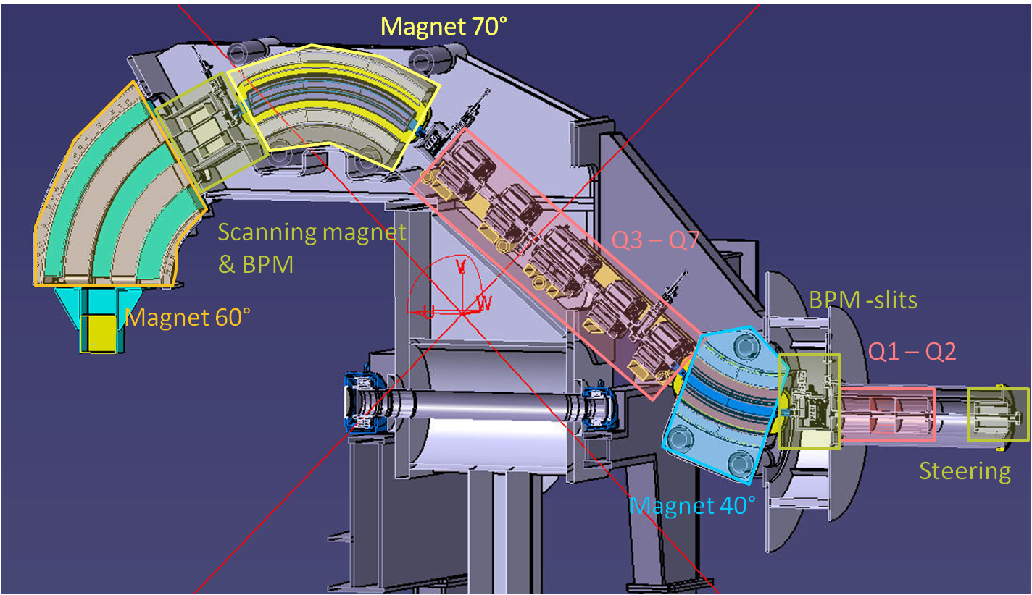
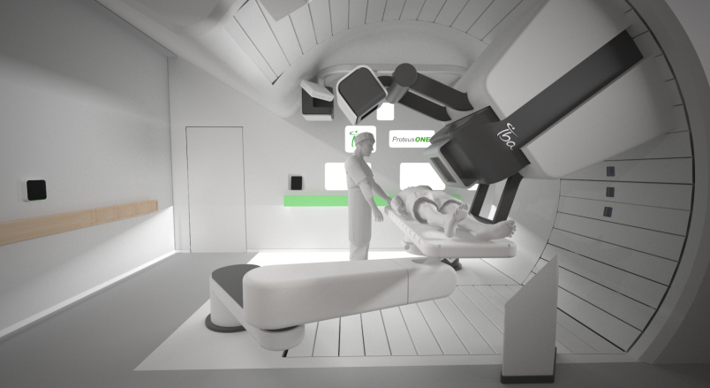
The IBA Single Room Proton Therapy Solution: ProteusONE®
High quality PBS cancer treatment: compact and affordable
12.8 m
Synchrocyclotron with superconducting coil: S2C2
New Compact Gantry for pencil beam scanning
30.4 m
Patient treatment room

Slide 25
The new compact gantry for pencil beam scanning
Design aimed at reducing footprint and cost
Scanning magnets are placed upstream of the last bending magnet
ESS integrated in the 45 deg inclined part
Rotation angle 220°=> more compact treatment room
Transport and installation in one part
The prototype is installed in Shreveport where patients are treated since September 2014

Slide 26
S2C2 overview
General system layout and parameters
An invited talk on this project was presented at the 2013 cyclotron conference in Vancouver
Several contributions can be found on the ECPM2012-website
Notes:
The idea grew in more detailed drawings and specifications, thanks to a fully dedicated team of Physicists and engineers inside and outside IBA

Slide 27
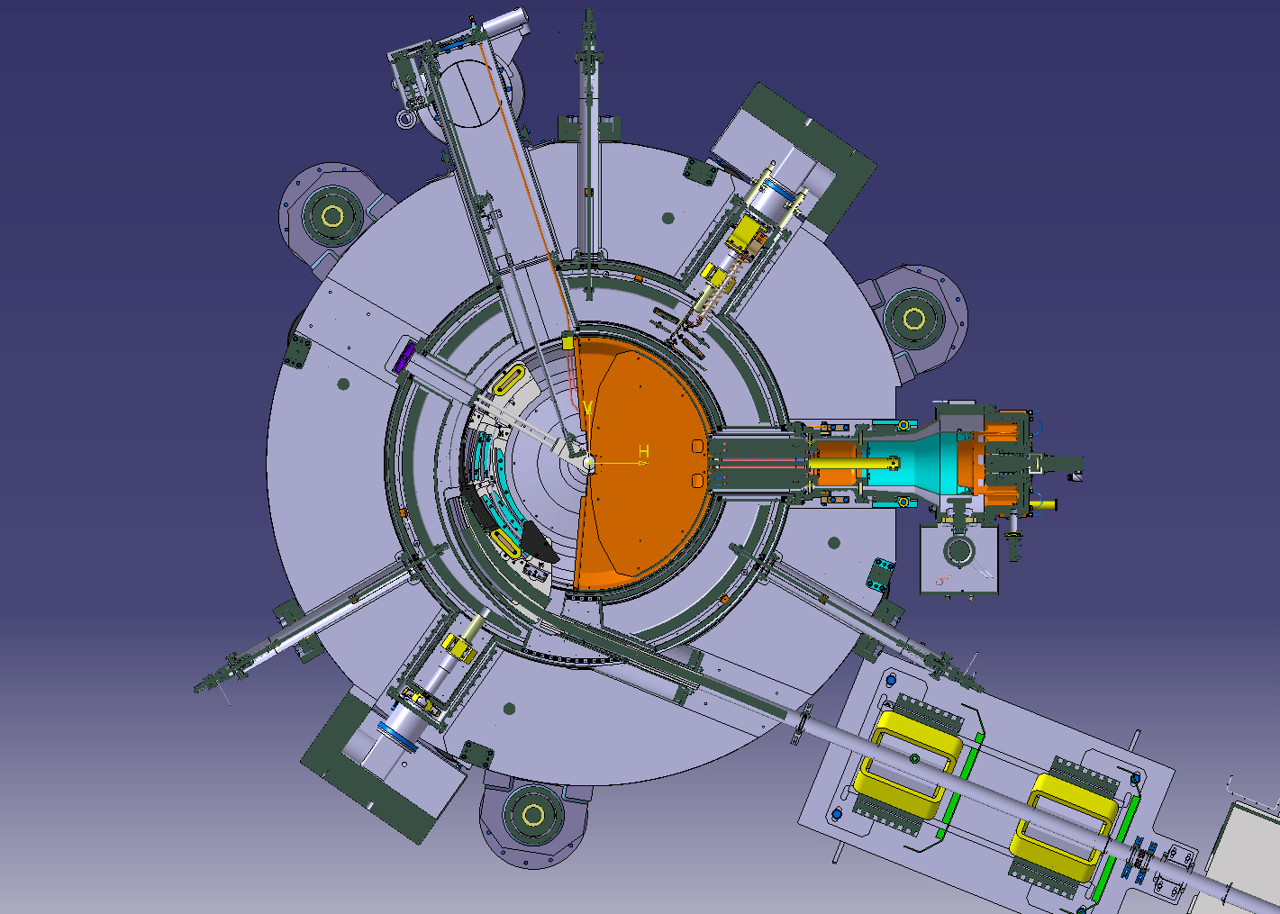
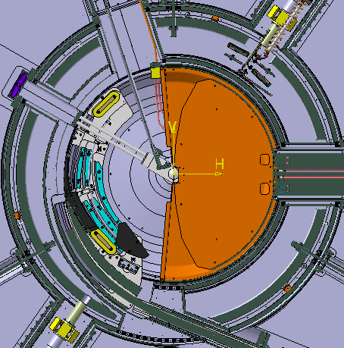
S2C2 overview
Main subsystems
Magnet return yoke
Cryostat with coil
RF system
Ion source+central region
Extraction system
Vacuum system
Yoke lifting system
Extracted beam line
Notes:
As for every guided tour, a small map is always welcome…

Slide 28
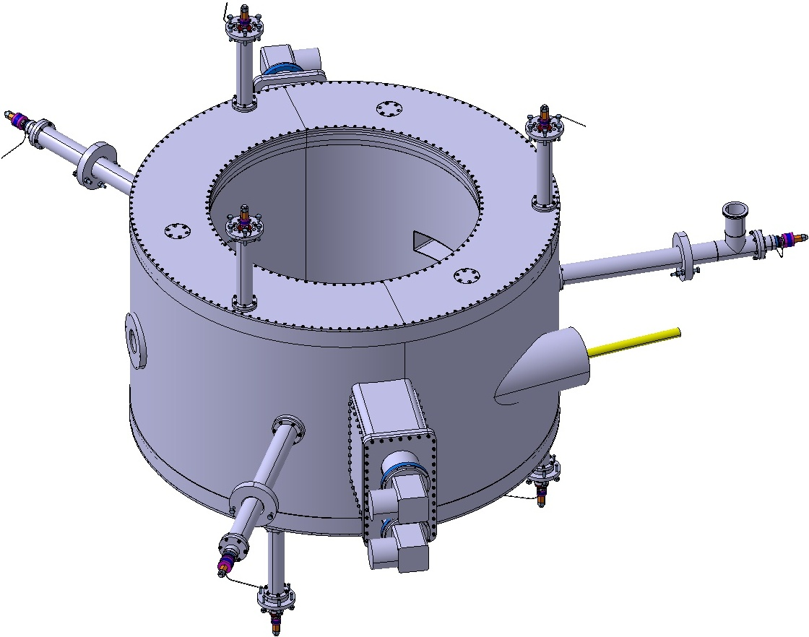
Superconducting coil
Designed and manufactured by ASG (Genua, Italy)
Radial tie rod
NbTi wire in channel coil.
Suspended cold mass: 3tons.
Nominal current: 650A (56 A/mm²).
Nominal ampere-turns: 4.3x10⁺⁶At.
Conduction cooled by 4 SHI cryocoolers.
Overall weight: 4tons.
9 Inconel tension rods with strain gauges.
(radial ø14mm; upper ø8mm; lower ø6mm)
Cryostat is the cyclotron vacuum chamber.
Vertical tie rods
RF system port
Beam exit port
Sumitomo
SRDK-415D
cryocoolers
Notes:
Niobium Titane coils, suspended cold mass of 3 tons though 9 tension rods, energy stored of 10 Mjoules.
The coil is dry cooled thankx to 4 cryo coolers, with cryo compressors stored near by, for compactness, safety
The coil has been fabricated by ASG-geneva
2 on top of each other Cryocooler configuration is to improve conduction path from coil to cold head without affecting the flux return cross section.

Slide 29
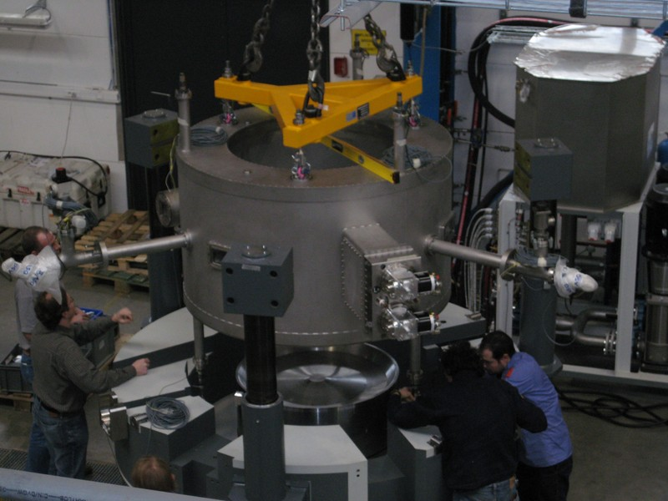
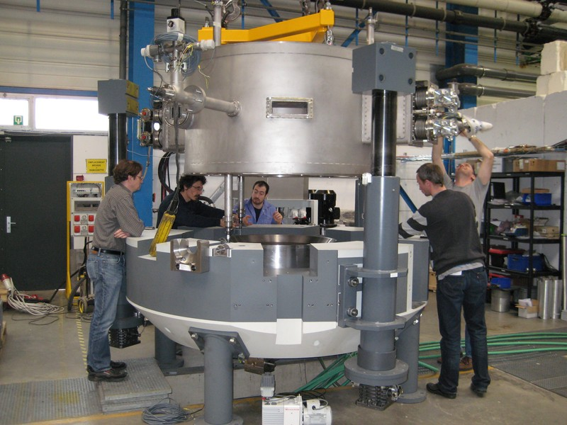
Superconducting coil
Installation of the cryostat in the yoke
Notes:
That was a real tight fit. 1mm clearance between yoke and outer wall of cryostat.

Slide 30
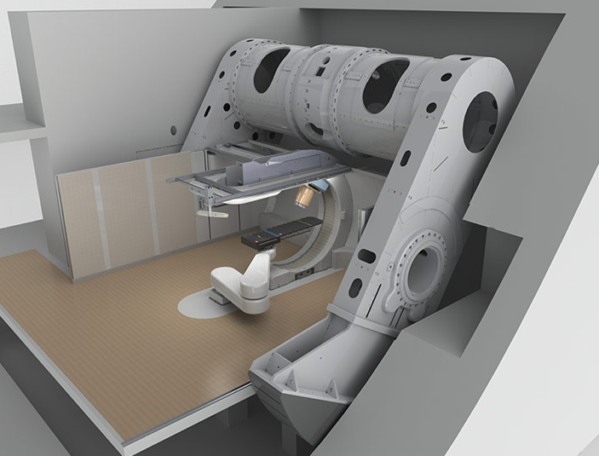
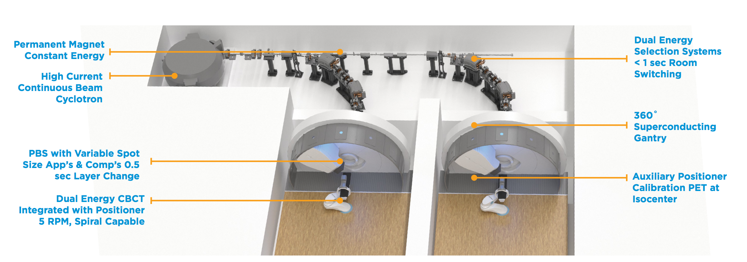
Typical proton therapy systems
IBA
Mevion
Pronova

Slide 31
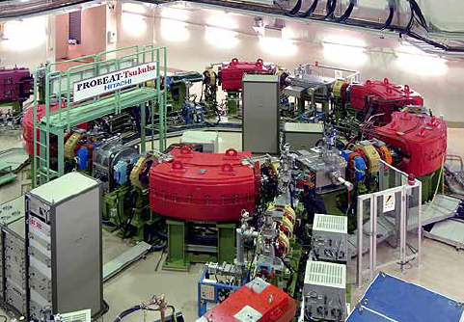
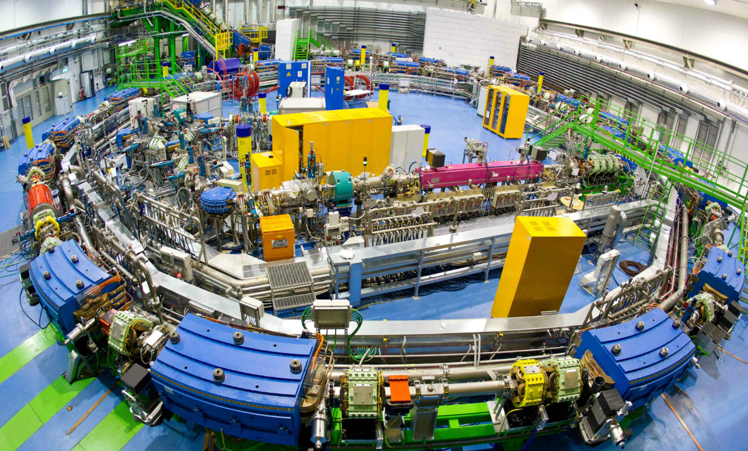
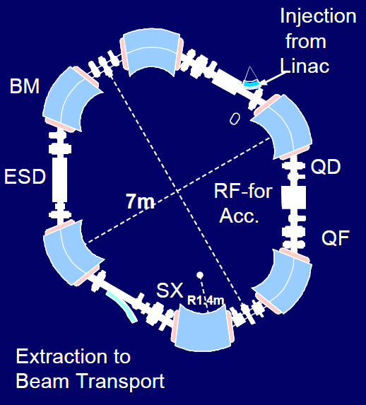
Synchrotrons
Hitachi
70-250 MeV protons
Slow cycle
7 m Diameter
“PIMMS” (CERN) design
Up to Carbon
25 m Diameter
Rep. rate: 5 Hz
Installed @CNAO, Medaustron
http://www.protominternational.com/about/about-radiance-330/
Rossi, EurPhysJPlus2011-126-78.pdf

Slide 32
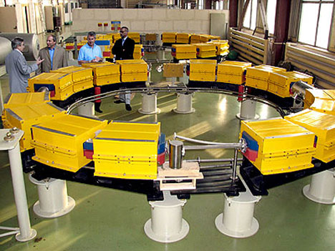
Trend: more compact
Protom
Up to 330 MeV protons
5 m Diameter, ~16 tons
Installed @MGH; recently first patient
http://www.protominternational.com/about/about-radiance-330/

Slide 33
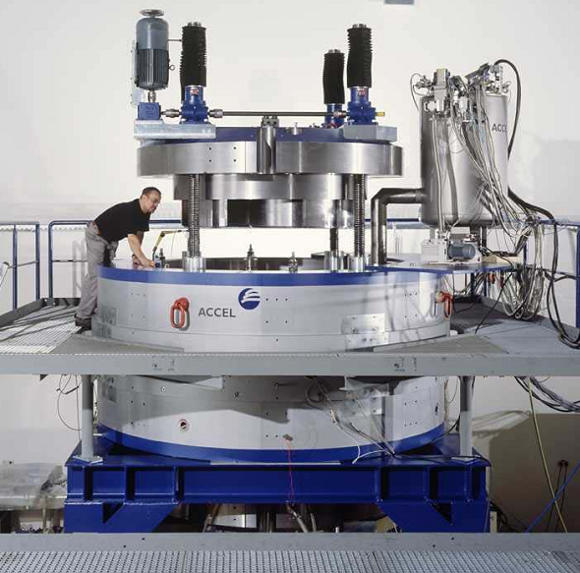
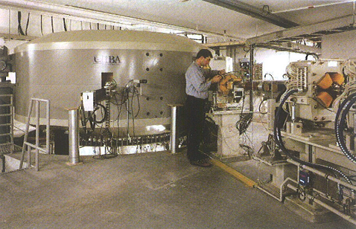
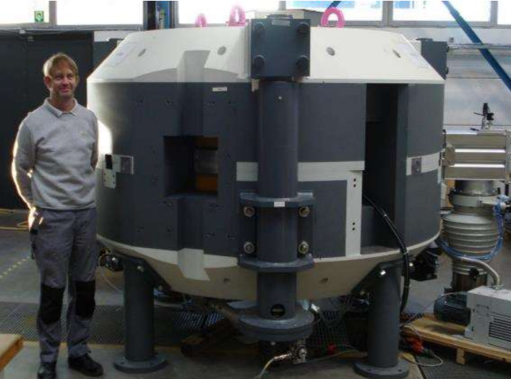
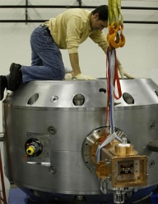
Cyclotrons in PT – commercial models
Mevion SC250
250 MeV protons
~1.5 m Diameter (shield)
Superconducting (Nb₃Sn)
IBA S2C2
MeV protons
2.2 m Diameter
Rep. rate: 1 kHz
Superconducting (NbTi)
RF: 11 kW
IBA C230
230 MeV protons
4.3 m Diameter
CW beam
Normal conducting
Magnet: 200 kW
RF: 60 kW
Varian-Accel Probeam
250MeV protons
3.1 m Diameter
CW beam
Superconducting (NbTi)
Magnet: 40 kW
RF: 115 kW
NB: refer also to P. Verbruggen’s talk at ECPM 2012 ”Development of the new IBA S2C2”
for beam properties, refer also to J. Van de Walle’s talk at « Cyclotrons 2016 » conference

Slide 34
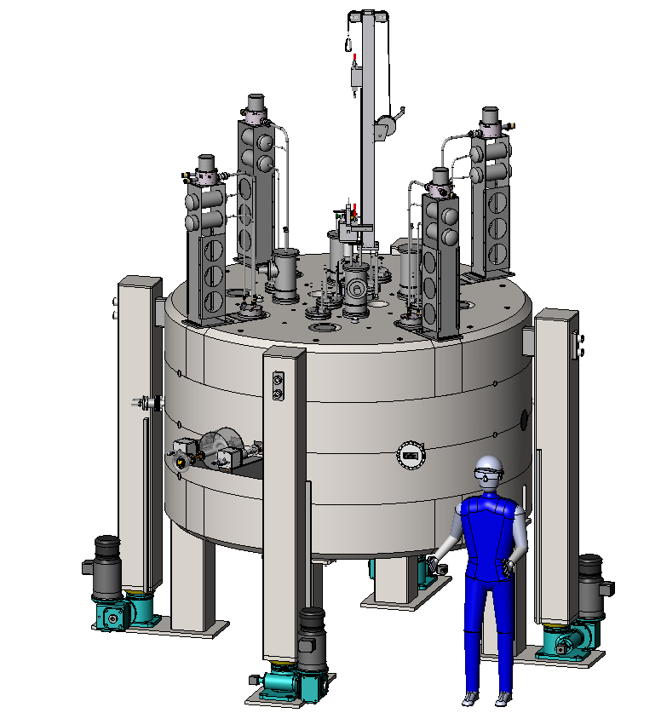
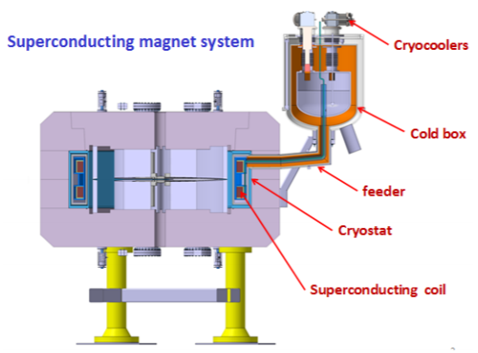
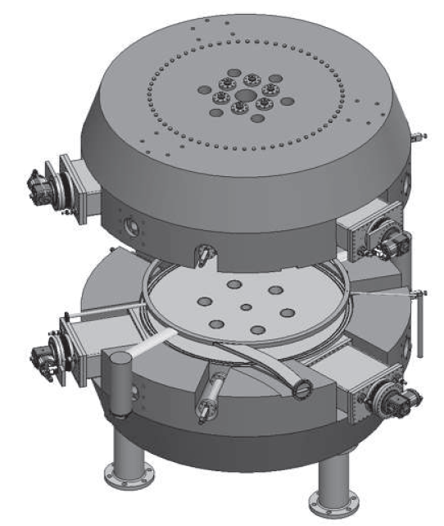
Proton cyclotrons - Ongoing developments
1. Isochronous: SHI, Varian/Antaya, Pronova/Ionetix, Heifei/JINR
Derenchuck - NAPAC 2016
Karamysheva - THP20 cyclotrons 2016
Antaya – CAS 2015
SHI
230 MeV protons
2.8 m Diameter
CW beam
Superconducting (NbTi)
55 tons
4 T (extr.)
Pronova/Ionetix
250 MeV protons
2.8 m Diameter
CW beam
Superconducting (Nb₃Sn)
60 tons
3.7 T (extr)
Heifei/JINR
200 MeV protons
2.2 m Diameter
CW beam
Superconducting
30 tons
3.6 T (extr.)
Varian/Antaya
230 MeV protons
2.2 m Diameter
CW beam
Superconducting (Nb₃Sn)
30 tons+
5.5 T (extr.)
“Flutter” coils

Slide 35
Proton cyclotrons - Ongoing developments
2. Synchrocyclotrons: MIT ironless
250 MeV protons
(2.4-)2.8 m Diameter
Pulsed beam
Superconducting (Nb₃Sn)
4 tons
T (extr.)
Cost?
Variable-energy possible
Minervini – Ciemat workshop 2016
Notes:
Beam
Ion [Z,q] 1,1
T [MeV] 252.7
Bex [T] 8.11
Rex [m] 0.302
Magnet
j [A/mm2] 235.9
Bmax [T] 12.4
Energy [MJ] 31.3
B(R=2m) [G] 4
B(Z=2m) [G] 13
Weight [tons] 4

Slide 36
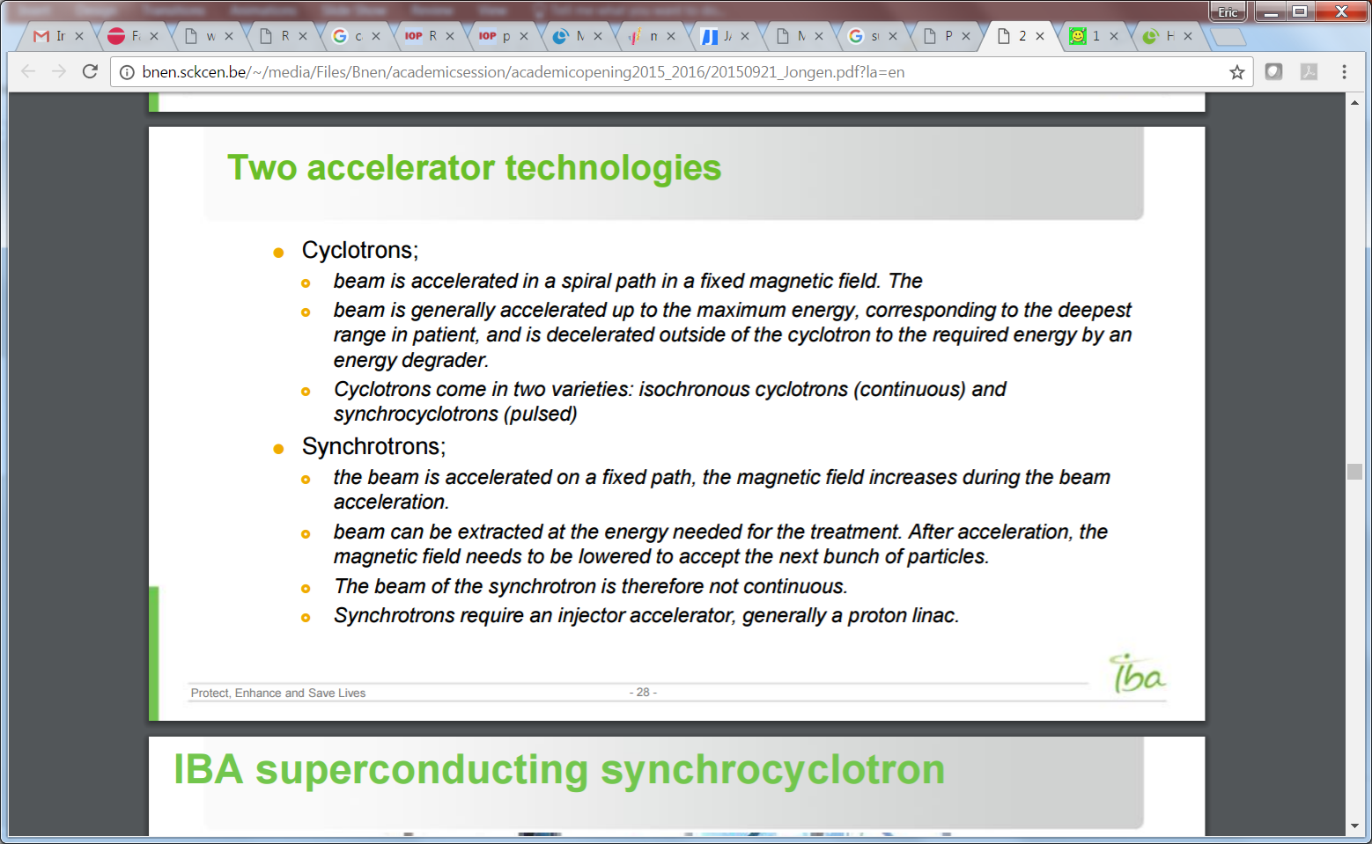
Accelerators in PT
(rough) requirements
  Max. energy: 230 (250 MeV) protons – 400 MeV/u carbon ions
  Min energy: ~70 MeV protons
  At least 2 Gy/l/min => a few nA average beam current at nozzle level
  Fast beam intensity modulation
  Minimum footprint
  Minimum energy consumption
Currently available on the market
  Synchrotrons
    Beam accelerated on a single path, magnetic field is ramped
    =>Variable energy, pulsed beam, multiple-stage
  Cyclotrons and synchro-cyclotrons
    Acceleration on a spiral path, fixed magnetic field
    => Usually fixed energy, CW or pulsed (high rep. rate), single stage
Potential (far) future developments:
  Linacs
  Wakefield accelerators
  Cyclinacs
  Trend: variable-energy
Notes:
We will focus on (synchro-)cyclotrons as these are those who use superconductivity the most

Slide 37
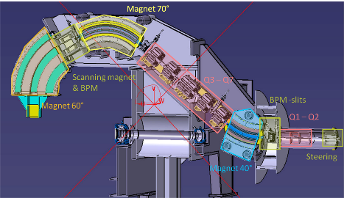
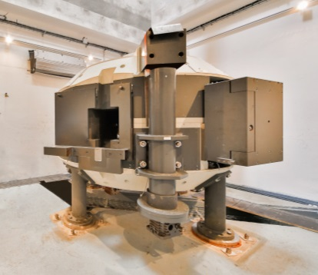
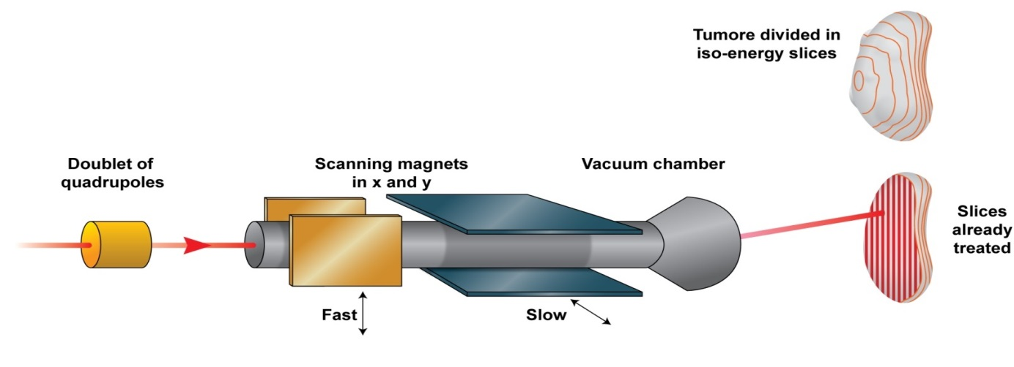
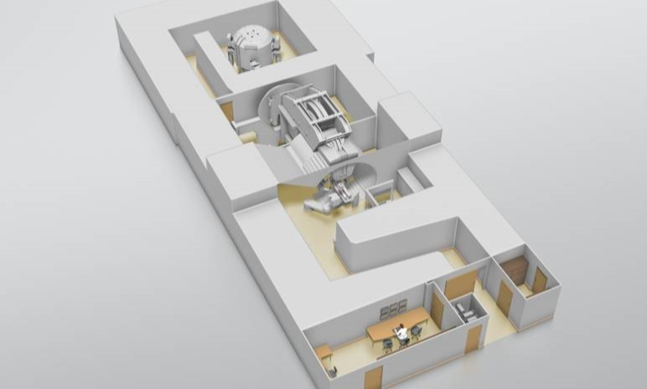
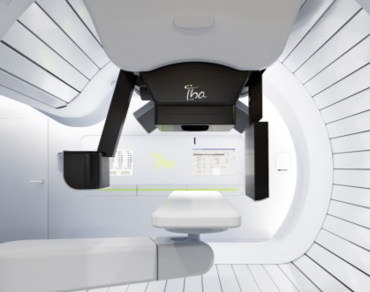
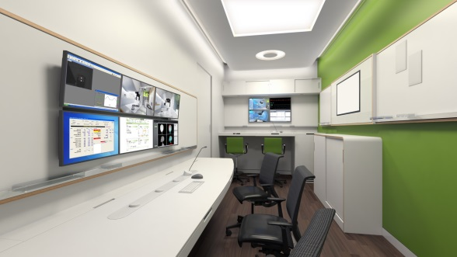
Major components (IBA ProteusONE)
Compact super-conducting accelerator for producing the energetic proton beam
A rotating gantry to set the beam at the right angle
Intensity-modulated proton therapy (IMPT) :
the most precise form of treatments
Stereoscopic imaging and CBCT at isocentre:
accurate patient setup,
quality images for adaptive treatments
Efficient software integration,
enabling easy & flexible workflows

