Slide 2
Amorphous Carbon coatings
2007:
Committee: “Proton Accelerators for the future”
Upgrade in luminosity is limited by electron cloud formation
Start development of amorphous Carbon coatings to mitigate electron cloud in SPS*
* NEG coating can’t be used as SPS is unbaked vacuum system
M. Taborelli et al: Nine years of carbon coating development for the SPS upgrade: achievements and heritage; CERN-ACC-2016-0010

Slide 3
The formation of electron clouds in particle accelerators.
+
+
+
+
Accelerator beam pipe
Proton bunch (charge +)
Gas molecule
Number of emitted electrons
Secondary electron Yield (SEY) =
Electron (charge -)
Number of impinging electrons

Slide 4
Why is electron cloud formation bad?
Pressure rises.
Heat load to the cryogenic beam pipes (superconducting magnets, not for SPS).
Beam instabilities.
With upgrade of injectors LIU for HL-LHC: higher intensity => more e-cloud.

Slide 5
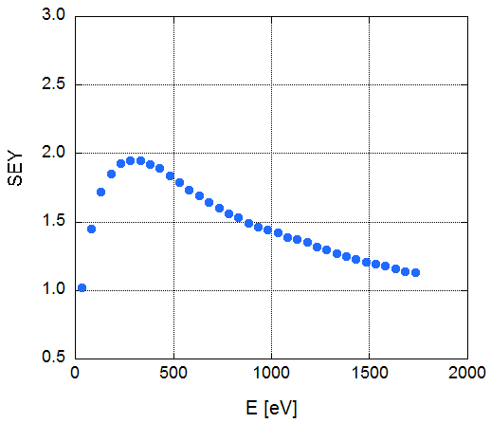
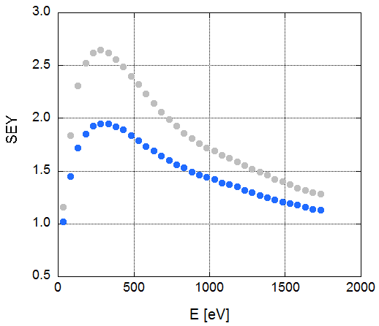
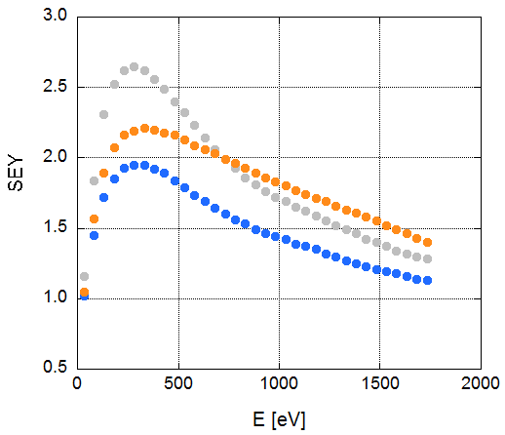
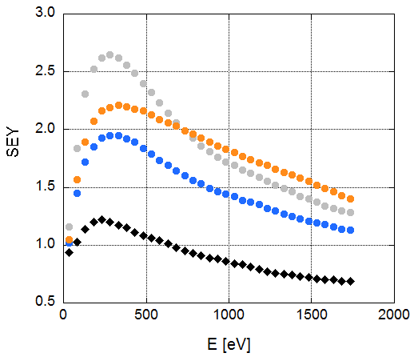
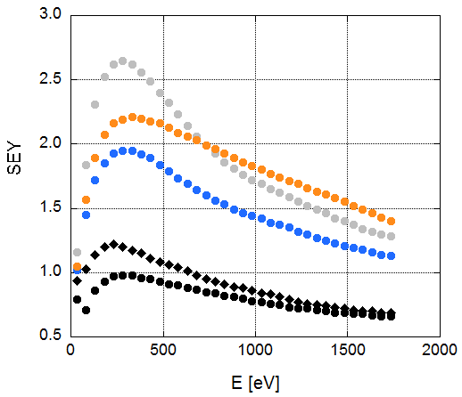
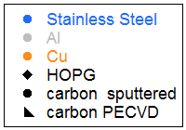
Development of carbon coatings (from 2007)
Why carbon?
Graphite has a low SEY (secondary electron yield)
Threshold
for e-cloud
Threshold for e-cloud

Slide 6
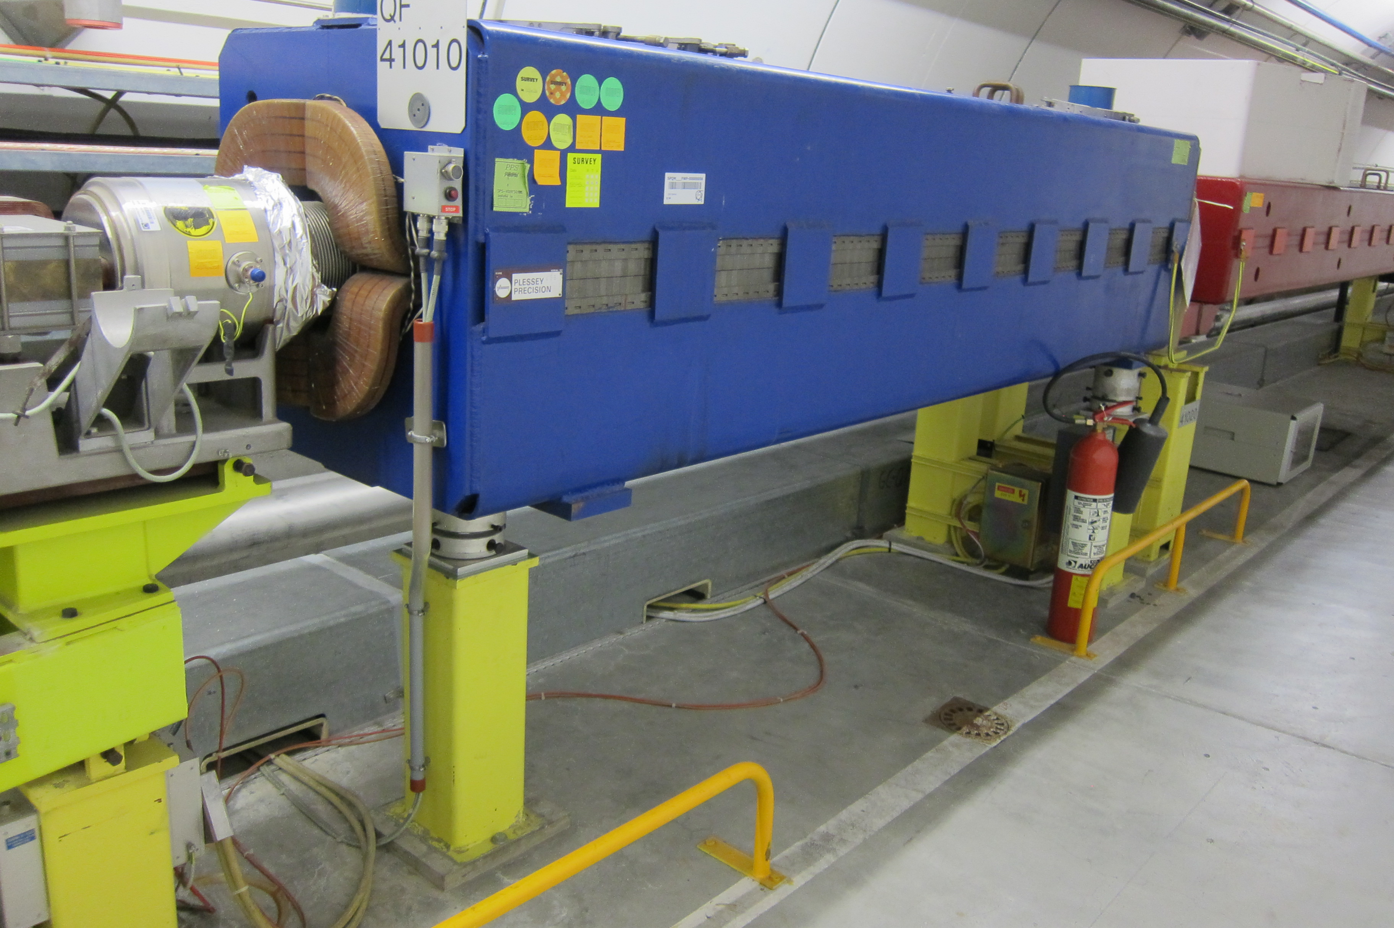
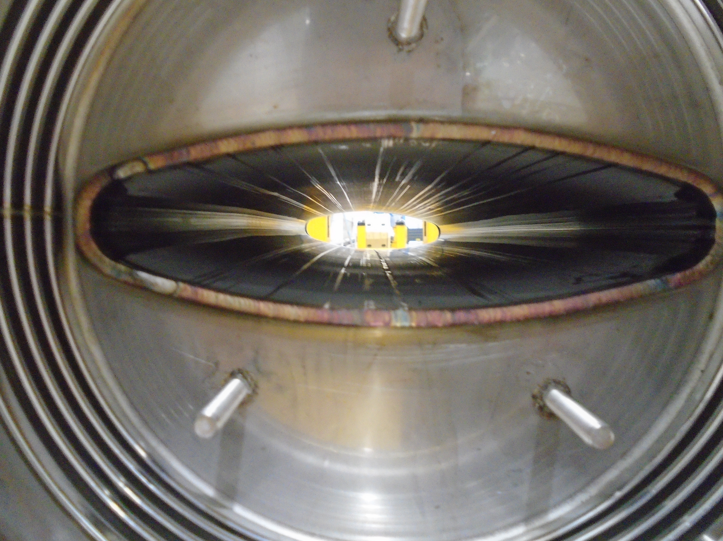
Development of coating process
Difficulty: Coat narrow elliptical beam-pipes in Magnets
QF with elliptical beam pipe
New technique: DC Hollow Cathode Sputtering

Slide 7
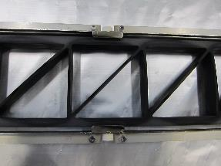
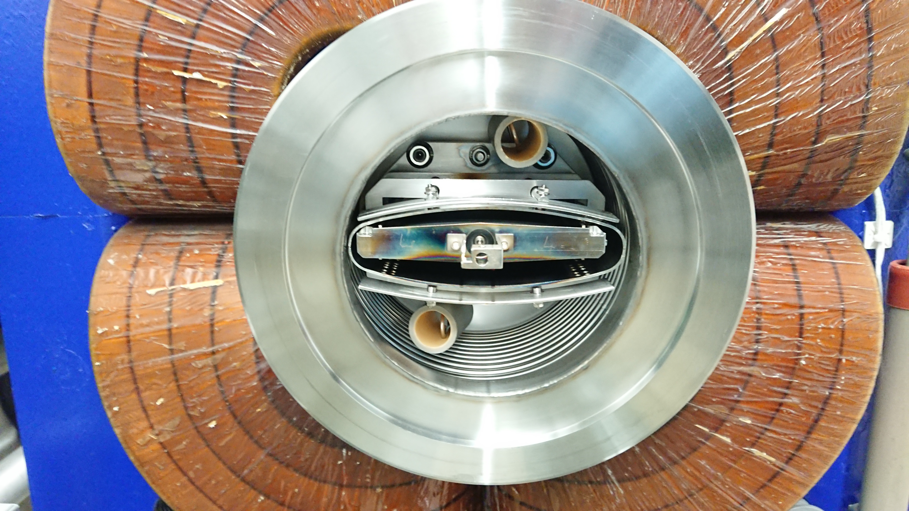
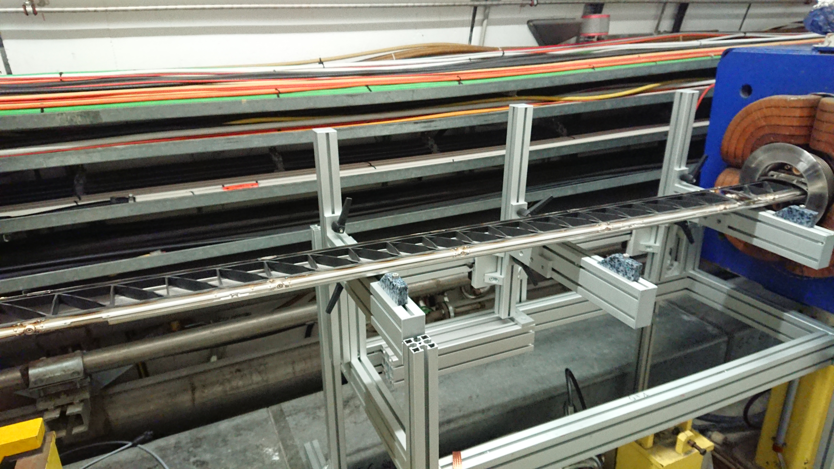
Coat beam-pipes in Magnets by DC Hollow Cathode Sputtering (DCHCS)
Based on electrical confinement of electrons in plasma
Cathode:
graphite targets
(cells)
82
82

Slide 8
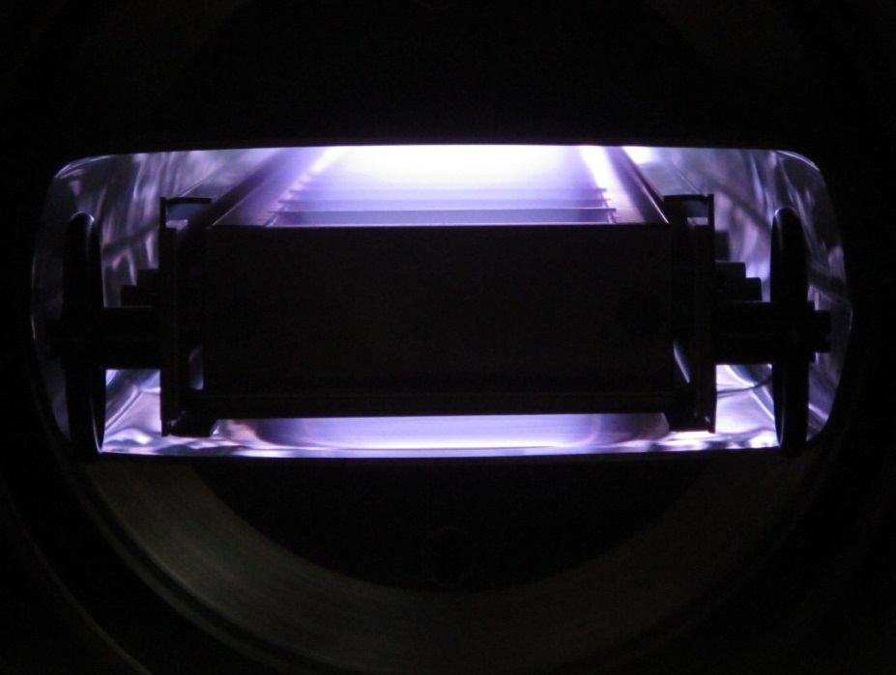
Coat beam-pipes in Magnets by DC Hollow Cathode Sputtering (DCHCS)
Based on electrical confinement of electrons in plasma
Cathode:
graphite targets
(cells)
82
82

Slide 9
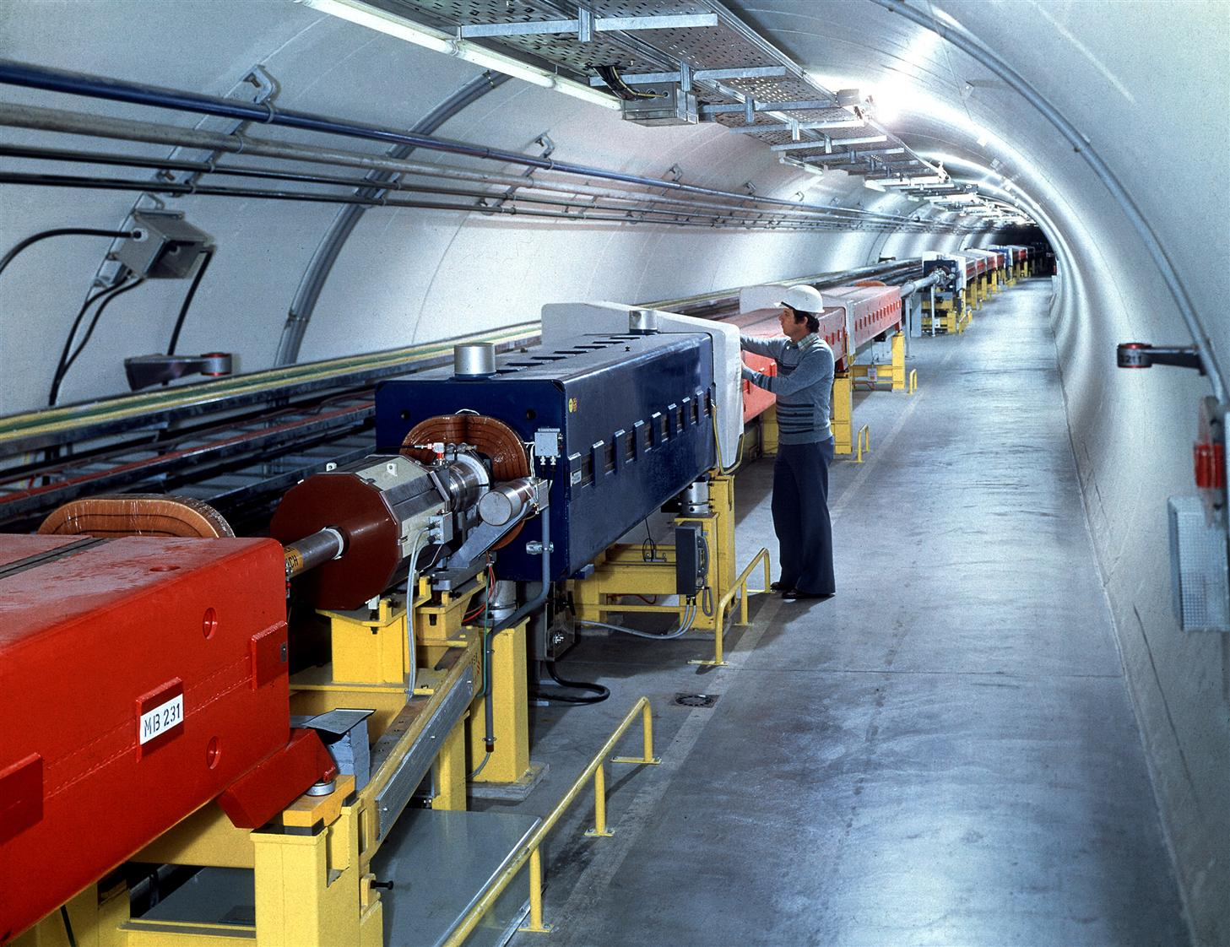
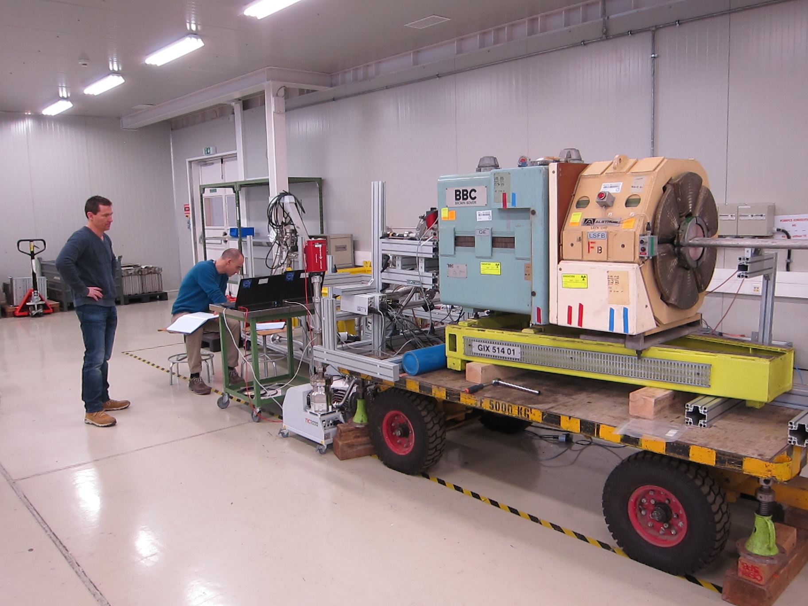
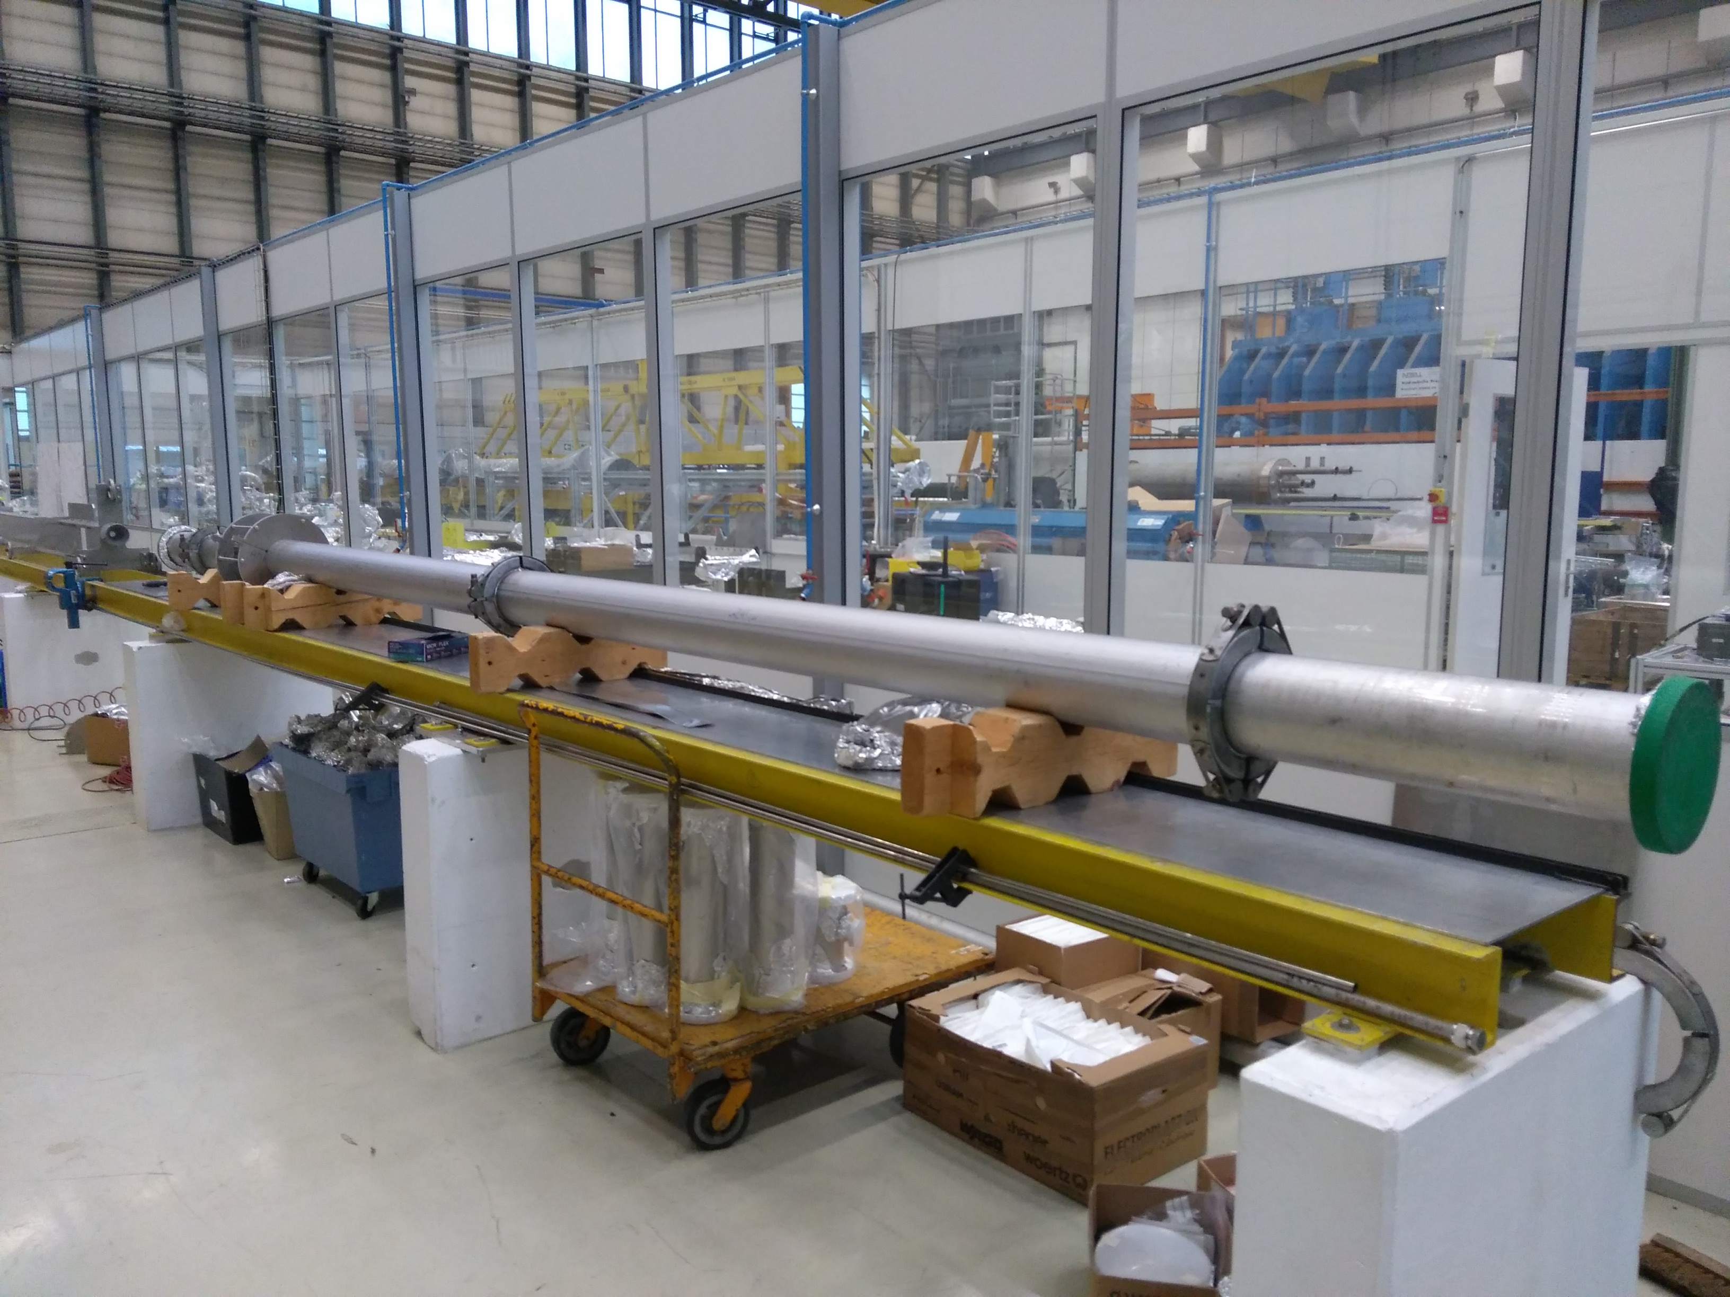
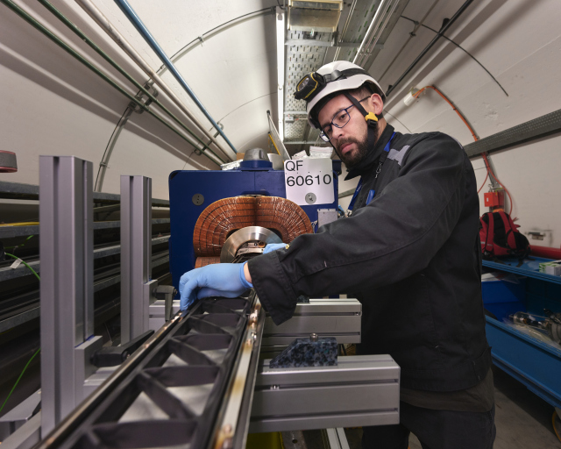
How to imply this in existing vacuum chambers
1 cell = 63.995 m
MBA
SSS
QF
MBA
MBA
MBB
MBB
SSS
QD
MBB
MBB
MBA
MBA
SSS
QF
Coating lab in surface building
Coating in SPS
SPS ARC:
Repetition of identical cells
2 units in 867
drifts to 181
2 mobile units in SPS

Slide 10
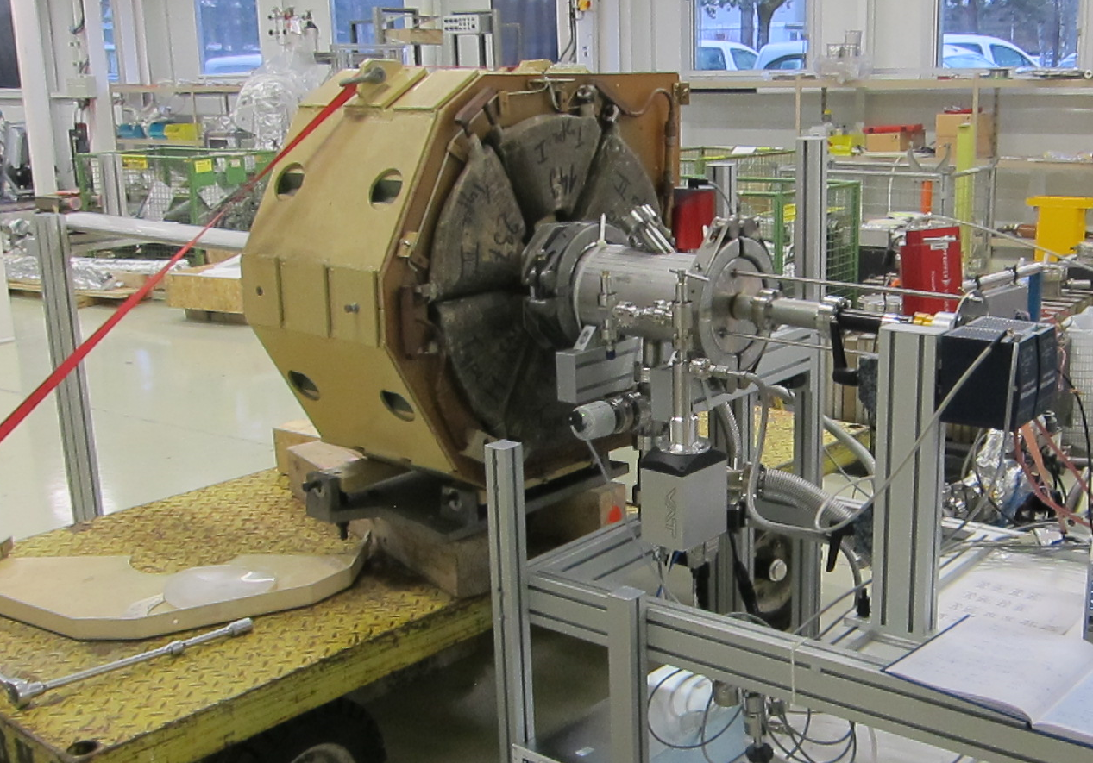
How does it look like?
Coating in surface building ; similar for SPS mobile system
Carbon cathode in constant move
Gas injection system
Pumping group
Coating process:
20 hours
C thickness: 400 nm
Sample for SEY measurement in extension
Q..C. during process: Residual Gas Analysis & Optical emission spectroscopy (OES)
Hydrogen Monitoring
Q.C. after process: - Visual inspection for short vacuum chambers
- Endoscopy for QF vacuum chambers
- SEY measurement of sample of each run: threshold: 1.1 – 1.25

Slide 11
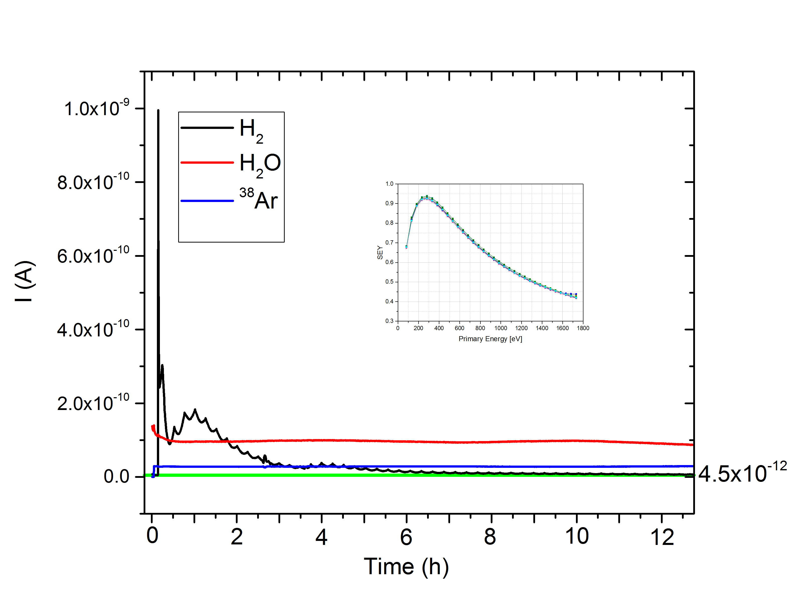
QC during coating run
RGA
OES
Ar
H
Intensity [AU]
5
10
15
20
Time [h]
Hydrogen decrease over time
aC coating
substrate

Slide 12
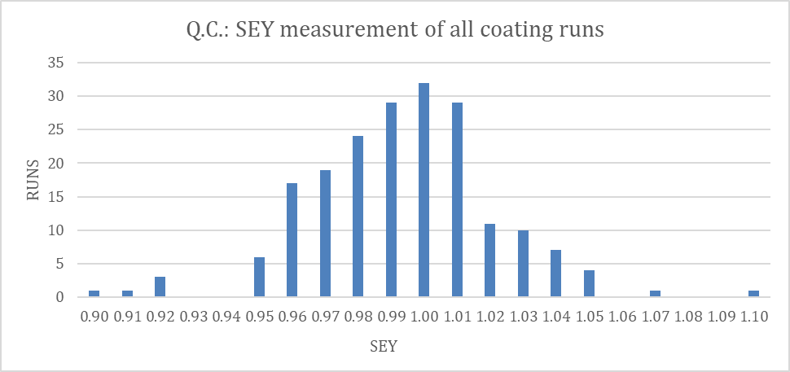
During LS2
88 QF magnets coated in SPS during LS2
In lab:
96 coating runs: 110 QF type elements coated
Round chambers: 14 runs; 29 chambers (up to 5.7 m)
SEY threshold: 1.25

