Slide 1


“Practical” Work @ CERN
Normal Conducting Magnets
Part 1: Magnet Technology, Production and Testing
Thursday 4th March & Friday 5th March 2021, 9:00 – 17:00
jeremie.bauche@cern.ch

Slide 2


Outline
Normal Conducting Magnets at CERN
Program and Organization of Magnet Practical Works
Magnet Technology, Production and Testing
Magnetic Measurements

Slide 3
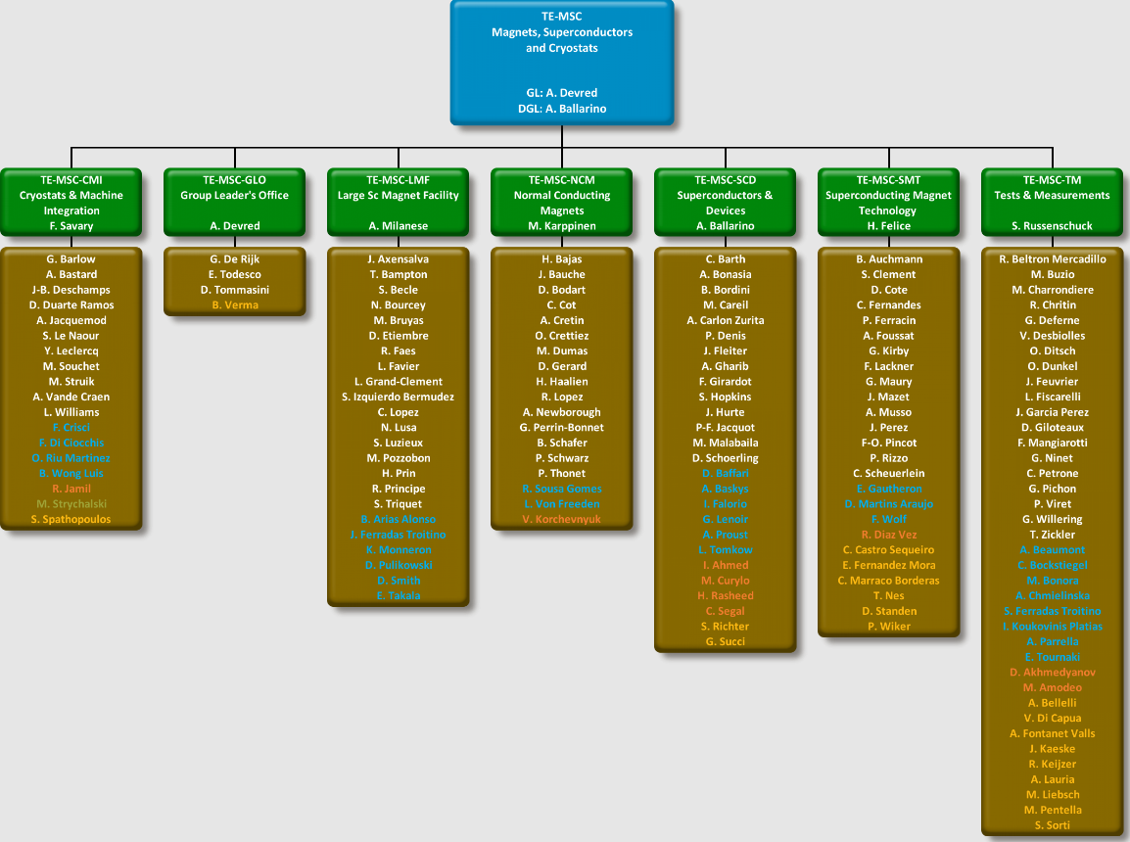
~100 staff members
~ 30 fellows
~ 20 students
~ 10 associates
~ 50 industrial contractors
Dealing with Superconducting Magnets
Dealing with Normal Conducting Magnets

Slide 4
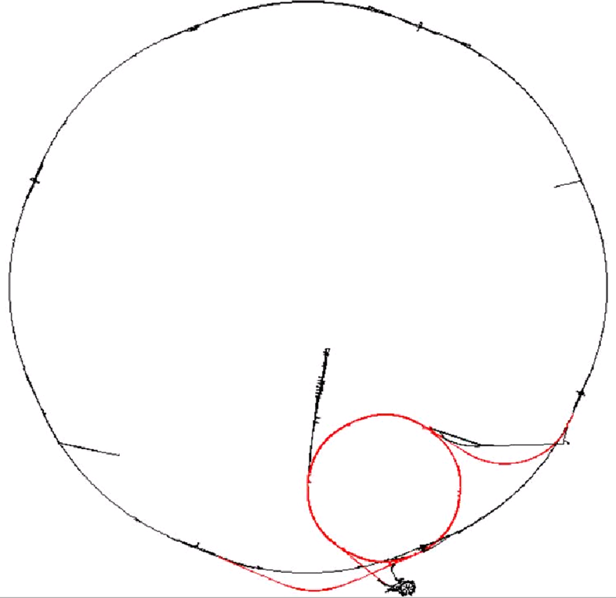
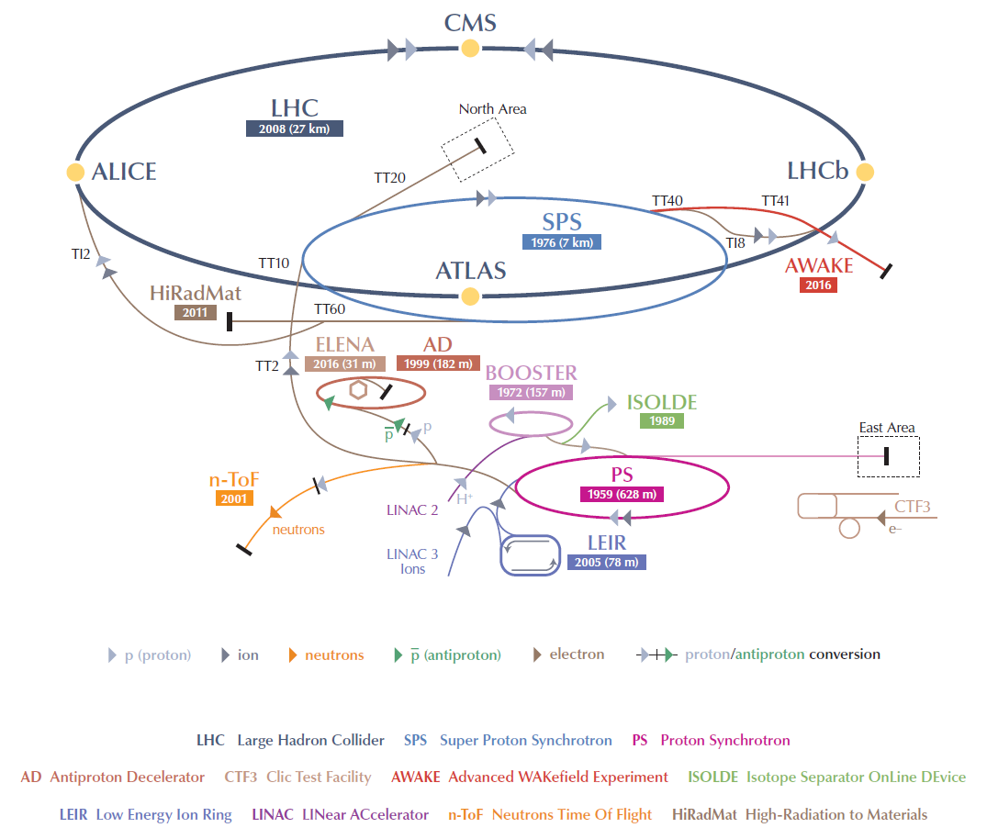

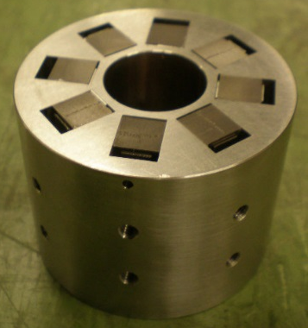
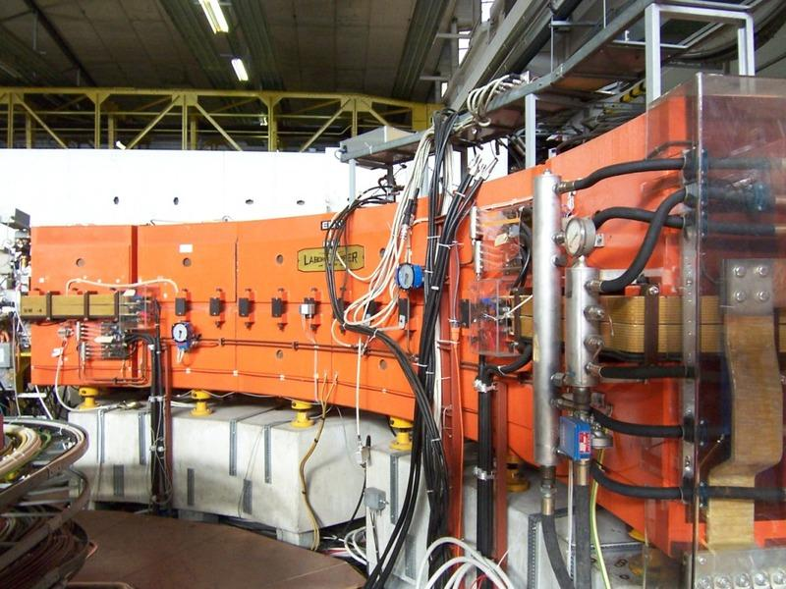
CERN Normal Conducting Magnets
About 20 km of beam lines in 16 different machines, all interconnected
~ 5000 installed magnets + ~ 2000 stored magnets → 50 000 tons
1 km
Large variety: ~ 500 different types
LINAC4 DTL PMQ, < 1 kg
LEIR main dipole, 60 tons

Slide 5

The MCM Section
Design, procurement/manufacture, maintenance, consolidation, and upgrades of the normal conducting magnets in the accelerators, transfer lines and experimental areas
Operation: maintenance and consolidation of existing machines
→ 2 dedicated workshops treating about 100 radioactive magnets/year
→ maintenance of installed magnets in the accelerators
→ interventions during physics run to minimize beam downtime
Projects: upgrades and new beam lines
→ 2 dedicated workshops for prototyping, tests and measurements
→ modification or construction of new magnets for machine upgrades (LIU, HL-LHC) or new beam lines (LINAC 4, ELENA, HIE-ISOLDE, AWAKE…)
www.norma-db.web.cern.ch

Slide 6
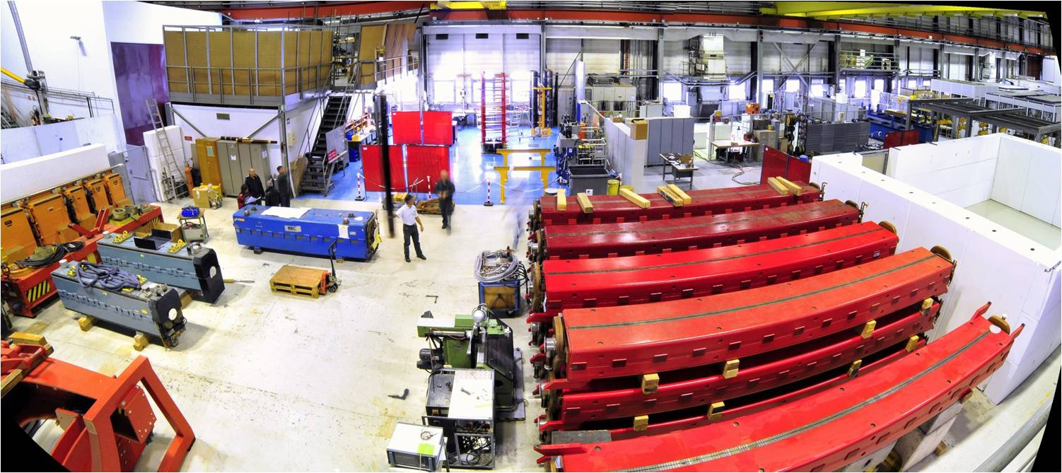
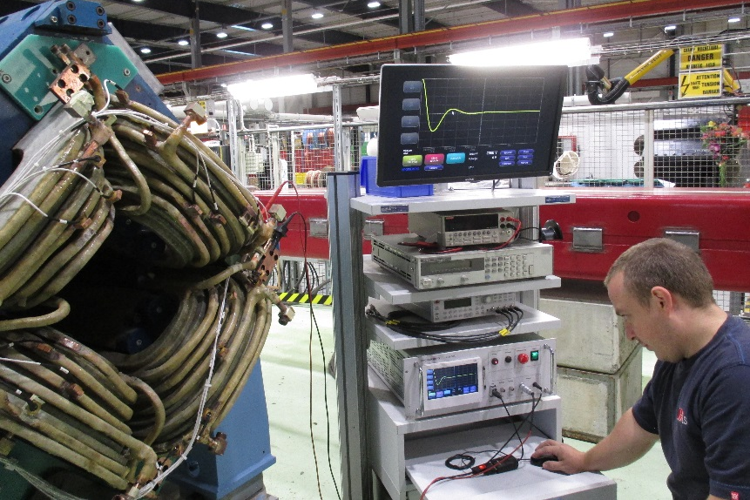
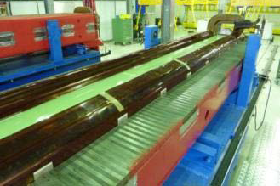
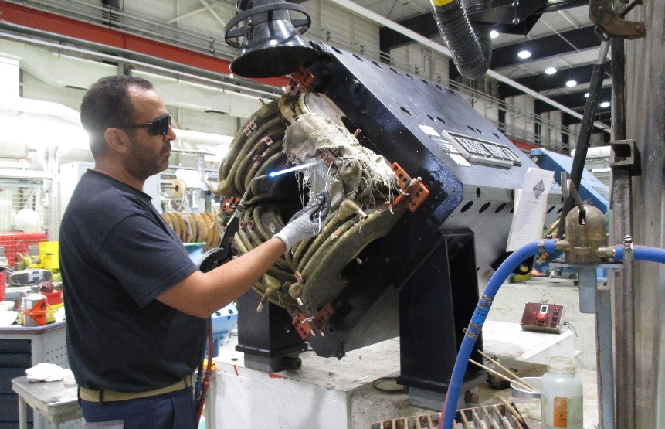
Operation and Maintenance
CERTIFICATION
MAGNET ASSEMBLY
REFURBISHMENT

Slide 7
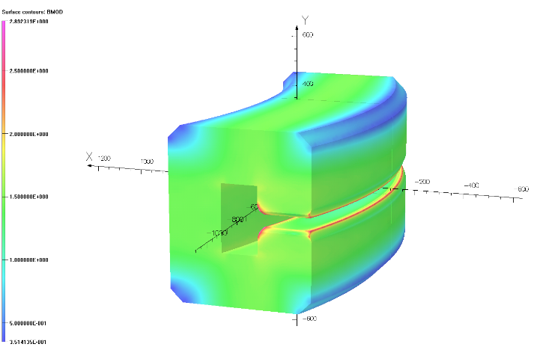
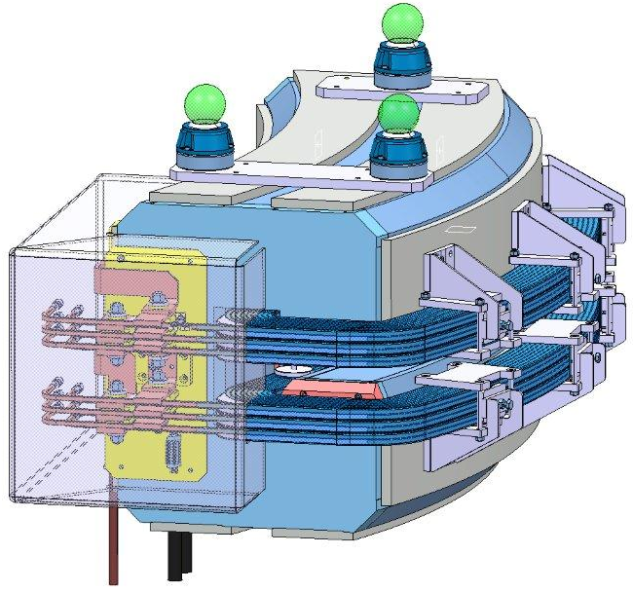
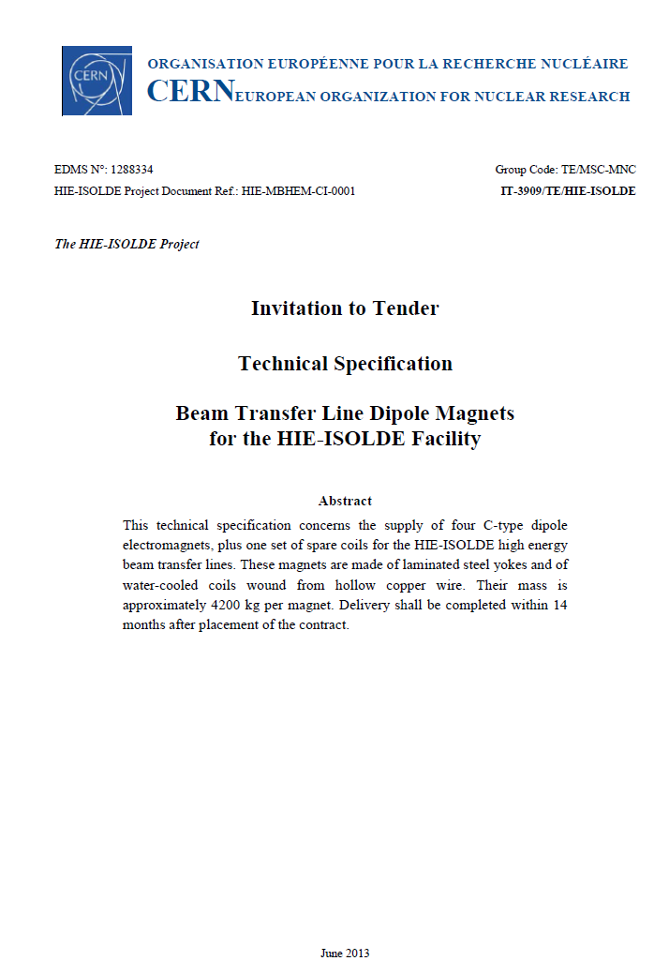
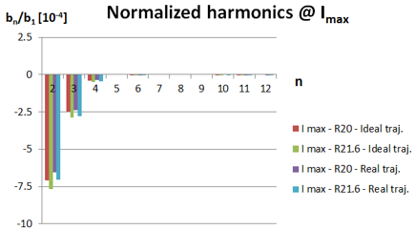
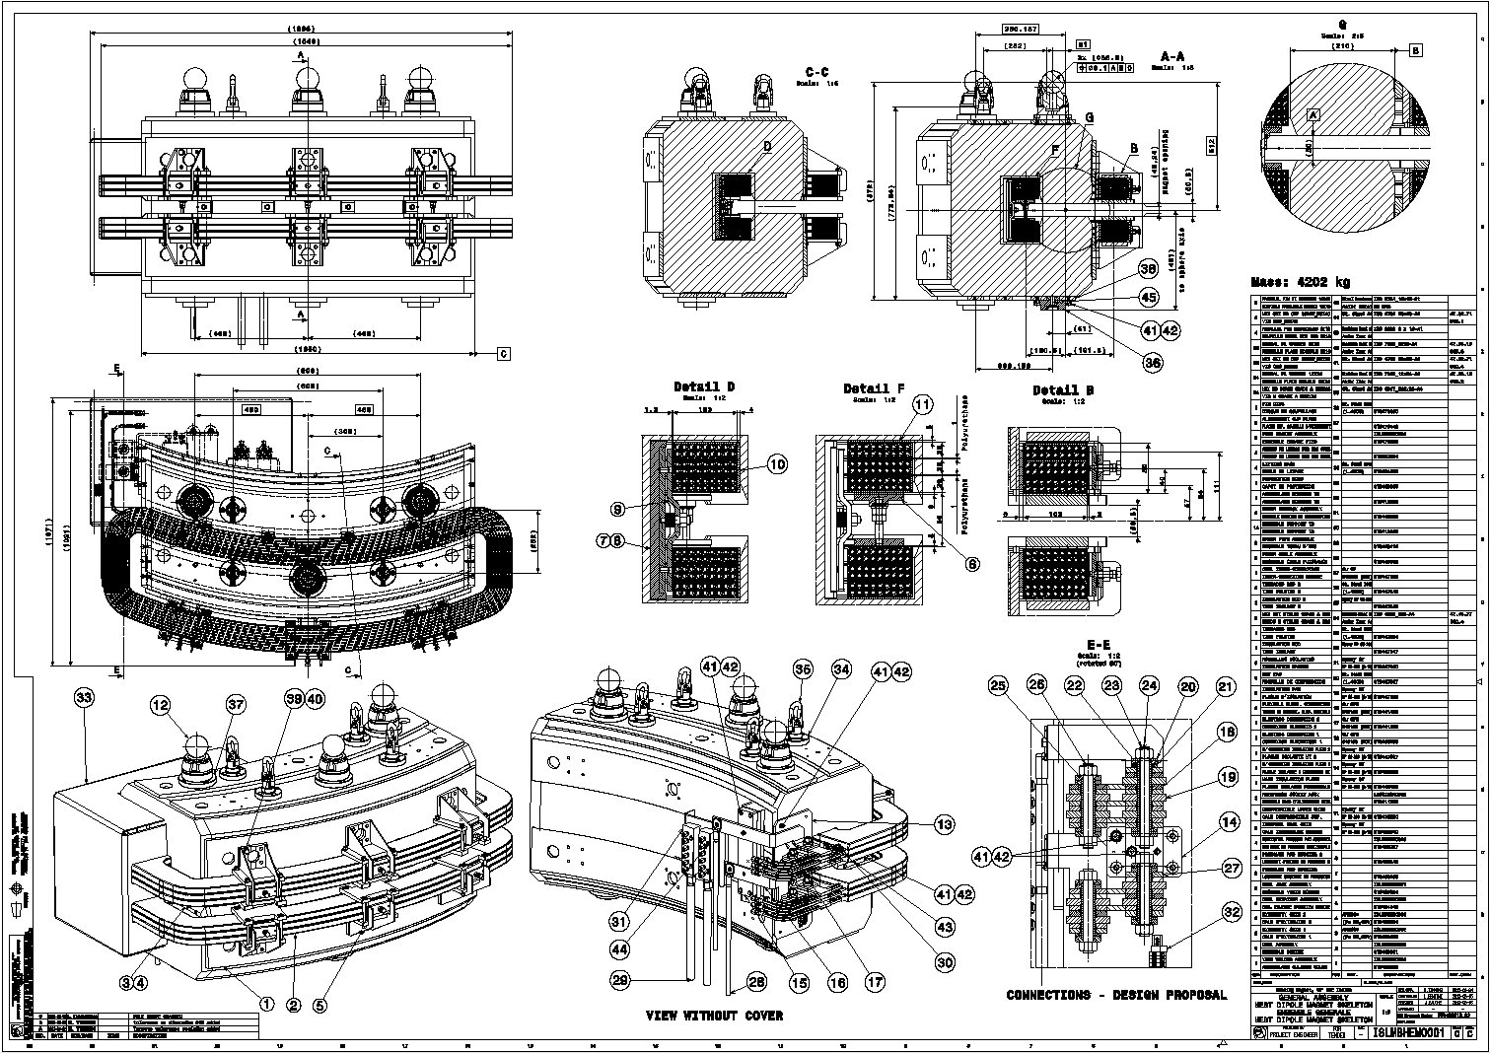
Design and Procurement
Magnetic design
Mechanical design
Specifications for manufacture;
follow-up in industry

Slide 8
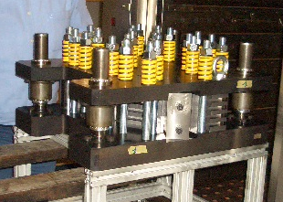
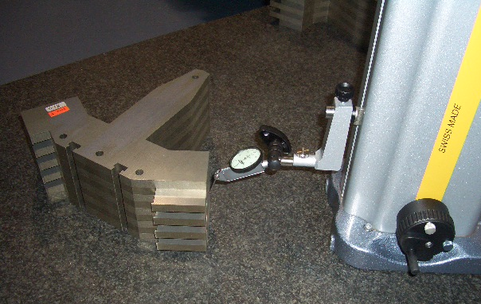
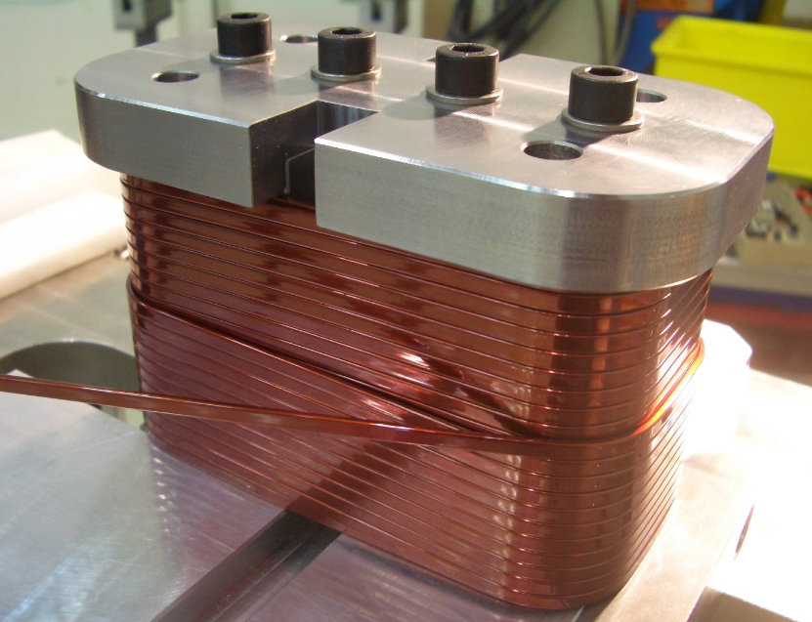
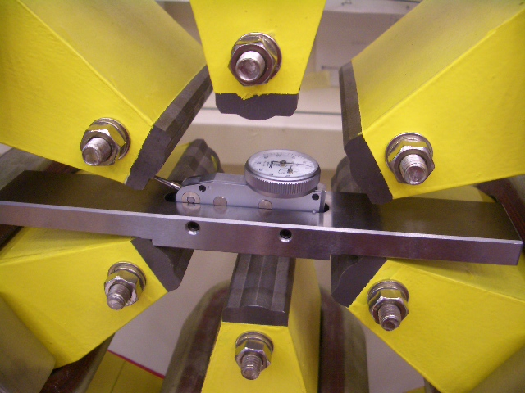
Manufacture and Tests
Manufacture
Tests and measurements

Slide 9
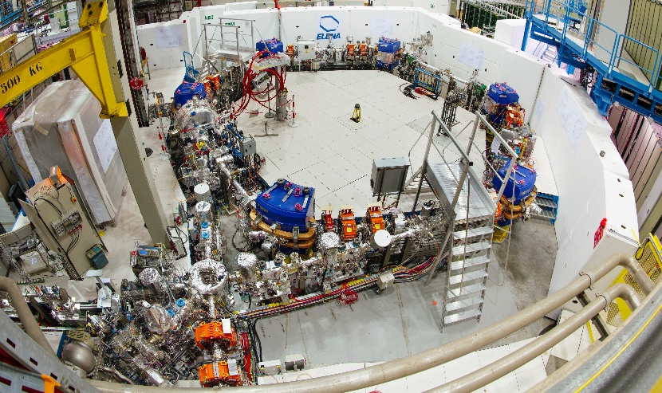
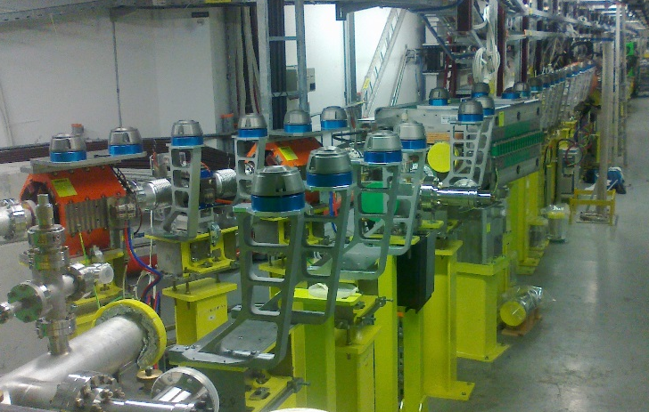
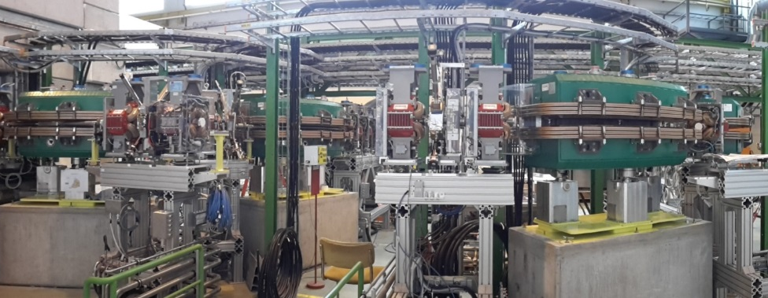
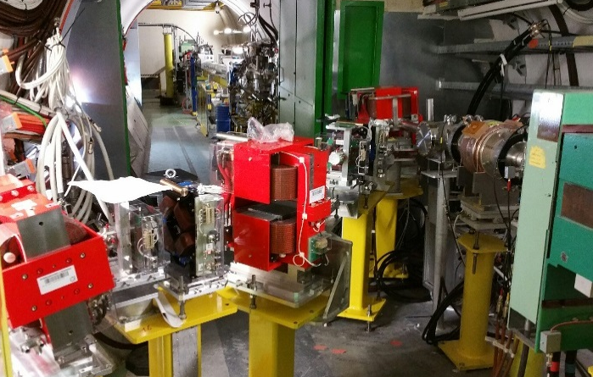
Projects – at CERN
ELENA
LINAC 4
HIE-ISOLDE
AWAKE

Slide 10
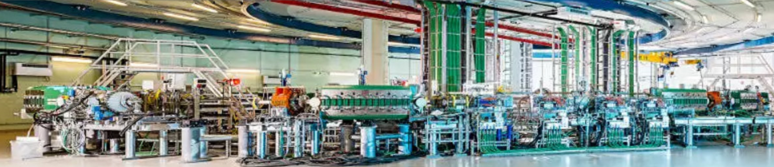
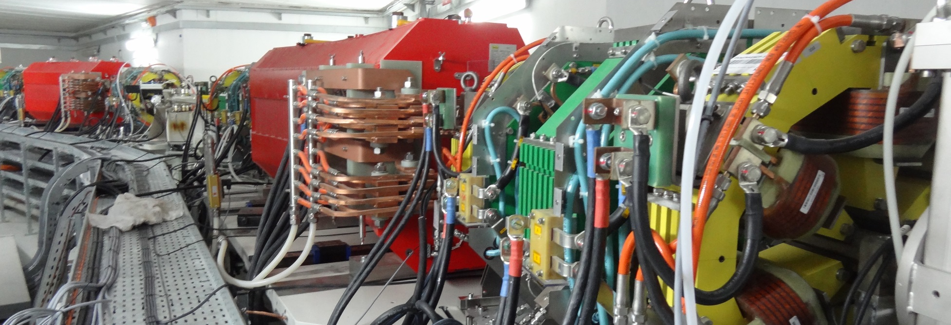
Projects – outside CERN
MEDAUSTRON, Austria
SESAME, Jordan

Slide 11
Program and Organization of Practical days
Up to 12 «active» participants/days («Full group»)
«Abridged group» participants welcome to attend, but without active participation
Two half-day sessions
Magnet manufacture and testing → morning
Magnetic measuremements → afternoon
Practical applications in CERN laboratories, organized remotely with Zoom
Try to preserve a maximum of interactivity
Guided by CERN magnet experts

Slide 12
Magnet Manufacture and Testing
Introduction to magnet manufacture (~45 min)
Materials for magnets
Magnet components
Manufacturing technologies
Yoke manufacturing
Coil winding and impregnation
Testing and measurement techniques
Practical applications in magnet test facility (~2 h)
Tests and measurements on recently built magnets
Measurements on systems and apparatus using instruments and formulae* learned during the theoretical courses
*See JUAS 2020 Indico page (https://indico.cern.ch/event/850755/timetable/ ):
“Magnet analytical design formulae” → timetable 5 March
“Introduction to magnets” lecture → timetable 2 March, 9:00

Slide 13
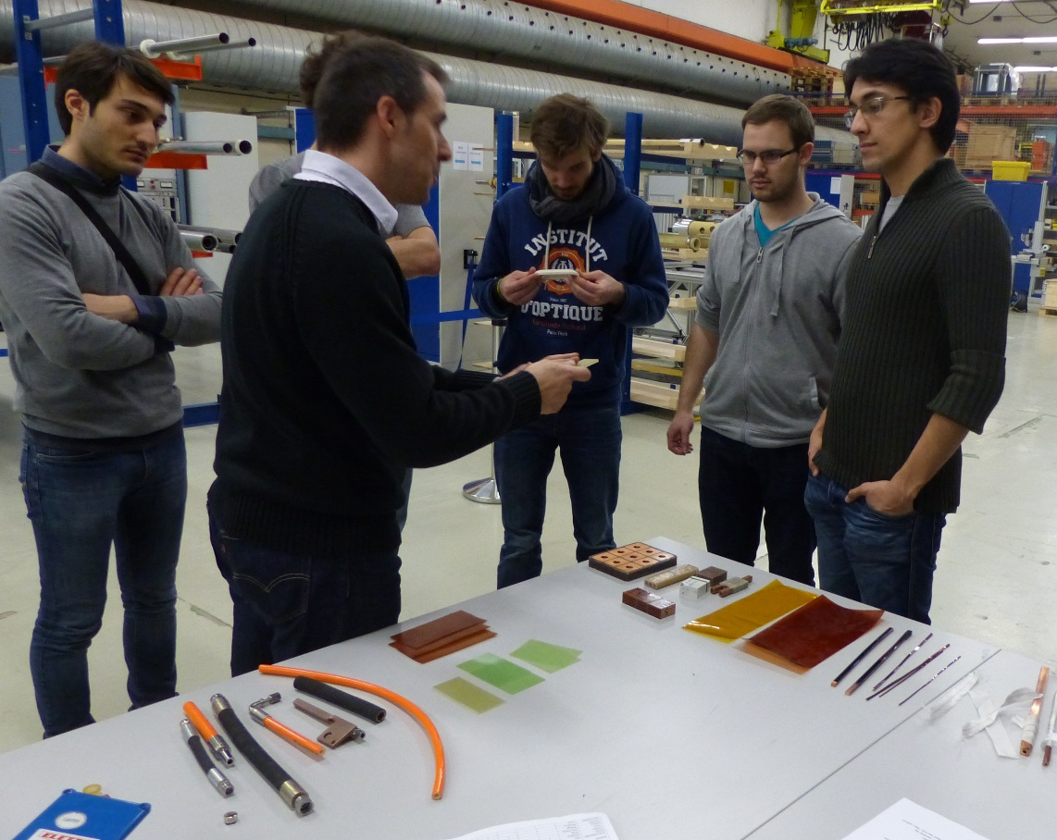
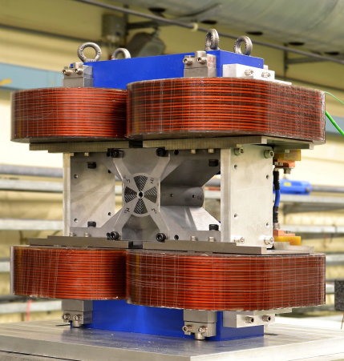
Magnet Manufacture
Coil winding
Yoke manufacturing
Materials, technologies, components, manufacturing processes, and assembly techniques
Coil impregnation
Magnet assembly
Magnet testing

Slide 14
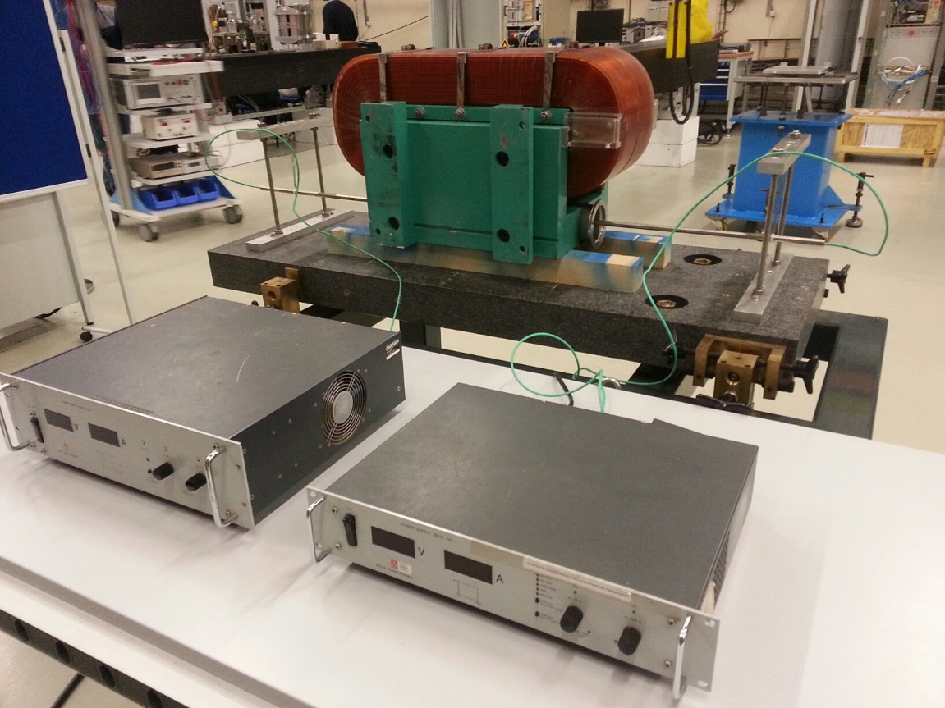
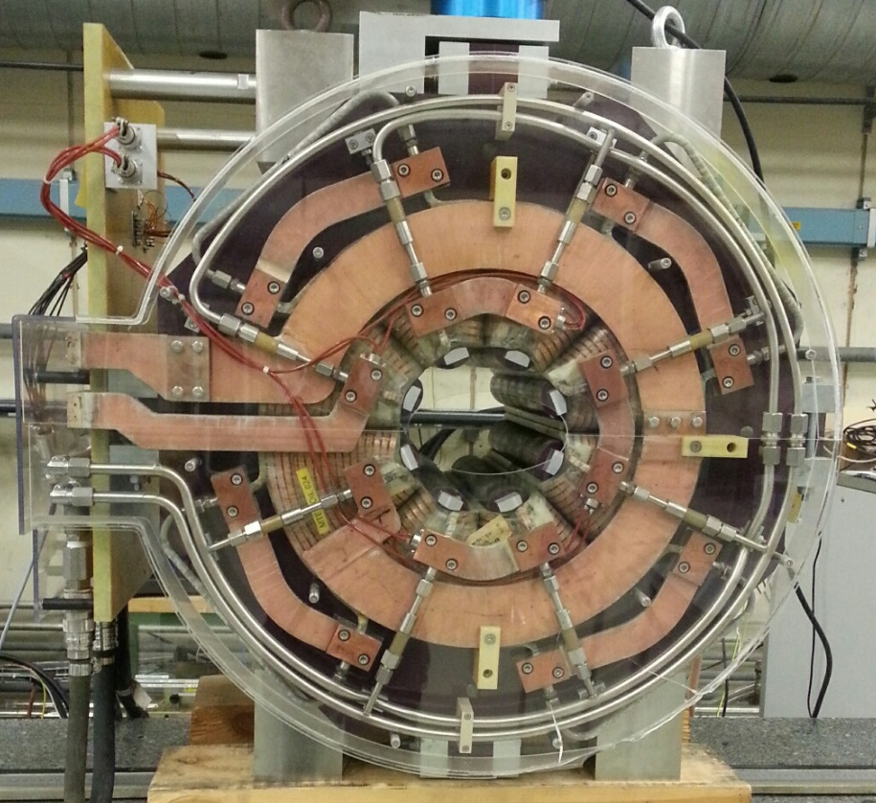
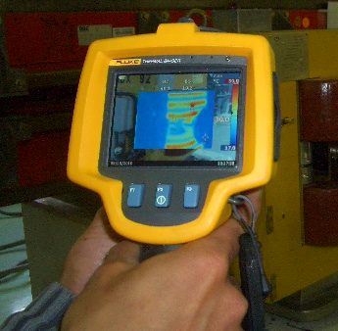
Magnet Testing and Practical Applications
Use of analytical formulae and measurements systems to calculate magnet parameters
Testing magnets to assess their functionnality and reliability

Slide 15
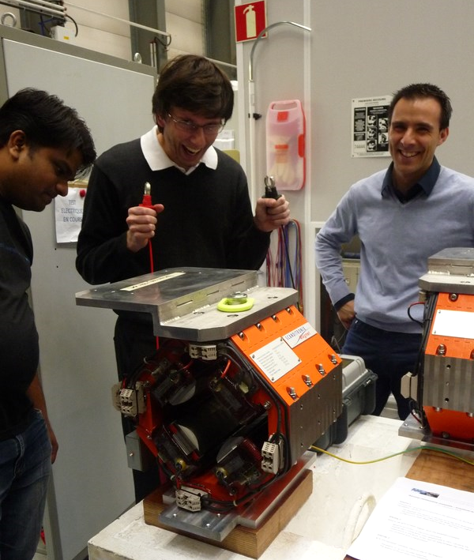
We are looking forward...
...to virtually welcome you at CERN
… and unravel the mysteries of the magnets
…in a relaxed atmosphere!

