Slide 1
Virtual Practical Work on Magnets Part 2: Magnetic Measurements 4th – 5th March 2021
Joint Universities Accelerator School
JUAS 2021
Lucio Fiscarelli
Thomas Zickler
CERN

Slide 2
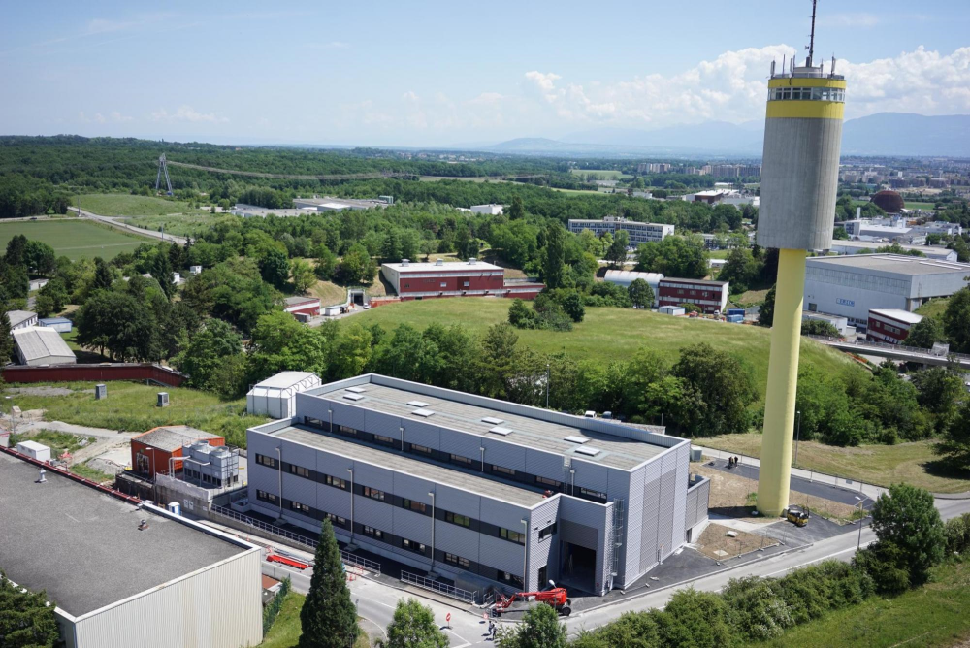
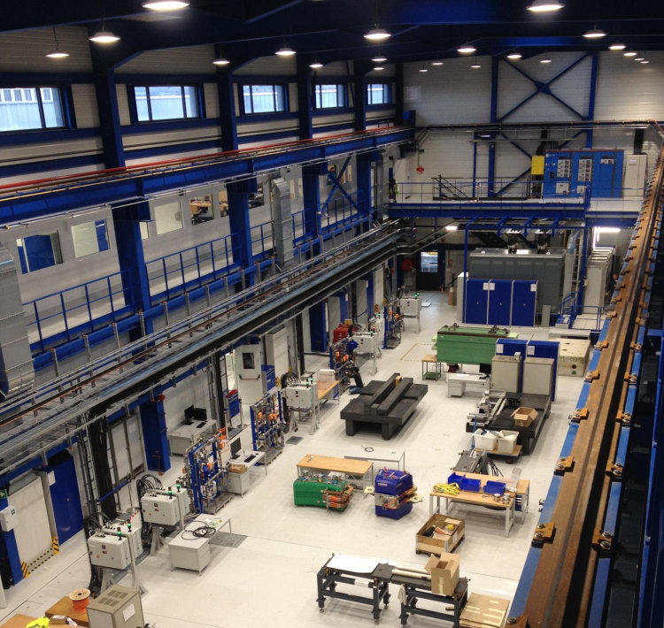
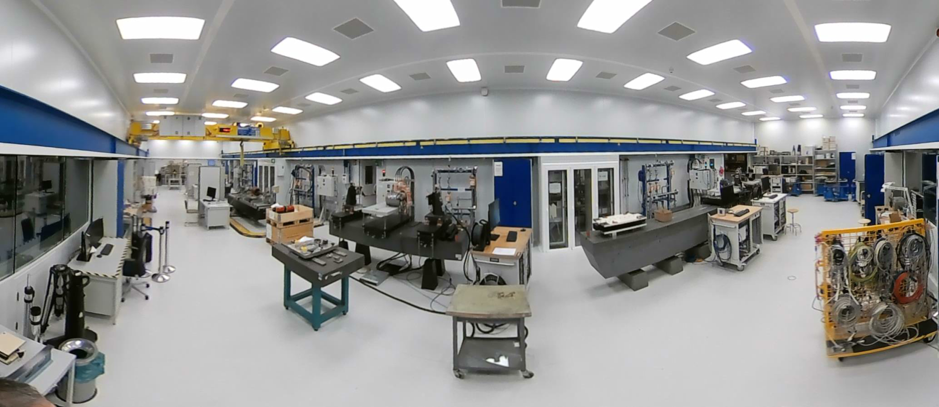
Virtual tour in one of our laboratory
New lab constructed in 2017

Slide 3
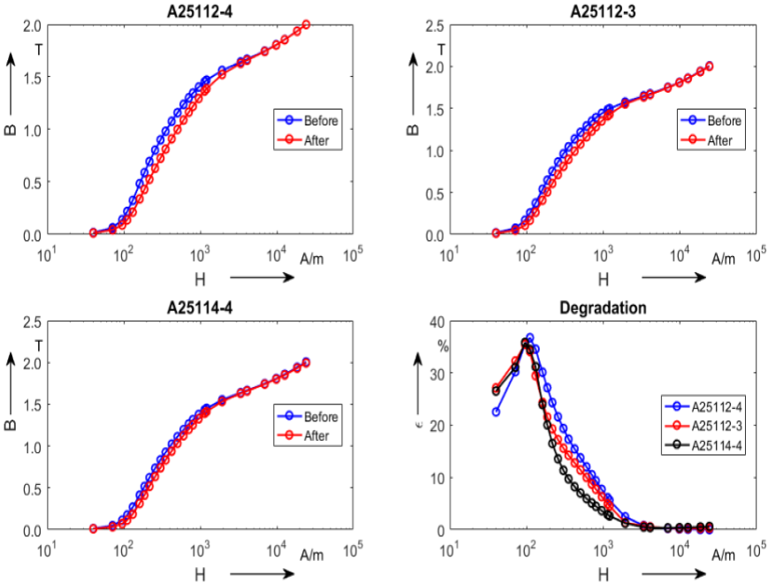
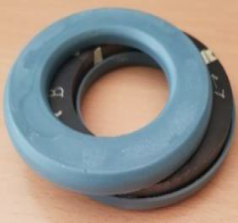
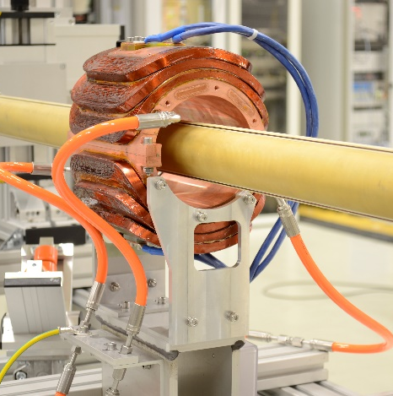
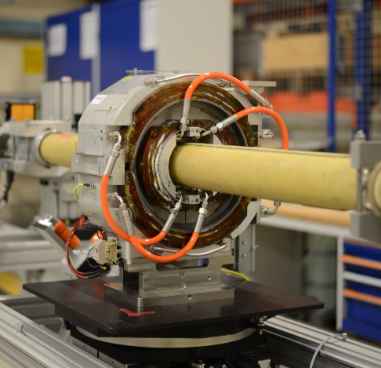
Unterstand the motivation for MM
Magnetic measurements (MM) are performed to:
Characterize soft (iron) and hard (permanent magnets) ferromagnetic materials
Prove that the electro-magnetic design is correct
Monitor production quality and steer manufacturing
Collect information and data for operations: transfer function, field uniformity, magnetic axis, dynamic effects (eddy currents) and cycling effects (hysteresis)
Real-time field measurements for operations
Characterize magnets after repairs or for operations in different ranges
Characterization of the BH-curve on samples of magnetic steel
Rotating coil measurement on a model and the final magnet
Field homogeneity reconstructed from rotating coils measurements

Slide 4
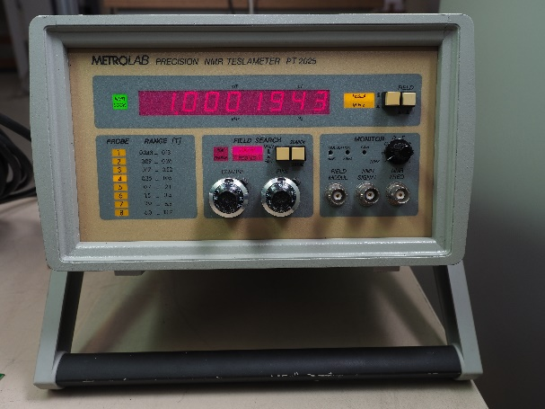
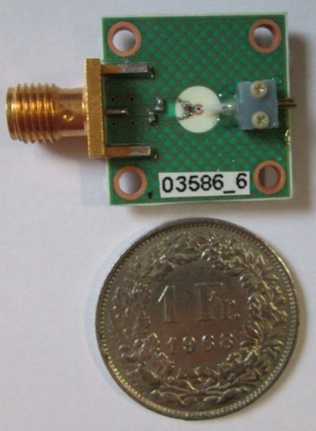
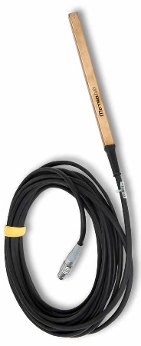
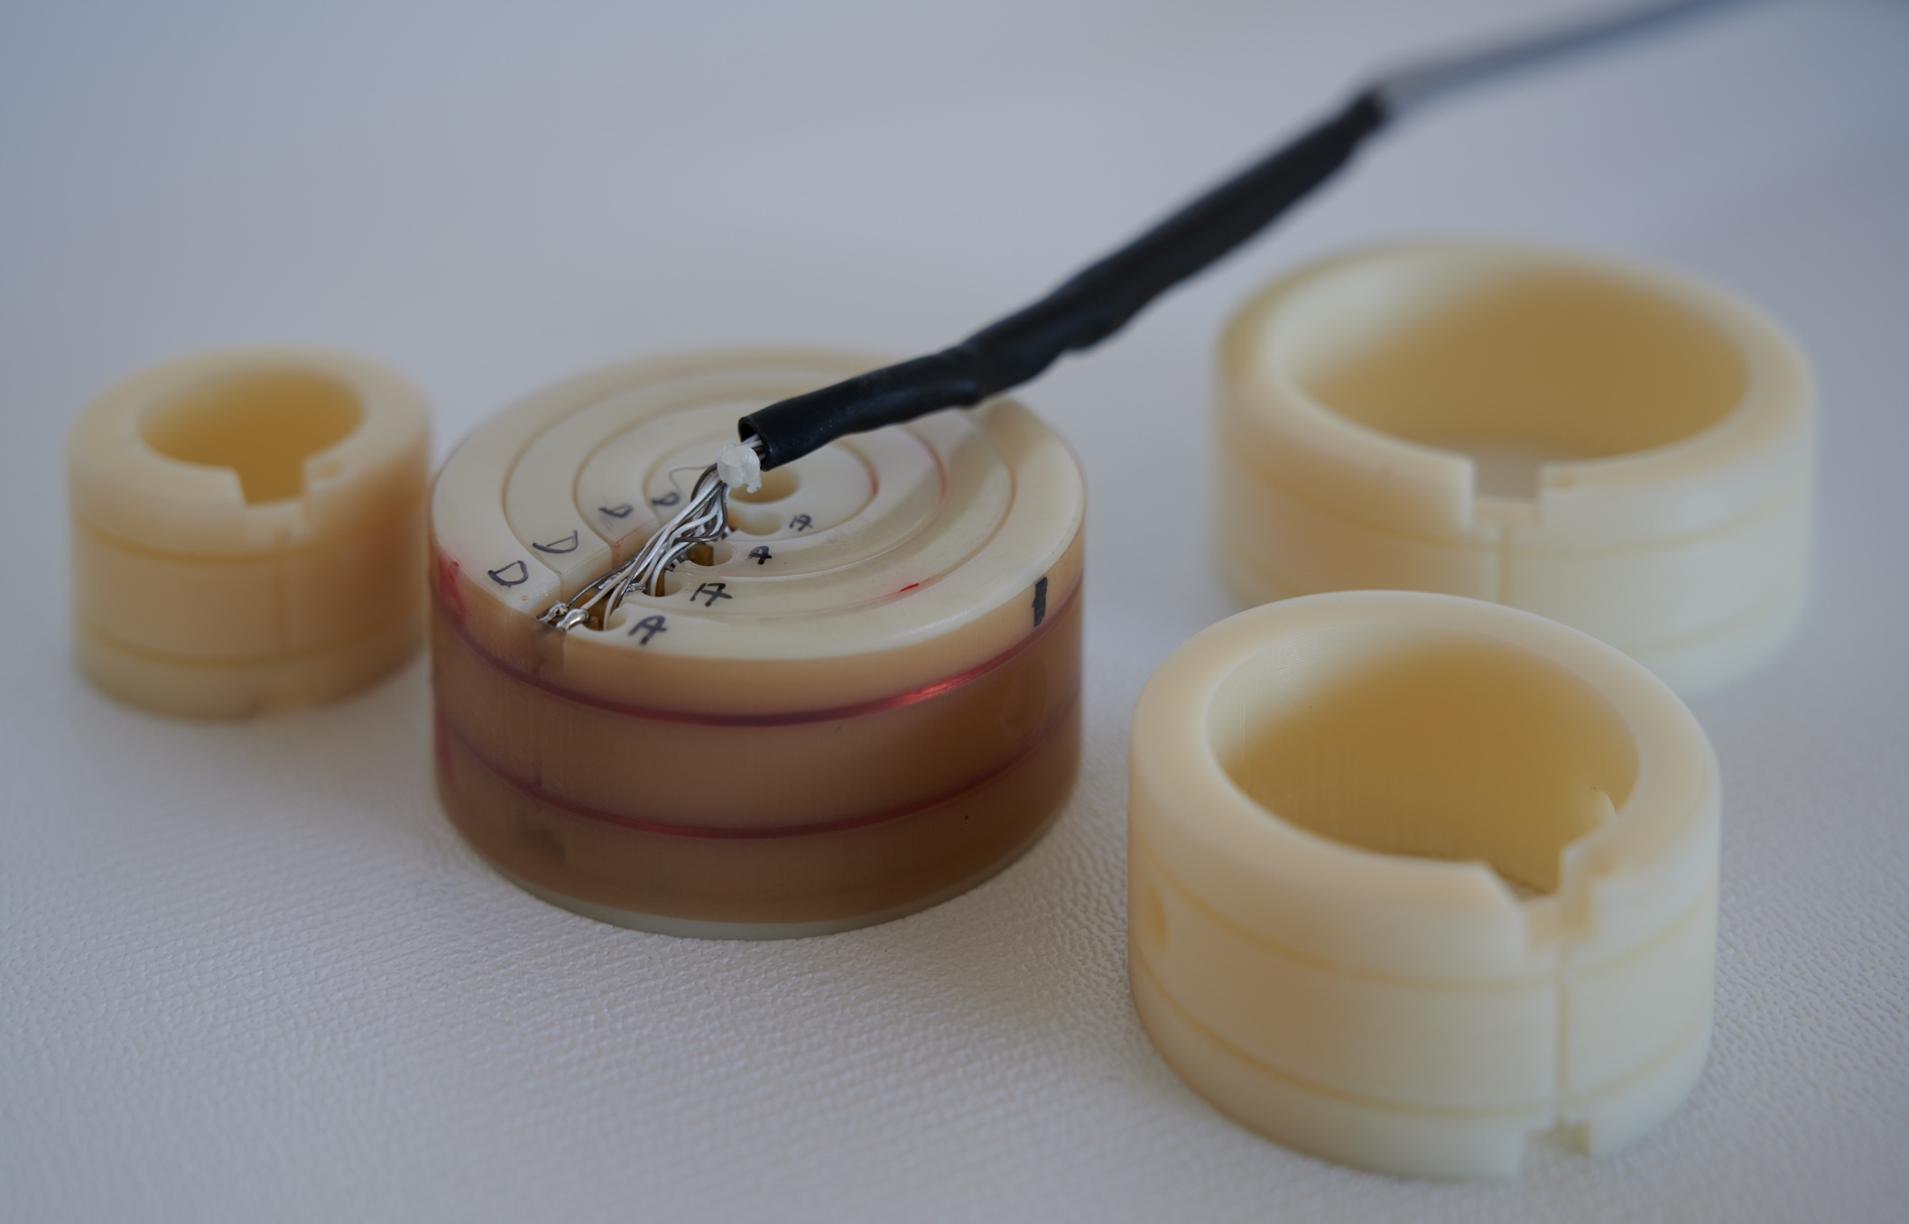
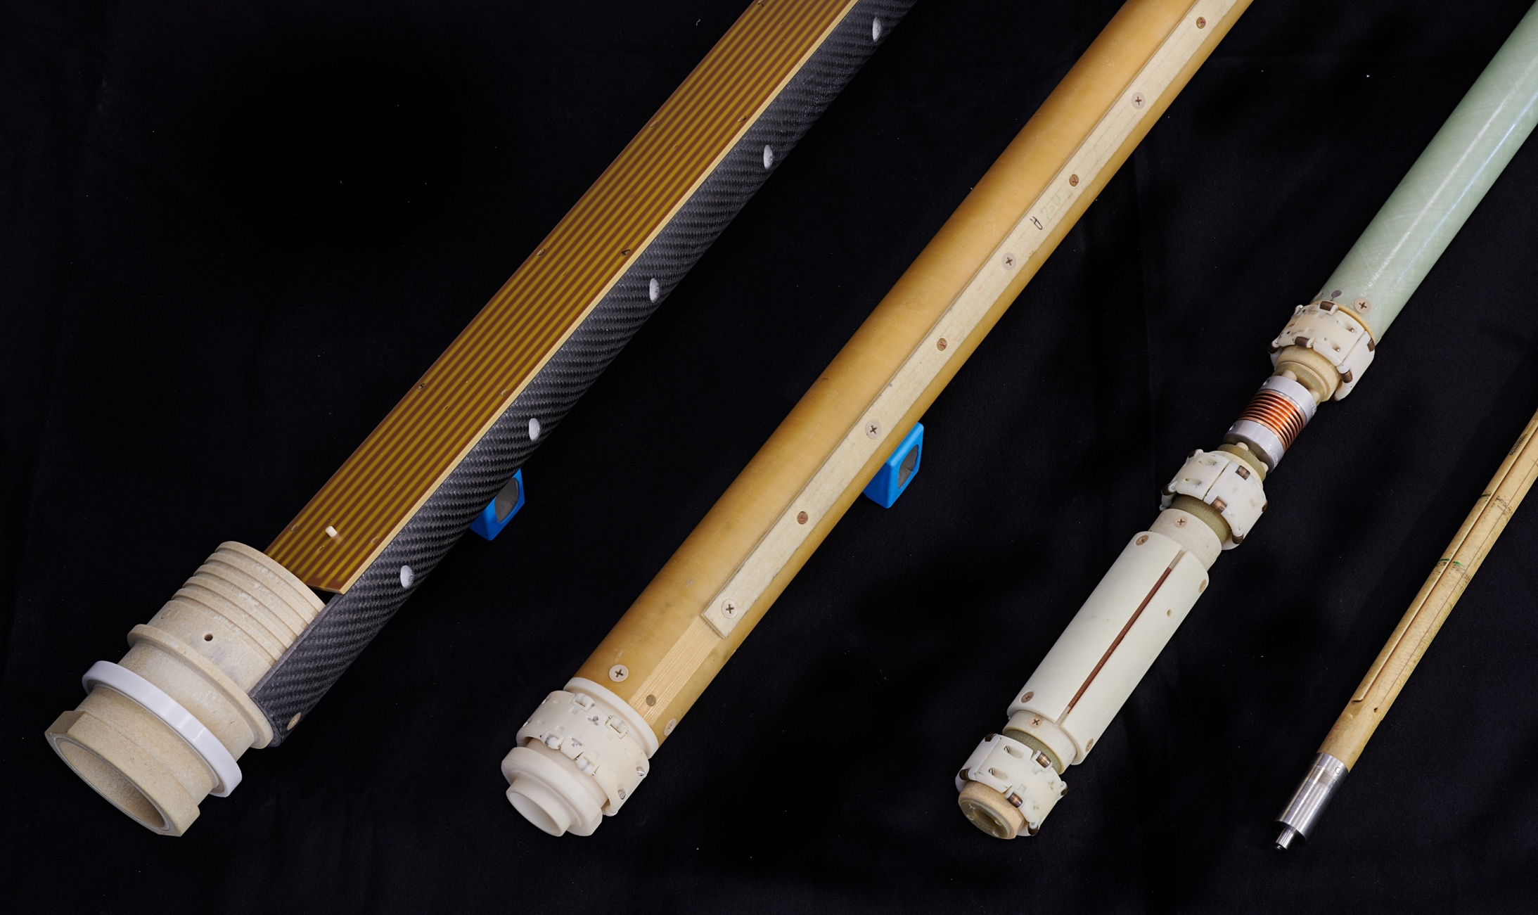
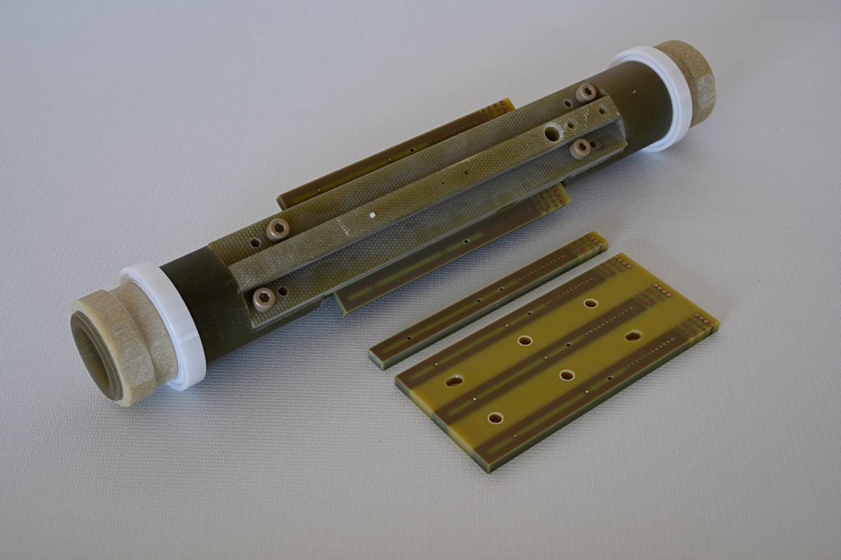
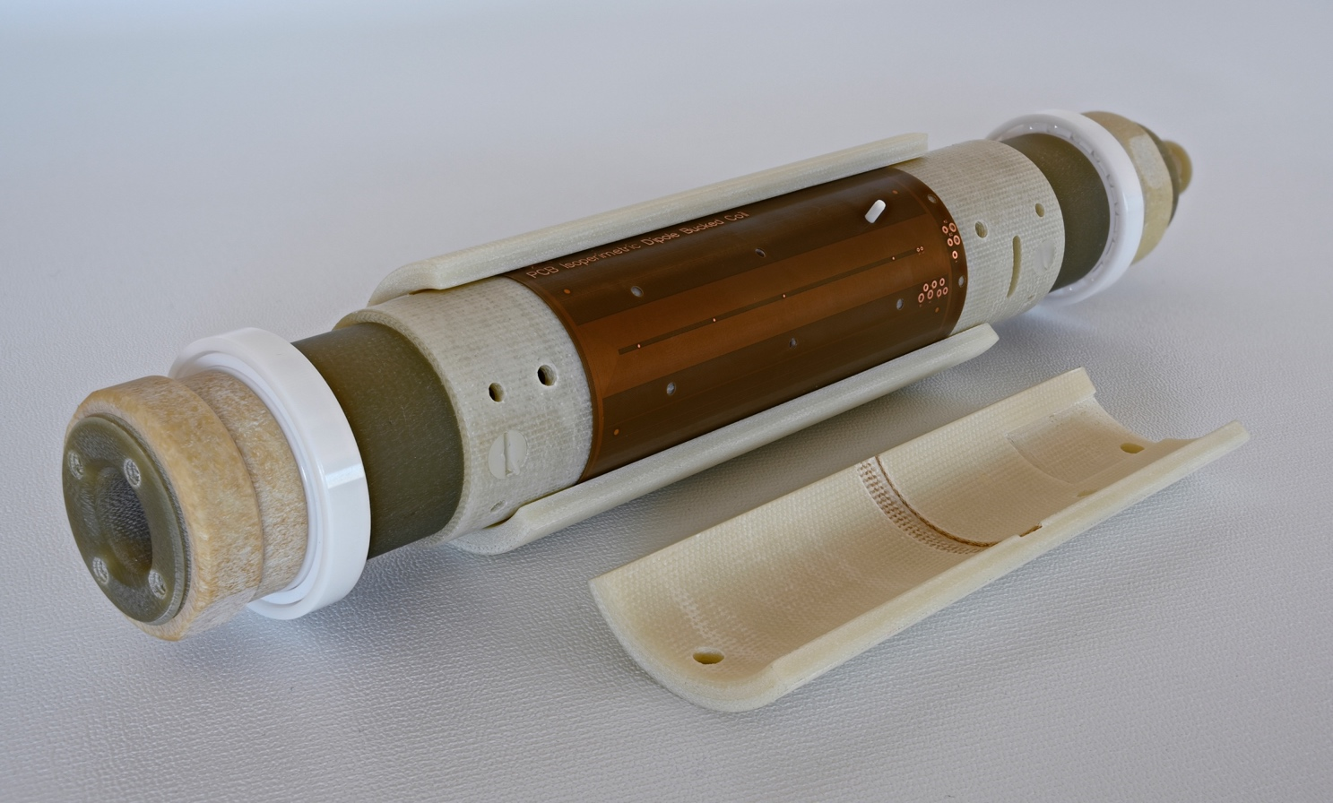
Explore different MM sensors
No single instrument or method can cover all requirements
Multiple instruments are complementary
Overlaps provide estimation of absolute uncertainty and error correction
Commercial teslameters based on Hall sensors and NMR
FMR marker
Concentric induction coils
Rotating coils with various diameters, lengths, and coil arrangement

Slide 5
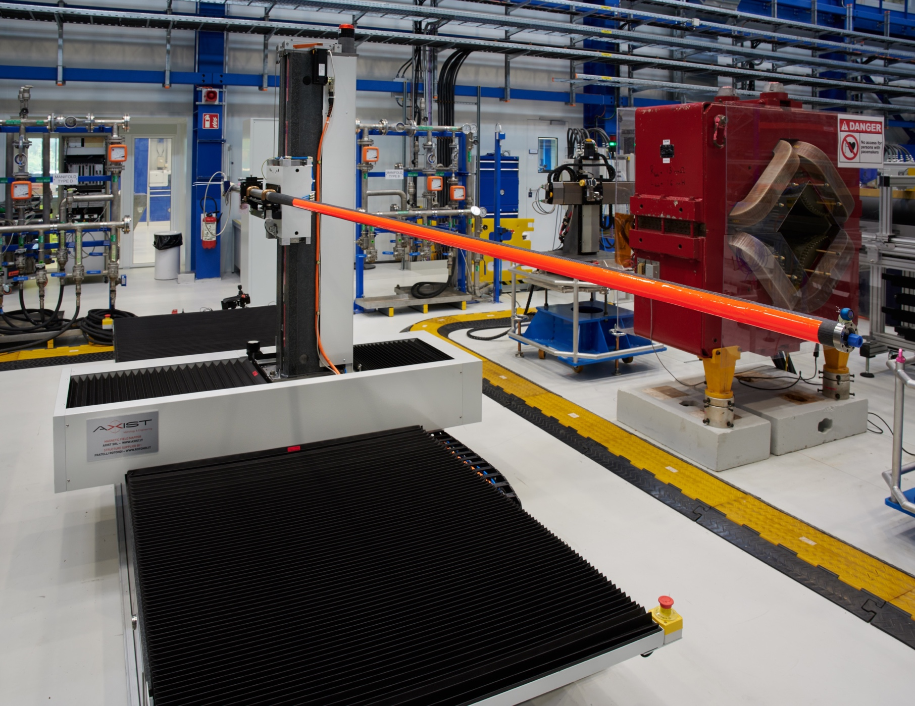
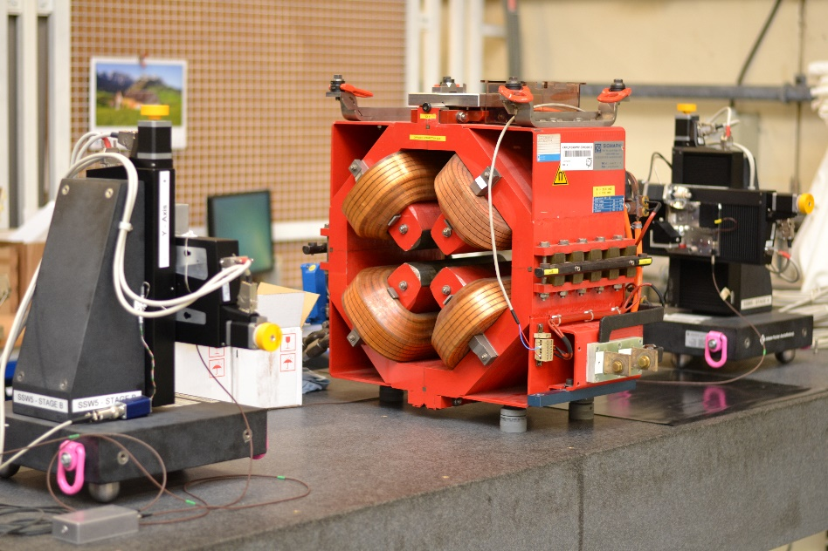
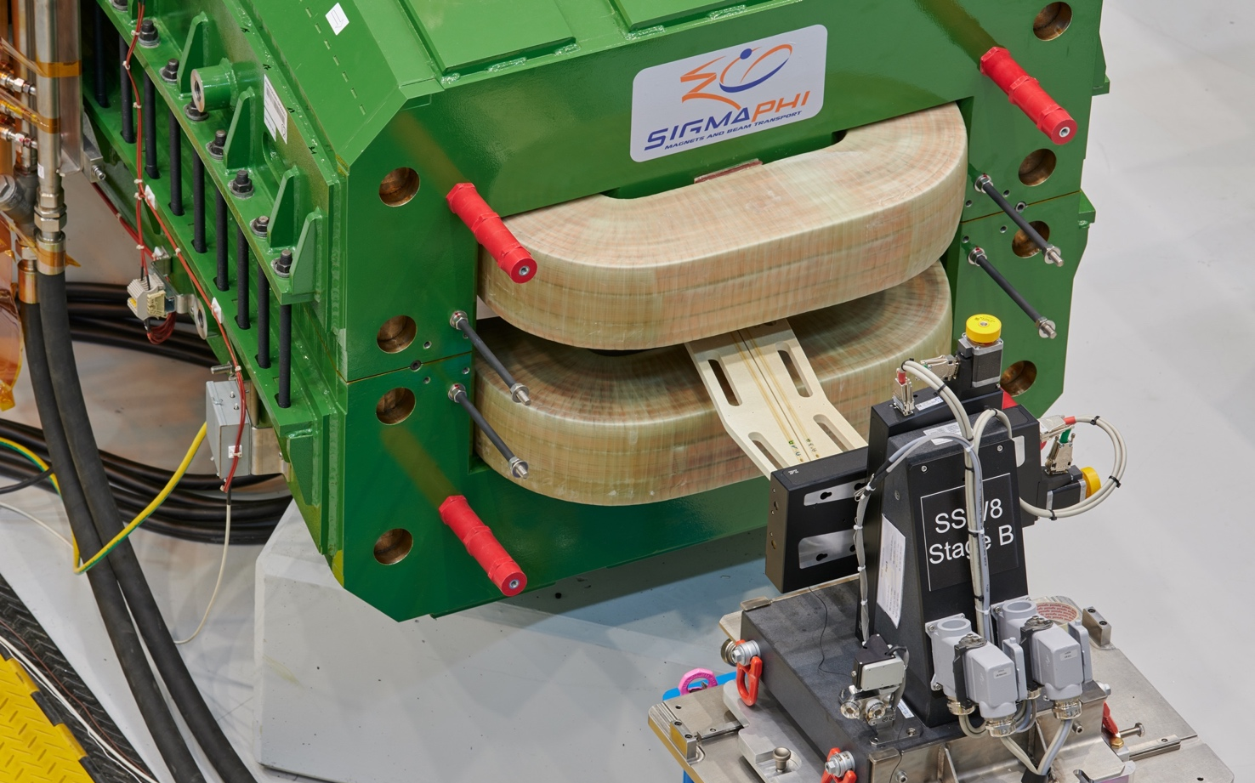
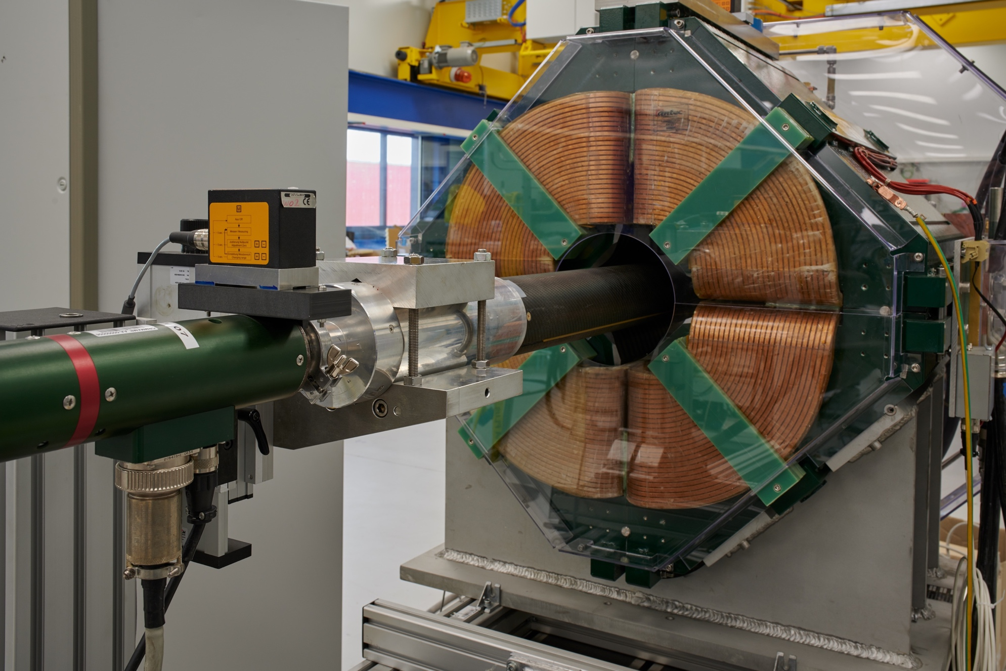
Discover the different MM techniques
3D mapper
Single stretched wire bench
Induction coil magnetometer (“fluxmeter”)
Rotating coil magnetometer

Slide 6
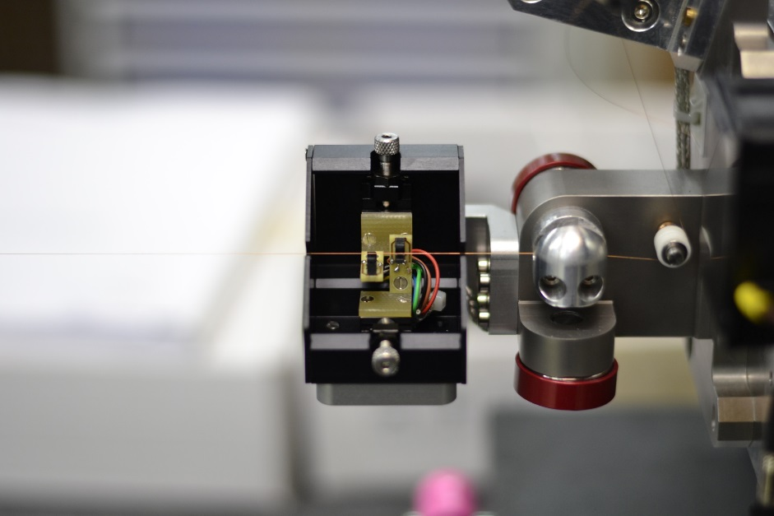
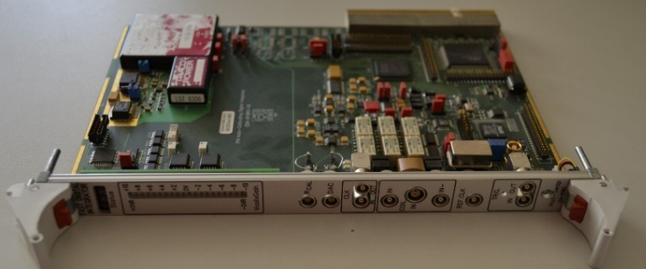
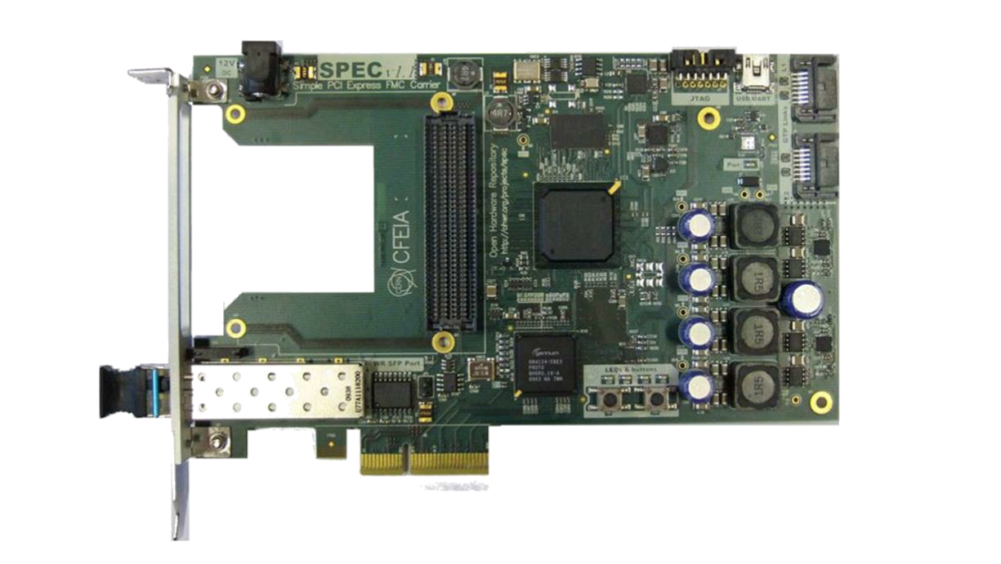
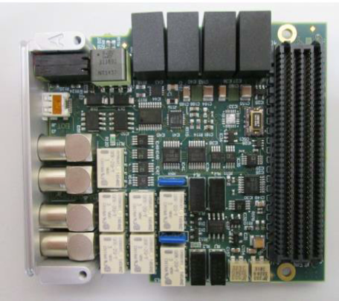
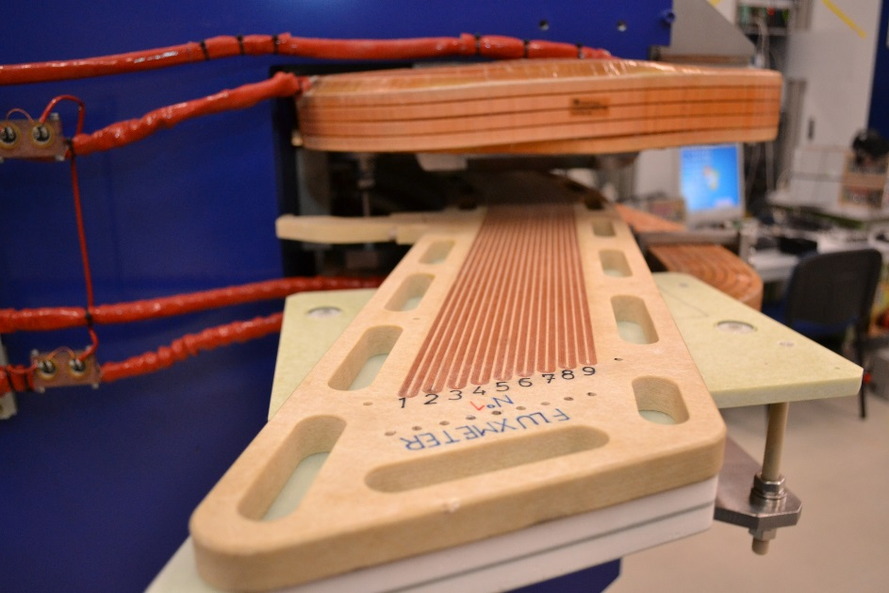
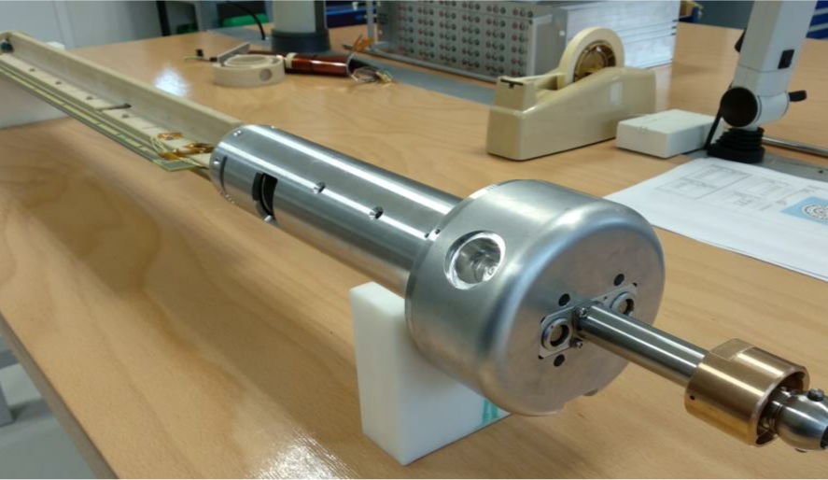
Find out about latest developments
Photodetectors in the vibrating wire system
Digital integrator modules
Multi-coil fluxmeter for the ELENA curved dipoles
Rotating-coil scanner for HL-LHC magnets

Slide 7
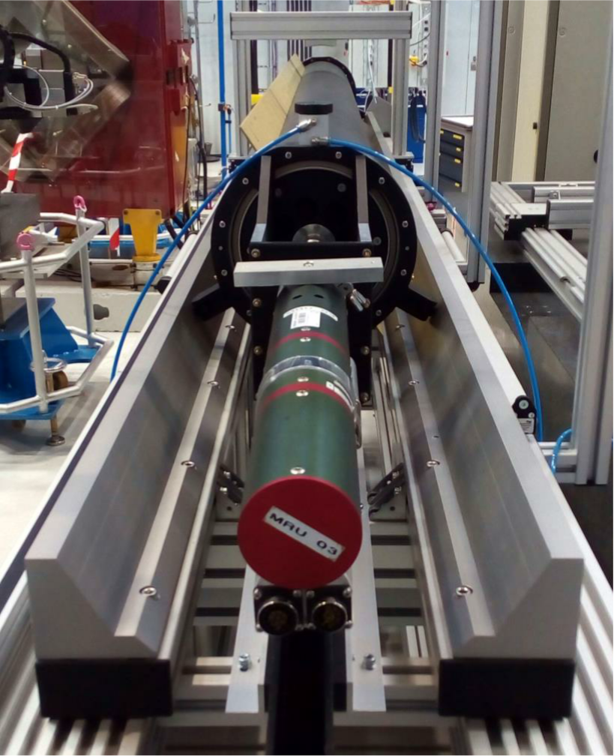
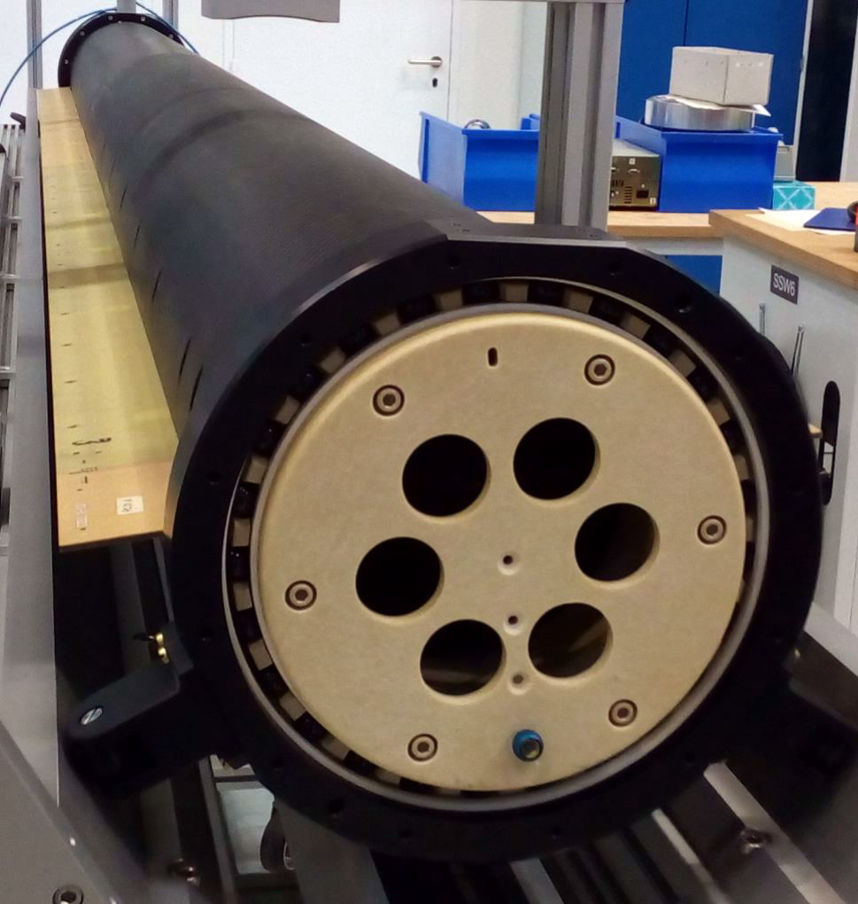
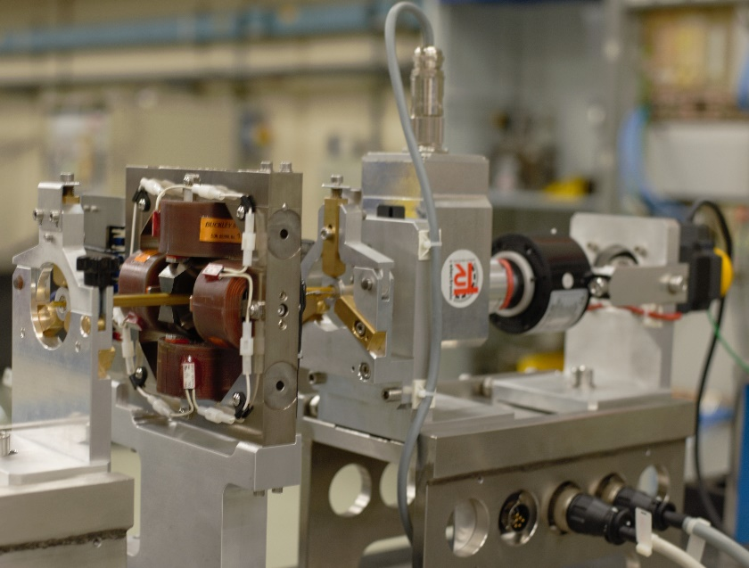
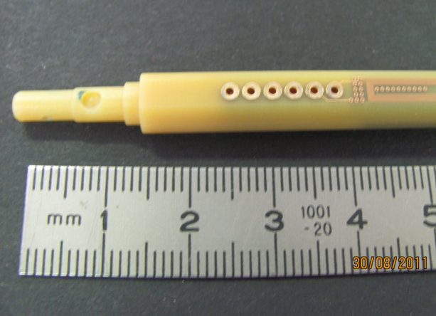
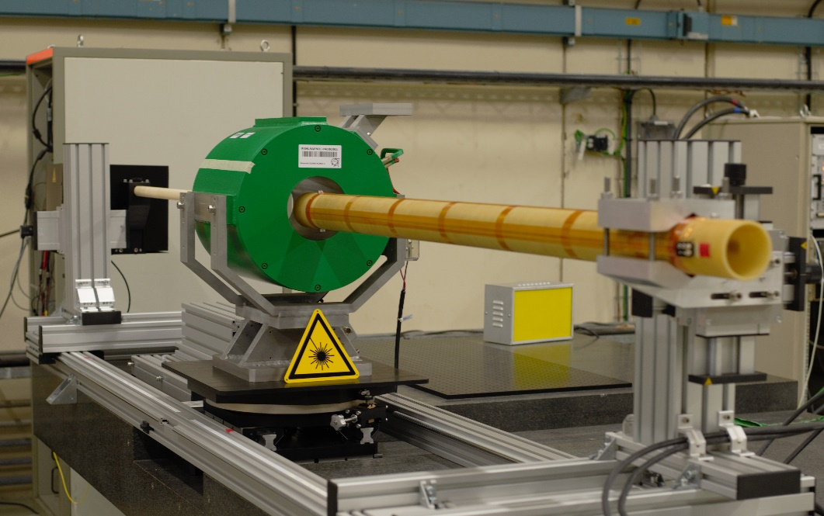
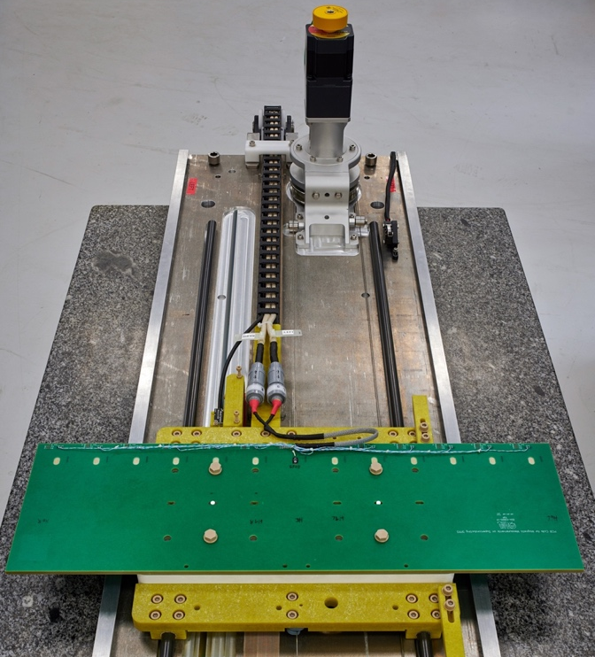
Find out about latest developments
Large-diameter carbon fibre shaft for FAIR
Miniature rotating coil using PCB technology for CLIC
Compass-laser probe for solenoids
Translating fluxmeter for FAIR dipoles

Slide 8
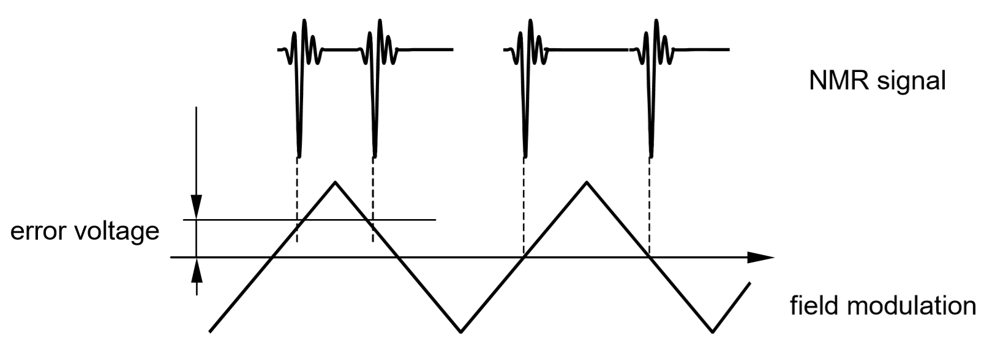
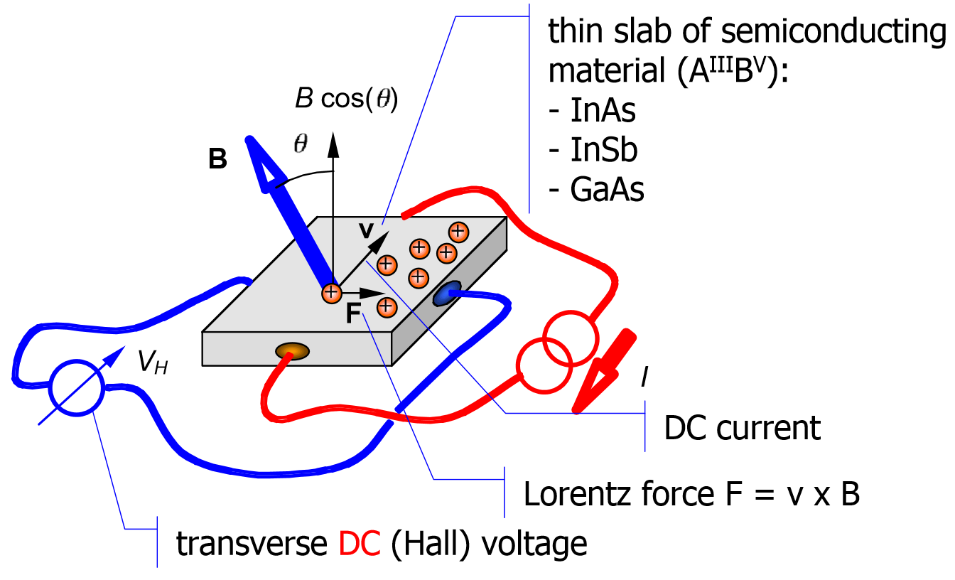
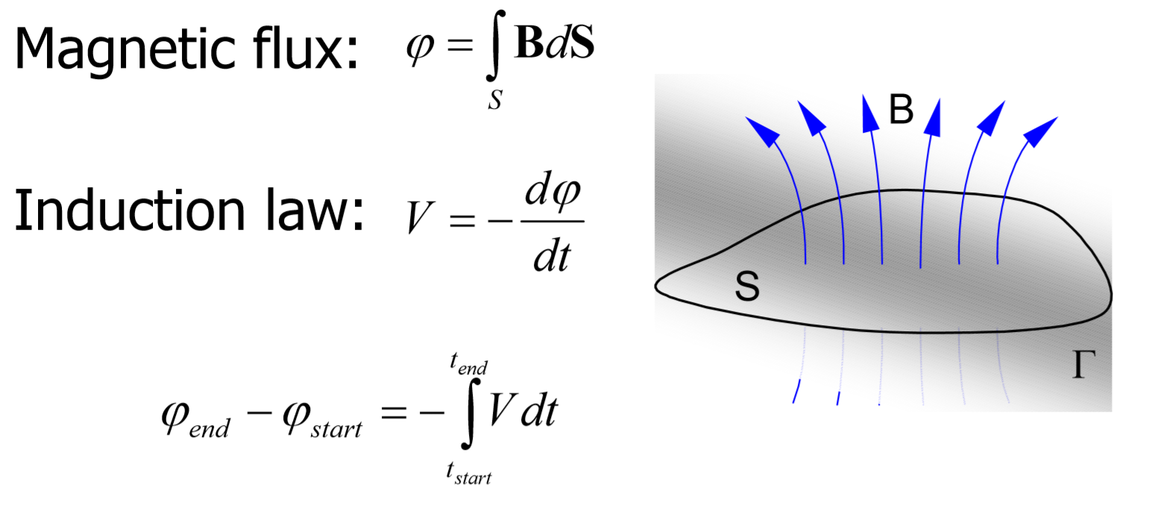
And learn…
… how the sensors work and how to chose the right one
NMR
Hall sensors
Induction coils

Slide 9
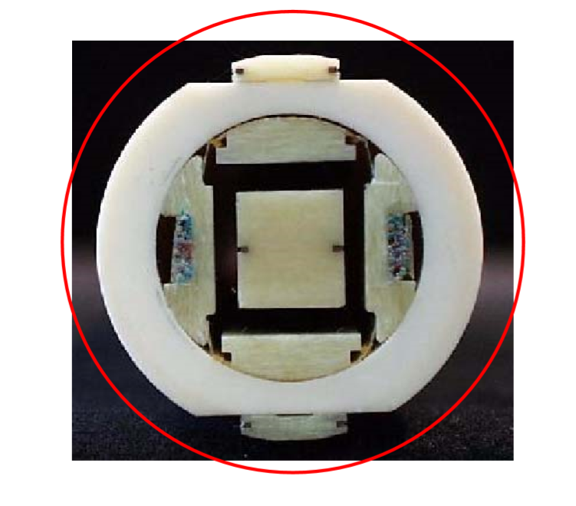
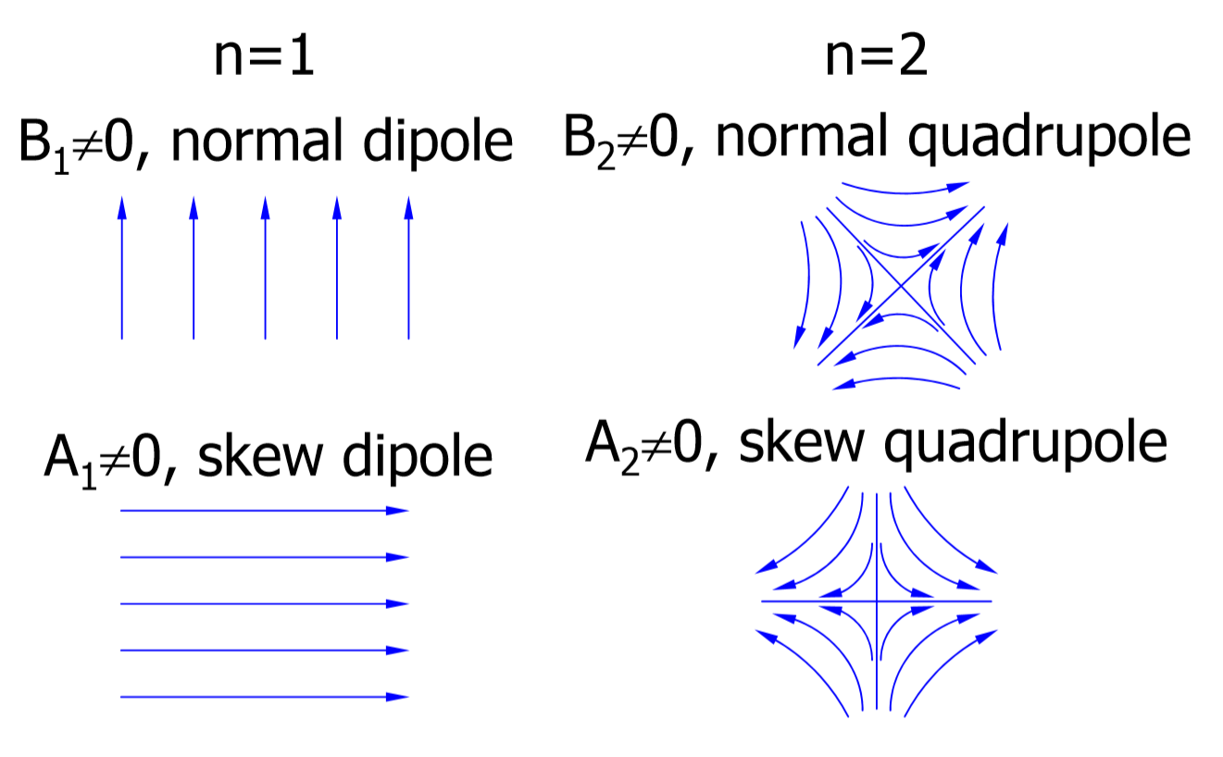
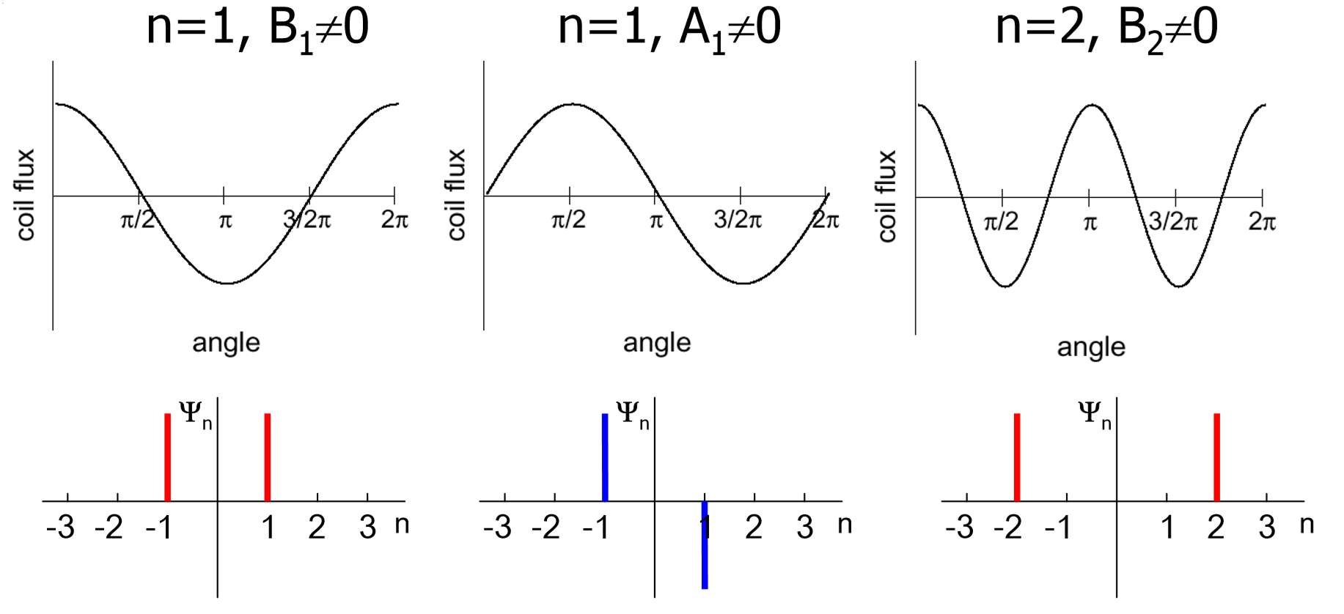
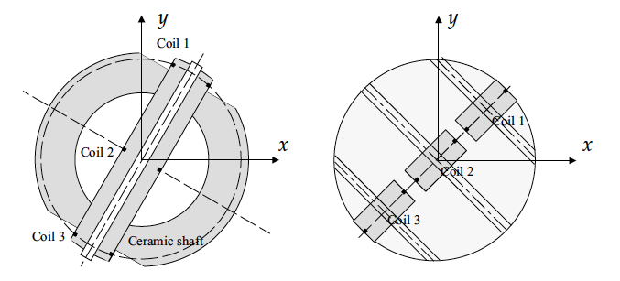
And learn…
… how a rotating-coil system works

Slide 10
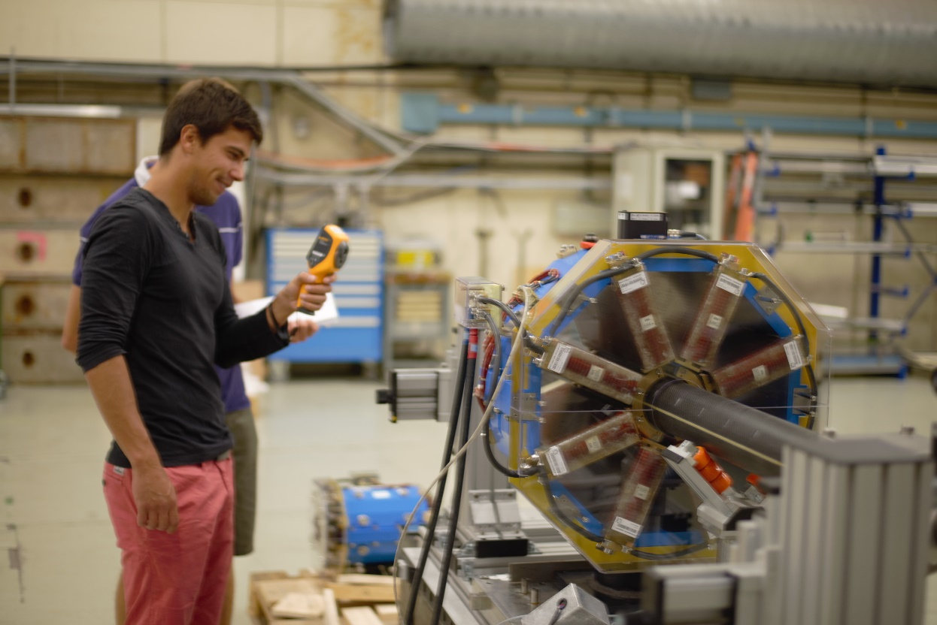
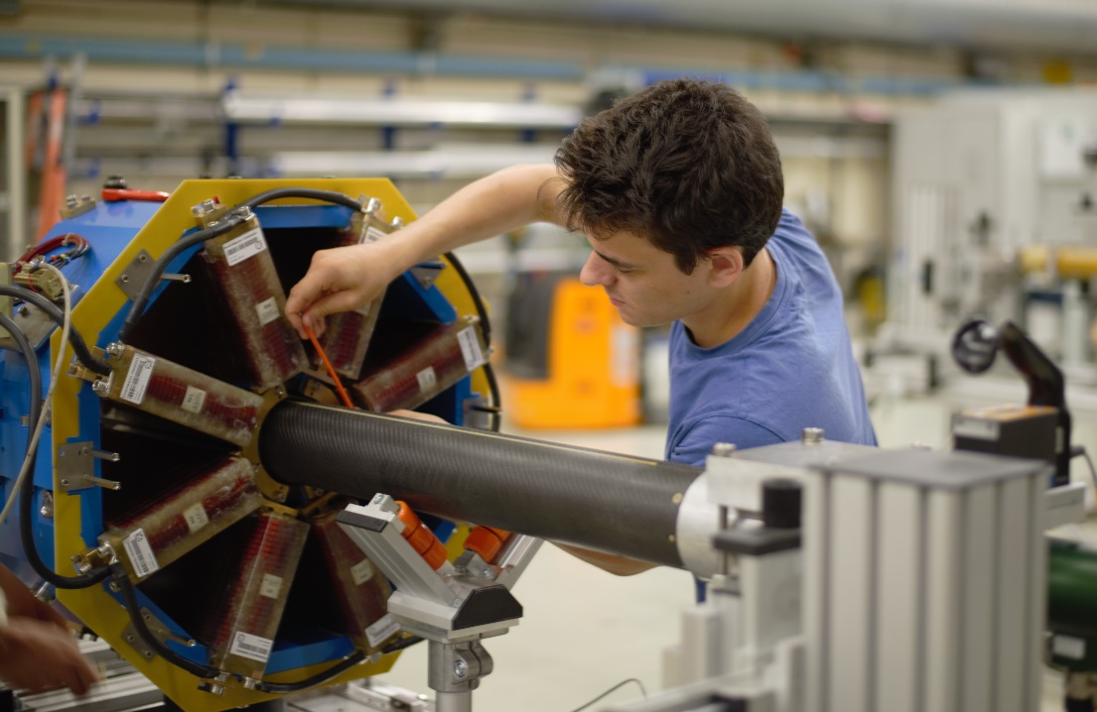
And learn…
… how to measure a real magnet (virtually) “hands-on”

Slide 11
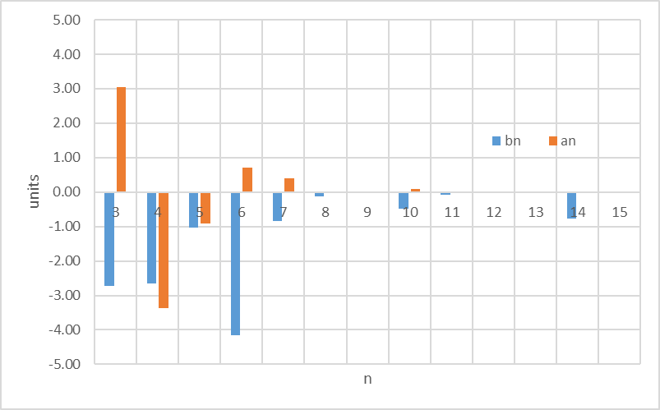
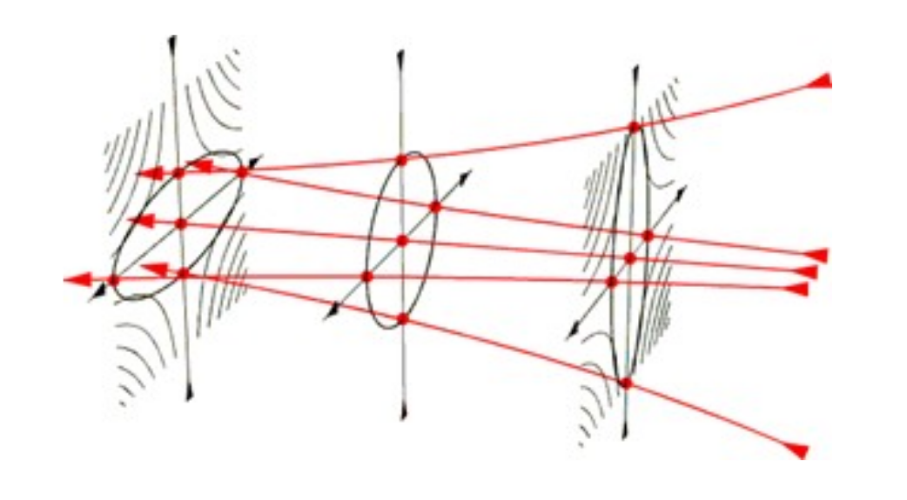
And learn…
… how to analyse and interpret the results

Slide 12
Additional references
S. Russenschuck, “Field Computation for Accelerator Magnets: Analytical and Numerical Methods for Electromagnetic Design and Optimization”, Wiley, 2011
L . Bottura, K. N. Henrichsen, “Field Measurements”, Proceeding of CAS - CERN Accelerator School on Superconductivity and Cryogenics for Accelerators and Detectors, 2002
A.K. Jain, “Measurements of Field Quality Using Harmonic Coils”, US Particle Accelerator School (USPAS) on "Superconducting Accelerator Magnets“, 2001
M. Buzio, “Fabrication and calibration of search coils”, Proceedings of CAS - CERN Accelerator School on Magnets, 2009
L. Walckiers, “Magnetic measurement with coils and wires”, Proceedings of CAS - CERN Accelerator School on Magnets, 2009

Slide 13
We are looking forward to meet you!
lucio.fiscarelli@cern.ch
Special thanks to my colleagues for providing the material and pictures

