Slide 1
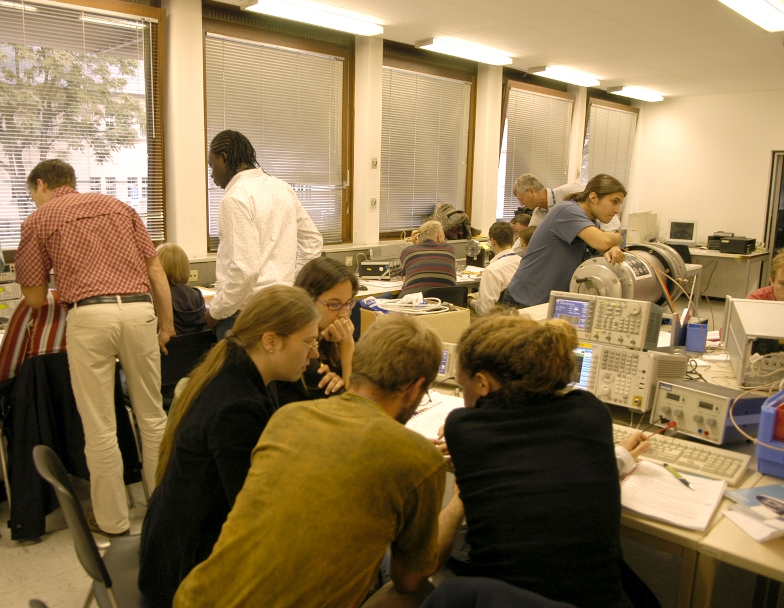
JUAS 2021
RF lab introduction
M.Bozzolan; F.Caspers; M.Wendt
Notes:
Welcome Ladies and gentlemen; we are trying to infect you (despite Covid) with the RF measurement virus. Unfortunately, this requires a small amount of theoretical basics but we will try to make it as tasty as possible. What you see on the first slide here is a picture taken a few years ago from the same course (but CAS) in some lab ..somewhere. We usually have teams of 3 or 4 people working (playing?) on a pre-set experiment and trying to make all possible mistakes (that’s the best way to learn)and the animators are drifting around int he room, available for questions and solving problems.

Slide 2
Contents
RF measurement methods – overview
The super-heterodyne concept
Characteristic impedance
Voltage Standing Wave Ratio (VSWR)
Introduction to Scattering-parameters (S-parameters)
The Smith chart
What awaits you?!
Notes:
..why not start with an overview one very important point is the good old superhet..why is disappearing more and more these days and replaced by DSP (digital signal processing) stuff; but for the basics understanding of the architecture of modern instruments like spectrum and network-analyzers it is really essential; then we should have a closer look on the term and meaning of characteristic impedance , a very fundamental term relevant for the entire range of Rf engineering. another important term which you find all over the place is VSWR. Its good to know where this comes from and why its still in use today, although its from the very early history............then we get to the scattering parameters....................and finally to the Smith Chart which is a graphic representation of the reflection coefficient in the complex plane and which uses basically two superimposed coordinate systems. The complex impedance and the complex reflection coefficient

Slide 3
Introduction – Simple RF System
Low-level
RF system
High power
RF system
RF source
High power RF
waveguide or coaxial
distribution system
LLRF
High power
RF input coupler
RF field probe
signal
RF cavity resonator
q
v
beam
E
metallic beam pipe
Things get a bit more complicated in the real world:
pulsed power RF, multi-cell resonators or traveling
wave structures, non-relativistic beams, HOM’s, etc.
Notes:
Here we go right into the real world of particle accelerators. A cavity symbolized as pillbox in this case used for acceleration thus we have a power coupler to feed in the power from some amplifier which will be used to show a strong electric field to the charged particles. A beampipe (under vacuum of course) and sometimes a feedback loop to make it all somewhat easier to control; the main function of the cavity here is a transformer, which converts a few Kilo-Volt from the generator into Mega-Volts seen by beam.

Slide 4
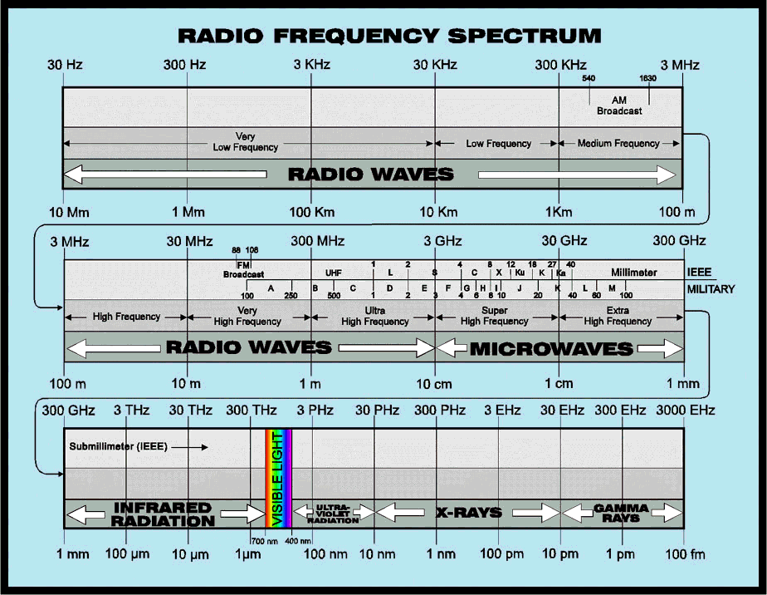
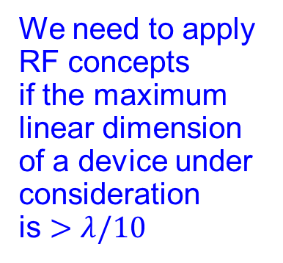
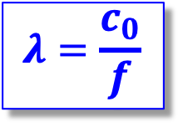
What are Radio Frequencies?
Free space
wavelength:
$$λ=\frac{c_{0}}{f}$$
accelerator
frequencies
We need to apply
RF concepts
if the maximum linear dimension of a device under consideration
is $>λ/10$
Notes:
Here we show the entire spectrum of electromagnetic waves staring around 50 Hz (yes also high voltage lines have to be treated in terms of wave mechanics if there length approaches λ/10 or more) and then we see highlighted the frequency range of practical relevance for charged particle accelerators. The numbers may be somewhat arguable. Certain devices used in accelerator engineering start already around 1 kHz..and others e.g. for diagnostics work in the optical range or beyond. The essential point however is that when the LINEAR dimensions of some device exceed λ/10 we have to give up low frequency approximations and apply real Rf concepts

Slide 5
Measurement methods - overview (1)
There are many ways to observe RF signals. Here we give a brief overview of the five main tools we have at hand
Oscilloscope: to observe signals in time domain
  periodic signals
  burst signal
  application: direct observation of signal from a pick-up, shape of common 230 V mains supply voltage, etc.
Spectrum analyser: to observe signals in frequency domain
  sweeps through a given frequency range point by point
  application: observation of spectrum from the beam or of the spectrum emitted from an antenna, etc.
5
Notes:
You are all familiar with the oscilloscope. It permits observation of signals in the time domain and these days you can even capture very short single events easily; the practical upper frequency limit is now around 50 GHz but one can find devices which even go beyond...
as for the spectrum analyser it was in the past an analog instrument with some sort of automatic tuning and filtering dials and displays signals in the frequency domain
Both types of instruments are absolutely essential and since modern devices have maybe 20 visible knobs but say 5000 functions its very easy to get lost unless one has a clear view of basic concepts applied .

Slide 6
Measurement methods - overview (2)
Dynamic signal analyzer (FFT analyzer)
  Acquires signal in time domain by fast sampling
  Further numerical treatment in digital signal processors (DSPs)
  Spectrum calculated using Fast Fourier Transform (FFT)
  Combines features of a scope and a spectrum analyzer: signals can be looked at directly in time domain or in frequency domain
  Contrary to the SPA, also the spectrum of non-repetitive signals and transients can be observed
  Application: Observation of tune sidebands, transient behavior of a phase locked loop, etc.
Coaxial measurement line
  old fashion method – no more in use but good for understanding of concept
Network analyzer
  Excites a network (circuit, antenna, amplifier or similar) at a given CW frequency and measures response in magnitude and phase => determines S-parameters
  Covers a frequency range by measuring step-by-step at subsequent frequency points
  Application: characterization of passive and active components, time domain reflectometry by Fourier transforming reflection response, etc.
6
Notes:
The dynamic signal analyser...a very popular tool these days in many labs is a blend between a scope and a spectrumanalzyer
Now comes an old fashioned instrument..the coaxial measurement line..which normally you can only find these days in some RF museum only; but it s very useful for understanding the different technical terms and to visualize certain physics aspects which are otherwise only accessible via numerical simulations
The Networkanalzyer (VNA) is the workhorse in any RF lab; it permits to characterize all sort of Rf elements in terms of input and output reflection coefficient vs frequency and in some cases also to carry out a nonlinear analysis. Note that there exist scalar and vector VNAs..these days mostly vector VNAs are in use since they deliver complex data and not just real data.

Slide 7
The Super-Heterodyne Receiver (1)
this is NOT a super-heterodyne receiver:
broadband
low-noise RF amp
e.g. 87-108 MHz
tunable
narrowband
band-pass filter
RF amp
demodulator
audio amp
…or: ’How does a ”traditional” analog radio works?
  It was, and still is, difficult to make precisely tunable narrowband, band-pass filters for high frequencies (~100 MHz)!!
  high frequency low-noise amplifiers are expensive!
  high frequency demodulators are not trivial.
  direct detection of radio and RF signals is challenging!
Notes:
This NON superhet is meant to show the functionality required to receive radio signals but only the very particular (weak) radio station we want to get and NOT an adjacent one with has a signal which is 60 dB =1 Millions times stronger in power).It would be extremely challenging to build such a narrowband and tuneable Rf filter with the required selectivity .....thus next slide..

Slide 8
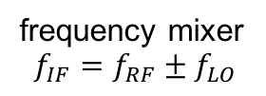




The Super-Heterodyne Receiver (2)
frequency mixer
$$f_{IF}=f_{RF}±f_{LO}$$
…but this is:
audio amp
$$f_{RF}$$
$$f_{IF}$$
broadband
low-noise RF amp
e.g. 87-108 MHz
IF narrowband
band-pass filter
e.g. 10.7 MHz ± 90 kHz
$$f_{LO}$$
IF amp
demodulator,
e.g. FM PLL or
AM diode detector
Introduce a non-linear element:
the (frequency) mixer!
  ”down-convert” the RF band to a fixed ”intermediate” frequency (IF)
  requires a tunable local oscillator (LO)
  well manageable IF section:
    narrowband band-pass filter(s) (BPF) and amplifier(s)
  RF telecommunication standard
  Often multiple mixing stages are used in modern RF instruments, line spectrum analyzers
tunable
local oscillator (LO)
e.g. 97.7-118.7 MHz
$$f_{IF}=f_{RF}±f_{LO}$$
Notes:
The trick is the mixer with the symbol X which stands for multiplication; with such a rather simple passive device we can multiply two sine waves and obtain a sum and difference frequency...note the term LO=local oscillator is a little tunable oscillator in the radio receiver which is called local as its inside the receiver which provides the downmixing signal. And then one can use a fixed frequency filter with excellent properties at some intermediate frequency (often around 10.7 MHz) to filter out all the unwanted radio-stations and after some intermediate frequency amplifier (which has an amplitude control loop to normalize all signal to about the same level regardless if they are very strong or rather weak and then after some demodulator (to obtain the desired audio signal) and some low frequency audio amplifier finally to the loudspeaker....and all thus from 10 Euro upwards..available..

Slide 9
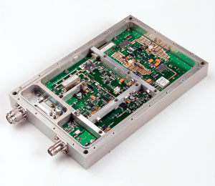
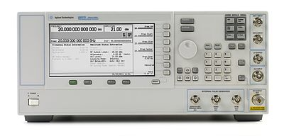
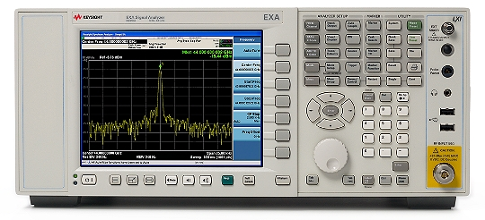
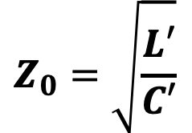
Characteristic Impedance
outer
conductor
dl
equivalent
circuit of a
lossless
TEM transmission-line
$$Z_{0}=\sqrt{\frac{L′}{C′}}$$
L’
C’
inner
conductor
dl
The reference impedance Z₀ in a RF system is defined by the characteristic impedance of the interconnect cables
  often coaxial cables of Z₀=50Ω (compromise: high voltage / high power handling)
The characteristic impedance of a TEM transmission-line is defined by the cross-section geometry
  Ratio of H- and E-field, represented by L’ [H/m] and C’ [F/m] in the equivalent circuit of a line segment dl
  The characteristic impedance Z₀ has the unit Ohm [Ω]
Notes:
At some point we need cables to connect our instruments and devices. And those (coaxial) cable typically have a characteristic impedance of 50 Ohm (definition on the slide) ; why this number was chosen is a long story but has something to do with minimal losses and practical implementation. In short: for a single travelling wave in this cable the ratio of "voltage“ and "current "is 50 Ohm.

Slide 10
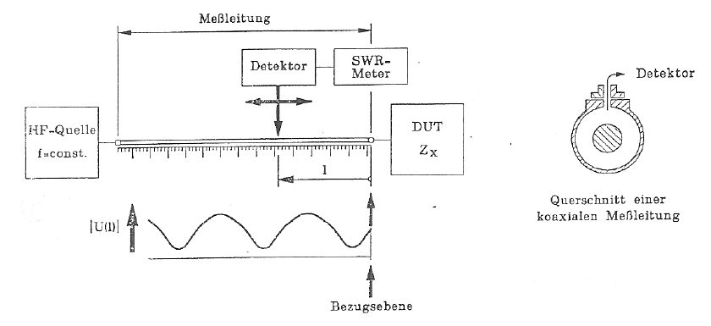
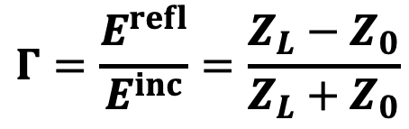
Voltage Standing Wave Ratio VSWR
On a transmission-line (single frequency, CW):
  Superposition of forward a (E^{inc}) and backward b (E^{refl}) traveling waves
  ⟹ standing waves
Slotted coaxial air-line is used as standing wave detector
  Probes the radial electric field along the slotted line.
  Measurement of E-field minima's E_{min} and maxima's E_{max} with a diode detector, thus detect |V_{min}| and |V_{max}| along the line.
  Evaluate the reflection coefficient Γ
  of a DUT of unknown Z_{L} at the end of the line
$$Γ=\frac{E^{refl}}{E^{inc}}=\frac{Z_{L}−Z_{0}}{Z_{L}+Z_{0}}$$
RF source
f=const.
Notes:
The term VSWR also used as VSR is omnipresent in Rf engineering. It comes historically from the method used more than 60 years ago to measure the impedance and the reflection coefficient of some DUT (device under test)Due to lack of other equipment the "Measurement line“ with a movable probe was applied and from the position of the minima with respect to some reference plane and the ration between maximum and minimum measure with a diode where the nonlinear response hat to be calibrated , one could obtain the required information .A really tedious and very time consuming method. We will do it ONCE on a slotted waveguide in order to demonstrate that the phase velocity in a waveguide is > c and the group velocity<c.

Slide 11
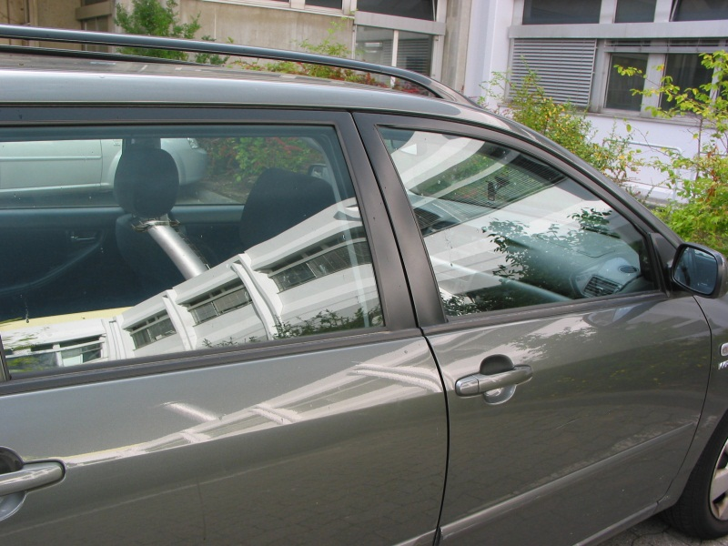
S-Parameters – Introduction
Light falling on a car window:
  Some parts of the incident light is reflected (you see the mirror image)
  Another part of the light is transmitted through the window
  (you can still see inside the car)
Optical reflection and transmission coefficients of the window glass define the ratio of reflected and transmitted light
Similar:
Scattering (S-) parameters of an n-port electrical network (DUT) characterize reflected and transmitted (power) waves
Notes:
Scattering..how to visualize it...well look at the windows of the car..you can see through and recognize what is inside but you also the an image of the surroundings. Thus we have transmitted waves and reflected wave in the optical range..very much the same way what we get in the microwave range but there we have to make it visible with special instrumentation

Slide 12
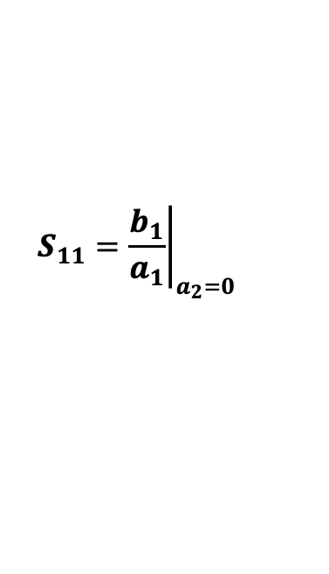
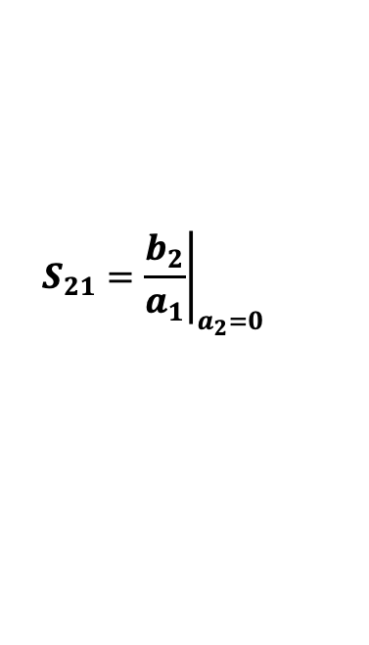
How to measure S-Parameters?
Z_{S}=50Ω
DUT
2-port
DUT = Device Under Test
4-port
Directional Coupler
detector
∝ b₂
detector
∝ a₁
detector
∝ b₁
Performed in the frequency domain
  Single or swept frequency generator, stand-alone or as part of a VNA or SA
  Requires a directional coupler and RF detector(s) or receiver(s)
Evaluate S₁₁ and S₂₁ of a 2-port DUT
  Ensure a₂=0, i.e. the detector at port 2 offers a well matched impedance
  Measure incident wave a1 and reflected wave b1
  at the directional coupler ports and compute
  for each frequency
  Measure transmitted wave b₂ at DUT port 2
  and compute
Evaluate S₂₂ and S₁₂ of the 2-port DUT
  Perform the same methodology as above by exchanging the measurement equipment on the DUT ports
$$S_{11}={\left.\frac{b_{1}}{a_{1}}\right|}_{a_{2}=0}$$
$$S_{21}={\left.\frac{b_{2}}{a_{1}}\right|}_{a_{2}=0}$$
Notes:
Here we have already a more complicated DUT some" two port" or 4 pole..why the hell introduce even some more names and create confusion? Well long as we are using coax lines we could say 2 -pole on each side where one 2-pole is a one-port BUT at some point the frequencies are so high that we would like to used waveguides which have no inner conductor..and then we need "ports". Thus the term "port“ is a generalisation that also works for waveguides , even optical fibres and all of you who are using numerical computer codes for RF circuit simulation will meet very quickly the term "port"

Slide 13








The Vector Network Analyzer (VNA)
RF
source
IF
A/D
X-switch
DAQ CTRL
Sig Proc
Display
term
IF $b_{1}$
IF $b_{2}$
directional
couplers
LO
source
IF $a_{1}$
IF $a_{2}$
2-port VNA
  Simplified
  block schematic
Port 1
Port 2
$a_{1}$
DUT
$b_{2}$
cable
cable
$b_{1}$
$a_{2}$

Slide 14
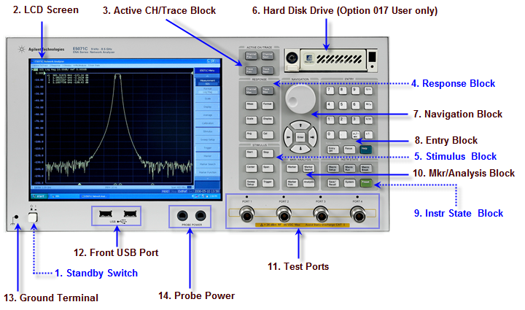
Fun with the VNA!
VNAs vary between manufacturers and models
  Concepts and operation is still very similar
Notes:
This is the real vector networkanalzyer..maybe 30 buttons and 5000 functions but don’t worry

Slide 15
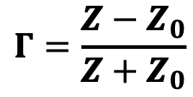
The Smith Chart
The Smith Chart (in impedance coordinates)
represents the complex Γ-plane within the unit circle.
It is a conformal mapping of the complex Z-plane
on the Γ-plane by applying the transformation:
  ⇒ the real positive half plane of Z is thus
  transformed (Möbius) into the interior of the unit circle!
Imag(Γ)
Imag(Ζ)
$$Γ=\frac{Z−Z_{0}}{Z+Z_{0}}$$
Real(Ζ)
Real(Γ)
Notes:
This is the famous Smith Chart (invented by Mr Smith 1938 or so but a few years ago it turned out that it had been already invented in Japan 2 years earlier. Anyway it a conformal mapping from the complex impedance plane by the formula shown into the plane of complex reflection coefficient. And whenever you talk about Rf sooner or later this terms comes up and if you don’t have glimpse what it is , you are lost. That’s why we discuss it here...

Slide 16
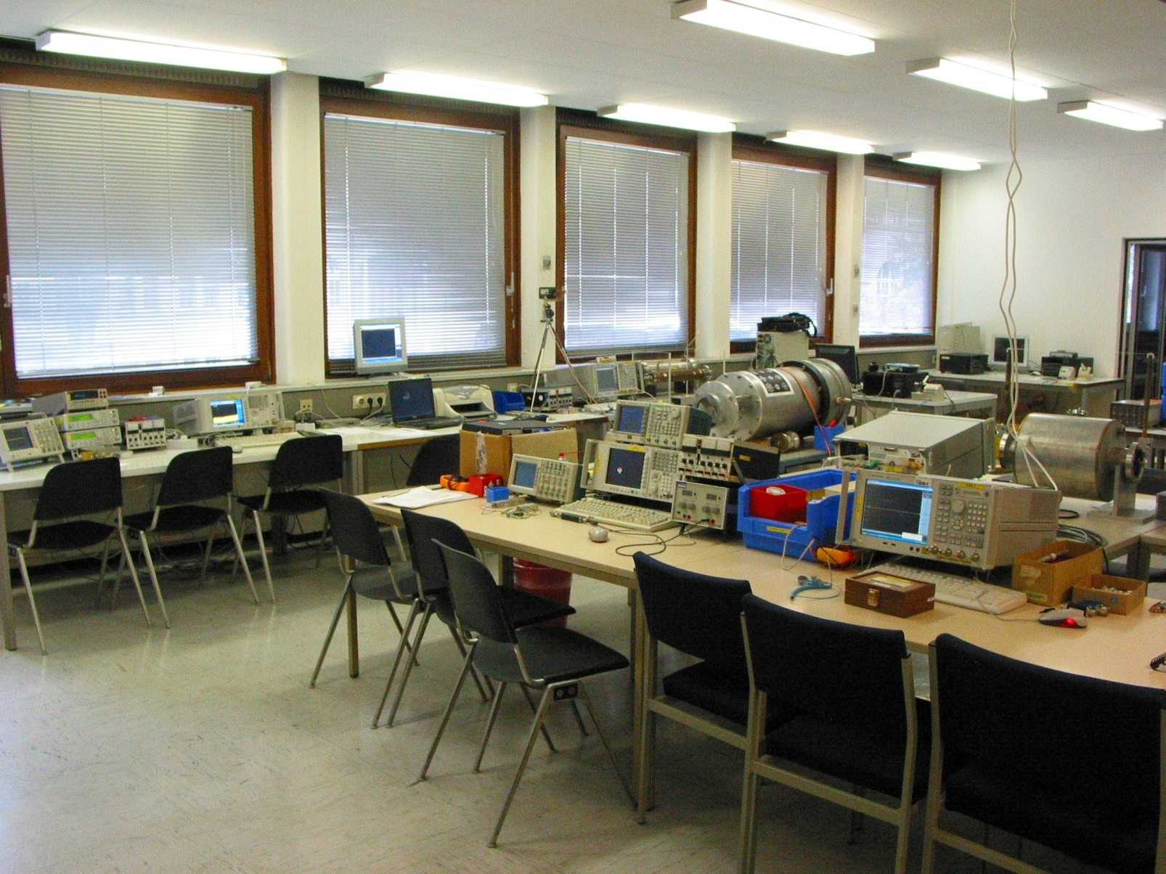
What awaits you?
Photos from RF-Lab CAS 2009, Darmstadt
16
Notes:
not many comments required..LOTS of nice toys waiting for you

Slide 17
Measurements using Spectrum Analyzer and oscilloscope (1)
Measurements of several types of modulation (AM, FM, PM) in the time-domain and frequency-domain.
Superposition of AM and FM spectrum (unequal height side bands).
Concept of a spectrum analyzer: the superheterodyne method. Practice all the different settings (video bandwidth, resolution bandwidth etc.). Advantage of FFT spectrum analyzers.
Measurement of the RF characteristic of a microwave detector diode (output voltage versus input power... transition between regime output voltage proportional input power and output voltage proportional input voltage); i.e. transition between square low and linear region.
Concept of noise figure and noise temperature measurements, testing a noise diode, the basics of thermal noise.
Noise figure measurements on amplifiers and also attenuators.
The concept and meaning of ENR (excess noise ratio) numbers.
17
Notes:
no need to repeat what is written on the slide

Slide 18
Measurements using Spectrum Analyzer and oscilloscope (2)
EMC measurements (e.g.: analyze your cell phone spectrum).
Measurement of the IP3 (intermodulation point of third order) on some amplifiers (intermodulation tests).
Nonlinear distortion in general; Concept and application of vector spectrum analyzers, spectrogram mode (if available).
Invent and design your own experiment !
18
Notes:
saturating your protein computer with sort of complicated looking stuff..but dont worry ..its much easier than it appears on the first glance

Slide 19
Measurements using Vector Network Analyzer (1)
N-port (N=1…4) S-parameter measurements on different reciprocal and non-reciprocal RF-components.
Calibration of the Vector Network Analyzer.
Navigation in The Smith Chart.
Application of the triple stub tuner for matching.
Time Domain Reflectometry using synthetic pulse
→direct measurement of coaxial line characteristic impedance.
Measurements of the light velocity using a trombone (constant impedance adjustable coax line).
2-port measurements for active RF-components (amplifiers):
1 dB compression point (power sweep).
Concept of EMC measurements and some examples.
19
Notes:
once can spent weeks with this kind of fun..

Slide 20
Measurements using Vector Network Analyzer (2)
Measurements of the characteristic cavity properties (Smith Chart analysis).
Cavity perturbation measurements (bead pull).
Beam coupling impedance measurements with the wire method (some examples).
Beam transfer impedance measurements with the wire (button PU, stripline PU.)
Self made RF-components: Calculate build and test your own attenuator in a SUCO box (and take it back home then).
Invent and design your own experiment!
(as time allows…)
20
Notes:
and you can design your own experiment..with the hardware available an even practise using a solder iron in case you are not yet familiar with it.

Slide 21
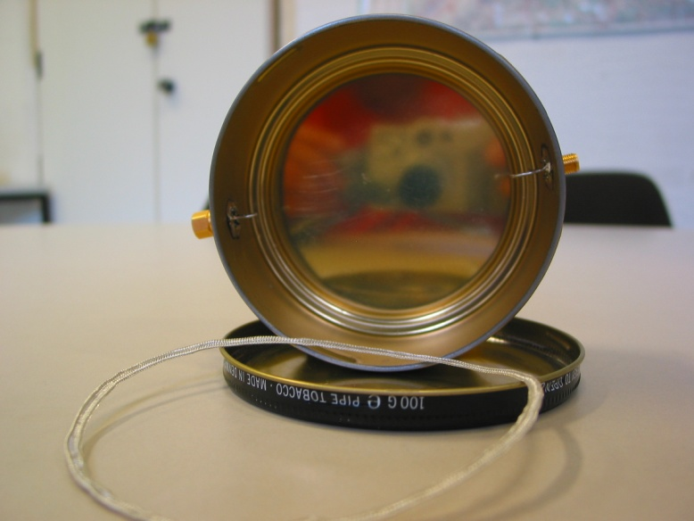
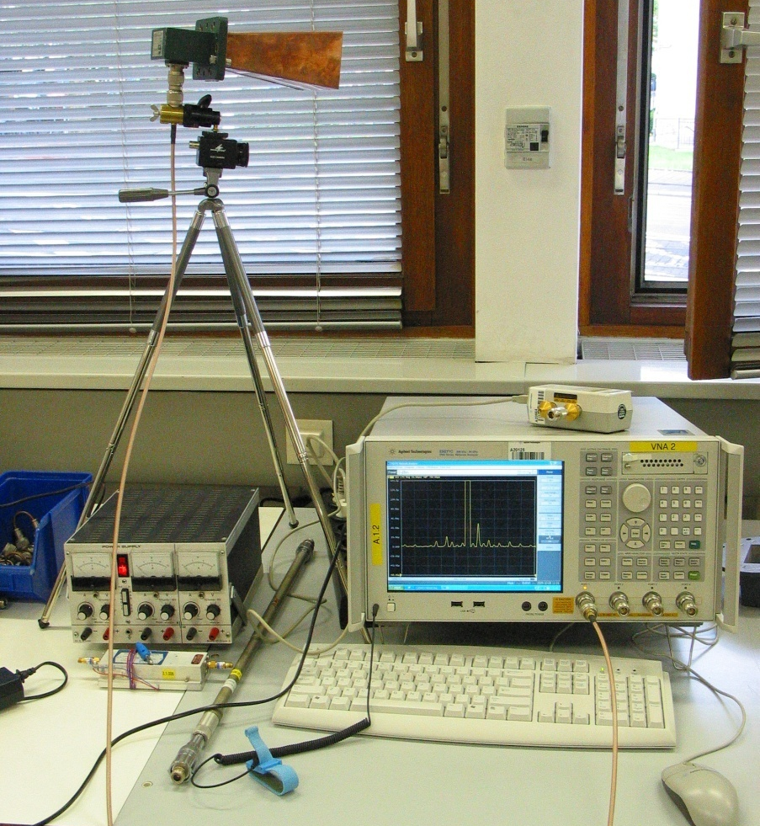
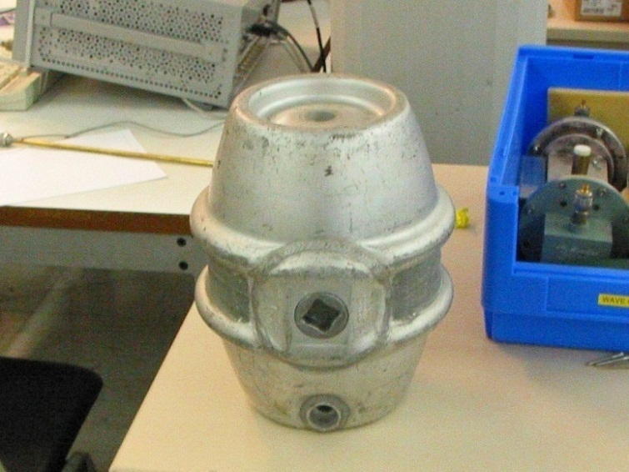
Invent your own experiment!
or „Tabacco-box” cavity
Build e.g. Doppler traffic radar
(this really worked in practice during CAS 2009 RF-lab)
or test a resonator of any other type.
21
Notes:
Interesting test objects and a traffic radar

Slide 22
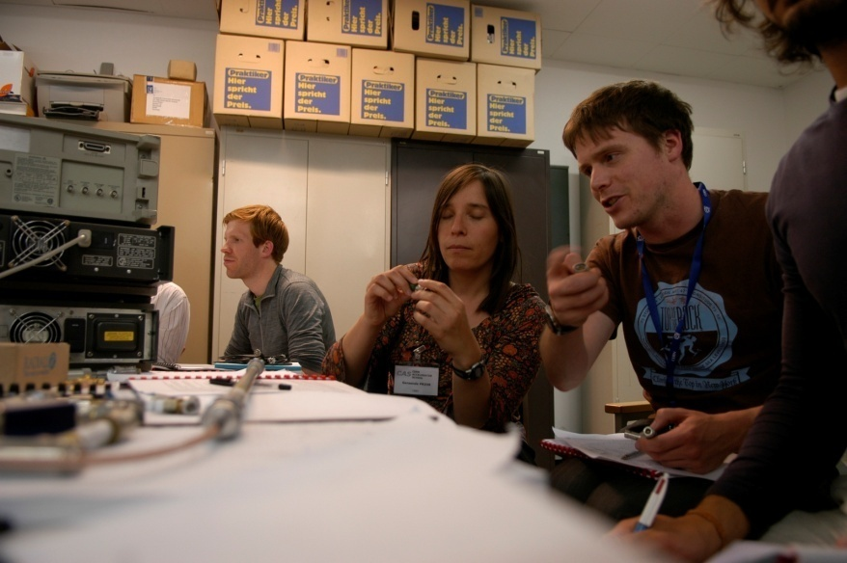
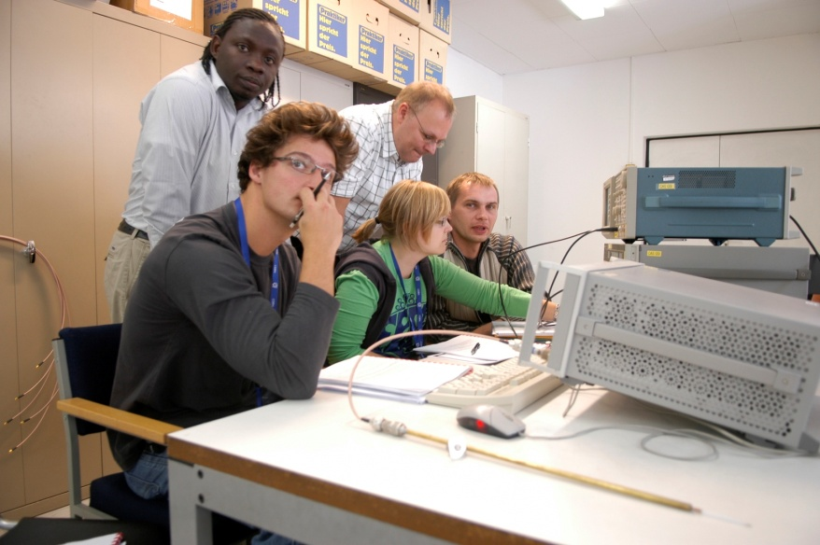
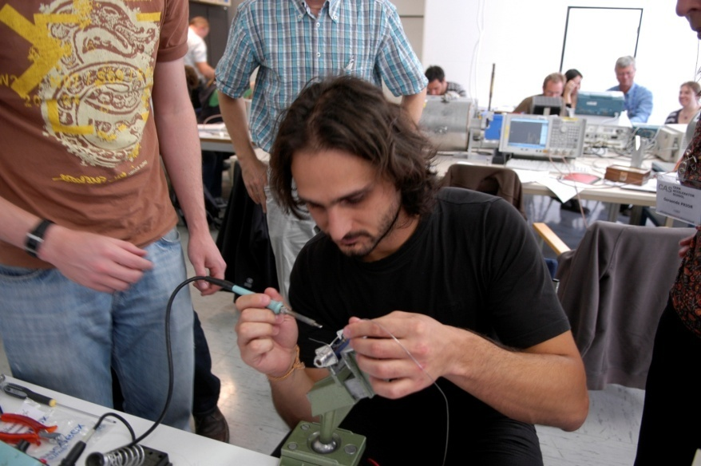
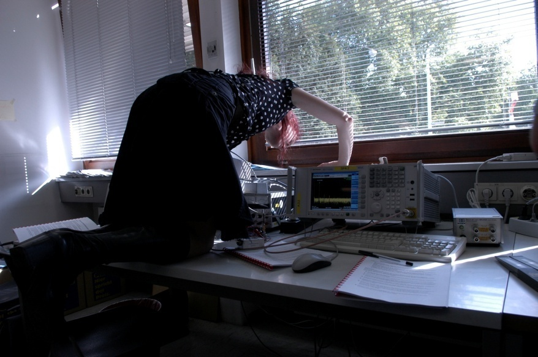
You will have enough time to think
and have a contact with hardware and your colleges.
22
Notes:
Hard work all over the place

Slide 23
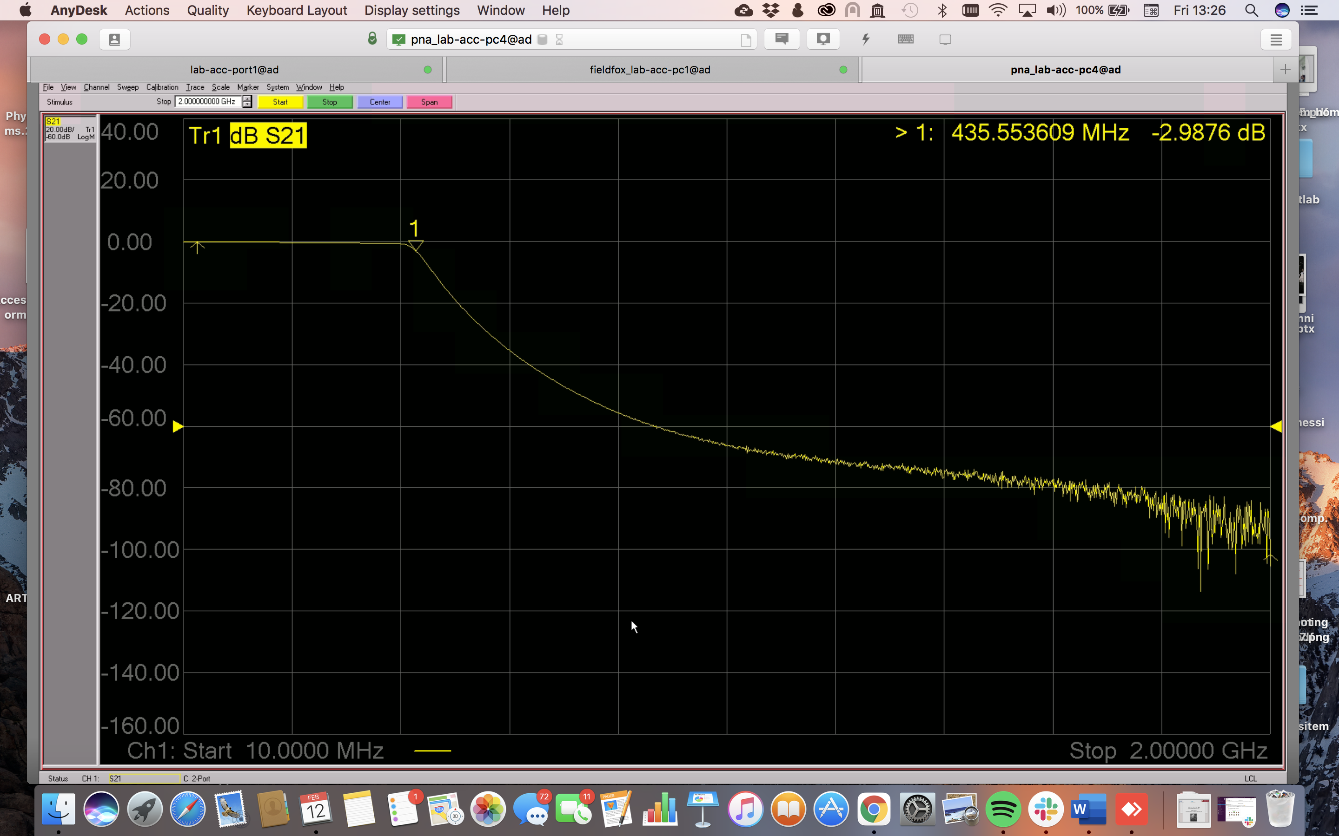
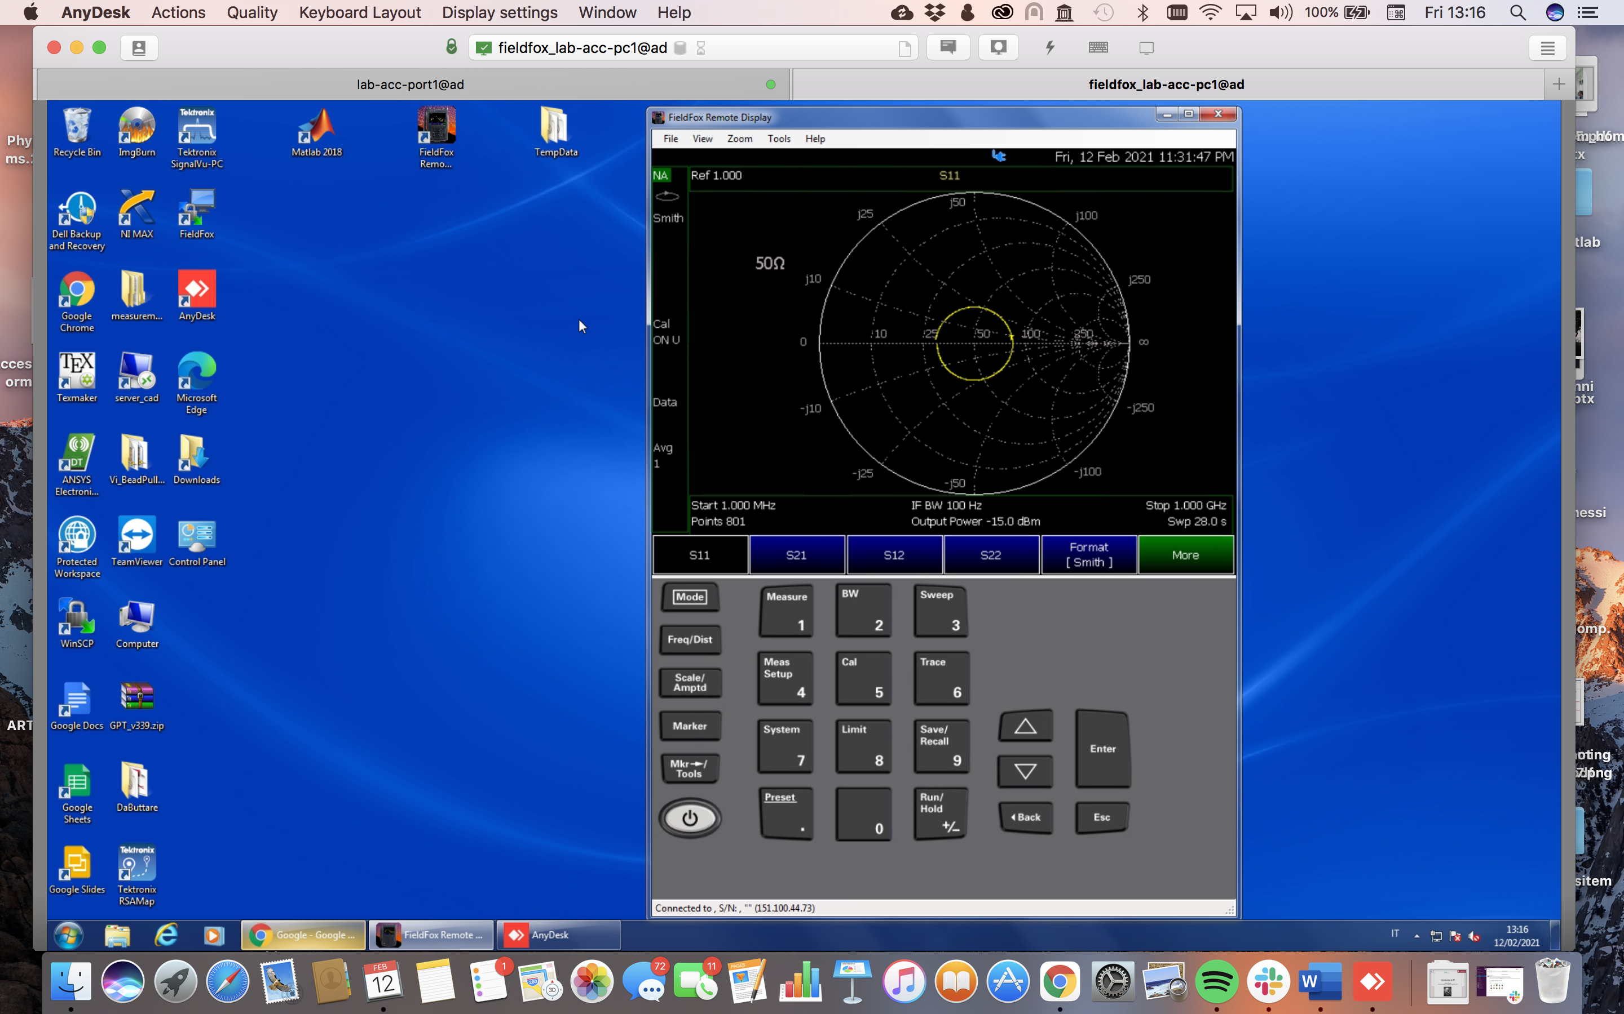
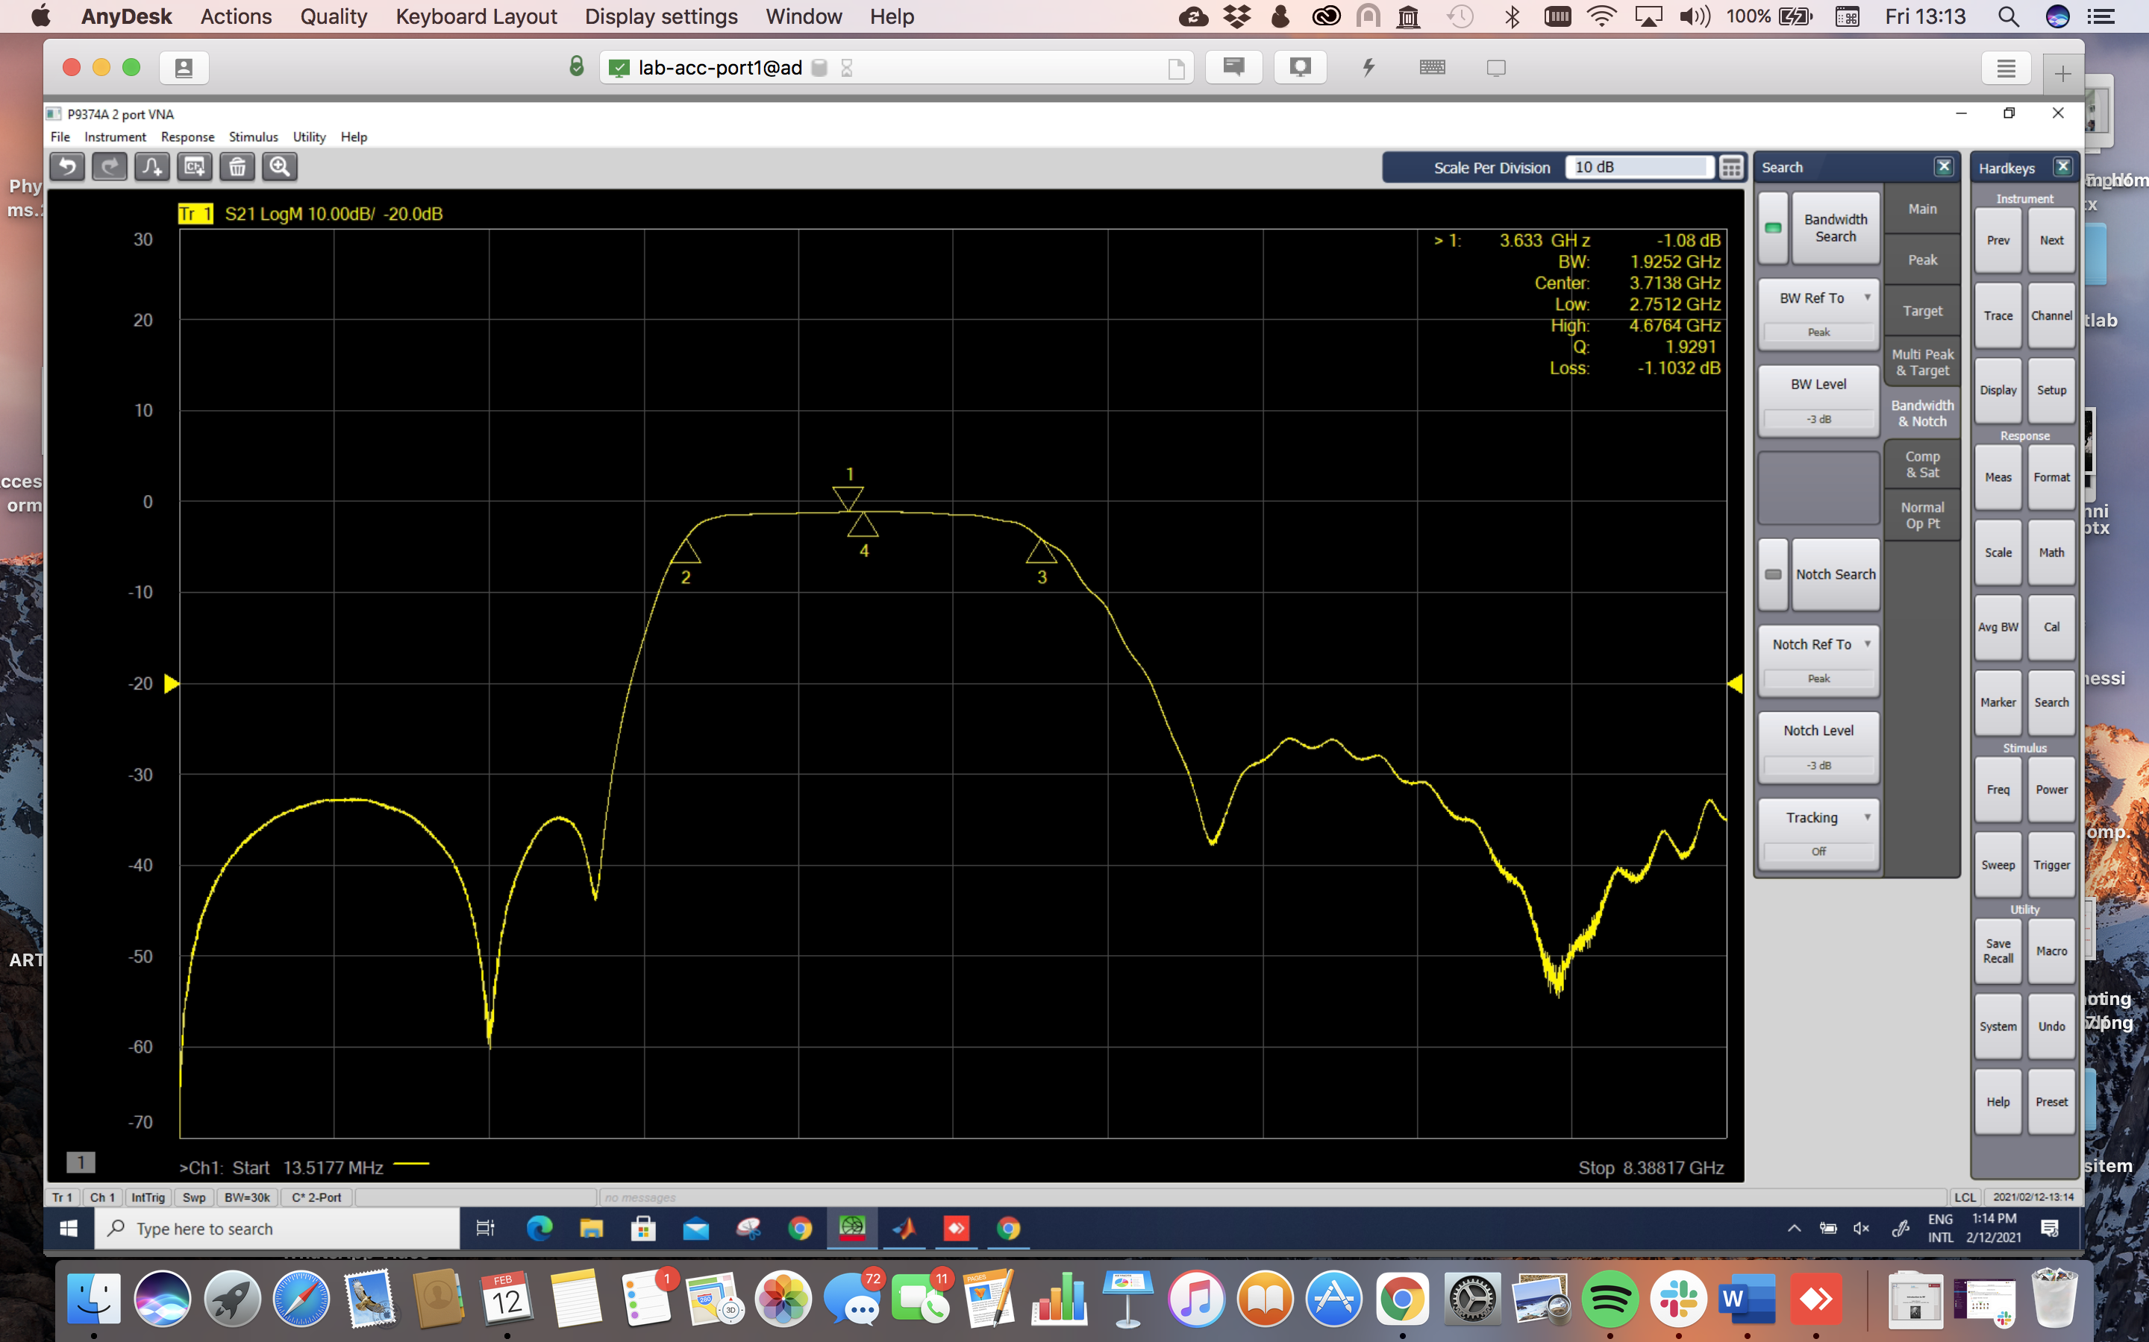

Hands on Network Analyser – remote connection
Supervised Remote Desktop connection with AnyDesk (free software) to be installed on the student computer (detailed instructions will follow).
23
Notes:
Hard work all over the place

Slide 24
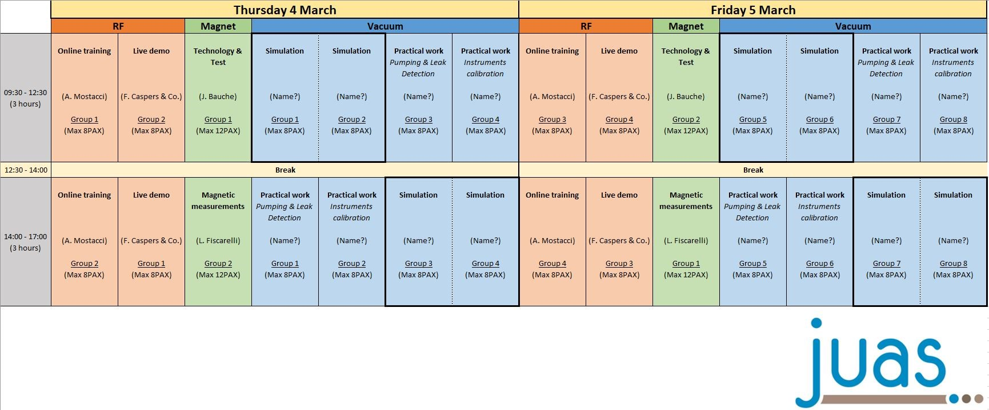
24
Notes:
Jumping into the real world..

