Slide 1





Guiding of high intensity laser pulses in 100 mm-long all-optical plasma channels
Simon Hooker, Roman Walczak, Aarón Alejo, Emily Archer, Chris Arran, Alexander von Boetticher, James Cowley, James Holloway, Oscar Jakobsson, Jakob Jonnerby, Alex Picksley, Aimee Ross, Rob Shalloo, Wei-Ting Wang​
John Adams Institute for Accelerator Science, University of Oxford​
Linus Feder, Bo Miao, Jaron Shrock, George Hine, Howard Milchberg​
University of Maryland​
Nicolas Bourgeois, Chris Thornton​
Rutherford Appleton Laboratory​
Laura Corner, Harry Jones, Lewis Reid​
Cockcroft Institute, University of Liverpool​

Slide 2
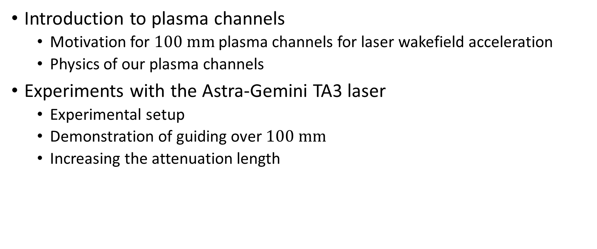
Outline
Introduction to plasma channels
  Motivation for $100 mm$plasma channels for laser wakefield acceleration
  Physics of our plasma channels
Experiments with the Astra-Gemini TA3 laser
  Experimental setup
  Demonstration of guiding over $100 mm$
  Increasing the attenuation length
Picksley, A, et al., PRAB (2020), 23(8), 81303.
Picksley, A, et al., PRE (2020), 102(9), 53201.
Picksley, A, et al., PRAB (2020), 23(8), 81303.

Slide 3
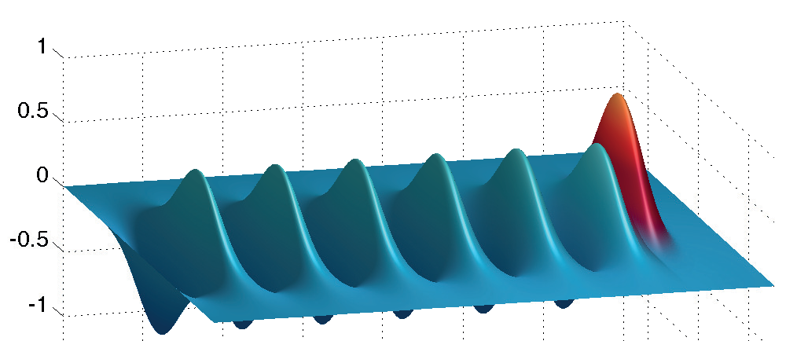
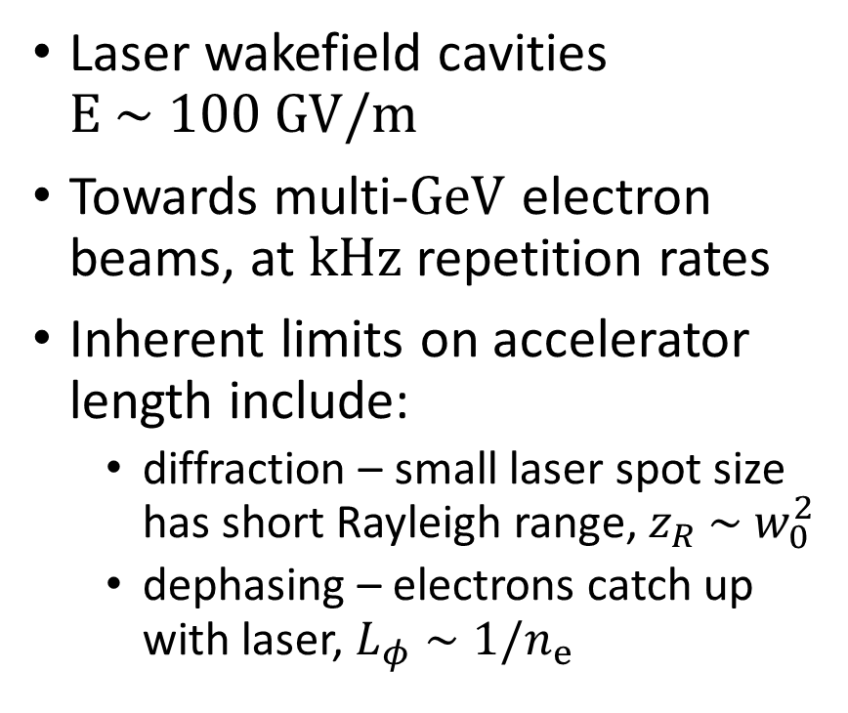


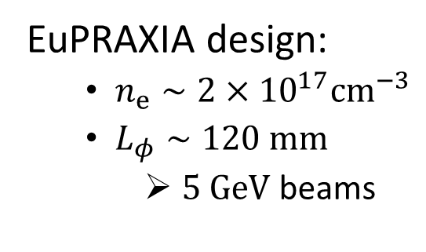
Laser Wakefield Acceleration
$$v_{g}\left(n_{e}\right)<c$$
Laser wakefield cavities $E \sim 100 GV/m$
Towards multi-$GeV$ electron beams, at $kHz$ repetition rates
Inherent limits on accelerator length include:
  diffraction – small laser spot size has short Rayleigh range, $z_{R} \sim w_{0}^{2}$
  dephasing – electrons catch up with laser, $L_{φ}∼1/n_{e}$
$$v_{e}=c$$
EuPRAXIA design:
  $n_{e}∼2×{10}^{17}{cm}^{−3}$
  $L_{φ}∼120 mm$
    $5 GeV$beams
T. Audet et al., EuPRAXIA Milestone Report M3.1 (2017)

Slide 4






HOFI plasma channels as laser waveguide
Hydrodynamic Optical-Field-Ionised (HOFI) plasma channels overcome diffraction length limitation
HOFI channels can be:
  All-optical, free-standing
  Low density = ${10}^{17}cm^{−3}$and lower
  Long = $100 mm$+
  Efficient
$$r$$
$$r$$
Laser Wakefield
Driver
$$η(r)$$
$$n_{e}(r)$$
EuPRAXIA design:
  $n_{e}∼2×{10}^{17}{cm}^{−3}$
  $L_{φ}∼120 mm$
    $5 GeV$beams
Durfee & Milchberg (1993), PRL, 71(15), 2409–2412.
Durfree, Lynch and Milchberg (1995). PRE, 51(3), 2368–2387.

Slide 5
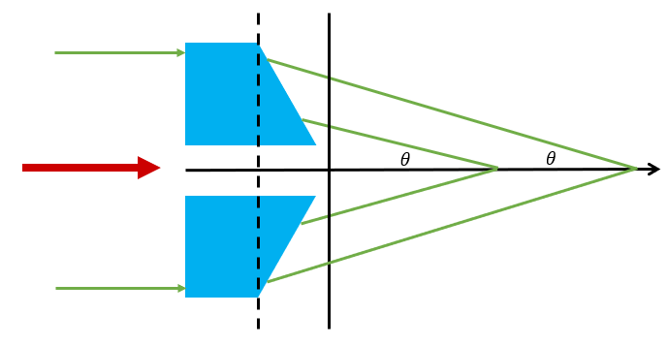
Physics of HOFI channels
Axicon
Channel-forming
Drive
Axicon focuses a channel-forming beam to a line longitudinally
Optical field ionisation liberates and instantaneously heats electrons
Rapid radial expansion leads to plasma channel with low on-axis density and high density walls
Electron density corresponds to refractive index variation
Plasma Channel
Expanding cylindrical blast wave
Shalloo et al., (2018), PRE, 97(5), 1–8
Lemos, N., et al. (2013). Physics of Plasmas, 20(6).
Lemos, N., et al. (2013). Physics of Plasmas, 20(10).

Slide 6
Experimental demonstration of 100 mm guiding

Slide 7
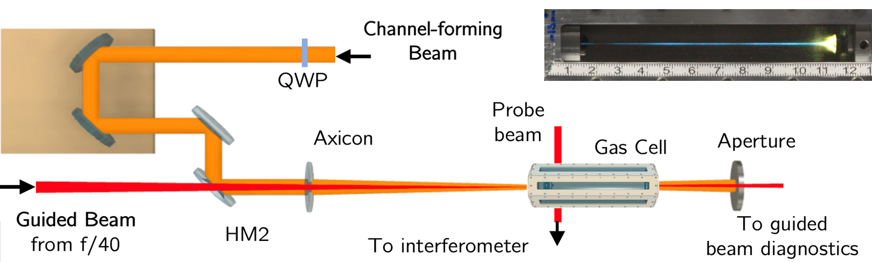
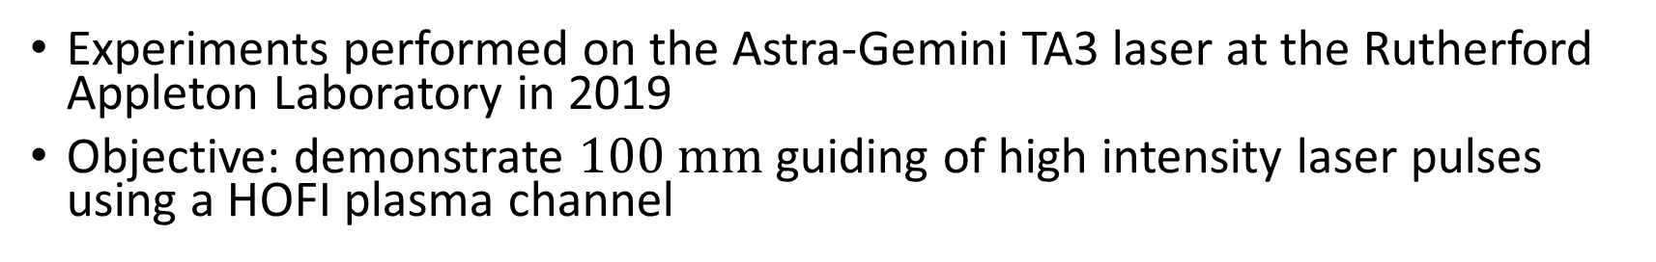
Experimental setup
Experiments performed on the Astra-Gemini TA3 laser at the Rutherford Appleton Laboratory in 2019
Objective: demonstrate $100 mm$guiding of high intensity laser pulses using a HOFI plasma channel
Picksley, A, et al., PRAB (2020), 23(8), 81303.

Slide 8
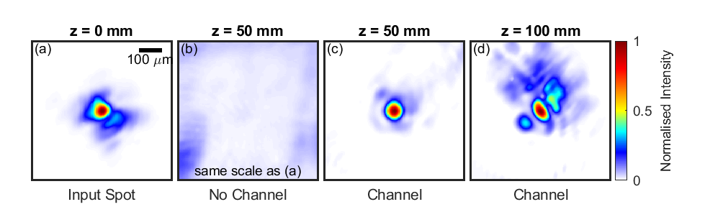
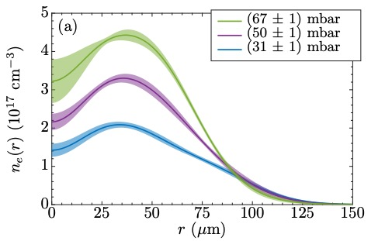

Guiding results
$100 mm∼20$ Rayleigh ranges
Parameters for $100 mm$guide:
  $n_{e,0}=1 ×{10}^{17} {cm}^{−3}$
  $I_{0}= 6×{10}^{17} W cm^{−2}$
Picksley, A, et al., PRAB (2020), 23(8), 81303.

Slide 9
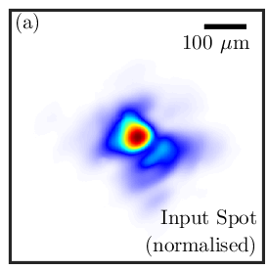
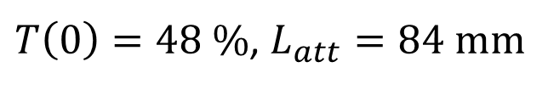
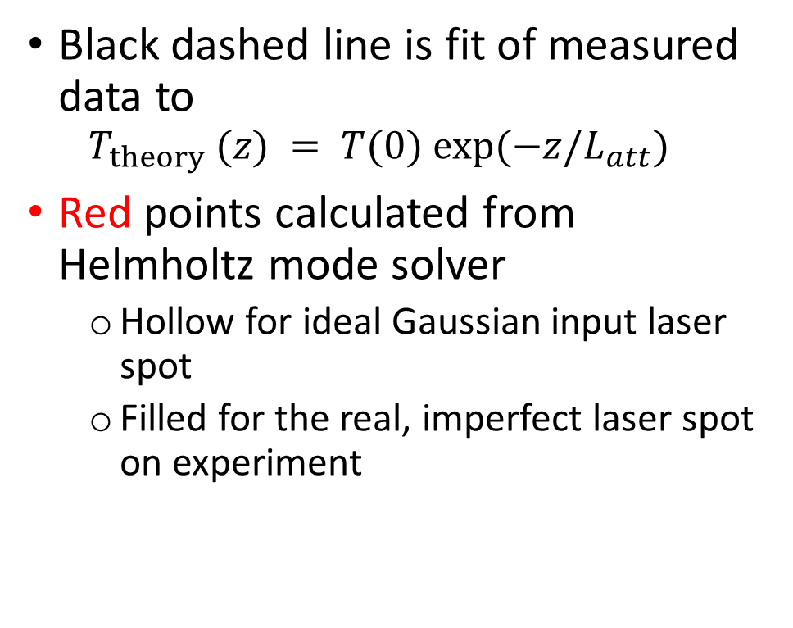
Guiding efficiency
Transmission fraction as function of longitudinal position down channel
Black dashed line is fit of measured data to
  $$T_{theory} (z) = T(0) exp⁡(−z/L_{att})$$
Red points calculated from Helmholtz mode solver
  Hollow for ideal Gaussian input laser spot
  Filled for the real, imperfect laser spot on experiment
$T\left(0\right)=48 \%$, $L_{att}=84 mm$
Picksley, A, et al., PRAB (2020), 23(8), 81303.

Slide 10
Increasing the attenuation length

Slide 11
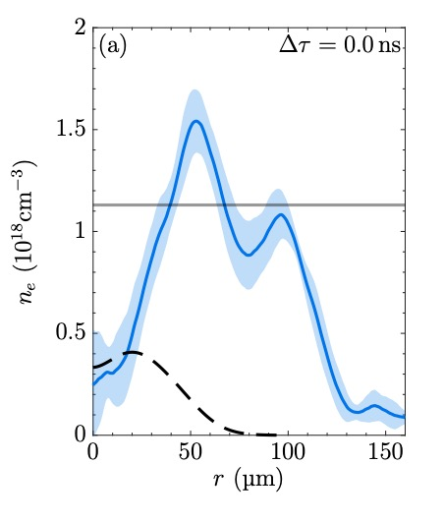
Conditioned HOFI plasma channels
Expanding cylindrical shock
CHOFI waveguide
After conditioning pulse
Data from experiment on Astra-Gemini TA2 in 2018
Guided pulse itself causes further ionisation beyond axicon-formed channel wall
Resulting channel is a highly efficient waveguide
Ionised Neutral gas collar
Axicon-formed channel
$$L_{att}≳1 m$$
Picksley, A, et al., PRE (2020), 102(9), 53201.

Slide 12
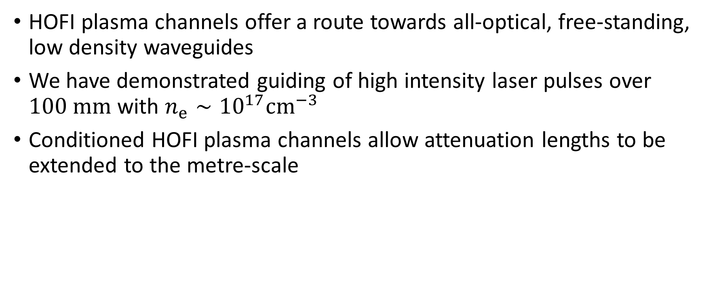
Summary
HOFI plasma channels offer a route towards all-optical, free-standing, low density waveguides
We have demonstrated guiding of high intensity laser pulses over $100 mm$with $n_{e}∼{10}^{17}cm^{−3}$
Conditioned HOFI plasma channels allow attenuation lengths to be extended to the metre-scale
Picksley, A, et al., PRAB (2020), 23(8), 81303.
Picksley, A, et al., PRE (2020), 102(9), 53201.

Slide 13
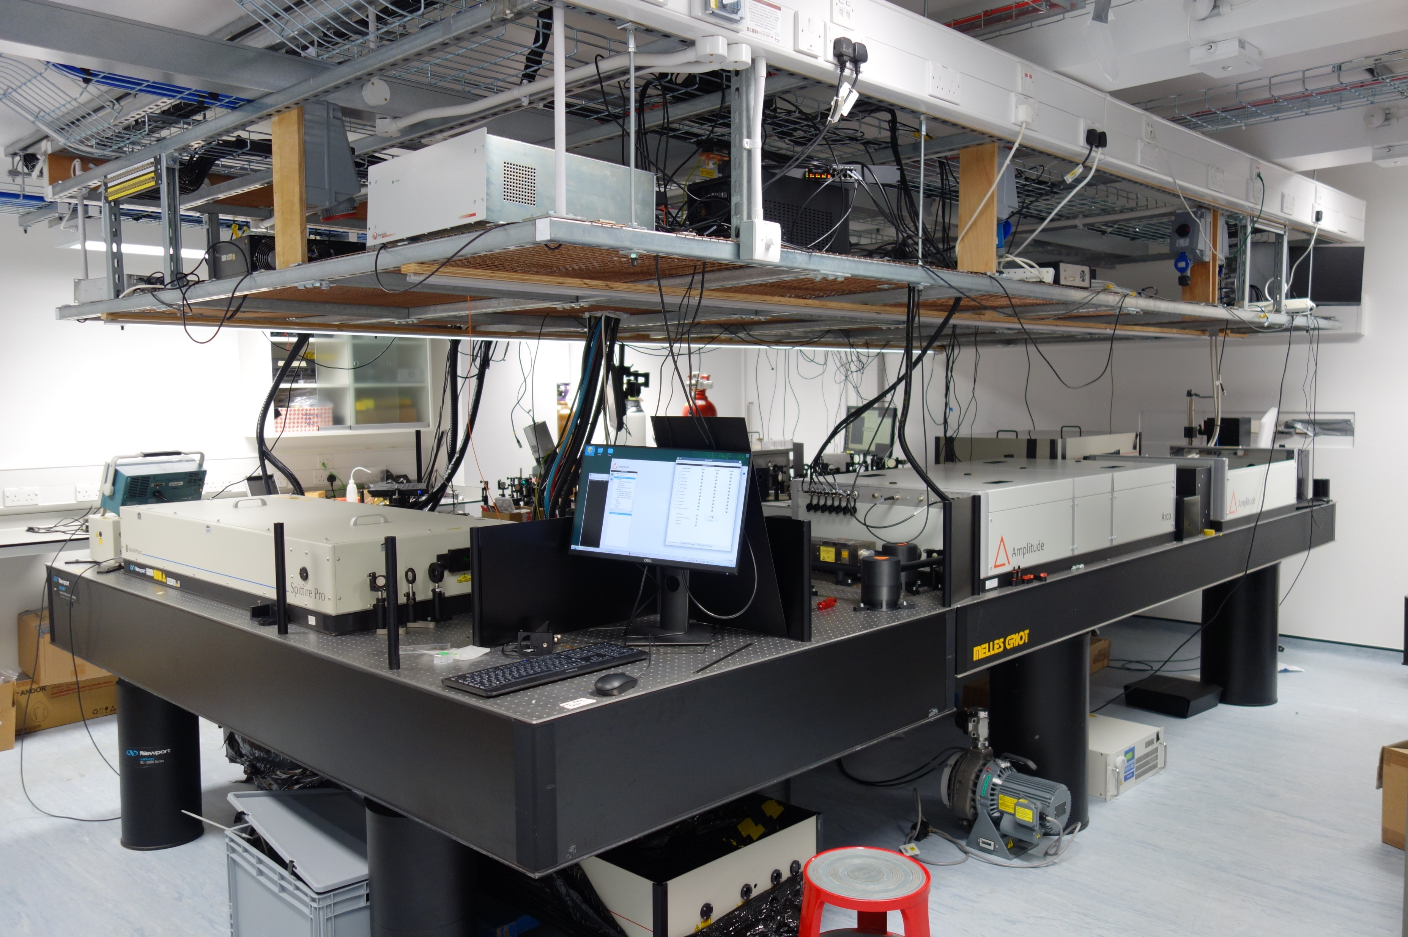
New Oxford Laser-Plasma Accelerator Lab

