Slide 1

QRL Modification
Giovanni Casula
19 Nov 2020

Slide 2
Overview
The QRL will be significantly modified for HL-LHC upgrade during LS3
Dismantling / moving of Service Modules, Pipe Elements, Interconnections
Components involved are in LSS of P1 and P5, quantities:
Sector | P1L |  |  | P1R |  |  | P5L |  |  | P5R
Component | SM | PE | IC | SM | PE | IC | SM | PE | IC | SM | PE | IC
Dismantle | 4 | 12 | 15 | 4 | 10 | 13 | 4 | 11 | 14 | 4 | 10 | 13
Move | 1 | 2 | 4 | 1 | 2 | 4 | 1 | 2 | 4 | 1 | 2 | 4
Cuts to be performed on interconnections between components
Standard tooling (Protem) doesn’t fit in some cases

Slide 3
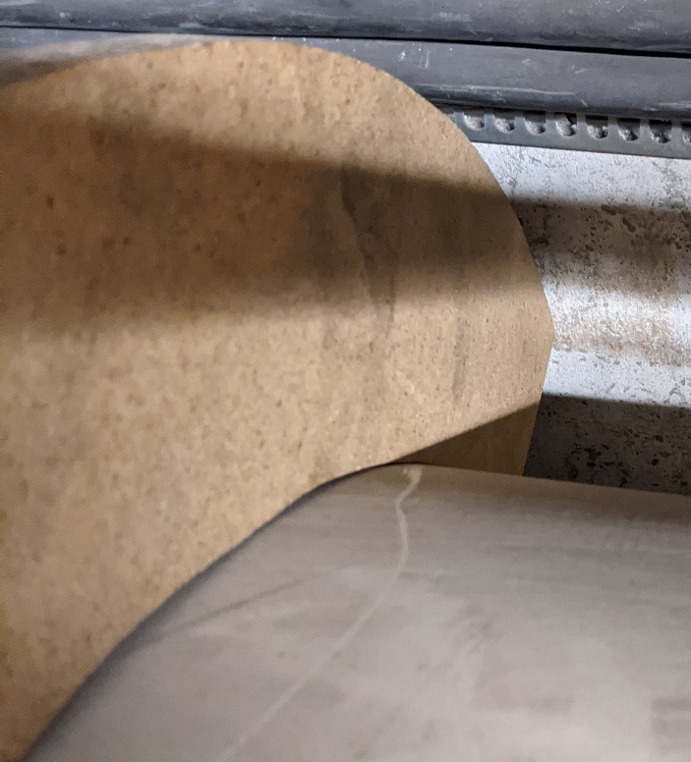
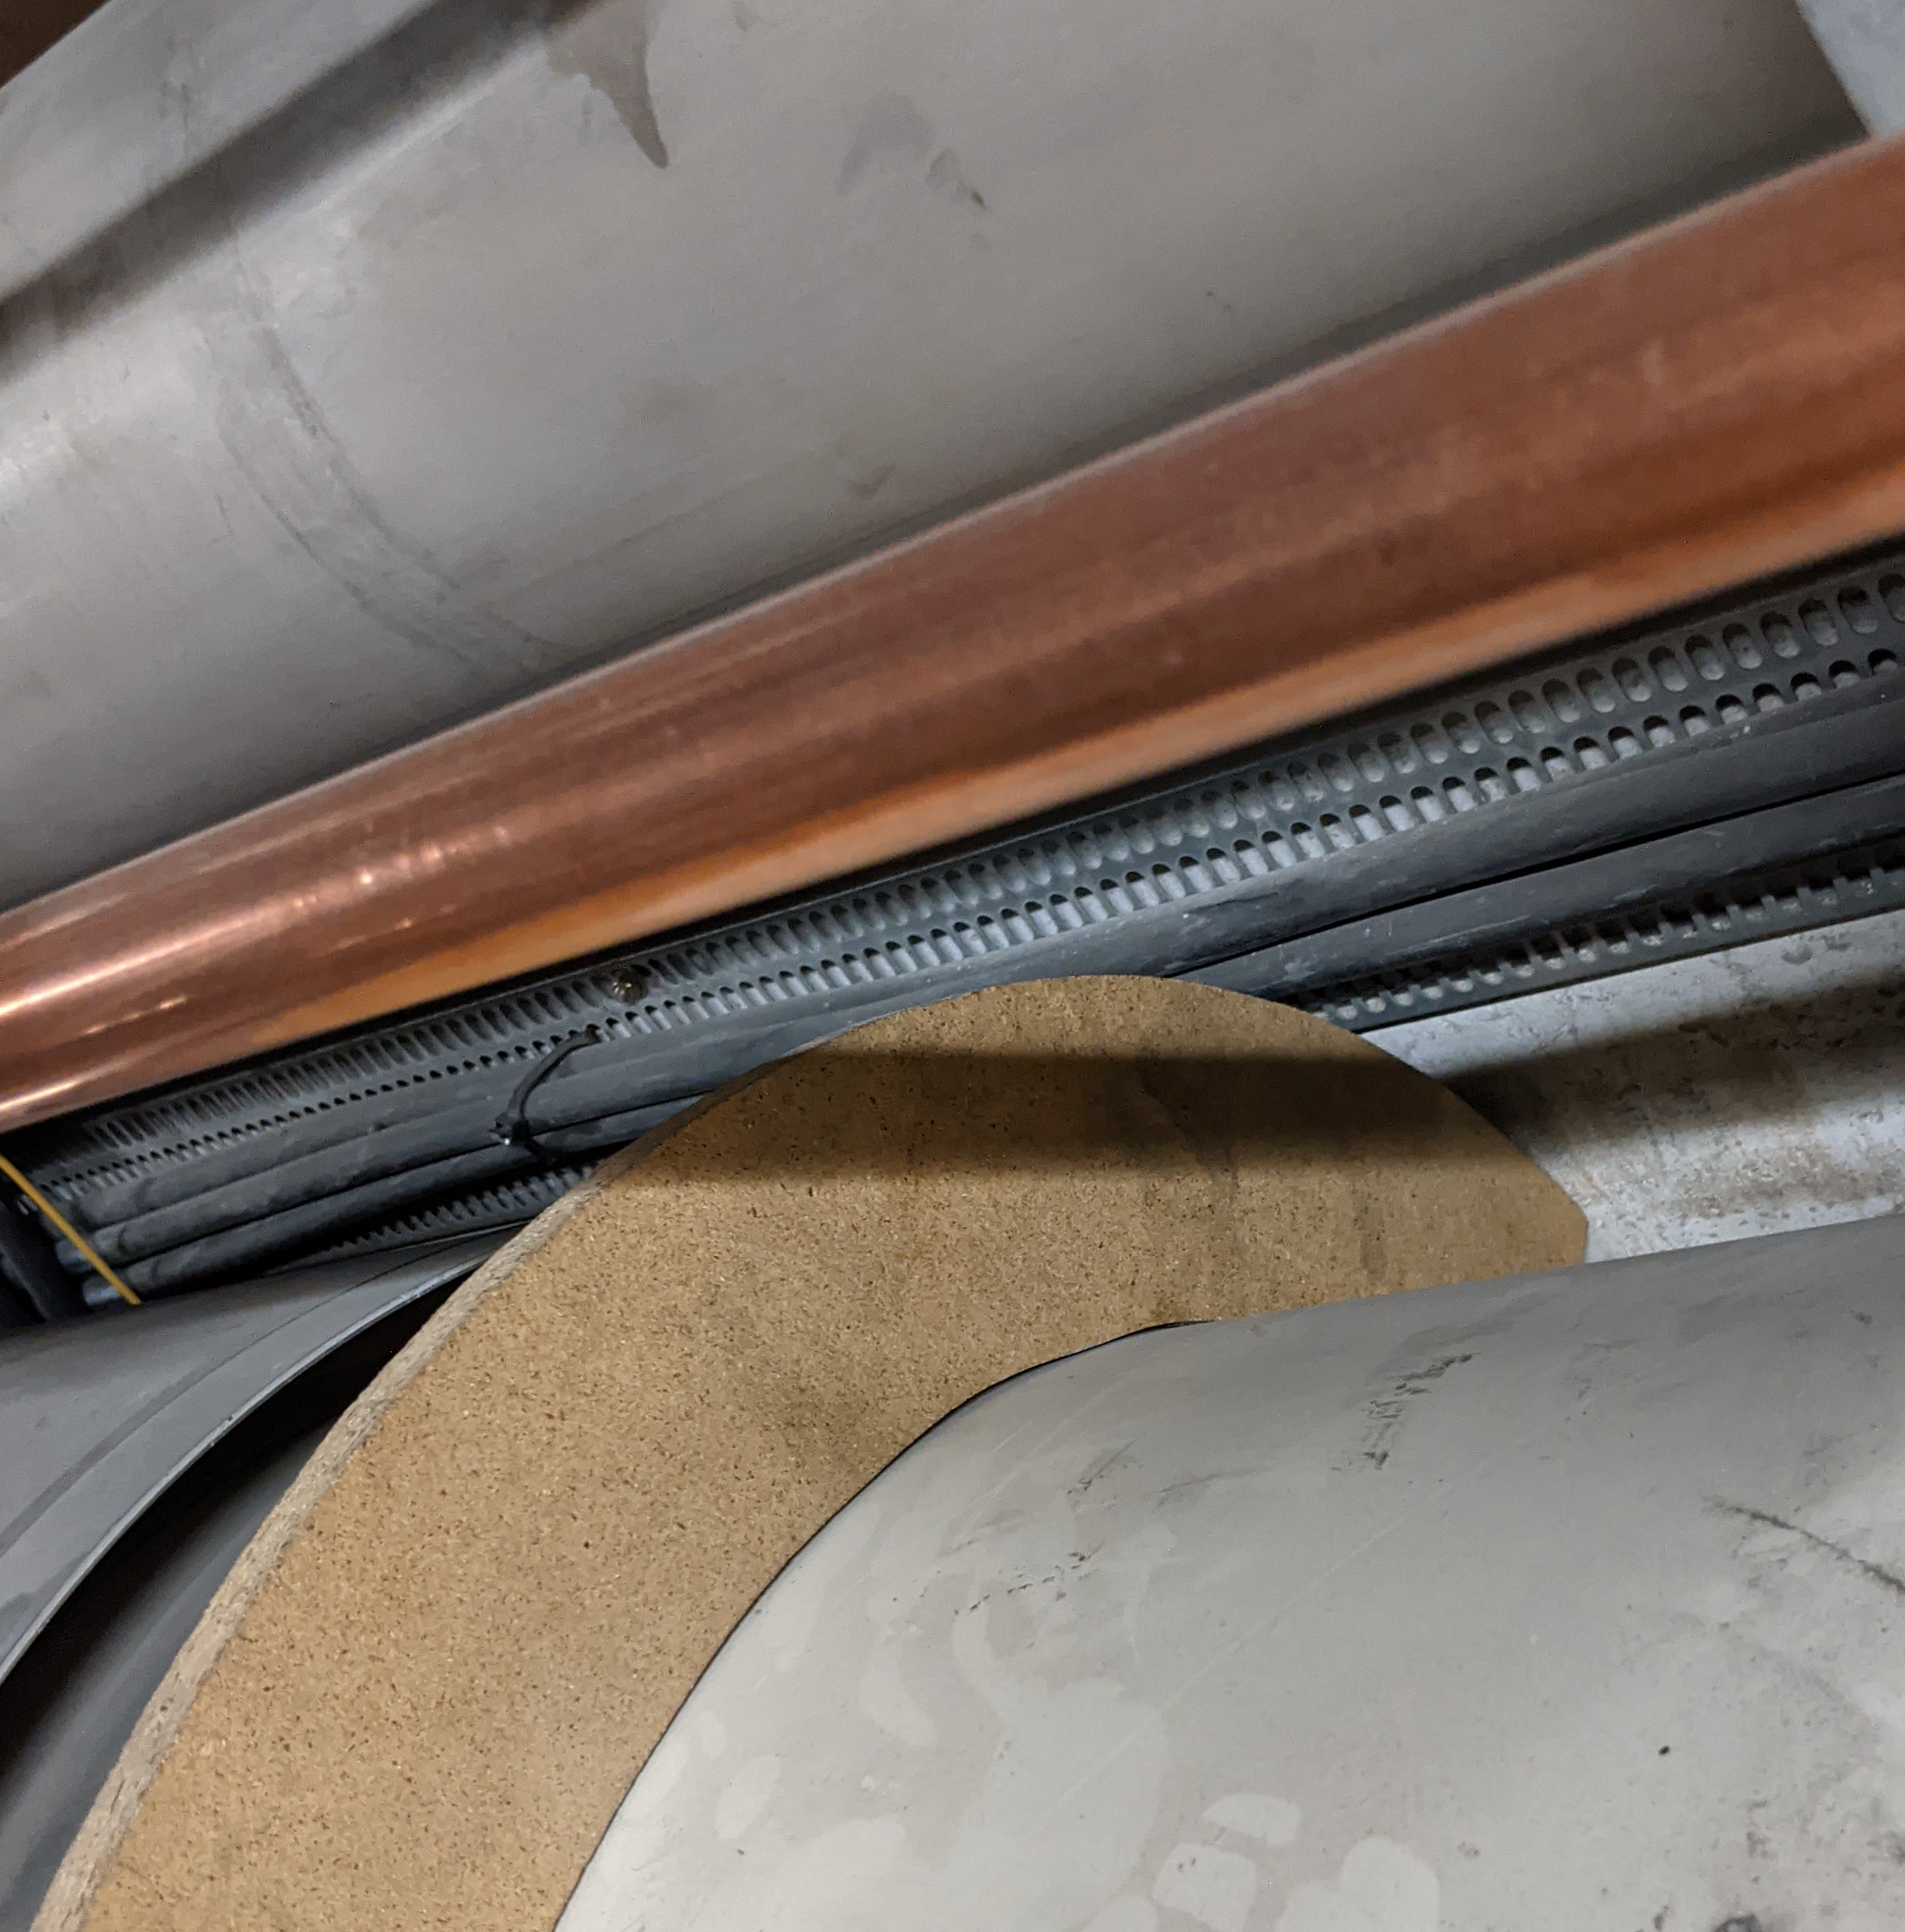
Problem Description
In several interconnections there is a lack of space for the Protem tool between the QRL and the wall.
Changing the cutting tool or opening a space in the wall would form dust, we want to avoid it for R.P. related reasons.
Protem Mock-up

Slide 4
Possible Conceptual Solution
Step 1
Step 2
Cut
Move
Cut
No Space
Cut
Cut

Slide 5
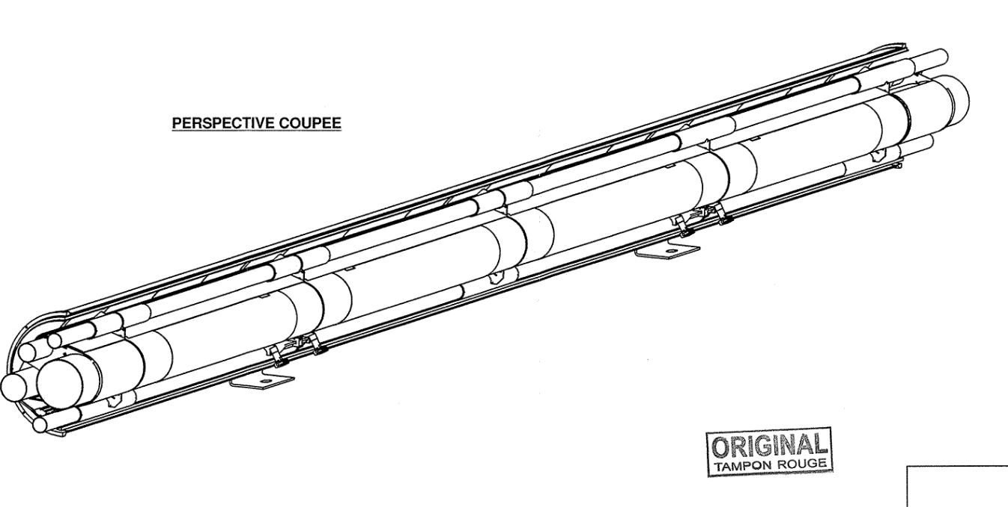
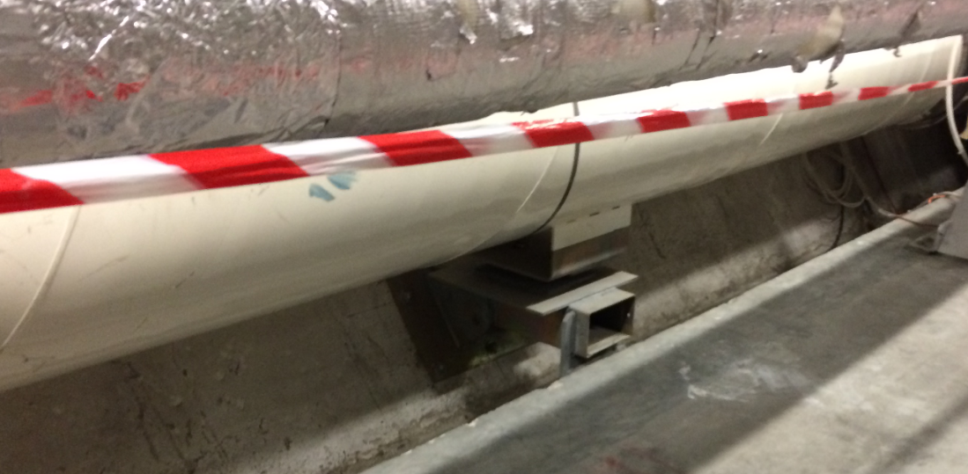
QRL Components: Pipe Elements
2 supports
Length: 7 m – 11 m
Mass ~ 2000 kg

Slide 6
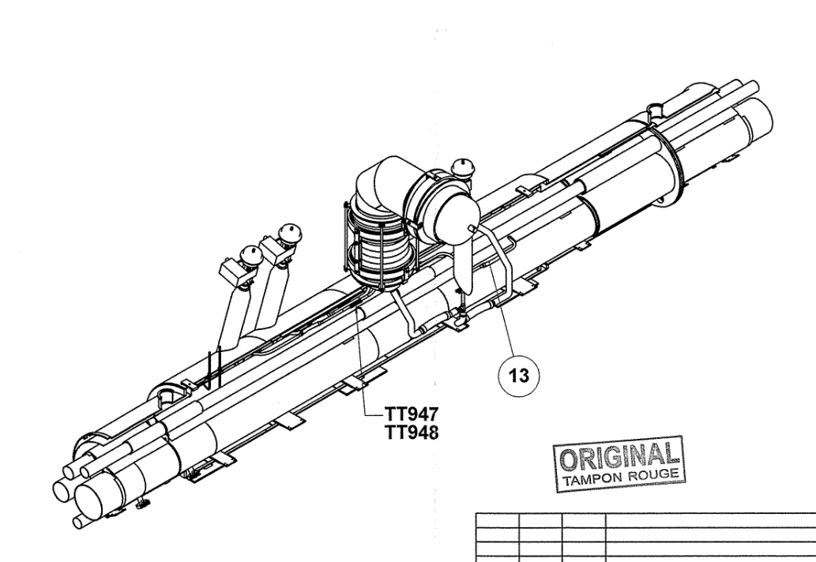
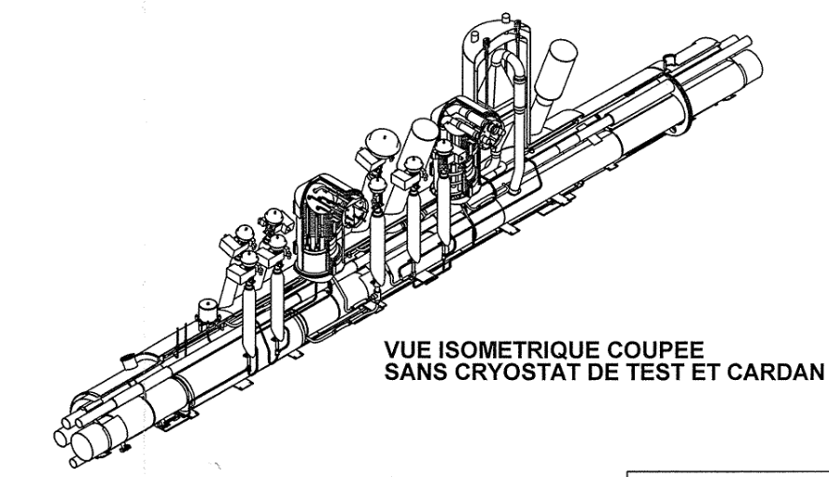
QRL Components: Service Modules
Length: 6 m – 8 m
Mass ~ 2000 kg - 3000 kg
Fixed point to the ground

