Slide 1
Benchmarking of Surface Conditioning
–
Problems of current technology & possible future development routes for electron cloud mitigation
Marcel Himmerlich on behalf of TE-VSC

Slide 2
Motivation
Laboratory solutions for a-C coatings and CuLESS for E-cloud
mitigation have proven efficiency
Some technical constraints require rethinking of the development strategy
Definition and agreement of target thresholds for initial SEY maximum
and required conditioning dose is required

Slide 3
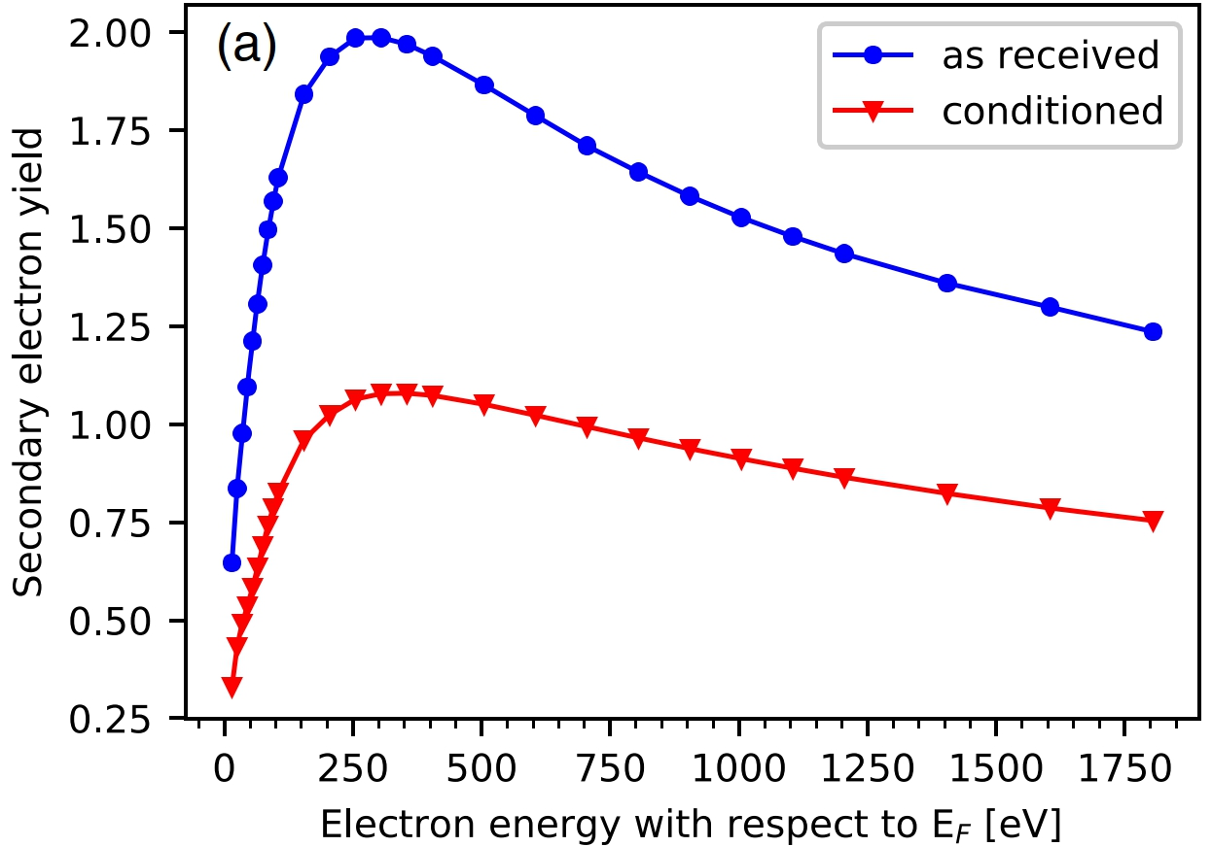
Lab-based analysis of electron-conditioning
SEY E-gun
COND E-gun
Sample
T = 293 K
V. Petit et al. Phys. Rev. Acc. Beams 22, 083101 (2019)
Analysis of SEY changes vs. Electron dose at room temperature as input
parameters for E-cloud and conditioning in the machine
Real conditioning dynamics depend on SE generation, magnetic field and
geometric aspects and have to be simulated

Slide 4
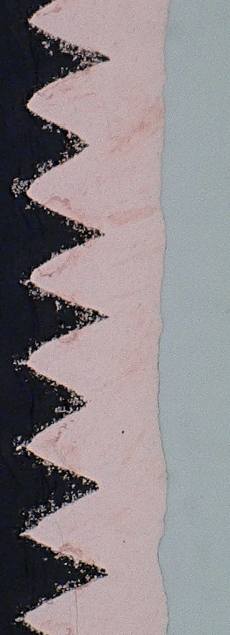
Two approaches for e-cloud mitigation
a-C film coating CuLESS
100 µm

Slide 5
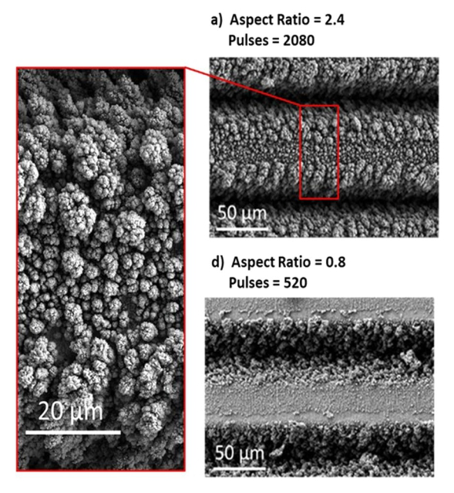
LESS – nanoparticles at the surface
ablated region
redeposited dendritic
surface layer
Surface patterning and redeposited nanoparticles define the SEY
Ablation depth, trench distance and SEY can be tuned via laser parameter adjustment
Surface is fragile and scratching, contact (i.e. RF Ball) should be avoided
Risk of particle release during a quench are currently evaluated

Slide 6
LESS beam screen characteristics
max.
100 µm
Ablation depth too high (< 25 μm)
Reduction of groove depth beneficial for
surface Impedance
SEY higher compared to lab LESS samples
surface conditions to SEY<1 for
electron doses <10⁻⁴ C/mm²
For machine-acceptance, the laser treatment has to be developed further.

Slide 7
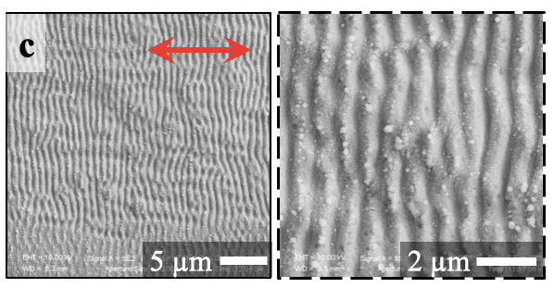
Low-Particle-density laser structuring
Courtesy of J. JJ Nivas (Univ. Naples), submitted to Appl. Surf. Sci.
Low-power treatment reduces particle
coverage and ablation/undulation depth
→ Better for machine acceptance in terms
of impedance aspects and risk of UFOs
SEY maximum is in this case higher and
can be tuned up to Cu OFE characteristics

Slide 8
a-C coating with residual H₂
Unintentional outgassing of
hydrogen during deposition or
intentional H₂ injection leads to an
increased SEY maximum
Coating setups, especially for
magnets, do not always allow
bakeout of the system prior film
deposition
If only hydrogen is incorporated,
conditioning requires a reasonable
amount of electron dose

Slide 9
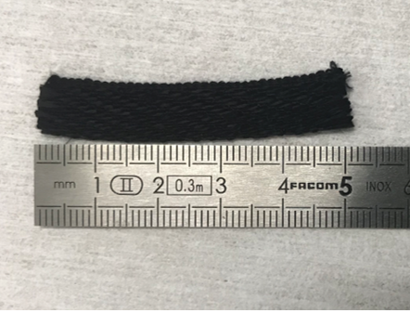
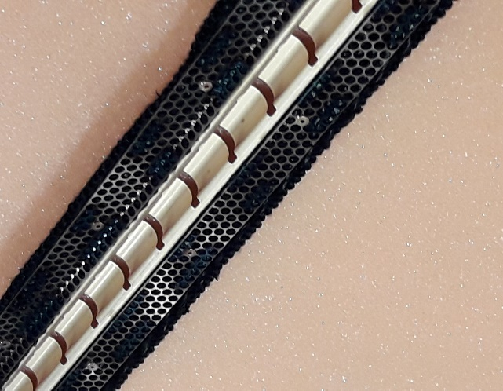
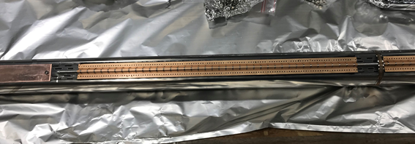
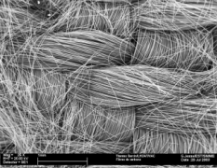
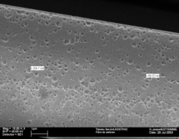
a-C coating with H₂ and Cryosorbers
unconventional
conditioning behavior
Warm-up of cryosorbers induced desorption of species that affect the coating
(not only H₂, also hydrocarbons) → R&D ongoing to mitigate the effect.

Slide 10
Discussion
Optimization of laser treatment for lower particle generation and low trench depth
+
a-C coatings in the presence of Cryosorbers
Initial SEY maximum of the surface will be > 1
Conditioning at reasonable doses will enable SEY < 1
The future development strategies requires consensus on parameters
and conditioning benchmarks
Proposal:
initial SEY maximum of the processes surfaces ≤ 1.5
Conditioning allows to reduce SEY max. to < 1 for a dose ≤ 5×10⁻⁴ C/mm²
The higher the values, the more flexibility for the treatment.

