Slide 1




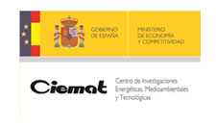










HITRI+ and I.FAST: next Eu programs for SC heavy ion therapy machine
Lucio Rossi
Univ. of Milano- Physics dept. and INFN-LASA-Milano
HITRI+ and I.FAST
HITRI
I.FAST
HITRIPlus and I.FAST Pre-start meeting of the WP8 (magnets) – Zoom platform 3 December 2020

Slide 2
Content
Status of ion therapy in Europe
SEEIST initiative
CNAO & MedAustron driven initiative
Roadmap
HITRI -> HITRI+
I-FAST

Slide 3
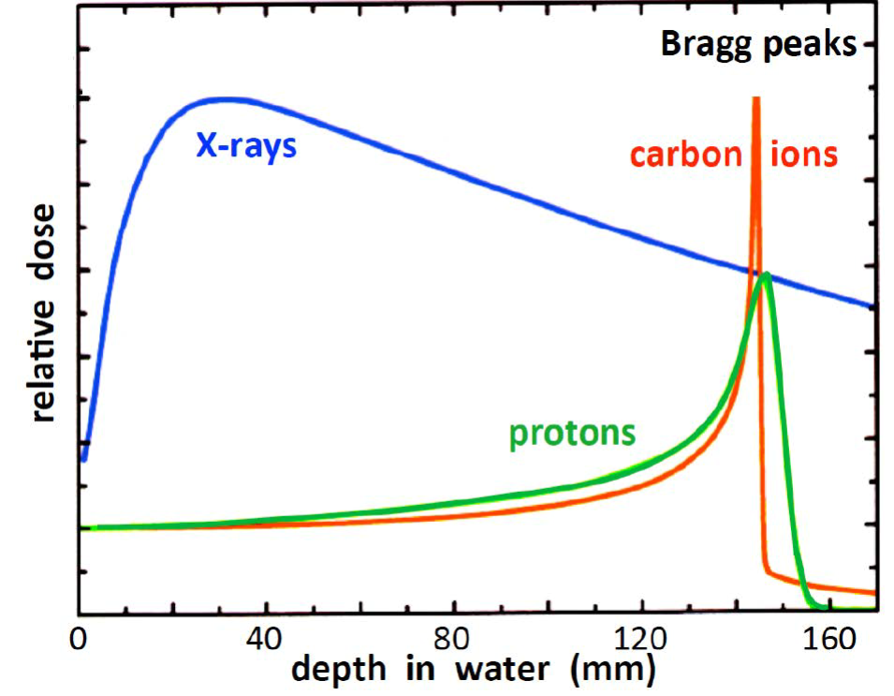
Hadrontherapy via carbon ions
Hadrons, proton and ions, are clinically better than X-rays, because they spare surrounding tissue (Bragg peak)
Proton therapy is expanding fast, while C-therapy is much behind
Carbon and other ions are much more precise and effective than protons especially for the so-called «radioresistant tumors».

Slide 4


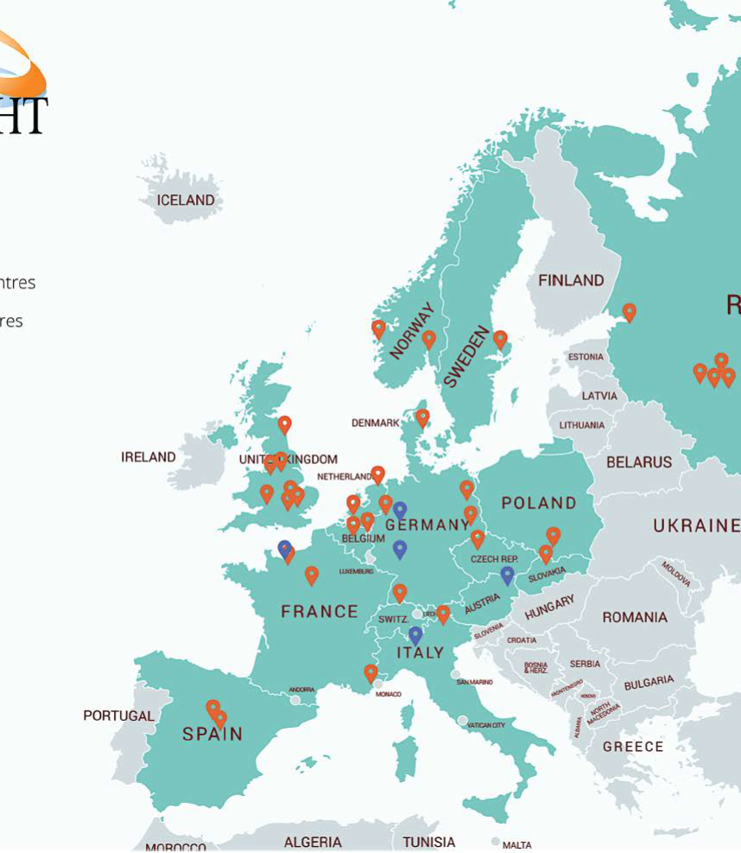
Hadrontherapy centers
Courtesy of
Hadrontherapy started beginning of 90’s
250,000 patients irradiated
  30,000 with carbon ions (5,000/y)
World: ∼ 100 hadron centers (160 by 2025)
  12 C-ions centers (Asia, especially Japan leading)
Europe:
  28 hadrontherapy centers
    4 C-ions centers

Slide 5
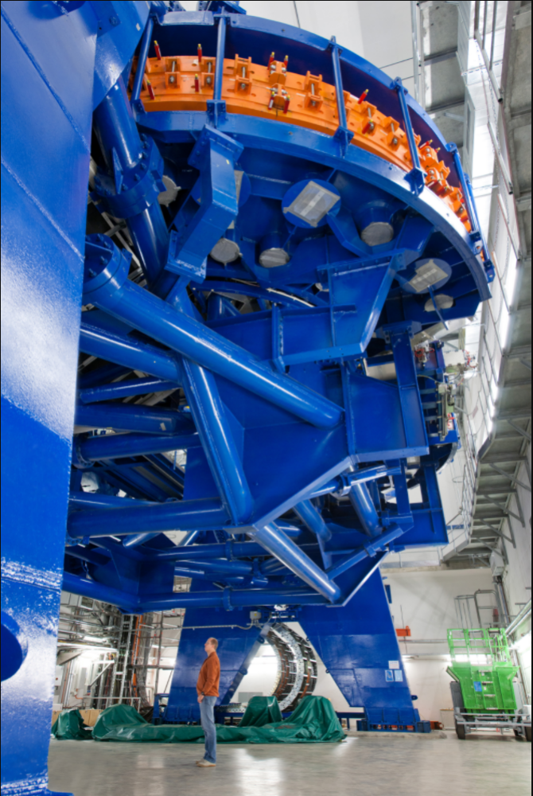
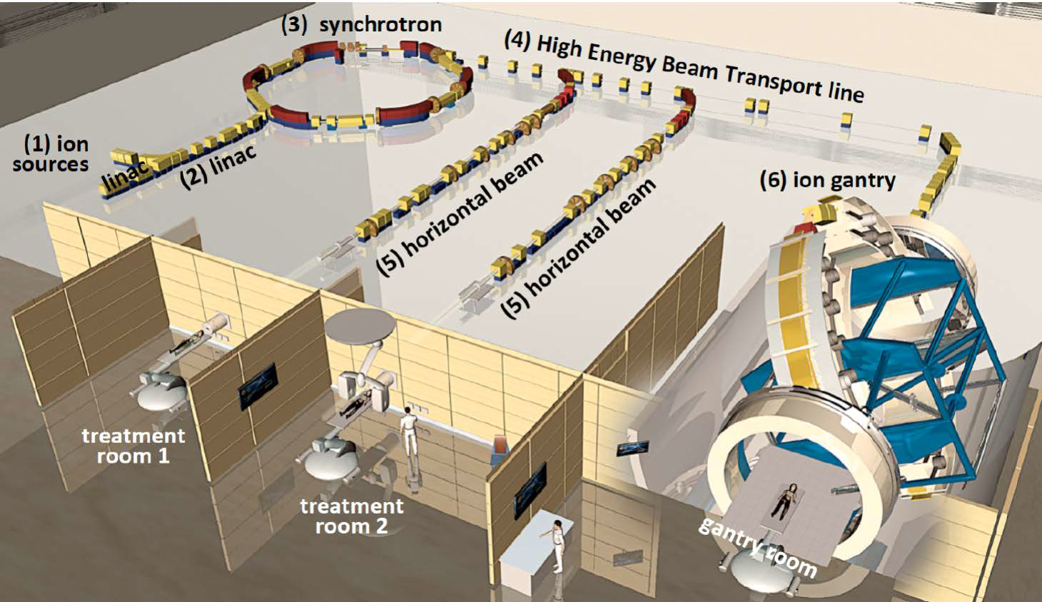
HIT - Heidelberg Ion Beam Therapy Center (first in EU)
25 m
25 m
Reducing footprint means cost reduction
Also saving electricity and infrastructure: superconductivty may play an important role
25 m long
13 m diameter
600 tons rotation
670 tons total

Slide 6


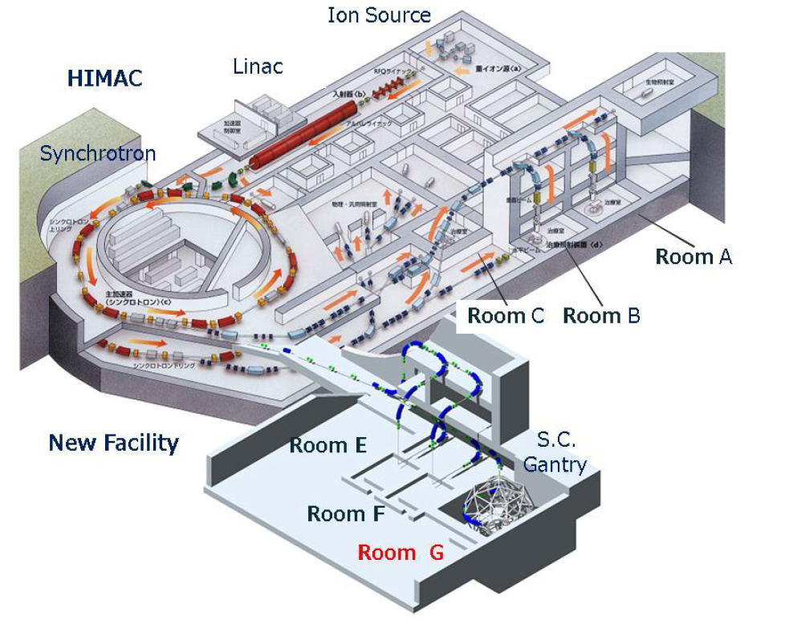
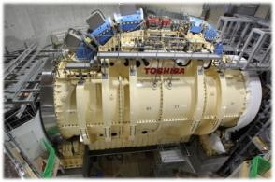
Japan: HIMAC at QST-NIRS
First SC Gantry in operation 2018
Cryocooled dry SC magnet
13 m
300 tons
Courtesy of T. Shirai, QST-NIRS

Slide 7
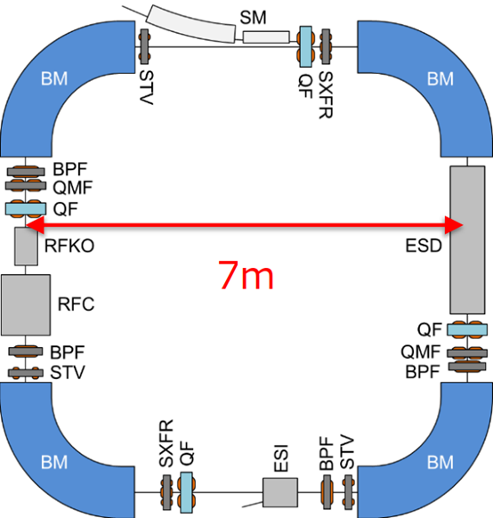
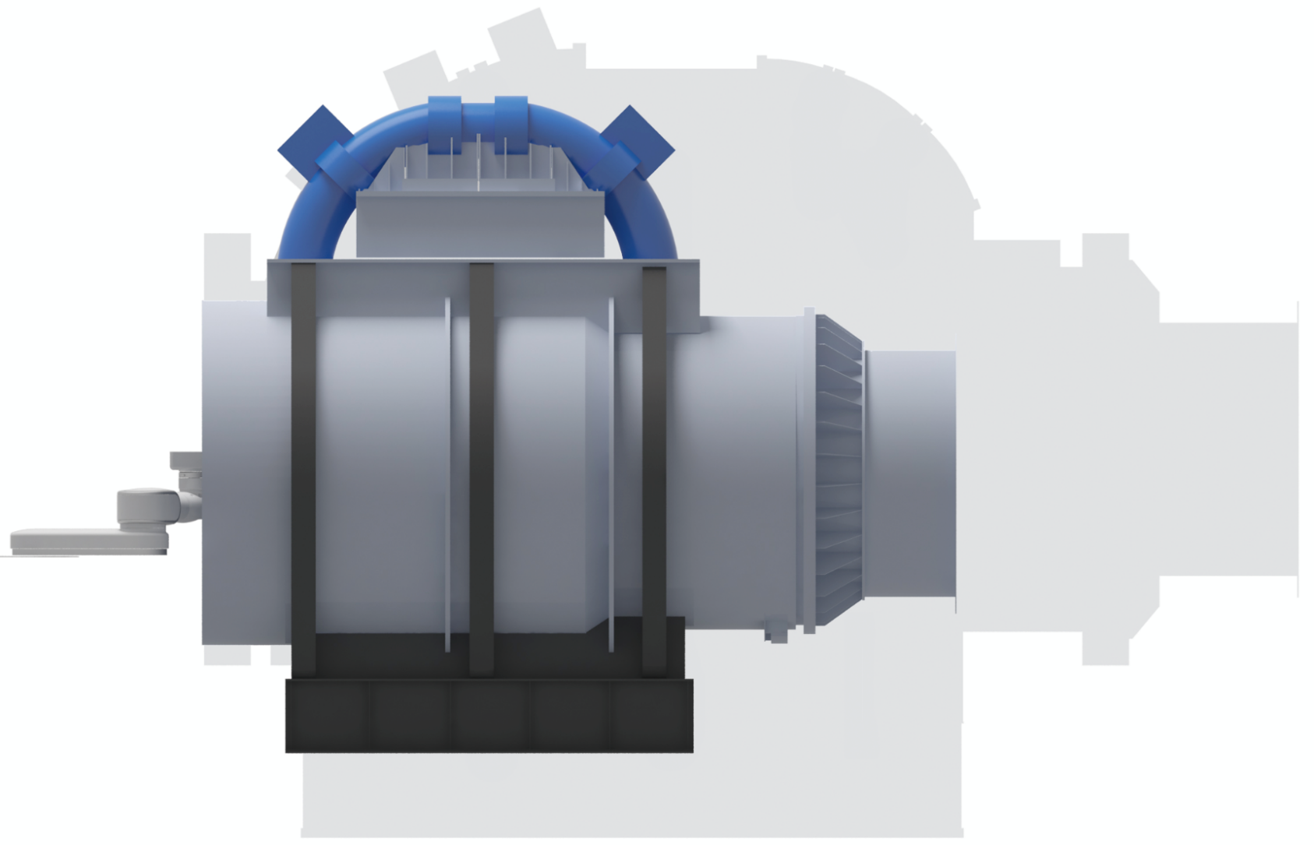
Japan: HIMAC at QST-NIRS strong push toward SC technologies
Courtesy of T. Shirai, QST-NIRS
operating SC gantry in NIRS
Courtesy of Koji Noda, QST-NIRS
2nd SC-gantry : L= 8 m
With same SC as the synchrotron
B0 = 3.5 T reducing accelerator dia. 20 → 7-10 m
Dip. Field: 2.9→ 3.5 → ∼ 5 T
Ramp time: 60 → 5 → 3 s
Op. Temp. : 4-5 K …….→ 10-20 K this requires HTS

Slide 8

SEEIIST
South East European International Institute for Sustainable Technologies
Fighting against cancer
Nuclear medicine as crucial component of future personalised cancer care
Develop advanced cancer therapy with ion beams and isotopes
Building international cooperation
and scientific capacity in South East Europe
Advance European integration, reverse brain drain, connect to Europe
Two
Strategic
Objectives
–
One
initiative

Slide 9

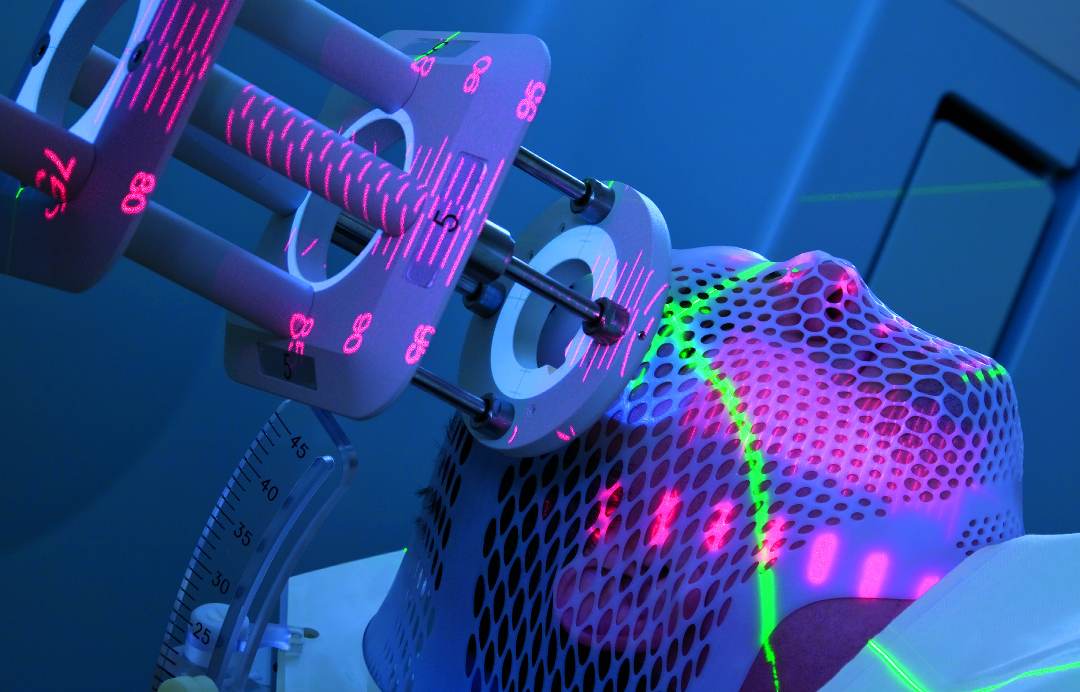
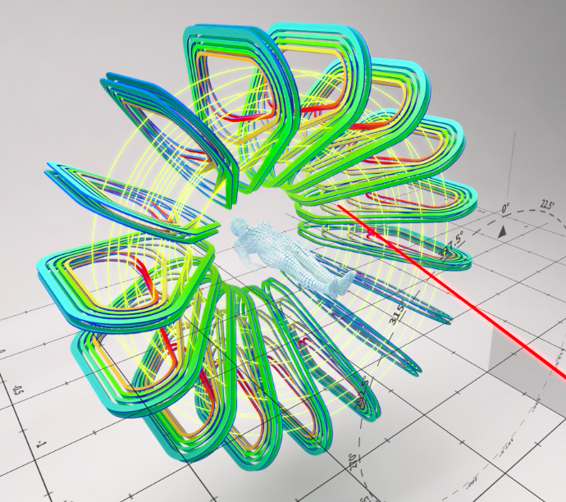
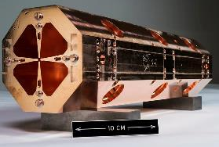
Comprehensive Dimension: both Cancer Therapy and Research Center with 50% of the beam time dedicated to research – other Unique Selling Points
MULTI-DISCIPLINARY RESEARCH WITH HEAVY IONS
BREAKTHROUGH IN TECHNOLOGY
SCIENCE
DIPLOMACY
Pre-clinical (medical, radiobiology)
Clinical, including clinical trials
Industrial research (microelectronics)
Material research
Ultra-high dose rates (FLASH)
Multi-ion synchrotron (beyond
presently used p and C-ions)
More compact and much cheaper Superconducting synchrotron
Superconducting gantry
Higher beam intensity, faster extraction; Real time imaging
Declaration of Intent signed at CERN in October 2017 by 8 SEE countries
MoC signed by 6 Prime Ministers of the SEE Region in July 2019, at the Summit of Berlin Process, Poznan
Political support by the Swiss
Government to establish SD roadmap
Cutting-edge innovative and novel research in any of these topics driven by novel technological opportunities
Complementary to all existing facilities
Will make cancer treatment with ions accessible to a large fraction of the European population and bring back Europe the lead position in this field
With the strong supporting consortium of 18 European research centers and clinics the SEE region is trying to revive its technological tradition

Slide 10
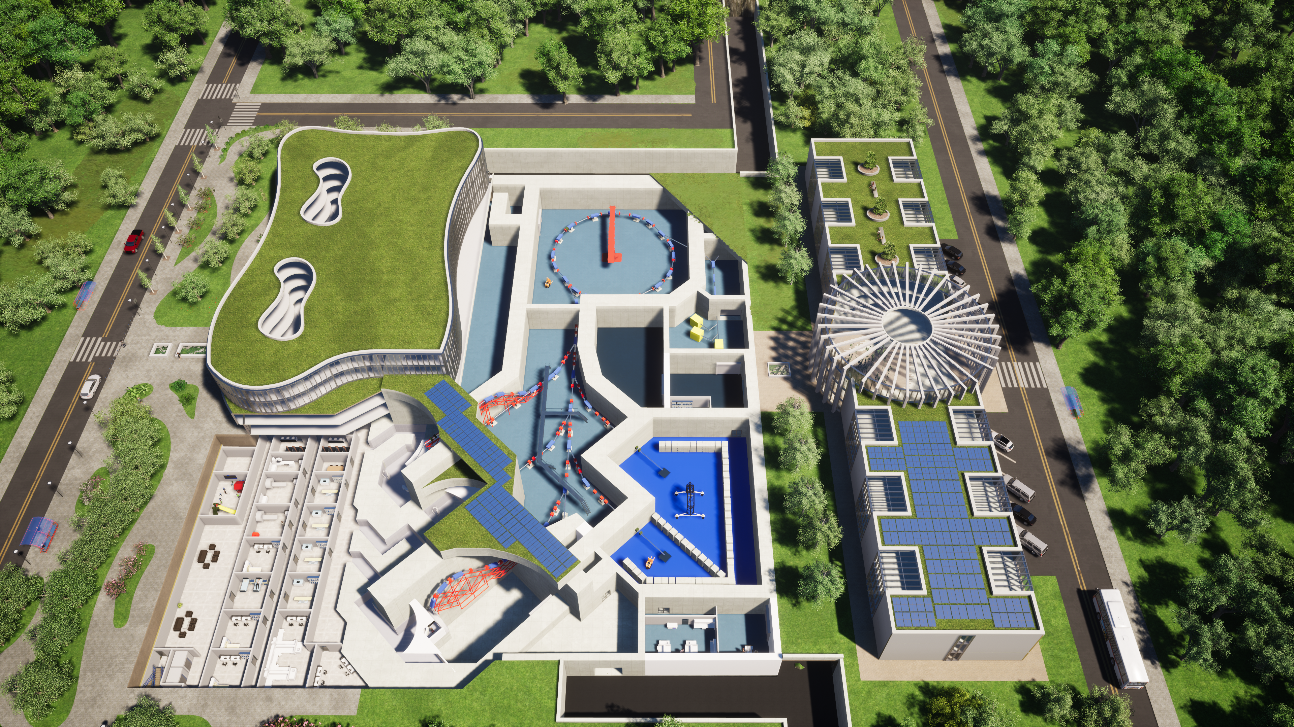



SEEIIST – First Green Infrastructure in line with
Horizon Europe Cancer Mission
SC magnet based synchrotron
SC magnet based gantry

Slide 11

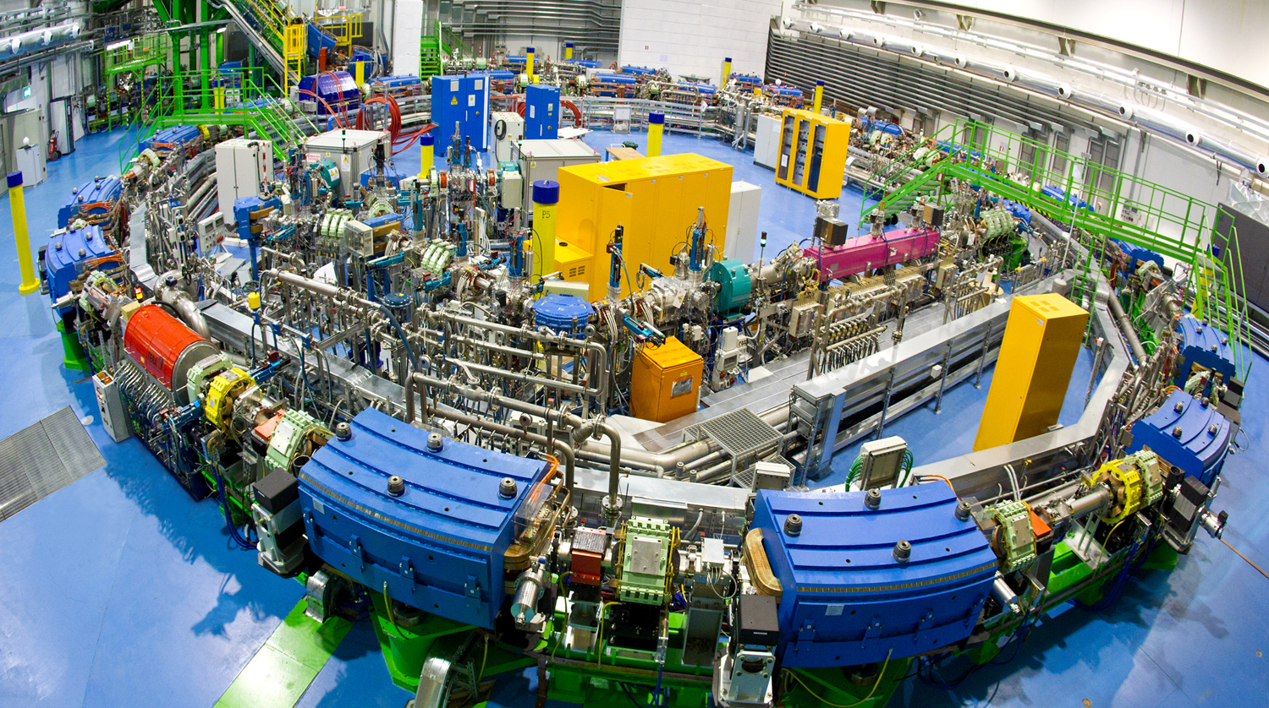
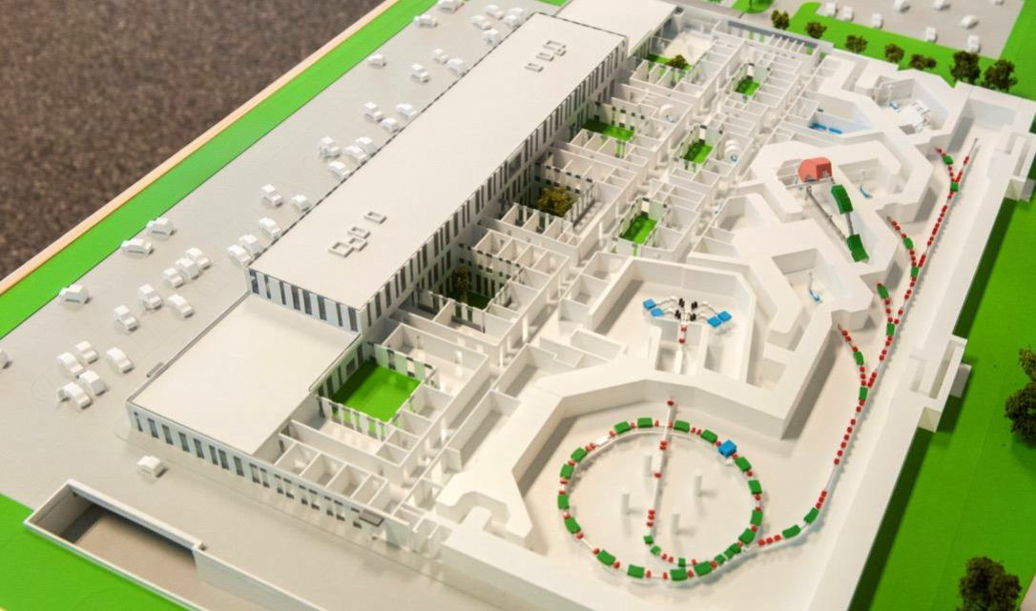

collaboration
CERN-CNAO-MedAustron-INFN on C-ion GANTRY
Improve the efficiency (medical effectiveness and treatment time) of the present facilities
  CNAO (Pavia, IT)
  MedAustron (Vienna, AT)
Design a gantry compatible with the present layout without large civil engineering and infrastructure investment
Leveraging the design capability and technology infrastructure of HEP community (CERN) to strenghten the medical technology in EU.
→ NIMMS program at CERN led by M. Vretenar
TRIGGERED by GaTOROID of L. Bottura in 2019

Slide 12

Collaboration CERN-CNAO-MedAustron-INFN on C-ion SC GANTRY (started end 2019)
Scope: design a SC gantry and demonstrate technology to allow its construction in 7-8 year
Exploring two lines:
  Light rotating gantry, weight ∼ 10-20% of HIT gantry (40-50% of of HIMAC-JP)
    Based on work driven by TERA foundation in collaboration with CERN
    Now mainly driven by NIMMS program at CERN, with TERA
  Static toroidal gantry of new design based on a CERN patent
L. Bottura, “A Gantry and apparatus for focussing beams of charged particles,” Patent, EP 18173426.0., May 2018
E. Felcini, phD thesis (EPFL Lausanne and CERN, 2020)

Slide 13


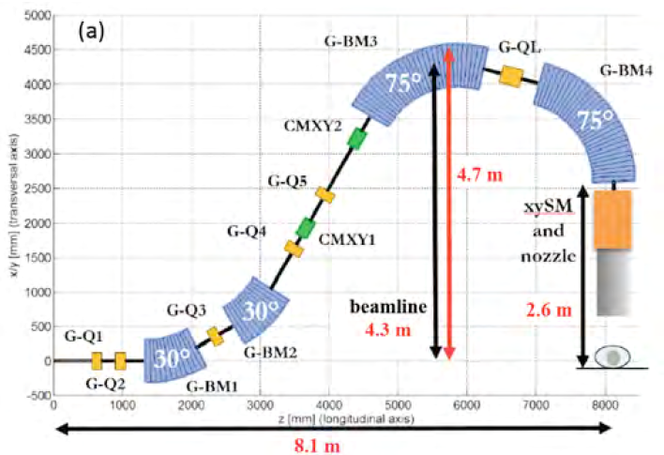
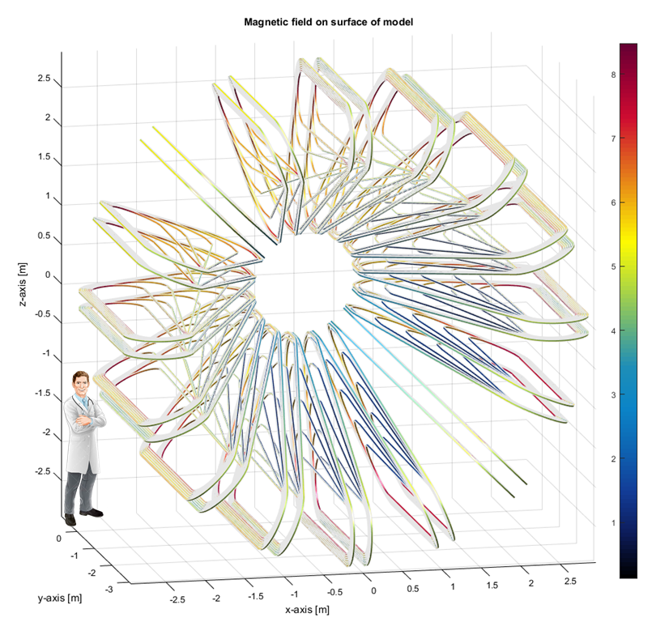
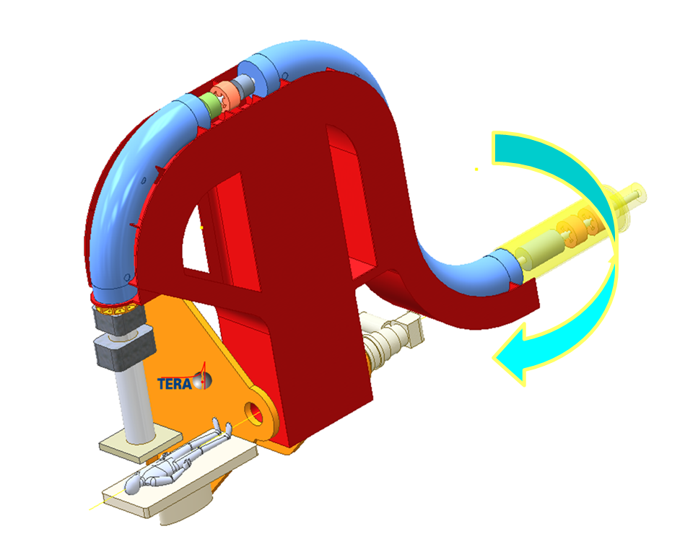
Collaboration CERN-CNAO-MedAustron-INFN on C-ion SC GANTRY
Light rotating gantry
Toroidal gantry
End 2020: decision on design based on International panel assessment. GOING on right now…

Slide 14
Exploring all SC technologies for next generation HEP colliders for advancing in Hadrontherapy
Nb-Ti remains the workshorse of superconductivity: first solution
For HiLumi LHC, now, and FCC-hh, in the near future, CERN and HEP communty is developing
  Nb₃Sn technologies for collider quality magnets. Next talks (CERN and USA)!
  (Requirements for HEP colliders slighty ≠ for sweeping synchrotrons)
  Canted Cosine Theta dipoles (Nb-Ti for HiLumi LHC, CERN and IHEP Beijing, Nb₃Sn for FCC-hh, PSI and LBNL). Self-funded initative by Uppsala U.and Scaditronix (CERN coll.)
For FCC-hh HEP is also exploring HTS coils for accelerator quality magnets:
  in Europe via mainly the EC funded FP7-EuCARD2 and H2020-ARIES
  In USA mainly in LBNL (in the frame of accelerator R&D for next collider).

Slide 15
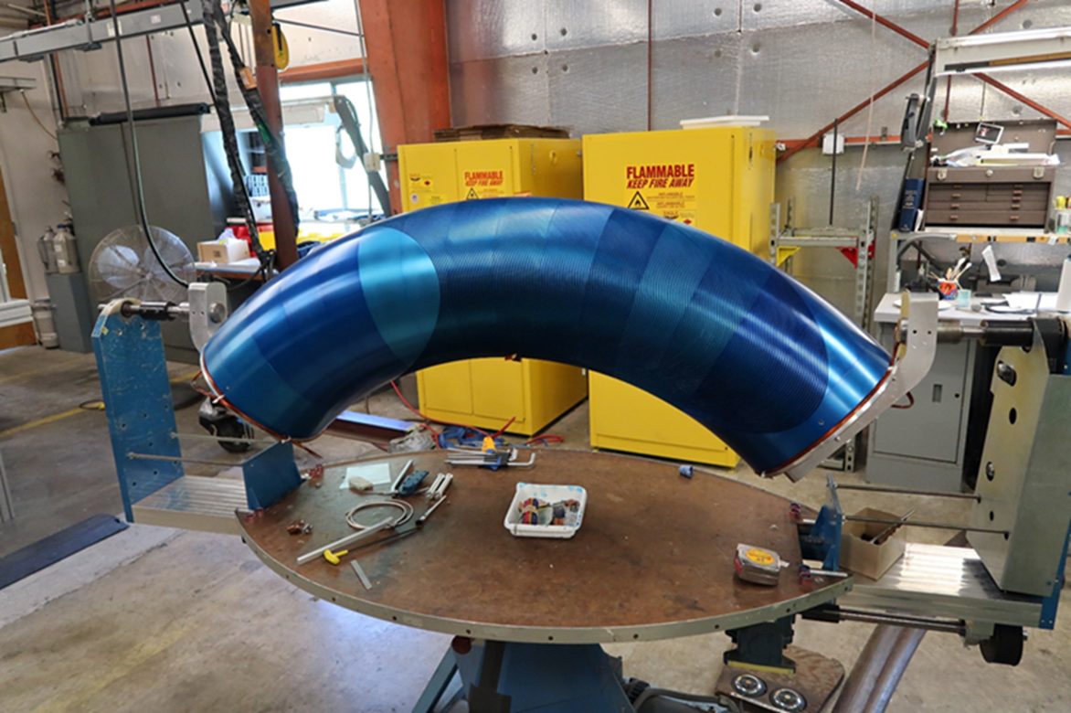
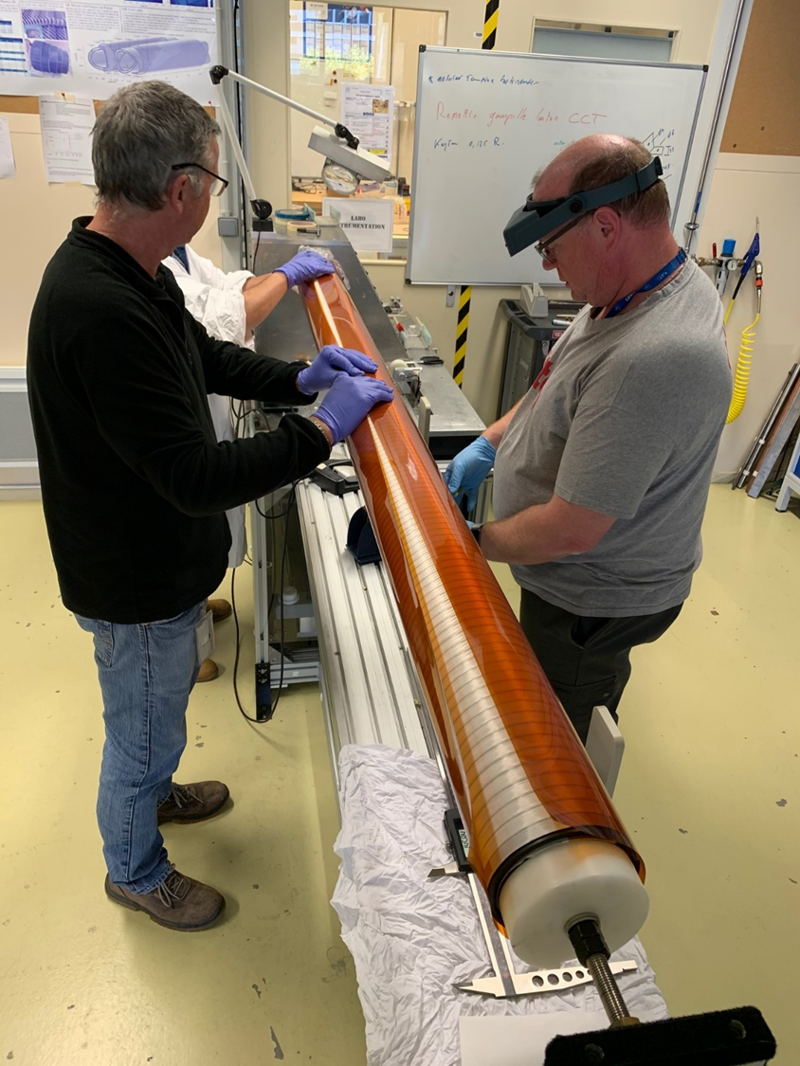
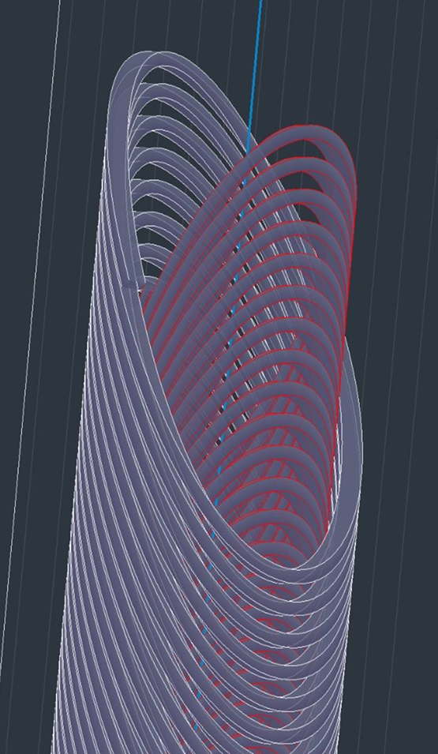
Nb-Ti CCT: p-gantry and HiLumi LHC
LBNL: CCT coil prototype for large acceptance proton gantry ∅ = 400 mm: Successfully tested to 3.5 T; segmented former
HiLumi LHC: CERN has designed, built and tested a dual 3 T, 2 m long - ∅ = 90 mm, straight CCT. Now IHEP Beijing producing 2x13 units

Slide 16


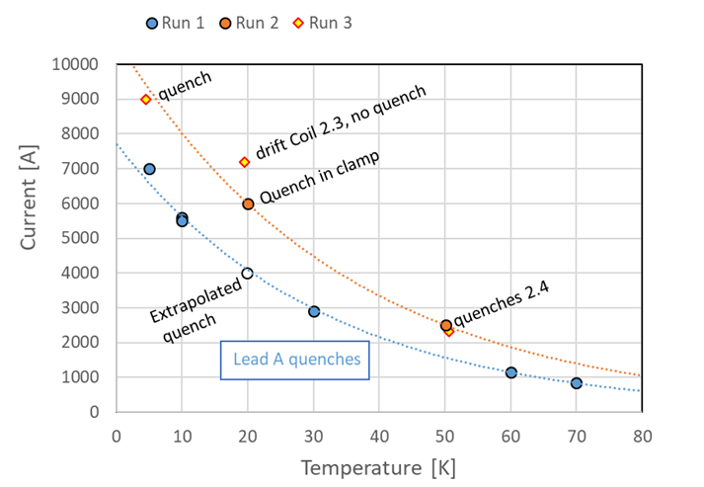
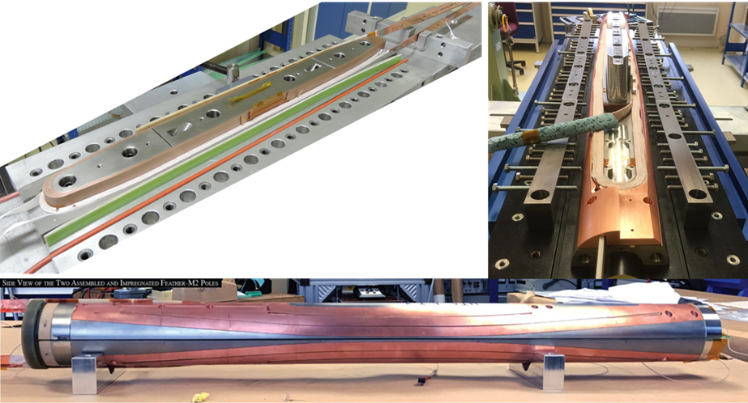
HTS for accelerator magnets: status in EU
CERN Feather_M2: flare end race track, REBCO Roebel cable, 40 mm bore
> 3 T in 2017; 1st magnet
> 4.5 T in 2019; 2nd magnet
∼ 6-7 T in 2021; 3rd magnet, hopefully!
CEA HAS ASSEMBLED a cosϑ dipole, 40 mm bore, with REBCO Roeble cable: test in 2021

Slide 17
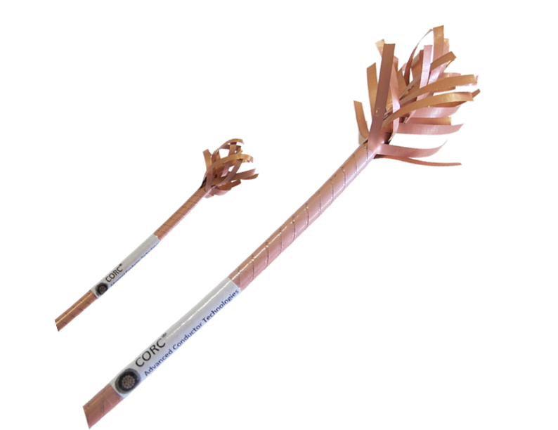

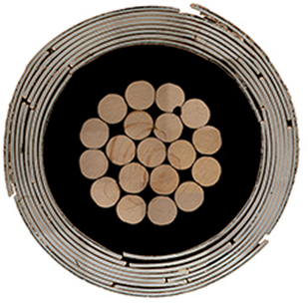

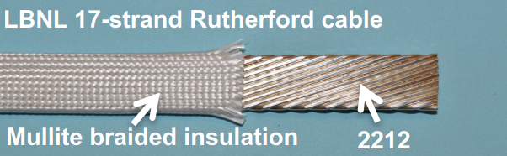
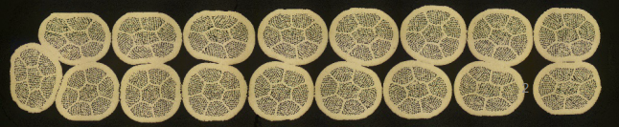
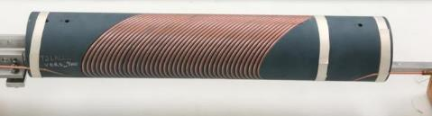
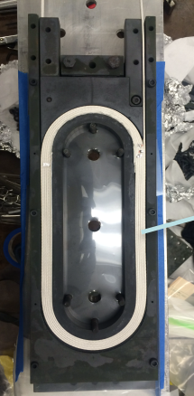
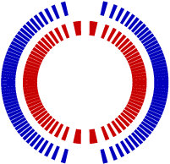
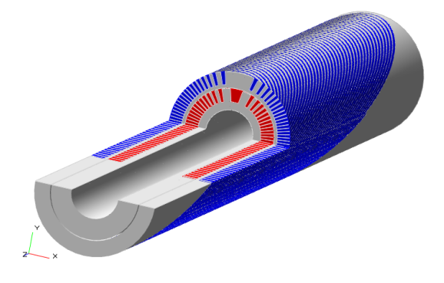
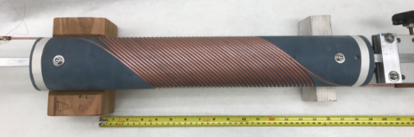

LBNL effort on HTS accelerator magnets
Program based on CORC and CCT layout led by X. Wang & S. Prestemon
Program on use of Bi-2212 Rutherford cable with race track and CCT layout
led by T. Shen and S. Prestremon
By Advanced Conductor
Technologies
Outer layer
Courtesy of Xiaorong Wang
Inner layer
Courtesy of Tengming Shen

Slide 18
The EC H2020 funded program - 1
HITRI: Prapared in May-June 2019 and submitted to EU in Nov.2019
  Heavy Ion Therapy Research Infrastructure
  Scope: design study mainly (if not purely) for SEEIIST
  Magnet WP scope:
    to produce an assessment and a design between CCT and CT for synchrotron and between CT/CCT/Toroid for gantry
    To build two protos one in HTS
Should have started in Summer 2020.
  Not approved: info in February 2020, official communication March 2020): weak in medical part and use… (Physics part OK)

Slide 19
The EC H2020 funded program - 1
I.FAST
  Is the omnibus program following CARE, Eucard, Eucard2, ARIES to integrate accelerator R&D across EU labs: It si about 10 ME form EU, many WPs…
  Each reasearch theme has been pre-selected by a TIARA/ARIES committee
    Proposal to the selection committee in July 2019. Programs were then defined in June-July 2019.
    Decision in October 2019 to be submitted in March 2020 and to start in May 2021 (after ARIES end)
    Proposals: 1) develop CCT for HT (approved); 2)to develop Toroids for HT (NOT approved)
  WP8 on Innovative Superconducting Magnets
    Conceived as after-HITRI: fostering innovation: → exploring HTS cable and new magnet layout
    Involve Industry in the know how build up is a key goal for the WP.
    CCT made of: CORC® ?, stacked tapes? Roebel? Or Bi-2212 Rutherford cable? Other magnet layout?
    The WP8 fosters also a panel to steer HTS for accelerator magnets in EU and the development of a HTS cable suitable for low losses - large size - fast cycling - synchrotrons (led by GSI)
    Applied in May 2020; Approved 3rd of November 2020!

Slide 20
The EC H2020 funded program - 1
HITRIplus (Hitri+)
  Once applied for I.FAST in March 2020 extension of 3 months of deadlines
  Opportunity to re-apply, withut too much effort a renewed HITRI program
  Medical part improved, scope expanded not only to SEEIIST (still most prominent project in EU). Physics part, MAGNETS, same as HITRI
  Infrastructure (not DS): 4 year long. Magnet program is stil foreseen in 3 years
  WP8 on Magnet Design
    overview and assessment of various conductors (LTS, HTS, various types of cables) and magnet layouts (cosϑ, CCT, racetracks – split coils or flare ends – etc…).
    Both for Synchrotrons (main dipole and extraction channel) and Gantry
    Design construction and test of 1 demontrator ∼500 mm long (either LTS or HTS)
    Very much CCT oriented!
  Applied in May 2020; Approved 3rd of November 2020!

Slide 21
The EU roadmap for enabling a full SC C-ion facility: synchrotron + gantry
Disclaimer: roadmap to be reviewed with stakeholders
I think we should not wait too much to prepare the next step: a large magnet program in HE …

Slide 22
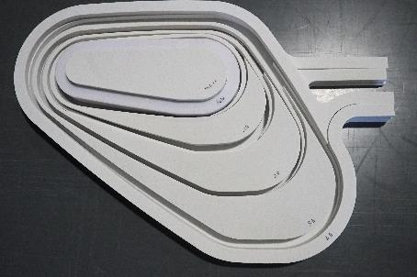
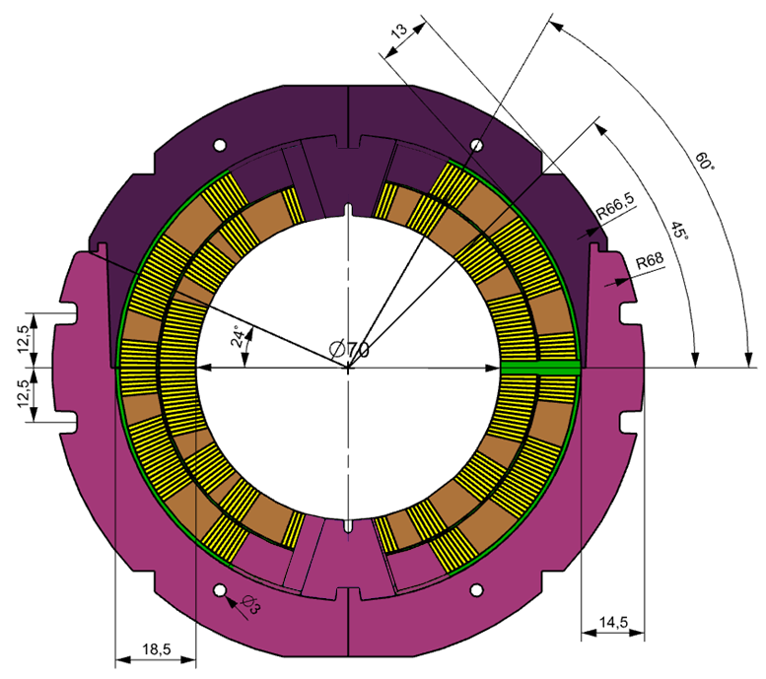
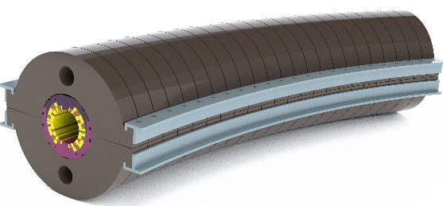
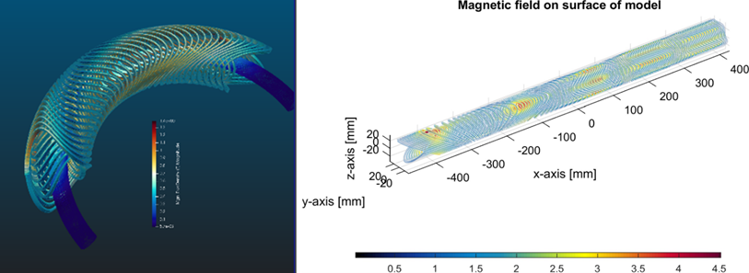
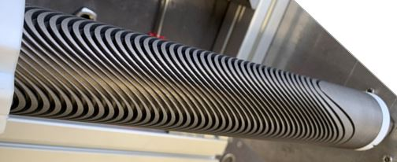
A few ideas (just as list…)
Winding plate of the HTS 0.5 m wide HTS demonstrator toroid for the Ga-Torroid; courtesy E. Felcini and G. de Rijk, CERN
Curved cosϑ dipole with H-split yoke with assembly clamps - Courtesy Mikko Karppinen, CERN
Solution for curved and straight CCT coils combining dipole and quadrupole in the same winding - Courtesy G. Kirby and J. van Nugteren, CERN
The challenge is not the field level, rather designing for ramping field and cryocooled magnets…

Slide 23

HITRI+ WP8 Magnet Design (with construction and test of a demonstrator)
INFN is two units (MI-GE). Sentronis is associate to SEEIIST
INFN is the WP8 – Magnet Coordinator
CEA is the deputy coordinator

Slide 24
I.FAST WP8 Innovative SC Magnet. Demonstrators in Industry!!!
INFN is the WP8 – Magnet Coordinator; CEA is the deputy Coord.
The budget includes 50 kE (placed at CERN) of the ESG and workshops; it does not include the 200 kE of GSI-UT-IEE-ILK for ramped cable

