Slide 1
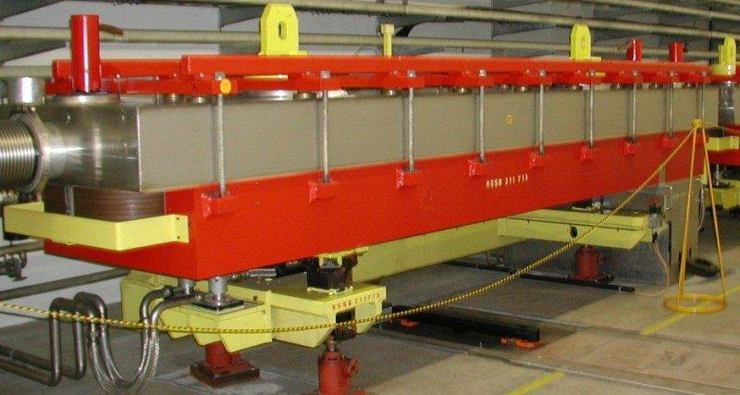
MSSB for the NEA at CERN
MSSB septum splitter magnet for the North Experimental Area at CERN in the context of the planned BDF/SHiP extraction line
TE-MSC Seminar
24th November 2020
Jakub Kurdej (TE-MSC-MNC)

Slide 2
Introduction
Beam Dump Facility (BDF) – proposed fixed target facility currently in approval phase.
The facility will be positioned to the left from the existing beam lines towards North Experimental Area (NEA).
Beam transfer system allowing switching the beam in both directions (left and right) is required.

Slide 3
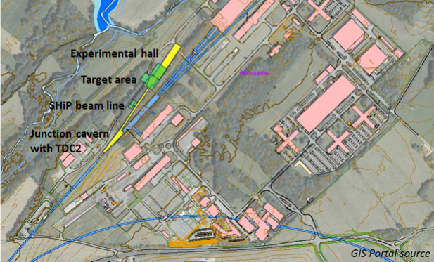
Future BDF / SHiP facility
North Area
North Area
TCC2
TCC2
TDC2
TDC2
TT20
SPS ring
BA3
BA3
TT20
SPS ring

Slide 4
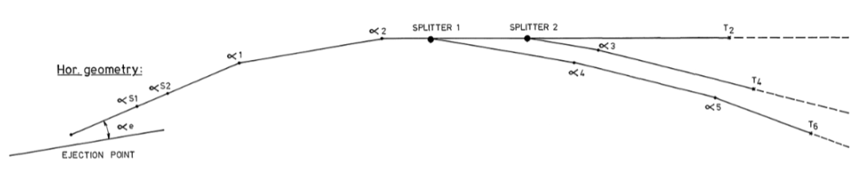
Existing transfer lines to NEA
Two MSSB splitters in TDC2 cut (split) the beam in two (each)
Three beams towards three different targets (T2, T4, T6) can be supplied simultaneously
MSSB
MSSB
TT20
T2
T4
T6
SPS
TDC2

Slide 5
How do we split the beam?

Slide 6
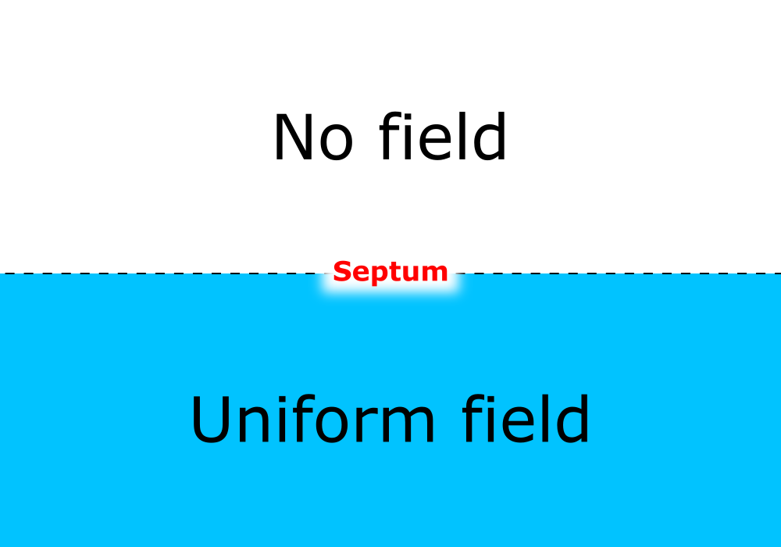
An ideal septum
Two regions, one with uniform field and one with no field
separated by a zero thickness partition - septum
Electric field
  Electrostatic septum
Magnetic field
  Septum magnet
Beam
B

Slide 7
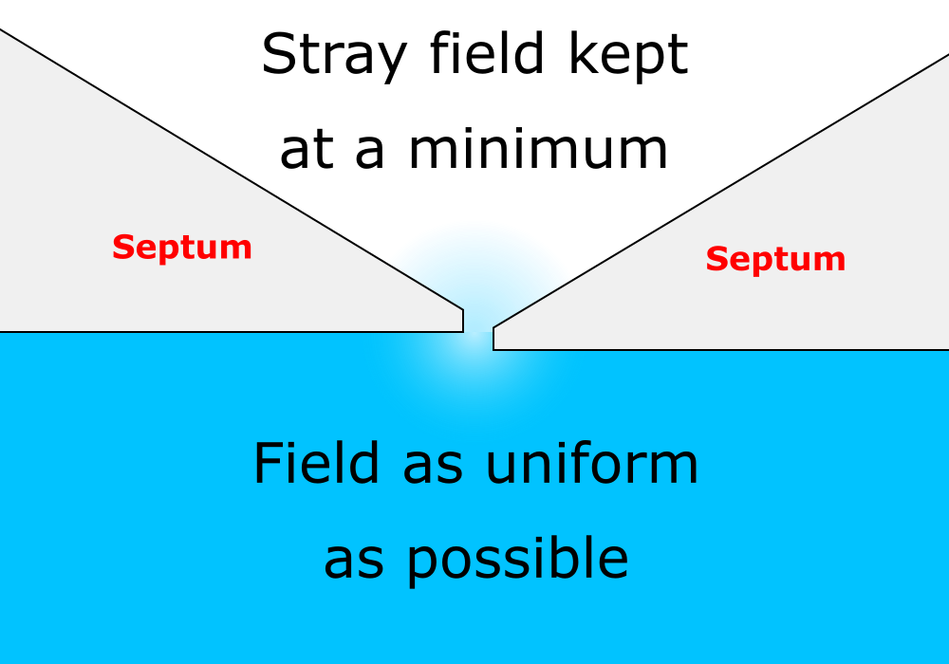
A real Lambertson septum magnet
Stray field in the no-field region is present
Non-uniformities in the „uniform” field region
Non-zero thickness septum blades
Saturation - uniform field cannot go arbitrarily high

Slide 8
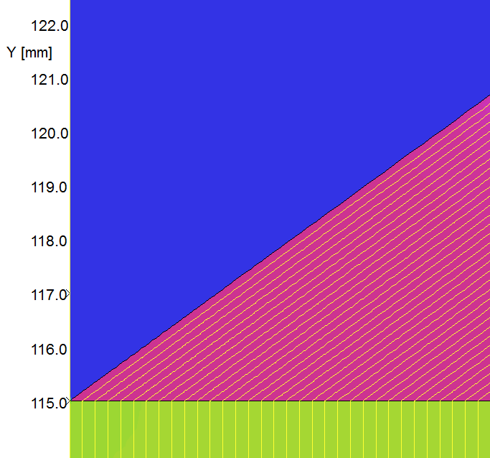

A real Lambertson septum magnet
Stray field in the no-field region is present
Non-uniformities in the „uniform” field region
Non-zero thickness septum blades
Saturation - uniform field cannot go arbitrarily high

Slide 9
MSSB

Slide 10
What is MSSB?
MSSB is a design family of Lambertson septum splitter magnets
Currently only installed in North Experimental Area (NEA) transfer lines (TDC2) – six units in packs of three
These MSSBs supply different experiments during the same cycle of SPS by cutting the beam and deflecting one part of it.

Slide 11
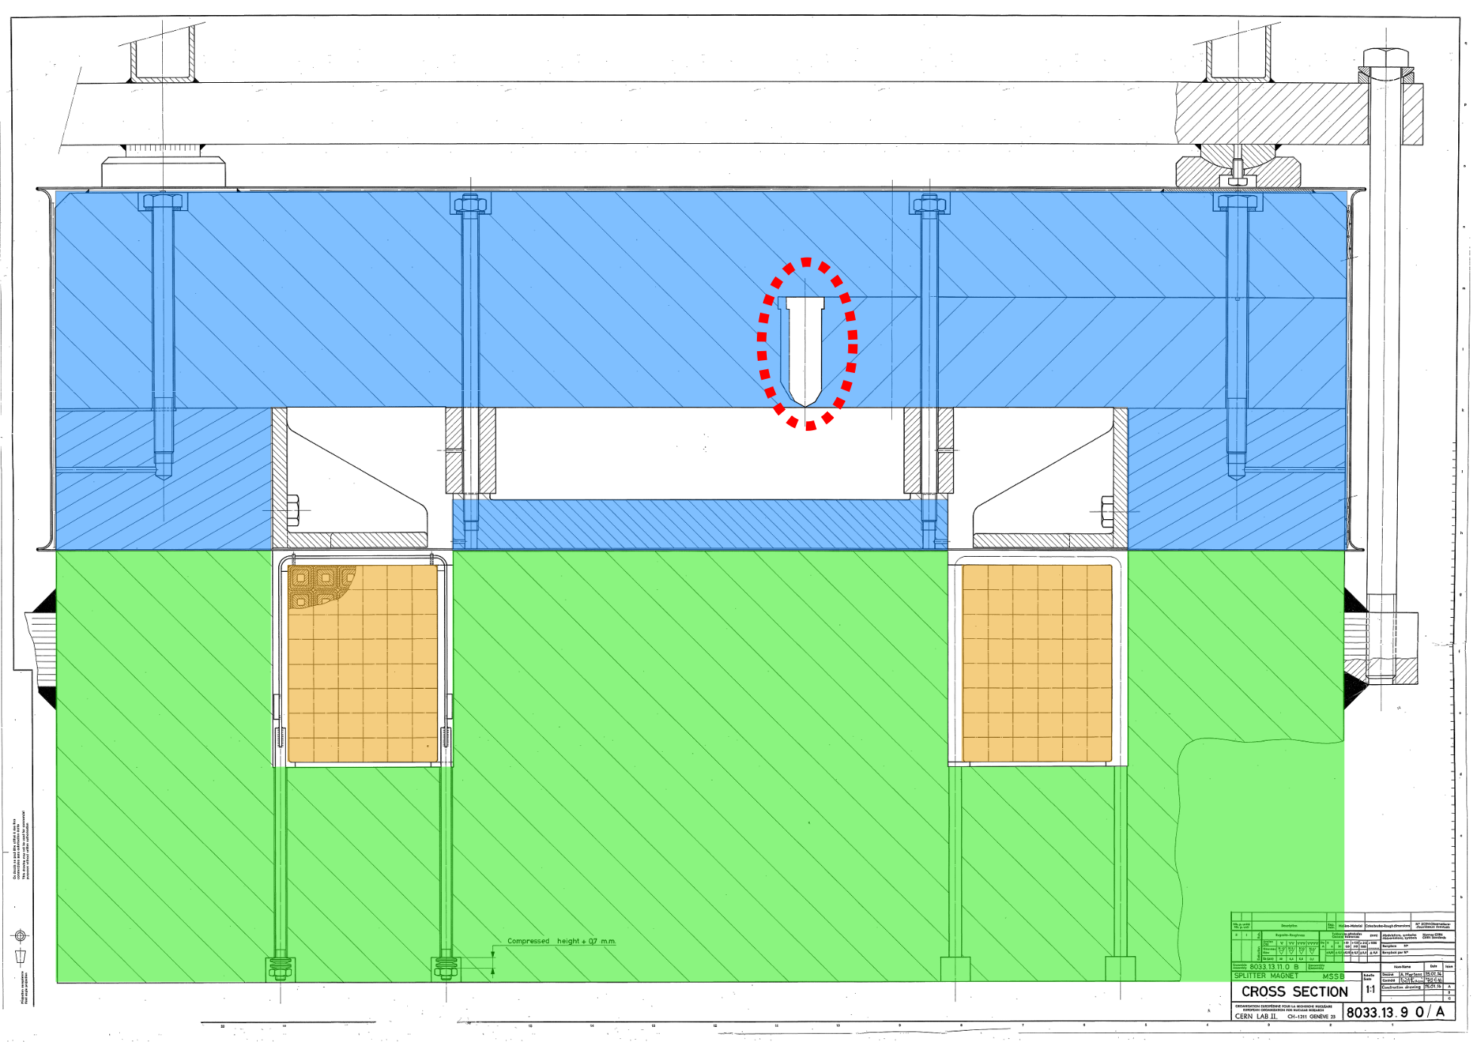
Current splitter (MSSB)
Septum hole
Uniform field

Slide 12
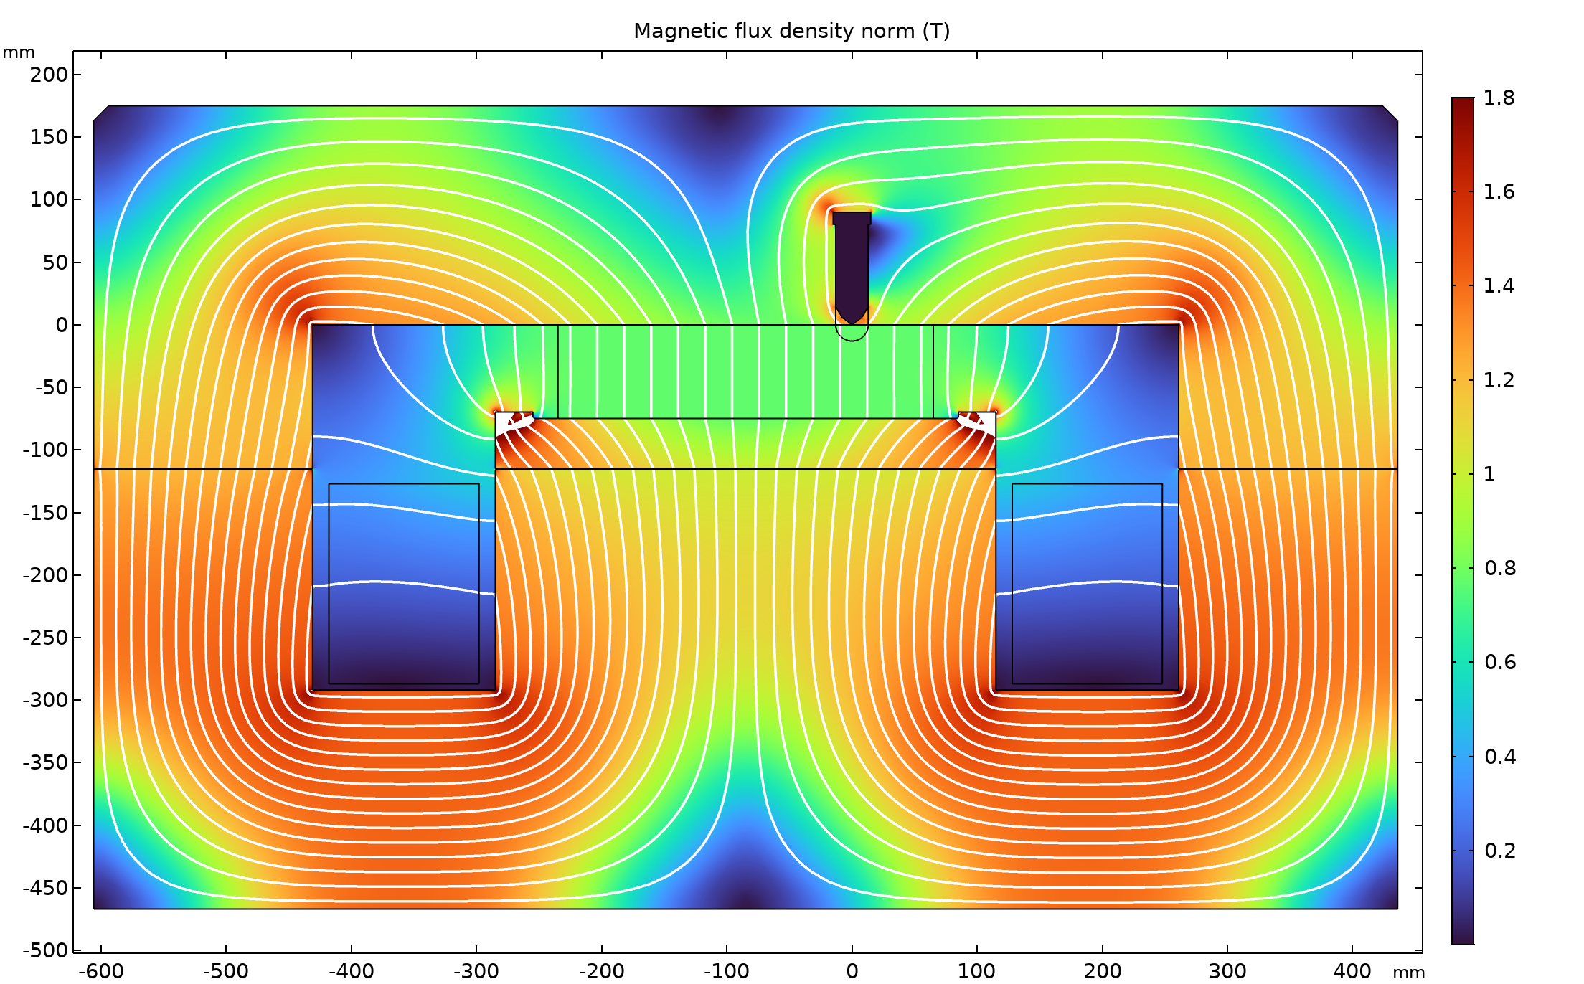
Current splitter (MSSB)
Septum hole
Uniform field

Slide 13
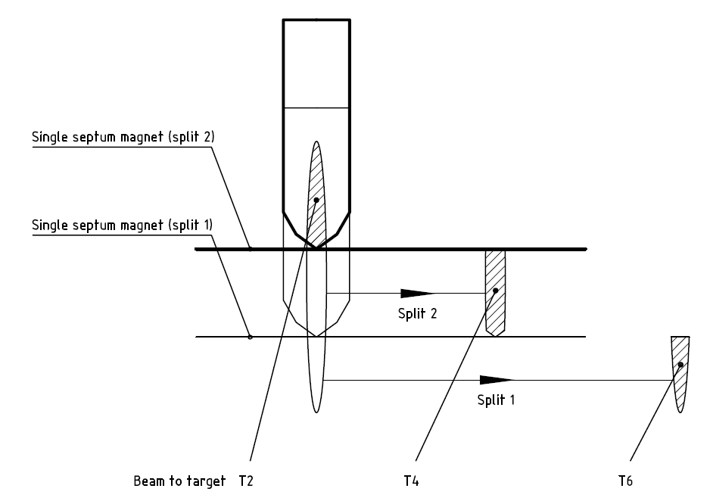
Beam size and shape

Slide 14
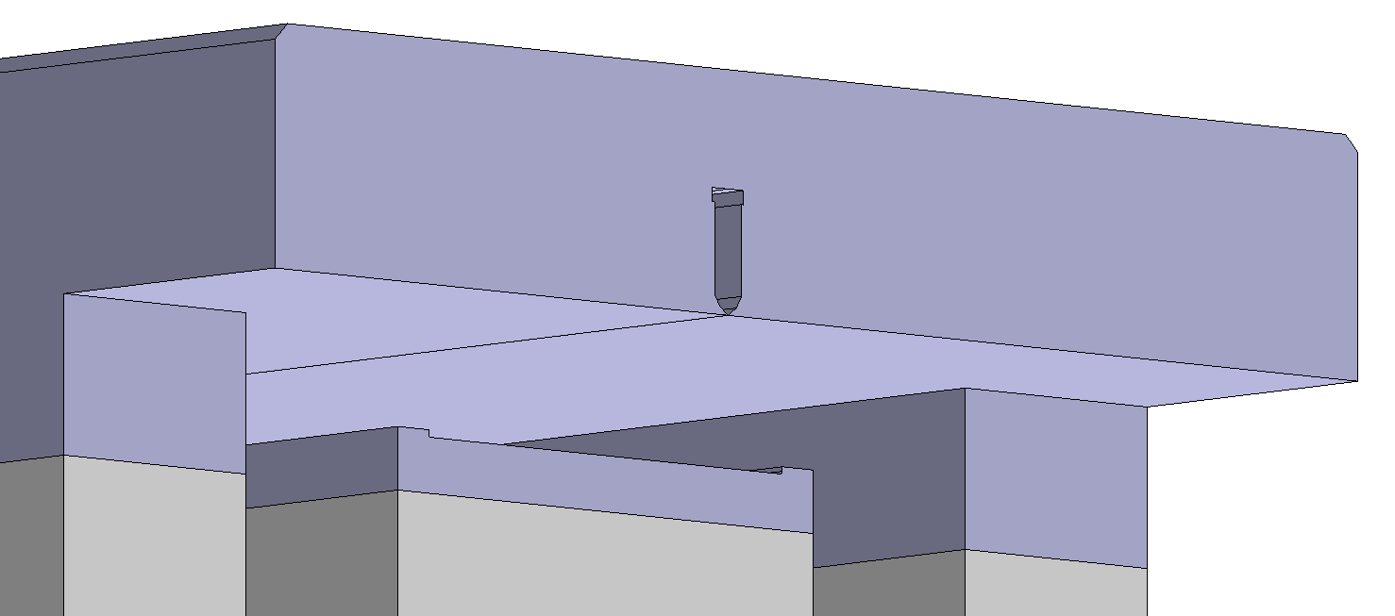
Current splitter (MSSB)
Upper yoke length – 5140 mm (magnetic)
Lower yoke length – 4700 mm

Slide 15
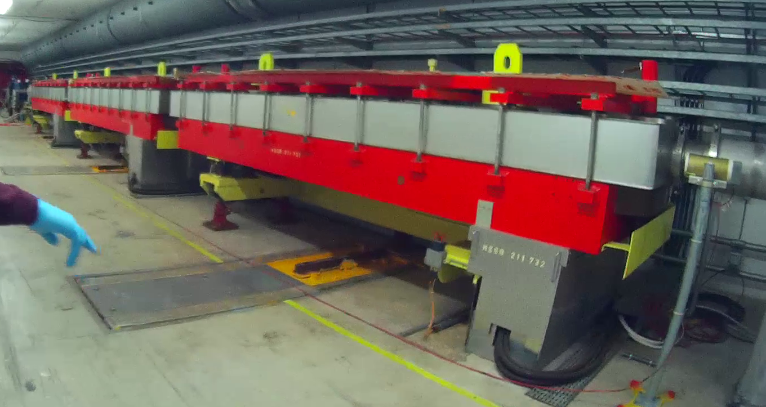
Current splitter (MSSB)
3 units of the first splitter
> 5 m
24 t

Slide 16
Challenges
Minimisation of beam losses
  Minimisation of the septum cross section area
    Saturation of the septum blades
  Minimum leakage field into the no-field region
  Field quality in the dipolar region
Mechanical tolerances
High levels of radiation
Vacuum compatibility of in-vacuum iron yoke

Slide 17
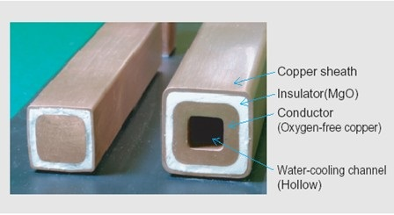
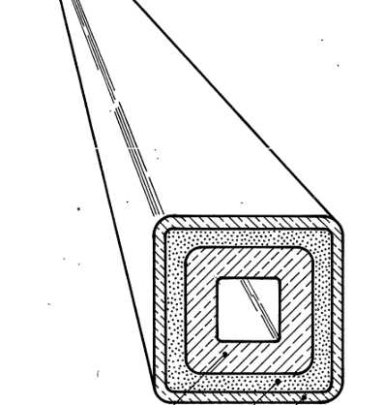
Mineral insulated coil
Coil made of Mineral Insulated Copper Conductor (MICC) for radiation resistance
No resin/glass fiber composite can be used

Slide 18
Measurements vs 2D simulations

Slide 19
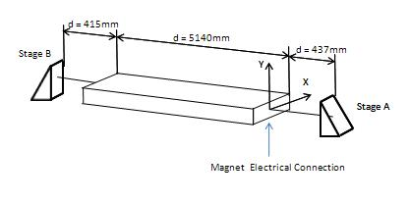
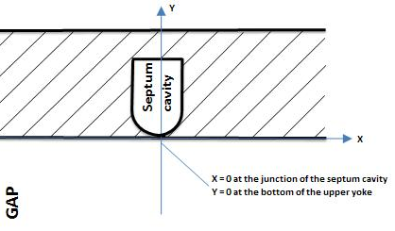
Magnetic measurements
Courtesy: Guy Deferne

Slide 20
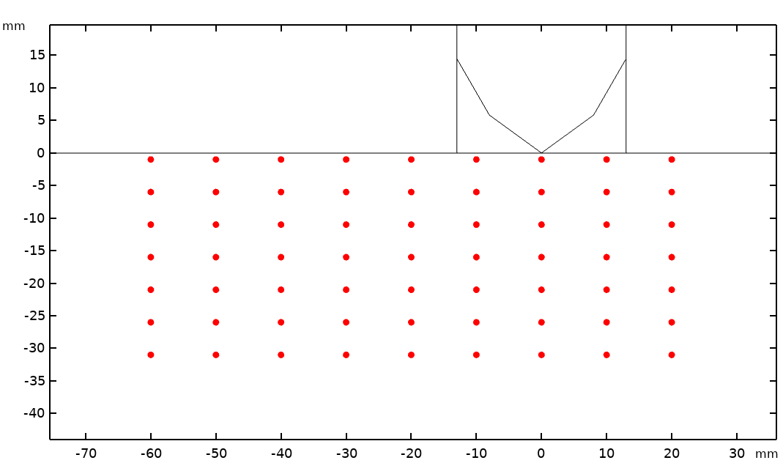
Locations of measurements

Slide 21
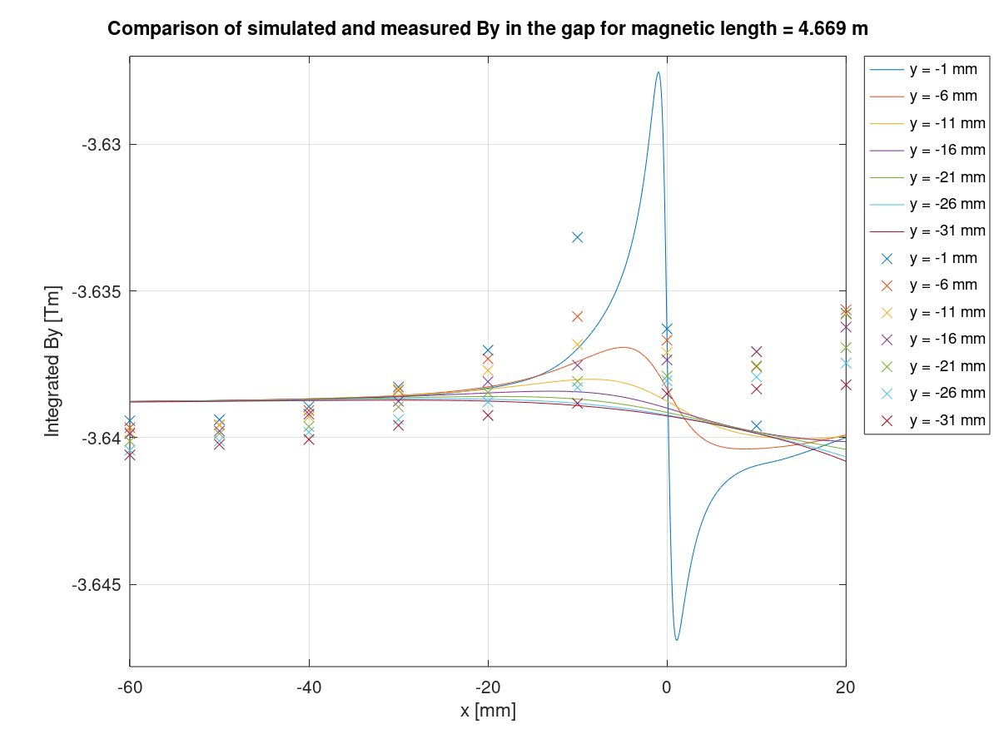
By in gap for 2D simulation
Lines are simulated values
Points are measured

Slide 22
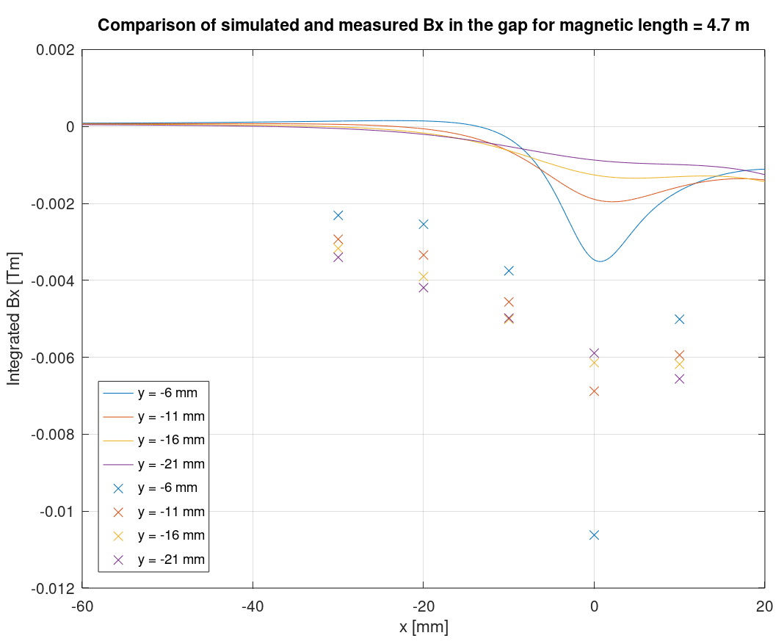
Bx in gap for 2D simulation
Lines are simulated values
Points are measured

Slide 23
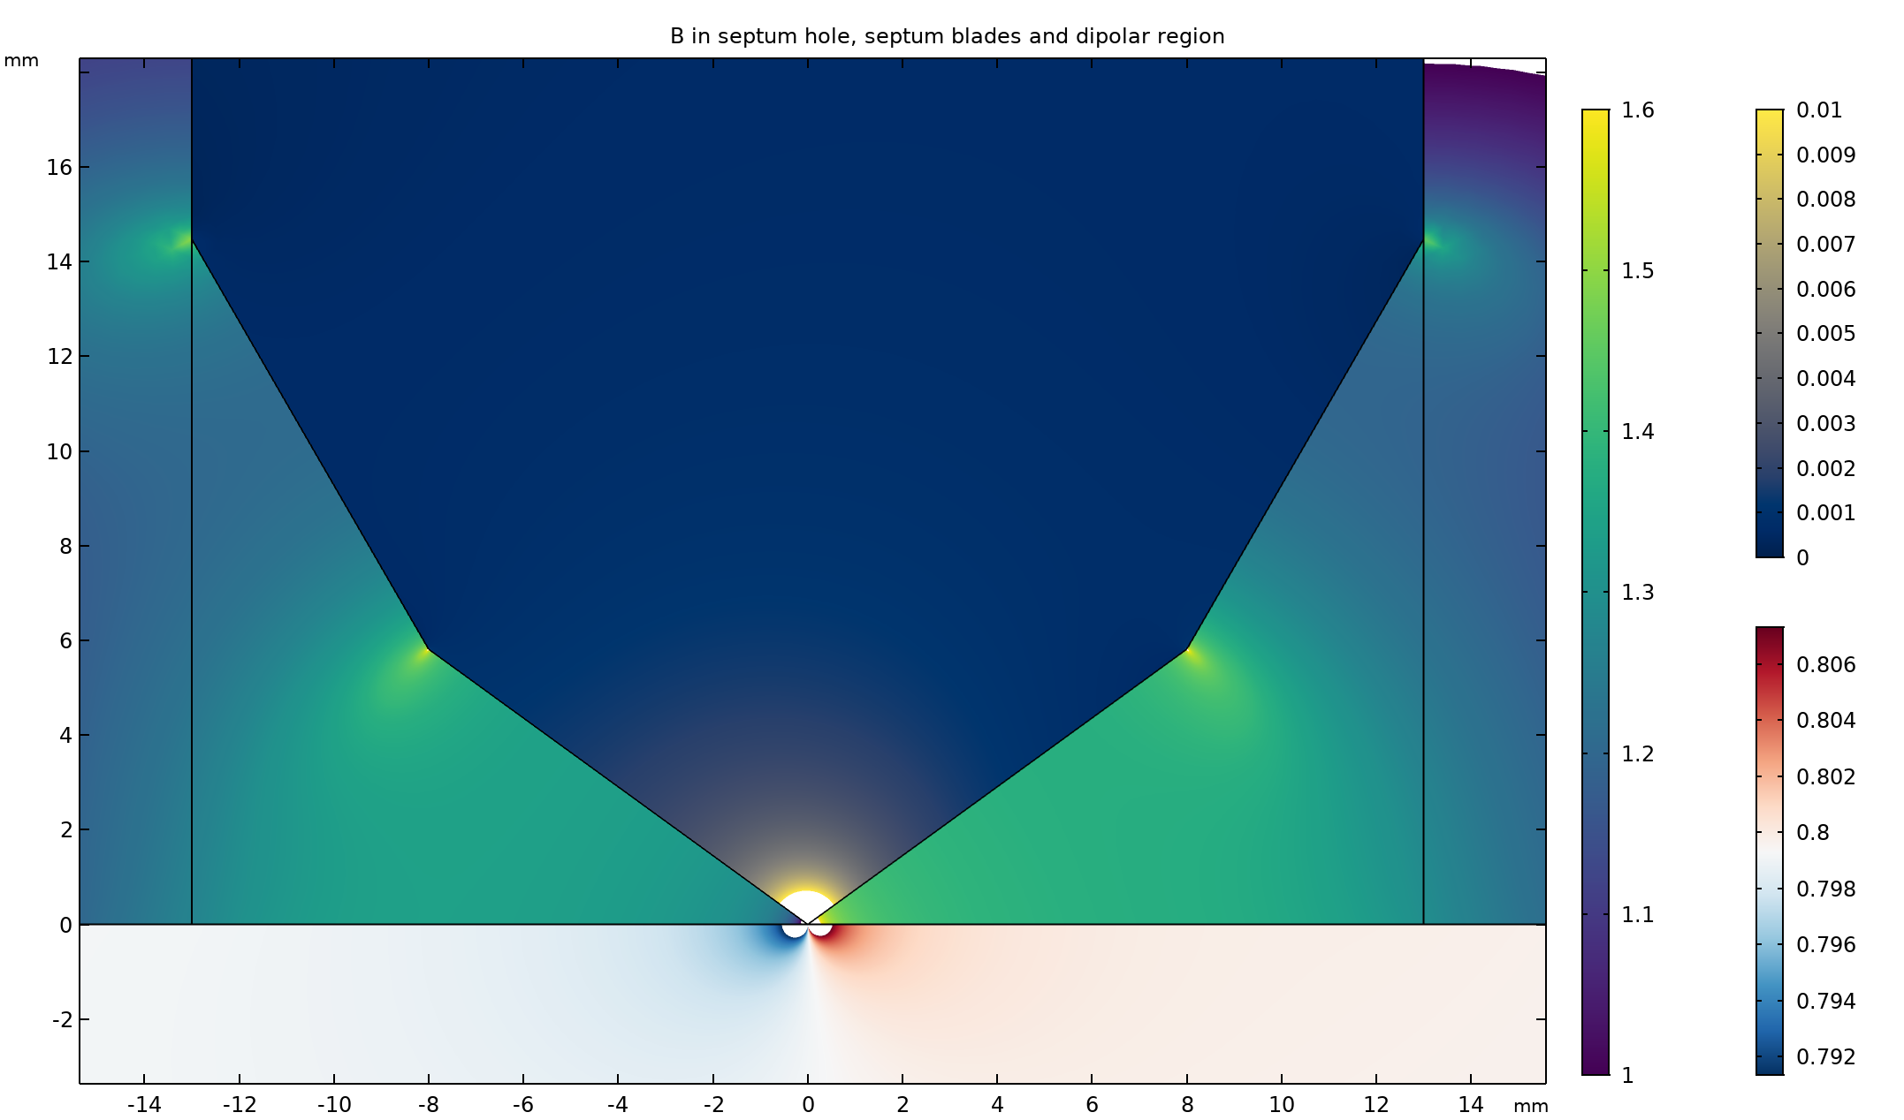
Zoom onto septum blades
Iron
[T]
Septum
hole [T]
Gap [T]

Slide 24
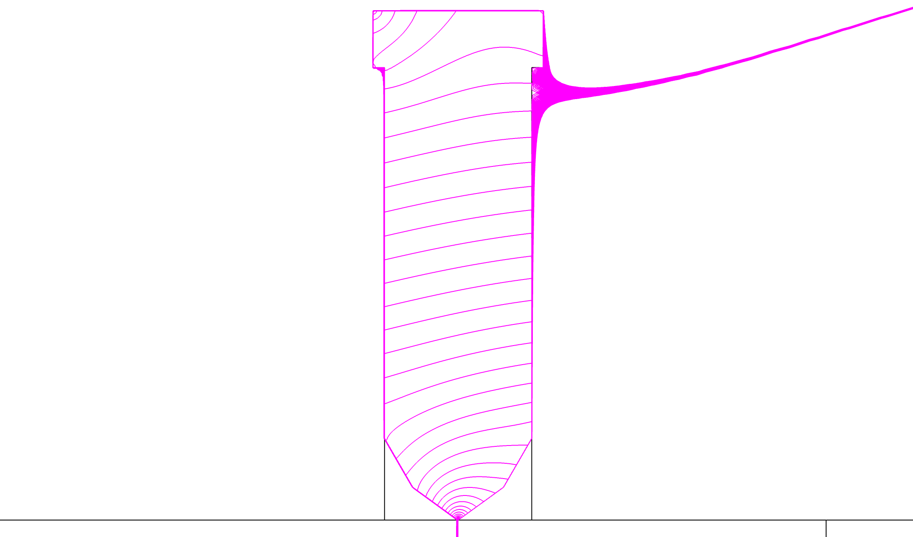
Field lines crossing the septum
0.7 mT

Slide 25
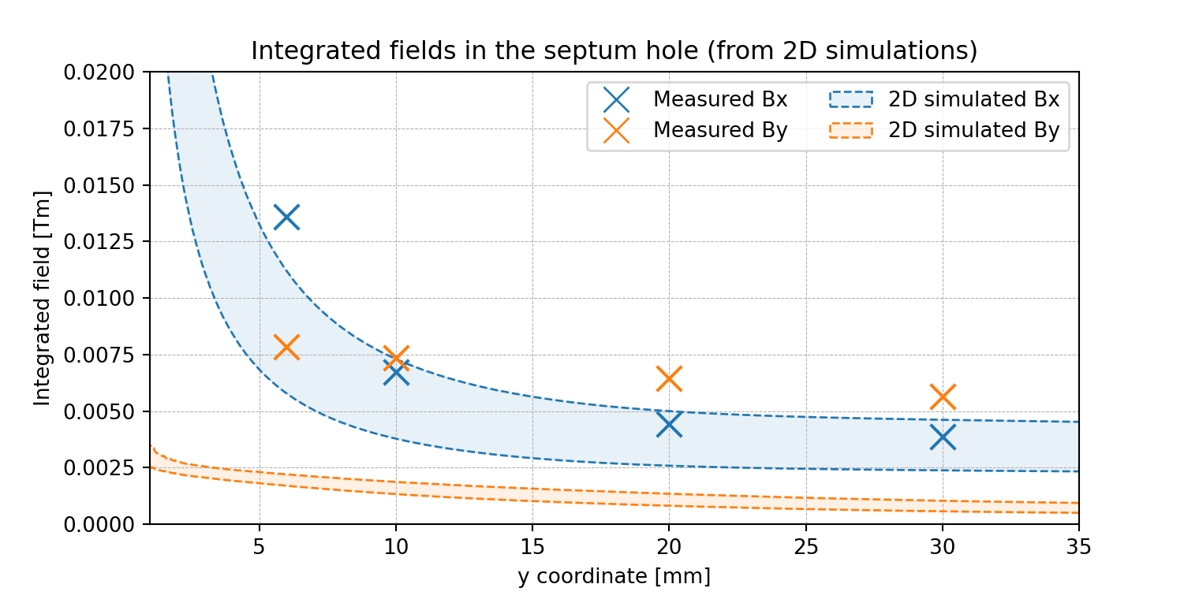
Hole field in 2D simulation
Coloured bands for uncertainty related to the BH curve of the material used for simulation

Slide 26
2D simulations summary
Reasonable match between shape of simulated and measured By profiles in gap.
Bx in the gap is underestimated by the simulation.
Reversed situation for the septum hole
  By is underestimated by simulation
  Bx is in a relatively good agreement
Bx in hole strongly affected by BH curve
3D simulations strongly recommended

Slide 27
Measurements vs 3D simulations

Slide 28
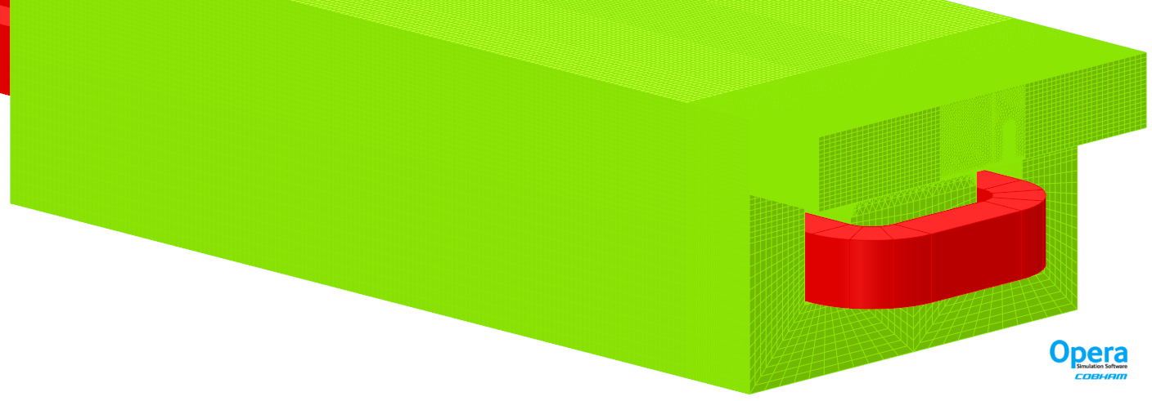
3D simulations
Conducted in both Comsol and Opera
SS vacuum chamber not simulated
Simulated for both materials
Max number of elements reaching 8 000 000

Slide 29
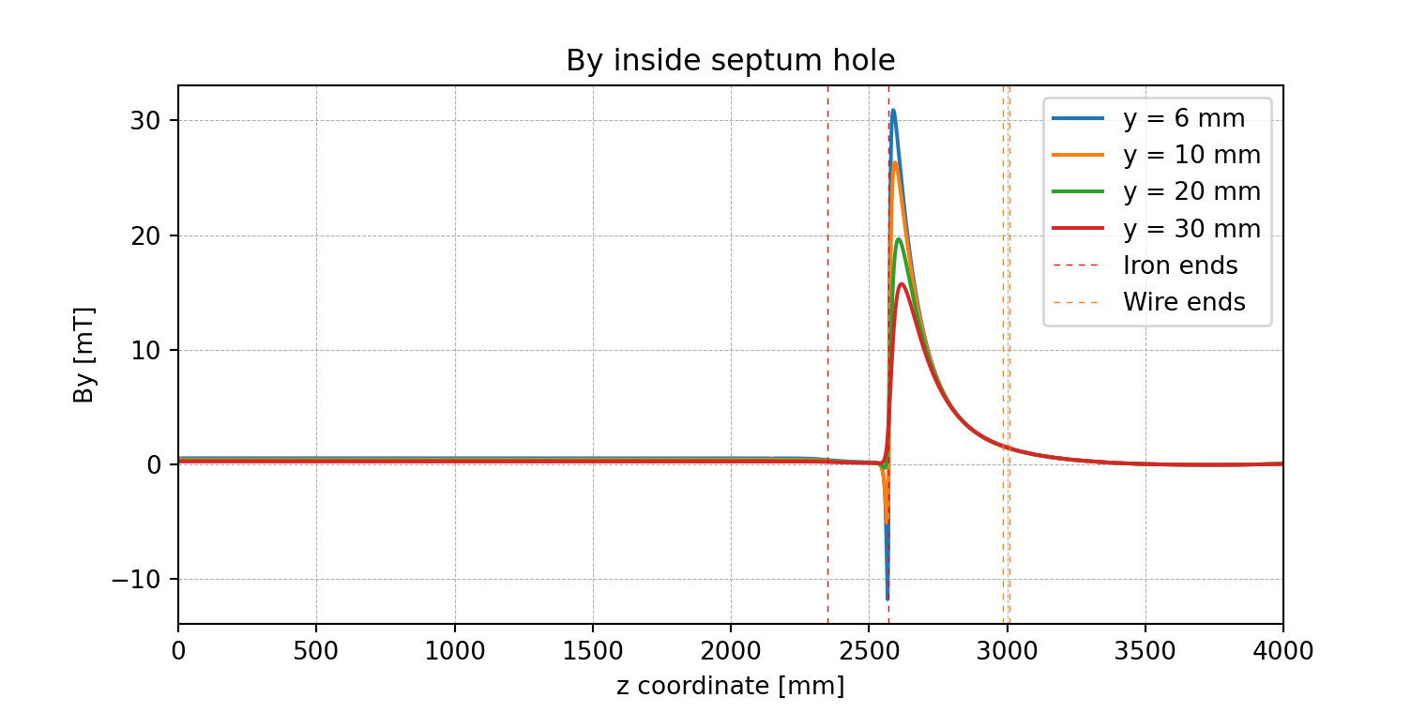
By in hole in 3D simulations

Slide 30
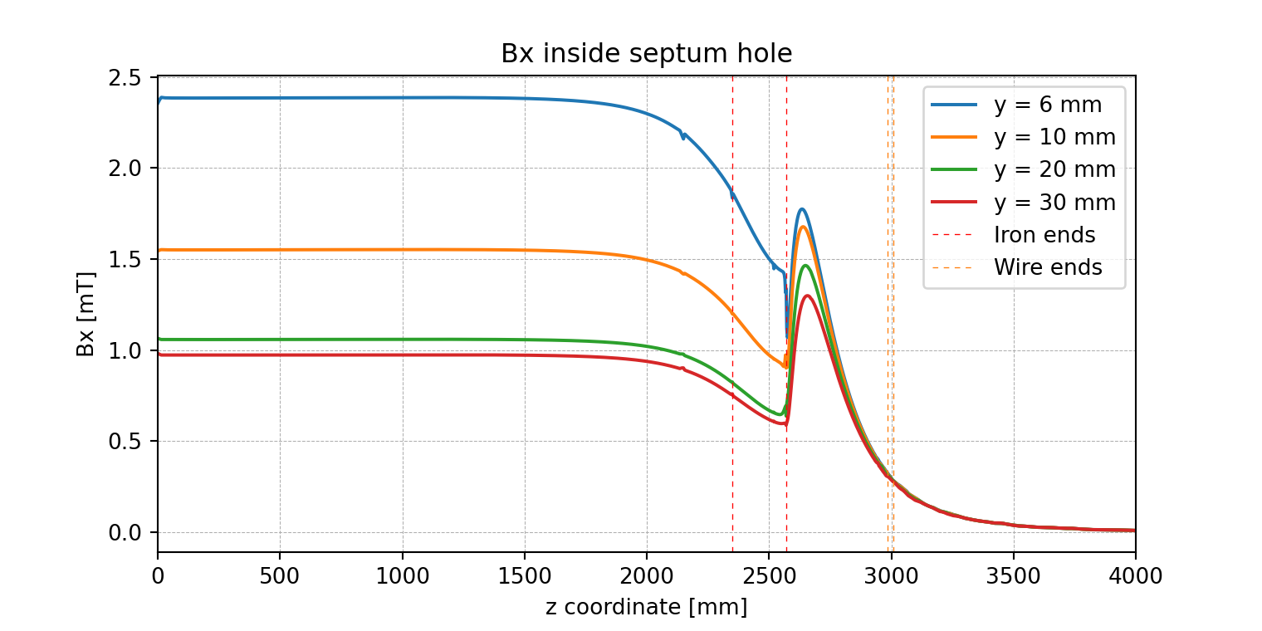
Bx in hole in 3D simulations

Slide 31
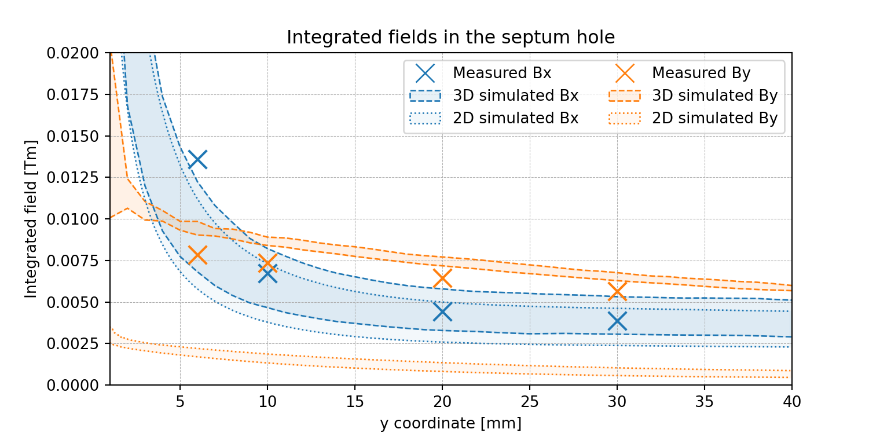
B in hole in 3D simulations

Slide 32
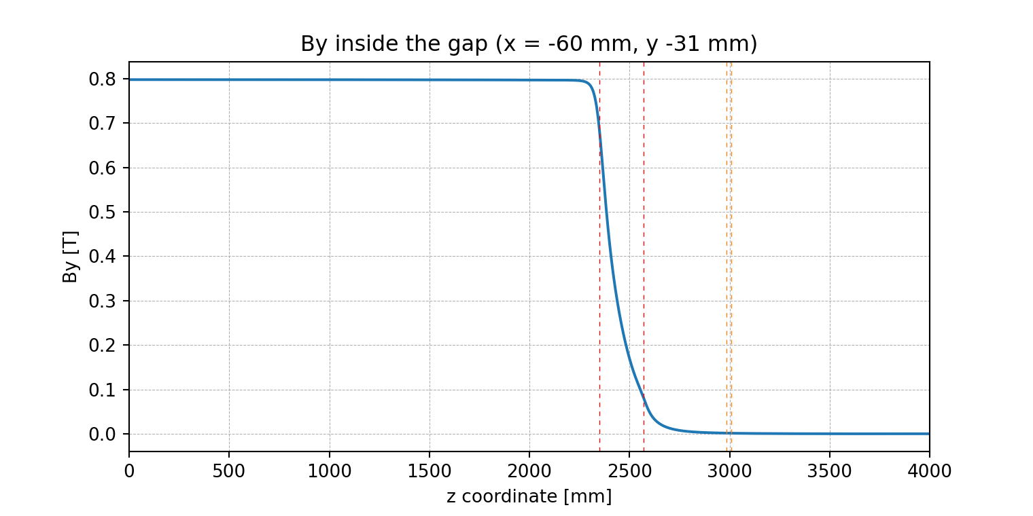
By in gap in 3D simulations

Slide 33
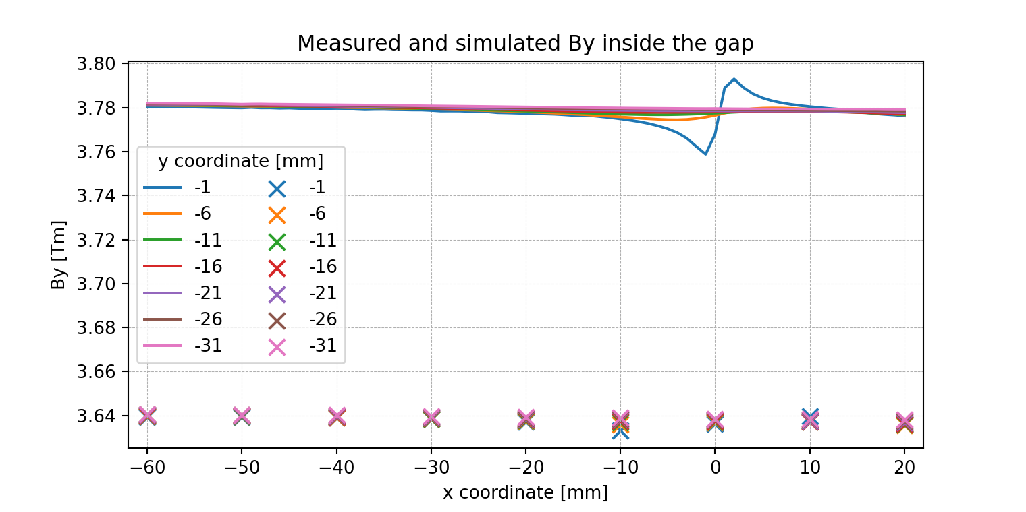
By in gap in 3D simulations
Error = 3.85 %
Offset = 0.141 Tm
Integrated
Lines are simulated values, points are measured

Slide 34
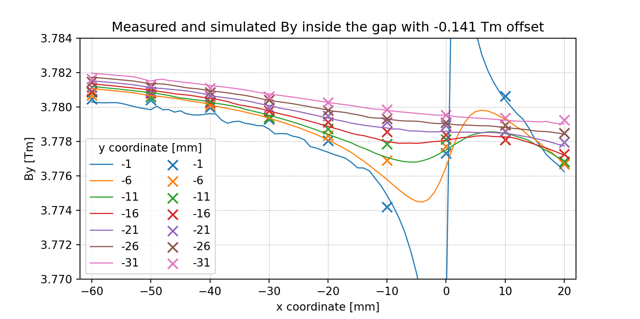
By in gap in 3D simulations
Integrated
Lines are simulated values, points are measured

Slide 35
By in gap - remarks
Vacuum tank of the top yoke not simulated.
It adds 2 mm (1 mm skin cutting the iron twice) to the air length in the field lines .
The error between measurement and simulation is ~3.85 %.
After subtracting 2.67 % for the missing gap, the remaining error is 1.21 %.

Slide 36
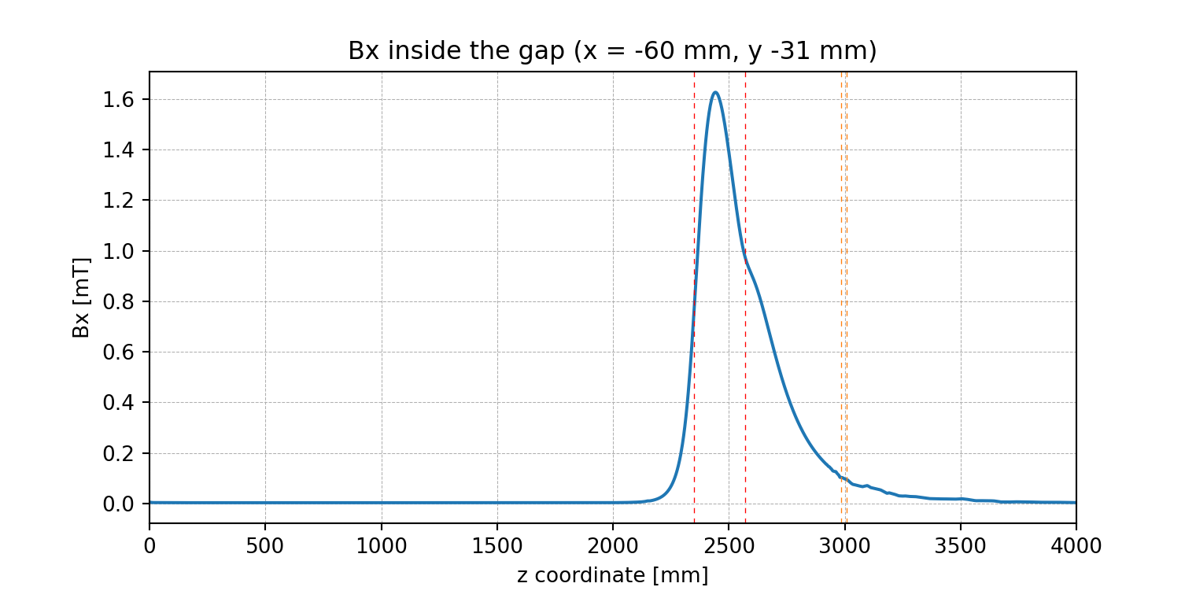
Bx in gap in 3D simulations

Slide 37
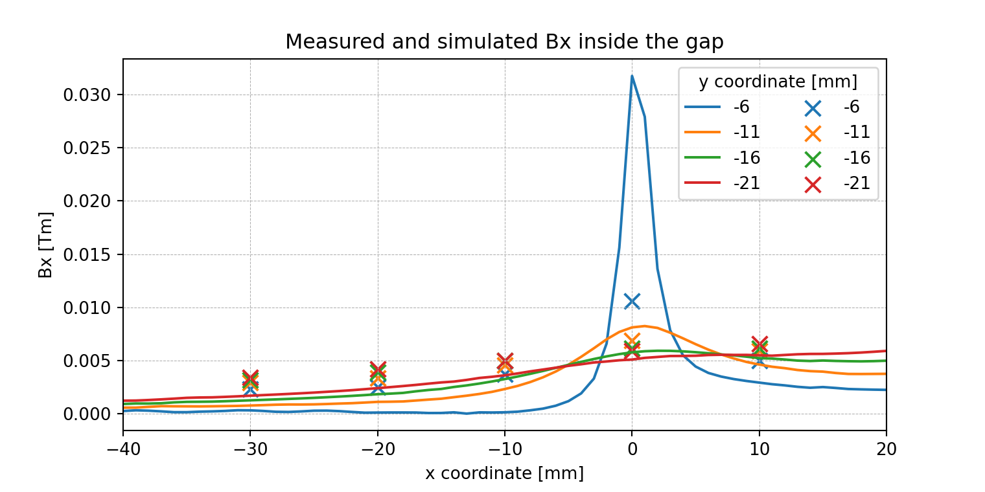
Bx in gap in 3D simulations
Integrated
Lines are simulated values, points are measured

Slide 38
Conclusions on the simulations
The 3D magnetic simulations are in good agreement with the measured values.
Large relative errors for Bx, but Bx has very small absolute values.
The impact of the ends of the magnet is very important, and cannot be neglected for practical purposes.

Slide 39
New design for the MSSB

Slide 40
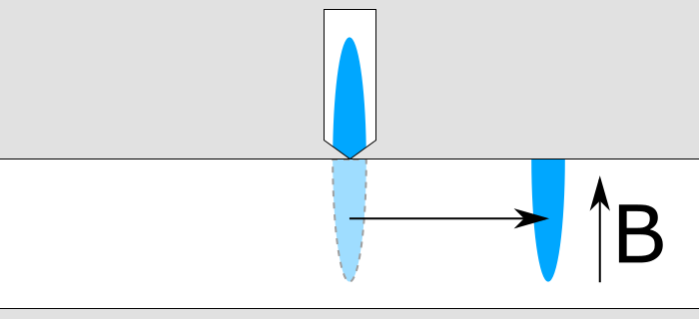
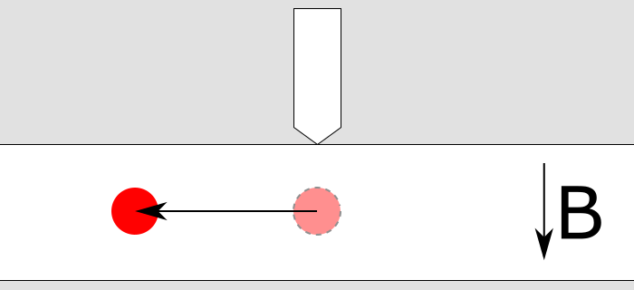
Why new design?
To send the beam to the left of existing lines, the first splitter pack has to switch polarity between SPS cycles (in seconds’ time)
Solid iron not compatible with relatively fast switching → the yoke must be laminated.

Slide 41
Challenges for laminated yoke
Challenges are the same as for solid iron yoke, but due to laminations, they are more difficult to achieve
  Hundred of µm precision over 5 m long laminated yoke
  In-vacuum surface area greatly increased by laminations – increased outgassing
    Inter-lamination insulation should not be organic

Slide 42
Requirements for new design
Beam deflection in both directions (L and R)
BDF operation without beam splitting (all particles in the gap)
NA operation not affected by the new splitter
  Same beam optics for the NA operation
  Same or lower beam losses
  Same or better field quality

Slide 43
Sensitivity studies for design optimisation
Impact of the opening between blades on hole field (gap vs bridge), losses compared.
Beam deflection in septum hole
Pole shim geometry
Operation with increased field

Slide 44
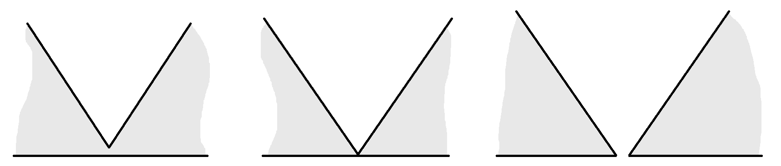
Desired septum geometry
Septum blades geometry based upon:
  magnetic performance
  mechanical strength
  beam performance

Slide 45
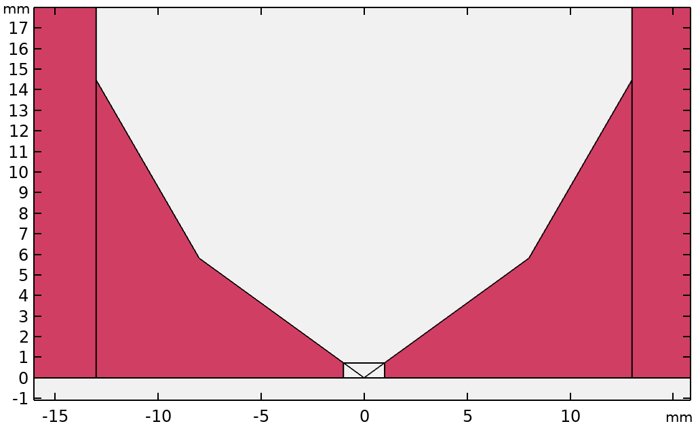
Septum gap/blade study

Slide 46
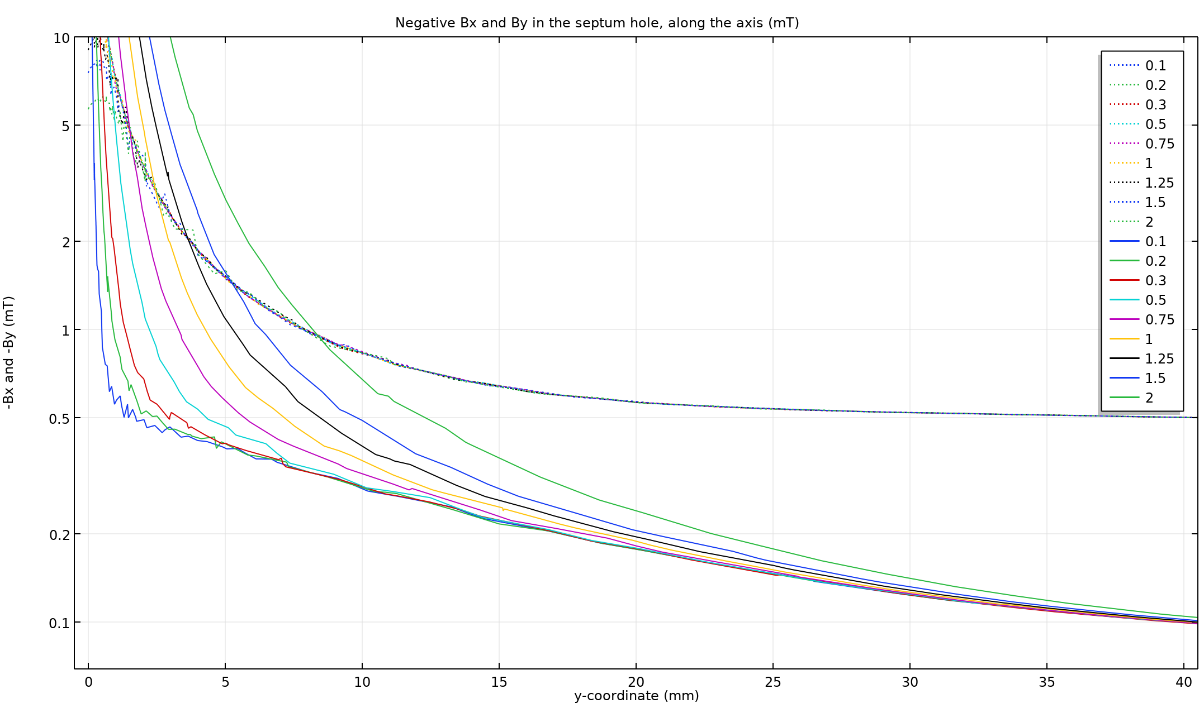
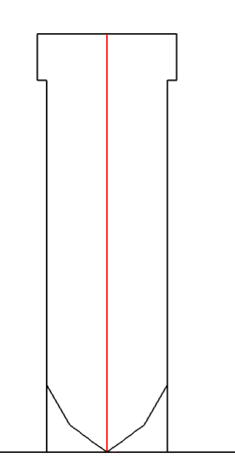
Septum gap/blade study
Distance
between
blades
[mm]
Dotted lines: By
Solid lines: Bx

Slide 47
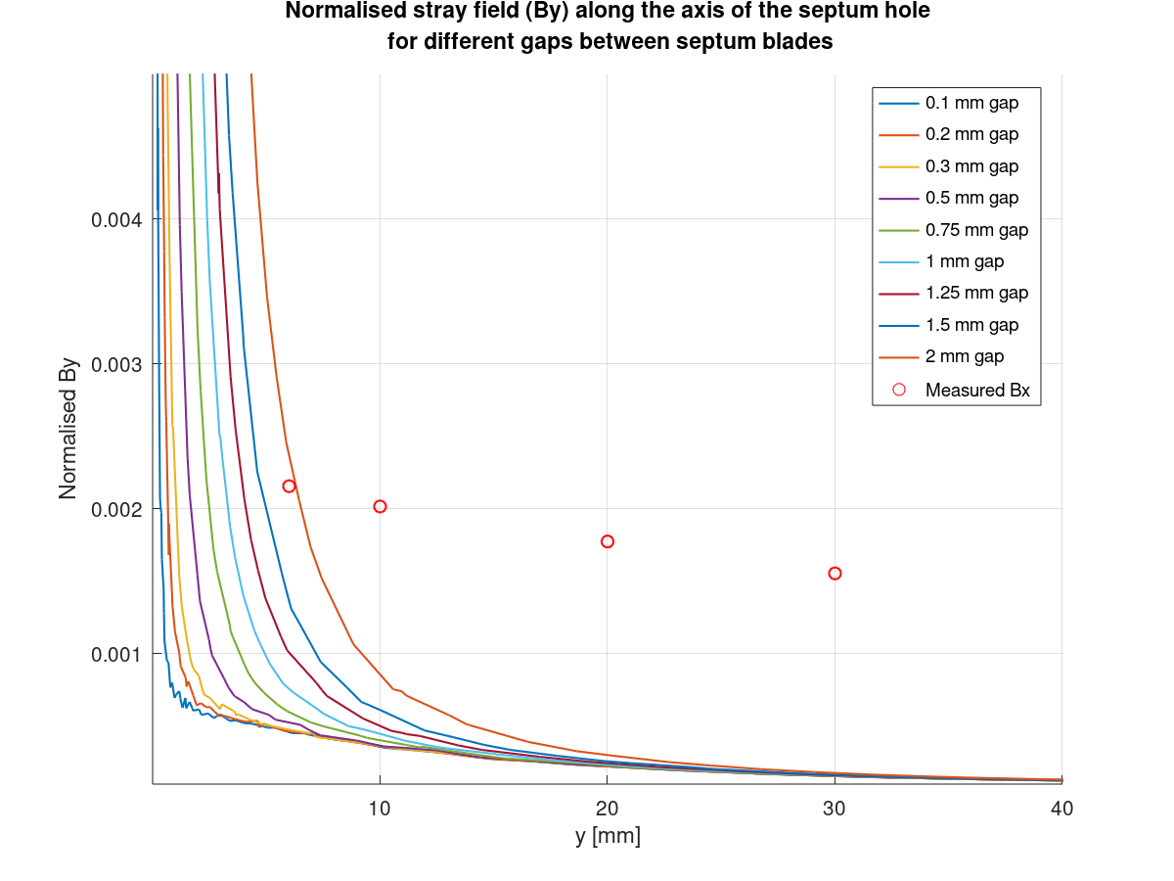
Septum gap/blade study

Slide 48
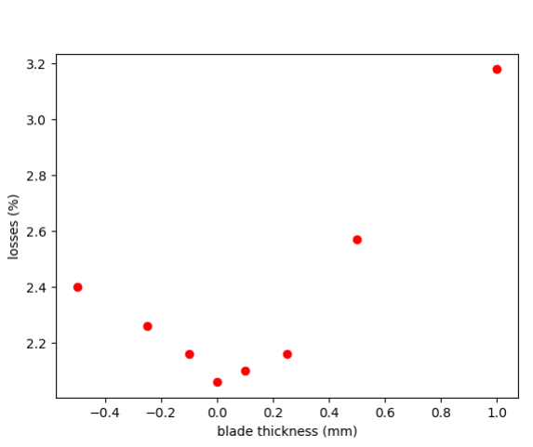
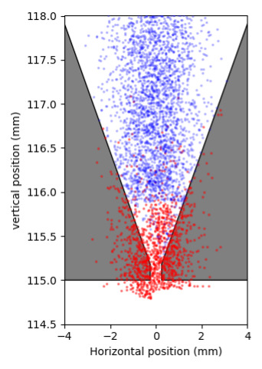
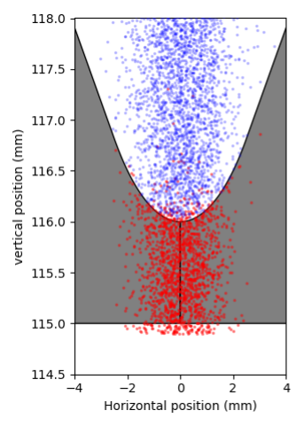
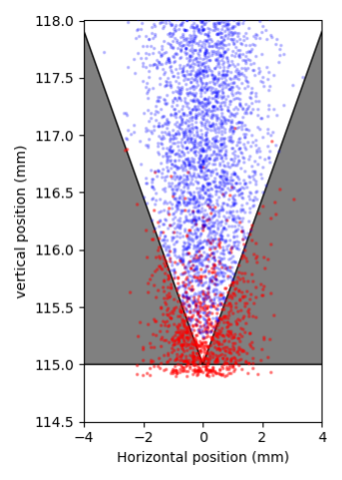
Septum gap study - losses
Courtesy: Yann Dutheil

Slide 49
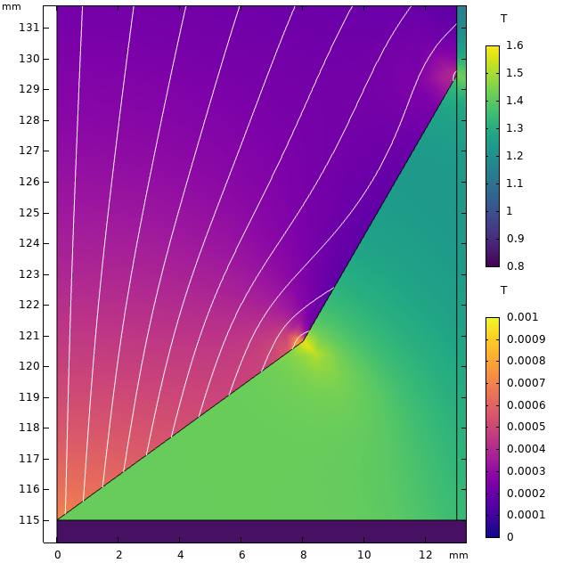
Hole offset study
Centred hole → hole field mostly vertical
Resulting Lorenz force is directed sideways
Offset varied by 10 mm from 0 to 90 mm,
Direction of beam deflection plotted

Slide 50
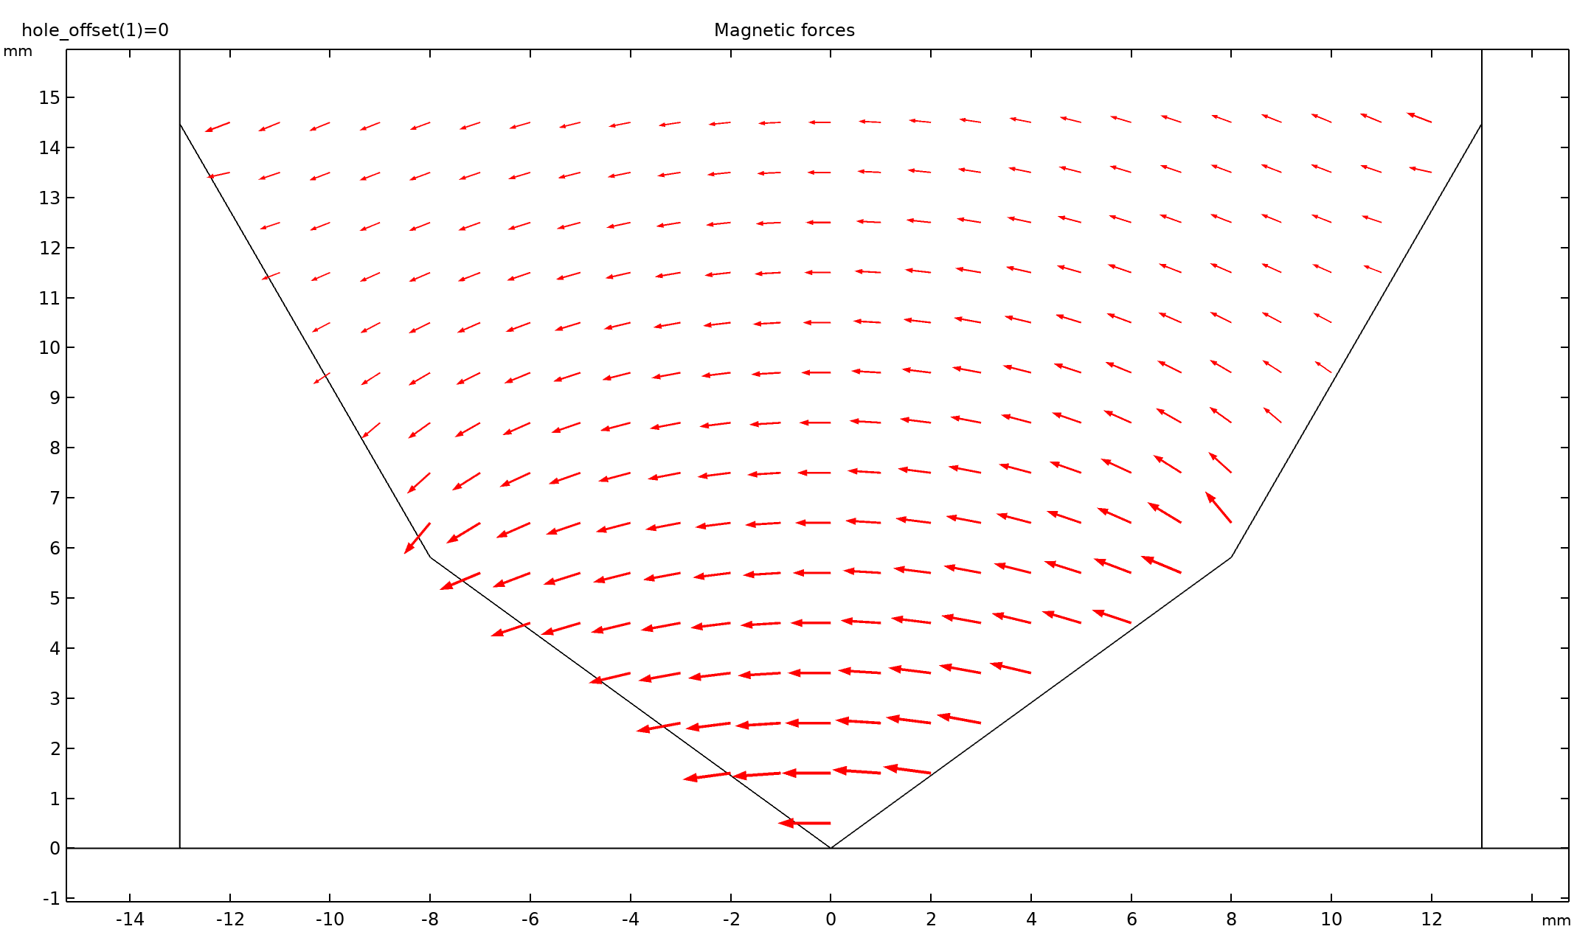
Hole offset vs Lorenz force

Slide 51
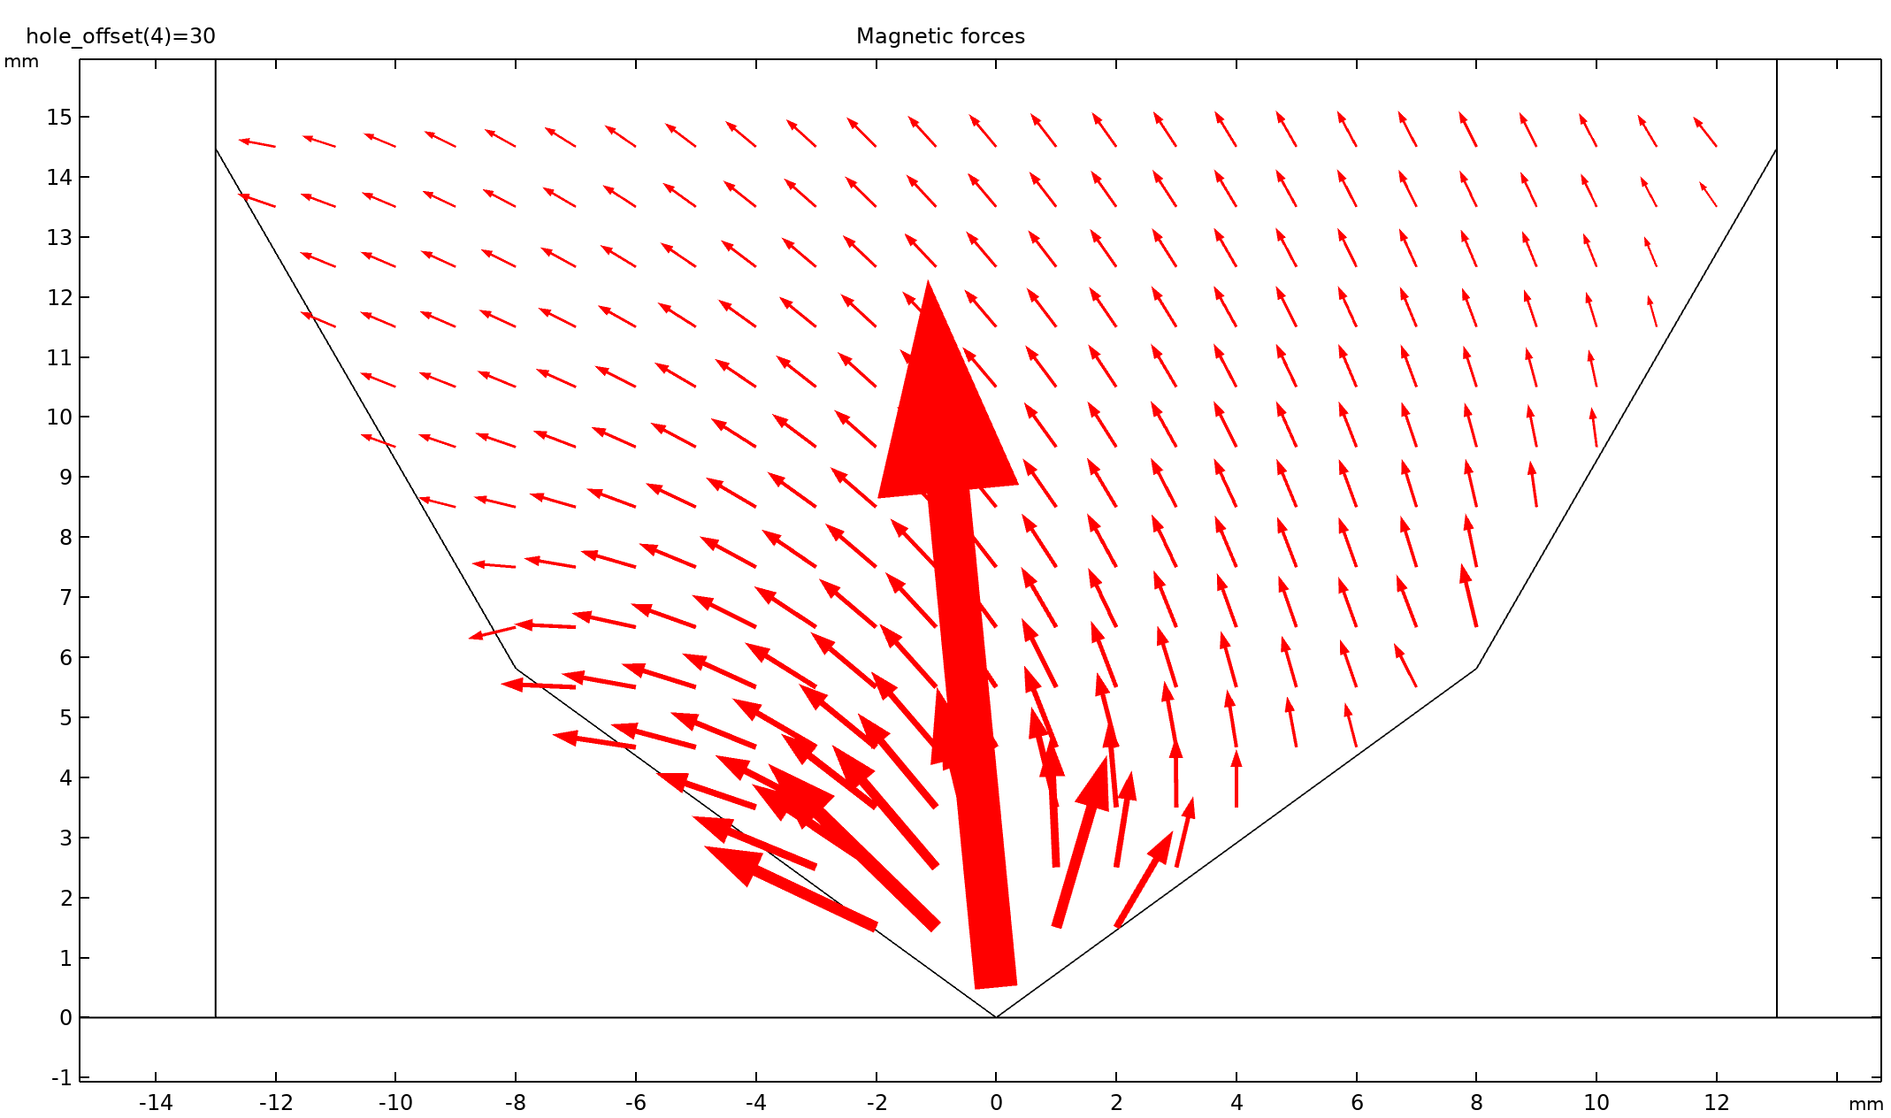
Hole offset vs Lorenz force

Slide 52
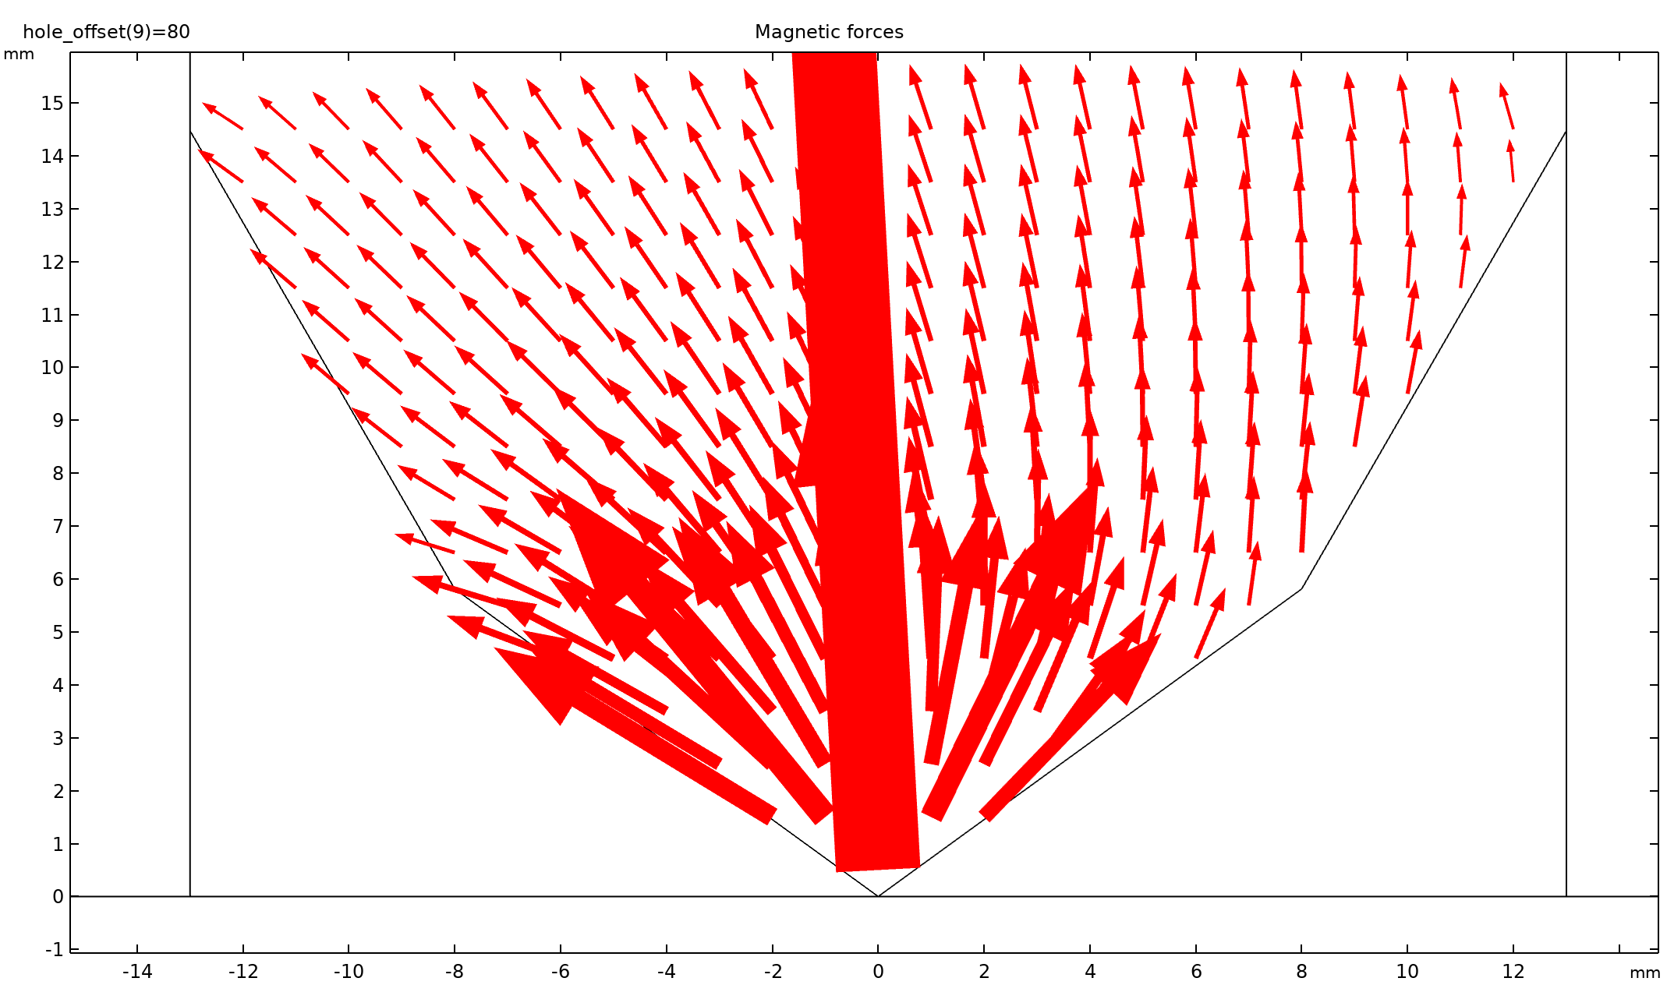
Hole offset vs Lorenz force

Slide 53
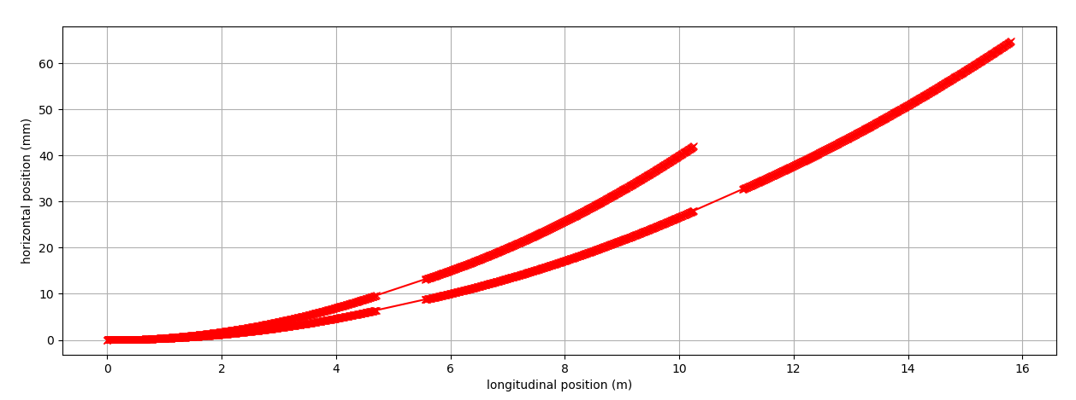
Increased field operation
Proposed by Yann Dutheil (TE-ABT) for the BDF operation (no split)
Field increased to 150 % gives same deflection angle at reduced offset (reducing the required pole width).
Courtesy: Yann Dutheil

Slide 54
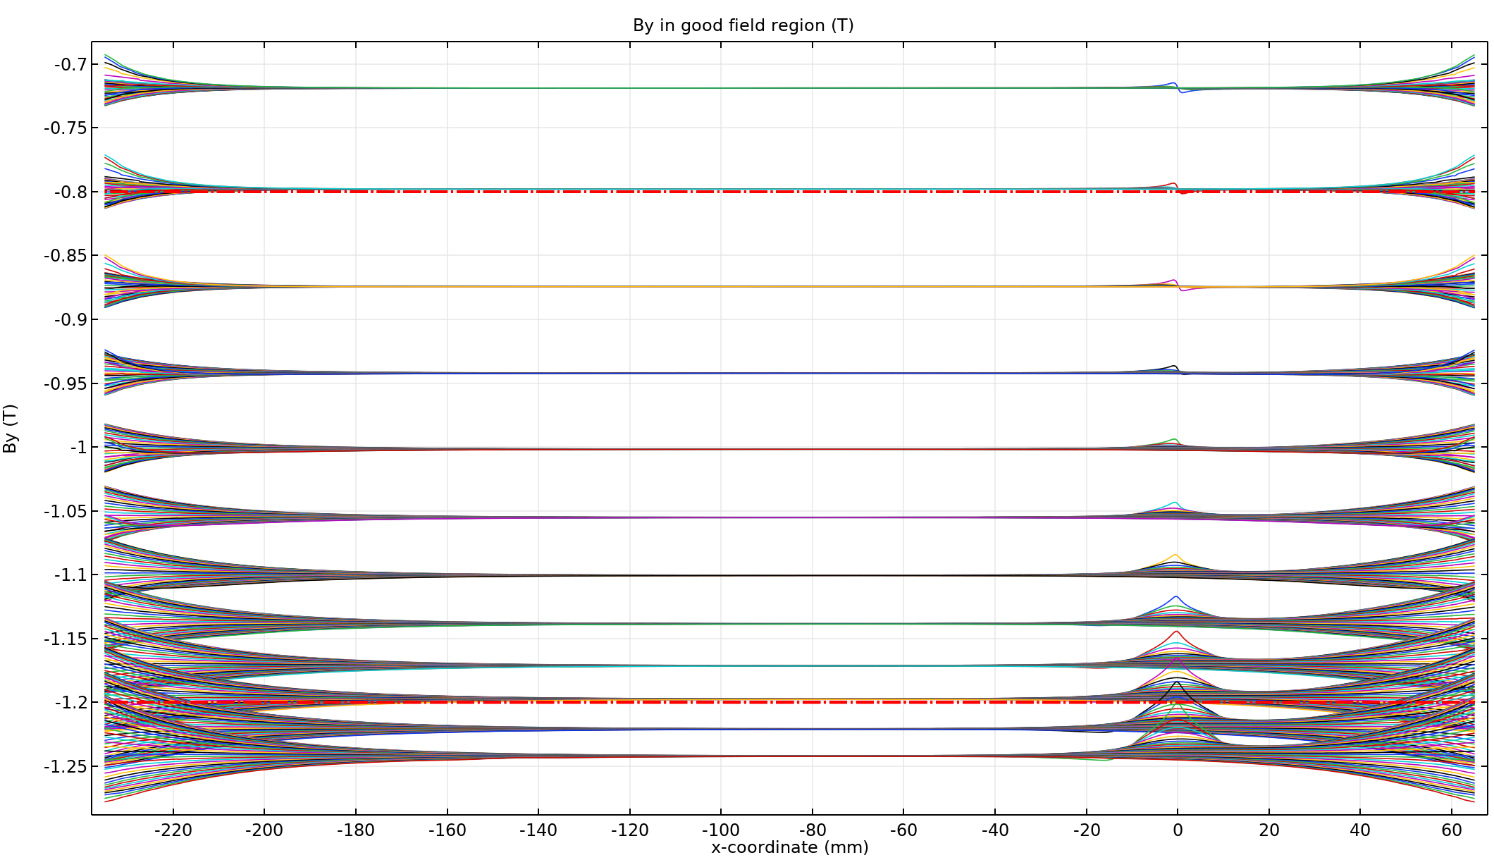
Increased field operation
Around 1.8x current needed for 1.5x field

Slide 55
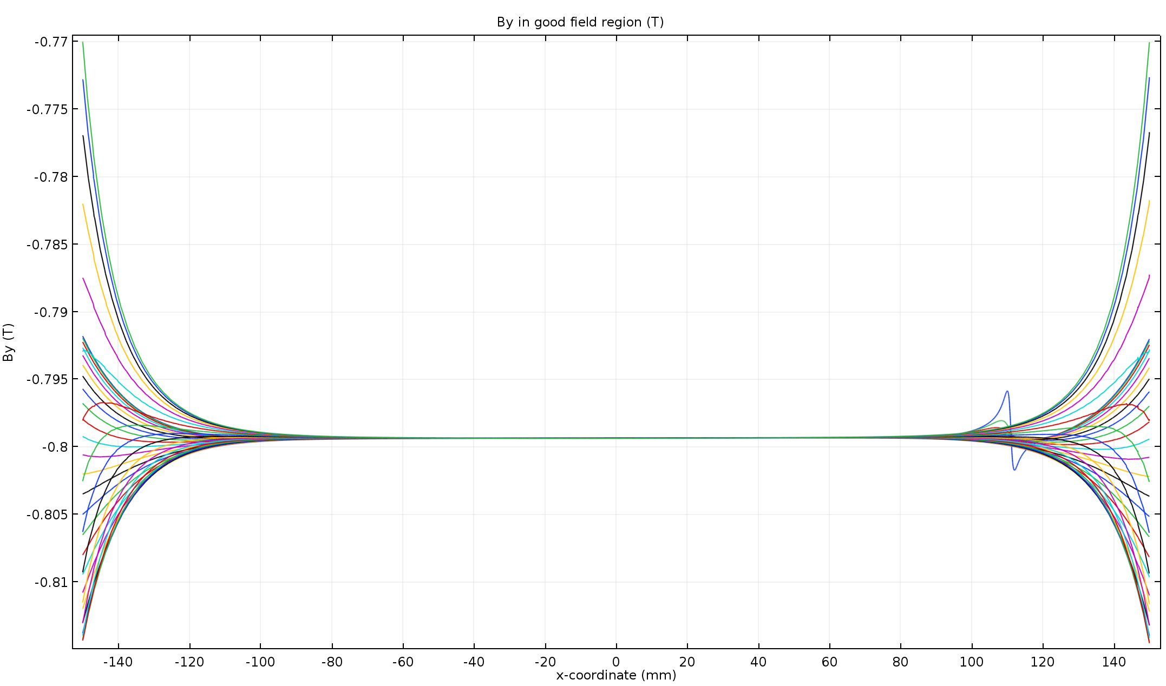
Increased field operation
Around 1.8x current needed for 1.5x field

Slide 56
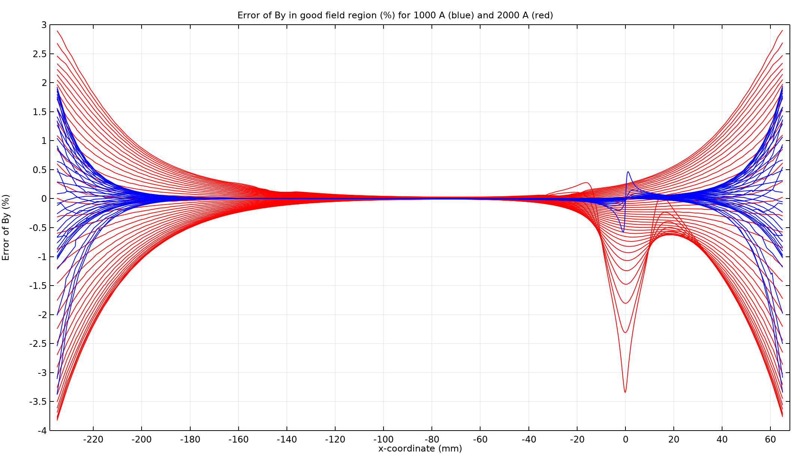
Increased field operation
Field quality for offset hole

Slide 57
Increased field operation
Even though the field quality is much worse than for nominal current operation, particle tracing results showed that it is acceptable from the beam optics point of view.
Increased current operation to be used only for BDF operation, so stray field in the septum hole is not a concern.

Slide 58
Pole shims optimisation
Assuming 295 mm pole width, a parametric study of shims widths and heights was run.
Histogram of the By values in the gap prepared as a way to assess field quality
Integrals of the histogram for various deviation ranges around the mean value were evaluated.

Slide 59
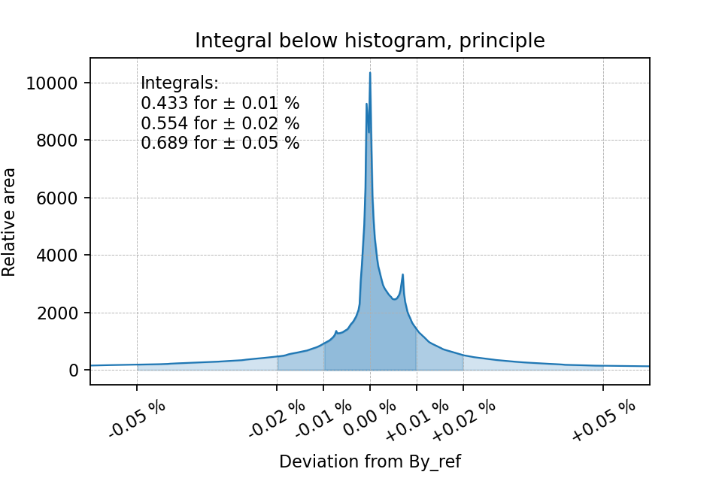
Pole shims optimisation

Slide 60

Pole shims optimisation

Slide 61

Pole shims optimisation

Slide 62

Pole shims optimisation

Slide 63
Final proposed design
Pole width reduced to 295 mm
Hole offset by 32.5 mm
Side and bottom legs widened to 180 mm
Top legs narrowed to 150 mm
Coil window width increased to 171 mm
Shims at 34 mm x 4.5 mm (W x H)
Iron mass reduced from 21.4 t to 19.4 t

Slide 64

Final proposed design

Slide 65
Future developments
Detailed magnetic design, fixing the design
  Magnetic simulations taking mechanical features into account
Electrical parameters, detailed coil design
Detailed mechanical design
Vacuum tests of steel and coatings
Prototype construction

Slide 66
Acknowledgements
Jérémie Bauche
Yann Dutheil
Guy Deferne
Other people involved
  Matthew Fraser, Pablo Andreas Arrutia Sota
  Chiara Pasquino, Jose Antonio Ferreira Somoza
  Jan Borburgh, Bruno Balhan, Miroslav Atanasov
  TE-VSC-SCC

Slide 67
References
L. Evans, A. Hilaire, A. Ijspeert, B. de Raad, N. Siegel, E. Weisse, “The external proton beam lines and the splitter systems of the CERN SPS”, CERN-SPS/ABT/77-10, Geneva, May 1977.
L. Evans, A. Ijspeert, B. de Raad, W. Thomi, E. Weisse, “The steel septum magnets for beam splitting at the CERN SPS”, CERN-SPS/ABT/77-13, Geneva, August 1977.
“Technical specification of the cores for the steel septum splitter magnets”, CERN-LAB II/BT/BdeR/EEK/D2-50, Geneva, July 1974.
“Technical specification of the coils for the steel septum splitter magnets”, CERN-LAB II/BT/LE/JK/D2-51, Geneva, July 1974.
C. Mühle, „Task7: NUSTAR2 - Design and Prototype Construction of a Radiation-Resistant Magnet”, https://slideplayer.com/slide/8201009/

Slide 68
Thank you for your attention

