Slide 1
LEIR extraction kickers impedance studies
N.Biancacci, L.C.Feliciano, L.Sermeus, C.Zannini
HSC meeting
30-11-2020

Slide 2
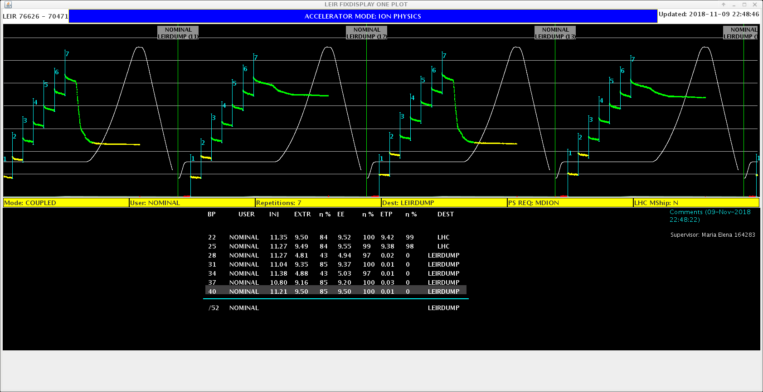
Introduction
Fast instabilities were observed in 2018 before RF capture.
Harmful during LHC run -> lengthened the ion beam setup time!
Complete list of known occurrences:
09/11/2018: elogbook link
07/08/2018: elogbook link
13/11/2018: elogbook link
15/11/2018: elogbook link
UNSTABLE
STABLE

Slide 3
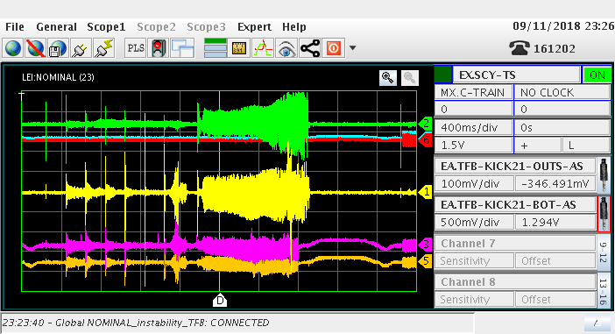
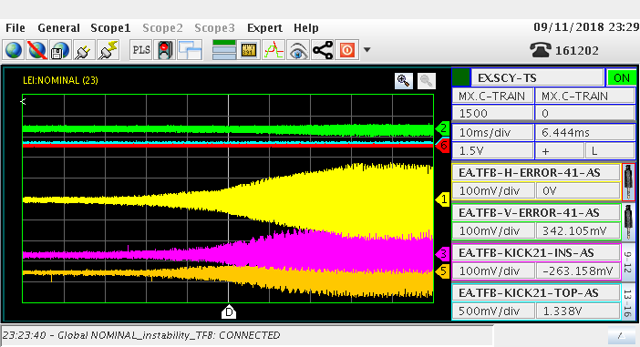
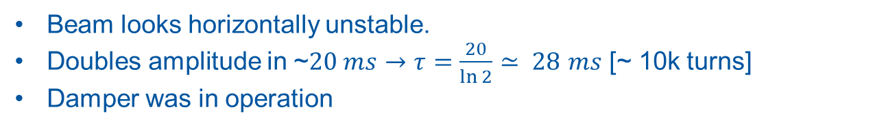
Coherent motion
7 injections
Capture
Extraction
Beam looks horizontally unstable.
Doubles amplitude in ~$20 ms$ $→$ $τ=\frac{20}{\ln{2}}≃ 28$ $ms$ [~ 10k turns]
Damper was in operation

Slide 4
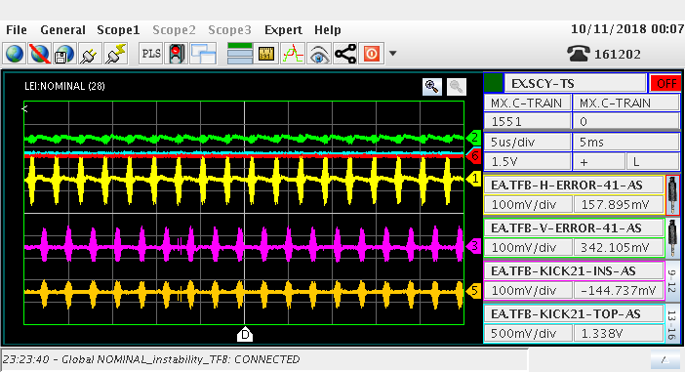
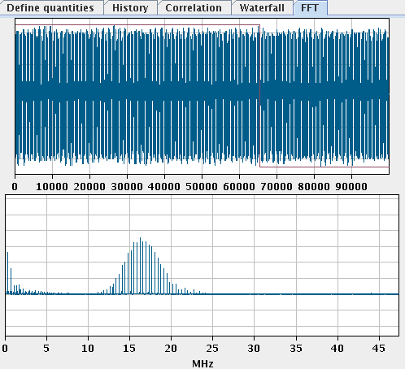
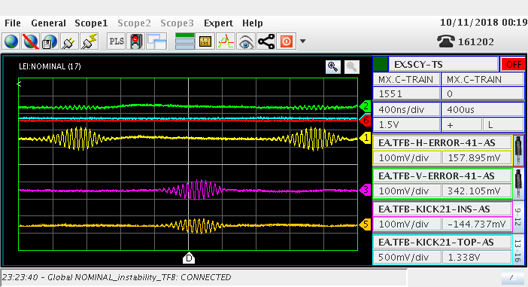
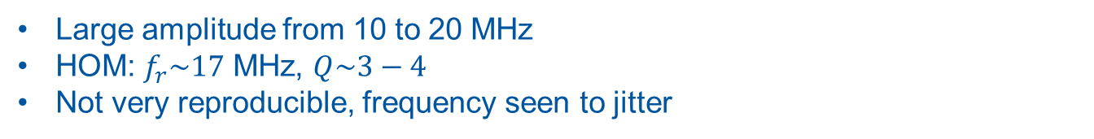
Frequency content
Large amplitude from 10 to 20 MHz
HOM: $f_{r}\sim 17$ MHz, $Q\sim 3−4$
Not very reproducible, frequency seen to jitter

Slide 5
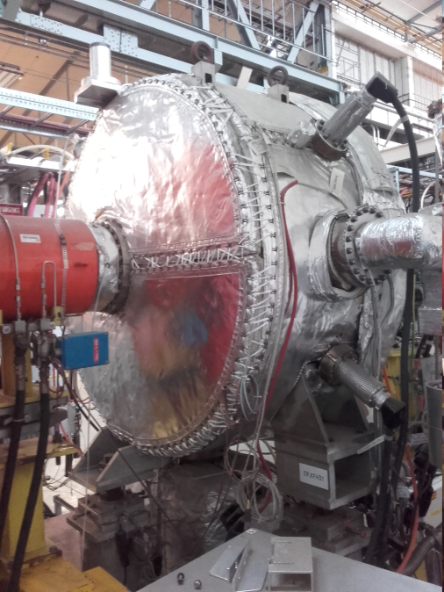
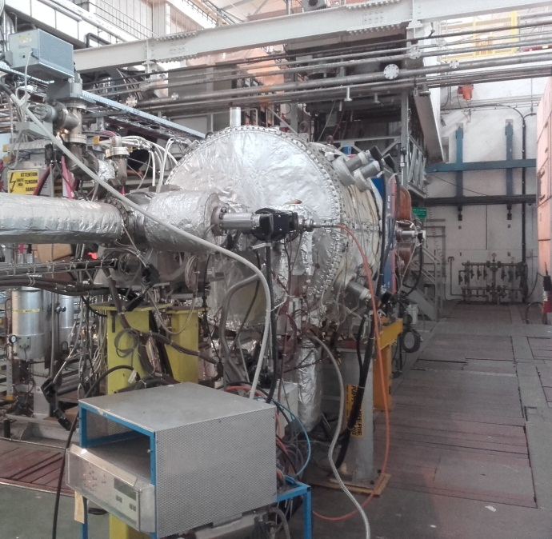
Seek for a source…
Given the plane of instability, relatively low HOM frequency and low Q factor, we started to investigate the LEIR extraction kickers.
ER.KFH31
ER.KFH32-34
ER.KFH31 and ER.KFH32-34 are used in LEIR to extract the beam.
No CAD models available.

Slide 6
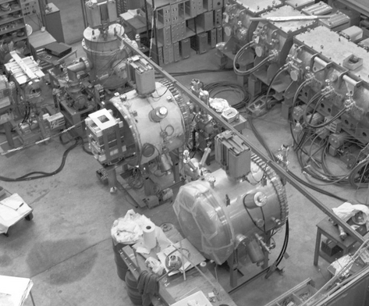
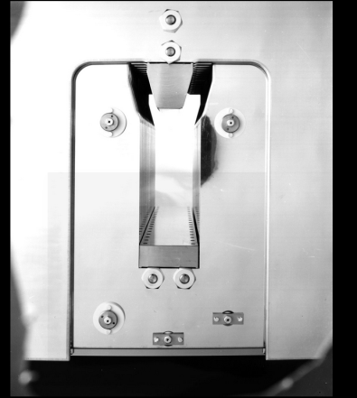
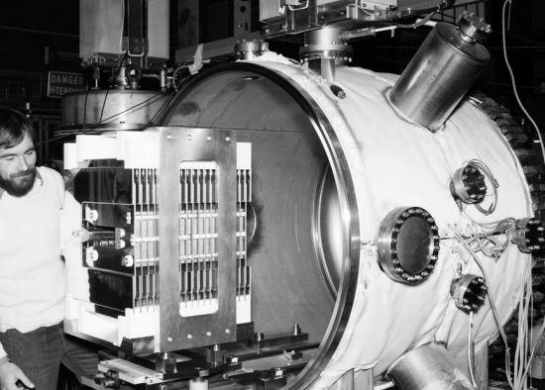
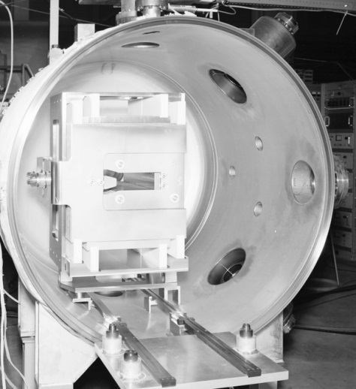
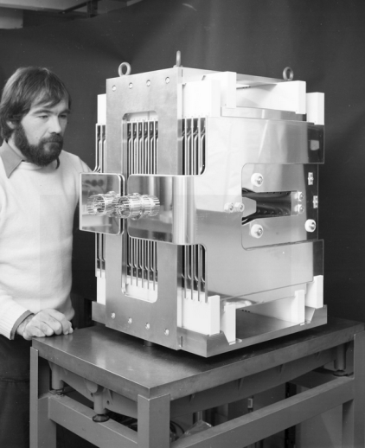
Pictures KFH3234 (LEAR 1981)
Pictures scanned from negative (Dec. 1981) https://cds.cern.ch/record/754592

Slide 7
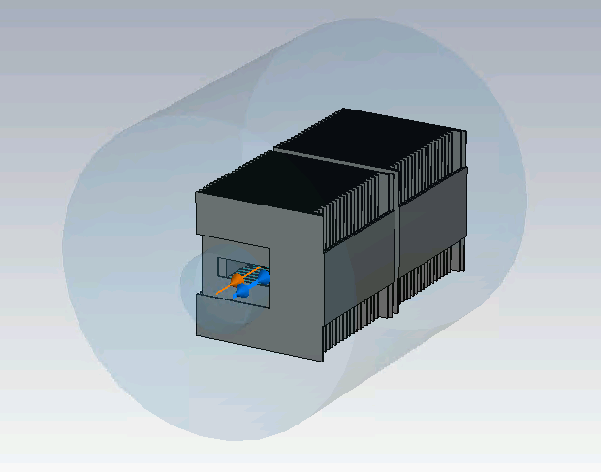
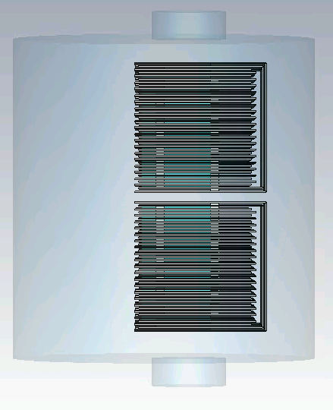
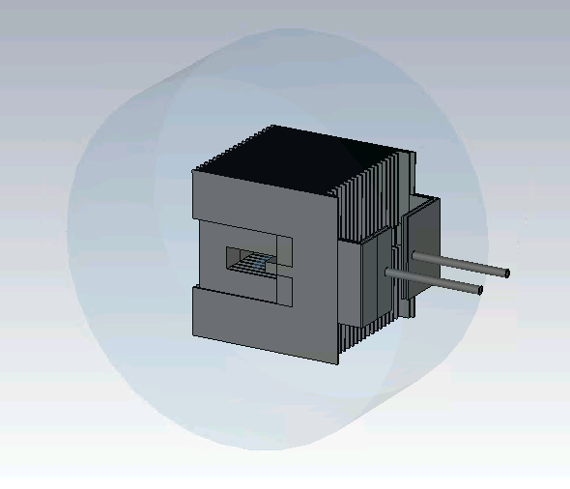
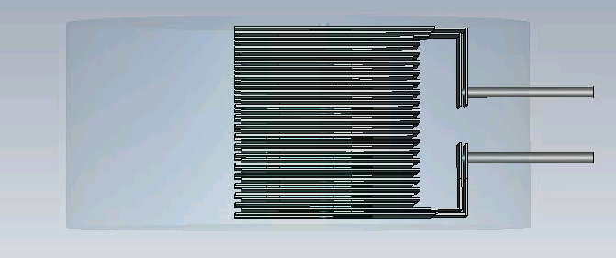
KFH31 - KFH3234 CAD models
KFH3234
KFH31

Slide 8
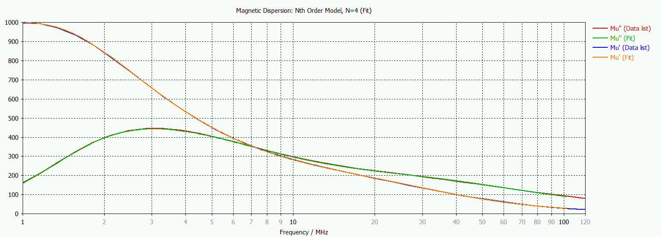
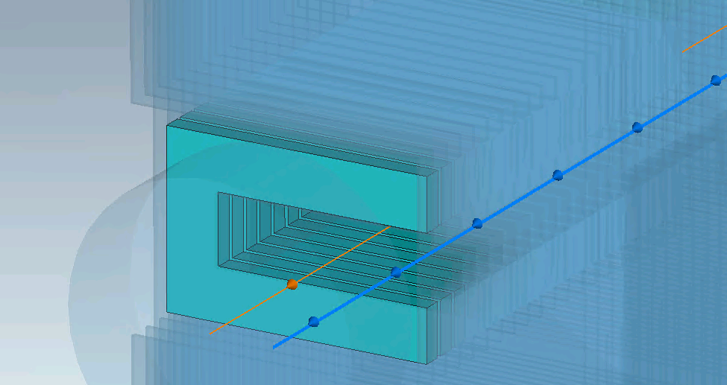
Ferrite material
Ferrite 8C11
Source:
https://www.ferroxcube.com/upload/media/product/file/MDS/8c11.pdf

Slide 9
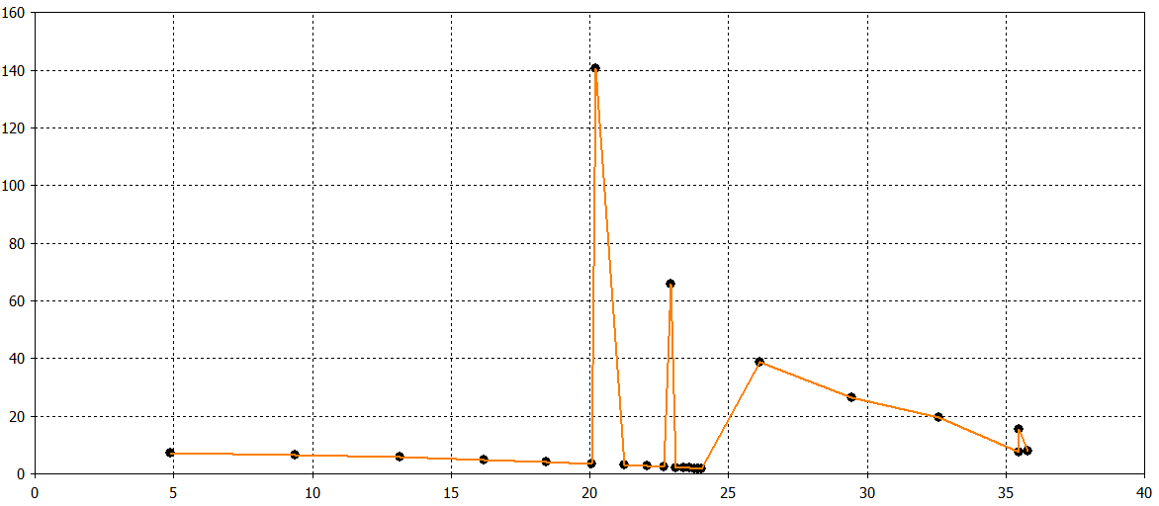
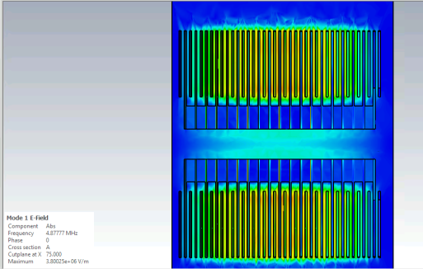
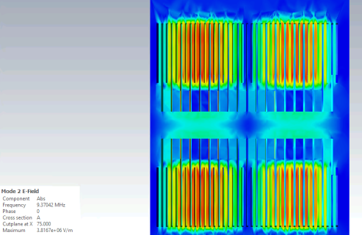
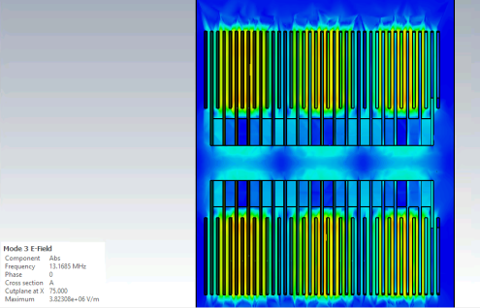
KFH31 Eigenmodes
Q factor
MHz

Slide 10
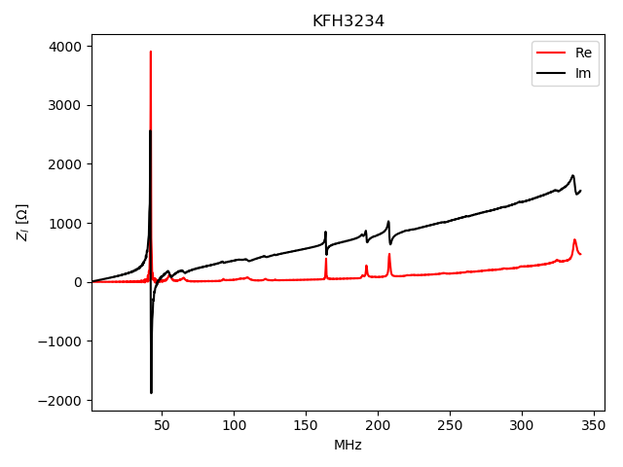
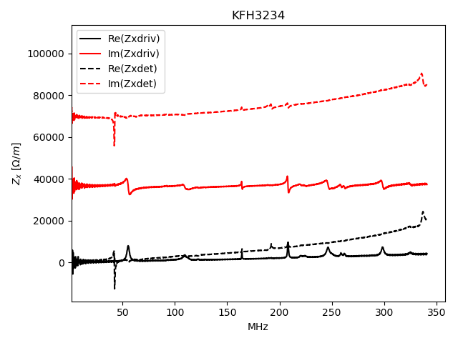
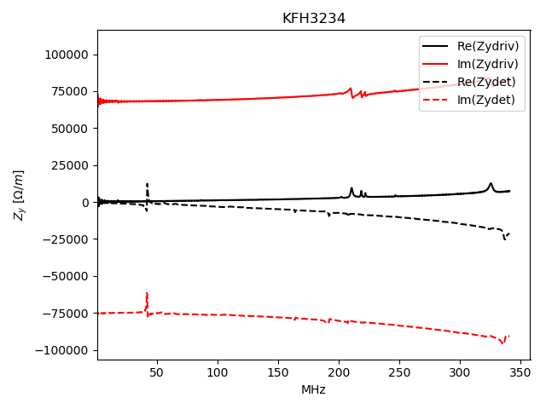
Impedances
Wakefield simulations of kicker module do not show large transverse modes at the observed frequencies.
Due to kickers spacing
Longitudinal
Horizontal
Vertical
Kicker structure can sustain a quasi-TEM mode $→$ cable effect could play a role.
We tried also to include the effect of the cables with available information.
Notes:
Add picture interconnection mode.

Slide 11
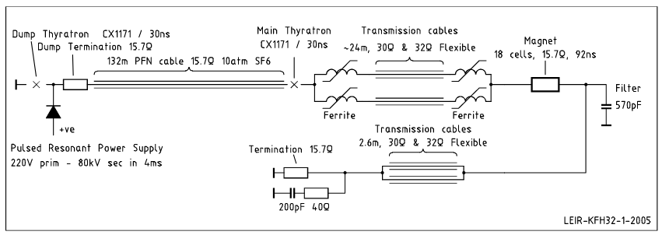
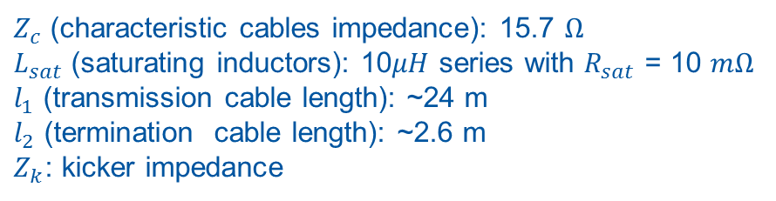
Kicker with circuitry
Circuit model available in Design Report.
Pulse Formation Path made of parallel of saturating inductors and TL cables.
Transmission cables
Magnet
Termination cables
$Z_{c}$ (characteristic cables impedance): 15.7 $Ω$
$L_{sat}$ (saturating inductors): 10$μH$ series with $R_{sat}$ = 10 $mΩ$
$l_{1}$ (transmission cable length): ~24 m
$l_{2}$ (termination cable length): ~2.6 m
$Z_{k}$: kicker impedance

Slide 12
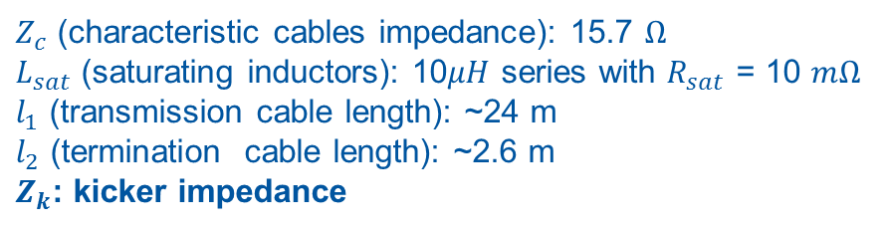
Kicker with circuitry
Circuit model available in Design Report.
Pulse Formation Path made of parallel of saturating inductors and TL cables.
Transmission cables
Magnet
Termination cables
$Z_{c}$ (characteristic cables impedance): 15.7 $Ω$
$L_{sat}$ (saturating inductors): 10$μH$ series with $R_{sat}$ = 10 $mΩ$
$l_{1}$ (transmission cable length): ~24 m
$l_{2}$ (termination cable length): ~2.6 m
$Z_{k}$: kicker impedance

Slide 13
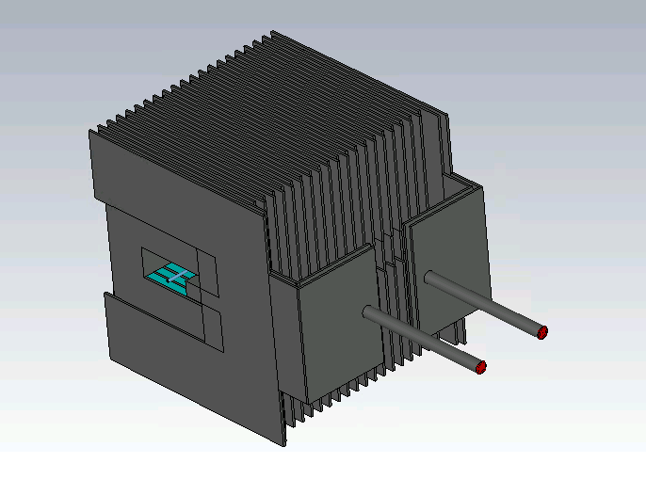
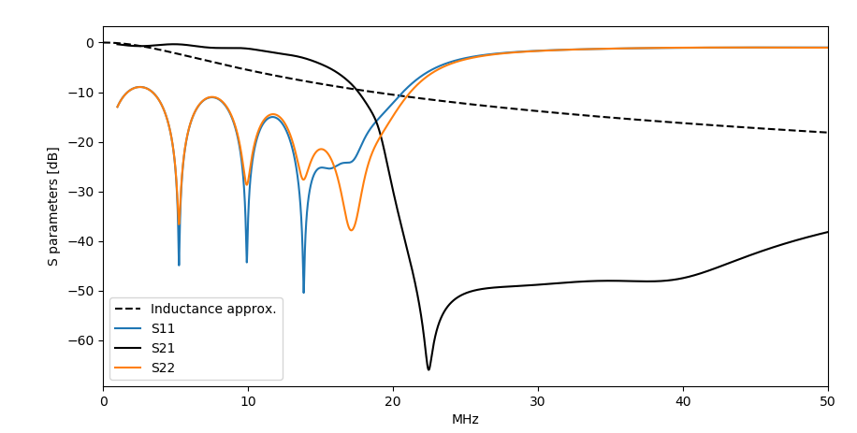
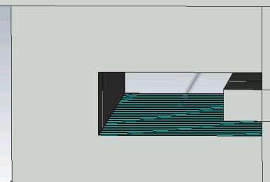

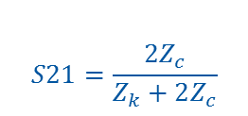
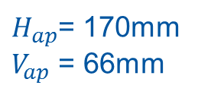
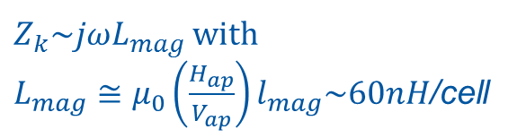

Kicker impedance
Simulated the kicker impedance from P1 to P2
Magnet as series impedance approximation:
$$S21=\frac{2Z_{c}}{Z_{k}+2Z_{c}}$$
P2
P1
$Z_{k}\sim jωL_{mag}$ with
$L_{mag}≅μ_{0}\left(\frac{H_{ap}}{V_{ap}}\right)l_{mag}\sim 60nH$/cell
$H_{ap}$= 170mm
$V_{ap}$ = 66mm
$$H_{ap}$$
$$V_{ap}$$
Inductive behavior up to ~20 MHz.
$→$ RF measurements between P1/P2 would help to cross-check the model!

Slide 14
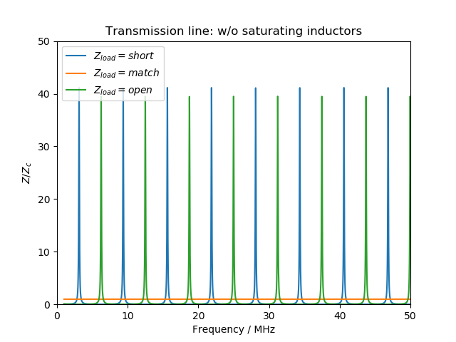
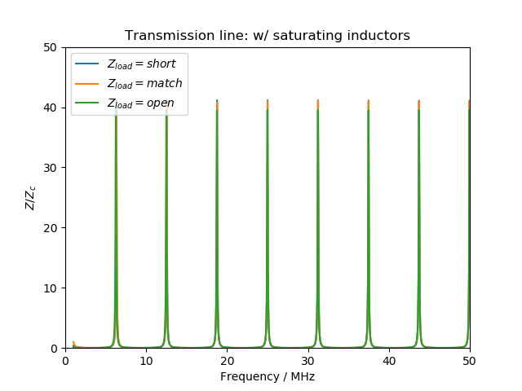
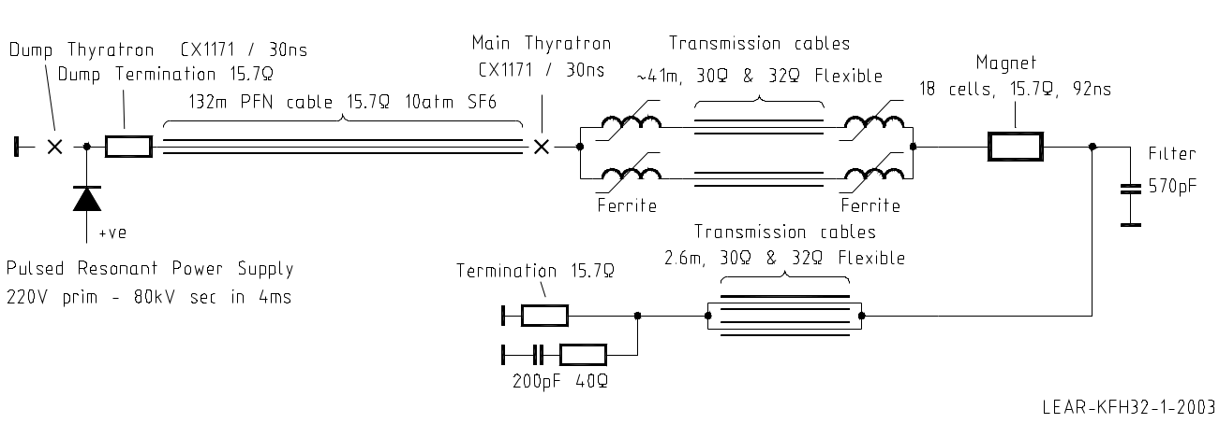
Transmission cables
Transmission side studied for different load (short, match, open).
Transmission cables
load
Saturating inductors show large load $→$ dominate response of transmission side

Slide 15
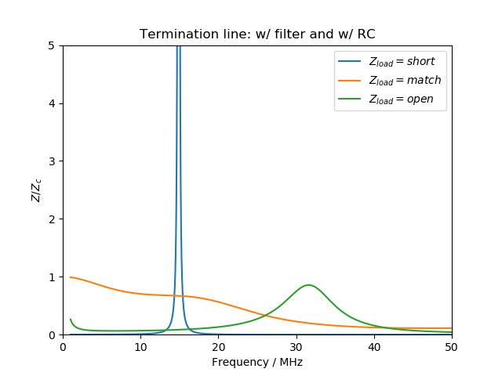
Termination cables
Termination side studied for different load (short, match, open).
load
filter
RC
Termination side is normally matched $→$ no issue.
Resonance with short: measurements recommended to benchmark the model

Slide 16
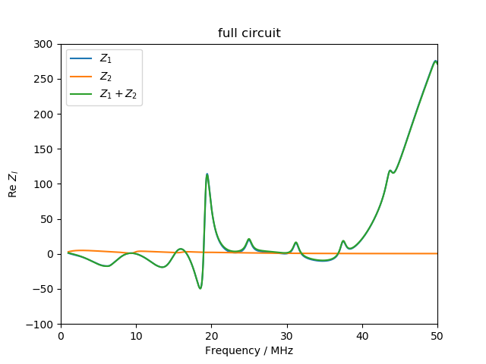
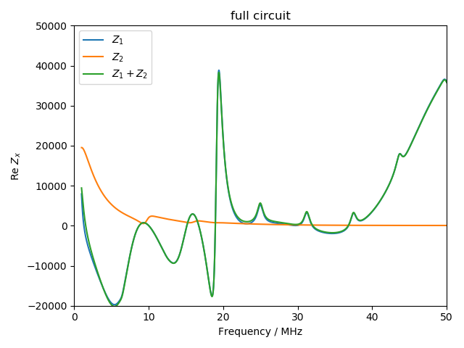
Kicker impedance with circuitry
Computed the effect of both transmission side ($Z_{1}$) and termination side ($Z_{2}$) with the approach of [1,2,3]:
A large resonance at 20 MHz between transmission side ($Z_{1}$) and magnet is generated.
[1] G. Nassibian and F. Sacherer, Nucl. Instrum. Methods159,21 (1979)
[2] D. Davino and H. Hahn, Phys. Rev. ST Accel. Beams6,012001 (2003)
[3] C.Zannini, G.Rumolo, V.G.Vaccaro, CERN-ATS-2012-134, Particle Accelerator Conference(IPAC’12) –May20-25, 2012, N. Orleans, USA
Notes:
Confronto con jOmegaL semplice. Ref -> Davino, hann, put both references.

Slide 17
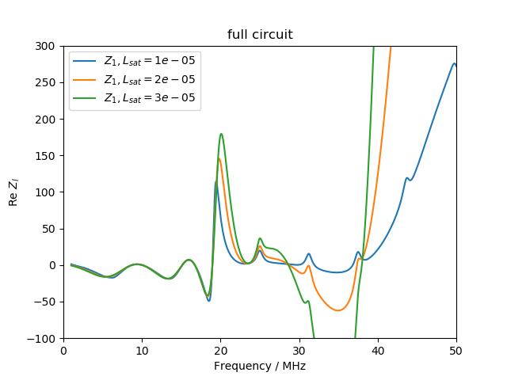
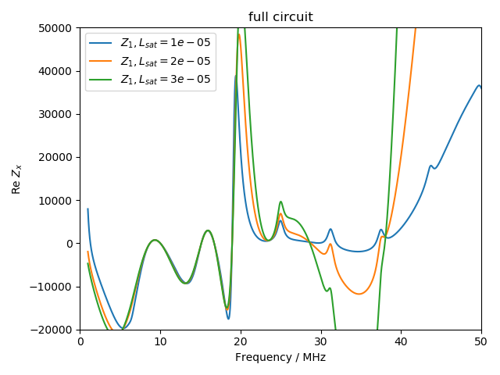
Kicker impedance with circuitry
Computed the effect of both transmission side ($Z_{1}$) and termination side ($Z_{2}$) with the approach of [1,2,3]:
A large resonance at 20 MHz between transmission side ($Z_{1}$) and magnet is generated.
Largely dependent on the saturating inductance value.
[1] G. Nassibian and F. Sacherer, Nucl. Instrum. Methods159,21 (1979)
[2] D. Davino and H. Hahn, Phys. Rev. ST Accel. Beams6,012001 (2003)
[3] C.Zannini, G.Rumolo, V.G.Vaccaro, CERN-ATS-2012-134, Particle Accelerator Conference(IPAC’12) –May20-25, 2012, N. Orleans, USA
Notes:
Confronto con jOmegaL semplice. Ref -> Davino, hann, put both references.

Slide 18
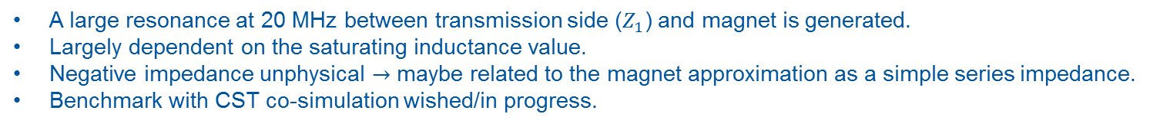
Kicker impedance with circuitry
Computed the effect of both transmission side ($Z_{1}$) and termination side ($Z_{2}$) with the approach of [1,2,3]:
A large resonance at 20 MHz between transmission side ($Z_{1}$) and magnet is generated.
Largely dependent on the saturating inductance value.
Negative impedance unphysical $→$ maybe related to the magnet approximation as a simple series impedance.
Benchmark with CST co-simulation wished/in progress.
[1] G. Nassibian and F. Sacherer, Nucl. Instrum. Methods159,21 (1979)
[2] D. Davino and H. Hahn, Phys. Rev. ST Accel. Beams6,012001 (2003)
[3] C.Zannini, G.Rumolo, V.G.Vaccaro, CERN-ATS-2012-134, Particle Accelerator Conference(IPAC’12) –May20-25, 2012, N. Orleans, USA
Notes:
Confronto con jOmegaL semplice. Ref -> Davino, hann, put both references.

Slide 19
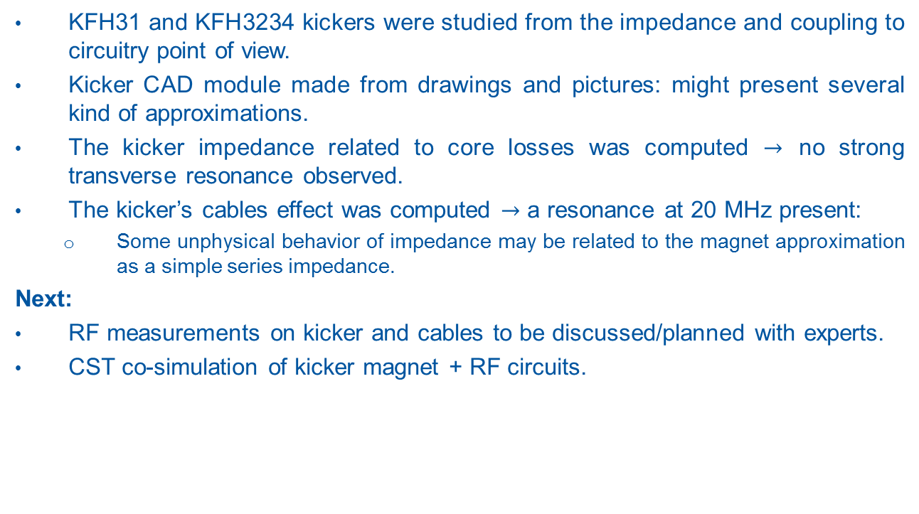
Summary and conclusions
KFH31 and KFH3234 kickers were studied from the impedance and coupling to circuitry point of view.
Kicker CAD module made from drawings and pictures: might present several kind of approximations.
The kicker impedance related to core losses was computed $→$ no strong transverse resonance observed.
The kicker’s cables effect was computed $→$ a resonance at 20 MHz present:
  Some unphysical behavior of impedance may be related to the magnet approximation as a simple series impedance.
Next:
RF measurements on kicker and cables to be discussed/planned with experts.
CST co-simulation of kicker magnet + RF circuits.

Slide 20
Appendix

Slide 21
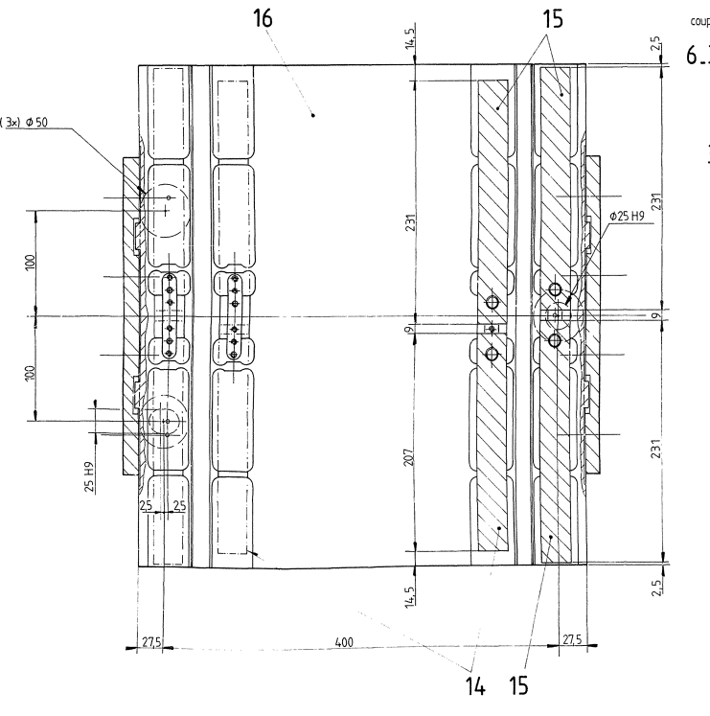
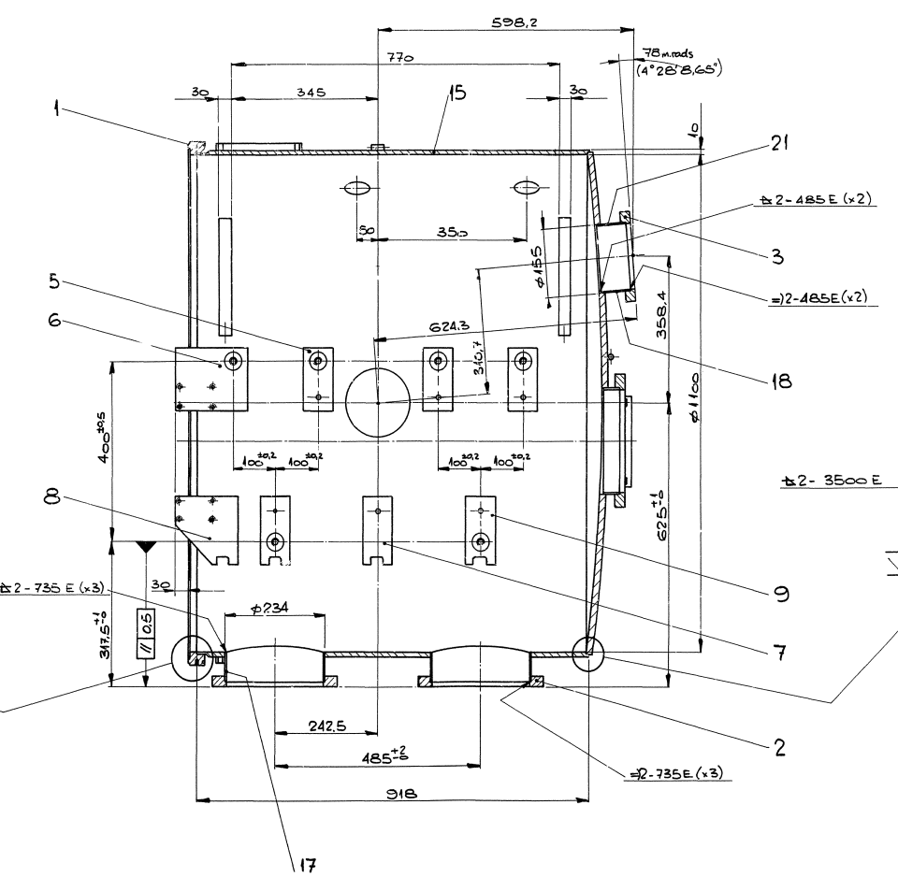
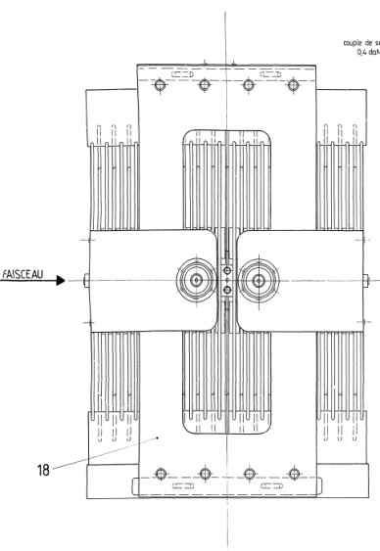

Original drawings
233mm
242.5mm
235.5mm
471mm

Slide 22


Details on module spacing
471mm full length (235.5 half)
461mm plate-to-plate (230.5 half)
Module distance 7mm full module to middle
12 mm plate to middle
14 (24)mm

Slide 23


Some references on kickers
M.Barnes “Injection and extraction magnets: kicker magnets ” CAS 2009: Specialised Course on Magnets, Bruges, 16-25 June 2009
L.Ducimetière, “Advances of transmission line magnets”, Proceedings of 2005 Particle Accelerator Conference, Knoxville, Tennessee.

Slide 24












RF networks: series impedance
$$b_{i}=\frac{U_{i}−I_{i}Z_{0}}{2\sqrt{Z_{0}}}$$
$$\frac{b_{2}}{a_{1}}{\left.​\right|}_{a_{2}=0}=\frac{U_{2}−I_{2}Z_{0}}{U_{1}+I_{1}Z_{0}}$$
$$a_{i}=\frac{U_{i}+I_{i}Z_{0}}{2\sqrt{Z_{0}}}$$
$$U_{2}=U_{0}\frac{Z_{0}}{2Z_{0}+Z}$$
$$I_{2} =−I_{1}={−U}_{0}\frac{1}{2Z_{0}+Z}$$
$$\frac{b_{2}}{a_{1}}{\left.​\right|}_{a_{2}=0}=\frac{U_{0}\frac{Z_{0}}{2Z_{0}+Z}{+U}_{0}\frac{Z_{0}}{2Z_{0}+Z}}{U_{0}\frac{Z+Z_{0}}{2Z_{0}+Z}+U_{0}\frac{Z_{0}}{2Z_{0}+Z}}=\frac{2Z_{0}}{Z+2Z_{0}}$$
$$\frac{b_{1}}{a_{1}}{\left.​\right|}_{a_{2}=0}=\frac{U_{1}−I_{1}Z_{0}}{U_{1}+I_{1}Z_{0}}$$
$$U_{1}=U_{0}\frac{Z+Z_{0}}{2Z_{0}+Z}$$
$$I_{1}=U_{0}\frac{1}{2Z_{0}+Z}$$
$$\frac{b_{1}}{a_{1}}{\left.​\right|}_{a_{2}=0}=\frac{Z}{2Z_{0}+Z}$$
https://cds.cern.ch/record/1415639/files/p67.pdf

Slide 25

KFH3234 front view

Slide 26

A simplified kicker schematic
T.Kramer, “Kickers, Septa and Protection Elements”, CAS2018 https://indico.cern.ch/event/683936/contributions/2803312/attachments/1564570/2691879/Kickers_and_Septa_2018_CAS_ESI.pdf

Slide 27


Kicker circuit model for impedance
$$Z_{l} =\frac{1}{4} \frac{Z_{k}Z_{g}}{Z_{k} + Z_{g}}$$
$$Z_{x} =\frac{c}{ω {(H}_{ap}^{}/2)^2 }Z_{l}$$
https://journals.aps.org/prab/pdf/10.1103/PhysRevSTAB.6.012001

