Slide 2
Introduction
PS 40/80 MHz feedback amplifier review
…
PS Machine Performance Coordination #24
01/12/2020

Slide 3
LIU-PS […] 40/80 MHz feedback amplifier
checkpoint meeting, 07/02/2019
Conclusions
  Recommended that a model of the 40 and 80 MHz cavity and amplifiers is realized to improve our understanding.
  Specification of the upgraded system with new amplifiers will be produced
  Testing of a prototype feedback amplifier during the recommissioning at the end of LS2
Proposed actions
  Proceed with the installation of fast coaxial lines to upgrade the feedback gain of the 40 MHz and 80 MHz systems
  A pre-series feedback amplifier close to a cavity should still be tested by the end of LS2
  refine the impedance model of the 40 MHz and 80 MHz RF systems for longitudinal beam dynamics simulations
  https://indico.cern.ch/event/795579/

Slide 4
Motivation
Seen from longitudinal beam performance
Bunch parameters reached in 2018: 2.6 · 10¹¹ p/b in 0.35 eVs
  Bunch-by-bunch parameter spread just acceptable (~10%)
  Only single point in parameter space
  Little margin to reduce long. emittance for PS-SPS transfer
  Difficult to reduce bunch-by-bunch parameter spread
Transient beam-loading degrades bunch-by-bunch equality during splitting and rotation (A. Lasheen: IPP#21, MPC#18)
Strong impact of 80 MHz impedance on stability
Seen from engineering point of view
Present pre-driver amplifiers (first stage) will reach end of life
Internal amplifier interlocks and protection not adapted to extended mode of operation, e.g. for Landau damping
Impossible to move pre-driver closer to cavity

Slide 5
Motivation
Seen from longitudinal beam performance
 | Reduce delay | Feedback close to cavity
Estimated (2019) impedance reduction | Add 3 dB | Add 6 dB
Cost | 3 kCHF/system → 15 kCHF | 20-70 kCHF/system (+ spares) 100-500 kCHF in total
Implementation time | 2 months | 1-2 years
Completed
Modelling and
characterization
Specification
of upgrade

Slide 6
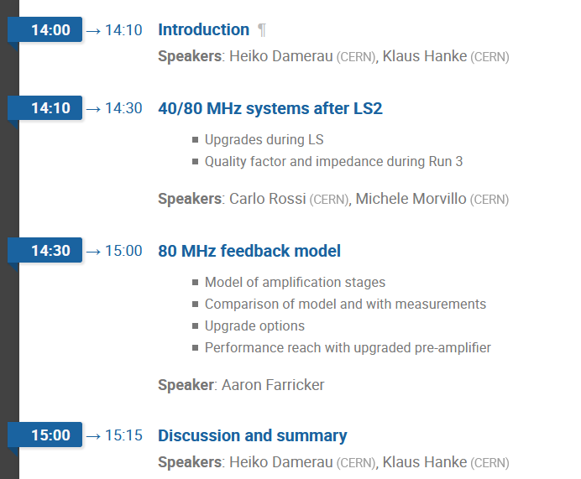
Agenda
Agenda

Slide 7
Questions/remarks
How to cover further modelling needs?
‘Feedback amplifier’
Draft specification for pre-driver amplifier prototype: 80 MHz
  Higher output power (~2-3 kW?)
  Shorter delay
  Mechanically compatible with slit
  Adapted interlocking outside amplifier
Production in industry
Test and installation on 80 MHz in alcove
…
Perform test of entire amplifier chain close to cavity
Order?
In parallel?

Slide 8

THANK YOU FOR YOUR ATTENTION!

Slide 9
Spare slides

Slide 10
Recommendations (07/02/19)
The target of a feedback upgrade appears achievable, however within the limits of LS2 only the option adopting the fast coaxial lines seems possible. All systems will then be upgraded with fast coaxial lines and additional test time will be requested at the end of LS2 to allow for a proper tuning of our systems. It is recommended that a model of the 40 and 80 MHz cavity and amplifiers is realized to improve our understanding of the PS impedance effects at high beam intensities. Based on the results from this model a specification of the upgraded system with new amplifiers will be produced, the goal being the testing of a prototype feedback amplifier during the recommissioning at the end of LS2.

Slide 11
Proposed actions (07/02/19)
With the aim of providing in any case a reduction of the impedance contribution from the 40 MHz and 80 MHz cavities (estimated at -2 to -3 dB), we will proceed with the installation of fast coaxial lines to upgrade the feedback gain of the 40 MHz and 80 MHz systems, with a total expected cost of 25 – 30 kCHF.

Slide 12
Proposed actions (07/02/19)
Concerning the fast feedback upgrade, the checkpoint meeting observes that the production and implementation of new feedback amplifiers is now practically out of reach within the timescale of LS2, which requires de-scoping of the corresponding work unit. However, seen the expected beam quality improvement, a pre-series feedback amplifier close to a cavity should still be tested by the end of LS2. This includes the studies aiming at further developing the PS impedance model. They are not only a necessary precondition to specify the feedback amplifier, but they will also refine the impedance model of the 40 MHz and 80 MHz RF systems for longitudinal beam dynamics simulations of intensity thresholds and uncontrolled emittance growth along the batch. The required manpower for the completion of the impedance model should be financed by LIU as part of the work unit for feedback amplifiers.

