Slide 1
40 & 80 MHz Feedback Roadmap

Slide 2
Outline
Overview of the System
Measurement of the Summing Point
High power measurements
  Measurement setup
  Pre-driver measurements
    Low Power
    High Power
  Driver measurements
Modelling of the Driver
  Simple Model
  Realistic Model

Slide 3
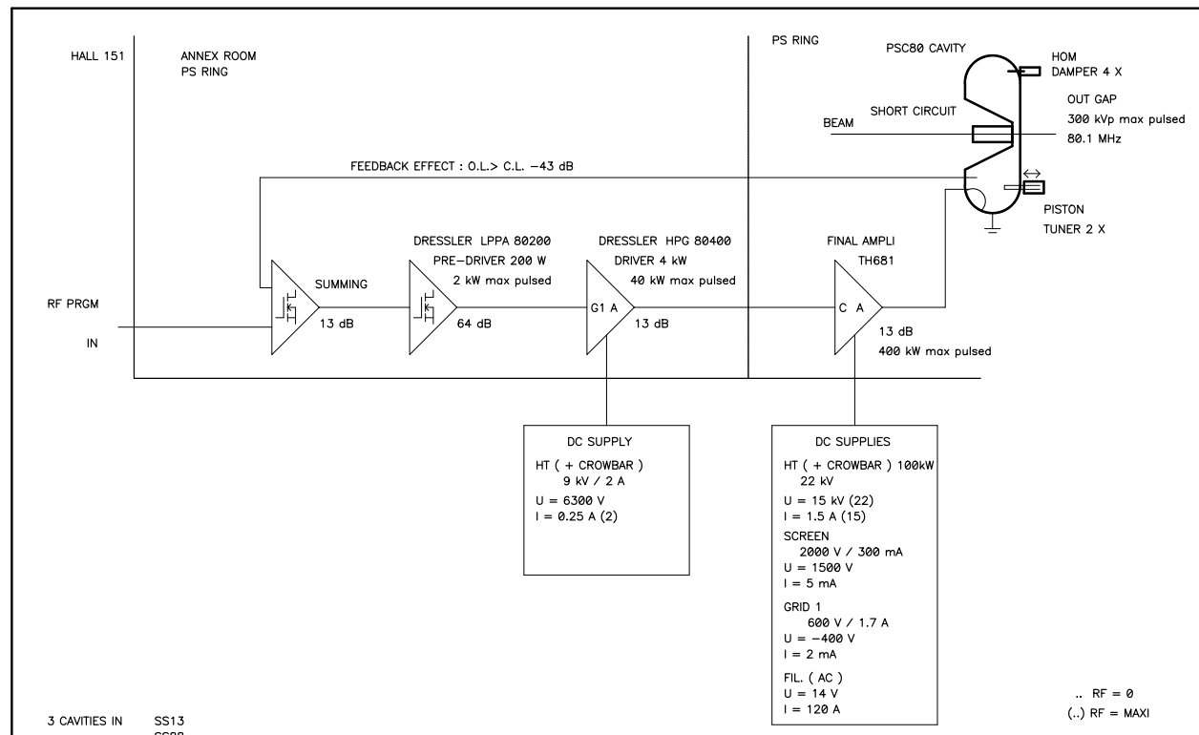
System Overview

Slide 4
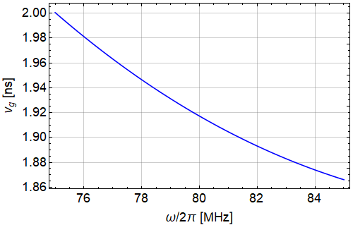
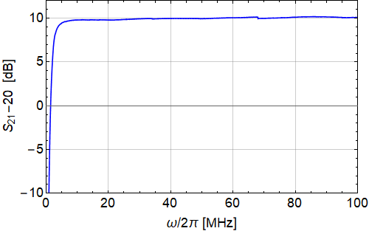
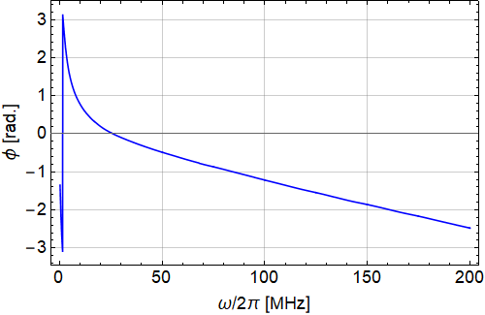
Summing Point
Summing amplifier measured in transmission using a VNA
Group delay in the region of interest is approximately 1.9 ns
The delay here is already low and any further reduction isn’t going to help much

Slide 5
High Power Measurements with a VNA
Measurement of high powers with a VNA are challenging (+26 dBm maximum input power)
This requires the signal to be attenuated significantly if we measure power levels of more than 100 mW
In addition the high power amplifiers are designed for pulsed operation which means standard VNA operation is not possible (VNA is always outputting a signal and has a long sweep time)
We need to only pulse the amplifier when a measurement is happening

Slide 6
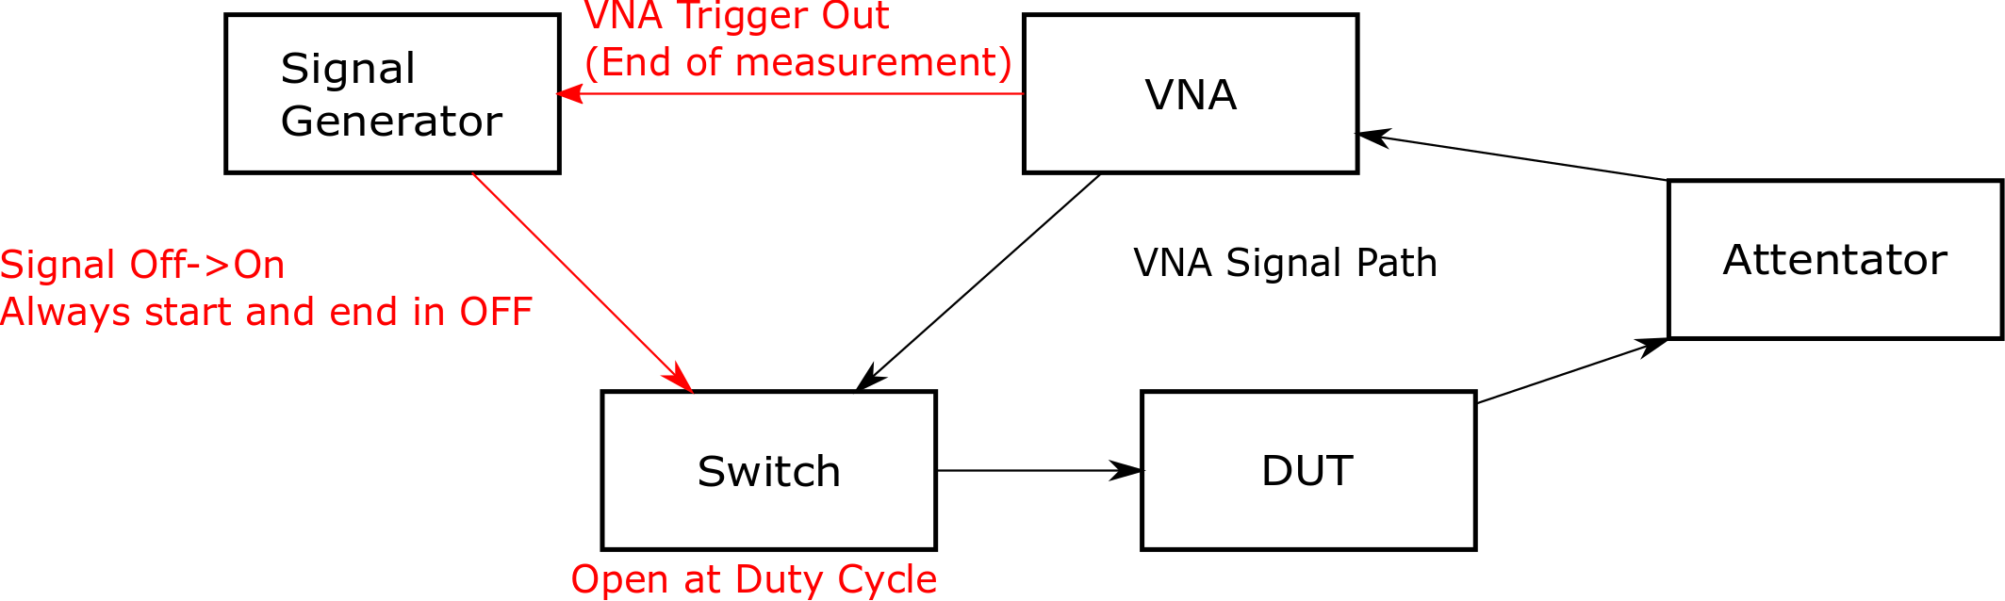
Measurement Setup (1/2)
Set the VNA to send an external trigger at the end of a measurement
From the minimum sweep time infer the measurement time per point for example 1000 points in 500 ms -> 500/1000 ms/point = 0.5 ms/point
Make this time match the amplifier specifications for the pulse duration eg. 1 ms at 1% duty cycle
Artificially extend the sweep time as any delay goes before the measurement and match the required duty cycle -> 100 ms/point total time

Slide 7
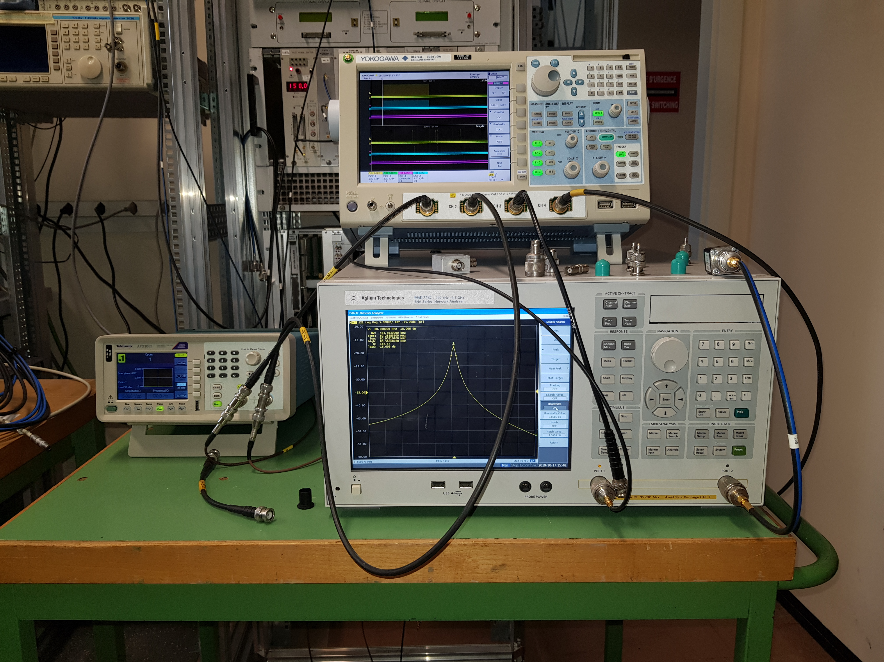
Measurement Setup (2/2)
In practice setting up the system is a little fiddly but it provides good results
The setup is shown to the right going through a circuit resonant at 80 MHz
There was no difference between with the trigger/switch system and without.
This means we can characterize the amplifiers at operational power levels

Slide 8
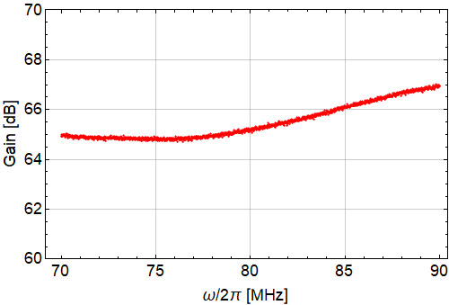
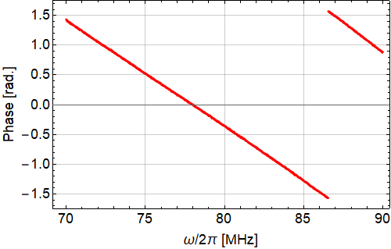
Pre-Driver - Low Power
Measurements at low power (Below the interlock) show almost constant gain with frequency
There is linear phase behavior with frequency
The group delay of the amplifier is 28.2 ns
In the model this can be a gain with a transmission line as the delay

Slide 9
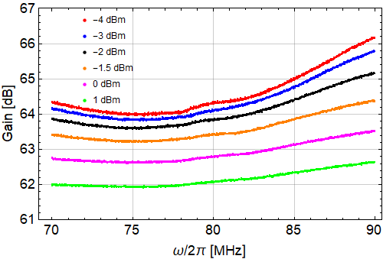
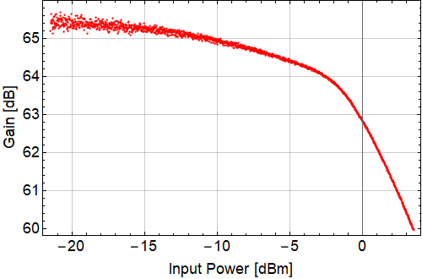
Pre-Driver - High Power
At high power the gain saturates but remains almost constant with frequency
Once the input power hits around -7 dBm the gain degrades by 1 dB

Slide 10
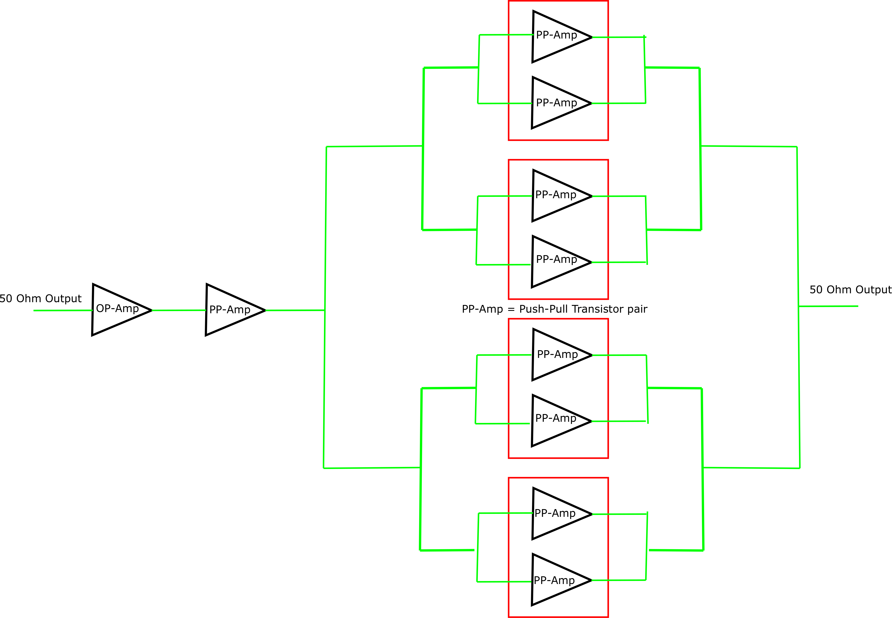
Pre-Drive Scope for Upgrade
The pre-driver comprises several stages of amplification
Having two stages which operate in push-pull gives a delay of 12.5 ns due to the 4 Baluns that are present
Dividing/combining the outputs also adds additional delay
Going to a single transistor stage would reduce the delay by at least 6.25 ns

Slide 11
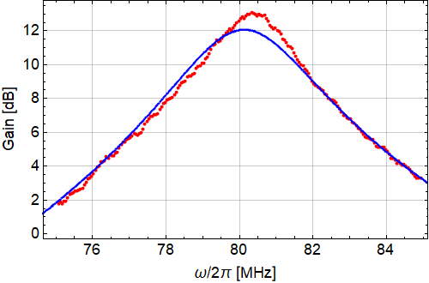
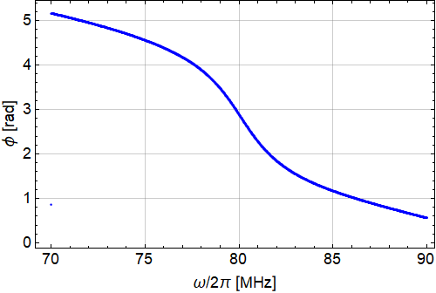
Driver Measurements
Driver shows clear resonant behavior expected
In the high power test the central frequency is higher and there is slightly more gain
The measured group delay is 88.1 ns @ 80 MHz at low power
At high power the group delay is 105 ns as the bandwidth has dropped
It is at least theoretically possible to reduce the group delay by increasing the bandwidth of the amplifier
This would mean that more drive power is required to compensate for the drop in gain

Slide 12
Delays in the Cables
7 ns of delay in the cables from summing point -> Pre-Driver & Pre-Driver ->Driver
Delays in the cables to the Final Amplifier and the Cavity Return
 | RG213 (Feedback Loop) | Rigid line 1 +5/8 (between driver and final) | Total
 | Delay (ns) | Delay (ns) | Delay (ns)
SS77 | 39.4 | 34.4 | 73.8
SS78 | 36.9 | 39.32 | 77.2
SS08 | 45 | 40 | 85
SS88 | 44.35 | 33.19 | 77.6
SS89 | 44.7 | 29.1 | 73.8
Realistically 4 m of line would be needed if the amplifiers were moved next to/below the cavity. Which is a delay of some 14 ns

Slide 13
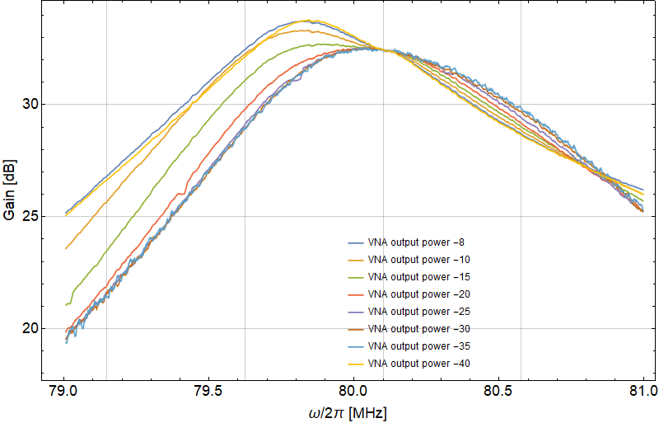
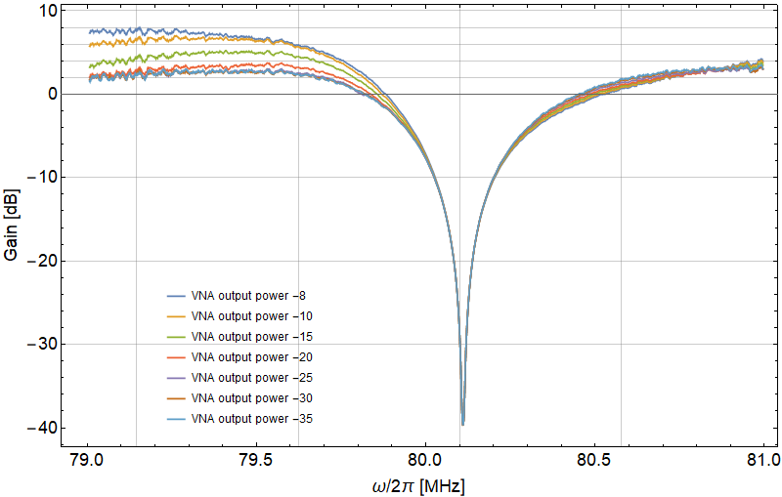
Measurements in Closed Loop
80-88
Raw measurement
Change relative to the OL
The measurement of the transfer function shows a clear reduction in the impedance
As the power is increased the transfer function has become asymmetric but still passes through the same point at the cavity resonance

Slide 14
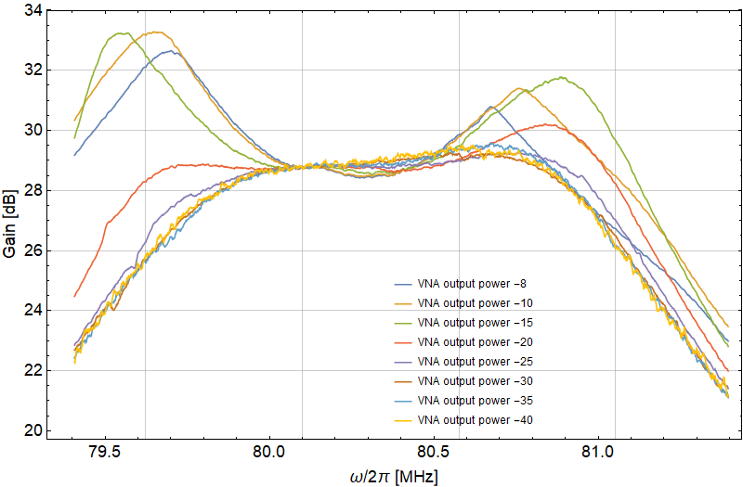
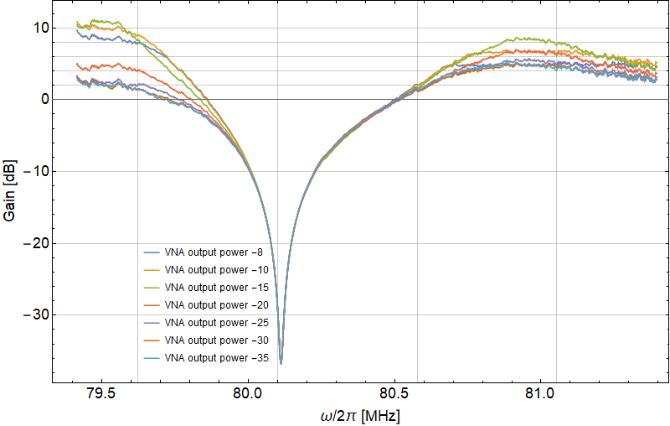
Measurements in Closed Loop
80-89
Raw measurement
Change relative to the OL
The measurement of the transfer function shows a clear reduction in the impedance
As the power is increased the transfer function has become asymmetric but still passes through the same point at the cavity resonance
What was unexpected is the appearance of two peaks as power increases
This means there is more impedance at h167 & h169 than at h168

Slide 15
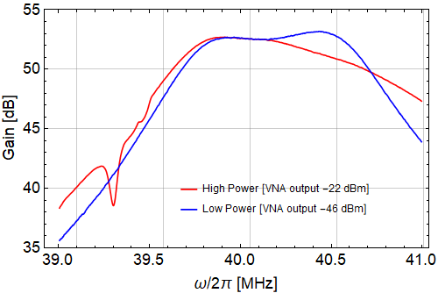
Measurements in Closed Loop
40-77
The measurement of the transfer function shows a clear reduction in the impedance
The transfer function looks as would be expect at both low and high power
We see a drop in gain which could be due to multipacting at 39.3 MHz

Slide 16
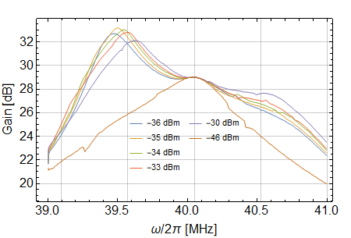
Measurements in Closed Loop
40-78
The measurement of the transfer function shows a clear reduction in the impedance
This was our first hint at some unexpected behavior
Here we see a huge asymmetry in the impedance and a factor of 4dB at h83 compared to h84 which is significant
This could have some impact on the beam dyanmics

Slide 17
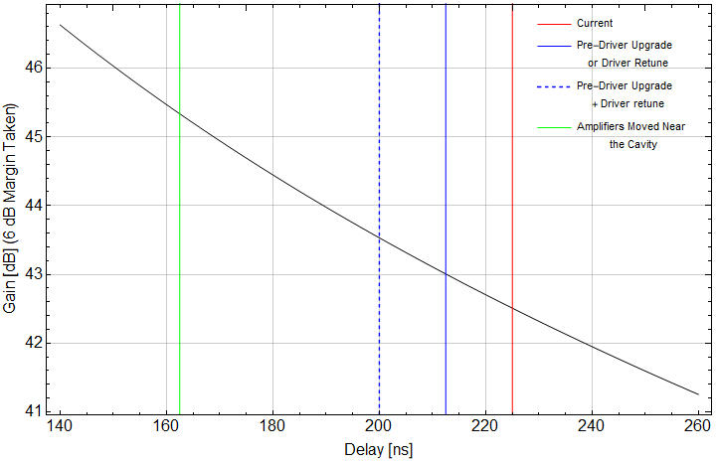
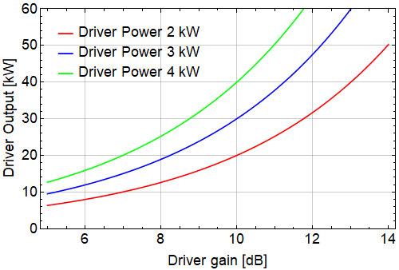
Possible Upgrade Scenarios
80 MHz
One option that may work is to retune the driver
  Dropping the gain and increasing the bandwidth would reduce the delay
  This requires more power from the pre-driver to compensate
  Currently the maximum pre-driver output to saturate the final amplifier is 1 kW (2 kW is its rating)

Slide 18
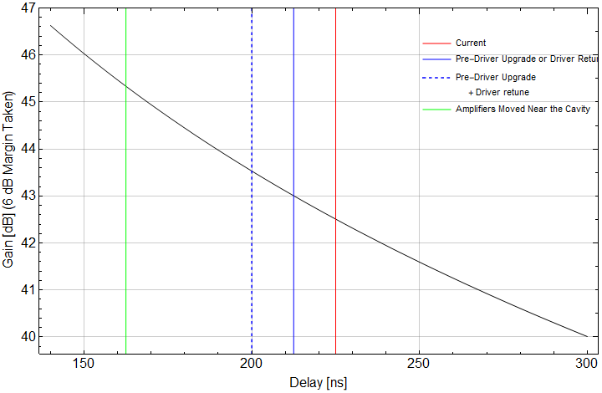
Possible Upgrade Scenarios
80 MHz
One option that may work is to retune the driver
  Dropping the gain and increasing the bandwidth would reduce the delay
  This requires more power from the pre-driver to compensate
  Currently the maximum pre-driver output to saturate the final amplifier is 1 kW (2 kW is its rating)
Upgrade the pre-driver
  Reduce the delay from 28.2 ns to maybe 15ns (optimistically)
  This could give 12.5 ns
  Increase in the output power also makes (1) more possible

Slide 19
Possible Upgrade Scenarios
80 MHz
One option that may work is to retune the driver
  Dropping the gain and increasing the bandwidth would reduce the delay
  This requires more power from the pre-driver to compensate
  Currently the maximum pre-driver output to saturate the final amplifier is 1 kW (2 kW is its rating)
Upgrade the pre-driver
  Reduce the delay from 28.2 ns to maybe 15ns (optimistically)
  This could give 12.5 ns
  Increase in the output power also makes (1) more possible
Move the amplifiers closer
  Reduction of delay by 55-65 ns
  All amplifiers need to be radiation hard
  Means a new pre-driver to fit in the location
  Control electronics in the driver need relocating
  Summing point may need addition changes

Slide 20
Suggested Roadmap
Retune the driver
  Test in bld.151 on the spare amplifier to see how much delay can be saved while still achieving 25 kW of output power
  20 kW of output power should saturate the final amplifier
  If it gives 12.5 ns improvement install on C80-08 to test
Upgrade the pre-driver
  Require the group delay to be as small as practical
  Increase the output power to 3 kW
  This should be possible with more recent technology
  Even if we can’t achieve 12.5 ns here we may be able to compensate the difference with the driver
  Have the form factor correct to be installed near the cavity
Move the amplifiers next to the cavity
  At this point the other improvements are in line with doing this
  Driver needs to be modified but this should be relatively straightforward

Slide 21
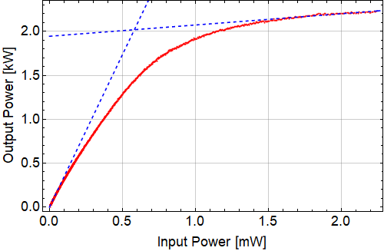
Pre-Driver Power Saturation

