Slide 1

Special Technical Meeting on the 11T Dipole QH-Trace to Wire Jointing
Test campaign, samples, and jointing procedures
M. Andreini*, M. D. Crouvizier, L. Favier, T. Genestier*, L. Grand-Clement, M.D. Jedrychowski, M.S. Meyer, P. Nervo*, R. Principe, F. Savary, S. Sgobba
*GE - Contract S197/TE
CERN – Virtual room https://indico.cern.ch/event/978144/ – 2020.11.27

Slide 2
Outlook
Introduction
Motivation - Test plan
Jointing concepts – Inventory of samples
Preparation of the samples / procedures
Concluding remarks

Slide 3
Introduction
Magnet ID | Impregnated QHs | External QHs | QH Failure - NCR
LMBHB001 – P0 – Proto | X |  | None
LMBHP001 – P1 – Hybrid | X |  | None
LMBHB002 – S1 | X |  | None
LMBHA001 – S2 | X |  | None
LMBHA002 – S3 |  | X | 1 circuit in C14
LMBHB003 – S4 |  | X | 1 circuit in C17
LMBHA003 – S5 |  | X | Not tested at cold
LMBHB004 – S6 |  | X | Not yet fabricated
LMBHA004 – S7 |  | X | Not yet fabricated

Slide 4
Outlook
Introduction
Motivation - Test plan
Jointing concepts – Inventory of samples
Preparation of the samples / procedures
Concluding remarks

Slide 5
Motivations
Following the QH failures observed in the magnets S3, and S4, it was decided to put on hold the assembly of the last coils, C26 to C35, and to conduct a test campaign aiming at characterizing the quality of the soldered joints
  Those used in the magnets S3, S4, and S5 (with almost the same concept, based on the use of a pin connector, as for the prototype magnet P1, the hybrid assembly H1, and the first two series magnets S1, and S2)
  AND
  Alternative jointing concepts / procedures
Determine the root cause of the non conformity
Based on the results, implement a solution that will guarantee robustness, endurance, reliability

Slide 6
Characterization – Test plan
For the different jointing procedures under consideration
Electrical tests:
  Endurance: carry out a sufficient number of discharge tests at RT (up to 50), on representative samples, see list in Slide 7
  Robustness: determine the effective margin of each jointing concept, w.r.t. the actual test conditions applied during the magnet construction (increase progressively the energy deposit, up to destruction of the sample)
Other quality control:
  Carry out NDT (computed tomography) and metallographic examination under a microscope in order to verify the quality of the soldered joints, looking for pores, cavities, and cracks, but also checking material diffusion at the interface between:
    The QH-trace and the solder material
    The solder material and the wire (w and w/o connector)

Slide 7
Outlook
Introduction
Motivation - Test plan
Jointing concepts – Inventory of samples
Preparation of the samples / procedures
Concluding remarks

Slide 8
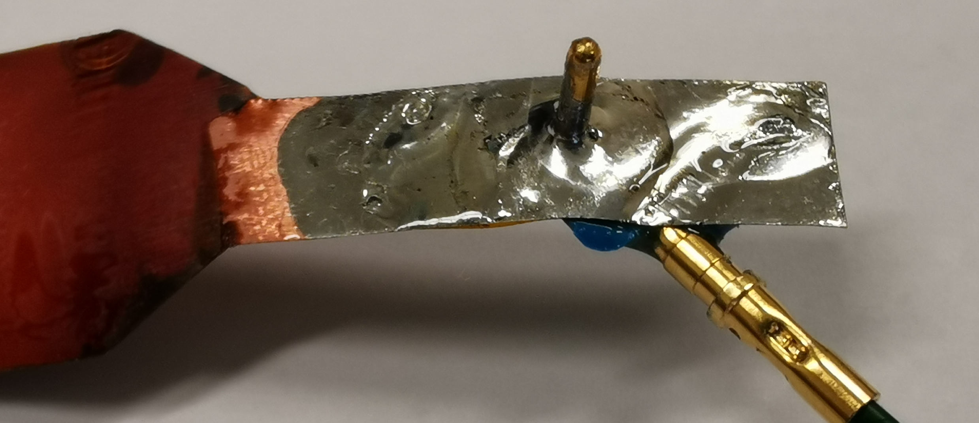
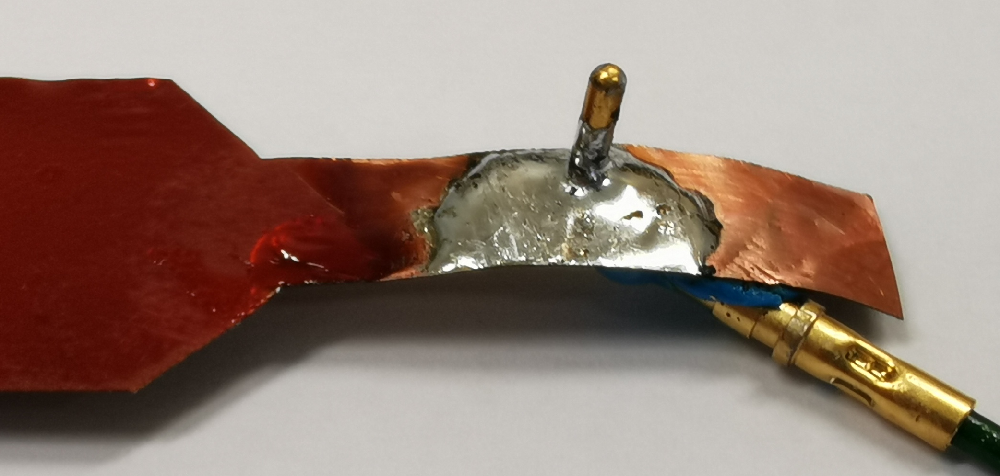
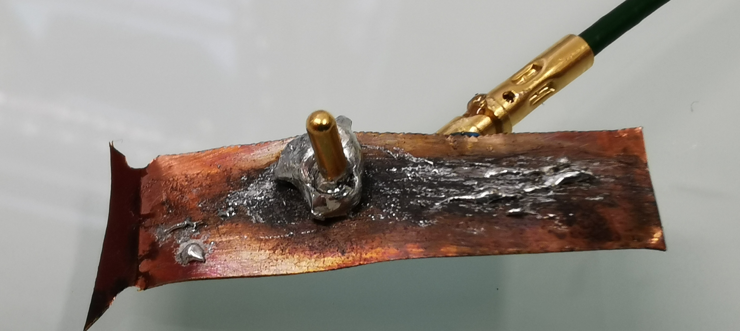
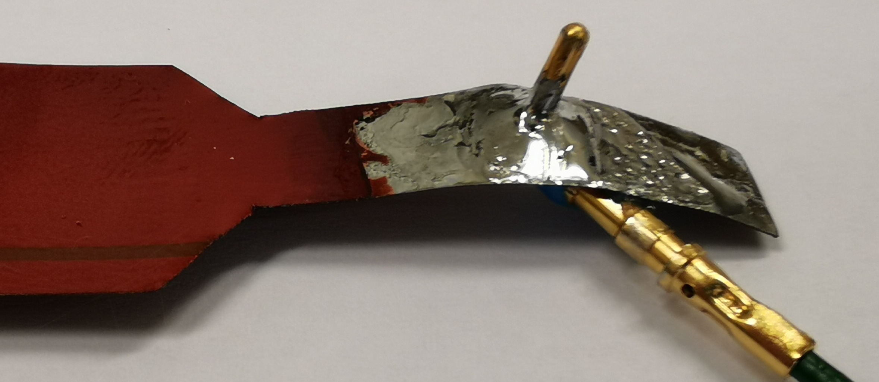
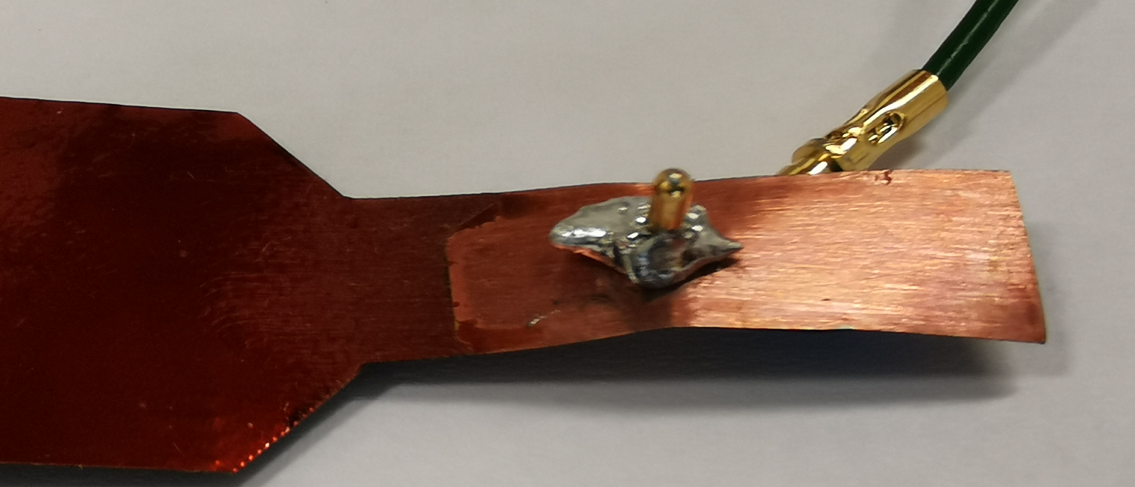
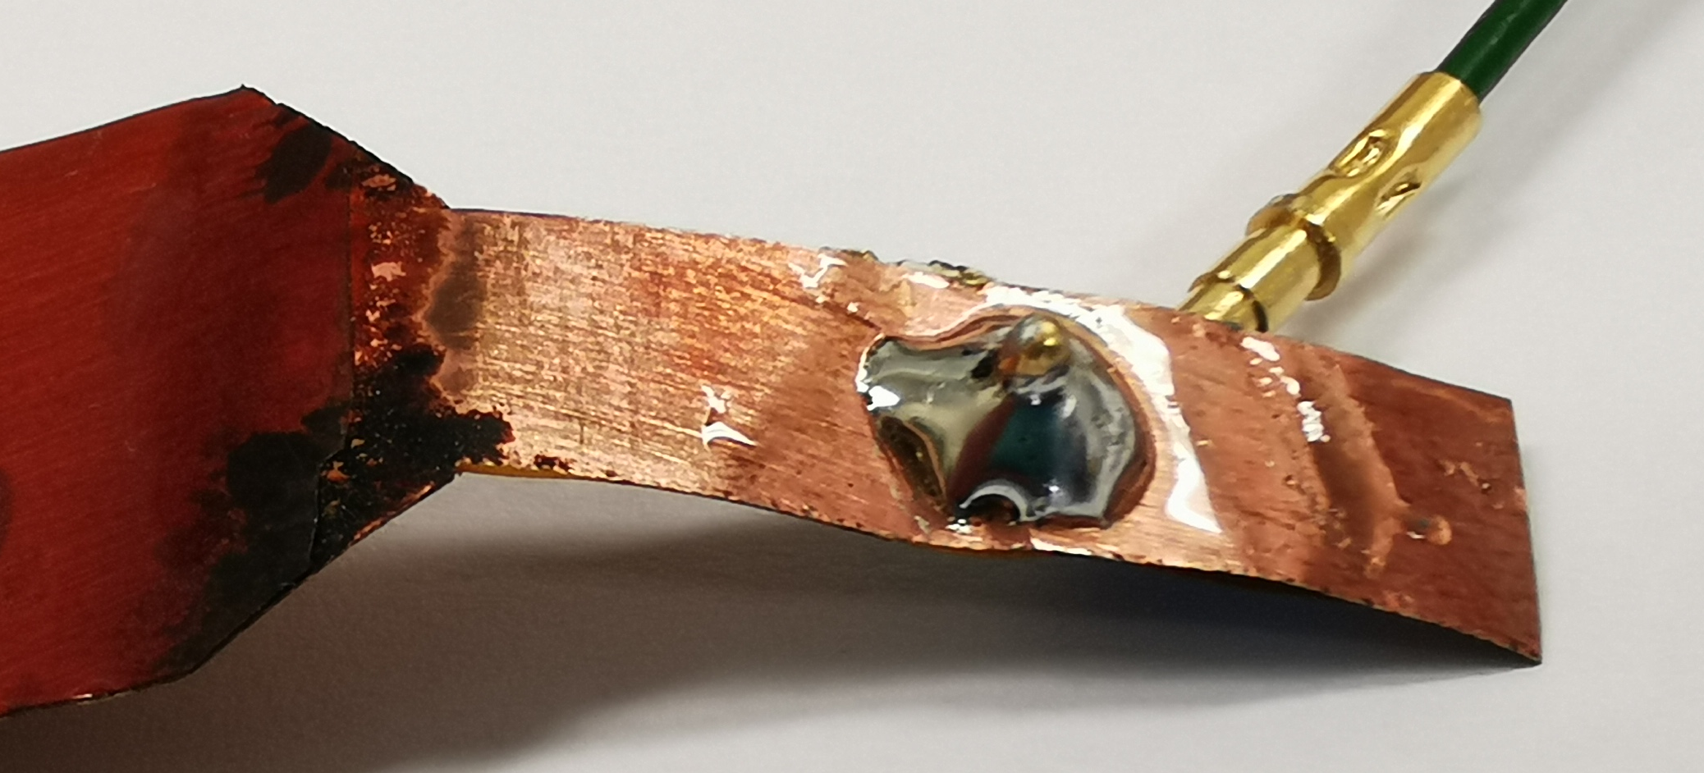
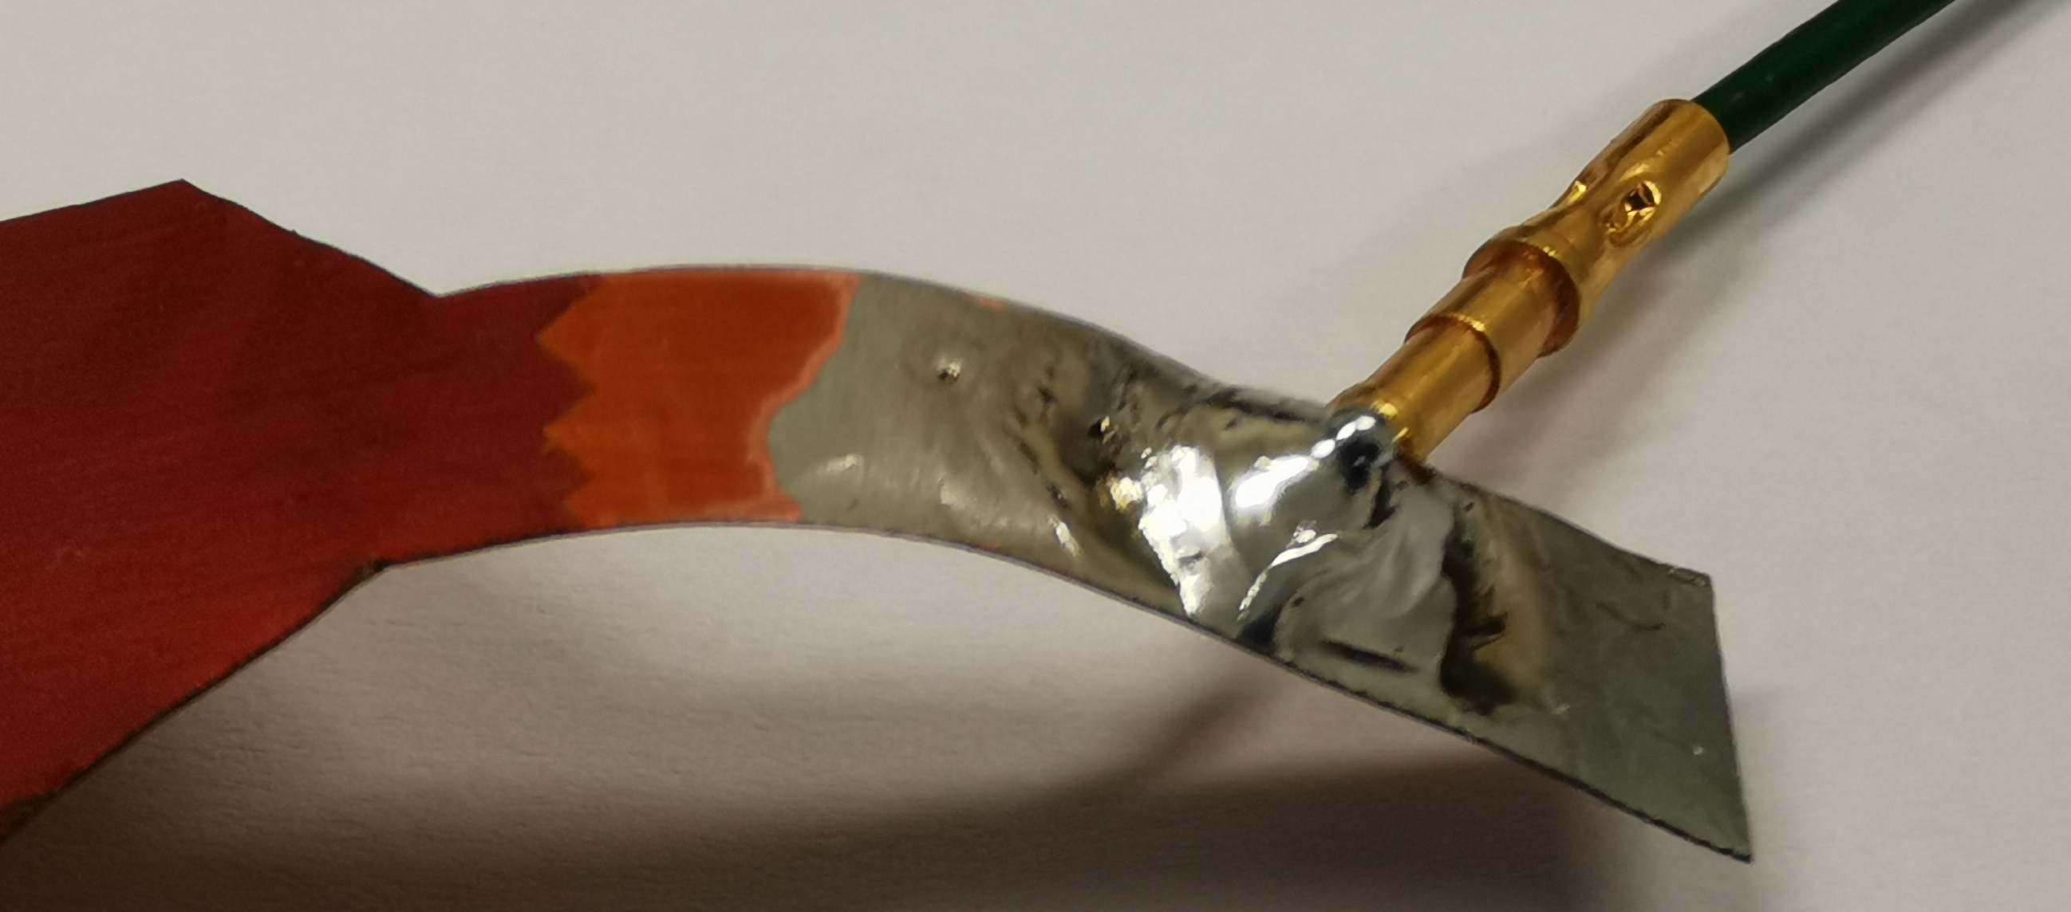
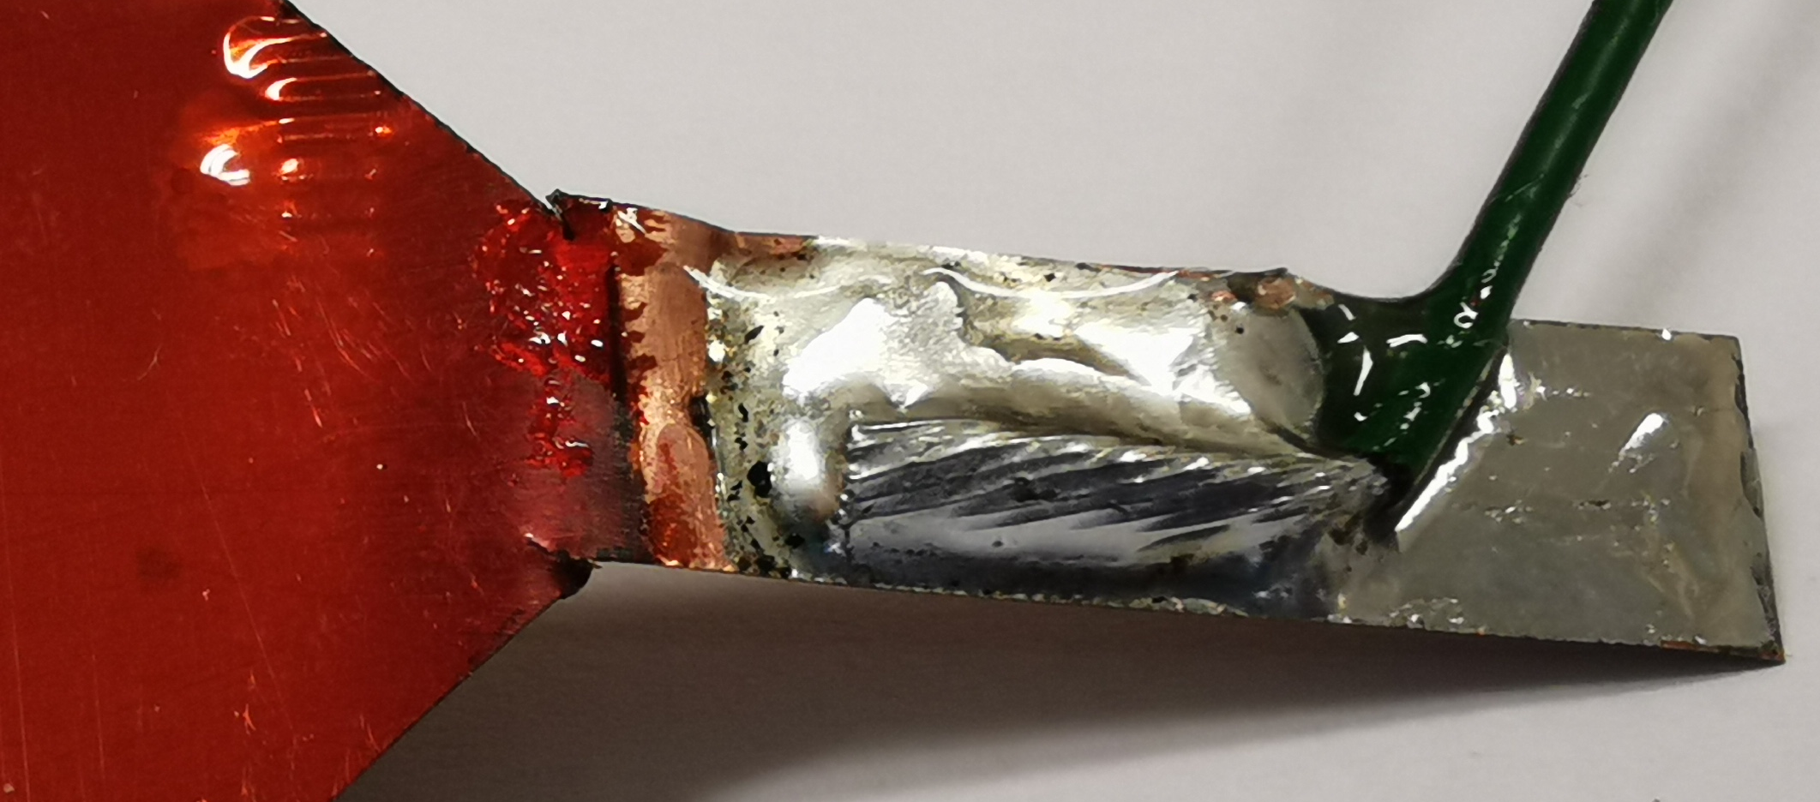
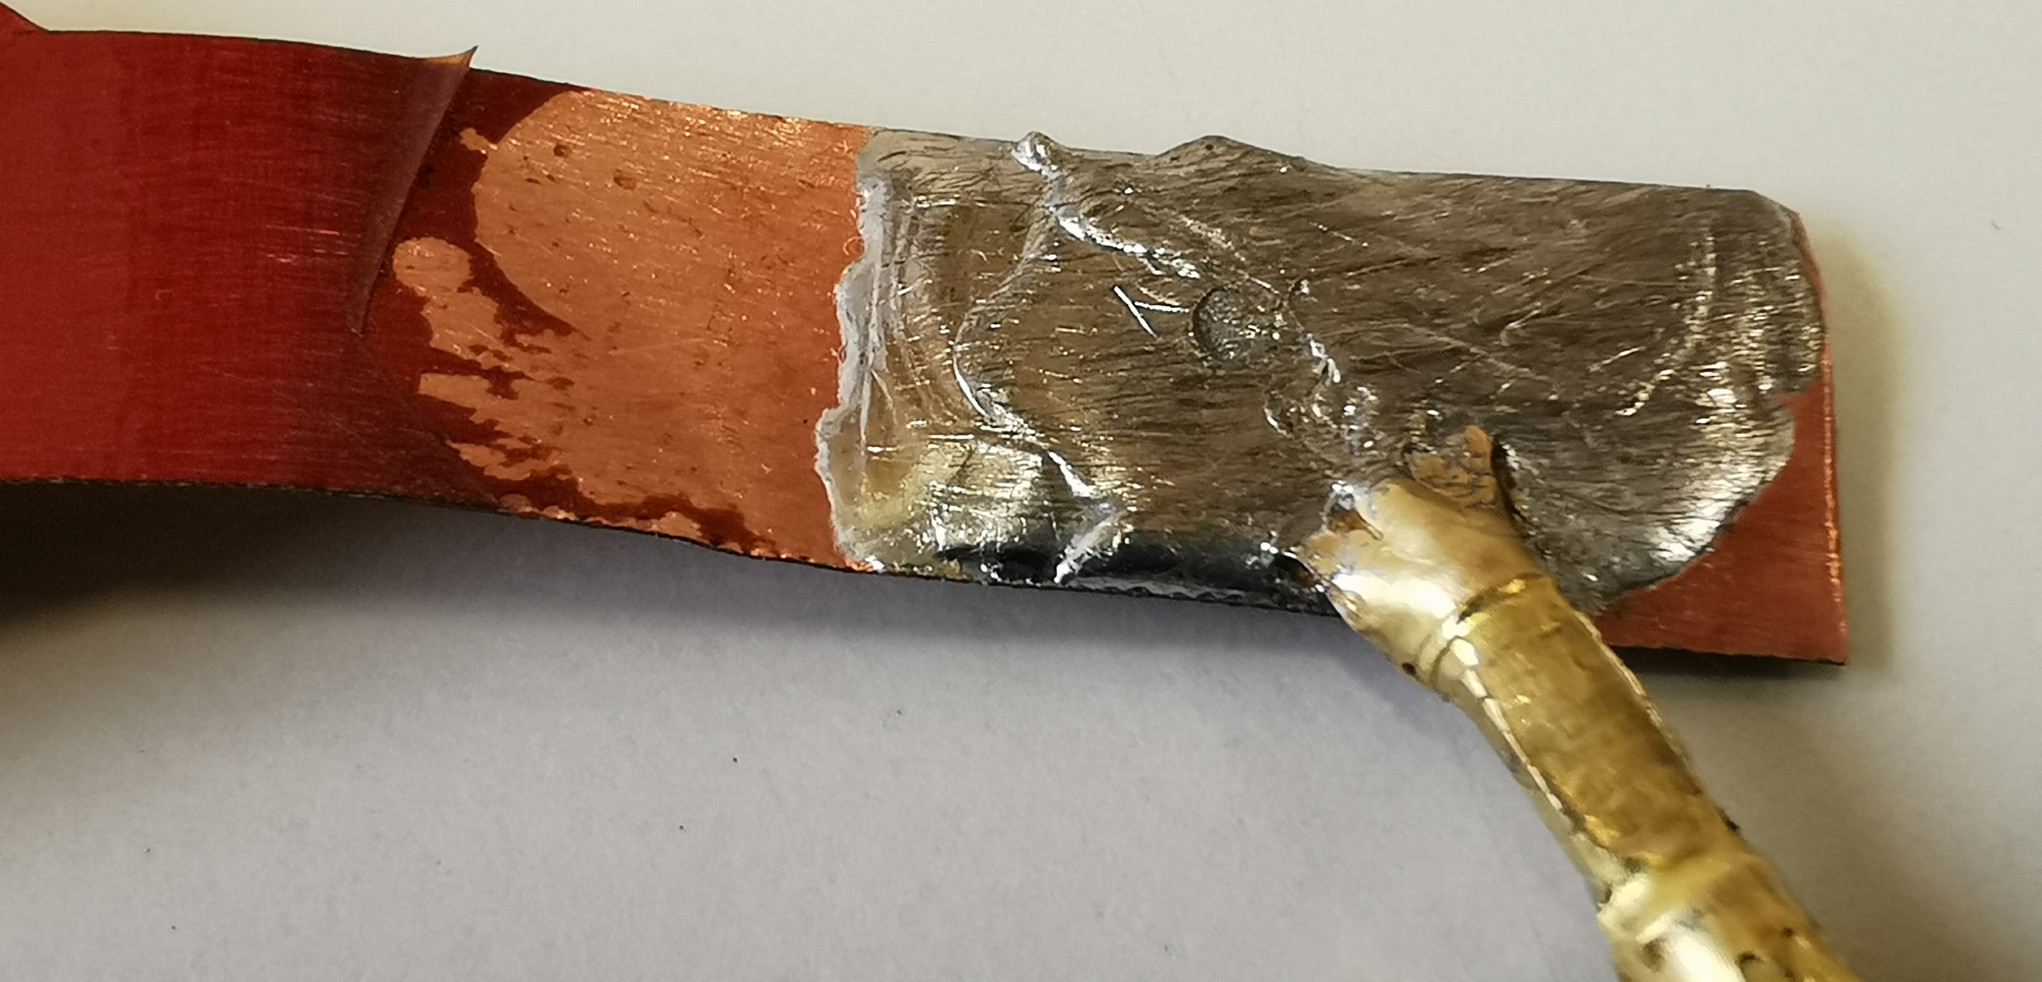
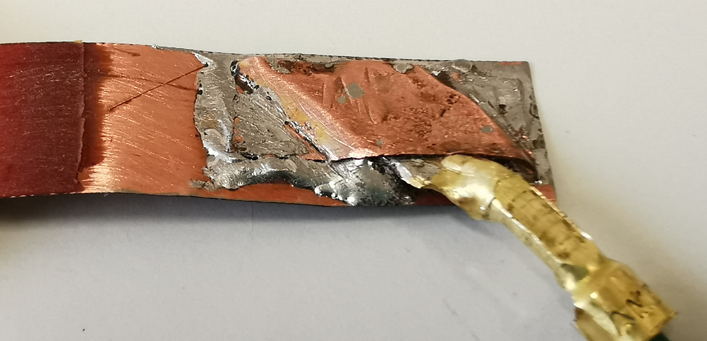
Jointing concepts and samples
Sample Reference | Jointing concept | Tinning | Cleaning | Pickling | By | Nb | Picture
1. ES-AE (S3, S4, and S5) | Pin connector | X | X | X | GE-S197/TE | 2 x 4
2. ES-SE | Pin connector |  | X | X | GE-S197/TE | 4
3. ENS-AE | Pin connector | X |  |  | GE-S197/TE | 1
4. ENS-AE-DP | Pin connector | X |  | X (partial) | GE-S197/TE | 3
5. ENS-SE | Pin connector |  |  |  | GE-S197/TE | 2
6. ENS-SE-DP | Pin connector |  |  | X (partial) | GE-S197/TE | 4
7. EGB-AE | Pin connector | X | X | X | GE-S197/GE | 3
8. EF-AE | No connector Wire on QH-trace | X | X | X | GE-S197/TE | 6
9. FCGB-SE | Flat connector |  | X | X | CERN | 4
10. FCGB-SE - Omega | Flat connector + Omega |  | X | X | CERN | 4
Total Nb of samples |  |  |  |  |  | 39

Slide 9
Outlook
Introduction
Motivation - Test plan
Jointing concepts – Inventory of samples
Preparation of the samples / procedures
Concluding remarks

Slide 10
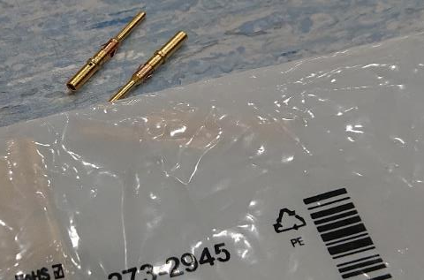
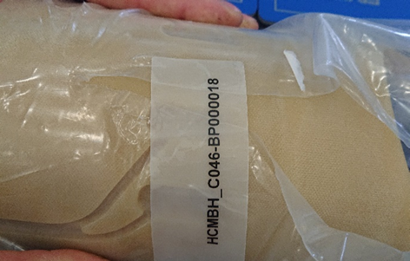
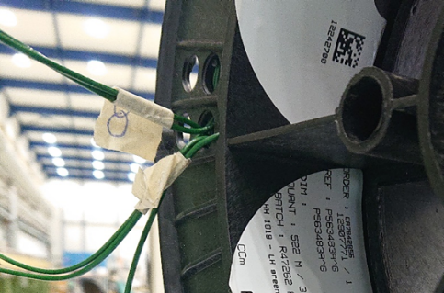
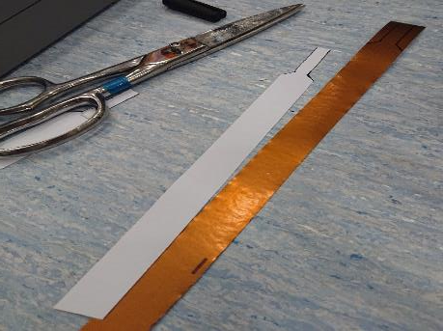
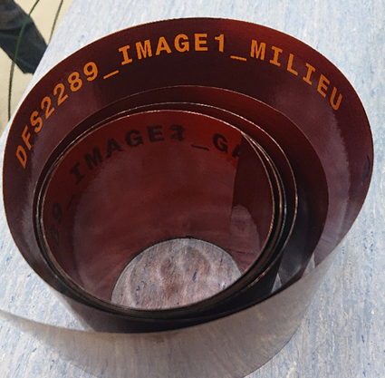
Material utilized to fabricate the samples
Saddle external layer HCMBH_C046-BP000018
Green cable
HH1819
Harting Connector
RM 16M23K
Remaining pieces of PCB after cuttings
Courtesy GE – M. Andreini et al.

Slide 11
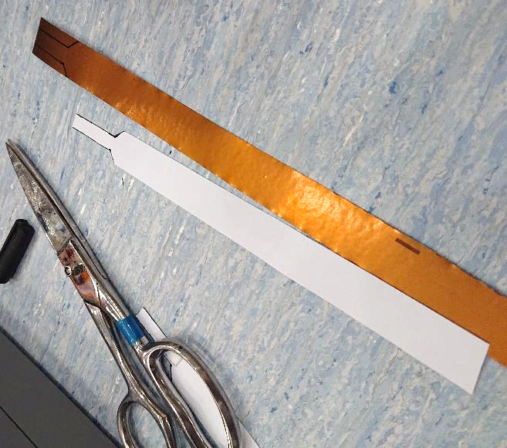
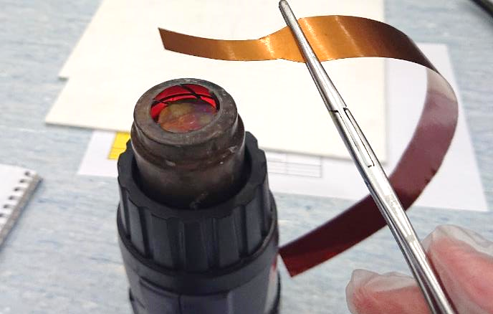
Preparation of samples, 1
A template (chablon) is used to draw the contour of the sample on the QH strip
The sample is cut from the QH strip with chisels
Courtesy GE – M. Andreini et al.
A heat gun (temperature set to 650°C) is utilized to strip off the trace in the soldering area
For this, the end of the sample is heated for 60 seconds at a distance of 50 mm

Slide 12
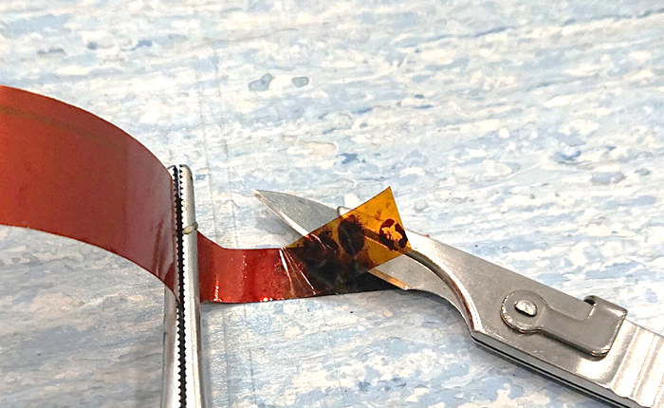
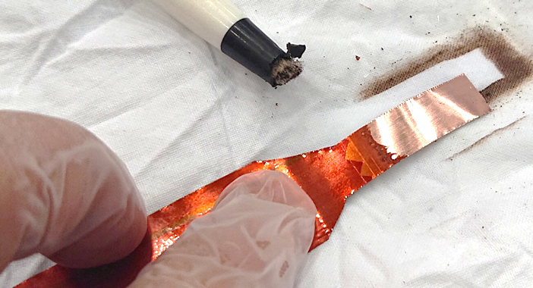
Preparation of samples, 2
When the end of the QH strip is hot enough, polyimide separates easily, a blade is inserted between the copper layer and polyimide film in order to peel it off
Courtesy GE – M. Andreini et al.
The excess of glue is then removed by means of a fiberglass pencil and fine sandpaper. Finally, alcohol is used to remove any residue

Slide 13
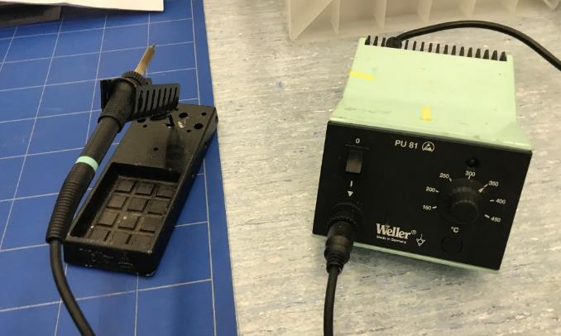
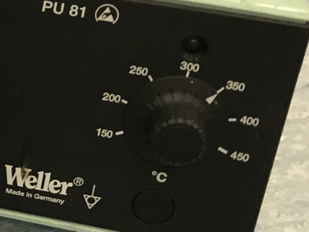
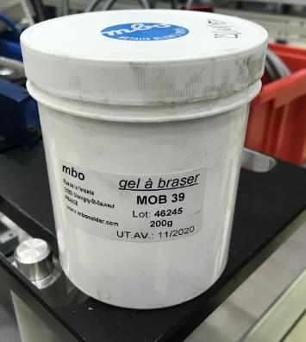
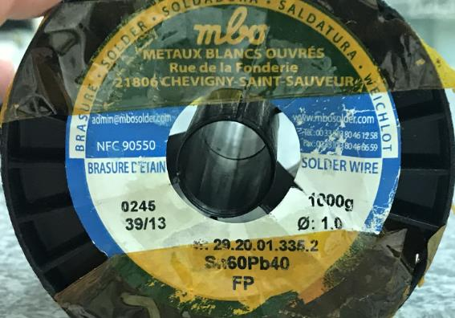
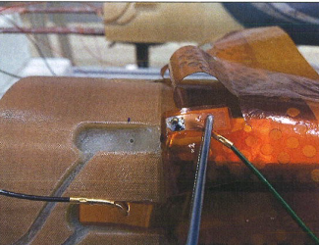
Soldering equipment, consumables, and parameters
Soldering with a Weller power unit 80 W, 230 V
The samples were tinned, and soldered, with the temperature potentiometer set to 350°C
Courtesy GE – M. Andreini et al.
Surgical clamp to hold the QH-trace and wire / connector
Flux MOB39
Solder Sn₆₀Pb₄₀

Slide 14
What’s been done till then
Magnets S3, S4, S5

Slide 15
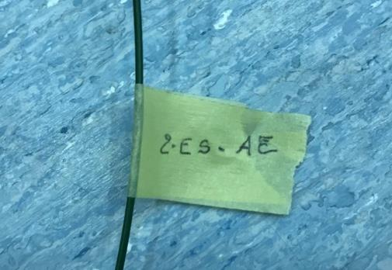
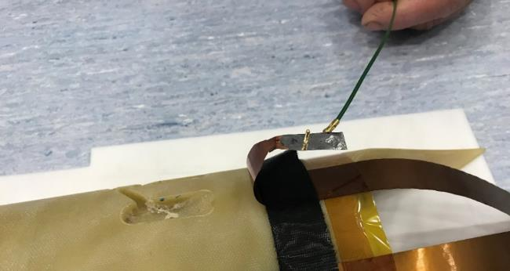
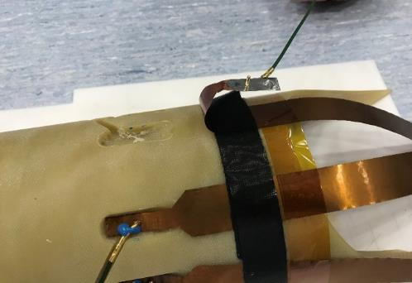
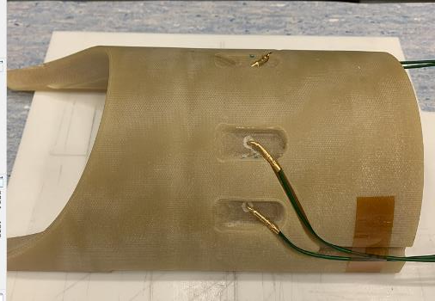
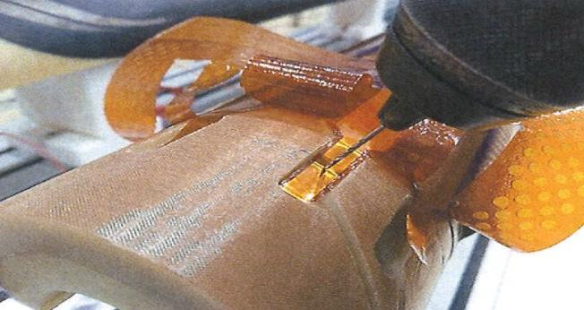
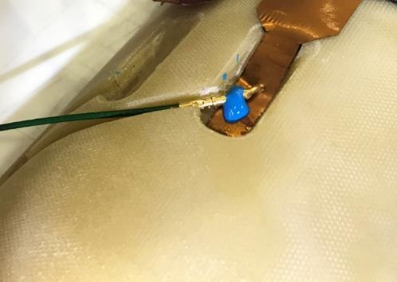
Identification of samples – soldering position
Courtesy GE – M. Andreini et al.
Each sample has a label with an ID that also indicates the position where the
sample was soldered on the saddle
The saddle has holes to house the tip of the pin connector
The sample is put in place and a hole of Ø 1.6 mm is drilled for the connector to pass through the sample, The connector is hold in position by a drop of Eccobond

Slide 16
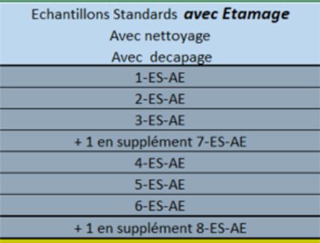
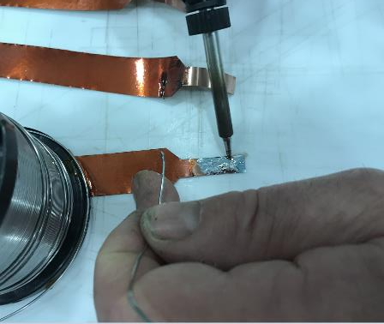

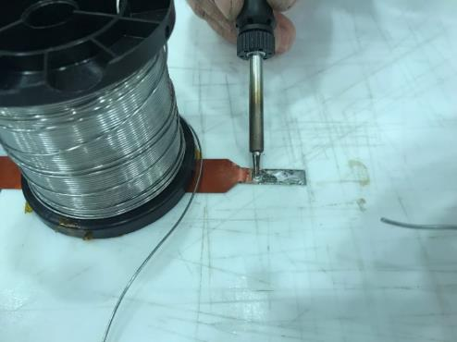
Preparation of samples with tinning of the QH-trace
Series AE
Courtesy GE – M. Andreini et al.
Prior to tinning, the samples are pickled with MOB39, and the Weller power potentiometer is set to 350°C
The tinning is carried out on the sample flat (not on the saddle)
At that stage, the QH-trace is not yet drilled for the positioning of the connector

Slide 17
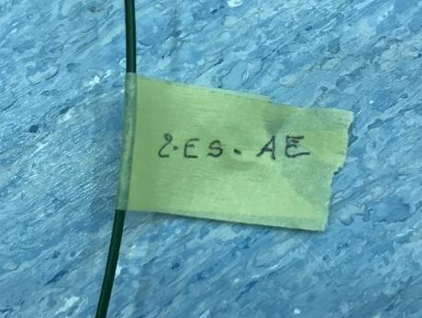
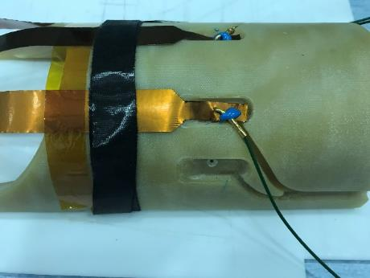
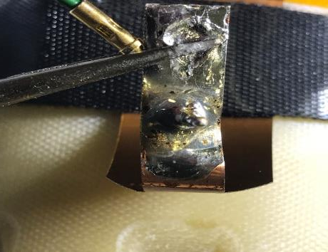
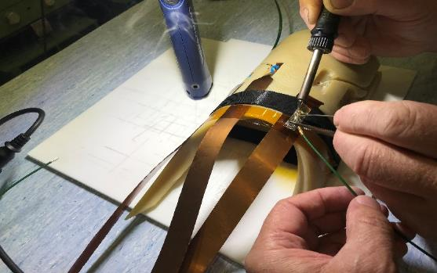
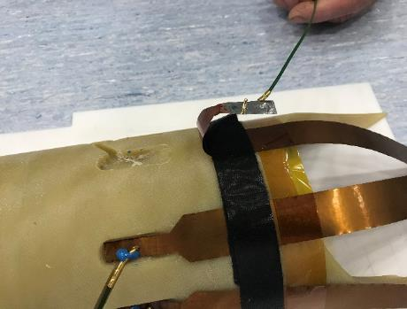
1. Samples with tinning, cleaning and pickling
Series ES-AE
Courtesy GE – M. Andreini et al.
List of samples
Identification
Position recording
Samples soldering

Slide 18
Degraded conditions
Defects created

Slide 19
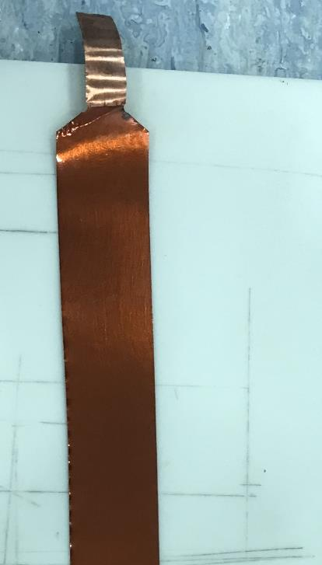
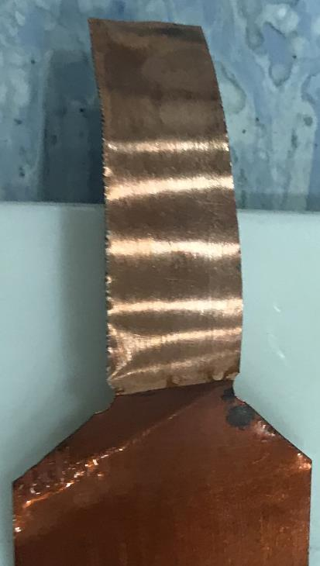
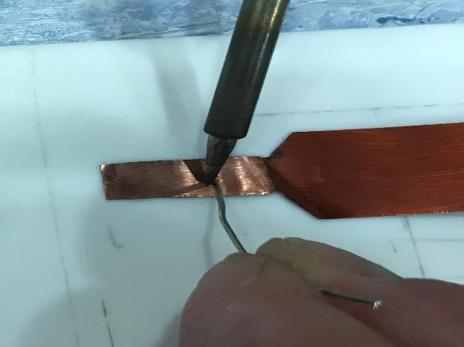
Samples w/o cleaning
Series ENS
Courtesy GE – M. Andreini et al.
The soldering area was touched with fingers, and stored in open air in order to trigger oxidation
The samples, oxidized, were then used without cleaning

Slide 20
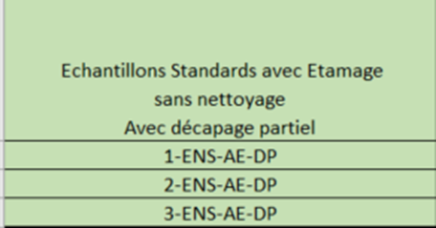
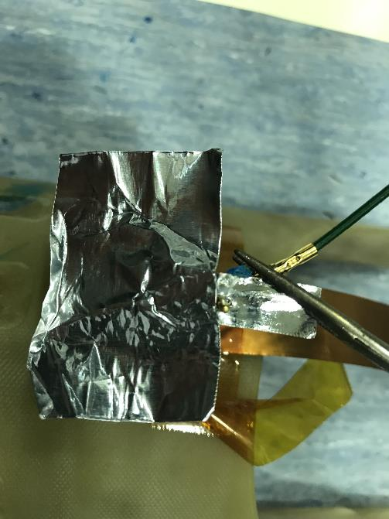
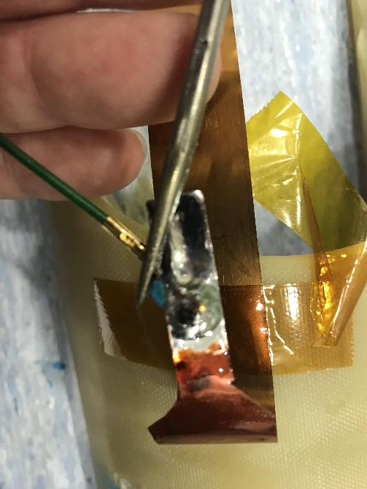
4. Samples with tinning and partial pickling, w/o cleaning
Series ENS-AE-DP
Courtesy GE – M. Andreini et al.
Partial pickling was done
Part of the soldering area was protected by means of adhesive tape in order to reduce the part of it fluxed with MOB39

Slide 21
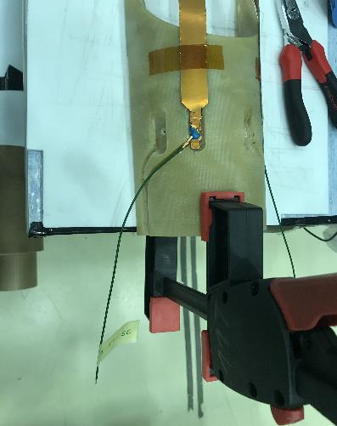
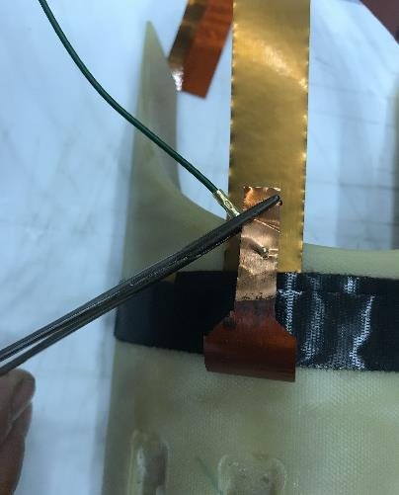
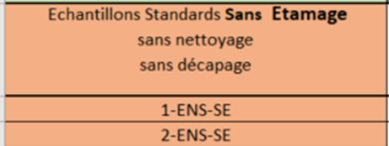
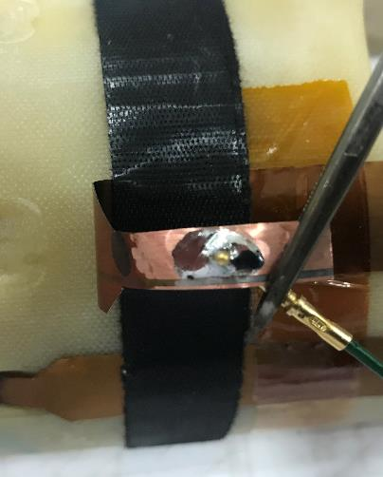
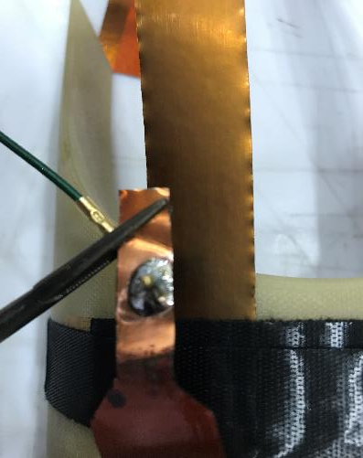
5. Samples w/o cleaning, w/o pickling and w/o tinning
Series ENS-SE
Courtesy GE – M. Andreini et al.
There were only two samples of this type because it was almost impossible to solder in these conditions, without cleaning, pickling, and tinning, despite all efforts put on trying, including playing with heating

Slide 22
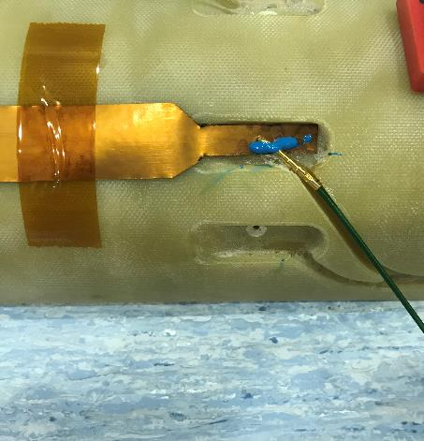





6. Samples w/o cleaning, partial pickling, and w/o tinning
Series ENS-SE-DP
Courtesy GE – M. Andreini et al.

Slide 24







7. Samples made with soldering jig (pin connector)
Series EGB-AE
Courtesy GE – M. Andreini et al.
The pin connectors are positioned in the jig, then the sample is put in place in the assembly
On the jig, the pin connector is soldered on a flat surface
This process facilitates a lot the soldering of the connector to the QH-trace

Slide 25





8. Samples wire soldered on QH-trace, with tinning
Series EF-AE
Courtesy GE – M. Andreini et al.
The samples were made with cleaning, pickling, and tinning

Slide 26


9. Sample with flat connector on soldering jig
Series FCGB-SE
Courtesy L. Favier – R. Principe
Functional requirements:
  Soldering in flat position
  Accurate positioning of the connector w.r.t. the QH-trace during soldering
Base plate for the positioning of the QH body
Slot for clearance of the cut part of the QH
Clamping to
attach the QH
Spring-loaded fingers to hold the connector in place
Slot for routing of the wires,
-55° and -45°
Soldering area

Slide 27






Four options were tried for the flat connector
Courtesy L. Favier – R. Principe
Option1
Connector used “as delivered” with wire crimped
Final version
Option 3, w/o pre-tinning Sn₆₀Pb₄₀ of the flat part
Option 3
Modified connector:
Removal of the side lugs
Pre-tinning Sn₆₀Pb₄₀ of the flat part
Manual adjustment of the crimping in order to fit better the soldering jig
Reinforcement of the crimped
part by soldering Sn₆₀Pb₄₀
Grinding off material excess
after crimping (for better fitting
@ assembly)
Option 2
Connector used “as delivered” with pre-tinning Sn₆₀Pb₄₀ of the flat part

Slide 28




Soldering trials on QH samples
Option1:
Pickling MOB39
Solder Sn₆₀Pb₄₀
Solder wire Ø 1mm
Option2:
Pickling MOB39
Flat part tinned with Sn₆₀Pb₄₀
Solder Sn₆₀Pb₄₀
Solder wire Ø 1mm

Slide 29

Soldering trials on QH samples
Utilization of MOB39 is difficult on the QH-traces because:
  Cleaning with Scotch-Brite is not convenient because of the small size of the
  QH-trace, the production of dust, and debris
  It implies careful cleaning with ethanol, as there is dust and debris everywhere
  It is difficult to apply a uniform layer of MOB39 only on the soldering area
  MOB39, when liquid, is spreading around, and this is hardly kept under control, implying a difficult execution of the work
  The final cleaning, including of the tooling, is long and tedious
Thus the idea of using a solder wire, which contains the pickling agent, with the following advantages
  Faster, and cleaner execution of the work
  Final cleaning easier, and less risky for the QH
  Better visibility of the interface between QH-trace and connector
  Better look and quality of the soldered joint

Slide 30



Final soldering conditions, on a soldering jig
Cleaning with ethanol of the flat connectors, and QH-traces (soldering area)
Soldering with wire Sn₆₀Pb₄₀, Ø 1mm
As to the contact conditions between the QH-trace and the connector, in addition to the action by the spring-loaded finger, the welder applies pressure on the connector with a stainless steel rod (this gives better results)
As a quality check, the welder verifies the presence and geometry of the fillets around the connector, and the good coverage of the flat part of the connector

Slide 31
10. Sample with flat connector and Omega
FCGB-SE

Slide 32
Outlook
Introduction
Motivation - Test plan
Jointing concepts – Inventory of samples
Preparation of the samples / procedures
Concluding remarks

Slide 33
Conclusions
The test plan to characterize the jointing concept used in the magnets S3 to S5, and the new concepts under consideration, was described
A list of the different samples was presented
Four alternative concepts/procedures have been tried (characterization in the next two talks)
The soldering procedures were described for the different concepts
Two soldering jigs were designed and fabricated in order to improve and facilitate the execution of the work, and to maximize the probability of success (quality-wise), thus increasing the robustness of the process
  One for pin connectors
  One for flat connectors / wire direct on QH-trace

Slide 34
Thank you for your attention!
Questions?

Slide 35




