Slide 1

11T QH connection Endurance, discharge, destructive On several types of connection
Ludovic Grand-Clément
F. Evrard, L. Favier, General Electric, J. Péchiney, F. Savary
TE/LMF/EE 09/10/2020

Slide 2
Summary
Test protocoles
Sample label: E(N)(S or GB)-(A or S)E-(DP)
E: Echantillon, N: Neither cleaning nor pickling , S: pin connector, GB: Assembly jig so flat connector, A: pre-tinning, S: No pre-tinning, DP partial pickling
Polyimide on both sides
Endurance test – Discharge test
Connection with pin connector
Cleaning, pickling, pre-tinning (ES-AE)
Connection with flat connector
No Cleaning, No pickling, pre-tinning only the connector,
Samples done with assembly jig (ENGB-AE)
Samples done with upgraded assembly jig (ENGB2-AE) – Connector pressed on trace during soldering.
Direct wire connected to trace
Cleaning, pickling, pre-tinning (EF-AE)
Connection on end spacer
Pin connector, Cleaning, pickling, pre-tinning (ES-AE)
Direct Wire, Cleaning, pickling, pre-tinning (EF-AE)
Destructive test
High current : Pin connector, Cleaning, pickling, pre-tinning (ES-AE)
Pull test: Connection on end spacer, filled by Eccobond
Pin connector, Cleaning, pickling, pre-tinning (ES-AE)
Direct Wire, Cleaning, pickling, pre-tinning (EF-AE)

Slide 3

Endurance test – Discharge test
Discharge like during 11T assembly
At warm
Endurance test: 15 discharges (50 for (1&2) -ES-AE)
4 in 180 during assembly per quench heater
80 A (150 at cold)
Discharge tester EFFACEC EP000183
Power resistor of 5 ohms in order to simulate the QH resistance
τ = 40 ms
Thermic picture to analyse weak point

Slide 4
Endurance test (ES-AE) Pin connector
Trace is cleaned, pickled and pre-tinned
Bent pin connector crimped on the wire
50 cm long wire
Pin connector soldered on 30 cm of trace
4 samples set up by General Electric
1-ES-AE
2-ES-AE
3-ES-AE
7-ES-AE

Slide 5
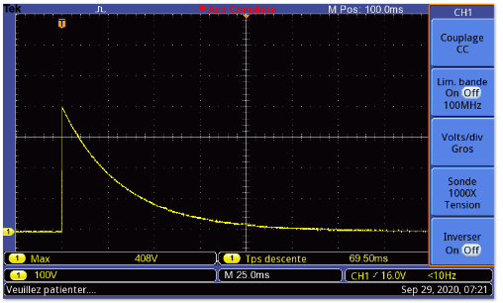
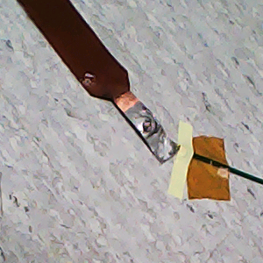
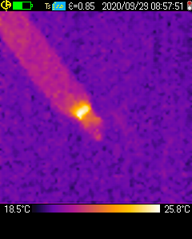
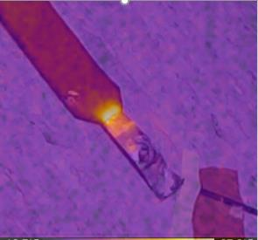
1-ES-AE / 15th discharge
No degradation
Warm spot in the insulated area
T < 27 °C

Slide 6
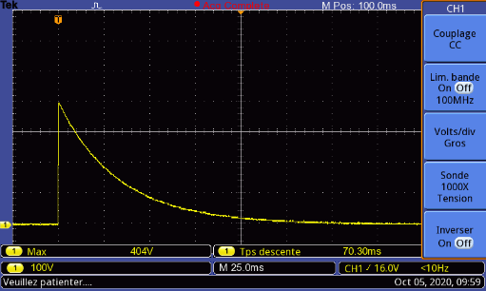
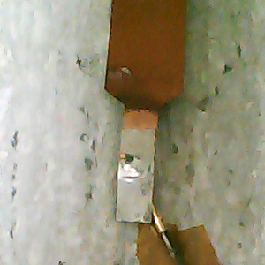
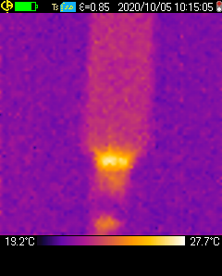

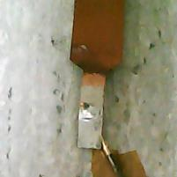
1-ES-AE / 50th discharge
No degradation
Warm spot in the insulated area
T < 29 °C

Slide 7

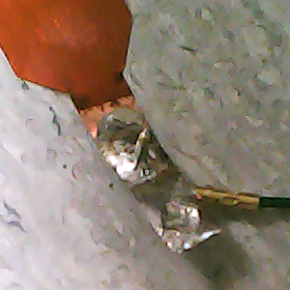
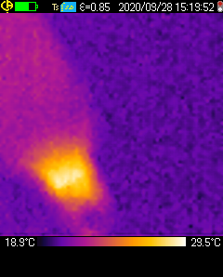

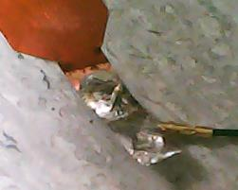
2-ES-AE / 15th discharge
No degradation
Warm spot in the insulated area
T < 31 °C

Slide 8
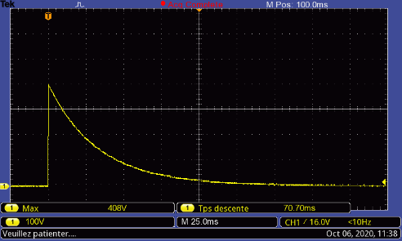
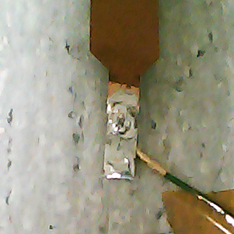
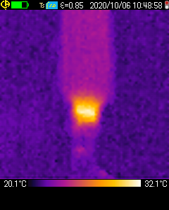


2-ES-AE / 50th discharge
No degradation
Warm spot in the insulated area
T < 33 °C

Slide 9
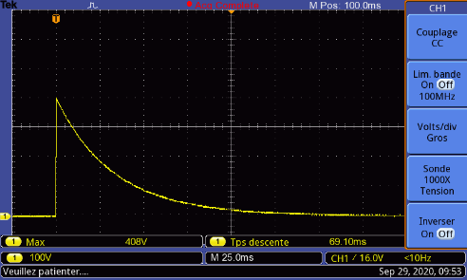
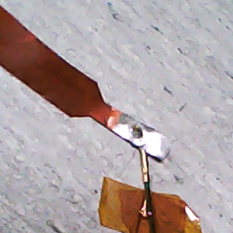
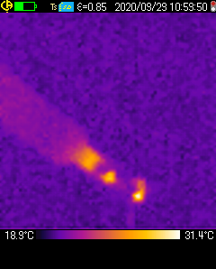
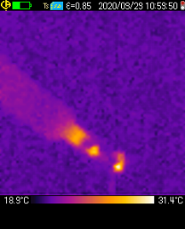

3-ES-AE / 15th Discharge
No degradation
Warm spot in the insulated area
Light effect in tin area
T < 33 °C

Slide 10

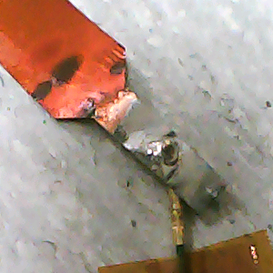
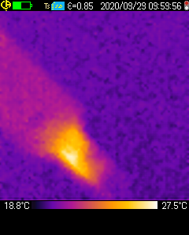
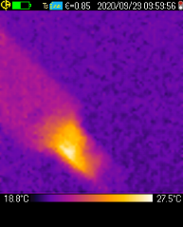

7-ES-AE / 15th Discharge
No degradation
Warm spot in the narrow area
T < 28 °C

Slide 11
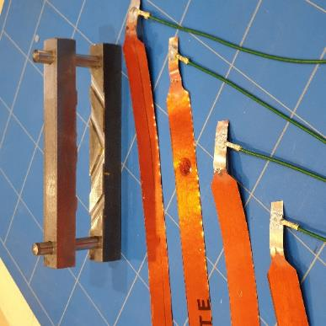
Endurance test (ENGB-AE) Flat Connector
Trace is neither cleaned, nor pickled
Only the flat connector is pre-tinned, not the trace
Flat connector crimped
50 cm long wire
Flat connector soldered on 30 cm of trace
4 samples set up by Ludovic Favier with assembly jig
1-ENGB-AE
2-ENGB-AE
3-ENGB-AE
7-ENGB-AE
By courtesy of Ludovic Favier

Slide 12

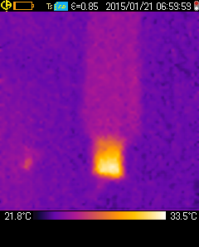
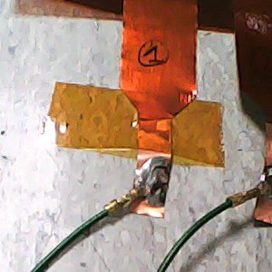

1-ENGB-AE / 15th Discharge
No degradation
Warm spot in the narrow area; Under the polyimide tape
T < 34 °C

Slide 13

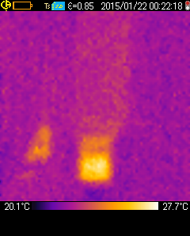
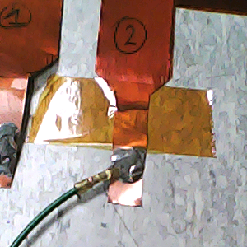


2-ENGB-AE / 15th Discharge
No degradation
Warm spot in the narrow area; Under the polyimide tape
T < 28 °C

Slide 14

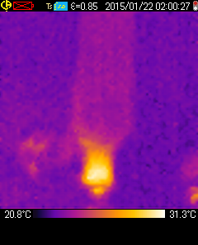
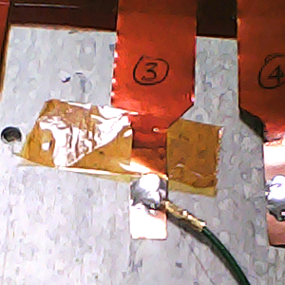

3-ENGB-AE / 15th Discharge
No degradation
Warm spot in the narrow area; Under the polyimide tape
T < 32 °C

Slide 15

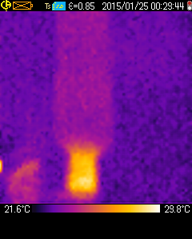
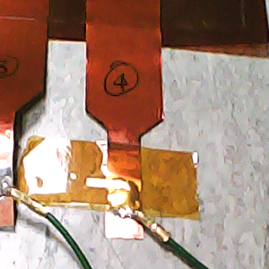

4-ENGB-AE / 15th Discharge
No degradation
Warm spot in the narrow area; Under the polyimide tape
T < 30 °C

Slide 16
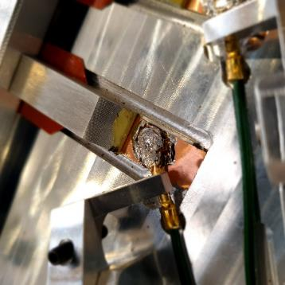
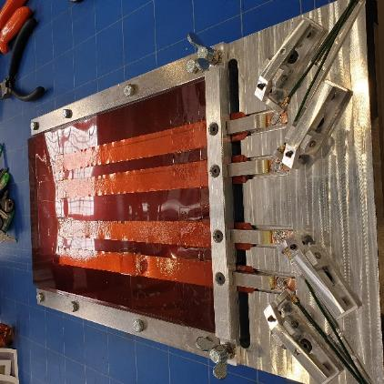
Endurance test (ENGB2-AE) Flat Connector – upgraded assembly jig
Trace is neither cleaned, nor pickled
Only the flat connector is pre-tinned, not the trace
Flat connector crimped and pressed on trace during soldering
50 cm long wire
Flat connector soldered on 30 cm of trace
4 samples set up by Ludovic Favier with assembly jig, only one for endurance test
1-ENGB2-AE
By courtesy of Ludovic Favier
Upgraded version

Slide 17

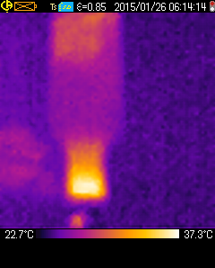
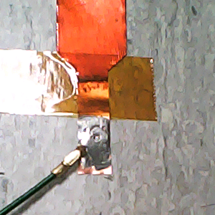


1-ENGB2-AE / 15th Discharge
No degradation
Warm spot in the narrow area; Under the polyimide tape
T < 38 °C

Slide 18
Endurance test (EF-AE) Wire soldered on trace
Trace is cleaned, pickled and pre-tinned
Wire directly soldered on the trace
50 cm long wire
3 samples set up by General Electric
1-EF-AE
2-EF-AE
3-EF-AE

Slide 19

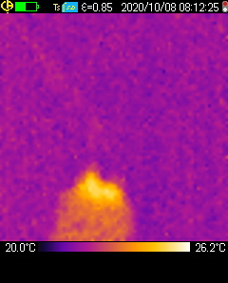
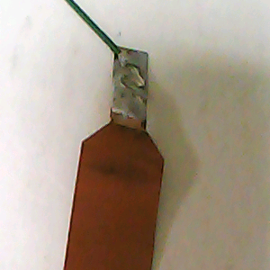
1-EF-AE / 15th Discharge
No degradation
Warm spot in the narrow area
T < 27 °C

Slide 20
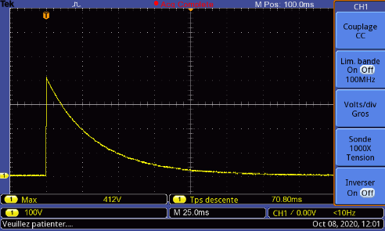
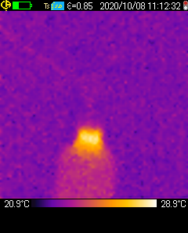
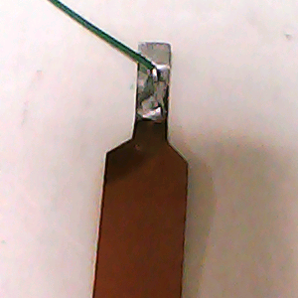

2-EF-AE / 15th Discharge
No degradation
Warm spot in the narrow area
T < 30 °C

Slide 21

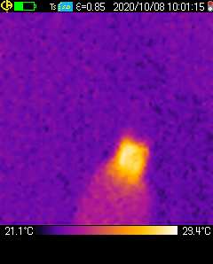
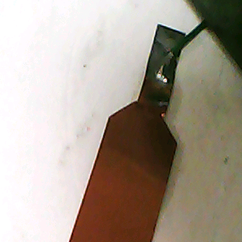
3-EF-AE / 15th Discharge
No degradation
Warm spot in the narrow area
T < 31 °C

Slide 22
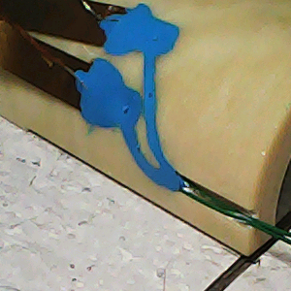
Endurance test (ES-AE) & (EF-AE) Connection on end spacer
Trace is cleaned, pickled and pre-tinned
50 cm long wire
Soldered on 30 cm of trace
The 2 samples had been used for endurance test; Set up by General Electric
Wire directly soldered on the trace
2-EF-AE – 15 discharges
Pin connector
2-ES-AE – 50 discharges
Trace set on end spacer
Thermocouple near the connection
Filled with Eccobond by GE

Slide 23

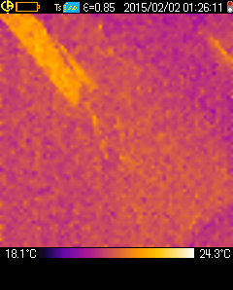
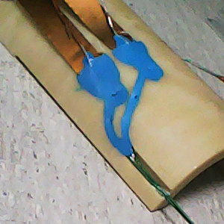
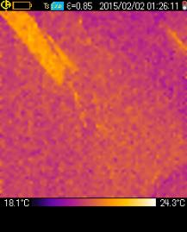

2-EF-AE / 15th Discharge (Total 30)
No degradation
Warm spot in the straight area
T < 25 °C by camera – Connection hided by Eccobond
No T°C rise saw by thermocouple (latency)

Slide 24
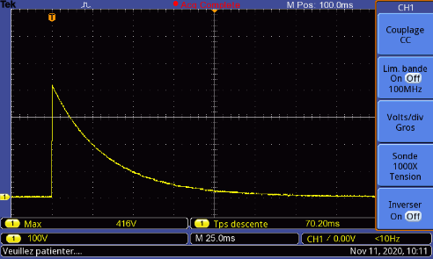
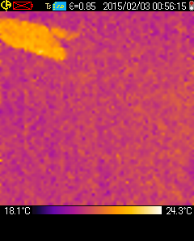
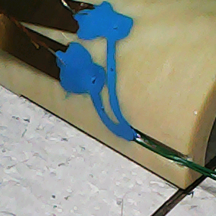
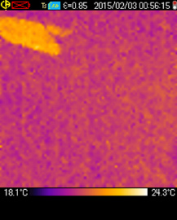

2-ES-AE / 15th Discharge (Total 65)
No degradation
Warm spot in the straight area
T < 25 °C by camera – Connection hided by Eccobond
No T°C rise saw by thermocouple (latency)

Slide 25
Destructive test (ES-AE)
DC current
Start at «low» energy as close as discharge test
At warm
Micro-ohm meter Megger DLR0-600
Per calculation 5 A, but equipment starts at 10 A
The impact of the length time is not taken in account, only the quantity of energy.
10 A (2.5 s ramp up, 2 s plateau, 2.5 s ramp down)
Increasing by 5 A up to breakage
Thermic picture to analyse weak point
Camera to record the breakage
The 2 samples had been used for endurance test 15; Set up by General Electric
3-ES-AE
7-ES-AE

Slide 26
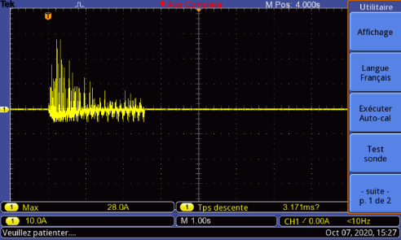




3-ES-AE
Breakage in the narrow part
50 A -> 56 250 J
Current curve not usable
280°C max temperature (camera limit)

Slide 27






7-ES-AE
Breakage in the narrow part
40 A -> 36 000 J
Current curve not usable
280°C max temperature (camera limit)

Slide 28
MIITs
Discharge test
Destructive test
0.00038
0.0091
0.0058
0.0001
0.00037

Slide 29
MIITs discharge and destructive test
Destructive test at 10 A is at the same level of MIITs than discharge test at cold
Destructive test at 40 & 50 A are more than 10 times higher than cold test

Slide 30
Temperature reached by calculation
Temperature dispersion not taken in account (Either to stainless Steel nor to He)
Copper thickness = 15 µm
Temperature dispersion not taken in account (Either to stainless Steel nor to He)
Copper thickness = 5 µm
1046
454
336
270
15

Slide 31

Destructive test (ES-AE & EF-AE)
Pull test
Connection on end spacer
Set up by General Electric
Wire directly soldered on the trace
2-EF-AE, 30 discharges so far
Test 1: Wire pulled
Test 2: Trace pulled
Pin connector
2-ES-AE, 65 discharges so far
Test 1: Wire pulled
Test 2: Trace pulled

Slide 32


2-EF-AE / Pull test
Connection on trace still intact
Wire cut at the plier level, 290.3 Nm
Trace cut at the Eccobond level, 215.8 Nm

Slide 33




2-ES-AE / Pull test
Connection on trace still intact
Wire cut at the plier level, 364.8 Nm
Trace cut at the Eccobond level, 333Nm

Slide 34
Conclusion
Endurance test 15 or 50 didn’t show degradation of the connection (soldering-crimped connector-wire), but a warm spot in the narrow part of the trace. The hot point is around 30 °C. That location strongly depends of the presence of insulation materiel on the trace. No significative difference between connection (pin & flat connector, direct wire).
Endurance test on end spacer, the Eccobond hides the temperature in the narrow part, and the thermocouple time response is too slow. Nevertheless no degradation has been seen.
Destructive test are in the same way, no degradation of the connection. The narrow part burnt at 40 and 50 A, 7 s test. Reported to 40 ms: Meaning 8 or 10 times more current than in cold condition during a quench, obviously the length time is not taken in account (fuse effect).
With MIITs calculation, the result is in the same order. To add, MIITs result of destructive test at 10 A is like discharge test at cold at 150 A.
Calculation of temperature reached in the narrow copper part shows the high impact of the copper coating thickness. With severe condition, no temperature dispersion, no stainless-steel layer, minimal thickness of 5 µm, the reached temperature (calculated) during a quench is less than 300 K; That is very conservative.
Pull test showed that the Eccobond adds more strength to the assembly,
To conclude:
In normal condition, the weak point is not the solder between connector and trace
The soldering has to be extremely bad to be burnt during a discharge
We can be confident against the narrow trace and the soldering

Slide 35
Result summary
Sample | Endurance test 15 Discharges | Endurance test 50 Discharges | Endurance test 15 Discharges End spacer | Pull test | Breakage current | Energy (breakage) | Matching Discharge Current (R = 5 Ω)
1-ES-AE | Ok | Ok | - |  | - | - | -
2-ES-AE | Ok | Ok | Ok | Wire 364.8 Nm Trace 333 Nm | - | - | -
3-ES-AE | Ok | - | - |  | 50 A | 56 250 J | 800 A
7-ES-AE | Ok | - | - |  | 40 A | 36 000 J | 640 A
1-ENGB-AE | Ok | - | - |  | - | - | -
2-ENGB-AE | Ok | - | - |  | - | - | -
3-ENGB-AE | Ok | - | - |  | - | - | -
4-ENGB-AE | Ok | - | - |  | - | - | -
1-ENGB2-AE | Ok
1-EF-AE | Ok | - | - |  | - | - | -
2-EF-AE | Ok | - | Ok | Wire 290.3 Nm Trace 215.8 Nm | - | - | -
3-EF-AE | Ok | - | - |  | - | - | -

Slide 36
Thanks for your attention

Slide 37
Annexe

Slide 38


Energy
Discharge test at warm
DLRO600
U = 400 V
C = 7.05 mH
$E= \frac{1}{2}×C×U^{2}$
E = 564 J
Ramp up: 2.5 s
Plateau: 2 s
Ramp down: 2.5 s
I = 10 A
R = 5 Ω
E = R.I^2.dt
$E=R×I^{2}×∆t$
E = 2250 J

