Slide 1
Bi-Weekly Update on Linac4 Availability
25 November 2020
A. Apollonio
AFT: Why was it invented?
Notes:
1

Slide 2
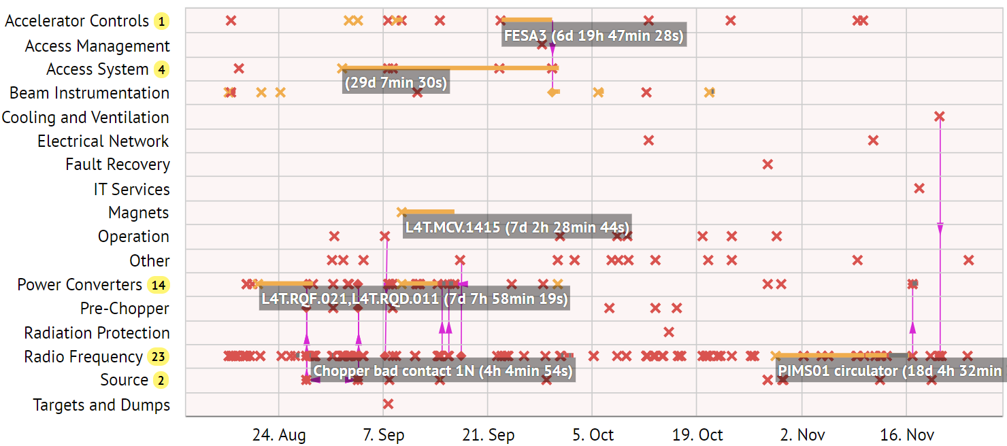
Linac4 Cardiogram (from restart)
Notes:
2

Slide 3
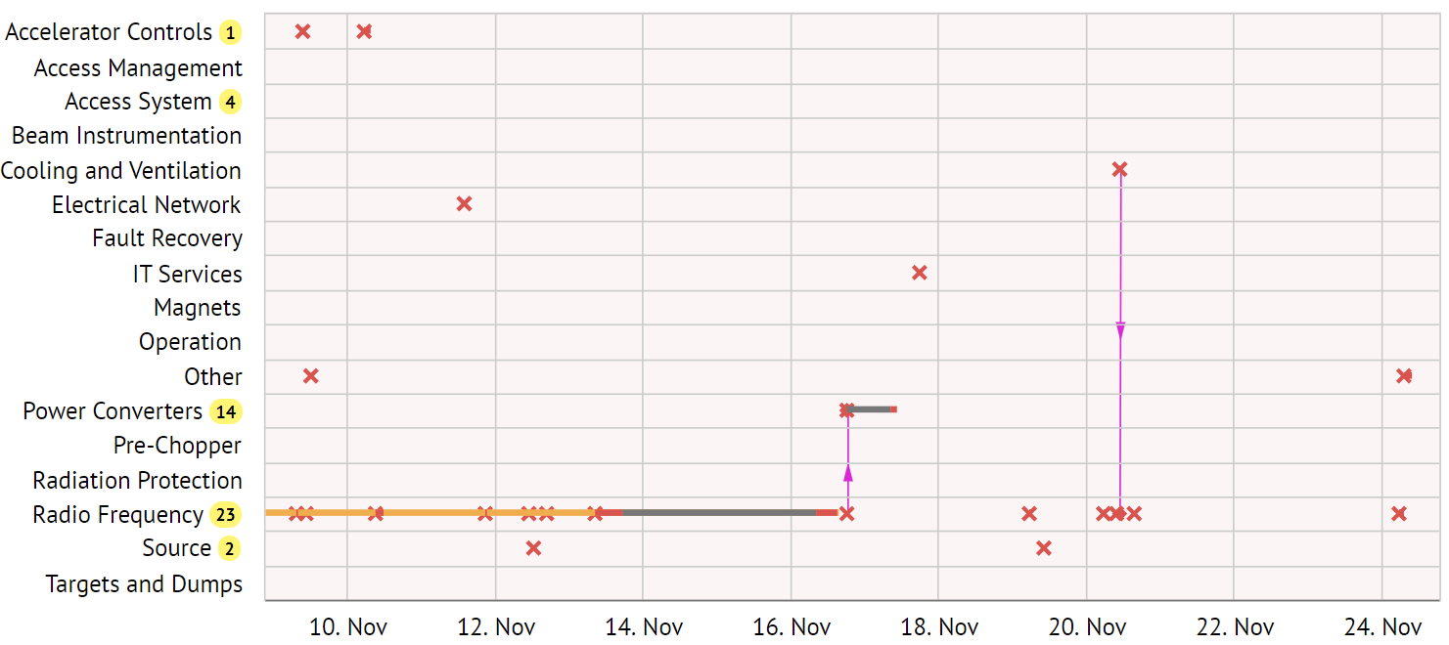
Linac4 Cardiogram (last 2 weeks)
Klystron oscillation, broken modulator mod-anode divider, suspended over night, ~2h blocking duration (link), recurring failure mode
Dedicated fault search with labels created (link)
DTL3 wrong phase, cause under investigation
PIMS01 circulator intervention,
suspended over the weekend,
~16h blocking duration (link)
Followed-up on comments from previous week, removed RF faults during phasing and RF MDs.
Few more comments to be looked at
Notes:
3

Slide 4
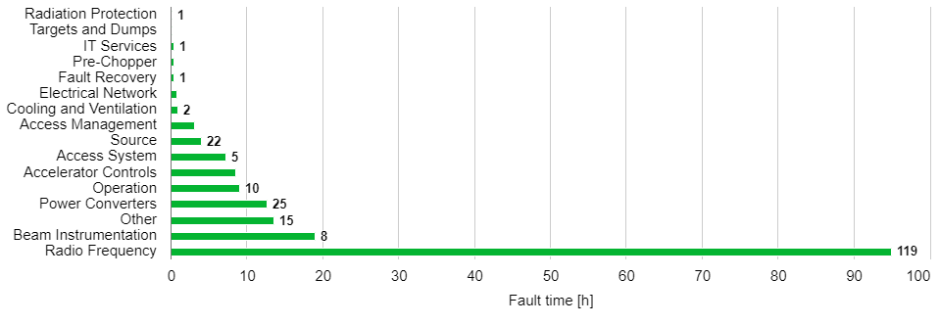
Downtime Statistics (full period)
Filter out non-blocking faults and suspended faults (link)
Note that some interventions (e.g. for RF) were potentially slower than during nominal operation for the beam commissioning period
Availability statistics in AFT are NOT correct for this period, unless manual corrections are done to account for suspensions over nights and weekends
Notes:
4

Slide 5
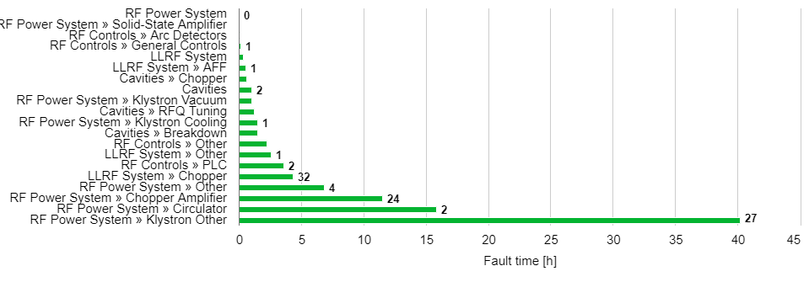
RF Downtime Statistics (full period)
Filter out non-blocking faults and suspended faults (link)
Note that some interventions (e.g. for RF) were potentially slower than during nominal operation for the beam commissioning period
Availability statistics in AFT are NOT correct for this period, unless manual corrections are done to account for suspensions over nights and weekends
Notes:
5

Slide 6
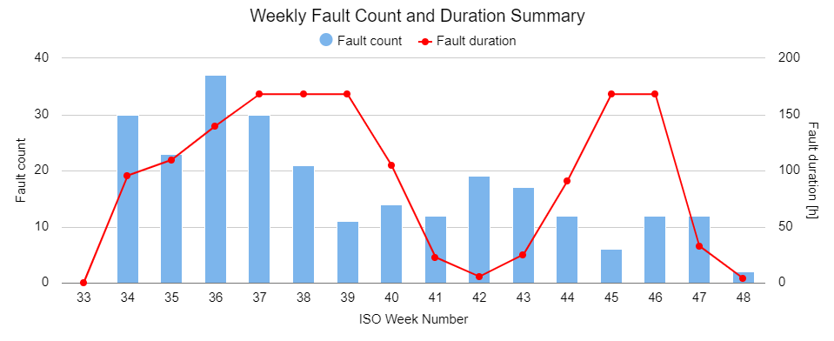
Fault Count and Downtime Statistics (full period)
Filter out non-blocking faults and suspended faults (link)
Note that some interventions (e.g. for RF) were potentially slower than during nominal operation for the beam commissioning period
Availability statistics in AFT are NOT correct for this period, unless manual corrections are done to account for suspensions over nights and weekends
Notes:
6

Slide 7
Fault Tracking in the Coming Months
Quick feedback on new logbook (after few hours of use, could be wrong):
  pop-ups in the logbook don't show the fault start and end times
  no timeline in the logbook, impossible to know if the machine is running or not at a quick glance
  no link in AFT to new logbook
Fault tracking options for Linac4 and PSB (to be discussed):
  Linac4: from next week on find a slot every Monday to discuss open points with the Linac4 coordinator of the previous week. This will be very useful to show an up-to-date AFT plot at the FOM on Tuesdays.
  PSB, two options:
    No AFT during the first phase of beam commissioning. Start AFT follow-up from 1st of March 2021 (first injection into the PS).
    Otherwise same proposal as for Linac4 (slot on Monday to discuss with the PSB coordinator of the previous week).
Notes:
7

Slide 8
Thanks for your attention!
Notes:
8

