Slide 2


CERN Pension Fund
Emilie Clerc

Slide 3
Content
The Fund
  Introduction
  Who for? / What for?
  Resources
2) Benefits
  Retirement
  Disability
  Surviving Spouse
  Orphans
  Transfer value

Slide 4
THE FUND

Slide 5
Introduction
CERN is not subjected to national laws
CERN created its own social security
The Pension Fund is an integral part of CERN
  Own Rules & Regulations
  not subjected to national laws (ex.no capital withdrawal for buying a property, no pension fund splitting in case of divorce, etc.)
Defined-benefit scheme
  Benefits based on reference salary

Slide 6
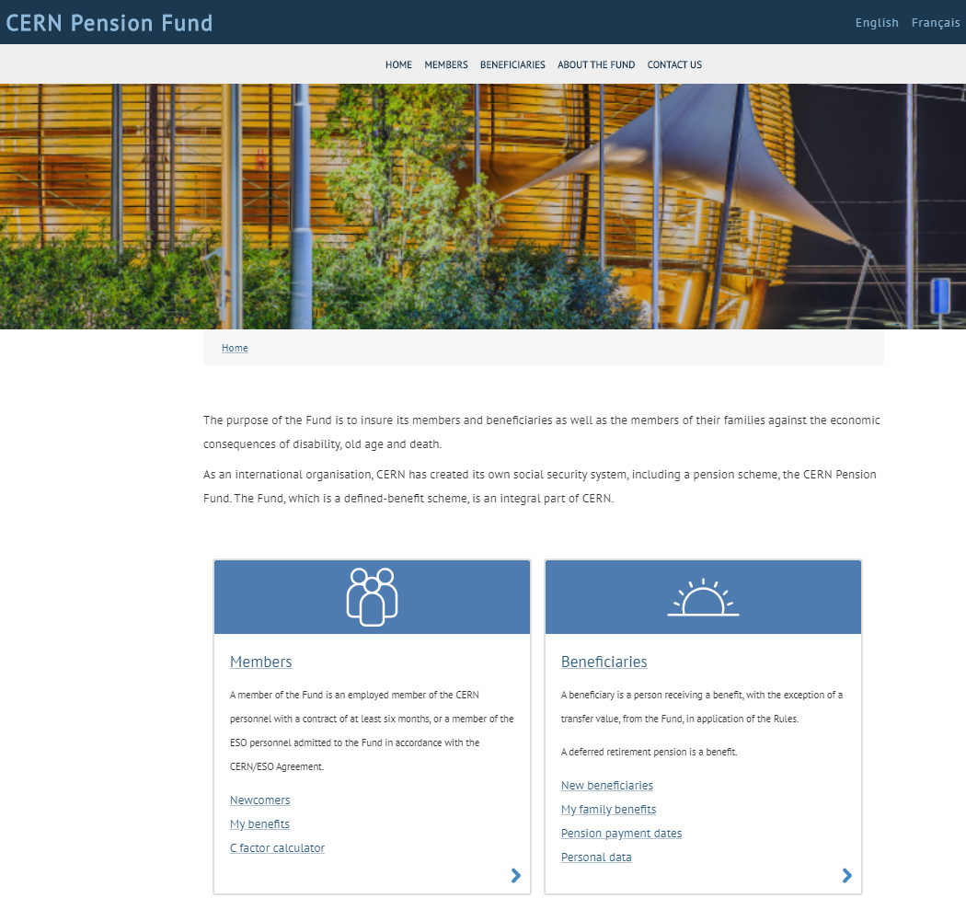
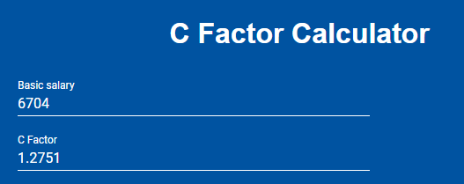
Reference salary
Staff members
Reference Salary = Basic salary * C Coefficient
  Basic salary: percentage of a midpoint of a grade
  Coefficient C: factor based on the basic salary

Slide 7
Reference salary
Fellows
(junior or senior)
6’108 CHF

Slide 8
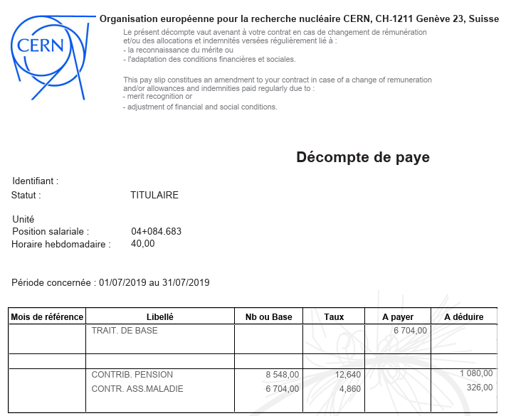
Reference salary

Slide 9



Who for? What for?
CERN
PENSION FUND
Staff
Fellow
Staff/Fellow

Slide 10

Resources
Monthly contributions from and
Monthly contributions from the
Income from the investment of assets
Transfers from other schemes

Slide 11
Monthly Contributions
Members who joined the Fund since 01.01.12:
 | 18.96% of the reference salary
 | 12.64% of the reference salary

Slide 12
Transfers from Other Schemes
Who: worldwide private pension schemes
(if they agree)
How: bank transfers
Purpose: - higher benefits
  - entitlement to pension

Slide 13
BENEFITS

Slide 14
Benefits
Benefits are paid in Swiss francs in Switzerland
Pensions and other benefits are taxable under the conditions defined in the national fiscal legislation that is applicable to the person concerned

Slide 15
Retirement Pension
Members who joined the Fund
on or after 01.01.12 with
at least 5 years of service:
the official retirement age is 67
pensions are calculated on the basis of 1.85% of the average of the last 3 years’ reference salary* per year of membership (maximum 37 years and 10 months)
* Based on the salary scale at the end of the contract

Slide 16
Disability Pension
Paid to a member whose disability is recognised by the Organization
Equal to the retirement pension the member would have received at the applicable retirement age*
It can be total or partial
*no matter the duration of the contract

Slide 17

Surviving Spouse Pension
Paid to the spouse/partner of a member whose marriage/partnership dates from at least 1 year:
  From the 1st day following the member’s death
  Until the death/remarriage of the spouse/partner
Equal to 1.1% of the last reference salary per year of membership until the applicable retirement age*
*no matter the duration of the contract

Slide 18

Orphan´s Pension
Paid to unemployed and unmarried dependent children until 20 years old or until 25 if they are in full-time education
Equal to:
  - 24%* for 1 orphan
  - 34%* for 2 orphans
  - 40%* for 3 orphans…
*of the member’s last reference salary

Slide 19
Transfer Value
Calculation:
- 14.7% of the last reference salary for the first 10 years of service
- 22% of the last reference salary for each further year of service
Payment: the month following the contract end date

Slide 20
Leaving CERN < 5 years
the transfer value
can be paid
into another private pension scheme
(in any currency)
the transfer value can be paid to the member

Slide 21
5 years≤ Leaving CERN < 10 years
For information: periods of Unpaid Leave (without contributions to the Fund) are not considered as periods of service
the member is entitled to a deferred retirement pension
the transfer value can be paid to the member
the transfer value can be paid into another private pension scheme
(in any currency)

Slide 22
Leaving CERN ≥ 10 years
the member is entitled
to a deferred retirement pension
the transfer value can be paid into another private pension scheme (in any currency)

Slide 23
Other Information
Web site : http://pensionfund.cern.ch
- Rules and Regulations of the CERN Pension Fund
    - Annual report and Financial statements
Annual Information Meeting
Benefits Service (tel. 72738 or 63156)
pension-benefits@cern.ch

Slide 24
THANK YOU FOR YOUR ATTENTION Benefits Service
Disclaimer: The information included in this presentation is not legally binding
CERN Pension Fund - Benefits Service

