Slide 1
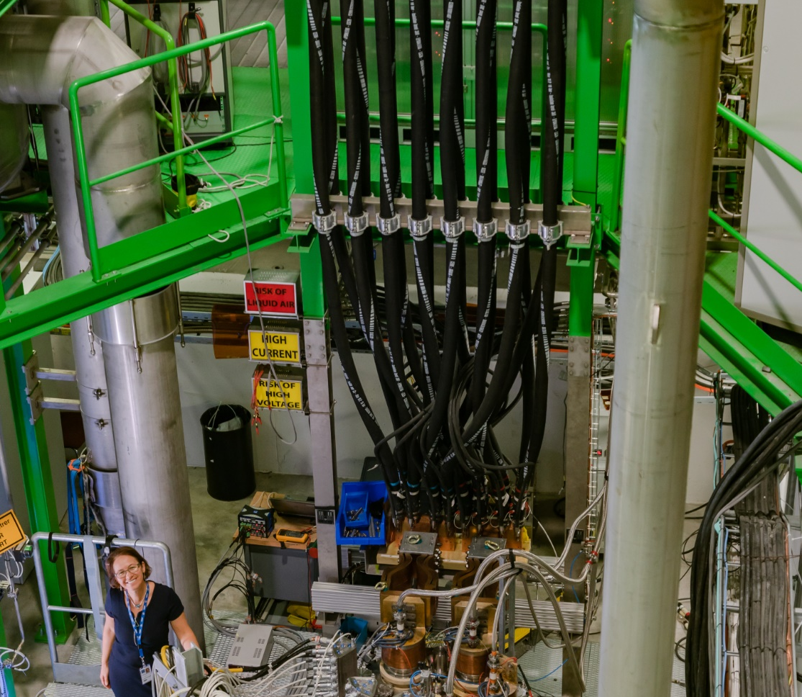
SM18 TEST FACILITY shaping for HL-LHC and beyond in the last 10 years
M. Bajko TE-M SC-TF
1st of December 2020 for TE-MSC Seminar

Slide 2
Abstarct
In this presentation I will show the strategy that was set up in 2009 for the modifications of the SM18 hall to fulfil the HL-LHC needs.
I will recall the main goals I proposed myself, in agreement with my line- and HL-LHC project-management, as a section leader of the magnet test stands.
I will show than the summary of the past 11 years accomplishments and give the status of the test facility today.
Before giving my own words on this great adventure that was the challenge of the SM18 test bench construction and the building of a great team of experts for its operation, I will tell you about the importance I payed for the communication in general, the exchange with experts at CERN and within the international community of people in the field.
I will finish my talk showing you my next challenge : the HL-LHC IT STRING that I am proposing to bring to success with a small, but very motivated team in the next coming (only few) years ? …once again in the SM18 ? shaping it even more!

Slide 3
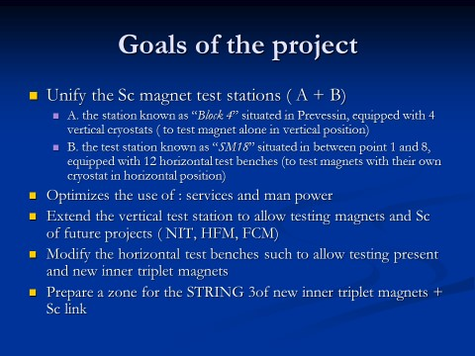
2009
TE-MSC-TF is created with one of the main task of moving Block 4 from Prevessin to SM18
Project proposal August 2009

Slide 4
The TE-MSC-TF mandate as I translated
Unify, Extend, Modify, Prepare = CONSTRUCTION
Optimize = OPITIMIZATION
(where cost, time and performance considerations are of equal level)
Service = to allow TESTING and OPEN SM18 to USERS
THE TF SECTION OBJECTIVES
giving the best possible service
  making test with good, performing and smart equipment and obviously also in time
  Assuring the safety of the personnel and the equipment
  giving reliable feed back ( raw data, analyzed data , reports, planning ect) to the projects
work within international collaboration and become a reference in our field.
Man Power = TEAM BUILDING

Slide 5
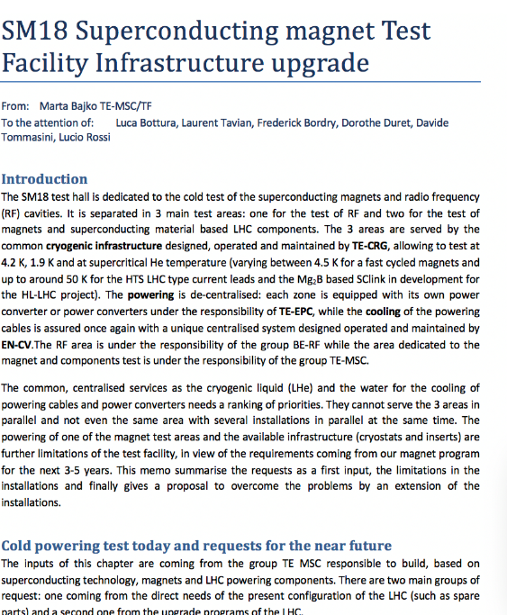
FROM BLOCK4 to CLUSTER G
2009
TE-MSC-TF is created with one of the main task of moving Block 4 from Prevessin to SM18
2010
Start of civil engineering in the SM18 – Cluster G
2011
The new vertical test stand called Cluster G with the “LONG CRYOSTAT” is operational.
2012
2nd cryostat and the feed box are operational.
Start of optimisations: new insert for “Long Cryostat” and a new one for FReSCa2: HFM test stand idea is born.
A memorandum is written to ask for extension of the test stand to fulfil HL-LHC magnet test requirements on the cluster D and the SM18 Infrastructure Uprgade

Slide 6
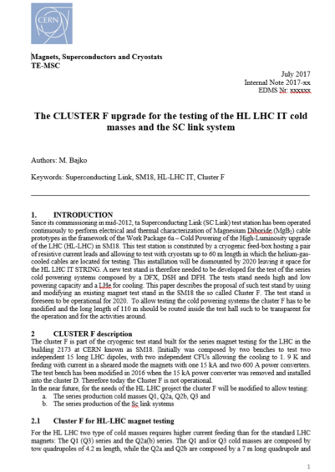
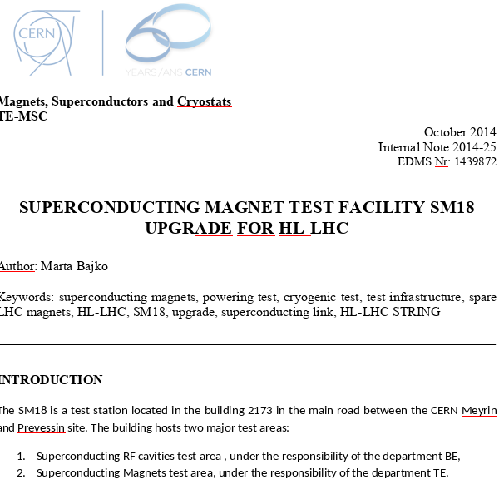
CLUSTER G extension with CLUSTER D
2014
In July Cluster D is dismounted, while the 3rd cryostat is operational in the cluster G.
2015
Start of civil engineering Cluster D, while we proved that Cluster A high current circuit can go up to 20 kA
2016
HFM cryostat ready for HL-LHC model magnets ; New demineralised water station, the new overhead crane became operational; new control room installed in August
2017
Cluster D ( but also G and A) is operational; ready for HL LHC magnet testing
Creation of the SM18 Infrastructure upgrade project.
Upgrade of the CERN Superconducting Magnet Test Facility
#28 Marta Bajko(CERN) et al. (Dec 2, 2016) Published in: IEEE Trans.Appl.Supercond. 27 (2017) 4, 9500307 Contribution to: ASC 2016

Slide 7
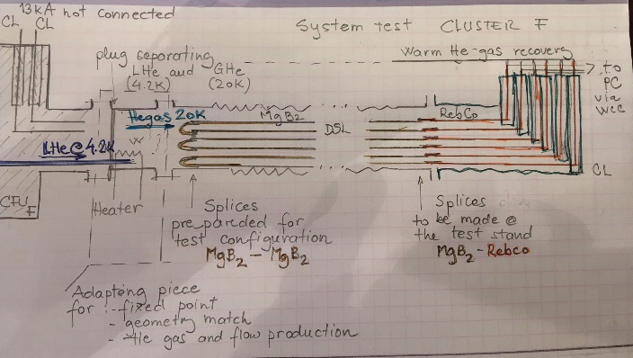
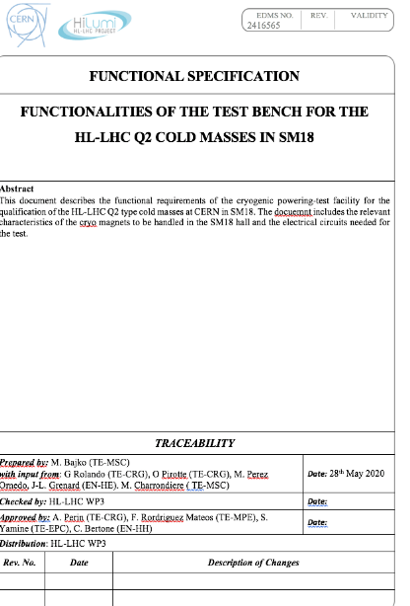
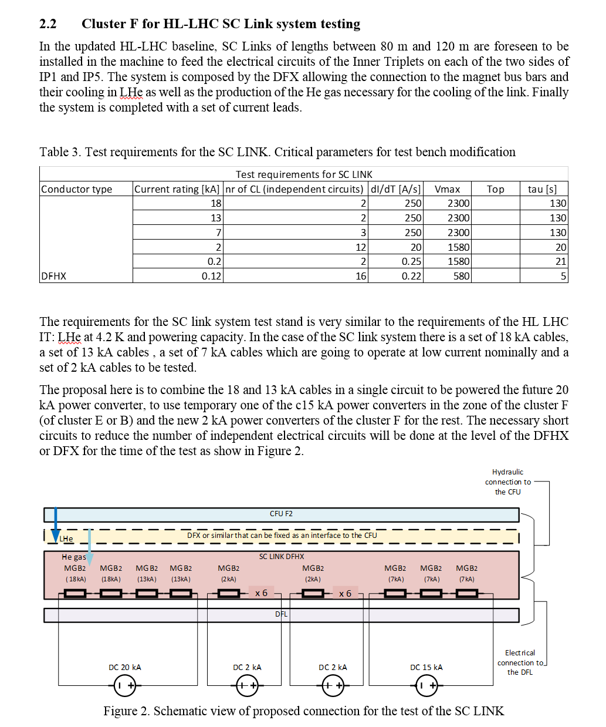
CLUSTER F: extension of magnet stand for Sc link
2018
Secondary circuit of of HFM test stand with EE ( IGBT) installation done
2019
Diode cryostat modification for TRIM lead testing, reviewed interlock of Cluster G with 2 circuits
2020
Secondary circuit of Cluster D, participation to Demo2 installation
Creation of the functional specification for benches we plan major changes
The idea of the SC link test stand on Cluster F is born…and we started to do a number of iterations

Slide 8
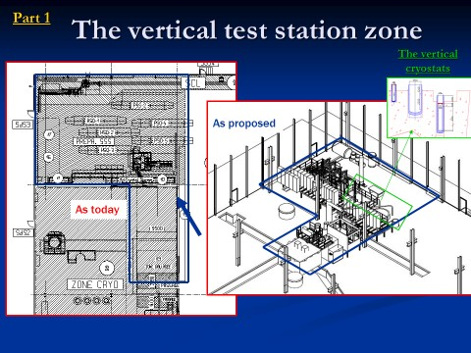
2009
TE-MSC-TF is created with one of the main task of moving Block 4 from Prevessin to SM18
Project proposal August 2009

Slide 9
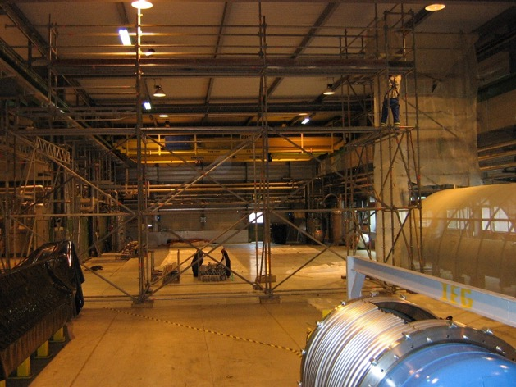
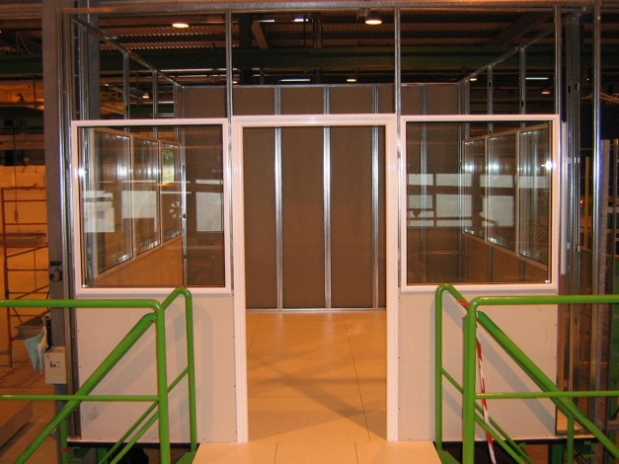
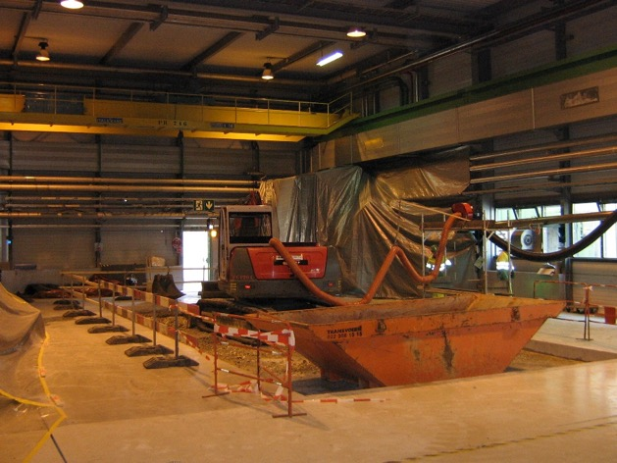
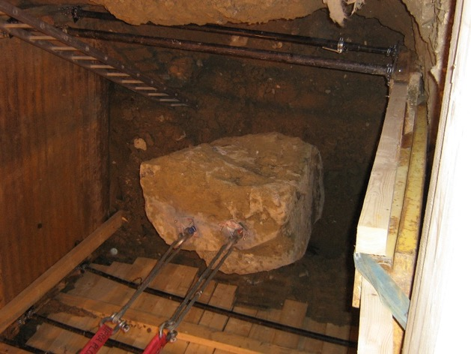
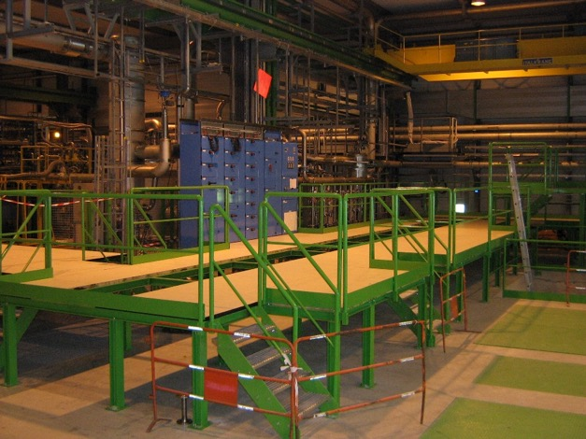
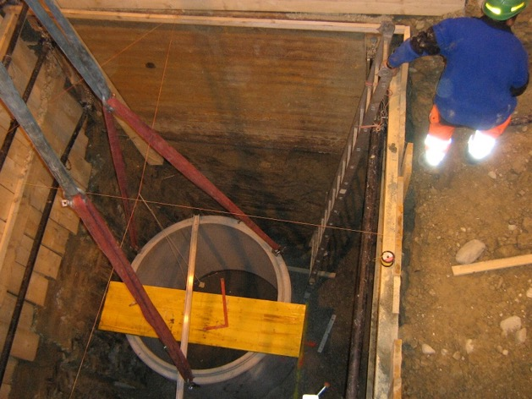
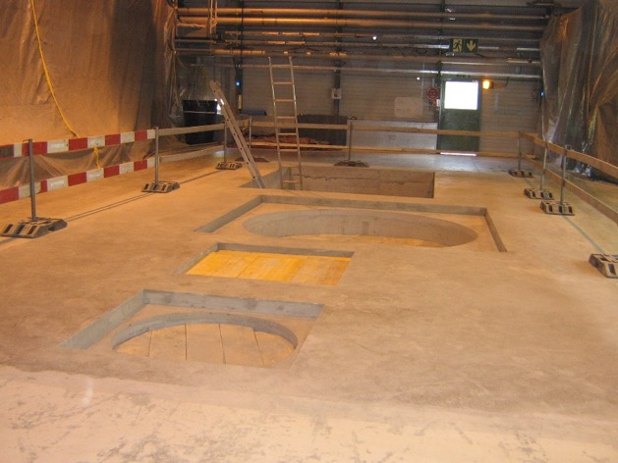
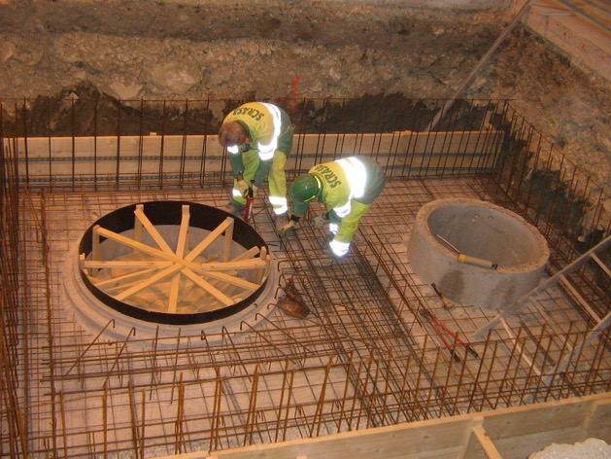
2010
Civil engineering started in the SM18 Cluster G
Mars 2010
Avril 2010
May 2010
June 2010
July 2010

Slide 10
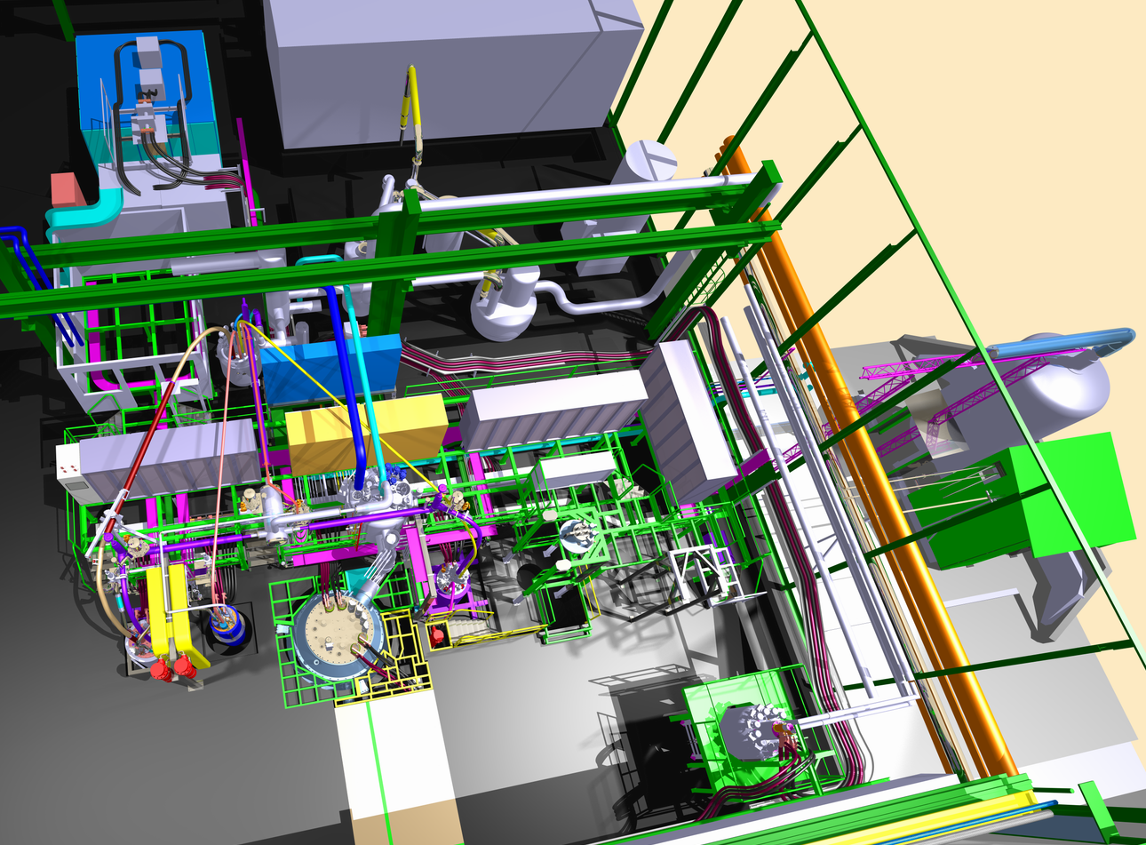
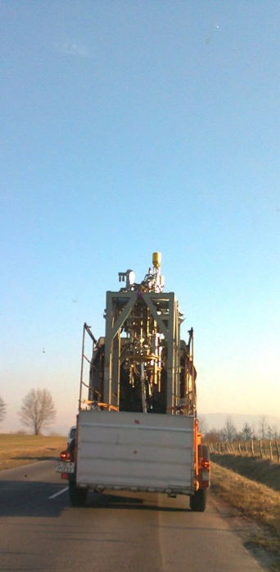
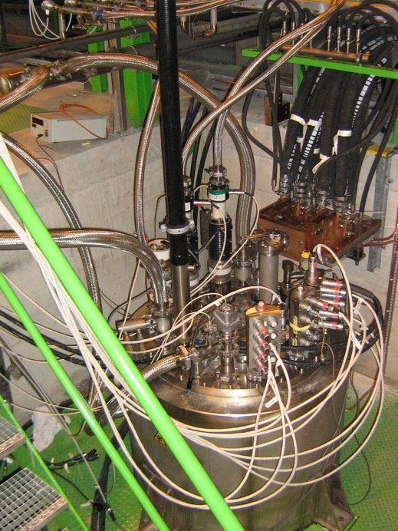
2011
The Cluster G with 1 cryostat fully operational
Block 4 integration in SM18
Block 4 on the road
Block 4 operational in SM18

Slide 11
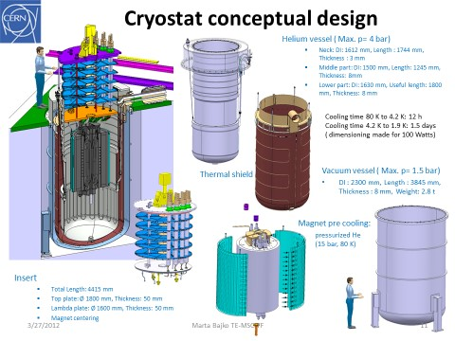
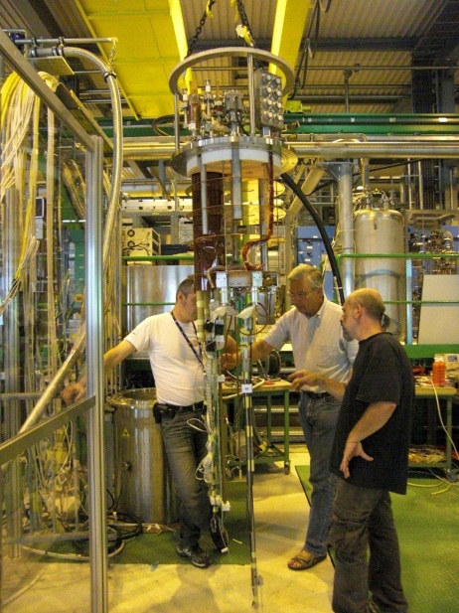
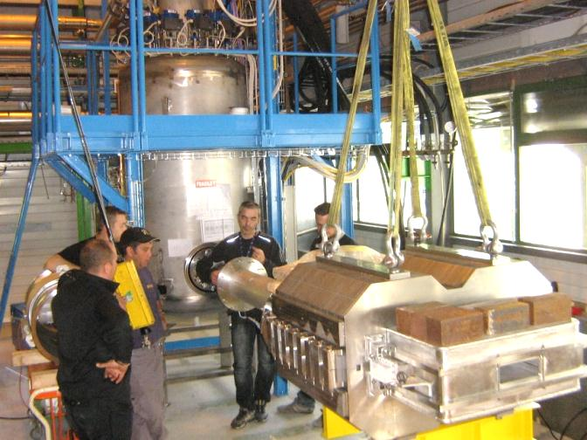
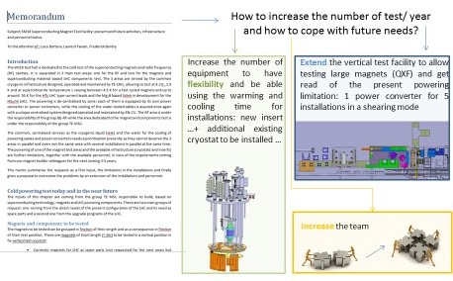
2012
2nd cryostat and the feed box are operational
Start of optimisations: new insert for Long Cryostat and a new one for FReSCa2: HFM .
A memorandum is written to ask for extension of the test stand of HL-LHC magnet
Feed Box ready for FCM testing
Diode cryostat ready for test

Slide 12
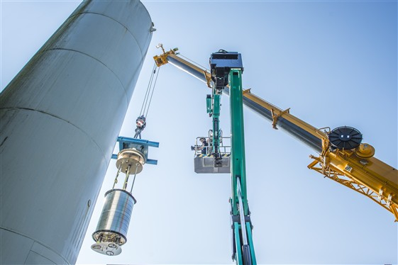
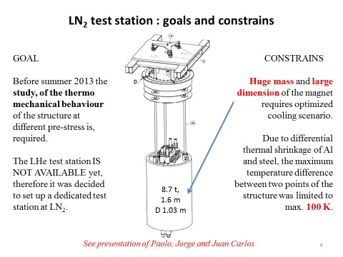
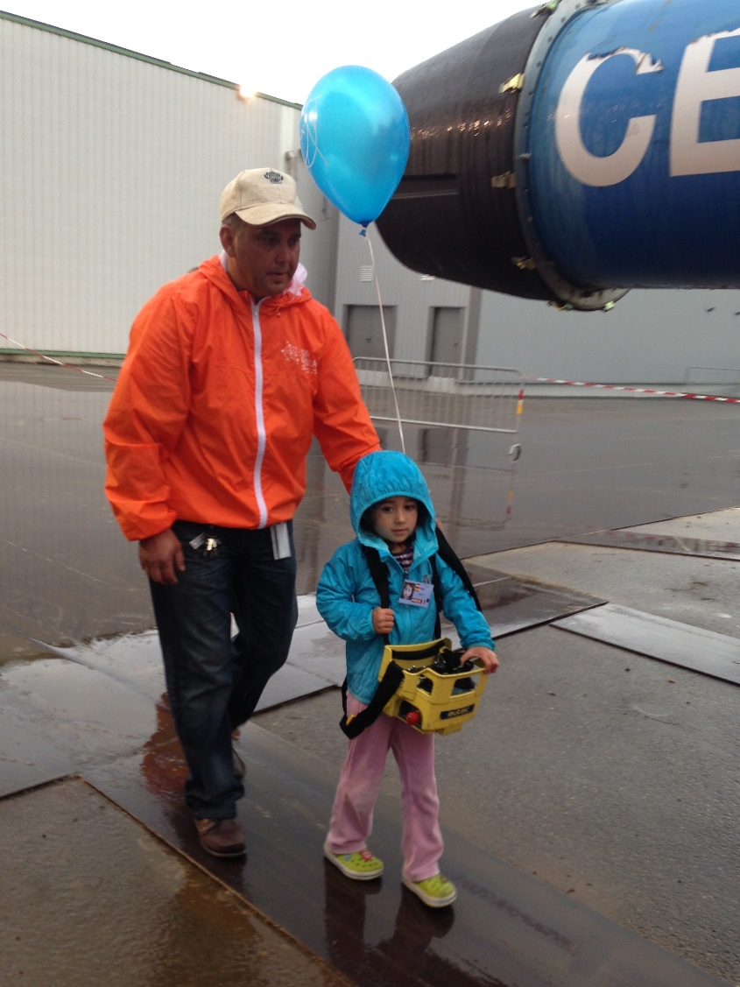
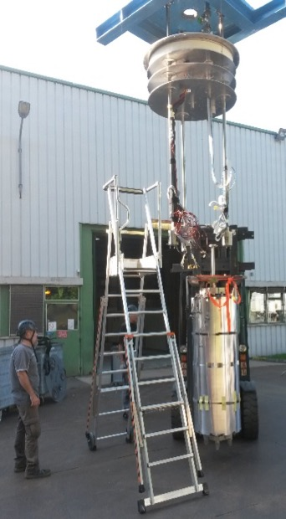
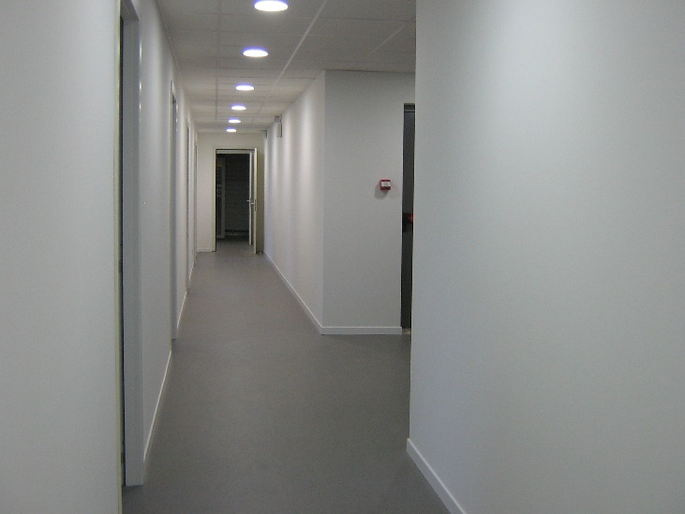
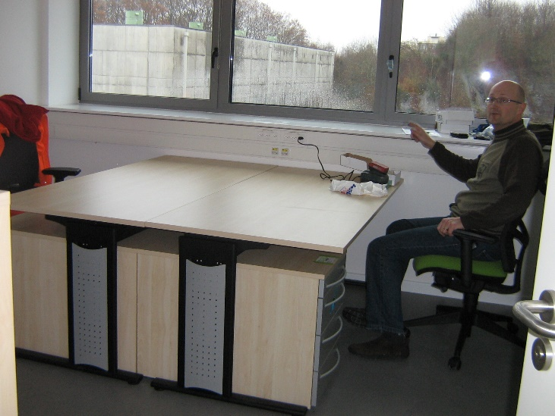
2013
OPEN DAYS… we have external help: I can count on my daughter.. she is now 4, and with Tonio even under the rain is transporting magnets
Construction of the LN₂ cryostat.
Special thanks to Hugo, Juan, Jorge, Maryline
We got our new offices

Slide 13
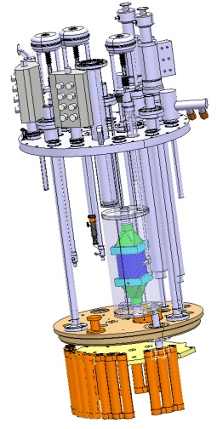
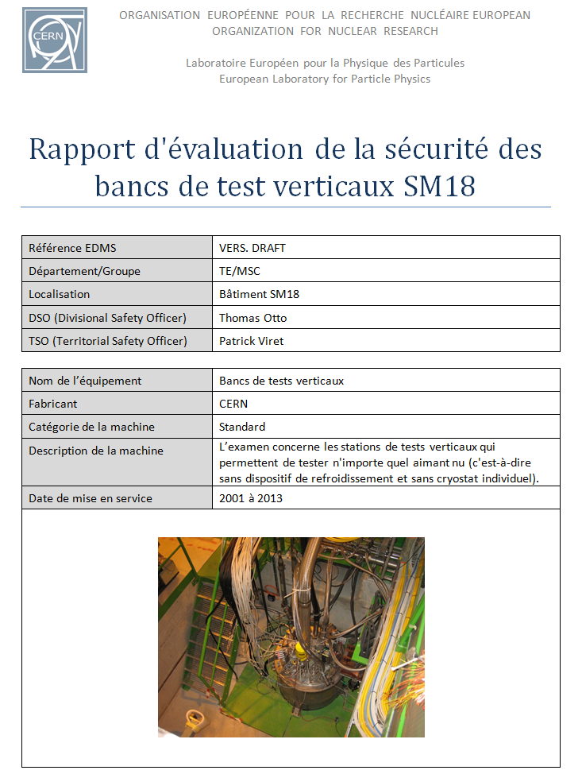
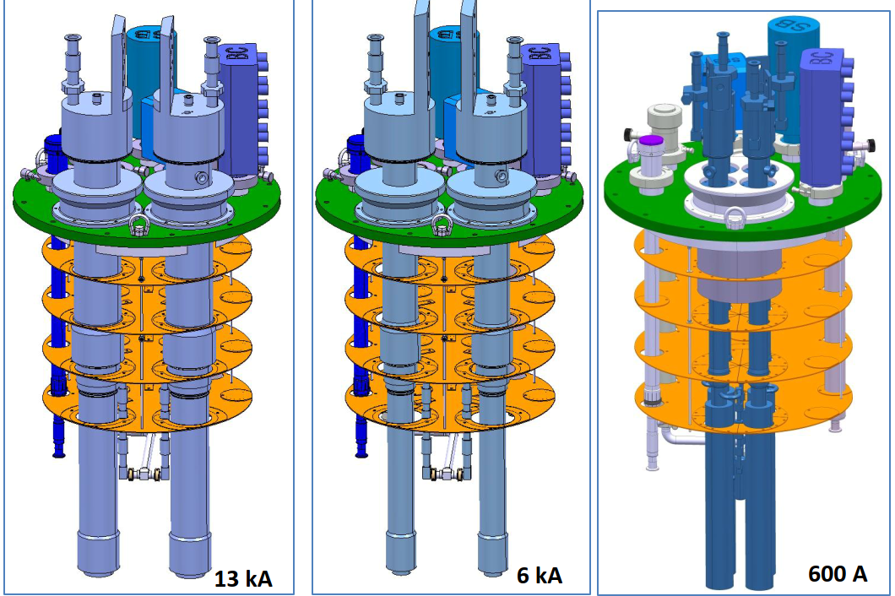
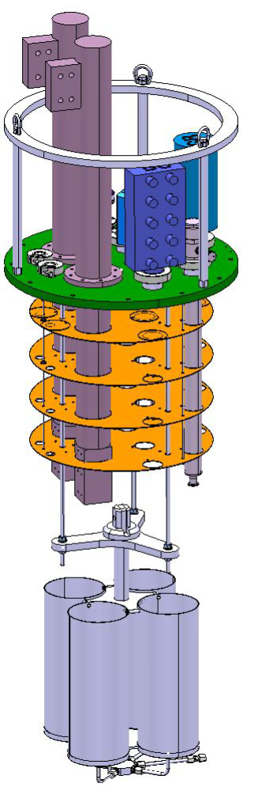
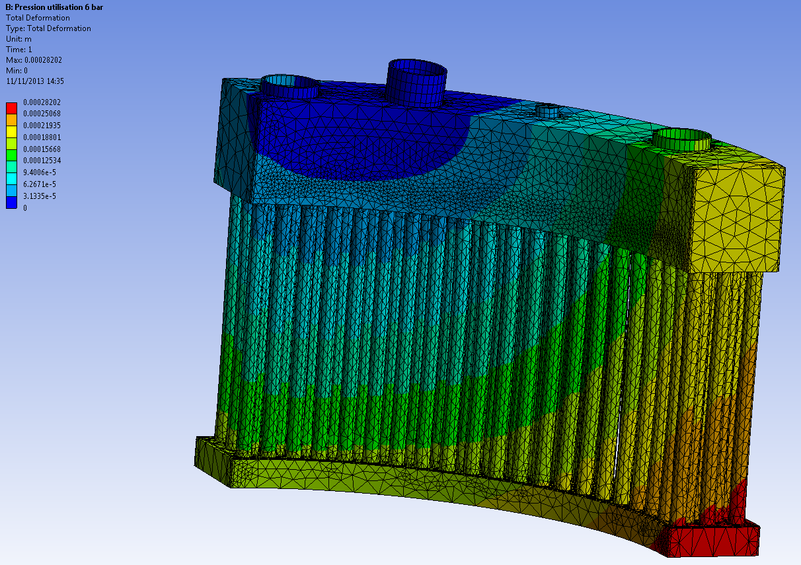
2013-2014
SAFETY a continues work on a constantly growing installations
Construction of the new Inserts for the old cryostats
Work of G. Villiger + V. Benda
While we kept the old Block 4 cryostats, we re-built the inserts. Ex. Diodes and LHC lead cryostats with an external satellite allowing us today to used a mixed gas to cool HTs coils at variable He gas temperature
New additional insert for the existing LONG cryostat with IMPROVED performance.
With an original idea of P. Viret
Design and produced by EN-MME design office and Main workshop
Integrated with CRG in the SM18 cooling system
Work with E. Bigot + T. Otto + P. Viret

Slide 14
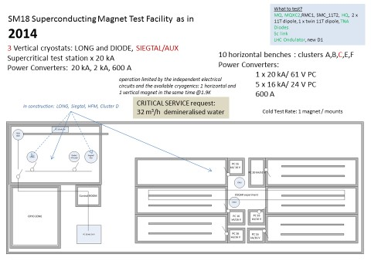
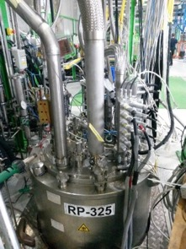
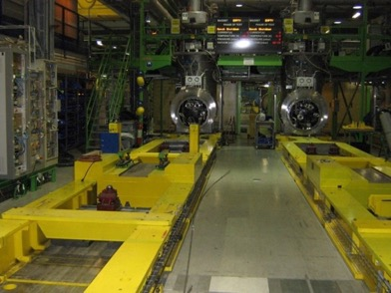
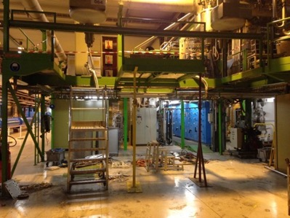
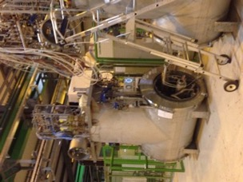
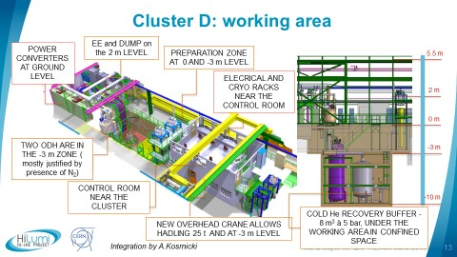
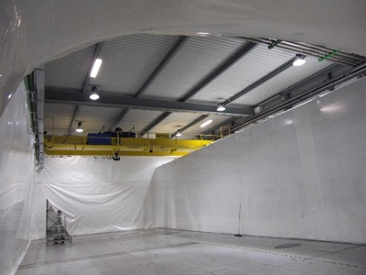
2014
In July Cluster D is dismounted. Creation of the SM18 Infrastructure UPG project. 3rd Cryostat is operational in the vertical test facility.

Slide 15
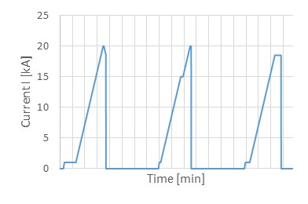
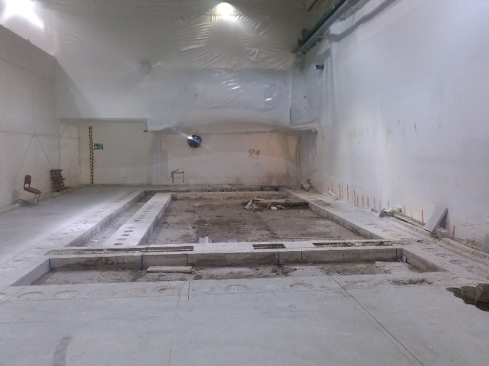
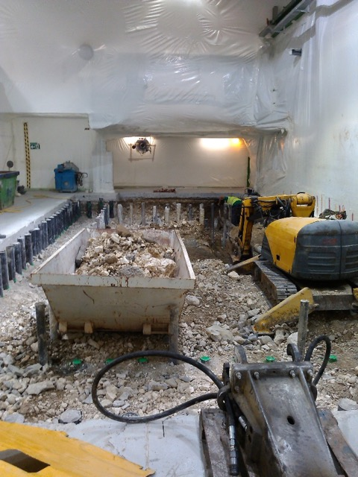
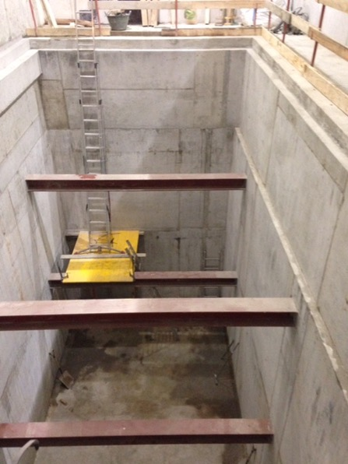
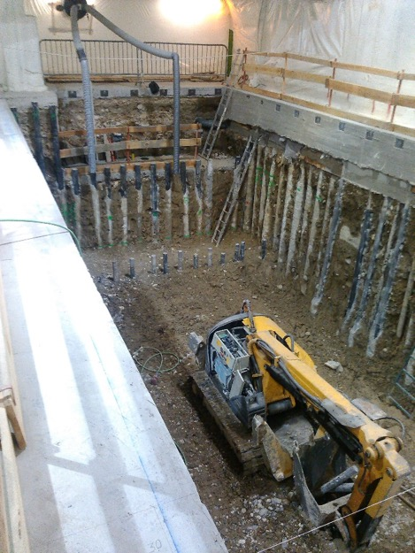
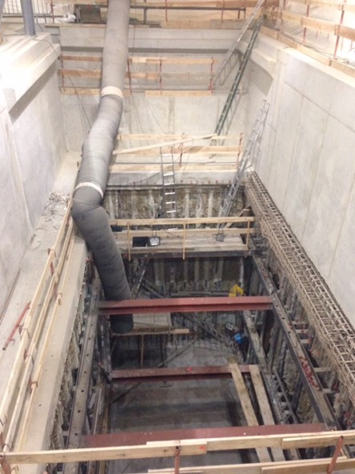
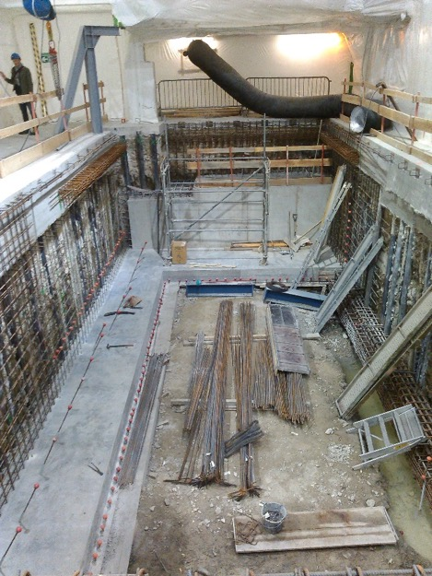
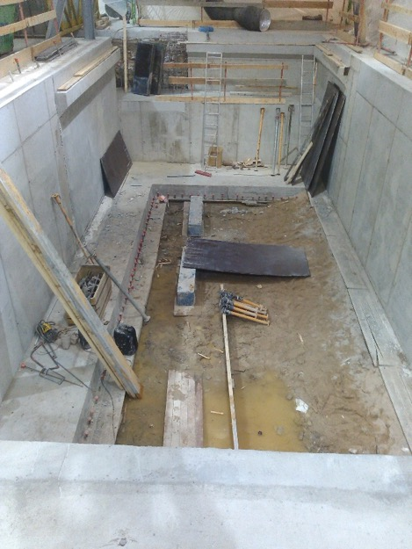

2015
while work is ongoing for the civil engineering of Cluster D, we start testing Cluster A at high current
20 kA kept for 30 s in Cluster A. ….so is feasible ….
June
July
18th of December
September
October
December
November

Slide 16





2016
HFM cryostat ready. Infrastructure improved
the new overhead crane operational
new control room installed
New demineralised water station, Operational in April
Cluster A CL consolidation

Slide 17




2017
Cluster G , D and A operational
And we enjoy EUCAS 2017 in SM18

Slide 18
SM18 INFRASTRUCTURE UPGRADE
The upgrade was driven by the recommendation to be able to carry out the full test programme withouth constraints
Operational from April 2016
  DEMINERALISED WATER PRODUCTION: + 150 m³/h
  NEEDED FOR DEMINERALISED WATER ENTIRELY COMING FROM MAGNET OPERATION
  HANDLING: 25 T and longer rope
  NEEDED FOR OVERHEAD CRANE CHANGE ENTIRELY COMING FROM MAGNET OPERATION
  nCONTROL ROOM
  NEEDED TO EXTEND THE TOO SMALL CONTROL ROOM OF THE VERTICAL TEST FACILITY TO BE USED ALSO FOR HORIZONTAL BENCHES AND SC LINK
  PRIMARY WATER COOLING CAPACITY: +736 m³/h
  NEEDED FOR MAGNETS, CRYO AND RF
  POWERING FROM THE NETWORK: 3 MVA
  NEEDED FOR NEW OR MODIFIED PCs FOR MAGNETS AND IR STRING
  CRYOGENIC COOLING PRODUCTION: + 35 g/s LHe
  NEEDED ESSENTIALLY FOR THE RUNNING OF THE HL LHC IR STRING IN PARALLEL WITH MAGNET TESTING
Operational from February 2016
Operational from 2017
Operational from 2019
Is under final commissioning 2020

Slide 19


SM18 handling infrastructure upgrade
  HANDLING: 25 t and longer rope
  NEEDS FOR OVERHEAD CRANE CHANGE ENTIRELLY COMING FROM MAGNET OPERATION
Special thanks to Roberto R.
To enable insertion of test objects into the HFM cryostat the operating height, had to be increased to 6 m (presently 5.3 m).
Cluster D, on the other hand, will be deeper than the existing vertical facilities. To handle the inserts the operation depth between the hook and the top of the cryostat must be increased to 9.3 m.
Operational from February 2016
25 T HANDELING CAPACITY

Slide 20

SM18 electrical distribution infrastructure upgrade
To allow some flexibility and margin with new requests that are not formulated yet, the proposal is to INSTALL a TRANSFORMER OF 3 MVA CAPACITY
Special thanks to Nuno D. S.
The new transformer will feed HL LHC IT STRING (Cluster J ) and the new Cluster F with the 20 kA power converter.
See document: https://edms.cern.ch/document/1604702.

Slide 21



New Control Room
  nCONTROL ROOM
  NEEDED TO EXTEND THE TOO SMALL CONTROL ROOM OF THE VERTICAL TEST FACILITY TO BE USED ALSO FOR HORIZONTAL BENCHES AND Sc link
NEW LARGER CONTROL ROOM AT THE PROXIMITY OF THE CRYOSTATS
OLD CONTROL ROOM WITH REDUCED SPACE
Special thanks to Maryline Ch.
NEW CONTROL ROOM: THE GROUND FLOOR
Last adjustments before testing MQXFS5

Slide 22

SM18 CRIOGENIC infrastructure upgrade
“SM18 Cryogenics Infrastructure Upgrade Proposal”: EDMS 1571317
  CRYOGENIC COOLING PRODUCTION: + 35 g/s LHe
  NEEDED FOR RUNNING IN PARALLEL MAGNET AND RF CAVITY WITH THE HL LHC IR STRING TESTING
Special thanks to Antonio P.
An additional 35 g/s liquefing capacity
Cold Compressor
Should be operational from January 2021
WPU1
Heater1
SC link tests
The existing total pumping capacity in SM18 at 1.8 K is 12 g/s today that was obtained by combining the capacity of WPU1 and 2.
This 12 g/s is to be shared between magnet and cavity testing
WPU2
Feedbox
EuHIT
Operational from April 2016

Slide 23




SM18 water cooling infrastructure upgrade
  DEMINERALISED WATER PRODUCTION: + 150 m³/h
  NEEDED FOR DEMINERALISED WATER ENTIRELY COMING FROM MAGNET operation
  PRIMARY WATER COOLING CAPACITY: +736 m³/h
  NEEDSED FOR MAGNETS, CRYO AND RF
Special thanks to Alexander J. B and Gerard C.
SFA18
Operational from 2019
See presentations of G. Cumer , A. J. Broche :https://indico.cern.ch/category/7651/

Slide 24











Test stand for magnets ( in vertical cryostats)
Vertical tests
Cluster G
Vertical tests
Cluster D
Magnets
A
E
Horizontal tests
CLUSTERS
B
F
C
NO modification of the test stand is required. The cryostats are all operational; all ancillary equipment are present and adaptable to needs.
We can test 2 independent circuits both at high and low current.
We have 2 x 2 kA 4 Q PC on D with EE.
Cliq and symmetric quench detection operational.
Cryogenic
Main entrance
All model magnets of (HL-)LHC and others can be tested in Cluster G or D

Slide 25








Test stand for HL-LHC : ongoing constructions
https://indico.cern.ch/event/647714/timetable/#20171114.detailed
Interface the CFU with a new phase separator to allow 4.2 K testing conditions of the triplets and also D2.
Interface the the warm powering cables with the CL (replace the DCB with an adequate PP). Place order for WCC in time.
Interface the cryo infrastructure

Slide 26
Installations for WP3 cryo magnets: Q2a/b, (Q1,Q3)
HORINZONTAL test
apertures | single
condutor technology | Nb3Sn
nominal/max current | 16 /20 kA
energy extraction | not possible
QH and CLIQ | possible
Energy | 10 MJ
handling | Modified Rocla
compatible CFU (LHC) | NO
Vertical tests
Cluster G
Vertical tests
Cluster D
Magnets
A
E
B
Horizontal tests
CLUSTERS
F
C
Target : June 2021
Installation & storage
Magnetic measurements
Opticalfiber & diode Installation
Modification of the test stand is required.
Strategy is to have two independent test bench fully equipped for Q2 type magnet testing. This implies modification of :
Electrical circuit
Cryogenic circuit
Handling
Interlocks
The 2nd prototype will be tested on the cluster A with a modification on the cold mass instrumentation to insure the magnet testing at 4.2 K ( difficult for the 1st prototype). This will be done using the test cryostat.
Cryogenic
Main entrance
Can be tested on cluster A and F

Slide 27




Testing WP6A: Sc Link system
Cluster F 20 kA,7 kA, 2kA, 0.6 kA, 0,12 kA
Cluster G 20 kA
- 18 kA
Protective insulation (outer layer)
+ 18 kA
6×2 kA
Vertical tests
Cluster G
Vertical tests
Cluster D
Magnets
A
3× 2 kA (7 kA)
E
B
6×2 kA
+ 13 kA
Horizontal tests
CLUSTERS
F
C
- 13 kA
Instrumentation wires
(twisted and cabled)
Installation & storage
Magnetic measurements
Opticalfiber & diode Installation
Φ∼ 75 mm
Including insulation
Modification of the test stand is required.
This implies modification of :
Powering circuit ( major)
Cryogenic circuit ( minor)
Handling ( major)
Cryogenic
Main entrance
Can be tested on cluster F
Should be tested on F2

Slide 28





Testing WP6a: Type test for CL
It is a test stand for type test , not implying extra charge for operation. Prototypes will be not tested here so it is not on the critical path.
Vertical tests
Cluster G
Vertical tests
Cluster D
Magnets
A
E
Horizontal tests
CLUSTERS
B
F
C
Installation & storage
Magnetic measurements
Opticalfiber & diode Installation
Minor modification of the test is required.
Cryogenic circuit ( minor) with hopefully existing or already designed pieces
Cryogenic
Main entrance
“The Feed Box” would be used for the high current lead test

Slide 29
Testing WP6a: Type test for CL
Hopefully existing or already designed pieces:
a. in yellow all existing
b. in green CL
c. other to be designed

Slide 30
The new distribution of test benches of SM18
Mechanical
Workshop
HTS Leads test
HL-LHC String test
Visitors
Vertical tests
Cluster G
Vertical tests
Cluster D
Q1, Q3
A
Q1,Q2,Q3,CD
E
MB, SS(SS), D1
Horizontal tests
CLUSTERS
MB, SS(SS), D1
B
Q1,Q2,Q3,CP
11T
F
Sc link system
D2
C
Installation & storage
Magnetic measurements
Opticalfiber & diode Installation
Cabling & electronics
Radio Frequency Cavities
Cryogenic
LN₂ test stand
Cryogenic
Main entrance

Slide 31










The TF R&D. Optical fiber based sensing at Low Temperature
  Strain monitoring inside the coil
    Magnet powering to 15 kA @ 1.9 K
  Quench detection in HTs sample in SULTAN
Work of Antonella and Juan Carlos
Work of Bernardo and Erica ( MIT)
Article copyright is: SUST-104163.R1
Minimum Quench Energy test on an HTS sample carried out in SULTAN test facility in Paul Scherrer Institut in the framework of CERN-MIT collaboration

Slide 32









Collaborations. Eucard² and ARIES Trans National Access
EUCARD²
The objectives foreseen for MagNet WP9 were to deliver at least 1,920 access units (hours) to an estimated number of 64 users from 8 projects.
1st access granted 20th of November 2013
  University of Sannio (IT)
  University of Napoli, Federico II (IT)
  University of Padova (IT)
  University of Debrecen (HU)
  Institute of Polymers, Composites
  and Biomedical materials (IT)
…to develop a non intrusive technology based on FOS for strain and temperature monitoring in the new generation of superconducting magnet and cryogenic devices…
The MagNet TNA at CERN provided access to 34 users from 15 different institutes, for a total of 2,660 access units of 9 projects, exceeding the initial requirement of 1,920 units.

Slide 33












Collaborations
International Workshops on Superconducting Magnet Test Facilities
Most of these participants has a valuable long experience and expertise
in superconducting magnet testing

Slide 34










@ BNL LONG ISLAND
https://www.bnl.gov/mts2018/
https://aries.web.cern.ch/content/application-and-follow-procedures
There is a large international community that I “bridged” through (till now) these workshops
@ GENEVA CERN
https://indico.cern.ch/event/507584/
Thanks Virginia, Joe and Kevin for the help in organization

Slide 35

Man Power = TEAM BUILDING
The TF section was the smallest section in the TE-MSC group!

Slide 36

Man Power = TEAM BUILDING
The TF section was the smallest section in the TE-MSC group!
H. Prin
J.C. Perez
F. Pincot
N. Bourcey
L. Fiscarelli
C. Petrone
S. Yamine
P. Perret
https://www.weka.ch/themes/competences-personnelles/gestion-de-soi/gestion-de-soi/article/modele-de-liceberg-comment-communiquons-nous-en-tant-quindividus/
But we had a “non mandated extension” of the section!!!
They played a key role in the construction and/or the operation of the test stands.
Many thanks to them for their valuable help, flexibility and availability!

Slide 37


The ACTORS of the bench construction
Powering circuits
Cryo Cooling
TE-EPC
TE-MPE
EN-EL
EN-CV
TE-MSC
TE-CRG
EN-MME
Handling
TE-MSC
EN-HH
Satefy and Interlock
TE-MSC
BE-ICS
Daq and Software
EN-SMM
TE-MSC
Integration/Planning
EN-ACE
Measuring systems
TE-MSC
EN-MME
PC TE-EPC
WCC EN-EL
WC EN-CV
EE TE-MPE
The main actors
CC EN-EL
Power distribution Cluster F(E)
Cryogenic cooling Cluster F Q2a
CFU TE-CRG
CRYO-magnet TE-MSC

Slide 38


EN-MME with TE-MSC and TE-CRG
Robin, Philippe
Herve, Gaelle
Gabriella, Olivier
Design Office and Main Workshop EN-MME
From 3D design
Checking the existing, the needed
Making fabrication drawings for ordering at main workshop

Slide 39


TE-CRG and EN-ACE
Nicolas G. + Estrella V.
I think is no doubt that this group is the major partner of the SM18 magnet test bench construction and operation.
I will therefor give one example relevant for the UPG and operation together but there are examples of the bench modifications in the annex slides aswel.
LHe estimate based on last the last week activity coordination work by ( N. Guillotin)
These estimates are based on a full Ms Project based on HL-LHC Master Plan, but not only: including RF and Magnets and R&D + LHC needs. Test are pre-distributed on benches and benches are characterized by its consumptions estimated together with CRG.
Ex. Cluster D planning
LHe estimate based on last the last week activity coordination work by ( N. Guillotin)

Slide 40


TE-EPC
Samer Y
An other key partner:
Cluster A PC UPG to 20kA!!! Saving !!!
Cluster F 20kA PC already operational! And all PC in SM18…. And even more important: we had an excellent and online (onsite) support of expert!!!!

Slide 41


TE-MPE
Felix + Gert
Magnet Protection and Energy Extraction: plans for needs in SM18
This is not the complete picture, but an example of a graphical example of an agreement of what we need and requested from MPE in time. We have EE and dump, QDS aswel.
… as in other cases: we have their experts with us for the constructions and operation!!!!

Slide 42



TE-MSC and EN-SMM
Hubert and Maryline
Example of HF system
DAQ SPECIFIED PARAMETERS
Input channels: +/- 10 V analog
Nr of HF channels: 200 differential
HF frequency: 200 kHz
HF,MF,LF resolution: 16 bit resolution
HF,MF,LF accuracy: 1mV
MF frequency: 50 kHz
Nr of LF channels: 144
LF frequency: 1kHz
Timing: GMT synchronization
Specification in 2016 for Cluster D
Data Analysis with DIADEM

Slide 43
Man Power = TEAM BUILDING
Many thanks to all our collaborators in the different sections, groups, departments; together we did and we will continue shaping the SM18 hall
The TF section was the smallest section in the TE-MSC group!
V. Parma, A.v.Craen , S. Yammine, H. Thiessen, A. Perin, V. Benda, O. Pirotte, G. Rolando, N. Guillotin, A. Kosmicki, R. Betemps, R. Ferrier, G. J. Coeling, F. R. Mateos, T. Otto , N. Dos Santos, R. Rinaldesi , E. Paulat, E. Bigot, E. Vergara, V. Mertens, F. Formenti, G. Cumer, L. Serio, V. Benda, A. Lee, M. Struik, S. Gianelli, P. Moyret, M. Strychalski, C. Gonzalves Perez, G.J. Coelingh, K. Dahlerup-Petersen, A. Dinius,V. Maire, A. J. Broche, R. Rinaldesi, R. F. Ortega, H. Reymond, M. I. Tapani, F. Gomez de la Cruz, C. Arregui, H. Botella, R. Morton, E. Perez Duenas, L. van den Boogaard
H. Prin
J.C. Perez
F. Pincot
N. Bourcey
L. Fiscarelli
C. Petrone
J. Fleiter
P. Perret
https://www.weka.ch/themes/competences-personnelles/gestion-de-soi/gestion-de-soi/article/modele-de-liceberg-comment-communiquons-nous-en-tant-quindividus/
But we had a “non mandated extension” of the section!!!
They played a key role in the construction and/or the operation of the test stands.
Many thanks to them for their valuable help, flexibility and availability!

Slide 44













Measurements in the SM18: training?

Slide 45











Service = to allow TESTING and OPEN SM18 to USERS
A part of the message that the test stand capacity is larger than expected, here I wish to say that we are also producing a lot of data, measurements, test results, reports and publications!!!
….and smiles!!!

Slide 46














The core of the TE-MSC-TF section
We are today about 25 max 28 including M4P and MPA from which 10 STAFF members.
A big thank for the members of the TF section : Christian, Hugo, Gerard, Franco, Antonella, Michal S., Vincent R., Patrick, Jerome, Gaelle, Olivier, Mary, Guillaum, Vincent J.D., Bernardo, Jose, Sara, Ioannis, Daniel T., Salvador, Yacine, Fred R, Fred F, Raphael, Abdelhay, Bertrand, Yannick,Ruben, Gyopar, Jean-Luc, Clinton;
as in 2016
Apart 2 staff members I have participated to hire all Staff, MPA and M4P of the section. We have trained people for FNAL, GSI, PSI (2) and of course for CERN. I thank you for all of YOU being so good COLLEAGUES AND COLLABORATORS.

Slide 47
What is the role of TF ?
Who is the owner of the data? Who should analyse, report , publish ect.
THERE IS NO UNIQUE ANSWARE FOR THIS, but a continues willing to look for a correct attitude and balance between teams.
The data can be used only if is validated.
The data can only be understood if we can correctly corelate with the magnet design.
The data is only produced because we get the magnets done by the others!
You can only make as well as you can measure
By Joseph Withworth,
The data is produced because the others needs them to understand the magnets they designed!
The data we produced to help the understanding the magnets behaviour.
The data is produced thanks to our work!
The data produced is valuable only if is analysed and published!
The analysed data can only be understood if we understand how it was produced.
When finally the data is analyzed, reported, published by the magnet designer, builder and not by you, think that your role was to make it possible to measure their magnet and this was crucial!!!

Slide 48
After one year of measuring the 1st Nb₃Sn magnet (the TQ) at CERN, in the old Block 4, and doing the LHC HWC, Lucio and Fredy to give me the challenge to merge Block 4 and SM18. If I have to summarise, it was:
  an honour to participate to this adventure and BE ONE OF THE MAJOR ACTORS of the shaping of the SM18 in these last 10 years.
  a pleasure to work with a great team ( remember the iceberg slide)
  a satisfaction to see how the SM18 hall get transformed for HL-LHC need during theses last years
I thank my line management: Lucio, Luca, Miguel and Volker for giving me this chance to participate to this work and to guide me during these years . Thank Ezio (WP3), Frederic (WP11) and Amalia(WP6a) for their collaboration.
I wish to those stepping behind me success and satisfaction in completing the remaining work for HL-LHC test benches and operation. I hope they will have also the chance to shape further the test benches for new projects and leave their own footprint in SM18!

Slide 49





The HL-LHC IT STRING SCOPE
The scope of the WP16 IT STRING is to represent, as far as reasonably achievable in a surface, the various operation modes to STUDY and VALIDATE the COLLECTIVE BEHAVIOURE of the different systems of the IT zone of the HL-LHC (magnets, magnet protection, cryogenics for magnets and superconducting link, magnet powering, vacuum, alignment, interconnections between magnets and superconducting link). Ref. HL-LHC IT STRING Scope https://edms.cern.ch/document/1693312/1
A.Kosmicki_20201001_edms 1582348

Slide 50


The next steps for me : HL LHC IT STRING
TE-MPE-SF
Marta Bajko SL
Samer Yammine
Davide Bozzini
Nicolas Heredia Garcia
Julian Zawilinski
As from 1st of January 2021, I will dedicate my time fully to the HL-LHC IT STRING not only as co-WP16 leader of the HL-LHC project, but also as the section leader of the a new, small, but extremely motivated TE-MPE-SF section with the help of many other collogues of different groups and departments and continue shaping SM18!

Slide 51
Thank you for your attention

