Slide 1
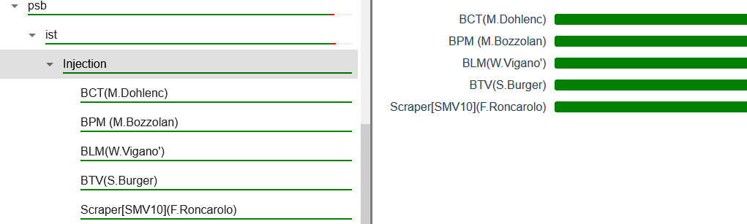
PSB injection webtool
BCT noise in the distributor region induced by pulsing elements
Miha and Roman working on the issue
TODO: upgrade of the BPM fesa class with the non linear position calculation feature for the new large aperture BPM

Slide 2
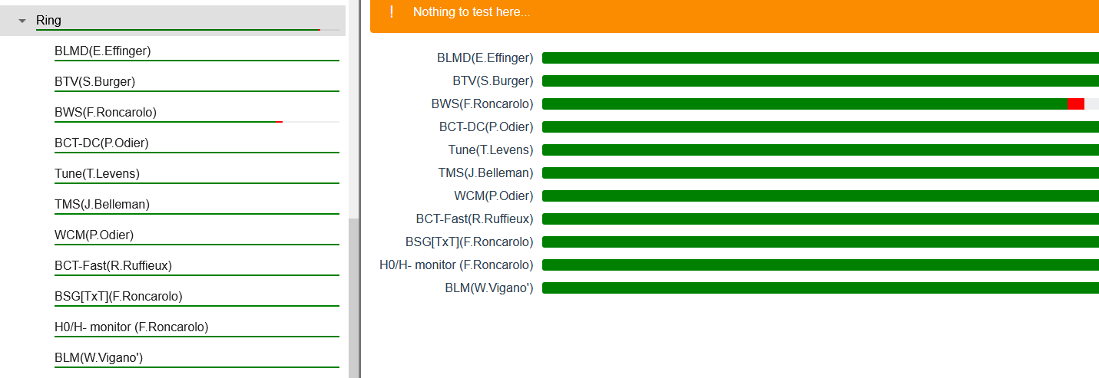
PSB ring webtool
Frequent reboots of TMS cPCI computer boards now solved by removing the crates from the UPS connected power strips
Issue with one wire scaner

Slide 3
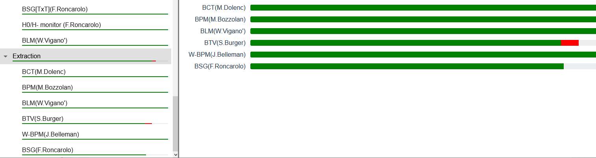
PSB extraction webtool
Two cameras to be installed in 2021

