Slide 1
HL-LHC BPM Electronics
Project Updates
M. Krupa, M. Wendt
WP13 meeting, 11/01/2021

Slide 2
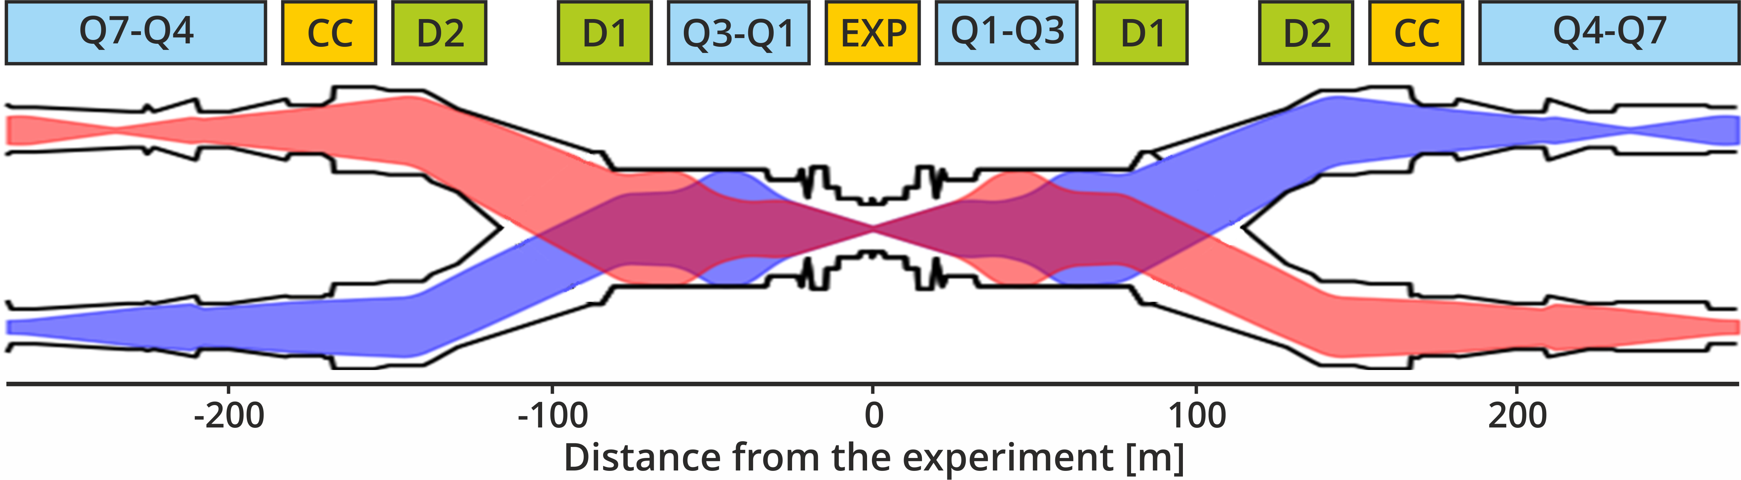
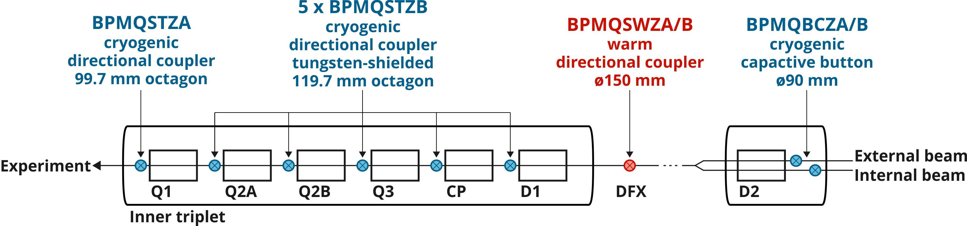
BPMs for HL-LHC IR 1/5
Beam 1
Will use WBTN
Beam 2
New acquisition needed
DESCOPED

Slide 3
IR 1/5 stripline BPMs
LHC
3 BPMs per IP side
  Q1: warm, Ø69 mm
  Q2: cold, Ø69 mm, 45°
  Q4: warm, Ø89 mm
All connected to WBTN (bunch-by-bunch measurements)
Some connected to DOROS (average orbit) in parallel by splitting signals
  Q1 & Q2 in IP1, Q1 in IP5
Electronics (mostly) in radiation classified areas
Satisfactory performance for the LHC needs
HL-LHC
6 BPMs per IP side
  Q1: cold, ⬡114.1 mm
  Q2A-D1: cold, ⬡125.1 mm, 45°
All connected to the new acquisition system (bunch-by-bunch)
Splitting with DOROS not foreseen for the moment
All electronics in R2E-free areas (new racks already requested)
Main areas of improvement:
  Resolution
  Stability
  Bunch-by-bunch

Slide 4
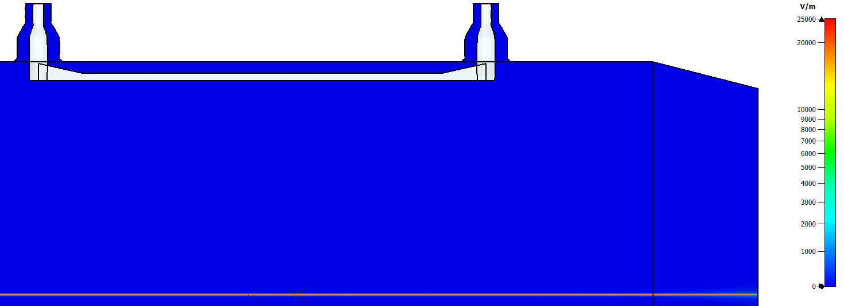
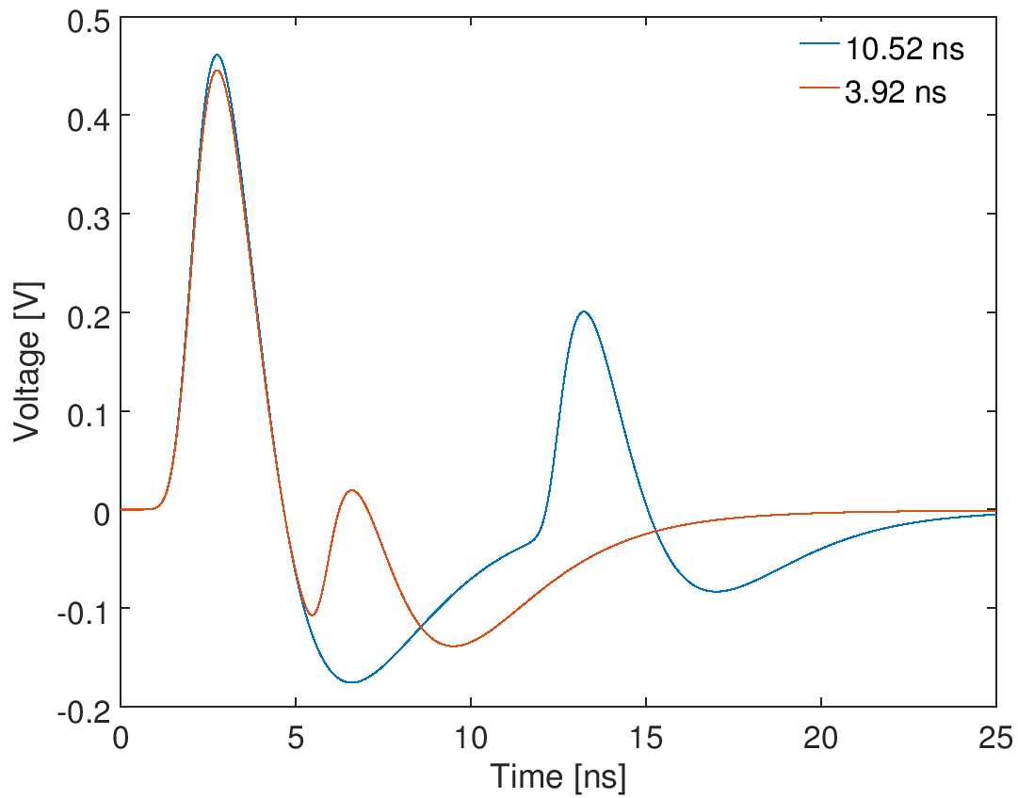
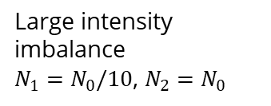
Disentanglement of both beams
Both counterrotating beams are measured by the same BPM
  Striplines with 24 dB directivity
  BPMs as far as possible from long-range beam-beam encounters
Correction of parasitic beam needed
  Doug simulated a maximum error of ~200 μm w/o correction
Proposed solution: direct sampling of each electrode, correction via DSP
  Algorithm theory – Doug
  FW implementation – BP section
  Main HW – commercial board needed
  Analogue FE – BP section
Large intensity imbalance
$N_{1}=N_{0}/10$, $N_{2}=N_{0}$
BPM | Z from IP [m] | Beam x-ing [ns]
Q1 | 21.871 | 3.92
Q2A | 33.108 | 3.92
Q2B | 43.893 | 6.82
Q3 | 54.679 | 9.72
CP | 65.770 | 10.52
D1 | 73.723 | 7.36

Slide 5
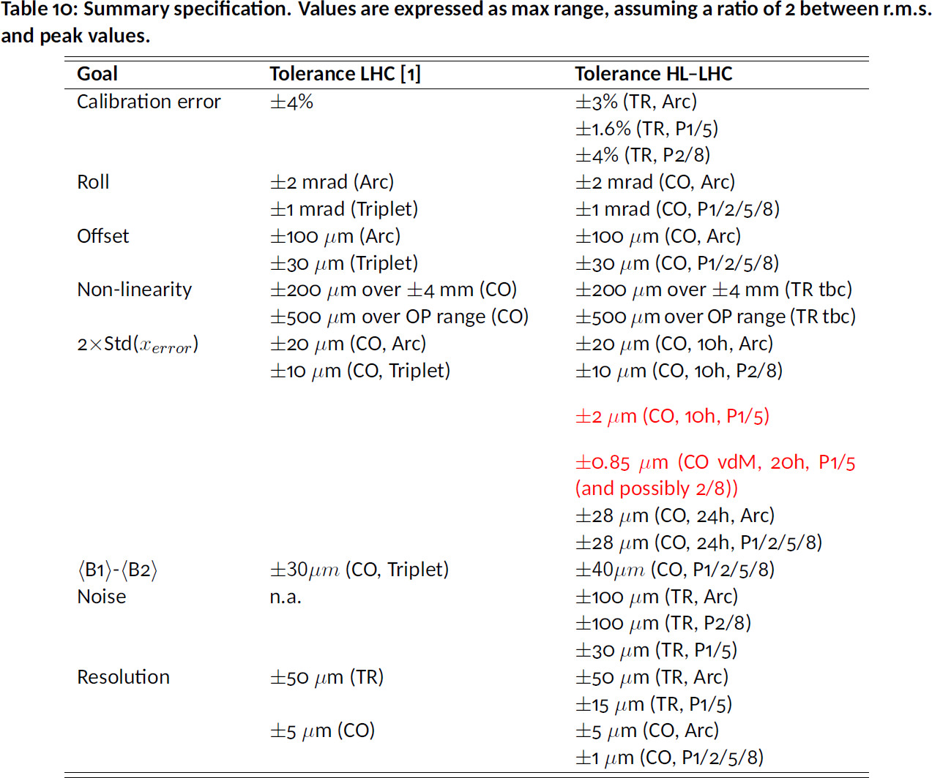
Specification
Discussions with ABP, OP and the experiments
  Three different users, very different needs…
All BPMs bunch-by-bunch
R. de Maria, D. Gamba and R. Tomas prepared a preliminary document for informal comments
Some requirements are much more challenging that for the LHC!

Slide 6
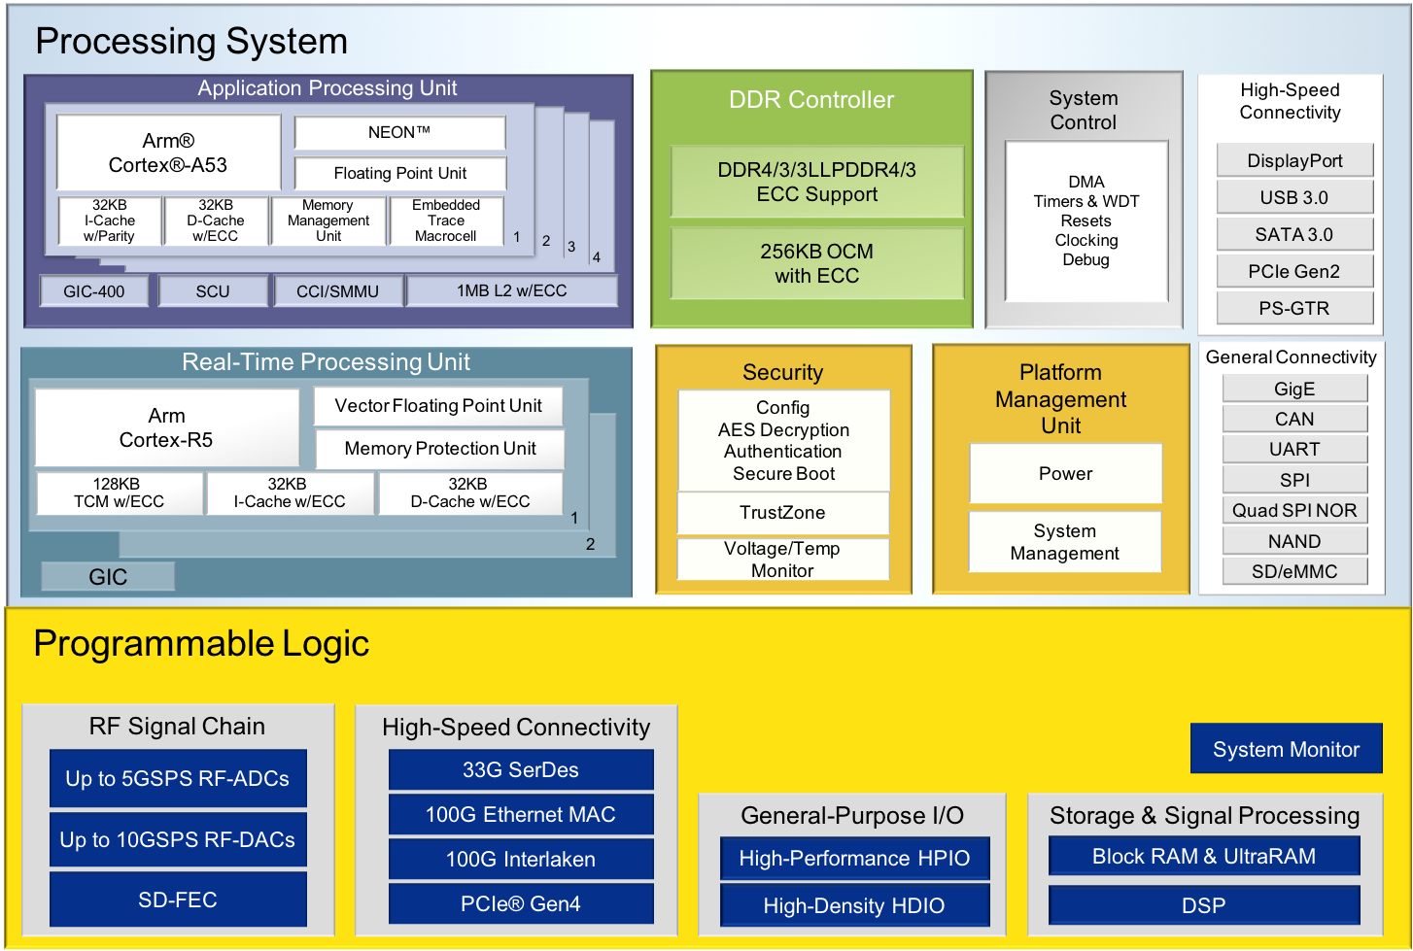
RF System-on-Chip (RFSoC)
Identified by Manfred in 2018
Integrated solution: CPU + FPGA + ADCs + DACs in a single die
  Developed for telecoms and autonomous vehicles
  State of the art performance
  No need for data converters, interfaces, high power etc.
Powerful logic for bunch-by-bunch position calculation with non-linearity correction, beam disentanglement and rotation correction
Several ADCs for simultaneous multi-electrode acquisition

Slide 7
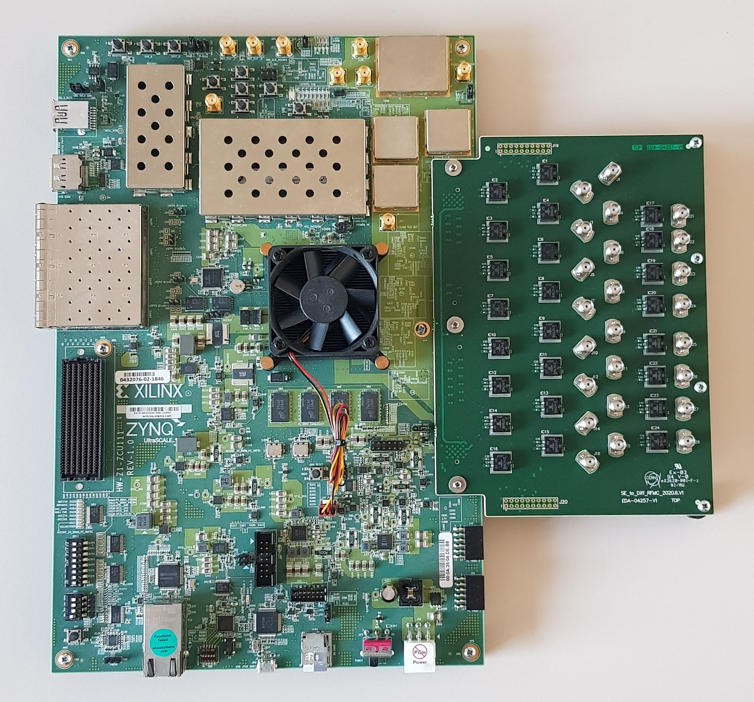
Available test hardware
ZCU111 Evaluation Kit
Purchased in 2018
Gen 1 RFSoC (XCZU28DR-2FFVG1517E)
  8 x ADC: 12-bit, 4.096 GSpS
  8 x DAC: 14-bit, 6.554 GSpS
Balun Adapter made by Selim Ozdogan: 16 x (200 kHz – 3 GHz) Baluns
Enough to equip 1 stripline BPM (both beams, both planes)

Slide 8
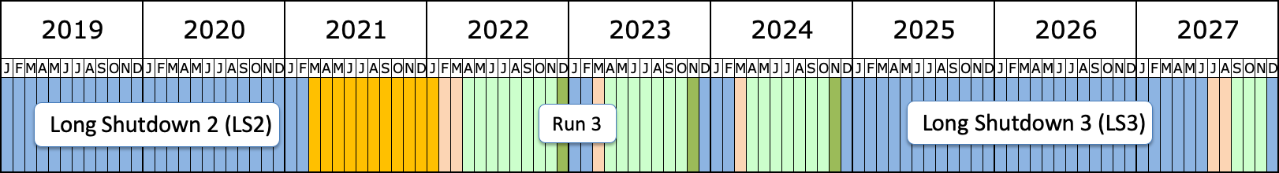
Test schedule
Ongoing: correction algorithm and calibration procedure development by Doug
September 2021: dump raw data into memory (scope-like)
  Parasitic on BPMS.2L5 (cold at 45°) or BPMSY.4L5 (warm) in USC55
  BPM disconnection needs to be discussed with Jorg
End of 2022 / early 2023: online correction algorithm
  Dedicated MD with RF cogging (beam-beam time delay)
  Parasitic long-term stability measurements
End of 2024: online position measurements with pre-series
In the lab: absolute calibration, long-term stability

Slide 9
Open points
Striplines in IP2 and IP8 – 3 per IP side
  Connected to WBTN (all) and in parallel to DOROS (Q1s only)
  WBTN will be phased-out in LS4 (2031) and replaced with new CONS electronics – not necessarily ideal for directive striplines
  Decision needed for IR2/8 stripline BPMs electronics!
uTCA foreseen as the system architecture
  Support from BE/CO needed
  Rhodri expressed his interest to collaboration with us in development and deployment of this new platform
Budget / spending profile
  RFSoC is an expensive non member state component
  Procurement will need to get involved soon

Slide 10
Thank you for your attention

