Slide 1

Carvings & Carpenter in SM18
Ioannis Koukovinis Platias

Slide 2

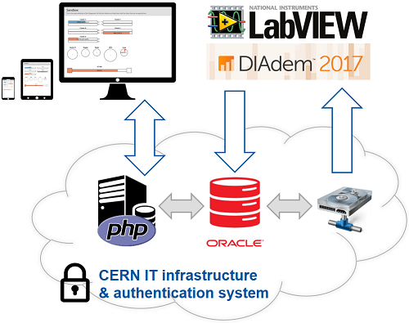
Overview
Main two parts of Carpenter ecosystem:
Carvings DB: Oracle Database
Carpenter: web interface to interact with Carvings DB
Other DB access points: OAQ, Wooden Bridge, Status board

Slide 3
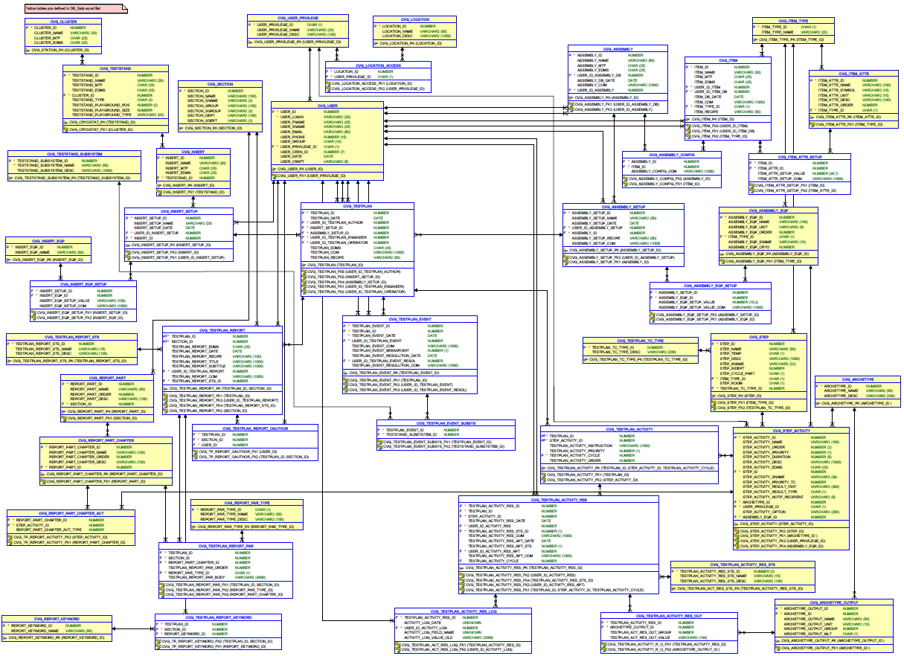
Carvings DB
Oracle Database
Constantly evolving and expanding
At the moment consists of > 40 tables and > 60 views
Currently holding > 380.000 result entries

Slide 4
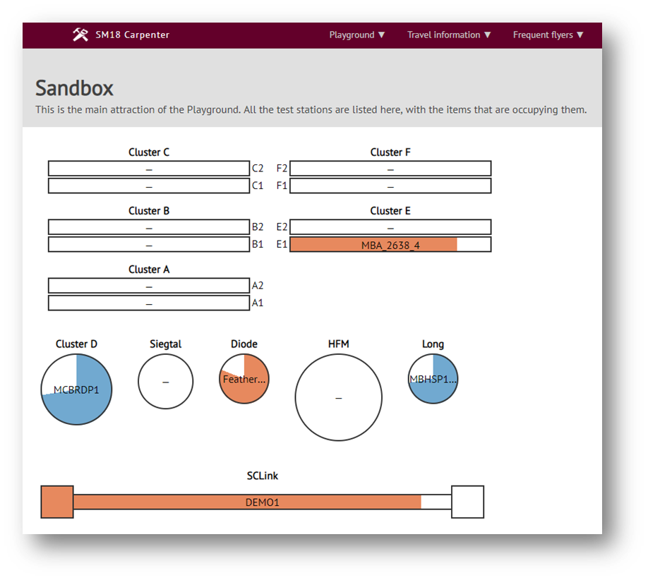
Carpenter
Quality Assurance / Quality Control:
Test progress tracking (who/when/what, results & events)
Efficient communication between ourselves and other groups
Allow authorized external users what we are doing in real time
Data processing and storage:
Store data from selected activities (e.g. quench, HV test)
Easy statistics and data filtering/mining
Reporting options

Slide 5
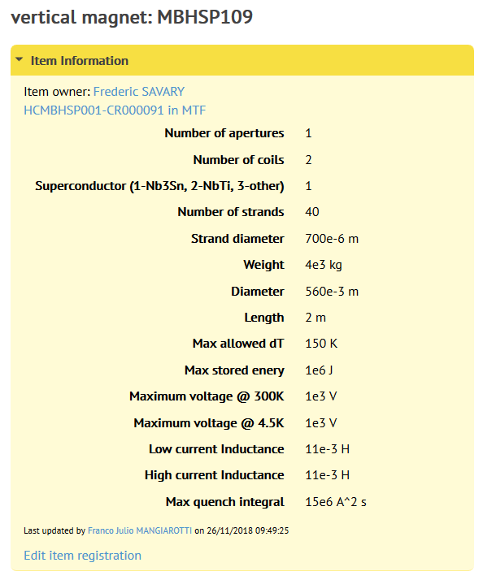
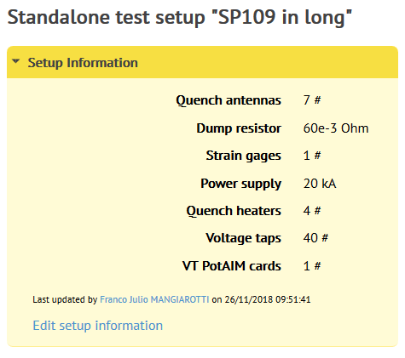
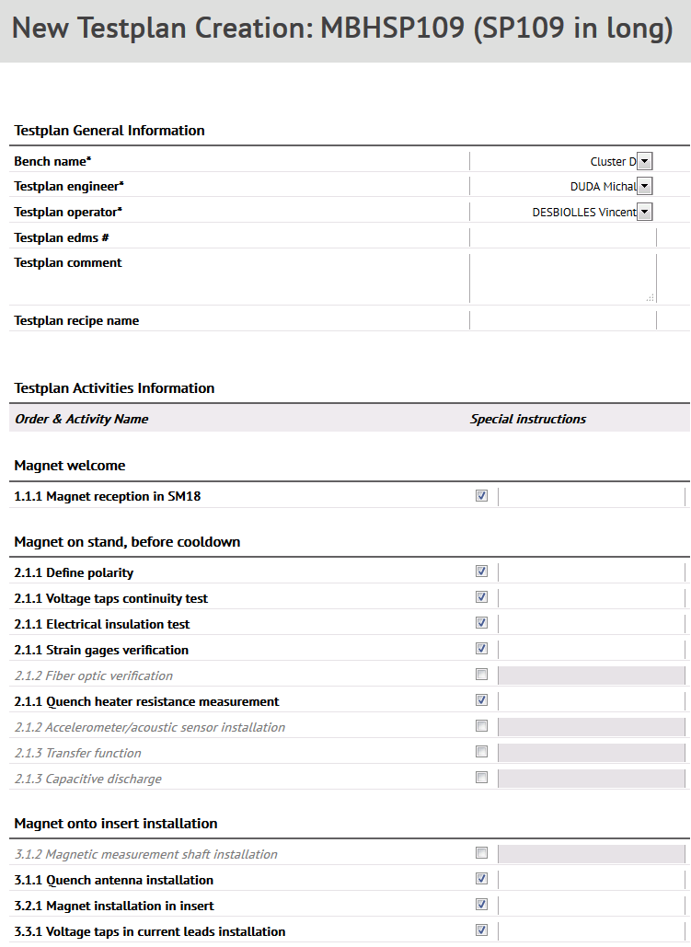
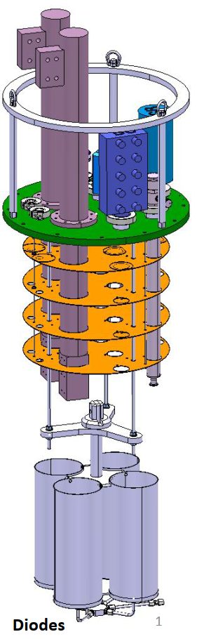
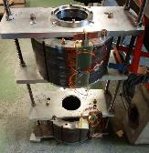
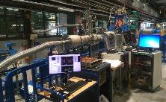

Carpenter
Item Registration
Assembly Setup
Testplan Creation
Assembly Creation
Multiple magnets on one insert
Stack of diodes
Cryomodule assembly

Slide 6
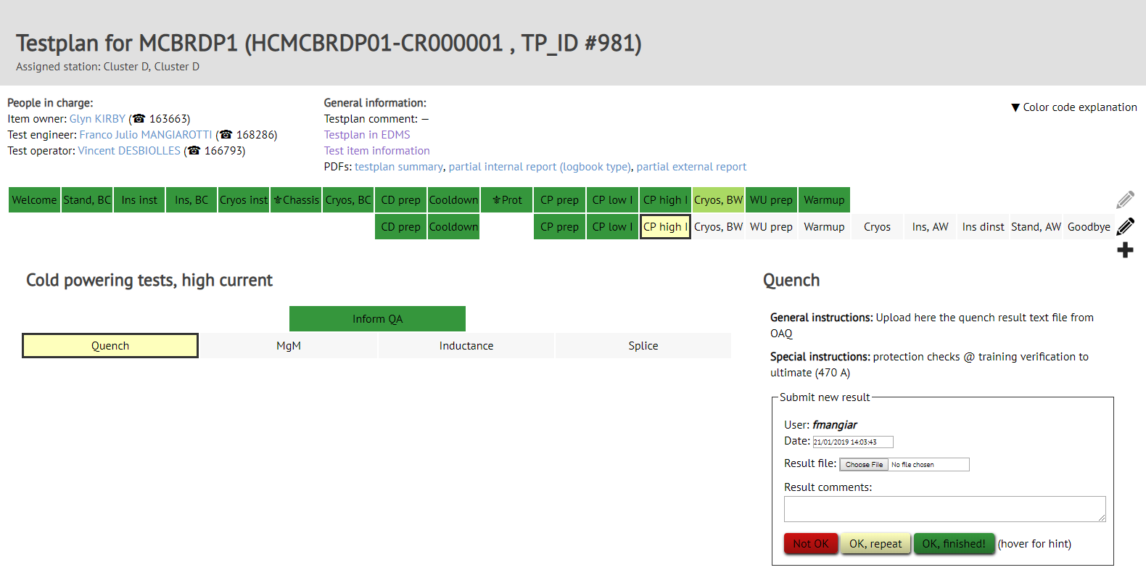
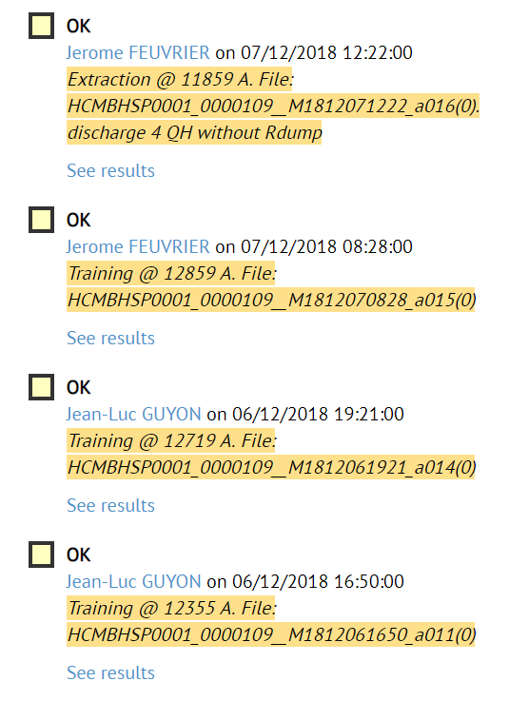
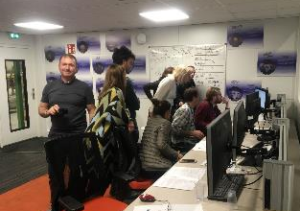
Carpenter
Test progress tracking:
Hierarchical structure to guide and follow the test
Only test engineer and operators can input data
Keeps track of what has been done, when, by whom

Slide 7
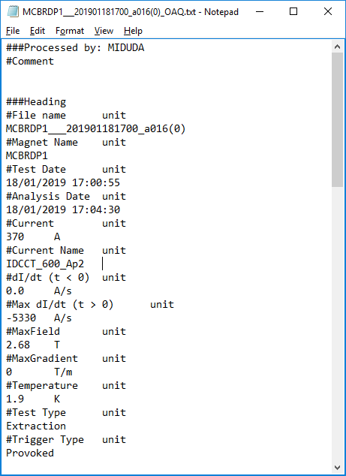
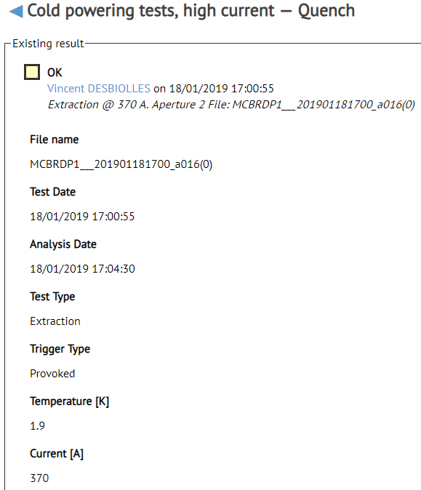
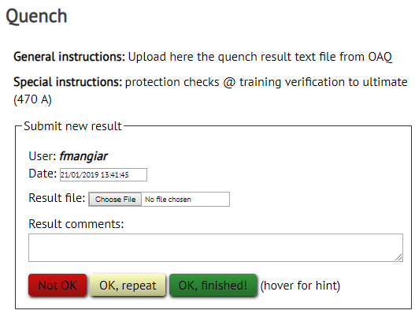
Carpenter
Data storage
Files from analysis software can be loaded and are automatically parsed
The results can be found in the Carpenter test plan

Slide 8
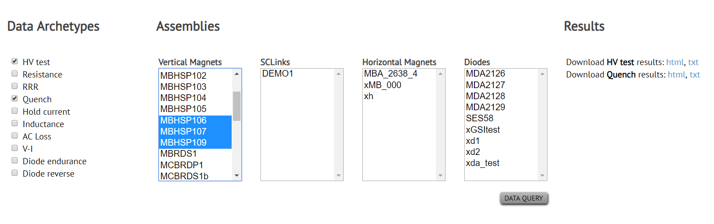
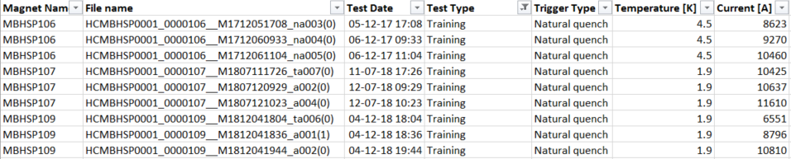
Carpenter
Data filtering/mining
Data can be filtered and then downloaded for further offline analysis
Future: statistics, training plots, etc.

Slide 9

Carpenter Versions
Version 1:
In development from mid-2017 to Q1-2019 by two developers
Entirely written in PHP
DFS-hosted website
Quick deployment
Technical limitations on technology utilized due to DFS hosting
Server not configurable
Lack of standardization

Slide 10
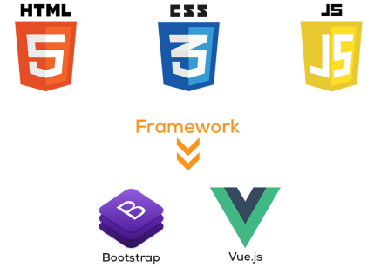

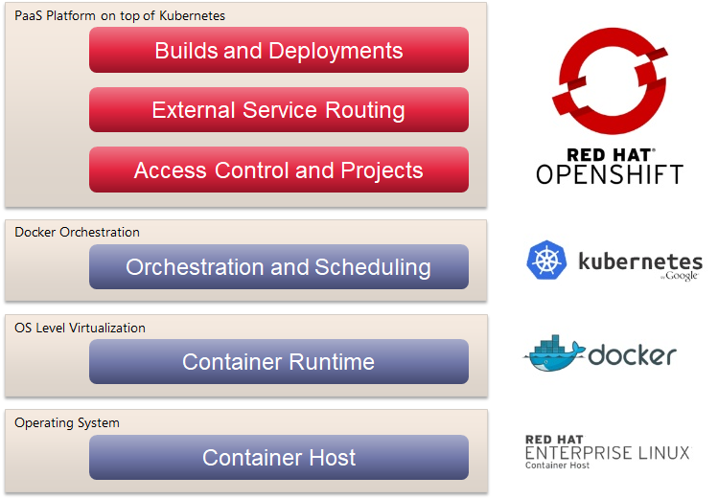
Carpenter Versions
Version 2:
Back-end: Laravel Framework (PHP)
Front-end: JavaScript/HTML/CSS, Bootstrap CSS Framework, Vue.js Framework, jQuery + various js libraries
PaaS (Platform-as-a-service) web application
OpenShift Container Platform: PaaS built around Docker containers orchestrated and managed by Kubernetes on a foundation of Red Hat Enterprise Linux
Dockerbuild and source code on Gitlab (auto deployment)
Highly interactive and mobile-friendly
Server totally configurable to current & future needs
Standardization → Maintainability
Ensures project’s longevity

Slide 11
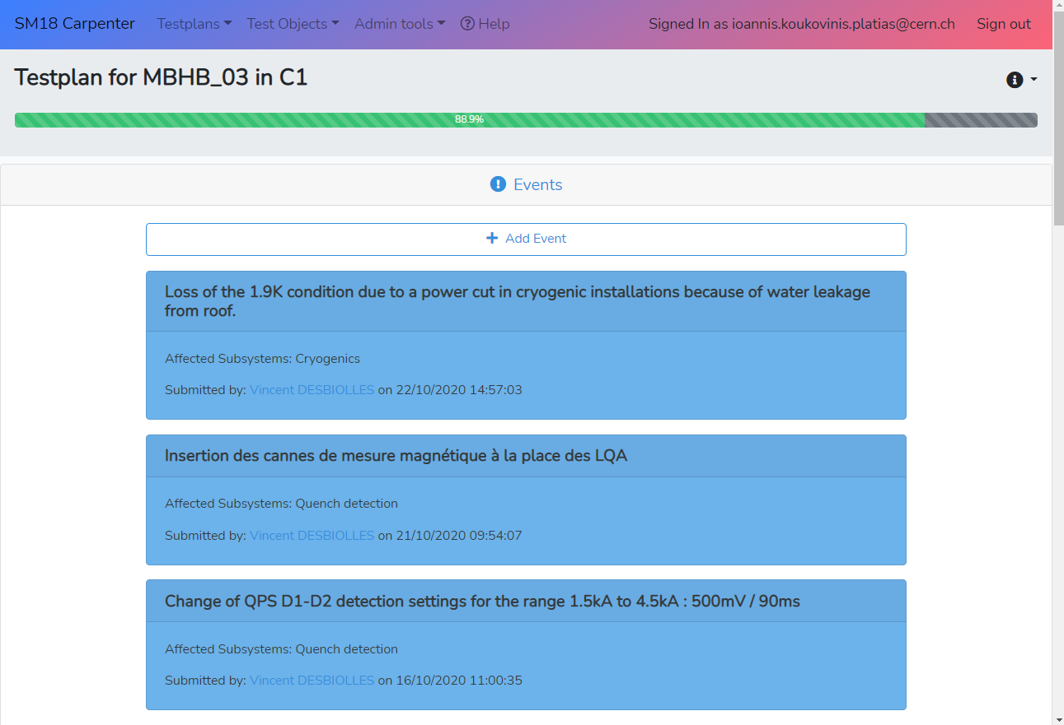
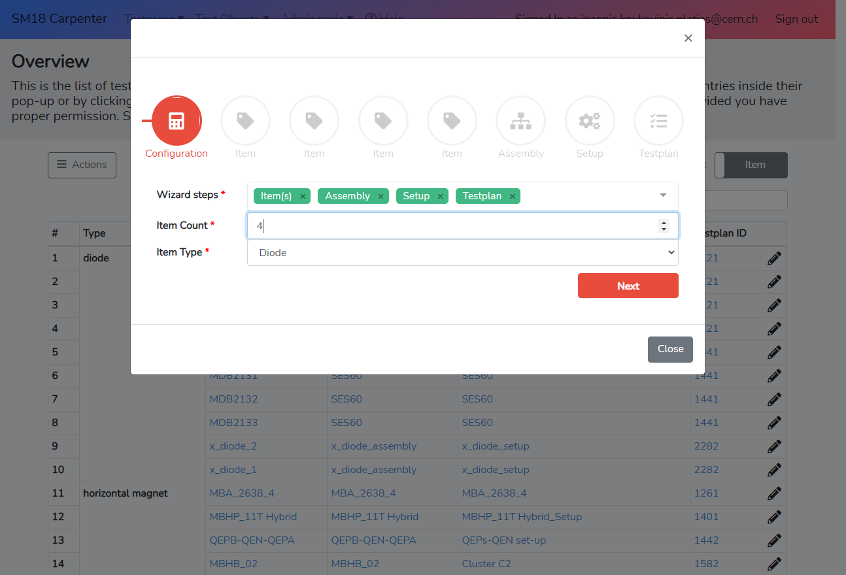
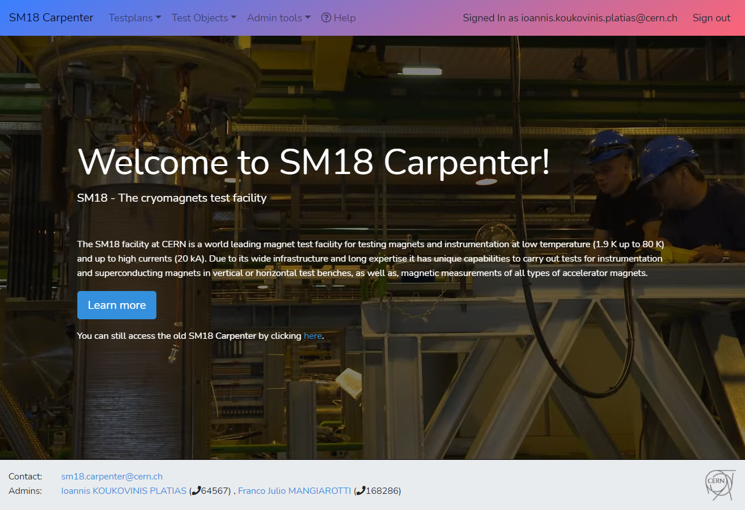
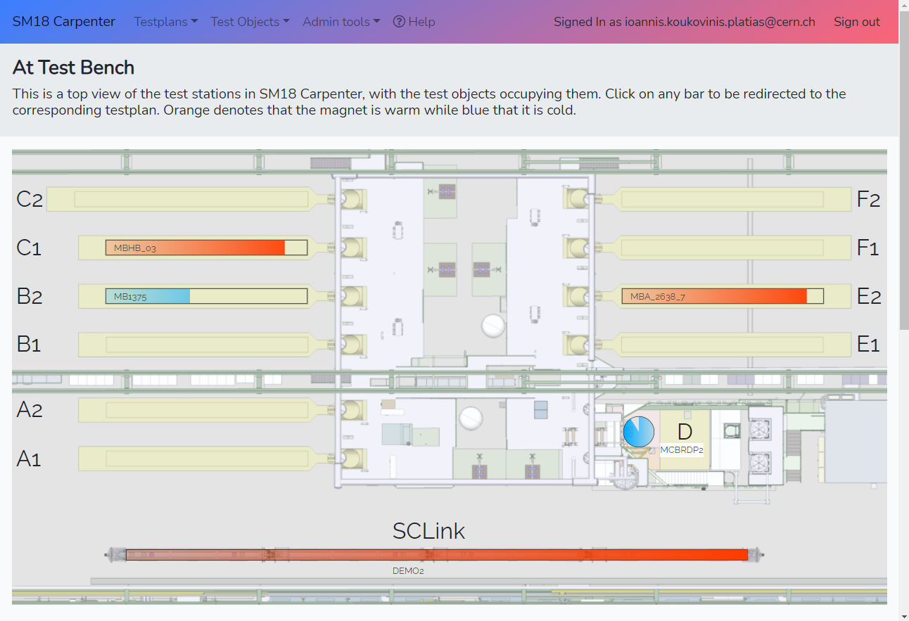
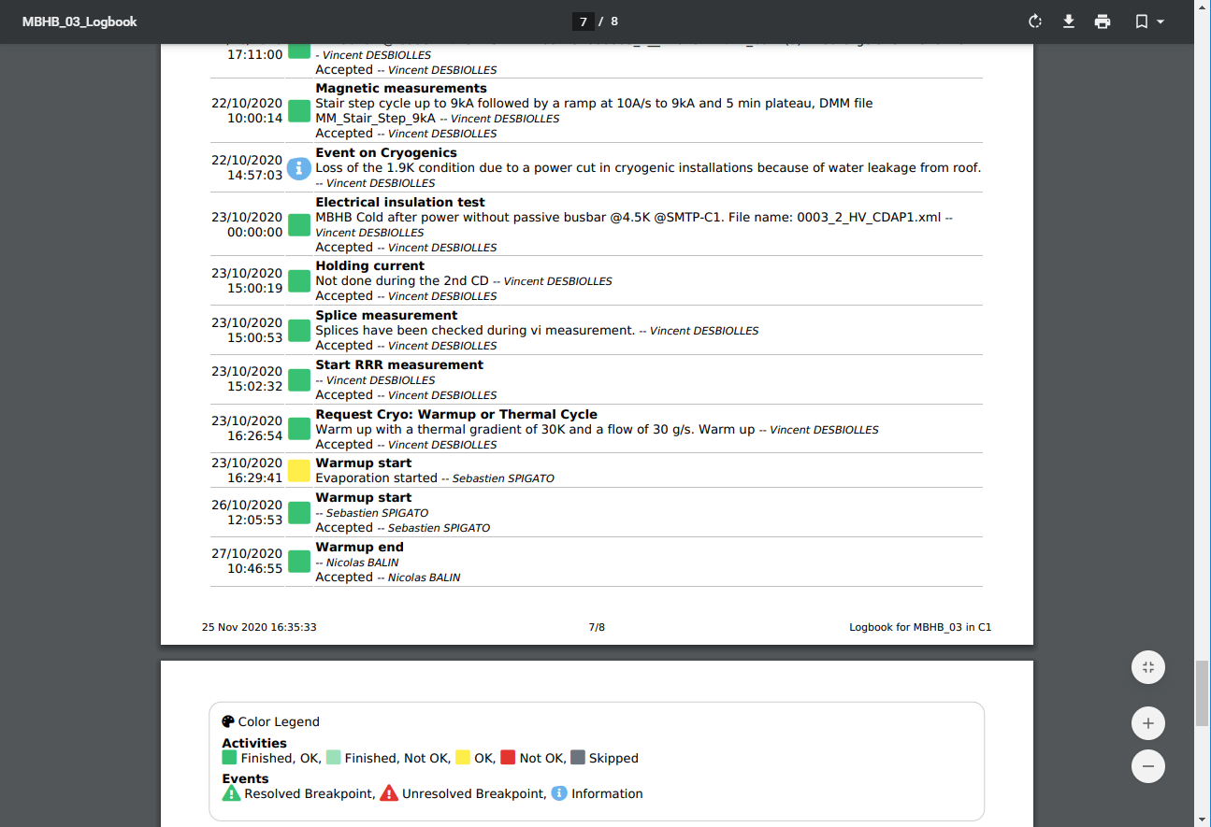
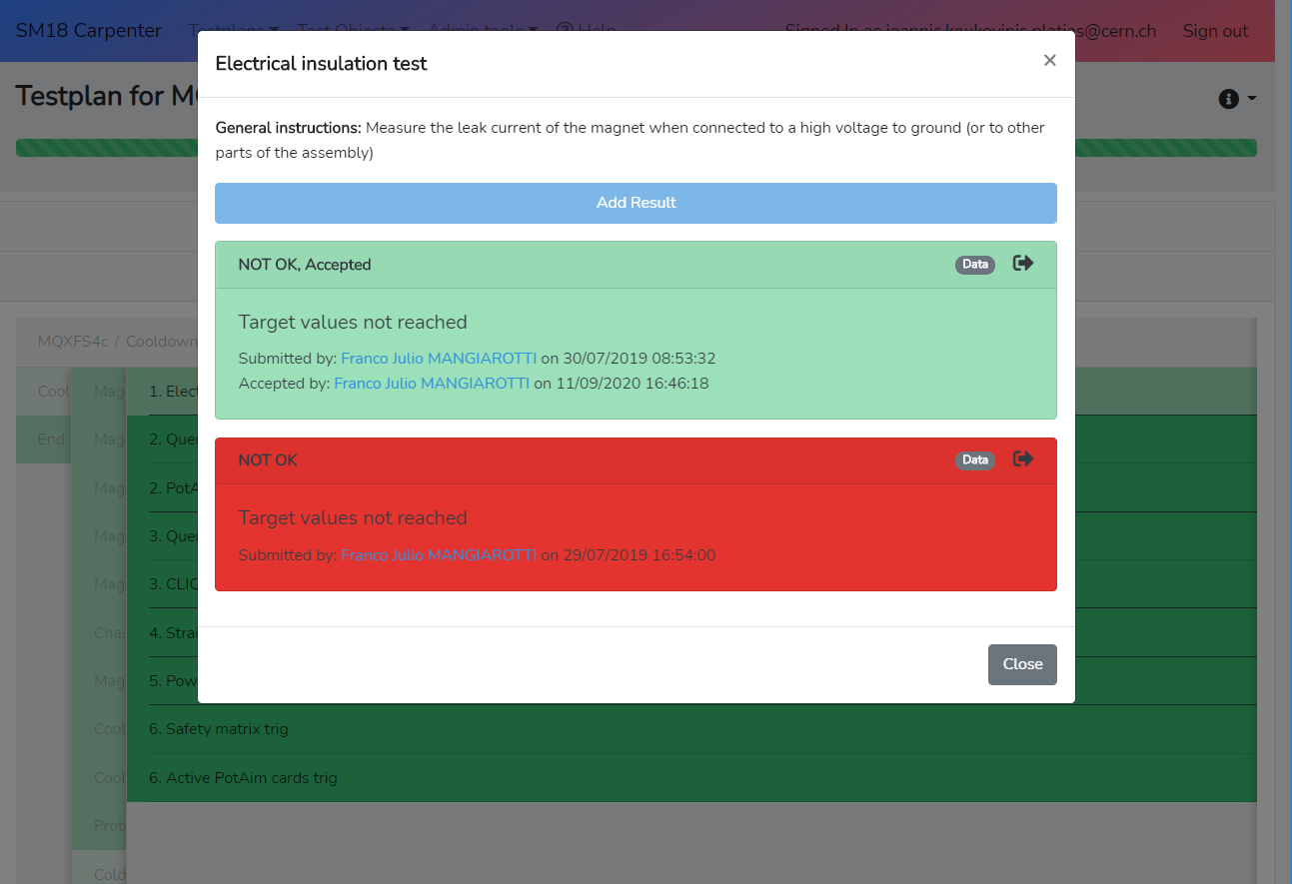
Carpenter Version 2

Slide 12

Next steps
Release Version 2 officially
Reach 100% functionality of Version 1
Advanced statistics
Automatic report generation / report filtering

Slide 13

Questions / Comments

