Slide 1

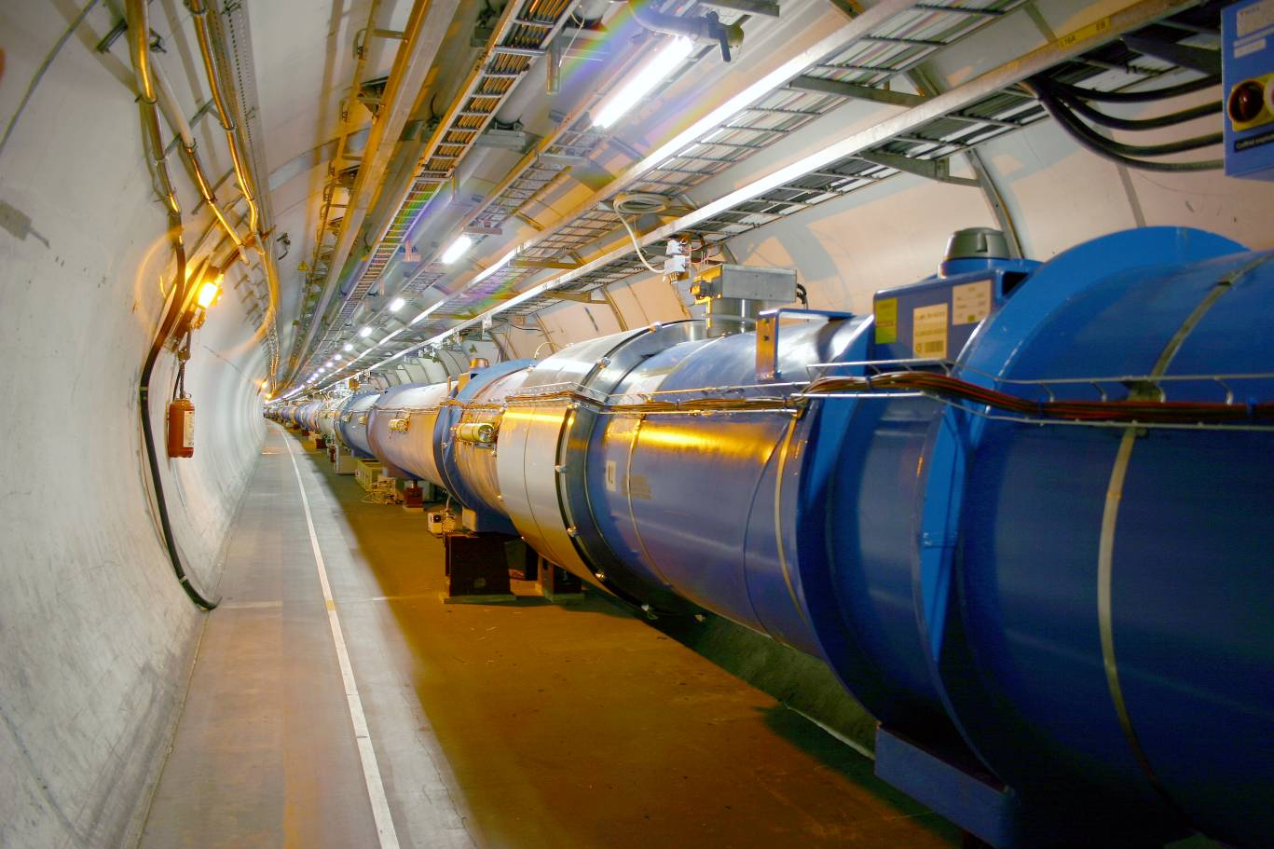


Requirements from the Vacuum Systems
HE-LHC
J.M. Jimenez
Thanks to V. Baglin, P. Chiggiato,
M. Taborelli and O. Grobner

Slide 2
Main Topics
Introduction
Machine parameters impacting vacuum performances
Remedies to vacuum dynamic effects
Gas load issue in cryogenic sections
Closing Remarks

Slide 3
Introduction
Accelerator vacuum requirements (1/3)
Particle beams are travelling under vacuum to reduce beam-gas interaction which is responsible for:
  Machine performance limitations
    reduction of beam lifetime (nuclear scattering),
    machine luminosity (multiple coulomb scattering),
    intensity limitation by pressure instabilities (ionization) and
    for positive beams only, electron (ionization) induced instabilities (beam blow up).
  Heat load to the cryogenic system induced by the scatted protons/ions
  Magnet quench i.e. a transition from the superconducting to the normal state.
    heavy gases are the most dangerous because of their higher ionisation cross-sections.
Beam-gas scattering frequently induces background to the Detectors
  Non-captured particles which interact with the detectors
  Nuclear cascade generated by the lost particles upstream the detectors.
Beam-gas scattering can be responsible for the increase of the radiations
  High dose rates could lead to material activation (personnel safety issues), premature degradation of tunnel infrastructures like cables and electronics
  Higher probability of single events (induced by neutrons) which can
  destroy the electronics even in the service galleries

Slide 4
Introduction
Accelerator vacuum requirements (2/3)
Vacuum system shall obey to severe additional constraints which have to be considered at the design stage since retrofitting mitigation solutions is often impossible or very expensive
  Minimise beam impedance and HOM generation
  Optimise beam aperture in particular in the magnets
  Intercept heat loads (cryogenic machines)
    Synchrotron radiation
    Energy loss by nuclear scattering
    Image currents
    Energy dissipated during the development of electron clouds

Slide 5
Introduction
Accelerator vacuum requirements (3/3)
Pressures in the accelerator beam vacuum pipes are dominated by:
  Thermal outgassing - is not beam related, results from design, material and procedures (firing and bake-out)
  Primary beam losses
    Cryogenic sections are the more critical since not baked out and covered by condensed gassed
    BUT “protected” by the quench limit of the cryomagnets
  Temperature of operation of the vacuum system is a determinant factor
  Beam induced desorption effects dominates at high energies and high intensities
    Effects linked to the bunched structure of beams
      Electron cloud and Ion instability build-up
    Effects linked to the total beam intensity
      Primary beam losses induced desorption
      Primary ionisation with circulating beams
      Ions-induced positive space charge
      Synchrotron radiation and photo-electrons induced desorption
    Feedback effects
      Secondary ionisation of residual gas by photo-electrons or electrons
      from the cloud

Slide 6
Machine parameters impacting vacuum performances
Synchrotron radiation
Synchrotron radiation power
  Factor 17.5 higher as compared to LHC
  Must be extracted by the cryogenic system at higher
  temperatures thus requiring a beam screen (BS)
Linear photon flux proton beam
  +30% of LHC nominal
  10 times more critical energy implies factor 3/4 in the photo-electron yield
  Results in 4.5 times more photo-electrons stimulated desorption
Photon stimulated pressure rise
  At RT, the yield will be increased
  by 17.5 ( NEG bring a factor 10
  reduction, 10 for the critical energy
  and factor17.5 increase for E and I dependence)
  At cold, the yield will be increased
  by 74 (10 for critical energy and 7.4 for E and
  I dependence)
    Pumping speed i.e. number of holes in
    the beam screen shall be significantly increased!

Slide 7
Machine parameters impacting vacuum performances
Energy and Total Intensity (1/2)
Energy (7 => 16.5 TeV)
  Is the dominant factor (power scaling) for SR power, photons and photo-electrons stimulated desorption
  Higher energies implies higher bending magnetic fields and thus affects the design of the beam screen which shall stand magnetic quenches
Total Intensity
  Image current/Impedance
    Smaller aperture would imply a ticker copper layer
      Larger forces on to the beam screen in case of a quench
      Mechanical stability still to be checked since increasing BS thickness will reduce aperture…
  RF shielding
    Engineering solutions exists and are applied in synchrotron rings

Slide 8
Machine parameters impacting vacuum performances
Energy and Total Intensity (2/2)
Intensity (factor 1.8 less compared to LHC)
  Is contributing linearly to all dynamic vacuum processes
  Is the determinant factor for Ion induced instability which results from the Primary ionisation with circulating beams (σ and I dependant)
    Circulating beams will ionise the residual gas molecules, then these ions will get accelerated by the beam potential and will impact the vacuum pipe walls inducing a local desorption
    If the conductance/pumping speed are not adapted, a feedback effect would take place resulting in an exponential increase of the pressure
    η is 10 times higher
    I is 1.8 times smaller
    σ does not vary significantly
    S_{eff} will depend on Temperature and transparency of the BS

Slide 9
Machine parameters impacting vacuum performances
Bunch Population: Electron Cloud (1/3)
Bunch population (1.15 => 1.3 10¹¹p/bunch)
  Significant effect on the threshold and intensity of the electron cloud
  Electron cloud is a limiting phenomenon since
    Increasing the heat load to the cryogenic system: electron bombardment
    Increasing the pressure and thus the background to Detectors: electron stimulated desorption
    Interacts with beams and induces instabilities and blow-up

Slide 10
Machine parameters impacting vacuum performances
Bunch Population: Electron Cloud (2/3)
Stimulated outgassing gas load is given by:
  k converts from molecular densities to pressures
The gas load is decreased by two beam induced effects:
  Vacuum cleaning
    Reduction of the stimulated desorption yields (η) ⇨ factor 10-100 reduction
  Beam conditioning (or scrubbing)
    Reduction of the secondary electron yield (SEY, δ) of the internal beam pipe wall
    Reduction from 2.1 down to 1.5 in the SPS after 4-5 days of beam scrubbing
Electron cloud considerations
  Number of protons/bunch decreased but still above the threshold (~3.10¹⁰ in SPS dipoles)
  Number of bunches is decrease by factor 2 ⇨ bunch spacing decreases electron cloud (50 ns is 10 times smaller than 25 ns)
    Trapping of electrons by space charge effects can compensate this effect
  Bunch size is reduced increasing the beam potential which is an important factor for the Ecloud
    Electrons receive a higher kick in energy

Slide 11
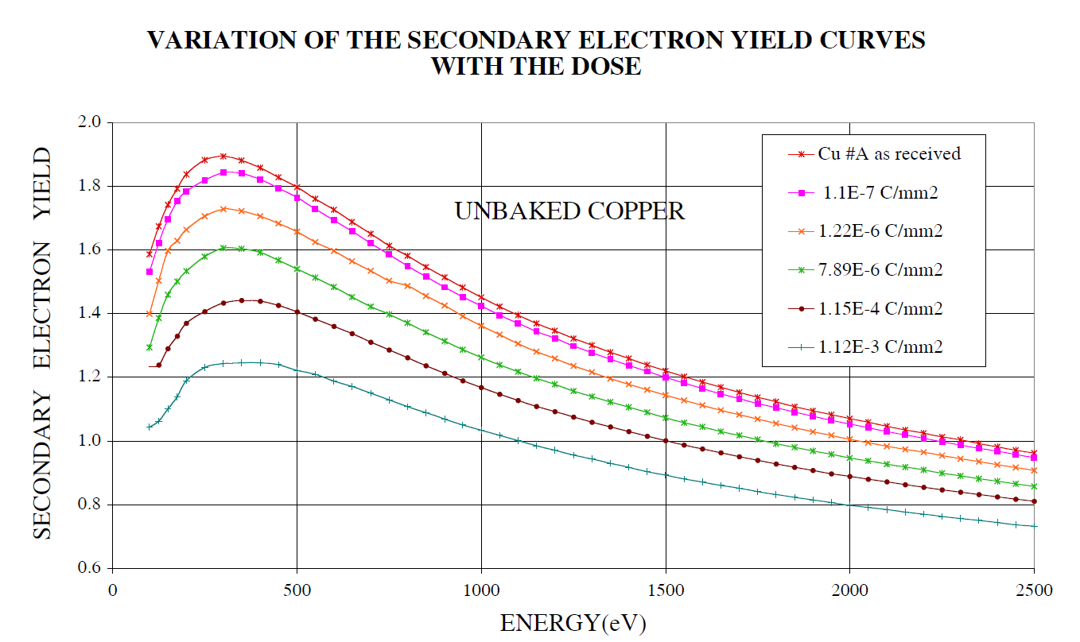
Machine parameters impacting vacuum performances
Bunch Population: Electron Cloud (3/3)
The dominant factors are:
  Energy of the primaries
  SEY and reflectivity of the low energy electrons (<5 eV)
  Energy of the primary electrons
  Magnetic field: at 22 Tesla, the larmor radius is of μm for a 100 eV electron...

Slide 12
Machine parameters impacting vacuum performances
Feedback Effects: Ecloud vs Ion instability
Ion induced pressure rise with electrons
  Secondary ionisation by an e-cloud can reduce the critical beam current and hence the vacuum stability
  Ionisation cross section for low energy electrons is about two orders of magnitude larger than for high energy protons.
  Assuming the SPS Ecloud intensity 0.05 A/m and the LHC total intensity 0.54 A, this effect will start dominating if the path of the electrons in the magnetic field exceed 0.1 m...
  Ecloud can bring a good design for ion instability to an unstable regime!

Slide 13
Remedies to vacuum dynamic effects
Synchrotron radiation & Ion induced instability
Synchrotron radiation
  Induced heat load
    BS are required to intercept the heat load at a higher temperature
    Absorbers could be considered, depends on magnet strength/length
      Their cooling shall be decoupled from the cooling of the BS to preserve the cooling capacity
  Photo-electron yield shall be reduced by using a sawtooth structure
    Normal incidence instead of grazing incidence
  Photon and photo-electrons induced desorption
    Will improve with time resulting from the vacuum cleaning effect (dose effect)
    Low memory effect in case of venting to air
Ion induced instability
  Make a design which provides enough effective pumping speed (considering beam pipe conductance) as from day-one
  Longitudinal conductance has a negligible effect
    Cold bore pumping dominates
  Operating temperature of the cryomagnets is a key factor

Slide 14
  Remedies to vacuum dynamic effects
  Temperature of operation of the cryogenic systems
The pumping on cold bore / beam screen is dependant from:
  Mean molecular velocity [ν]
  Sticking probability [s]
  Surface area of pumping per unit of length of the beam pipe [F]
  The increase of the magnet operating temperature will:
    Keep the pumping speed constant as [F] does no vary
    Decrease the pumping capacity as [s] will decrease
  To compensate:
    The transparency of the beam screen shall be increased
      Since the aim is to reduce the magnet aperture, the % of hole will also increase
      HOM effects ?
    If T_{op} is higher than 3 K, cryosorbers will be required and shall be “thermalised” by the cold bore (not by the beam screen)
    If pumping capacity is limited, regenerations will be required BUT in this case the magnet will have to be warmed-up instead of the beam screens
      Permanent turbomolecular pumping of the beam vacuum will then
      be needed...

Slide 15
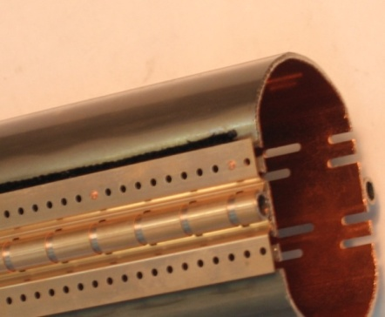
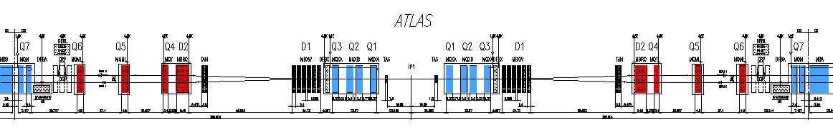
Remedies to vacuum dynamic effects
Adsorption isotherms
Cryosorbers
1.9 K
4.5 K

Slide 16
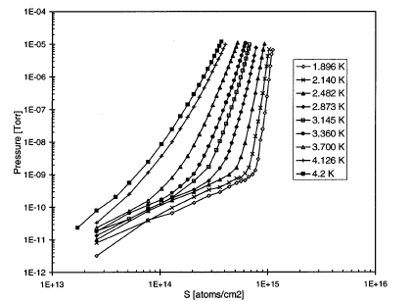
Remedies to vacuum dynamic effects
Pumping capacity
He adsorption isotherms on stainless steel (similar for H)
Pumping capacity decreases
by 10
between 4.2K and 1.9 K

Slide 17
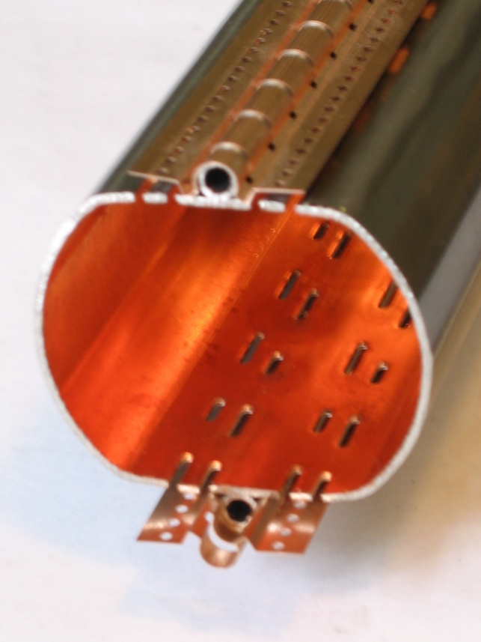
Remedies to vacuum dynamic effects
Electron Cloud mitigation (1/3)
Active solutions: clearing electrodes
  No threshold efficiency
  No lifetime issues
  Can suppress also the surviving electrons
    Low-energy electrons surviving gaps between bunches
  Does not degrade in case of venting to air
  Similar efficiency at cryogenic temperatures
  BUT
  Shall be in the vertical plane in dipoles since electrons are
  confined in 2 (3) strips in the vertical plane
  Shall be large enough to cover the spacing of the vertical strips
  which varies with bunch intensity
  Can be placed behind the pumping holes of the BS
  Results in an aperture reduction

Slide 18
Remedies to vacuum dynamic effects
Electron Cloud mitigation (2/3)
Passive solutions: coatings
  NEG coatings (SEY=1.1 after activation)
    Needs a bake out. Solution validated in many accelerators
    Improvements ongoing to achieve low-temperature NEG activation coatings
    (120-140 °C), compatible with their use in RT magnets and Detectors
  a-C (graphite) coatings (SEY<1)
    Looks promising, lifetime being evaluated
    SEY could be further decreased by a combination of geometrical surface effects (rougthness)
      Impedance effects to be evaluated
    Higher outgassing rates but could be decreased with a low-temperature bake out (<120°C)
    Ongoing studies for its qualification at cryogenic temperatures
      Will help with background to Detectors
      Could provide more pumping capacity for hydrogen (cryosorber material)
      Thick gas coverage could modify the SEY
  Other types of coating could be considered for SEY>1.5: TiN

Slide 19
Remedies to vacuum dynamic effects
Electron Cloud mitigation (3/3)
Scrubbing effect
  Efficient only up to the bunch intensity used during the scrubbing periods
  Detectors can not take any data during the scrubbing run since saturated by the beam-gas scattering
  Little experience of its efficiency on surfaces at cryogenic temperatures
    Measurements show that condensed gasses significantly modify the “apparent” SEY

Slide 20
Gas load issue in cryogenic sections
Beam Screen /Cold Bore Recycling
Thick coverage of beam screens (BS) and cold bore (CB) by atoms/molecules desorbed directly (beam losses) and indirectly (photons, electrons and ions) could lead to pressure oscillation and vacuum instabilities.
In practice, should not become a limiting factor since:
  Thick coverage in BS
    BS can be recycled by heating up to 80 K
    Gas will be “flashed” towards the cold bore through the BS pumping holes
    Conditions can be met during short LHC Technical Stop (2-3 days)
  Thick coverage of CB
    CB can be recycled by warming-up to 80 K
    Gas is pumped away using mobile turbomolecular pumps
    Conditions met once per year during the LHC Technical Stop (Christmas)

Slide 21
Closing Remarks
Start-up with beams
Start-up scenario
  Accelerator vacuum system can not be designed for nominal performances on day-one, often
    Rely on vacuum cleaning (reduction of the desorption yields by photon, e-, ions bombardments)
    Rely on beam scrubbing (reduction of the secondary electron yields)
  With bunched beams, two options
    Nominal number of bunches and progressive increase of the intensity per bunch
      Allows to benefit from vacuum cleaning effects and therefore the effects linked to the bunched structure of beams (electron cloud and ion instability) are less limiting since stimulated desorption coefficients (η) have decreased with time/dose (photons)
        Areas with two circulating beams will behave differently...
    Nominal intensity per bunch and progressive increase of the number of bunches
      Allows for higher luminosities with lower machine optimisation but all effects linked to the bunched structure of beams (electron cloud and ion instability) will be at their maximum

Slide 22
Closing Remarks
Observations from other accelerators: LHC vs SPS
Effects linked to the bunched structure of beams (electron cloud and ion induced instability) are hard limits for performances of accelerators. Alternative solutions can be found to allow running up to nominal/ultimate performances but always by compromising on other aspects
  SPS requires a Scrubbing Run (3-5 days) to be able to operate nominal LHC beams with limited electron cloud and acceptable pressure rise. This Run relies on:
    The reduction of SEY by electron bombardment: dose effect
    The low stimulated desorption yields: avoid as much as possible venting of vacuum sectors
  LHC (will) require a both a vacuum cleaning and scrubbing period BUT with larger constraints since background to the experiments, induced heat load to cryogenics and cryomagnet quench limits (beam-gas scattering) prevent operation with large electron cloud which should have lead to a faster vacuum cleaning and beam scrubbing

Slide 23
Closing Remarks
Preliminary consideration for HE-LHC (1/2)
Considering what was observed in other accelerator, HE-LHC shall go for more conservative design: Effects linked to the bunched structure of beams shall be mitigated as from the design
  Will help to reduce to the minimum the background to Detectors
  Will help in case the beam scrubbing of cryo surfaces and cold/warm transitions is slower than initially considered
  Will help in case the accumulation of the low energy electrons with high reflectivity (survivals) compensate the reduction of the secondary electron yield (SEY)
    Beam scrubbing no longer help, photo-electrons production will dominate (design issue i.e. will not be significantly improving with time/dose)
    At the moment, no evidence of this phenomenon as can not be observed in SPS, tentative to study it at RHIC did not go to the end.
    Have evidence for the long survival time of the very low energy electrons (< 5eV)

Slide 24
Closing Remarks
Preliminary consideration for HE-LHC (2/2)
Vacuum system shall be designed to
  Be stable on day-one against ion-instability
  Reduce the number of photo-electrons
  Rely on vacuum cleaning (decrease of η_{ph}/η_{e-}) for gas desorption stimulated by SR and photo-electrons
  Implies the use of a beam screen but as compared to LHC, the following issues must be looked at:
    More pumping speed is required: more pumping slots
    Mechanical constraints: deformation with quench, impedance and HOMs
  Cooling capillaries at BS to thermalise it between 40-60 K
  Cryosorbers are required if the cryomagnets are operated above 3 K
  Clearing electrodes in dipoles behind the BS and attached to the cooling capillaries to suppress electron cloud, alternatively:
    Proceed to a coating of quads and cold/warm transitions of standalone cryomagnets
    Use solenoids (3-5 mT) to mitigate electron cloud build up in vacuum instrumentation ports and interconnecting pieces which can not be coated
  Long straight sections at RT should be baked and use NEG coatings
    Alternatively, install solenoid if coating is not feasible

