Slide 1
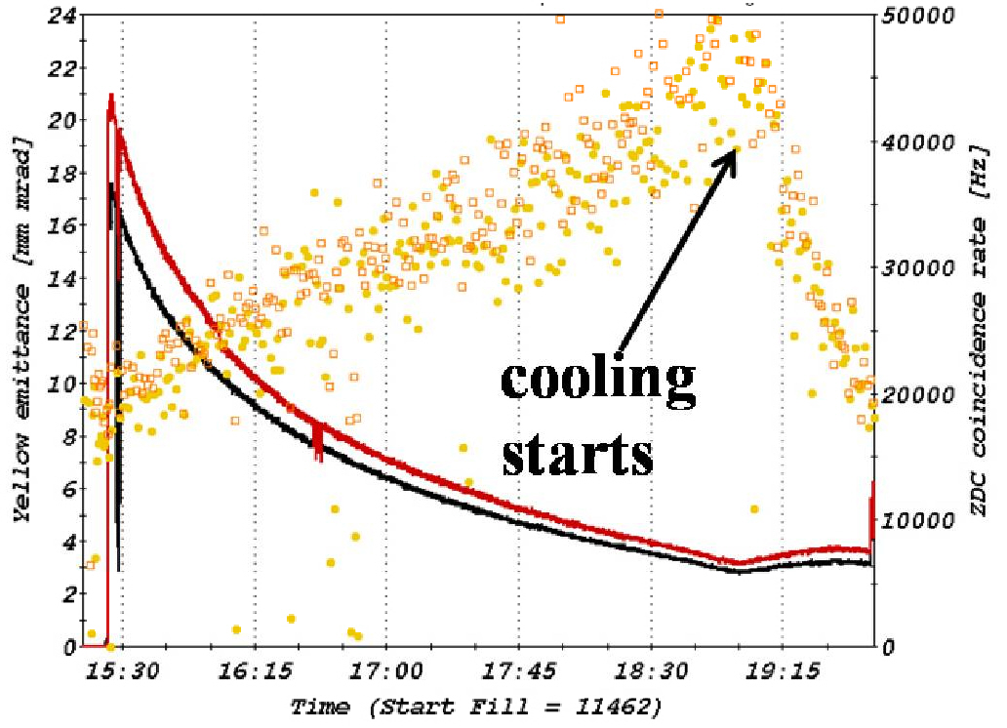

IBS and cooling in RHIC,
HE-LHC active emittance control
W. Fischer and M. Blaskiewicz
14 Jan 2010
1st vertical
stochastic
cooling in
RHIC
15 October 2010
High-Energy LHC, Malta
Notes:
Friday 10/15/2010, 10:30-10:50, 15 min talk, 15 slides

Slide 2
Content
LHC active emittance control
− HE LHC damping times
− Maximization of integrated luminosity
IBS and cooling in RHIC
− Measurements and simulations for IBS
− Au⁷⁹⁺ beam dynamics with stochastic cooling

Slide 3
High Energy LHC parameters (from F. Zimmermann)
[R. Assmann et al, “First thoughts on a higher energy LHC”, CERN-ATS-2010-177]
 | Nominal LHC | High energy HE-LHC
beam energy [TeV] | 7 | 16.5
peak luminosity [10³⁴ cm⁻²s⁻¹] | 1.0 | 2.0
luminosity lifetime [h] | 23 | 13
events per crossing | 19 | 76
# bunches / beam | 2808 | 1404
bunch population [10¹¹] | 1.15 | 1.3
Luminosity leveling | no | yes: e_{x,y}
initial transverse normalized emittance [mm] | 3.75 | 3.75 (x) 1.84 (y) | 2.59
number of IPs contributing to tune shift | 3 | 2
maximum total beam-beam tune shift | 0.01 | 0.01
IP beta function [m] | 0.55 | 1.0 (x), 0.43 (y) | 0.6
full crossing angle [mrad] | 285 (9.5 s_{x,y}) | ~180 (12 s_{x0})
longitudinal SR emittance damping time [h] | 12.9 | 0.98
horizontal SR emittance damping time [h] | 25.8 | 1.97
initial long. IBS emittance rise time [h] | 61 | 64
initial hor. IBS emittance rise time [h] | 80 | 80
initial ver. IBS emittance rise time [h], (k=0.2) | ~400 | ~400

Slide 4
Means of active emittance control during stores
Assume that initial beam parameters have been adjusted to acceptable values.
Adjust strength of active cooling (currently not an option in LHC)
change of gain, power, average “system on” time
changes equilibrium emittance
Increase transverse emittance
random dipole kicks θ [M. Syphers, Handbook]
Use x-y coupling to equalize transverse emittances
when operating at beam-beam limit, maintains same bb parameter in both planes
works well in RHIC without and with active cooling
Increase bunch length to reduce peak currents
random phase kicks δϕ [M. Syphers, Handbook]

Slide 5
HE LHC emittances without and with heating
Heating condition: ξ = 0.01 (constant)
Constant crossing angle θ ~ 180 mrad.
Courtesy of O. Dominiguez, F. Zimmermann, in CERN-ATS-2010-177.

Slide 6
HE LHC emittance without and with heating
Heating determined by: ξ = 0.01 (constant)
Same luminosity with round and flat beams.
Courtesy of O. Dominiguez, F. Zimmermann, in CERN-ATS-2010-177.

Slide 7
HE LHC luminosity with round beams
f_{c} collision frequency
γ Lorentz factor
r₀ classical proton radius
N bunch intensity (N₁=N₂=N)
ξ beam-beam parameter
β* envelope function at IP
F correction factor for
hourglass and crossing angle θ
Larger beam-beam parameter ξ allows for larger luminosity,
or smaller N (and stored energy) for same luminosity
Assumed beam-beam parameter (ξ_{tot} = 0.01) is
conservative, smaller than SppS, Tevatron, RHIC
May be increased beyond 0.01 (and even further
with electron lenses)
evolution without heating, max = 0.02, .
(max = 0.035 for flat beams, ) ➔
Courtesy of O. Domininguez, F. Zimmermann
in CERN-ATS-2010-177.

Slide 8
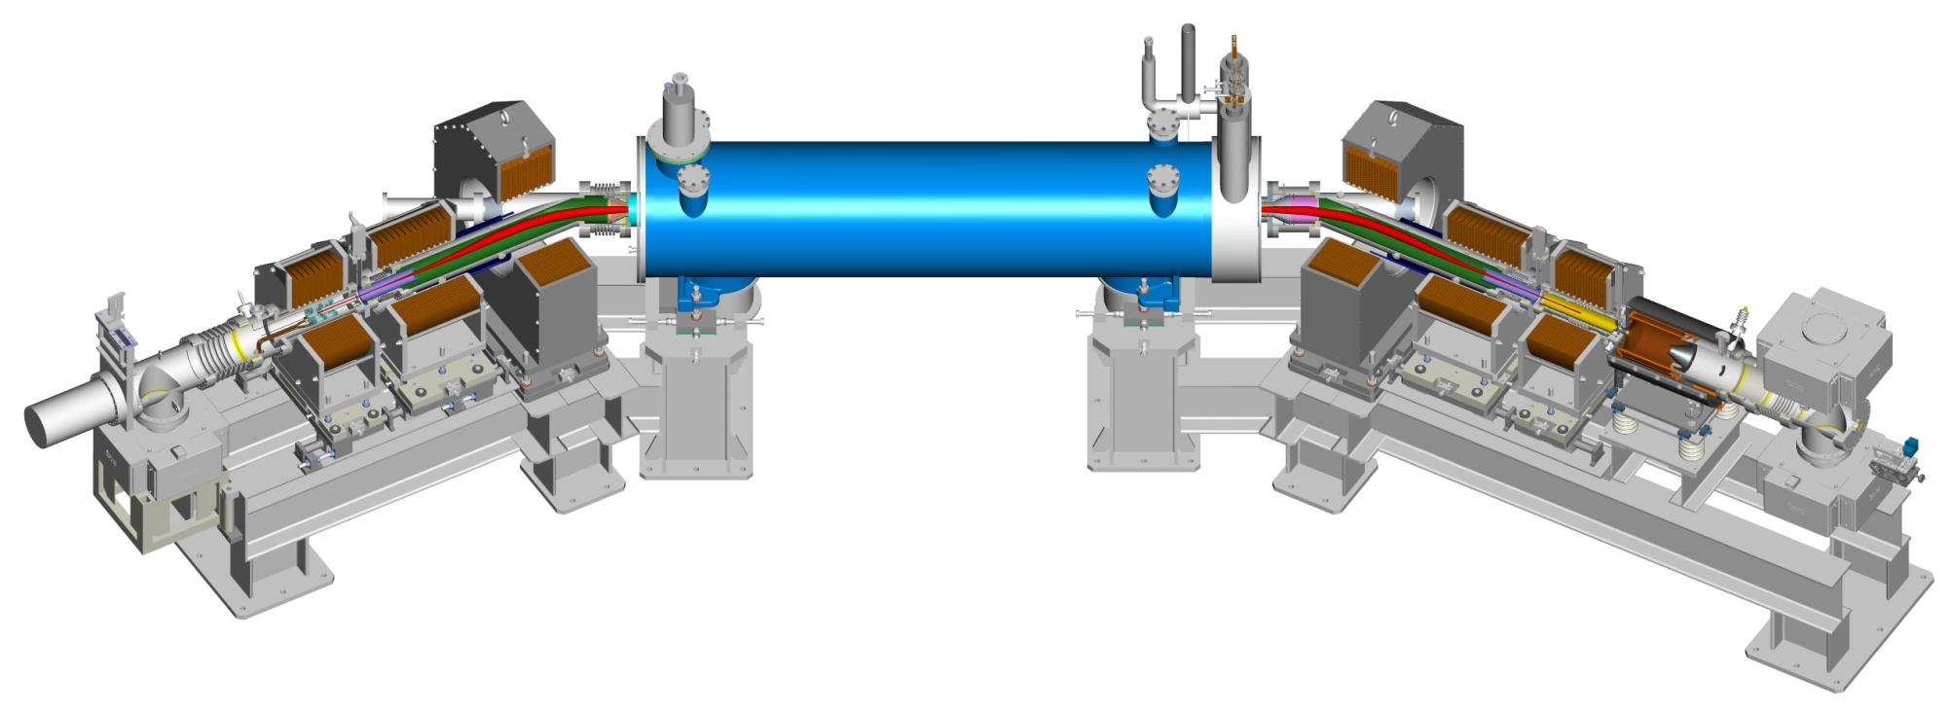
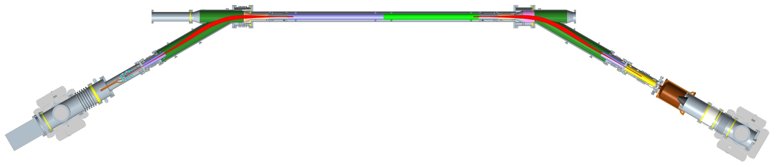
2 Tevatron electron lenses in operation (not operationally used for HOBBC).
2 RHIC electron lenses for head-on BB compensation under construction.
Superconducting magnet
Solenoid GSB
Solenoid CSB
Solenoid GS2
Solenoid CS2
Solenoid GS1
Solenoid CS1
RHIC electron lens
Electron gun
Electron collector
Drift tube 1
BPM
Drift tube 6
Drift tube 7
Gate valve
Drift tube 8
BPM
Gate valve
Electron gun
Drift tube 3
Drift tube 2
Drift tube 3
Drift tube 4
Drift tube 5
Drift tube 9
Ion pumps
Electron beam volume
Drift tube 10
2x Ion Pump
Vacuum system
Electron collector
Cryopump
Ceramic HV break

Slide 9
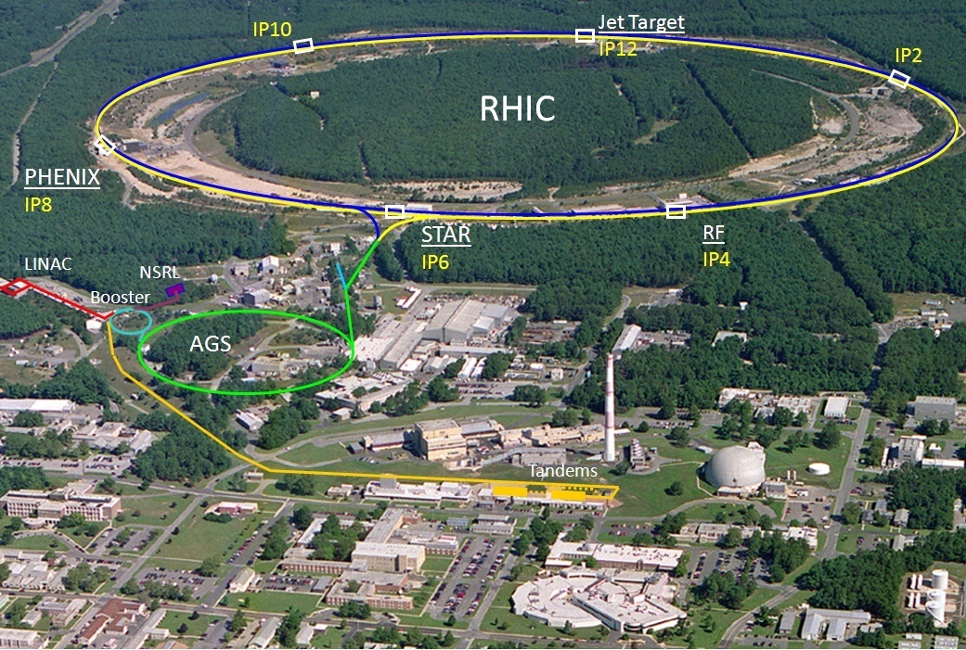
Relativistic Heavy Ion Collider
1 of 2 ion colliders, only polarized p-p collider
2 superconducting 3.8 km rings
2 large experiments
100 GeV/nucleon Au
250 GeV polarized protons
Performance defined by
1. Luminosity L
2. Proton polarization P
3. Versatility
Au-Au, d-Au, Cu-Cu, polarized p-p (so far)
12 different energies (so far)

Slide 10
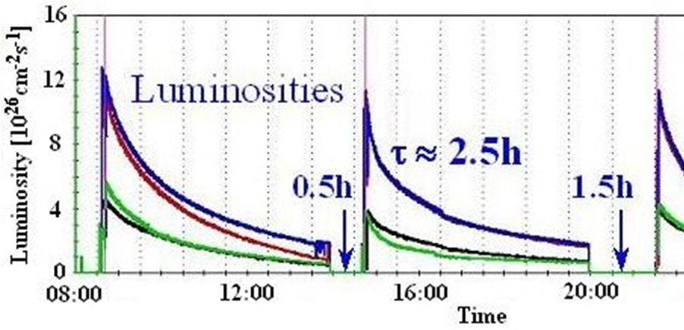
Intrabeam scattering in RHIC
IBS leads to debunching and
transverse emittance growth
of heavy ion beams
without cooling
Comparison of measured and simulated ε(t) and σ_{s}(t) [A. Fedotov et al., proceedings HB2008.]
Emittance
Sim: 82 deg/cell
bunch length
Sim: 95 deg/cell
Exp: 95 deg/cell
Beam: Au⁷⁹⁺,100 GeV/nucleon, 95 deg/cell, N_{b}=0.92x10⁹ Simulation: BETACOOL

Slide 11
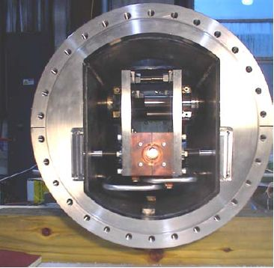
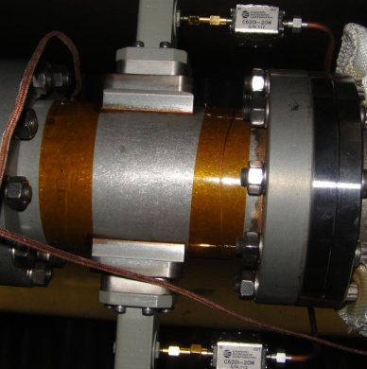
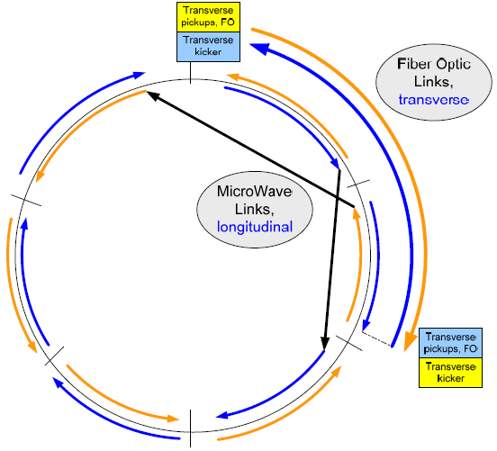
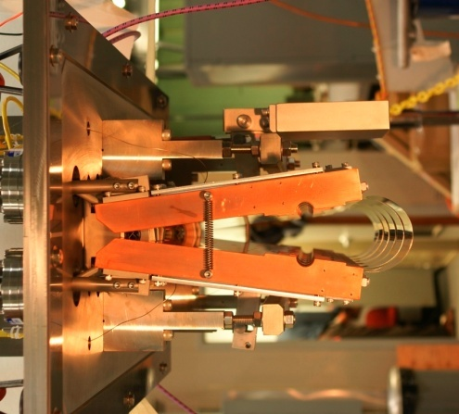
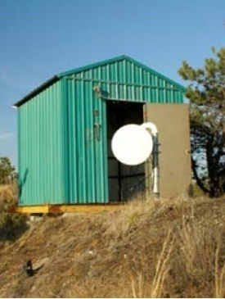
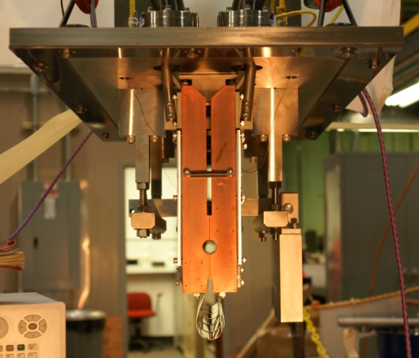
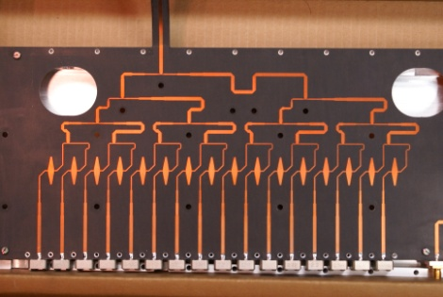
RHIC – 3D stochastic cooling for heavy ions
longitudinal pickup
longitudinal
kicker
(closed)
Y h+v pickups
B h+v kickers
horizontal
kicker
(open)
horizontal and
vertical pickups
B h+v pickups
Y h+v kickers
vertical
kicker
(closed)
5-9 GHz, cooling times ~1 h
M. Brennan, M. Blaskiewicz, F. Severino, Phys. Rev. Lett. 100 174803 (2008); PRST-AB, PAC, EPAC
Notes:
Frequency range: 5-8 GHz transverse, 6-9 GHz longitudinal

Slide 12
RHIC – bunched beam stochastic cooling for heavy ions
Longitudinal cooling since 2007
First transverse (vertical) cooling in 2010
M. Brennan
M. Blaskiewicz
K. Mernick et al.
So far stochastic cooling
increased average store
luminosity by factor 2
Expect another factor 2
with full 3D cooling
Issues being addressed:
Vacuum leaks at feedthroughs
Mechanical motion of long. kickers
Cross-talk between Blue and
Yellow vertical system
(addressed by 100 MHz shift in Blue)
Construction, installation, and
commissioning of horizontal systems
14 Jan 2010

Slide 13
RHIC Au beams with vertical stochastic cooling
Blue emittances
without vertical cooling
Yellow emittances
with vertical cooling
Emittance measurement with Ionization Profile Monitor (IPM).
[M. Blaskiewicz, J.M. Brennan, and K. Mernick, PRL 105, 094801 (2010).]

Slide 14
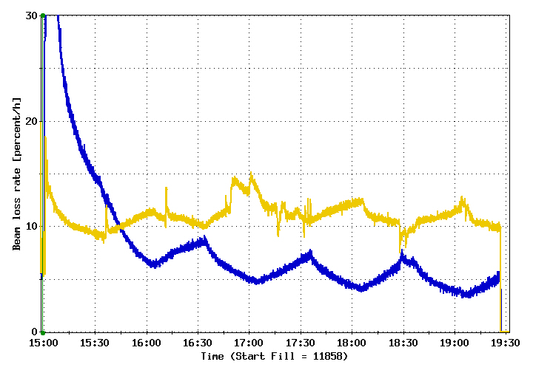
Cooling only one beam
Because of Blue-Yellow cross talk of vertical cooling systems in 2010, only one
beam could be cooled at the time. Loss rate of other beam increased as a result
(from unmatched beam sizes at the IP).
Initial beam-beam parameter
ξ ~ 0.002/IP (2 IPs)
Y
on
B
on
Y
on
B
on
Y
on
B
on
Y
on
B
on
Y
on
HE LHC: Adjust heating to maintain same emittances in both beams.
(Known effect from SppS, HERA, RHIC.)

Slide 15
RHIC store evolution with 3D stochastic cooling
Simulation by M. Blaskiewicz
Longitudinal profiles with h₁ = 360 (360 kV) and h₂ = 7x360 (4 MV)
6
beginning of store
after rebucketing
Au beam with
N_{b} = 0.5x10⁹
N_{b} = 1.0x10⁹
N_{b} = 1.5x10⁹
after 5 h in store
current [A]
0
0 35 70
time [ns]
Simulations have matched observable cases so far.
Notes:
Simulation with nominal noise (estimated from 0.2 mm beam offset at pick-up).

Slide 16
RHIC store evolution with 3D stochastic cooling
Simulation by M. Blaskiewicz
3
Au beam with
N_{b} = 0.5x10⁹
N_{b} = 1.0x10⁹
N_{b} = 1.5x10⁹
total beam-beam parameters (2 IPs)
ΔQ = 0.0015
ΔQ = 0.0030
ΔQ = 0.0046
2
ΔQ = 0.0009
ΔQ = 0.0019
ΔQ = 0.0029
rms emittance [mm mrad]
1
Expect ~3x larger ΔQ
with 56 MHz SRF
(under construction)
Then closer to LHC.
0
0 5
time in store [h]

Slide 17
Summary
LHC
LHC damping times of 1h (long.) and 2h (transv.) much shorter
than IBS growth times (>50h)
Heating required to maintain constant beam-beam parameter ξ ∼ 0.01
(increase in ξ allows for more luminosity or a reduction in intensity)
RHIC
Observations and simulations of IBS induced emittance growth
generally agree well, evolution of with stochastic cooling predictable.
With cooled Au beams not yet operating at beam-beam limit
(need new 56 MHz SRF to reduce debunching, >= 2013)
Even at relatively small beam-beam parameters, equal cooling in
both beams (= equal heating in HE LHC) is necessary to maintain good beam lifetimes

