Slide 1
Elements of a Physics Case for HE LHC
James Wells
Cambridge University
October 14, 2010

Slide 2
Do we want a higher energy LHC in the future?
First reaction is obvious…. YES
Nevertheless, we need to understand the potential physics gains of HE-LHC
Emphasis here is on discovery capability, and not so much “precision study” capability (often associated with luminosity upgrades)
Outline a few thoughts worthy of more study, with focus on solution to “Naturalness Problem”.

Slide 3
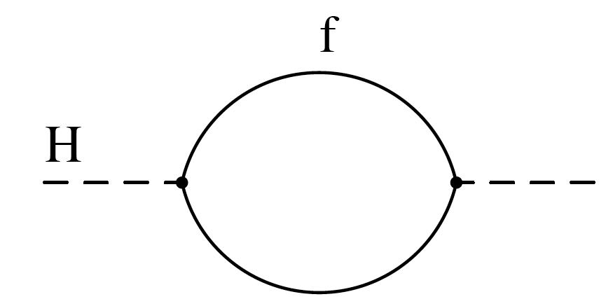
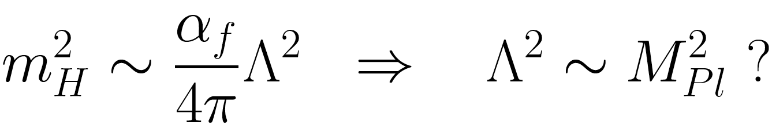
Higgs boson unstable to QM
Naturalness Problem connected to:
A quantum loop is quadratically divergent. Higgs
Mass, connected to Higgs vev, is unstable to the
Highest mass scales in the theory.

Slide 4
Cures of the Naturalness Problem
Disallow all scalars in the theory (Technicolor).
Disallow higher mass scales (extra dimensions).
Symmetry cancels quadratic divergences (supersymmetry)

Slide 5
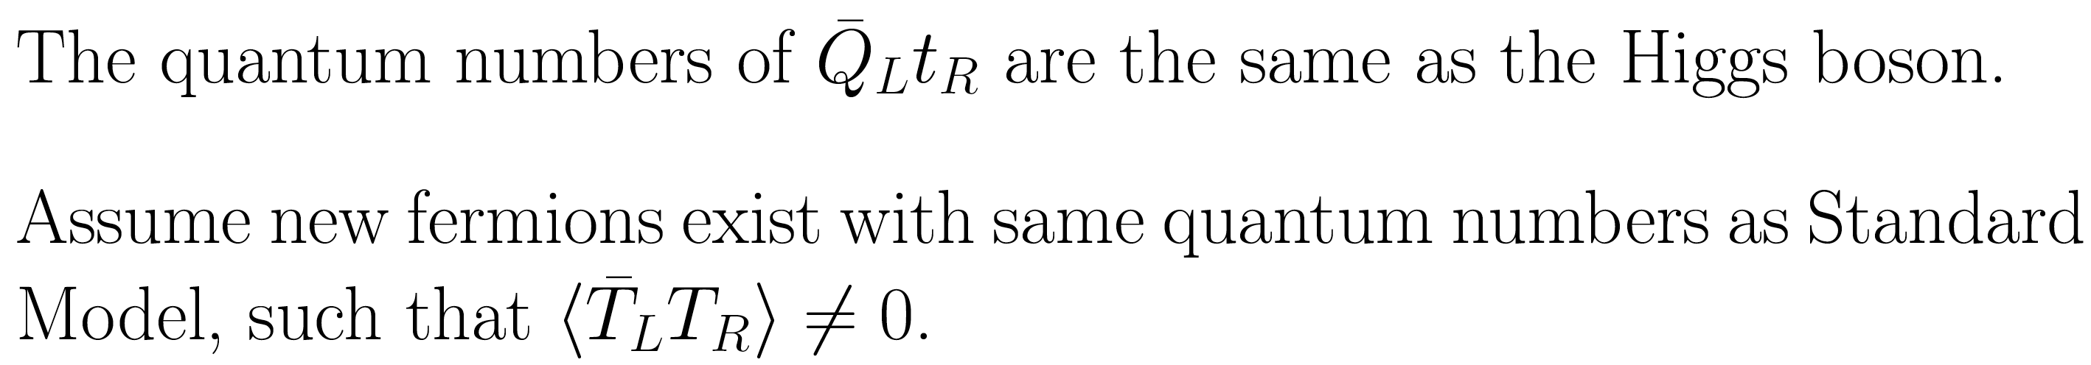
Technicolor
Problems: Proliferation of Pseudo-Nambu Goldstone Bosons, challenges with precision measurements of Z decays, and difficulty giving both light quark and heavy quark masses.
(BUT, not ruled out by any means and worth consideration….)

Slide 6
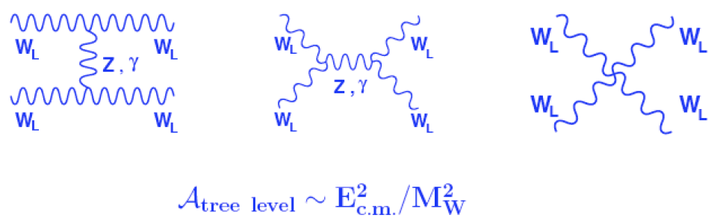
Traditional Primary Emphasis
Electroweak symmetry breaking is a mystery.
Symmetry breaking might produce Higgs boson or might not, depending on how hierarchy problem is solved
Longitudinal W scattering unitarized for E>1 TeV by Higgs or some other non-perturbative dynamics (techni-ρ meson)

Slide 7
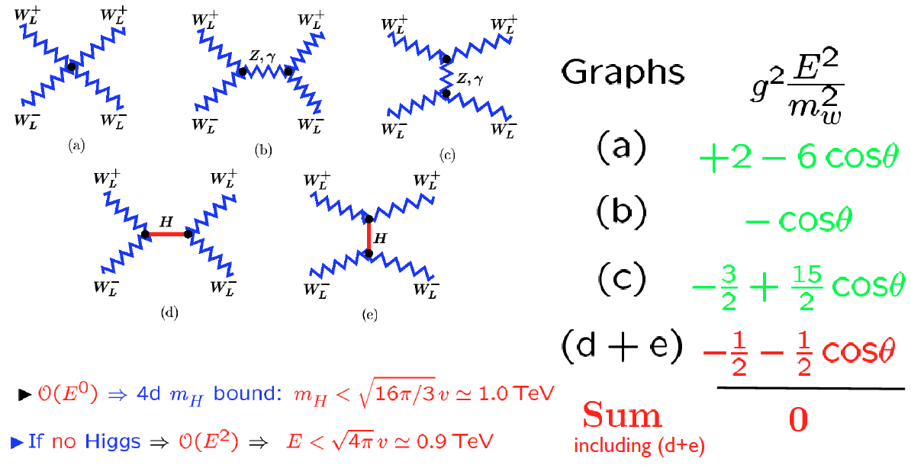
Unitarization
Simmons, ‘06
In technicolor theories, the techni-ρ meson unitarizes W_{L}W_{L} scattering, just as the ρ meson of QCD unitarizes ππ scattering.
M_{ρ} could be anywhere from ~1 TeV to ~3 TeV or even higher.

Slide 8
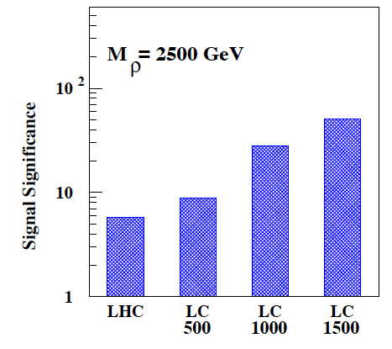
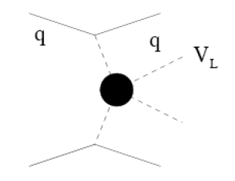
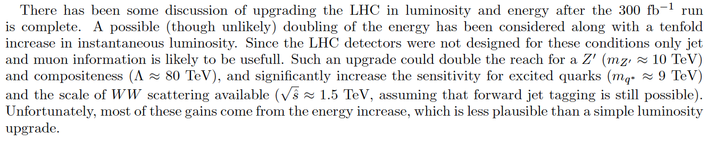
Collider Expectations
Barklow et al., 2002
1 ab⁻¹
1 ab⁻¹
14 TeV
300 fb⁻¹
500 fb⁻¹
Doubling energy would be good!
Assumes favorable narrow resonance M_{π}>M_{ρ}/2
Barklow et al., 2002

Slide 9
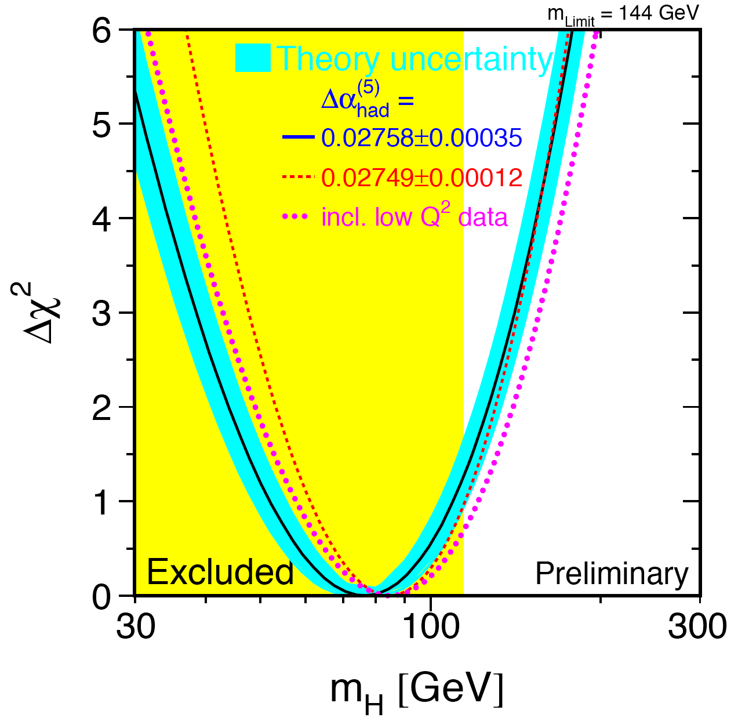
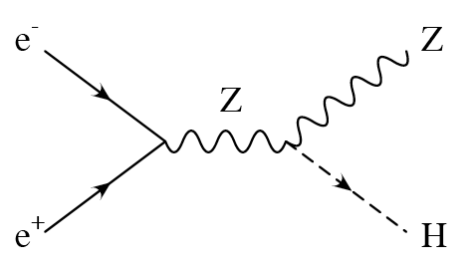
Perhaps to be given less emphasis….
Interesting further ideas in this vein: Higgsless theories, top condensate, etc.
But perhaps less emphasis is in order given recent expt results.
Higgs boson mass upper limit (95% CL) from precision
Electroweak is less than 180 GeV.
Lower limit from lack of
direct signal at LEP 2
is about 115 GeV.
LEPEWWG
Tevatron 95% exclusion 160 GeV < m_{h} < 170 GeV
Experiment Summary: 115 GeV < m_{h} < 160 GeV or 170 GeV < m_{h} < 180 GeV
In other words, Higgs boson (or equivalent dynamics) is likely to be LIGHT and PERTURBATIVE electroweak interactions are expected.

Slide 10
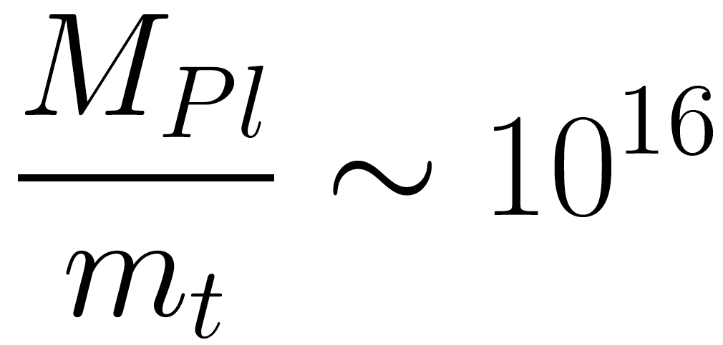
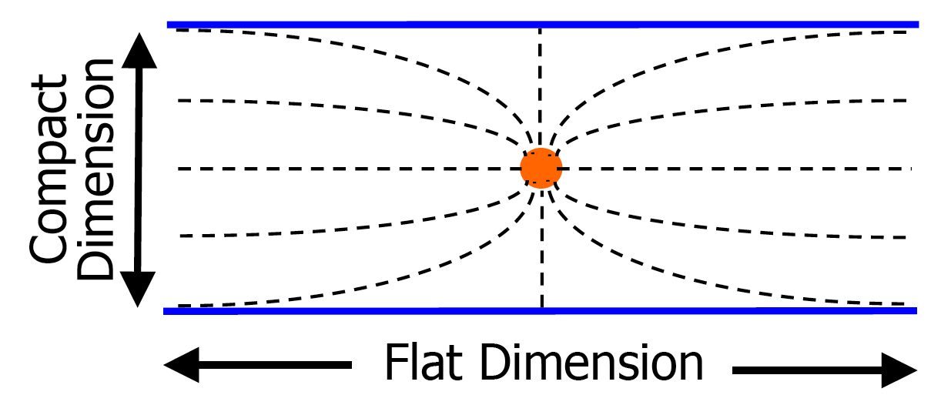
Large Extra Dimensions
Quadratic divergence ok if no high scales!
But gravity surely exists, with its high Planck Scale --
Much larger than any known SM particle mass.
Extra Dimensions may
Explain large Planck Mass.
(Arkani-Hamed, Dimopoulos, Dvali)
How can this hierarchy
be explained?
Landsberg, 2001

Slide 11
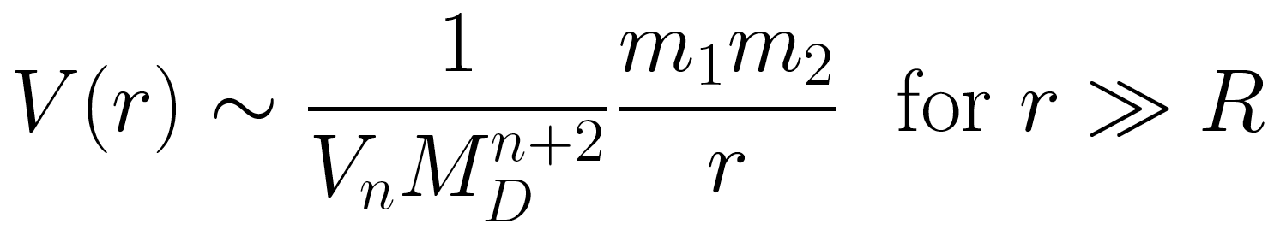
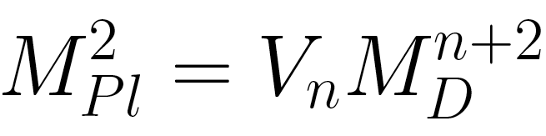
Strength of Gravity
Large Planck mass is
fake. Comes from large
Extra-dimension Volume.
Landsberg, 2001
M_{D} is ~ TeV if Xdim solves the hierarchy problem

Slide 12
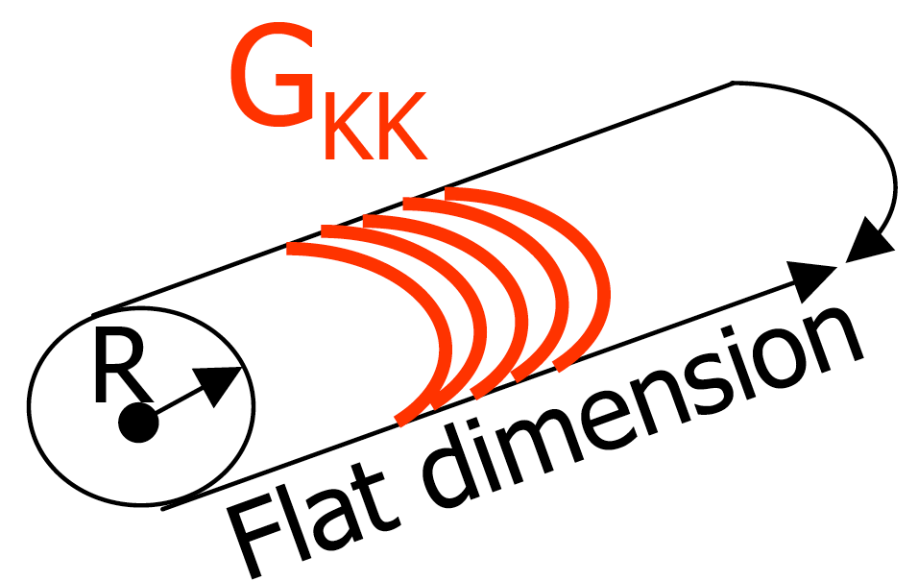
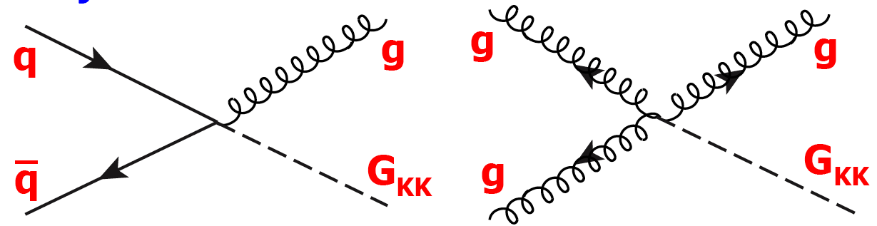
Implications of Large Extra Dimensions
Kaluza-Klein copies of
The graviton accessible
At high-energy colliders.
Landsberg, 2001

Slide 13
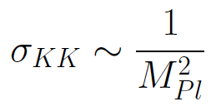
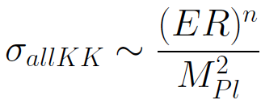
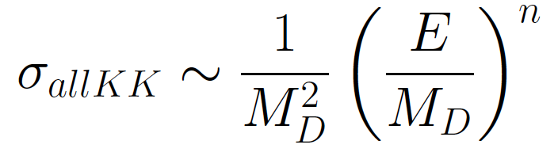
KK Graviton cross-sections
Cross section of producing one KK gravition
KK Gravitons are spaced closed to each other. There are approximately (ER)^{n} KK gravitions with mass < E.
So, total gravitons cross-section up to energy E is
But R^{n}=M²_{pl}/M_{D}^{2+n}, which means total cross-section is

Slide 14
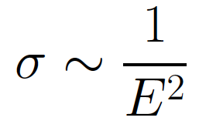
Fast growth with energy….
Compare this cross-section, with E^{n} growth,
With the usual cross-section growths of other theories

Slide 15
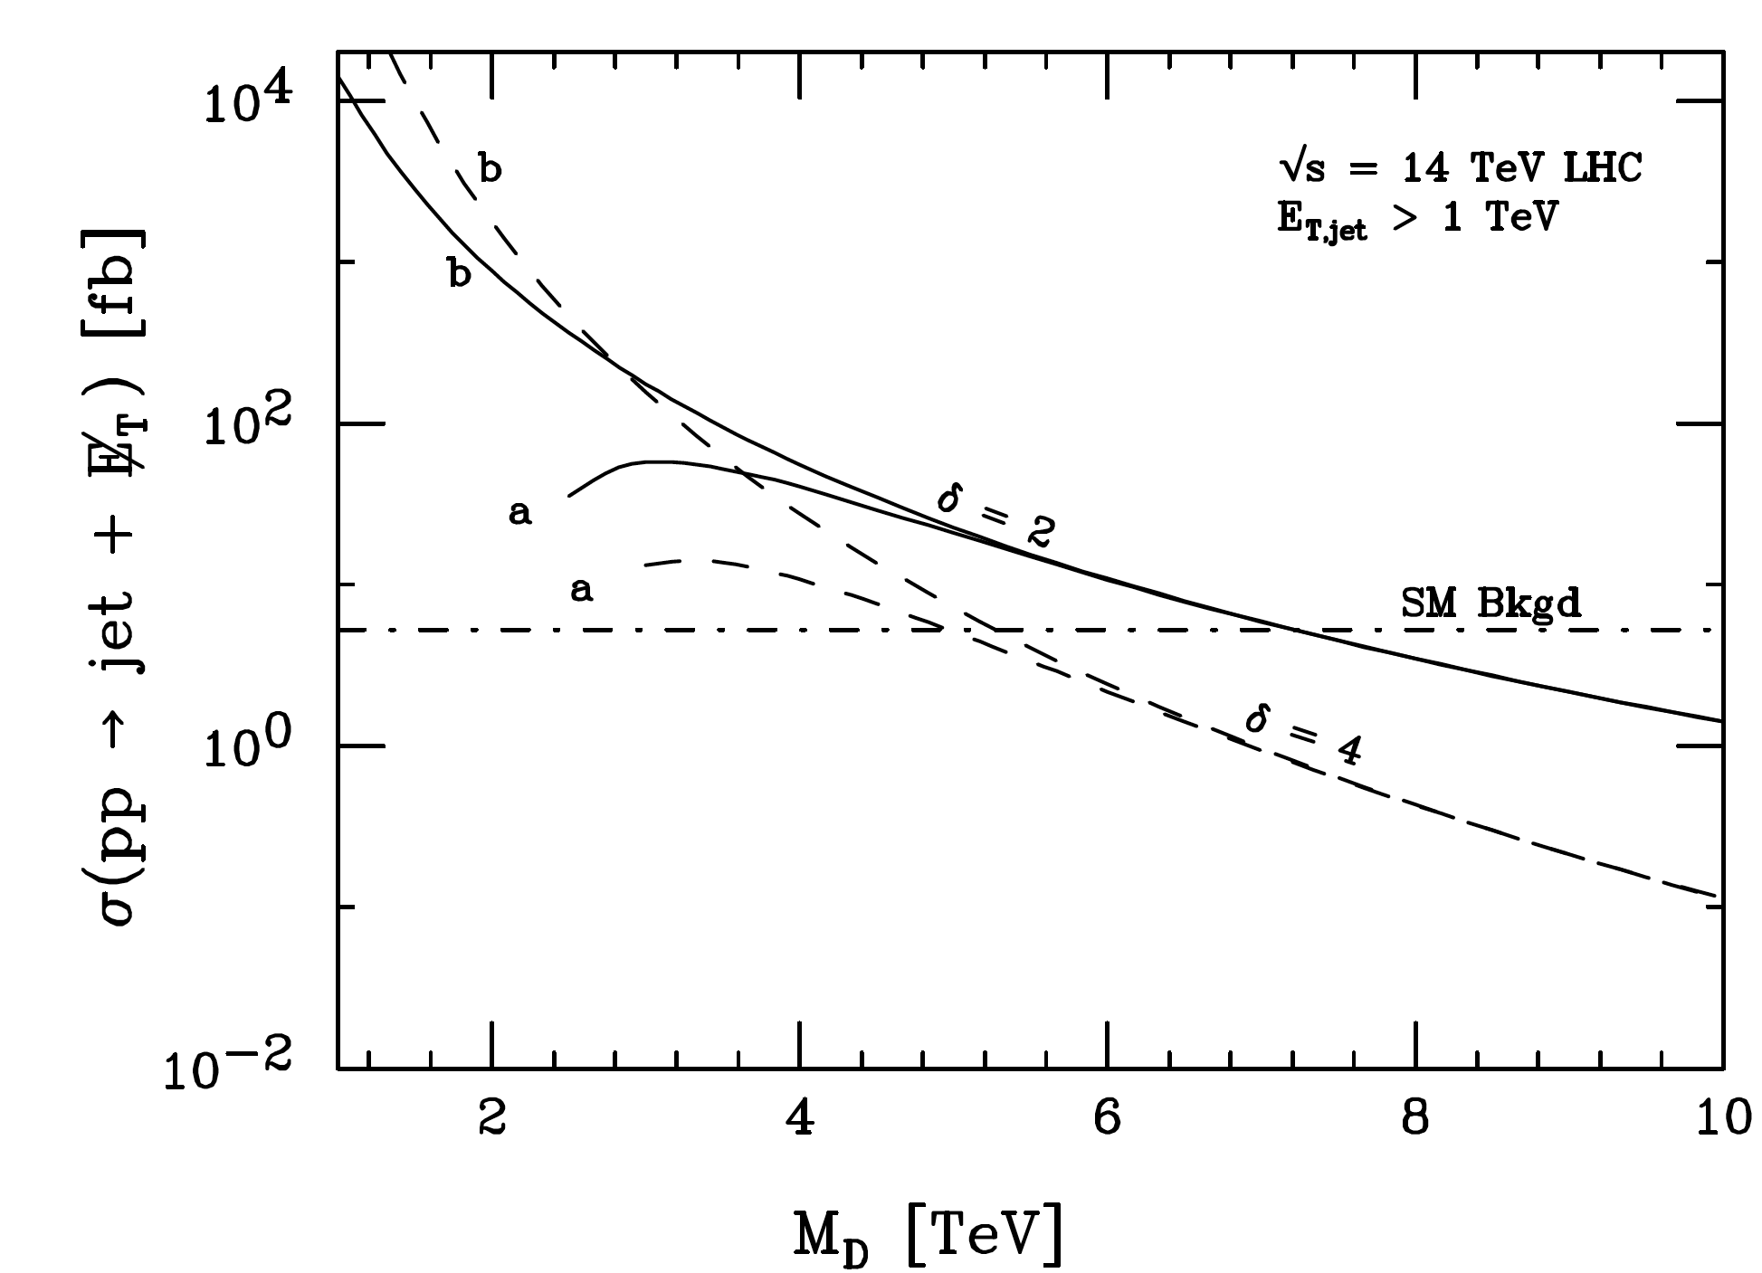
Higher energy extremely helpful
This plot: Keep energy fixed, but vary M_{D}.
Yet, illustrates how sensitive cross-sec is to ratio of E/M_{D}.
Higher energy pays huge dividends!
Giudice, Rattazzi, JW

Slide 16
Energy and Extra Dimensions other studies to propose
Shown that HE extremely valuable for graviton emissions
Many more benefits possible amenable to careful study:
Non-linear gravity objects (NGOs = Black holes, string balls, etc.)
String Regge excitations
Transplanckian scattering (calculable in E>>M_{D} limit!)
Multi-TeV gravitons and gauge bosons in Randall-Sundrum warped extra dimension

Slide 17
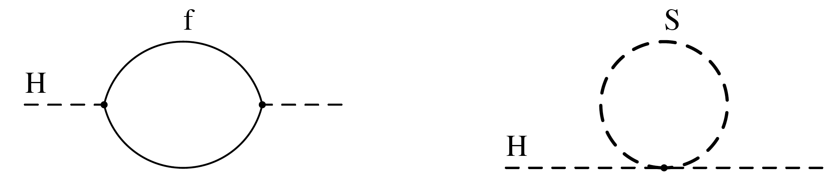
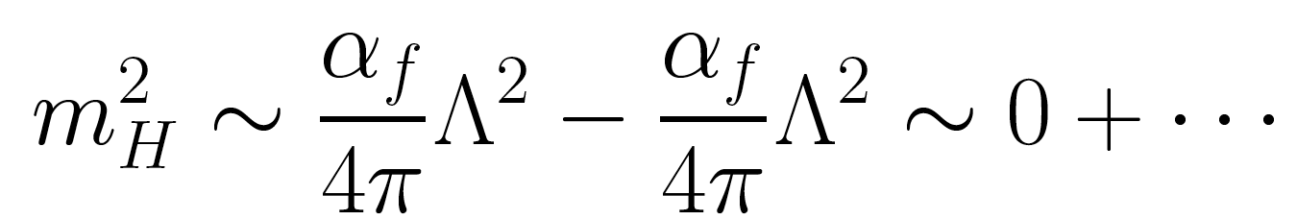
Supersymmetry
Symmetry cancels the quadratic divergence, making solutions natural.
Martin, hep-ph/9709356

Slide 18
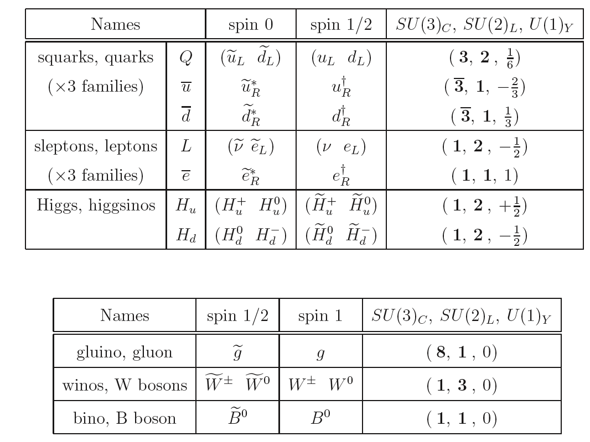
The Particle Spectrum of Minimal Supersymmetry
Excellent source from which to learn the fundamentals.
Scalar Superpartners highlighted in red.
SUSY Primer: Martin, hep-ph/9709356v5 (Dec 08)

Slide 19

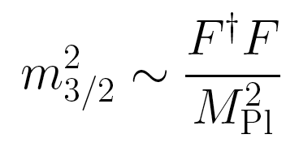
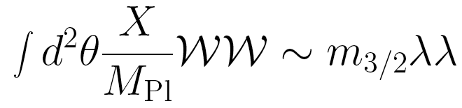
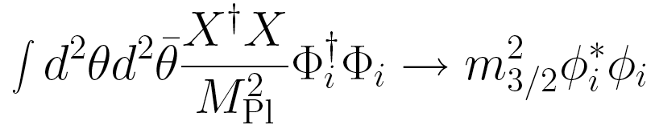
Description of SUSY Breaking
SUSY breaking resides in <F> of chiral multiplet
Gravitino is spin 3/2 particle. ψ is the absorbed ±1/2 spin component (goldstino).
This leads to gravitino mass:
Gaugino masses:
Scalar masses:

Slide 20
Challenges for Low-Energy SUSY
Throw a dart into Minimal SUSY parameter space,
And what do you get?
Observable predictions would be
Incompatible with experiment.
Briefly review these challenges ….

Slide 21
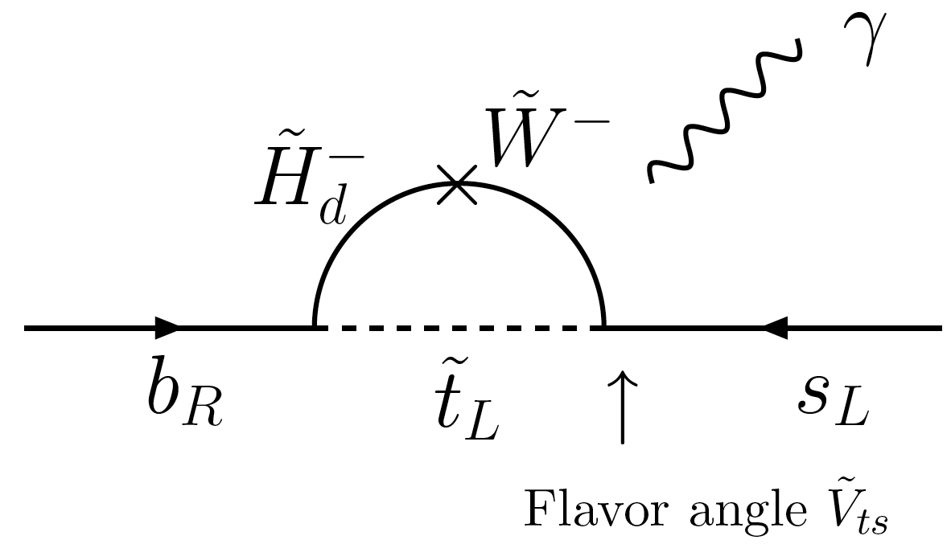
Flavor Changing Neutral Currents
Random superpartner masses and mixing angles
would generate FCNC far beyond what is measured:
However: heavy scalars would squash these FCNCs

Slide 22
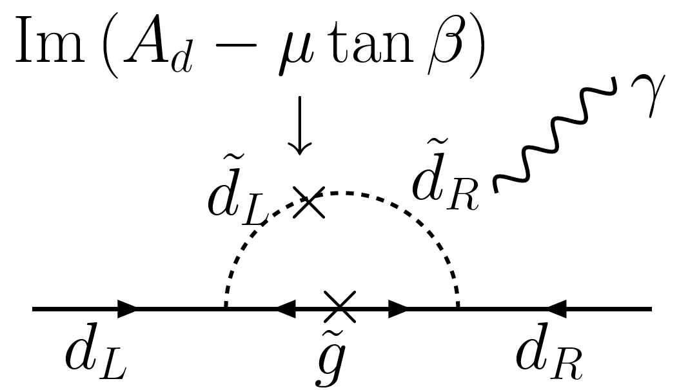
CP Violation
Supersymmetry has many new sources of CP violation:
Large unless CP angle small or scalar masses heavy.

Slide 23
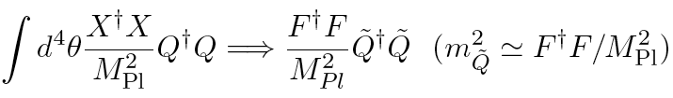

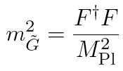
Non-singlet SUSY breaking
Theory home to these ideas:
SUSY breaking accomplished by non-singlet.
Scalars don’t care:
On the other hand, gauginos do care:
Assuming cosmological constant = 0 (I.e. tiny)
the gravitino mass is

Slide 24

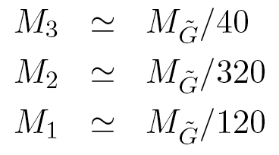
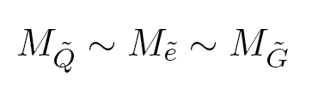
Mass Spectrum
In this case, leading contribution to gaugino
mass can be, e.g., the AMSB contribution:
(Randall, Sundrum;
Giudice, Luty, Murayama, Rattazzi)
The complete spectrum is
Ratios of scalar/gaugino can be altered significantly, but hierarchy may be generic.
(light gauginos)
LSP is Wino!
(Heavy scalars)

Slide 25
Collider Implications of Heavy Flavor Supersymmetry
Example spectrum:
Very heavy squarks/sleptons – flavour masses
M2 = 100 GeV
M1 = 300 GeV
M3 = 700 GeV
M_{3/2}~M_{scalars} >> M_{gauginos}
Increasing mass
Gluinos – best hope
Bino – not produced!
Scalars are out of LHC reach!
Binos are not produced
Higgs mass predicted to be above current limit (but <140 still)
Winos not directly detectable
gluino pair production give colliders hope
W⁺,W⁻,W⁰ winos -- LSP (not detectable)

Slide 26
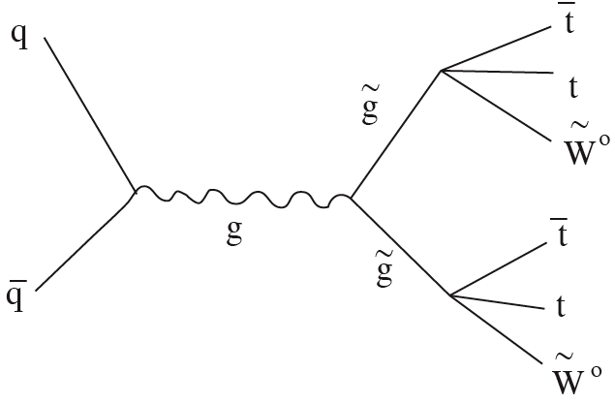
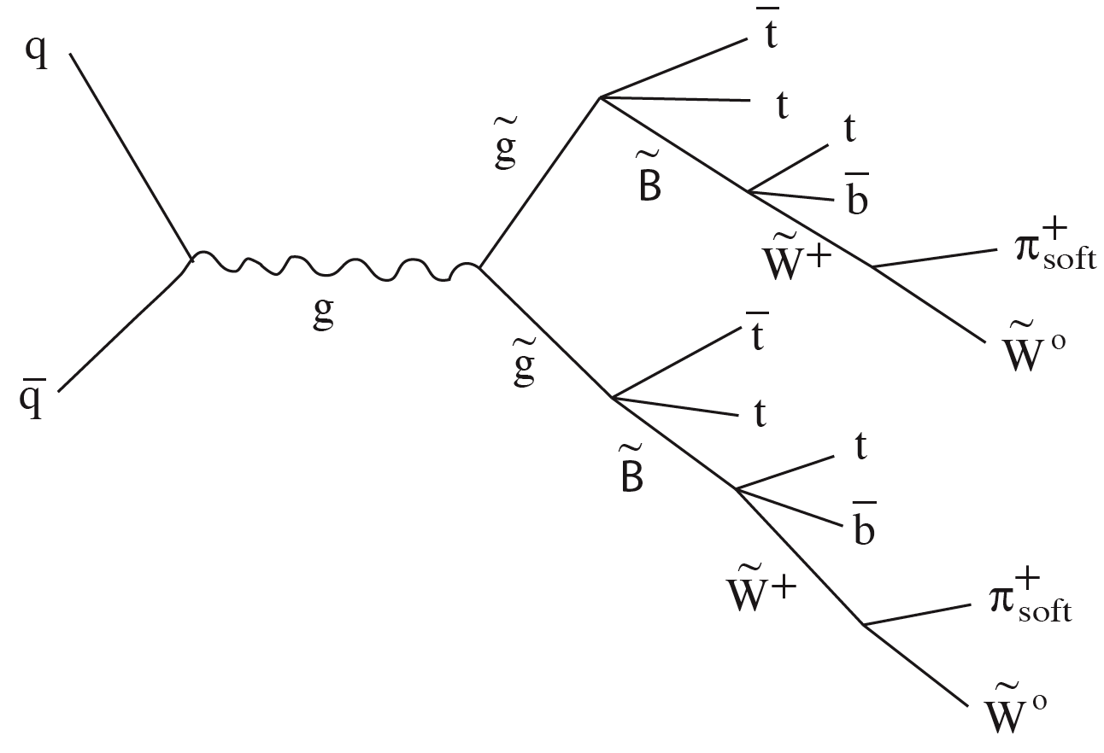
High multiplicity tops+MET events
LHC or HE-LHC can discover susy through gluinos:
Simplest event type: 4 top quarks
plus missing energy.
Combinatoric/experimental
Challenge.
6 tops + 2 b’s + 2 pions + MET
Toharia, JW

Slide 27
Scalar superpartner discoveries
Scalar superpartners are unlikely to be directly produced at LHC in this framework.
In general, scalars are heavier than fermion superpartners across many variants of susy model building. Generic prospect.
Need high energy to produce directly these heavy squarks.
Perhaps best bet is gaugino + squark production. Suggest careful study of the various prospects at HE LHC. May be one of principle motivators for HE LHC upgrade.
Keep in mind, may have rough idea of where scalar masses are through LHC experiments (Higgs mass, gluino decay widths, etc.).

Slide 28
Conclusions
We have reviewed science gains that would be important if nature chooses any one of the three theory approaches to the Naturalness Problem.
Each idea has its higher energy needs:
Technicolour: Heavy techni-rho resonances, and V_{L}V_{L} scattering sensitivities
Extra dimensions: Graviton emission sensitivity, KK graviton resonance searches (Warped), and KK gauge boson production.
Supersymmetry: direct measurement of heavy squarks

