Slide 1

A High Energy LHC machine. Experiments’ first impressions
HE-LHC’10, October 14th, 2010
Villa Bighi, Malta
Marzio Nessi

Slide 2
General Statements
Most of what I present is coming out of individual discussions with experimentalists, mostly within ATLAS
Many of the statements are my own ones
In general, we have no idea yet of what kind of new physics we will be facing. It might take at least a few (3-4) fb⁻¹ to have a real entry point ….. or maybe, if nature is kind with us, even less! ….. So we might ask the question once more in summer of next year

Slide 3
General Statements
At some point, while scanning through the rare physics signals, Luminosity will not buy more statistics …. Cross-sections are simply too small and drop by many orders of magnitude, in particular as a function of mass
Energy will buy much more, because rare physics cross-sections, and in particular if large mass objects are involved, will be boosted. More energy available to create heavy objects !!
I assume we want to keep at least ATLAS and CMS alive and operational

Slide 4
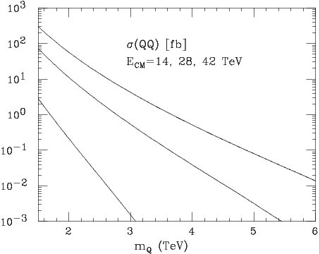
A few examples
W’ sensitivity for different integrated luminosity
Cross sections (in fb) for production of heavy quark pairs (A.Blondel et al, CERN-PH-TH/2006-175)

Slide 5
Some considerations
In today’s scenario, the type of physics we will be studying at high energy will basically be the same we are investigating now, but with some “nuances” !
  Discovery of high mass new particles (beyond what will be explored at the HL-LHC, m ~ 2.5 TeV)
  Precision measurements on known standard model physics (top precision measurements, rare decays, …)
  Measuring in detail properties of new discovered phenomena (masses and couplings of sparticles, ….)
  Precision measurements of new discoveries (higgs spin, self- couplings, rare decays, ...)
  Search for new phenomena, not anticipated by theory

Slide 6
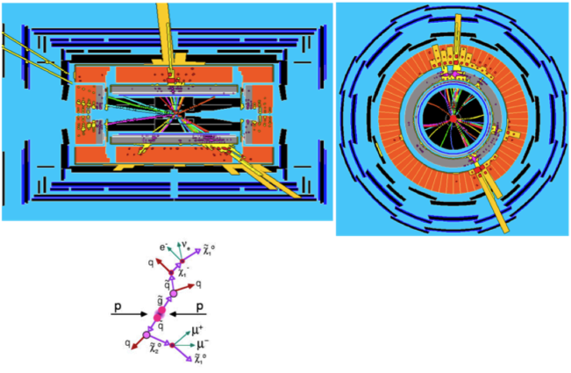
Some considerations
It is hard to guess which parameters in today’s detector properties might be relaxed
If we will still be looking for SUSY-type phenomena, with large multiplicities of leptons, jets and heavy flavor decays …. and missing transverse energy … then we will have to count on:
  Lepton identification, in particular electrons wrt jets
  Photon identification
  Muon identification
  b and c quarks decay tagging, via b-tagging
  Excellent missing energy resolution
  Excellent calorimeters performance (resolution and E scale)
  Excellent tracking efficiency (>95%)

Slide 7
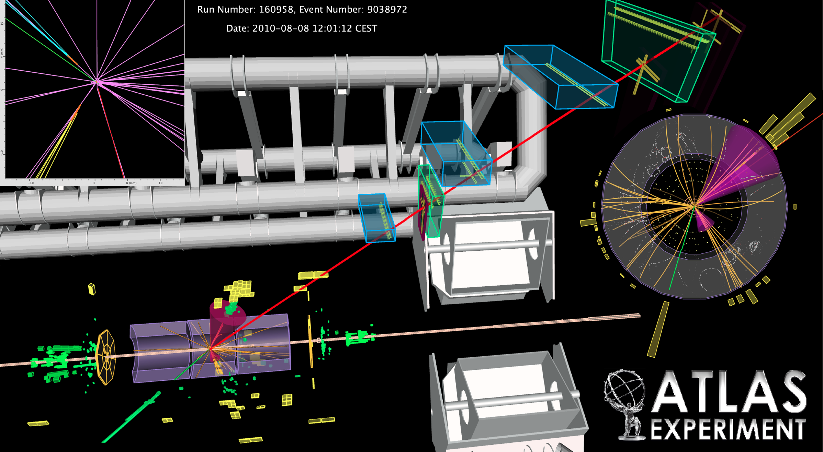
A real collision event (a Top quark candidate)
_
Displaced secondary vertices
tt -> e ν b , μ ν b
Muon tracking and identification
Hadronic jets reconstruction
Charge particles tracking
Electrons and Photons identification
Missing transverse energy reconstruction

Slide 8
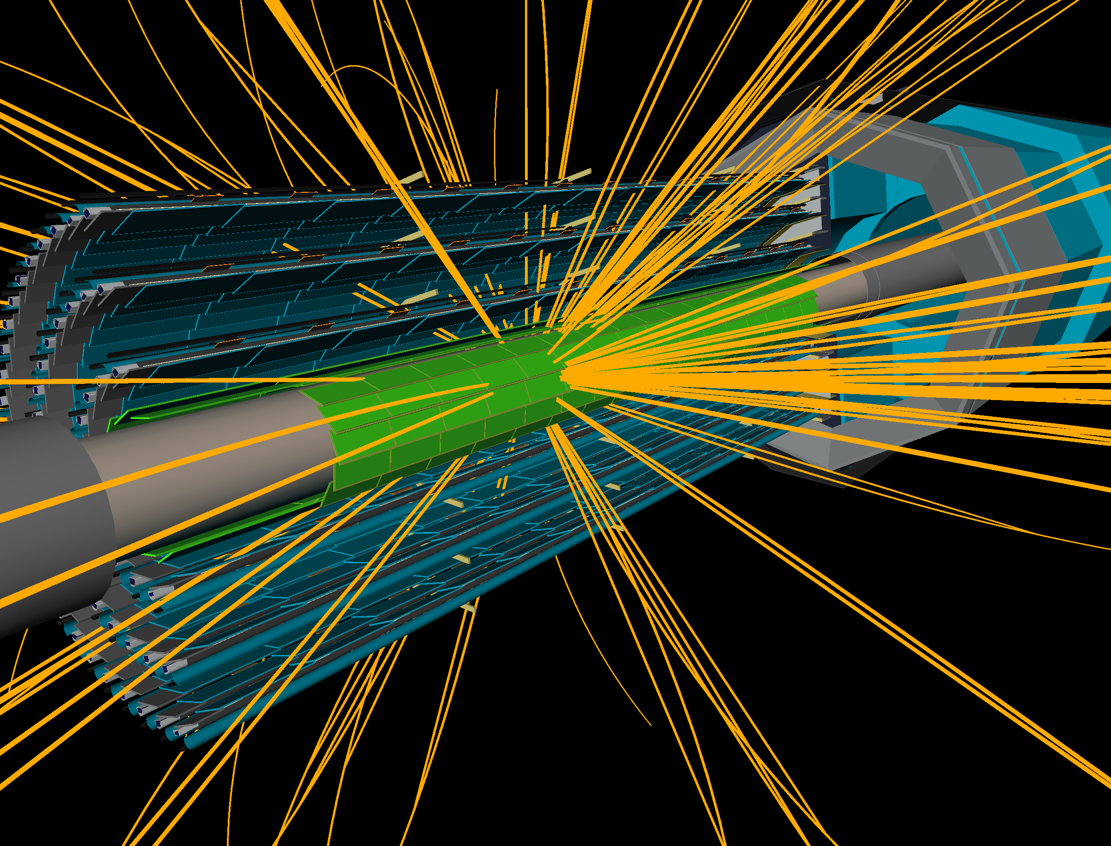
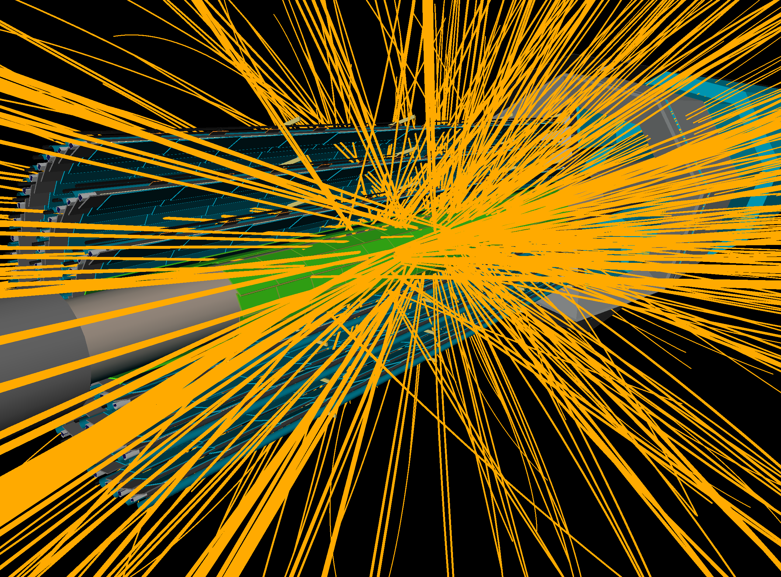
Some Considerations
After a few years of enthusiasm for the high energy regime, for sure physicists will ask (because then they will be used to the HL-LHC) to run with high luminosity too.
  High pile-up event with many tracks and risks of fake hits/tracks association
  Important cavern backgrounds, in particular from slow neutrons captured in the detector materials
  Unprecedented levels of radiation and tracks density in particular in the forward detectors, which will limit their effectiveness
50 pile-up events

Slide 9
Detector concerns
After the HL-LHC experience the detectors
  will be old in their structure and base material. From the time of construction (1996-2006) about 30 years will have elapsed. Some more critical parts like rubber components, o-rings, PCBs, cables and connectors, optical fibers, cryo and vacuum infrastructure …. will need a careful analysis and probably will need to be replaced
  will be heavily irradiated. Some innermost parts will be already classified as potential nuclear waste components. Access will be limited in the regions around the beam pipes (~ 2 m radius) and near to the TAS

Slide 10
Detector concerns
After the HL-LHC experience
  Calorimeters using scintillation dopants risk to be completely irradiated and therefore will have changed their transparency property regarding optimum light collection. No idea on what to do then. Either accept less light collection and a bigger constant term in the resolution or start replacing components.
  For example the ATLAS Tile calorimeter will need to be evaluated. No way to dismount it without dismounting a major part of ATLAS. Maybe something can be done in the end-caps. If not, just accept the lower level of performance.
  Similar reasoning for the CMS calorimeters (crystals + hadronic scintillators). Maybe here access is better and it is easier to replace components
  ATLAS LAr calorimeter will be very radioactive and polluted with dust type of material (HV breakdowns, ….). Might need some level of consolidation

Slide 11
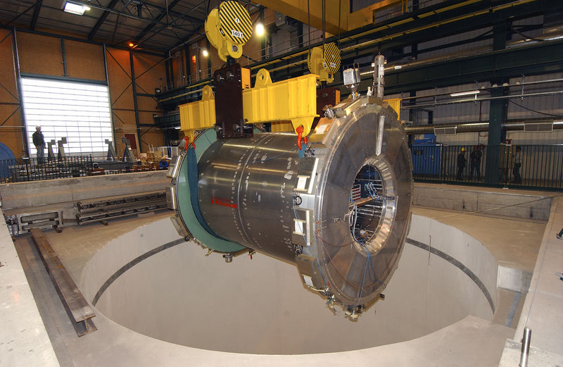
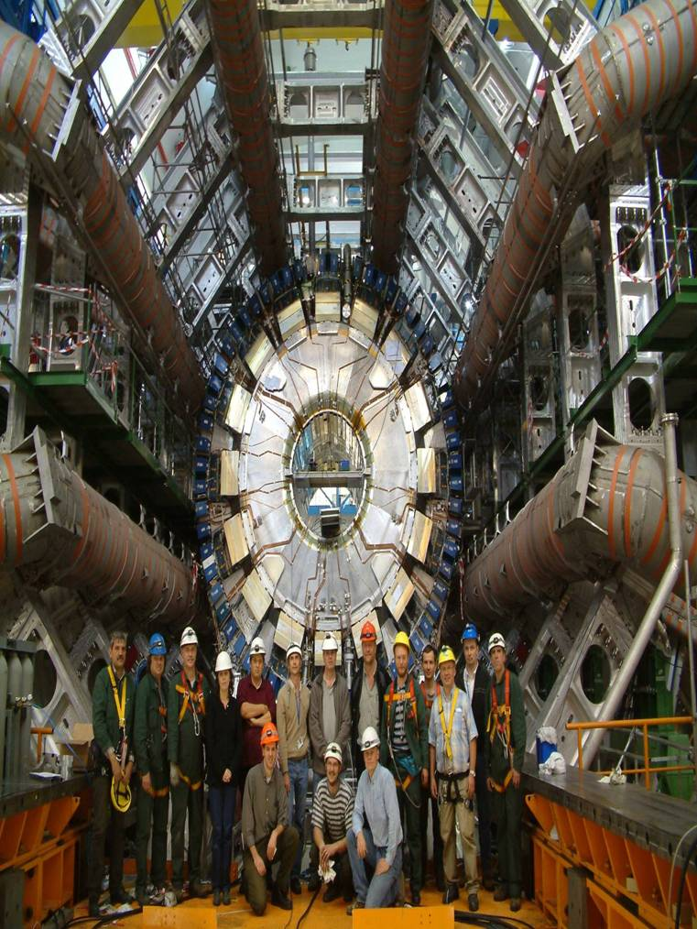
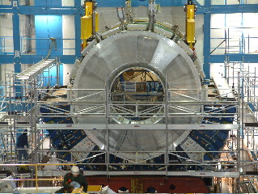
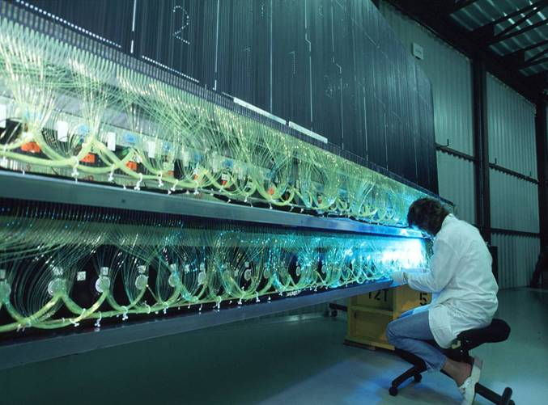
Tiles calorimeter example (impossible to dismount)
40 tons of scintillator
1100 km of WLS fibers

Slide 12
Inner detectors
After the HL-LHC experience
  To arrive to the HL-LHC we will construct a new inner detector with very high granularity and with radiation-harder sensors and front-end electronics (~2020)
  We will need to have, as a requirement, the possibility to upgrade and exchange part of it as a function of time. In particular for the innermost layers (b-layer and pixel detector in general). Both ATLAS and CMS have now already adopted this concept for the future
  We have now to add to our 2020 specifications a radiation resistance up to ~6000 fb⁻¹
  Here one of the main issues is the irradiation of the services and electronics. We will probably be at the level of ~0.5 mSv/h.

Slide 13
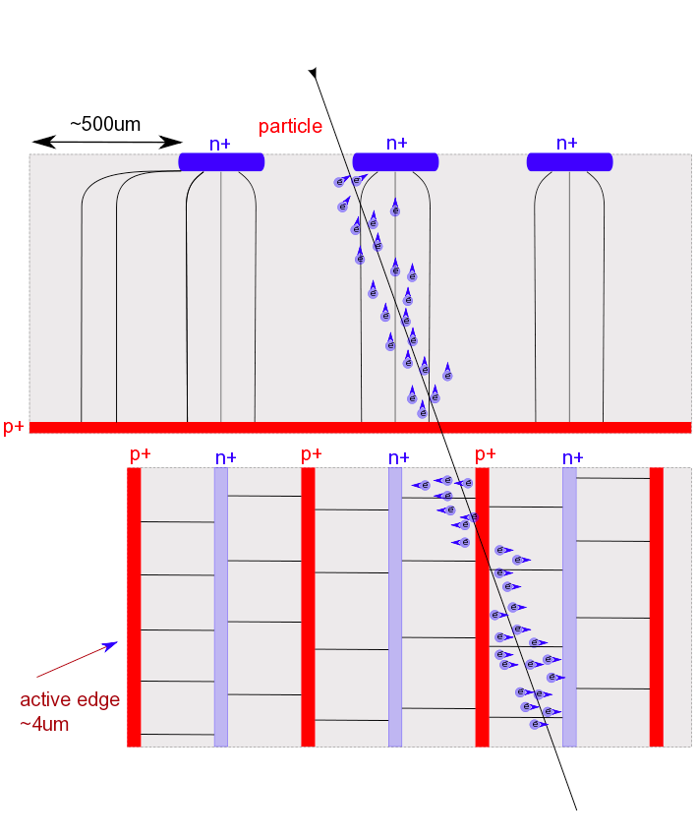
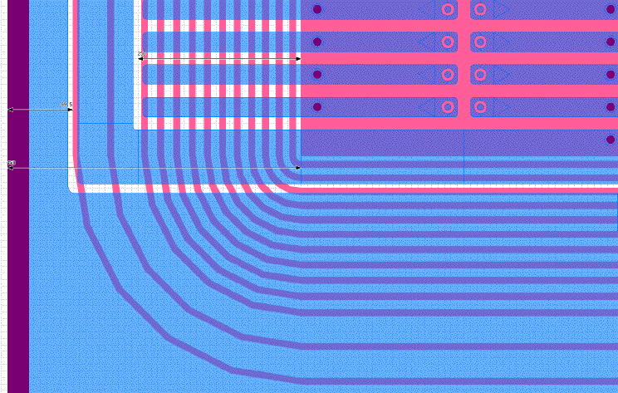
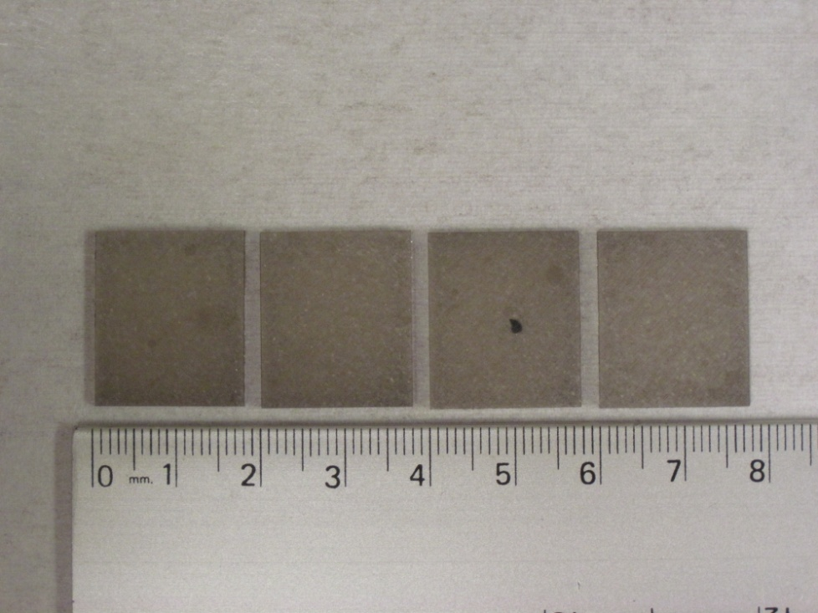
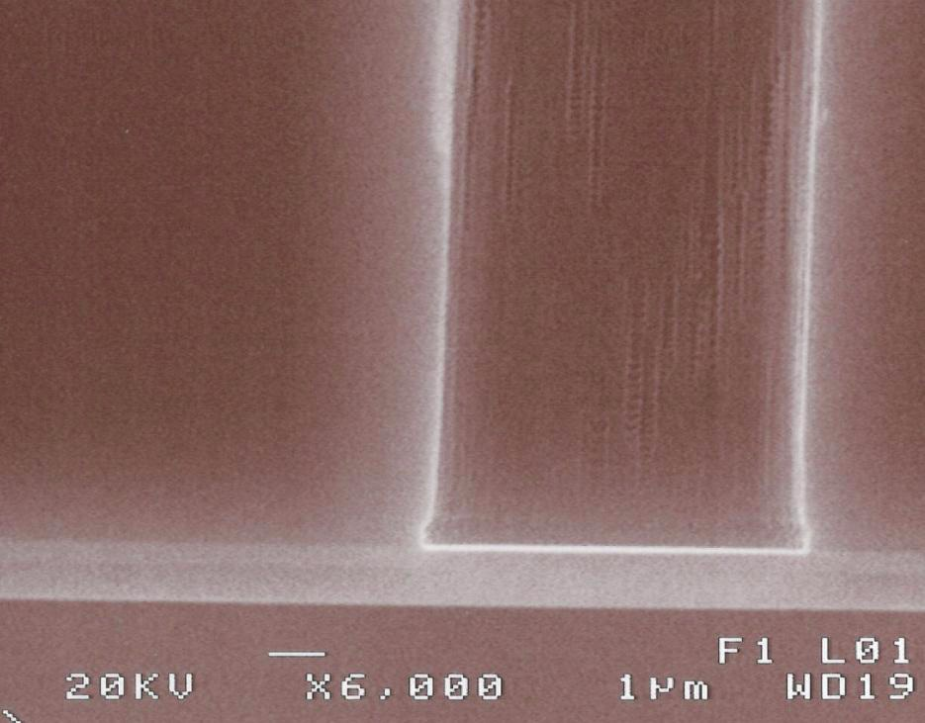
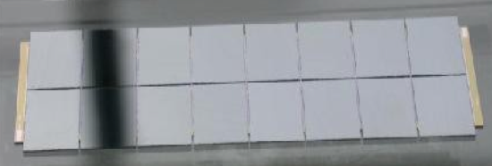
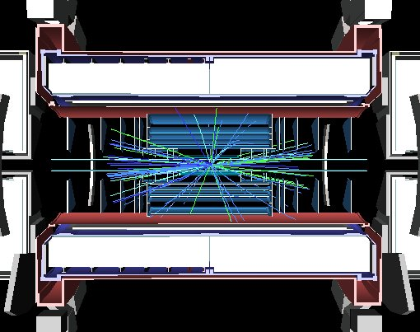
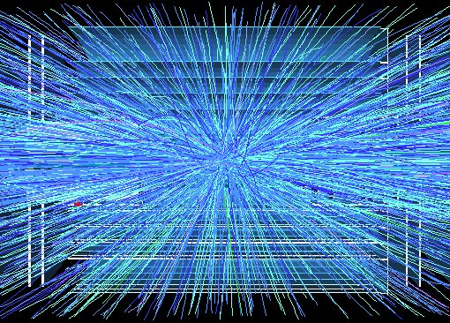
Inner Detectors
Intense R&D ongoing
450 µm
n-in-n slim edge
IBL layout
Planar Sensor
IBL FE-I4 diamond sensors
Thin n-in-p
3D column
11 µm
3D Sensor
ATLAS Pixel FE-I3 diamond module
5 collisions (0.2 x 10³⁴ cm⁻²s⁻¹)
~200 collisions (5 10³⁴ cm⁻²s⁻¹)

Slide 14
Muon spectrometers
After the HL-LHC experience
  Here the problem I see is the natural aging of critical components and of the base materials in general. Most of the active components have been designed for lifetime of 15-20 years. These are gaseous detectors and therefore less robust and more stressed in term of mechanics and services (gas leaks, gas distribution infrastructure, connectors, resistive materials,…)
  In the 2016 and 2020 upgrades we will foresee already to replace with more granular and trigger effective components the chambers in the end-caps at high rapidity. New technologies will be brought in.
  Probably it is possible to foresee around 2030 to start replacing most or all of the muon stations during the regular shutdowns
  Electronics will be obsolete and will need to be replaced in any case (in the racks rooms, but also on the detector)

Slide 15

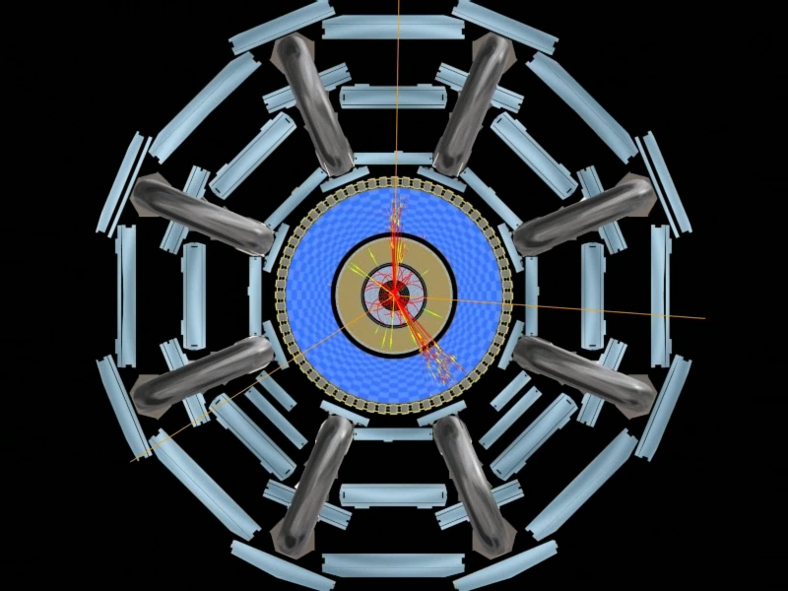
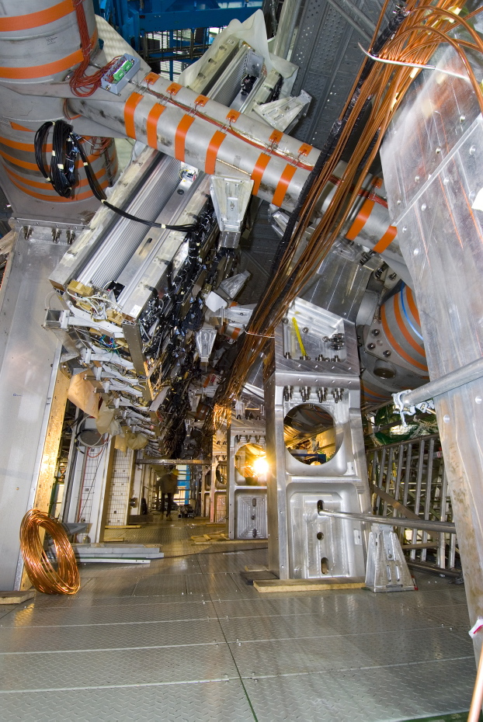
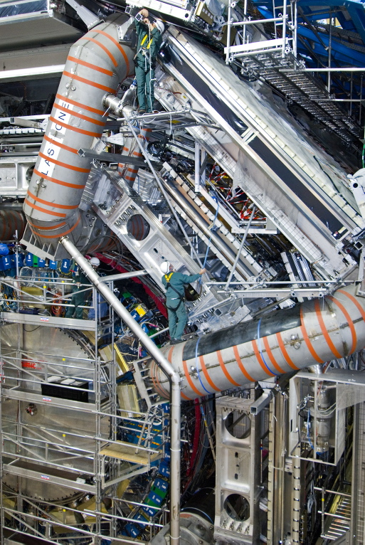
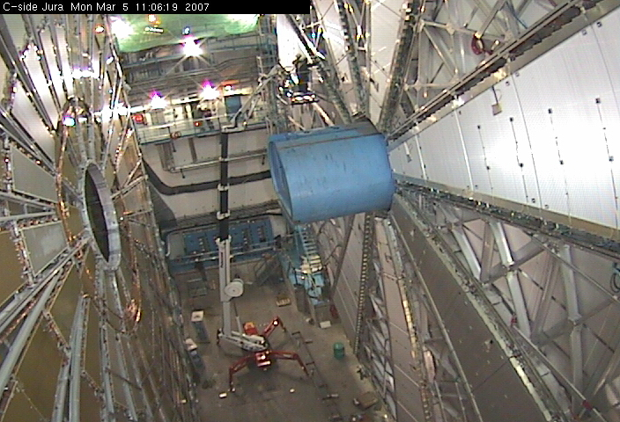
Muon spectrometer

Slide 16
In general
Thinking about the ATLAS and CMS evolution
  Most of the electronics will need to be rebuilt and upgraded. This will partially already happen for the HL-LHC and therefore no reason no to do it later too. This would solve the problem of obsolete technologies
  Inner detectors will be upgraded in >2020, no reason not to keep doing it further, maybe just in a modular way. Similar story for the muon spectrometer. Consolidation/upgrade can by continuous
  The Calorimeters are the more critical items, need a particular evaluation and might represent a serious showstopper
  We will for sure with time revisit the trigger hardware and strategies. But this already for the HL-LHC. Physics will guide us !

Slide 17
In general
Thinking about the ATLAS and CMS evolution
  RP issues will become fundamental from 2016 on, and on the very long term a real problem. We have in any case to change our culture and be more proactive in this domain
  All these changes will require a substantial shutdown of the detectors infrastructure for at least 2-3 years to reconfigure and retest everything
  Planning for cables and services upgrade will need a major effort and a lot of resources. Same for the electronics and computing power
  An adiabatic move from HL-LHC to HE-LHC might be very interesting and valuable for the detectors and the community in general
  I did not say anything about HI, but it might surface again

Slide 18
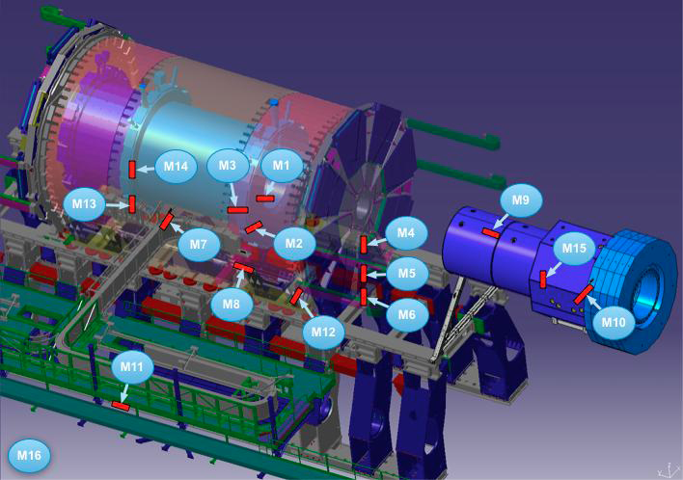
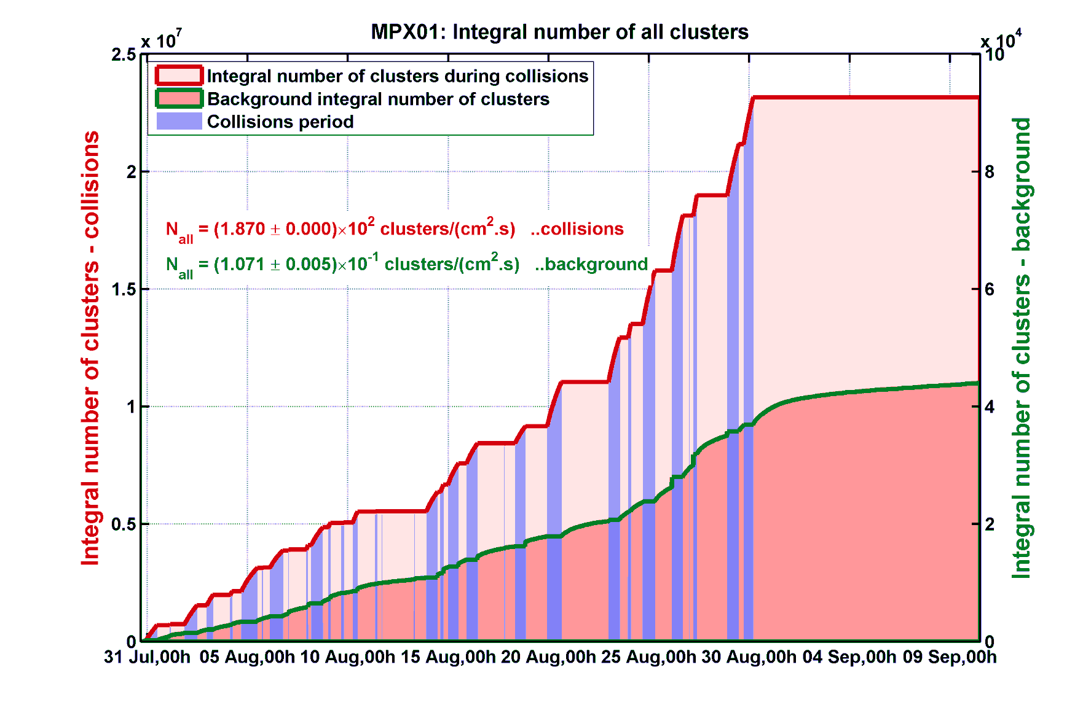
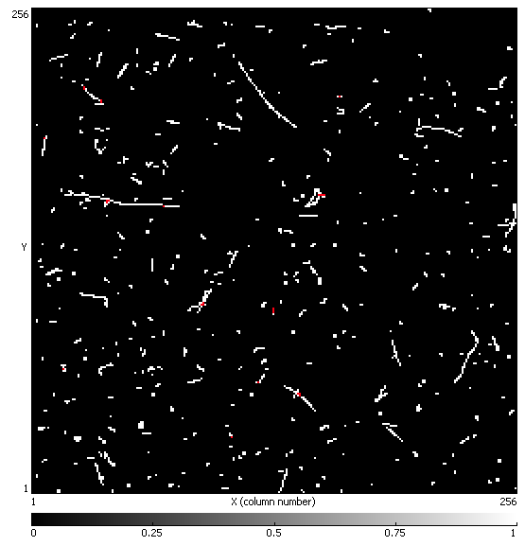
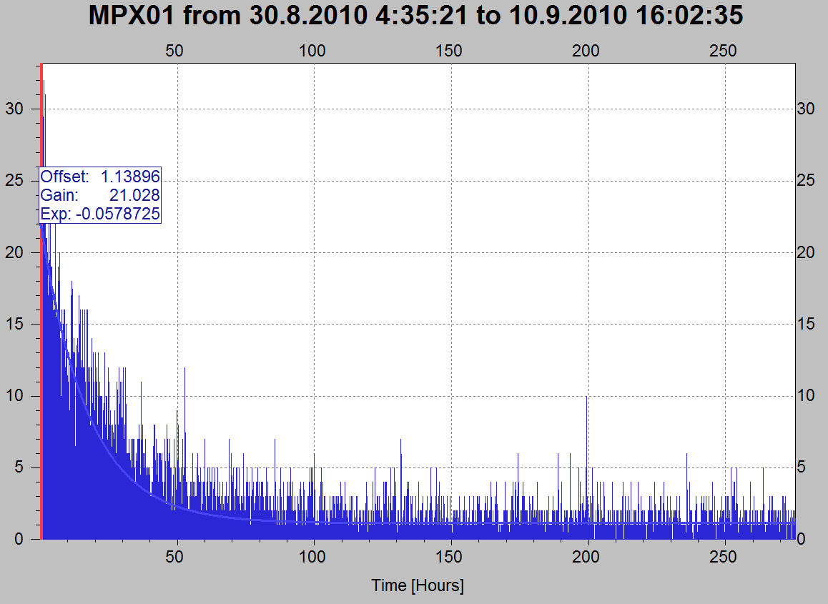
Activation first results
Medipix2 ASIC with 300μm Si
Sensor + conversion structure (measures alphas, protons, ions, fast neutrons, thermal neutrons,..)
~ 2.5 10⁶ thermal neutrons/cm²/pb⁻¹

Slide 19
A new detector ?
Why not think and plan for a very new detector in general (in parallel to ATLAS and CMS)
  If we go the HE-LHC way, probably it means no Linear Collider for a while!
  A large detector community is in standby, with a lot of new ideas and a lot of new technologies to be deployed
  A new detector could be tuned from the beginning to the type of new discoveries the LHC will do and go further in a more affective way
  It will take 16-18 years to arrive to a fully functional new detector, this means that green light should be given around 2014-15

Slide 20
Thank you

