Slide 1
Status of HTS Magnets and the conductors they depend upon
Justin Schwartz
Department of Materials Science and Engineering
North Carolina State University
EuCARD - HE-LHC'10 AccNet
mini-workshop on a “High-Energy LHC”
14 October 2010
Malta

Slide 2
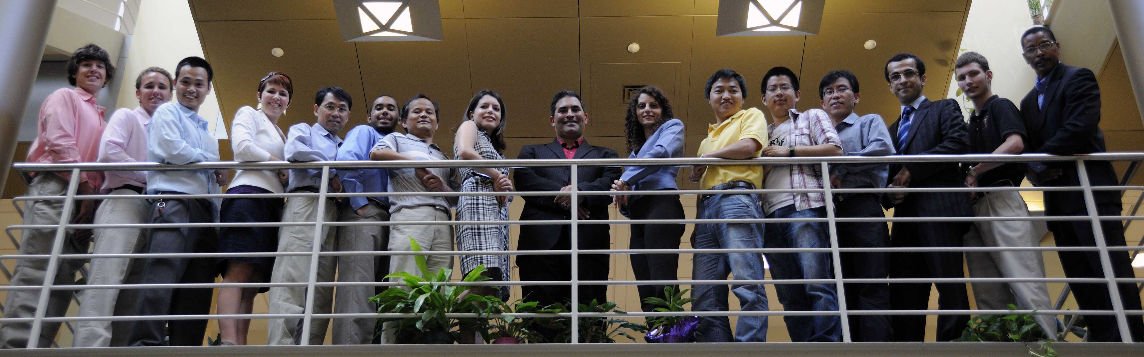
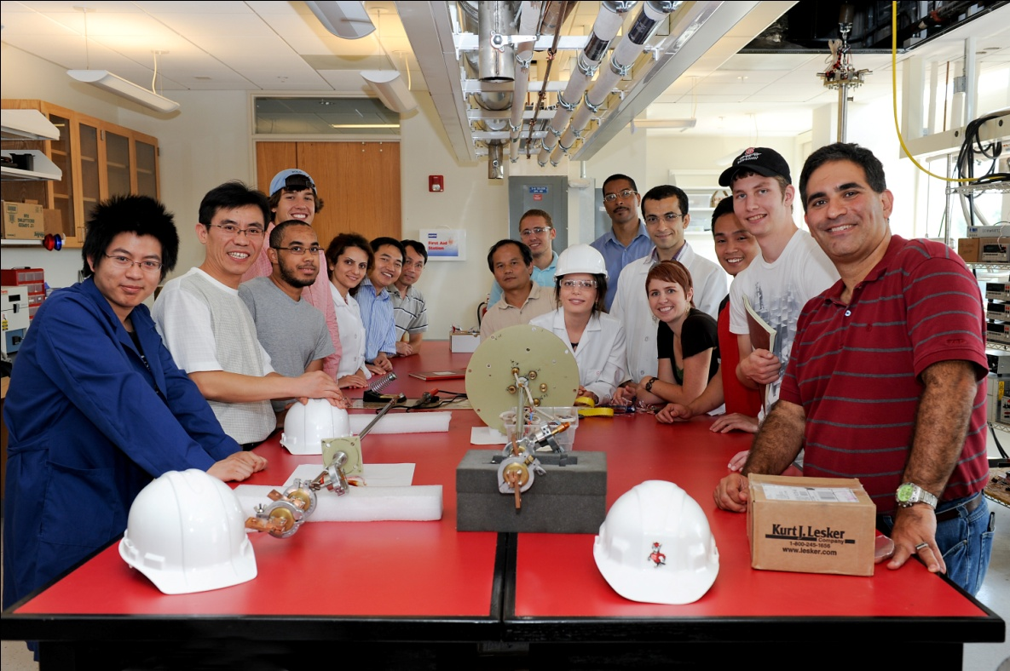
Schwartz Research Group
Five undergraduates, seven PhD students, two post-docs, two Research Professors (one Visiting) … and me
With openings for PhD students and a post-doc interested in HTS materials & technology

Slide 3
In partial collaboration with the
Very High Field Superconducting Magnet Collaboration (VHFSMC)
(a collaboration focused on Bi2212 R&D)

Slide 4
Other key collaborators
Supercon Inc.
Muons Inc.
American Superconductor Corporation
SuperPower Inc.
GE R&D
nGimat
We’re always open to new partnerships

Slide 5
Outline
Motivation for HTS magnets
The conductors
Magnet challenges and reasons for hope
Potential “game changers”
Conclusions

Slide 6
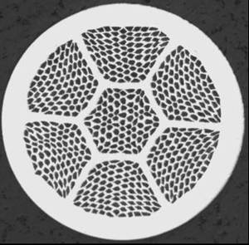
Why use HTS for magnets?
Magnet engineering issues: LTS versus HTS
Conductor J_{c}(B,T), n-value, homogeneity
Conductor I_{c}- strain
Conductor scale-up
Conductor cost
Conductor availability
Packaging (insulation & reinforcement)
Coil manufacturing
Stability, quench detection, quench protection
Application specific issues field profile, homogeneity, heat load, radiation resistance
Overall materials complexity
HTS is an enabling technology, not replacement technology
Notes:
But HTS really means two-paths & any discussion of “Status of magnets” has to begin with “status of conductors”

Slide 7
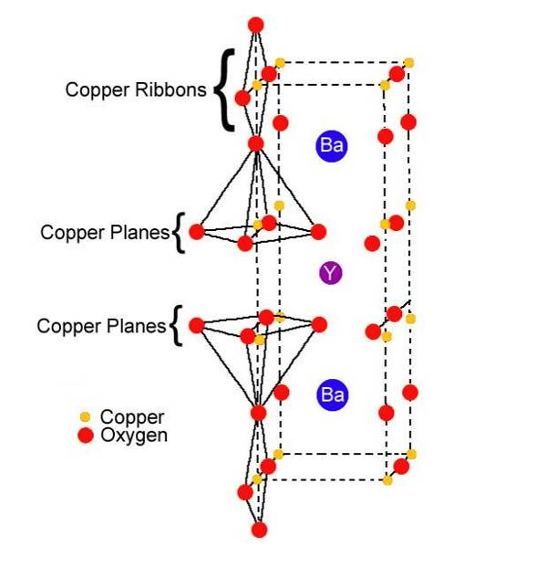
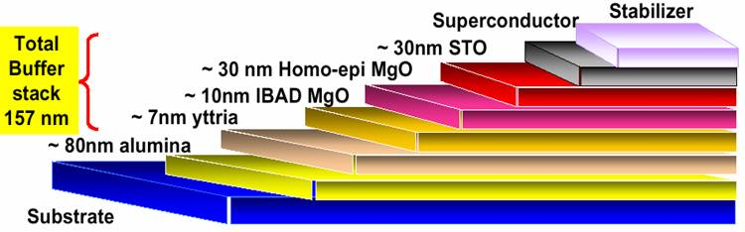
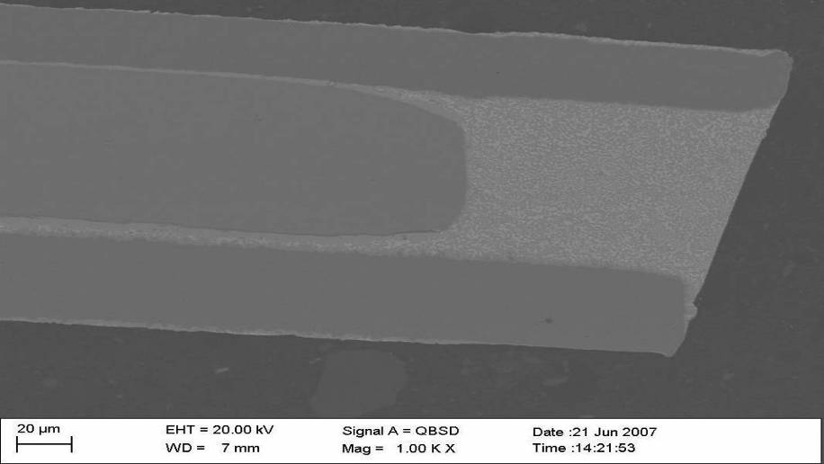
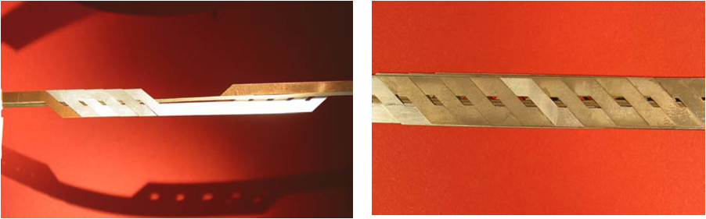
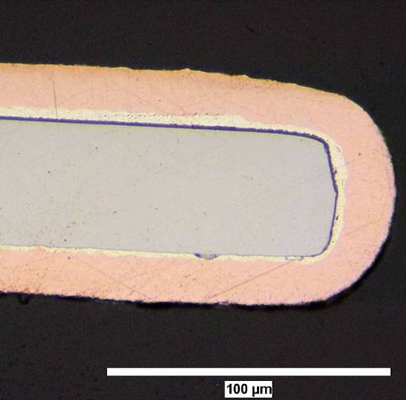
Emerging conductor: RE-Ba-Cu-O coated conductor
Formed by thin-film deposition processes
Specialized buffer layers required
  Transmit/provide textured template
  Chemical barrier between YBCO and Ni
Biaxial texture required
Wide, thin tapes only
Anisotropic EM properties
4-12 mm wide
Copper or SS Stabilizer
Ni alloy
Solder fillet
YBCO + oxides (1-5 μm)
Ag (<1 μm)
Copper or SS Stabilizer
Roebel Cable
Notes:
RABiTS – textured substrate
IBAD – texture for BL deposition
MAIN FOCUS OF THE REST OF THE TALK

Slide 8
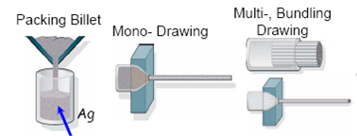
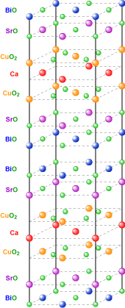
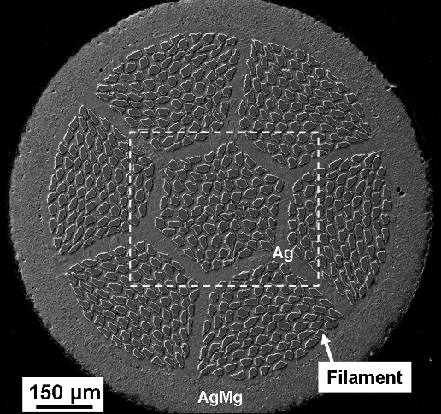
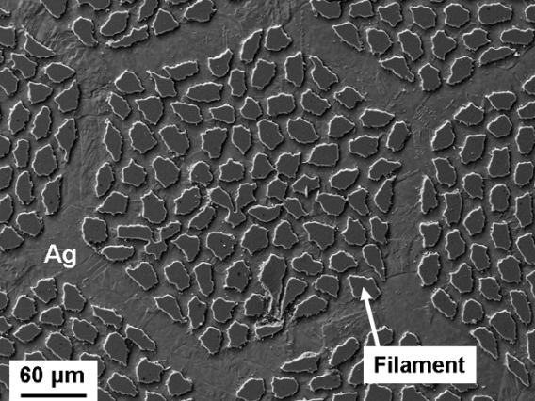
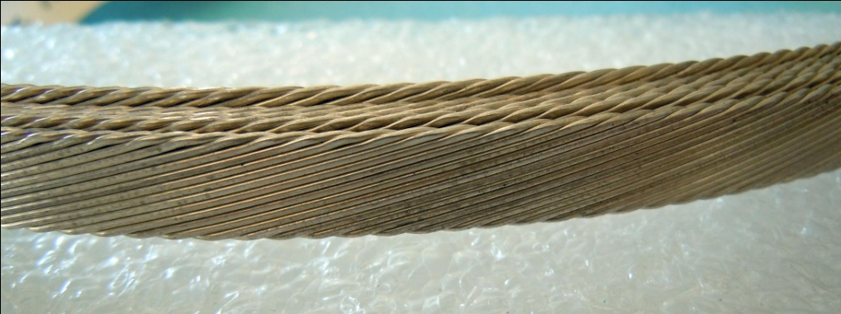
Emerging conductor: Bi₂Sr₂CaCu₂O_{x}
Formed by “powder-in-tube” process
Requires Ag/AgX matrix
Uniaxial texture essential (?)
Micaceous due to double Bi-O layer
Only HTS round wire option
Only HTS conductor w/isotropic EM behavior
Bi2212 Cable courtesy E. Barzi, FNAL

Slide 9
Bi2212 versus (RE)BCO
What are the main differences?
Bi2212
  Round wire, ~30% fill factor
  Isotropic
  Cabled (relatively) easily
  Weak, plastic matrix
  Not well understood microstructure-property relationships
  Wind & react magnets; highly sensitive to heat treatment
  Readily scalable process
  High field only potential market
(RE)BCO
  Wide, thin tape, ~1% fill factor
  Anisotropic
  Roebel cable option
  Strong Ni-alloy matrix
  Highly engineered microstructure (nanostructure)
  React & wind magnets
  Scale-up involves challenges
  High temperature primary market driving development
Notes:
Discussion of “HTS magnets” bifurcates to some extent

Slide 10
Some high field HTS inserts
Year | Conductor | B + ΔB = B_{net} (T) | J (A/mm²) | Stress (MPa) (J_{e}xBxR)
2003 2008 2008 | Bi2212 | 20 + 5 = 25 T 20 + 2 = 22 T 31 + 1 = 32 T | 89 92 80 | 175 109 89 | NHMFL + OST NHMFL/ASC NHMFL/ASC
2007 | YBCO | 19 + 7.8 = 26.8 T | 259 | 382 | SuperPower
2008 | YBCO | 31 + 2.8 = 33.8 T | 460 | 324 | NHMFL/ASC
2009 | YBCO | 20 + 7.2 = 27.2 T | 211 | 314 | SuperPower
2009 | YBCO | 20 + 0.1 = 20.1 T | 241 | 611 | NHMFL/ASC

Slide 11
HTS magnets moving forward
Numerous active HTS magnet programs around the world!
In US alone, funded projects include:
  NHMFL (NSF): 32 T YBCO user magnet
    15 T LTS + 17 T YBCO
  MIT (NIH): 30 T, 1.3 GHz NMR
    700 MHz LTS + 600 MHz Bi2223/YBCO
  ABB (ARPA-E): 24 T, 3 MJ YBCO magnet for energy storage
    Largest industrial project yet!
  VHFSMC is focused on Bi2212 technology
And at NIMS, Japan
  1.03 GHz NMR magnet
    20.6 T LTS + 2.6 T Bi2223

Slide 12
Magnet pull…
Magnet pull let’s us (re)think
  Conductor issues … the building blocks
  Coil manufacturing … putting the pieces together
  Mechanical behavior … JxB is high
  Quench behavior … and so is E ~ B²
  Additional important issues … on which we’ve only begun
    Joints
    Irradiation effects

Slide 13
Conductor materials issues could fill the whole day…
Primary (RE)BCO R&D:
  Scale-up
  Cost
  Anisotropy as a function of temperature (nanoscale engineering)
  Thickness dependence … as a route to higher I_{c} … and lower $/A
Primary Bi2212 R&D:
  Fundamental structure - property (- processing)
    why does Bi2212 carry current?
  Densification
  Role of oxygen
  Heat treatment peak-temperature sensitivity
  Heat treatment optimization
  … lots of materials science…

Slide 14
Magnet pull…
Magnet pull let’s us (re)think
  Conductor issues … the building blocks
  Coil manufacturing … putting the pieces together
    Focus on Bi2212
  Mechanical behavior … JxB is high
  Quench behavior … and so is E ~ B²
  Additional important issues … on which we’ve only begun
    Joints
    Irradiation effects

Slide 15
Coil manufacturing: Bi2212
Wind & react magnet issues, but with O₂ and a sensitive conductor
  Heat treatment uniformity for large magnets
  Presence of insulation reduces wire performance
  Conductor leakage in coils lowers performance further
Key step!

Slide 16
From short samples to coils
Without insulation
With insulation
CF- Light; AEC-Black
Short samples
Element | CF (at%) | AEC (at%)
SrL | 53.87 | 30.90
CaK | 17.88 | 13.19
CuK | 0.57 | 54.73
BiL | 27.68 | 01.18
I_{c}=488A
I_{c}=438A
I_{c}=348A
I_{c}=186A
With insulation, more CF phase observed at the outer filaments
For cut coil sections, more filaments wicked away
Coil section 1
Coil section 2
X.T. Liu

Slide 17
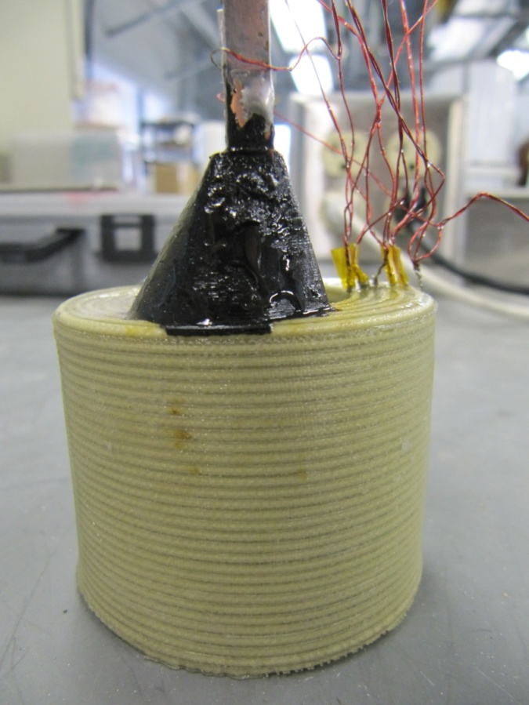
Solutions on the horizon?
Optical-fiber based distributed sensor to detect equilibrium T-profile
Oxford Instruments may have learned to avoid leakage (albeit with lower short sample Jc)
Oxygen pre-annealing reduces inhomogeneities within coils
Change the insulation…
… or add additional Cu

Slide 18
Magnet pull…
Magnet pull let’s us (re)think
  Conductor issues … the building blocks
  Coil manufacturing … putting the pieces together
  Mechanical behavior … JxB is high
    Focus on Bi2212
  Quench behavior … and so is E ~ B²
  Additional important issues … on which we’ve only begun
    Joints
    Irradiation effects

Slide 19
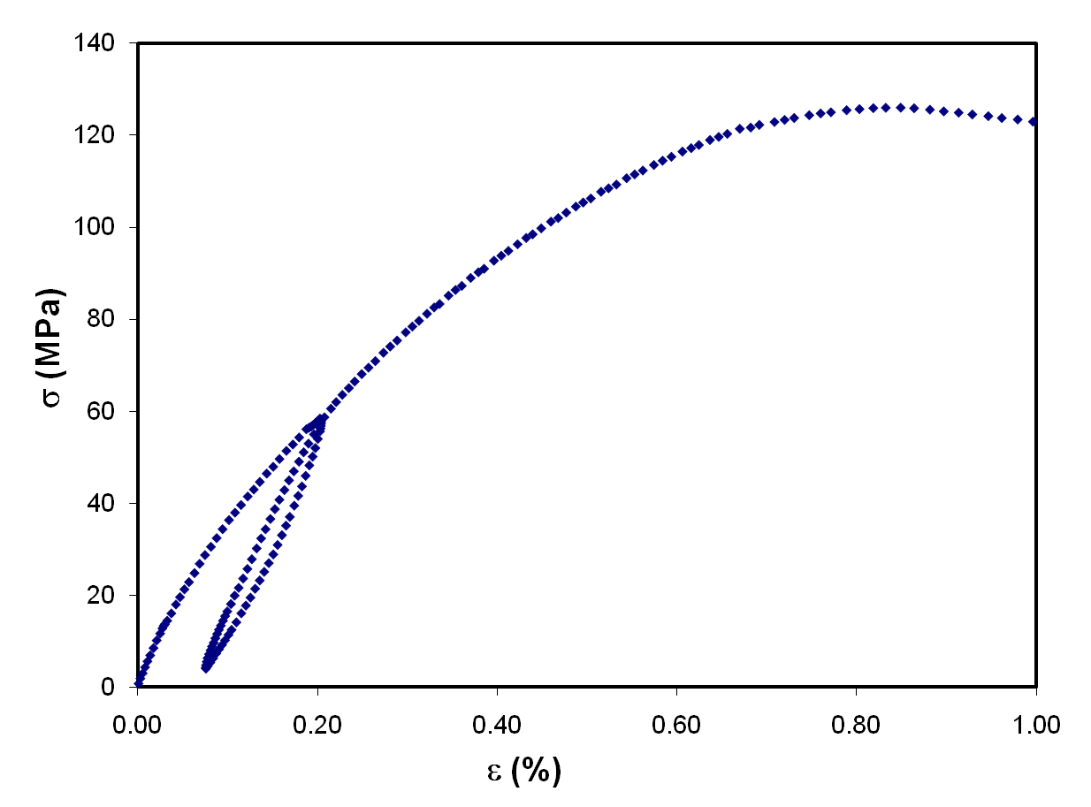
Bi2212 electro-mechanical behavior
Bi2212 wire is mechanically irreversible, weak, and non-uniform
Weak matrix with a brittle ceramics “fiber” as functional element
  Brittle materials often best-studied using statistical approaches

Slide 20
Weibull statistical analysis of electromechanical behavior
Three-parameter Weibull distribution function:
where α, β and γ are scale, shape and location parameters respectively.
Rearranging and taking double logarithms we get:
The function F(x;α,β,γ) is estimated from the experimental data by formula below:
Measure: yield stress, Young modulus, I_{c} at strains ranging from ε=0% to yield
I_{c} test condition: 4.2 K, self-field for Bi2212; 77 K, self-field for YBCO
Electric field criterion: 1 μV/cm
25 samples tested for each strain value

Slide 21
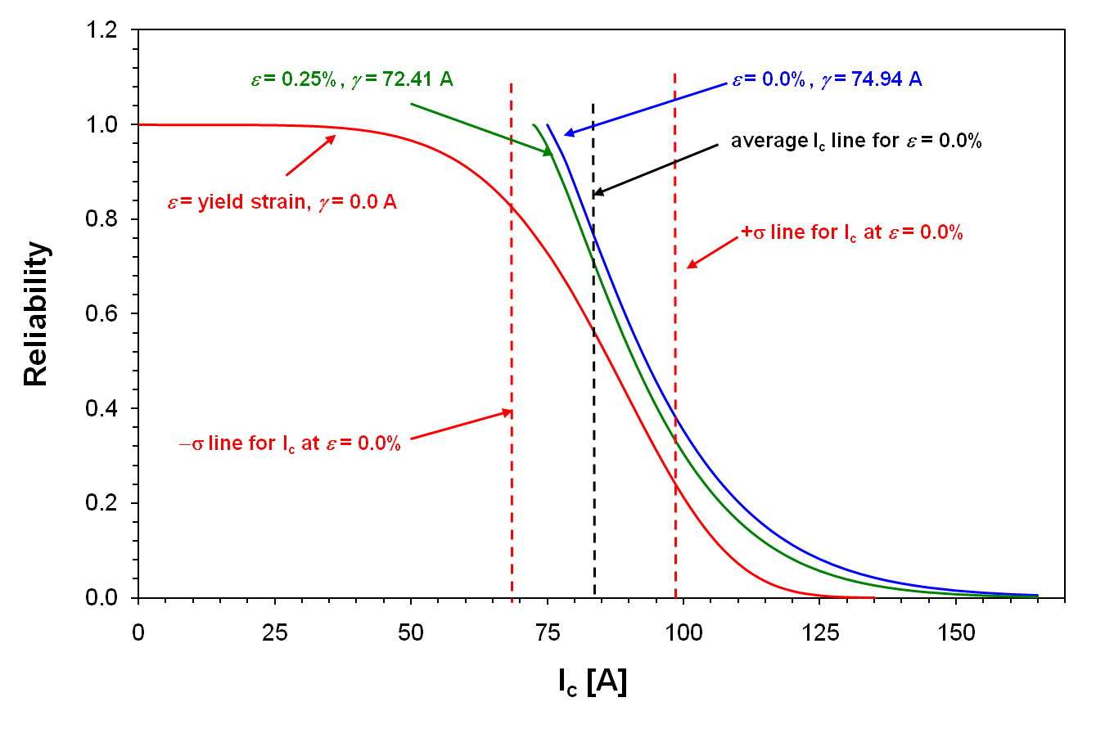
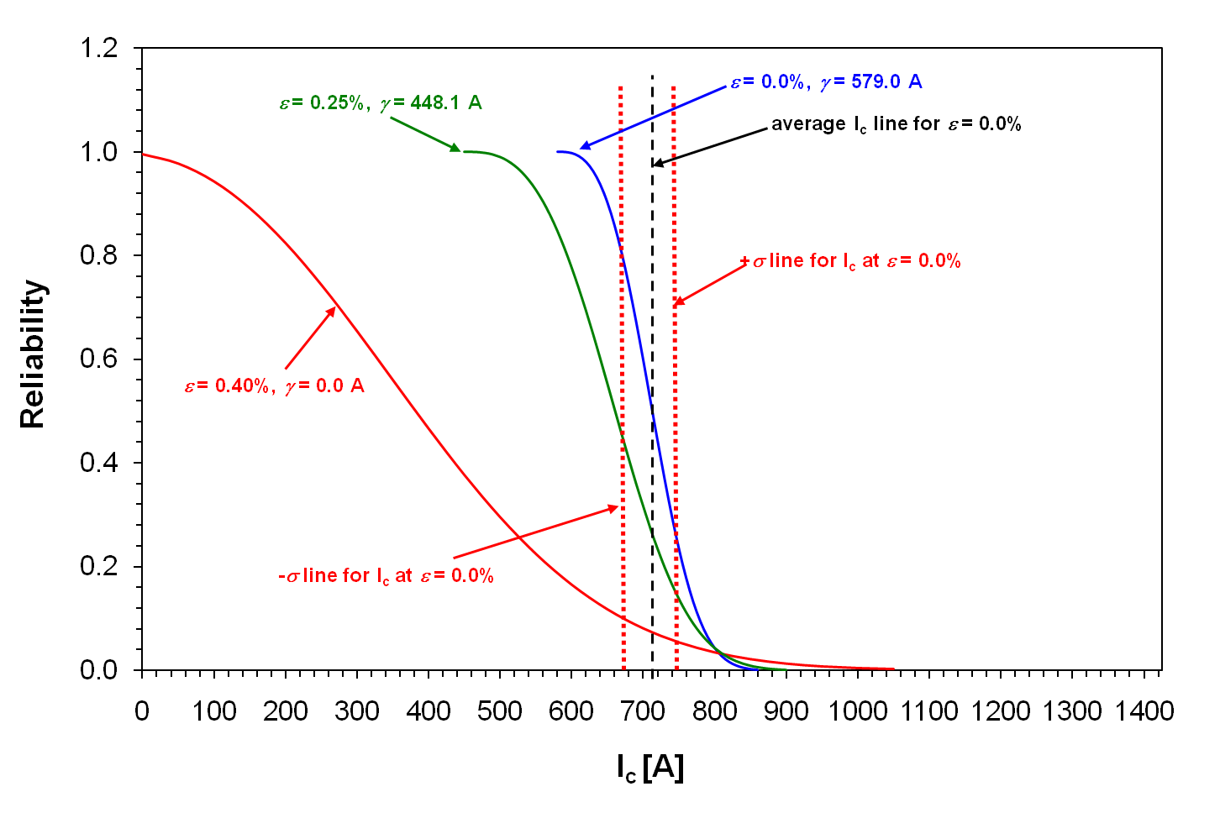
Bi2212 RW versus YBCO
Weibull reliability curves
YBCO
Bi2212
γ(ε) = zero-margin design limit
YBCO: indicative of metallic behavior at low/intermediate strain; ceramic-like at high strain
Bi2212: inhomogeneous, defect-dominated behavior; high current tail in high strain curve may indicate a strain-resistant “backbone”
Mbaruku et al., SuST 23 115014 (2010)

Slide 22
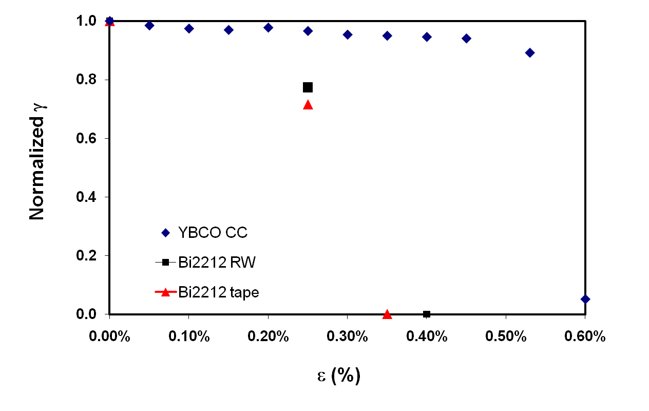
What do the Weibull results mean for magnets?
ε_{c} model may not be best for present-day Bi2212 wires

Slide 23
Bi2212 electro-mechanical behavior is it the end of the story?
Does Bi2212 strong, reversible backbone imply potential for significant improvements?
Can we engineering the Ag matrix significantly better?
Can we understand what’s happening at the microscopic level?
  will higher J_{c} also lead to more strain-resistance?
  microstructurally-driven fractal analysis of localized stress concentrations says yes!

Slide 24
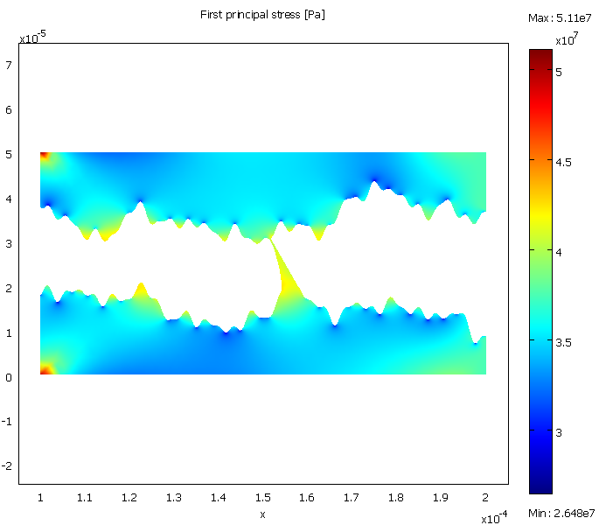
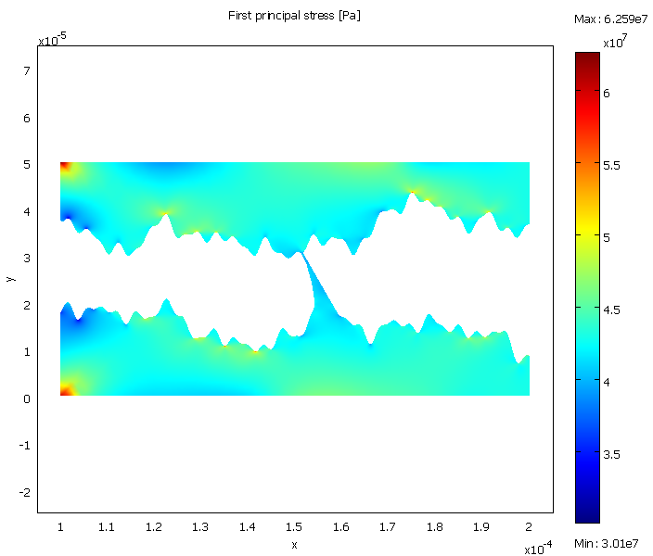
Fractal-based stress-concentration results
Stress concentrations in bridges not dominant
Lower stress
Higher stress

Slide 25
Magnet pull…
Magnet pull let’s us (re)think
  Conductor issues … the building blocks
  Coil manufacturing … putting the pieces together
  Mechanical behavior … JxB is high
  Quench behavior … and so is E ~ B²
    Focus on (RE)BCO
  Additional important issues … on which we’ve only begun
    Joints
    Irradiation effects

Slide 26
HTS magnet quench protection
Protection in HTS qualitatively similar to LTS; requires
  Detection → typically depends on propagation
  Understanding of failure limits
    Does NON-catastrophic quenching effect electromechanical behavior?
  Protective response
Some simple truths remain true
  High field → high energy
  High J_{E} → high energy density

Slide 27
HTS magnet quench protection
Protection in HTS quantitatively very different from LTS
  Propagation is very slow
  But perhaps temperature rise is slow too?
  It’s primarily the localization of the problem … traditional detection has limited spatial resolution; is it sufficient?
The key is to limit the local growth of the temperature (gradient) relative to our ability to detect
A key remaining challenge to HTS magnets, especially YBCO
Song & Schwartz, IEEE TAS 2009

Slide 28
Possible solutions attacking the problem at both ends
Distributed (co-wound) optical fiber sensor to give fast, localized detection
  Spatial resolution approaches wavelength of light!
  Data overwhelm!
  In practice, this “data problem” → trade-off between temporal and spatial resolutions
  Is it sufficiently intimate with the conductor?
Can a 3D “propagation” mode reduce the local temperature (gradient)?
  Thermally-conducting electrical insulators under development
Have we even quantified the problem accurately?
  Multiscale modeling attacking the problem

Slide 29
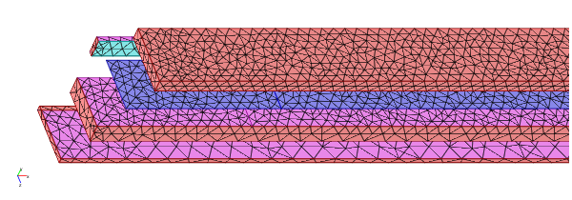
Multiscale (3D/2D) tape model
Silver layer*
YBCO (2D)
Side interlayer*
Stabilizer
Bottom interlayer*
Side Cu
Buffer layers*
Substrate
Top Cu
* Not meshed
YBCO (2D)
Substrate
Bottom Cu
Chan et al., IEEE Tranactions on Applied Superconductivity in press

Slide 30
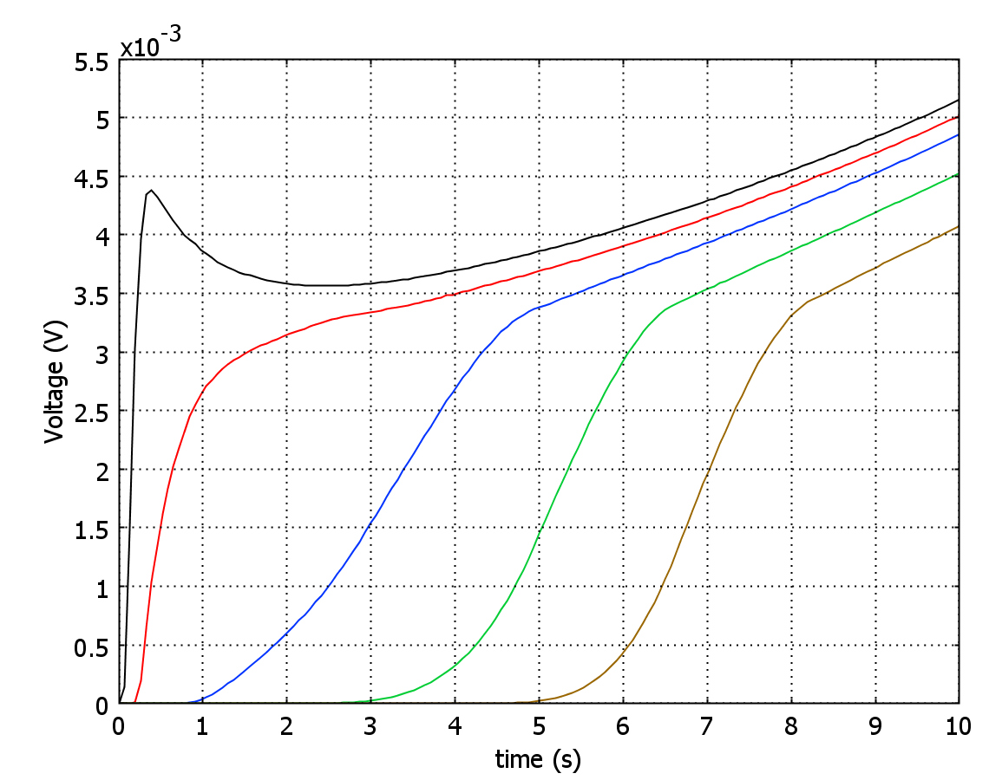
Experimental Validation
Model
Experiment
Voltage (V)
Dashed: experiment
Solid: model
40 K
50 K
60 K
70 K
77 K
X. Wang et al., J. Applied Physics 2007
W. K. Chan et al., IEEE Transactions on Applied Superconductivity in press

Slide 31
Using the model to engineering better conductors for quench protection
YBCO thickness (um) | ~MQE density (W/m³) | NZPV (cm/s) | T @ V2, 4 mV (K)
1.4 | 1.16e9 | 2.00 | 121.0
2.8 | 0.845e9 | 4.22 | 170.0
Cu thickness (um) | ~MQE density (W/m³) | NZPV (cm/s) | T @ V2, 4 mV (K)
25 | 0.6e9 | 2.53 | 146.5
37 | 1.16e9 | 2.00 | 121.0
50 | 1.45e9 | 1.75 | 104.0
Stabilizer material | ~MQE density (W/m³) | NZPV (cm/s) | T @ V2, 4 mV (K)
Cu | 1.16e9 | 1.78 | 121.0
Brass (UNS 22000) | 0.3e9 | 3.18 | 226.0
Buffer conductivities ρ (S/m)/κ (W/m-K) | ~MQE density (W/m³) | NZPV (cm/s) | T @ V2, 4 mV (K)
1 / 1 | 1.16e9 | 2.00 | 121.0
5e7 / 250 | 1.16e9 | 2.00 | 121.0

Slide 32
Embed conductor model into a hybrid 3D coil model
Effort to compute
Coil with laminated tapes
Difficult
Coil with homogenized tapes
Homogenized coil
Hybrid coil
Easy
cm
mm
µm
Precision
Homogenized coil model embedded with localized multilayer tape model
  Obtain global, macroscopic and local, microscopic data without building globally complicated, expensive-to-compute coil model
Localized multilayer tape model is the center building block
  Precise quench details at µm scale down to each layer within a tape.
  Estimate lump parameters and effective material properties for coil model.
Coil model provides background magnetic field and acts as heat mass and magnetic energy storage.
32
32

Slide 33
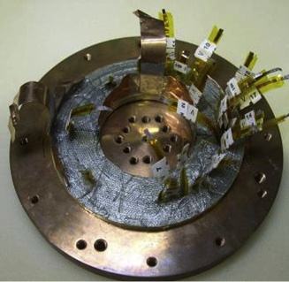
Compare coil model with experimental data
Homogenized Coil
(= 97 turns)
Cryocooler Copper Plate
5.08 cm
Embedded multilayer tape model
(~ 8.2 cm x 4.8 mm)
Side stabilizer
Substrate
Copper stabilizer
Turn 62
3D/2D
tape model
Turn 61
Turn 60
+ heater
Insulation
Turn 59
Turn 58

Slide 34
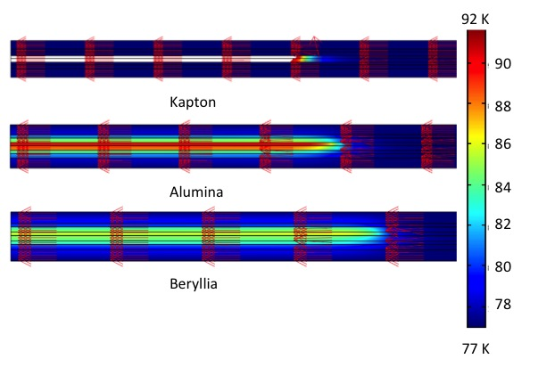
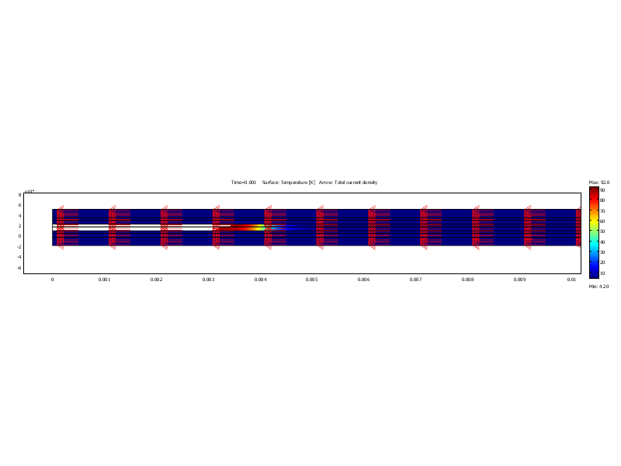
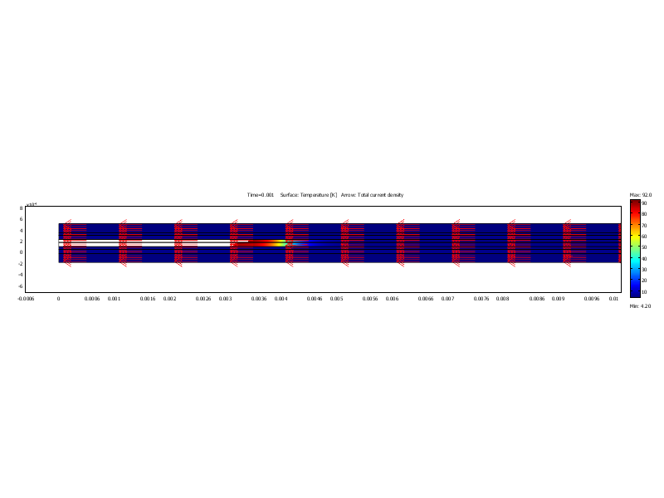
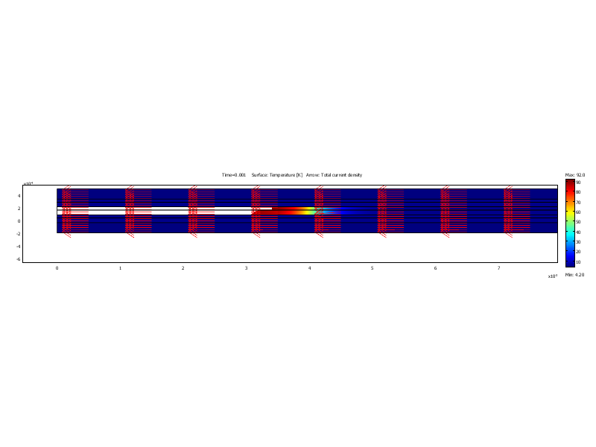
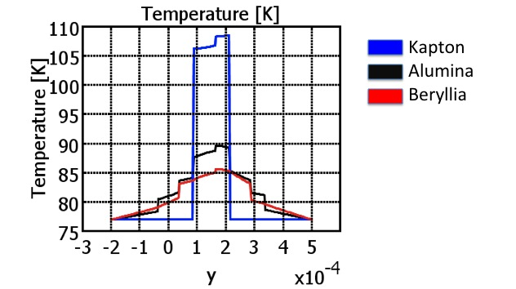
Thermally conducting insulation might just work!

Slide 35
Other important technology issues
Joints – little has been done for either Bi2212 or (RE)BCO
Irradiation … we know that the MQE is very large
  Some beginning results on neutron irradiation of YBCO are coming thanks to ITER but not enough to be conclusive
  Ag renders Bi2212 irradiation studies more difficult
  Conceivably IR magnets could operate at higher temperature than 4.2 K if irradiation tolerance is sufficient … T_{op} would be an optimization issue

Slide 36
Potential “game changers”
YBCO
  High performance round wire would probably eliminate Bi2212 immediately
  Low cost processing
Bi2212
  100% dense filaments
    Impact on J_{c}(B)?
    Impact on J_{c}(ε) and γ(ε)?
  Alternative mechanisms to significantly improve mechanical behavior of cables

Slide 37
Conclusions
HTS magnets are progressing
Bi2212 and YBCO magnets have vastly different limitations and challenges
Solutions include
  some “LTS extrapolations”
  some “out of the box” approaches
At present it’s a staircase, but there are potential elevators
Materials community getting away from “if we make a conductor, applications will come”
Magnet community should not view conductor as a “fixed” product
Applications pull is THE necessary driving force
  YBCO: applications aplenty, though not all R&D relevant for high field magnets
  Bi2212: high energy physics and NMR are only two players in the game

Slide 38
Coil manufacturing: (RE)BCO
(RE)BCO
  Bending strain is a minor factor
  Lack of cables (Roebel simply not tested for magnet applications)
  Anisotropy issues (ends of a solenoid)
  Winding direction reversals (solenoids)
  Mostly “conventional” R&W magnet issues with a tape conductor

Slide 39
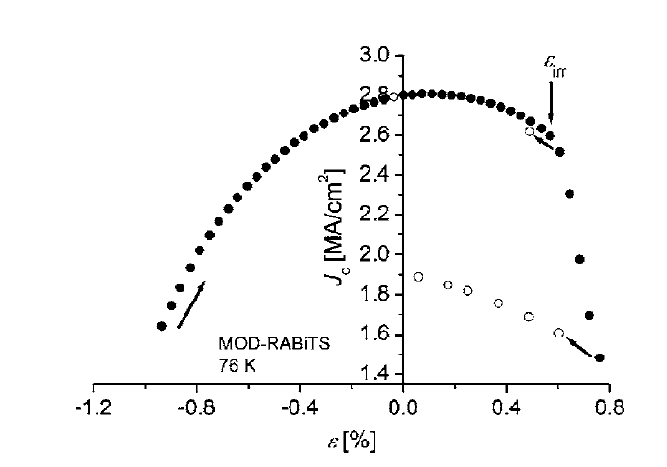
YBCO electro-mechanical behavior
YBCO is reversible and strong
  van der Laan & Ekin, APL 2007
Hastelloy substrate gives excellent behavior!

Slide 40
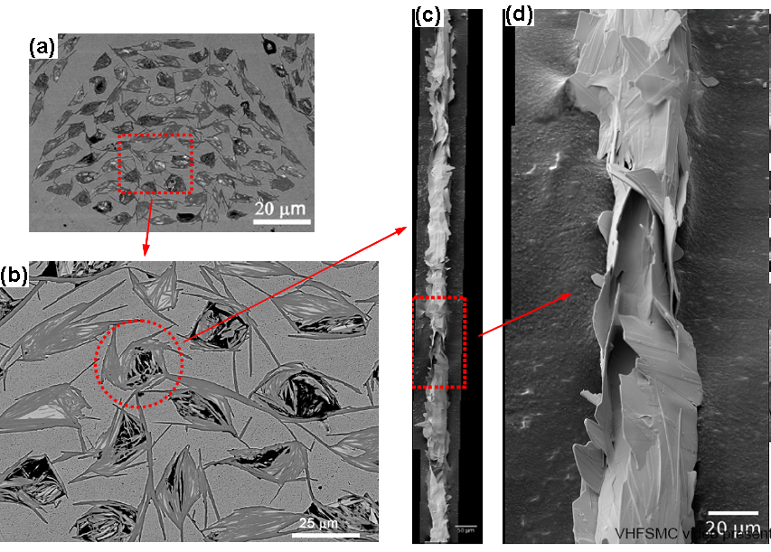
Hi-res image of an individual filament
Kametani, FSU

Slide 41
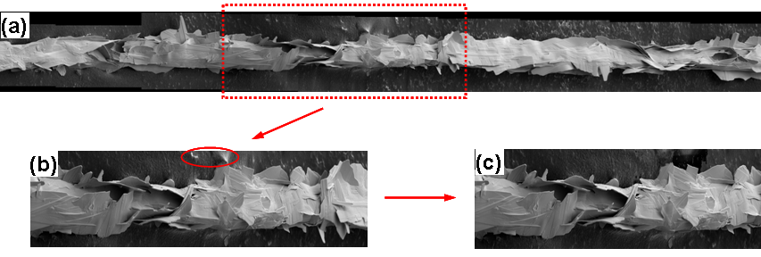
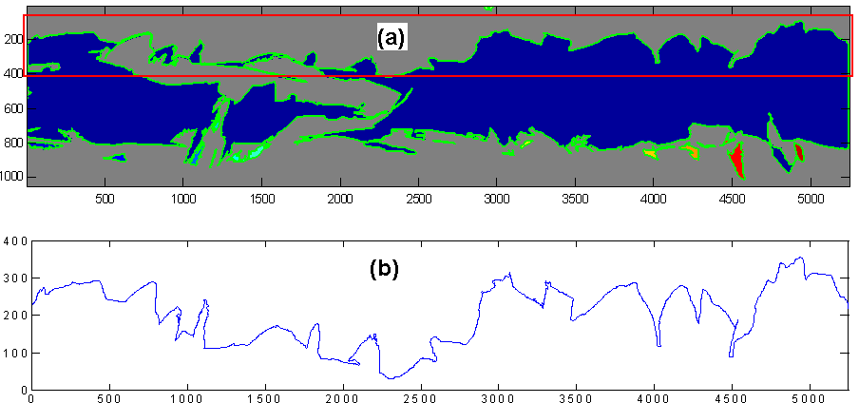
Digitize the filament image for fractal analysis
Xiaofan Gou

