Slide 1
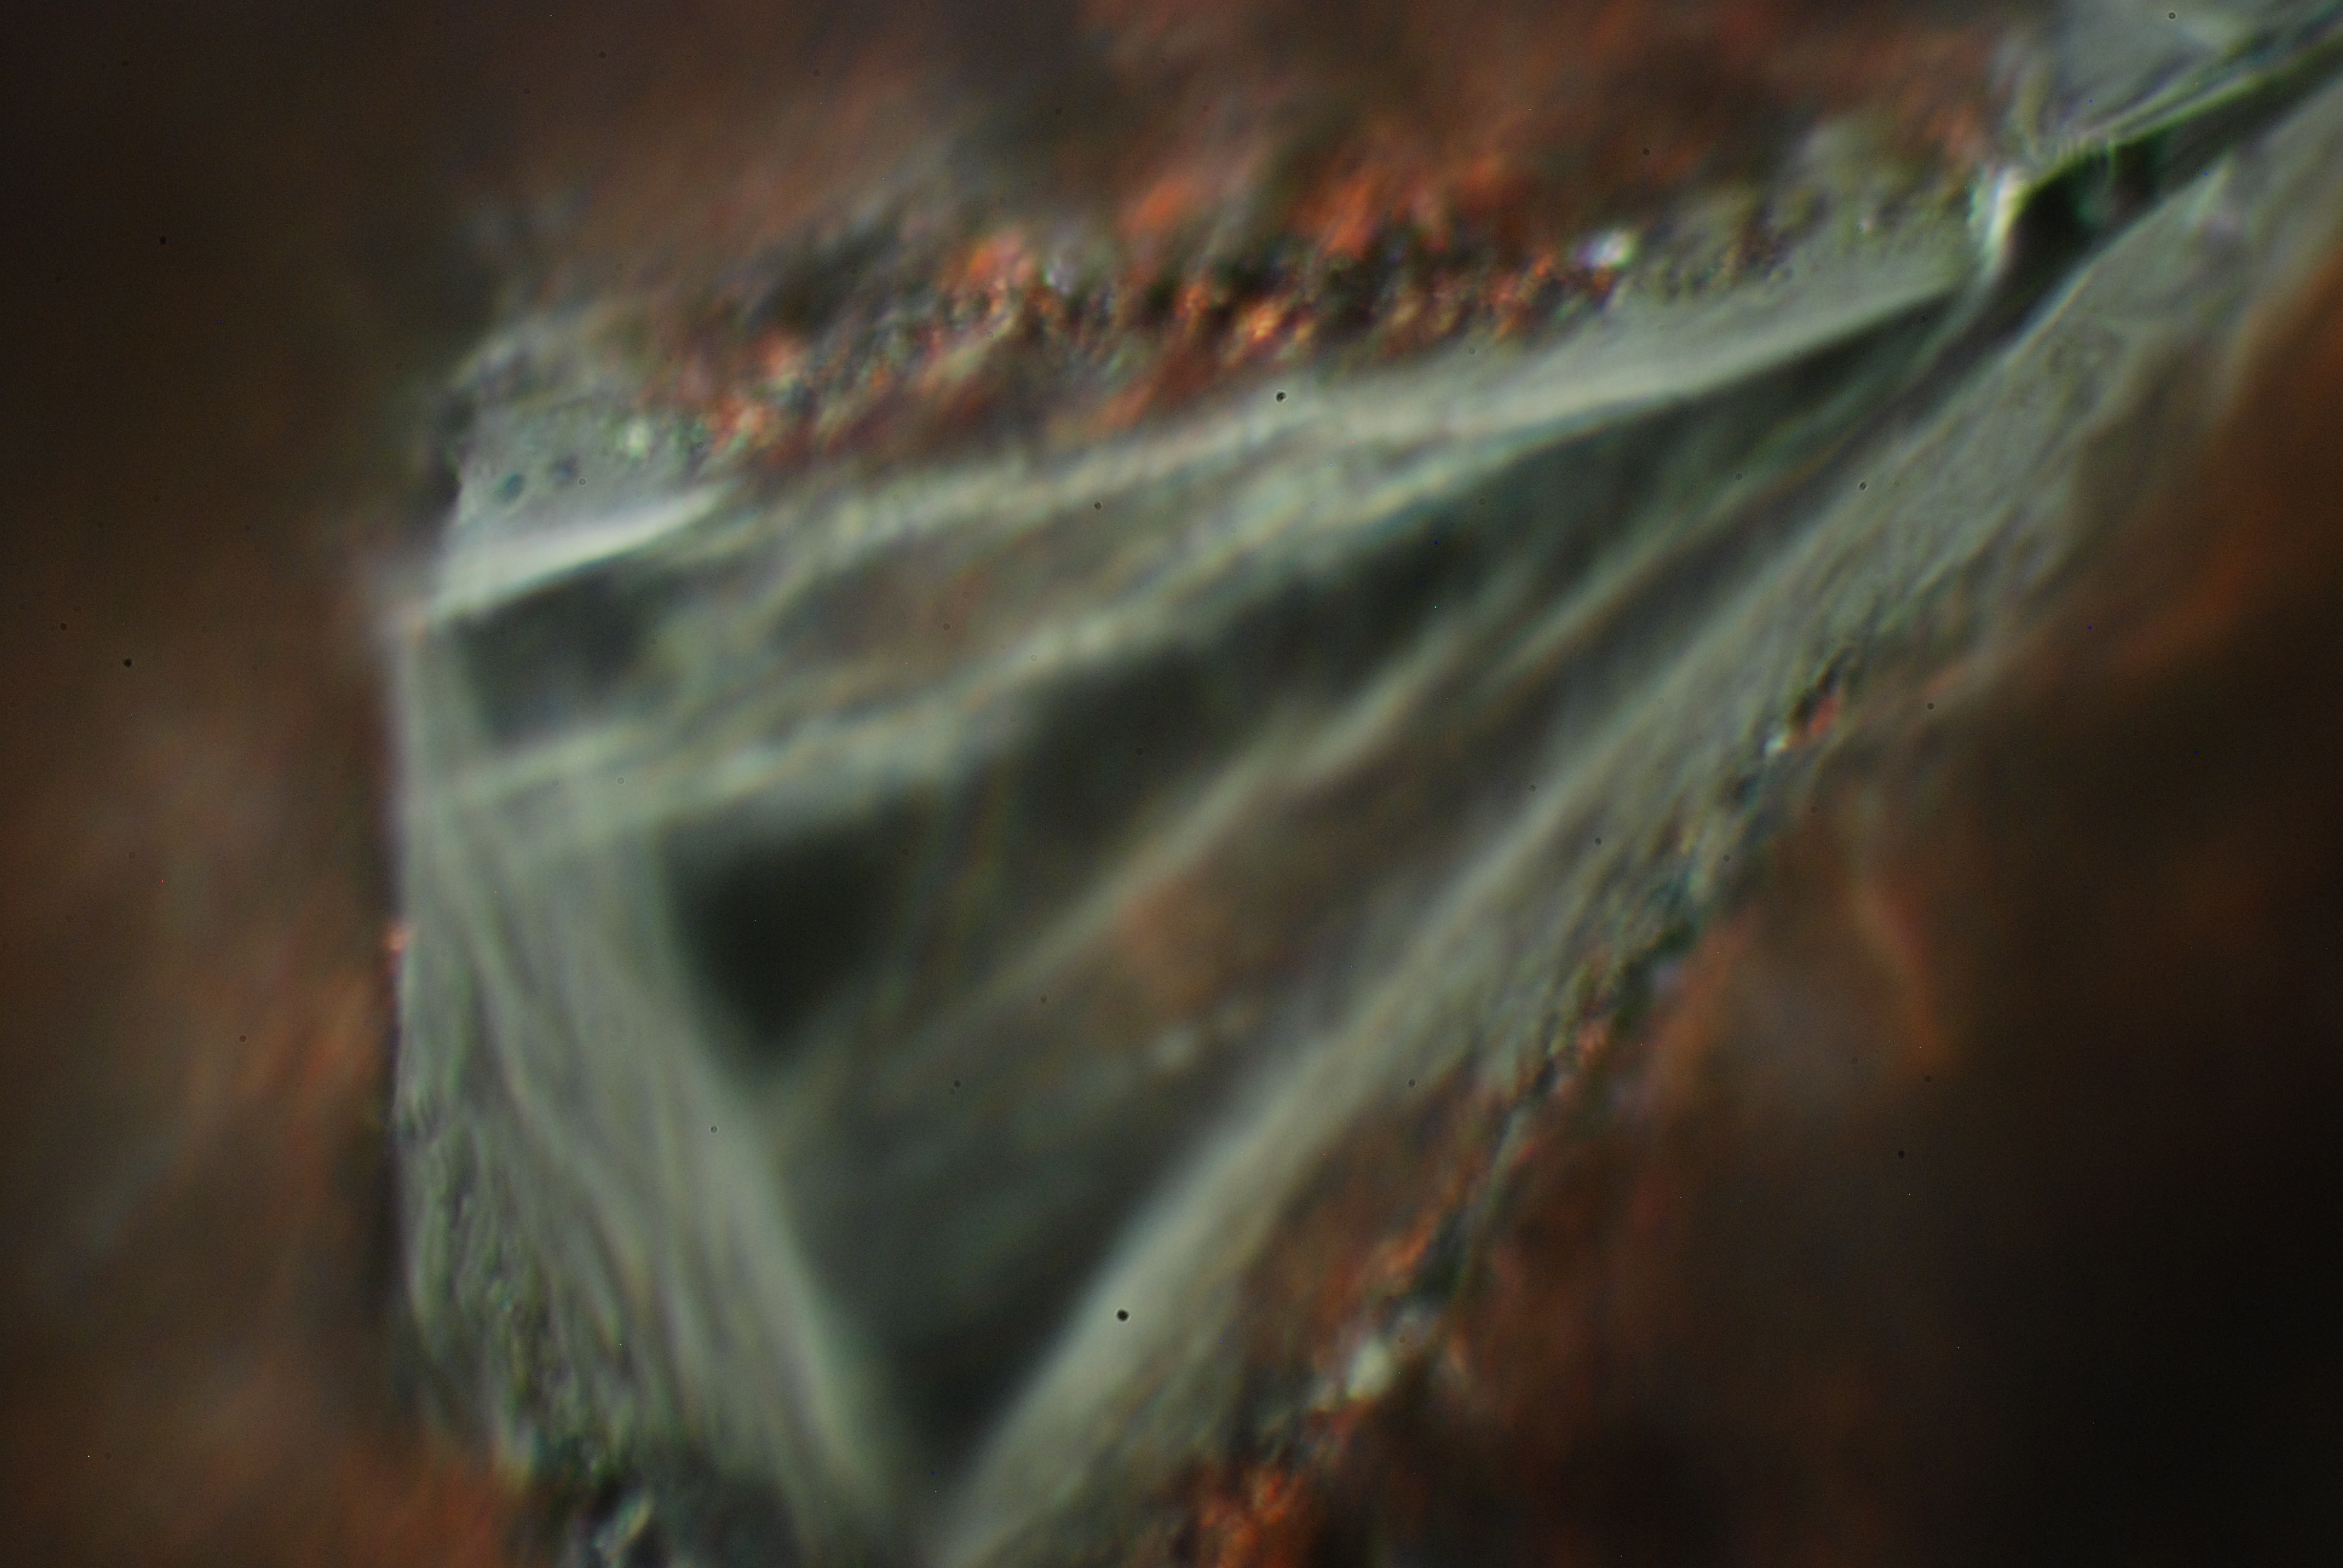
Intensity Issues and
Machine Protection
R. Assmann, CERN
HE – LHC Workshop
Malta, 14.-16.10.2010
Picture of Copper-Dimanod Collimator Material
EuCARD/ColMat, GSI

Slide 2
Parameters HE-LHC
Consider:
Round case
Compare to nominal LHC
Typical collimator location β = 80m
Main issues:
Nominal Upgrade
E 7.0 TeV 16.5 TeV
γ 7461 17587
ε 0.5 nm 0.15 nm
E_{stored} (tot) 362 MJ 482 MJ
ρ_{e} (tot) 2.9 GJ/mm² 15.4 GJ/mm²
E_{stored} (1b) 128 kJ 242 kJ
ρ_{e} (1b) 1.0 MJ/mm² 7.7 MJ/mm²

Slide 3
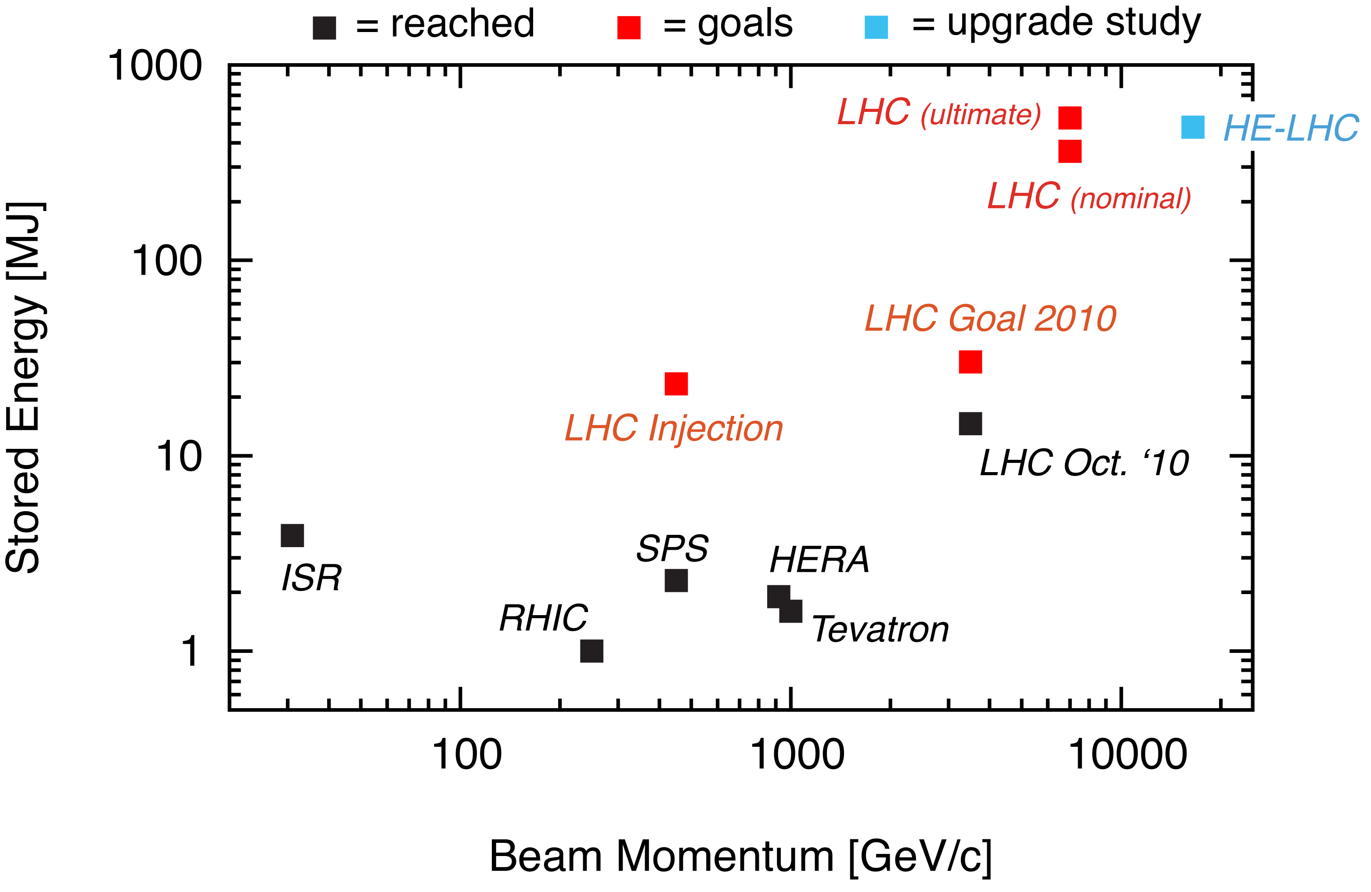
Stored Energy

Slide 4
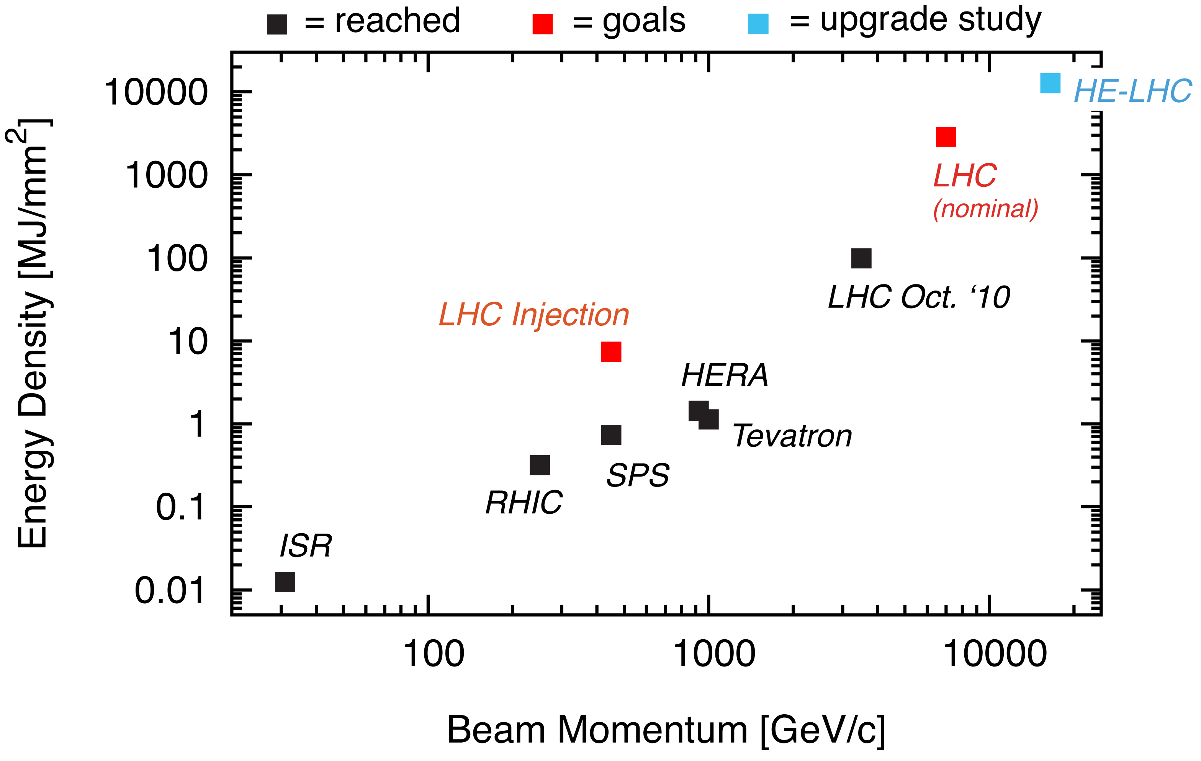
Energy Density

Slide 5
Issues to be Discussed
Collimation Efficiency
Machine Robustness
Issues due to Smaller Gaps
Comments on MP
Comments on Cleaning Insertions

Slide 6
Collimation and Cleaning
LHC has a sophisticated collimation system.
This system intercepts and absorbs stray beam particles with ultra-high efficiency.
It is located in the two cleaning insertions (IR3, IR7).
The system had been optimized for 7 TeV by:
  proper choice of 138 collimator locations
  4-stage collimation hierarchy
  3 different collimator jaw material types
  2 different lengths of jaws
  4 different orientations in x, y, skew plane
Involved nuclear physics processes depend strongly on energy.
System behaves differently at higher energies.

Slide 7
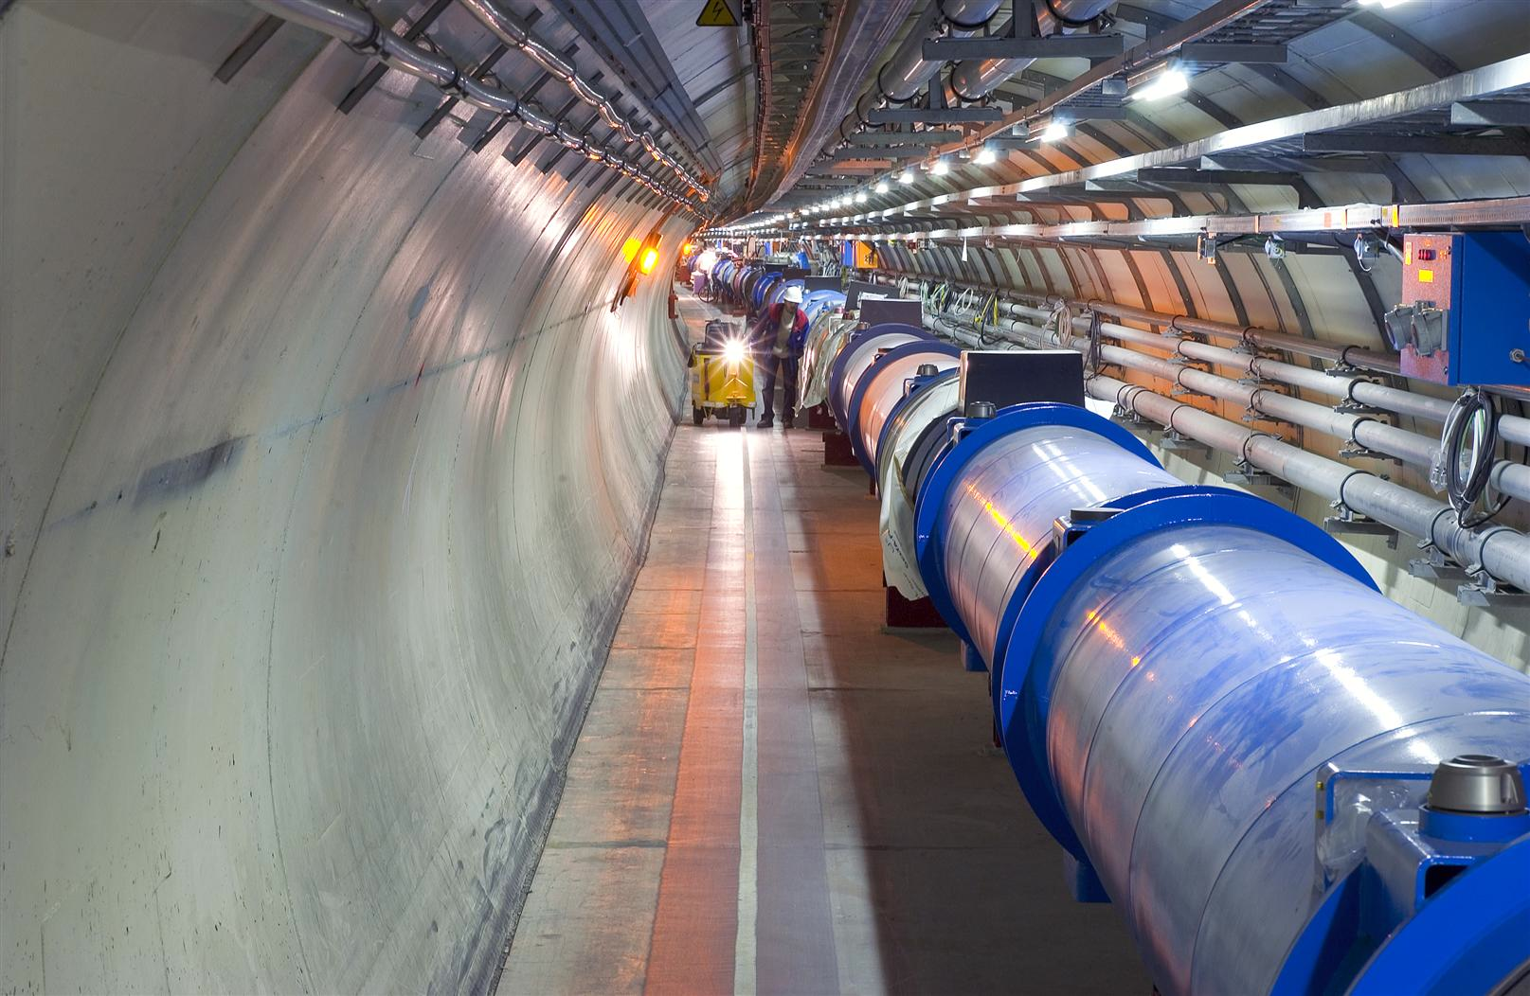
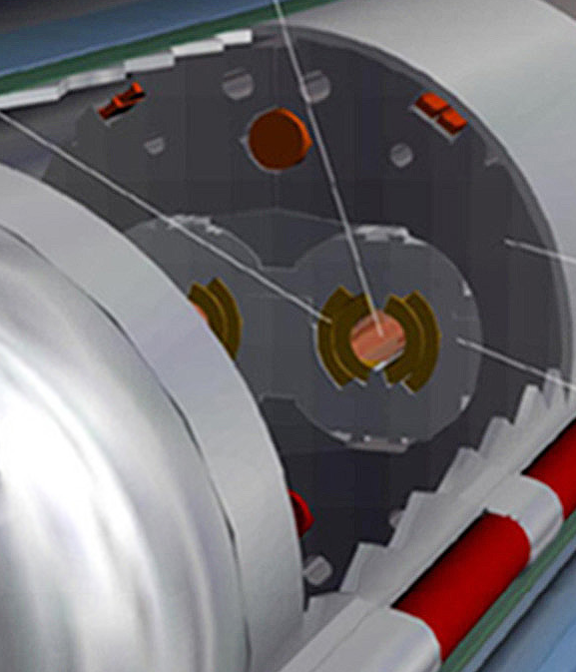
Quench Limit versus Stored Energy
Beam
30 MJ (2010) ➔ 362 MJ (2013) ➔ 500 MJ (HE-LHC)
56 mm
SC Coil:
quench limit
5-30 mJ/cm³

Slide 8
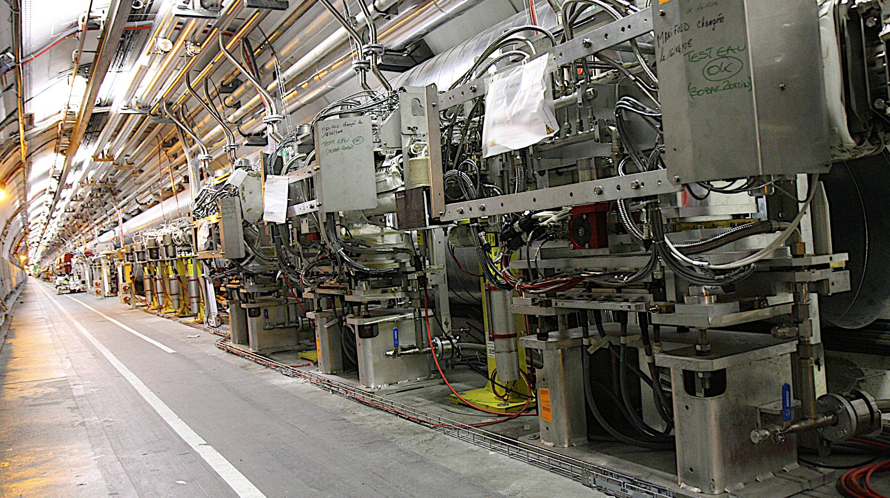
Three Primary Collimators (x, y, skew)
3 Primary Collimators in Betatron Cleaning (IR7)

Slide 9
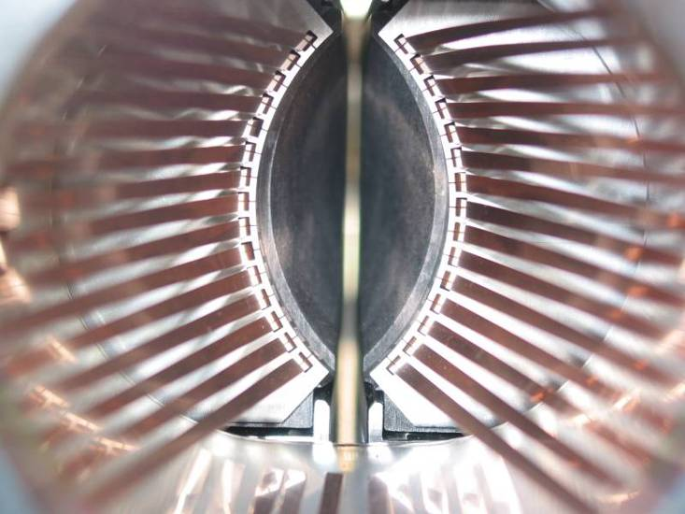
Multi-Stage Cleaning & Protection 3-4 Stages
CFC collimator
Beam propagation
Core
Unavoidable losses
Primary
halo (p)
Secondary
halo
π
p
Shower
Impact
parameter
≤ 1 μm
π
Tertiary halo
p
Primary
collimator
e
p
Shower
Secondary
collimator
e
Super-conducting magnets
High Z coll
SC magnets and particle physics exp.
High Z coll
CFC
CFC
W/Cu
W/Cu

Slide 10
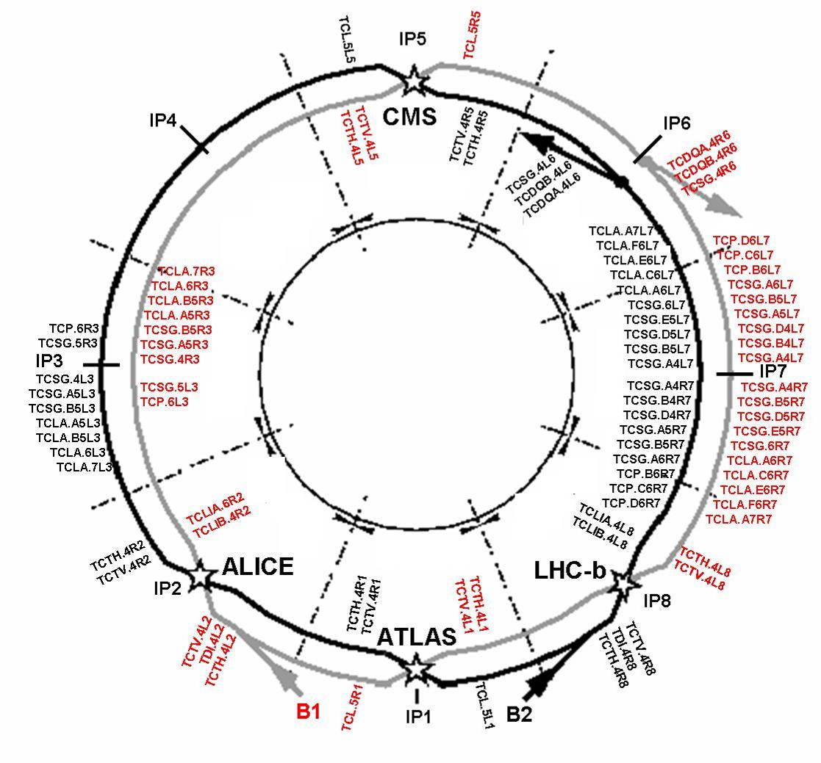
“Phase I”
Momentum
Cleaning
Betatron
Cleaning
108 collimators & absorbers in 1st generation (only movable shown in sketch)

Slide 11
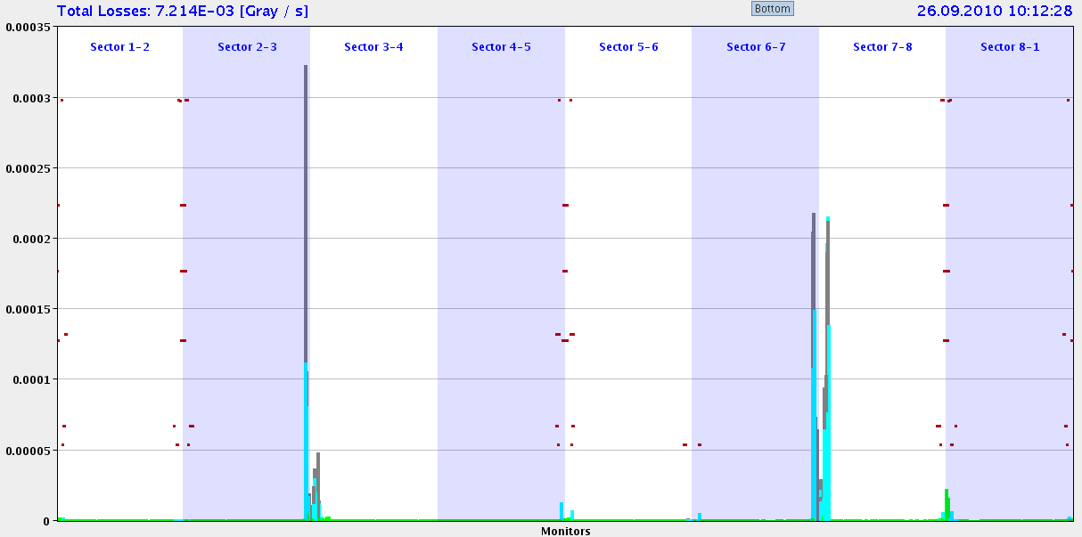
Losses in the Ring (3.5 TeV, End Fill 26.9.2010, τ > 75 h)
× 10⁻⁴ Gy/s
3.5
3.0
2.5
2.0
1.5
1.0
0.5
0.0
Beam 1
Momentum
Collimation
Betatron Collimation
Beam 2
Beam 1
Beam 1
Beam 2
ATLAS
ALICE
CMS
LHC-b
Beam 2
0 – 27 km
Essentially all losses at collimators → No beam dump or quench!

Slide 12
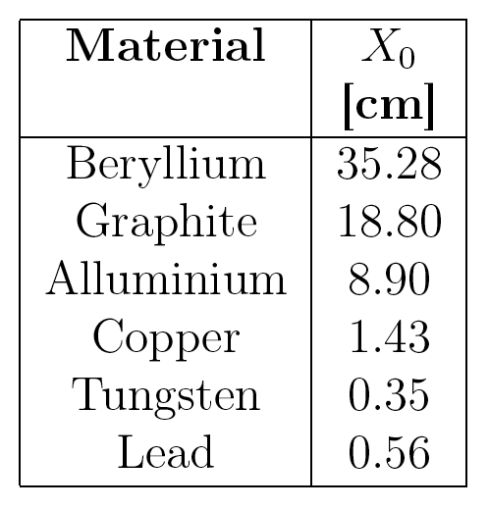
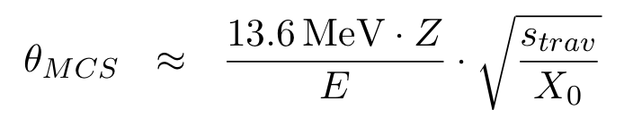
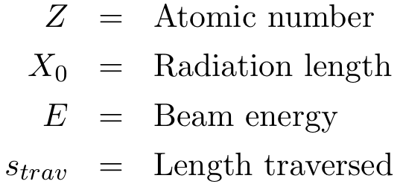
Multiple Coulomb Scattering
MCS scattering angles decrease with the energy.
Particles get less kicks and return for multi-turn traversals.
Kick goes with the square root of total length traversed.
Collimator material (Graphite) has weak MCS.

Slide 13

Single-Diffractive (SD) Scattering
Single-diffractive scattering creates off-energy protons.
These are the limiting losses in the LHC at higher energy and lost in the dispersion suppressors of the LHC.
Cross section:
SD scattering cross section increases slowly with beam energy E.
Indeed we do see losses in the predicted dispersion suppressor locations at 3.5 TeV.

Slide 14
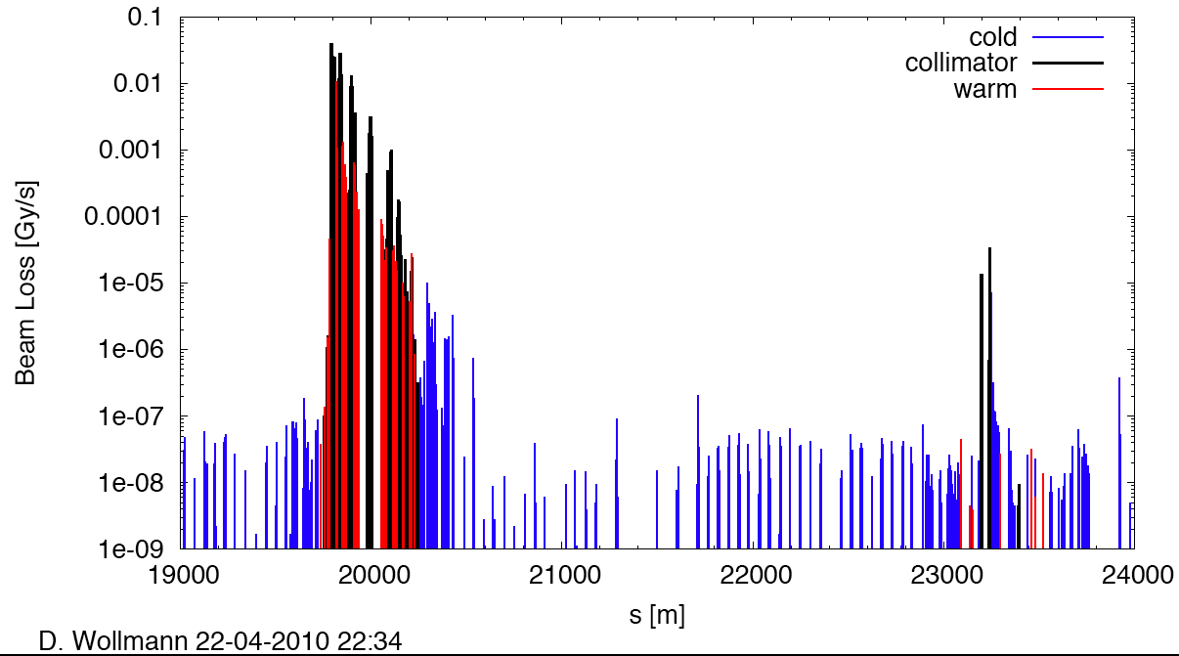
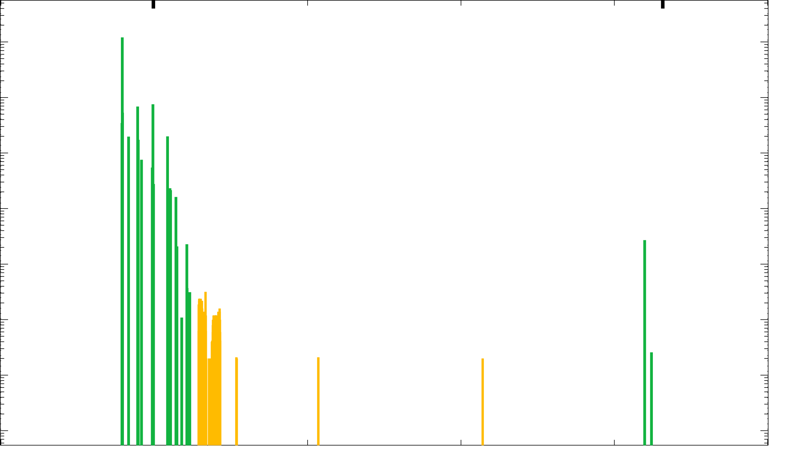
Meas. & Sim. Cleaning at 3.5 TeV
(beam1, vertical beam loss, intermediate settings)
IR7
Confirms expected limiting losses in SC dispersion suppressor:
single-diffractive losses
IR8

Slide 15
Comparing MCS and SD processes I
Parameter | MCS | SD
Energy E | ~ 1/E | ~ ln (E)
Length L | ~ √L | ~ L
MCS brings p from primary to secondary collimator:
  Imagine going from E0 to E1 in energy.
  Typical scattering angle: θ₁ = θ₀ * E₀ / E₁
  Required scattering angle: θ_{1,req} = θ_{0,req} * √(E₁ / E₀)
  For required scattering angle travel longer length:
  L₁ = L₀ * E₀ / E₁

Slide 16
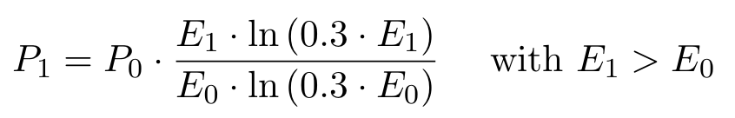
Comparing MCS and SD processes II
Now SD scattering:
  Length traversed: L₁ = L₀ * E₀ / E₁ (from MCS)
  Cross section: σ₁ = σ₀ * ln(0.3*E₁) / ln(0.3*E₀)
  Probability for SD scattering with MCS scaling:
  Effects from SD scattering become stronger with higher beam energy.
  Loss from 7 TeV to 16.5 TeV: factor 2.6

Slide 17
Situation More Complicated (of course)
Multi-turn behavior not so simple to just linearly add up kicks (as assumed before).
It is not fully correct to express the transport from primary to secondary collimator by a required kick (diffusion process).
Single-diffractive scattering and MCS produce combined effects.
Other processes play into the game.
Still a very useful analytical estimate…

Slide 18
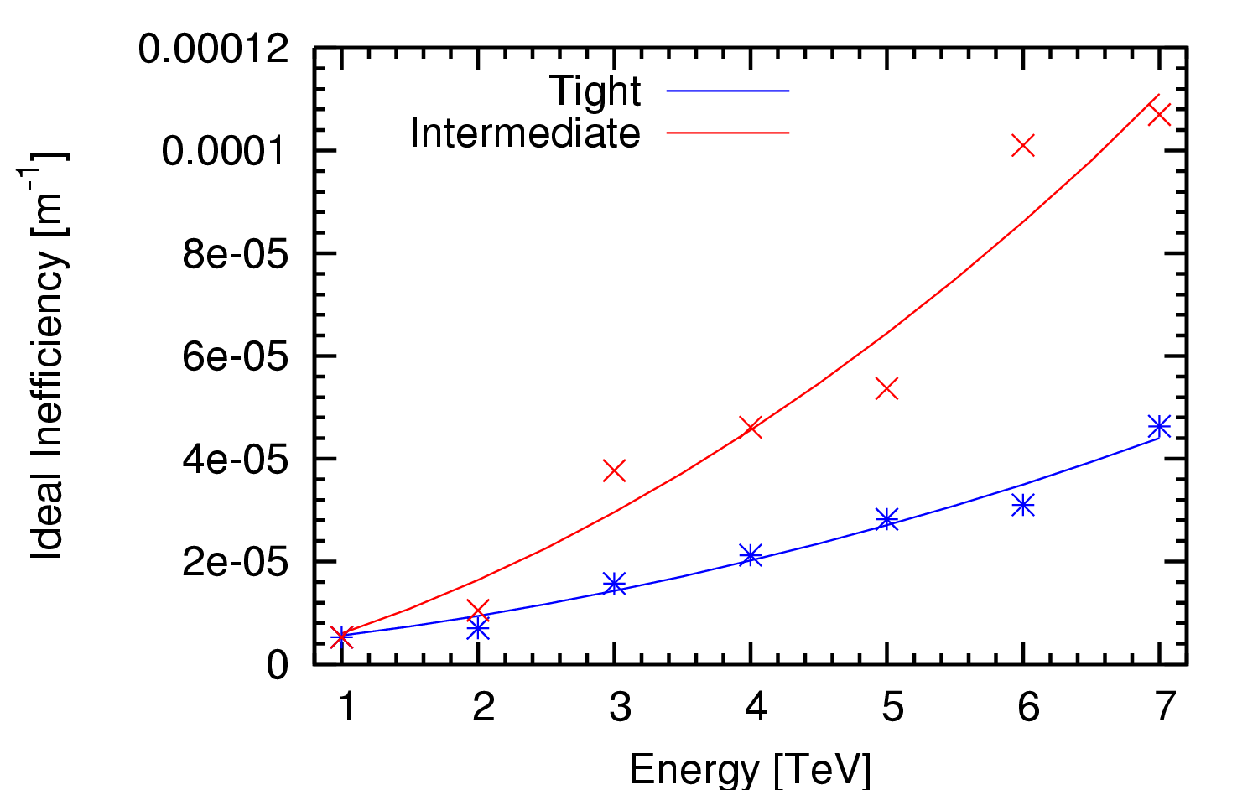
Compare Simple Model to Simulations
x 10
simple model
… quite reasonable agreement…

Slide 19
Impact Collimation Efficiency
Beam energy increase: 7 TeV → 16.5 TeV
We loose a factor 2-3 in cleaning efficiency due to energy dependence of nuclear processes.
Single-diffractive losses in dispersion suppressors will become more and more pronounced.
Can easily loose another factor 10 if aperture in dispersion-suppressor magnets would be smaller.
Could be compensated by higher Z collimator materials but these would be less robust.
Our cryo(DS)-collimators for LHC will also help for HE-LHC.
Must be assessed in detailed collimation simulations with detailed aperture model, quench limits, …
Strong impact but I believe solutions can be found.

Slide 20
Issues to be Discussed
Collimation Efficiency
Machine Robustness
Issues due to Smaller Gaps
Comments on MP
Comments on Cleaning Insertions

Slide 21
Limit on Bunch Density
Damage is a matter of beam density (this is why low power electron beams with a very small beam size can drill holes).
To guide the extrapolation we consider a simple model.
Assumption:
  Ultimate bunch intensity (1.7e11 p) and nominal beam emittance (0.5 nm at 7 TeV) are OK.
  Survival of accelerator elements (collimators, dumps, absorbers) OK.
  Here focus on collimators.
Model can also be used to define valid phase space for operation of the collider.

Slide 22
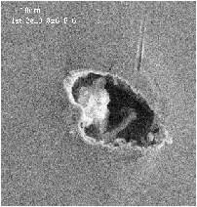
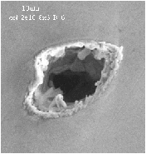
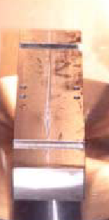
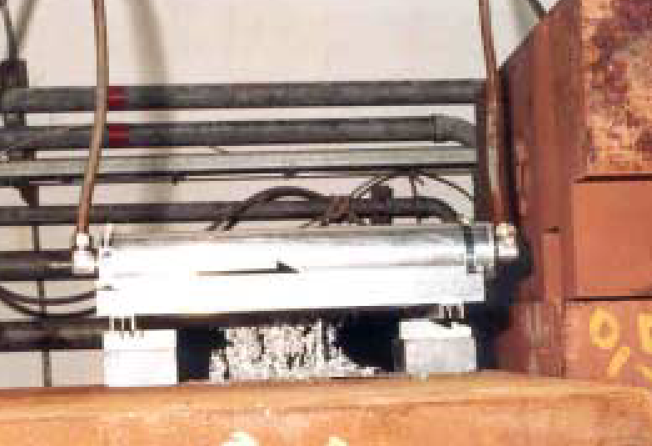

Beam-Induced Damage is Possible
Tungsten collimator
in the SPS
Entry and exit holes of an electron beam impacting on a spoiler
(courtesy P. Tenenbaum)
Lead block accidentally put into a p beam
Damage of coating of a SLC collimator
(courtesy G. Stevenson)

Slide 23
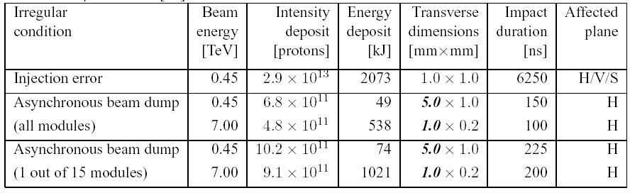
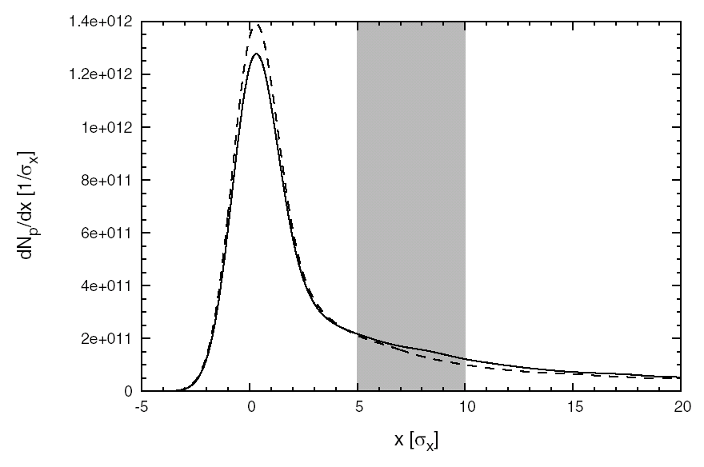
Irregular Beam Impact
R. Assmann et al
➔
A. Ferrari,V. Vlachoudis

Slide 24
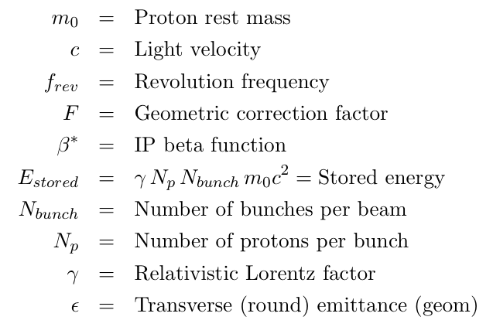
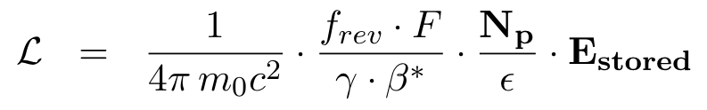
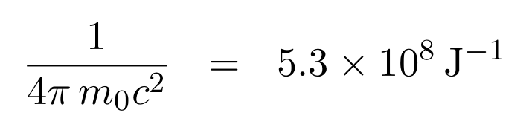
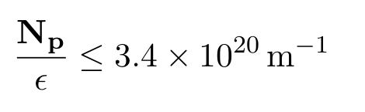
Relevant Robustness Parameter

Slide 25

Present LHC Collimation Robustness
Respect absolutely the following condition:
Luminosity reach is then:

Slide 26
Example 1: Performance Reach 3.5 TeV
Best performance reach parameters while respecting robustness limit:
  Bunch intensity: 1.7e11 p (ultimate)
  Norm. emittance: 1.9 μm (half nominal)
  Geom. emittance: 0.5 nm (nominal value at 7 TeV)
  Number of bunches: 1404 (50 ns)
  β*: 2.5 m
We then get:
  Stored energy: 133 MJ
Luminosity reach:
  Luminosity limit: 2.9 × 10³³ cm⁻² s⁻¹
… have to add F correction …

Slide 27
Example 2: Performance Reach 3.5 TeV
Best performance reach parameters while respecting robustness limit:
  Bunch intensity: 1.15e11 p (nominal)
  Norm. emittance: 1.3 μm (half nominal)
  Geom. emittance: 0.34 nm (nominal value at 7 TeV)
  Number of bunches: 2808 (25 ns)
  β*: 2.5 m
We then get:
  Stored energy: 180 MJ
Luminosity reach:
  Luminosity max: 3.9 × 10³³ cm⁻² s⁻¹
… have to add F correction …

Slide 28
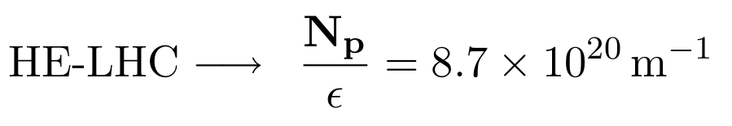
HE-LHC Situation for Robustness
Respect absolutely the following condition:
Present design parameters HE-LHC at 16.5 TeV:
→ Not a priori OK!
Comparison assumes similar kicker rise times, leakage, failure scenarios,…

Slide 29
HE-LHC with Present Technologies
Bunch density factor 2.6 above limit.
Possibility 1 (this works for sure):
  Increase emittance: 0.15 nm → 0.38 nm
  Feasible with present technologies.
  Luminosity reach: 9.4 × 10³³ cm⁻² s⁻¹ (~ half)
Possibility 2 (can be good or bad news):
  Review damage limits.
  Further simulations.
  Experimental studies: HiRadMat
Possibility 3 (looks quite promising):
  New collimator and absorber technology
  Studies are underway → EuCARD/ColMat
No showstopper

Slide 30
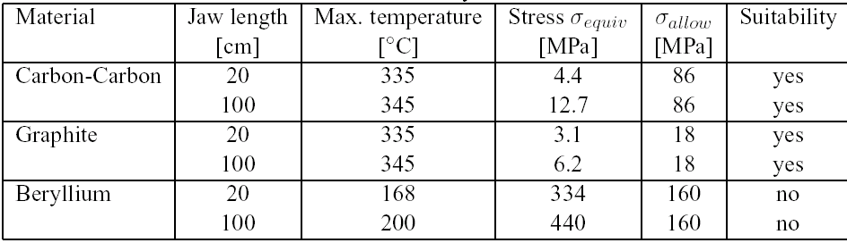
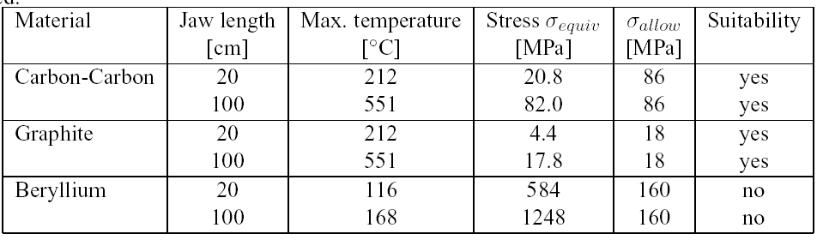
Mechanical Stresses: Present LHC Coll.
(a) Injection
Calculated: 82 MPa → Allowed: 86 MPa
Not much margin, even for nominal intensity!
(b) 7 TeV
O. Aberle, L. Bruno
… being reviewed …

Slide 31












Collimator R&D
Collimator R&D is done in a European/US collaboration.
Supported by EU FP7 and LARP.

Slide 32

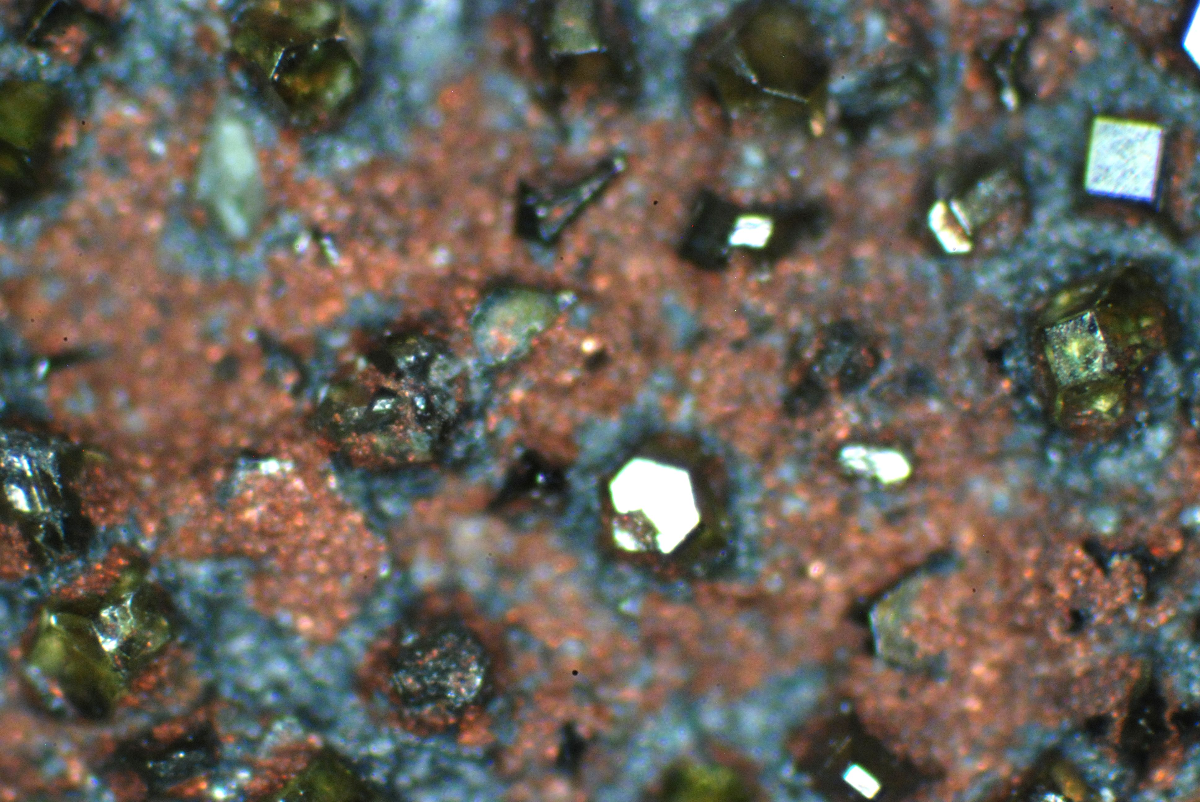

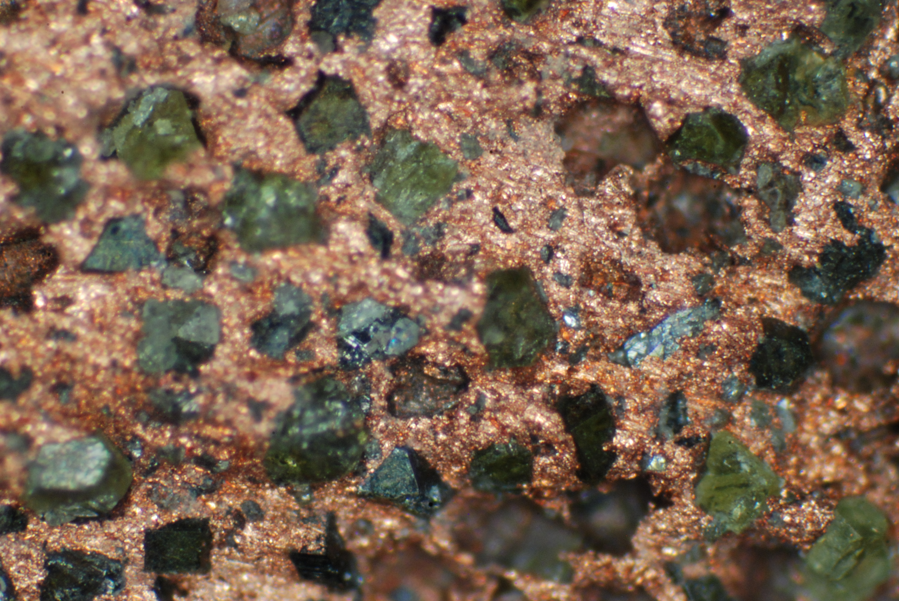
Manufacturing of Cu-diamond composite
Manufacturing of Cu-diamond plates with 60 vol.%
Water jet cutting of samples for:
  Thermal Diffusivity
  CTE
  Mechanical Testing
  Meas. of mech. properties at high T
150 mm x 150 mm

Slide 33
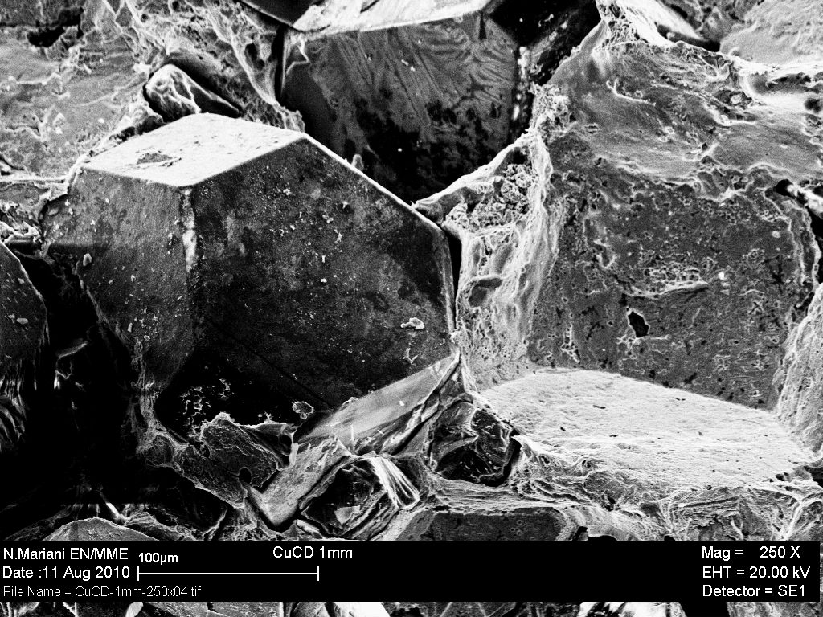

Slide 34

Mechanical behaviour of Diamond MMCs: Bending strength
L. Weber
Ag-Si-D with > 500 MPa bending strength (particle size 45 µm)
CuD with a bending strength around 130 MPa (some plasticity, elastic limit much lower). Particle size 200 µm.
AlD bending strength <30 Mpa, large plastic defor-mation. Particle size 45 µm.

Slide 35
Innovative materials…
We are producing materials with a bending strength beyond 500 Mpa!
This is significantly beyond the strength of the fiber-reinforced graphite that we used (86 Mpa – already extremely strong material).
This R&D might allow us to overcome the limitations that we presently must respect!
Too early to conclude whether we can use these materials in the LHC.
Tests (radiation, vacuum, …) ongoing and continued in EuCARD2!
86 Mpa → 500 Mpa (?)

Slide 36
Issues to be Discussed
Collimation Efficiency
Machine Robustness
Issues due to Smaller Gaps
Comments on MP
Comments on Cleaning Insertions

Slide 37
Collimating with Small Gaps
~ 0.15
~ 0.6
Collimator gap must be 10 times smaller than available triplet aperture for nominal luminosity!
Collimator settings usually defined in sigma with nominal emittance!
The limiting super-conducting (sc) aperture is usually in the triplet during collisions.
If the super-conducting aperture is reduced, we might have to run with lower gaps.
This means: tighter tolerances for machine and collimators.
It also means that the impedance will be larger (factor 6?).
Half gap 5.7 σ: 1.1 mm (7 TeV) → 0.6 mm (16.5 TeV)

Slide 38
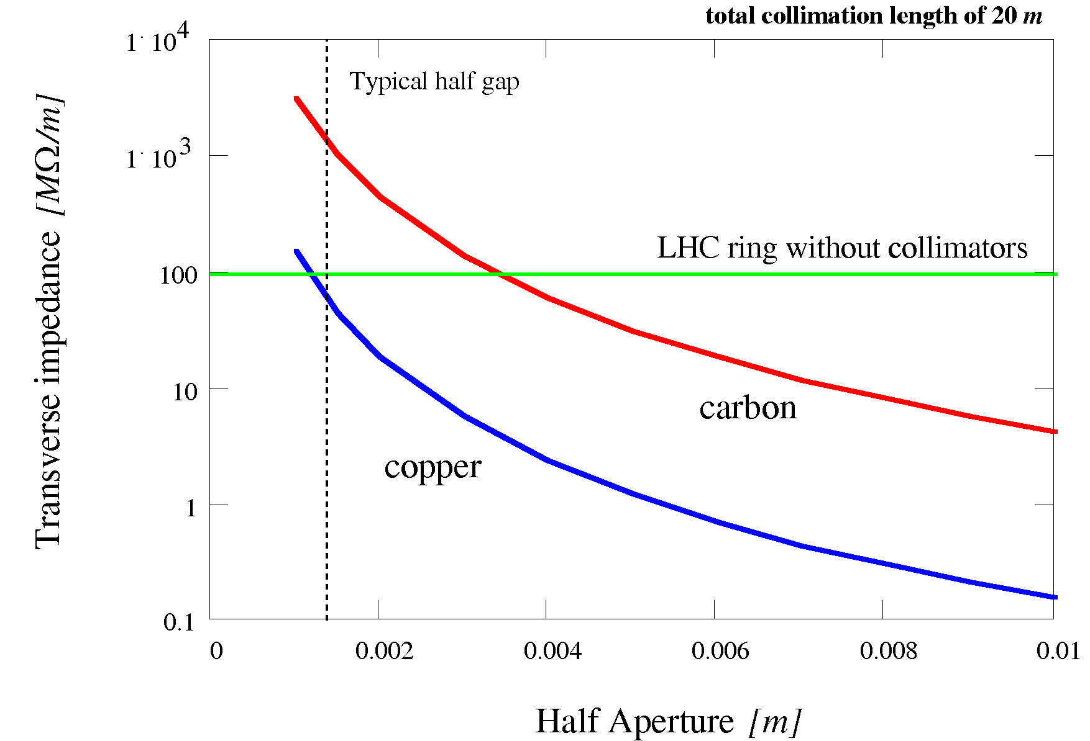
The Impedance Challenge
Machine impedance increases while closing collimators (Carbon curve).
LHC will operate at the impedance limit with collimators closed!
2003, F. Ruggiero, L. Vos
Transverse impedance ~ 1 / (half gap)³
→ To be addressed in detailed studies with E. Metral et al

Slide 39
Issues with Smaller Gaps
Must try to keep collimator gaps reasonably large.
Ideally for available SC aperture a [σ] in collision:
a [σ] (16.5 TeV) = 1.5 × a [σ] (7 TeV)
This costs reach in β* or requires the same IR/DS apertures (in mm).
Alternative (if we keep collimation at ~6 σ):
  New LHC collimator technology for factor 2 smaller gaps and even higher precision and reproducibility.
  Live with much higher impedance.
  Live with operational tolerances (orbit) at the 20-30 μm level.

Slide 40
Issues to be Discussed
Collimation Efficiency
Machine Robustness
Issues due to Smaller Gaps
Comments on MP
Comments on Cleaning Insertions

Slide 41
Comments on MP
Passive protection to a large extend covered by collimation aspects (see before).
The robustness issues have been discussed before.
Injection and dump protection to be discussed by experts (B. Goddard et al) independently. Originally next talk on this…
MP system (interlocks, surveillance, …):
  Instrumentation systematics (orbit changes, …).
  Check and possibly adjust dynamic range of BLM’s.
  Energy and squeeze factors.
Requires detailed study by machine protection team.

Slide 42
Issues to be Discussed
Collimation Efficiency
Machine Robustness
Issues due to Smaller Gaps
Comments on MP
Comments on Cleaning Insertions

Slide 43
Comments on Cleaning Insertions
Cleaning insertions (warm magnets) were carefully designed for collimation:
  Establish a three stage cleaning per insertion, in H/V/Skew/Mom.
  Protect magnets/elements against excessive heating and radiation damage.
  Radiation control. Remote handling.
Important constraints:
  Essentially, no space left (had to already move warm magnets to make space for collimators). Musty keep magnet length ~constant.
  Phase advance is at the limit of what is required.
  Optics must be kept similar: no way to decrease lattice strength, remove quadrupoles, increase beta functions, …
  No way to increase inter-beam distance (w/o civil engineering): require very strong warm dogleg bends.
Redesign for 16.5 TeV will be a MAJOR challenge.

Slide 44
Conclusion
HE-LHC puts challenges for high intensity beam control.
Cleaning efficiency:
  Loose factor 2-3 in cleaning efficiency due to nuclear processes. Easily loose factor 10 in efficiency with smaller aperture in DS/arc.
  Planned collimation upgrade (cryo/DS coll) will help for this.
Material robustness:
  HE-LHC parameters factor ~3 beyond present robustness limit.
  Either increase emittance which is aimed for (loose factor 2 in L) or use new materials & technologies (under study in EuCARD/ColMat).
Gaps and tolerances:
  Should aim for 50% larger normalized aperture at 16.5 TeV.
  Alternatively, new collimator technologies required.
MP requires further attention but no show-stopper expected.
Cleaning insertion re-design for 16.5 TeV a major challenge.

